Slide 1

Geography of Global Changes
Urban analysis
A.Y. 2024/2025
Dr. Giuseppe Borruso
Department of Economics, Business, Mathematics and Statistics
University of Trieste
E-mail. giuseppe.borruso@econ.units.it
Ph. +39 040 558 7008
Skype: giuseppe.borruso
Notes:
Slides with (*) in footnotes have been modified by Jean-Paul Rodrigue materials concerning “Transportation Geography”. Slides with (*) in footnotes are referred to “Transport and the Urban Environment” materials (see copyright). I have modified and elaborated materials in order to be suitable for the current course.
For references visit http://people.hofstra.edu/geotrans
Copyright © 1998-2010, Dr. Jean-Paul Rodrigue, Dept. of Global Studies & Geography, Hofstra University. For personal or classroom use ONLY.

Slide 2
Topics
World urban population
Cities: a definition
Transport, urban form and spatial structure
The analysis of urban structure
  The bid rent and the models of urban structure
  The global model
  The urban density
The urban crisis and the urban lifecycle
Case study: the Megalopolis

Slide 3
An Urbanizing Society
An urban world
  The world is getting increasingly urbanized.
  Since 1950, the world urban population has more than doubled.
  In 1999, half of the world’s population of 6 billions lived in urban areas.
  75% were in developing economies.
  The majority of economic activities are taking place in cities.
  Cities are dominant attributes of the human landscape.
Notes:
**

Slide 4
An Urban World
Links
UNICEF – An Urban World
https://www.unicef.org/sowc2012/urbanmap/
https://www.youtube.com/watch?v=Yi-rEL8i46Y
Notes:
**

Slide 5
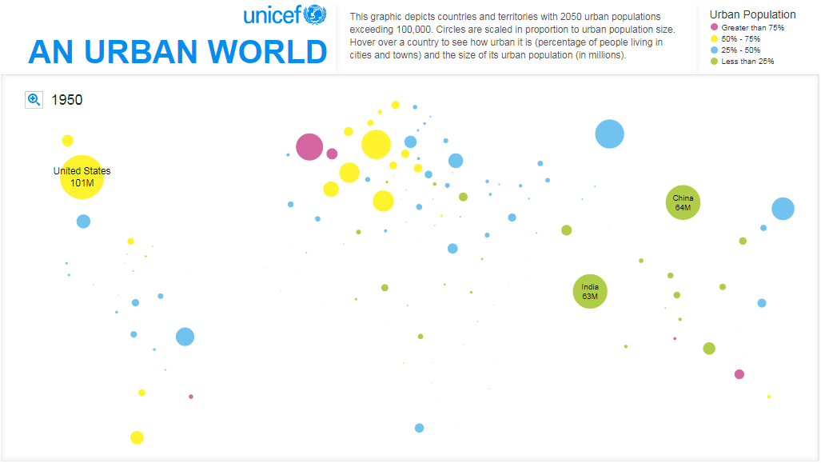
1950

Slide 6
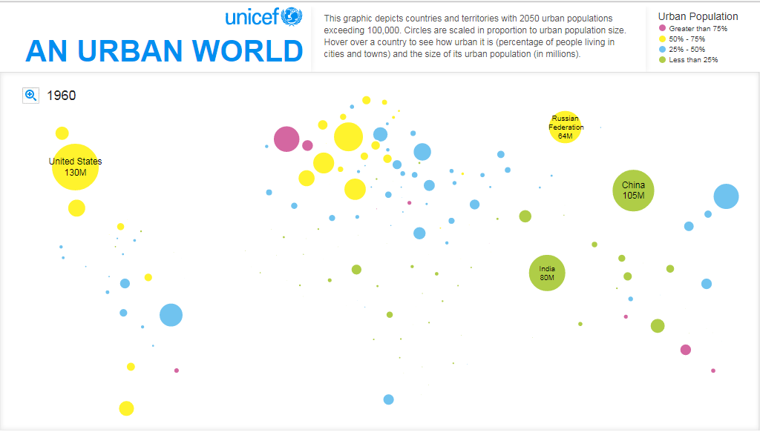
1960

Slide 7
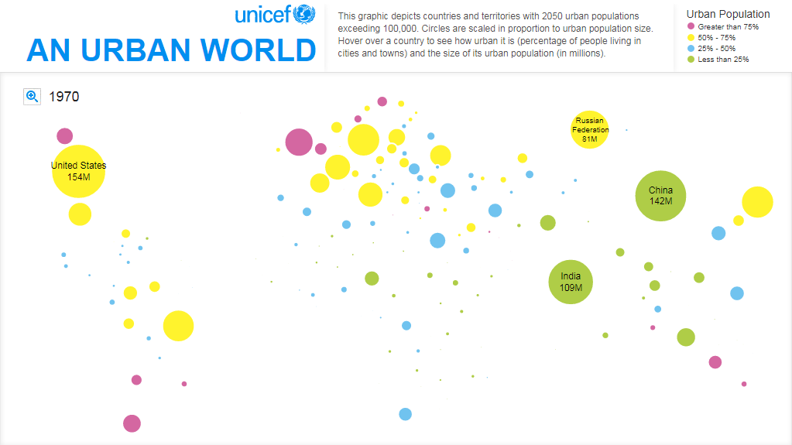
1970

Slide 8
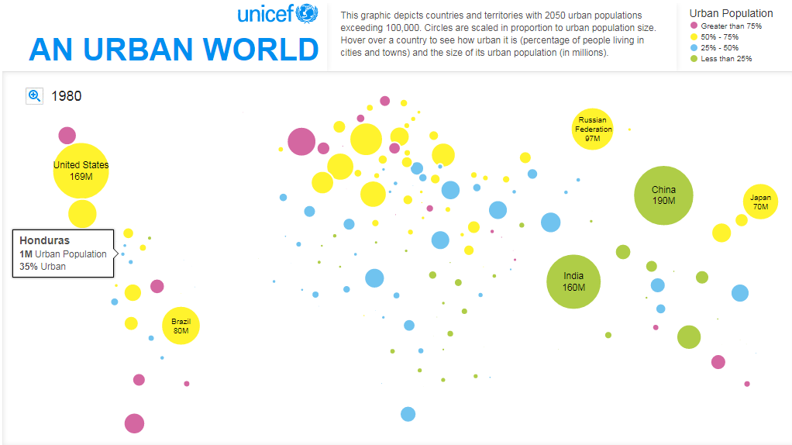
1980

Slide 9
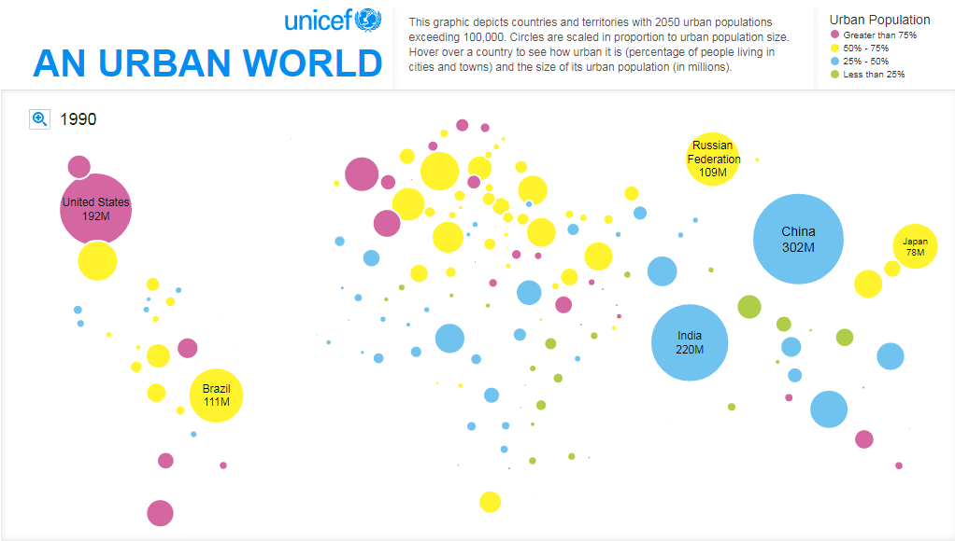
1990

Slide 10
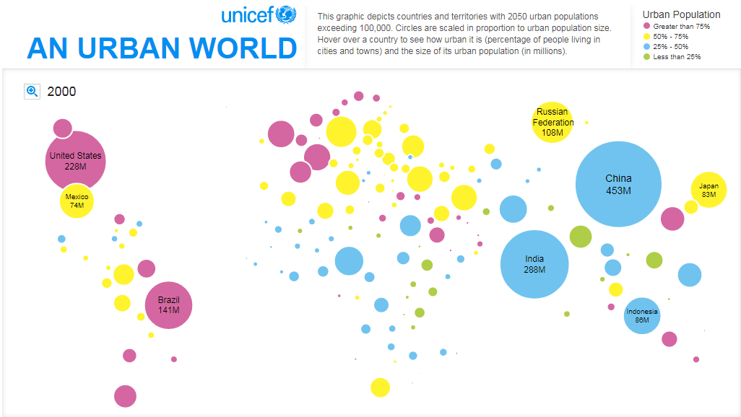
2000

Slide 11
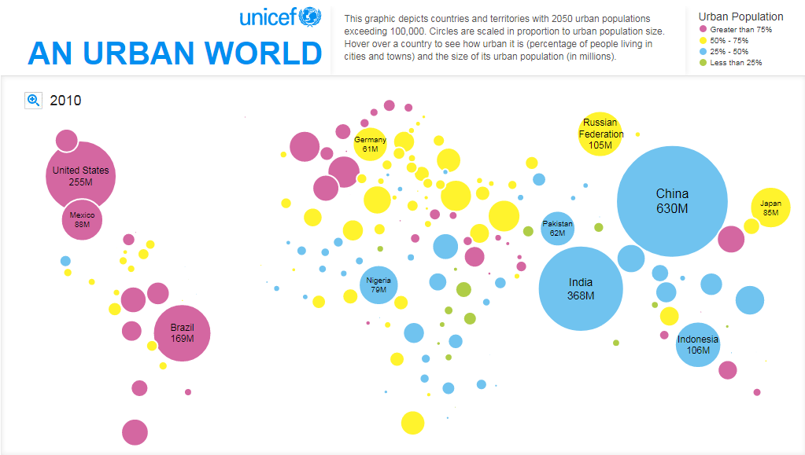
2010

Slide 12
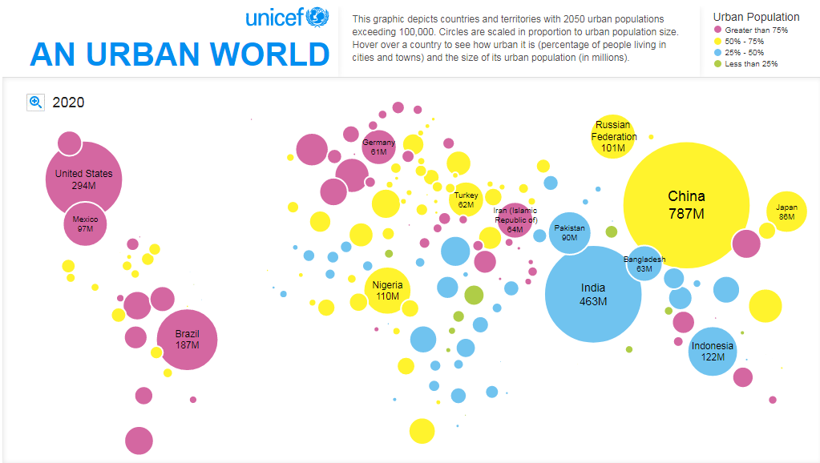
2020

Slide 13
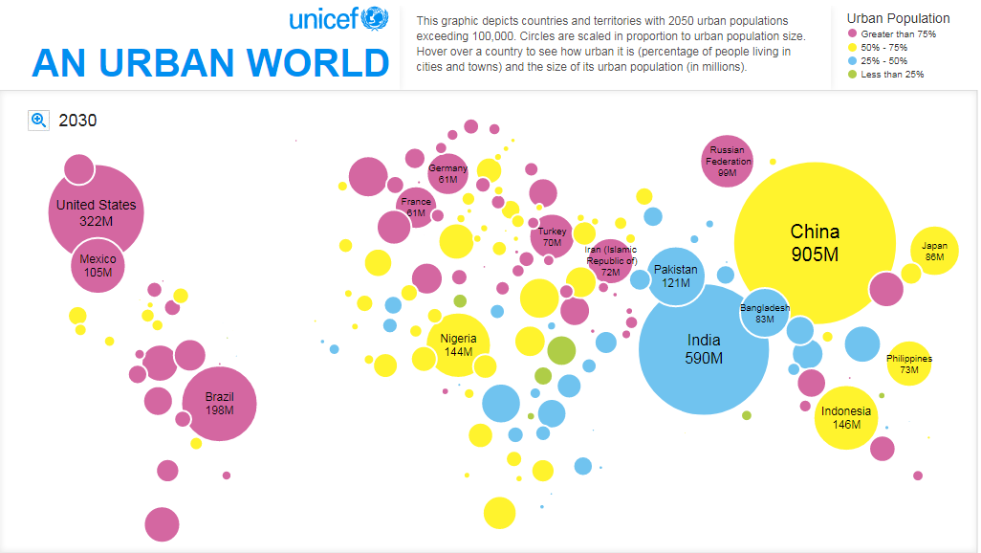
2030

Slide 14
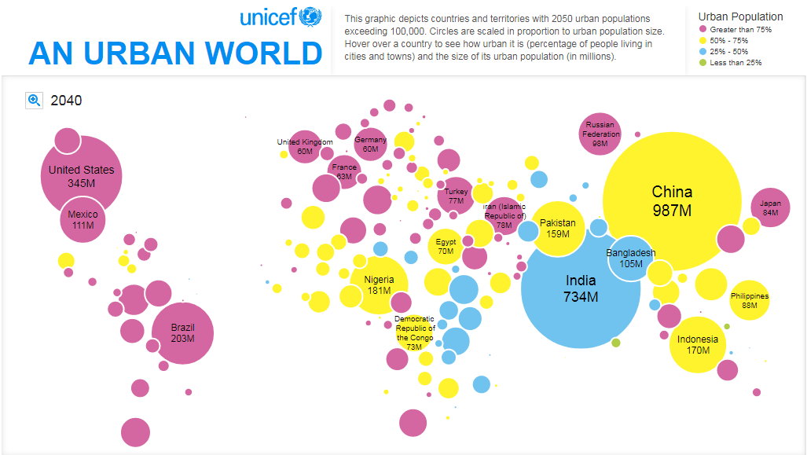
2040

Slide 15
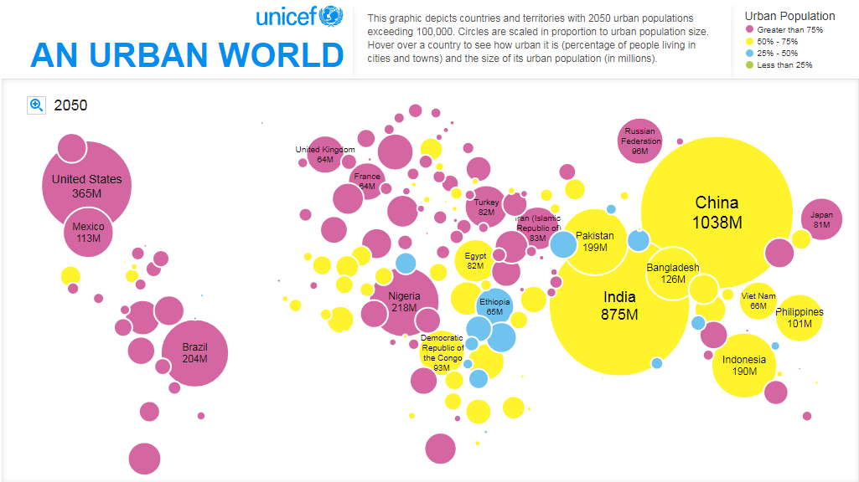
2050

Slide 16
Urbanization
Stages
Cities, a difficult definition
Urban functions
Urban structures

Slide 17
Stages of Urbanization
Initial Stage
Transition Stage
Terminal Stage
100
Demographic transition
Rural to urban migration
Developed countries
80
Rural
Society
Developing
countries
Urban
Society
60
Urban Population
40
Least developed
countries
20
Urbanization
0
Time
Notes:
Source: Adapted from Peters and Larkin, 1999.
**

Slide 18
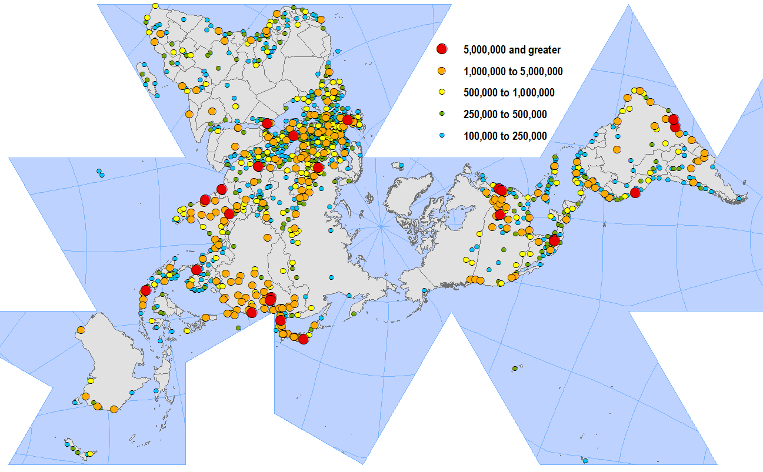
World’s Largest Cities
Copyright © 1998-2010, Dr. Jean-Paul Rodrigue, Dept. of Global Studies & Geography, Hofstra University. For personal or classroom use ONLY. This material (including graphics) is not public domain and cannot be published, in whole or in part, in ANY form (printed or electronic) and on any media without consent. This includes conference presentations. Permission MUST be requested prior to use.
Notes:
**
18

Slide 19
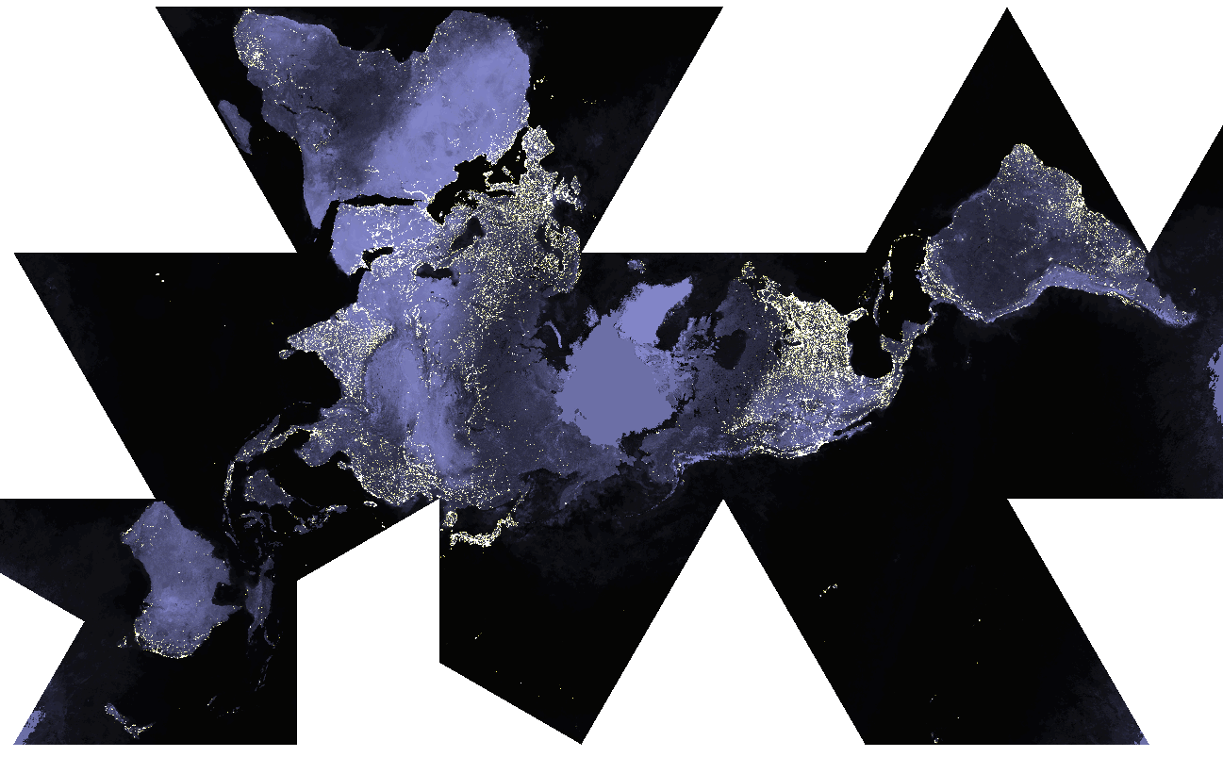
World at Night
Copyright © 1998-2010, Dr. Jean-Paul Rodrigue, Dept. of Global Studies & Geography, Hofstra University. For personal or classroom use ONLY. This material (including graphics) is not public domain and cannot be published, in whole or in part, in ANY form (printed or electronic) and on any media without consent. This includes conference presentations. Permission MUST be requested prior to use.
Notes:
**
19

Slide 20
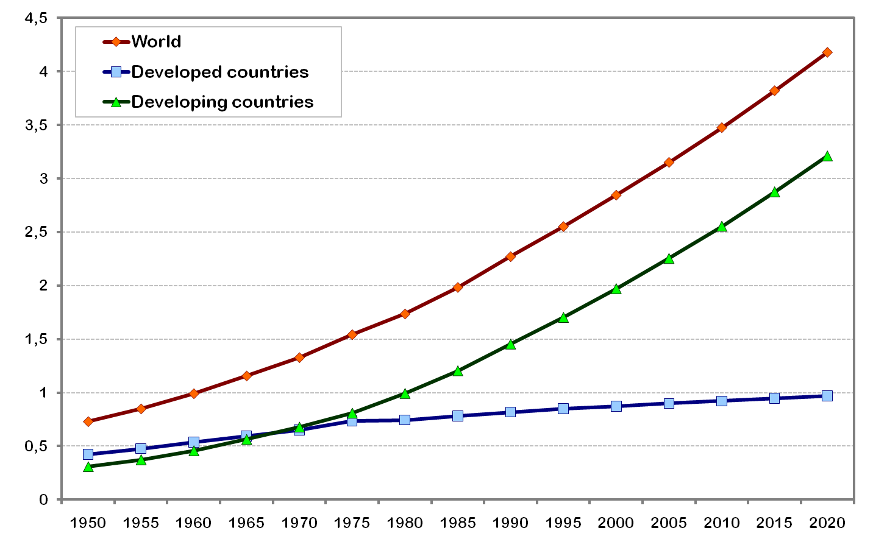
World Urban Population, 1950-2005 with Projections to 2020 (in billions)
Copyright © 1998-2010, Dr. Jean-Paul Rodrigue, Dept. of Global Studies & Geography, Hofstra University. For personal or classroom use ONLY. This material (including graphics) is not public domain and cannot be published, in whole or in part, in ANY form (printed or electronic) and on any media without consent. This includes conference presentations. Permission MUST be requested prior to use.
Notes:
20
Source: United Nations, Department of Economic and Social Affairs, Population Division (2006). World Urbanization Prospects: The 2005 Revision. New York: United Nations.
**

Slide 21
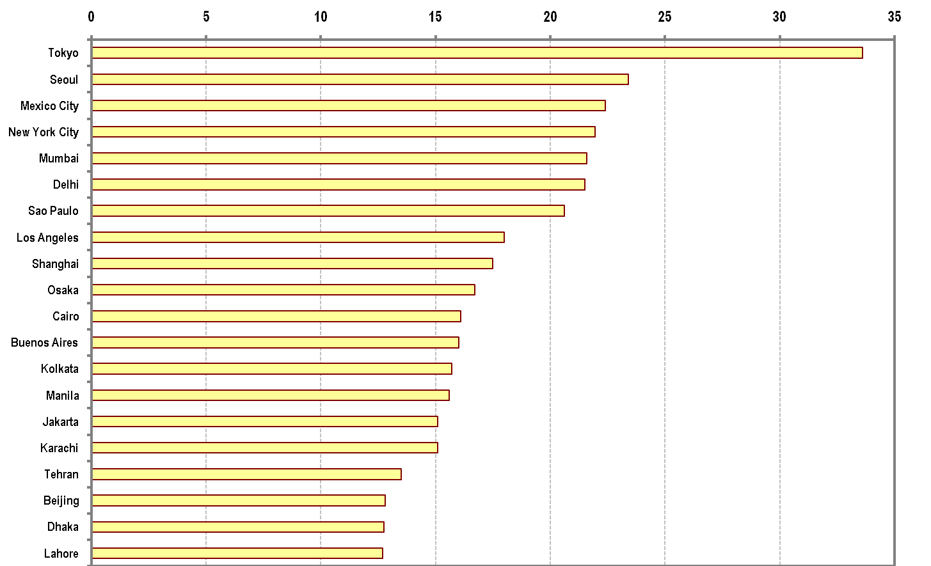
World’s Largest Metropolitan Areas, 2006 (in millions)
Copyright © 1998-2010, Dr. Jean-Paul Rodrigue, Dept. of Global Studies & Geography, Hofstra University. For personal or classroom use ONLY. This material (including graphics) is not public domain and cannot be published, in whole or in part, in ANY form (printed or electronic) and on any media without consent. This includes conference presentations. Permission MUST be requested prior to use.
Notes:
Source: United Nations, Department of Economic and Social Affairs, Population Division (2006). World Urbanization Prospects: The 2005 Revision. New York: United Nations.
**
21

Slide 22
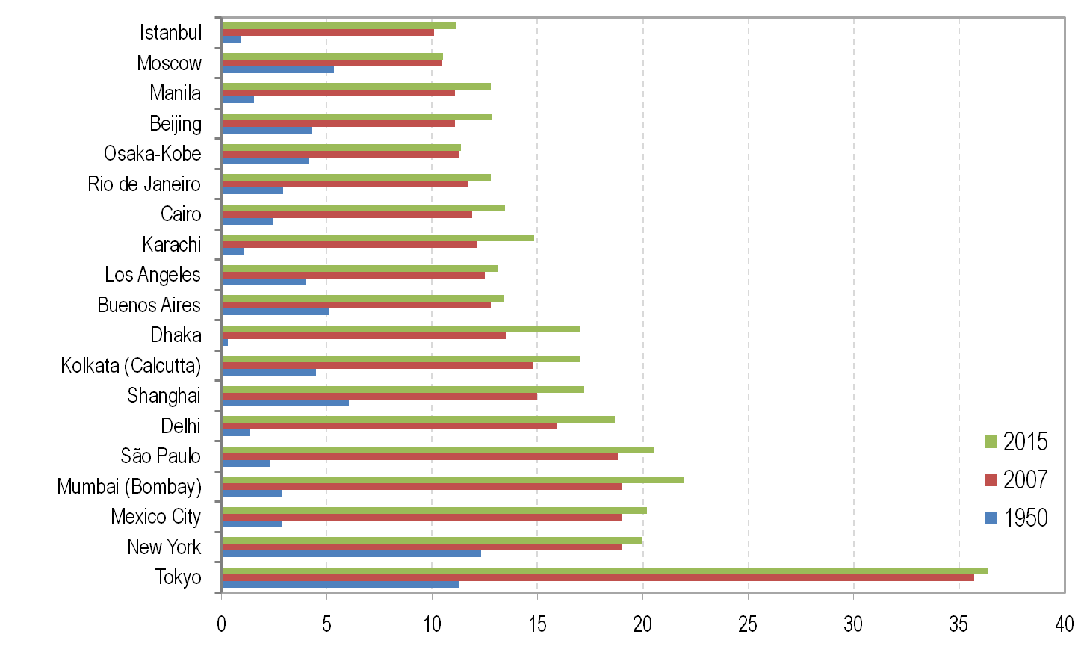
Cities of More than 10 Million Inhabitants, 2007
Copyright © 1998-2010, Dr. Jean-Paul Rodrigue, Dept. of Global Studies & Geography, Hofstra University. For personal or classroom use ONLY. This material (including graphics) is not public domain and cannot be published, in whole or in part, in ANY form (printed or electronic) and on any media without consent. This includes conference presentations. Permission MUST be requested prior to use.
Notes:
Source: Compiled by Earth Policy Institute.
**
22

Slide 23
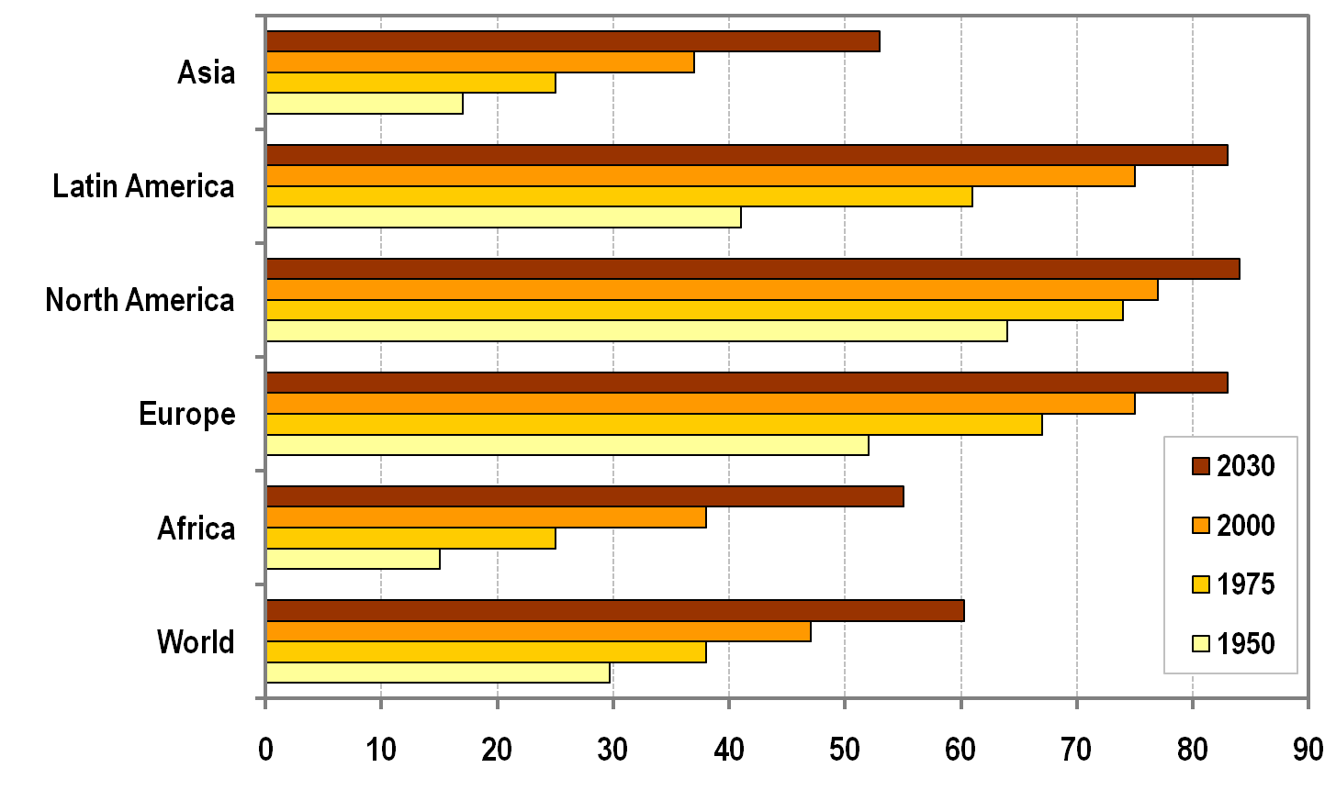
Percentage of Urban Population by Region, 1950-2030
Copyright © 1998-2010, Dr. Jean-Paul Rodrigue, Dept. of Global Studies & Geography, Hofstra University. For personal or classroom use ONLY. This material (including graphics) is not public domain and cannot be published, in whole or in part, in ANY form (printed or electronic) and on any media without consent. This includes conference presentations. Permission MUST be requested prior to use.
Notes:
23
Source: United Nations Population Program.
**

Slide 24
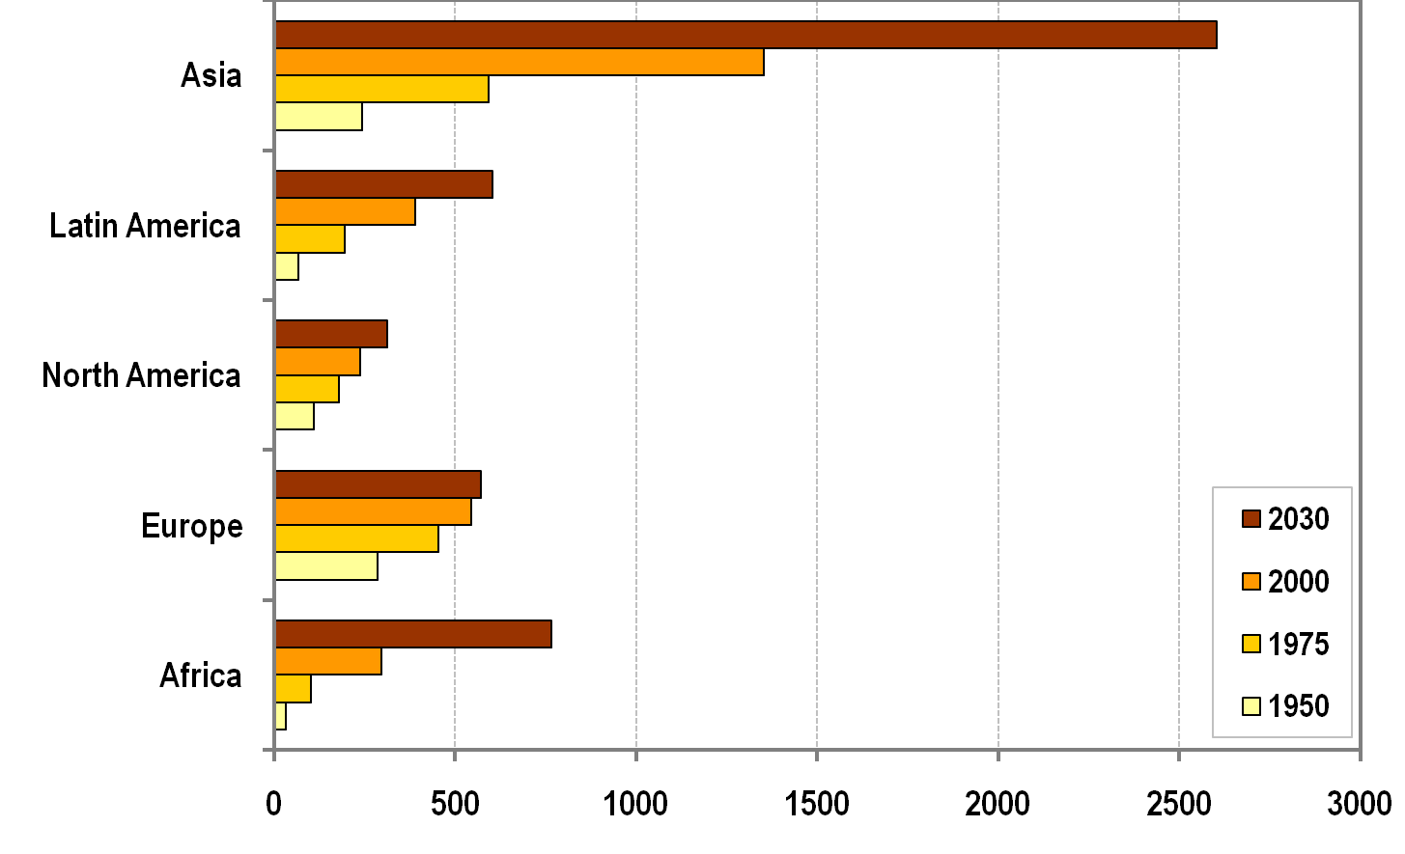
Urban Population by Region, 1950-2030 (in millions)
Copyright © 1998-2010, Dr. Jean-Paul Rodrigue, Dept. of Global Studies & Geography, Hofstra University. For personal or classroom use ONLY. This material (including graphics) is not public domain and cannot be published, in whole or in part, in ANY form (printed or electronic) and on any media without consent. This includes conference presentations. Permission MUST be requested prior to use.
Notes:
24
Source: United Nations Population Program.
**

Slide 25
Cities
The city: a difficult definition. Criteria:
  Topographic – construction (= concentration of buildings)
  Demographic (= concentration of inhabitants)
    I.e., urban population in centres > 2.000 inhabitants
  Economic (= concentration of activities)
    Quantity and quality of concentration:
    different activities and different from agriculture, extra-urban demand
  =>
  Functional definition:
    Aggregation of people to better realise some activities
    (activity = a function of the city);
    Cities as rare, ,non ubiquitous in the geographical space produce functions over a service area

Slide 26
Cities
Empirical evidence: positive correlation between demographic dimension and functional rule of a city:
FU = f (P)
FU = set of urban function’s activities
P = number of inhabitants

Slide 27
Urban functions and gravitation
Urban functions:
  city serving
    Activities that depend on the existence of the city itself;
    Aimed at satisfying inhabitants’ needs (i.e., retail, schools, etc.)
  city forming
    Essence of the city: i.e., specialized medical services, university and research centres, specialized banks, etc.
    Sectors of activity or single companies can work both for the internal urban market and for a wider area
  =>
  Analysis on gravitation towards cities to identify the borders of such area

Slide 28
Urban functions and gravitation
Reilly’s law (1929) on the forming of retail areas
Interaction of a city and its service area can be expressed as :
F = a * D ^{– b}
a = mass of the city (population or other indexes of ‘centrality’)
D = distance of places out and around the city
b = parameter to indicate the slope (=> extension of the gravitating area)
Notes:
Diparimento di Scienze Geografiche e Storiche - Introduzione ai GIS
28
1 ora

Slide 29
Transportation, Urban Form and Spatial Structure
Spatial
imprint
Infrastructures
Modes
Users
Transportation
Urban Form
Spatial
interaction
Urban Spatial Structure
Copyright © 1998-2010, Dr. Jean-Paul Rodrigue, Dept. of Global Studies & Geography, Hofstra University. For personal or classroom use ONLY. This material (including graphics) is not public domain and cannot be published, in whole or in part, in ANY form (printed or electronic) and on any media without consent. This includes conference presentations. Permission MUST be requested prior to use.
Notes:
29
**

Slide 30
One Hour Commuting According to Different Urban Transportation Modes
Streetcar line
Freeway
Walking
10 km
Streetcar
Cycling
Automobile
Automobile with
freeways
Copyright © 1998-2010, Dr. Jean-Paul Rodrigue, Dept. of Global Studies & Geography, Hofstra University. For personal or classroom use ONLY. This material (including graphics) is not public domain and cannot be published, in whole or in part, in ANY form (printed or electronic) and on any media without consent. This includes conference presentations. Permission MUST be requested prior to use.
Notes:
30
Source: adapted from P. Hugill, (1995), p. 213.
**

Slide 31
Evolution of the Spatial Structure of a City
A
B
C
Core activities
Peripheral activities
Major transport axis
Central activities
Central area
Copyright © 1998-2010, Dr. Jean-Paul Rodrigue, Dept. of Global Studies & Geography, Hofstra University. For personal or classroom use ONLY. This material (including graphics) is not public domain and cannot be published, in whole or in part, in ANY form (printed or electronic) and on any media without consent. This includes conference presentations. Permission MUST be requested prior to use.
Notes:
31
**

Slide 32
Evolution of Transportation and Urban Form in North American and European Cities
IV
II
I
I
II
III
IV
III
North America
Europe
I - Walking-horsecar era (1800-1890)
III - Automobile era (1920-1945)
Streetcar line
II - Streetcar era (1890-1920)
IV - Highway era (1945-)
Highway
Copyright © 1998-2010, Dr. Jean-Paul Rodrigue, Dept. of Global Studies & Geography, Hofstra University. For personal or classroom use ONLY. This material (including graphics) is not public domain and cannot be published, in whole or in part, in ANY form (printed or electronic) and on any media without consent. This includes conference presentations. Permission MUST be requested prior to use.
Notes:
32
*

Slide 33
The analysis of urban structure
The bid rent and the models of urban structure
The global model
The urban density

Slide 34
The analysis of urban structure
Partial models – concern the location of specific sectors of activity;
Global models – concern the location of all residential and production forms of an urban area
Role of transport in shaping the distribution of types of land use:
  in terms of transport costs;
  in terms of accessibility and urban land value

Slide 35
The bid-rent (I)
Pattern of land uses depend on a variety of settlements’ decisions
Decisions guided by economic process operating gin the system. The distribution of urban areas’ use represent a visual and structured phenomenon.
Basic aspects:
  Each activity derives utility from every site of the urban area;
  Utility is measured by the rent an activity is willing to pay for the use;
  Among the different rents from the utility of the site, the maximum one will determine the market value

Slide 36
The bid-rent (II)
In the long run the market competition in urban areas will result in the optimal use of each site
The rent is influenced by elements as the evaluation of the exchange between the major rent paid for the use of a site with higher accessibility and the transport costs’ savings compared to a less accessible site
The competition for land use minimizes the effects of distance on the urban area
The spatial distribution of urban rent is function of the transport cost.

Slide 37
The bid-rent (III)
Savings in transport costs can lead to payments of extra-rents;
More accessible sites in urban areas are NOT occupied by activities that pay more BUT by those that can gain the higher advantage from that part of urban land;
Bid rent become land values and depend on different accessibilities of sites within the urban area

Slide 38
The bid-rent (IV)
Land values are important to comprehend the internal geographical economic structure of a city :
Different motivations for residential uses;
Production is affected by land value as an expression of accessibility:
  Land value is maximum in the city centre and decreases when moving gto peripheries;
  Higher land values close to main radial road than in the space between them;
  Higher land values, with respect to the distance from the city centre, can be found at intersection between major radial roads and ring roads
Accessibility has different meanings for different activities:
  Retail – closeness to potential market;
  Services – closeness to places of supply of complimentary services;
  Industry – availability of suited soils; Transport; public services, closeness to other industries;
  Residential – closeness to working places, shopping centres; also environmental and social qualities

Slide 39
Von Thunen’s model of land use
Replay
The isolated state
Modified conditions
Secondary market
Central market
River
dairy & vegetables
forestry
Intensive crop rotation
Arable and pastures
Three-field crop rotation system
Extensive stock grazing
Notes:
Diparimento di Scienze Geografiche e Storiche - Introduzione ai GIS
39
(*)

Slide 40
Bid rent and land use
1 – bid rent lines
2 – Overlay of rents
rent
B- Industry and retail
A- Retail
Distance
City borders
C - Apartments
D – Detached
houses
Notes:
Diparimento di Scienze Geografiche e Storiche - Introduzione ai GIS
40
(*)

Slide 41
Bid-rent
A
rent
Area A: commercial land use
Area B: industrial land use
Area C: residential land use
B
C
C’
A
B
P
A’
Q
B’
distance
C
Curve AA’: commercial activities’ rent
Curve BB’: industrial activities rent
Curve CC’: residential activities rent
Notes:
Diparimento di Scienze Geografiche e Storiche - Introduzione ai GIS
41

Slide 42
Bid rent
Rent
1/S
S = π D²
ΔD
S = 3.14
Δ1/S
S = 75.40
1 km
5 km
10 km
S = 235.62
Notes:
Diparimento di Scienze Geografiche e Storiche - Introduzione ai GIS
42
(*)

Slide 43
Variations to bid-rent theory
A – CBD
B – Commerce / industry
C – residential high– medium density
D – sub-centres
E – Suburbia
rent
A
B
C
D
E
Notes:
Diparimento di Scienze Geografiche e Storiche - Introduzione ai GIS
43
(*)

Slide 44
Land use value for activity sector according to the distance from the CBD
Retail
Residential (several components families)
Land use value
Residential (single families)
Distance from the centre
Notes:
Diparimento di Scienze Geografiche e Storiche - Introduzione ai GIS
44
(*)

Slide 45
Global models
Effort to highlight an order within the topographical and functional structure of a city
Different models used to represent and study such ‘order’ :
  Circular Models i (Burgess, 1967)
    Urban values decrease regularly from city centre
  Sectors Models (Hoyt, 1932)
    elaboration: inner city’s structure is influenced by radial road, pre-existing nuclei, geomorphology, etc.
  Multi-centre Models (Harris and Ullman, 1945)
    Development of no single centres but in a number of centres within urban area:
      Specialized request for soil;
      Concentration of activities;
      Conflict between different activities in land use;
      Bid-rent differences

Slide 46
Bugess’ model of land use
Model
Chicago, years ‘20
Single Family Dwellings
Second Immigrant
Settlement
Little
Sicily
Ghetto
LOOP
Two Plan
Area
Apartment Houses
Black Belt
Residential District
Bungalow
Section
I - Loop (downtown; CBD)
IV – working class area
II – industries
V – residential area
III – transition area
VI – suburban area
Notes:
Diparimento di Scienze Geografiche e Storiche - Introduzione ai GIS
46
(*)

Slide 47
Models: ‘sectors’ (Hoyt) and
‘nuclei’ (Harris and Ullman)
Sector
Nuclei
2
3
3
4
2
1
3
3
4
5
3
1
3
5
3
7
3
6
2
3
4
9
8
1 CBD
2 Wholesale and light manufacturing
3 Low-class residential
4 Middle-class residential
5 High-class residential
6 Heavy manufacturing
7 Sub business district
8 Residential suburb
9 Industrial suburb
Notes:
Diparimento di Scienze Geografiche e Storiche - Introduzione ai GIS
47
(*)

Slide 48
Urban density
Topographic and functional structures: different characteristics for different cities
The distribution of urban density maintains similar characteristics for all cities
Density decreases following a negative exponential function of distance from urban centre.
P_{d} = P₀ * e ^{– gd}
  P_{d} = population density at distance d from the centre (CBD)
  – g = factor of negative slope of the density function
  P₀ = density of the central area

Slide 49
Profiles of urban density
Density
a) P_{d} = P₀ * e ^{– gd}
b) P_{d} = P₀ * e ^{– gd2}
c) ‘volcano’
CBD
Distance
Density
CBD
Distance
Density
CBD
Distance

Slide 50
Evolution of urban densities in North America and Europe
North America
Europe
r(NA)
r(E)
Density
Density
IV
II
III
I
II
III
I
IV
Distance
Distance
I – Before mechanized transport
II – first forms of mechanized transport (tram)
III – Motorization (bus, private cars)
IV - Suburbanization
Notes:
Diparimento di Scienze Geografiche e Storiche - Introduzione ai GIS
50
(*)

Slide 51
The urban crisis and the urban lifecycle

Slide 52
The urban crisis (?)
Urban and urbanization
Urban: city = way of living, thinking, working, building the environment, etc.
Urban: concentration and high density
Urbanization = spreading of urban life model to those parts of the geographical space that do not present the physical characters of urban (concentration and high density)
Urbanization => ‘trivialization’ of some urban functions, extended to the entire population
New urbanized geographical spaces : periurban or rururban

Slide 53
The urban crisis (?)
Counter-urbanization (Berry): “a process of de-concentration of urban population implying the passage from a higher concentration state to a minor concentration one”
End of ’60 – end of ’80
Fielding (1989): counter-urbanization = ratio of inverse proportion between index of migration variation and urban demographic dimension

Slide 54
The urban crisis (?)
Core ring agglomeration
+ +- -
- + +
- - -
+ - +-
Cities’ life cicle
Core (central city; inner city)
Ring (surrounding suburban municipalities)
Stages:
  Urbanization
  Suburbanization
  Deurbanization
  Reurbanization

Slide 55
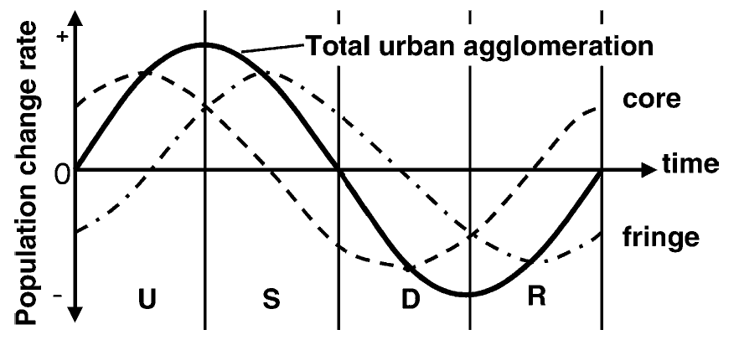
Urban life cycle
(Van den Berg et al., 1982; Paddison, 2001)
Urbanization
Sub - urbanization
dis - urbanization
re - urbanization
Stages of development

Slide 56
Case study:
Megalopolis and Megacities

Slide 57
Evolution of Megalopolis
Megalopolis: conurbation of two or more metropolis (already realized or in formation) originating an urban un continuum, particularly along major transport routes
Gottmann’s term megalopolis to refer to a string of closely interconnected metropolises was logical and inspired and has become part of the language;
BoWash (Boston – Washington) – studied by Gottmann (1961): coastal conurbation showing a trend to full conurbation – although characterized by interstitial areas
Stages:
  1950-1970: growth of suburbs: suburbanization;
  1970-1990: slowed suburban growth; edge cities, out of town industrial and retail parks; new growth in central areas;
  1990-2000: back to the core. Gentrification; preferences (residential, service) for central locations; creative class;
  immigration, economic restructuring and gentrification => higher level of social and economical inequity.
  Movement of poor and immigrants towards old suburban internal areas. Growth of suburbs for specialized functions (smart growth), once separated by cities, now incorporated in megalopolis.
  Suburbs: industry and retail (mall etc.); Centre: selected services and financial activities
It is reasonable to conclude, with Gottmann, that Megalopolis remains the Main street of America, despite the much faster rate and amount of growth in the metropolitan South and West.
Megalopolis (see. map): 42.400.000 people in 2000.
Extra urban area around Megalopolis (commuting area) + 8 millions

Slide 58
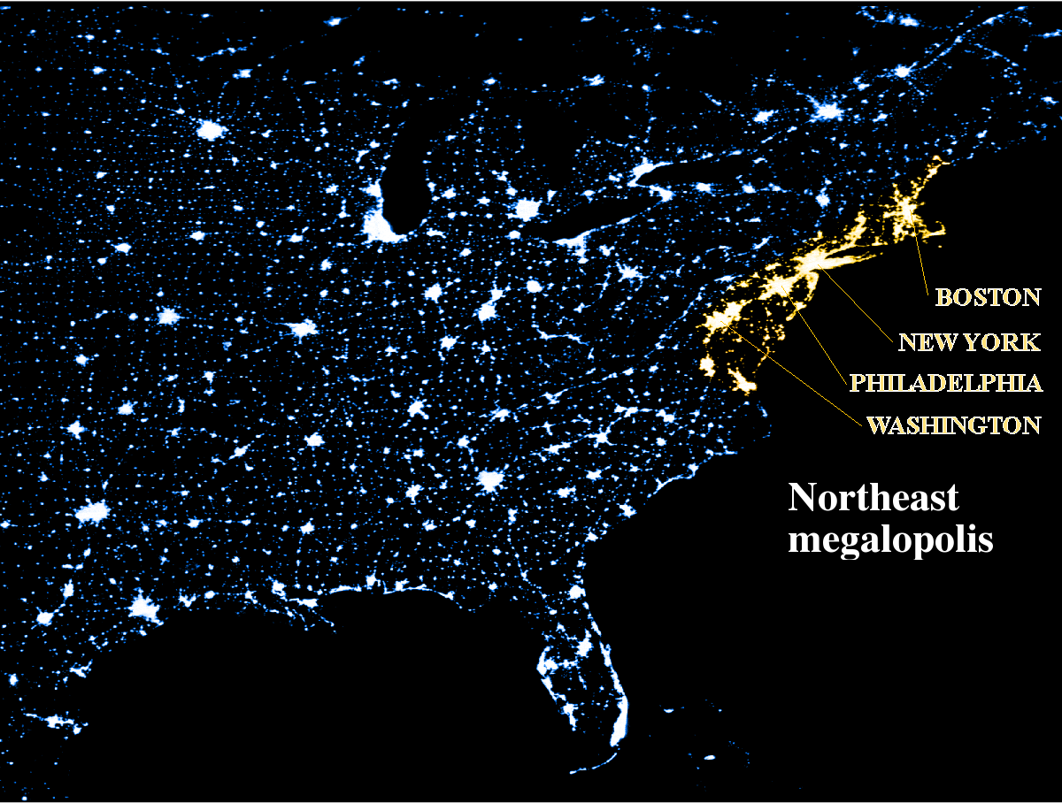

Slide 59
Population and growth of the urbanized area in the Megalopolis (1950 – 2000)
Morrill R., Classic Map Revisited: The Growth of Megalopolis, The Professional Geographer, 58(2) 2006, pages 155–160

Slide 60
Population and growth of the urbanized area in the Megalopolis (1950 – 2000)
Year | Population (millions) | Surface (km2) | Density (Inhabitants/ km2)
1950 | 24,5 | 8.499 | 2.883
1960 | 29,4 | 13.845 | 2.123
1970 | 34 | 18.137 | 1.875
1980 | 34,4 | 21.720 | 1.584
1990 | 36,6 | 26.367 | 1.388
2000 | 42,4 | 34.924 | 1.214
Morrill R., Classic Map Revisited: The Growth of Megalopolis, The Professional Geographer, 58(2) 2006, pages 155–160

Slide 61
Megalopolis
USA:
  Chicago – Pittsburg
  Santa Barbara – San Diego (30 millions inhab.)
    includes Los Angeles, low-density, horizontal metropolis
Japan:
  Tokio - Osaka (25 millions inhab.)
  Tokio Bay (50 millions inhab.)
China:
  Bejing – Tientsin (northern megalopolis)
  Hangzhou
    With Shangai
Europe:
  London – Milan:
  Renan Megalopolis; Blue Banana
  The “Pentagon”

Slide 62
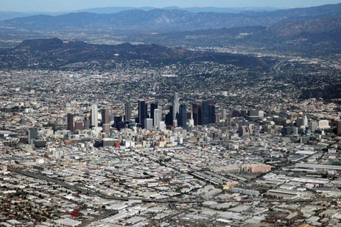
Los Angeles, low-density, horizontal metropolis

Slide 63
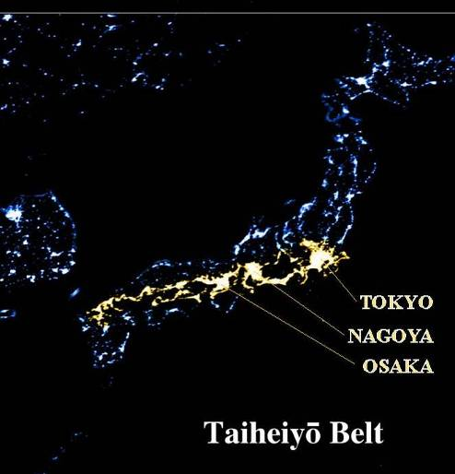
Tokio – Osaka Megalopolis

Slide 64
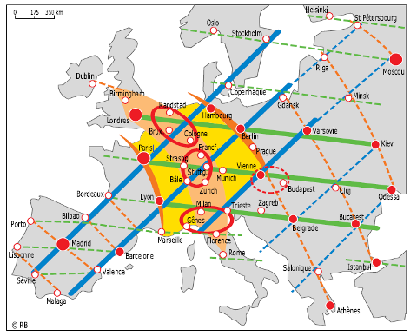
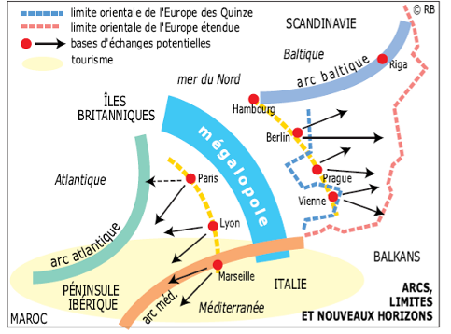
European Treillage and Renan Megalopolis
Brunet R., Lignes de force de l’espace européen, Mappemonde, 66 (2) 2002, pp. 14-19

Slide 65
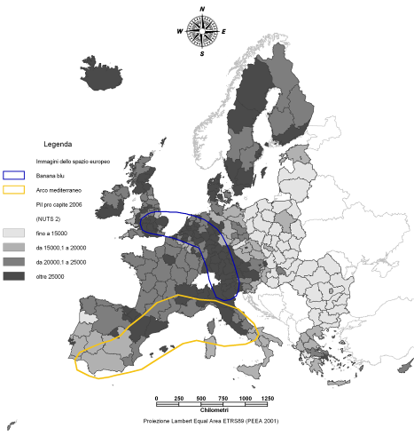
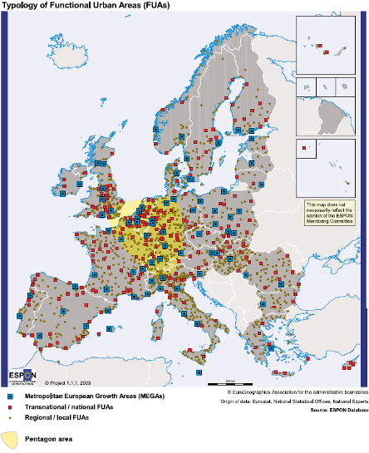
Images of the European space: the “blue banana” and the “pentagon” of cities
https://www.youtube.com/watch?v=Yi-rEL8i46Y
Mediterranean Arch and Blue Banana
Pentagon: London, Paris, Milan, Munchen, Hamburg
14% of Europe - 27 space
32% of urban population
46,5% of EU GDP.

Slide 66
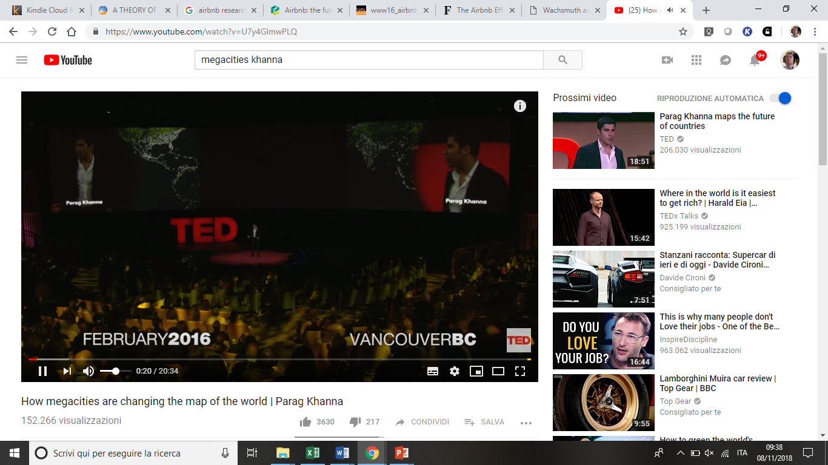
How Megacities are changing the map of the World
https://www.youtube.com/watch?v=U7y4GlmwPLQ

Slide 67
References
Berry B. J. L., Urbanization and Counterurbanization, SAGE, Beverly Hills, 1976
Brunet R., Les ville “européenne” Datar-Reclus-Documentation Francaise, Montpellier, 1989
Brunet R., Lignes de force de l’espace européen, Mappemonde, 66 (2) 2002, pp. 14-19
Camagni R., Economia e pianificazione della città sostenibile, Il Mulino, Bologna, 1996.
De Blij H. J. e Murphy A. B., Geografia umana. Cultura. Cultura, società, spazio, Zanichelli, Bologna, 2002
Dematteis G., Lanza C., Nano F. e Vanolo A., Geografia dell’economia mondiale, quarta edizione, UTET, Torino, 2010 (cap. 3, cap. 10)
Diappi L. e Campeol A., “Sostenibilità urbana: lo sviluppo di un approccio sistemico”, in Diappi L. (a cura di), Sostenibilità Urbana. Dai princìpi ai metodi di analisi - Forma urbana, energia e ambiente , Paravia, Torino, 2000
European Environmental Agency (EEA), Urban sprawl in Europe. The ignored challenge, European Commission, European Environmental Agency (EEA), Luxemburg, 2006. (http://eea.europe.eu)
Gottmann, J. Megalopolis revisited: 25 years later. University of Maryland Institute for Urban Studies, Baltimore, 1987
Gottmann, J., Megalopolis: The urbanized northeastern seaboard of the United States. Twentieth Century Fund, New York, 1961.
Gottmann, J., Megalopolitan systems around the world. Ekistics 243, 1976, pp. 109–13.
Haggett P., Geografia – Volume 1: Geografia umana, Zanichelli, Bologna, 2004 (cap. 5, cap. 11, cap. 12)
Lloyd P. E., DICKEN P., Location in space. A theoretical approach to economic geography, Harper International, New York, 1972.
Haggett P., Geography. A global synthesis, Pearson Education Limited, 2001
Morelli P., Geografia economica, McGraw-Hill, Milano, 2010 (cap. 7, cap. 9)
Morrill R., Classic Map Revisited: The Growth of Megalopolis, The Professional Geographer, 58(2) 2006, pp. 155–160
UN-HABITAT, Annual Report 2009, UNITED NATIONS HUMAN SETTLEMENTS PROGRAMME, Nairobi, 2010 (http://www.unhabitat.org)
Rodrigue J. P., Comtois C., Slack B., Geography of Transport Systems, Second Edition, Routdledge, 2010

Slide 68
https://www.facebook.com/events/495804477473216/
https://www.ted.com/talks/parag_khanna_how_megacities_are_changing_the_map_of_the_world?language=en

