Slide 1

Environmental risk and business strategies trick or treat?
GEOGRAFIA DEI CAMBIAMENTI GLOBALI E CITTÀ SOSTENIBILI
Trieste, 29 October 2024
Bruno Barbera

Slide 2
Environmental risk and business strategies threat or opportunity?
GEOGRAFIA DEI CAMBIAMENTI GLOBALI E CITTÀ SOSTENIBILI
Trieste, 29 October 2024
Bruno Barbera

Slide 3
Why should a company deal with the environment and the changes on our Planet?
Adaptation to a market orientation.
Savings and competitiveness (long term).
Social responsibility as an ethical and communicative element.
Sustainable finance.
Legislative obligations.
Multiple responses, often linked together

Slide 4
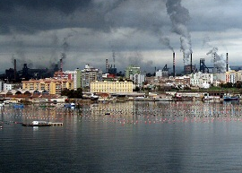
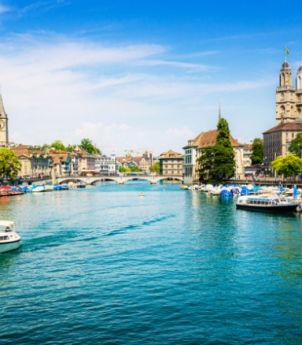
What really is the state of the environment? Must it be protected?

Slide 5
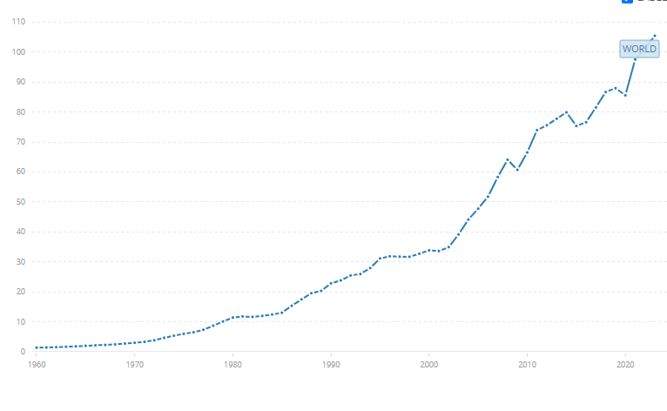

GDP world (US$)
trillion
Gross Domestic Product
Source:

Slide 6
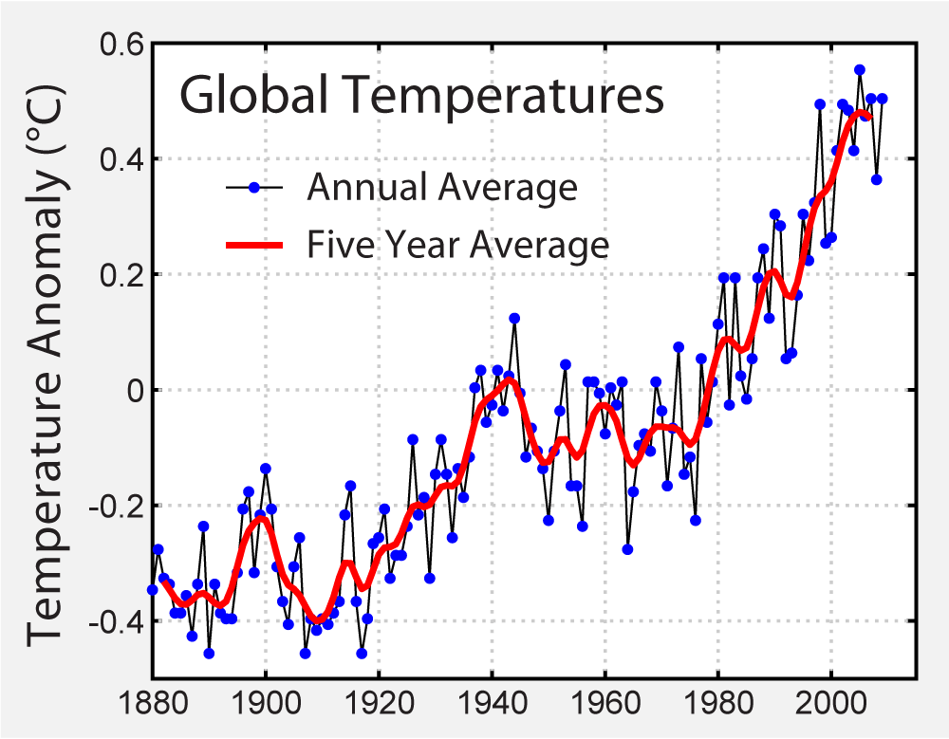
Source:
IPCC - Intergovernmental Panel on Climate Change

Slide 7
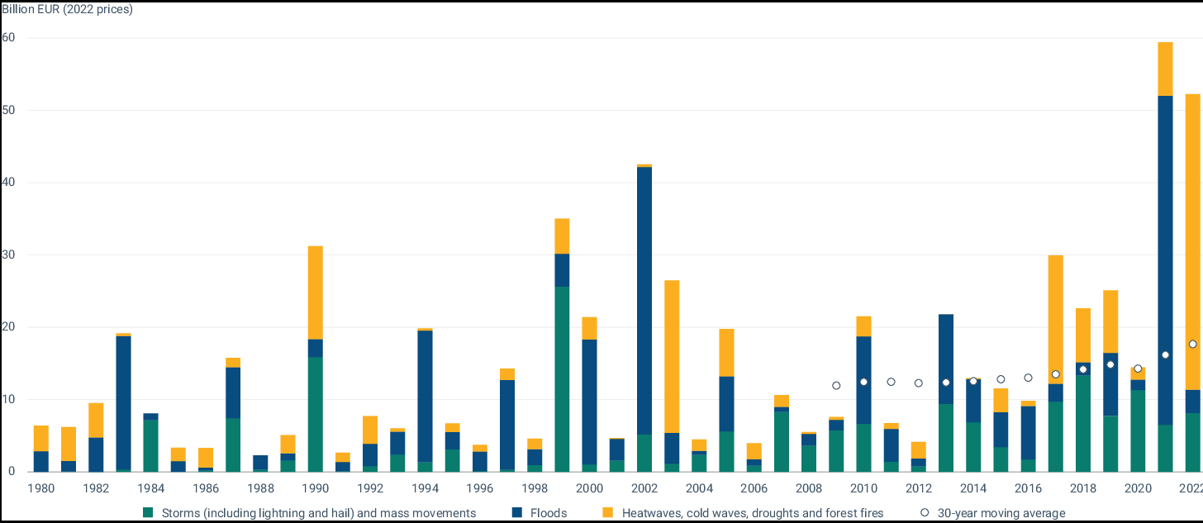

Annual economic losses caused by weather - and climate - related extreme events in the EU Member States

Slide 8
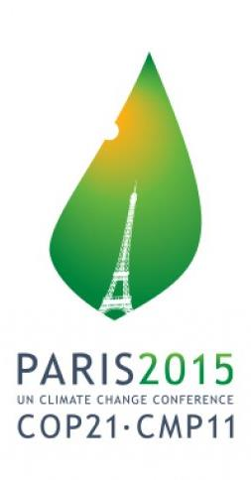
The World Answer - Paris Agreements
Financial commitments for mitigation and adaptation initiatives:
Financing by developed countries for poor developing countries with a $100 billion Green Climate Fund to be established by 2020.
Mobilization of resources at national level to implement initiatives to achieve reduction objectives: depending on policy choices, based on contributions determined at national level.
Entity indicated by some international organizations: "some points of GDP“.

Slide 9
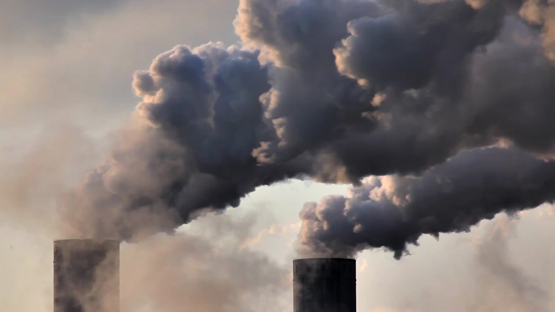
THE RELATIONSHIP BETWEEN DEVELOPMENT AND POLLUTION

Slide 10
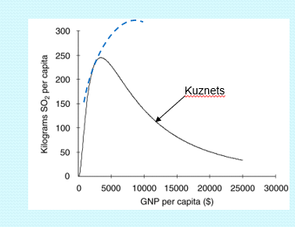
The Kuznets curve and its forcings
Physical constraints (e.g., availability of raw materials)
Changing value patterns and behaviors of consumers
Acceptance of higher production costs and product prices in exchange for a healthier environment
Development of new technologies
Relocation of more polluting production
Spontaneous choice of companies in a rewarding socio-political environment
Advent of environmental protection legislation

Slide 11



Europe: health and environmental protection
56. In addition to the significant health and environmental benefits, the advantages given by the effective implementation of the Union's environmental legislation are threefold:
the creation of a level playing field for economic actors operating in the internal market,
- the stimulation of innovation, and
- the promotion of “first mover” advantages in different sectors for European businesses.
DECISION No 1386/2013/EU OF THE EUROPEAN PARLIAMENT AND OF THE COUNCIL
of 20 November 2013
on a General Union Environment Action Programme to 2020 ‘Living well, within the limits of our planet’
7th Community Environment
Action Programme
Then: also stimulating innovation and competitiveness

Slide 12

Legislation
It presides over the public interest in environmental protection.
A risk?
No: a point of attention

Slide 13
Environmental legislation
Focal points
Localization:
Environmental Vulnerability
Environmental quality
Environmental receptivity
Social Deterrence
Local government history with respect to parallel location case histories
Homogeneity with planning framework
Flexibility with respect to possible developments
Administrative Framework:
Complexity and plurality of referents
Procedural timelines and homogeneity
Routine and extraordinary periodic controls
Business technical skills in the environmental field:
Technical competence
Continuity and efficiency of environmental principals
Quality of purchased Environmental Services
Management and investment framework:
Relative rigidity in management and plant changes
Obligations/opportunities for plant, process, product upgrades (e.g., new laws, BAT, substance ban.... permit review)

Slide 14

Strategic Scenarios
They are often not under the enterprise’s control
How to manage them?

Slide 15
Strategic Scenarios
Related to the world situation, conditioned or not by the environmental match
Accessibility to environmental resources (raw materials, water, soil, .....)
International policy scenarios (wars ....)
Agreements between countries to manage global scenarios
Energy market (Russian gas ...)
Changing cultural patterns
Trade agreement
Unilateral impositions on markets (EU fees vs China ...)

Slide 16
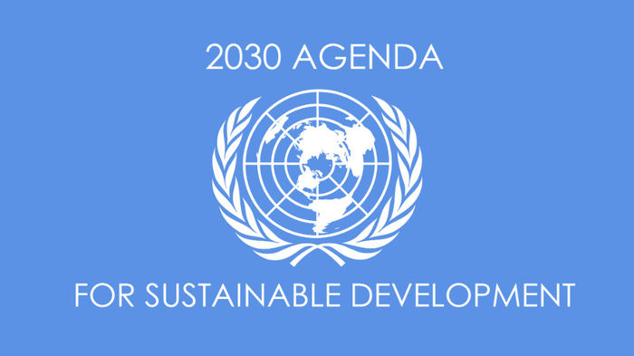
Strategic directions:
institutional sources, institutional responses

Slide 17
Strategic directions:
institutional sources, institutional responses

Slide 18

Sustainability Strategies
Environmental sustainability, in the many aspects mentioned, can be a strategic element for the sustainability of the Company in economic-financial terms

Slide 19
Sustainable finance
Sustainable finance refers to the process of taking environmental, social and governance (ESG) considerations into account when making investment decisions in the financial sector, leading to more long-term investments in sustainable economic activities and projects.
Environmental considerations might include climate change mitigation and adaptation, as well as the environment more broadly, for instance the preservation of biodiversity, pollution prevention and the circular economy.
Social considerations could refer to issues of inequality, inclusiveness, working relations, investment in people and their skills and communities, as well as human rights issues.
The governance of public and private institutions – including management structures, employee relations and executive remuneration – plays a fundamental role in ensuring the inclusion of social and environmental considerations in the decision-making process.

Slide 20
A corporate strategy for sustainability
A strategy is based on a thorough understanding of the aspects of a business
That condition
That are conditioned by
There are many possible commonalities between the levels of company knowledge needed to :
  Answer positively to regulatory requests
  Define your own sustainability strategy
  Improving market positioning
There are established instruments to help :
Get to know the company and, at the same time
Implement some forms of sustainability actions
its environmental footprint

Slide 21
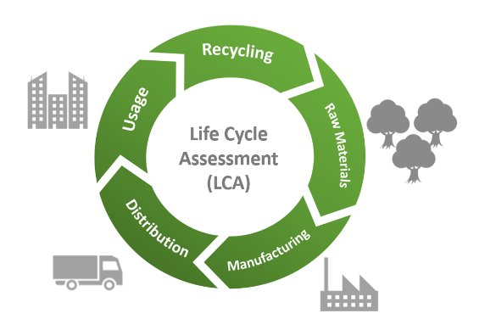
Tools for sustainability: Product Policies
Life Cycle Analysis (LCA)
LCA is an objective process of assessing the environmental burdens associated with a product, process or activity, through the identification and quantification of energy and materials used and wastes released to the environment, to evaluate the impact of these energy and materials uses and releases to the environment, and to assess and realize opportunities for environmental improvement. The assessment includes the entire life cycle of the product, process or activity, including the extraction and processing of
raw materials, manufacture, transportation, distribution, use, maintenance, reuse, recycling and final disposal” (SETAC, 1993).

Slide 22
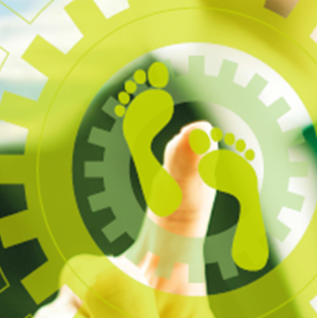
Tools for sustainability: Product Policies
What is the Environmental Footprint?
The European Commission proposed the Product Environmental Footprint (PEF) and Organisation Environmental Footprint (OEF) methods as a common way of measuring environmental performance (EU Commission Recommendation 2021/2279).
The PEF and OEF are the EU recommended Life Cycle Assessment (LCA) based methods to quantify the environmental impacts of products (goods or services) and organisations.

Slide 23



Tools for sustainability: Product Policies
What is the Environmental Footprint?
The overarching purpose of PEF and OEF information is to enable to reduce the environmental impacts of goods, services and organisations taking into account supply chain activities (from extraction of raw materials, through production and use to final waste management).
This purpose is achieved through the provision of detailed requirements for modelling the environmental impacts of the flows of material/energy and the emissions and waste streams associated with a product or an organisation throughout the life cycle.
https://green-business.ec.europa.eu/environmental-footprint-methods_en

Slide 24

Tools for sustainability:
between management and communication.
Eco-Management and Audit Scheme (EMAS)
Regulation (EC) No 1221/2009
the Regulation gives companies the opportunity to register in a special list established at the European Commission, following a stringent investigation (third-party verification and public verification) that the existence of precise requirements: existence of a valid EMS, regulatory compliance, validated Environmental Declaration.

Slide 25
Tools for sustainability: strategic tools.
Corporate Sustainability Reporting Directive (EU) 2022/2464
an obligation but also an opportunity
It modernises and strengthens the rules concerning the social and environmental information that companies have to report.
It is a document with which an organization relates to different categories of stakeholders to account for the results, effects and spillovers generated with its activities.
The rationale for this obligation is to provide analytical tools to define a sustainability strategy for the enterprise.

Slide 26

A Corporate strategy for sustainability:
goals and results
Implementation of principles of social responsibility
Cost savings and internal efficiency through optimization of processes, especially energy, raw materials, waste disposal and workers.
Competitive advantages, gaining or maintaining market share, including through product innovation aimed at environmental aspects, relationship with markets more sensitive to the “green market”.
Improved relations with funding sources, thanks to increased credibility in markets and because of the perception of a long-term rationale (some lenders impose environmental certifications as a prerequisite for funding).
Improved relations with regulators.
Reduction of litigation with social actors.

Slide 27
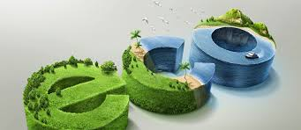
Eco-innovation and circular economy
The Circular Economy is provided for in Decision 1386/2013/EU of the European Parliament and Council of November 20, 2013, and the environmental regulatory framework is strongly directed toward its implementation.
Privileged tools for the purposes of the Circular Economy are Ecolabel regulations, life cycle indicators, sustainable consumption and production, incentives and green certificates.
Eco-innovation is closely linked with the Circular Economy in a mutual symbiotic relationship.

Slide 28
Eco-innovation and circular economy
The Circular Economy is based on a broad concept that emphasizes the need to attend to and care about the use of resources prior to the production of consumer goods, encouraging their recovery and subsequent re-entry into the same or another cycle of use, in order to make the best use of resources, decrease carbon emissions, and reduce reliance on landfilling.
Eco-innovation is defined as any innovation that results in significant progress toward the goal of sustainable development by reducing the impacts of our production methods on the environment, strengthening nature's resilience to environmental pressures, or enabling a more efficient and responsible use of natural resources

Slide 29
Eco-innovation
Eco-innovation refers to all forms of innovation, technological and otherwise, that create business opportunities and benefit the environment by preventing or reducing its impact or optimizing the use of resources. Eco-innovation is closely related to the way we use natural resources and our production and consumption patterns, as well as to the concepts of eco-efficiency and eco-industries.
It encourages the manufacturing industry to move away from “end-of-pipe” solutions in favor of “closed-loop” approaches that minimize material and energy flows through changes in products and production methods, resulting in competitive advantage in various sectors and business segments.

Slide 30

Eco-innovation and circular economy
Through supporting new processes, technologies and services that enable businesses to be more environmentally friendly, eco-innovation contributes to the optimization of growth while responding to common challenges: climate change, resource scarcity, and biodiversity loss.
Eco-innovation is also an opportunity for businesses because it leads to lower costs, helps to seize new growth opportunities, and improves corporate image in the eyes of consumers.

Slide 31
Legislation
Today, legislation, even of European derivation, is often inadequate for the purpose of timely regulation of all application cases, and Authority finds itself having to take the most conservative positions possible in self-defense in the absence of clear indications of laws, to the detriment of the most innovative and perhaps virtuous recovery technologies.
The regulatory gap, which lends itself well to contradictory case law rulings, can also generate distortions: matrices obtained from the same waste and virtually identical process, but subject to different regulatory regimes, are not obliged to guarantee the same standards of environmental protection.

Slide 32
Difficulties
Low trust of the population in those who check
Uneven approach of institutions in verification (in the interpretation and application of the standard)
Sometimes bureaucratic approach
Unclear regulations that favor neither those who operate nor those who check
Distrust of the waste sector and even recycling

Slide 33
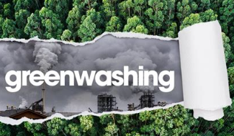
Greenwashing
The practice of giving a false impression of the environmental impact or benefits of a product, which can mislead consumers (European Union)
Greenwashing presents a significant obstacle to tackling climate change. By misleading the public to believe that a company or other entity is doing more to protect the environment than it is, greenwashing promotes false solutions to the climate crisis that distract from and delay concrete and credible action (United Nations).

Slide 34
Greenwashing
Greenwashing manifests itself in several ways:
Claiming to be on track to reduce a company’s polluting emissions to net zero when no credible plan is actually in place.
Being purposely vague or non-specific about a company’s operations or materials used.
Applying intentionally misleading labels such as “green” or “eco-friendly,” which do not have standard definitions and can be easily misinterpreted.
Implying that a minor improvement has a major impact or promoting a product that meets the minimum regulatory requirements as if it is significantly better than the standard.
Emphasizing a single environmental attribute while ignoring other impacts.
Claiming to avoid illegal or non-standard practices that are irrelevant to a product.
Communicating the sustainability attributes of a product in isolation of brand activities (and vice versa) – e.g. a garment made from recycled materials that is produced in a high-emitting factory that pollutes the air and nearby waterways.
United Nations

Slide 35
Thank you

