Slide 1
LECTURE 9 Small RNA analysis, single-cell RNA-seq and spatial transcriptomics

Slide 2
Small RNA sequencing – a definition
The term “small RNA” is generally used to describe a heterogeneous group of RNA molecules which size ranges between 20 and 200 nt, and are therefore smaller than the usual size of mRNAs
Nevertheless, such definition is broad and arbitrary, since many different types of RNA molecules with different function would fall within this definition: snRNA, snoRNA, piRNA, miRNA, YRNA, tRNA and siRNA
However, in the overwhelming majority of cases the target of small RNA sequencing approaches are miRNAs, the most abundant class of cellular small RNAs
Therefore, small RNA sequencing and miRNA-seq are often used interchangeably as synonymous terms

Slide 3
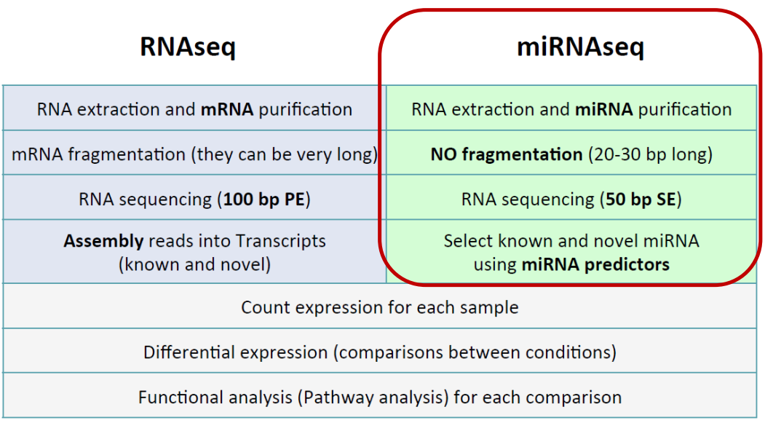
Small RNA analysis – a brief overview
The approach is very similar to that of a classical RNA-seq, but there are fundamental differences in how the libraries are extracted (with special kits) and prepared (without the need for fragmentation)

Slide 4
Small RNA analysis – a brief overview
Show can miRNAs be isolated from total RNA extracts?
Keep in mind that miRNAs usually represent an extremely small fraction of total RNA
Avoid over-drying RNA pellets: this may lead to the impossibility of re-solubilizing small RNAs
The most common strategies may involve:
-The separation of small RNAs via gel electrophoresis, followed by their recovery (the gel needs to be cut and the miRNAs need to be released from agarose). This is impractical and may lead to significant sample loss; however, this is an inexpensive approach
-The use of commercial kits based on solid-phase extraction (column-based kits), which enable the exclusive recovery of low molecular weight RNAs. This is a very effective and reproducible approach, which is however quite expensive
Above: standard total RNA extraction vs miRNA-enriched RNA extraction, checked on an Agilent Bioanalyzer

Slide 5
Small RNA analysis – a brief overview
Problems very similar to those described for the analysis of RNA-seq data related to mRNAs are encountered in the case of the analysis of small RNAs, particularly miRNAs. Of course, the handling of reads (trimming and mapping) must be thought of differently than for an RNA-seq, since the size of miRNAs is very small (about 22 nt)! The sequencing itself will be of a very specific type (e.g., it does not make sense to use very long reads or paired-end approaches!)
Two distinct approaches are possible here:
1)Counting the different types of miRNAs obtained in a sequencing experiment and then comparing them with a reference database (mapping-free, “lighter” approach, does not require a reference genome)
2)Mapping reads to an annotated genome and counting how many fall within regions annotated as miRNAs (a “heavier” approach, applicable only to model organisms, in which the genome is well annotated)

Slide 6
Small RNA analysis – a brief overview
There are miRNA-specific databases, the most important of which is miRbase (http://www.mirbase.org)
It is possible to compare sequences obtained from sequencing with those deposited in these databases by associating each known miRNA with a number of digital counts
Differential expression analysis can proceed similarly to what is done for RNA-sequencing data
N.B. In this case, talking about RPKM, TPM and FPKM does not make sense since the length of miRNAs is always the same. Normalization will therefore have to be done solely on the basis of sequencing depth

Slide 7
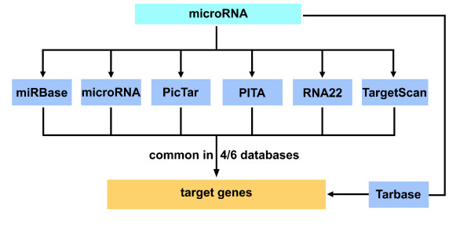
Small RNA analysis – a brief overview
A typical workflow of a miRNA-seq analysis involves comparison with multiple databases to obtain robust data
The ultimate goal is not only to identify miRNAs that undergo differential expression, but also to predict what the target genes and thus the most affected biological processes may be
The databases contain not only information regarding the sequence of miRNAs, but also about their known biological targets, i.e., the genes that can be modulated by them, and consequently also the molecular pathways undergoing regulation (as each target gene is in turn associated with one or more functional annotations)

Slide 8
The young story of single-cell sequencing
So far, we have always discussed about bulk RNA-sequencing approaches, which target a large number of cells analyzed simultaneously, providing average levels of expression
Single-cell approaches can, however, greatly improve the resolution of the analyses, clarifying the biological role of single cells
N.B. Although single-cell approaches are most frequently used for RNA-seq, other –omic applications are also possible, although there are some limitations

Slide 9
The young story of single-cell sequencing
Single-cell sequencing approaches include a large number of different techniques that have been developed over the years, most of which deal specifically with sc-RNA-seq
However, the development of different cell isolation protocols, library preparation strategies and microfluidics devices strongly contributed to the recent extension of single-cell sequencing approaches to genomic DNA
Here, we are just going to briefly discuss a few key points shared by most scRNA-seq strategies

Slide 10
Single-cell RNA-seq approaches
The ability to perform these studies depends on our ability to isolate individual cells from a biological sample
Multiple approaches are possible, but each one has its advantages and its disadvantages. Among these, the most relevant ones are:
Throughput (i.e. number of cells that can be analyzed)
Specificity of isolation of cells of interest
Need to dissociate cells, losing spatial information
High cost of the equipment needed and technical expertise required

Slide 11
Single-cell isolation approaches
FACS (Fluorescence Activated Cell Sorting): allows the identification of different cell types in a heterogeneous cell population based on size, granularity, and fluorescence. Fluorescence is due to the use of monoclonal antibodies directed towards surface markers of target known cell types
Cells need to be separated from each other before the analysis, a large number of cells is required in suspension (>10,000 per sample); requires the use of fluorescent markers, one for each type of known target cell type (resolution up to 10-15 types)

Slide 12
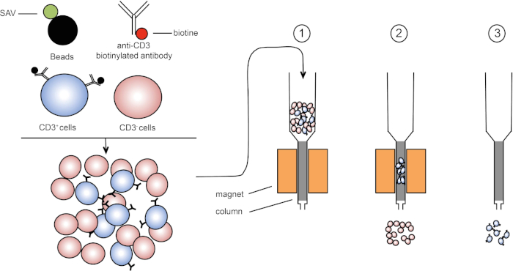
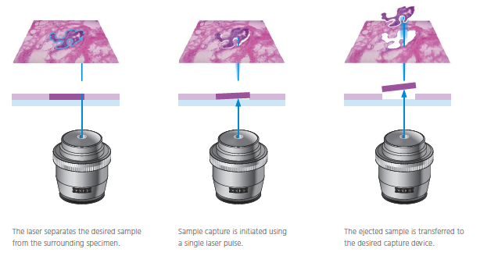
Single-cell isolation approaches
Magnetic-Activated Cell Sorting (MACS): magnetic beads coated with an antibody specific towards a surface antigen can be used to separate target cells in a sample from all the other cell types. Cost-effective and simple, but (i) can only target surface antigens and (ii) unlike FACS does not allow to discriminate populations by expression level
Laser Capture Microdissection (LCM): allows high precision, can work with solid tissue samples, usually previously fixed on a slide, but requires highly trained staff for cell identification; the throughput is low
Manual Cell Picking/Micromanipulation: similar to LCM, but involves the use of pipettes for cell picking. Can be also used on live cell cultures or on embryos. Very low throughput, requires highly skilled staff

Slide 13
Single-cell isolation approaches
Microfluidic devices: their use has been steadily increasing over the past few years due to the possible application to very low reaction volumes, the ease of use and the possibility to combine them with FACS/MACS approaches
These approaches can isolate single cells based on 3 main types of approaches: (1) traps-based methods; (2)valves-based methods; (3) droplet-based methods
Traps are very simple, as they are basically microwells that can only accommodate a single cell; valve-based methods are the most complex ones, and they usually involve the combination of FACS/MACS; in droplet-based methods, each cell is associated with a droplet and beads in oil (resembles emulsion PCR, but beads are not magnetic)

Slide 14
Droplet-based approaches
This slide shows three examples of different commercial kits used for a microfluidics droplet-based scRNA-seq approach
The beads serve the purpose of isolating mRNAs, since their surface is coated with oligos ending with polyT and including PCR primers (for polony generation), UMI and cell barcodes
The libraries are prepared with dual indexes (one barcode at each end), allowing a very high level of multiplexing
Different strategies are used for library preparation, which in any case also requires a cell lysis step before mRNA isolation

Slide 15
Single-cell RNA-seq approaches
Because mRNA input is low and selection strategies are based on poly-A selection, it is known that only the top 10-20% of the most highly expressed transcripts will be represented in the library
We exclusively use a 3'-tag library preparation approach because of the need to keep the costs down and analyzing large numbers of cells in parallel
Fundamental use of barcodes and UMIs (reads derived from each cell must be clearly identifiable!)
Approach subject to much more potential bias than classical RNA-seq approaches

Slide 16
Single-cell RNA-seq: barcodes and UMI
Each barcode identifies a cell
Each UMI identifies a molecule
Useful in scRNA-seq because you start with little input RNA and consequently the “amplification noise” can be considerable
Dramatically reduces the number of duplicate reads, ensuring more accurate quantification
Usually the target of scRNA-seq analysis ranges from about 500 to 10 thousand cells (each one is characterized by a unique barcode)

Slide 17
Single-cell RNA-seq approaches
What is the ultimate goal?
Identifying groups of cells that show similar expression profiles -> cell types that share the same function (specialized blood cells for example), or groups of cells with aberrant expression profiles (cancer cells)
At the same time, we can better define which genes are specifically expressed by highly specialized cells in a tissue
This information would be “lost” (because it is averaged with expression data from all other cell types) in RNA-seq data from a whole tissue

Slide 18
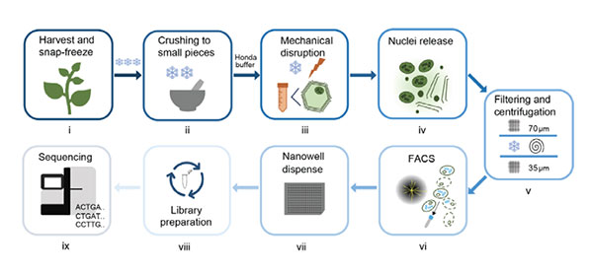
Single-cell vs single-nuclei RNA-seq
Some cell types (e.g., adipocytes, neurons, extracellular matrix cells) can be extremely difficult to separate
Nucleus isolation allows analysis of these cells as well, using a rapid (and not too aggressive) isolation protocol
Pros: ability to analyze expression profiles of any cell type, easy operation even from non-fresh, frozen or preserved samples by various methods
Cons: highlights nuclear transcription (pre-splicing), no possibility to study alternative splicing, excludes mitochondrial and plastidial transcripts

Slide 19
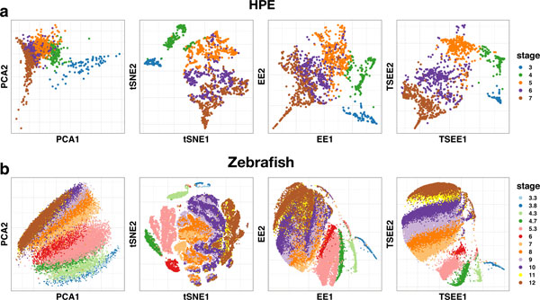
Graphical representation of scRNA-seq data
PCA-like graphs are the standard way for representing scRNA-seq data
N.B. in these representations, each dot corresponds to a cell type, colors are used to discriminate different tissues from each other
Some alternative algorithms have been developed in recent years, which seem in some cases to be able to present in a more “informative” graphical guise the main differences between different samples. These include the methods of tSNE (t-distributed stochastic neighbor embedding) and elastic embedding (EE), which are encountering strong expansion in recent years in the field of single-cell RNA-seq

Slide 20
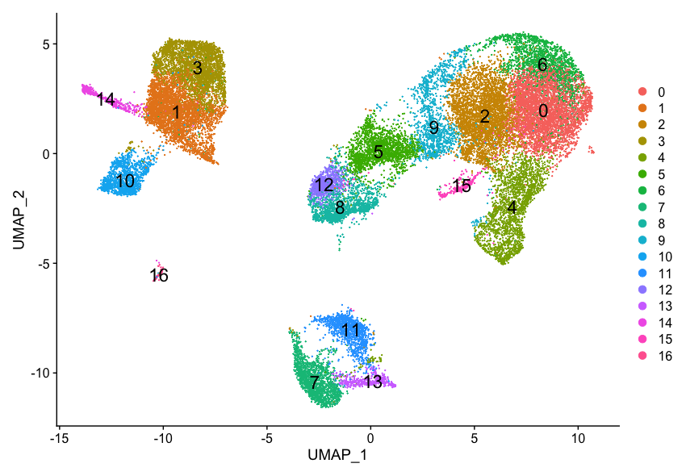
Graphical representation of scRNA-seq data
Final goals:
Identifying different cell populations that share a similar gene expression profile (these are usually labeled with different colors) -> this process is known as clustering
Functionally characterizing each cluster -> this exploits the high specificity of expression of one or more molecular markers, which are exclusively associated with a given cell type

Slide 21
Graphical representation of scRNA-seq data
A few additional notes:
Some clusters may remain uncharacterized, if no molecular marker is known (especially in non-model organisms)
The distinction between different cell types is not always clear: cells may display a gradual shift from one type to another one, depending for example on their maturation
The number of generated clusters can be arbitrarily defined based on the required level of resolution

Slide 22
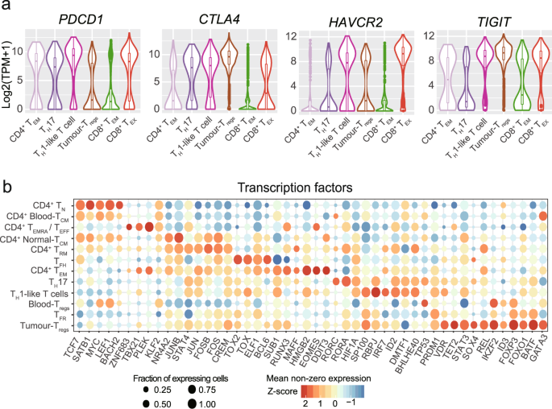
Graphical representation of scRNA-seq data
Heat maps can provide some help for the interpretation of scRNA-seq expression data, in particular in relation with clusters
Due to the usual presence of extreme inter-cellular variability, violin plots can be also very useful to display the distribution of gene expression levels of selected molecular markers across different cell types.
Bubble plots also help a lot, as they show: (i) the % of cells that express a given gene (bubble size) and the average expression level of the same gene (bubble color)

Slide 23
scRNA-seq: how much does it cost?
Cost is highly dependent on the type of sample, cell isolation approach and on the number of target cells. However, the library preparation step is always the most expensive phase. Sequencing itself is pretty cheap, due to the low number of reads required per cell (due to the low amount of RNA that can be recovered per cell). We can provide a few examples…
Chromium 10X: library prep is about 2000$ per sample, and each microfluidics chip is about 270$. Each cheap can be used for up to 40K cells (i.e. 8 samples, up to 5K cells theoretically possible, but the typical output is around 1K cells)
Subsequent sequencing would require about 50-100K reads per cell
Take home message: library prep costs about 10-20X more than bulk RNA-seq. Although the number of reads per cell is much lower than bulk RNA-seq, the total number of reads required is also higher due to the high number of cells analyzed

Slide 24
Spatial transcriptomics – what is it?
Despite their usefulness, most scRNA-seq methods require the disruption of the target sample for the isolation of single cells (or single nuclei), thereby precluding the possibility to study the spatial distribution of cells within tissues
Some cells types (e.g. neurons) are not as amenable for scRNA-seq approaches as others, and scRNA-seq data do not provide information about the subcellular localization of mRNAs, which can be sometimes quite a useful information
A growing number of platforms now allow the possibility to obtain a spatially resolved, high-dimensional assessment of gene transcription, known as ‘spatial transcriptomics’
This has been nominated the “method of the year” in 2020 by Nature Methods

Slide 25
Spatial transcriptomics: the platforms
Available commercial platforms are still at their early stage of development
Some of them hold promises not just for transcriptomics, but also for other omics approaches: proteomics, for example, with the simultaneous use of multiple antibodies
They require, preferentially, fresh-frozen samples, in order to avoid RNA degradation; however, they can also work on FFPE (Formalin-fixed, paraffin-embedded) samples
RNA quality is obviously as important as in regular RNA-seq approaches
Usually, the samples need to be prepared as thin slices by microdissection, but some platforms also accept tissue blocks
Most applications still just concern human or mouse, but the technology itself could be potentially applied to any organism

Slide 26
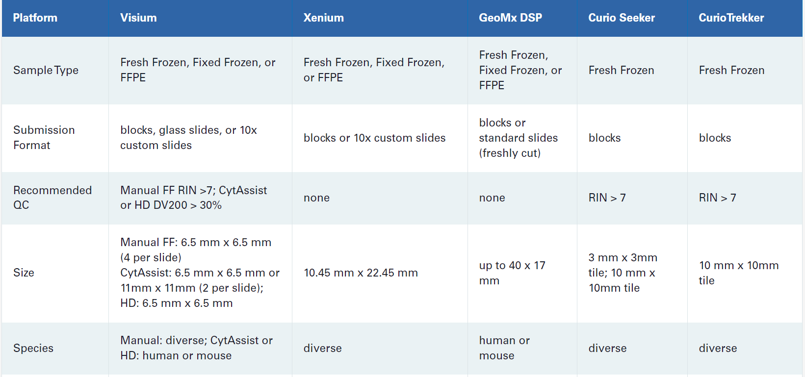
Spatial transcriptomics: the platforms

Slide 27
Different platforms, different approaches
imaging-based spatial transcriptomics
in situ hybridization (ISH) (use of a high number of probes directed against target mRNAs)
in situ sequencing (ISS) of target mRNAs amplified in situ with a sequencing by ligation approach
sequencing-based (NGS) spatial transcriptomics
array-based methods: record position and target capture
microdissection-based methods: use of spatially barcoded probes

Slide 28
Imaging-based spatial transcriptomics
ISH is clearly limited by the number of fluorescent probes than can be hybridized simultaneously (i.e. 4), which would only allow the imaging of 4 target mRNAs at a time. However, this is solved by the use of different rounds of hybridization, each one using the same probe linked with different barcodes. Each mRNA is therefore identified by a given temporal sequence of detected colors. This “temporal barcoding” strategy, with 20 hybridization rounds, can actually track all the mRNAs expressed in a sample, even though the risk of “optical crowding” is high
ISS uses a particular type of probes which allow, following hybridization and ligation, to amplify the signal thanks to rolling circle amplification, thereby allowing a better signal-to-noise ratio. The sequence of the mRNAs is determined through sequencing by ligation (this is somewhat inspired by old SOLiD NGS).
The 10X Xenium platform used an ISH/ISS hybrid approach: following the use of 8 padlock probes targeting specific mRNA targets, which lead to rolling circle amplification, the signal is given by several successive cycles of hybridization with fluorescently labeled probe. Temporal barcoding allows the identification of each target. See the video available on Moodle about the 10X Xenium platform for an example
Pros: high spatial resolution, leading to the identification of subcellular localization of mRNAs
Cons: high chance for errors, not all mRNAs can be profiled, the procedure is long and generates extremely large output files

Slide 29
Sequencing-based spatial transcriptomics
Microdissection-based methods are inspired by a few early precursors, such as Tomo-seq (where the tissue was cryosectioned, with each section undergoing RNA-seq). They currently used modern microdissection techniques
The Nanostring GeoMx DSP is one of the most modern devices: in this case genes are barcoded with gene-specific photocleavable probes (the probes can be either antibodies directed against the target protein, or oligos complementary to target mRNAs). When UV light is shone on the tissue, one region of interest at a time, probes are released and sequenced
Cons: low spatial resolution, mRNA degradation due to laser use
See the video on Moodle for additional details

Slide 30
Sequencing-based spatial transcriptomics
Overview of the Nanostring GeoMX protocol
Note the possibility to use either:
-RNAscope probes (complementary to target mRNAs)
-Fluorescent antibodies (against target proteins)
These need to be fluorescently-labeled to allow the selection of the region of interest (ROI) for photocleavage and targeted sequencing

Slide 31
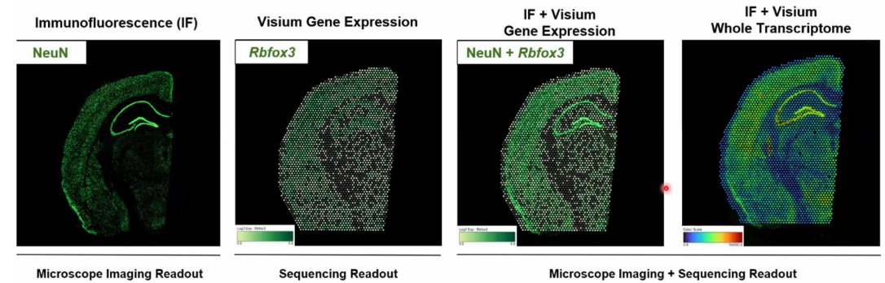
Sequencing-based spatial transcriptomics
Array-based methods do NOT use gene specific probes, but rather use a spatial array of generic mRNA probes (based on oligo-dT selection) that are used to barcode all the mRNAs associated with a given area in the grid of the array
Captured mRNAs are converted to cDNAs and used for library preparation and sequencing
An example is provided by 10X Visium. The spatial resolution of array methods is defined by the size of a capture area harbouring any given unique positional barcode
Pros: avoids image-processing pipelines; being untargeted, offers the opportunity to profile the full transcriptome. Spatial resolution is lower than imaging-based methods
See the video on Moodle for further details

Slide 32
Imaging-based spatial transcriptomics
The Curio Seeker in another array-based platform, which uses spatially indexed beads to extract spatial information (check the video on Moodle)
The Curio Trekker allows single-nuclei tagging, offering the possibility to investigate spatial transciptomics at the single-cell level

Slide 33
Spatial transcriptomics: how much does it cost?
The total cost is highly dependent on the size of the area to be investigated, on the number of targets of interest and on the technology selected
For example, the commercial price of a 10X Visium analysis (whole transcriptome spatial transcriptomics) can range between 8000 and 14000$ depending on the size of the slide (6,5 – 20 mm)
A 10X Xenium analysis has a variable cost related with probe design (standard panel vs custom panel), plus a cost for hybridization and imagining. The total price can range from 7500$ (1-50 gene targets) to about 12000$ (5000 targets)
The cost of a Nanostring analysis depends on the number of targets: from a few thousand euros or small target sets, to 15000 euros for up to 6K targets

