Slide 1
UV-VIS spectroscopy

Slide 2
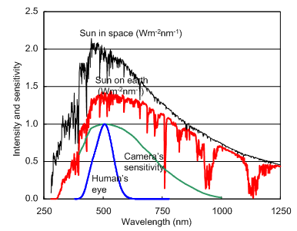
UV-Vis spectroscopy
小川技研 3.1光波長と色 （2017.1.23改定）
http://wwwb.pikara.ne.jp/ogawa-giken/image_process/image_031.html
Wavelength
/nm
200
300
400
800
FUV
DUV
near-UV
VIS
energy
Wavenumber
/cm⁻¹
50000
33000
25000
12500
O₃
O₂
visible（400 – 800 nm)
ultraviolet（< 400 nm）-- Near-UV（300 - 400 nm)
Deep-UV（ 200 - 300 nm)
Far-UV（< 200nm）
Electronic transitions are observed
Ozone absorption
Doesn't arrive from space
Oxygen absorption
Does not propagate in air

Slide 3
What can we learn from UV-VIS spectroscopy
Quantitative analysis
Beer-Lambert law Sensitivity of about 10⁻⁶ mol L⁻¹
Simultaneous multi-component quantification
Understand the electronic states
HOMO-LUMO gap
Molecular orbitals
→ Selection rule of chemical reactions = Woodward-Hoffman rule
Frontier orbit theory
Can identify molecules
not good at investigating the details of structures
and functional groups compared to infrared spectra.
Contains information about intermolecular interactions
and associated structures
J-aggregates/H-aggregates
H-aggregate
Shorter wavelength
than monomer
J-aggregate
Longer wavelength
than monomer

Slide 4
Selection rule for observing electronic transitions
Bohr‘s frequency condition
The wavelength of light with energy matching the energy difference (transition energy) between the ground state and excited state of the molecule is strongly absorbed
ΔE＝hν
Energy interval
Molecular states
=Energy of light
The motion of electrons within molecules is quantized. This is because the quantum properties of the atomic nucleus and electrons are prominent in tiny spaces such as molecules, and the orbits that the electrons can take are limited. The energy of an electronic state is determined by what kind of spin an electron exists in an orbit with what kind of energy.

Slide 5
Selection rule for observing electronic transitions
Light is absorbed when the excitation dipole moment is not zero.
The probability that an electronic transition occurs is proportional to the transition dipole moment $μ_{12}$. For simplicity, if we assume that the electric field of light oscillates in the spatial coordinate z direction, the transition dipole moment ${\left(μ_{z}\right)}_{12} is defiened as:$
${\left(μ_{z}\right)}_{12}=\int{ψ_{2}^{∗}μ_{z}ψ_{1}dr}$
$μ_{z}=\sum{ez_{i}}$ the z component of the dipole moment of the molecule
(z_{i} is the z component of the i-th electronic coordinate)
$ψ_{1}^{}$and $ψ_{2}^{}$the electronic wave function before and after the transition, ($ψ_{2}^{∗}$shows the complex conjugate of $ψ_{2}^{})$.
Notes:
In other words, whether or not an electronic transition occurs is determined by the electron configuration within the molecule, and if the transition dipole moment is 0, no light will be absorbed and no electronic transition will occur even if Bohr's conditions are muched.

Slide 6
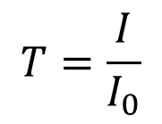
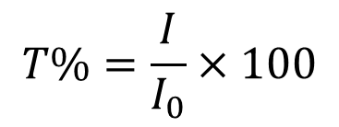
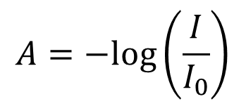
Absorption spectra
Transmittance light
I
Incident light I₀
If there is absorption signal downwards
If there is absorption signal upwards
100
No abosorption
Transmittance（％）
Absorbance
No absorption
0
wavelength
wavelength
Wavenumber
Wavenumber
$$T=\frac{I}{I_{0}}$$
$$T\%=\frac{I}{I_{0}}×100$$
$$A=−log⁡\left(\frac{I}{I_{0}}\right)$$

Slide 7
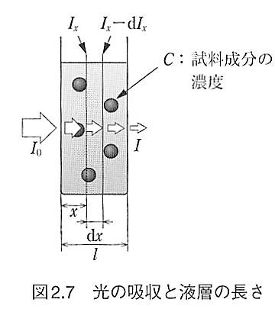

Beer-Lambert law
Lambert’s law
molarity
/mol L⁻¹
Absorbance is proportional to the optical path lengt, x.
Beer’s law
Absorbance is proportional to the volume molarity, C.
$$\int_{I_{0}}^{I}{\frac{1}{I_{x}}dI_{x}}=k_{2}A$$
$$−\log{\frac{I}{I_{0}}}=2.303k_{2}A$$
A:C,dx
Beer-Lambert law
dI_{x}= kI_{x}CdxI
Absorbance is proportional to
optical path length x and concentration C of the sample
$A=−\log\left(\frac{I}{I_{0}}\right)=ε\left(\text{L}{\text{mol}}^{−1}{\text{cm}}^{−1}\right)C(\text{mol}{\text{L}}^{−1})$ $x(\text{cm})$
$ε(\text{L}{\text{mol}}^{−1}{\text{cm}}^{−1})$ ;molar absorption coefficient

Slide 8
Quantitative analysis using UV-Vis spectra
Beer-Lambert Law
Condition
The measured substance must be uniform and
their molar absorption coefficient does not change within the measurement concentration rangeT
$A=−\log\left(\frac{I}{I_{0}}\right)=ε(\text{L}{\text{mol}}^{−1}{\text{cm}}^{−1}) C(\text{mol}{\text{L}}^{−1})$ $x(\text{cm})$
$$For a molecule with a known value of ε,$$
$$the absorbance A is measured in a cell with a known value of x$$
$$C(\text{mol}{\text{L}}^{−1})=\frac{A}{ε\left(\text{L}{\text{mol}}^{−1}{\text{cm}}^{−1}\right)x(\text{cm})}$$
Molarity can be determined by measuring absorbance

Slide 9
Error estimation of absorbance ーTwyman-Lothian’s plot
Relative error of transmittance
⇦relative error of observed intensity
Values that can be
measured reliably
Relative error of Absorbance
Relative error of Absorbance
Absorbance A
Relative error in absorbance when relative error in transmittance is 0.001.
Even in absorbance, the same relative error occurs only between 0.1 and 1.0.

Slide 10
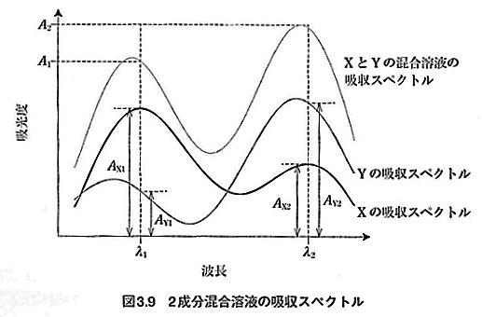
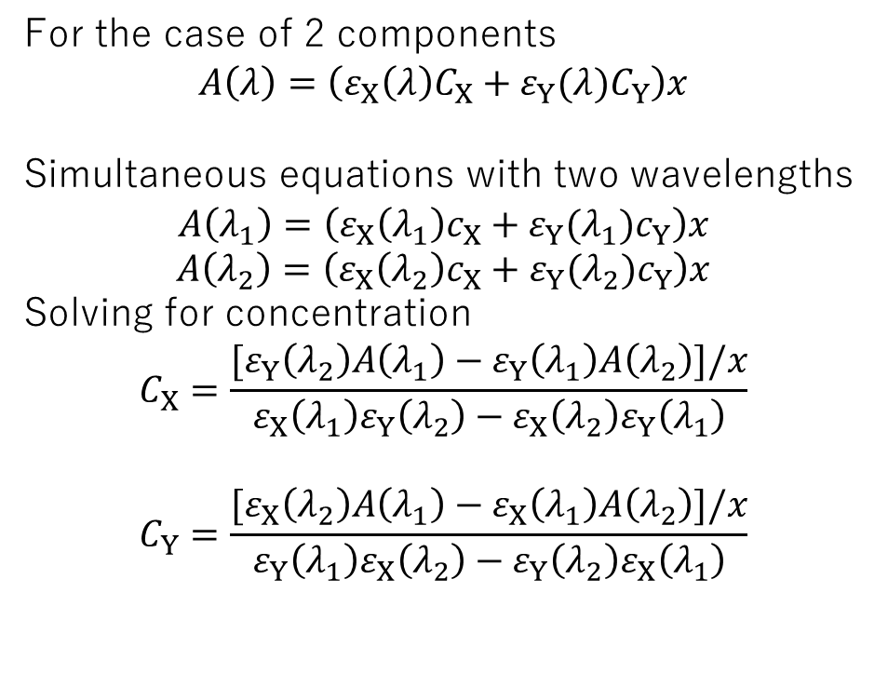
Simultaneous quantification of multiple components
When the maximum wavelengths are far apart and
there is no interaction between the components
condition
Even in a solution where a few components are mixed, all the components can be quantified simultaneously from the absorbance at the corresponding number of wavelengths of the spectrum.
Additivity of Beer-Lambert laws
For the case of 2 components
$$A\left(λ\right)=\left(ε_{X}\left(λ\right)C_{X}+ε_{Y}(λ)C_{Y}\right)x$$
Simultaneous equations with two wavelengths
$$A\left(λ_{1}\right)=\left(ε_{X}\left(λ_{1}\right)c_{X}+ε_{Y}(λ_{1})c_{Y}\right)x$$
$$A\left(λ_{2}\right)=\left(ε_{X}\left(λ_{2}\right)c_{X}+ε_{Y}(λ_{2})c_{Y}\right)x$$
Solving for concentration
$$C_{X}=\frac{[ε_{Y}\left(λ_{2}\right)A\left(λ_{1}\right)−ε_{Y}\left(λ_{1}\right)A\left(λ_{2}\right)]/x}{ε_{X}\left(λ_{1}\right)ε_{Y}\left(λ_{2}\right)−ε_{X}\left(λ_{2}\right)ε_{Y}\left(λ_{1}\right)}$$
$$C_{Y}=\frac{{[ε}_{X}\left(λ_{2}\right)A\left(λ_{1}\right)−ε_{X}\left(λ_{1}\right)A\left(λ_{2}\right)]/x}{ε_{Y}\left(λ_{1}\right)ε_{X}\left(λ_{2}\right)−ε_{Y}\left(λ_{2}\right)ε_{X}\left(λ_{1}\right)}$$
x
Spectrum of
Mixed solution
Absorbance
Spectrum of Y
Spectrum of X
wavelength

Slide 11
instruments
Sample section
spectrometer
Light
source
slit
slit
detector
A UV-visible spectrometer is divided into
light source,
spectrometer,
sample section
detector.
monochromator
Sample section
spectrometer
Light
source
polychromator
detector

Slide 12
Light source
tungsten lamp（350-2600 nm）
D2 lamp （190~400 nm）
others
Xenon flash lamp
discontinuous/high intensity （190~2000nm）
Super continuum (SC) light source:
coherent broadband light, short pulse
(very expensive) (400~2400nm)

Slide 13
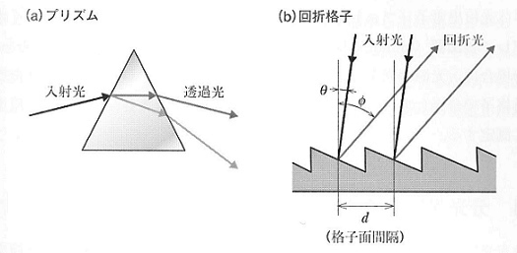
Spectrometer
Sample section
spectrometer
Separates light into wavelengths
with a spectroscopic element
Light
source
slit
slit
detector
prism
grating
α
β
monochromator
Sample section
spectrometer
Utilizes wavelength dispersion of refractive index.
light of different wavelengths
refract to different angles
Using interference of diffracted light
Light of different wavelengths strengthens each other at different angles of reflection
$$d\left(\sin{α+\sin{β}}\right)=nλ$$
Light
source
polychromator
detector

Slide 14
Sample compartment
Single beam
① Measurement without sample I₀
② Measurement with sample I
With sample
Spectrometer
Double beam
① Measuring the difference in detecting sensitivity between two optical paths
② Simultaneous measurement
Measurement without sample I₀
Measurement with sample I
Without sample
=reference
Example of double beam set up

Slide 15
Detector
Si photodiode (1100-180 nm)
Sensitivity is stable over a wide range of wavelengths (sensitivity is lower than PMT)
Photomultiplier tube（PMT) (200-900 nm)
High sensitivity
Photodiode for Nera-Infrared light
InGaAs (800-1700 nm)
PbS (1000-3500 nm)
multichannel detector for polychromator
・Charge-Coupled Device (CCD) (800-400nm)

Slide 16
Do you remember?
Which of the following sentences regarding the Lambert-Beer law is incorrect?
Beer-Lambert law states that transmittance is proportional to the concentration of solute and the optical path length.
To apply this law, the object to be measured must be uniform.
Under certain conditions, it is possible to quantify the concentrations of the three components using this law.

Slide 17
Checking
Which of the following sentences regarding the Lambert-Beer law is incorrect?
Beer-Lambert law states that transmittance is proportional to the concentration of solute and the optical path length.
To apply this law, the object to be measured must be uniform.
Under certain conditions, it is possible to quantify the concentrations of the three components using this law.
$$A=−\log\left(\frac{I}{I_{0}}\right)=ε(\text{L}{\text{mol}}^{−1}{\text{cm}}^{−1})l(\text{cm})C(\text{mol}{\text{L}}^{−1})$$
absorbance

Slide 18
Materials used for measurement - spectroscopic cell

Slide 19
Materials used for measurement – Selection of solven
1) Can dissolve the measurement sample
It is enough to dissolve about 10⁻² mol L⁻¹ (in some cases, even less is OK)
2) No absorption in the measurement wavelength range
3) No reaction occurs
4) If volatile
Pay attention to changes
in concentration
5) Polar/nonpolar solvents

Slide 20
Preparation of solution -key process for calibration
Solvent selection (previous slide)
Precautions during preparation
Pay attention to accuracy when weighting - take at least 0.2g if possible
Dilution is more accurate than small weighting when done
with a volumetric pipette + volumetric flask.
When diluting a solution of unknown concentration, adjust the dilution rate by diluting in 10-fold increments so that it falls within the appropriate absorbance range.
(Absorbance 3~4 may be around 10 in practice)
Determine the amount of solution to be prepared depending on the size of the cell.
(Approximately 4ml is required for 1cm cell)
If the accuracy of the electronic balance is 1mg

Slide 21
Measurement (1) Setting experimental conditions
Slit width
Small slit width → High monochromaticity of light = wavelength resolution of measurement
→The amount of light used is small = it takes time to measure
Determine the appropriate slit width based on experimental purposes
Data acquisition interval/ Scan speed
Set the data acquisition interval smaller than the wavelength interval corresponding to the slit width
The scan speed determines the time it takes to process one point of data.
Relationship with slit width is important
Measurement range Various switching wavelengths
If the measurement range is wide, it will take time to measure.
If the measurement range is wide, it is necessary to switch the detector and light source.
If the measurement range is wide, an appropriate high-order optical filter is required.
Due to the characteristics of the diffraction grating, 800nm ​​primary light and 400nm secondary light reach the same location.
↑To measure this accurately, filter the short wavelength side.

Slide 22
Measurement (2) Baseline/reference light
The most influential measurement in an experiment
The reference light should compare to that in previous measurements.
For single beam= reference beam measurement
For Double beam baseline
= correction of detecting sensitivity on two cite
Measuring pure liquid
Measure air (without anything)
Measurement of solutions
Measurement with solvent
= Removes solvent effects and cell effects
The effect of reducing the solvent in the solution appears

Slide 23
Measurement（３）sample placement
Negative absorbance
= more light when measuring sample than reference?
Reflection by cells changes
or
Effect of decreasing solvent concentration
Scattering by the sample
= decrease light in all wavelength → baseliene of absorbance fluctuate
Eliminate scattering effects using an integrating sphere etc.
Data analysis removes increased absorbance
sample
reference
Absorbance when there is no absorption
absorbance
Affect quantitative analysis
By scattering

Slide 24
Data analysis (1) Calibration curve
Measure absorbance at 4 to 5 points with known concentration
y_{i}(λ）=ax_{i} + b
←Zero point deviation due to measurement
(residual error)
$$A=−\log\left(\frac{I}{I_{0}}\right)=ε\left(\text{L}{\text{mol}}^{−1}{\text{cm}}^{−1}\right)x(\text{cm})C(\text{mol}{\text{L}}^{−1})$$
Determine a and b by measuring known concentrations.
absorbance
Calibration point
Unknown absobance
Analyzed molarity
Molarity/10⁻⁶ mol L⁻¹

Slide 25
least squares method
Determine a and b by measuring known concentrations.
y
minimize the deviation of each data (x_{i}, y_{i}) from the approximate line.
δ_{i}
y = ax + b
( x_{i}, y_{i} )
δ_{i} = y_{i} − (ax_{i} + b)
x
n
(y − (ax + b))
s =
∑
2
i
i
Determine (a, b) such that the sum of squared residuals takes the minimum value
7

Slide 26
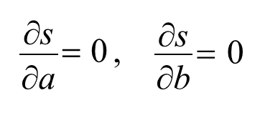
least squares method
n
(y − (ax + b))
s =
∑
2
s
i
i
To determine (a, b) when s takes the minimum value..
a or b
s is a quadratic expression of a and b
The coefficient of a2 is x2, the coefficient of b2 is 1 (both positive values)
→The minimum value is unique
Solve simultaneous equation
n n
n
n n
n
n
∑ i i ∑ i ∑ i
∑ i ∑ i ∑ i i ∑ i
2
n
x y − x y
x y − x y x
_{a =} i=1 i=1 i=1
_{b =} i=1 i=1 i=1 i=1
⎞2
⎞2
n
⎛
n
n
⎛
n
∑ i
∑ i
n
∑ i i=1
2
∑ i
n
x² − ⎜
x ⎟
x − ⎜
x ⎟
・・・(1)
⎝ i=1 ⎠
⎝ i=1 ⎠
i=1
8

Slide 27
Data analysis (2) Difference spectrum in solution
Extract the target component from the difference using the additivity of absorbance
Measured spectrum
of solution
cannot be measured
separately
Additivity of
Beer-Lambert laws
A （solute+solvent）＝A（solvent）+ A（solution）
A（solute）＝ A （solute+solvent）ー A（solvent）
Measured spectrum
of solution
Calculated from spectrum of pure solvent
A（solute）＝ A （solute+solvent）ー $\frac{molarity of solvent in solution}{molality of pure solvent}$A（pure solvent）
Measure the concentration of the solvent (amount of solvent) when preparing the solution in a volumetric flask.

Slide 28
Data analysis (3) derivative spectrum
Gaussian
1st derv.
Remove baseline shift
derivative
wavelength
wavelength
1st derv.
2nd derv.
2nd derv.
Remove
1st derv.
additive baseline
b
linear baseline
cλ
2nd derv.
wavelength
Notes:
In the first derivative, the peak position crosses 0, so it is useful for determining precise peak positions.
In the second derivative, the peak becomes sharper than the original peak. Separation becomes possible when two peaks overlap
The height of the peak in the derivative spectrum is proportional to the height of the original peak.
However, care must be taken to reduce the height of the differential spectrum when the spectral linewidth is large.

Slide 29
equipment（１）Integration sphere
Reference
light
Sample
Reference
light
Standard reflector
(standard scatterer)
Sample
Standard reflector
(standard scatterer)
Standard reflector
(standard scatterer)
detector
detector
Measurement for suspended solutions
Measurement for diffuse reflection
Notes:
An integrating sphere is an element whose inner surface is spherical and whose inner wall is covered with a highly reflective material. The light taken into the integrating sphere is uniformly scattered by the wall surface and guided to the light-receiving section where the detector is placed. In addition to the light-receiving section, two entrance and exit holes are made in the wall surface so that the optical path of the spectrophotometer passes through. Using this device, absorption spectra of suspended solutions and diffuse reflection spectra of solid samples can be measured.

Slide 30
測定法（２） 光ファイバー

Slide 31
データ解析 （２）差スペクトル
・二つのスペクトルを比べて
ｂの試料に多く含まれるものの吸収 → +
ａの試料に多く含まれるものの吸収 → －
例えば反応が進むときの時系列データ
aの試料＝反応前のスペクトル
bの試料＝反応後のスペクトル
→反応物の吸収 －
生成物の級数 +

