Slide 1
INTEGRATED PETROPHYSICS – WELL LOGGING MODULE – 2 CREDITS
TEACHERS: ANNA DEL BEN
EMANUELE FORTE
MICHELE PIPAN
CONTACT: pipan@units.it
SLIDES AND NOTEBOOKS ON: TEAMS & MOODLE
SUGGESTED TEXTS:

Slide 2
TOPICS:
Introduction and fundamentals (borehole environment, petrophysical properties of interest,
Measurement methods and representation of results
Lithology and permeability log
Resistivity log
Porosity log
VSP fundamentals
Application examples and interpretation

Slide 3
EXAM:
Oral: starting from the logs of a real well in clastic sequences, description of the different methods, commentary and interpretation
Dr. Davide Baldini of ENI holds an intensive course in Well-logging (40 hours) in the second semester
Internships and theses are possible both at UNITS and at ENI (latter subject to selection)

Slide 4
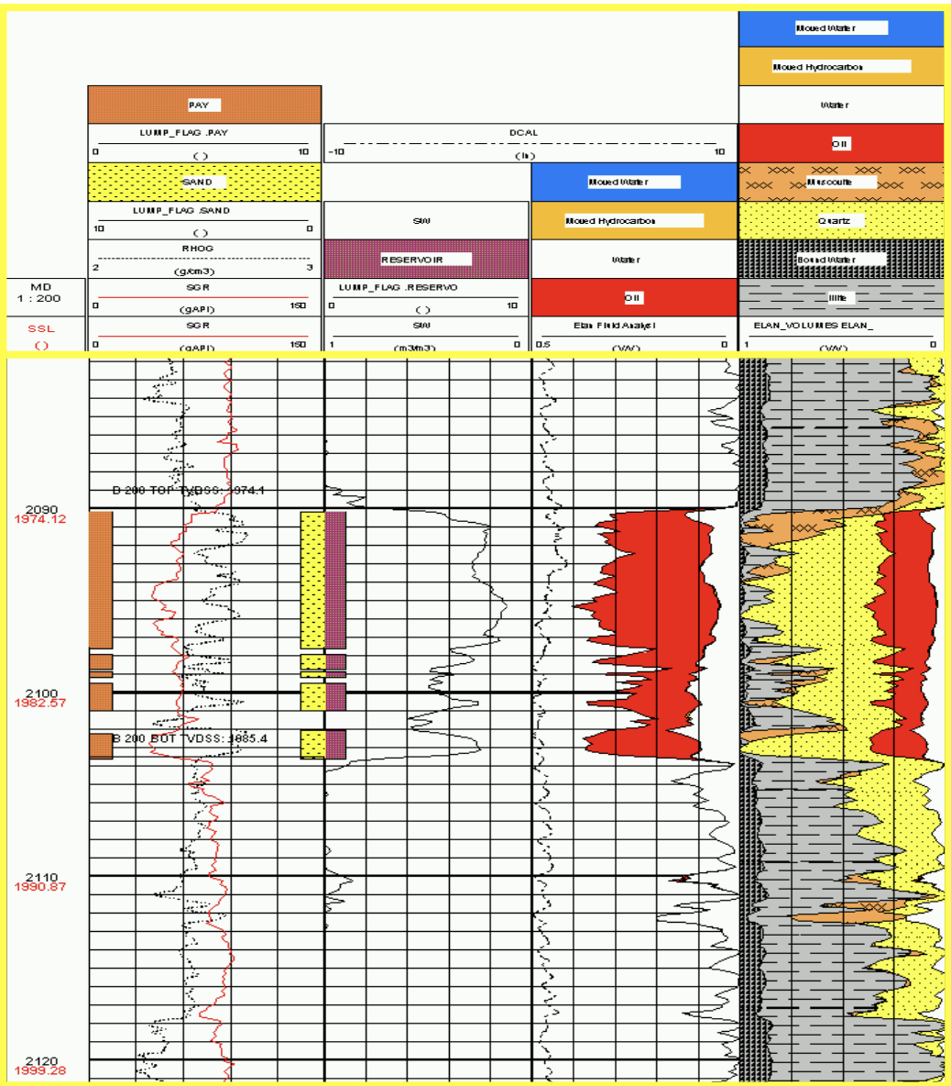

Slide 10
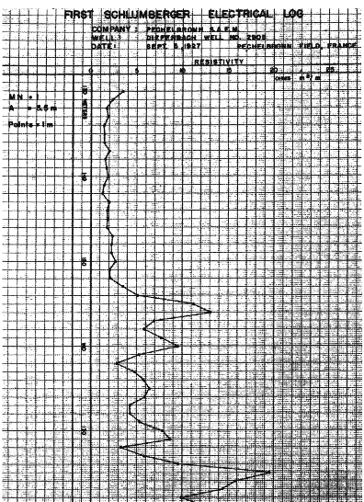

Slide 17
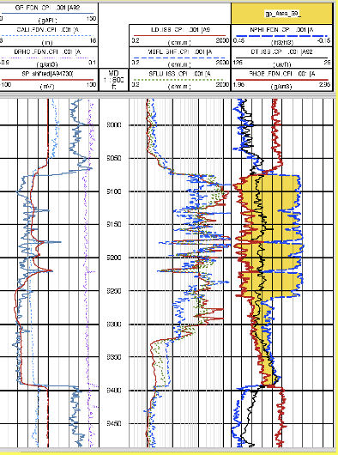

Slide 18
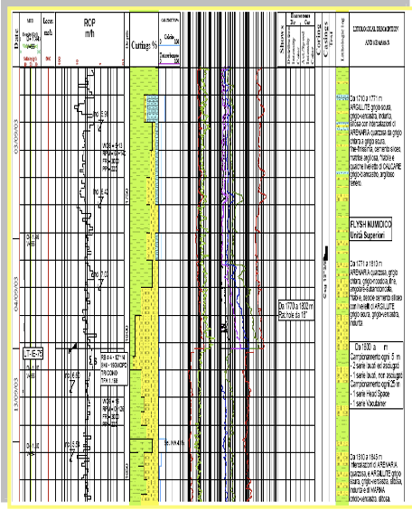

Slide 19
