Slide 4
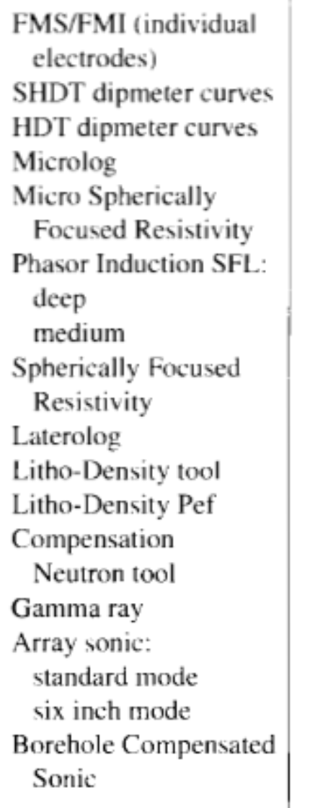

Slide 5
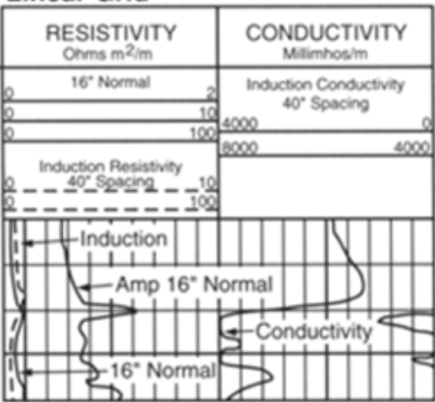

Slide 9
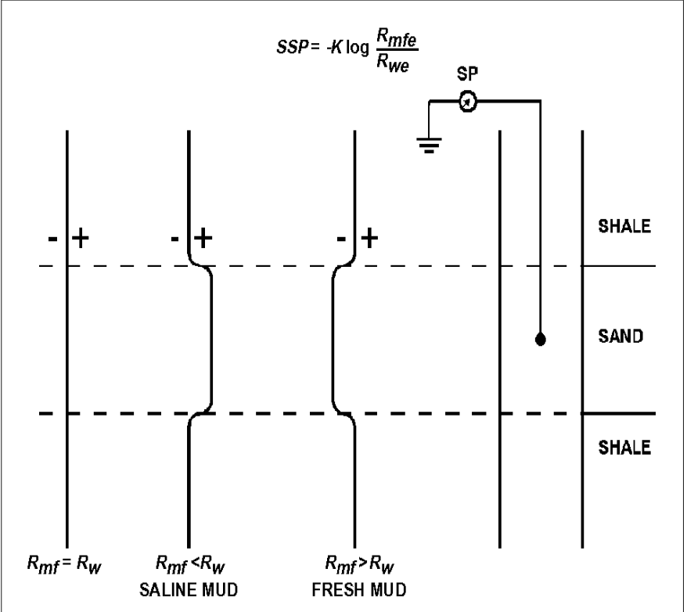

Slide 18
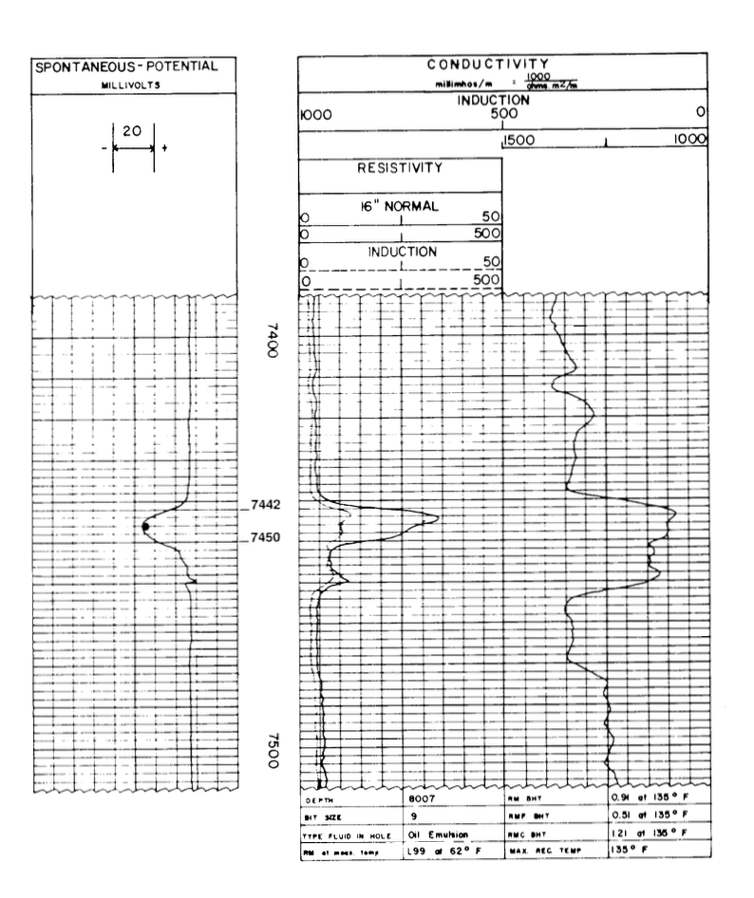
GIVEN:
Rmf= 0.51 @ 135°F (BHT)
Rm= 0.91 @ 135°F (BHT)
Surface Temperature = 60°F
Total Depth= 8007 ft
BHT= 135°F
DETERMINE:
SP =
Bed Thickness =
Resistivity short normal (Ri) =
Formation depth =

Slide 19
GIVEN:
Rmf= 0.51 @ 135°F (BHT)
Rm= 0.91 @ 135°F (BHT)
Surface Temperature = 60°F
Total Depth= 8007 ft
BHT= 135°F
ANSWERS:
SP = -40 mV
Bed Thickness = 8 ft
Resistivity short normal (Ri) = 28 Ohm m
Formation depth = 7446 ft

Slide 20
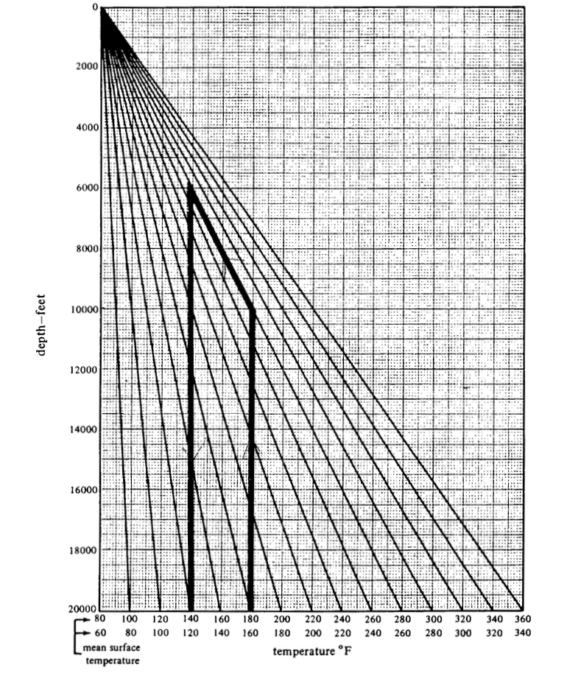
STEP 1: estimation of formation temperature
Surface Temperature = 60°F
Total Depth= 8007 ft
Formation depth = 7446 ft
Temperature @ formation depth =

Slide 21
STEP 1: estimation of formation temperature
Surface Temperature = 60°F
Total Depth= 8007 ft
Formation depth = 7446 ft
ANSWER:
Temperature @ formation depth = 130°F

Slide 22
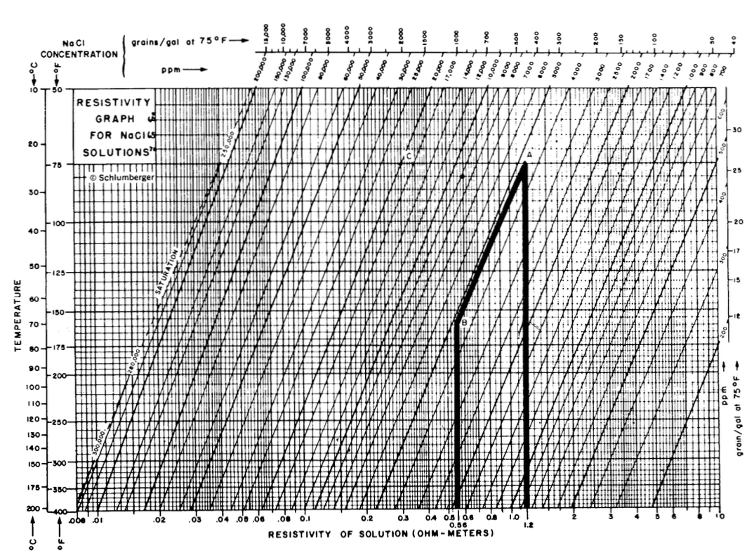
STEP 2 – correct Rm and Rmf @ Tf:
Rmf= 0.51 @ 135°F (BHT)
Rm= 0.91 @ 135°F (BHT)
Temperature @ formation depth = 130°F
DETERMINE:
Rmf= ……. @ 130°F (FD)
Rm= ……. @ 130°F (FD)

Slide 23
STEP 2 – correct Rm and Rmf @ Tf:
Rmf= 0.51 @ 135°F (BHT)
Rm= 0.91 @ 135°F (BHT)
Temperature @ formation depth = 130°F
ANSWERS:
Rmf= 0.53 @ 130°F (FD)
Rm= 0.94 @ 130°F (FD)

Slide 24
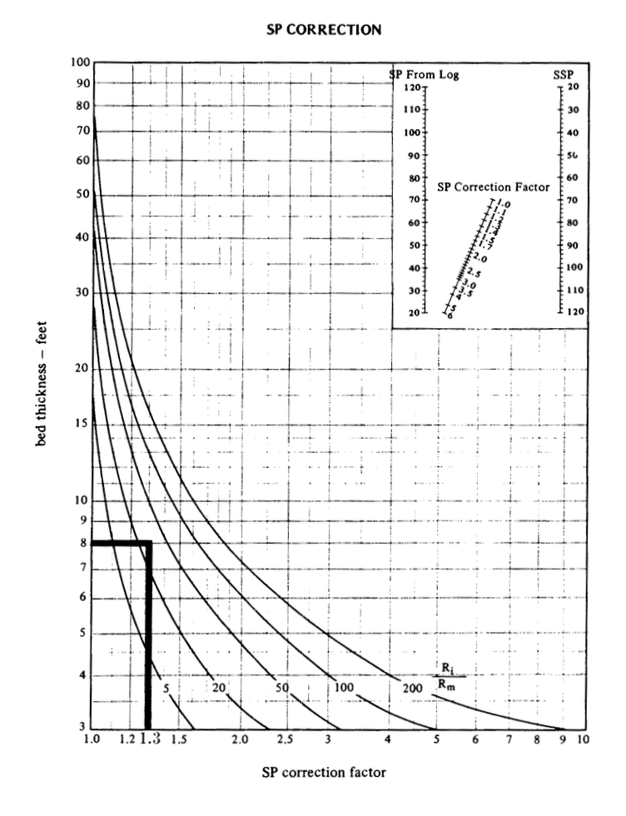
STEP 3 – correct thin bed effect >> from SP to SSP:
Ri= 28 Ohm m
Rm= 0.94 Ohm m
Bed Thickness = 8 ft
DETERMINE:
SP correction factor =
SSP = SP x SP correction factor =

Slide 25
STEP 3 – correct thin bed effect >> from SP to SSP:
Ri= 28 Ohm m
Rm= 0.94 Ohm m
Bed Thickness = 8 ft
ANSWERS:
SP correction factor = 1.3
SSP = SP x SP correction factor = -52 mV

Slide 26
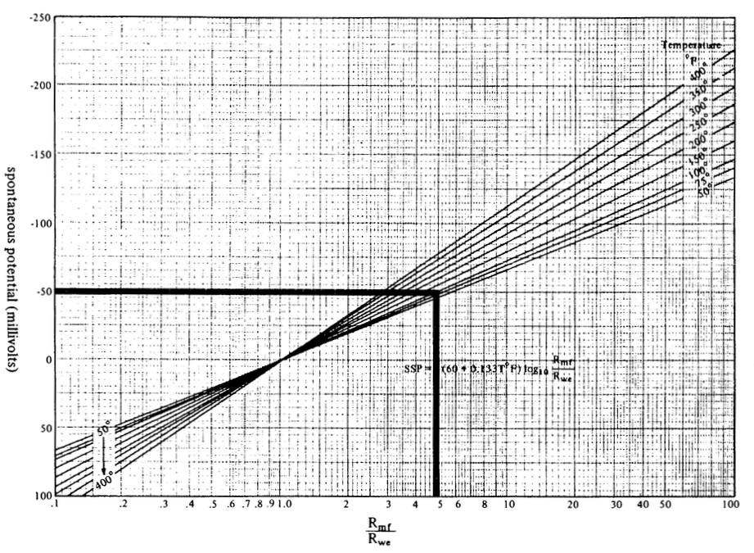
STEP 4 – determine Rmf/Rwe ratio:
SP= -52 mV
Formation temperature = 130°F
DETERMINE:
Rmf/Rwe =

Slide 27
STEP 4 – determine Rmf/Rwe ratio:
SP= -52 mV
Formation temperature = 130°F
ANSWER:
Rmf/Rwe = 5

Slide 28
STEP 5 – determine Rwe :
Rwe = Rmf / (Rmf/Rwe) =

Slide 29
STEP 5 – determine Rwe :
ANSWER:
Rwe = Rmf / (Rmf/Rwe) = 0.53/5 = 0.106 Ohm m

Slide 30
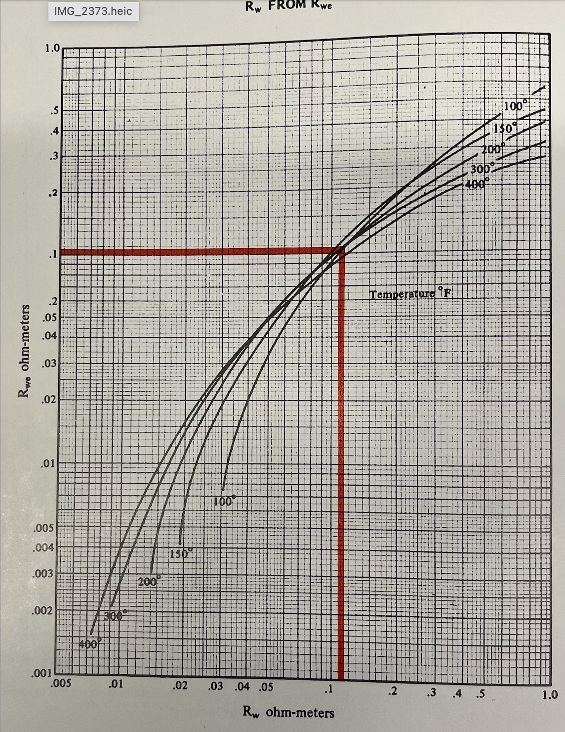
STEP 6 – correct Rwe to Rw:
Rwe= 0.106 Ohm m
Formation temperature = 130°F
DETERMINE:
Rw=

Slide 31
STEP 6 – correct Rwe to Rw:
Rwe= 0.106 Ohm m
Formation temperature = 130°F
Answer:
Rw=

Slide 32
Calculation of Volume of Shale Vsh:
Vsh (in %) = 1 – PSP/SSP = (SSP-PSP) / SSP
SSP = -K x log (Rmf/Rw)
K = 60 + (0.133 x Tf)

