Slide 1
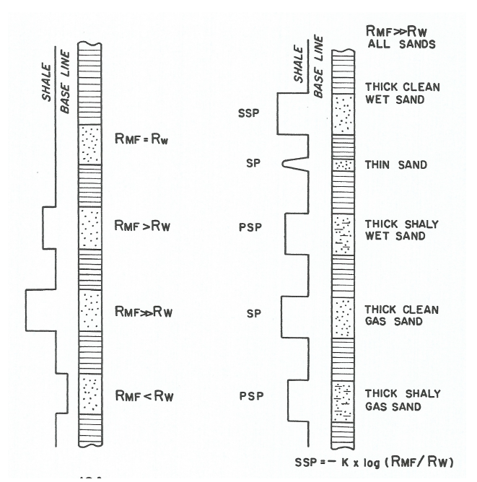






Slide 2
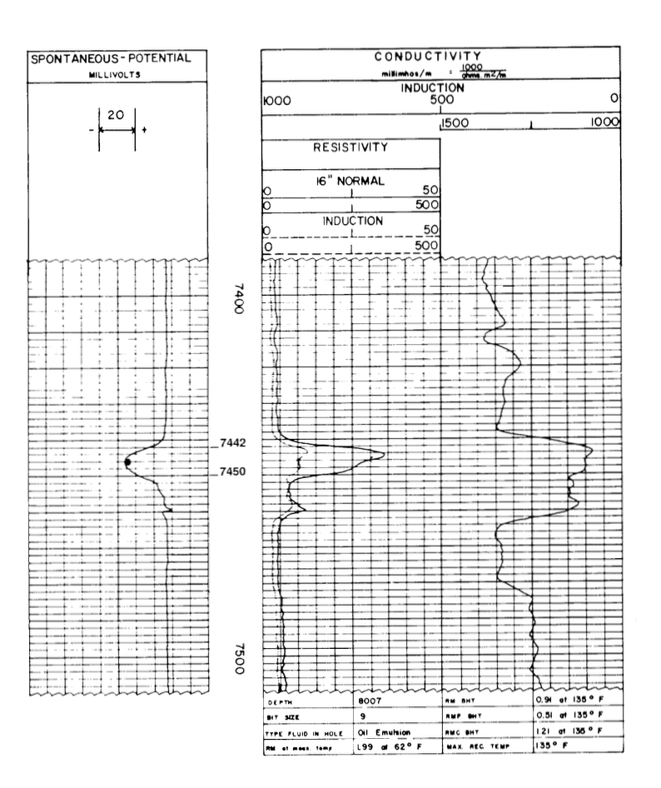








GIVEN:
Rmf= 0.51 @ 135°F (BHT)
Rm= 0.91 @ 135°F (BHT)
Surface Temperature = 60°F
Total Depth= 8007 ft
BHT= 135°F
DETERMINE:
SP =
Bed Thickness =
Resistivity short normal (Ri) =
Formation depth =

Slide 3








GIVEN:
Rmf= 0.51 @ 135°F (BHT)
Rm= 0.91 @ 135°F (BHT)
Surface Temperature = 60°F
Total Depth= 8007 ft
BHT= 135°F
ANSWERS:
SP = -40 mV
Bed Thickness = 8 ft
Resistivity short normal (Ri) = 28 Ohm m
Formation depth = 7446 ft

Slide 4
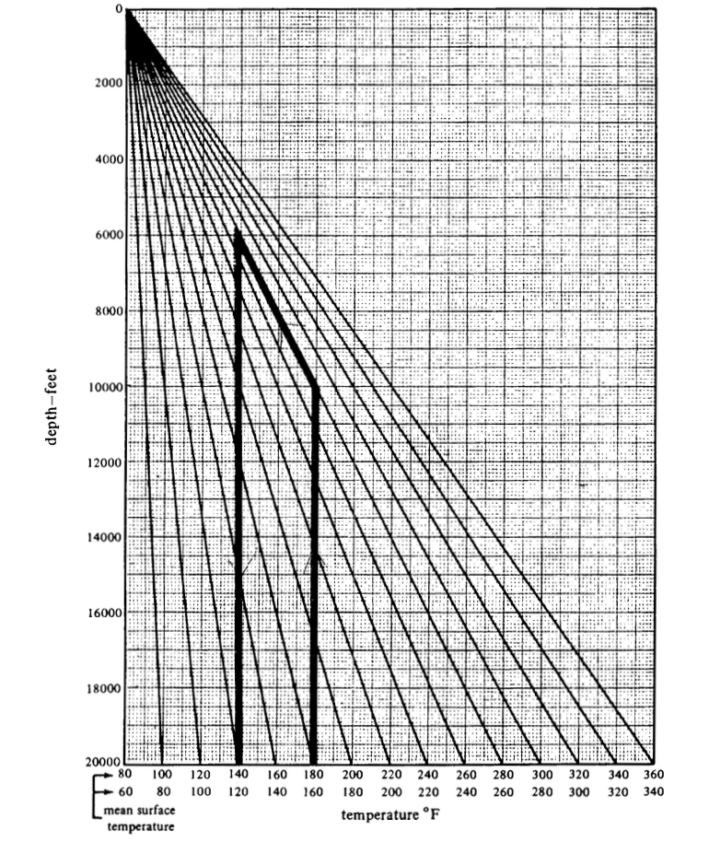



STEP 1: estimation of formation temperature
Surface Temperature = 60°F
Total Depth= 8007 ft
Formation depth = 7446 ft
Temperature @ formation depth =

Slide 5
STEP 1: estimation of formation temperature
Surface Temperature = 60°F
Total Depth= 8007 ft
Formation depth = 7446 ft
ANSWER:
Temperature @ formation depth = 130°F

Slide 6
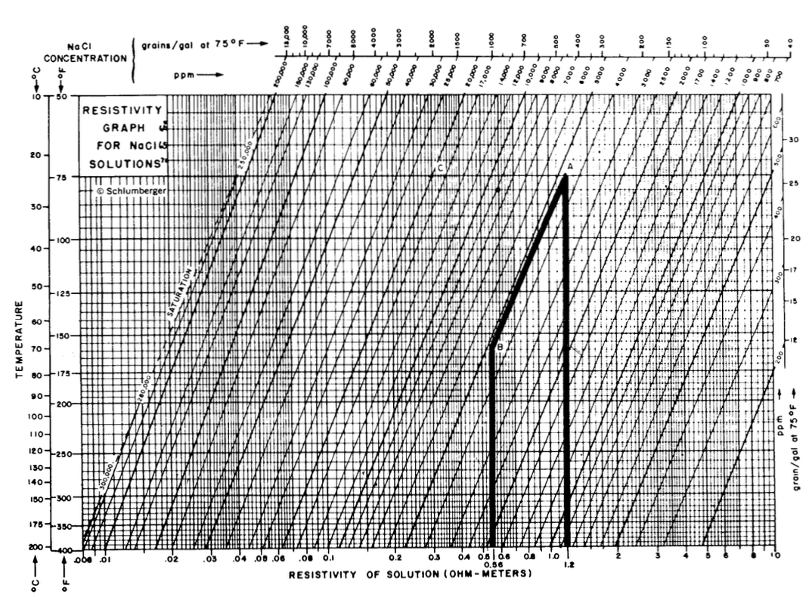


STEP 2 – correct Rm and Rmf @ Tf:
Rmf= 0.51 @ 135°F (BHT)
Rm= 0.91 @ 135°F (BHT)
Temperature @ formation depth = 130°F
DETERMINE:
Rmf= ……. @ 130°F (FD)
Rm= ……. @ 130°F (FD)

Slide 7

STEP 2 – correct Rm and Rmf @ Tf:
Rmf= 0.51 @ 135°F (BHT)
Rm= 0.91 @ 135°F (BHT)
Temperature @ formation depth = 130°F
ANSWERS:
Rmf= 0.53 @ 130°F (FD)
Rm= 0.94 @ 130°F (FD)

Slide 8
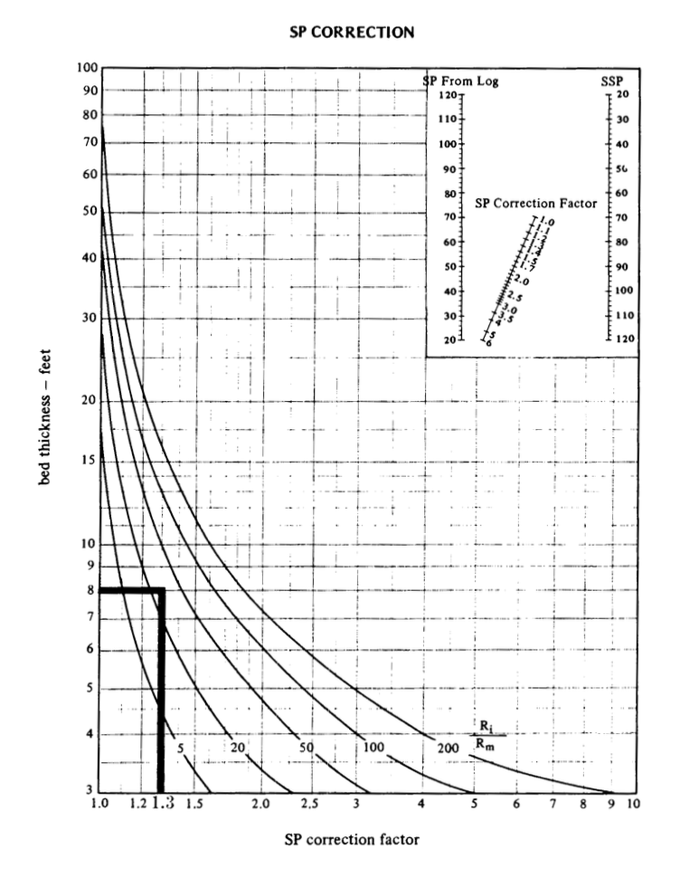
















STEP 3 – correct thin bed effect >> from SP to SSP:
Ri= 28 Ohm m
Rm= 0.94 Ohm m
Bed Thickness = 8 ft
DETERMINE:
SP correction factor =
SSP = SP x SP correction factor =

Slide 9



STEP 3 – correct thin bed effect >> from SP to SSP:
Ri= 28 Ohm m
Rm= 0.94 Ohm m
Bed Thickness = 8 ft
ANSWERS:
SP correction factor = 1.3
SSP = SP x SP correction factor = -52 mV

Slide 10
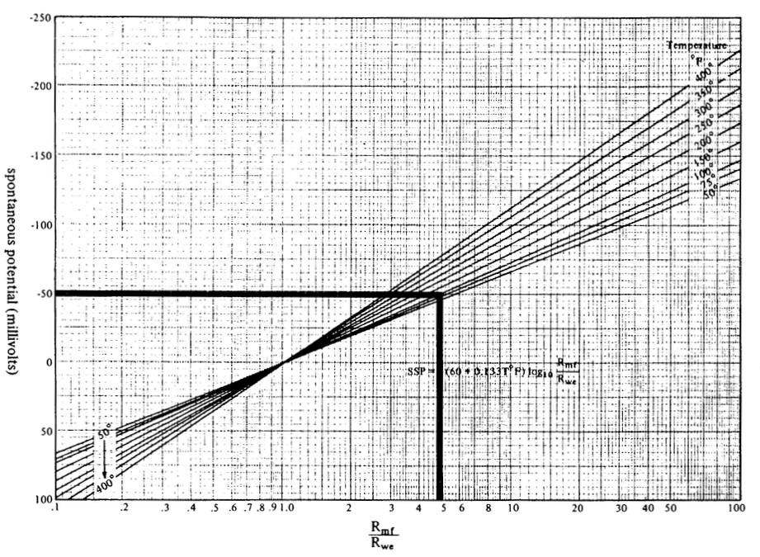


STEP 4 – determine Rmf/Rwe ratio:
SP= -52 mV
Formation temperature = 130°F
DETERMINE:
Rmf/Rwe =

Slide 11





STEP 4 – determine Rmf/Rwe ratio:
SP= -52 mV
Formation temperature = 130°F
ANSWER:
Rmf/Rwe = 5

Slide 12


STEP 5 – determine Rwe :
Rwe = Rmf / (Rmf/Rwe) =

Slide 13
STEP 5 – determine Rwe :
ANSWER:
Rwe = Rmf / (Rmf/Rwe) = 0.53/5 = 0.106 Ohm m

Slide 14
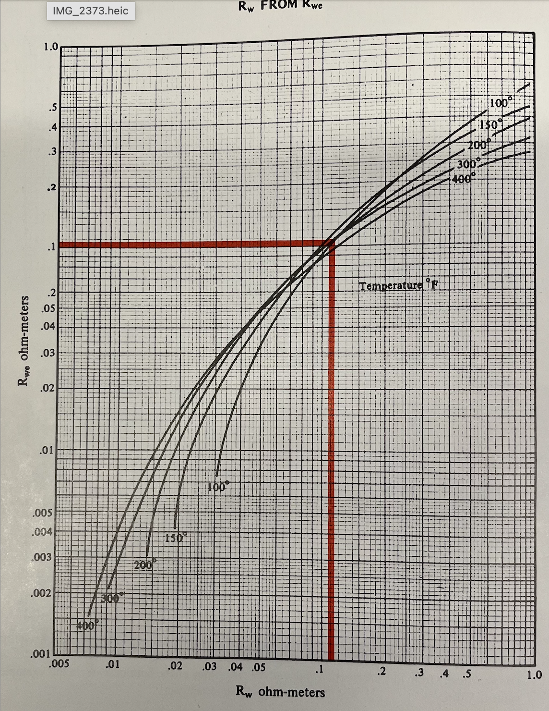

STEP 6 – correct Rwe to Rw:
Rwe= 0.106 Ohm m
Formation temperature = 130°F
DETERMINE:
Rw=

Slide 15

STEP 6 – correct Rwe to Rw:
Rwe= 0.106 Ohm m
Formation temperature = 130°F
Answer:
Rw=

Slide 16
Calculation of Volume of Shale Vsh:
Vsh (in %) = 1 – PSP/SSP = (SSP-PSP) / SSP
SSP = -K x log (Rmf/Rw)
K = 60 + (0.133 x Tf)

Slide 17
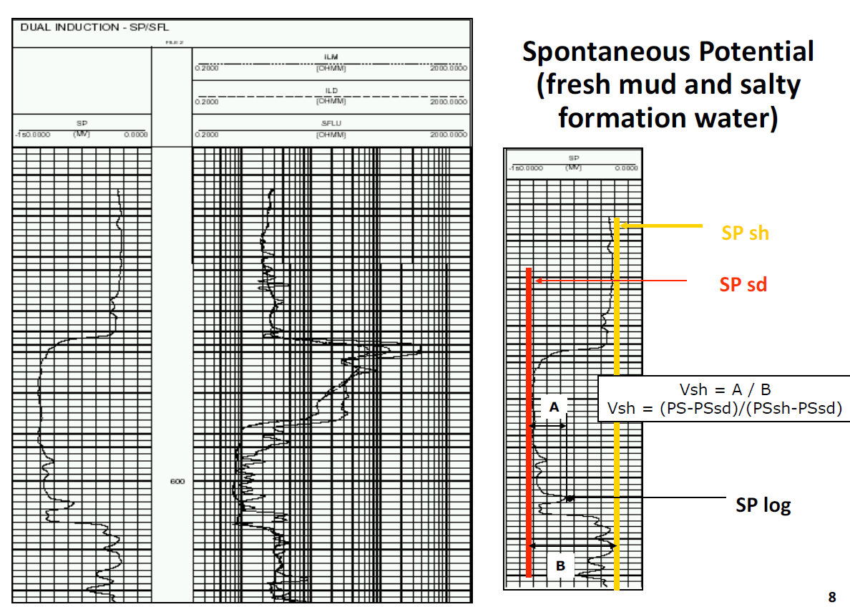





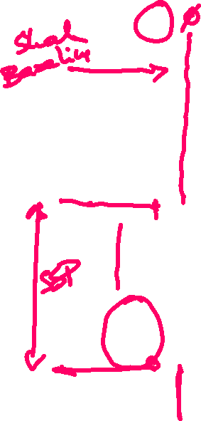




Slide 18



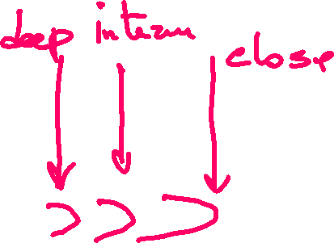


Slide 19


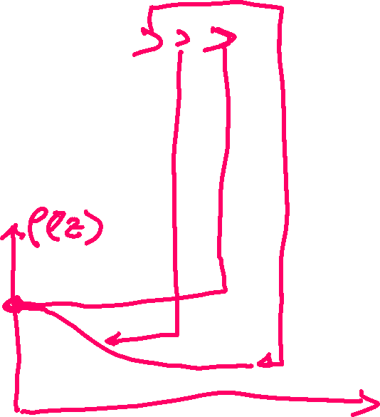
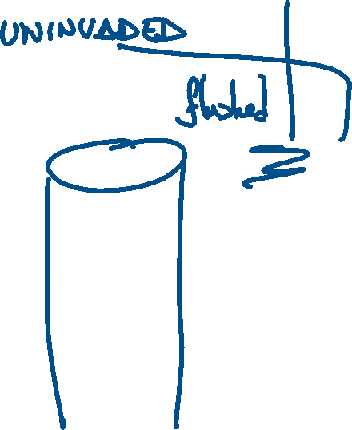





Slide 21
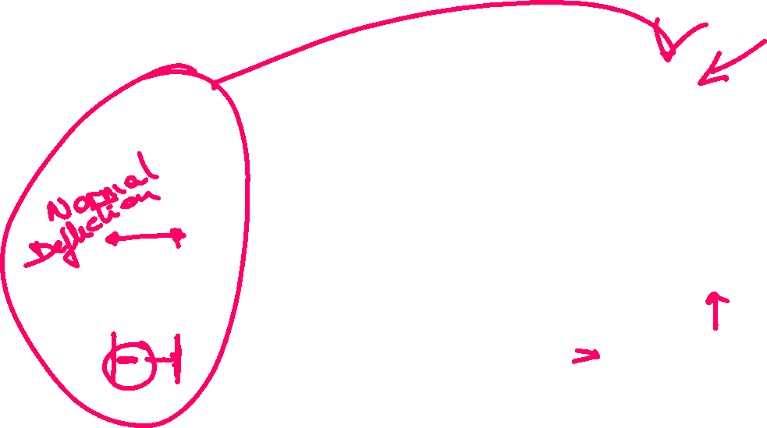

Slide 22
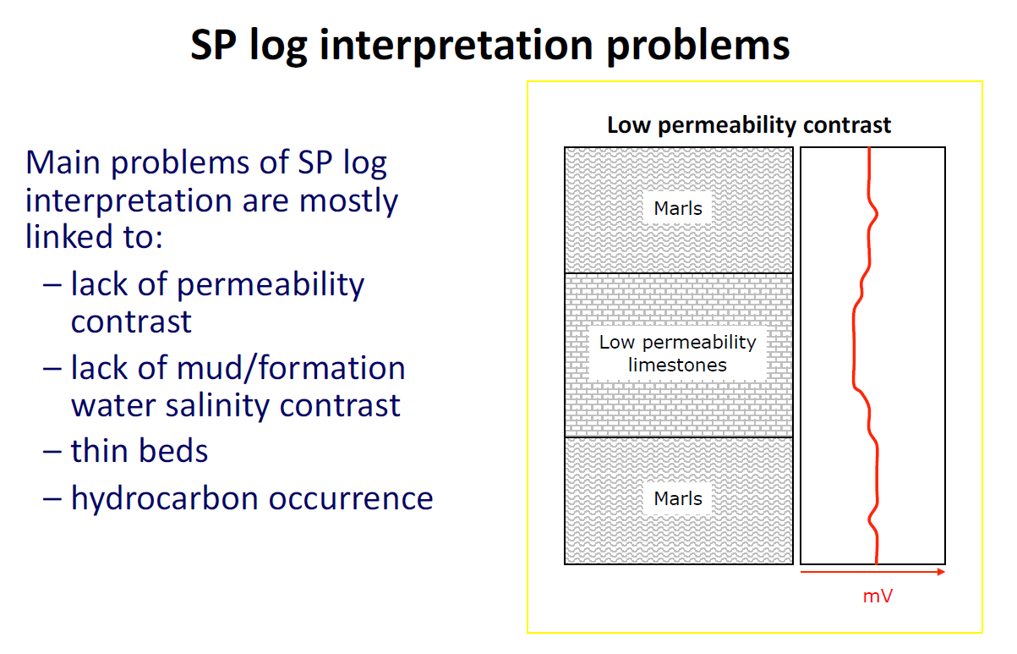


Slide 23
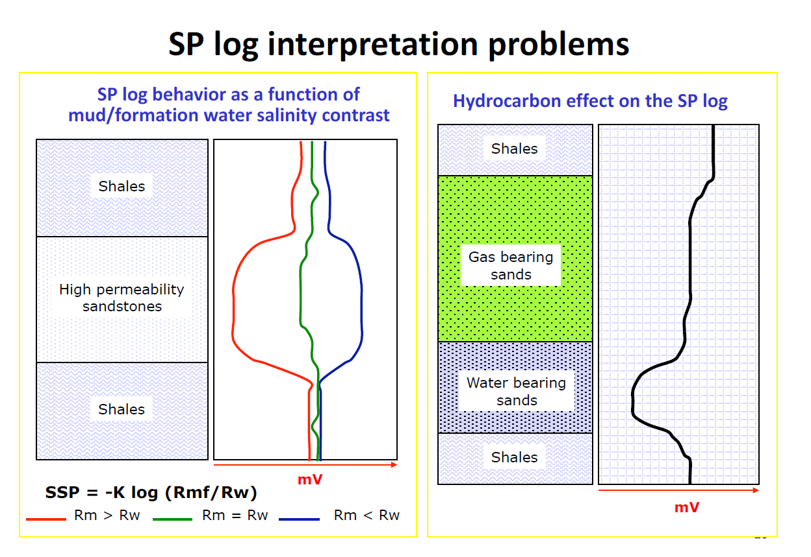











Slide 24
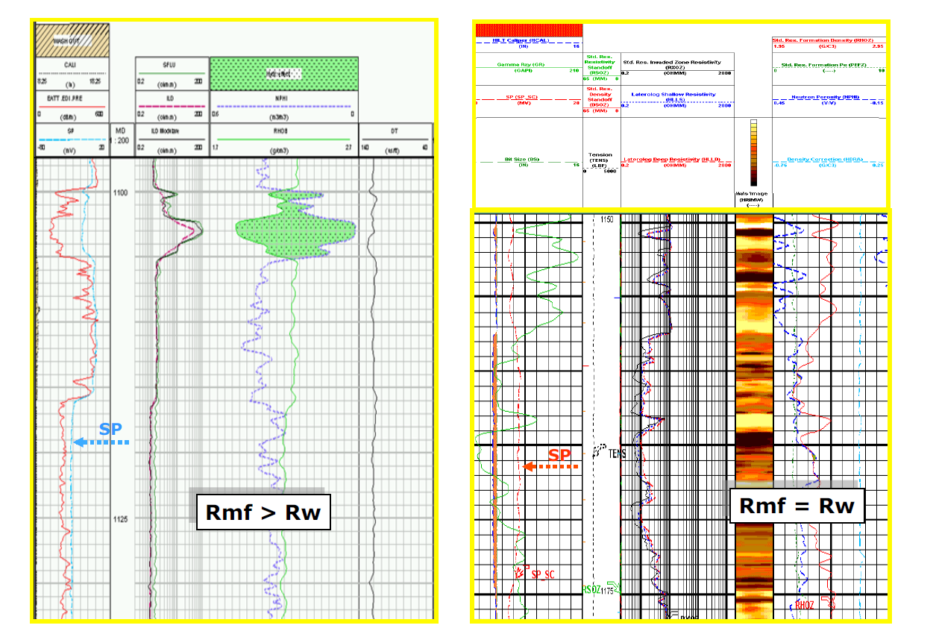









Slide 25




Slide 26
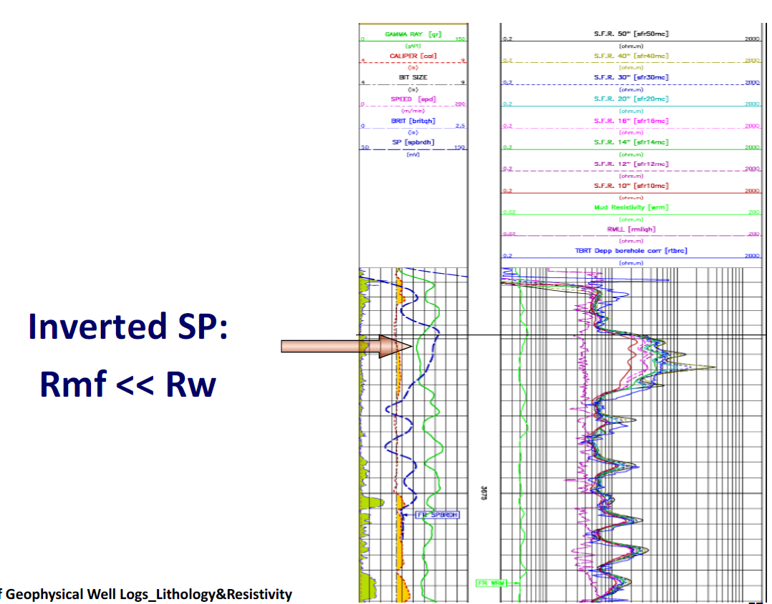







Slide 27
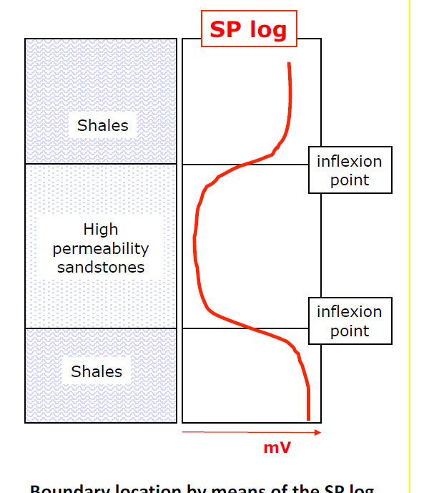






Slide 28
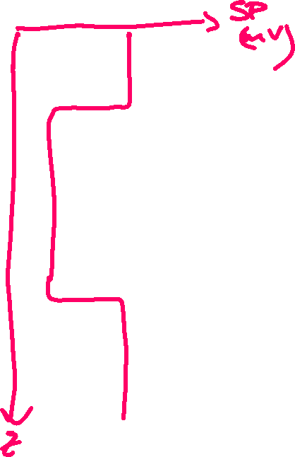




Slide 29

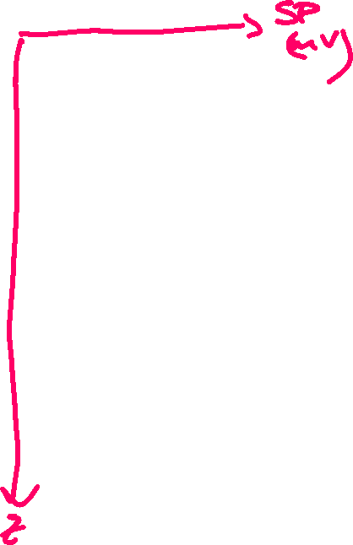



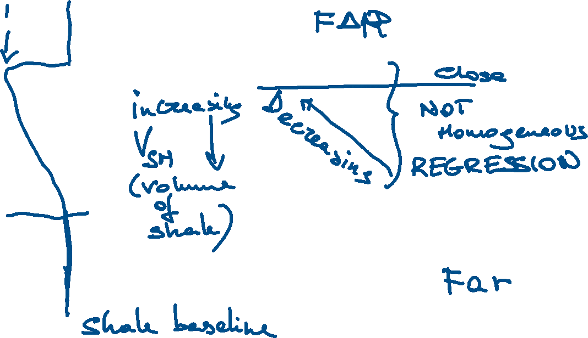


Slide 30







Slide 31
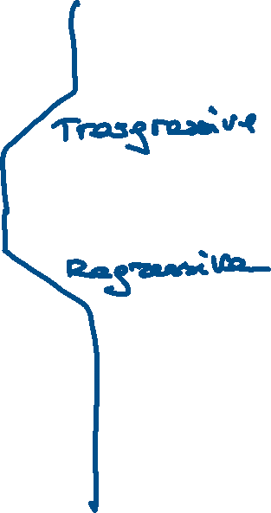

Slide 33
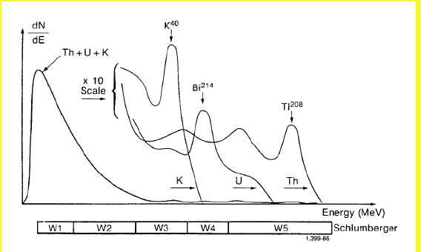











Slide 34
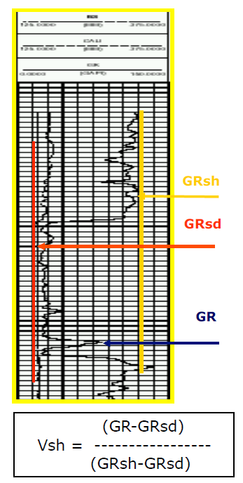



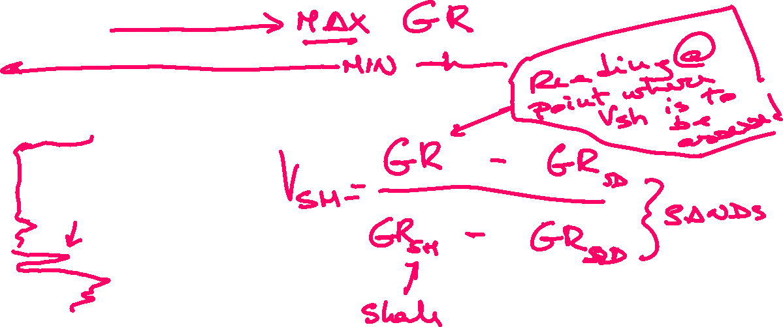





Slide 35
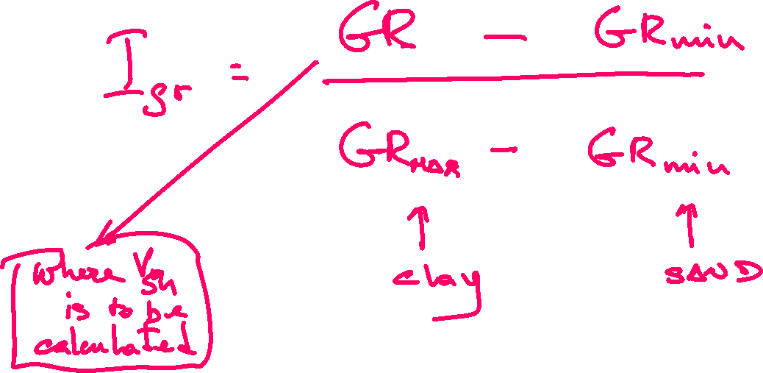

Slide 36
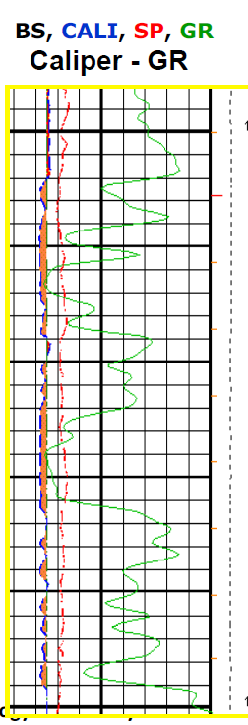


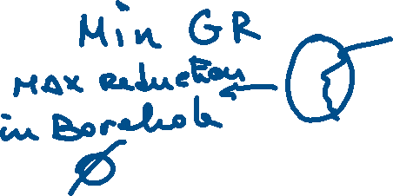
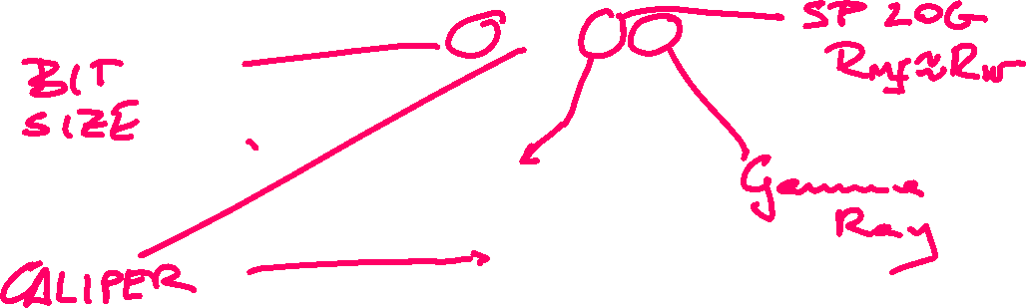

Slide 37
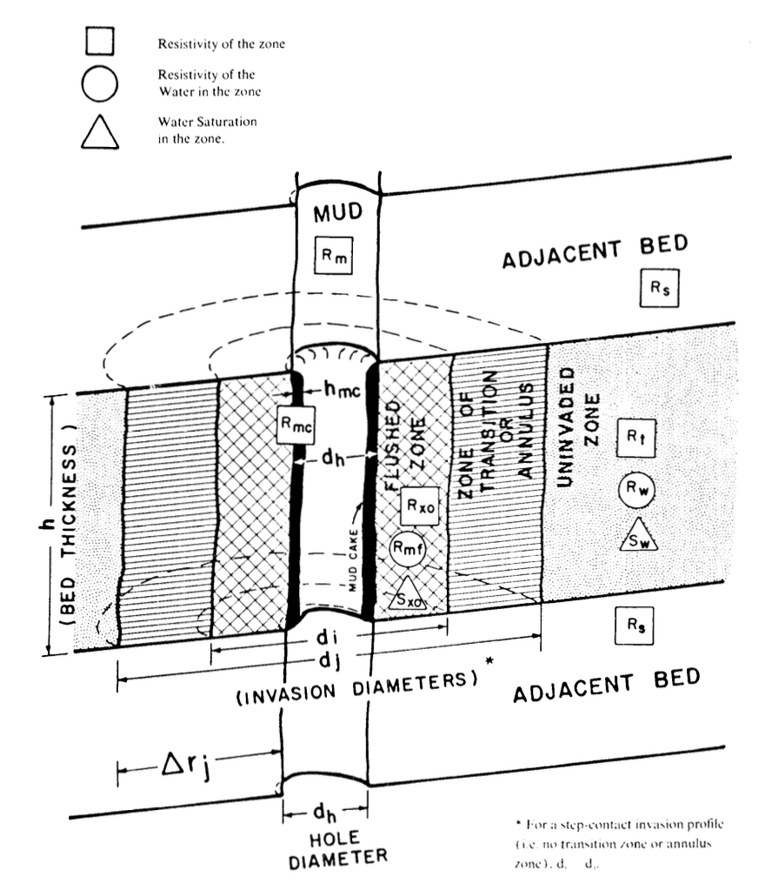

Slide 38







Slide 39


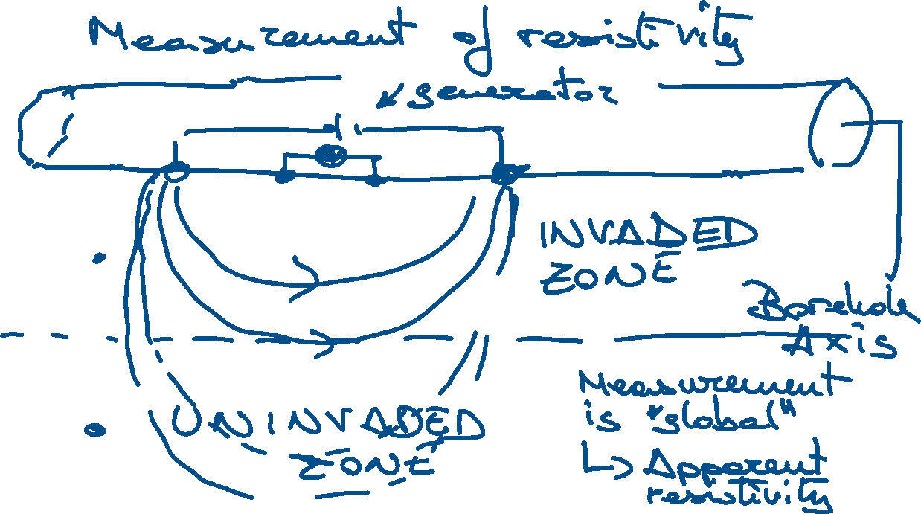

Slide 40
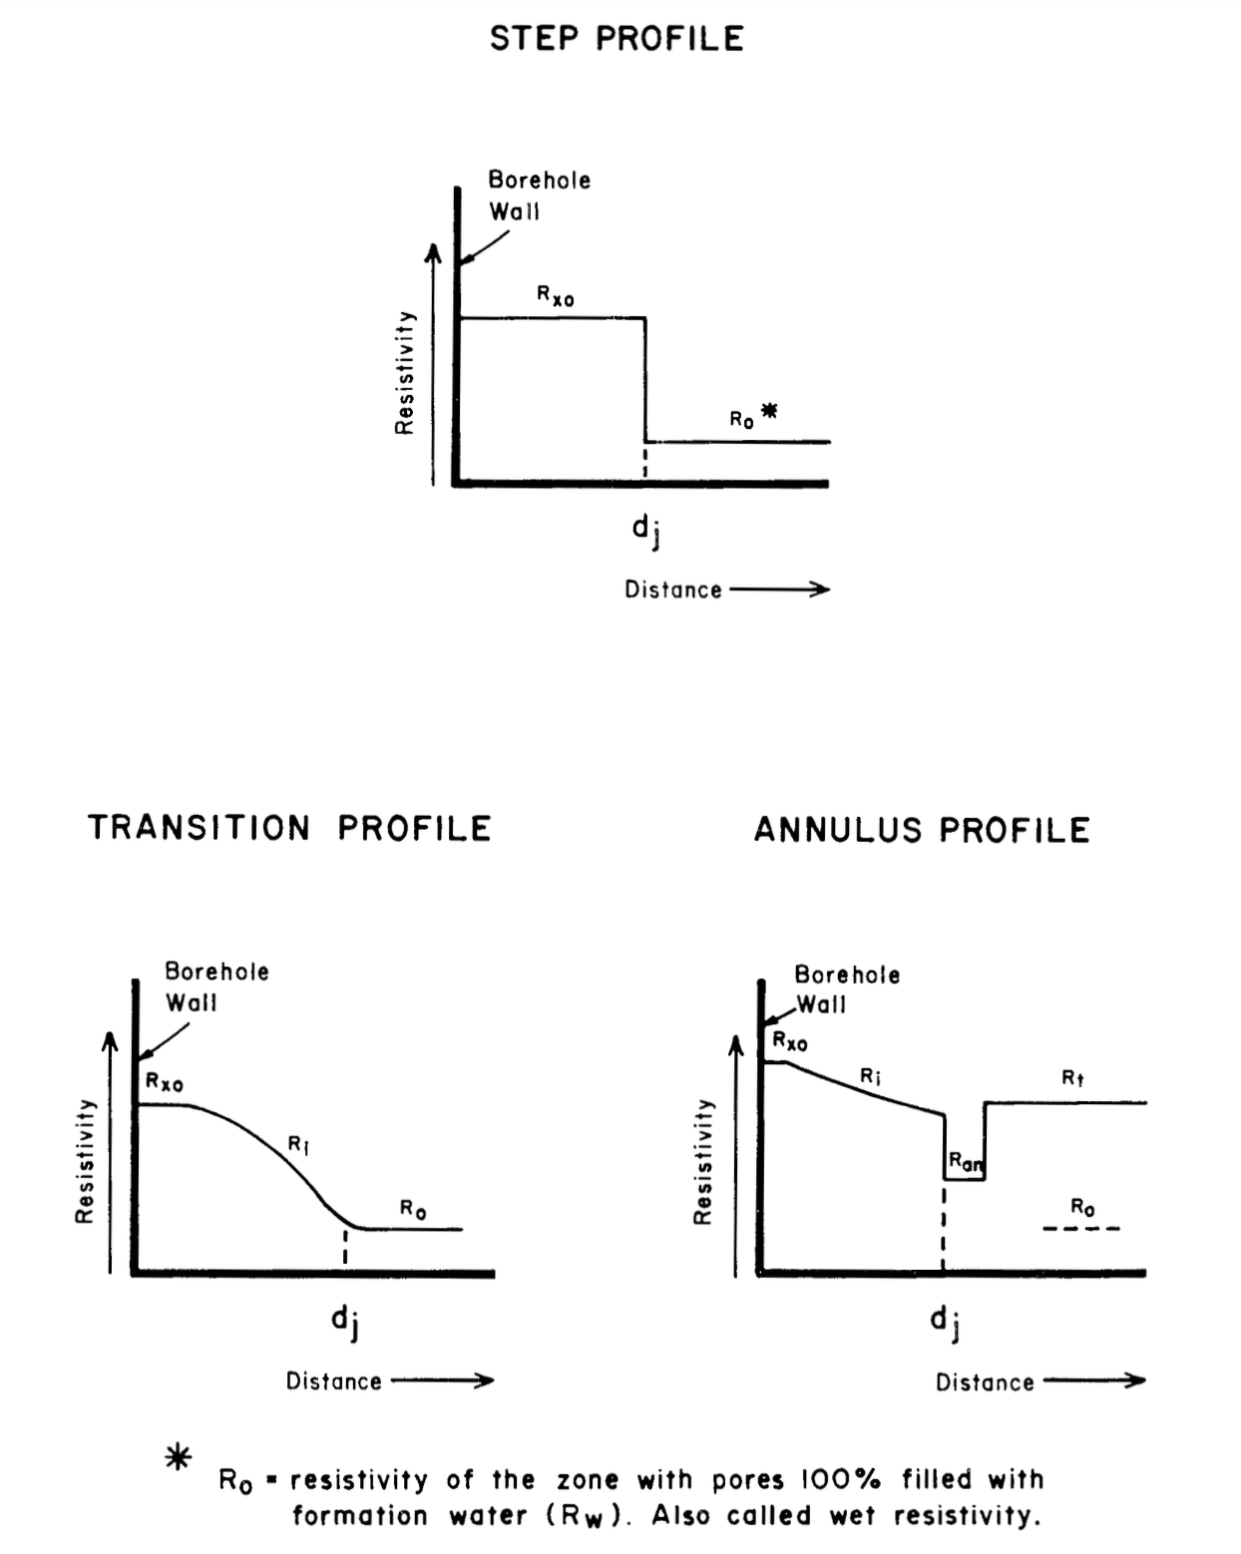

Slide 41
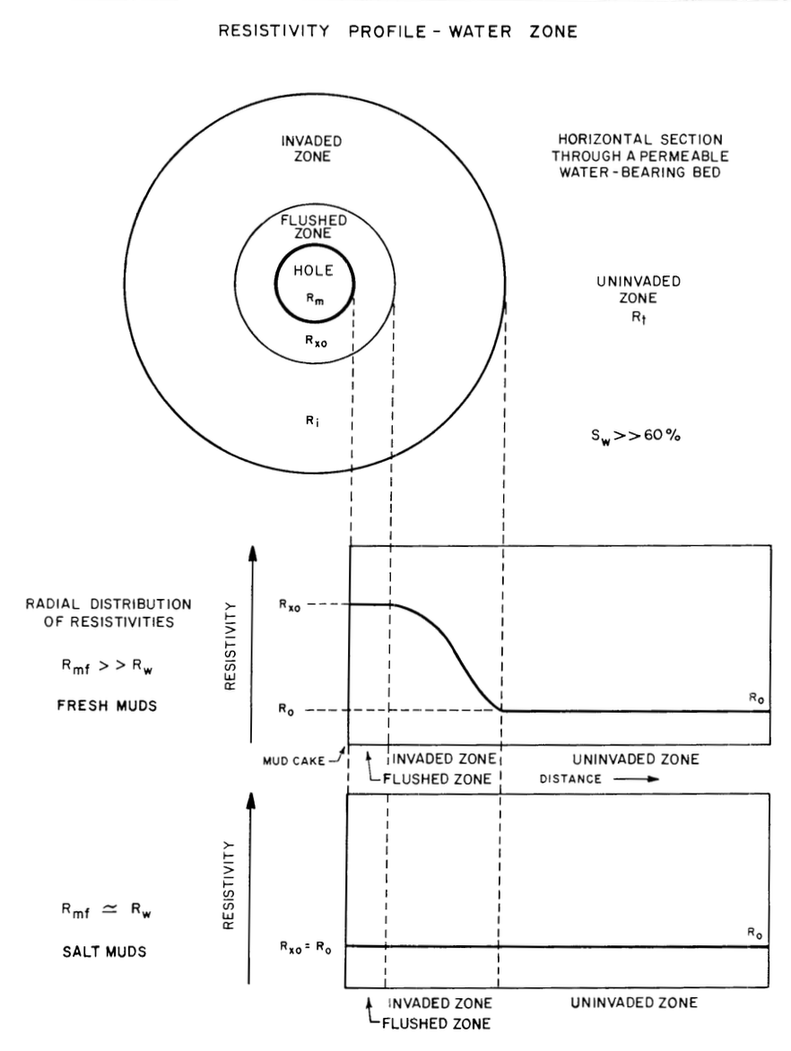

Slide 42
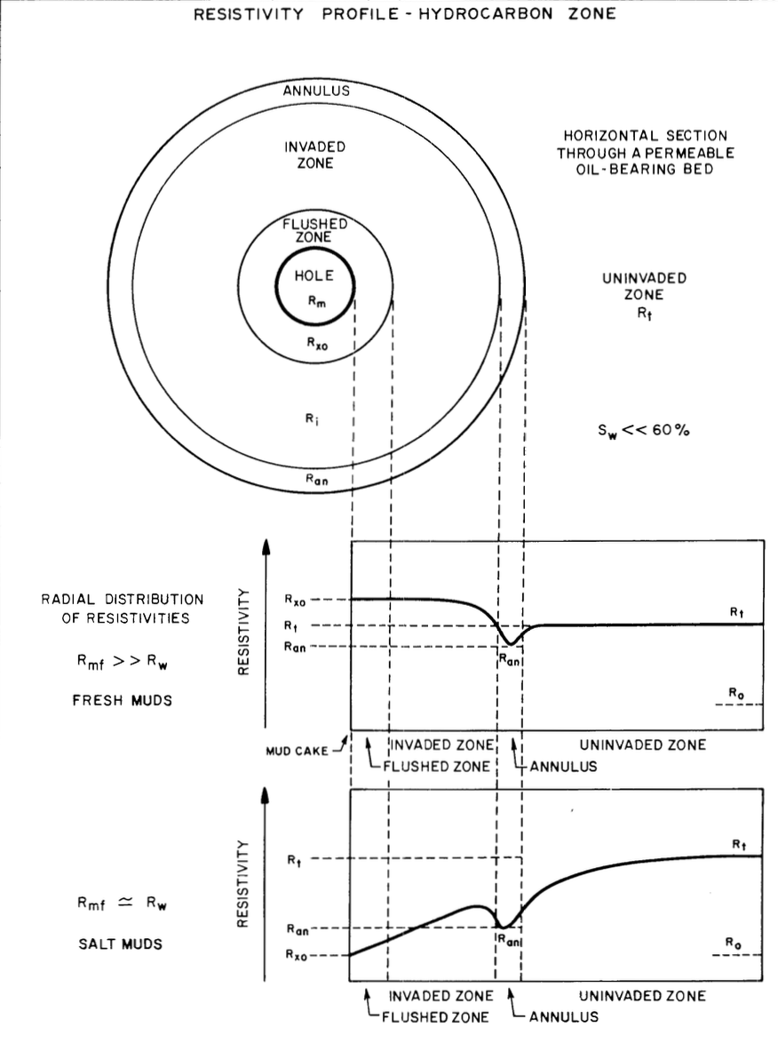

Slide 43
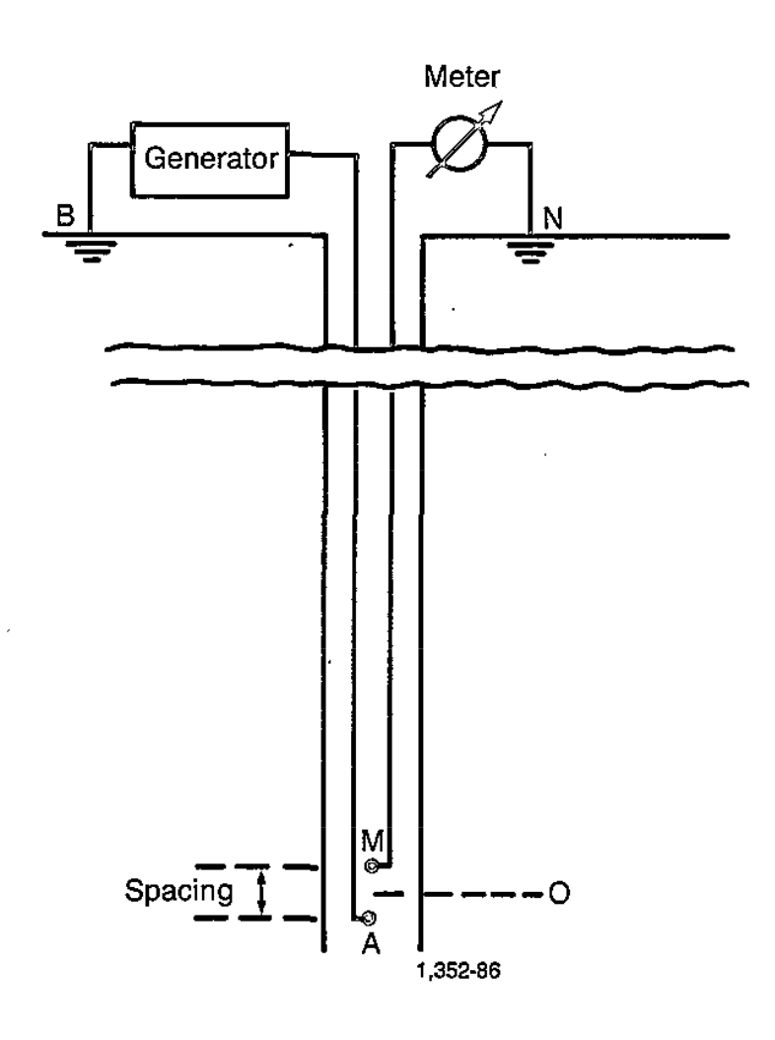
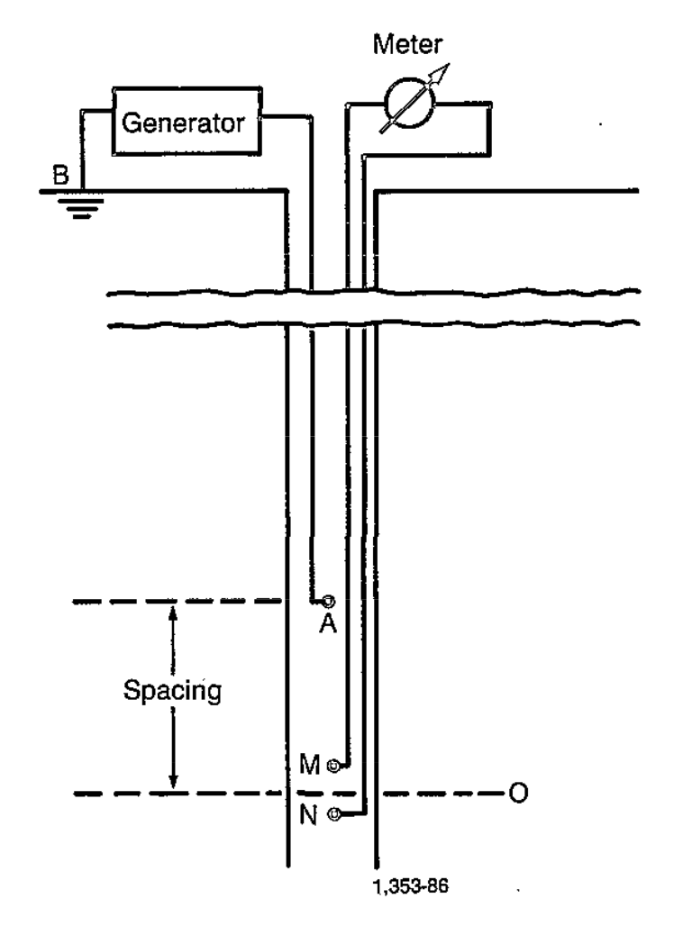
NORMAL
LATERAL

Slide 44
