Slide 1
In SHORT: how pollution is controlled
In accordance to UE’s policy, in our country the control of environmental pollution is carried out on the basis of three approaches:
Ecotoxocological tests before any permission to market a new product, carried out by the producer according to international test guidelines.
Definition of specific emission limit values for each “producer” for those substances that are emitted/released in dependence to the type of production process involved, with successive controls on emissions at the source, for a small fraction of time.
Use of "air quality" automated recording gauges, where the concentrations of some persistent airborne pollutants (CO, SO₂, NO_{x} and O₃, benzene; PM10 on a mass basis) are continuously measured, to provide very precise data for a few points on the territory, that are used in mathematical diffusion model together with meteorological data; pollution is defined in reference to arbitrarily set threshold values.

Slide 2
Hundreds of xenobiotic or potentially harmful substances are released into the environment, the fate of which little or nothing is known.
There is little or no data on the fate of too many contaminants, generally released into the environment at low concentrations and (presumably) below the emission limits set by law, such as heavy metals, polycyclic aromatic hydrocarbons, dioxins, furans, new generation nanomaterials etc. which can be harmful even at extremely low concentrations.
These substances, together with many others, including the "generalist" ones, can exert effects on the biotic and abiotic components which are
INDEPENDENT (“every substance for itself”);
ANTAGONISTS (“they cancel each other out”);
SYNERGIC ("they add up or amplify")

Slide 3
BIOMONITORING consists of the measurement - extended in time and space - of the response effects manifested by organisms, in particular by those that prove to be particularly sensitive - or rather - "reactive": we could define them as "environmental sentinels".
In the biomonitoring approach, the question is not primarily "what is the concentration of substance X?" but rather «are any effects observed on the living component? How serious are they?", possibly in connection with the human component, because if an animal is showing signs of damage, we cannot exclude that also human beings will be affected.
From the response effects shown by single individuals, populations or whole communities, the degree of environmental compromise can be derived: if there is a statistically significant deviation from those recorded under “normal conditions”, in absence of other disturbing factors, and on the basis of the knowledge of the biology of the organism under study, the cause of the observed effects can be referred to a single pollutant or - more generally - to pollution.

Slide 4
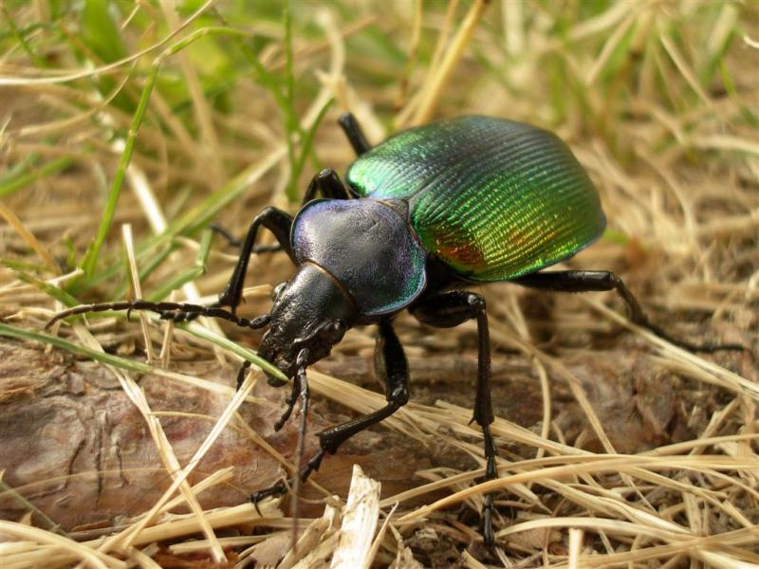
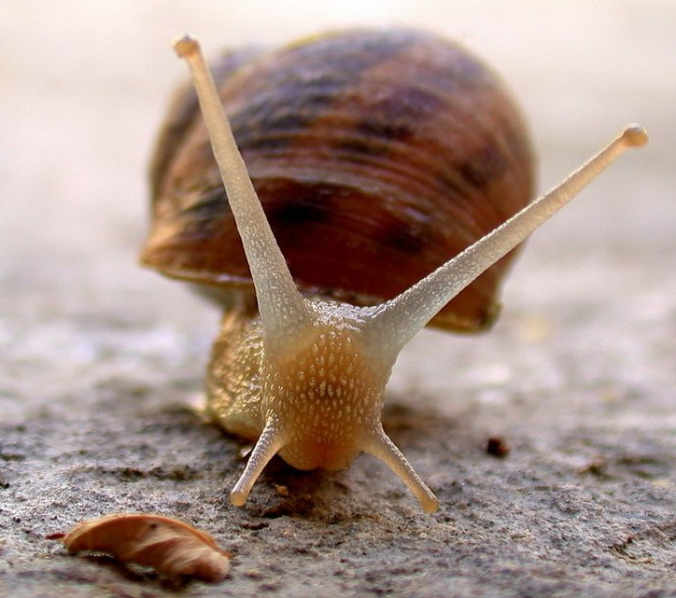
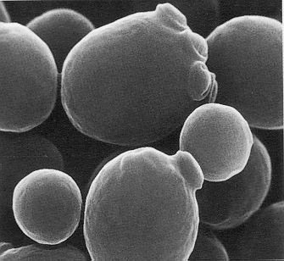
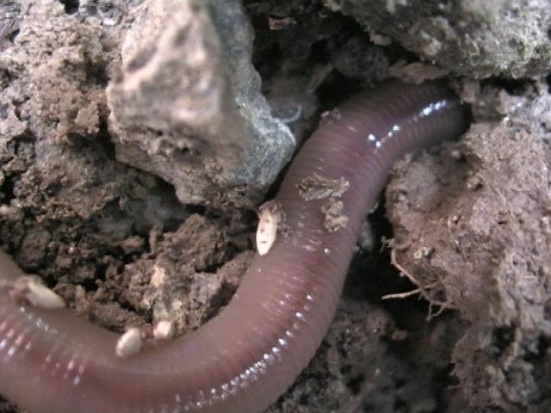
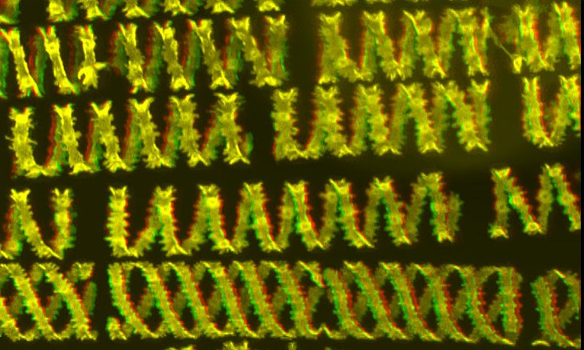
Practically every organism is able to provide information on the environment in which it lives, especially if it is compared with others (concept of the "ecological niche" or ecological hyper-space), but above all if it is "interrogated" in the right way..
Plants, yeasts, insects, birds, earthworms, molluscs, …. They are all potential “biomonitors”…

Slide 5
Potentially every organism is an environmental sentinel since, by definition, the very fact of being alive gives us information on the presence of specific conditions which are compatible to the life of that organism.
Among all organisms, there are many that have a physiology and ecology that is partially or largely unknown, and in any case too complex, for which it is difficult to identify a response attributable to specific causes.
For this reason, specific groups of organisms are selected, because particularly reactive toward a specific factor or groups of factors. The choice also depends on the specialization (and scientific strength) of the people who study them: a deep knowledge of the biology of that group of organisms is of paramount importance to ensure scientifically sound results.

Slide 6
The ideal biomonitor should be:
ubiquitously present;
easily available and easily identifiable;
stationary and always available;
capable of reacting to environmental variation, but sufficiently resistant to environmental stress.
Many good reasons might suggest to consider this short list “false” or “misleading”. Actually, different biomonitors can be selected on the basis of the aims of our study, or on the basis of the subject of our study.

Slide 7
There are two different types of biomonitors:
• BIOINDICATORS have high sensitivity towards the polluting substance (or group of substances), and already following exposure to low doses they manifest clear and specific symptoms that are easily quantifiable, undergoing evident variations in physiology, morphology or frequency distribution following the influence of substances present in the environment: from the quali-quantitative measurement of the observed change, the presence of the pollutant(s) in the environment can be derived.
• BIOACCUMULATORS have high tolerance and accumulation capacity, storing the pollutant (which must have persistence characteristics; alternatively, its stable derivatives must be measured), often without showing symptoms; in this case, the concentration of the substance measured in the body should reflect the environmental one: from the measurement of its concentration in the bioaccumulator, the environmental availability of that substance in the environment can be inferred.

Slide 8
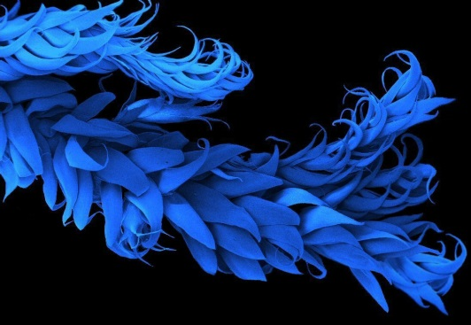
We will proceed with EXAMPLES:
Bioindication, Active biomonitoring: Observations on individual plant species (Nicotiana tabacum, Trifolium pratense) as bioindicators of a specific pollutant, ozone.
Bioindication, Passive biomonitoring: determination of a Biodiversity Index of epiphytic lichen communities as indicators of air quality.
Bioaccumulation, active and passive biomonitoring: analysis of samples of mosses, lichens and bees as bioaccumulators of potentially toxic elements, polycyclic aromatic hydrocarbons, persistent airborne organic pollutants or pesticides.

Slide 9
Ozone (O₃) is a gaseous pollutant with a characteristic odor, whose molecules are made up of three oxygen atoms, which causes the so-called «Los Angeles smog»
Nitrato di perossiacetile

Slide 10
Traditional chemico-physical ozone monitoring has limitations in:
peculiar nature of this pollutant which is of secondary origin;
non-optimal location of the automated recording gauges;
need to know the environmental state even in near-natural areas where ozone may possibly be present at unsuspectedly high concentrations.
Alternative methods of measuring the concentration of specific pollutants can be found… For instance, passive samplers, that, unlike automatic analyzers, do not use a pump. A specific adsorbent contained in the passive sampler captures a certain mass of a specific airborne substance, that enter in the sampler by diffusion.
The concentration in air is obtained by measuring the mass of substance captured as a function of exposure time.

Slide 11
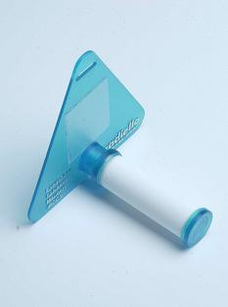
This sampling method, based on the principle of molecular diffusion (i.e. without the use of a pump), does not provide real-time concentration values, like automatic analyzers, but only the average concentrations relating to the sampling period. They cannot give any information concerning the maximum concentration present (“acute episodes of pollution”)
However, it has the following advantages:
Preparation, use and analysis are easy;
The analytical technique in particular is simple;
It does not require electricity;
Possibility of having a high spatial density of measuring points;
Possibility of reusing display structures and cartridges.
There are now around fifty substances tested experimentally in standard atmosphere, for which accuracy values ​​(expressed as relative percentage error) better than 1% are guaranteed.
Among these: SO₂, NO₂, NO, Ozone, H₂S, benzene, formaldehyde, toluene and xylenes.

Slide 12
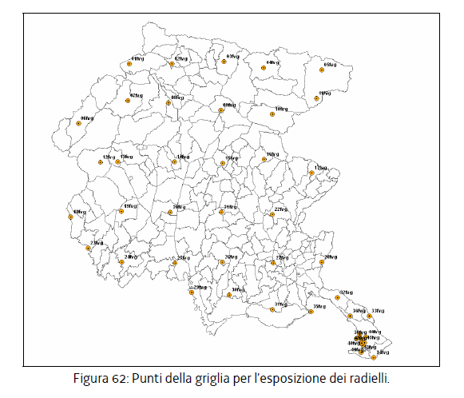
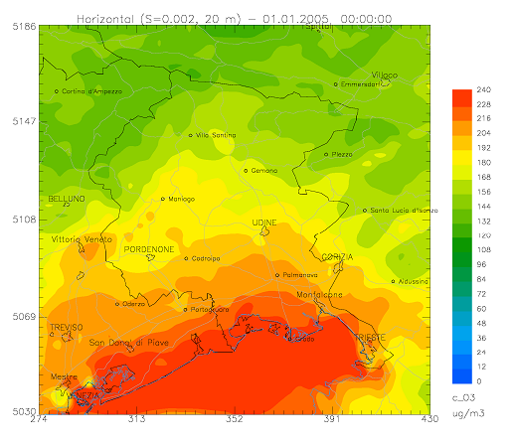
Passive samplers
Math. model applied to the data of automated recording gauges

Slide 13
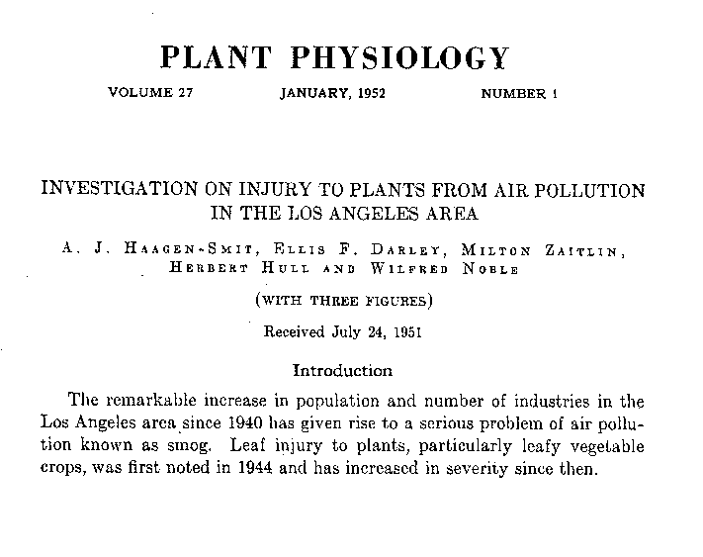
The example that best summarizes the operational possibilities of biomonitoring methods of a single pollutant (ozone) is represented by a cultivar (cv.) of the tobacco plant (Nicotiana tabacum L.), Bel-W3, used since 1962 for detecting the effects of ozone.
It presents interesting aspects, starting from the high sensitivity to the pollutant, as exposures of a few hours to concentrations of the order of 40 ppb are sufficient to cause the appearance of typical lesions. It must be noted that 40 ppb is considered the discriminating threshold between natural O₃ levels and those deriving from photochemical activity.

Slide 14
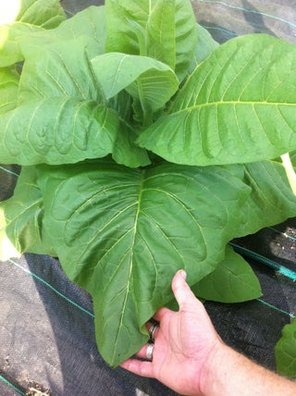
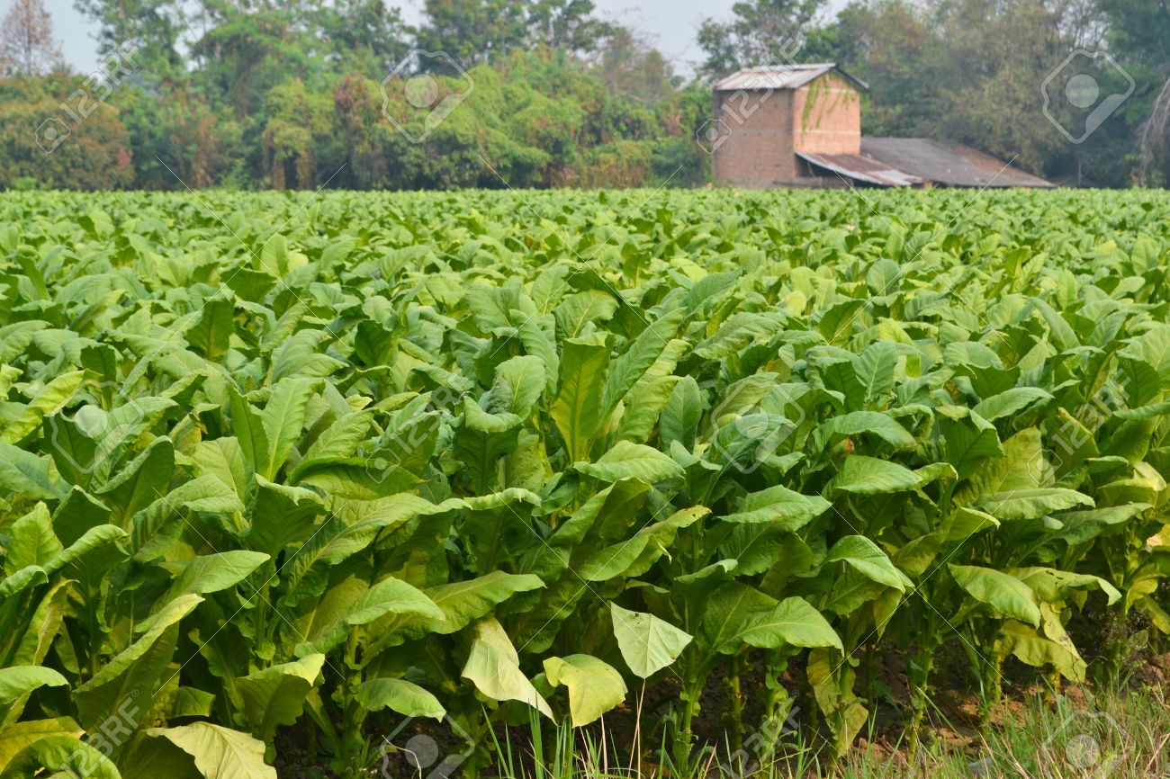
The tobacco plant has an annual cycle. It continuously produces new leaves during the growing season, with very vigorous growth. Flowering is determined by the ratio of the number of hours of light/dark. The farmers are interested in the leaves. If damaged, their prize drastically declines.

Slide 15
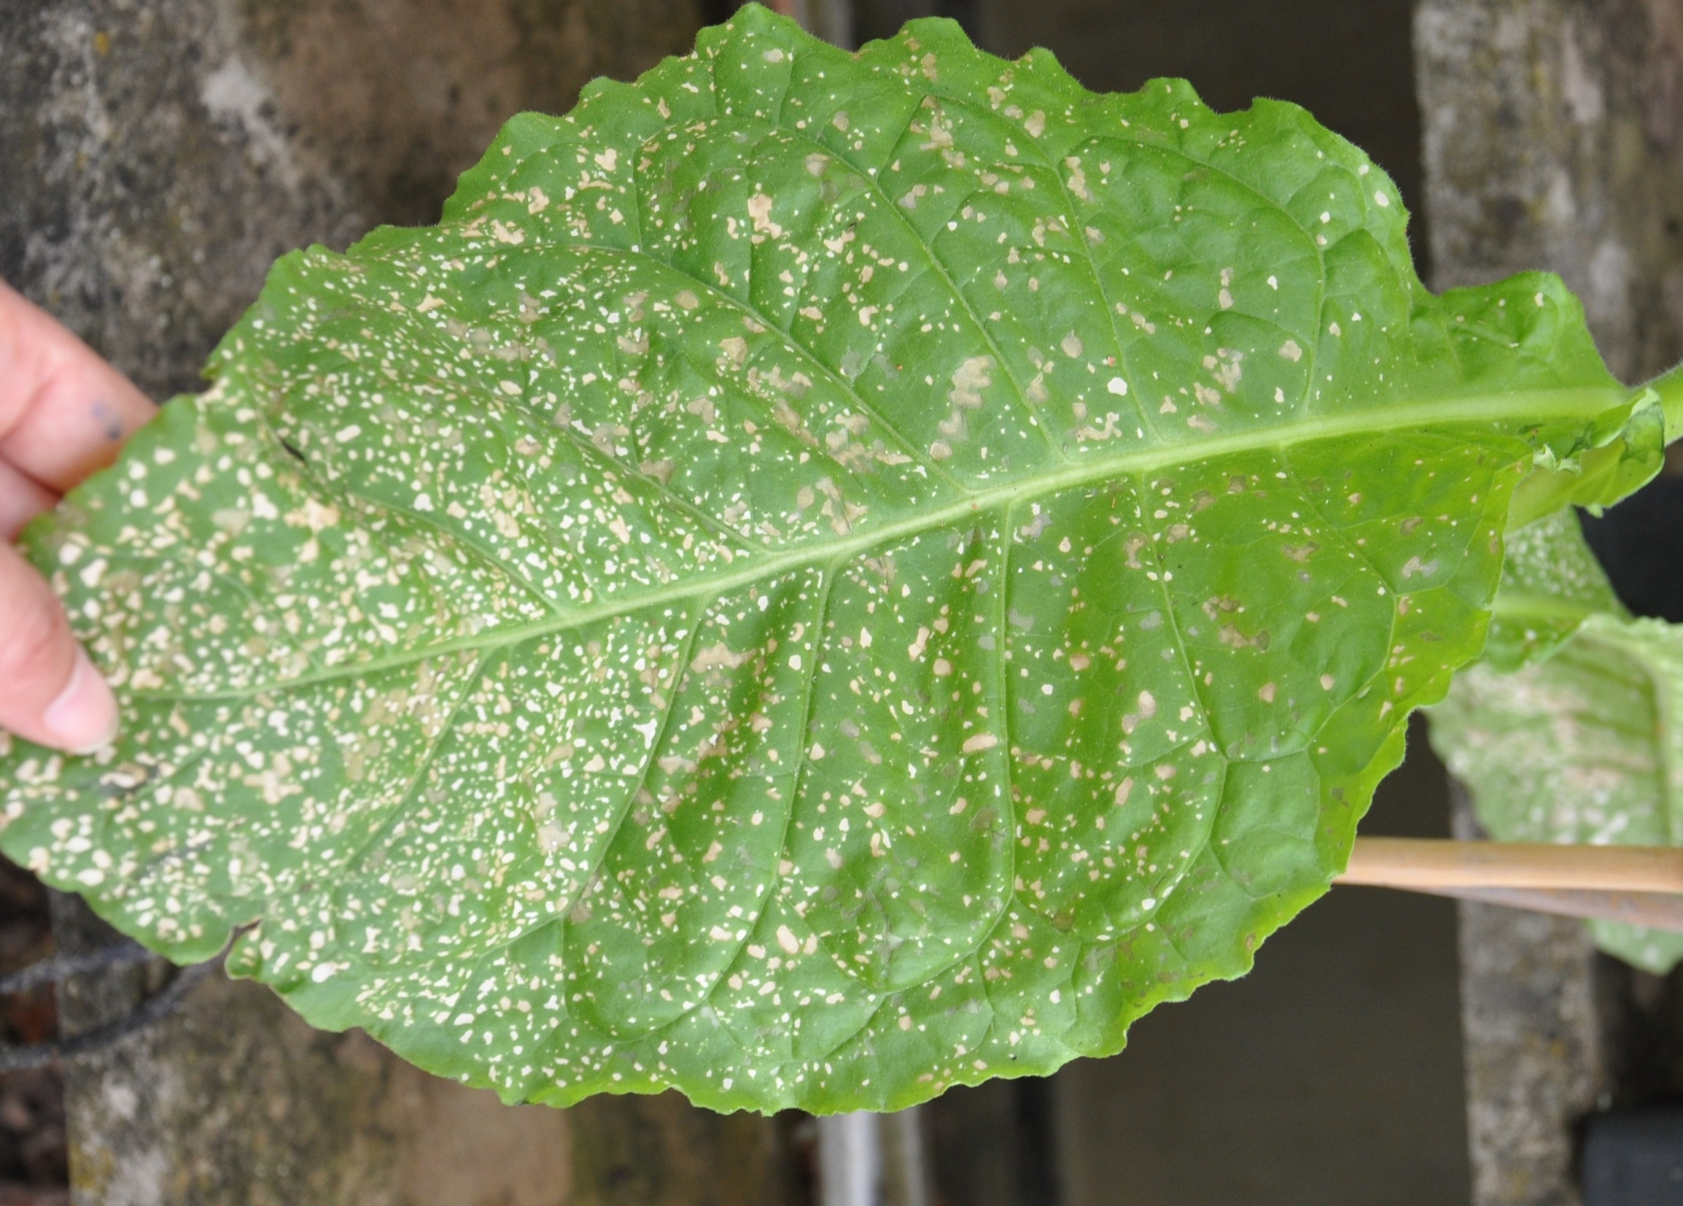
Some varieties are particularly sentitive to O₃. The lesions caused by O₃ are easily identifiable and quantifiable, as they consist of punctiform bifacial necroses, a few millimetres in diameter and with a clear outline, which start to become confluent if the exposure to ozone goes on, whereas their color lightens from blackish to dirty-white in a few days.

Slide 16
If farmers simply moved from O₃-sensitive varieties towards O₃-tolerant ones, there was also who was able to understand that the O₃-sensitive varieties or – better – the most sentitive one, could become a perfect biomonitor of O₃ pollution, and provided to officially register it:
BEL-W3 was officially born as leaf-spot sensitive indicator of air polluting ozone in July 1976.

Slide 17
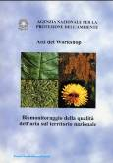
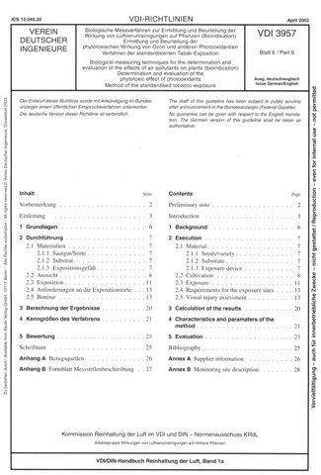
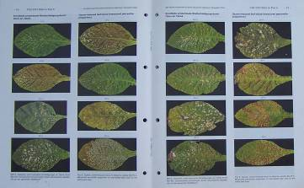
The most frequently applied operational method was developed by researchers at Imperial College, London. It is based on the determination of a Leaf Damage Index (LDF) or Leaf Injury Index (LII), later appropriately modified to increase the quality of the data and the correctness of sampling, therefore of the information obtained.
A first attempt was successfully conducted by Pisa scientists in cooperation with the Italian environmental agency (ANPA, Rome, 1999) to describe the fundamental standard procedures of O₃ bioindicators, with special attention to plant growth, staff training and data analysis.
Soon later, the VDI (Verein Deutscher Ingenieure) protocol followed, with further compelling information on seed and soil quality, watering etc.
The last step was given by the acceptance of the VDI protocol by the International Co-operative Programme on effects of air pollution and other stresses on vegetation (ICP - VEGETATION).

Slide 18
Due to its high standardization and frequency of application, the Tobacco procedure can now be considered an excellent example - although not the only one - of the application of biomonitoring techniques for the characterization of air quality in relation to a single pollutant.
The current method is used in environmental investigations, especially linked to authorization processes of large industrial complexes (e.g. thermoelectric power plants).
The procedure aims to reconstruct the distribution patterns on the territory of the ground concentrations of ozone, and its temporal variations on a weekly or monthly scale for the entire period of the photochemical season.

Slide 19
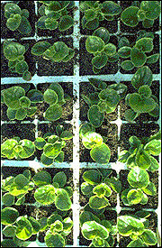
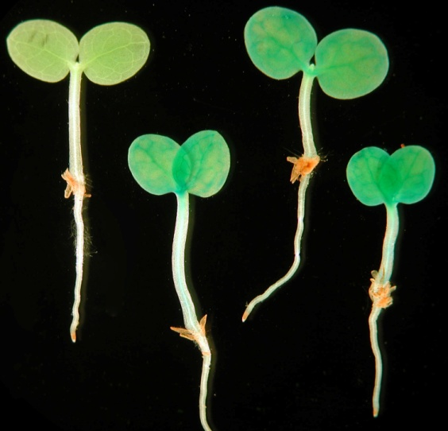
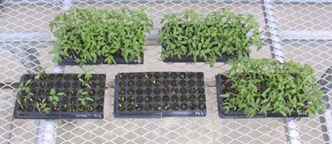
Growth protocol:
Instruction are given in terms of:
• Seed mass per surface unit, how to plant them, how and when to transplant young seedlings;
• growth conditions: in a climate cell at 20-23°C, 70-80% RH, light/dark photoperiod 14/10, 500-550 µmol photons m⁻² s⁻¹, good water availability.
• It is mandatory to growth the plants in FILTERED AIR

Slide 20
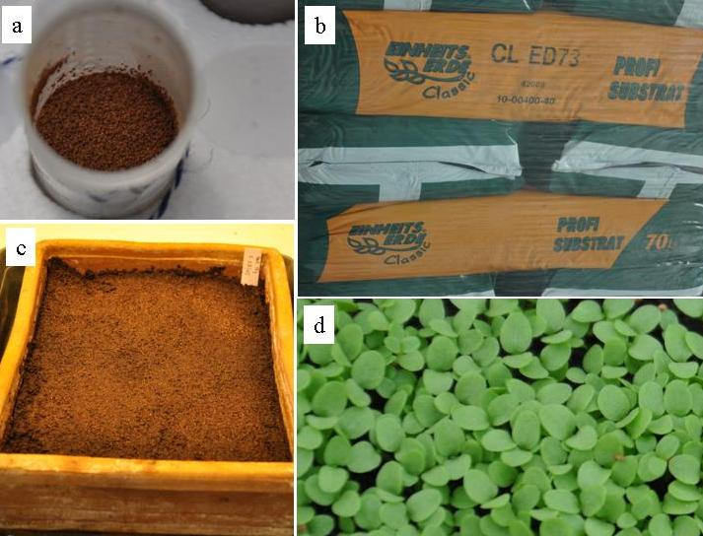
a) Nicotiana tabacum cv. Bel-W3 seeds;
b) soil Einheitserde Patzer ED73;
c) seedbed;
d) Seedlings with extended cotyledons.

Slide 21
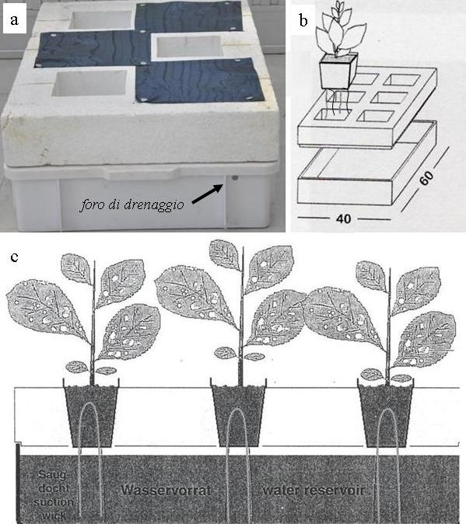
The adult plant are transplanted in plastic pots with pieces of cotton twine protruding from the holes in the bottom, which are inserted in a polystirene frame inserted in a plastix box (A) that will contain water, to provide the correct soil hydration by capillarity.
b) schematic drawing of the operation;
c) explanatory diagram.

Slide 22
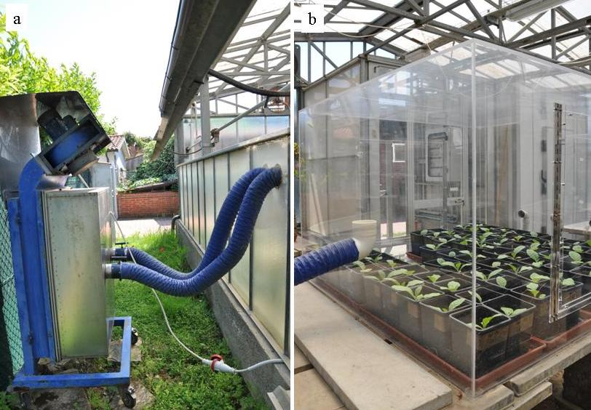
Seedlings and adult plants are grown in closed glasshouses
provided with filtering system with active carbons, to exclude the presence of ozone (A);
Eventually, boxes in plexiglass can also be used.

Slide 23
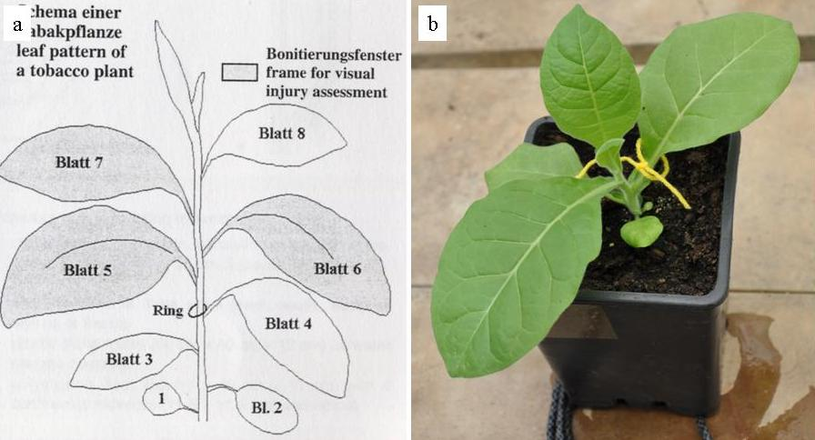
According to the instructions given in VDI 3957/Part 6 (2003) guidelines, the fourth leaf of each plant must be marked with a colored wool thread. (a) Exemplary diagram taken from the guidelines; (b) Indicator plant marked. All the following leaves will also receive their proper number.

Slide 24
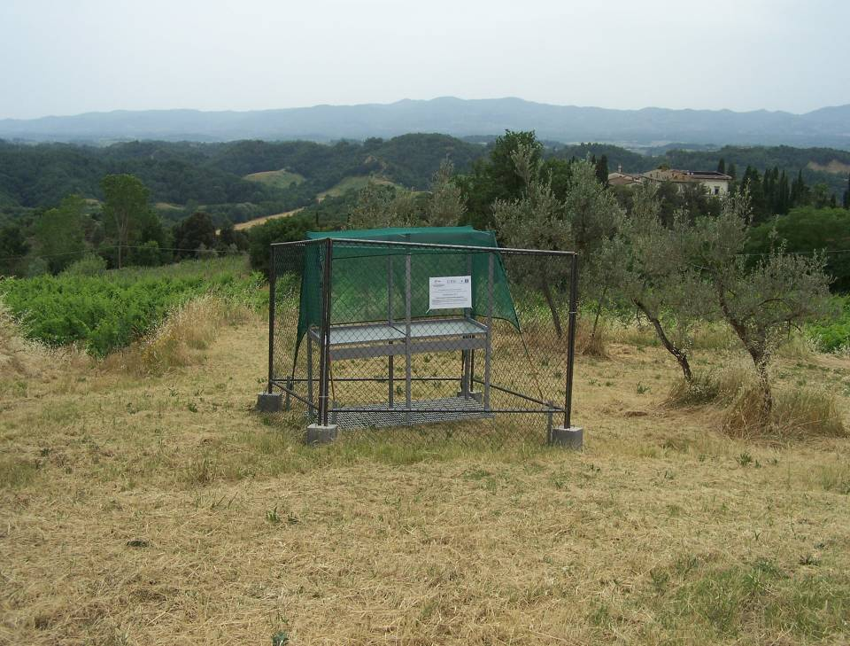
After 8 weeks from sowing (when the seedlings have 4-5 fully expanded leaves), the plants must be selected for homogeneity and transferred to the exposure sites, away from roads, tall trees and walls.
(Left) Exposure structures according to the requirements and indications contained in the reference VDI standard
[VDI 3957/Part 6, 2003]

Slide 25
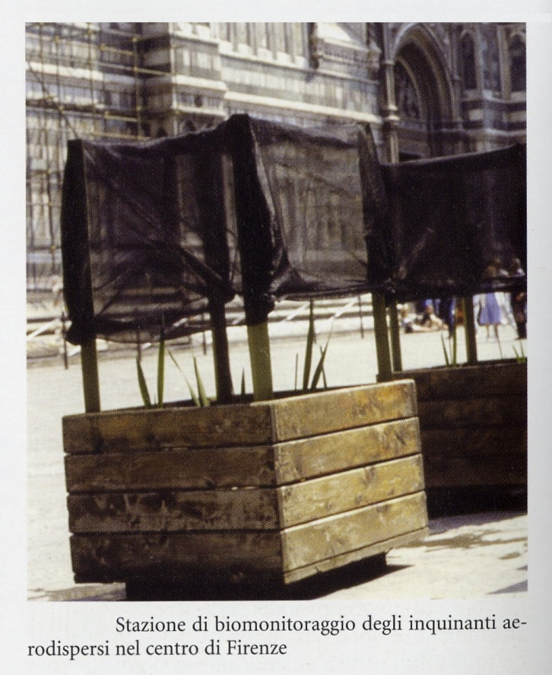
In each site at least 6 plants of the cv. Bel-W3 and at least 3 Bel-B (as a control) are placed, possibly inside frames with shade net, inside a fence, at a distance of 50 cm from each other according to a scheme like this:
S S R
S R S
R S S

Slide 26
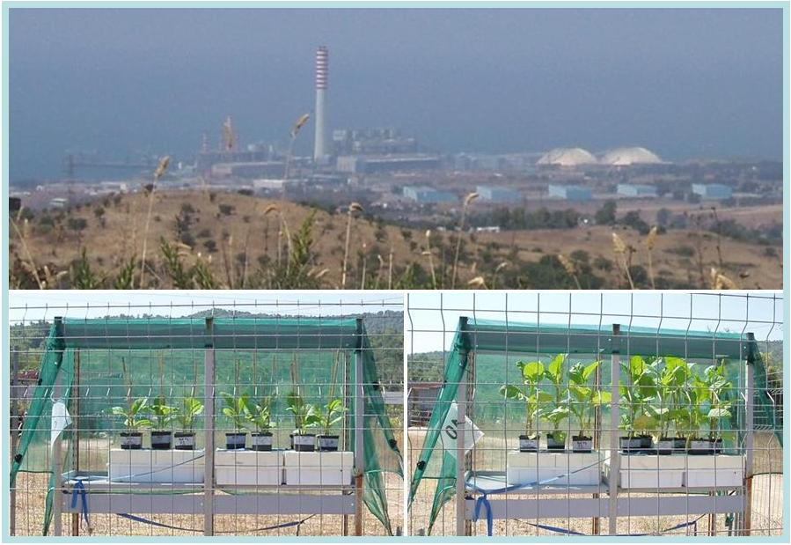
Indicator plants of Nicotiana tabacum exposed during the active biomonitoring campaign of tropospheric ozone conducted in the area surrounding the Enel Thermoelectric Power Plant of Torre Valdaliga Nord of Civitavecchia (RM), in the year 2012.

Slide 27
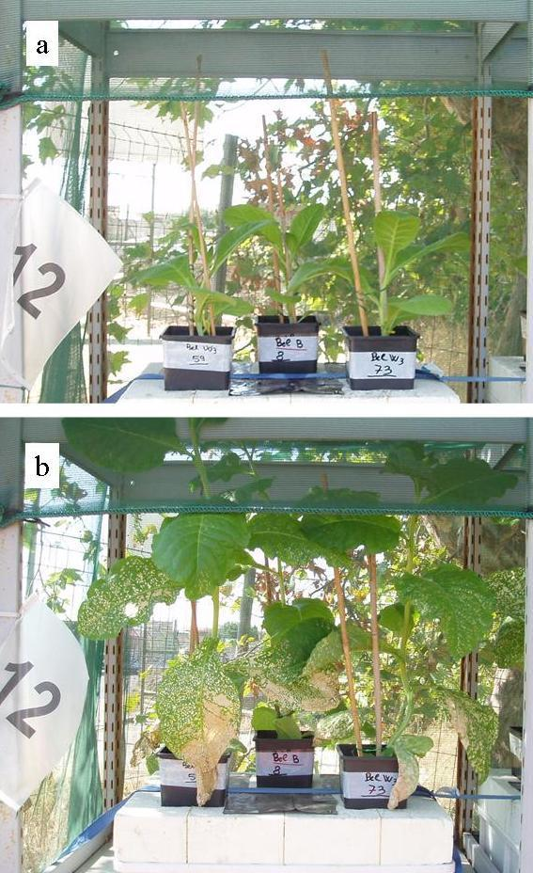
Indicator plants of Nicotiana tabacum exposed in the urban center of Civitavecchia (station n. 12), during the active biomonitoring campaign of tropospheric ozone conducted in the area surrounding the Enel Thermoelectric Power Plant of Torre Valdaliga Nord of Civitavecchia (RM), in the year 2012, at respectively: a) beginning and b) end of an exposure cycle.

Slide 28
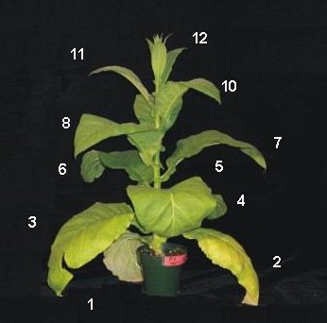
To each plant a reference code is assigned, then the leaves are numbered; the numbering will be extended to those that will form with growth.
The set of plants is kept for 4 weeks, and then is replaced with a new set of 8 week old plants, 4-5 expanded leaves coming from filtered air. If necessary, plants damaged by vandalism are replaced during construction with "twins" kept in cultivation under controlled conditions.

Slide 29
Symptoms are assessed on a weekly basis, always on the same day.
The number of leaves present on each plant is counted, and the percentage of necrotized surface area for each leaf is recorded. The percentage of damage is expressed in intensity class of the phenomenon, as follows:
0 = no damage;
1= >0 damage <5% of the total leaf surface;
2 = damage from 5 to less than 10%;
3 = damage from 10 to less than 15%;
4 = damage from 15 to less than 20%;
5 = damage from 20 to less than 30%;
6 = damage from 30 to less than 40%;
7 = damage more than 40%.

Slide 30
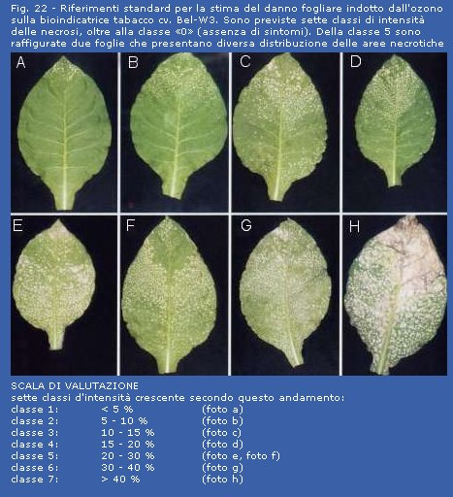

Slide 31
The leaf damage index is then calculated, based on leaves longer than 6 cm, and those that had not suffered damage exceeding class 2 in the previous week:Si
N
IDF = Σ_{i=1} (D_{t}-D_{t-1})_{i}/N
where:
n = leaf progressive number (from the plant base);
N = total numer of the observed leaves;
D_{t} = leaf damage at the last week;
D_{t-1} = leaf damage at the end of the previous week.

Slide 32
Alternatively, field data can be collected by interpreting photographs of leaves or by using more sophisticated image processing techniques.
In any case it is useful to have reference photographs available for:
a) compare the damage observed;
b) correctly estimate the intensity of the phenomenon.

Slide 33
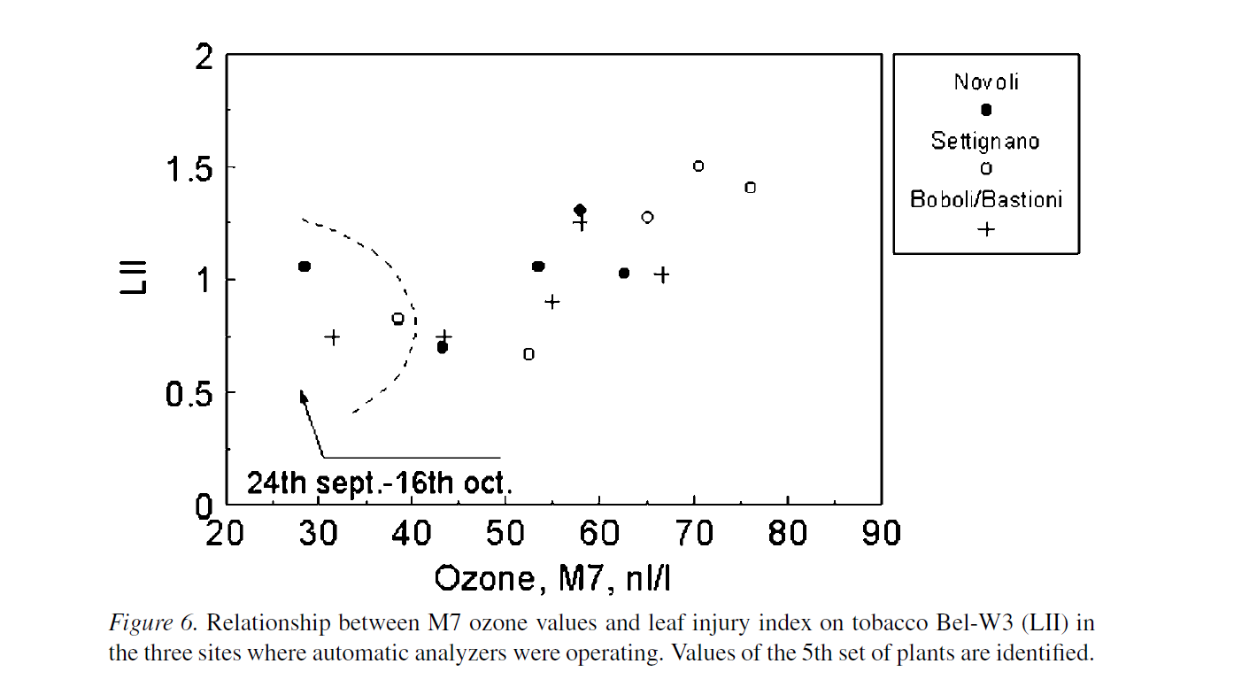
The LDI is linearly correlated to AOT40 values. From the mean LDI value of a site the corresponding AOT40 value is easily obtained.
With respect to passive samplers (see above), the tobacco plants show the effects caused by acute pollution, which is particularly important also for human health.

Slide 34
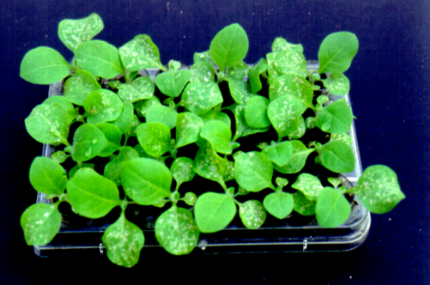
The main operational limitations consist of:
need for large spaces (and a long time) in an environment with filtered air;
due to the fragility of the leaves, transport over long distances is difficult;
the indicator plants remain in place for several weeks (usually 4).
To avoid these problems, a new system based on the use of tobacco seedlings grown in tissue culture plates has recently been developed.
The sensitivity of the cotyledons and of the first expanding leaves is well correlated to that of mature leaves

Slide 35
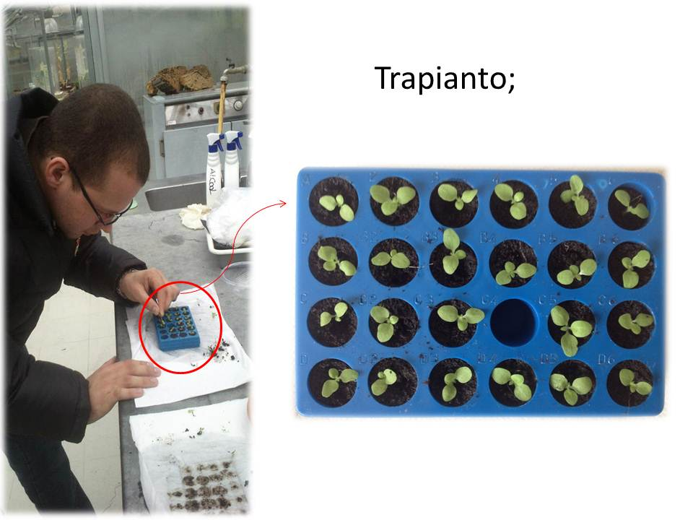
TRANSPLANT

Slide 36
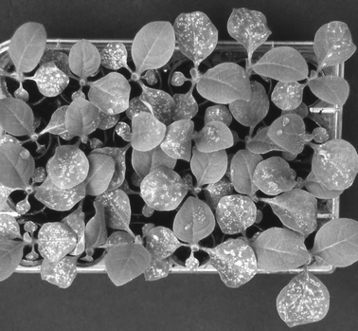
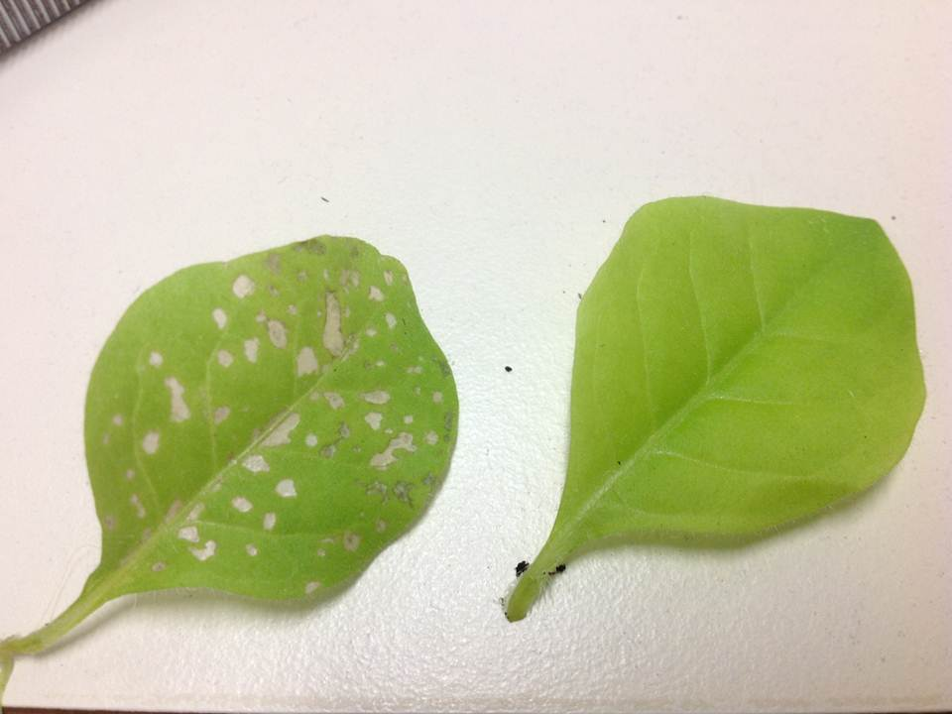
A kit of Bel-W3 tobacco seedlings after seven days of exposure to ozone-polluted air.
After exposure, the young seedlings can remain for 1 day in ozone-free conditions, thus allowing the full development of the damage induced by the pollutant.

Slide 37
The advantages deriving from ozone biomonitoring with this miniaturized kit of young Tobacco plants can be summarized as follows:
(i) the space required for plant growth is reduced;
(ii) a large number of individuals may be exposed;
(iii) the plates are small and therefore easily transportable, so they can be shipped and brought back to the laboratory easily to conveniently estimate the damage by the same operator, ensuring standardization of the reading;

Slide 38
NOT ONLY TOBACCO…
The visual estimation of leaf damage represents the weakest point of the tobacco-based methodologies discussed so far.
A methodology based on non-subjective measures and not significantly influenced by other factors evidently represents a clear improvement of the present systems.

Slide 39
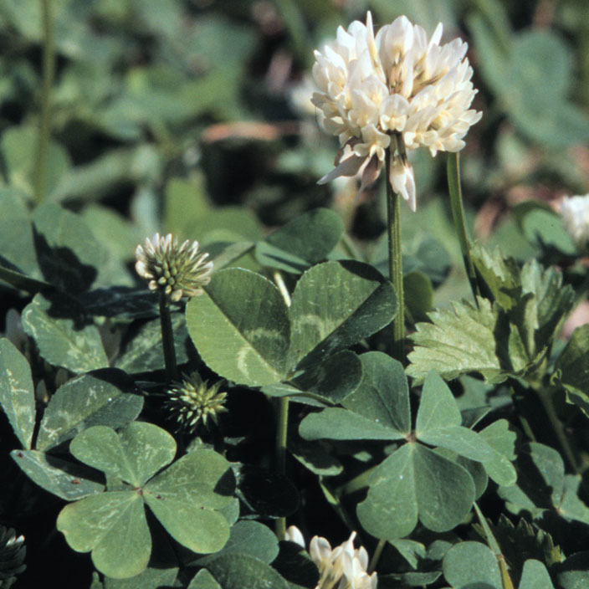
Trifolium repens L. cv. Regal
SENSITIVE CLONE:
NC-S
TOLERANT CLONE :
NC-R

Slide 40
The ozone-sensitive (NC-S) and ozone-resistant (NC-R) clones show measurable differences in biomass growth in response to the presence of ozone while responding in the same way to all other factors tested so far that can positively or negatively influence growth.
The growth of NC-S and NC-R is similar when the ozone concentration is low, while the growth of the NC-S clone is much lower than that of the NC-R clone when the ozone concentration is high.

Slide 41
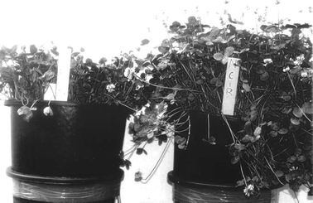
Biomass production of white clover (Trifolium repens) cv. Regal NC-S clone (left) compared to that of NC-R clone (right) in a monitoring campaign concerning tropospheric ozone conducted in Pisa.

Slide 42
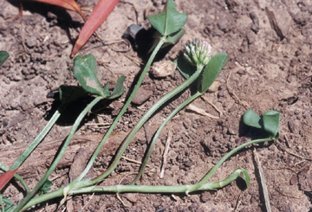
Clover stem cuttings of the two clones are transplanted in standard conditions (3-4 leaf nodes in soil with certain characteristics, irrigated with a suspension of Rhizobium, fertilized and maintained at 20-23°C, 14 hours of photoperiod, etc.
After 28 days of rooting, the seedlings are transplanted into plastic pots diam. 30 cm and 15 dm³ of volume, and the pots are transferred to the exposure sites (n = 20 NC-S and 20 NC-R)

Slide 43
L’esposizione dura 28 gg. All’inizio della quarta settimana, si effettuano rilievi sullo stato di salute delle piante se compaiono sintomi imputabili all’ozono su almeno il 20% degli individui: punteggiature necrotiche biancastre e a maturità viranti al bruno, con localizzazione internervale.
Si utilizza una scheda semplificata rispetto al tabacco: S=pianta sana; N=nanismo; P=patogeni; I=insetti; A=appassimento; O=ozono (O1: danno leggero; O2: danno moderato; O3: danno severo)

Slide 44
The first harvest is carried out 56 days after rooting, cutting the epigeal portion (leaves, stems, flowers) at a height of 7 cm above the surface of the soil.
The dry weight of the sample is made placing in a paper bag the material, and kept it at 80°C until the constant weight is reached (to measure the weight, the sample is left to cool over silica in a closed cabinet).
The harvest is repeated every 28 days, for a total of 5 in a season.

