Slide 1




The sensitivity of lichens to air pollution has been known for a long time.
…we are sensitive beings, said the lichen…

Slide 2
This sensitiveness to specific pollutants (e.g. SO₂), and tolerance towards others (e.g. O₃) is linked to specific biological peculiarities of lichens:
their metabolism depends on dry and wet depositions from the atmosphere: the continuous change in hydration status implies a continuous bi-directional matter flux of water and dissolved substances;
This flux occurs over the entire surface of the thallus, as they have no cuticle or stomatal openings;
nutrient and pollutants can be absorbed in gaseous form, in solution and associated with particulate matter;
there are no external selection mechanisms;
there are no specific mechanisms for getting rid of contaminated parts;
lichens are "long-living" organisms, with temporal integration of phenomena.

Slide 3
In epiphytic lichens the alterations induced by damaging pollutants can manifest themselves at three levels:
Alteration of some fundamental aspects of lichen symbiosis, e.g. impairment of photosynthetic activity, specific enzymatic activities, etc.
Fisiological
Morphological
Discolouration, changes in the morphology of the thallus, reduction in growth
Modification in the coverage/frequency of single species, with alteration of competition among species, and change in the composition of the communities (eventually, with compromise of “lichen biodiversity“)
Ecological

Slide 4
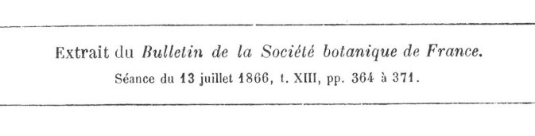
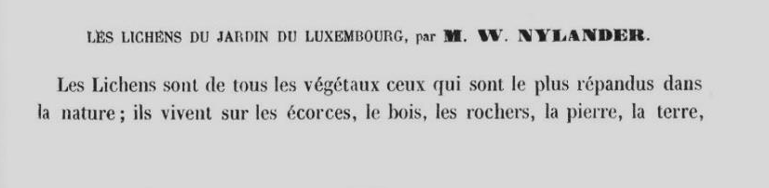

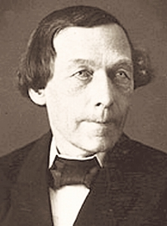
Erasmus Darwin

Slide 5
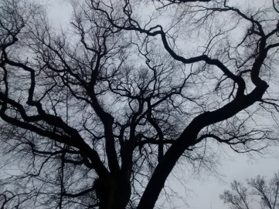
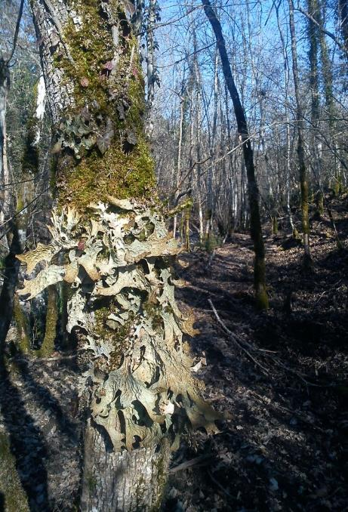
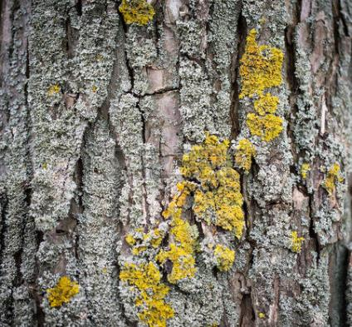
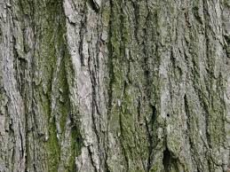

Slide 6
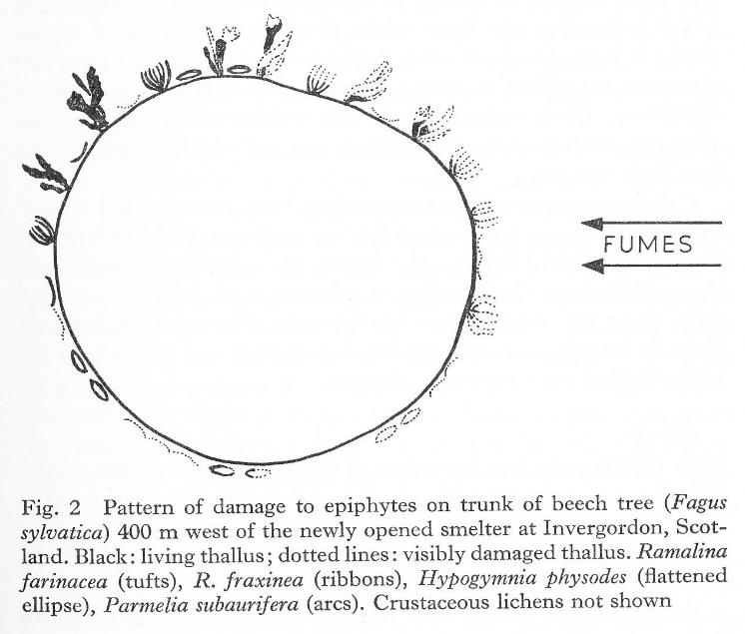
FUMES

Slide 7
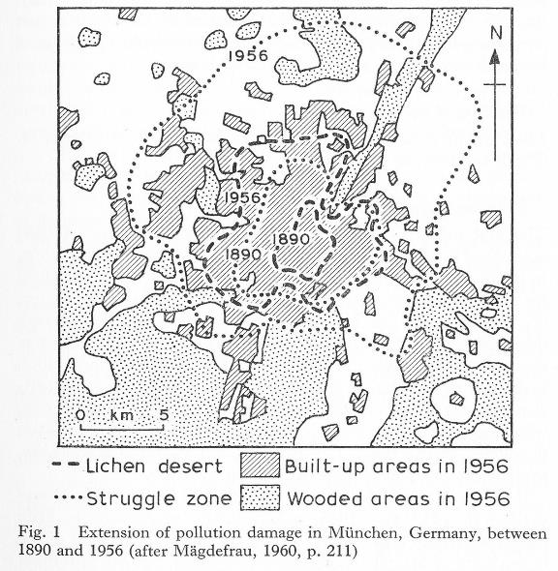

Slide 8
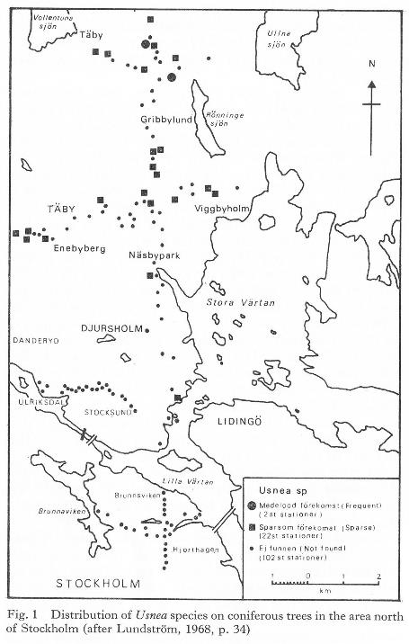

Slide 9
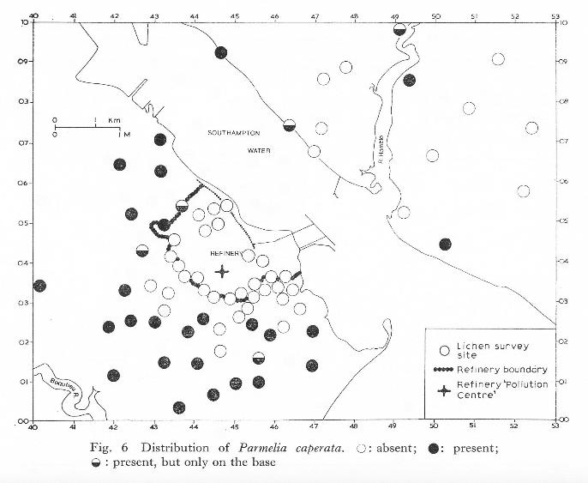

Slide 10
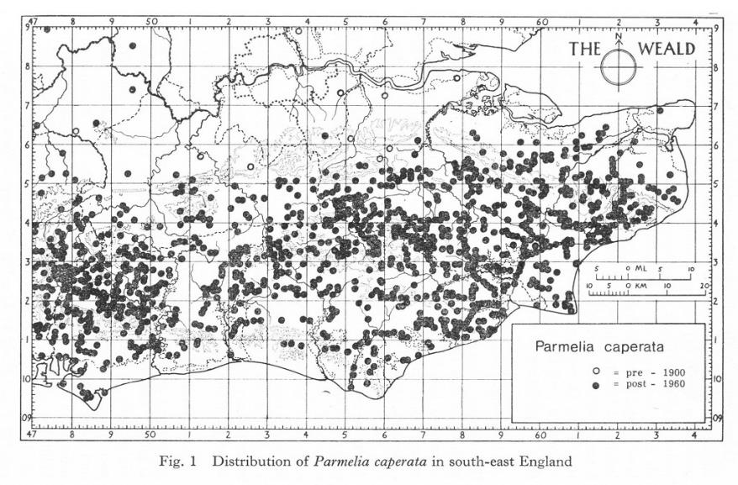

Slide 11
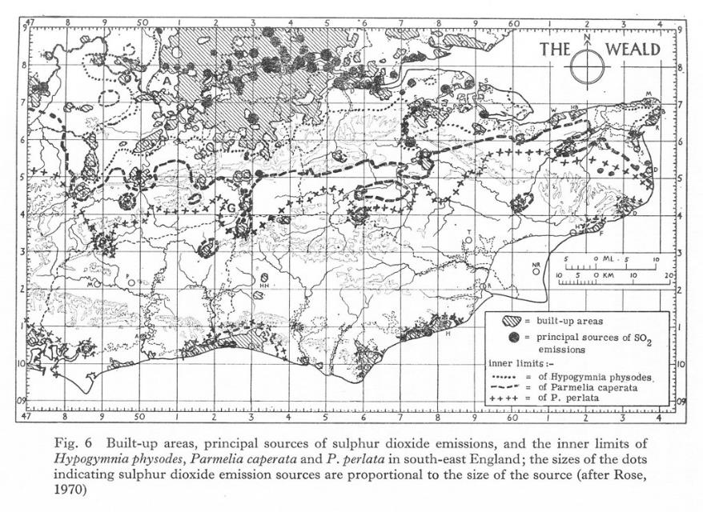

Slide 12
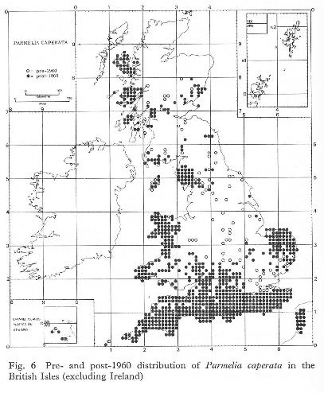
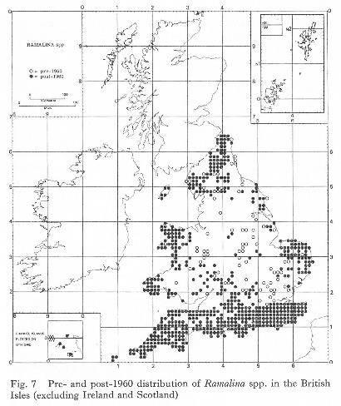

Slide 13
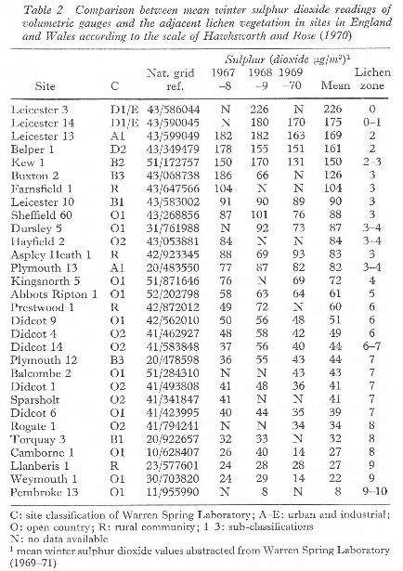

Slide 14
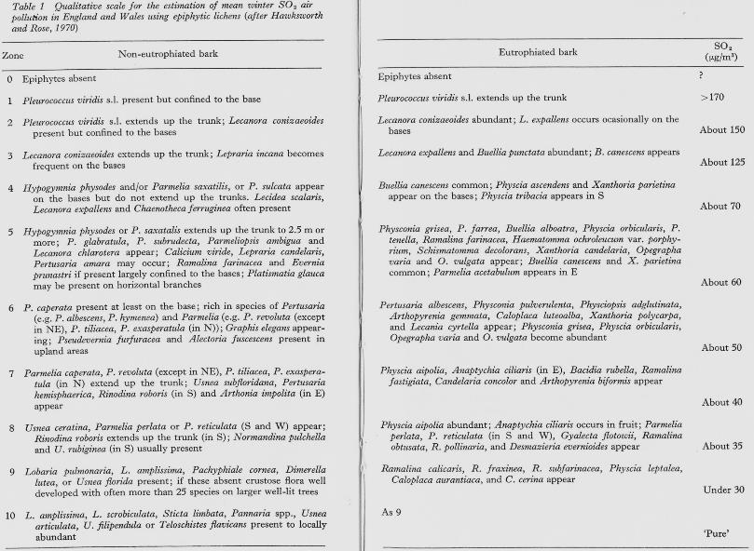
Hawksworth, D.L., Rose, F. (1970) Qualitative scale for estimating sulphur dioxide air pollution in England and Wales using epiphytic lichens. Nature 227: 145-148.

Slide 15
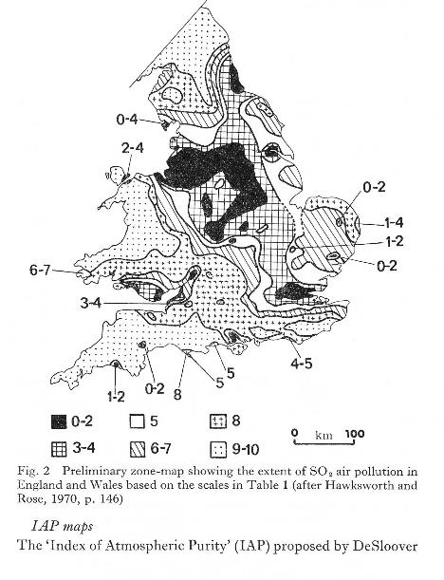
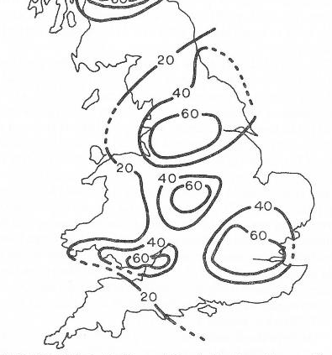

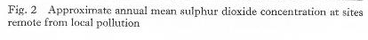

Slide 16
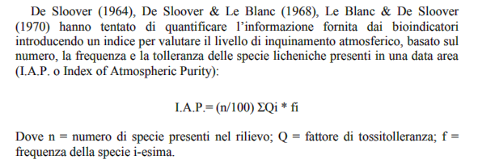
From the mid-1960s two researchers, De Sloover and Le Blanc, attempted to quantify the information provided by bioindicators by introducing a numerical index that should evaluate the level of air pollution, based on the number, frequency and tolerance of the different lichen species present in a given area (I.A.P., Index of Air Purity).
where: n= number of species within the relevé; Q = toxitolerance value of a certain species «i»; f = frequency of the same specie «i»

Slide 17
In a few years, there was a «florilegium» of new IAPs, because many authors proposed their own IAP formula, changing e.g. the poleotolerance values, the weight to the cover values of poleo-sensitive species, or of poleo-tolerant ones, introducing correction factors etc.

Slide 18
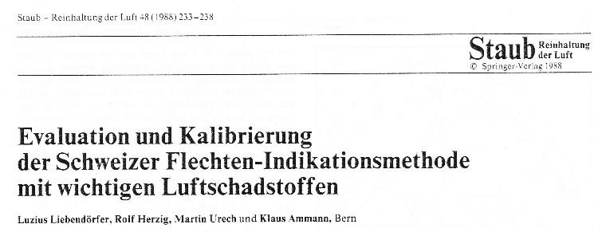
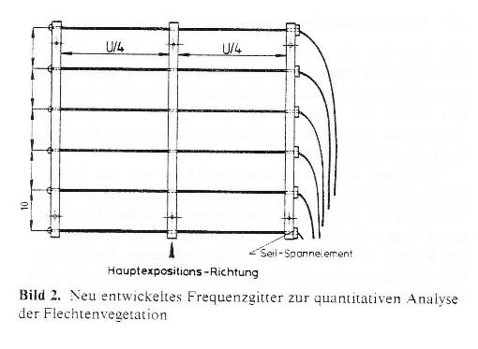
The born of the «Ammann» or «Swiss» method

Slide 19
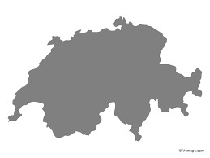
Where: Bern, CH
What they have at their disposal: ten automated recording gauges, with data on the main generalist pollutants: SO₂, NO_{x}, PM elemental content, Benzene.
What they do: they select trees in the immediate vicinity of the automated recording gauges, on which they detect the lichen flora and vegetation: list of species present, coverage of individual species, n. of individuals and so on and so forth. Each relevé is taken within an extendable grid, covering half the circumference of the tree trunk, selected where the lichen cover is the highest.
Next steps: different I.A.P.s are "invented", constructed in a different way each time. Just for fun, try to propose yours. Eventually, there will be 20 IAP, numbered IAP1 to IAP20.

Slide 20
Then, they study the polynomial correlations between the chemical-physical descriptors of "air quality" and the IAPs calculated for all the sites hosting a automated recording gauge.
Some of these correlations are very bad, but one is highly significant, which is the one calculated based on the IAP18.
Another interesting observation: if the number of pollutants is reduced, the polynomial correlations are progressively less significant, but the most important contribution to the significance is given by SO2, subordinately by NOx, and then progressively by the trace elements, which bring a contribution very reduced.
How is IAP₁₈ calculated?

Slide 21
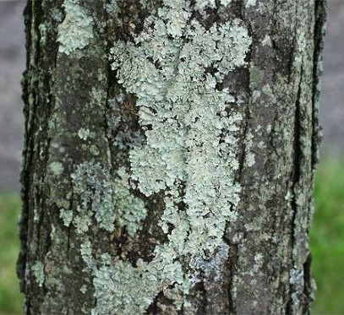
5
5
4
8
3
25
«I.A.P.₁₈ dell’albero n del sito x»

Slide 22
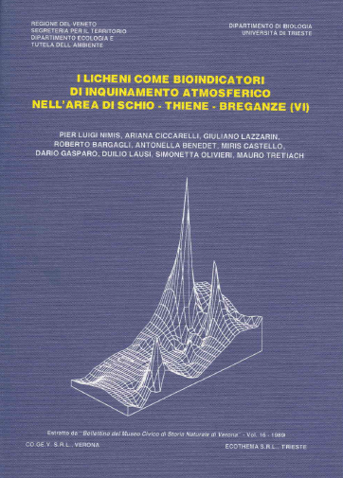
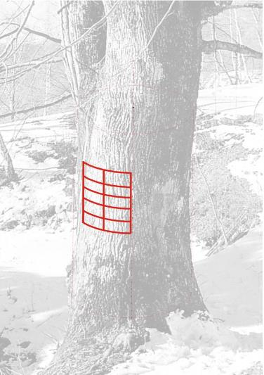
The first pilot project in Italy: a case-study in North-eastern Veneto

Slide 23
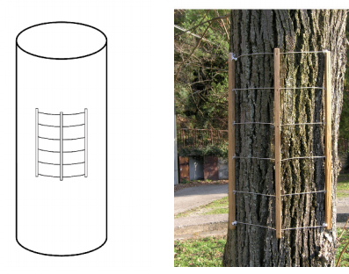
The empirical decision of using a standard sampling area of 30x50 cm (10 sampling units, 15x10 cm each) actually determined the passage from a I.A.P.₁₈ value to a true biodiversity value.
10 cm
15 cm

Slide 24
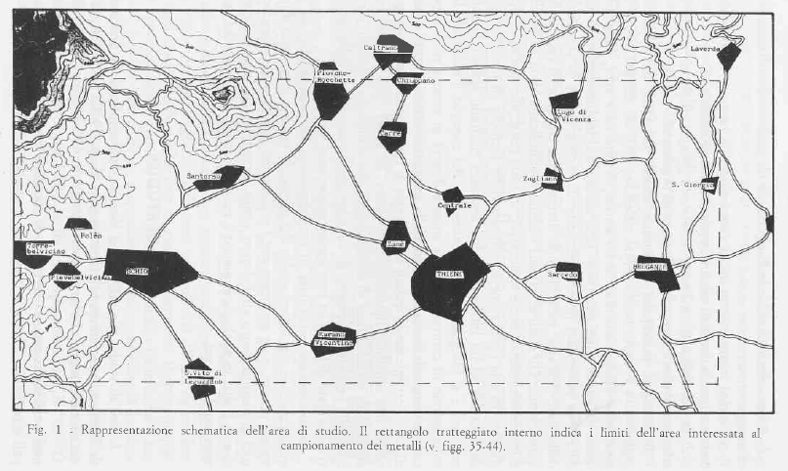

Slide 25
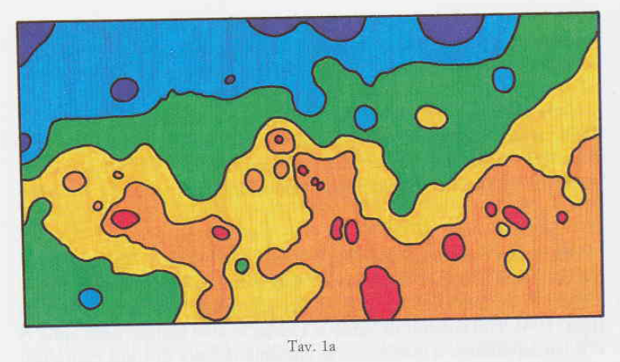
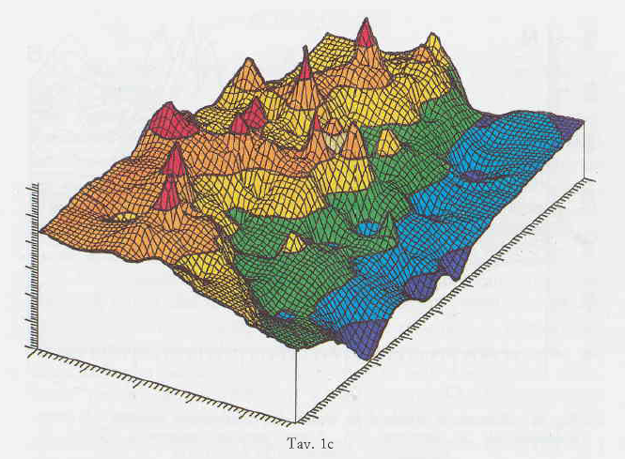

Slide 27
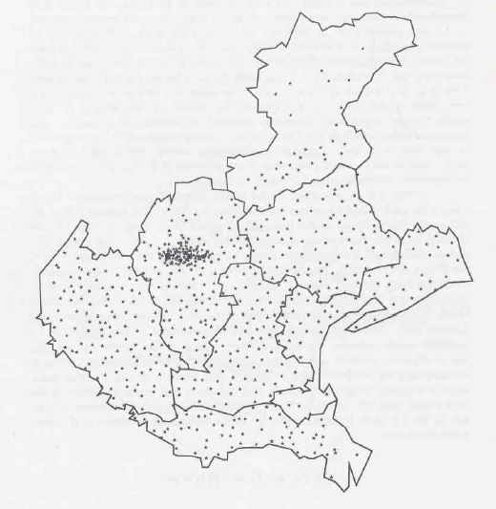
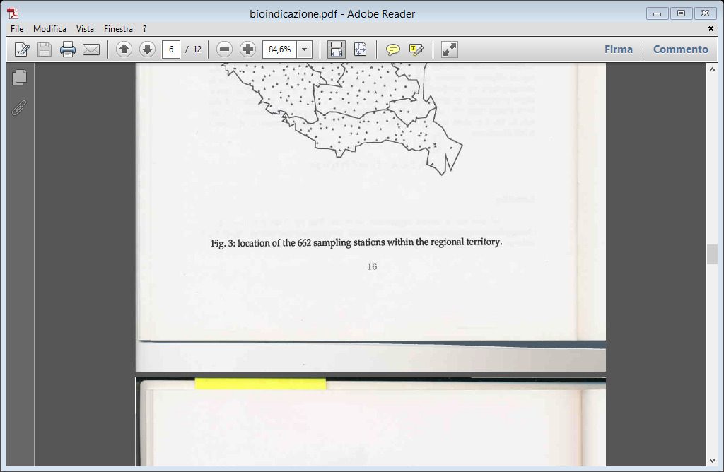
…soon extended to the whole Veneto Region

Slide 28
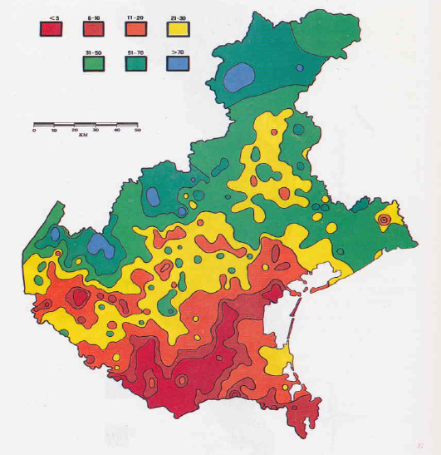

Slide 29
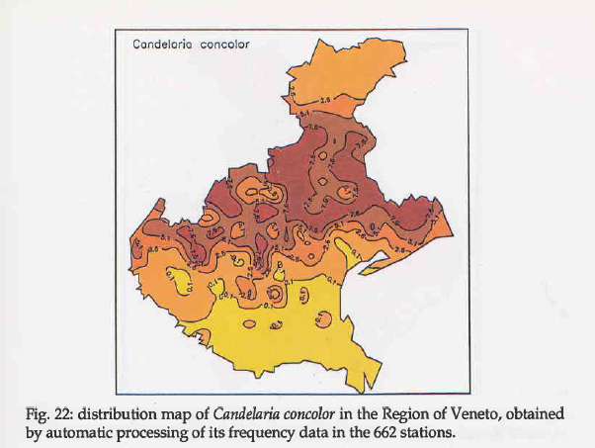

Slide 30
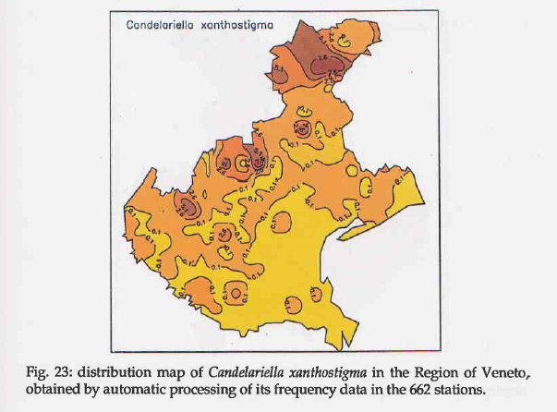

Slide 31


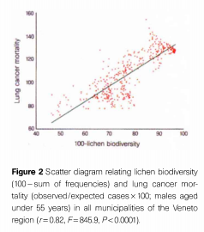

Slide 32
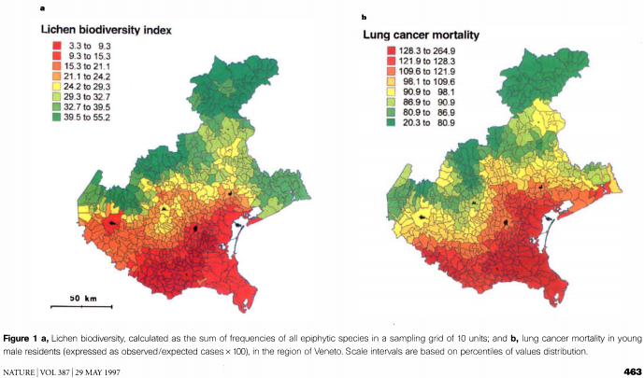
Cislaghi, C., Nimis, P.L. (1997). Lichens, air pollution and lung cancer. Nature 387, 463-464.

Slide 33
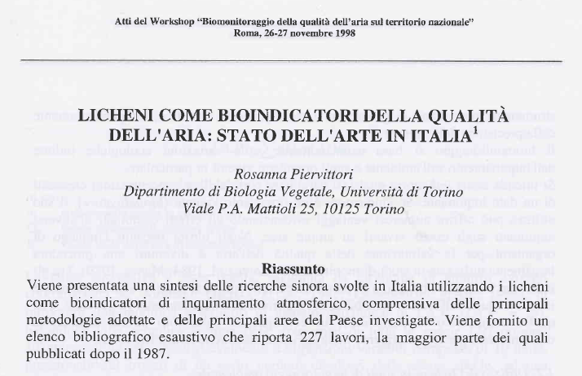

Slide 34
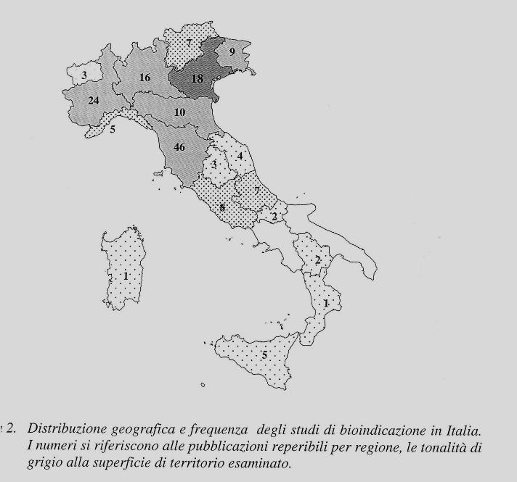
Analisi dei dati al 1998

Slide 35
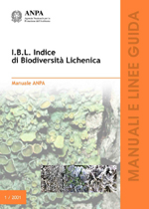

Towards the standardization
A central aspect of the development of bioindication methods with epiphytic lichen communities has concerned the standardization of procedures.
Piccini C., Salvati S. (Eds.): Atti Workshop Biomonitoraggio Qualità dell’aria sul territorio Nazionale. ANPA, Ser. Atti, 2.
Nimis, P.L. (1999). Linee guida per la bioindicazione degli effetti dell’inquinamento tramite la biodiversità dei licheni epifiti. Ibid., pp. 267-277.

Slide 36
Asta, J., Erhardt, W., Ferretti, M., Fornasier, F., Kirschbaum, U., Nimis, P.L., Purvis, O.W., Pirintsos, S., Scheidegger, C., van Haluwyn, C. , Wirth, V. (2002). Mapping lichen diversity as an indicator of environmental quality. In: Nimis P.L., Scheidegger C., Wolseley P. (Eds.). Monitoring with lichens – Monitoring lichens. NATO Science Series, IV, vol. 7. Kluwer, Dordrecht, pp. 273 -279.

Slide 37
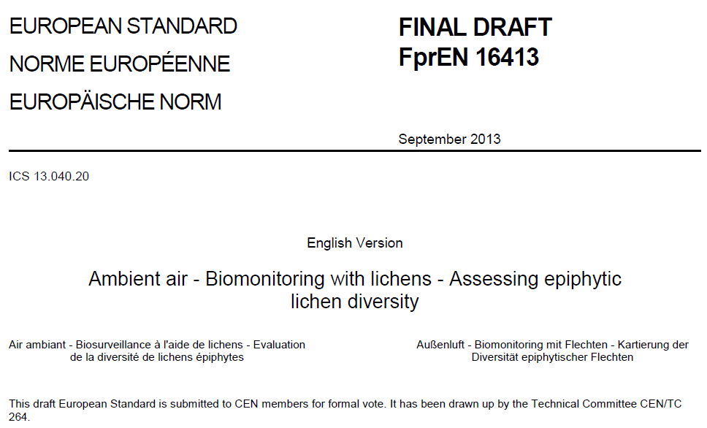
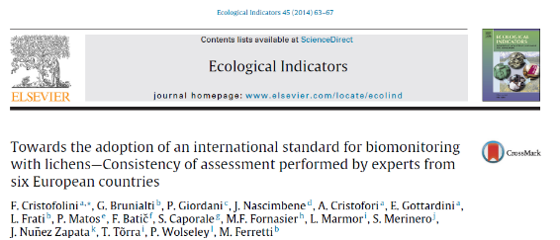
Towards the standardization

Slide 38
…some confusion caused by terminological changes:
IAP _{«Ammann»} or IAP₁₈ became:
LBI o IBL («Lichen Biodiversity Index»), then:
VBL o LBV («Lichen Biodiversity Value»), then:
LDV («Lichen Diversity Value»)

Slide 39
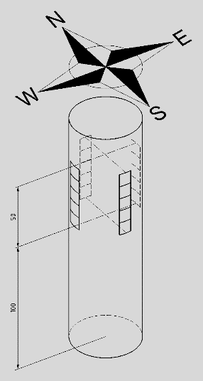
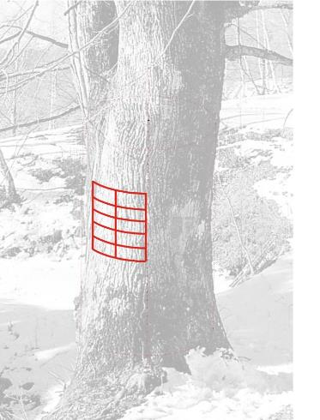
On the area of maximum coverage of the lichen community on the trunk, defined based on the operator's experience
At the four cardinal points, adopting a smaller grid (5 square areas of 10x10 cm)

Slide 40
There is a correlation between the values provided by the old grid (10 meshes of 10x15 cm), corresponding to the "old" IAP₁₈ and those of the new grid (5 meshes of 10x10 cm, moved to the four cardinal points of the trunk), corresponding to the new LDV?
Castello M., Skert N. (2005). Evaluation of lichen diversity as an indicator of environmental quality in the North Adriatic submediterranean region. Science of the Total Environment 336: 201-214.
The survey was carried out in 61 sampling sites of two areas of the Friuli Venezia Giulia region (Italy) and Slovenia, characterized by similar climatic conditions and a wide range of anthropic pressure.

Slide 41
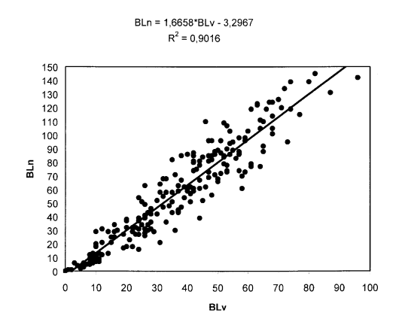
Biodiversity values obtained with the two sampling methods are highly statistically correlated;
this suggests an interpretative continuity of lichen diversity data for biomonitoring purposes.

Slide 42
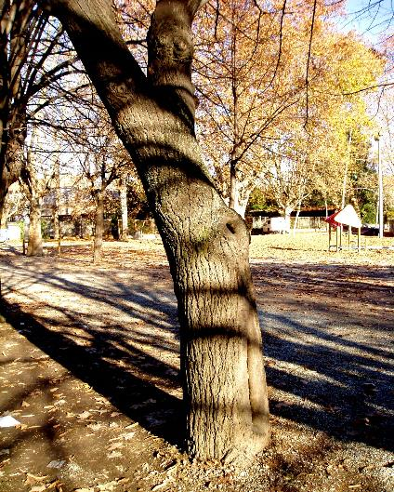
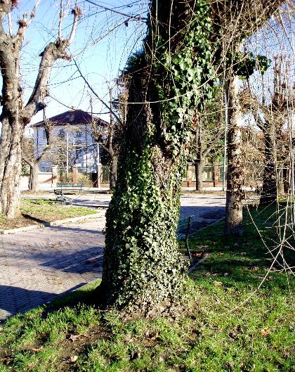
In biomonitoring studies it is necessary to respect a protocol when choosing trees, in order to avoid anomalies that could negatively affect the data.
Avoid trunks with an inclination greater than 20° or with large knots…
Avoid trunks with bryophyte or climbing plant coverage greater than 20%...

Slide 43
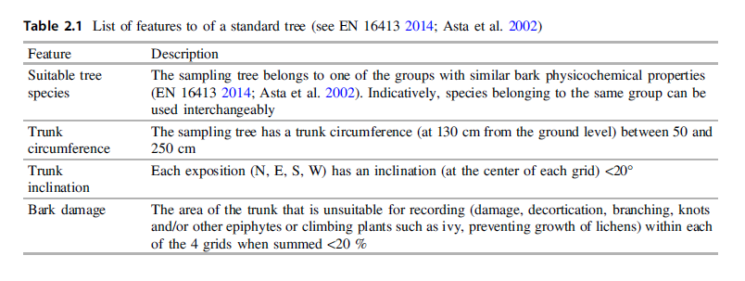

Slide 44
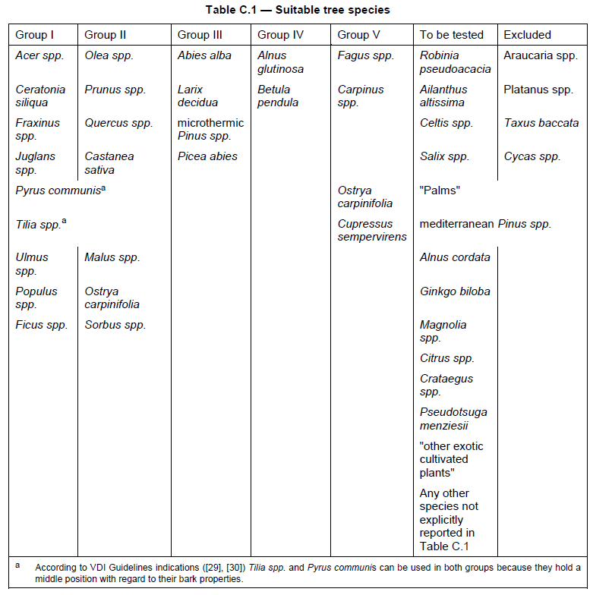
Elements of variability: the tree species

Slide 45

Elements of variability: the tree species
When choosing tree species (in preference order):
A single tree species within the whole study area (e.g. A).
Different tree species, within the same bark-type group (e.g. A and B).
iii. Different tree species within different bark-type groups (e.g. A, B and C), excluding unsuitable taxa, e.g. some Conifers, Platanus - D).

Slide 46

Elements of variability: the individual trees

Slide 47

http://www.lichenologia.eu/

Slide 48


Slide 49
Biomonitoring in environmental litigation
Research to support standardization
Greater objectivity, with the verification of some sampling methods on a probabilistic basis.
Study of the between-site spatial variability of lichen diversity for the optimization of sample size.
Investigation of within-site variability for the definition of natural background noise, to obtain a better interpretation of the data.
Definition of Quality Assurance procedures to evaluate and minimize non-sampling errors due to operators.
Interpretation of data

Slide 50
Cline, S.P., Burkman, W.G. (1989). The role of quality assurance in ecological programs. In: Bucher, J.B., Bucher-Wallin, J. (Eds.): Air pollution and forest decline. IUFRO, Birmensdorf, 361 pp.
EPA (2002). Guidance for Quality Assurance Project Plans. EPA QA/G-5.
Brunialti, G., Giordani, P., Ferretti, M. (2004). Discriminating between the good and the bad: quality assurance is central in biomonitoring studies. In: Wiersma, B. (Ed.): Environmental Monitoring. CRC Press LLC, pp. 443-464.
Brunialti, G., Giordani, P., Isocrono, D., Loppi, S. (2002). Evaluation of data quality in lichen biomonitoring studies: the Italian experience. Environmental Monitoring and Assessment 75, 271-280.

Slide 51
Baseline study (5.3)
Quality Assurance and quality control (Clause 7, i. Project management)
Preliminary knowledge:
Aim of the study, characteristics of the study area (5.4.2)
Standard tree species
(5.4.3, Annex C)
Sampling scheme (5.4.5)
Sampling unit (5.4.6)
Sampling density (5.4.7)
Quality assurance and quality control (Clause 7, ii. adopted Standard Operating Procedures)
Selection of standard trees (5.4.4)
Survey of lichens (5.4.8)
Identification of critical specimens (5.4.9)
Quality assurance and quality control (Clause 7, iii. Data quality control activities)
Calculation of lichens diversity metrics (Annex B)
End of survey (Annex E)
White rectangles: Indoor or lab
Grey rectangles: fieldwork
Bold rectangles: Quality assurance.

Slide 52

Biomonitoring in environmental litigation Standardization of sample designs

Slide 53





From preferential to probabilistic sampling
Preferential sampling
Probabilistic sampling

Slide 54

Biomonitoring in environmental litigation
Spatial variability 'between sites'

Slide 55
The application of the bioindication method with lichens in its first forms (IAP18, IBL) immediately met with great success.
Since the early days, values (in themselves continuous) were represented on the basis of an attribution to scales divided into classes, originally defined empirically, and associated with different colors (and definitions) to allow an effective graphic representation.
In their original interpretation, these scales had a certain reference in the "zero" value represented by the so-called "lichen desert", while the highest class, particularly large, remained undetermined in its absolute maximum value.

Slide 56

For a decade, each operator proposed the most varied classes, associating them with non-standardised colours, creating quite a bit of confusion when comparisons were made between the various studies, also because not all of them reported the values for individual stations.
With the publication of the proceedings of this workshop it is proposed to standardize:
CLASS SIZE (n=7)
DEFINITIONS OF THE SAME CLASSES in terms of NATURALITY/ALTERATION
ASSOCIATED COLORS FOR THE CARTOGRAPHIC REPORT
DEFINITION OF RANGES DEFINED ON A STATISTICAL BASIS

Slide 57


Nimis P.L., Linee-guida per la bioindicazione degli effetti dell’inquinamento tramite la biodiversità dei licheni epifiti. In: Atti del Workshop… AMPA, Atti 2, 1999

Slide 58


Slide 59


fasce è proposto da Wirth (1995):

Slide 60


Slide 61


Inevitably, with the increase in the number of investigations also extended to non-urban environments, we realized that:
in relatively remote areas, particularly in forest environments, the values were often "surprisingly" low (the environmental typology is very different, many ecological factors can intervene to limit the development of lichen vegetation...).

Slide 62
However, there are substantial differences in the maximum values that can be recorded in the different areas of the country ("who finds the highest value? And where?"). Strong differences in the maximum values were reported from different areas of our country, because also the climate has its own effect on the LDVs.
The maximum values are typical of a rural landscape with relatively isolated trees or trees present in poorly closed (therefore bright) forest consortia, characterized by a slight anthropic disturbance; an inevitable consequence was the extension of the scale to higher values, previously included in the definition of "high naturalness" because they were higher than 50 (>50).

Slide 63

…...but is it correct to consider the highest LDV values found in a territory as those that describe the "maximum" naturalness?
In other words, are we sure that the maximum LDV is necessarily associated with the total absence of anthropic disturbance?

Slide 64
Hypothetical linear relationship between pollutant concentration and LDV
More realistic curvilinear relationship between pollutant concentration and LDV
Pollutants (SO₂)
DISTURBANCE
0
56
112 «Adriatic scale»
0
66
132 «Thyrrenian scale»
Lichen desert
Lichen Diversity Value
Values ​​falling within the original class 7, of "very high naturalness"

Slide 65






Slide 66
But what does the CEN standard say?
CEN/TC 264
Date: 2012-03
prEN 16413:2012
CEN/TC 264
Secretariat: DIN
Air quality — Biomonitoring with lichens — Assessing epiphytic lichen diversity
Luftqualität — Biomonitoring mit Flechten — Kartierung der Diversität epiphytischer Flechten
Qualité de l'air — Biosurveillance à l'aide de lichens — Evaluation de la diversité de lichens épiphytes
Document type: European Standard
This document (prEN 16413:2012) has been prepared by Technical Committee CEN/TC 264 “Air quality”, the secretariat of which is held by DIN.

Slide 68
Unfortunately, the CEN document says nothing about the interpretation of the results, simply because this topic was removed when no convergence was found between the participants at the technical discussion table.
Rather than proceed with a vote by strict majority, it was decided to postpone the production of an ad hoc document to a later date, which never arrived.

Slide 69

How to establish the level of "naturalness"?
It would seem logical to calculate an average value of n surveys carried out within a specific biogeographical area in remote, presumed near-natural areas.

Slide 70

The interpretation scale could be developed based on the percentage deviation from the level of naturalness.
The current proposal, not yet shared by everyone, is the following: taking into account the variability of biological data, the influence of the operator in data collection, the condition of naturalness would be included in a range of 25 percentage points, i.e. 0-25% deviation from average value of values higher than the 98th percentile of values observed in a large climatically homogeneous area.
In this way a scale of 4 or 5 classes would be obtained which in turn could be divided into smaller intervals

