Slide 1
Instructions:
Get the complete qRT-PCR data of your ”turno” from excel files placed on Moodle
Perform data analysis according to the practice session in the laboratory Make the data analysis all groups of your “turno” (for details see next slide).
Perform data analysis using the COMBINED data of “turno 1, 2 and 3” (for details see next slide).
4. Generate the data blot (figure panel). The bar diagram shoud show: medium expression, standard deviation and p-values (paired Student’s t-test), labelling of x+y axis, number of biological replicates (N=) and a brief figure legend. Place the data on SFPQ and CCL5 into a single graph. As model you can use figure panel 1b from this publication LINK: https://www.nature.com/articles/s41467-022-29907-z
5. Insert the complete figures on page 2 (Field 1 + 2) of this ppt file. Insert your figure generated from your tunro in Field 1. Insert the figure obtained by collecting data from turno 1, 2 and 3. Place the figure legends below each of the 2 figures.
5. Give a brief answer to the questions you can find on page 2. Do not write more than 30 words for each answer.
6. Covert page 2 into a pdf file and name the file: “TURNO 1, 2 o 3_ COGNOME” and deposit into Moodle
DEADLINE: 19.12.2024
Please Note: Documents that are uploaded or modified after this date will be evaluated with ZERO points.

Slide 2
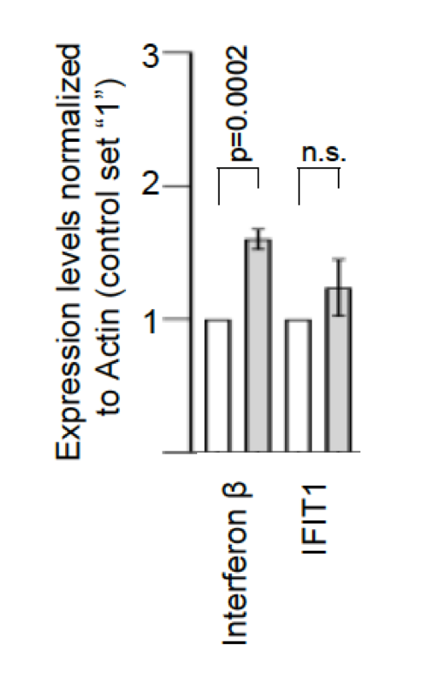
TURNO “X” – NOME COGNOME
Figure 1
Figure 2
Field 1:
Figure of exercise in laboratory
-your turno -
SFPQ and CCL5 in a single graph
Put data from all groups of your turno into a single figure.
For example:
Turno 1: 4 groups Combine the data of all biological replicates: N=4
Calculate Stdev and p-value on N=4
Field 2:
Figure generated as homework
- Turno 1, 2 and 3
SFPQ and CCL5 in single graph
Put all data from all groups of turno 1, 2, 3 into a single figure.
For example:
Turno 1: 4 groups
Turno 2: 6 groups
Turno 3: 5 groups
Combine the data of biological replicates: N=15
Calculate Stdev and p-value on N=15
siControl
siSFPQ
Insert figure legend= home work exercise
Insert figure legend= exercise homework
Question 1: make general observations For example what could impact on size of standard deviatio?; what may have caused the standard deviation observed? What may have impacted on fold change values? what could be done do improve the data? between extent of standard deviation and p-value (max. 30 words)
Question 2: Why is p-value of figure 2 better then that shown in figure 1 (max 30 words)

