Slide 1
MULTITARGET APPROACH

Slide 2
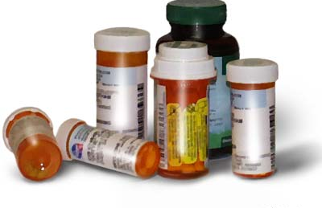
Neurodegenerative Diseases: complex multifactorial syndromes
Polypharmacology

Slide 3
Three main clinical scenarios for multitarget therapy
POLYPHARMACOLOGY
Fixed-dose combination
Drug combination
MT
D
Multi-target drug
Bolognesi, Curr Med Chem submitted (2012)

Slide 4
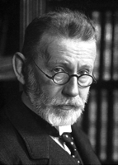
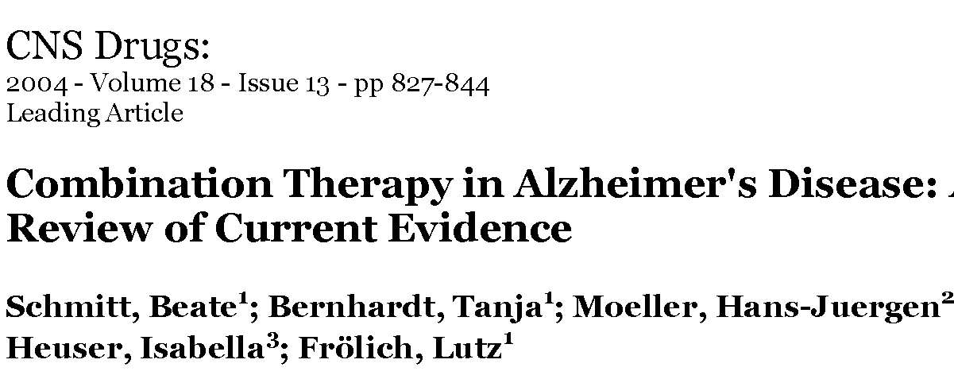
Combination therapy timeline
WHO recommends artemisinin-based combination therapy (ACT) for malaria
combination regimens against TBC
1913
1960
1993
2003
2004
Paul Ehrlich: ‘attack the parasites from various point’
Three-drug combination
stops HIV

Slide 5




Multitarget drug discovery timeline
Youdim: “Multi-functional drugs for various CNS targets in the treatment of neurodegenerative disorders”
Decker: “Hybrid molecules/designed multiple compounds with antiamnesic properties”
2005
2006
2007
2008
Millan: “Multi-target strategies for the improved treatment of depressive states”
Morphy: “Designed multiple ligands. An emerging drug discovery paradigm”

Slide 6
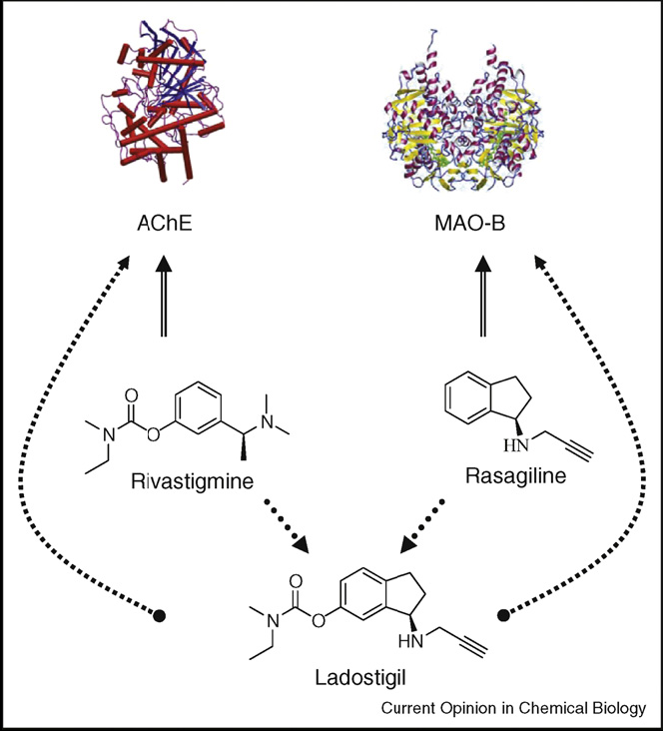
MTDD Strategy: a successful example
Bolognesi et al., Curr Opin Chem Biol 13, 303 (2009)
Notes:
Ladostigil (TV-3,326) is a novel neuroprotective agent being investigated for the treatment of neurodegenerative disorders like Alzheimer's disease, Lewy body disease, and Parkinson's disease.[1] It acts as a reversible acetylcholinesterase and butyrylcholinesterase inhibitor, and an irreversible monoamine oxidase B inhibitor, and combines the mechanisms of action of older drugs like rivastigmine and rasagiline into a single molecule.[2][3] In addition to its neuroprotective properties, ladostigil enhances the expression of neurotrophic factors like GDNF and BDNF, and may be capable of reversing some of the damage seen in neurodegenerative diseases via the induction of neurogenesis.[4] Ladostigil also has antidepressant effects, and may be useful for treating comorbid depression and anxiety often seen in such diseases as wel

Slide 7
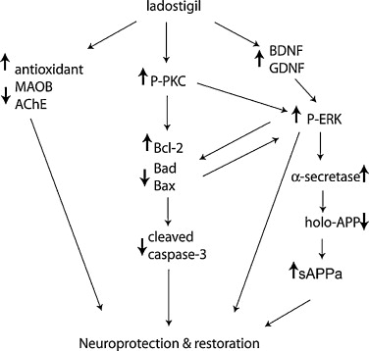
MTDD Strategy: a successful example
Ladostigil is currently in Phase II studies
Geldenhuysa et al., Progr Neurobiol 94, 347 (2011)

Slide 8

Combinations vs multitarget drugs: a clash of the Titans in the polypharmacology arena
MT
D
Drug-drug
interaction
Patient
compliance
Therapy
personalization
Bolognesi, Curr Med Chem submitted (2012)

Slide 9
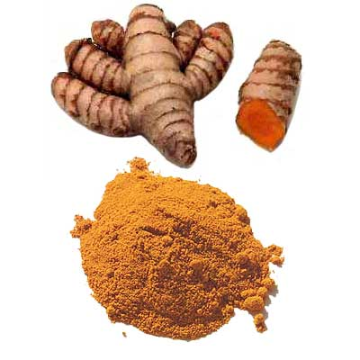
Multi-Target Drug Discovery (MTDD
Modulating a multiplicity of targets can be an asset in treating a range of (complex) disorders e.g. psychiatry, cancer, asthma
2 tablets
2 agents
1 tablet
2 agents
1 tablet
1 agent
folk
medicine
traditional
polypharmacy
fixed dose
combinations (FDCs)
designed
multiple ligand
Advair
Atripla
etc.
Ziprasidone
Lapatinib
etc.

Slide 10
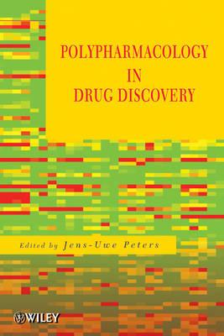
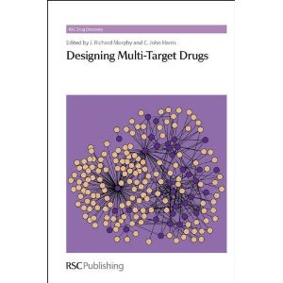
Two books in 2012 on MTDs

Slide 11
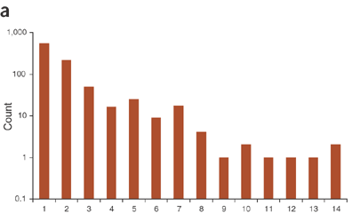
Existing Multi-Target Drugs
Many currently marketed drugs have a multi-target profile
The profile of most marketed multi-target drugs (MTDs) was discovered retrospectively and the relationship to efficacy and safety is unclear
Nature Biotech. 2007, 1119
number
of drugs
anti-psychotics
multikinase inhibitors
number of targets

Slide 12
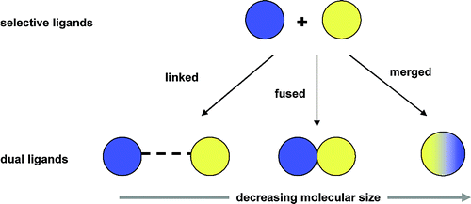

  Hit identification strategies
Framework combination is a design strategy in which two distinct pharmacophores are combined in the same structure to afford hybrid molecules.
Linked
Merged
Fused
decreasing molecular size
Morphy, R. K., C.; Rankovic, Z. Drug Discov. Today 2004, 9, 641-51.
Morphy, R.; Rankovic, Z. J. Med. Chem. 2005, 48, 6523-43.

Slide 13


Slide 14
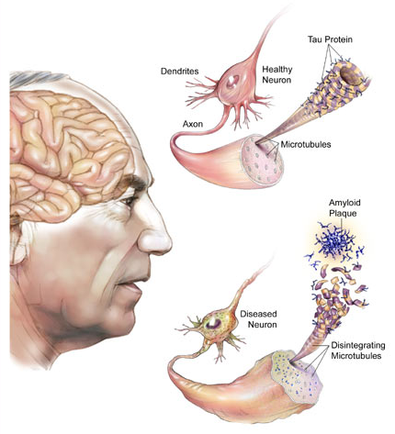
Pathological hallmarks of AD
In 1906, the firse case of AD was reported by Alois Alzheimer
Stelzmann et al., Clinical Anat 1995, 8, 429
Neurofibrillary
Tangles (NFTs)
Senile
Plaques
Intra-cellular
Hyper-phosphorylation
of τ protein
Extra-cellular
aggregation
of Aβ peptide
Amyloid hypothesis
Aβ generation is a key event in AD
[Karran et al., Nat Rev Drug Discov 2011 , 10, 698]
[Hardy & Selkoe, Science 2002, 297, 353]
[Mattson, Nature 2004, 430, 631]
[Esler & Wolfe, Science 2001, 293, 1449]

Slide 15
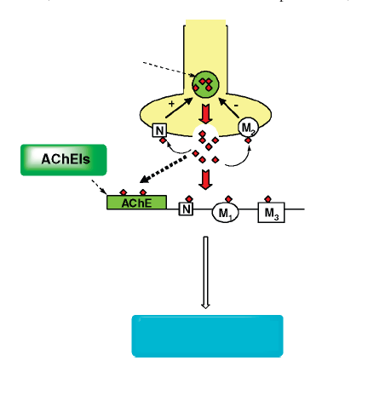
IPOTESI COLINERGICA
INCREMENTO TONO COLINERGICO
NEURONE PRESINAPTICO
ACh neuronale
Riduzione catabolismo ACh: INIBITORI ACETILCOLINESTERASI (AChEI)
Aumento rilascio ACh:
ANTAGONISTI MUSCARINICI M2 selettivi che agiscono sugli autorecettori presinaptici
Attivando direttamente i recettori nicotinici centrali o muscarinici postsinaptici:
AGONISTI N, AGONISTI M1
In Terapia
NEURONE POSTSINAPTICO
AUMENTO CAPACITÀ COGNITIVE

Slide 16
MTDs: development of MEMOQUIN
Caproctamine: AChE inhibitory activity
Coenzyme Q10:
antioxidant and antiaggregating activity
Memoquin
Cavalli et al., Angew Chem 46, 3689 (2007)
Bolognesi et al., J Med Chem 50, 4882 (2007)

Slide 17
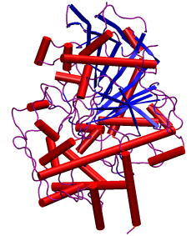
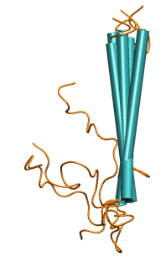
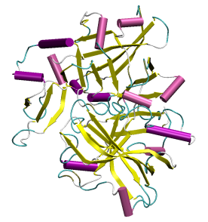
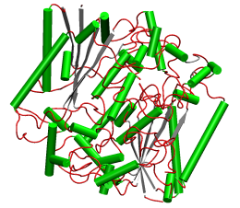
MEMOQUIN: AChE + Aβ formation/oligomerization + ROS inhibition
AChE: IC₅₀ = 1.55 nM
Aβ42 (self): IC₅₀ = 5.93 μM
Memoquin
BACE-1: IC₅₀ = 108 nM
NQO1: K_{m} = 12.7 μM
Bolognesi et al., J Med Chem 50, 4882 (2007)

Slide 18
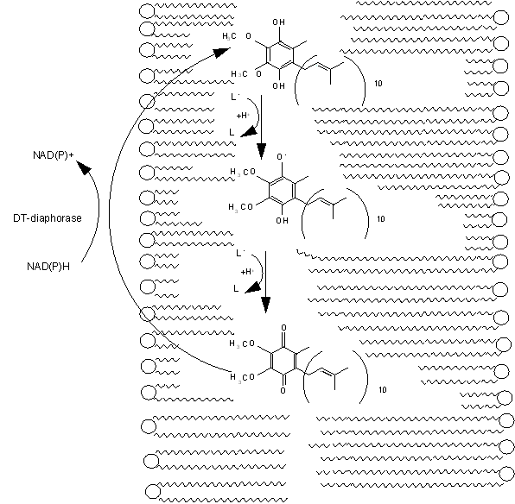
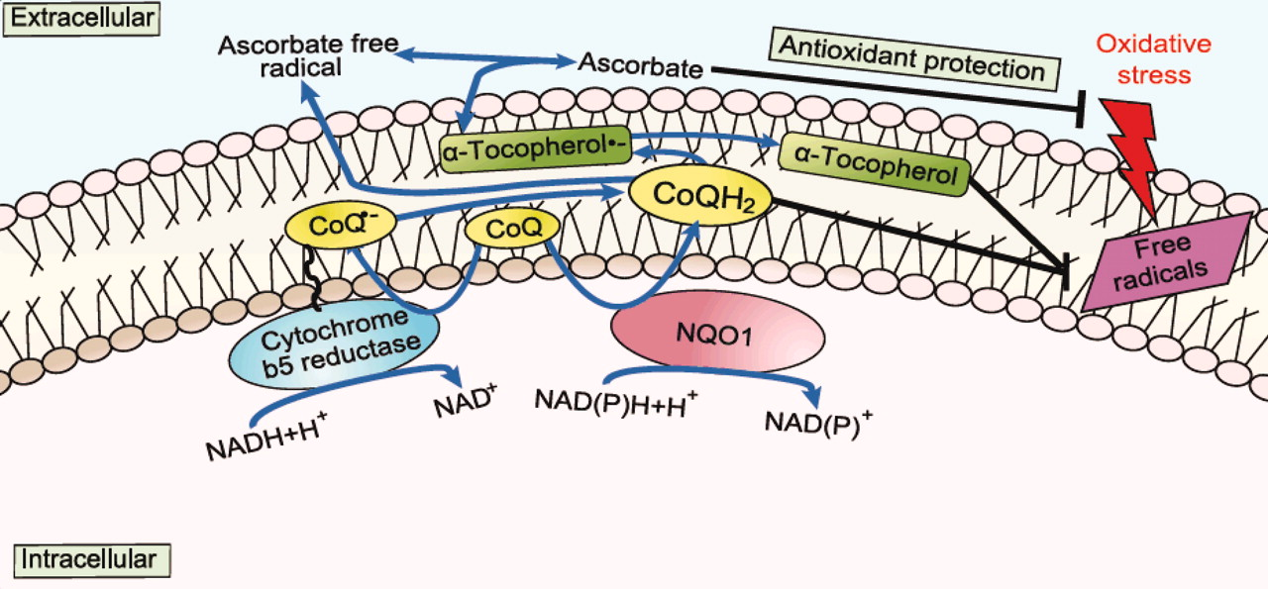
MEMOQUIN antioxidant activity is mediated by NQO1 (DT-diaphorase)
• NQO1 is overexpressed in AD patients
• NQO1 colocalizes with AD pathology
Bolognesi et al., Neurotherapeutics 6, 152 (2009)
Notes:
NAD(P)H:quinone oxidoreductase 1 (DT-diaphorase, NQO1) was shown to be responsible for the regeneration and maintenance of the CoQ-reduced state. This inducible enzyme, in fact, catalyzes the two-electron reduction of quinones to hydroquinones, bypassing production of semiquinones and thus providing a shunt that competes with the formation of reactive oxygen species (ROS). More interestingly, NQO1 is increased in AD
NAD(P)H:quinone oxidoreductase 1 (NQO1), a redox-regulated flavoenzyme, plays a central rolein monitoring cellular redox state. NQO1 acts to protect against oxidative stress induced by a variety of metabolic situations, including metabolism of quinones and other xenobiotics, by: (i)functioning as a two electron donor to provide a shunt that competes with the formation of reactive oxygen species; (ii) maintaining reduced coenzyme Q; and (iii) regulating the stress activated kinase pathway. In Alzheimer's disease, while there is abundant evidence for the involvement of oxidative stress, the cause or the consequences are largely unresolved. We suspected that increased NQO1 could signal a major shift in redox balance in Alzheimer's disease and, in this study, found that NQO1 is localized not only to neurofibrillary tangles but also the cytoplasm of hippocampal neurons. By marked contrast, there is very little NQO1 in the same neuronal populations in young and age-matched controls. This novel association of NQO1 further buttresses the nexus of oxidative stress, via free radicals, with selective neuronal vulnerability and also supports a fundamental abnormality in redox balance in Alzheimer's disease.
More interestingly, NQO1 is increased in AD37 as response to the shift of redox balance typical of the pathology.38 Therefore, we might speculate that, being specifically reduced by NQO1 into the corresponding hydroquinone, 2 may exert its antioxidant activity specifically in those brain regions affected by AD, where a co-localization of NQO1 activity with AD pathology has been experimentally verified.39

Slide 19


Slide 20

MTDs strategy: the Lead Optimisation Tightrope
Balanced activities
Off-target selectivity
Oral pharmacokinetics
Courtesy by Richar Morphy, UK.

Slide 21
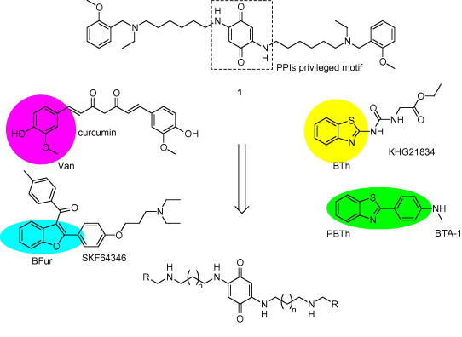

Slide 22
Anti-cholinesterase and antiamyloid profile in vitro
2: R = Van; n= 1
4: R = Bfur; n= 1
6: R = BTh; n= 1

Slide 23
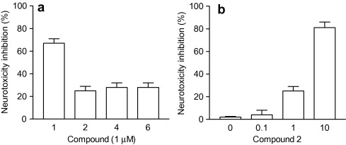
Proving the MTD profile in a cellular context

Slide 24
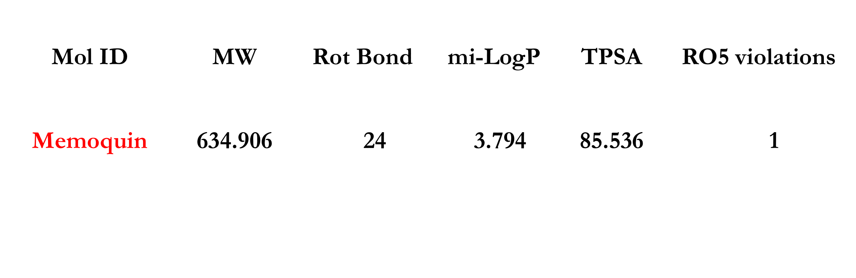

Looking for novel Memoquin derivatives with improved drug-like properties
THE POLAR SURFACE AREA (PSA) is defined as the surface sum over all polar atoms, primarily oxygen and nitrogen:
< 140 for optimal permeation
< 60 for BBB permeation
RULE OF SEVEN ROTATABLE BONDS: The bioavailability of a drug like molecule is related with it rotatable bond number. Less than seven rotatable bonds are essential for good bioavailablity. (GSK)
CNS drug rules: Compared with non CNS drugs, CNS drugs should have "fewer hydrogen bond donors, fewer positive charges, greater lipophilicity, lower polar surface area and reduced flexibility".-J. W. Polli (GSK)

Slide 25
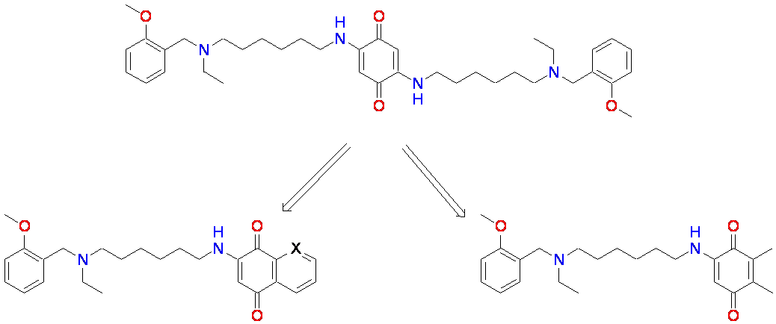
Back to monomeric compounds
memoquin
2: X = CH
3: X = N
4
Bolognesi et al., J Med Chem 54, 8299 (2011)

Slide 26
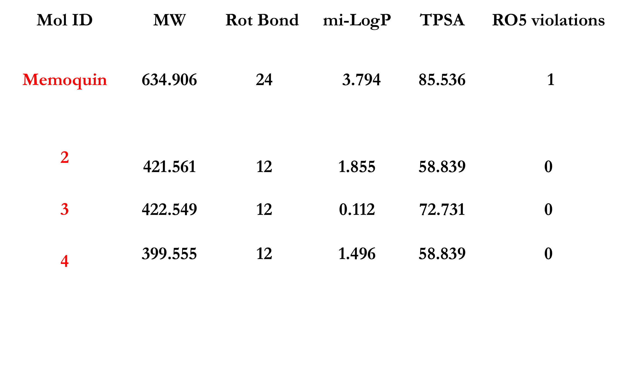
Novel Memoquin derivatives with no RO5 violation
Bolognesi et al., J Med Chem 54, 8299 (2011)
Notes:
MW, Molecular Weight; Rot bond, Rota table bonds; miLogP, molinspiration LogP; TPSA, Total Polar Surface Area and RO5 violations, Rule of Five violations
The number of Lipinski violations refers to the number of the Lipinski parameters that are out of range for a particular compound.

Slide 27
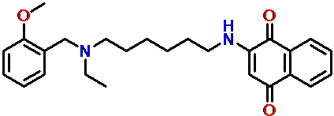
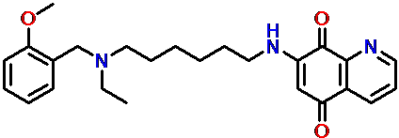
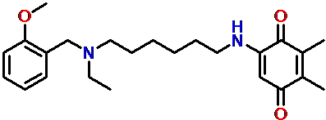
Biological profile of monomeric MTDs
 | IC₅₀ AChE (M) | IC₅₀ BChE (M) | % Inhibition Aβ-aggregatio | BACE1 (M)
2 | 9.73 ± 0.44 10⁻⁹ | 1.49 ± 0.10 10⁻⁶ | 27.3 at 10 μM | 2.84 10⁻⁶
3 | 2.79 ± 0.16 10⁻⁸ | 2.56 ± 0.17 10⁻⁶ | 15.4 ± 6.7 at 10 μM | n.d.
4 | 2.90 ± 0.40 10⁻⁸ | 3.14 ± 0.21 10⁻⁶ | 30.2 ± 1.4 at 10 μM | >4 10⁻⁶
memoquin | 1.55 ± 0.11 10⁻⁹ | 1.44 ± 0.10 10⁻⁶ | 66.8 ± 4.4 at 10 μM | 4.64 10⁻⁶
Bolognesi et al., J Med Chem 54, 8299 (2011)

Slide 28
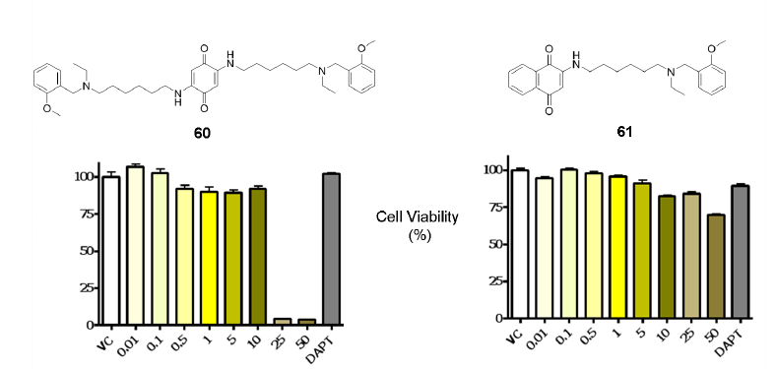
Neurotoxicity after 24 h of treatment in primary neurons
mmm
2
2 inhibited Aβ38, Aβ40, and Aβ42 secretion, with IC₅₀ values of 19, 21, and 46 μM, respectively
Bolognesi et al., J Med Chem 54, 8299 (2011)

Slide 29
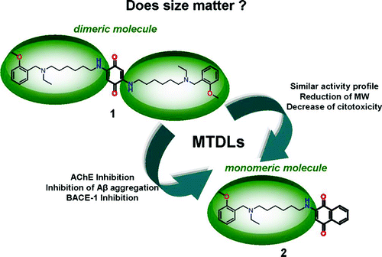
Two heads are better than one?
Bolognesi et al., J Med Chem 54, 8299 (2011)

Slide 30
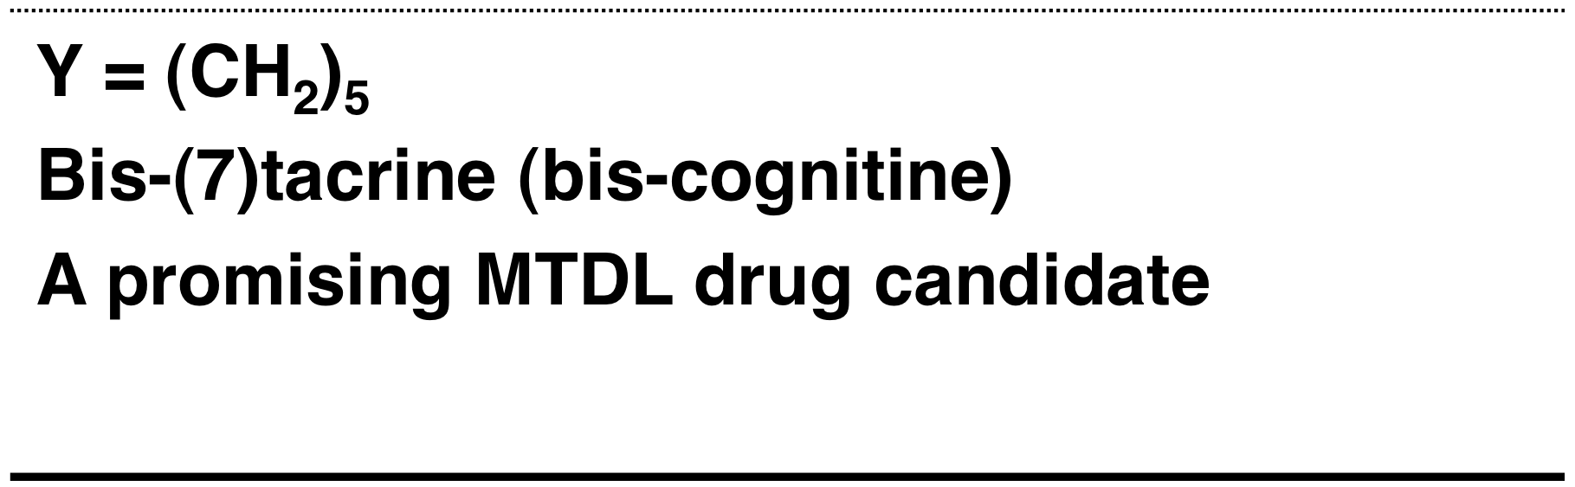
MTDs: Dimeric compounds⇨bis-tacrines
linker
Li, W. et al., Neurotherapeutics, 2009, 6, 187-201

Slide 31
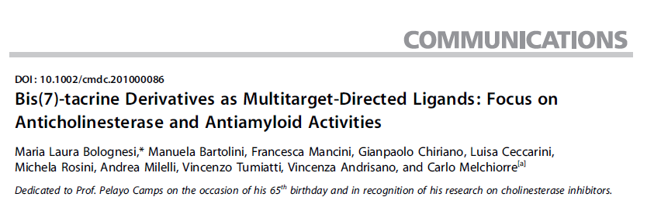
New tacrine-dimers as MTDs:
Bolognesi et al., ChemMedChem 5, 1215 (2010)

Slide 32
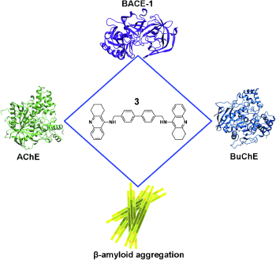
New tacrine-dimers as MTDLs
IC₅₀ = 2.77 nM
IC₅₀ = 3.61 nM
IC₅₀ = 0.86 nM
AChE-induced [62 %] at 100 μM
Self-aggregation [ 75 %] at 10 μM
Bolognesi et al., ChemMedChem 5, 1215 (2010)

Slide 33
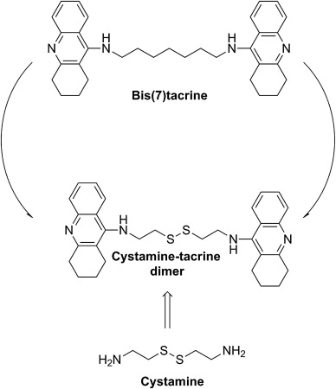
New tacrine-dimers as MTDs:
ChemMedChem 2010, 5, 1215 – 1220

Slide 34
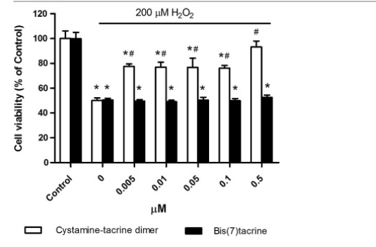
Cytoprotective Effects of cystamine-tacrine dimer and bis(7)tacrine
Against H₂O₂-Induced cell Death

Slide 35
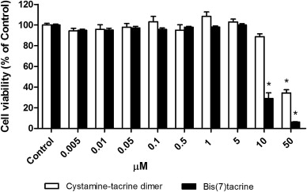
Effects of cystamine-tacrine dimer and bis(7)tacrine on SH-SY5Y cell viability
Notes:
Funziona meglio anche contro gli stress ossidativi per la presenza del ponte disolfuro

Slide 36
3

Slide 37
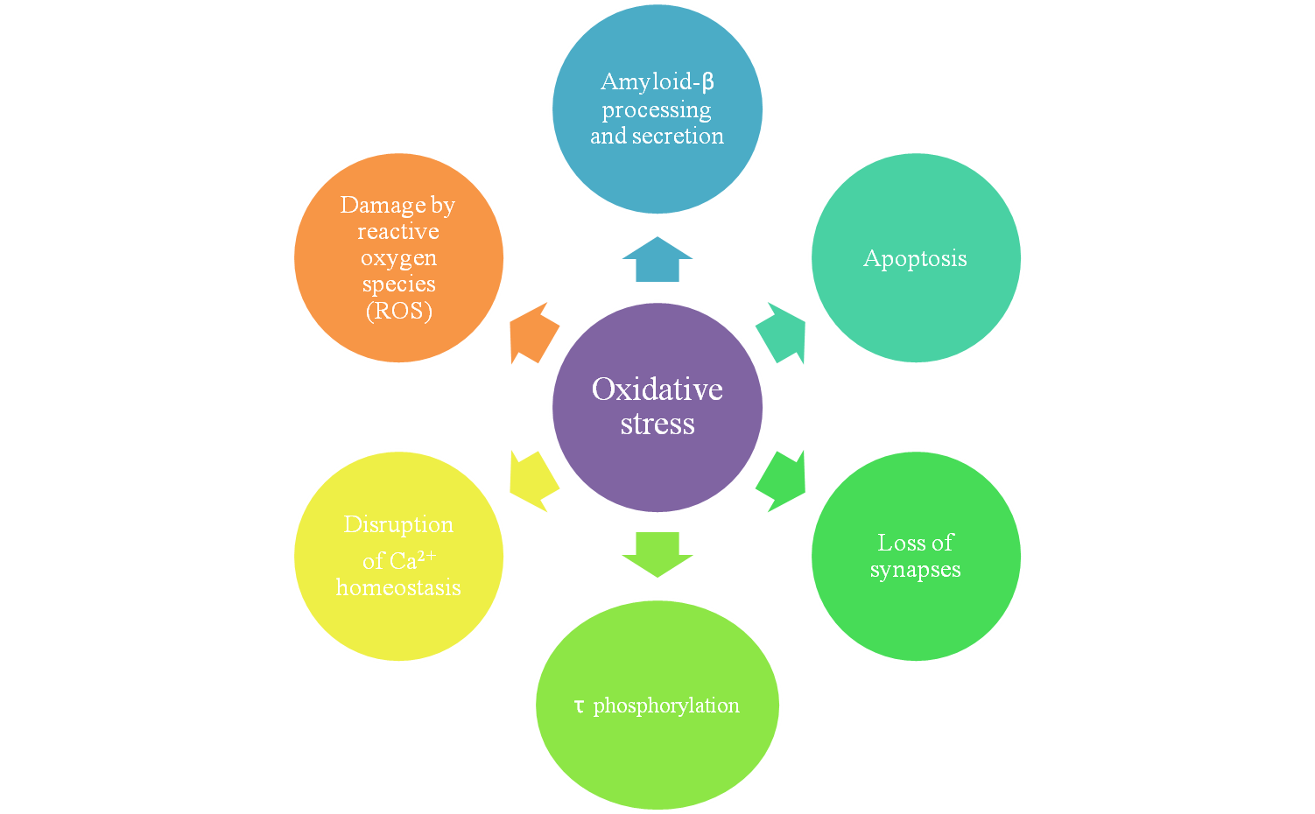
Oxidative stress: a major culprit in Alzheimer’s disease?
Praticò D. et al., Tips, 29, 609 (2008)

Slide 38
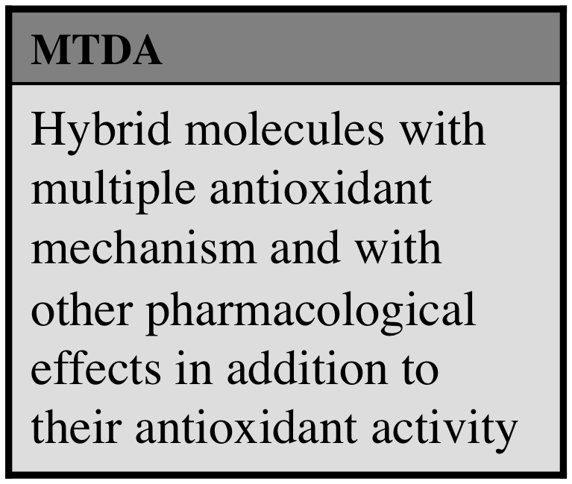
Multitarget-directed Antioxidants (MTDA) Design Strategy: starting point
disappointing results of
clinical trials of antioxidants
single antioxidants maybe not be adequated
combinations of antioxidants
Multitarget-directed Antioxidants (MTDA)

Slide 39
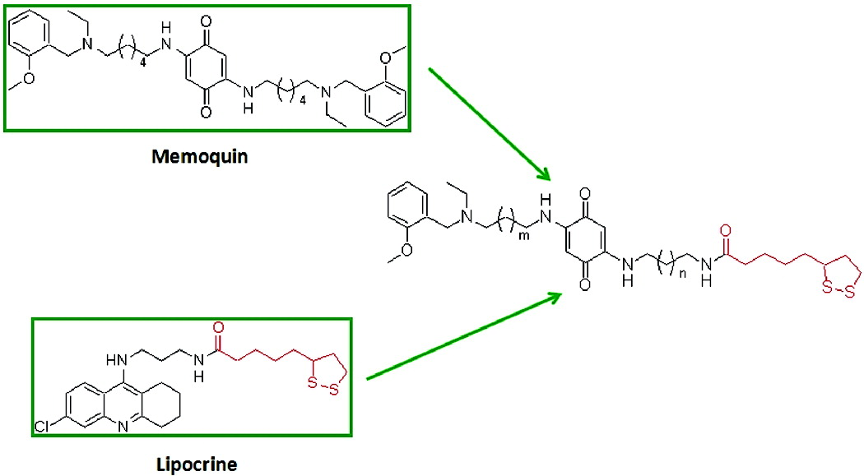
Multi-target antioxidant: development of memoquin-lipocrine hybrids
(1)
3: m = 4, n = 4
4: m = 4, n = 1
5: m = 1, n = 4
6: m = 1, n = 1
(2)
Bolognesi et al., J Med Chem 52, 7883 (2009)
Notes:
merging the antioxidant features of 1 and 2 in a single chemical entity could, hopefully, lead to ligands (3−6) with multiple antioxidant mechanisms, hence a better potential for AD prevention and therapy. These hybrid molecules can be defined as multifunctional antioxidants, i.e., MTDLs with other pharmacological effects in addition to their antioxidant activity. Since LA(14) and CoQ(15) have shown antiaggregating properties, the new compounds 3−6 may also have intrinsic antiamyloidogenic capacities. Finally, since LA reduces CoQ to ubiquinol (the actual antioxidant form) by the transfer of a pair of electrons,(16) they should in principle possess a more effective antioxidant profile in vivo.

Slide 40
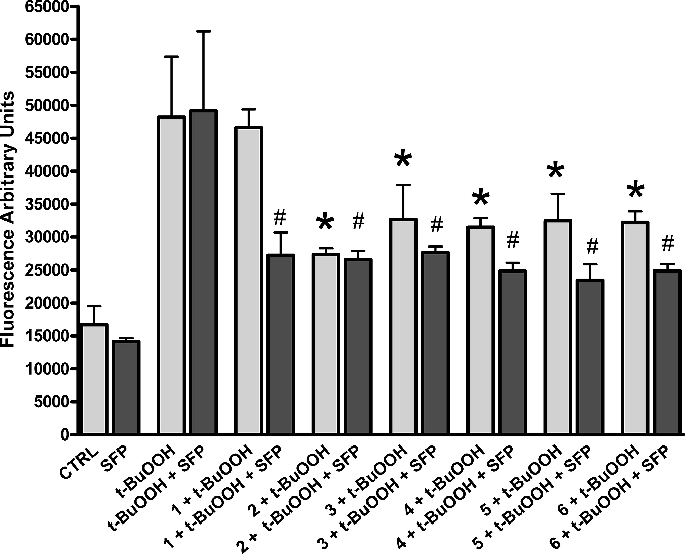
Effect on ROS formation in T67 cells:
Bolognesi et al., J Med Chem 52, 7883 (2009)

Slide 41

3 versus Lipocrine and Memoquin
Lipocrine
3
Memoquin
Inhibition of
Aβ aggregation
Antioxidant
activity
Bolognesi et al., J Med Chem 52, 7883 (2009)

Slide 42
4

Slide 43
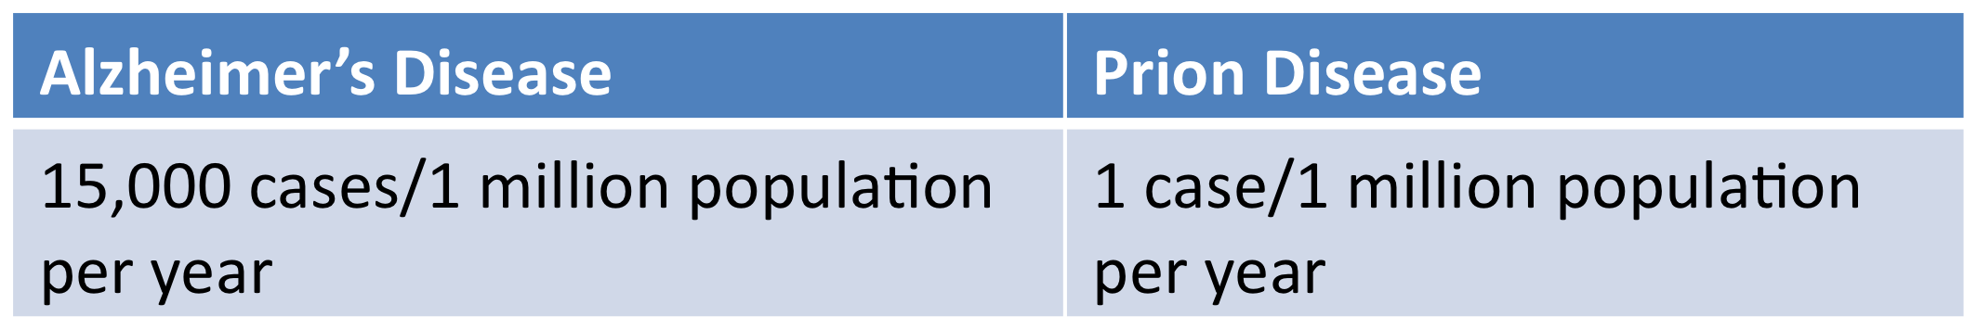


Prion and Alzheimer’s diseases are neurodegenerative pathologies with some differences:
Incidence
Transmissibility
Infectivity
43

Slide 44
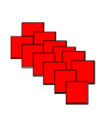
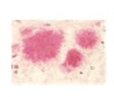
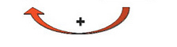
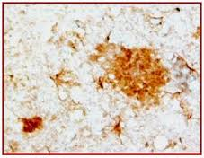
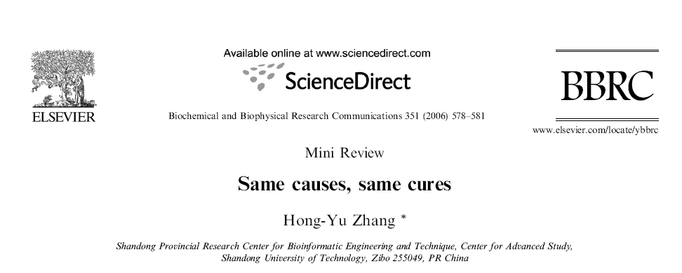
….. and many similarities
PrP^{C}
PrP^{C}
Prion
rods
Prion plaques
Aβ
Aβ
Aβ
fibrils
Senile
plaques
44
44

Slide 45
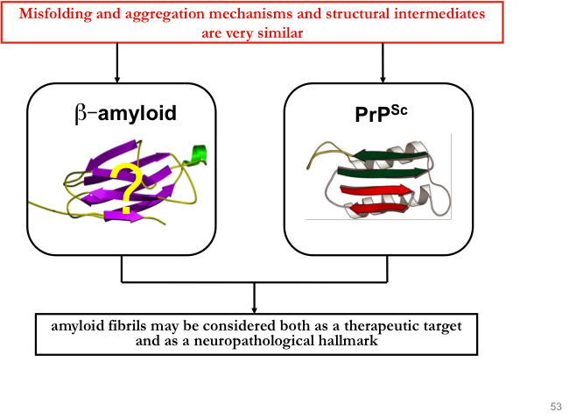
45
45
Notes:
Building on the hypothesis that
The mostr remarkable convergence of AD and PrP
It is now clear that these devastating transmissible spongiform encephalopathies (TSEs) are all due to misfolding of one specific protein: mammalian prion protein (PrP) (Prusiner, 1998), a glycosylphosphatidylinositol (GPI)-anchored plasma membrane protein of uncertain function
Many neurodegenerative diseases are associated with the accumulation of fibrillar proteins. The unifying features of a fibril formation is the structural transition from an initial globular or intrinsically disordered state to a β-structural form.
Protein misfolding is a common hallmark of several neurodegenerative disorders including Alzheimer's disease, Parkinson's disease, amyotrophic lateral sclerosis (ALS), as well as Prion-related disorders (PrDs), among other pathologies [1]. Although in many diseases, the molecular events underlying neurodegeneration has been elucidated, there is an urgent need for the identification of reliable biomarkers for early diagnosis and to follow disease progression in clinical trials. PrDs are the classic example of a protein misfolding disorder where alterations in the structure of the prion protein (PrP) lead to progressive degeneration

Slide 46
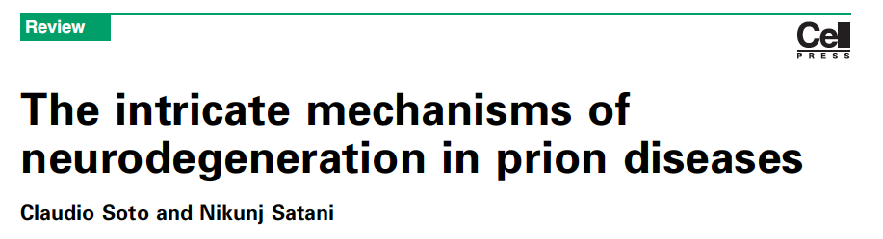
A multifactorial prion disease pathogenesis?
a complex array of processes that operate simultaneously and synergistically
PrP^{C_}PrP^{Sc} interaction
Lipid and protein oxidation
Decreased level of potent freeradical scavengers
Imbalance of metal ions
Oxidative Stress
Oligomeric species and amyloid fibrils
Klamt F. et al. Free Radic. Biol. Med. 2001, 30, 1137-44.
Milhavet O. et al. Proc. Natl. Acad. Sci. U S A 2000, 97, 13937-42.
Pamplona R. et al. Free Radic. Biol. Med. 2008, 45, 1159-66.
Singh N. et al. Antioxid. Redox Signal. 2010, 12, 1271-94
Lehmann S. Curr. Opin. Chem. Biol. 2002, 6, 187–192
Novitskaya V. et al. J. Biol. Chem. 2006, 281, 13828-26
46
46

Slide 47
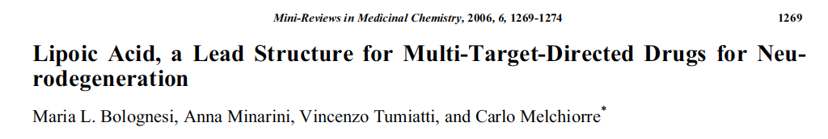
DEVELOPMENT OF HYBRID LIPOIC ACID DERIVATIVES AGAINST PRION DISEASES
WHY LIPOIC ACID?
It was administered to a patient affected by prion disesases showing moderate therapeutic effects Drisko, J. J. Am. Coll. Nutr. 2002, 21, 22-5.
is an endogenous antioxidant;
it is well tolerated in vivo;
it is chemically linkable to amine groups
17
12: n=2
13: n=1
14: n=2
15: n=1
16
Lipocrine
Rosini et al. J. Med. Chem. 2005
47
S. Bongarzone,* H. N. Ai Tran,* A. Cavall, M. Roberti, M. Rosini, P. Carloni, G. Legname, M. L. Bolognesi ChemMedChem 2011, 6, 601
* These authors contributed equally to this work

Slide 48
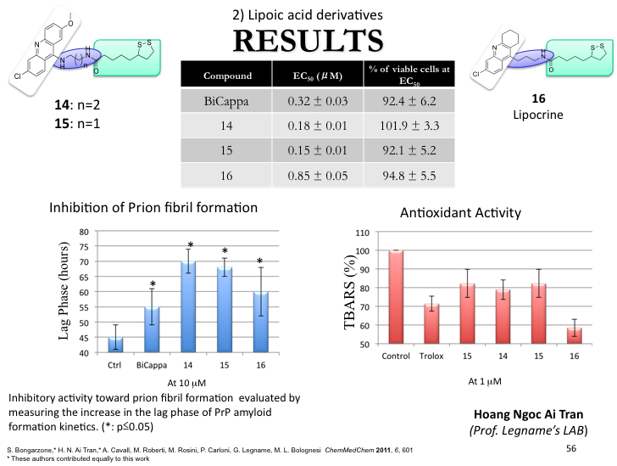
48

