Slide 1
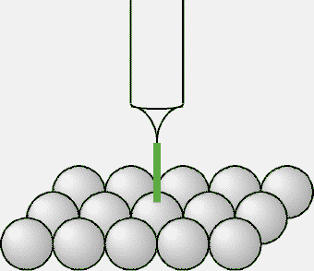
Microscopia a scansione ad effetto tunnel
COS’È?
Punta
CORRENTE
Se sulla superficie ci sono delle asperità anche piccolissime la corrente di tunneling cambia intensità

Slide 2
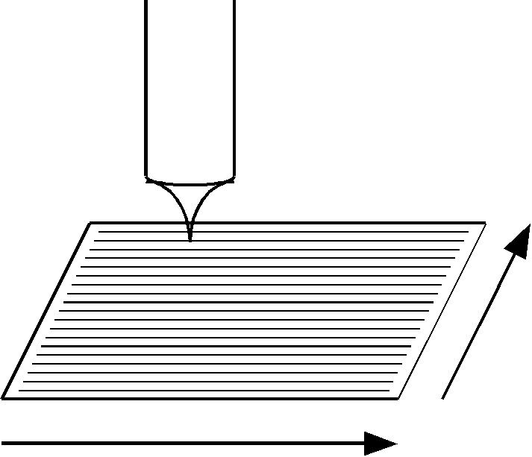
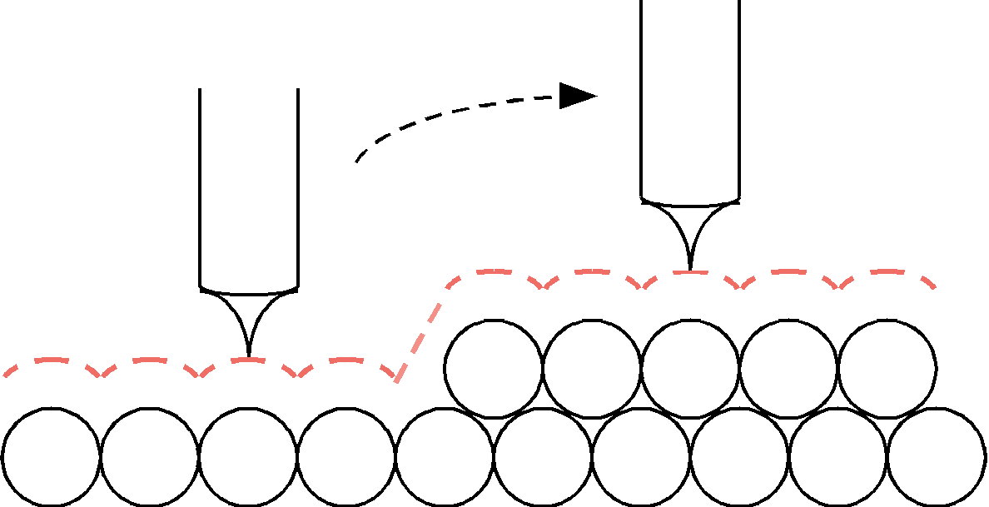
COME SI USA?
Percorso seguito dalla punta

Slide 3
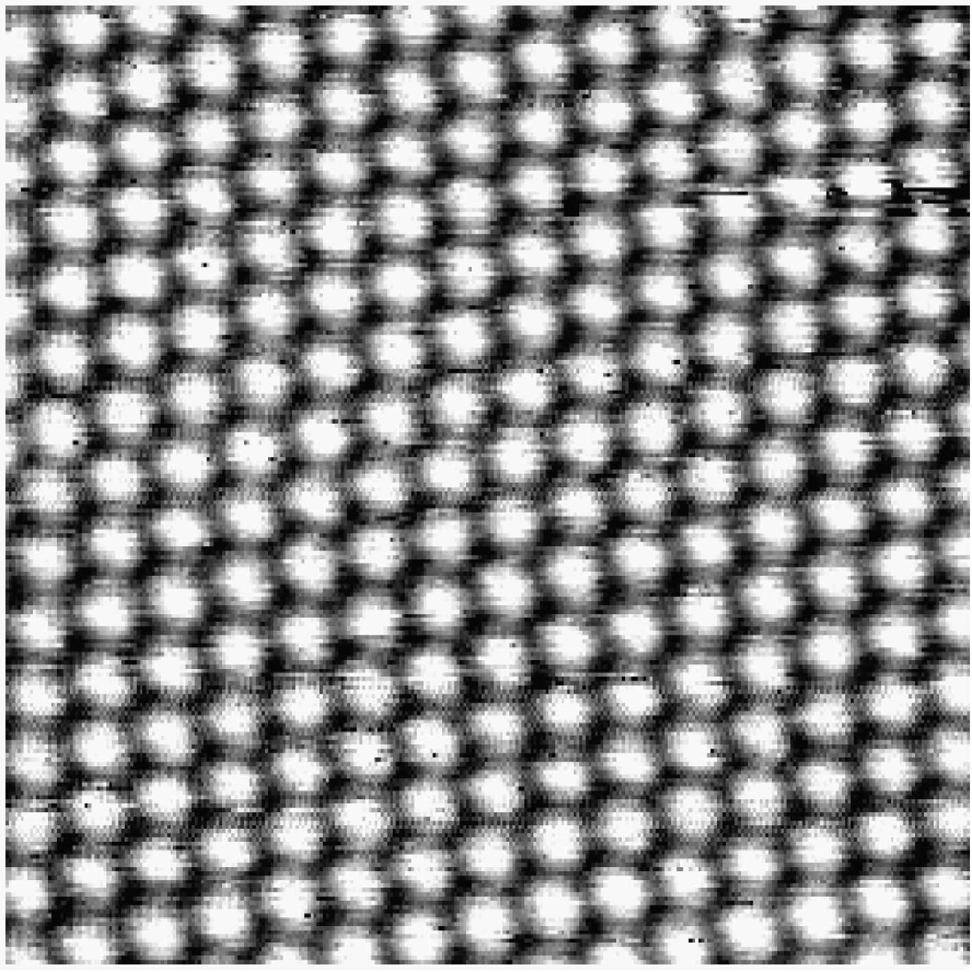
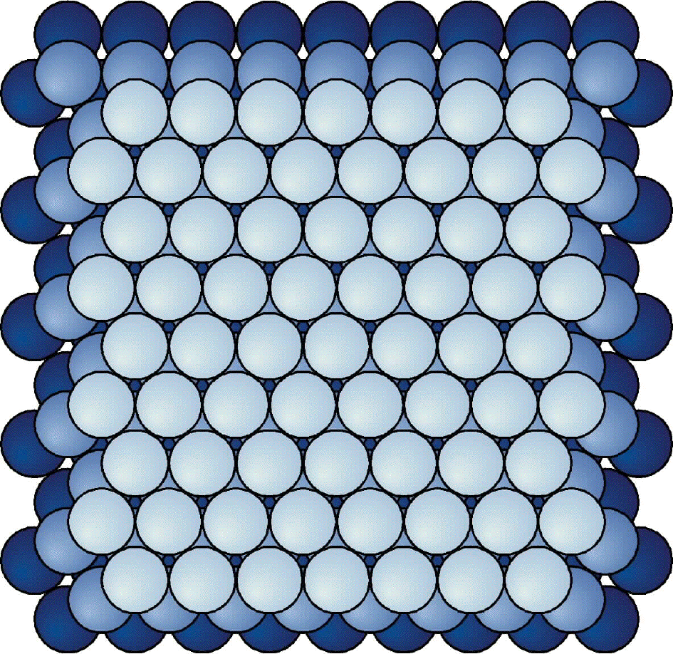
COSA VEDO?
Superficie (111) di Pt

Slide 4
STM: Scanning Tunneling Microscopy
Developed by Binning and Rohrer at the IBM Zürich research laboratory in the early 1982 (Noble Prize in 1986)
Based on a new concept:
To examine a surface at very close range (near field) with a scanning probe, the position of which can be perfectly controlled in three dimensions to within ± 0.1 nm. The signal generated on each point by the interaction between the probe and the surface atoms is translated electronically into an image of the surface.
Technique for “topografical” investigation of surfaces

Slide 5
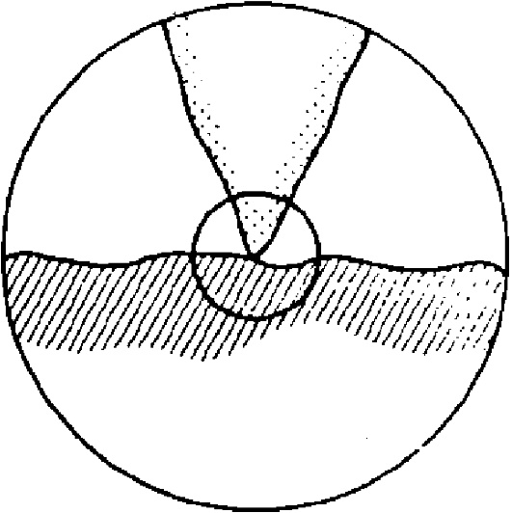
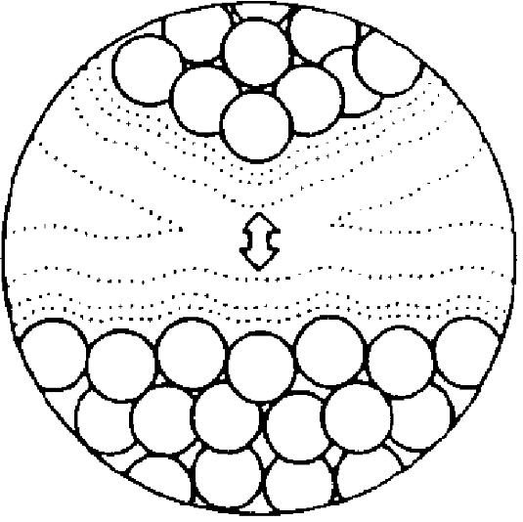
Principle of the technique
“The principle of STM in straightforward. It consists essentially in scanning a metal tip over the surface at constant tunnel current. The displacements of the metal tip given by the voltage applied to the piezodrives then yield a topographic picture of the surface. The very high resolution of STM rests on the strong dependence of the tunnel current on the distance between the two electrodes, i.e., the metal tip and the scanned surface.”
G. Binning et al. Phys. Rev. Lett. 49 (1), 57-61 (1982)
Tip
Tunnel
Current
<1nm
Surface

Slide 6
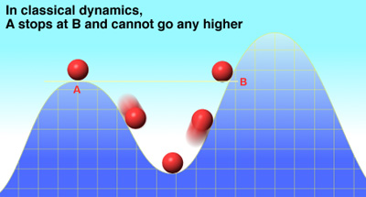
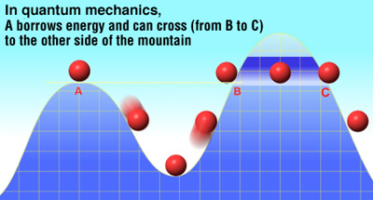
Tunnel effect
In classical physics, an electron cannot penetrate into or across a potential barrier if its energy E is smaller than the potential φ within the barrier.
The quantum mechanics treatment predicts that an electron have a finite probability to exist behind the potential barrier.
This is called TUNNEL EFFECT

Slide 7
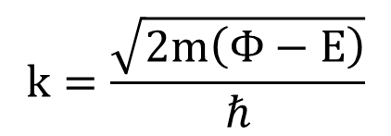

Theoretical basis of tunnel effect
A quantum mechanic treatment predicts an exponential decaying solution for the electron wave function in the barrier. For a rectangular barrier of width d:
$$k=\frac{\sqrt{2m\left(Φ−E\right)}}{ℏ}$$
$$Ψ_{(d)}=Ψ_{(0)}e^{−kd}$$
where

Slide 8


Theoretical basis of tunnel effect
A quantum mechanic treatment predicts an exponential decaying solution for the electron wave function in the barrier. For a rectangular barrier of width d:
$$k=\frac{\sqrt{2m\left(Φ−E\right)}}{ℏ}$$
$$Ψ_{(d)}=Ψ_{(0)}e^{−kd}$$
where
The probability of finding an electron behind the barrier of the width d is:
$${W_{(d)}=\left|Ψ_{(d)}\right|}^{2}={\left|Ψ_{(0)}\right|}^{2}e^{−2kd}$$
When a little bias potenzial V is applied between 2 electrodes (sample and tip, in this case), the tunneling of electrons results in a tunneling current I.
The tunneling current is proportional to propability of electrons to tunnel through the barrier:
$$I∝{\left|Ψ_{(0)}\right|}^{2}e^{−2kd}$$
It is necessary that the tip is very close to the surface to have a measureable current!

Slide 9
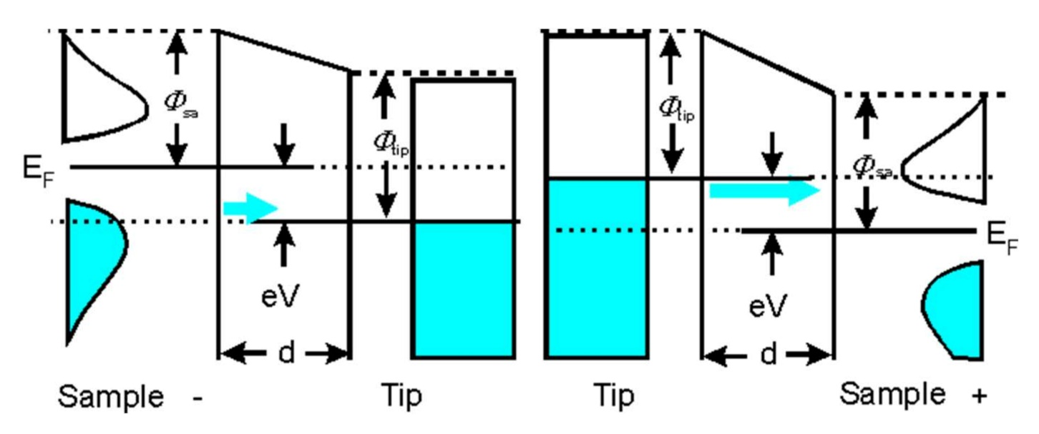
Theoretical basis of tunnel effect – Bardeen Approach
The current is given by a combination of the local densities of states of the sample and the tip.
In case of a negative potential on the sample the occupied states generate the current, whereas in case of a positive bias the unoccupied states of the sample are of importance. It should finally be mentioned that the probability of tunneling is larger for electrons which are close to the fermi edge due to the lower barrier.

Slide 10
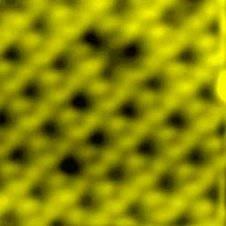
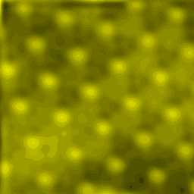
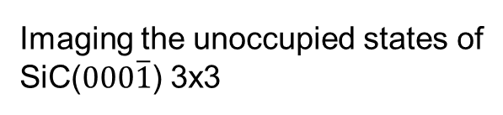
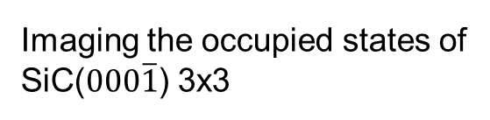
Theoretical basis of tunnel effect – Bardeen Approach
Examples:
Imaging the occupied states of
SiC($000\overline{1}$) 3x3
Imaging the unoccupied states of
SiC($000\overline{1}$) 3x3

Slide 11
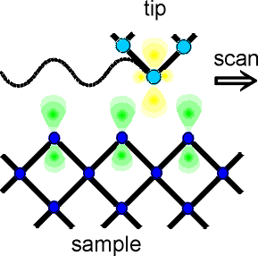
Lateral resolution
It is possible to obtain ATOMIC RESOLUTION of the surfaces investigated.
Calculations and experiments showed that there is often a d_{z}² like state near the Fermi edge present at the apex atom which also predominantely contributes to the tunneling current. It is understood that this state (and also the p_{z} like state) is advantageous for a «sharp» tip.

Slide 12
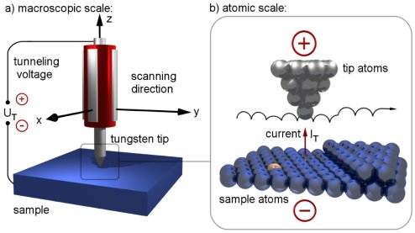
Schematic rappresentation of an STM apparatus

Slide 13
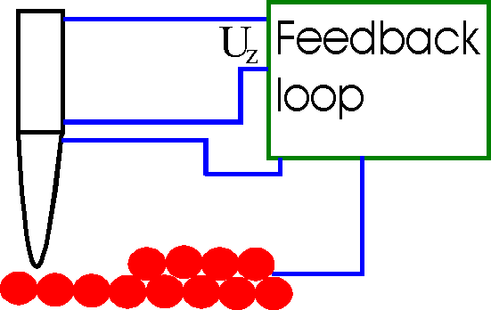
Modes of operation
1. Constant Current Mode
By using a feedback loop the tip is vertically adjusted in such a way that the current always stays constant.
A kind of a topographic image of the surface is generated by recording the vertical position of the tip.

Slide 14
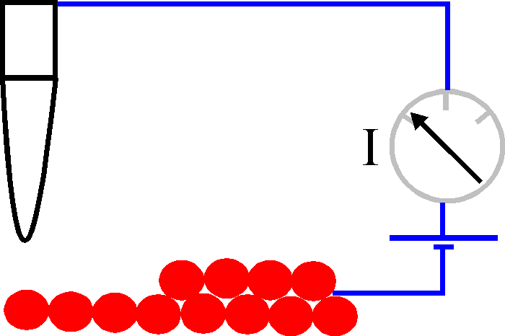
Modes of operation
1. Constant Current Mode
By using a feedback loop the tip is vertically adjusted in such a way that the current always stays constant.
A kind of a topographic image of the surface is generated by recording the vertical position of the tip.
2. Constant Height Mode
In this mode the vertical position of the tip is not changed. The current as a function of lateral position represents the surface image. This mode is only appropriate for atomically flat surfaces as otherwise a tip crash would be inevitable.

Slide 15
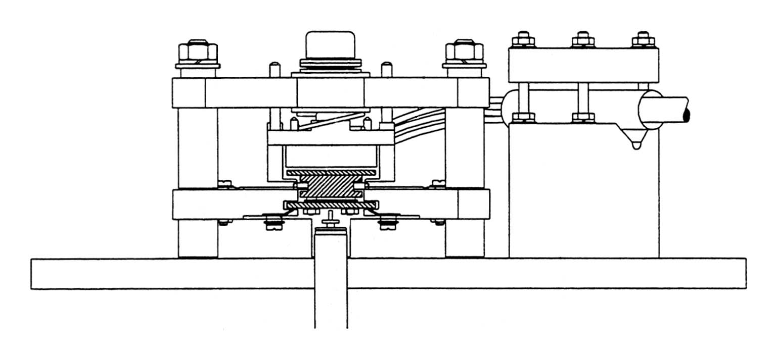
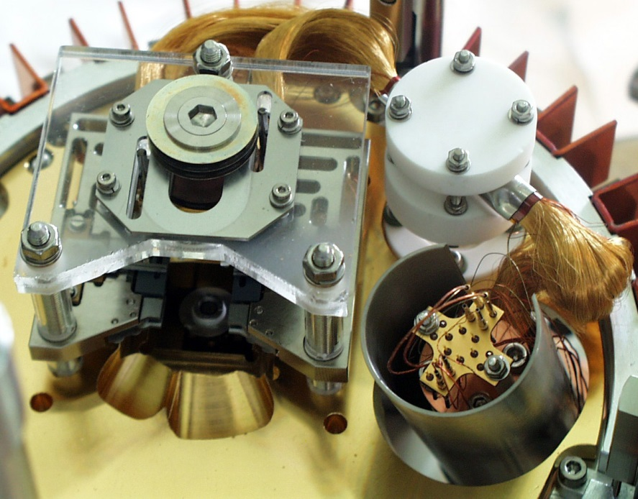
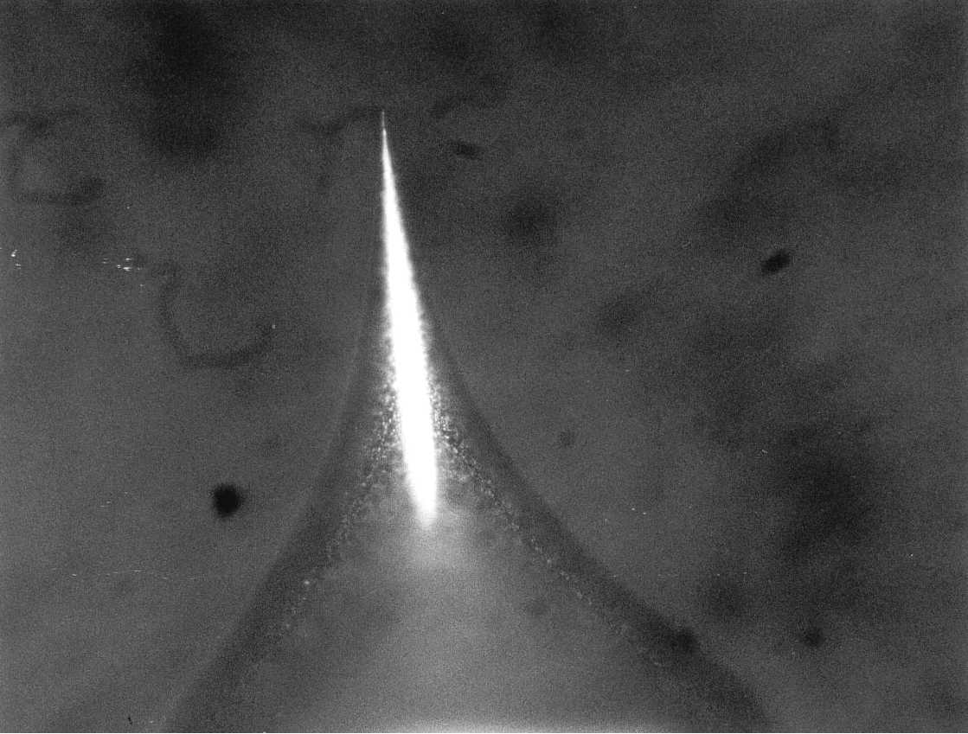
COME È FATTO LO STRUMENTO?
0.38 mm

Slide 16
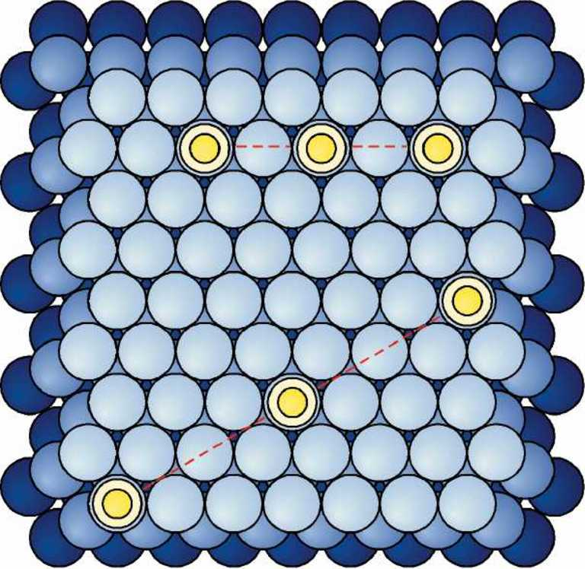
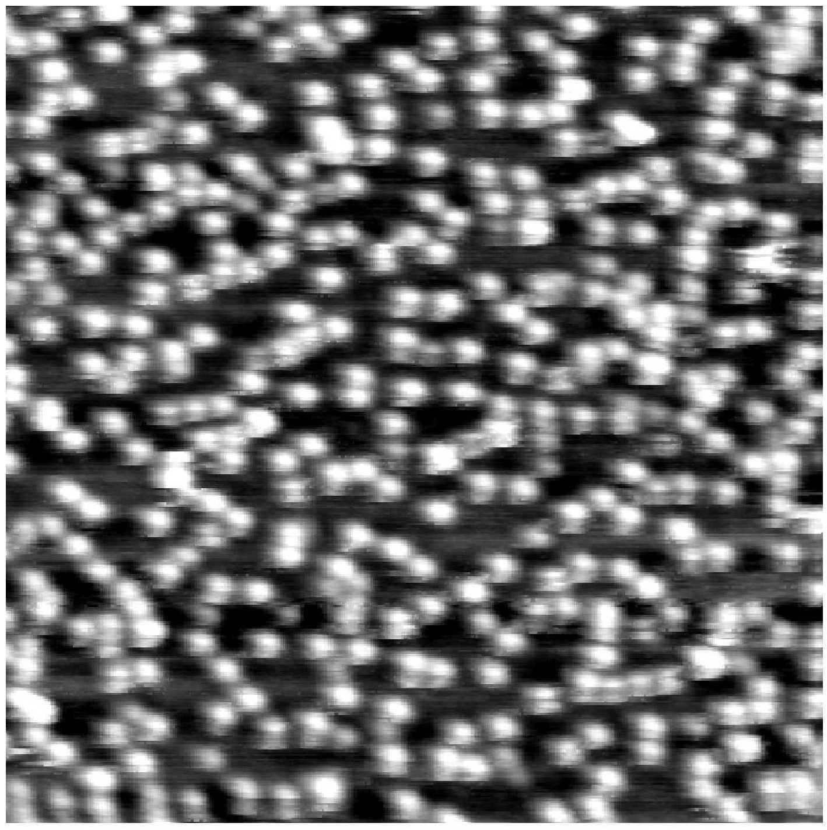
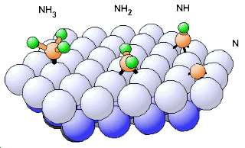
Molecole di NH₃ su una superficie Pt (111)

Slide 17
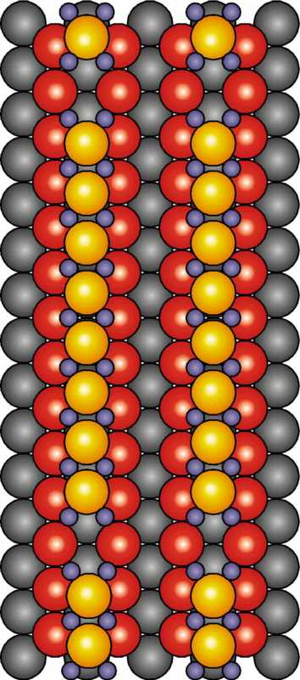
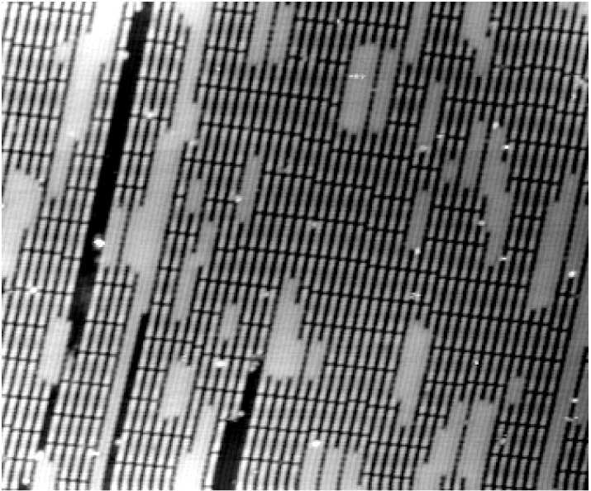
Applicazioni alla catalisi
Struttura intermedia nella formazione di un ossido sul rodio
40×30 nm²
3.0 Å invece di 2.7 Å
Altezza
53×53 Å²
Distanza lungo il profilo
Rh (110) saturata con O

Slide 18
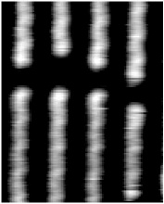
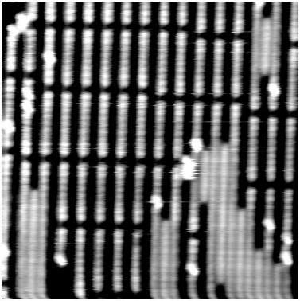
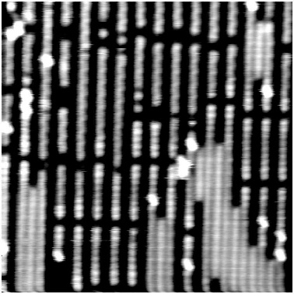
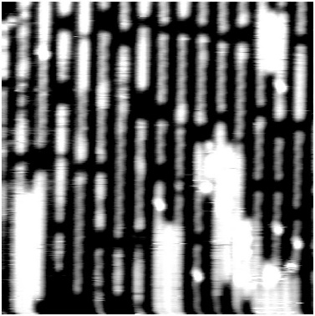
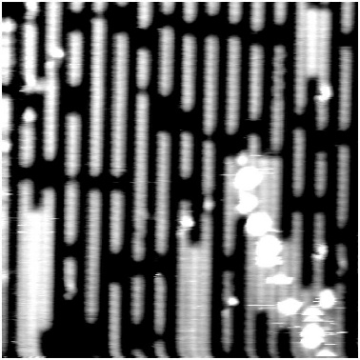
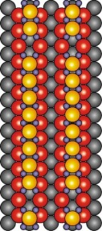
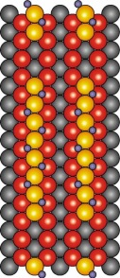
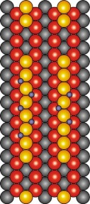
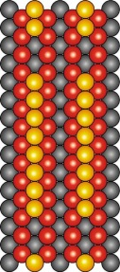
L’STM COME UNA VIDEOCAMERA
Catalizzatore di rodio ricoperto di ossigeno esposto ad idrogeno
15×15 nm²
Superficie iniziale
I step: l’onda
II step: la reazione continua
Superficie pulita
1 min
3 min
11 min
Un’onda chimica spazza il catalizzatore
Rh (110) saturata con O

Slide 19
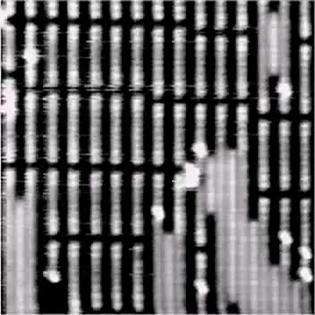
Rh (110) saturata con O

Slide 20
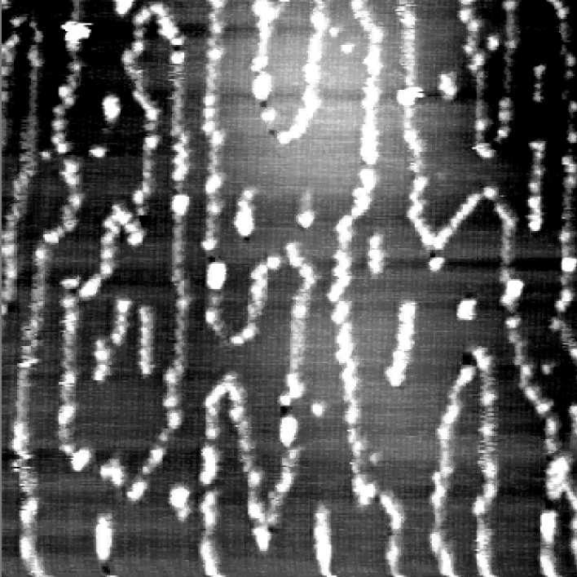
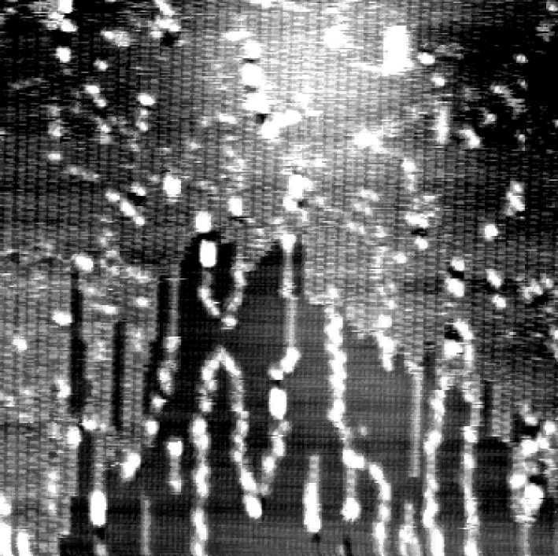
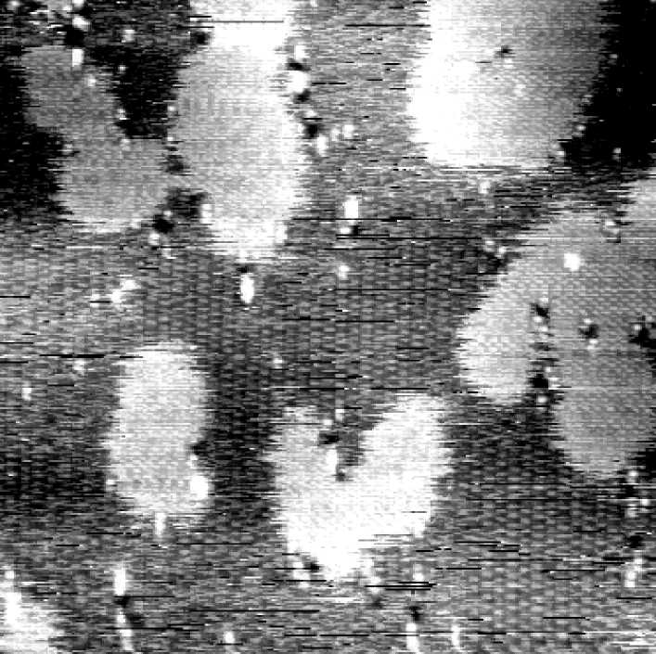
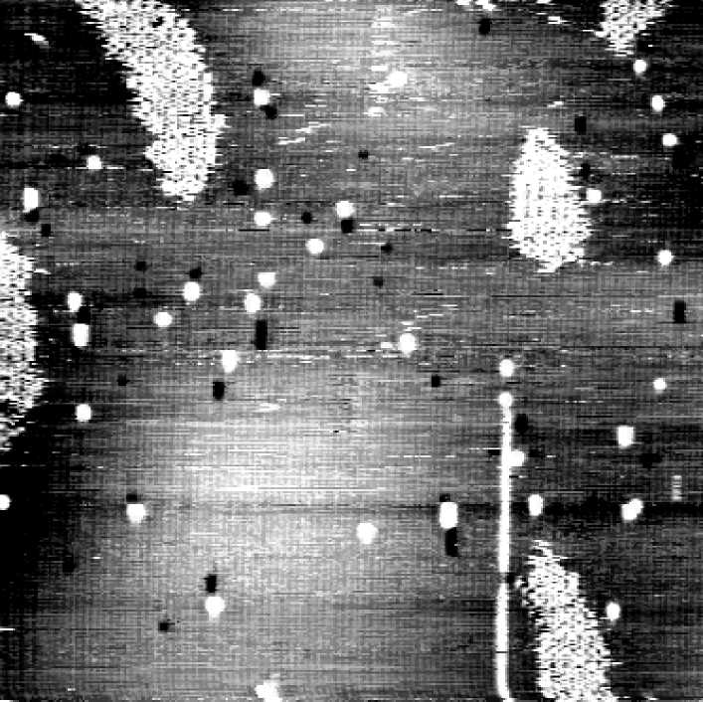
50×50 nm²
Superficie iniziale
Coppie di ossigeni
Specie intermedia
Fase finale
1 min
3 min
7 min
Si formano dei prodotti intermedi

Slide 21
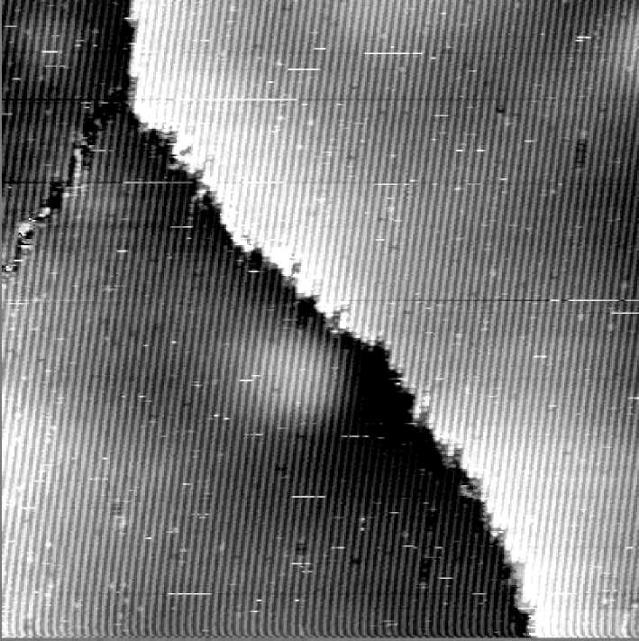
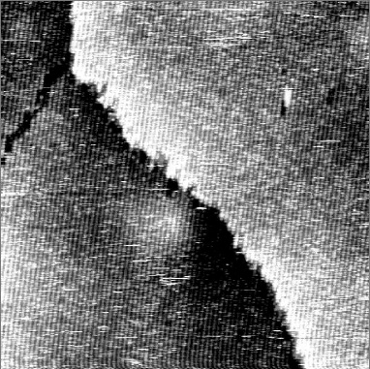
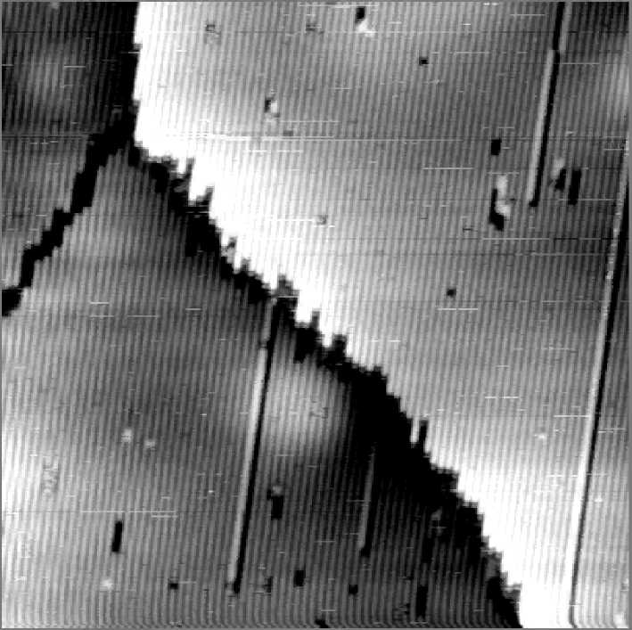
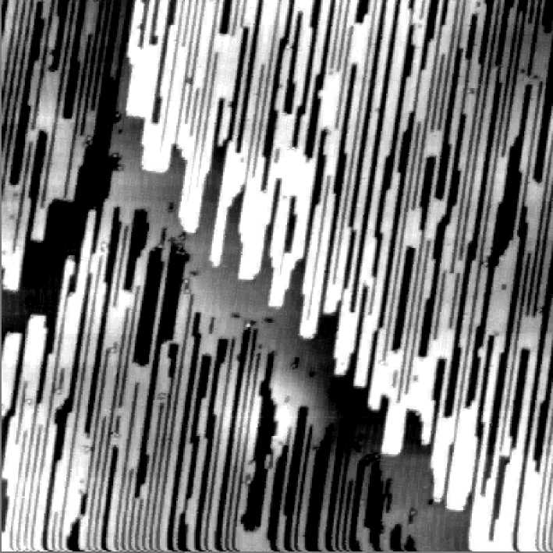
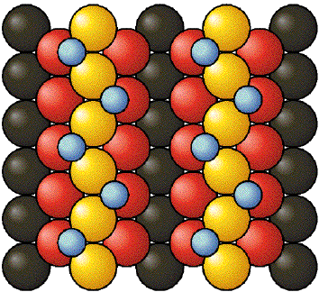
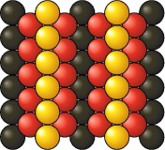
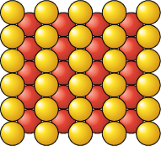
60×60 nm²
Superficie iniziale
Reazione
Superficie pulita
Superficie finale
4 min
10 min
2h 39 min
Gli atomi di superficie si riarrangiano

Slide 22
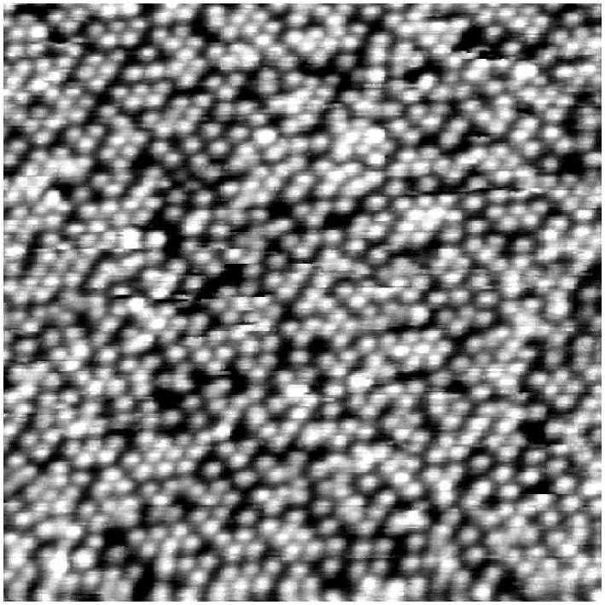
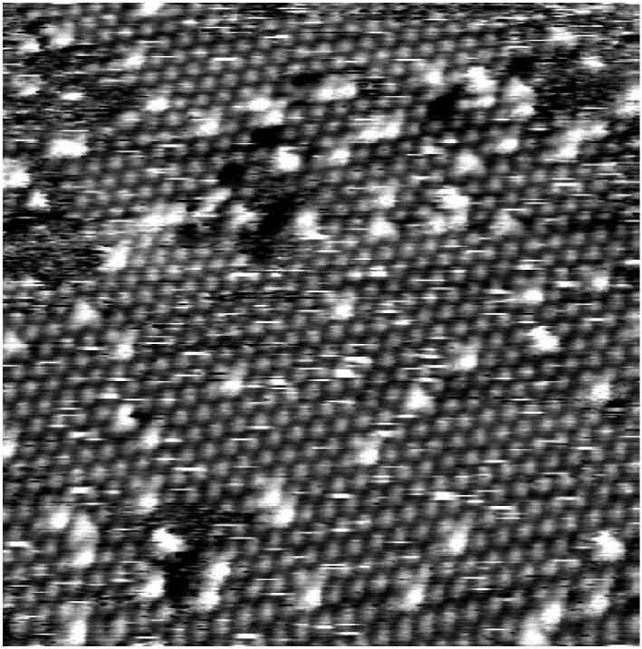






L’STM PER MISURE STATICHE
Ammoniaca (NH₃) + monossido di azoto (NO) sul platino (Pt)
NH₃
NO
NH₃ + NO

Slide 23

Example: CeO₂ (111)
Crystal of CeO₂ provided by Commercial Crystal Inc., grown with (111) orientation
Surface of the crystal
Terraces
Flat
Large enough for topographical study of the surface
200nm x 200nm

Slide 24






Slide 25


Example: CeO₂ (111)
Cleaned surface
10nm x 5 nm
M.A. Henderson et al.
Surface Science 526 (1-2), 1-18 (2003)
The main contribution to the STM image contrast originates from the oxygen 2p states.
H. Nöremberg et al. Physical Review Letters 79 (21), 4222-4225 (1997)

Slide 26

Example: CeO₂ (111)
After cleaning:
sputtering with Ar⁺ + annealing in O₂ up to 1000°C
20nm x 20nm

Slide 27

Example: CeO₂ (111)
After 3h H₂ 1x10⁻⁸ mbar 400°C
Single vacancy
Line
defect
20nm x 20nm

Slide 28

Example: CeO₂ (111)
After 3h H₂ 1x10⁻⁸ mbar 400°C
Oxygen atoms around the vacancies are brighter.
Oxygen vacancies corrisponds to a Ce^{III} in the first sub-layer.
For the explanation of the enhanced brightness of oxygen atoms one has to consider the possibility of a small charge transfer from vacancies to these oxygen atoms.
20nm x 20nm

Slide 29

Difetti superficiali su CeO₂ (111)
Annealing a 900°C
1 min
5 min
F. Esch, S. Fabris, L. Zhou, T. Montini, C. Africh, P. Fornasiero, G. Comelli, R. Rosei Science 309 (2005), 752

Slide 30

Difetti singoli su CeO₂ (111)
F. Esch, S. Fabris, L. Zhou, T. Montini, C. Africh, P. Fornasiero, G. Comelli, R. Rosei Science 309 (2005), 752

Slide 31

Difetti multipli sotto superficiali su CeO₂ (111)
Difetti superficiali di CeO₂:
Siti di attivazione di piccole molecole
Stabilizzazione di cluster di Au attraverso interazione con difetti superficiali / sotto superficiali
F. Esch, S. Fabris, L. Zhou, T. Montini, C. Africh, P. Fornasiero, G. Comelli, R. Rosei Science 309 (2005), 752

