Slide 1
Catalysts Deactivation
Loss of activity with time on stream
Poisoning
Pore blocking / Fouling
Sintering
Phase Transformation

Slide 2
1. Poisoning
Loss of activity due to the strong chemisorption on the active sites of impurities present in the feed stream
Geometric effect: blocking an active site
Electronic effect: alter the adsorptivity of other species
Chemical effect: alter the chemical nature of the active site
Reconstruction: formation of new compounds

Slide 3
1. Poisoning
Reversible: not too strongly adsorbed
Irreversible: irreversible damages
Selective: contribution of the characteristics of the active site
Non-Selective: poison occurs in a uniform manner
Affected
Selectivity
Not Affected (Selective Poisoning)

Slide 4
1b. Preventing Poisoning
Best method:
Decrease to acceptable levels the poison
content in the feed stream
HDS + H₂S absorption
Methanation of CO_{x} in NH₃ synthesis
Another approch:
Choose proper catalyst formulation and design

Slide 5
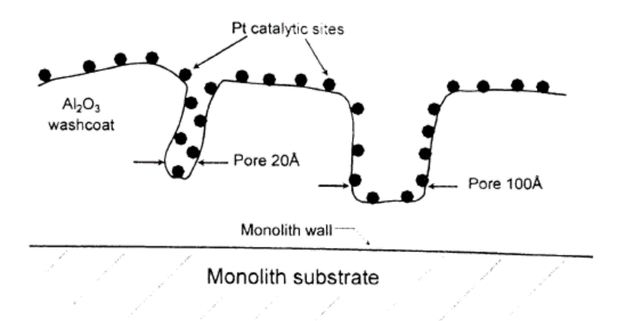
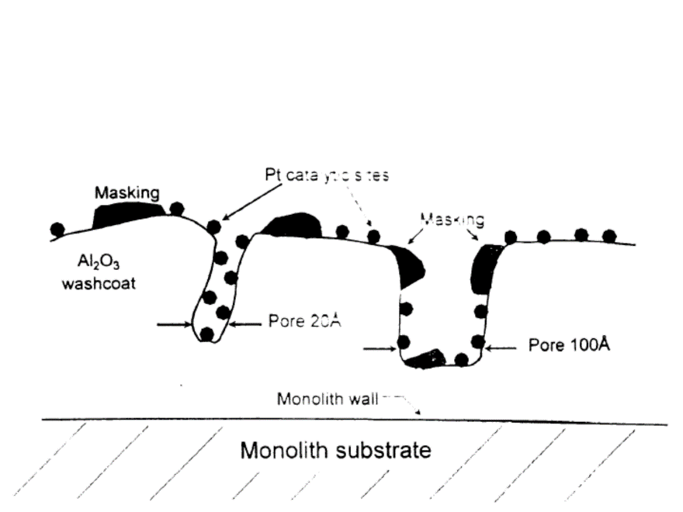
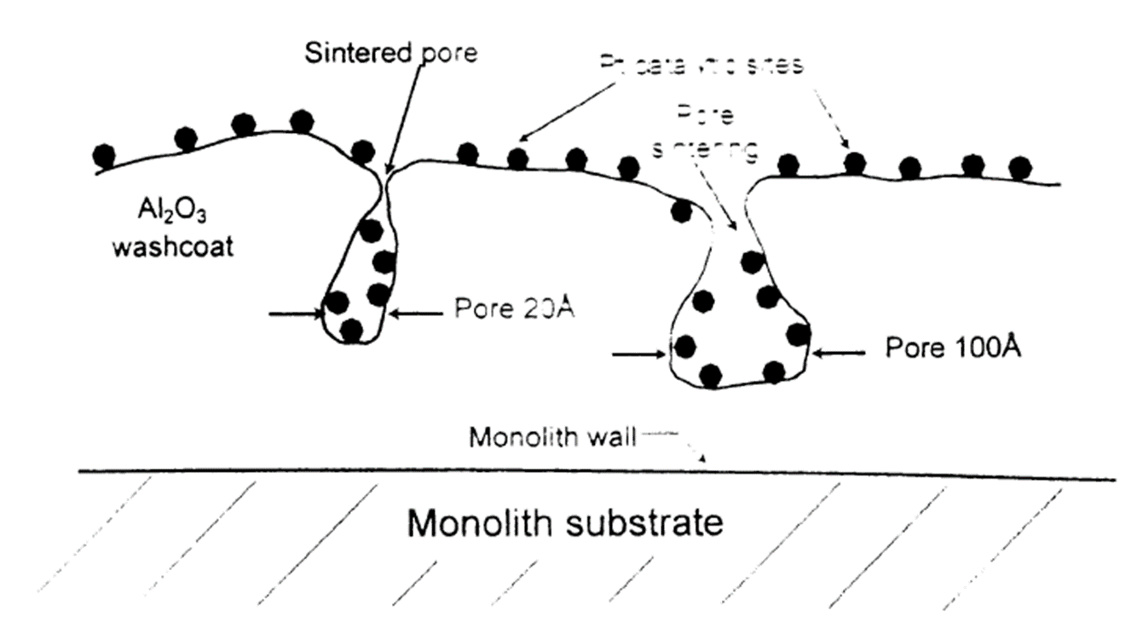
2. Pore blocking
Ideal catalyst
Pore blocking
Fouling

Slide 6
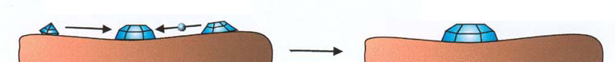
3. Sintering
Loss of active surface area via structural modificaion of the catalyst.
Metal catalysts (supported or unsupported)
Agglomeration and coalescence of small metal crystallites into larger ones with low surface - to - volume ratio.
Crystalline
migration
Atomic
migration
Result:
Particle size growth
Low
Temperature
High
Temperature

Slide 7
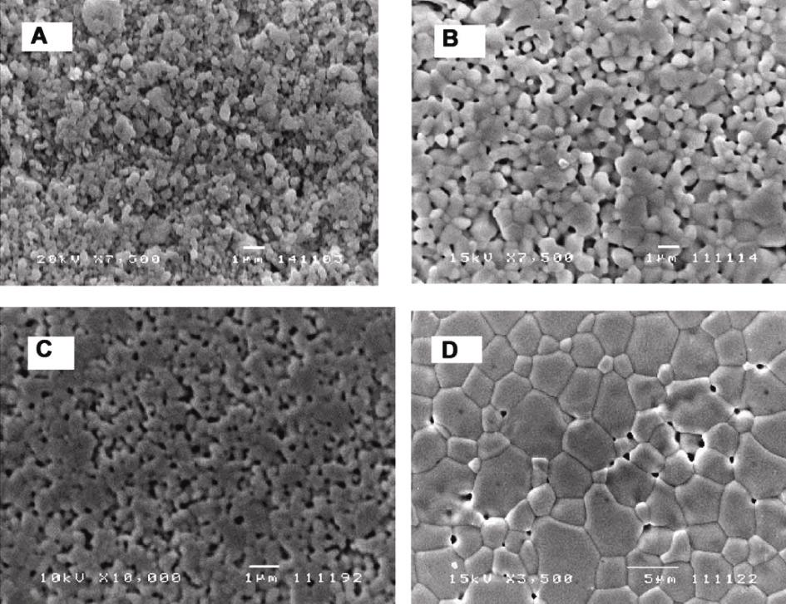
3. Sintering
Oxide catalysts
Coalescence and growth of bulk oxide cristallites
1250°C
1400°C
Result:
Increase in crystallite dimension
Increase in grain dimensions
Decrease of surface area and porosity
1550°C
1600°C
SEM images of CeO₂ sintered at different temperatures
Zhang T. et al. Materials Letters 57 (2002), 507 - 512

Slide 8
3. Sintering
Key factors:
Temperature
Sinterisation is a thermic activated process
Reaction atmosphere
Water vapor accelerates crystallization and structural change in oxide catalysts.

Slide 9
4. Solid Phase Transformations
Transformation of one phase into a different one
Metal supported catalysts
Incorporation of metal into the support
Ni/Al₂O₃
NiAl₂O₄
active for reforming
inactive for reforming
Rh/Al₂O₃
Lean conditions
Rh₂Al₂O₄
Three - Way catalyst

Slide 10
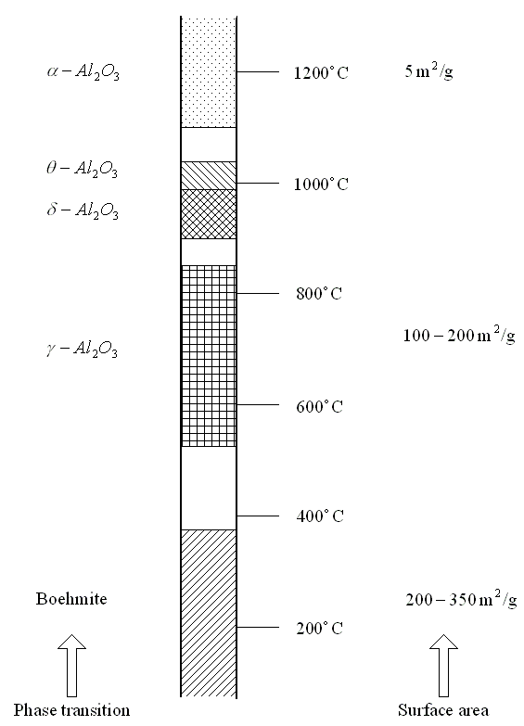
4. Solid Phase Transformations
Metal oxide catalysts
Transformation of one crystalline phase into a different one with a step - wise decrease in the internal surface area
Limited by rate of nucleation
Foreign compounds in the bulk or even on the surface can influence this process:
Na₂O enhances sintering of γ - Al₂O₃
BaO, CeO₂, La₂O₃, SiO₂, ZrO₂ improve the stability of γ - Al₂O₃

Slide 11
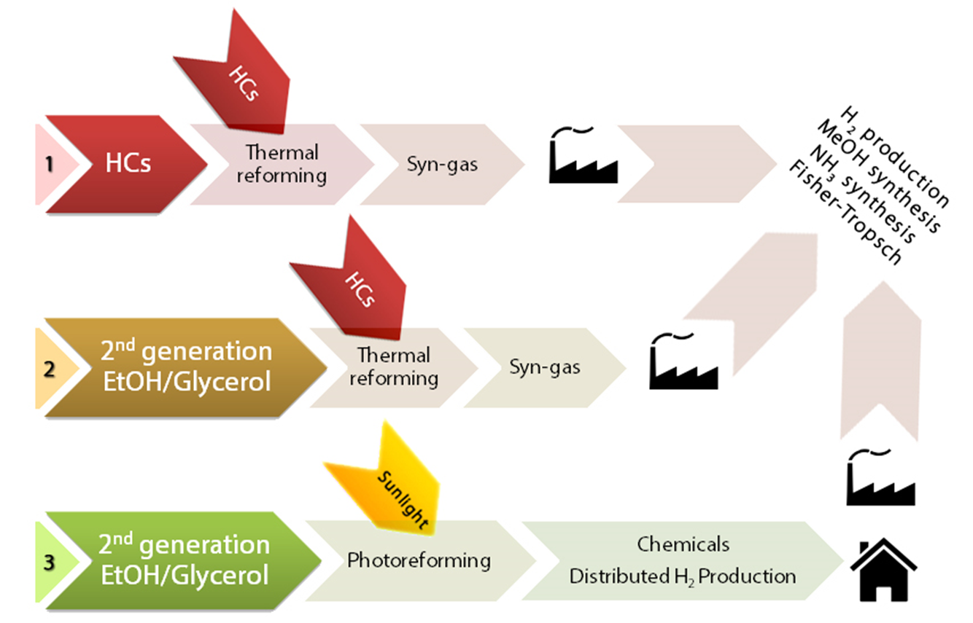
Production of Syn-gas and Hydrogen

Slide 12
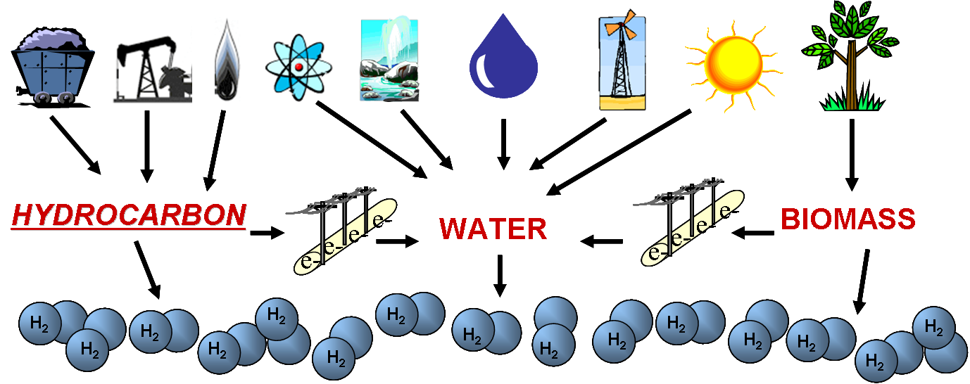
Steam Reforming
Partial Oxidation
Autothermal Reforming
Aqueous Phase Reforming

Slide 13
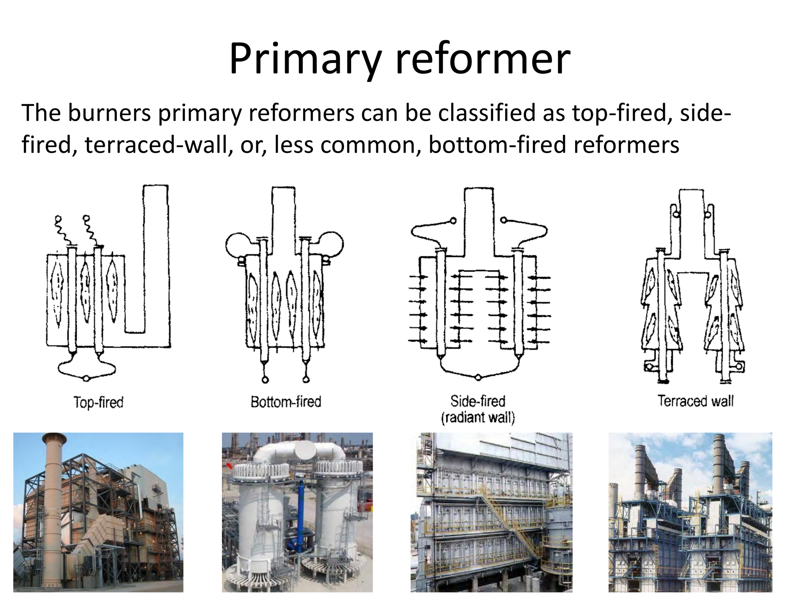

Slide 14

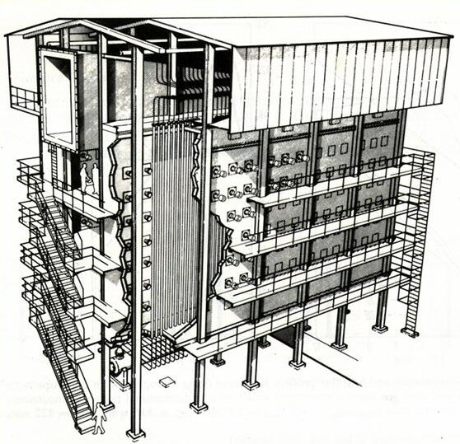
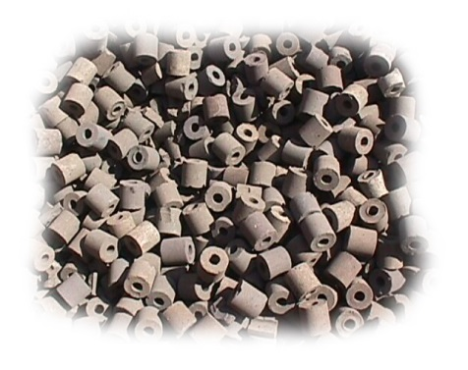
Today: Steam Reforming
Hydrocarbons
e.g. Methane
Steam at high T
High metal loading
(Ni/Al₂O₃ until 15% wt)
High coking deposition
(catalyst deactivation)
High operative temperature
(highly endothermic reaction, 600-900 °C)
Ni based
Catalyst

Slide 15
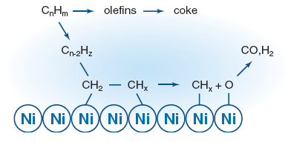
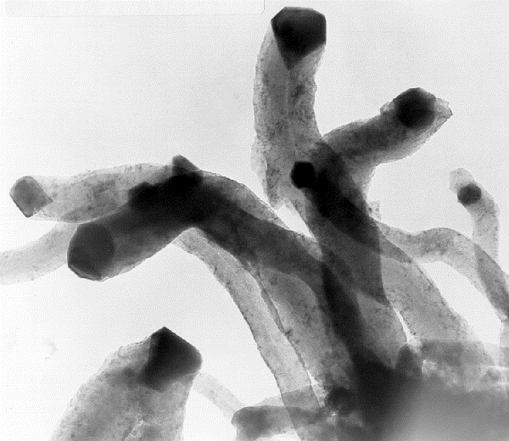
Ni/Al₂O₃
Steam Reforming Mechanism
Adsorption and dehydrogenation of C_{n}H_{m} on surface catalyst;
Adsorption and dissociation of H₂O on surface catalyst;
Reaction of intermediate species to form H₂/CO
Catalyst deactivation:
C filament formation
TEM picture
I. Alstrup, Haldor Topsøe A/S.

Slide 16
Coking
Catalytic reactions involving HC or CO
Formation of carbonaceous residues
Coke
or
Carbon
Coking or condensation
of HC
CH_{x}: 0.5 < x < 1
CO disproportionation
2 CO C + CO₂
Physically cover the active sites
Coke or
Carbon
Pore blocking

Slide 17
Coking
Mechanism of coke formation
Olefin polymerization
Olefin cyclization to substituted benzenes
Formation of polynuclear aromatics from benzenes
via carbonium ions intermediates
Analytical techniques
IR
EPR
TG-DTA
UV-vis
¹³C-NMR
Evolution of combustion products
(CO₂ and H₂O)

Slide 18
Coking
Coke deposition
Preferencially on the exterior of the particles
Resistance to the transport of reactants and products in the pores
Pore blocking

Slide 19
Preventing Coking
Appropriate combination of process conditions
The gas mixture composition is kept as far as possible from conditions under which carbon formation is thermodynamically favored
High H₂ pressure in catalytic reforming
Low HC / H₂O ratios in steam reforming over Ni catalysts
Optimal catalyst composition
Promoters or additives that enhance the rate of gasification adsorben carbon or coke precursors and / or depress the carbon - forming reactions.
K in Ni - based steam - reforming catalysts
Pt - Re / Al₂O₃

Slide 20
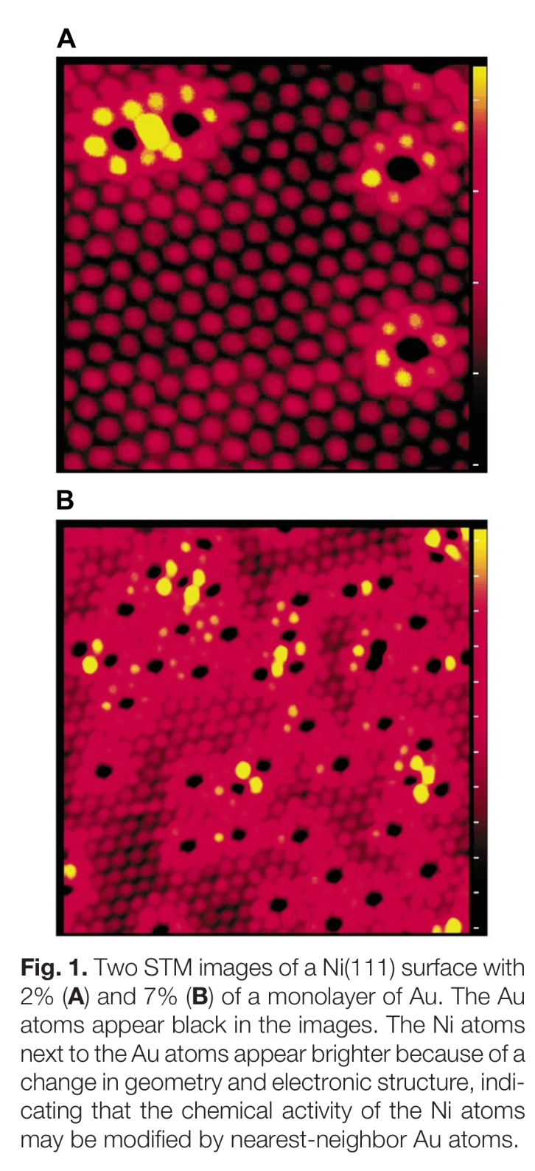
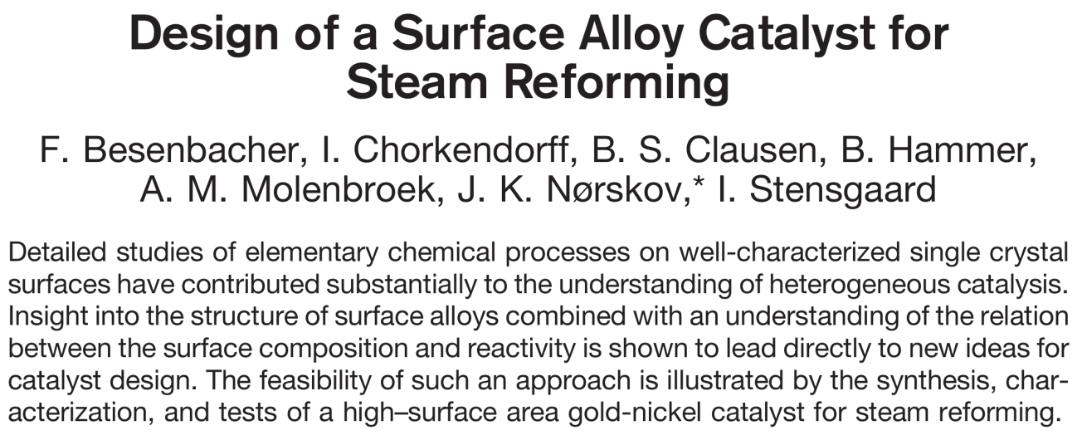
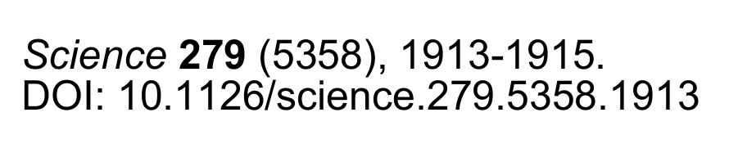
Preventing Coking

Slide 21
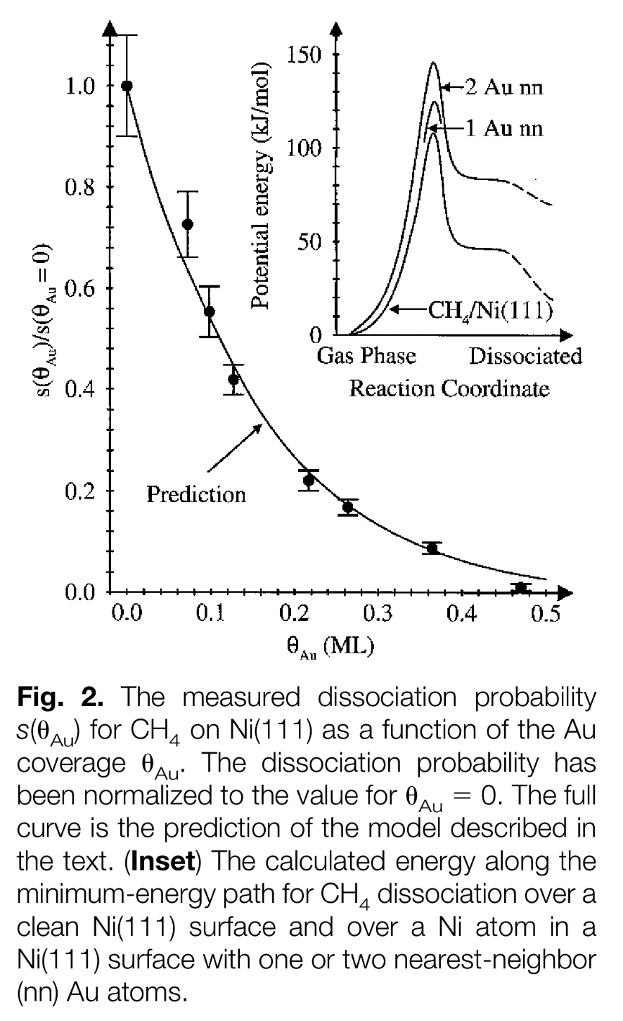
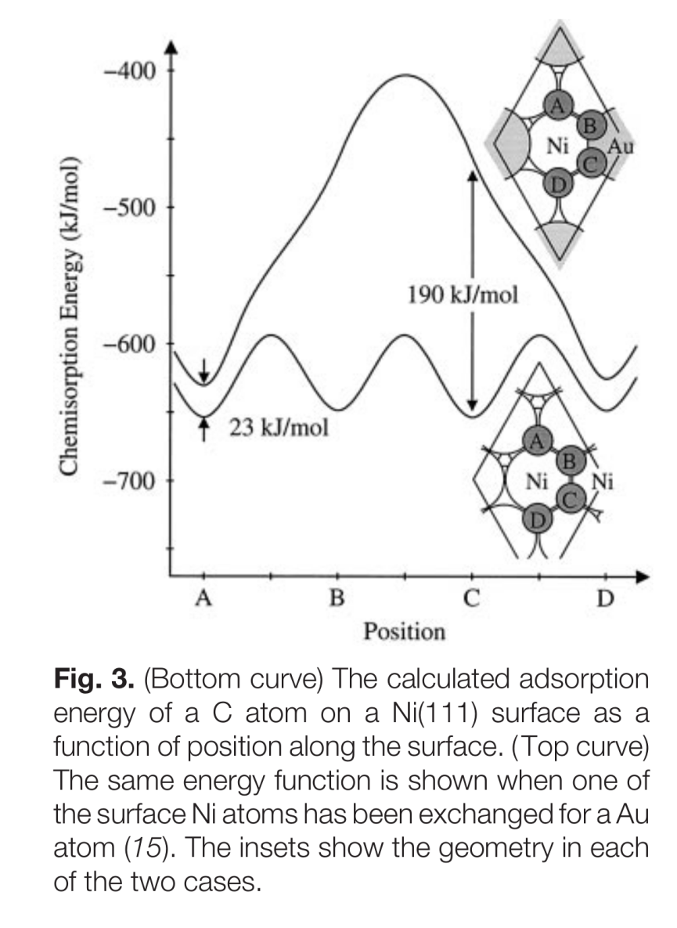
Preventing Coking

Slide 22
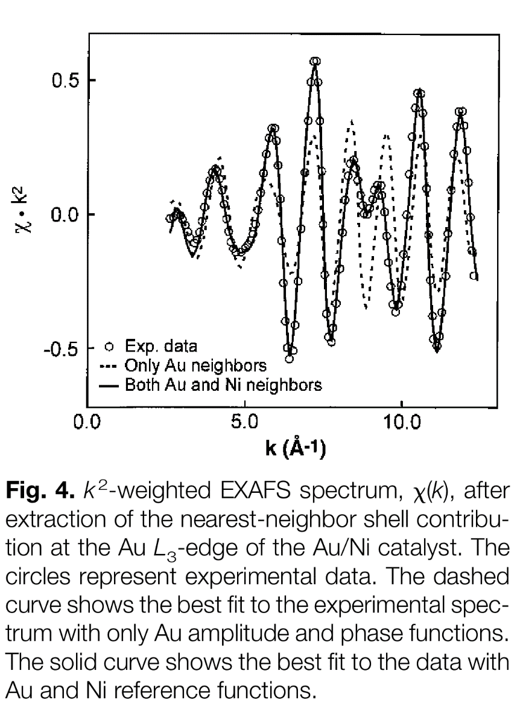
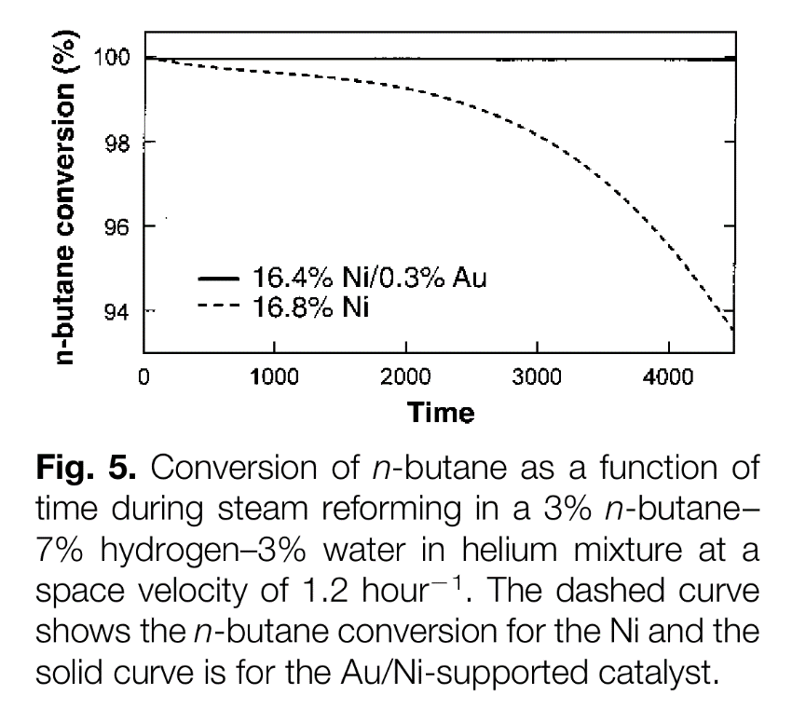
Preventing Coking

Slide 23
Alternative reaction route
Partial Oxidation
It may be carried out with a much broader range of compounds,
from Natural Gas to heavy residues and even coal
is mildly exothermic and is much more energy efficient;
a smaller reactor can be used to achieve high CH₄ conversion and selectivities to CO and H₂ with short contact time;
no need for large amounts of expensive superheated steam

Slide 24
Alternative reaction route
Methane Partial Oxidation Mechanism
Two reaction pathways are
generally accepted:
Direct Partial Oxidation (DPO)
Combustion-Reforming Reactions (CRR)

Slide 25
Partial Oxidation di CH₄: MPO su Rh(1%)@Al₂O₃
CH₄ (2.0%) + O₂ (1.0%) in Ar
GHSV = 700000 mL g⁻¹ h⁻¹
Meccanismo CRR:
Combustione + Reforming
Fino a 410°C:
Oltre a 410°C:

Slide 26
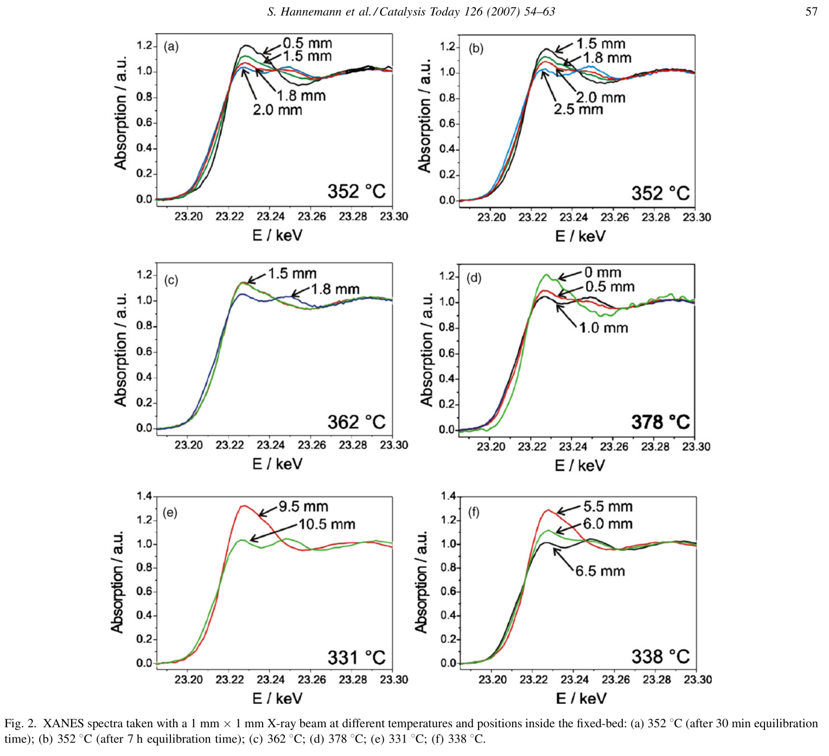
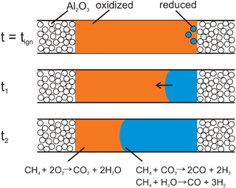
Partial Oxidation di CH₄: MPO su Rh(1%)@Al₂O₃

Slide 27
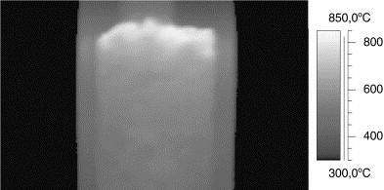
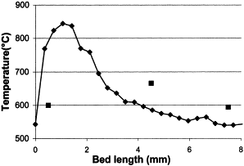
Partial Oxidation di CH₄: MPO su Rh(1%)@Al₂O₃
Thermographic picture of the Rh1 catalyst during the autothermal tests of methane partial oxidation (CH₄/O₂/He = 2/1/4, reaction gas mixture .
Catal. Today 64 (2001) 21-30

Slide 28
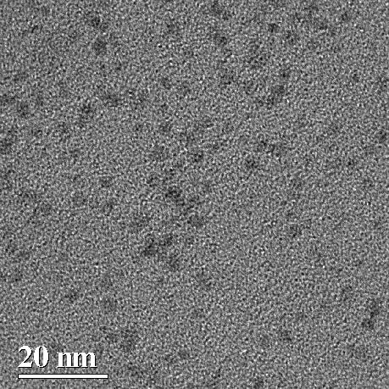
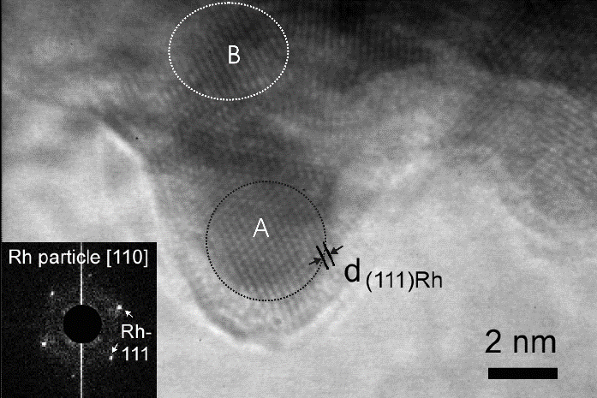

Rh(1%)@Al₂O₃ : Caratterizzazione
Sinterizzazione della fase attiva
HRTEM
Nanoparticelle di Rh
Campione secco
Campione attivato
Campione disattivato
2 nm

Slide 29
Rh(1%)@Al₂O₃
“Ringiovanimento” del catalizzatore
Stabilità
CH₄ (2.0%) + O₂ (1.0%) in Ar
GHSV ~ 700000 mL g⁻¹ h⁻¹
T = 750°C
= O₂ per 1minuto

Slide 30
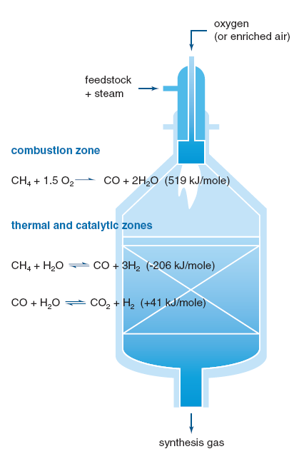
Alternative reaction route
Autothermal Reforming
It is probably the most interesting among coming developments
in H₂ production processes from hydrocarbons.
Its main benefit lies in compensating for the endothermic reaction of Steam Reforming with the exothermic reaction of Partial Oxidation
no extra heating
no extra cooling
e.g. Methane

Slide 31
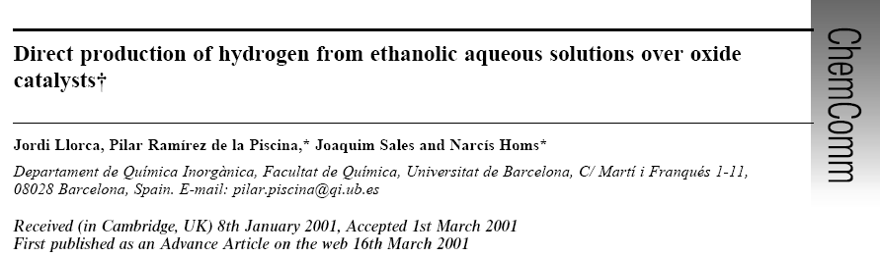
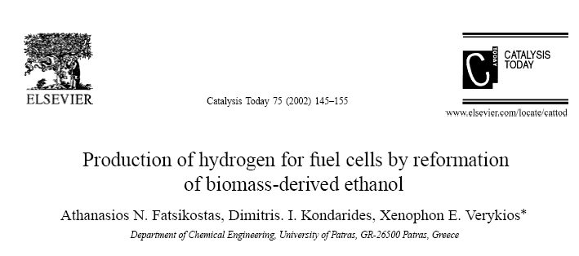
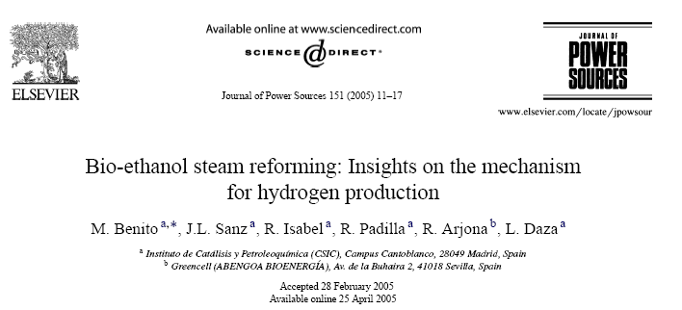
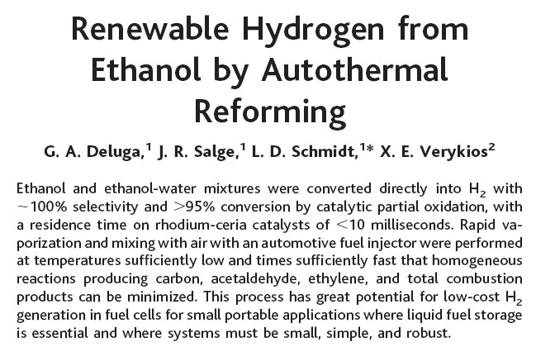
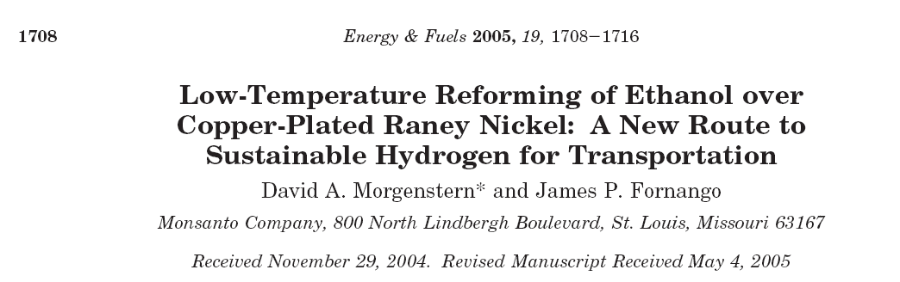
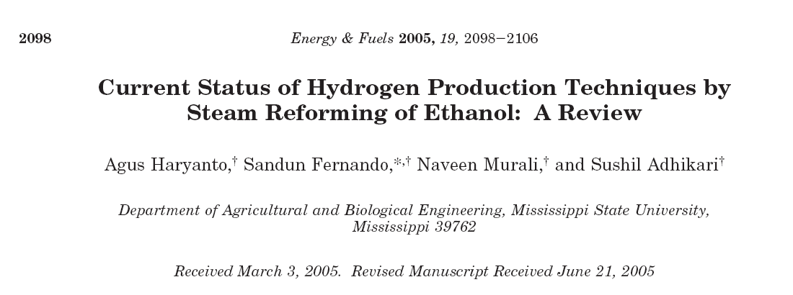
... Ethanol
GREAT ATTENTION

Slide 32
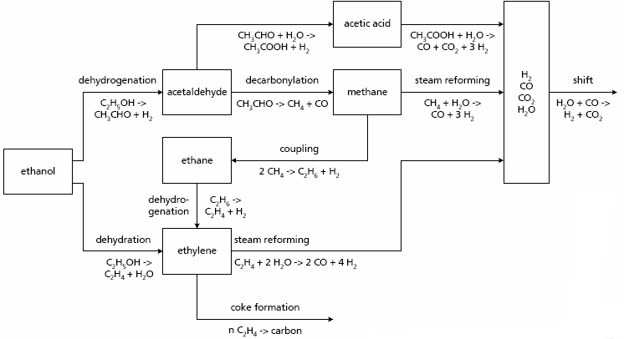
Ethanol Steam Reforming
Reaction Pathway
S.Cavallaro, Energy & Fuels 14(2000)1195

Slide 33
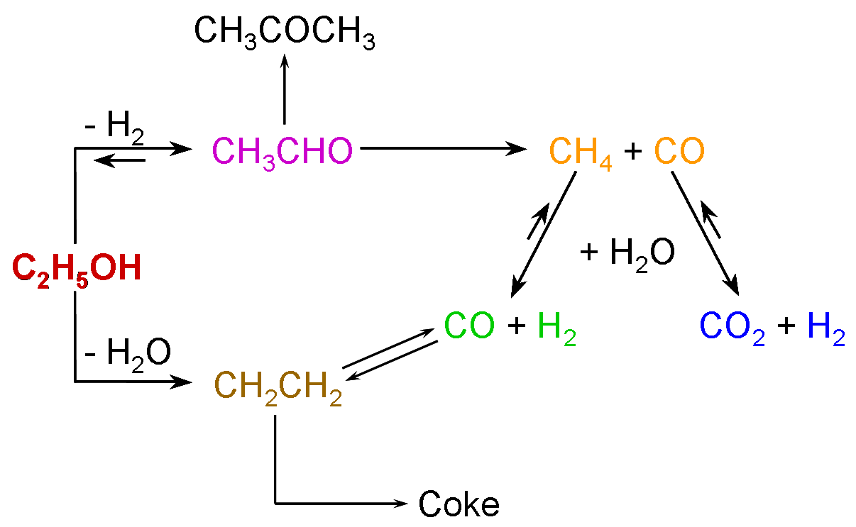
Al₂O₃
EtOH + H₂O 1 : 5
GHSV = 150000 mL g⁻¹ h⁻¹
Conversion/Yield (%)
Temperature (°C)
T. Montini, Appl. Catal. B: Environ. 71 (2007). 125-134

Slide 34
Rh(1% wt)@Al₂O₃
EtOH + H₂O 1 : 5
GHSV = 150000 mL g⁻¹ h⁻¹
Conversion/Yield (%)
Temperature (°C)
Water Gas
Shift
T. Montini, Appl. Catal. B: Environ. 71 (2007). 125-134

Slide 35
Rh(1% wt)@Ce_{0.2}Zr_{0.8}O₂(40%)/Al₂O₃
EtOH + H₂O 1 : 5
GHSV = 150000 mL g⁻¹ h⁻¹
Conversion/Yield (%)
Temperature (°C)
T. Montini, Appl. Catal. B: Environ. 71 (2007). 125-134

Slide 36
Effect of promoters on the catalytic performance
EtOH + H₂O 1 : 5
GHSV = 150000 mL g⁻¹ h⁻¹
T = 450 °C
Yield (%)
T. Montini, Appl. Catal. B: Environ. 71 (2007). 125-134

Slide 37
EtOH-SR su Rh(1%)@Ce_{x}Zr_{1-X}O₂(YY%)-Al₂O₃ :
Deposizione di coke
TPO dopo reazione
a 600°C per 150h
= 0.1 μmol CO₂ min⁻¹
μmol CO₂ min⁻¹

Slide 38
Hydrogen production from steam reforming of ethanol and glycerol over ceria-supported metal catalysts
B. Zhang, X. Tang, Y. Li, Y. Xu, W. Shen, Int. J. Hydrogen Energy 32 (2007) 2367-2373
CeO₂-supported Ni, Co and Ir catalysts
Deposition-precipitation method over commercial CeO₂.
Temperature between 250 – 550 ºC
Pressure: 1 bar
EtOH or Gly/H₂O/He= 2/18/80 vol%
Complete conversion of ethanol at T > 400 ºC.
Good selectivity values at that temperature.
Ir/CeO₂ is the most selective catalyst for ethanol and glycerol reforming.
Ethanol reforming
Glycerol reforming

Slide 39
Hydrogen production from steam reforming of ethanol and glycerol over ceria-supported metal catalysts
Ethanol reforming: stability tests
(350 ºC)
B. Zhang, X. Tang, Y. Li, Y. Xu, W. Shen, Int. J. Hydrogen Energy 32 (2007) 2367-2373
Over Ir/CeO₂, ethanol was totally converted into methane, CO, CO₂ and H₂. Stable catalyst for at least 16 h.
For Co/CeO₂ the formation of significant amount of acetone (8%) indicated that decarbonylation of acetaldehyde takes place and the activity is too low to promote the reforming reactions.
The Ni/CeO₂ sample exhibited good activity for ethanol decomposition to methane and CO, and the later was converted into CO₂ by the water gas shift reaction.

Slide 40
Conversion of glycerol to hydrogen via a steam reforming process over nickel catalysts
S. Adhikari, S.D. Fernando, S.D. Filip To, R. Mark Bricka, P.H. Steele, A. Haryanto, Energy and Fuels 22 (2008) 1220-1226
CeO₂, MgO and TiO₂-supported Ni catalysts
Incipient wetness technique over commercial supports.
Temperature between 550 – 650 ºC
Pressure: 1 bar
Water/glycerol= 6:1
Ni/CeO₂ and Ni/TiO₂ show slow deactivation while Ni/MgO does not deactivate.

Slide 41
Conversion of glycerol to hydrogen via a steam reforming process over nickel catalysts
S. Adhikari, S.D. Fernando, S.D. Filip To, R. Mark Bricka, P.H. Steele, A. Haryanto, Energy and Fuels 22 (2008) 1220-1226
H₂ selectivity increases with an increase in temperature.
The maximum H₂ yield was 66% for Ni/CeO₂ followed by 52% for Ni/MgO and 47% for Ni/TiO₂ at 650 ºC.
The lower activity of Ni/TiO₂ can be due to the higher coke formation (higher acidity of the support)
Effect of temperature on H₂ selectivity
Effect of temperature on glycerol conversion
Coke formation

Slide 42
Production of hydrogen by steam reforming of glycerin over alumina-supported metal catalysts
S. Adhikari, S. Fernando, A. Haryanto, Catal. Today 129 (2007) 355-365
Alumina-supported catalysts
Incipient wetness technique
Temperature between 700 – 900 ºC
Pressure: 1 bar
Glycerin/H₂O= 1:6 vol
Feed: 0.15 ml/min
Alumina-supported samples
The highest H₂ selectivity was obtained over Ni/Al₂O₃. 60, 56 and 48% at 900, 800 and 700 ºC. This could be due to the promotion of C-C ruptures over Ni.
H₂ selectivity pattern: Ni > Ir > Ru > Pt > Rh, Pd.
Conversions are favoured at higher temperatures due to the endothermicity of reforming.

Slide 43
Production of hydrogen by steam reforming of glycerin over alumina-supported metal catalysts
S. Adhikari, S. Fernando, A. Haryanto, Catal. Today 129 (2007) 355-365
The highest H₂ selectivity was obtained over Pd/CeO₂/Al₂O₃ at 900 ºC and Rh/CeO₂/Al₂O₃ at 800 ºC. However at 700 ºC the most selective is Ni/CeO₂/Al₂O₃.
With the addition of CeO₂ all the samples show a higher H₂ selectivity (WGSR promoted)
Glycerin conversions show mixed results with the addition of CeO₂.
CeO₂/Al₂O₃-supported samples

Slide 44
Production of hydrogen by steam reforming of glycerin over alumina-supported metal catalysts
S. Adhikari, S. Fernando, A. Haryanto, Catal. Today 129 (2007) 355-365
The H₂ selectivity and glycerin conversion increased with a decrease in flow rate.
With the increase in water/glycerin ratio the glycerin conversion increased monotonously for Ni/Al₂O₃. Mixed results over other samples.
With an increase in metal loading, the glycerin conversion increased for Ni/Al₂O₃ and Rh/CeO₂/Al₂O₃.
The samples Ni/Al₂O₃ and Rh/CeO/Al₂O₃ were stable for at least 13 h of operation.
Ni/Al₂O₃
Rh/CeO₂/Al₂O₃

Slide 45
An integrated catalytic approach for the production of hydrogen by glycerol reforming coupled with water-gas shift
E.L. Kunkes, R.R. Soares, D.A. Simonetti, J.A. Dumesic, Appl. Catal. B 90 (2009) 693-698
Pt-based bimetallic catalysts supported on C (reforming)
Incipient wetness impregnation
CeZrOx catalyst (WGSR)
Temperature between 548 – 623 K
Pressure: 1 bar
30<wt% Glycerin
Feed: 0.32 ml/min
Glycerol conversion
Pt-Re/C is the most active sample.

Slide 46
An integrated catalytic approach for the production of hydrogen by glycerol reforming coupled with water-gas shift
E.L. Kunkes, R.R. Soares, D.A. Simonetti, J.A. Dumesic, Appl. Catal. B 90 (2009) 693-698
It was possible to produce syngas with controlled H₂:CO ratios using two catalytic beds.
First bed of Pt-Re/C gives high conversions of glycerol to produce H₂/CO gas mixture.
Second bed consisting of Pt(1%)/CeO₂/ZrO₂ promotes WGSR in a stable way.

Slide 47
Renewable hydrogen by autothermal steam reforming of volatile carbohydrates
P.J. Dauenhauer, J.R. Salge, L.D. Schmidt, J. Catal. 244 (2006) 238-247
High selectivities to H₂ can be achieved by adjusting the fuel/air and fuel/steam feed ratios, as well the catalyst.
Pt and Rh-based catalysts supported on alumina
Incipient wetness impregnation
Temperature between 519 – 1055 ºC
Pressure: 1 bar
The addition of steam suppress CO selectivity while increasing selectivity to H₂. Rh/CeO₂/Al₂O₃ showed high fuel conversion and H₂ selectivity.

Slide 48
Integrated catalytic approach for conversion of biomass to hydrogen
S.M. Swami, M.A. Abraham, Energy & Fuels 20 (2006) 2616-2622
Catalyst containing Cu, Ni and Pd (Pd/Ni/Cu/Al₂O₃)
Sequential wet impregnation technique
Temperature between 500 – 800 ºC
Pressure: 1 bar
H₂ yield up to 60% can be achieved at 750 ºC. If the amount of oxygen increases in the feed, the amount of CO₂ also increases.
The addition of oxygen enhanced the breakdown of the glycerol reactant, and decreased the formation of coke precursor, improving the H₂ production.
Autothermal reforming of glucose

Slide 49
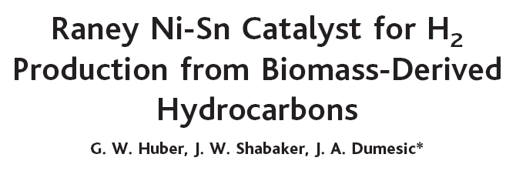
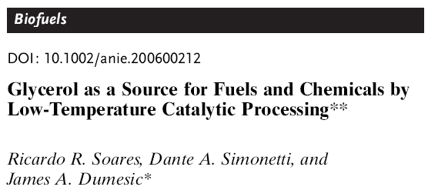
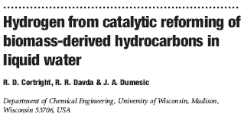
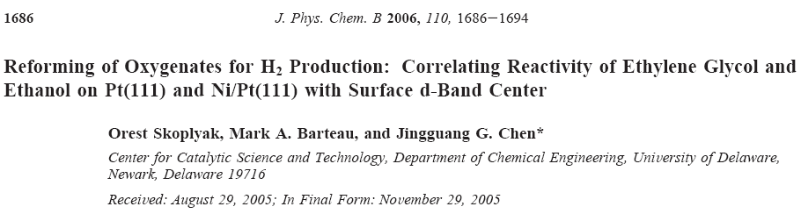
Aqueous-Phase Reforming
(APR) Process
Science 2003, 300, 2075
Angew.Chem.Int.Ed. 2006, 45, 3982
Nature 2002, 418, 964

Slide 50
Aqueous-Phase Reforming
(APR) Process
Hydrogen-Rich Gas
Less than 100 ppm CO
Methanol
Ethylene Glycol
Glycerol
Sugars (Glucose) (Xylose)
Sugar Alcohols (Sorbitol)
Liquid-Phase Reforming
Single Reactor System
Low Temperature
160 – 265 ºC
Relatively Low Pressure
Less Than 68 bar
Simple Vapor-Liquid Separator
Liquid-Water
Eliminates Energy required to vaporize water
Allows processing bioproducts that cannot be vaporized without decomposition
Compatible with processing wet feedstocks, avoiding need for an initial dehydration step
Operates at low T compared with conventional reforming, reducing energy costs
Water gas shift reaction occurs simultaneously with reforming
Pressurized product is compatible with membrane or p swing H₂ purification

Slide 51
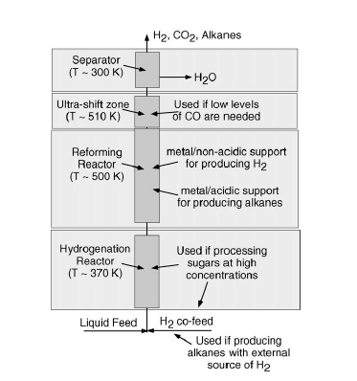
APR PROCESS
Process Conditions
It is possible to obtain
a product of the desired specifications
R.R. Davida et al., Appl.Catal.B 56(2005)171
29/37

Slide 52
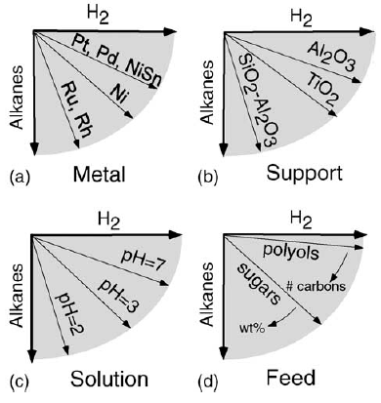
APR PROCESS: FACTORS CONTROLLING THE SELECTIVITY
R.R. Davida et al., Appl.Catal.B 56(2005)171
30/37

Slide 53
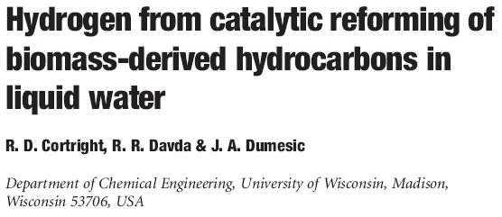
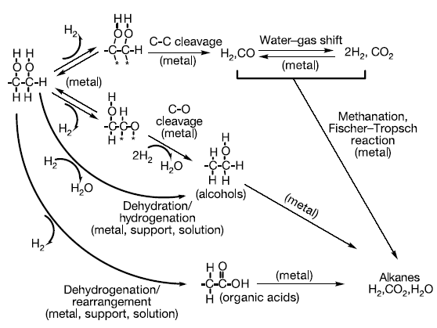
Reaction pathways for production of H₂ by reactions of oxygenated hydrocarbons with water. (Asterisk represents a surface metal site.)
Nature 418, 964 (2002)
31/37

Slide 54
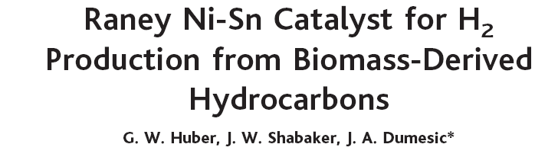
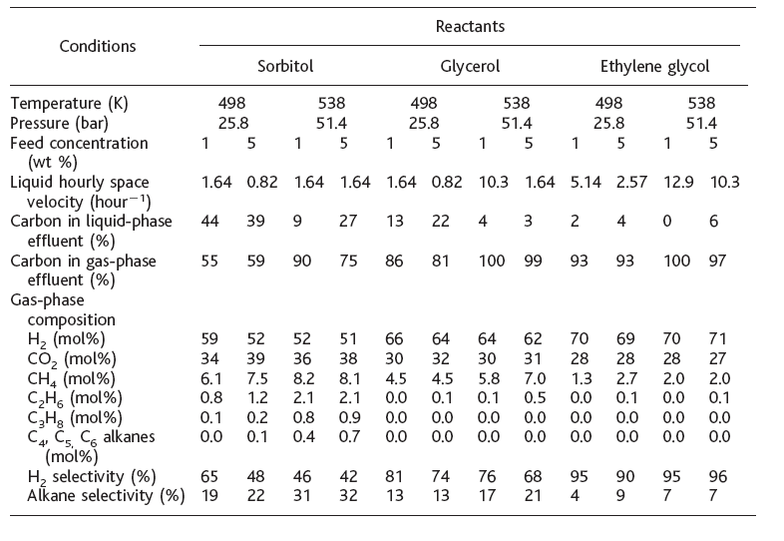
Hydrogen was produced by aqueous-phase reforming of biomass-derived oxygenated hydrocarbons at T near 500 K over a tin-promoted Raney-nickel catalyst.
The performance of this non–precious metal catalyst compares favorably with that of platinum-based catalysts for production of hydrogen from ethylene glycol, glycerol, and sorbitol.
The addition of tin to nickel decreases the rate of methane formation from
C-O bond cleavage while maintaining the high rates of C-C bond cleavage required for hydrogen formation.
Science 300, 2075 (2003)
32/37

Slide 55

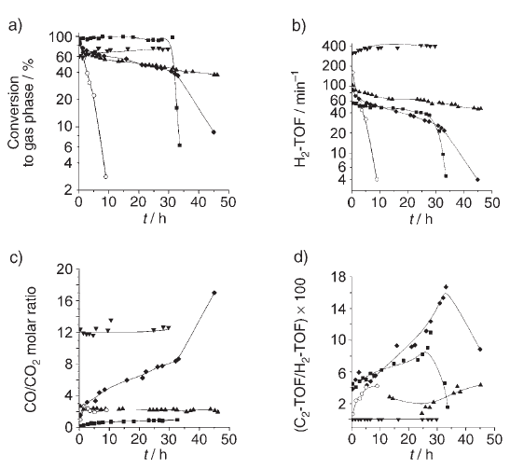
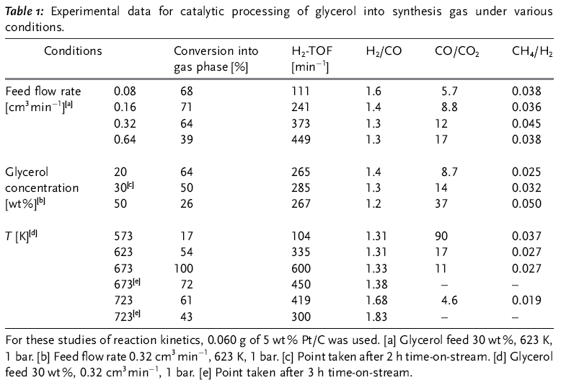
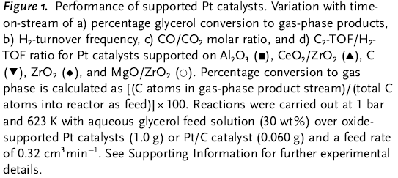
Angew.Chem.Int.Ed. 45(2006)3983

Slide 56
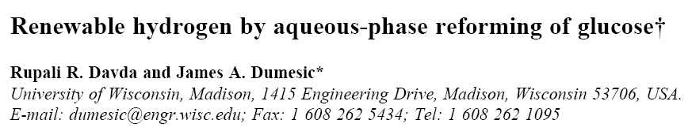
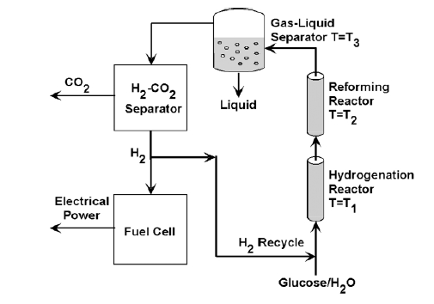

Reaction pathways involved in
glucose and sorbitol reforming.
Schematic representation of the recycle loop for
generation of hydrogen by APR of glucose.
Chem.Commun. (2004)36
34/37

Slide 57
Influence of Pt particle size and support type on the aqueous-phase reforming of glycerol
K. Lehnert, P. Claus, Catal. Comm. 9 (2008) 2543-2546
Pt(3%)/Al₂O₃ catalysts
Calcination Temp: 260 – 600 ºC
Temperature: 523 K
Pressure: 20 bar
10 wt% glycerol
Increasing particles size produces higher catalytic activity and higher selectivity to H₂.
APR of glycerol is structure sensitive. It is assumed that the adsorption of glycerol for subsequent cleavage of a C-C bond can be realized preferably on face positions.

Slide 58
Influence of Pt particle size and support type on the aqueous-phase reforming of glycerol
K. Lehnert, P. Claus, Catal. Comm. 9 (2008) 2543-2546
Effect of the Pt loading
Effect of the glycerol purity
The nature of the metal precursor does not influence the catalytic activity.
Although lower H₂ yields are obtained, even crude glycerol can be converted

Slide 59
Production of hydrogen by aqueous phase reforming of glycerol
G. Wen, Y. Xu, H. Ma, Z. Xu, Z. Tian; Int. J. Hydrogen energy 33 (2008) 6657-6666
M/Al₂O₃ catalysts
Pt/support catalysts
Temperature: 503 K
Pressure: 3.2 MPa
10 wt% glycerol
Hydrogen production decreases in the order: Pt > Cu > Ni > Co.
Pt/Al₂O₃ is the only stable catalyst.

Slide 60
Aqueous-phase reforming of ethylene glycol over supported Pt and Pd bimetallic catalysts
G.W. Huber, J.W. Shabaker, S.T. Evans, J.A. Dumesic, Appl. Catal. B 62 (2006) 226-235
Pt/Al₂O₃, Pd/Al₂O₃, bimetallic Pt-M/Al₂O₃ and Pd-M/Al₂O₃ (more than 130 samples)
Temperature: 423-498 K
Pressure: 4.8 – 25.8 bar
5 wt% ethylene glycol
PtNi, PtCo, PtFe, PdFe were significantly more active than Pt and Pd monometallic samples.
Alloying Pt with Ni, Co or Fe improves the activity for H₂ production by lowering the heats of CO and H₂ adsorption, increasing the fraction of the available sites for reaction.
Notes:
Adsorbimento competitivo di

Slide 61

Purification of H₂ from Syn-Gas
PEMFC
basso contenuto di CO (<10ppm)
basse temperature per reforming

Slide 62
Processes for CO removal
Water - Gas Shift Reaction
PReferential OXidation
of CO in excess H₂
CO + H₂O
CO₂ + H₂
HTS: Fe₂O₃ / Cr₂O₃
LTS: Cu/ZnO/Al₂O₃
CO + 1/2 O₂
CO₂
Pt / CeO₂ / Al₂O₃
Au / CeO₂
CuO / CeO₂
Cu, Ni, Fe, Co, Pd, Pt su CeO₂
Au / CeO₂
Notes:
PROX è selettivo se il metallo adsorbe preferenzialmente CO e non H2.

Slide 63

WGSR
“Redox” mechanism
“Associative formate with –OH regeneration” mechanism
The factor governing WGSR is the extension of the metal-promoter interface, as a result of a good contact between the two components.

Slide 64




WGSR
J. Mater. Chem. A, 5 (2017), 20024–20034

Slide 65



WGSR
Deposition-precipitation on SBA-16
Deactivation by sintering (irreversible)
Impregnation of SBA-16 with Pt-DT and Ce(OR)₄
Deactivation by deposition of intermediates and/or electronic effects (reversible)
Impregnation of hydrophobic SBA-16 with Pt-DT and Ce(OR)₄
J. Mater. Chem. A, 5 (2017), 20024–20034

