Slide 1
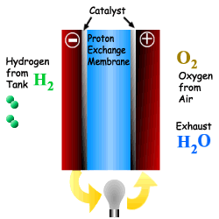
Purification of H₂ from Syn-Gas
PEMFC
basso contenuto di CO (<10ppm)
basse temperature per reforming

Slide 2
Processes for CO removal
Water - Gas Shift Reaction
PReferential OXidation
of CO in excess H₂
CO + H₂O
CO₂ + H₂
HTS: Fe₂O₃ / Cr₂O₃
LTS: Cu/ZnO/Al₂O₃
CO + 1/2 O₂
CO₂
Pt / CeO₂ / Al₂O₃
Au / CeO₂
CuO / CeO₂
Cu, Ni, Fe, Co, Pd, Pt su CeO₂
Au / CeO₂
Notes:
PROX è selettivo se il metallo adsorbe preferenzialmente CO e non H2.

Slide 3
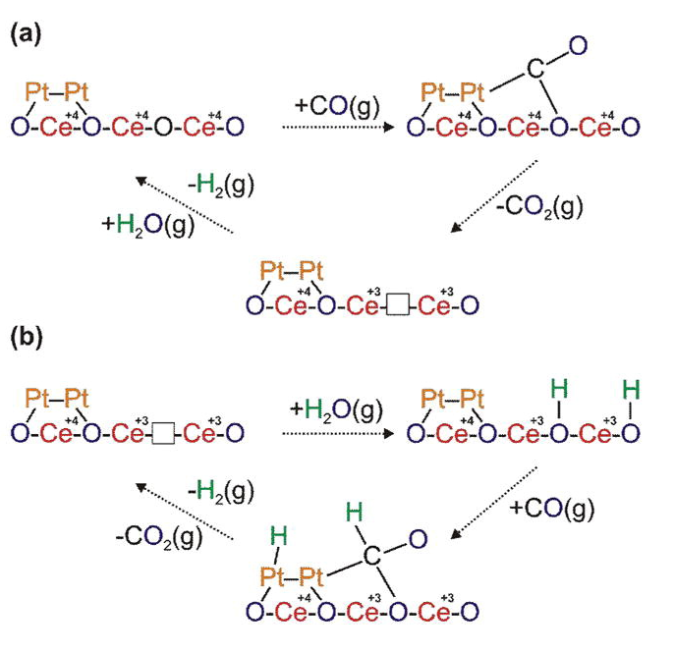
WGSR
“Redox” mechanism
“Associative formate with –OH regeneration” mechanism
The factor governing WGSR is the extension of the metal-promoter interface, as a result of a good contact between the two components.

Slide 4
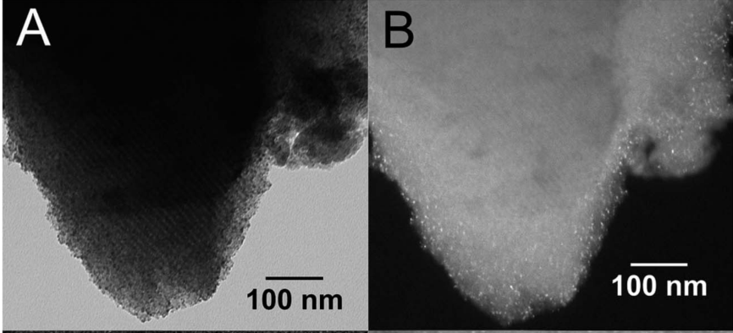
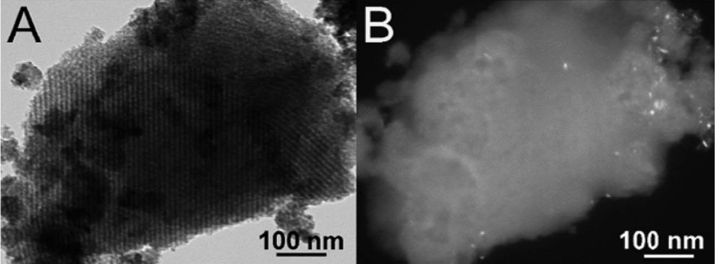
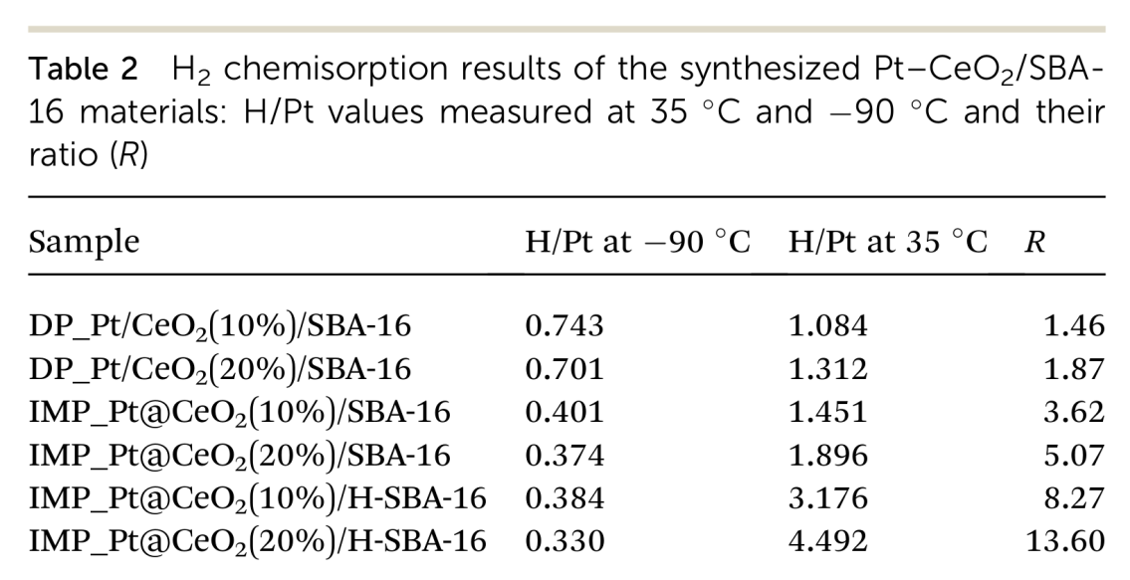
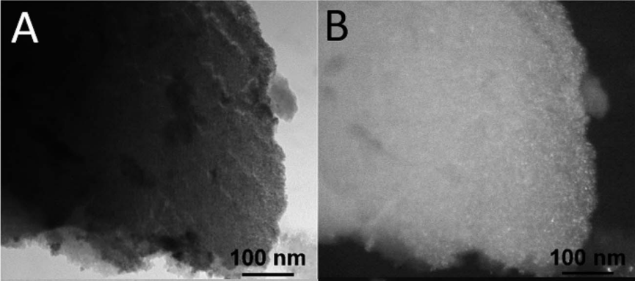
WGSR
J. Mater. Chem. A, 5 (2017), 20024–20034

Slide 5
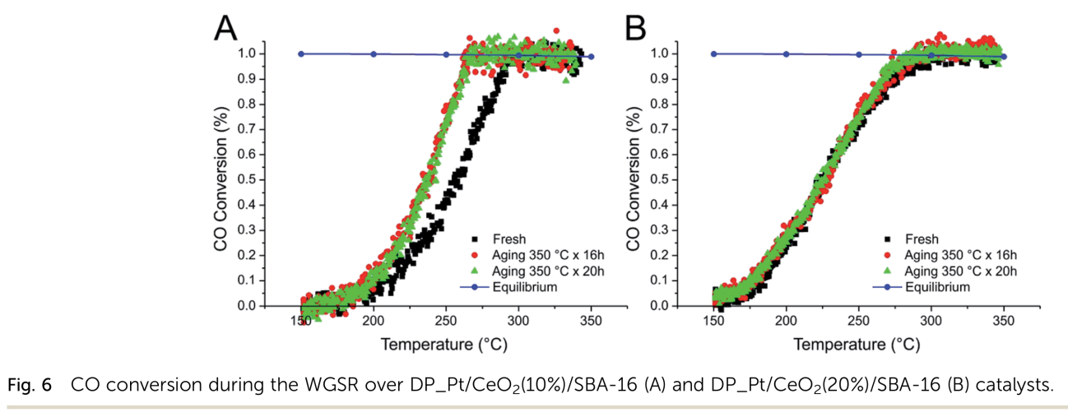
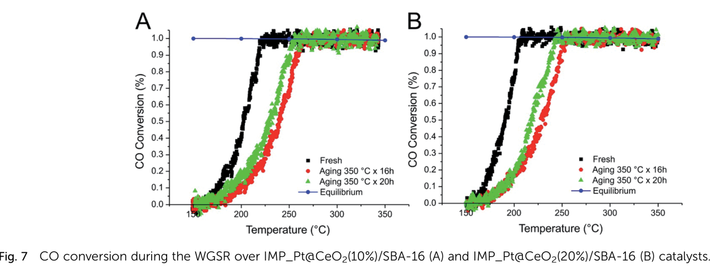
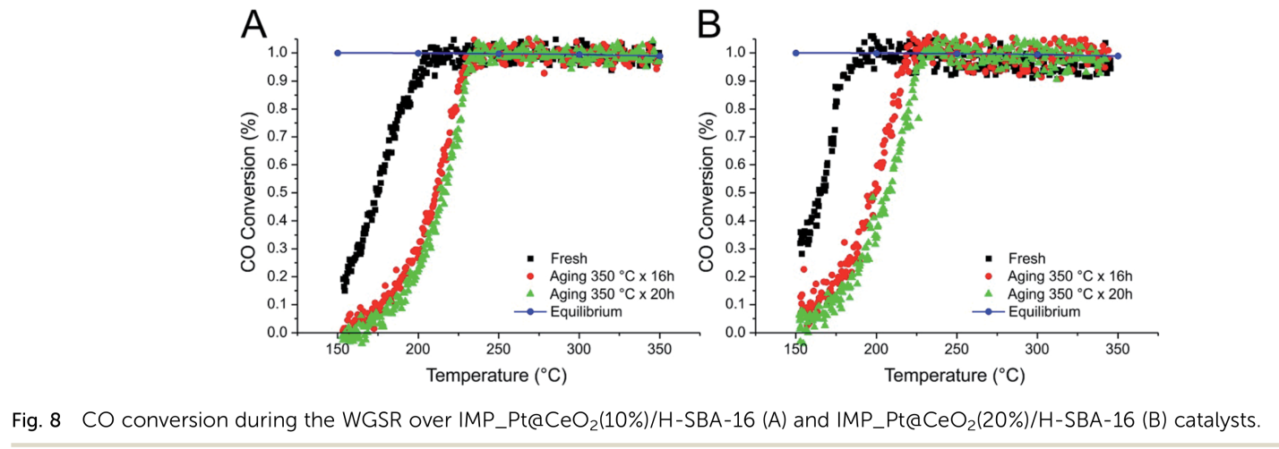
WGSR
Deposition-precipitation on SBA-16
Deactivation by sintering (irreversible)
Impregnation of SBA-16 with Pt-DT and Ce(OR)₄
Deactivation by deposition of intermediates and/or electronic effects (reversible)
Impregnation of hydrophobic SBA-16 with Pt-DT and Ce(OR)₄
J. Mater. Chem. A, 5 (2017), 20024–20034

Slide 6
Air pollution
MOBILE SOURCES
EXHAUST
HYDROCARBONS (HC)
CARBON MONOXIDE (CO)
NITROGEN OXIDES (NO_{X})
SULFUR COMPOUNDS
PM10

Slide 7
Possible solutions
Hydrogen car
Fuel cell
Electric car
Technical problem - batteries
Hybrid car
Catalytic converters – TWC
Cycling - walking

Slide 8
Properties of a suitable Three Way Catalyst
Highly active: Conversion > 98%.
50-100 liters of exhaust to be converted in
1 sec per liter of catalyst.
Highly selective: H₂O, CO₂ and N₂ as products.
Thermally stable: working temperature 350-1100°C.
Long life: 200.000 Km.

Slide 9
Exhaust emissions vary as a function of air-to-fuel ratio (A/F)
STOICHIOMETRIC COMBUSTION
(A/F = 14.6 - 14.7)
C₈H₁₈ + 12.5 O₂ + 12.5 * 3.76 N₂
9 H₂O + 8 CO₂ + 12.5 * 3.76 N₂
Air to fuel ratio, by weight
Engine power NO X 5
Hydrocarbons CO

Slide 10
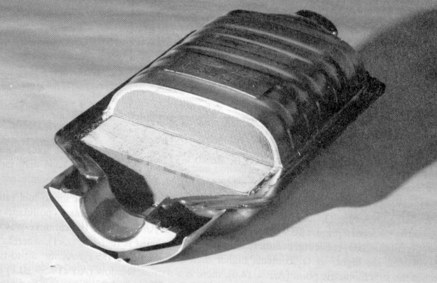
TWC: How is the exhaust converted?
3 way catalyst
CO oxidation:
CO + ½ O₂ ➔ CO₂
HC oxidation:
HC + O₂ ➔ CO₂ + H₂O
NO reduction:
NO + ½ CO ➔ ½ N₂ + CO₂
HC + 2 NO ➔ CO₂ + N₂ + H₂O
Catalyst: Pt (Pd) / Rh / Al₂O₃ / Ce_{x} Zr_{1-x}O₂

Slide 11
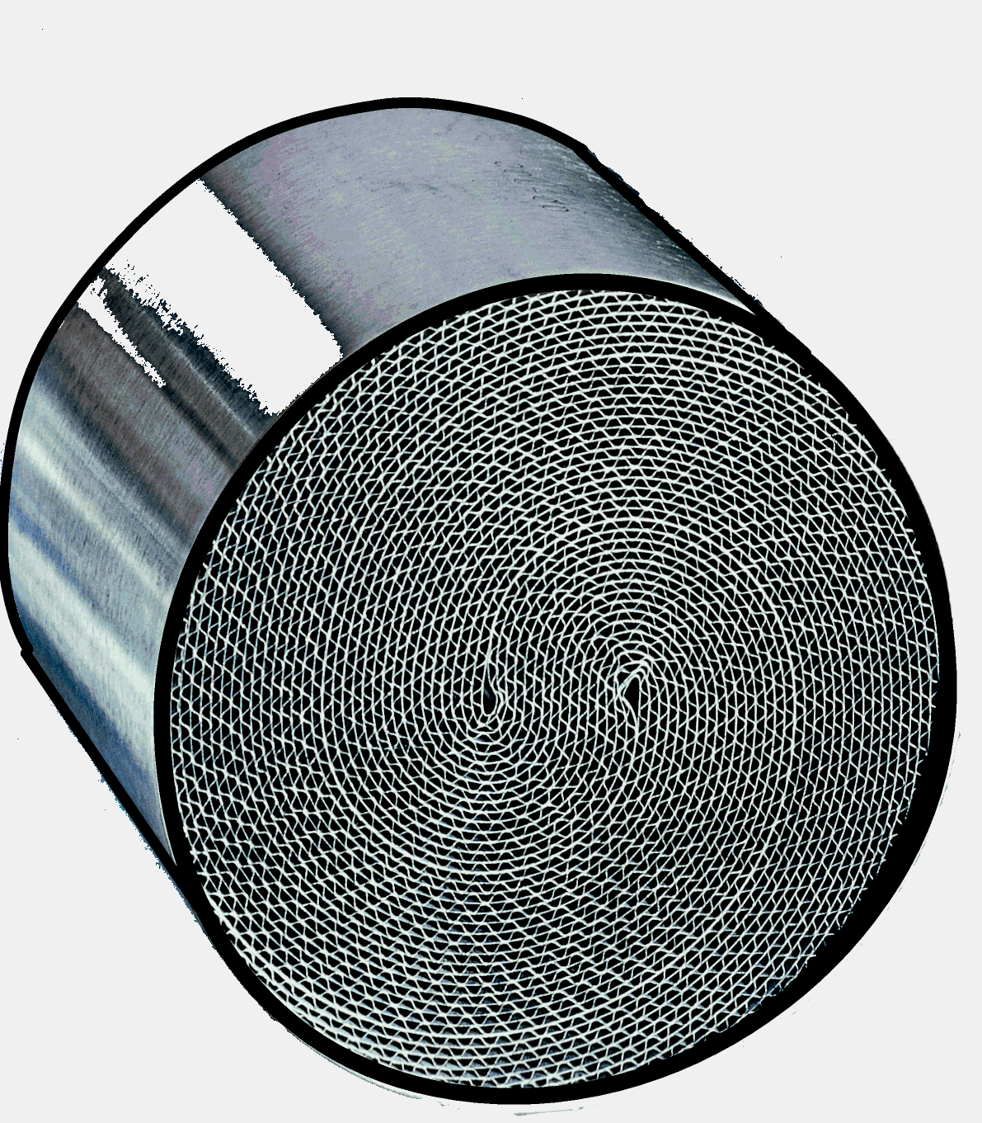

Slide 12
Gas phase diffusion
NO
Product desorption
Dissociative adsorption
CO
Surface diffusion
CO₂
Surface reaction
Molecular adsorption
Adsorbed product
Metal
Support

Slide 13
Three-way catalysts
M_{s, p}
NO
e⁻
M_{d}
Fermi Level
2 π*
1 σ
1 π
Rh Pd Pt
nuclear charge
Rh for NO reduction
Pt and Pd for CO and
HC oxidation
4 d 4d 5d
R. Hoffmann et al., J.Phys. Chem., 97 (1993) 7691.

Slide 14
Temperature dependence of conversions
100
50
0
CO
HC
Conversion / %
NO
473 573 673 773
Temperature / K

Slide 15
Three-way catalyst
CO
NO_{x}
HC
Rich
Lean

Slide 16
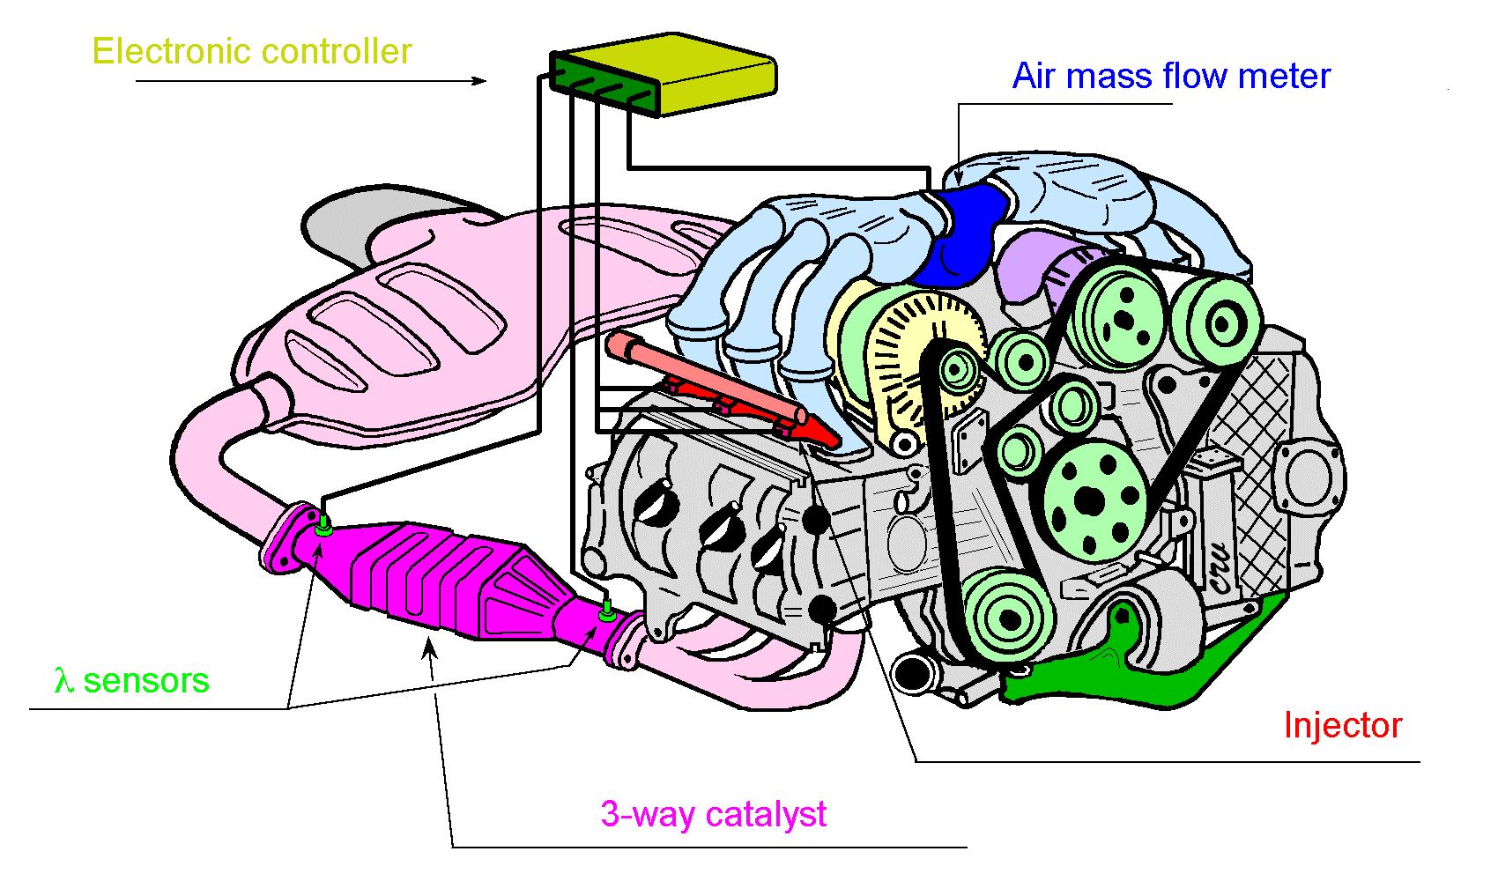
Drawbacks of current TWCs
Low activity below 300 - 400 °C
Solutions:
Active catalyst at low temperature
Close Coupled Converter (high thermal stability)

Slide 17
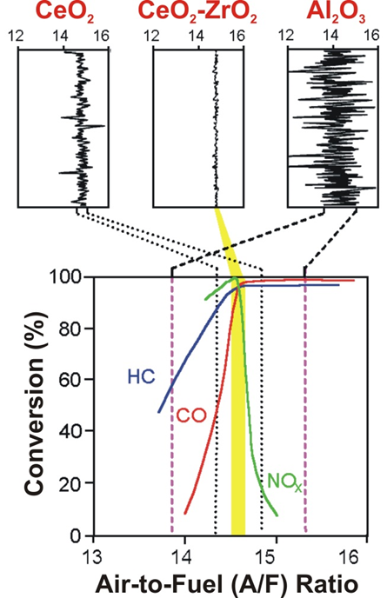
Oxygen buffer in TWCs
Need A/F close to the stoichiometric value
2CeO₂ ⇔ CeO_{2-x} + x/2 O₂
CeO₂ is an oxygen buffer

Slide 18
Why CeO₂-ZrO₂ solid solutions ?
  High thermal stability (ceramic materials)
  incorporation of CeO₂ in the solid solution
  may prevent the undesirable fixation of
  ceria in the 3+ state such as in CeAlO₃ or
  Ce₂(CO₃)₃.

Slide 19
CeO₂-ZrO₂ structure
CeO₂ CeO₂-ZrO₂ ZrO₂
Ce Zr O

Slide 20
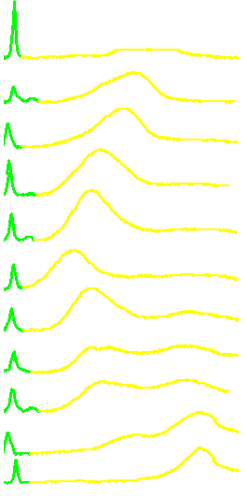
Temperature programmed reduction of 0.5% Rh/CeO₂-ZrO₂
Ce⁴⁺  Ce³⁺
% CeO₂
Rh₂O₃
10
20
30
40
50
50
60
70
80
90
100
Surface area < 1 m²/ g
Bulk effects
Hydrogen Consumption / a.u.
Tetragonal
Cubic
300 500 700 900 1100 1300
P. Fornasiero et al., J.Catal., 151 (1995) 168.
Temperature / K

Slide 21
Dynamic Oxygen Storage Capacity
Both H₂ and CO are present
in the exhaust
How the dynamic-OSC is affected by the nature of the reducing agent ?
What is the importance of surface area in the NM/CeO₂-ZrO₂ system?

Slide 22
Room temperature dynamic H₂ - OSC on Pt/Ce_{0.68}Zr_{0.32}O₂
Partial Pressure / torr x 10⁸
Pt/Al₂O₃
Pt/Ce_{0.68}Zr_{0.32}O₂
Time /s
OSC: H₂ and O₂ pulses are buffered using Pt/Ce_{0.68}Zr_{0.32}O₂

Slide 23
XRD of CeO₂/Al₂O₃ and Ce_{0.2}Zr_{0.8}O₂/Al₂O₃
Samples calcined at 1100°C and after redox ageing
CeAlO₃
CeO₂/Al₂O₃
CZ20/Al₂O₃
2 θ
ZrO₂ prevents CeAlO₃ formation

Slide 24
Dynamic CO-OSC at 600°C over the
Ce_{x}Zr_{1-x}O₂/Al₂O₃ system
CZ20/Al₂O₃
CZ60/Al₂O₃
CZ60
R. Di Monte et. al., Chem.Comm., (2000) 2167.

Slide 25
Thermal stability: effect of the interaction between Ce_{x}Zr_{1-x}O₂ and Al₂O₃
CZ20
CZ20/Al₂O₃
CZ60/Al₂O₃
CZ100/Al₂O₃

Slide 26
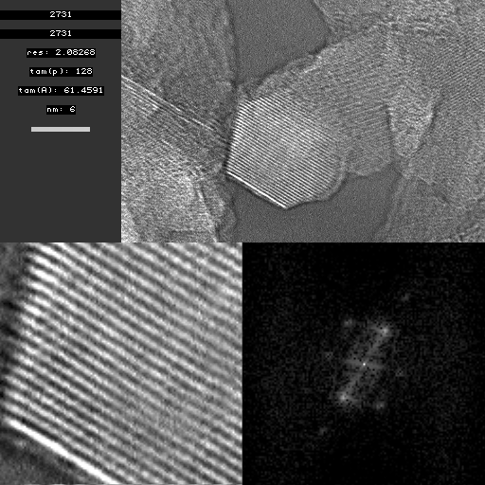

HREM of Ce_{0.2}Zr_{0.8}O₂ (13%)/ Al₂O₃
Calcined at 1100°C 5h
10 nm
30 nm
t-Ce_{0.2}Zr_{0.8}O₂
In collaboration with S. Bernal and J.M. Gatica, Univesity of Cadiz, Spain
Digital Diffraction Pattern

Slide 27
Role of Ce³⁺ sites: NO + CO Reaction
Rh/Ce_{0.6}Zr_{0.4}O_{2-x}
Rh/Al₂O₃
P. Fornasiero et al., J. Catal., 175 (1998) 269

Slide 28
NO reduction over ceria-based systems
T < 500 K T > 500 K
CO, H₂
CO, HC
CO₂, H₂O
M - CO
M
CO₂
H₂O
M - H
M - O
M
Ce³⁺
Ce⁴⁺- O
N₂O, N₂
NO
NO
N₂O, N₂
M = Rh, Pt, Pd

Slide 29
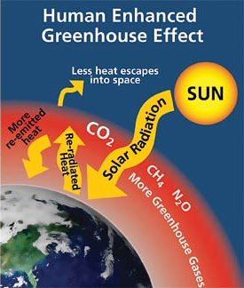
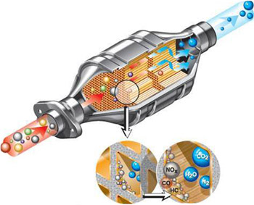
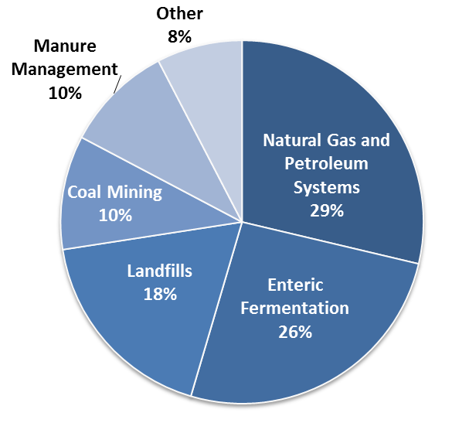
CH₄ & GREENHOUSE EFFECT
Lifetime in the atmosphere is much shorter than CO₂
More efficient at trapping radiation than CO₂
Impact of CH₄ on climate change is more than 25 times greater than CO₂
Source Identification
and Quantification
NEEDS FOR
CATALYTIC ABATEMENT
Anthropogenic sources
EPA, Emission Overview 2015

Slide 30
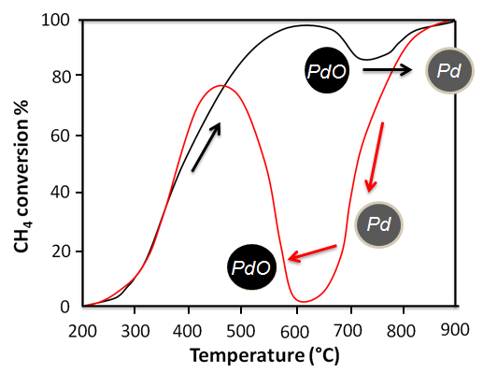
Pd-based CH₄ combustion catalysts
CH₄ + 2O₂ CO₂ + 2H₂O
Noble metal-based catalysts (Pd, Pt, Au)
PdO
2 active phases: PdO and Pd
Pd
High T
Al₂O₃
Al₂O₃
Low T
High specific activity
Lower specific activity
Pd(5%)/La-Al₂O₃
P. Gélin, M. Primet, Appl. Catal. B-Environ. 39 (2002), 1–37

Slide 31
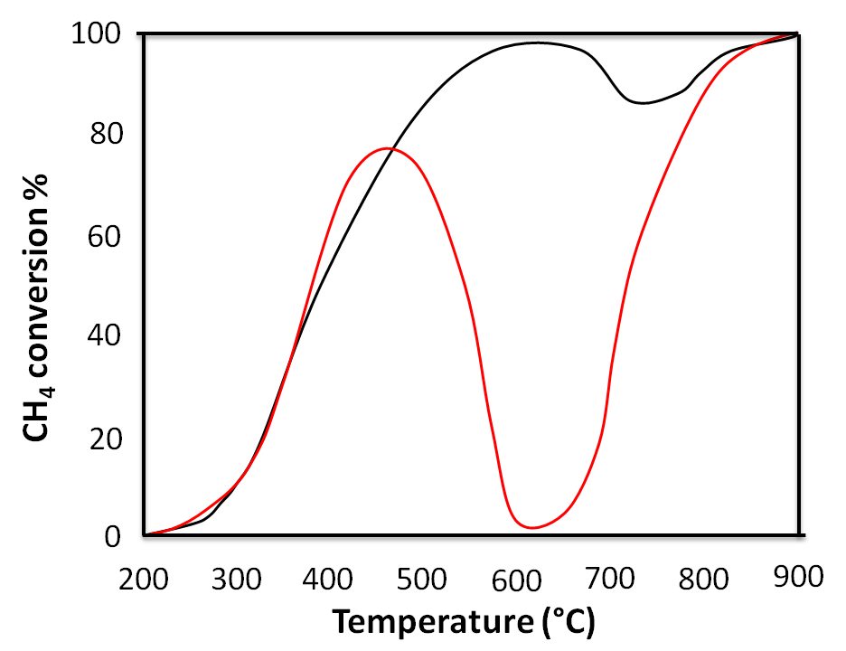
Pd-based CH₄ combustion catalysts
Catalyze re-oxidation
O₂ from the gas phase
O₂
Pd
Al₂O₃
O₂ from a PROMOTER
Pd
O₂
O
Pd
PdO
Pd
Ce ^{III}
Ce ^{III}
CeO₂
Al₂O₃
Maximize PdO - CeO₂
interaction
REDUCIBLE OXIDES

Slide 32


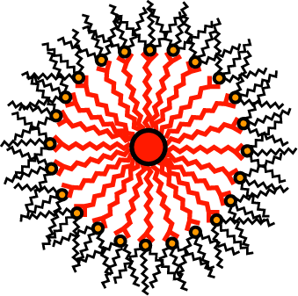
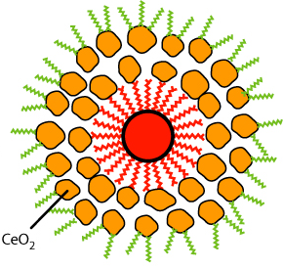
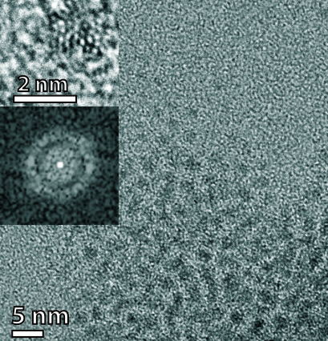
Pd@CeO₂ SUPRAMOLECULAR STRUCTURES
Ce(IV) tetrakis(decyloxide)
Hydrolysis conditions:
THF + 30 eq H₂O
(120 mol vs Ce) in 4 h
THF
MUA-Pd NPs
MUA: 11-Mercapto
Undecanoic Acid
Controlled Hydrolysis
Pd core size:
1.8 ± 0.2 nm
Dispersible in CH₂Cl₂, toluene, hexane
Montini et al. J. Am. Chem. Soc. 132 (2010), 1402-1409.

Slide 33
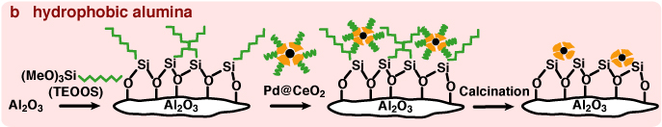
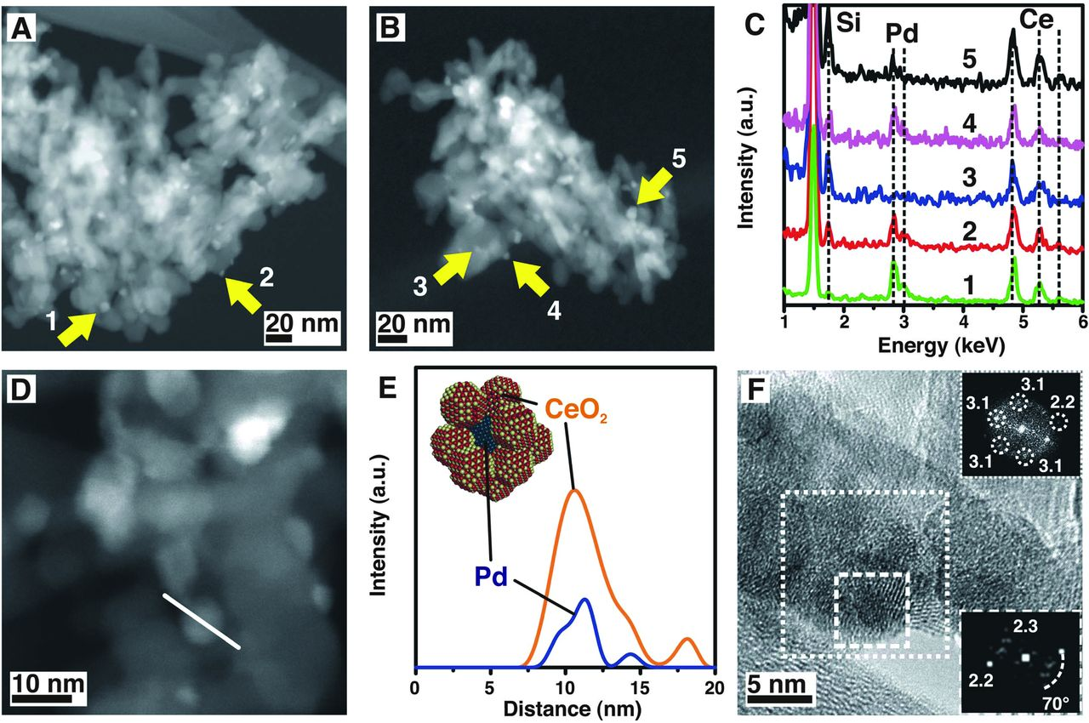
Pd@CeO₂ FOR CH₄ combustion
HAADF-STEM
Montini et al. Science 337 (2012), 713-717.

Slide 34
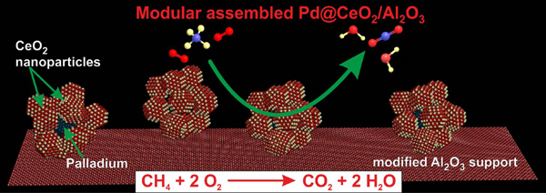
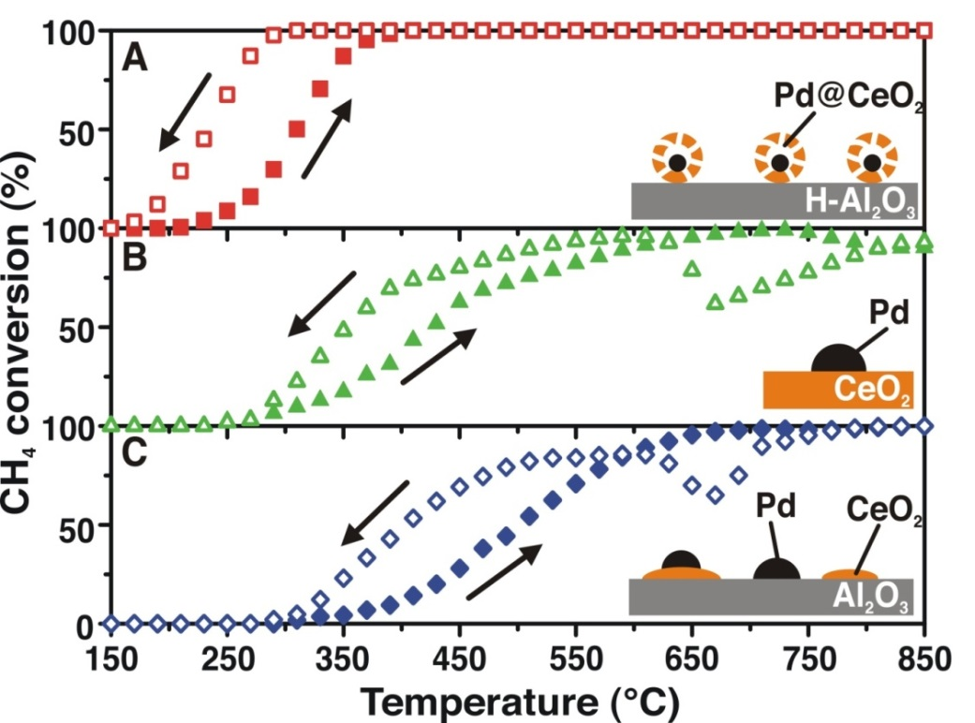
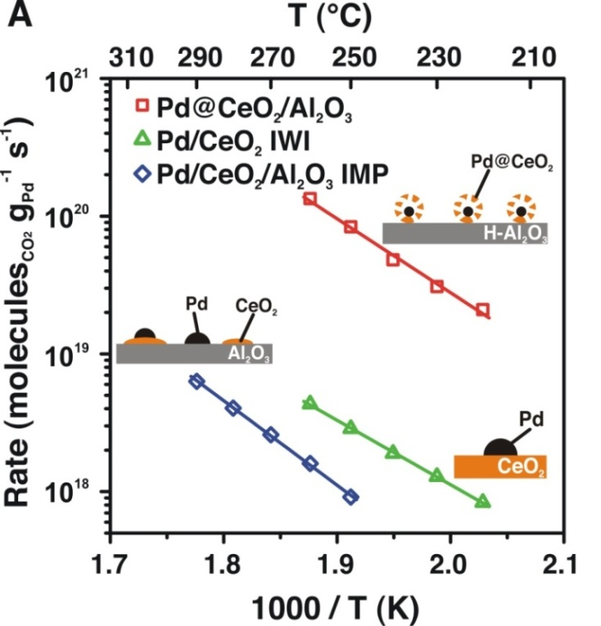
Pd@CeO₂ FOR CH₄ combustion
Montini et al. Science 337 (2012), 713-717.

Slide 35
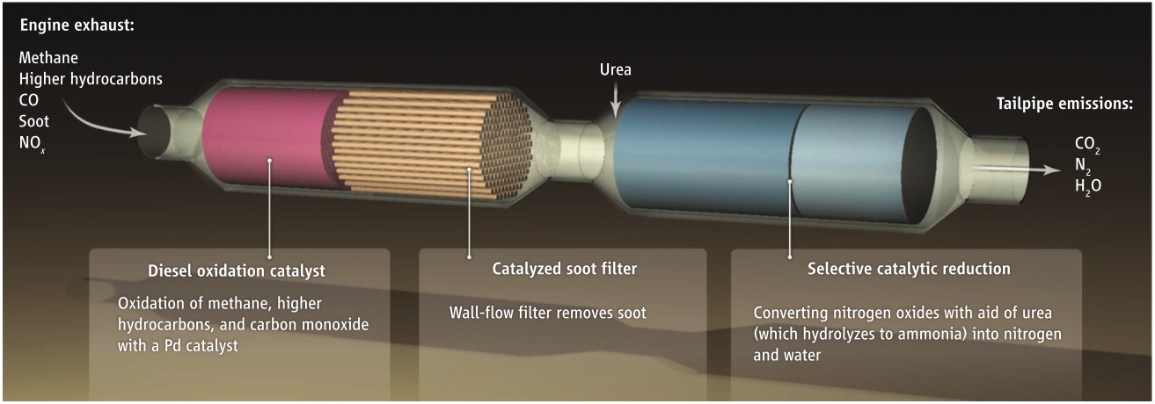
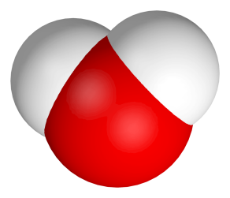
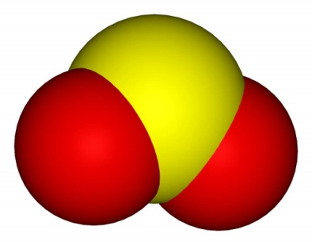
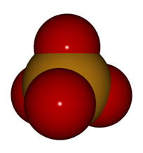
Pd@CeO₂ FOR CH₄ combustion
Water vapor
Phosphates
SO₂
PdO DEACTIVATION
R. Farrauto, Science 337 (2012), 659

Slide 36
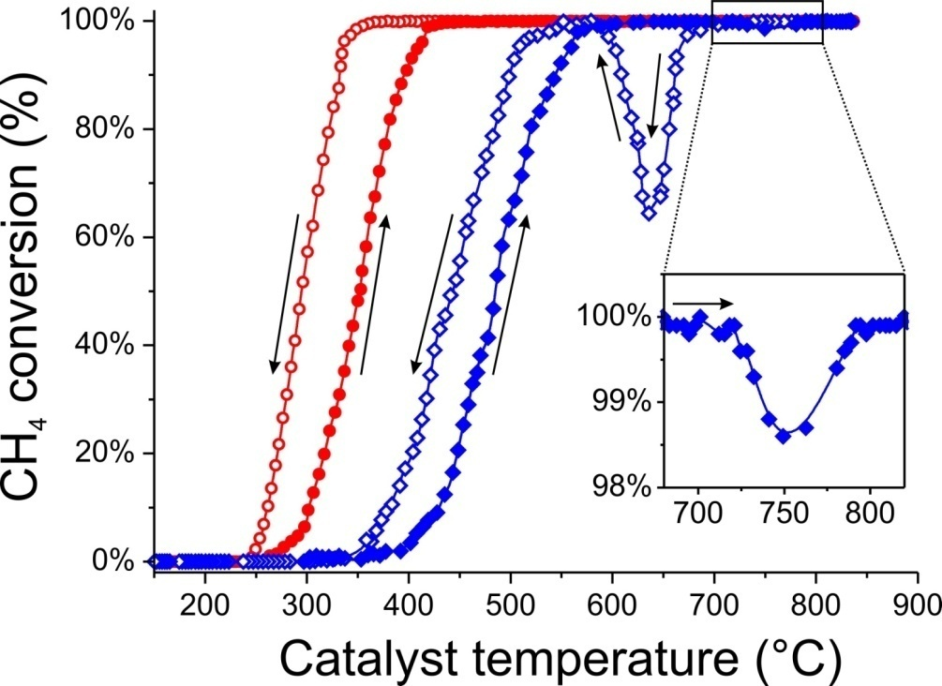

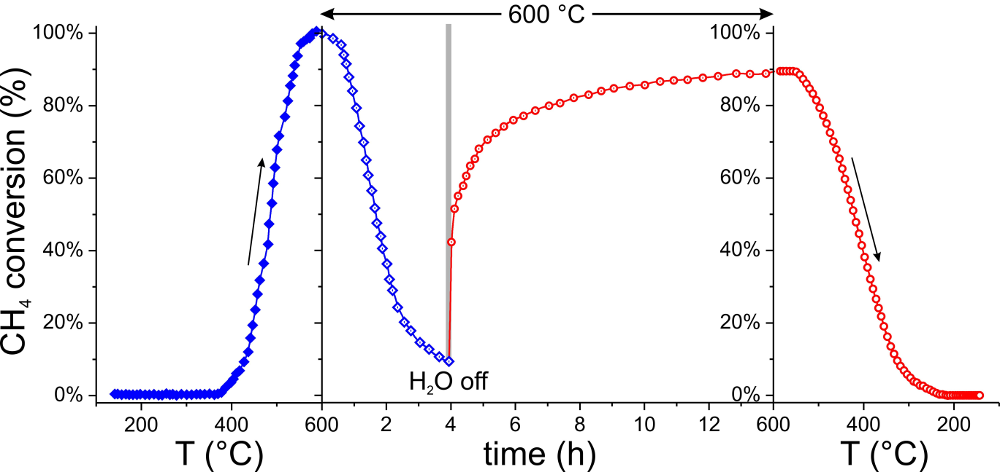
Pd@CeO₂ FOR CH₄ combustion
Light Off
Dry
Wet
Effect of water
Steady State
Wet
Dry
0.5% CH₄, 2.0% O₂, 15% H₂O (if present), Ar balance, O₂/O_{2(stoich)}=2, GHSV = 200000 mL g⁻¹ h⁻¹
Montini et al. ChemCatChem 7 (2015), 2038-2046

Slide 37


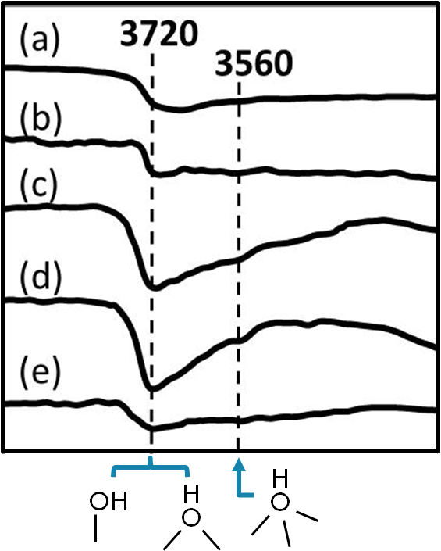
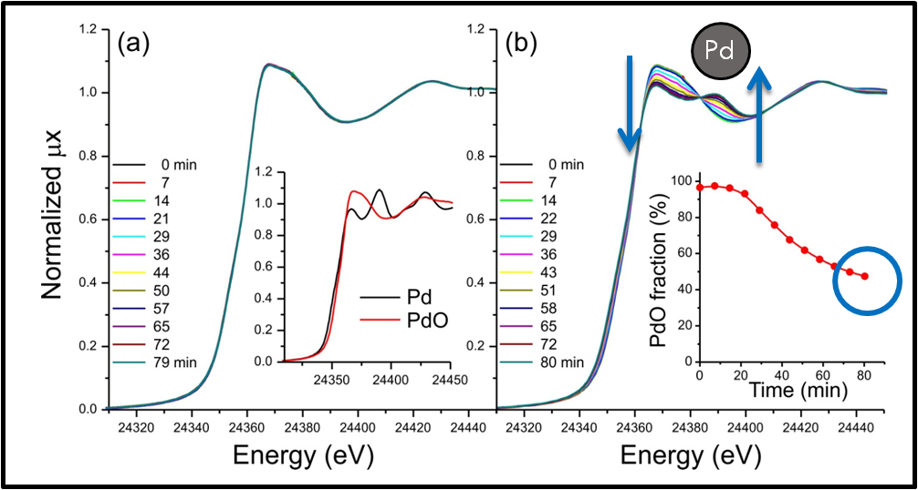
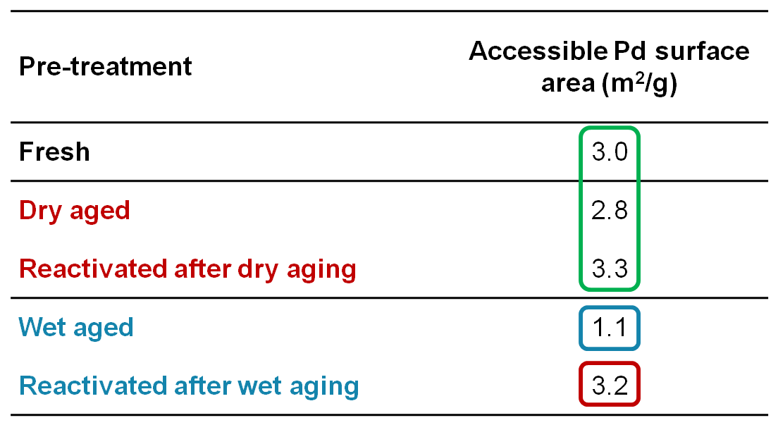
Pd@CeO₂ FOR CH₄ combustion
IR
EXAFS
Dry
Wet
Fresh
Dry-aged
Wet-aged
Chemisorption
Montini et al. ChemCatChem 7 (2015), 2038-2046

Slide 38
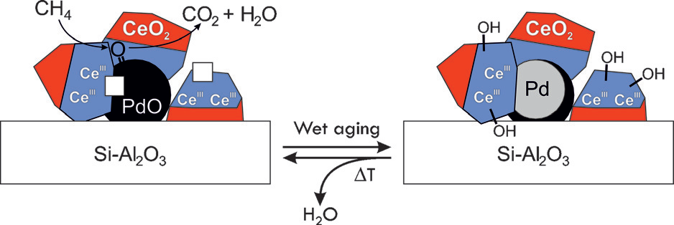
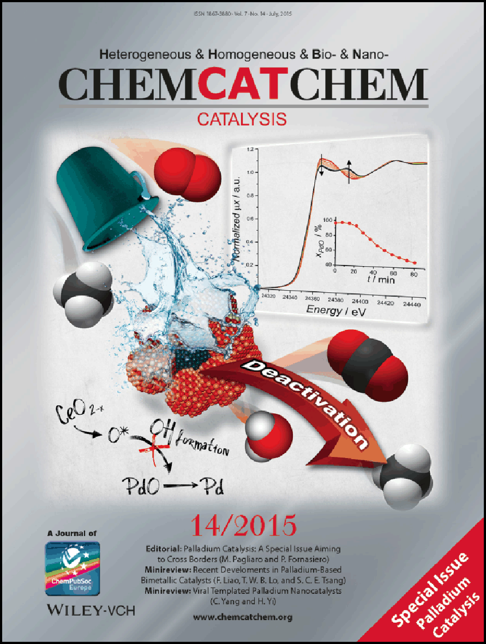
Pd@CeO₂ FOR CH₄ combustion
Reduction of PdO to Pd
Increase in population of OH
Wet aging reduces Pd accessibility
Montini et al. ChemCatChem 7 (2015), 2038-2046

Slide 39

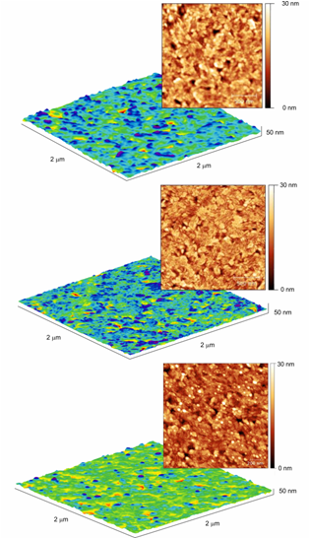
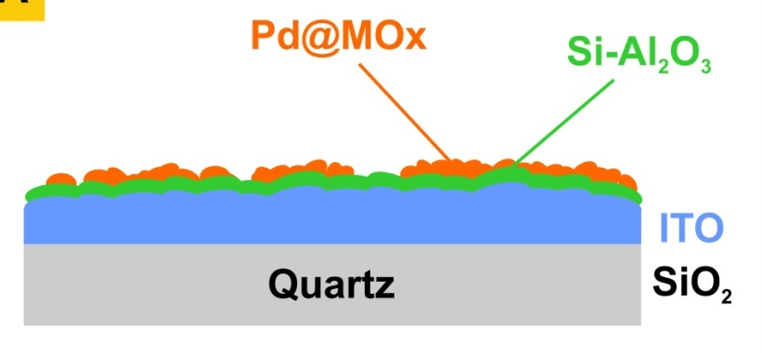
Ce⁴
Surface study: SO₂ POISONING
ITO/quartz
ALD
Al₂O₃/ITO/quartz
Pd@MOx/Al₂O₃/ITO/quartz
850°C calcination
Montini et al. Appl. Catal. B-Environ. 202 (2017), 72-83

Slide 40
Ce⁴
Surface study: SO₂ POISONING
ITO/quartz
Choose layer composition
Change thickness
General applicability
ALD
Al₂O₃/ITO/quartz
Model materials comparable to real catalysts
Pd@MOx/Al₂O₃/ITO/quartz
850°C calcination
Montini et al. Appl. Catal. B-Environ. 202 (2017), 72-83

Slide 41
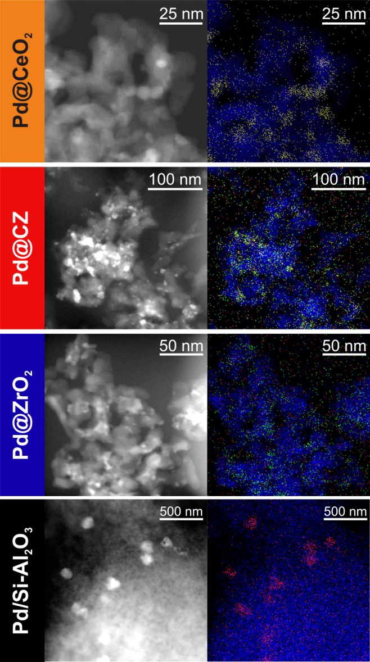
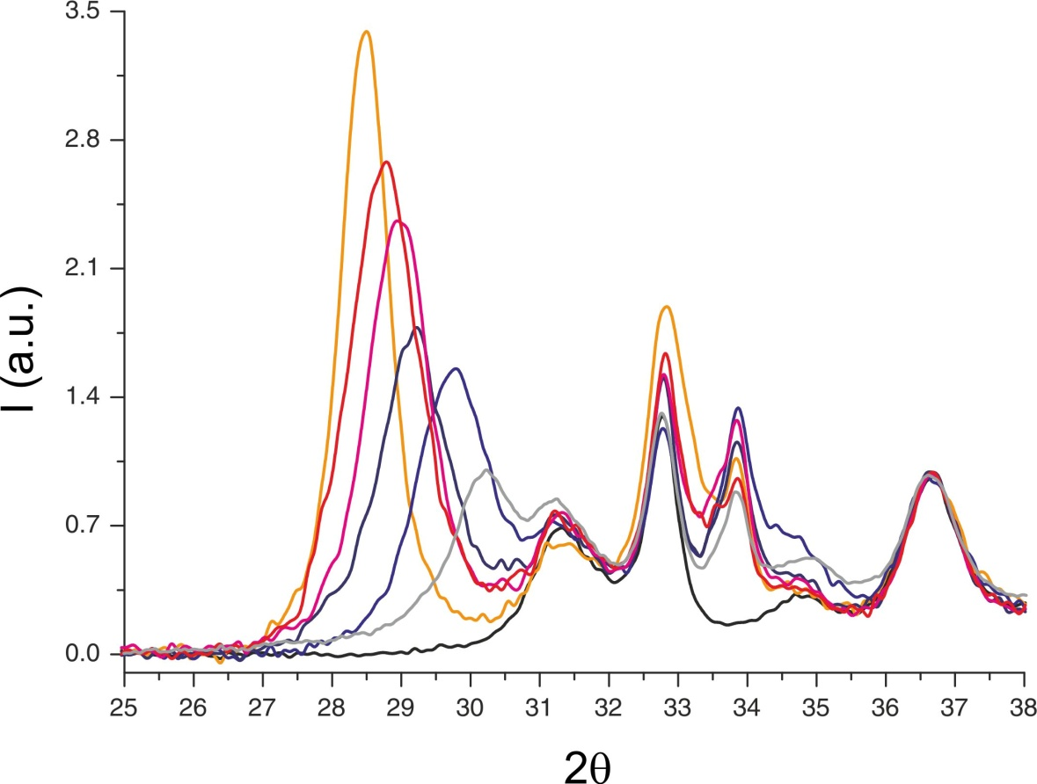
Ce⁴
Surface study: SO₂ POISONING
Surface area 90-100 m²g⁻¹
Pd accessible area 3 m² g⁻¹ (~ 60% D)
Similar activity in light off experiments
CeO₂
XRD
80:20
60:40
PdO
40:60
20:80
ZrO₂
Montini et al. Appl. Catal. B-Environ. 202 (2017), 72-83

Slide 42
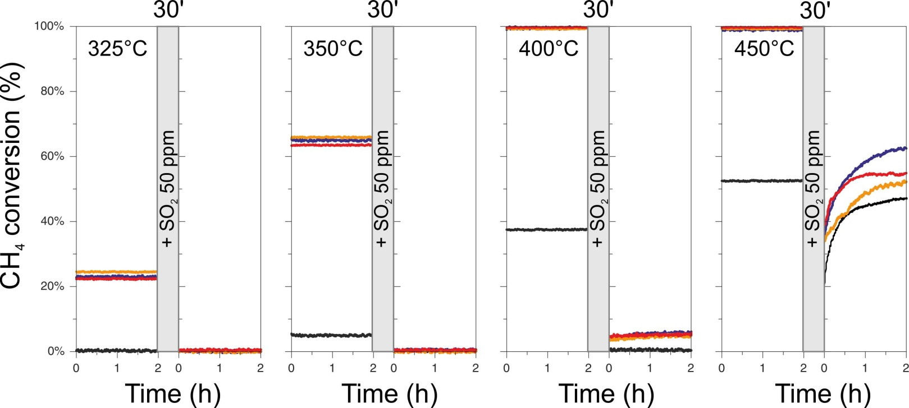
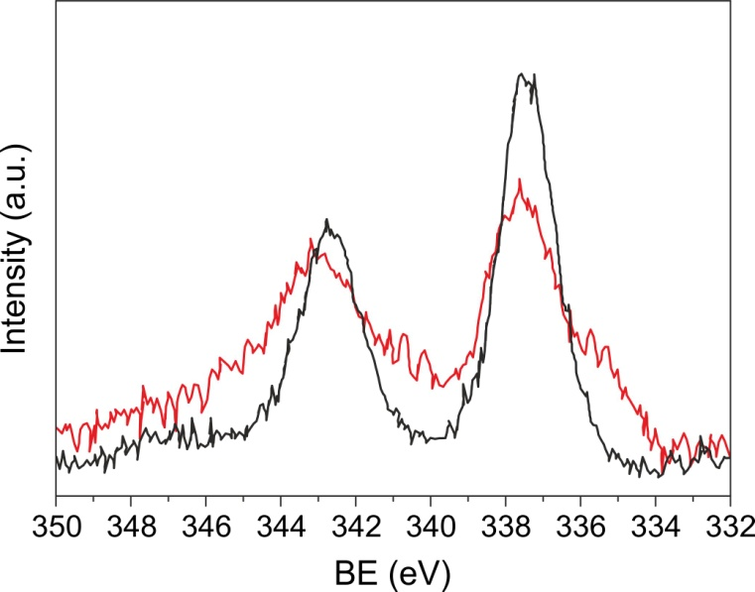
Ce⁴
Surface study: SO₂ POISONING
Low T
Pd@ZrO₂
Pd@CeO₂
Pd@CZ
Pd
0.5% CH₄, 2.0% O₂, SO₂ 50 ppm (if present), Ar balance, O₂/O_{2(stoich)}=2, GHSV = 200000 mL g⁻¹ h⁻¹
Pd-SO₄
Pd (0)
Fresh
Similar performances
complete deactivation
SO₂ 350°C Aged
SO₂ + PdO → SO₃ + Pd
SO₃ + PdO → PdSO₄
Montini et al. Appl. Catal. B-Environ. 202 (2017), 72-83

Slide 43
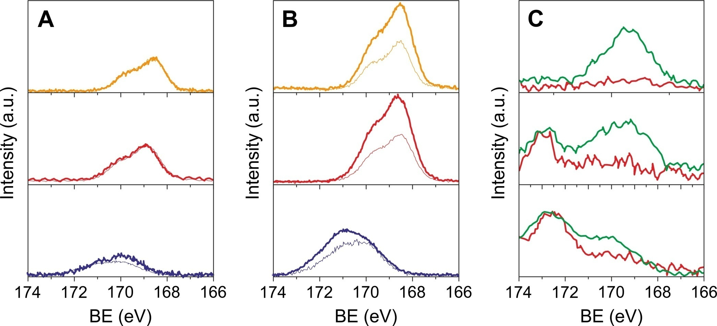
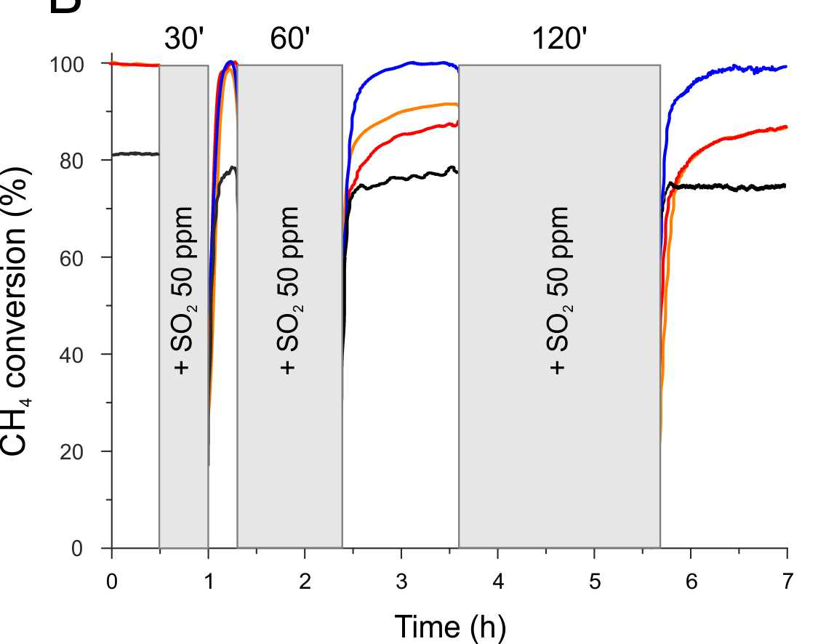
Ce⁴
Surface study: SO₂ POISONING
Sulfates formation/desorption
Pd@ZrO₂ more resistant
Less sulfates formed and partial desorption
S 2p region
CeO₂
Catalytic Activity
CZ
Pd@ZrO₂
ZrO₂
Pd@CeO₂
Pd@CZ
Pd
0.5% CH₄, 2.0% O₂, SO₂ 50 ppm(if present), Ar balance, O₂/O_{2(stoich)}=2, GHSV = 200000 mL g⁻¹ h⁻¹
Montini et al. Appl. Catal. B-Environ. 202 (2017), 72-83

Slide 44
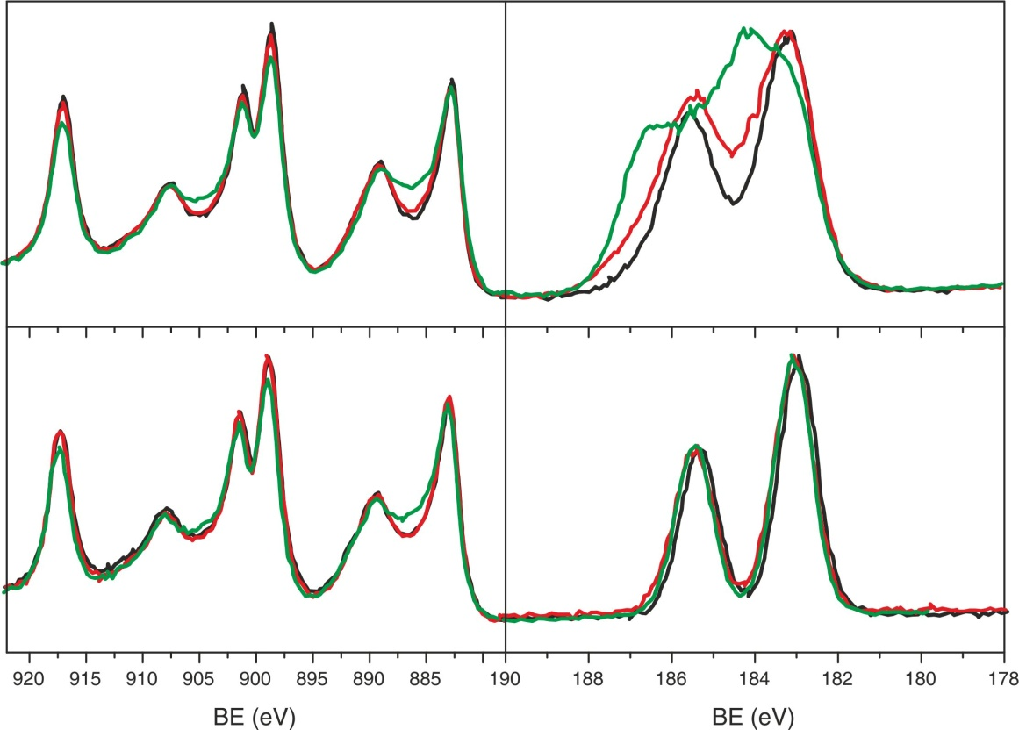
Surface study: SO₂ POISONING
Single Cations Sulfates
XPS
Ce 3d
Zr 3d
CeO₂
ZrO₂
Pristine
500°C SO₂/dry
600°C SO₂/dry
At 600°C: no deactivation observed
Modification of Ce and Zr spectra
Zr signal not affected in CZ
In CZ, sulfates are mostly formed on Ce
CZ
CZ
Montini et al. Appl. Catal. B-Environ. 202 (2017), 72-83

Slide 45
Advantages of Lean technology
Lean technology (Excess of air: A/F > 14.6)
fuel economy (15-35%)
decreased CO₂ emissions
low HC and CO emissions
Drawback of Lean technology
The reduction of NO_{x} is very
difficult in the presence of a large excess of O₂
4 NH₃ + 4NO + O₂ ⇒ 4 N₂ + 6 H₂O
C. Cohn et al., 1961, US Patent 2, 975, 025.

Slide 46
Selective Catalytic Reduction of NO_{x} with NH₃
4 NH₃ + 4NO + O₂ ⇒ 4 N₂ + 6 H₂O
4 NH₃ + 2NO₂ + O₂ ⇒ 3 N₂ + 6 H₂O
Stationary applications but NOT (yet) for car :
Separate and additional supply system
Slip of ammonia
and on board NH₃ production ?
2NO + 5 H₂ ⇒ 2 NH₃ + 2 H₂

Slide 47
APPARATUS FOR POLLUTANTS ABATEMENT FROM DIESEL ENGINEES

Slide 48
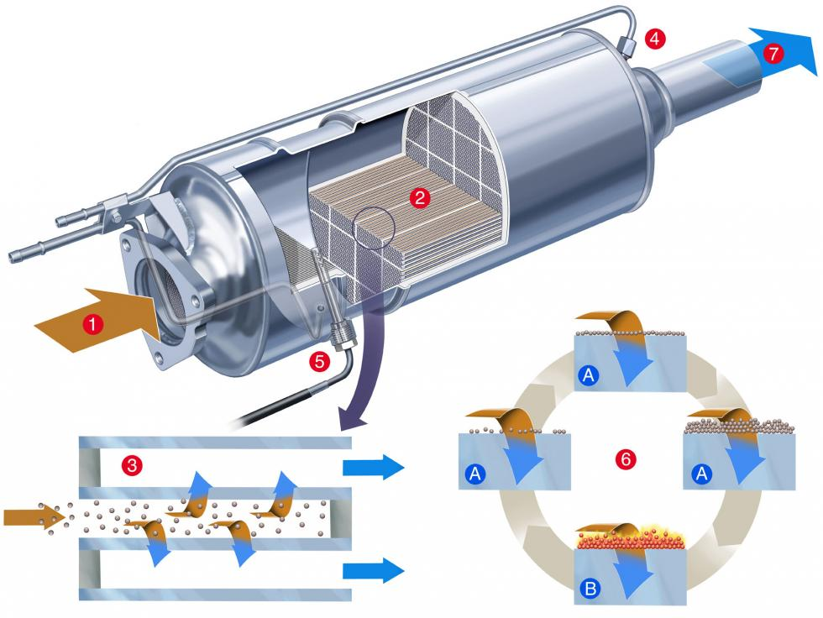
APPARATUS FOR POLLUTANTS ABATEMENT FROM DIESEL ENGINEES

Slide 49
Scheme of the converter
HC Oxidation
NH₃-SCR
Urea

Slide 50
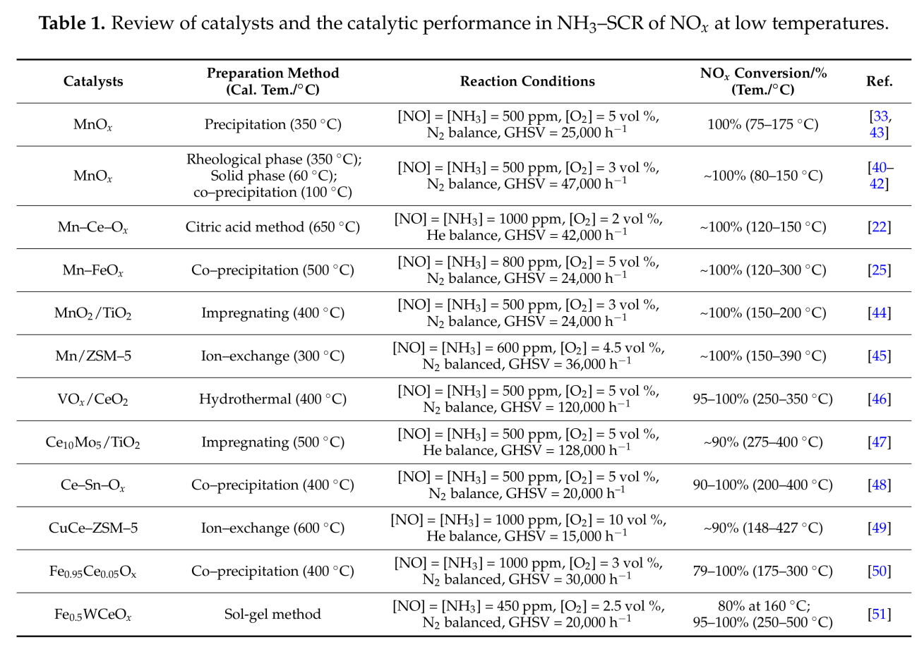

Catalysts
Catalysts 2017, 7, 199

Slide 51

Mechanism

Slide 52
Lean burn catalysts: zeolite-based materials
NO decomposition on Cu-ZSM5
NO ⇒ N₂ + O₂
High temperatures favours NO desorption
H₂O slightly effects the activity
NO decomposition is inhibited by O₂
Selective catalytic reduction of NO with hydrocarbons
HC + NO_{x} + O₂ ⇒ N₂ + H₂O + CO₂

Slide 53
Bifunctional DeNO_{x} catalyst
100
Mn₂O₃ / Ce-ZSM-5
(%)
₂
80
Ce-ZSM-5
60
Conversion on NO to N
40
20
0
100
200
300
400
500
600
Temperature (°C)
O₂
C₃H₆
NO₂/O₂
NO
NO₂
X
N₂ (+ CO_{x}, H₂O)
i
ii
iii
X = organic nitro/nitroso compound
C. Yokoyama and M. Miosnoi, Catal. Lett., 29 (1994) 1.

Slide 54
Silver DeNO_{x} catalysts
DeNO_{x}: NO + HC N₂ + CO₂
HC combustion: O₂ + HC H₂O + CO₂
Pt and Pd good oxidation catalyst
Growing interest in the use of Ag-based catalysts as possible alternatives
Ag/Al₂O₃ has been widely studied

Slide 55
Silver DeNO_{X} catalyst:
Particle size effect on activity
Increasing the silver loading shifts the activity to lower temperature
C₃H₆ and NO Conversion (%)
10% Ag/ γ - Al₂O₃
1.2% Ag/ γ - Al₂O₃
F.C. Meunier et al. J. Catal. 187 (1999) 493.

Slide 56
Silver DeNO_{X} catalyst:
Particle size effect on selectivity
10% Ag/ γ -Al₂O₃
1.2% Ag/ γ - Al₂O₃
60
60
50
50
40
40
NO₂
Yield (%)
Yield (%)
N₂
30
30
NH₃
20
20
N₂O
10
10
0
0
200
300
400
500
600
200
300
400
500
600
Temperature (°C)
Temperature (°C)
F.C. Meunier et al. J. Catal. 187 (1999) 493.

Slide 57
Silver DeNOx catalyst: Different roles of Ag during the C₃H₆-SCR over Ag/ γ - Al₂O₃
NO / O₂
C₃H₆
H₂O
CO_{x}
N₂O + N₂
O₂
N₂
NO + O₂
C₃H₆
NO₂
O
N
N
O
C_{x}H_{y}
R-ONO
Ag ⁰
NO_{x}⁻
R-NO₂
R-NCO
R-NH₂
NH₃
Ag⁺
Al₂O₃

Slide 58
Silver DeNO_{x} catalysts
There is a support effect on the De-NOx activity of Ag:
Both using ZrO₂ and Ce_{0.16}Zr_{0.84}O₂ as support results in a much lower activity range in comparison with Al₂O₃.
Ag/ZrO₂ deactivates completely in the presence of SO₂ but it can be easily regenerated.
Ag/Al₂O₃ deactivates partially in the presence of SO₂ and it is not easily regenerated.
Ag/Ce_{0.16}Zr_{0.84}O₂ deactivates partially in the presence of SO₂ and it can be easily regenerated.

Slide 59
“ The Toyota” concept
None of the studied system show acceptable activity, hydrothermal stability or resistance to sulphur.
So, perhaps it is not possible to achieve the goal of efficiently reducing NO_{x} in the car exhaust under oxidising condition.

Slide 60
NO_{X} storage catalyst: lean conditions
CO₂
NO + 1/2 O₂
NO₂
Pt
Ba(NO₃)₂
BaCO₃
Rh
Al₂O₃

Slide 61
NO_{X} storage catalyst: rich conditions
CO + HC + H₂
NO_{x}
CO
Pt
Ba(NO₃)₂
BaCO₃
Rh
Al₂O₃
N₂ + CO₂

Slide 62
Toyota catalyst: time profiling
350
Temperature / °C
325
300
300
NO_{x} inlet
200
NO_{x} / ppm
100
Rich pulse
NO_{x} outlet
0
0
0.5
1.0
1.5
2.0
2.5
Time / min

