Slide 1
Photocatalytic oxidation of naphtalene in aqueous and organic solvents

Slide 2
Selective oxidation of alcohols in gas phase using light activated TiO₂
J. Catal. 2002, 211, 434-444

Slide 3
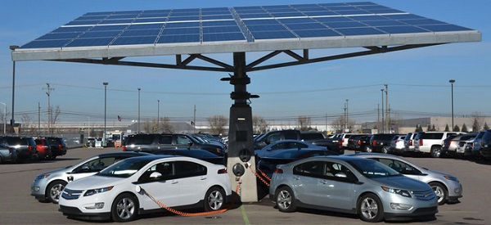

ELECTRICAL VEHICLES
Electric Vehicles Smart Fleets
Electric Unmanned aerial vehicles

Slide 4
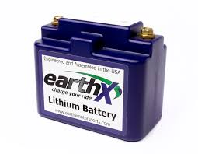

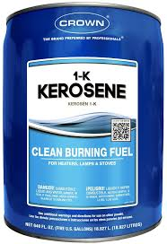

ELECTRIC / HYBRID AIRCRAFT
2 hrs 250 Kg of batterie
1 MJ/Kg
43 MJ/Kg
7 hrs 260,000 Kg of batteries

Slide 5
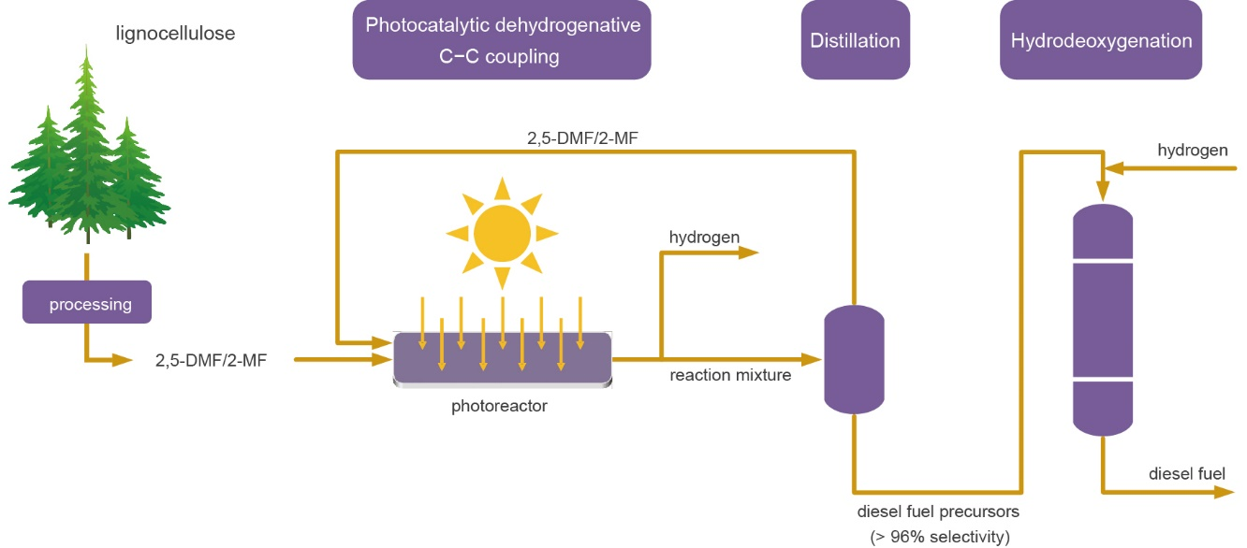
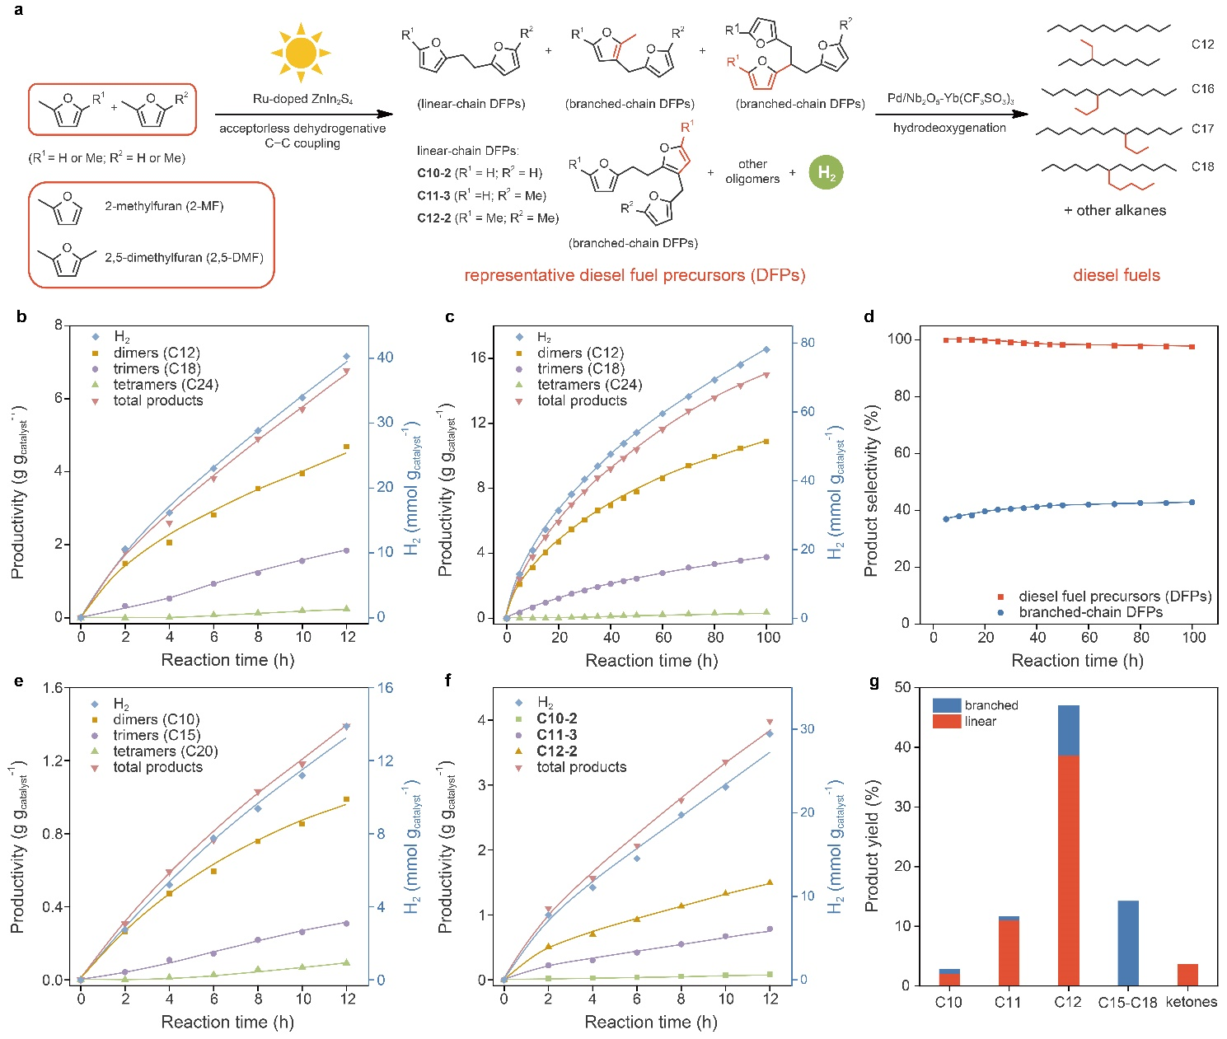


VISIBLE-LIGHT-DRIVEN COPRODUCTION OF
DIESEL FUEL PRECURSORS AND HYDROGEN
Nature Energy 4 (2019), 575-584

Slide 6
VISIBLE-LIGHT-DRIVEN COPRODUCTION OF
DIESEL FUEL PRECURSORS AND HYDROGEN
Nature Energy 4 (2019), 575-584

Slide 7
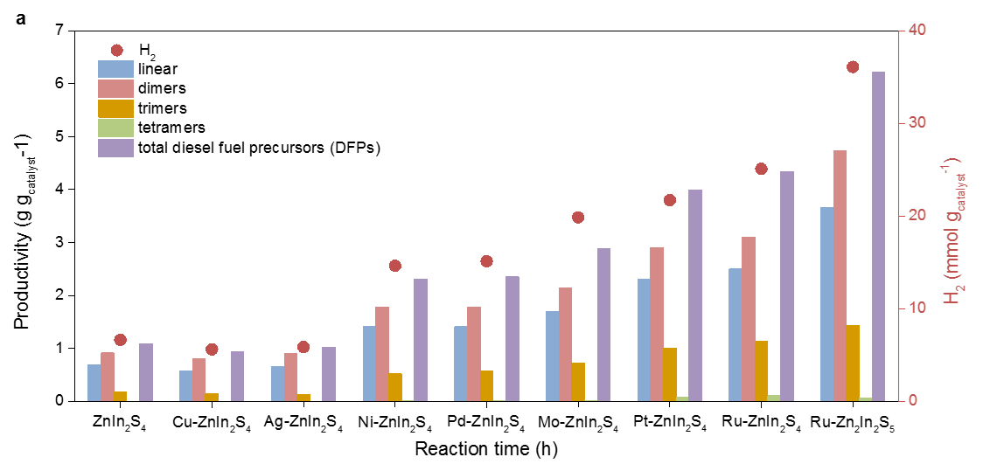
VISIBLE-LIGHT-DRIVEN COPRODUCTION OF
DIESEL FUEL PRECURSORS AND HYDROGEN
Doped-ZnIn₂S₄ photocatalysts
Nature Energy 4 (2019), 575-584

Slide 8
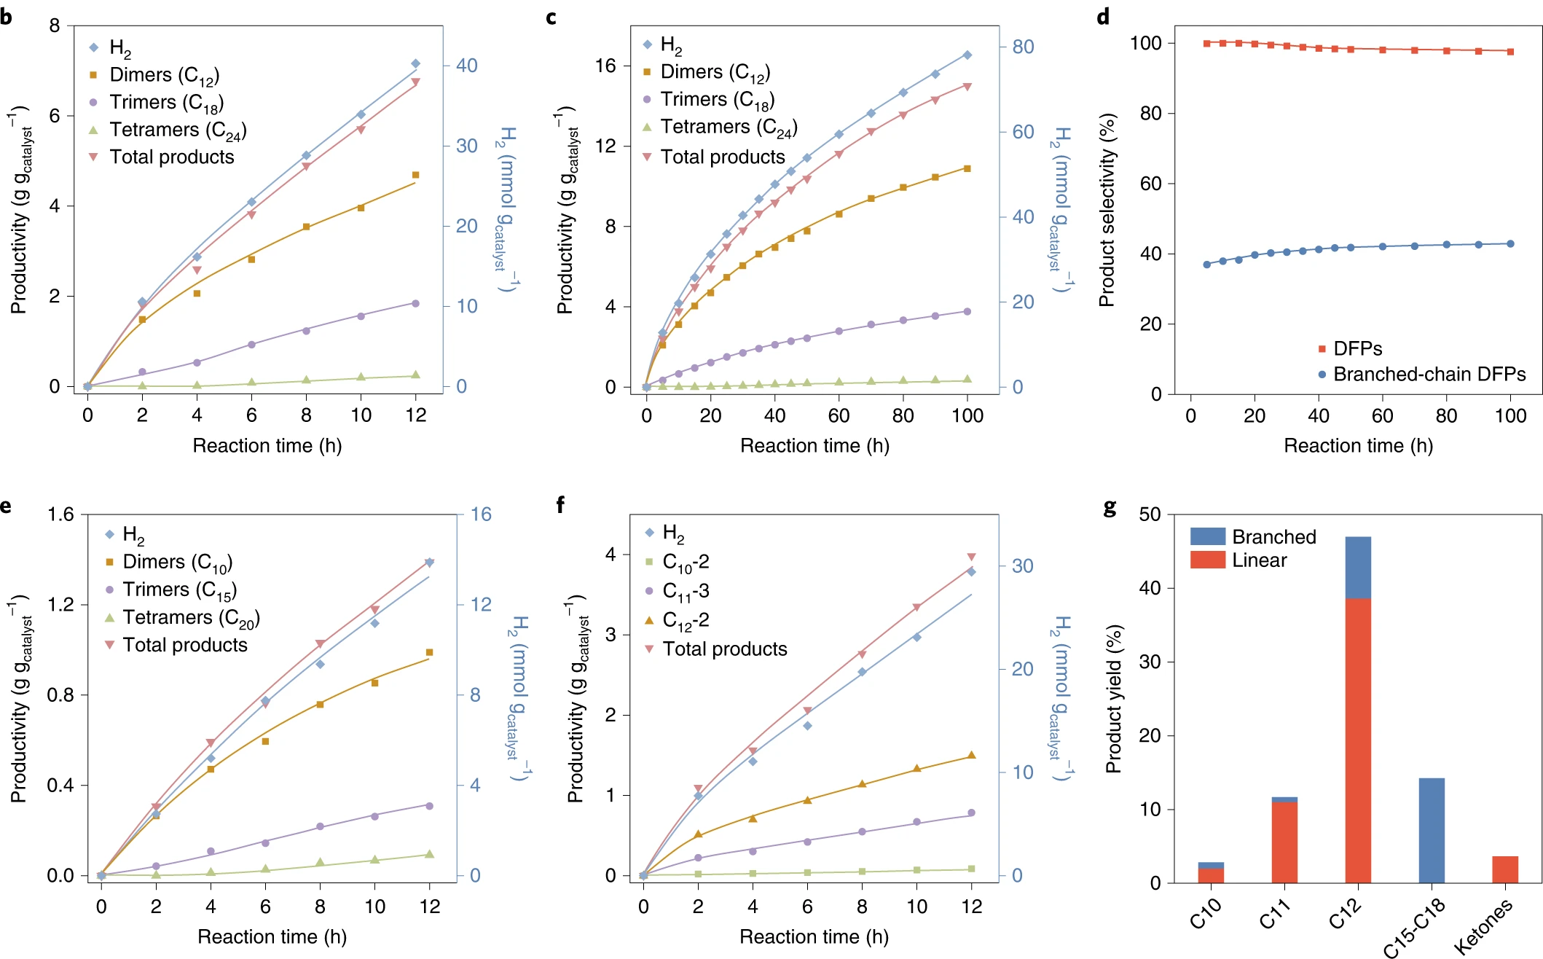
VISIBLE-LIGHT-DRIVEN COPRODUCTION OF
DIESEL FUEL PRECURSORS AND HYDROGEN
Ru-ZnIn₂S₄ photocatalyst
2,5-DMF
0.56 g of DPF g _{cat}⁻¹ h⁻¹
3.3 mmol of H₂ g _{cat}⁻¹ h⁻¹
AQY 15.2 %
2-MF
2,5-DMF + 2-MF
Nature Energy 4 (2019), 575-584

Slide 9
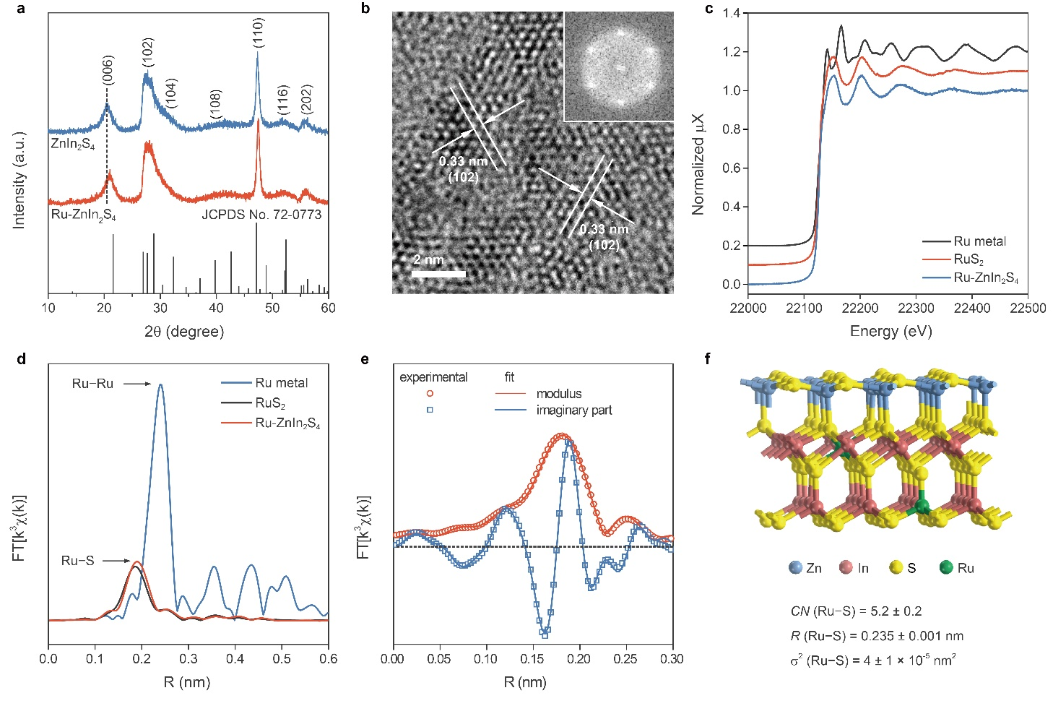
VISIBLE-LIGHT-DRIVEN COPRODUCTION OF
DIESEL FUEL PRECURSORS AND HYDROGEN
Ru-ZnIn₂S₄ photocatalyst
Nature Energy 4 (2019), 575-584

Slide 10
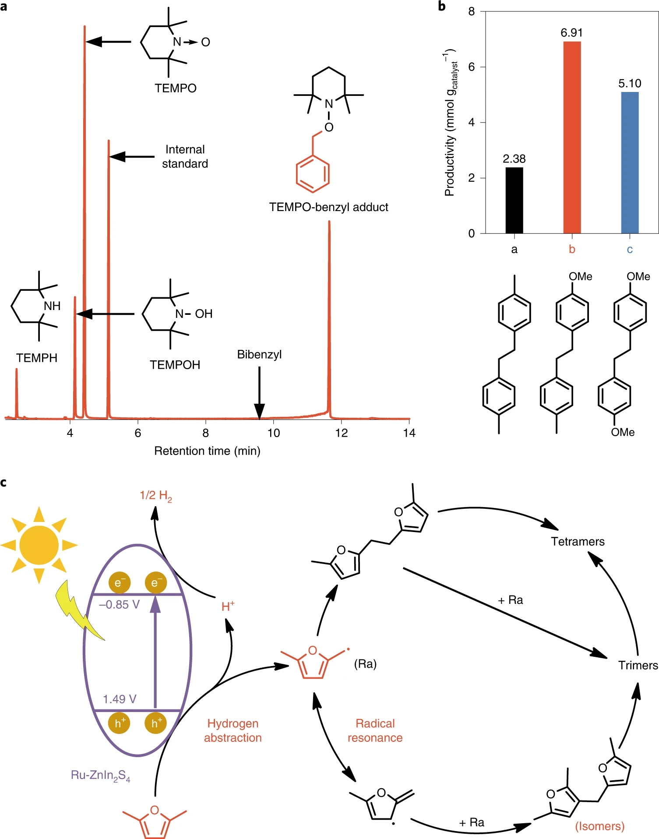
VISIBLE-LIGHT-DRIVEN COPRODUCTION OF
DIESEL FUEL PRECURSORS AND HYDROGEN
Ru-ZnIn₂S₄ photocatalyst
Radical mechanism
confirmed
Nature Energy 4 (2019), 575-584

Slide 11
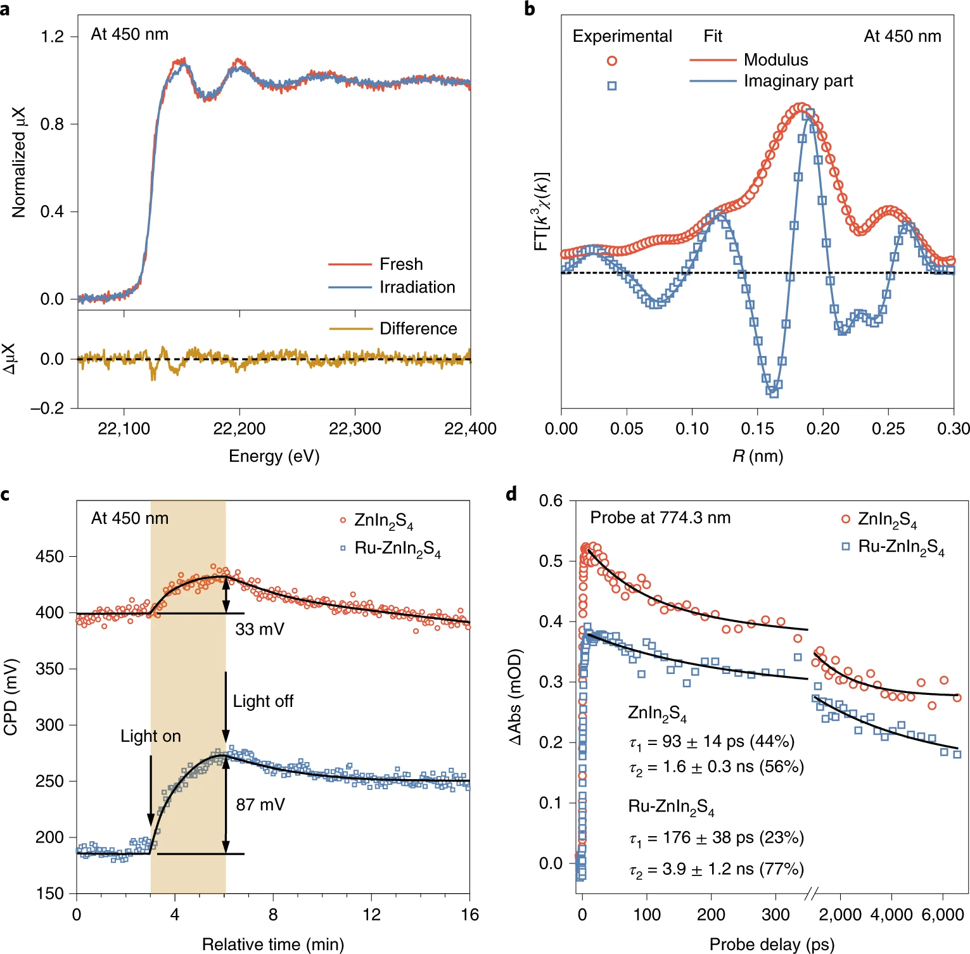
VISIBLE-LIGHT-DRIVEN COPRODUCTION OF
DIESEL FUEL PRECURSORS AND HYDROGEN
Ru-ZnIn₂S₄ photocatalyst: role of Ru
Decreased band gap
Stabilization of e⁻/h⁺ pairs
Reduction of Ru ions to Ru(0) justifies slight deactivation
Nature Energy 4 (2019), 575-584

Slide 12
PHOTOCATALYTIC SYNTHESIS OF BENZIMIDAZOLES
Conventional synthesis of benzimidazoles:
T = 100 – 200 °C
Strong acidic conditions
Strong oxidants
Very toxic and
carcinogenic
Synthesis of natural products and pharmaceuticals (bactericides, anticarcinogens, peptic ulcera agents, etc.)
Metal complexes (homogeneous catalysts, sensors, etc.)

Slide 13
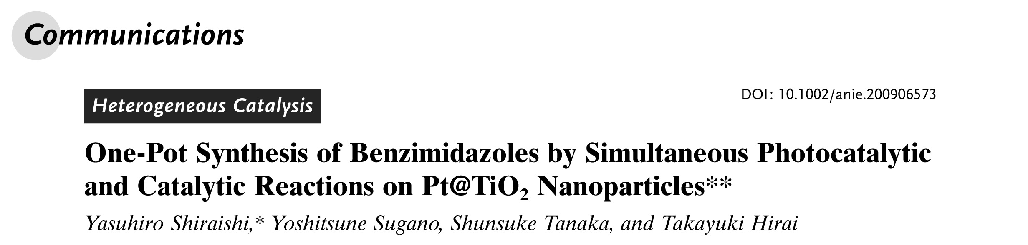

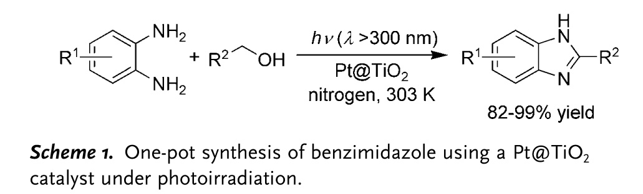
PHOTOCATALYTIC SYNTHESIS OF BENZIMIDAZOLES
Conventional synthesis of benzimidazoles:
T = 100 – 200 °C
Strong acidic conditions
Strong oxidants
Very toxic and
carcinogenic

Slide 14
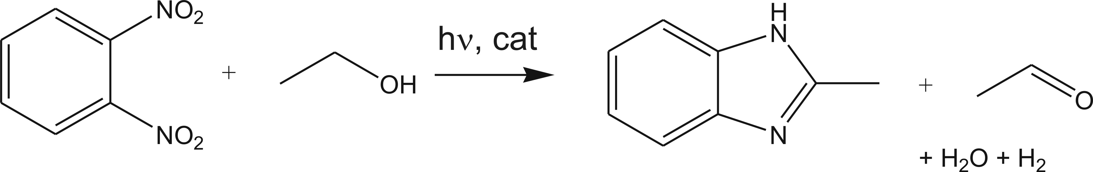
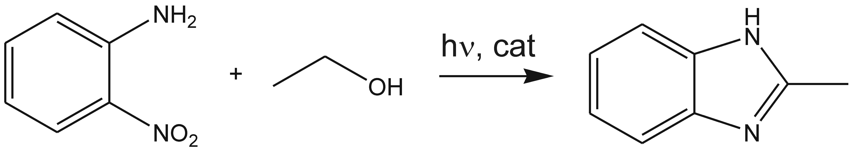
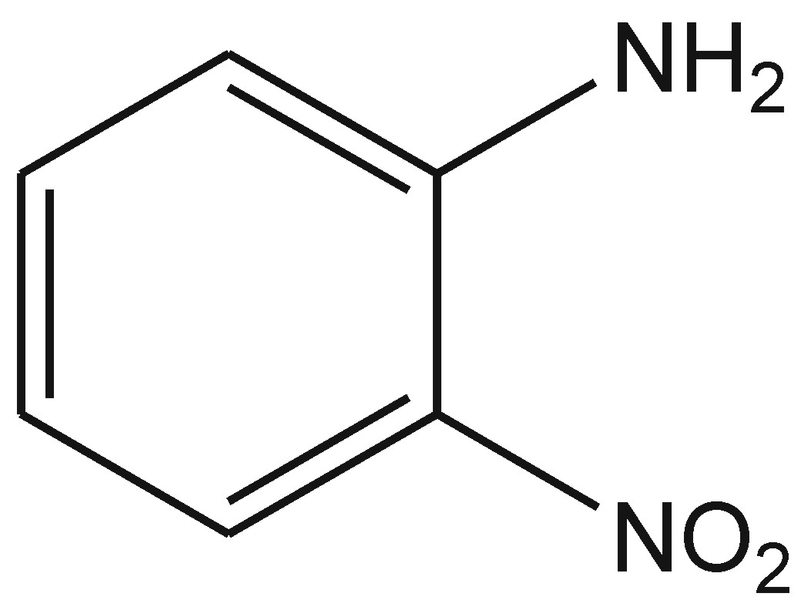
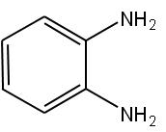


PHOTOCATALYTIC SYNTHESIS OF BENZIMIDAZOLES
Alternative processes:
Less toxic reagents
Renewable and cheap solvent
[H]_{ads}
hν, cat

Slide 15
PHOTOCATALYTIC SYNTHESIS OF BENZIMIDAZOLES
Anatase
TiO₂-B,N
Brookite
TiO₂
Rutile
Mixture of polymorphs
High surface area
Improved by B,N doping
TiO₂-B,N
 | Composition (wt%) |  |  | Crystallite size (nm) |  |  | Surface area (m² g⁻¹)
 | Anatase | Brookite | Rutile | Anatase | Brookite | Rutile
TiO₂ | 64 | 28 | 8 | 11 | 11 | 32 | 80
TiO₂-B,N | 68 | 26 | 6 | 8 | 7 | 12 | 138
Inorg. Chim. Acta 520 (2021), n° 120289

Slide 16
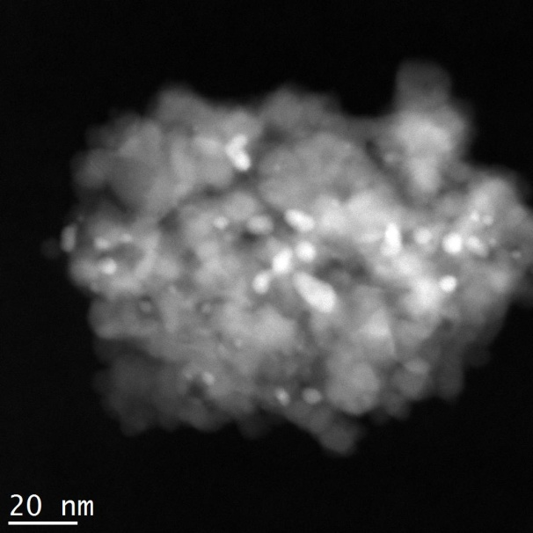
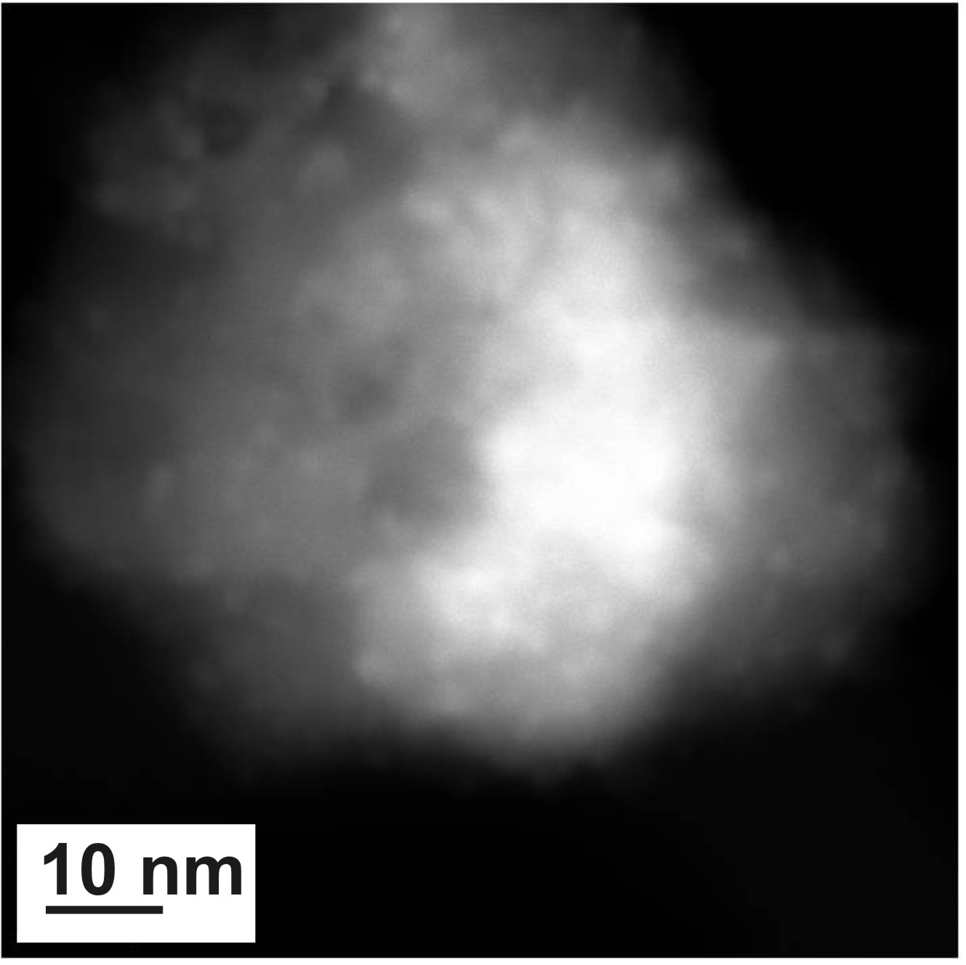
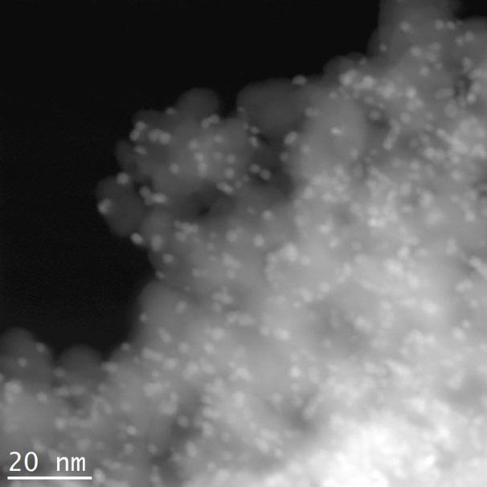
PHOTOCATALYTIC SYNTHESIS OF BENZIMIDAZOLES
Metal photodeposition
Support +
metal nitrate
50% water- 50% ethanol
Metal/TiO₂-B,N
UV-vis irradiation
Pd 0.5wt%
HAADF-STEM
Ag 0.5wt%
Pt 0.5wt%
Cu 1.0wt%

Slide 17
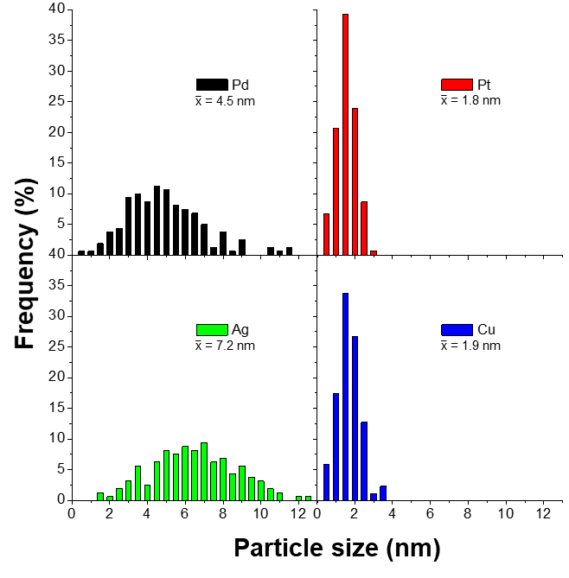
Characterization of the M/TiO₂-B,N
PHOTOCATALYTIC SYNTHESIS OF BENZIMIDAZOLES
Inorg. Chim. Acta 520 (2021), n° 120289

Slide 18
H₂ production from ETHANOL 96%
PHOTOCATALYTIC SYNTHESIS OF BENZIMIDAZOLES
Gas phase
Effect of:
Support
Cu/TiO₂
Cu/TiO₂-B,N
Doping TiO₂, leaching is significantly reduced
More stable performances for TiO₂-B,N supported catalysts
Metal
Inorg. Chim. Acta 520 (2021), n° 120289

Slide 19
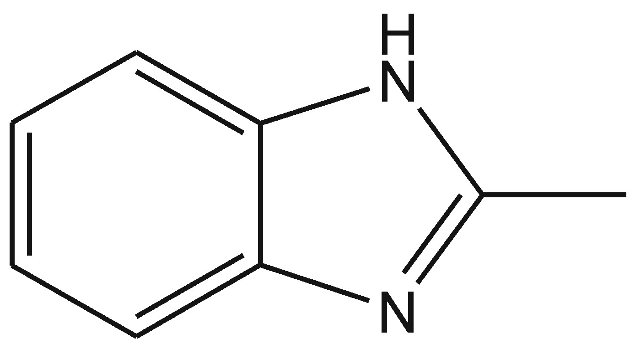
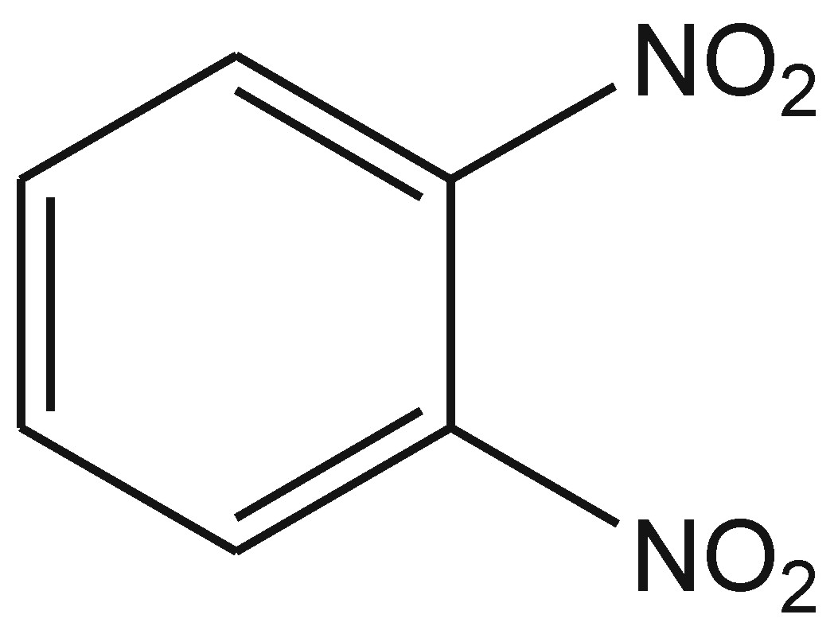
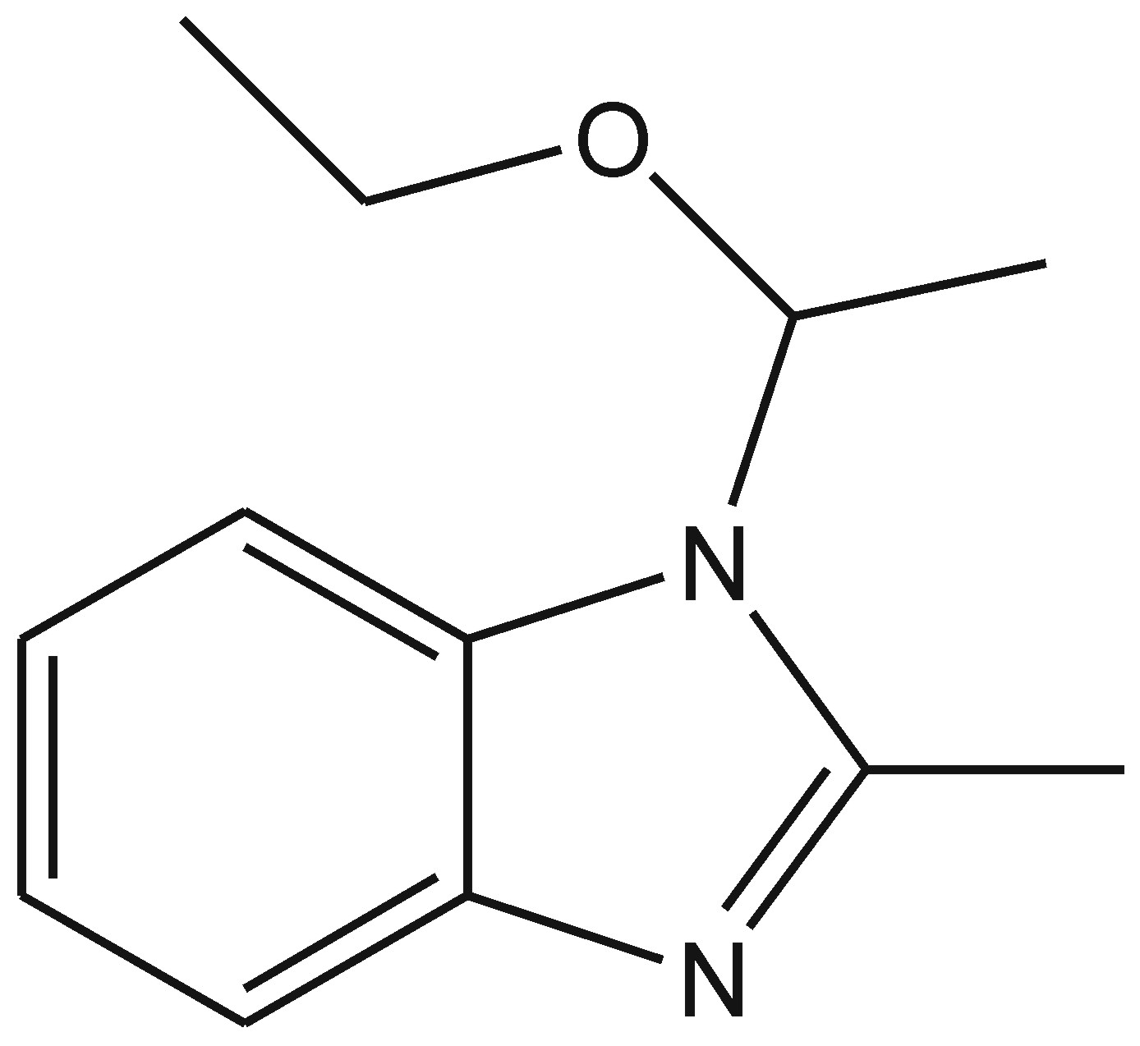
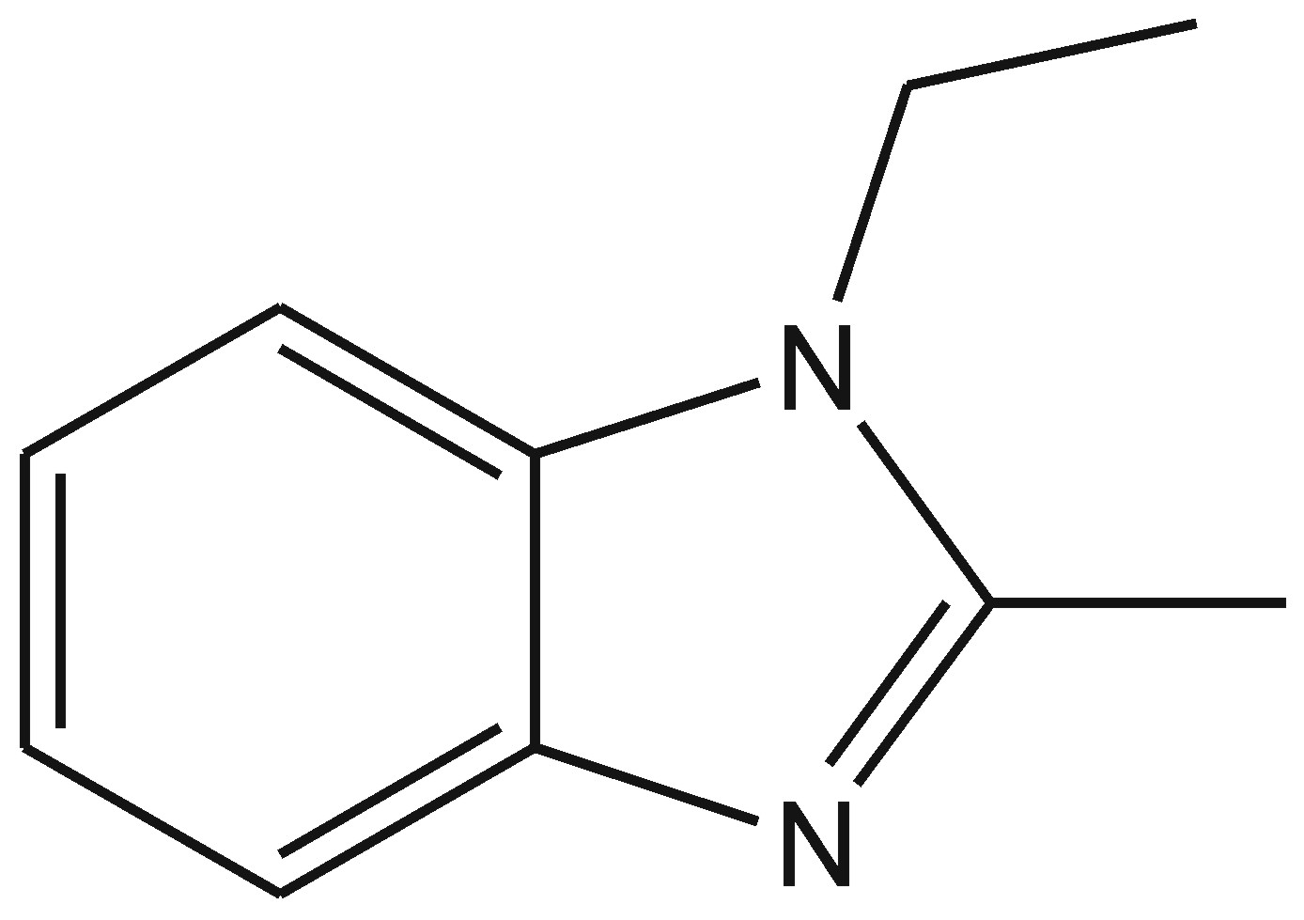
Synthesis of
2-methylbenzimidazole
PHOTOCATALYTIC SYNTHESIS OF BENZIMIDAZOLES
Conditions:
60 mL DNB/NA 2mM in EtOH 96%
150 mg Pd/TiO₂-B,N
Ar flow, 30°C
Simulated sunlight irradiation
Inorg. Chim. Acta 520 (2021), n° 120289

Slide 20
Synthesis of
2-methylbenzimidazole
PHOTOCATALYTIC SYNTHESIS OF BENZIMIDAZOLES
1200
1000
-1
)
800
h
production rate
-1
600
mol g
Conditions:
60 mL DNB/NA 2mM in EtOH 96%
150 mg Pd/TiO₂-B,N
Ar flow, 30°C
Simulated sunlight irradiation
μ
400
(
H
2
200
0
Inorg. Chim. Acta 520 (2021), n° 120289

Slide 21
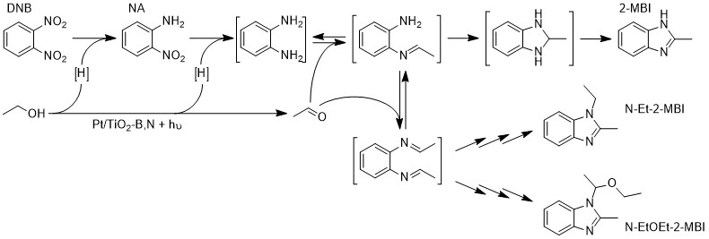
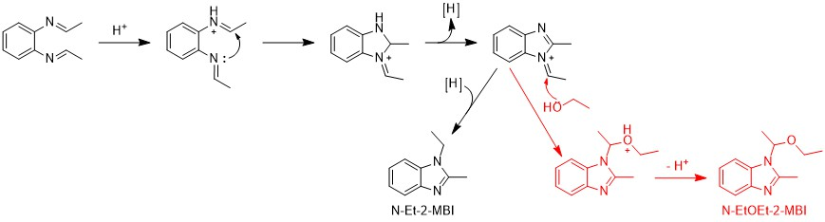
PHOTOCATALYTIC SYNTHESIS OF BENZIMIDAZOLES
Inorg. Chim. Acta 520 (2021), n° 120289

Slide 22
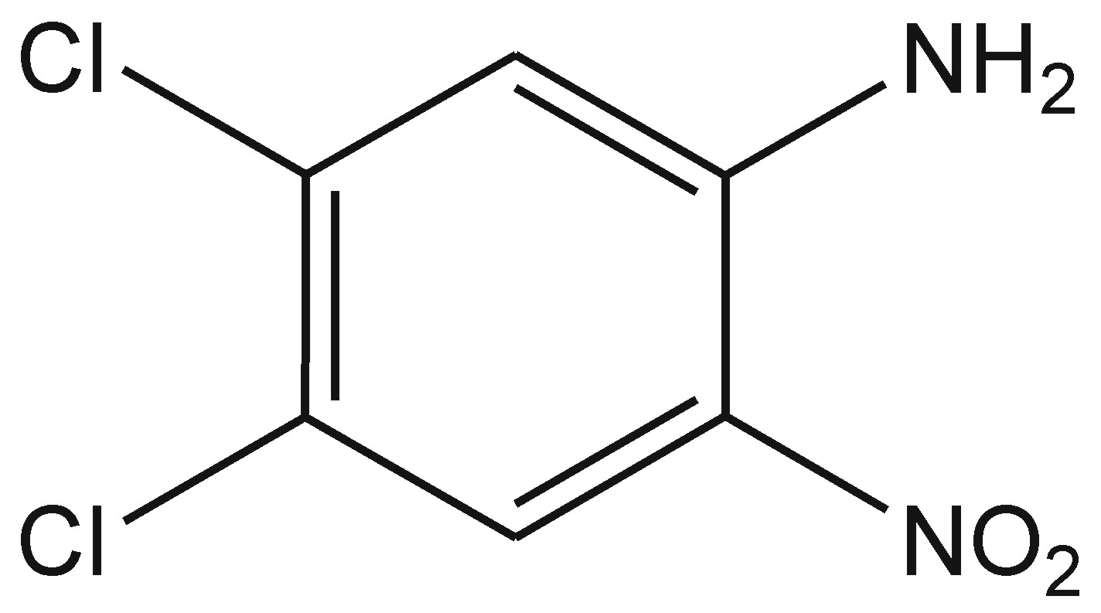
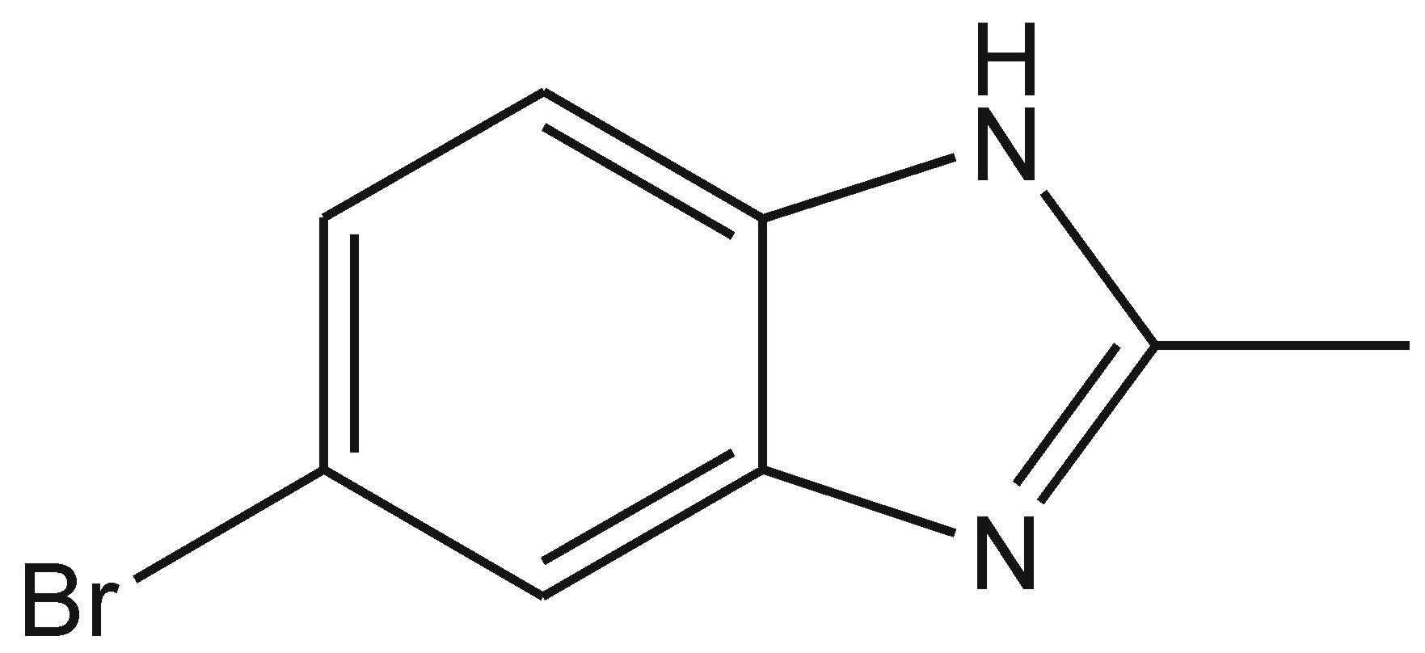
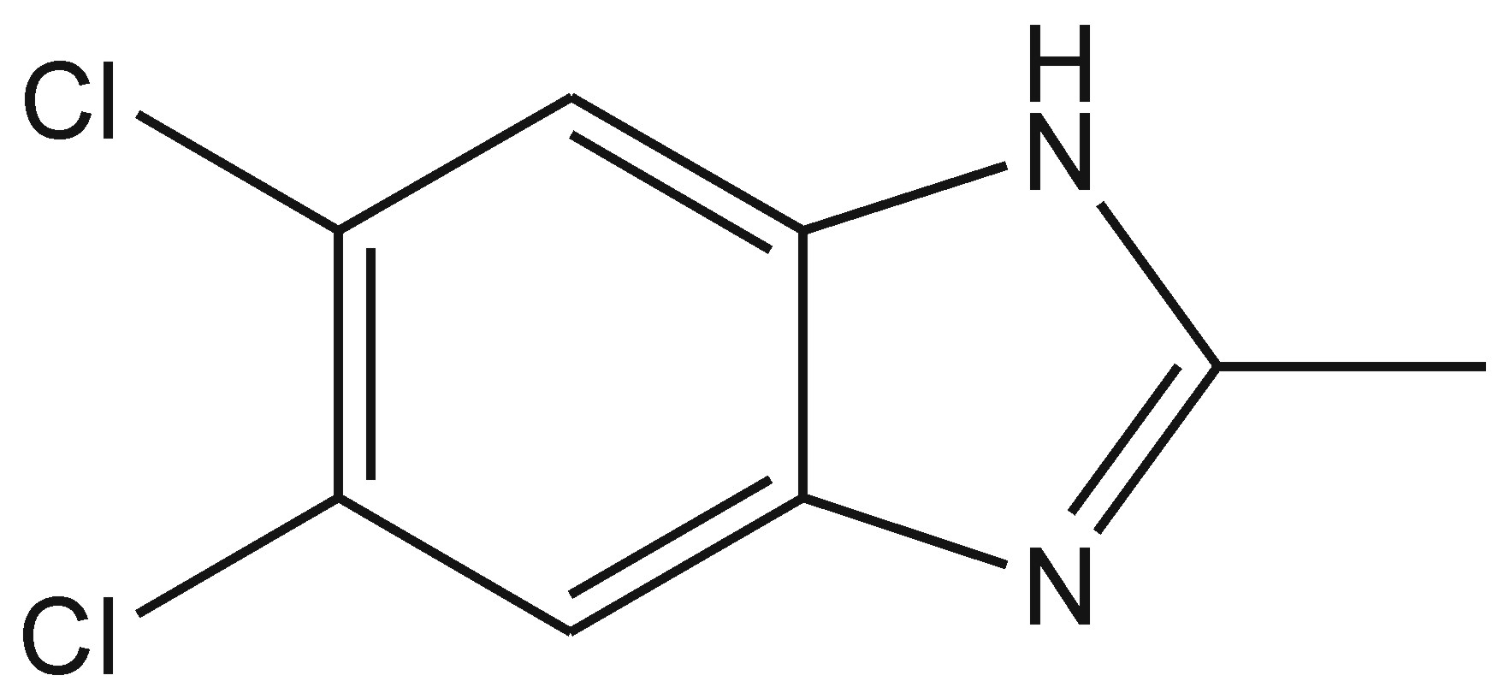
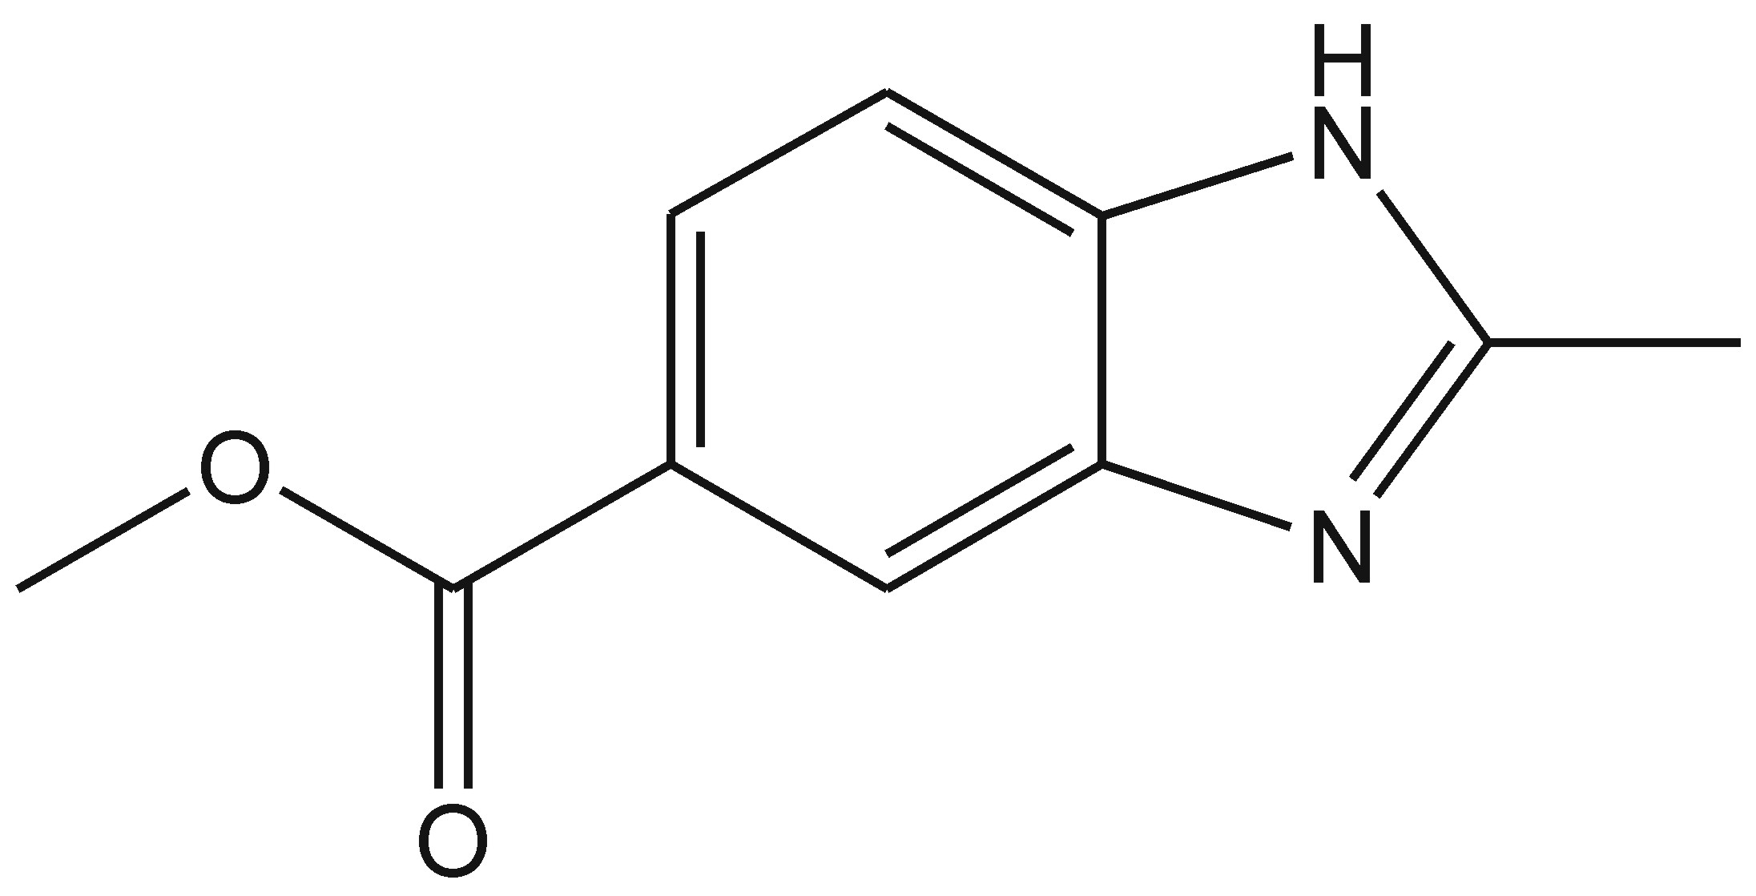
Substituted 2-methylbenzimidazole
PHOTOCATALYTIC SYNTHESIS OF BENZIMIDAZOLES
Br
Futher functionalization
Inorg. Chim. Acta 520 (2021), n° 120289

Slide 23
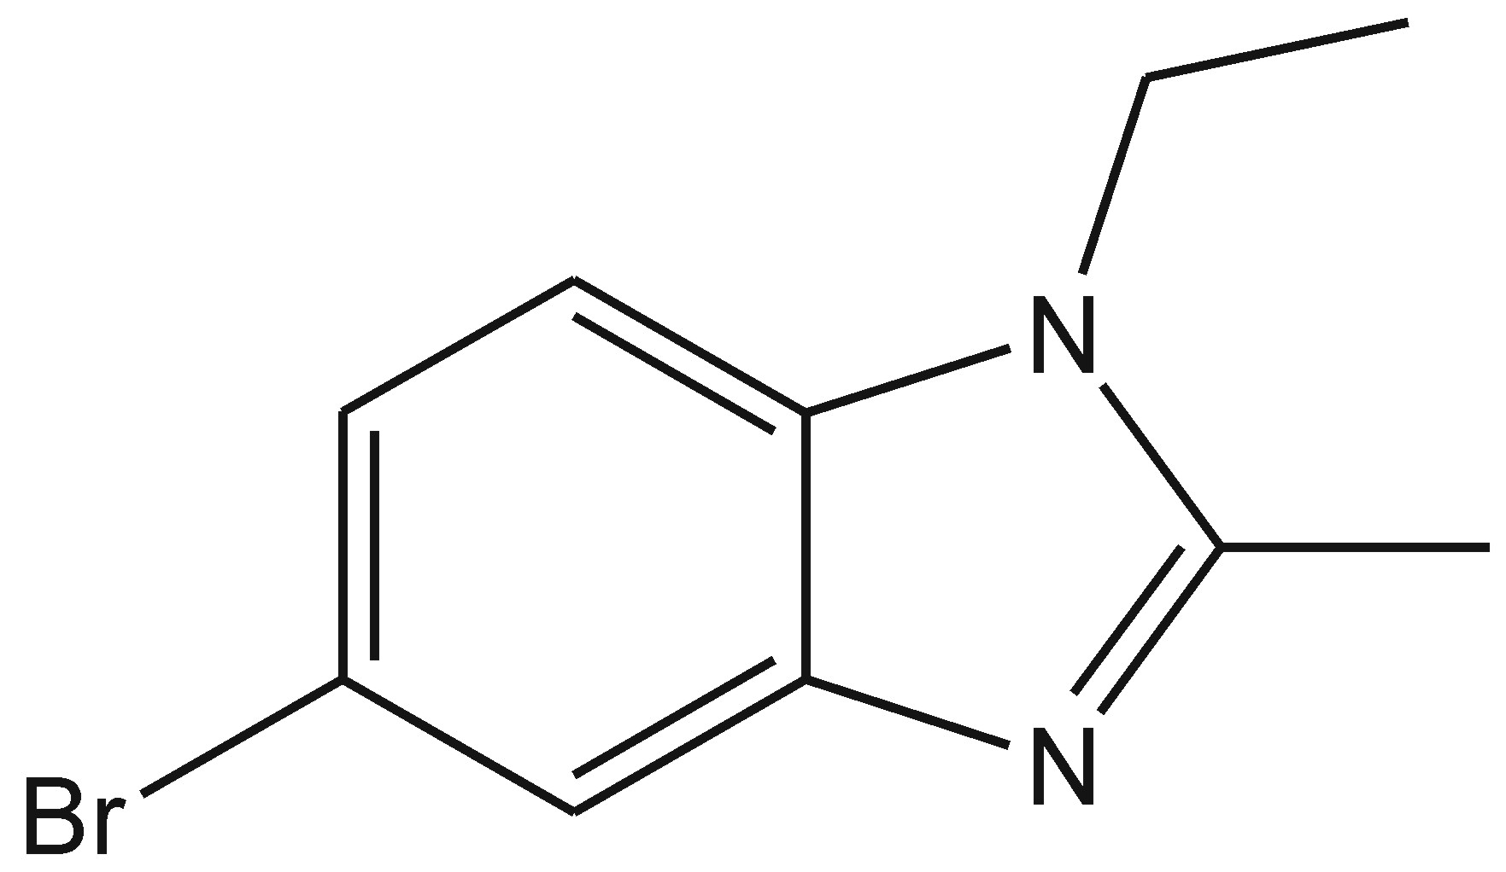

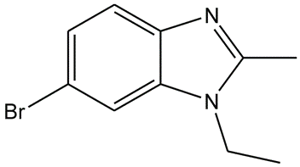
5-bromo-2-methylbenzimidazole
PHOTOCATALYTIC SYNTHESIS OF BENZIMIDAZOLES
Br
Br-2-MBI
N-Et-2-MBI
Br-N-Et-2-MBI
2-MBI
Pt highly active and selective
Pd promotes hydrodehalogenation
Ag and Cu take long reaction time and selectivity is not satifactory
Inorg. Chim. Acta 520 (2021), n° 120289

Slide 24
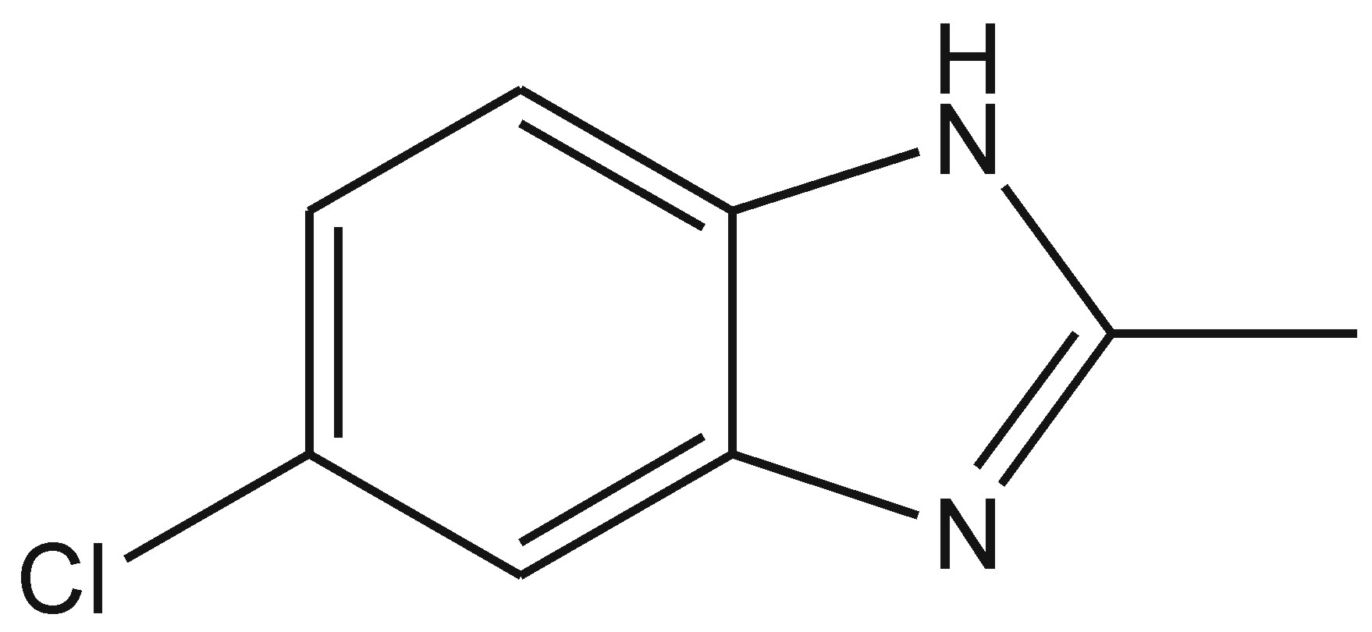
5,6-dichloro-2-methylbenzimidazole
PHOTOCATALYTIC SYNTHESIS OF BENZIMIDAZOLES
diCl-2-MBI
Cl-2-MBI
2-MBI
Pt highly active and selective
Pd promotes hydrodehalogenation
Inorg. Chim. Acta 520 (2021), n° 120289

Slide 25
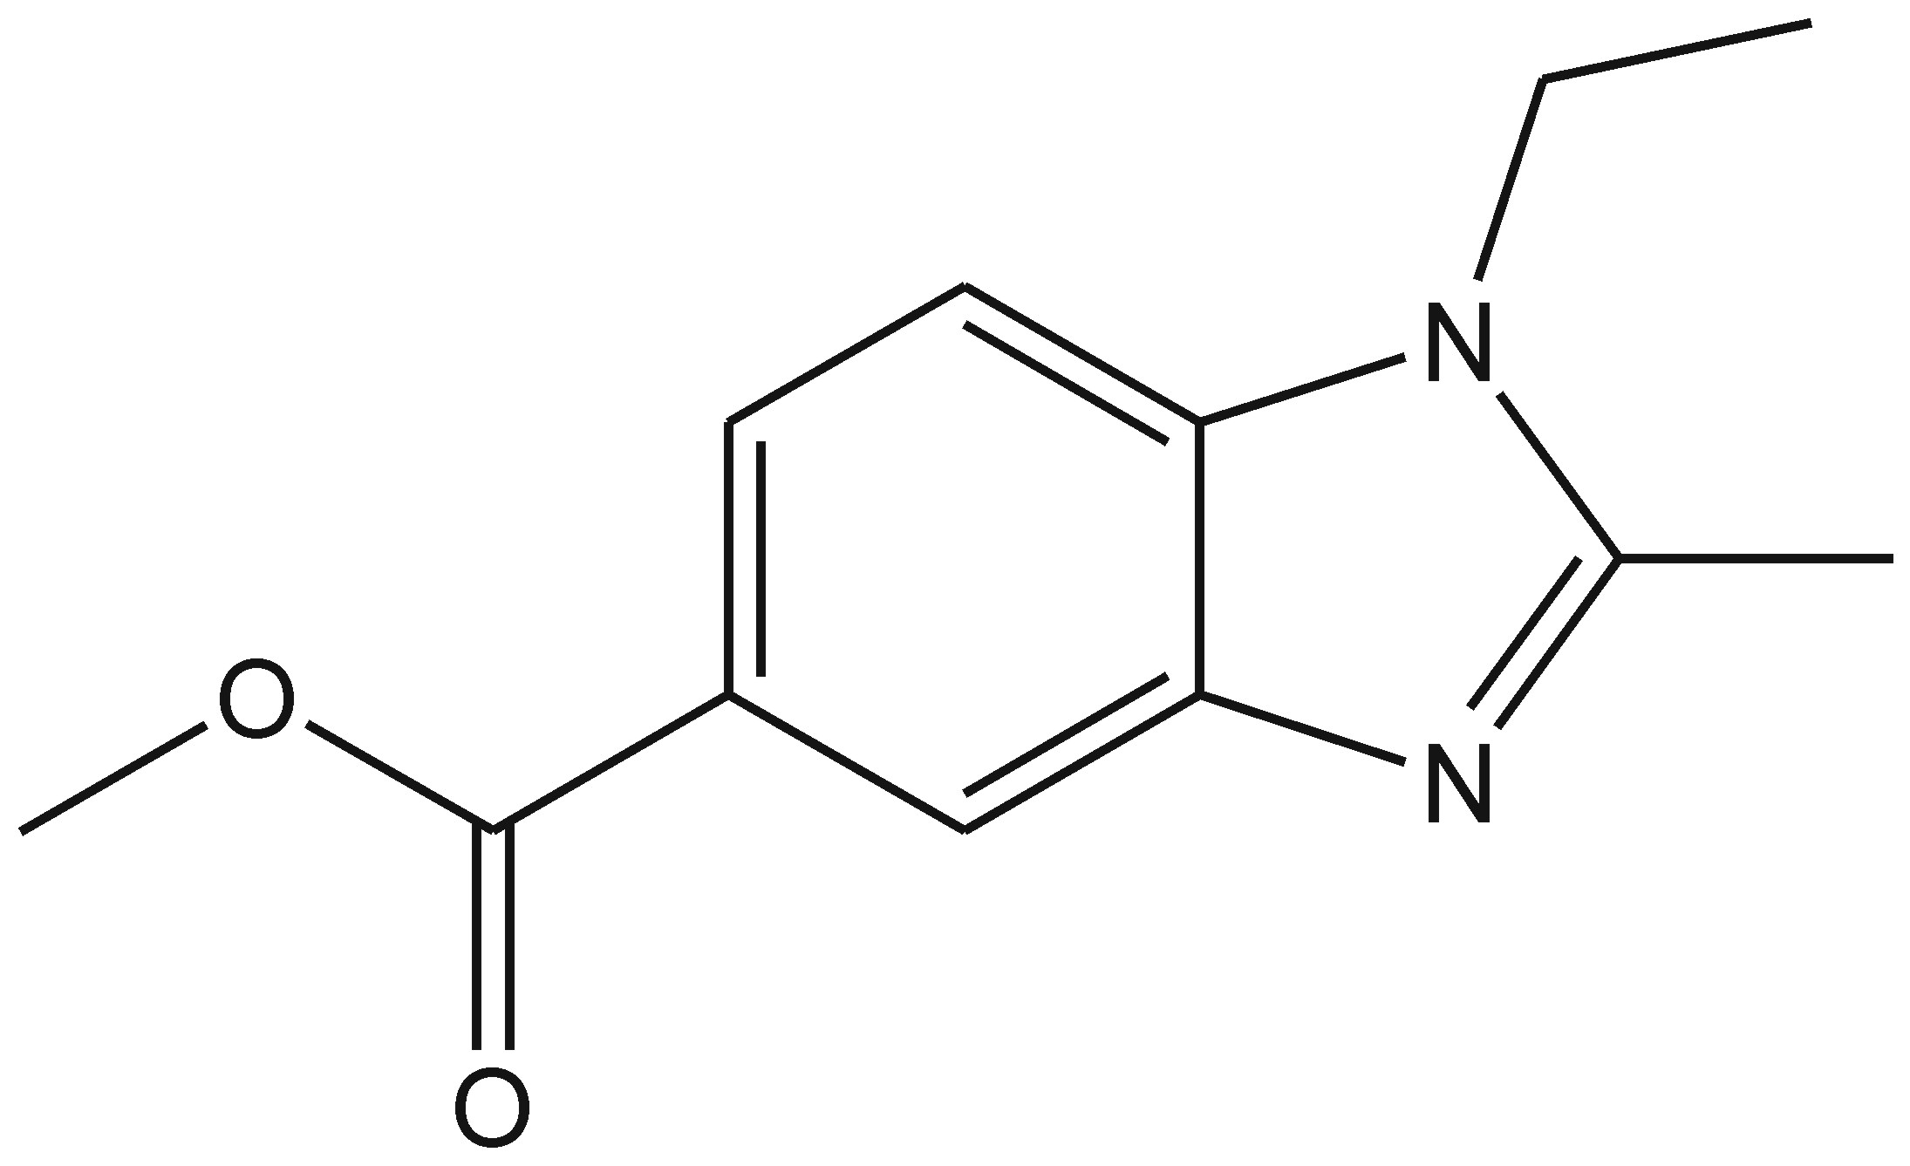
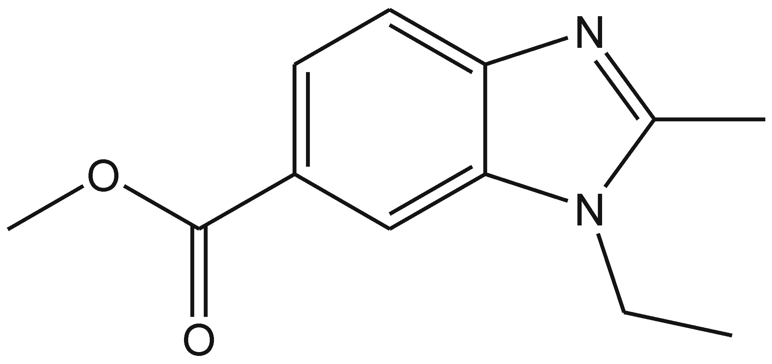
5-carboxymethyl-2-methylbenzimidazole
PHOTOCATALYTIC SYNTHESIS OF BENZIMIDAZOLES
COOMe-2-MBI
COOMe-
N-Et-2-MBI
COOMe-
2-MBI
COOMe-
N-Et-2-MBI
Inorg. Chim. Acta 520 (2021), n° 120289

Slide 26
Photocatalytic reduction of CO₂ to solar fuels

Slide 27
Photocatalytic reduction of CO₂ to solar fuels
pH = 7
Highly negative reduction potential arises from change in ibridization of C
Proton-Coupled Electron Transfer (PCET) are preferred

Slide 28
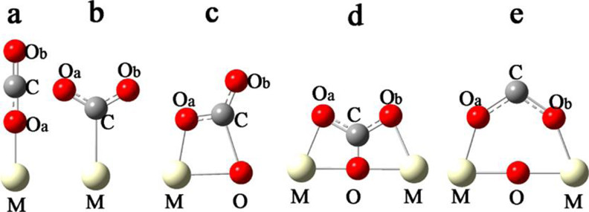
Photocatalytic reduction of CO₂ to solar fuels
Schematic of the possible CO₂ adsorption
configurations on surfaces of photocatalysts
The reduction potentials for the PCET reactions are within the range of −0.7 to −0.2 V and are close to the reduction potential of water (−0.414 V at pH 7). The reduction products of CO₂ (HCHO, CH₃OH, and CH₄) require multielectron transfer, whereas the reduction of water is a two-electron process. Reduction of water therefore competes with the reduction of CO₂. Because of this, the extent of hydrogen generation is greater in liquid-phase reactions compared to vapor-phase reactions.

Slide 29
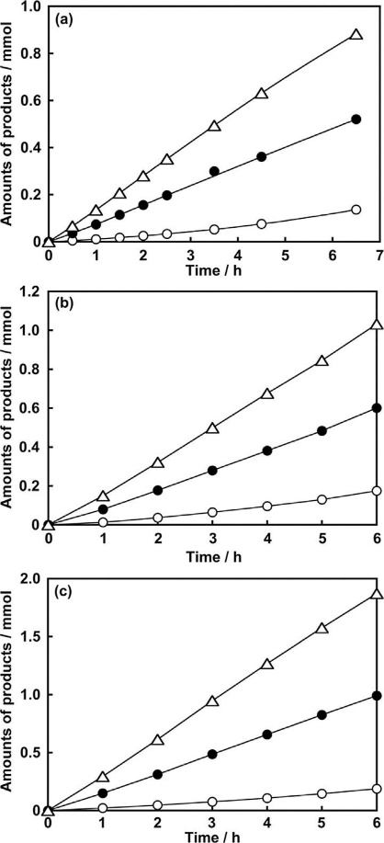
Photocatalytic reduction of CO₂ to solar fuels
Photocatalytic CO₂ reduction on (a) Ag-NaTaO₃:Ca, (b) Ag-NaTaO₃:Sr, and (c) Ag-NaTaO₃:Ba in the liquid phase under UV irradiation. Figure legends: hydrogen (open circle), oxygen (solid circle), and CO (triangle).
ChemSusChem 2017, 10, 112– 118

Slide 30
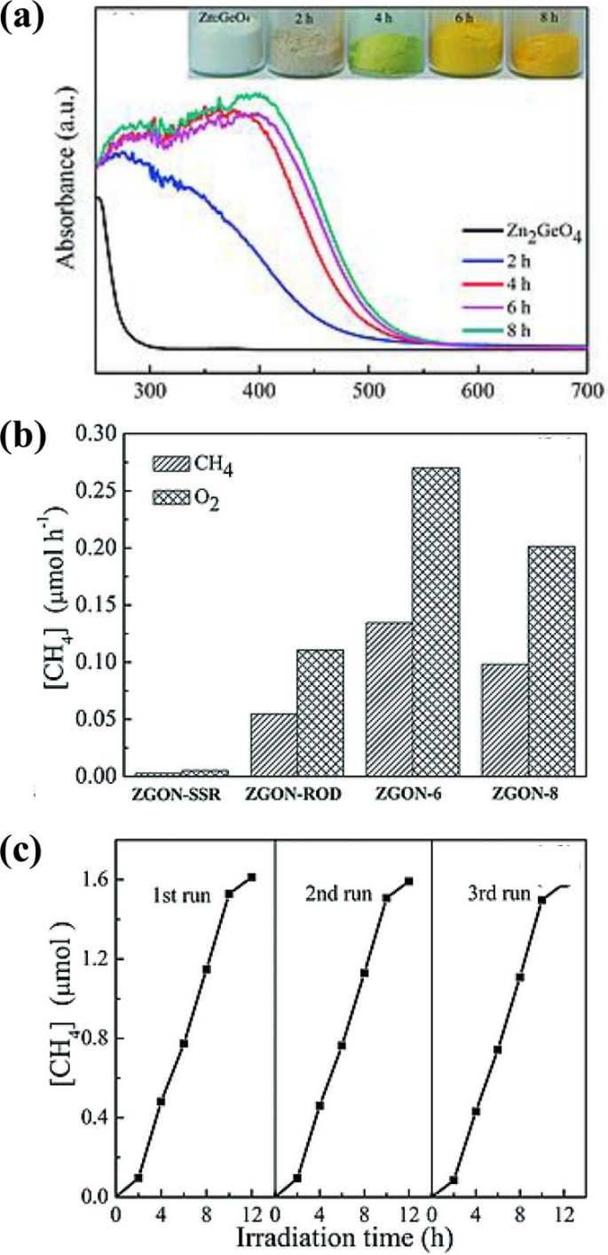
Photocatalytic reduction of CO₂ to solar fuels
(a) Electronic absorption spectra of nitridation products of Zn₂GeO₄ and (b) corresponding photocatalytic methane product activities. (c) Curve depicting the recyclability and stablitity of the photocatalyst.
Eur. J. Inorg. Chem. 2017, 2017, 2195– 2200

Slide 31
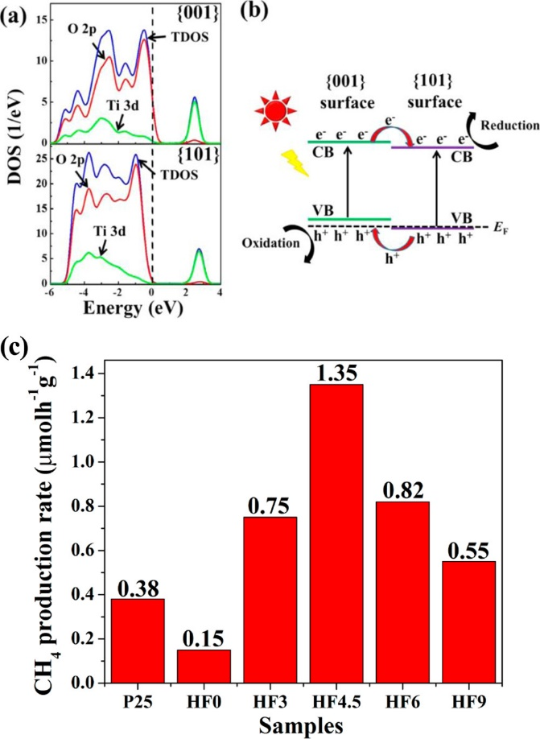
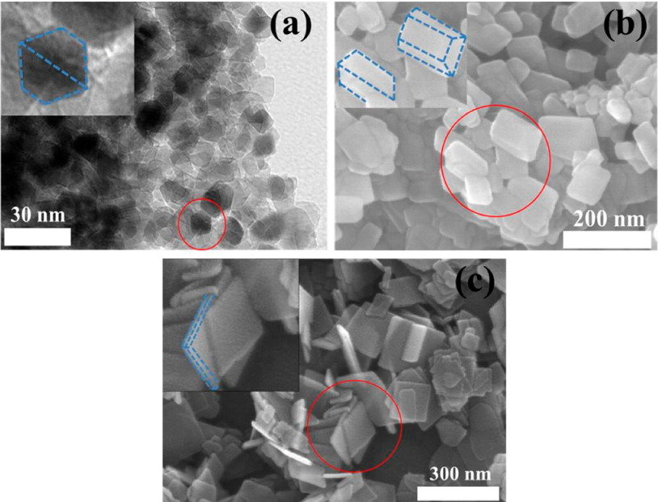
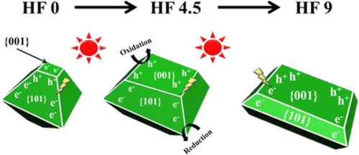
Photocatalytic reduction of CO₂ to solar fuels
Comparison of (a) density of states and (b) relative band positions in (001) and (101) facets of TiO₂. (c) Photocatalytic CO₂ reduction to CH₄ with different ratios of (001) to (010) facets in TiO2.
TEM image of HF0 and (b and c) FESEM images of HF4.5 and HF9.
J. Am. Chem. Soc. 2014, 136, 8839– 8842

Slide 32
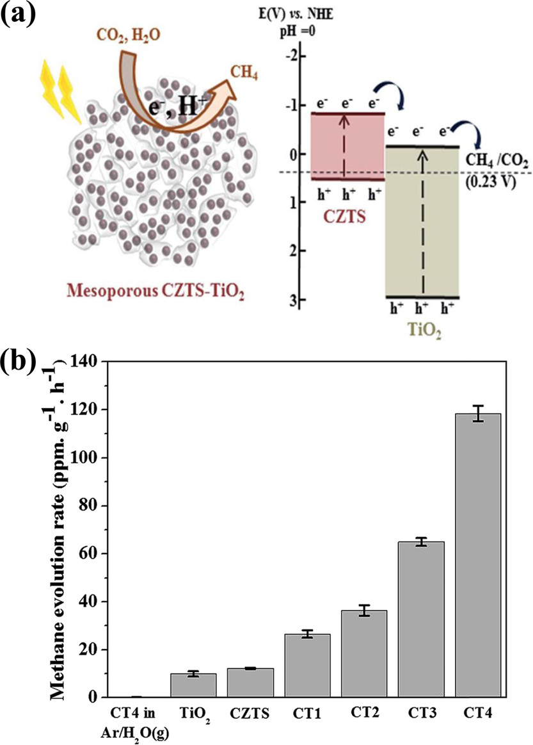
Photocatalytic reduction of CO₂ to solar fuels
(a) Schematic illustration of the process of charge transfer and CO₂ reduction in Cu₂ZnSnS₄/TiO₂ heterostructures. (b) Comparison of photocatalytic activities of Cu₂ZnSnS₄/TiO₂ with different compositions and individual Cu₂ZnSnS₄ and TiO₂.
RSC Adv. 2017, 6, 38964– 38971

Slide 33
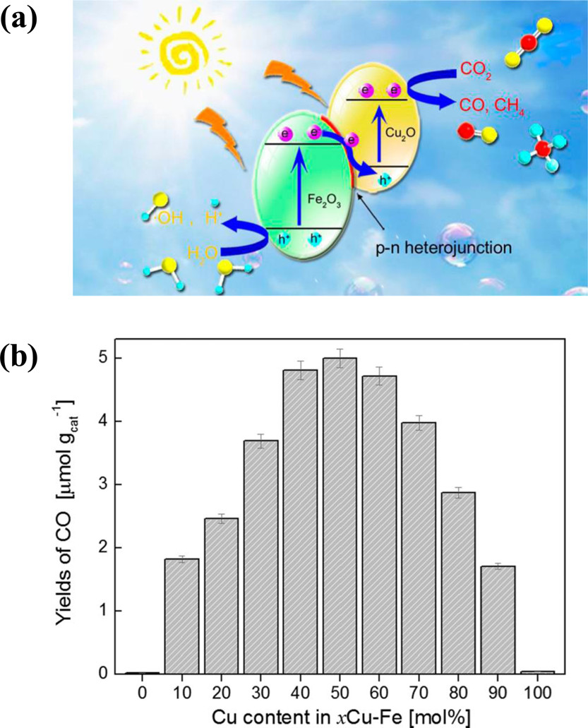
Photocatalytic reduction of CO₂ to solar fuels
(a) Schematic illustration of the process of Z-scheme charge transfer and CO₂ reduction in α-Fe₂O₃/Cu₂O heterostructures. (b) Comparison of yield of CO production with varying the Cu content in these heterostructures.
ACS Appl. Mater. Interfaces 2015, 7, 8631– 8639

Slide 34
Photocatalytic reduction of CO₂ to solar fuels
Tandem CH₃OH oxidation and CO₂ reduction by Ag and Ru complex, respectively. [Ru(bpy)₃]²⁺ derivative and TaON are light absorbers.
Ru catalyst on
visible light absorbing C₃N₄
Re catalyst and organic dye on TiO₂.

