Slide 1
ANATOMIA COMPARATA
DA ANFIBI A RETTILI

Slide 2
  OVIPARI:
  le femmine depongono all’esterno del proprio corpo uova ricche di nutrienti (perché la madre non alimenta l’embrione),
  OVOVIVIPARI
  come gli squali e alcuni serpenti, l’uovo resta invece nel corpo materno fino a quando nascono i piccoli. (ETEROTERMI /OMOTERMI)
  VIVIPARI
  cellule-uovo da cui l’embrione si sviluppa restando dentro il corpo materno, che lo nutre fino alla nascita (placentati/marsupiali)
  MONOTREMI

Slide 3
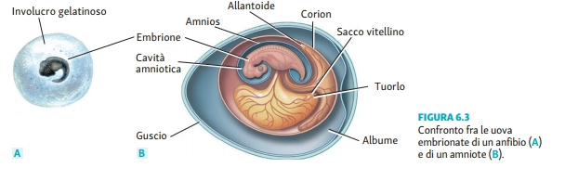
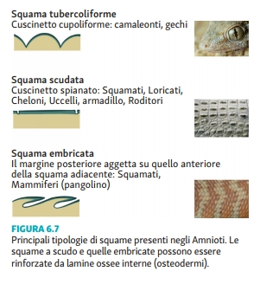


Notes:
Le squame sono rivestimenti cornei (origine epidermica) formate da protuberanze con una disposizione regolare separate da aree più sottili e flessibili per favorire il movimento. In molti rettili e negli armadilli ciascuna squama cornea è rinforzata in profondità da una placca ossea (osteoderma) contenuta nel derma.
Le scaglie ossee dei pesci sono di origine dermica (derivano da antiche corazze dermiche).

Slide 4
Amniota :caratterizzati dalla presenza di una membrana amniotica, durante lo sviluppo.
L’uovo cleidoico permette agli amnioti di evitare uno stadio larvale acquatico. Un uovo cleidoico (dal greco, kleis, gen. kleidòs = chiave) è autosufficiente, ed è stato il fattore determinante per una vita completamente terrestre.
La sua grande provvista di tuorlo è contenuta in un sacco del tuorlo collegato all’embrione. Il fluido contenuto nella membrana amniotica forma un cuscino liquido intorno all’embrione, e altre membrane extraembrionali proteggono l’embrione e provvedono allo scambio di gas e all’eliminazione dei rifiuti azotati

Slide 5
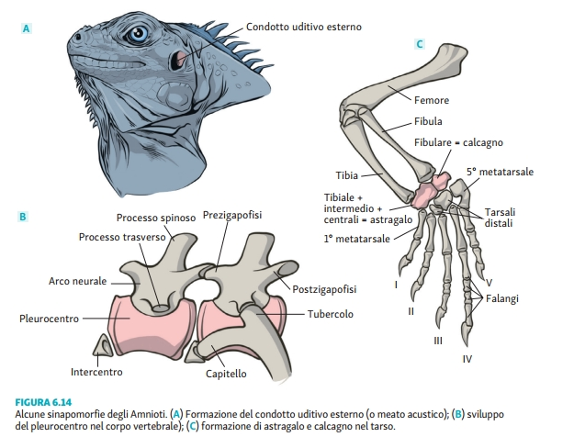

Slide 6
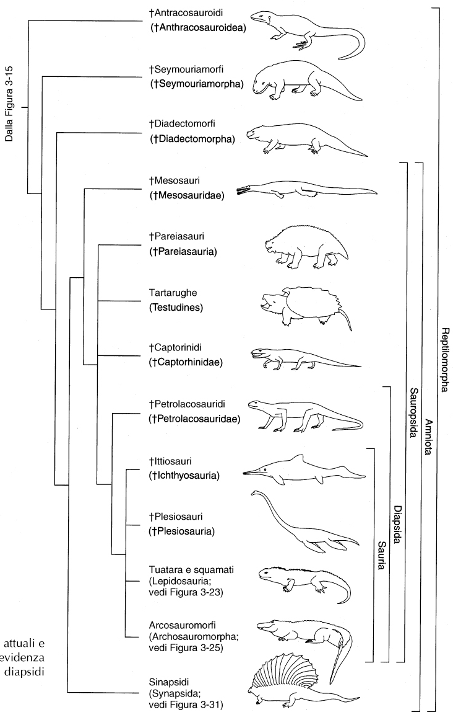

CARBONIFERO-PERMIANO
ANAPSIDI
ASTRAGALO (CAVIGLIA)
CARBONIFERO
FIGURA 3-20
Filogenesi dei Reptilomorpha attuali e fossili nella quale è messa in evidenza l’origine e la diversità dei diapsidii (Diapsida).
AC 029SV_Florian

Slide 7
Amnioti
Sauropsidi
Sinapsidi
Sauropsidi
Anapsidi”
– Mesosauri
– Pareiasauri
– Captorini
Diapsidi

Slide 8
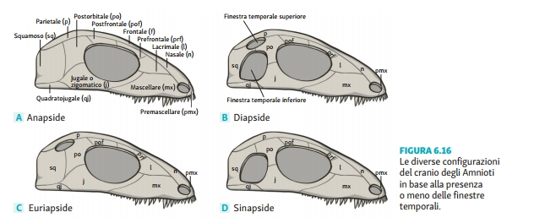
Ordine Testudines (tartarughe)
sauropsidi (Sauropsida) sono un clado che riunisce i rettili e gli uccelli.
Attualmente si ritiene che gli euriapsidi siano a tutti gli effetti rettili diapsidi che hanno perso la finestra temporale inferiore. Non hanno discendenti diretti sopravvissuti fino ai giorni nostri.
Classe Mammalia (Mammiferi)

Slide 9
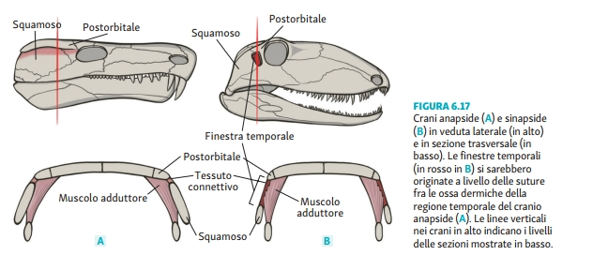

Slide 10
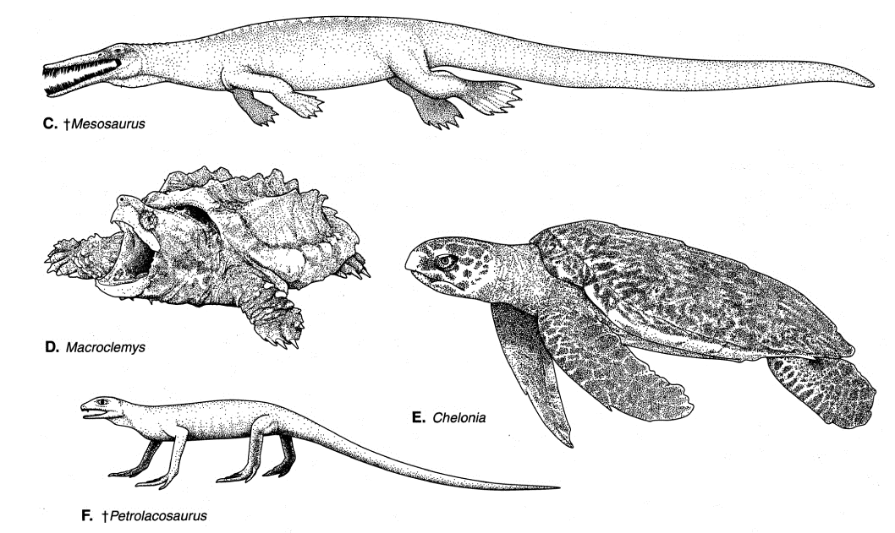
Permiano inferiore, acque dolci
Africa e America del Sud
Famiglia Chelydridae
ARTICOLAZIONE TRA TARSO E METATARSO→CORRERE VELOCEMENTE
FIGURA 3-21
AC 029SV_Florian
Notes:
The alligator snapping turtle (Macrochelys temminckii) is a species of turtle in the family Chelydridae. The species is native to freshwater habitats in the United States.

Slide 11
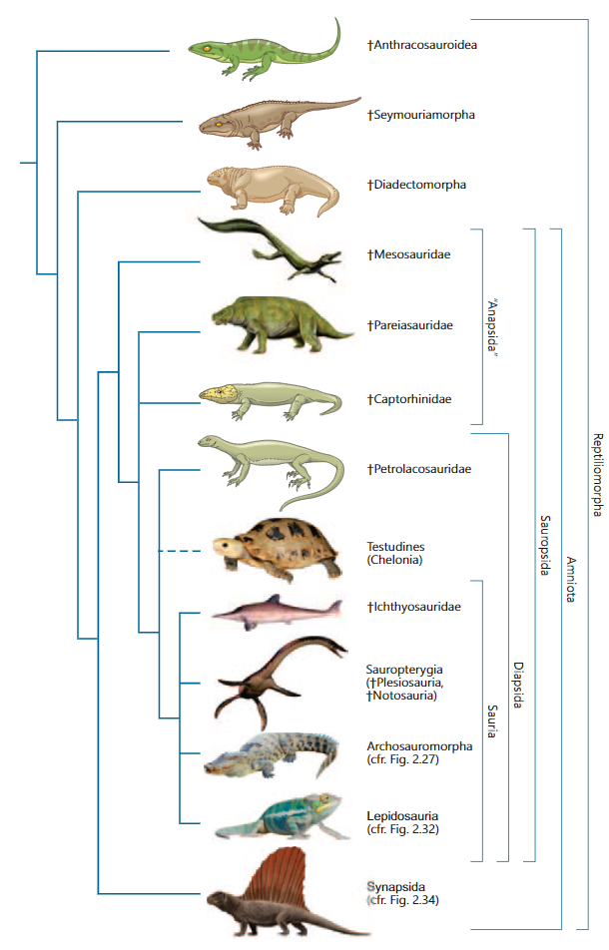
Albero filogeneti-co dei rettilomorfi.
La linea tratteggiata in corrispondenza delle tartarughe indica l’incertezza della loro posizione filogenetica.
I nomi tra virgolette indicano gruppi parafiletici

Slide 12
Cheloni
I cheloni (Chelonia o Testudines), testuggini e tartarughe, sono gli unici amnioti viventi con cranio anapside.
I cheloni sono unici tra i vertebrati per avere una corazza composta da un carapace dorsale di osteodermi, che incorpora gli elementi endocondrali delle vertebre e delle coste, e da un piastrone ventrale, che incorpora clavicola e interclavicola e coste addominali.
Unici tetrapodi nei quali la cintura pettorale è posizionata internamente alla cassa toracica.
Caratterizzati dall’assenza di denti su mascella e mandibola, sostituiti da un becco corneo.

Slide 13
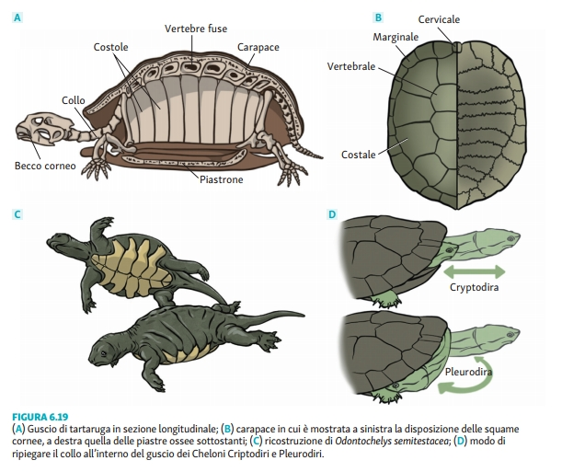

Slide 14
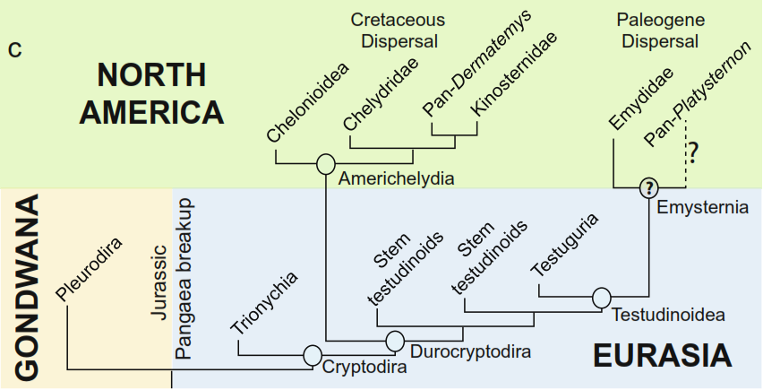
100-66 Ma
45-23 Ma
< 145 Ma
Fig. 3. (c) UCE phylogeny mapped against intercontinental paleobiogeography. Two dispersal events of durocryptodires into North America are shown. The geographic origin of Pan-Platysternon is uncertain so the Paleogene radiation may have included the common ancestor of Emysternia.
AC 029SV_Florian
Notes:
L’analisi degli elementi ultra conservati (UCE) stabilisce l’origine monofiletica dei due principali sottordini, uno comprendente testuggini d’acqua dolce aventi dimensioni ridotte con la capacità di muovere il collo solo in orizzontale (Pleurodira) e l’altro composto da specie di dimensioni maggiori, colonizzanti habitat d’acqua dolce, marini e terrestri in grado di ritrarre il collo nella corazza (Cryptodira). In questo secondo gruppo viene inclusa la superfamiglia Trionychia accanto a quella denominata Durocryptodira che comprende, tra le altre, le tartarughe asiatiche (Famiglia: Geoemydidae) e le tartarughe dalla testa grossa (Famiglia: Platysternidae), così come le Chelonioidea, le tuttora esistenti tartarughe marine, con distribuzione oceanica cosmopolita. Le relazioni riguardanti molti fossili di tartarughe marine sono confuse da potenziali fenomeni di polifilia (origini multiple) e da evoluzione parallela e per questo non è chiaro se le Chelonioidea si siano discostate dagli altri lignaggi nel primo o nel tardo Cretaceo, ma in entrambi i casi i fossili collocano la loro origine presunta nelle Americhe.
I primi fossili di testuggini appartenenti alle superfamiglie Trionychia e Cryptodira provengono dall’Eurasia, con stima della comparsa della seconda nel Giurassico (< 145 Ma) in contemporanea con l’origine della superfamiglia Pleurodira nell’emisfero Sud. I ricercatori hanno tratto questa conclusione elaborando i dati attraverso la filogenesi UCE, ipotizzando, di conseguenza, che la divisione tra Cryptodira e Pleurodira sia legata alla rottura della Pangea. Nel tardo Cretaceo (100-66 Ma), la superfamiglia Cryptodira è comparsa in Nord America e tre dei lignaggi, originatisi da una radiazione piuttosto veloce durante il periodo caldo del Paleogene, sono tuttora esistenti.
Similmente, in questo periodo alcuni gruppi di Testudines hanno subito una rapida radiazione adattativa ad alte latitudini. Questo modello suggerisce che il cambiamento climatico globale ha avuto un impatto importante sulla diversità e la distribuzione delle tartarughe. La fine del Paleogene (45-23 milioni di anni fa) coincide con cambiamenti ambientali globali, in cui il clima diventa significativamente più fresco e secco e quindi meno favorevole per le tartarughe, con la conseguente estinzione di molti lignaggi che avevano colonizzato questi ambienti.
[Nella scala dei tempi geologici, il Paleogene o Nummulitico è il primo dei tre periodi in cui è suddiviso il Cenozoico, l'ultima era del Fanerozoico, ed è compreso tra 65,5 ± 0,3 e circa 23,03 milioni di anni fa (Ma). È preceduto dal Cretaceo e seguito dal Neogene.
Ebbe una durata di circa 43 milioni di anni e fu caratterizzato dalla grande evoluzione dei mammiferi che, a partire dalle piccole e poco importanti specie del Cretacico, si svilupparono in modo notevole. Si divide in Paleocene, Eocene e Oligocene.

Slide 15
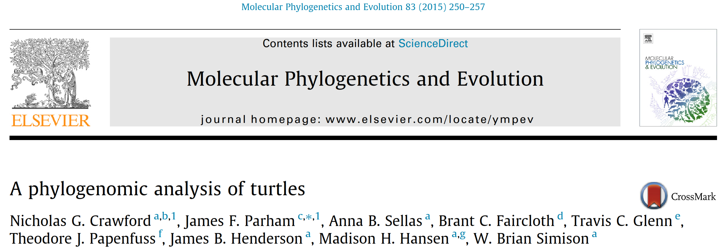
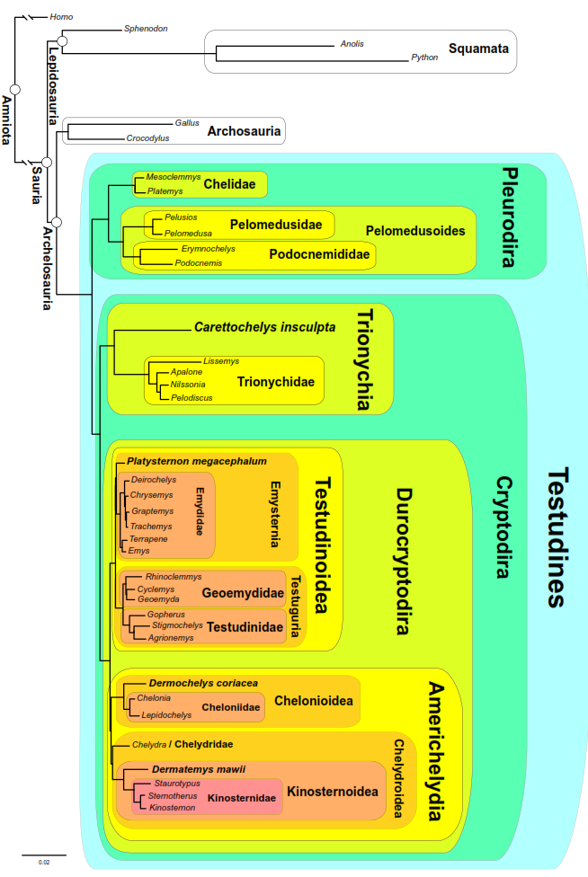
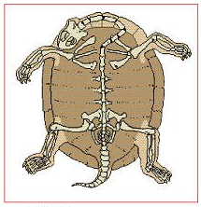
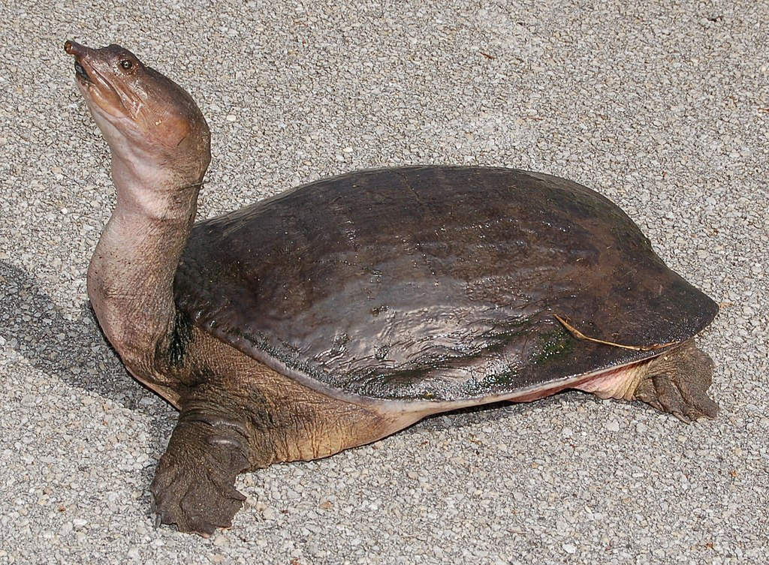
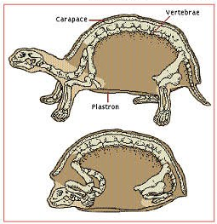
tartaruga dal guscio molle della Florida (Apalone ferox)
183
38
AC 029SV_Florian
Notes:
Molecular Phylogenetics and Evolution 83 (2015) 250–257
Le relazioni evolutive delle tartarughe (Testuggini) sono contrastanti. Fino a poco tempo fa, il posizionamento delle tartarughe negli Amnioti era incerto. Analisi di genome-scale e whole genome hanno confermato la posizione filogenetica delle tartarughe come sister group degli arcosauri, rigettando l’ipotesi di una relazione tra tartarughe e lepidosauri.
In questo studio sono stati usati degli Elementi Ultra-Conservati (UCEs) per desumere la filogenesi genome-scale delle tartarughe.
4.1. The phylogeny of turtles based on UCEs
4.1.1. Pleurodira, Trionychia, and Durocryptodira
The UCE phylogeny supports the monophyly of Cryptodira, with Trionychia [A- An extant trionychian showing some of the bizarre diagnostic characters for the group such as the lack of scales and a ﬂeshy proboscis] as the sister taxon to all other cryptodires (Figs. 2, 3a, c). The clade including non-trionychian cryptodires was phylogenetically deﬁned as ‘Durocryptodira’ by Danilov and Parham (2006).
A monophyletic Durocryptodira is consistent with the temporal appearance of lineages in the fossil record. Pan-trionychians (trionychians and their stem) are the most ancient cryptodire lineage. Therefore, the molecular phylogenetic placement of Trionychia as the sister taxon to all other cryptodires (Durocryptodira) is most consistent with their antiquity (Fig. 3a, b).
The Florida softshell turtle is a widespread species and occupies almost every freshwater habitat, even tolerating some brackish (salmastro) environments; however, it is not often found in water with strong currents, preferring habitats with slow-moving or still water. The Florida softshell turtle is a large turtle with a flattened, pancake-like body, a long neck, an elongated head with a long snorkel-like nose, and large webbed feet, each with three claws. While most turtles have hard shells composed of scutes, the Florida softshell has a cartilaginous carapace covered in leathery skin, ranging from 15 to 76 cm in length. They also exhibits significant sexual size dimorphism, adults females are often 3-5x larger than males (6.65 kg and 2.68 kg respectively).

Slide 16
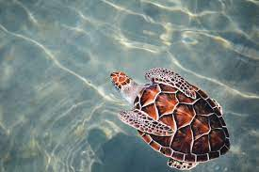
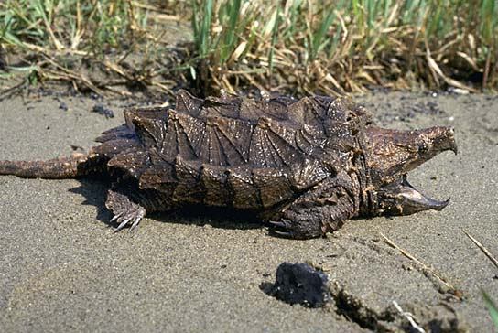
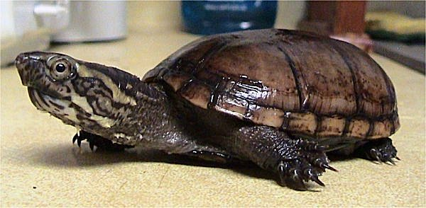
Caretta caretta, tartaruga testa di legno
Famiglia Cheloniidae
183
Macrochelys temminckii, tartaruga alligatore
Famiglia Chelydridae
Kinosternon subrubrum hippocrepis
Mississippi mud turtle
Famiglia Kinosternidae
38
AC 029SV_Florian
Notes:
Molecular Phylogenetics and Evolution 83 (2015) 250–257
4.1.2. Americhelydia
The UCE phylogeny supports the division of durocryptodires into the diverse and long recognized Testudinoidea (183 species) and the recently named Americhelydia (38 species). Americhelydia is comprised of three major lineages that share a common ancestor in the Cretaceous of North America. Two of these lineages, the chelydroids and kinosternoids, are still North American endemics. The third lineage is the chelonioids, extant marine turtles, which have a cosmopolitan, oceanic distribution.
Whereas the exclusive monophyly of extant marine turtles relative to extant, non-marine lineages is not controversial, the relationships of many fossil marine turtles are confounded by potential polyphyly (multiple origins of marine turtles) and parallel evolution. Given this confusion it is unclear whether the chelonioid lineage diverged from other Americhelydians in the Early or Late Cretaceous, but in either case their oldest fossils and presumed origins are in the Americas. Therefore, just as the UCE phylogeny ﬁts with the temporal appearance of clades in the fossil record, it also coincides well with biogeography by uniting some American durocryptodires into a monophyletic group.
Kinosternon is a genus of small aquatic turtles from the Americas known commonly as mud turtles.
They are found in the United States, Mexico, Central America, and South America. The greatest species richness is in Mexico, and only three species (K. dunni, K. leucostomum, and K. scorpioides) are found in South America. They are very similar to the musk turtles, but generally smaller in size, and their carapaces are not as highly domed.
The alligator snapping turtle (Macrochelys temminckii) is a species of turtle in the family Chelydridae. The species is native to freshwater habitats in the United States. M. temminckii is one of the heaviest freshwater turtles in the world. It is the largest freshwater species of turtle in North America. It is often associated with, but not closely related to, the common snapping turtle (tartaruga azzannatrice), which is in the genus Chelydra. It has three distinct rows of spikes and raised plates on the carapace, whereas the common snapping turtle has a smoother carapace. It is found primarily in waters of the southeastern United States.
Males are typically larger than females. Usually very old males comprise the specimens that weigh in excess of 45 kg. Among extant freshwater turtles, only the little-known giant softshell turtles of the genera Chitra, Rafetus, and Pelochelys, native to Asia, reach comparable sizes. Maturity is reached around 12 years of age. The sex of the young depends on the temperature at which the eggs are incubated, higher temperatures produce more males. Incubation takes from 100 to 140 days. The alligator snapping turtle is believed to be capable of living to 200 years of age, but 80 to 120 is more likely.
The loggerhead sea turtle (Caretta caretta), is the world's largest hard-shelled turtle, slightly larger at average and maximum mature weights than the green sea turtle and the Galapagos tortoise. It is also the world's second largest extant turtle after the leatherback sea turtle. It is a species of oceanic turtle distributed throughout the world. It belongs to the family Cheloniidae. The average loggerhead measures around 90 cm (35 in) in carapace length when fully grown and weighs approximately 135 kg with the largest specimens weighing more than 450 kg. It is found in the Atlantic, Pacific, and Indian Oceans, as well as the Mediterranean Sea. It spends most of its life in saltwater and estuarine habitats, with females briefly coming ashore to lay eggs. It reaches sexual maturity within 17–33 years and has a lifespan of 47–67 years.
4.1.3. Testudinoidea
Testudinoidea (183 species, more than half of turtle diversity) has deep fossil roots in Asia where it maintains a high diversity today. Within testudinoids, the sister taxon relationship between terrestrial tortoises (testudinids) and the geoemydids was phylogenetically deﬁned as Testuguria. At that time the phylogenetic position of the big-headed turtle (Platysternon) was not well established. Early molecular phylogenies placed it outside of Testudinoidea or as the sister taxon to Testuguria. Parham et al. (2006a) placed Platysternon as the sister group of the Emydidae based on an analysis of complete mitochondrial genomes, and this result has been conﬁrmed by more comprehensive nuclear data sets (Barley et al., 2010; this study). The Platysternon – Emydidae node is the only node uniting two or more of the traditional families of turtles that does not have a name. We ﬁll this important nomenclatural gap, and phylogenetically deﬁne the name ‘Emysternia’ to refer to the clade that originated from the most recent common ancestor of Platysternon megacephalum Gray, 1831 and Emys orbicularis (Linnaeus, 1758). The name was chosen to evoke the two included lineages Emydidae and Platysternon.

Slide 17
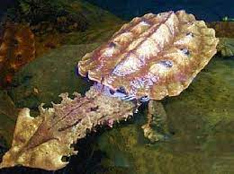
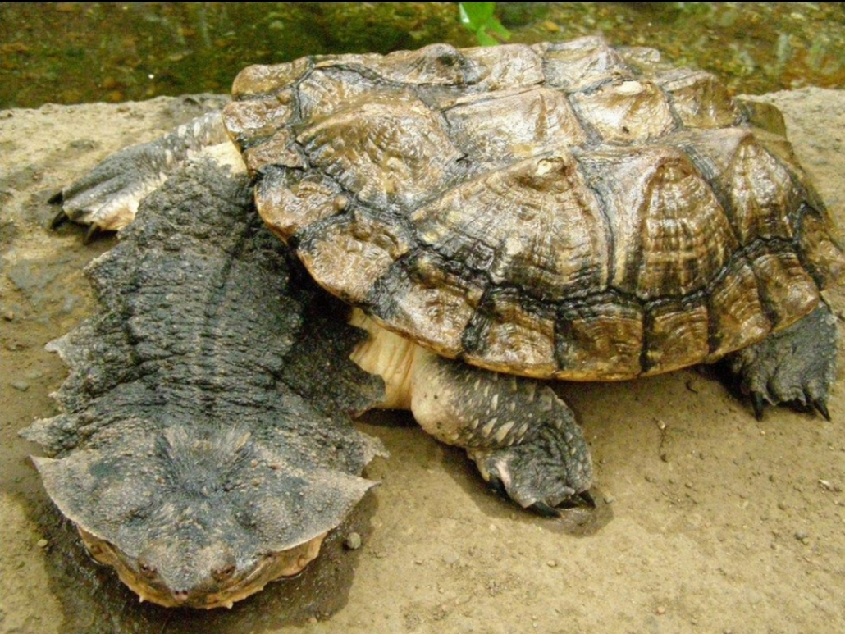
183
Chelus fimbriatus
Matamata
38
AC 029SV_Florian
Notes:
matamata (Chelus fimbriata) is a freshwater turtle species found in South America, primarily in the Amazon and Orinoco basins.
4.1.3. Testudinoidea
Testudinoidea (183 species, more than half of turtle diversity) has deep fossil roots in Asia where it maintains a high diversity today. Within testudinoids, the sister taxon relationship between terrestrial tortoises (testudinids) and the geoemydids was phylogenetically deﬁned as Testuguria. At that time the phylogenetic position of the big-headed turtle (Platysternon) was not well established. Early molecular phylogenies placed it outside of Testudinoidea or as the sister taxon to Testuguria. Parham et al. (2006a) placed Platysternon as the sister group of the Emydidae based on an analysis of complete mitochondrial genomes, and this result has been conﬁrmed by more comprehensive nuclear data sets (Barley et al., 2010; this study). The Platysternon – Emydidae node is the only node uniting two or more of the traditional families of turtles that does not have a name. We ﬁll this important nomenclatural gap, and phylogenetically deﬁne the name ‘Emysternia’ to refer to the clade that originated from the most recent common ancestor of Platysternon megacephalum Gray, 1831 and Emys orbicularis (Linnaeus, 1758). The name was chosen to evoke the two included lineages Emydidae and Platysternon.

Slide 18
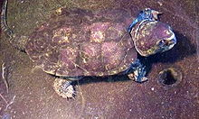
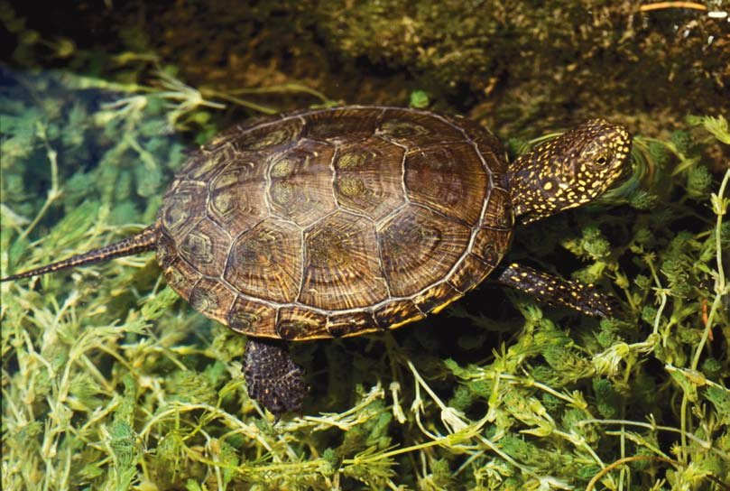
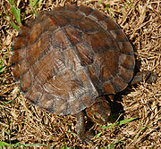
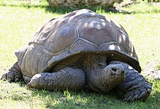
big-headed turtle
(Platysternon megacephalum)
la testuggine palustre europea
(Emys orbicularis)
183
Asian leaf turtles
Cyclemys dentata
38
tartarughe giganti delle Seychelles (Aldabrachelys gigantea)
AC 029SV_Florian
Notes:
Molecular Phylogenetics and Evolution 83 (2015) 250–257
4.1.3. Testudinoidea
Testudinoidea (183 species, more than half of turtle diversity) has deep fossil roots in Asia where it maintains a high diversity today. Within testudinoids, the sister taxon relationship between terrestrial tortoises (testudinids) and the geoemydids was phylogenetically deﬁned as Testuguria. At that time the phylogenetic position of the big-headed turtle (Platysternon) was not well established. Early molecular phylogenies placed it outside of Testudinoidea or as the sister taxon to Testuguria. Parham et al. (2006a) placed Platysternon as the sister group of the Emydidae based on an analysis of complete mitochondrial genomes, and this result has been conﬁrmed by more comprehensive nuclear data sets (Barley et al., 2010; this study). The Platysternon – Emydidae node is the only node uniting two or more of the traditional families of turtles that does not have a name. We ﬁll this important nomenclatural gap, and phylogenetically deﬁne the name ‘Emysternia’ to refer to the clade that originated from the most recent common ancestor of Platysternon megacephalum Gray, 1831 and Emys orbicularis (Linnaeus, 1758). The name was chosen to evoke the two included lineages Emydidae and Platysternon.
Emydidae (Latin emys (freshwater tortoise) + Ancient Greek εἶδος (eîdos, “appearance, resemblance”)) is a family of testudines (turtles) that includes close to 50 species in 10 genera. Members of this family are commonly called terrapins, pond turtles, or marsh turtles.
The European pond turtle (Emys orbicularis)is a species of long-living freshwater turtle in the family Emydidae. The species is endemic to the Western Palearctic.
The Geoemydidae (formerly known as Bataguridae) are one of the largest and most diverse families in the order Testudines (turtles), with about 70 species. The family includes the Eurasian pond and river turtles and Neotropical wood turtles.
Geoemydidae are turtles of various sizes (from about 10 to 80 cm (4 to 30 in) in length) with often a high degree of sexual dimorphism. They usually have webbed toes, and their pelvic girdlesì articulate with their plastrons flexibly.
Geoemydidae live in tropics and subtropics of Asia, Europe and North Africa, the only genus in Central and South America is Rhinoclemmys. Their habitats include freshwater ecosystems, coastal marine areas, and tropical forests. Most are herbivorous, but some are omnivorous or carnivorous species.
Cyclemys is a genus of freshwater turtles, commonly referred to as Asian leaf turtles, from the family Geoemydidae. The genus occurs throughout Southeast and South Asia, and currently contains seven species.
Asian leaf turtles average 25 cm (9.8 in) in length. They are mostly brown to greenish in color, with round to rectangular shells. Their carapaces bear a superficial resemblance to plant leaves, hence their common name. They can be found around shallow, slow-moving bodies of water in hilly forests. Adults are primarily terrestrial, though juveniles are more aquatic.
Le tartarughe giganti delle Seychelles (Aldabrachelys) è un genere di tartarughe giganti ampiamente distribuito nell'atollo delle Seychelles e in Madagascar, il cui membro più grande, oltre che specie tipo, è la famosa tartaruga gigante di Aldabra (Aldabrachelys gigantea).

Slide 19
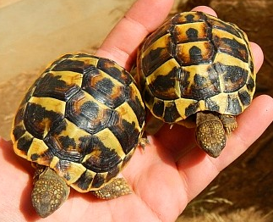
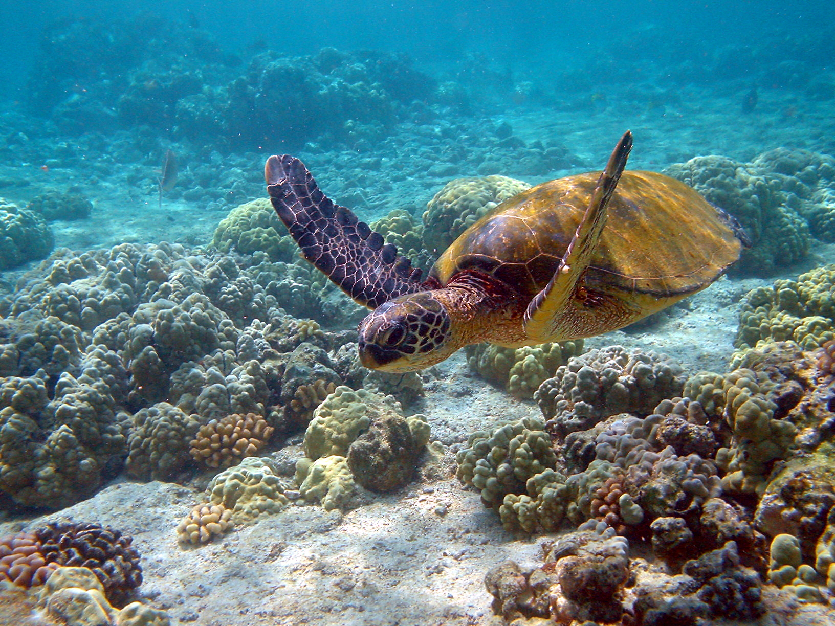
IN ITALIA:
CRIPTODIRI:
Terrestri (genere Testudo)
Palustri (genere Emys)
Marine (genere Caretta, Chelonia, Dermochelys)
Rischio estinzione
Testudo hermanni h.(fenotipo sardo)
Chelonia mydas (tartaruga verde)
Testudo hermanni ed Emys orbicularis sono le sole specie autoctone italiane appartenenti all'ordine Testudines
AC 029SV_Florian

Slide 20
ANAPSIDI
ASTRAGALO (CAVIGLIA)
TARDO CARBONIFERO
FIGURA 3-20
Filogenesi dei Reptilomorpha attuali e fossili nella quale è messa in evidenza l’origine e la diversità dei diapsidii (Diapsida).
AC 029SV_Florian
Notes:
Sauri: lucertole

Slide 21
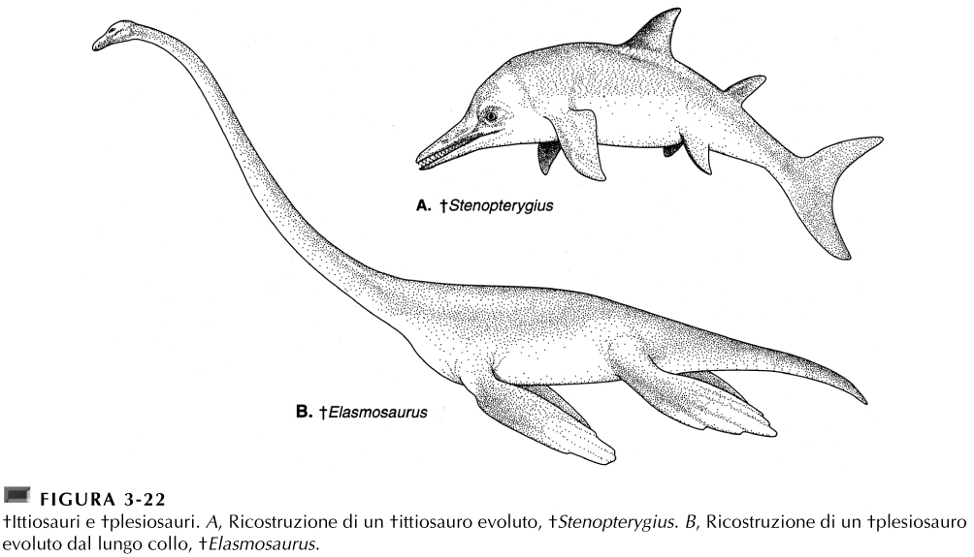
MESOZOICO
TARDO CRETACEO, NORD AMERICA OCCIDENTALE
AC 029SV_Florian

Slide 22
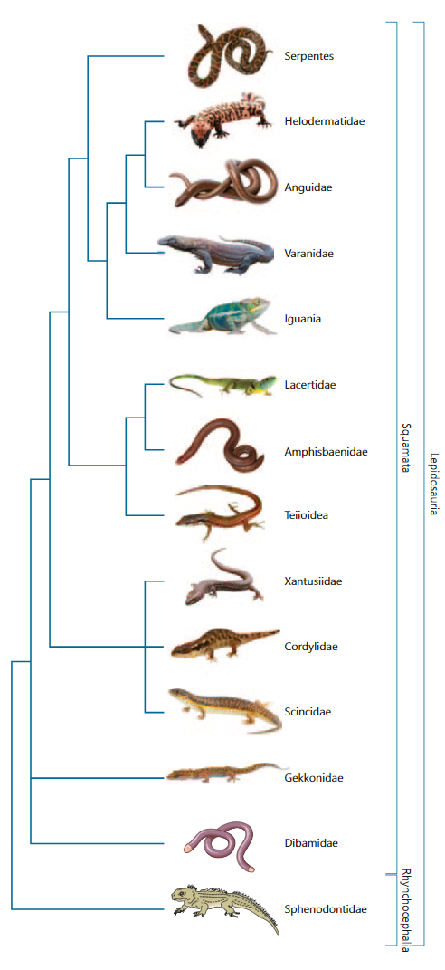
Lepidosauri - diapsid
Tutti i rettili attuali, con l’eccezione dei coccodrilli e, forse, dei cheloni.
Sono distinguibili dagli arcosauromorfi per la loro postura, che, in generale, presenta un arto di tipo trasversale, e per la dentatura pleurodonte;
mancano le finestre anterorbitarie e mandibolari nel dermatocranio

Slide 23
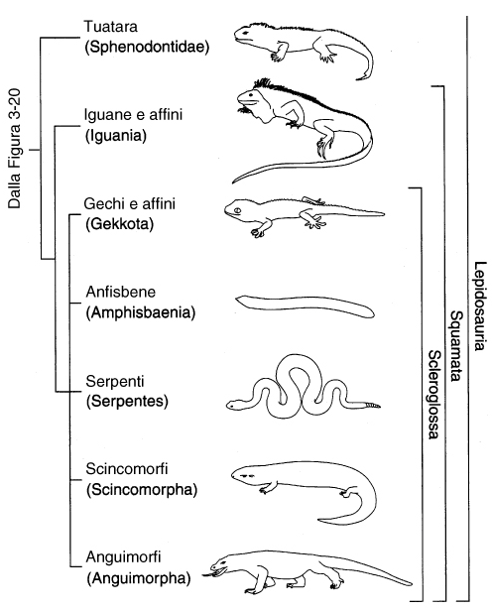

COLUMELLA SOTTILE
FESSURA CLOACALE TRASVERSALE
SQUAME EPIDERMICHE EMBRICATE
PIANO DI ROTTURA VERTEBRE CAUDALI
6000
ORBETTINO
LUCERTOLA OCELLATA
VARANI
AC 029SV_Florian

Slide 24
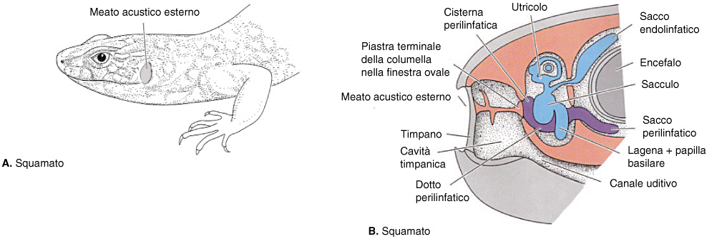
FIGURA 12-19
Orecchio degli squamati
AC 029SV_Florian

Slide 25
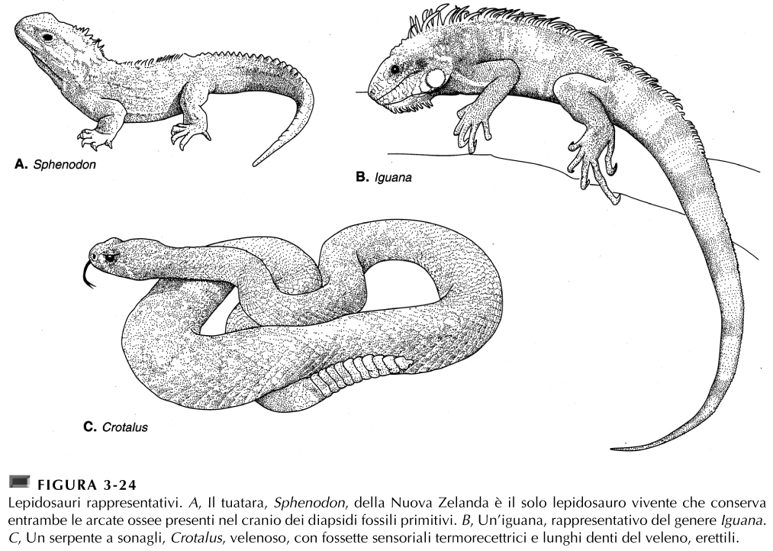
DIAPSIDI CLASSICI
PERDITA BARRA INFERIORE
+ Camaleonti
(zigodattilia)
PERDITA BARRA INFERIORE E SUPERIORE
COBRA , SERPENTI CORALLO, SERPENTI MARINI, VIPERE, BOA, PITONI
AC 029SV_Florian
Notes:
Tuatara: unico rappresentante sopravvissuto dell'ordine dei Rincocefali. Il nome comune è una parola di origine maori che significa aculei sul dorso. I tuatara possono essere lunghi fino a 60 cm e arrivare a pesare 1300 g nei maschi, mentre le femmine, di dimensioni più modeste, sono lunghe circa 50 cm e pesano solitamente sui 550 g.
Superficialmente sono simili a delle lucertole, i tuatara se ne discostano, però, per alcune caratteristiche fisiche: per esempio, essi sono privi di membrana timpanica esterna, sono provvisti di estensioni uncinate su alcune coste (come negli uccelli) e inoltre presentano due ampie aperture ai lati del cranio dietro e sopra la cavità che ospita il globo oculare. Nel maschio è assente l'organo copulatore.
I tuatara, inoltre, posseggono il "terzo occhio", ovvero un complesso organo posto sulla sommità del capo.
I tuatara sono animali notturni, che abitano in tane che accolgono un solo esemplare, e sono particolarmente attivi tra i 17° e i 20° (temperature ancora troppo basse per altri rettili). La loro attività è inoltre regolata dagli agenti atmosferici (ad esempio, dato che gli sfenodonti soffrono molto la disidratazione, sono particolarmente attivi durante le giornate piovose dopo una lunga siccità). Si cibano principalmente vermi, lumache e insetti, ma non disdegnano granchi o pesciolini.
Durante l'inverno e la primavera si iberna, per risvegliarsi solamente all'inizio di giugno.
Uova del Ø di 3 cm, rivestite da una membrana tipo pergamena, mancano di albume. Lo sviluppo embrionale richiede 13-15 mesi.
18°C solo femmine, 20°C 80% femmine, 21°C 50% femmine, 22°C 80% maschi. Crescono fino a 35 anni. I maschi possono vivere + di 100 anni. Vive esclusivamente nelle piccole isole al largo dell'Isola Nord, in Nuova Zelanda.

Slide 26
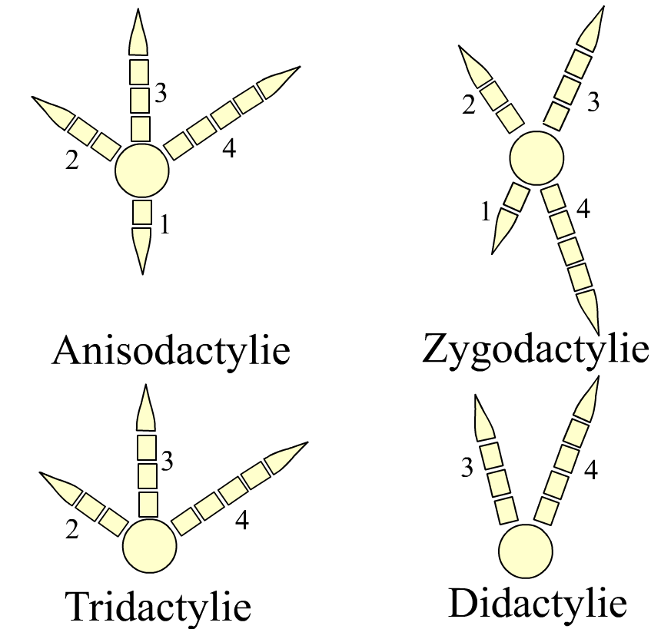
è un adattamento delle dita delle zampe di alcune specie di uccelli e di rettili,

Slide 27
arcosauromorfi
Gli arcosauromorfi (Archosauromorpha) sono un ampio clade di diapsidi che include alcuni gruppi basali e il grande raggruppamento degli arcosauri (Archosauria), che ha avuto un grande successo evolutivo in tutto il mesozoico.
Tendenza al bipedalismo, una modalità di locomozione che consente di muoversi sul terreno senza il coinvolgimen-to degli arti anteriori.

Slide 28
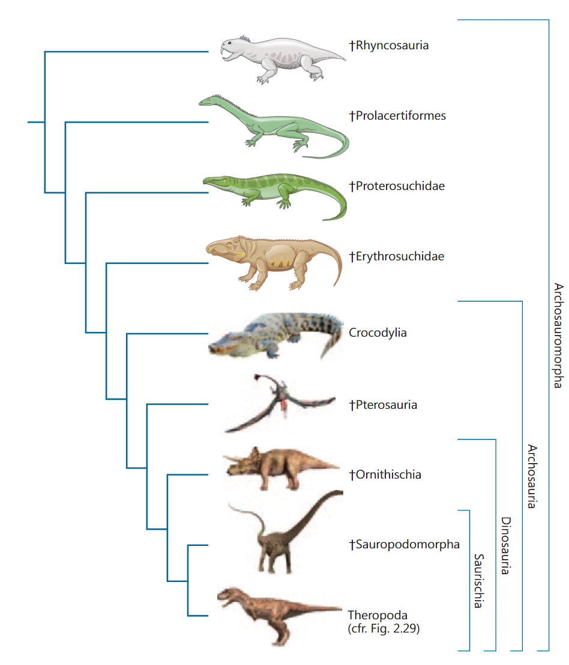
pterosauri (Pterosauria)- i primi vertebrati volatori dotati di volo attivo, appartengono agli arcosauri

Slide 29
FIGURA 3-20
Filogenesi dei Reptilomorpha attuali e fossili nella quale è messa in evidenza l’origine e la diversità dei diapsidii (Diapsida).
AC 029SV_Florian

Slide 30
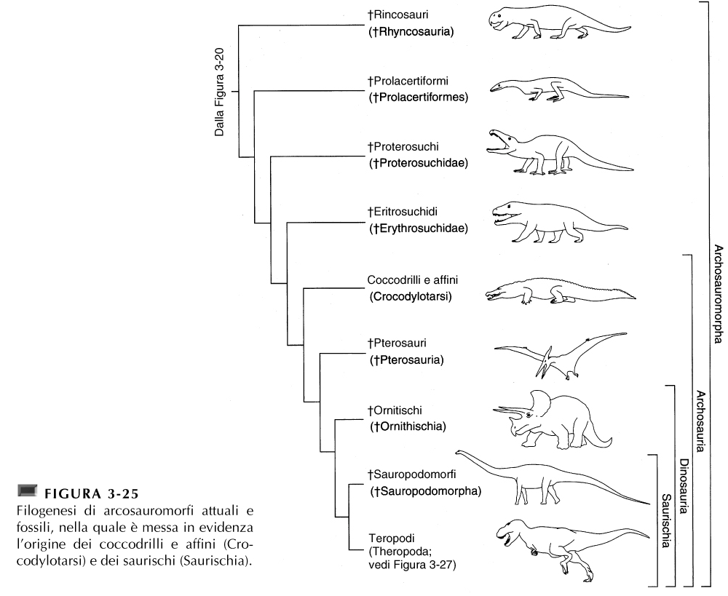
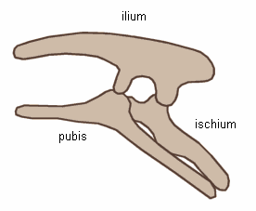
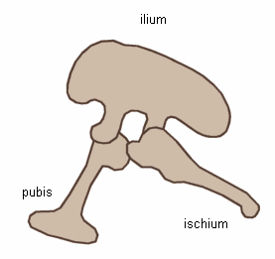
ANTERIORE
POSTERIORE
3 vertebre sacrali
ORNITISCHI
TRIASSICO
SAURISCHI
MESOZOICO
AC 029SV_Florian
Notes:
Gli ornitischi sono noti come "dinosauri dal bacino da uccello" a causa della struttura della loro pelvi, anche se gli uccelli in effetti discesero dai dinosauri "dal bacino da lucertola" (saurischi). Essendo degli erbivori che spesso vivevano in branchi, gli ornitischi furono più numerosi dei saurischi, dal momento che in sostanza erano le prede dei teropodi ed erano più piccoli dei sauropodi.
Il pube degli ornitischi punta in basso e verso la coda, mentre quello dei saurischi punta in basso ma verso la parte anteriore dell'animale.

Slide 31
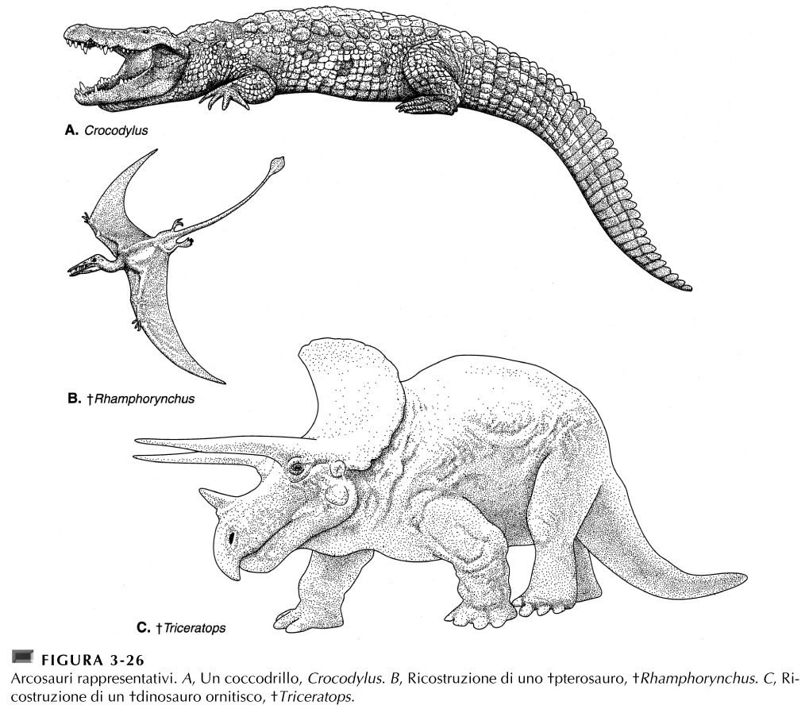
4° DITO
TRIASSICO
AC 029SV_Florian

Slide 32
ANATOMIA COMPARATA
DA RETTILI A UCCELLI

Slide 33
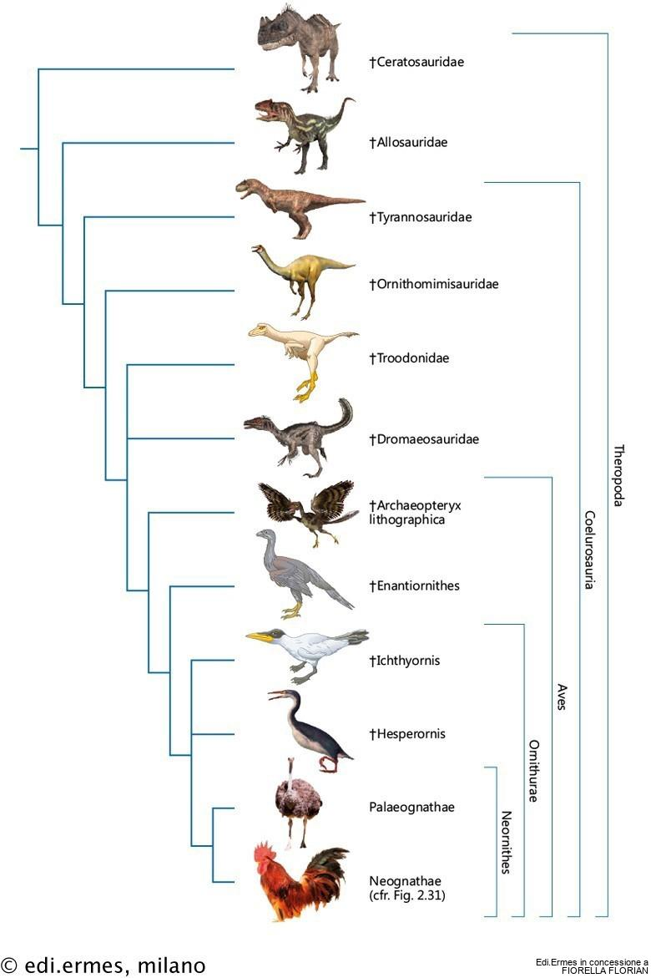
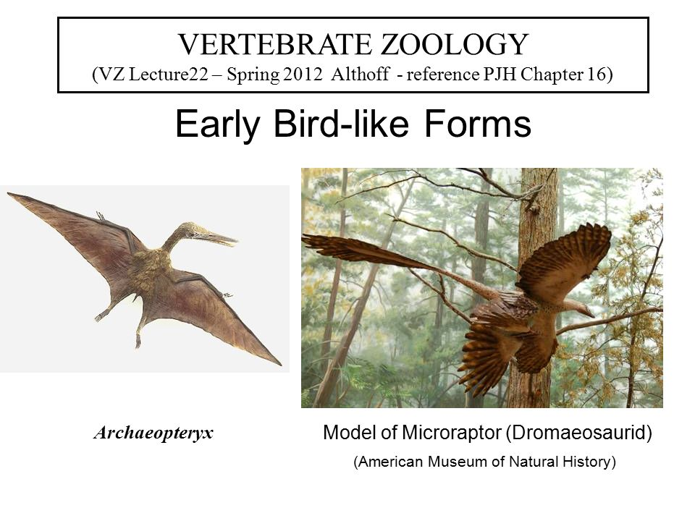
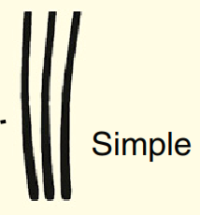

filamentous feather
THEROPODA
CENOZOICO | QUA
 | TER
MESOZOICO | CRE
 | JUR
 | TRIA
PALEOZOICO | PERM
 | CAR
 | DEV
 | SIL
 | ORD
 | CAM
0 MA
furcula
50 MA
100 MA
150 MA
200 MA
VELOCIRAPTOR
MICRORAPTOR
250 MA
had distinct wings on its legs,
resurrecting the old “tetrapteryx,”
a supposed four-winged precursor of modern two-winged birds
300 MA
350 MA
Sinornis
400 MA
CRETACEO
450 MA
FIGURA 2-29
Filogenesi di teropodi attuali e fossili, nella quale è messa in evidenza l’origine degli uccelli (Aves) e degli uccelli neognati (Neornithes).
500 MA
550 MA
AC 029SV_Florian
Notes:
Vaned=barbe

Slide 34
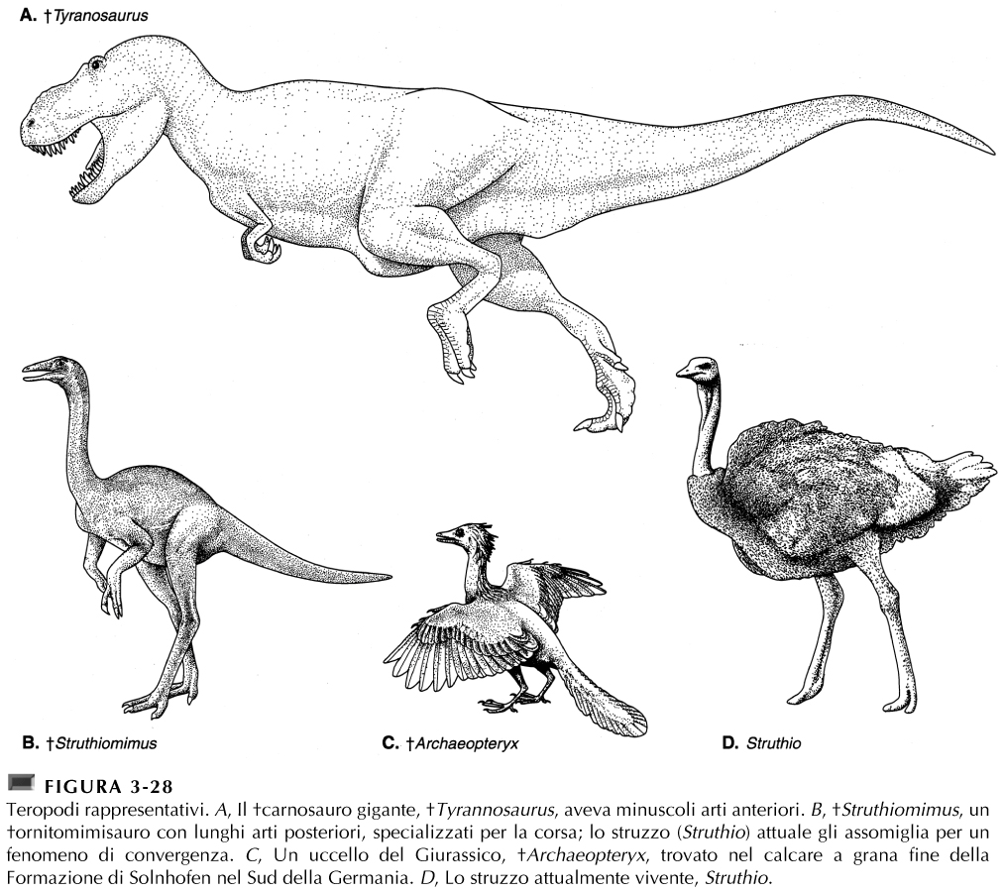
AC 029SV_Florian

Slide 35
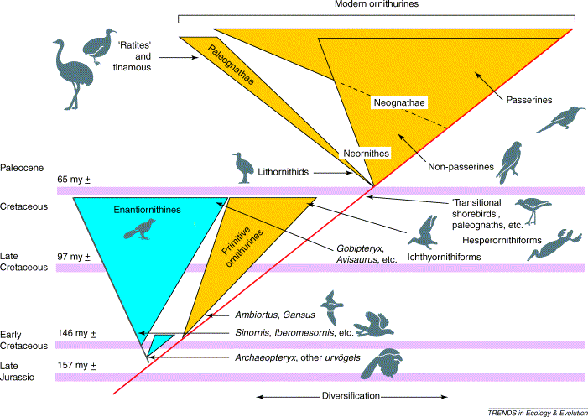
The Tertiary ‘big bang’ model for modern bird evolution
subclass Sauriurae
subclass Ornithurae
A near total demise of archaic birds occurred at the K–T boundary, with a rapid reorganization and explosive early Tertiary evolution from a bottleneck of modern ornithurine morphological types, perhaps involving ‘transitional shorebirds', paleognaths and some other lineages. The initial diversification of modern ornithurines might have taken place in the late Cretaceous. This explosive, punctuated model, following a major extinction event, reflects the standard pattern of vertebrate evolution, especially documented following the Permian extinctions. (From: Feduccia 2003).
AC 029SV_Florian
Notes:
Una scomparsa quasi totale di uccelli arcaici avvenne al confine K-T, con una rapida riorganizzazione e un'evoluzione terziaria iniziale esplosiva da un collo di bottiglia dei moderni tipi morfologici di orniturini, che forse coinvolse "uccelli costieri di transizione", paleognati e alcune altre linee. La diversificazione iniziale degli orniturini moderni potrebbe aver avuto luogo nel tardo Cretaceo. Questo modello esplosivo, interrotto, a seguito di un grave evento di estinzione, riflette il modello standard dell'evoluzione dei vertebrati, documentato in particolare a seguito delle estinzioni Permiane.

Slide 36
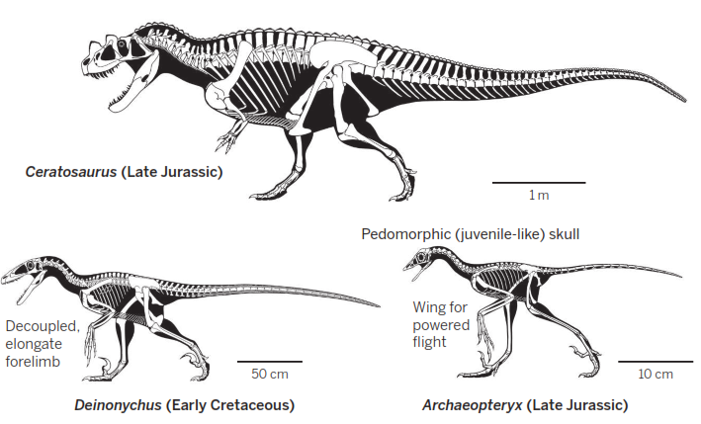
How birds became birds
Dromaeosauridae
Making a bird from a dinosaur. Key characteristics of birds that distinguish them from their theropod ancestors include quill-like feathers, forelimbs that are decoupled from hindlimbs, a pedomorphic skull, and small size.
Science. 2014 345(6196)508-9
AC 029SV_Florian
Notes:
quill-like feathers=penne simili a piume

