Slide 1
Nanotechnology and Nanoscience:
ISO/TS 80004 defines :
nanomaterial as the "material with any external dimension in the nanoscale or having internal structure or surface structure in the nanoscale“;
nanoscale as the "length range approximately from 1 nm to 100 nm".
This includes both nano-objects, which are discrete pieces of material, and nanostructured materials, which have internal or surface structure on the nanoscale.
We will define it as science and technology of structures
made of materials or composites of inorganic and organic materials where at least one dimension is
less than 100 nm, and in addition new phenomena are observed which result from such a small size.

Slide 2
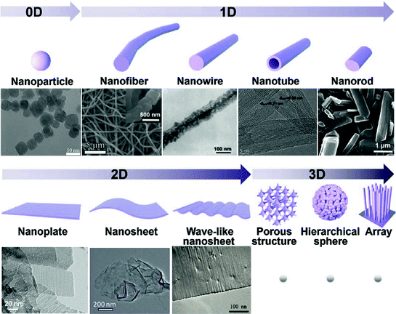
Nanomaterials

Slide 3
Nanomaterials
Zero-dimensional
A material with all three external dimensions in the nanoscale.
One-dimensional nanostructures
The smallest possible crystalline wires with cross-section as small as a single atom can be engineered in cylindrical confinement.
Two-dimensional nanostructures
2D nanomaterials are materials consisting of a two-dimensional single layer of atoms. The most important representative graphene was discovered in 2004. Thin films with nanoscale thicknesses are considered nanostructures but are sometimes not considered nanomaterials because they do not exist separately from the substrate.
3D nanostructured materials
Bulk materials that contain features on the nanoscale, including nanocomposites, nanocrystalline materials, nanostructured films, and nanotextured surfaces.

Slide 5
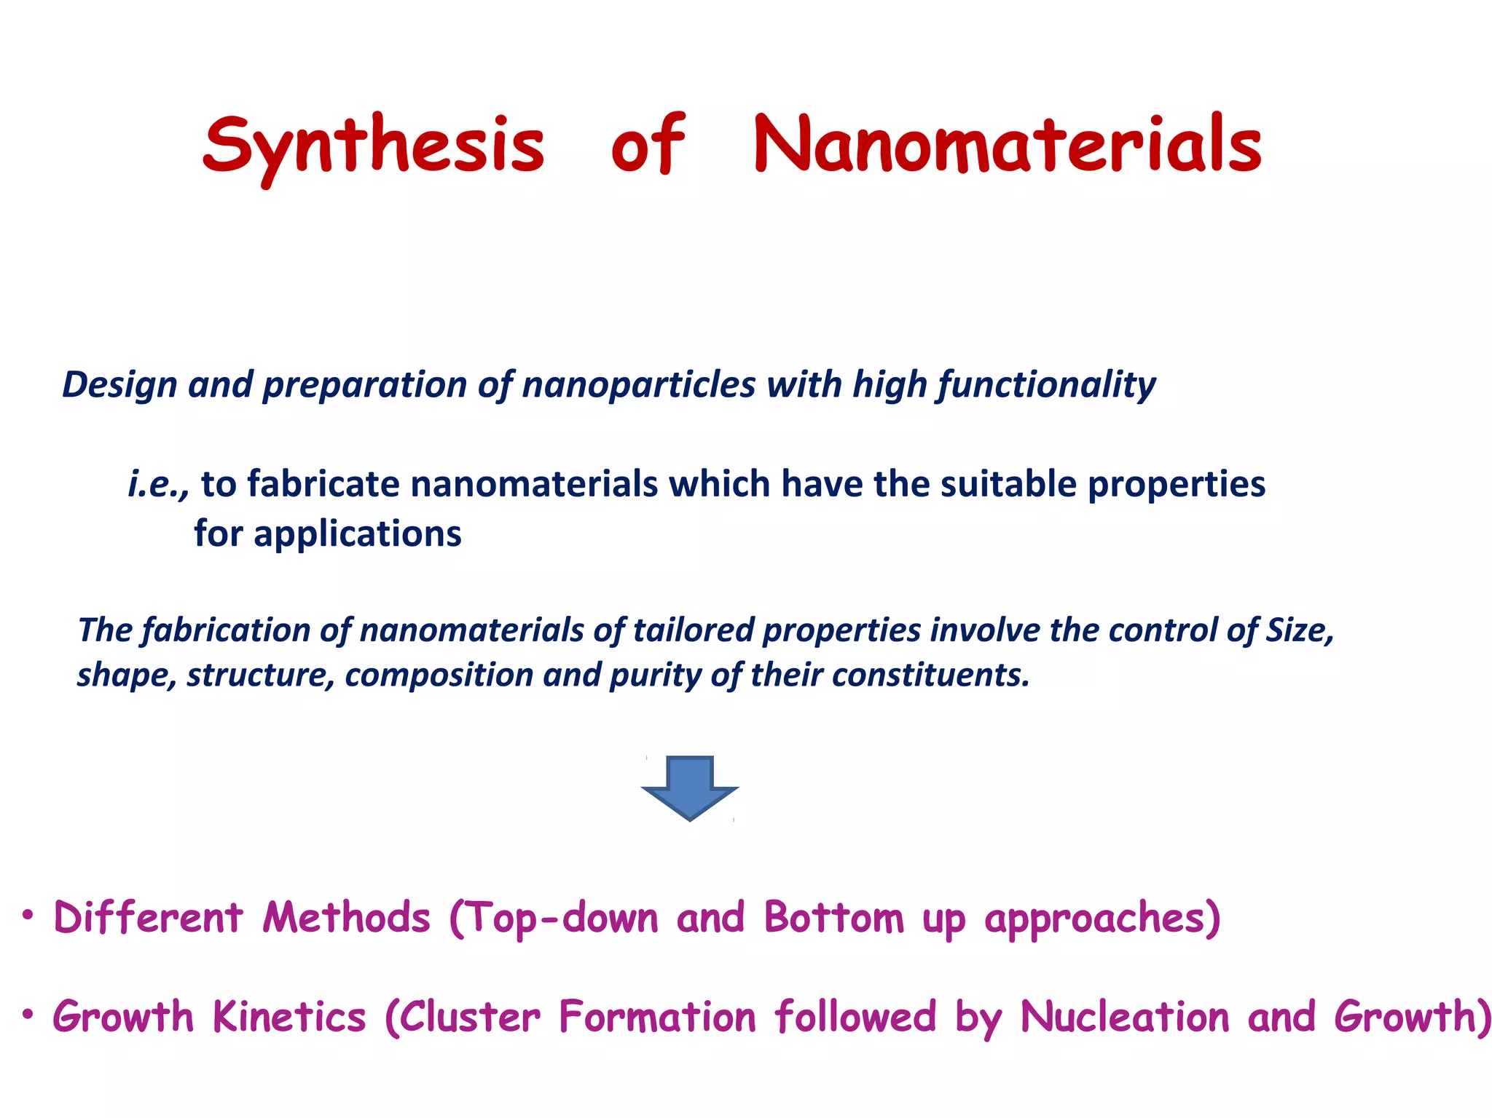

Slide 6
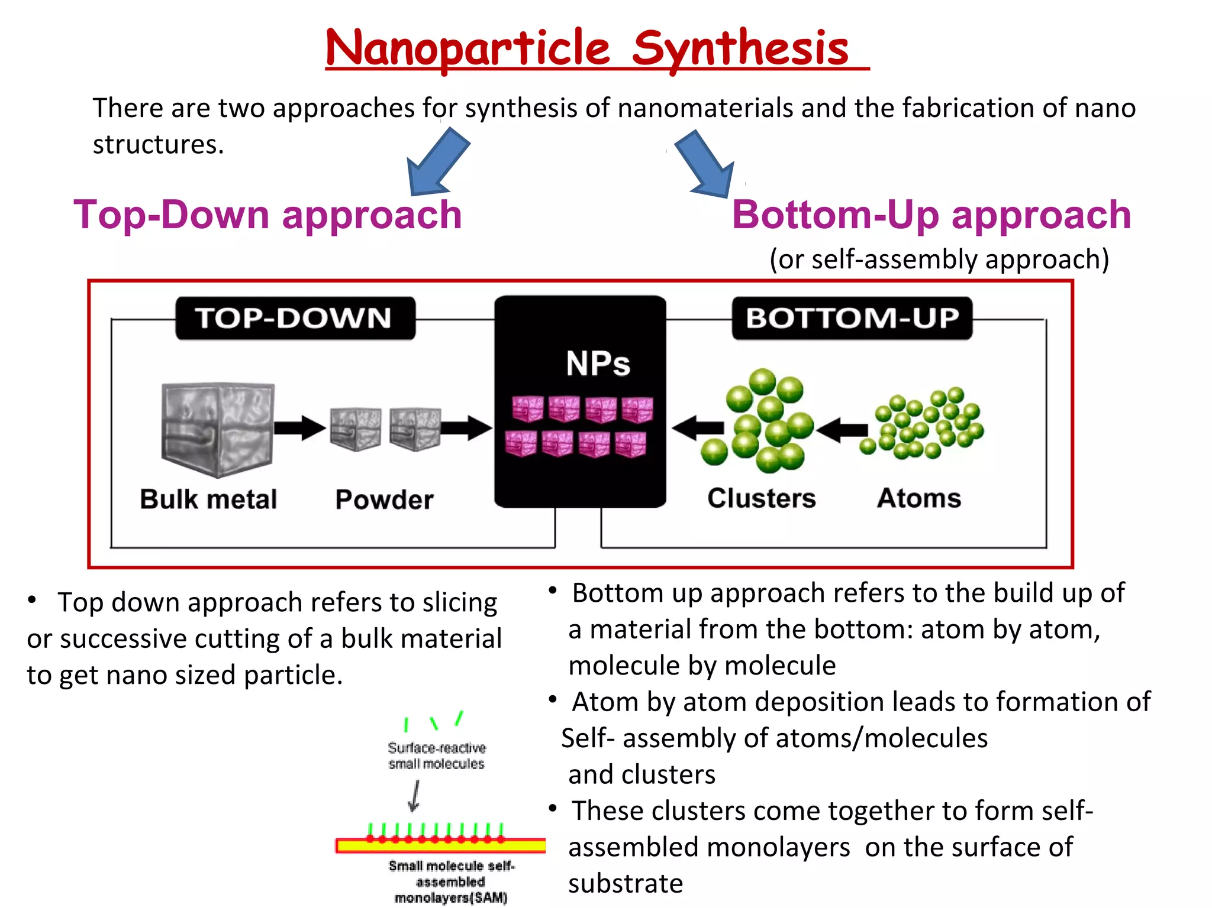

Slide 7
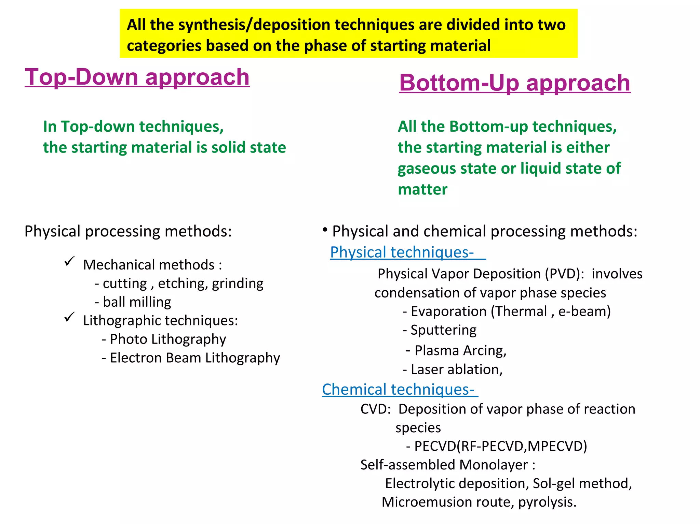

Slide 8
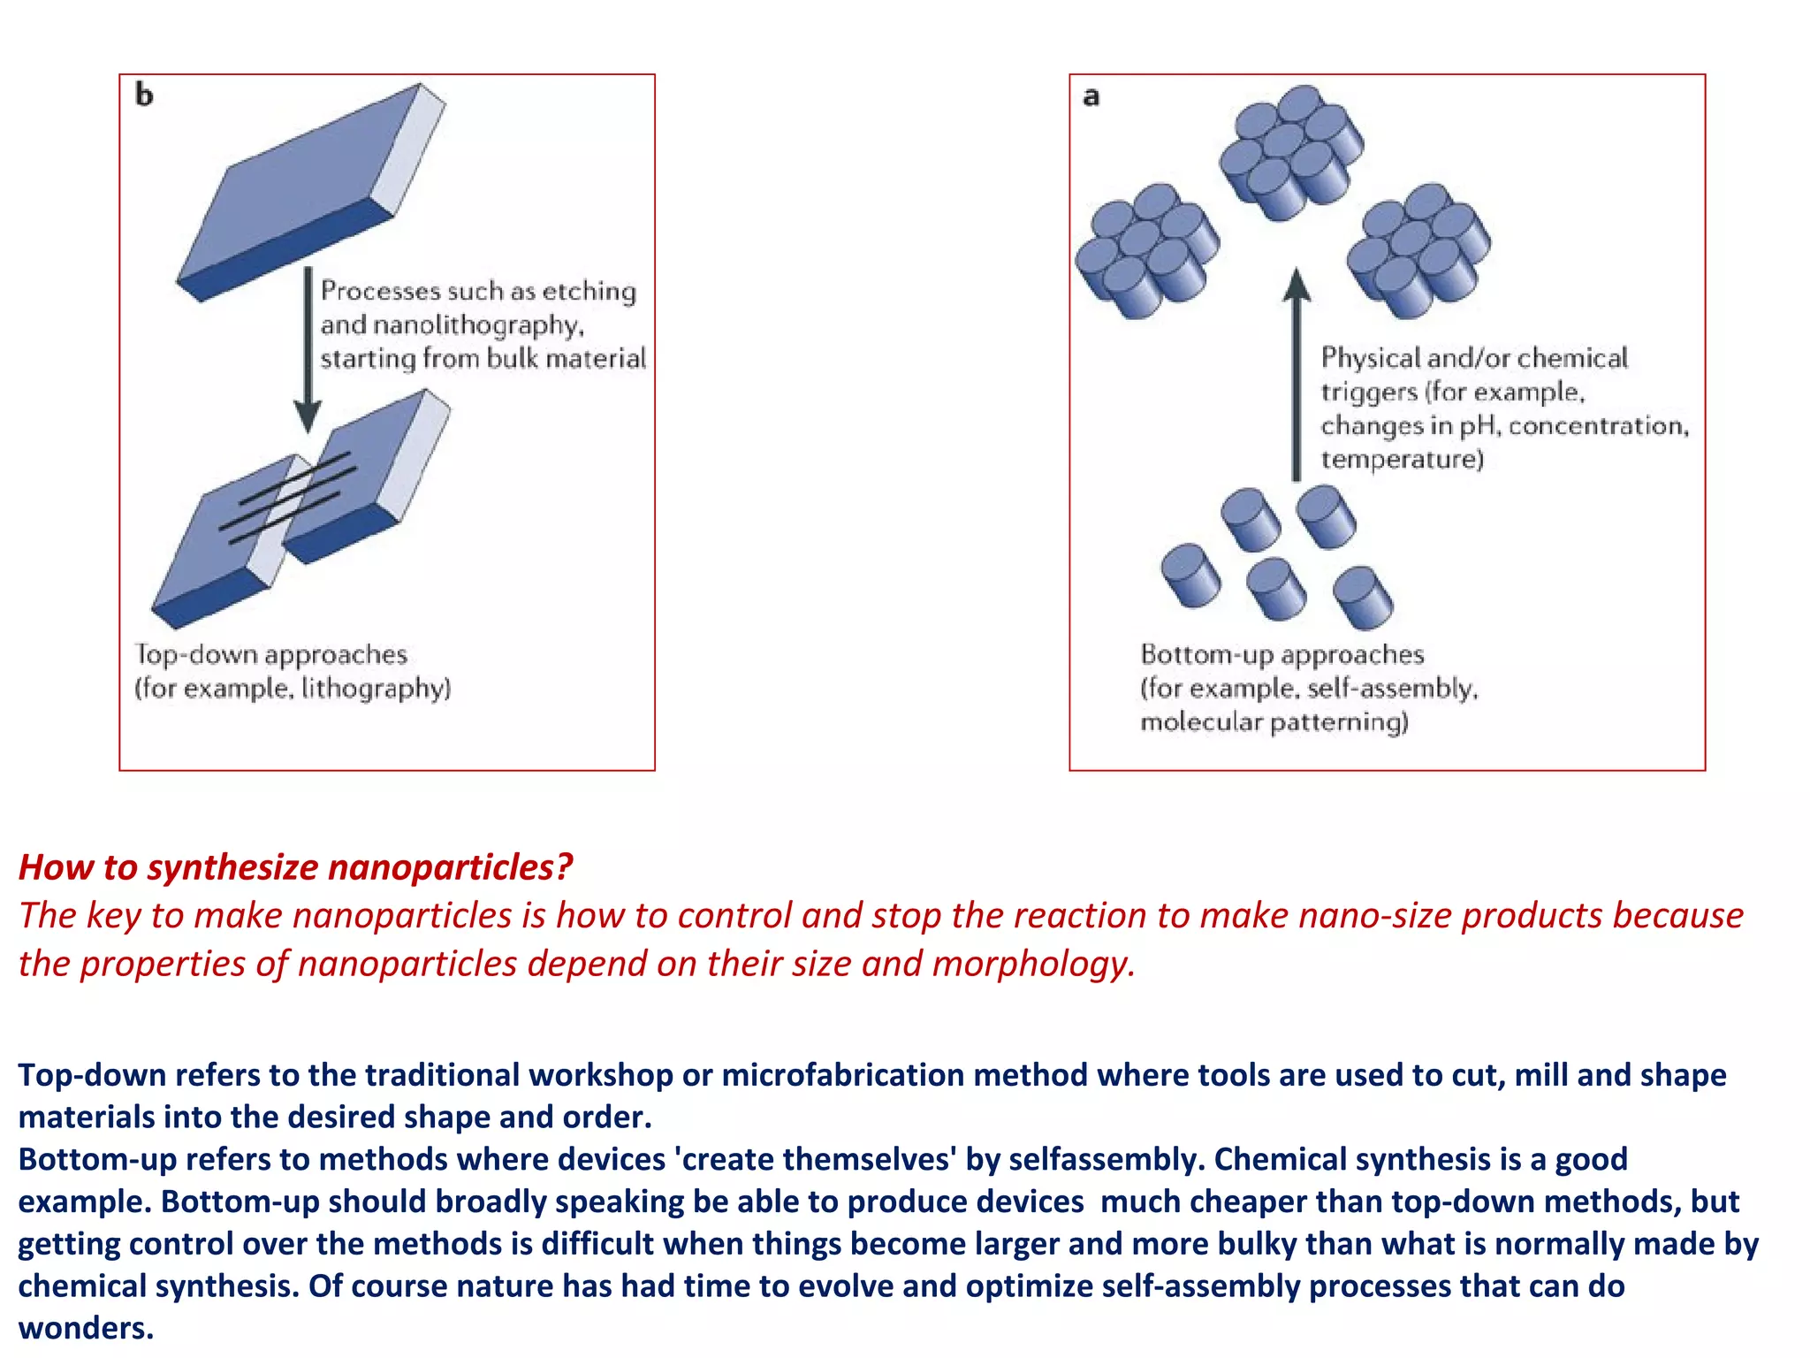

Slide 9
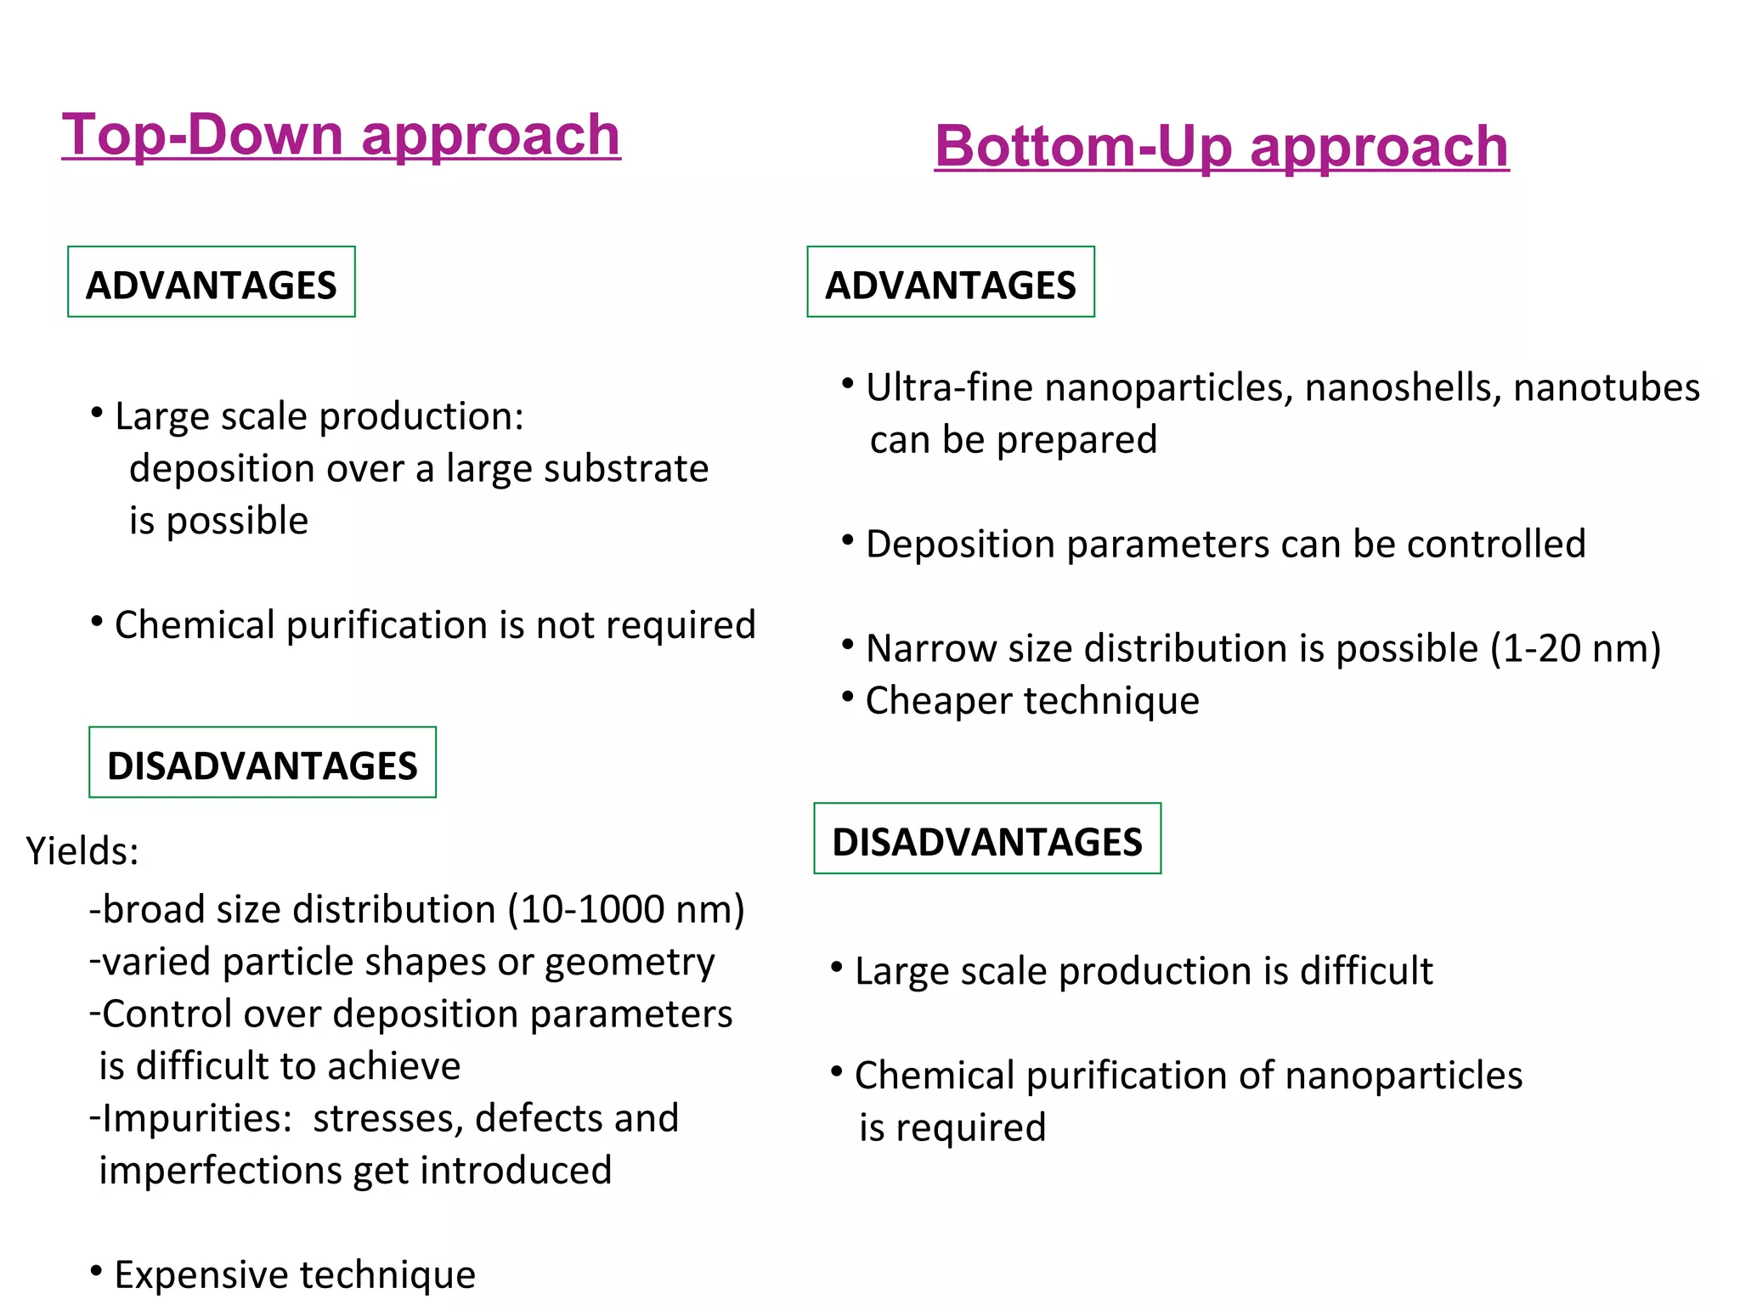

Slide 10
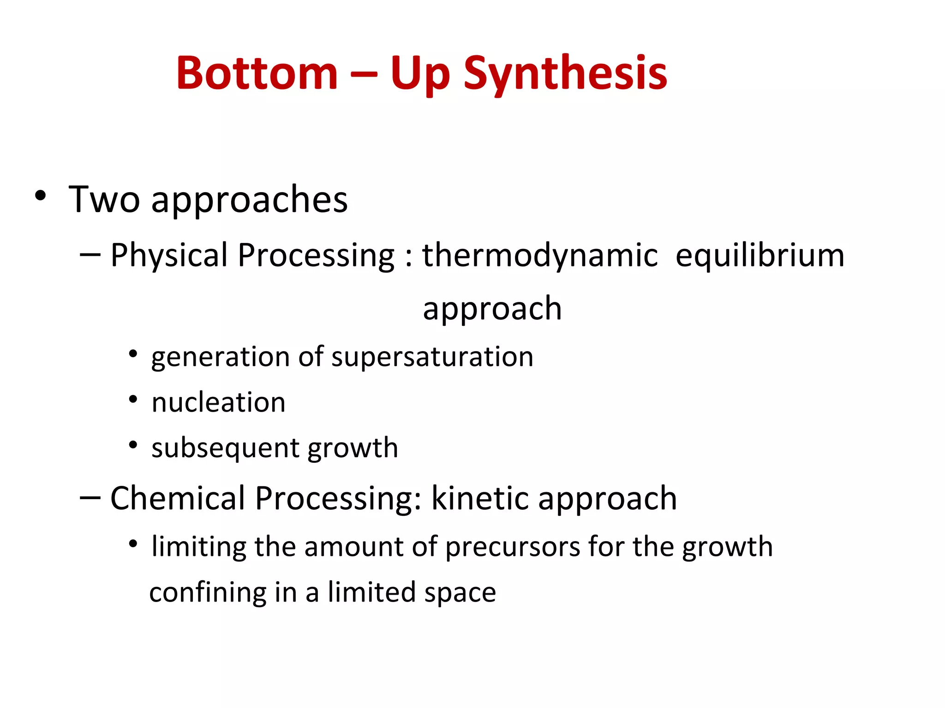

Slide 11
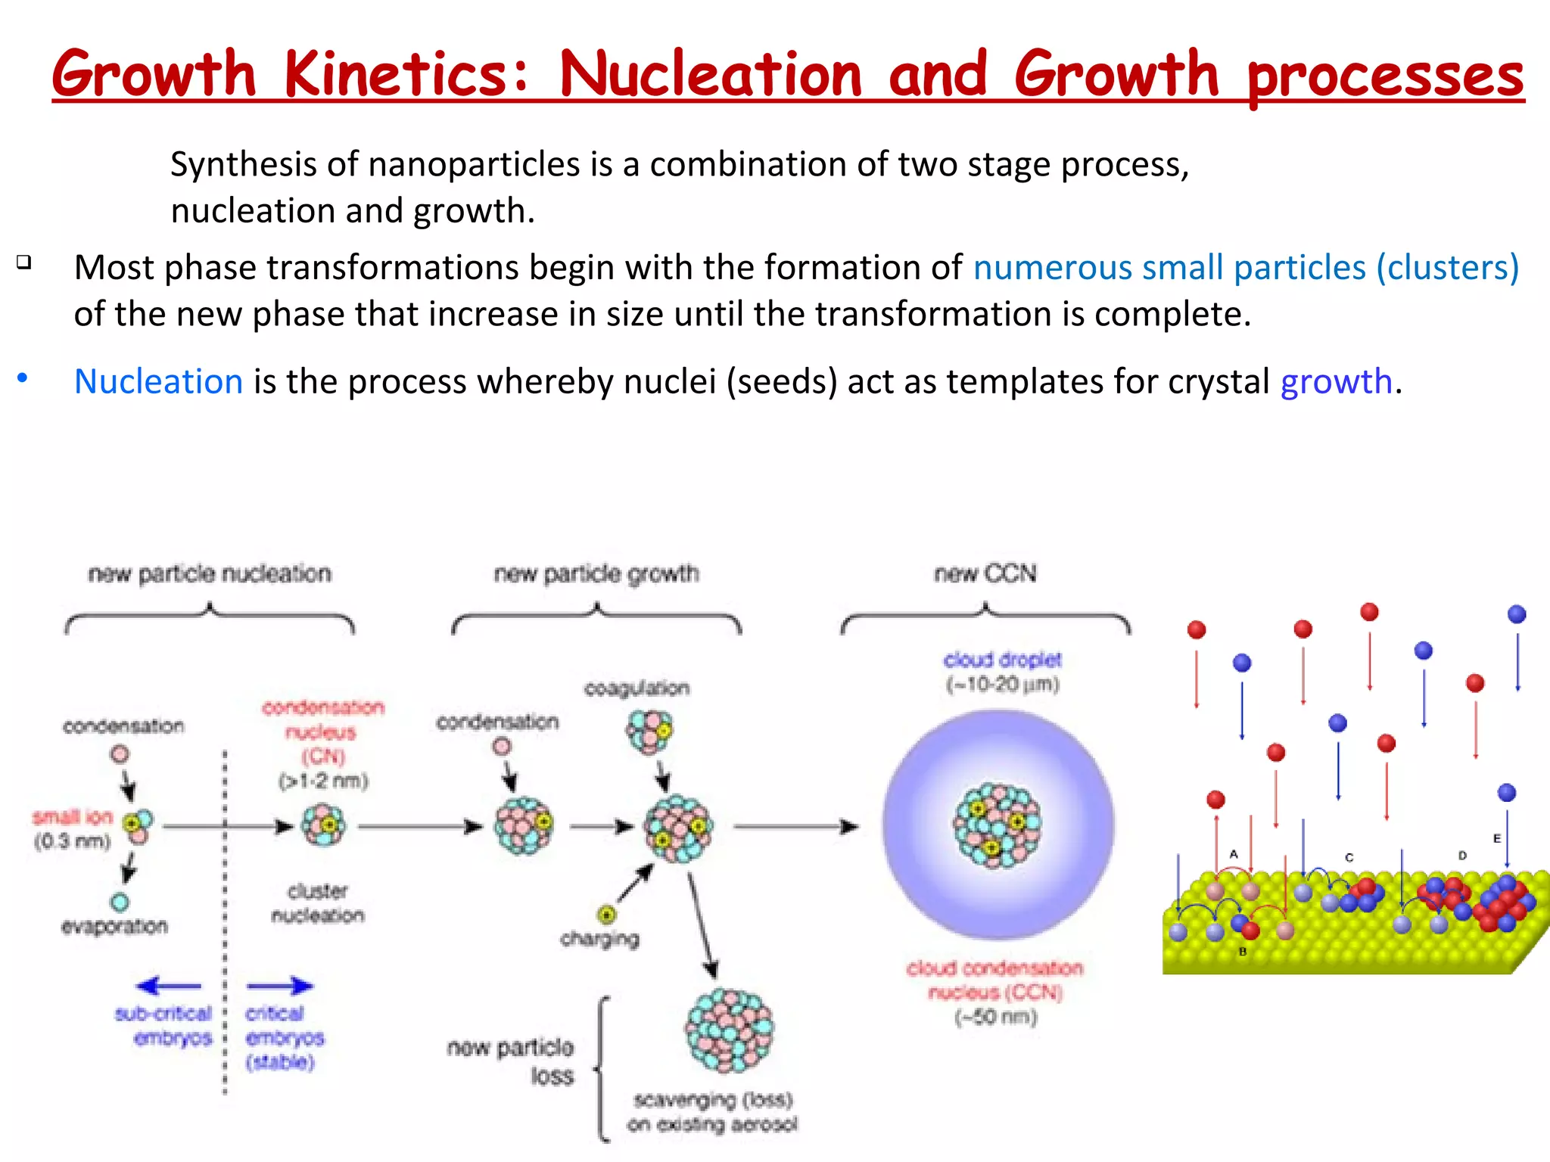

Slide 12
