Slide 1
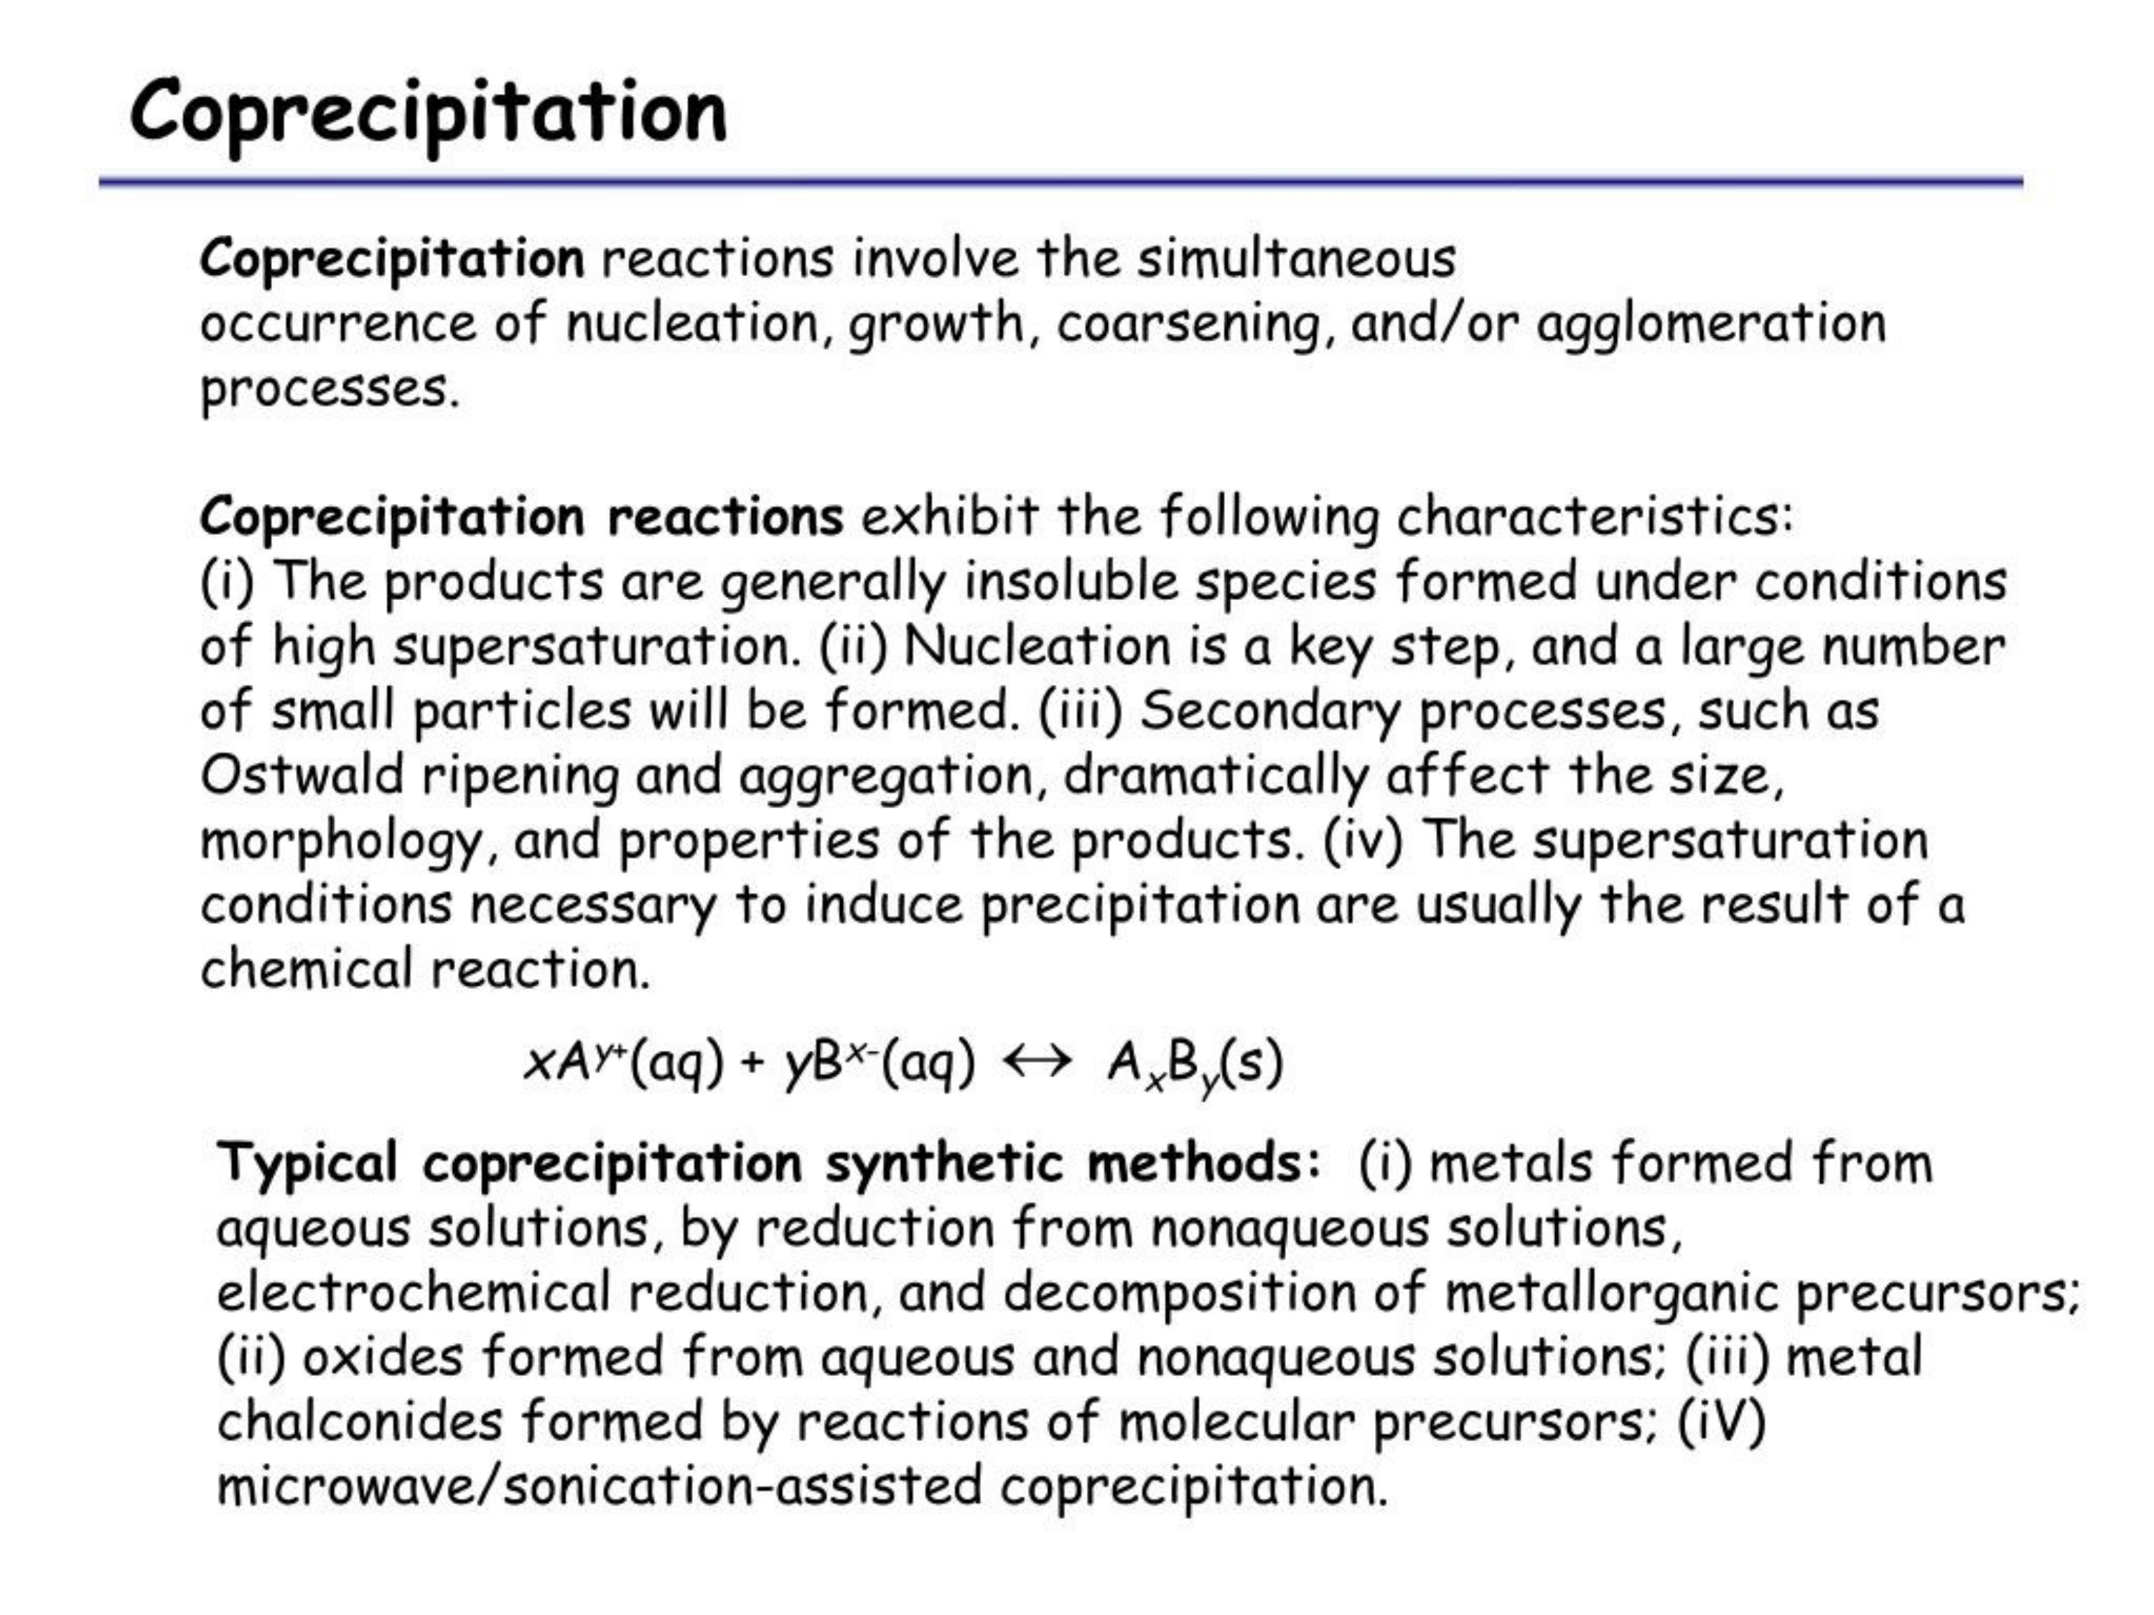

Slide 2
Coprecipitation

Slide 3
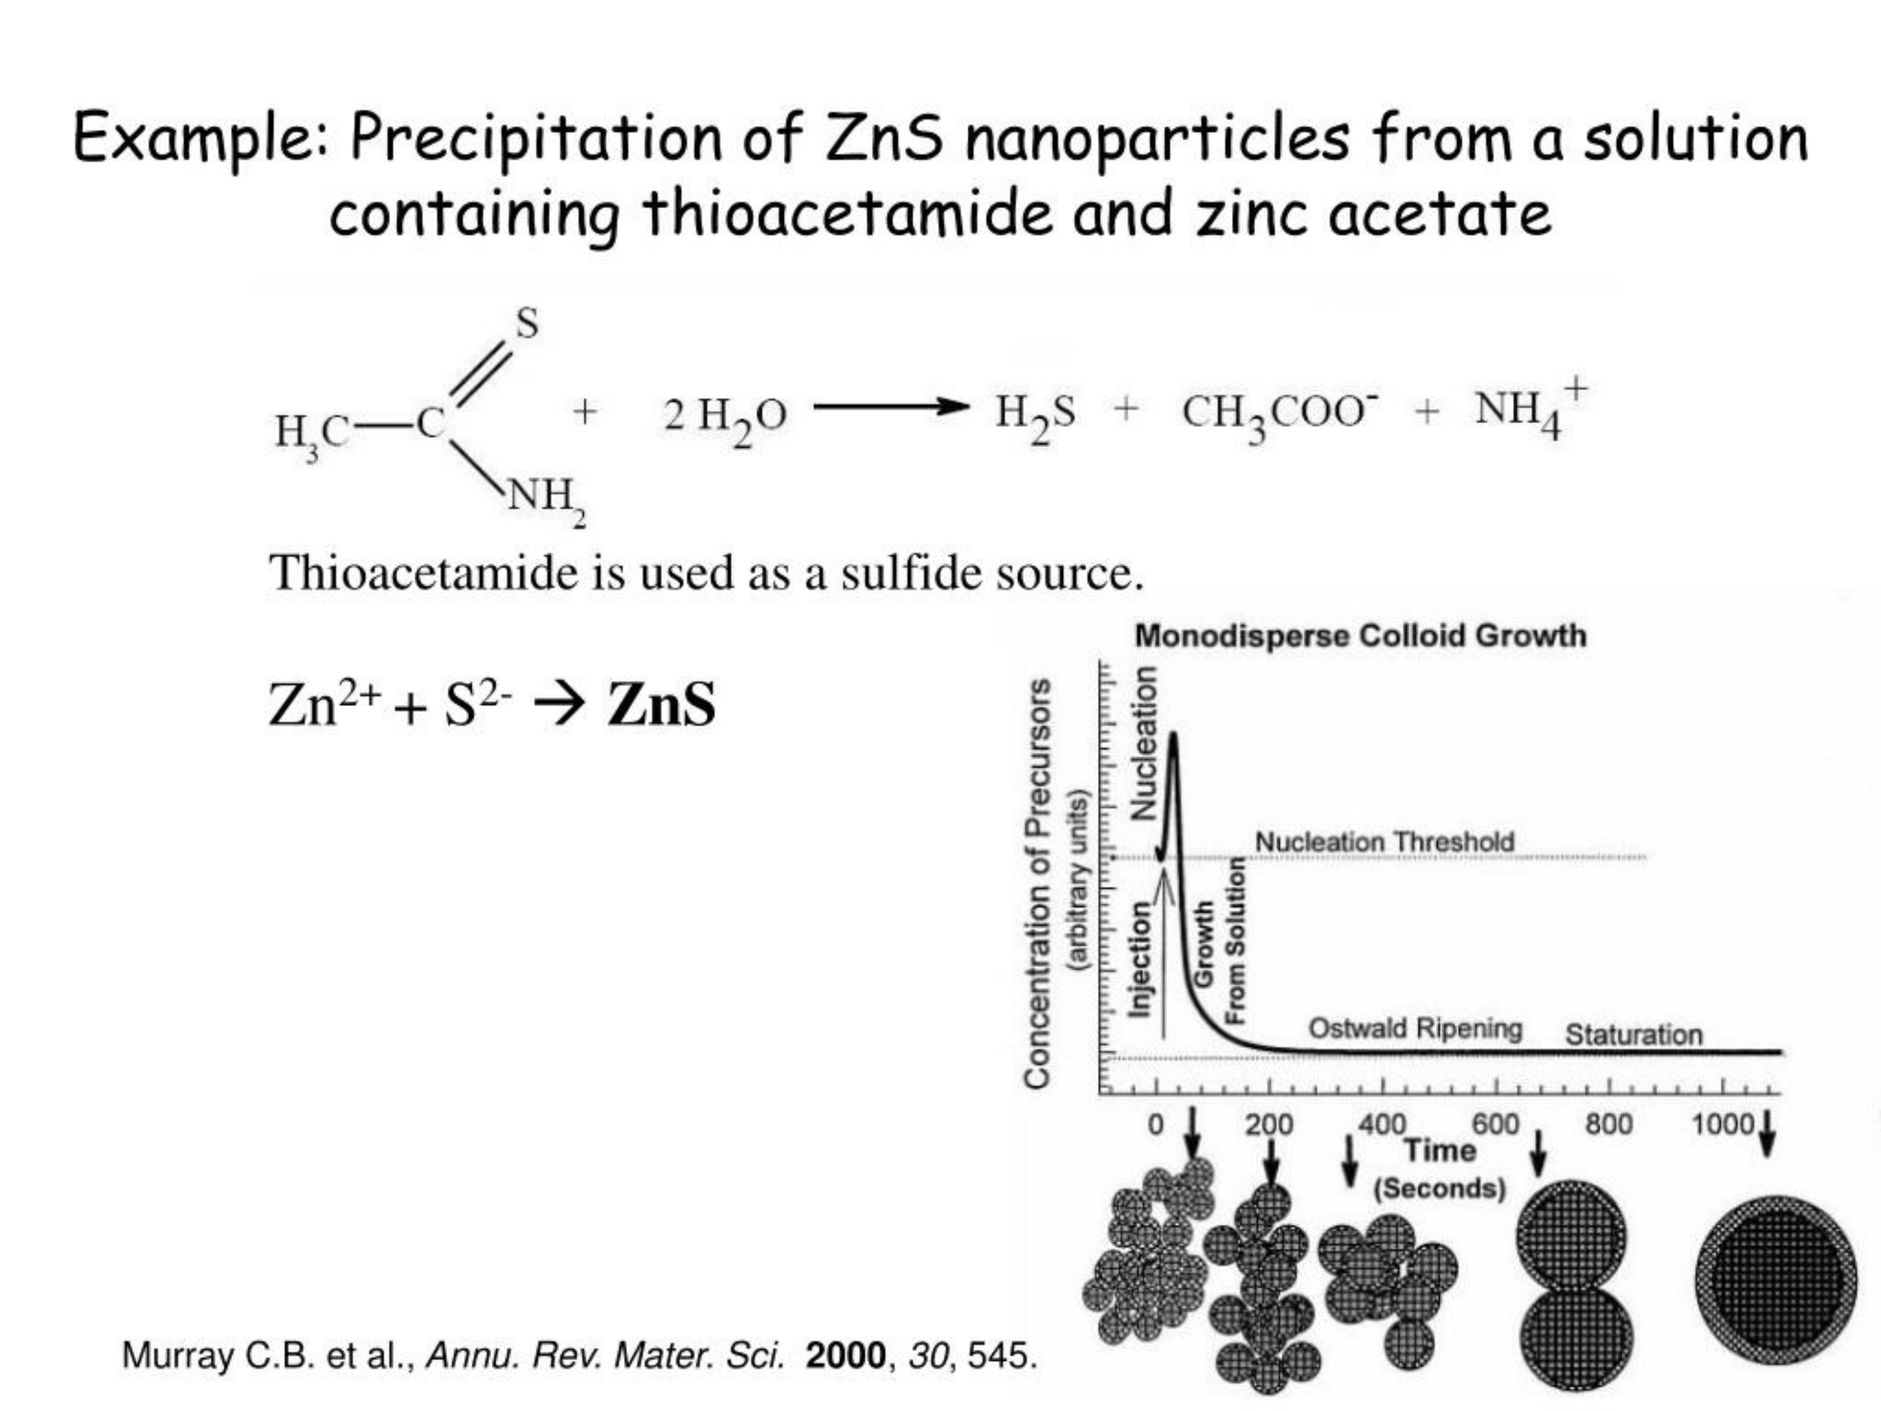

Slide 4
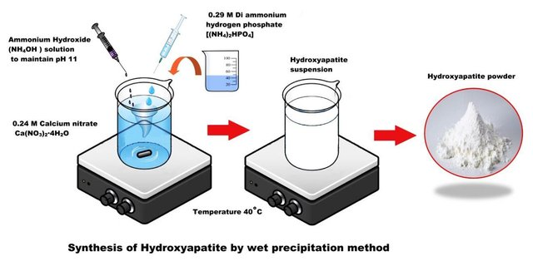
Example: hydroxyapatite
Simple precipitation by increase of pH
Ca₁₀(PO₄)₆(OH)₂

Slide 5
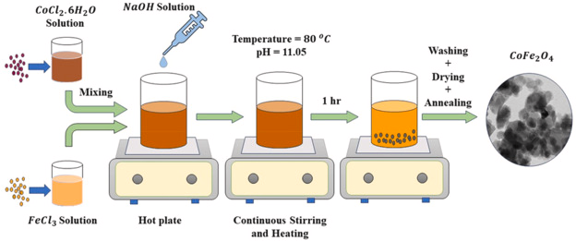
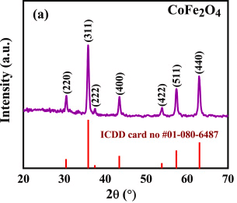
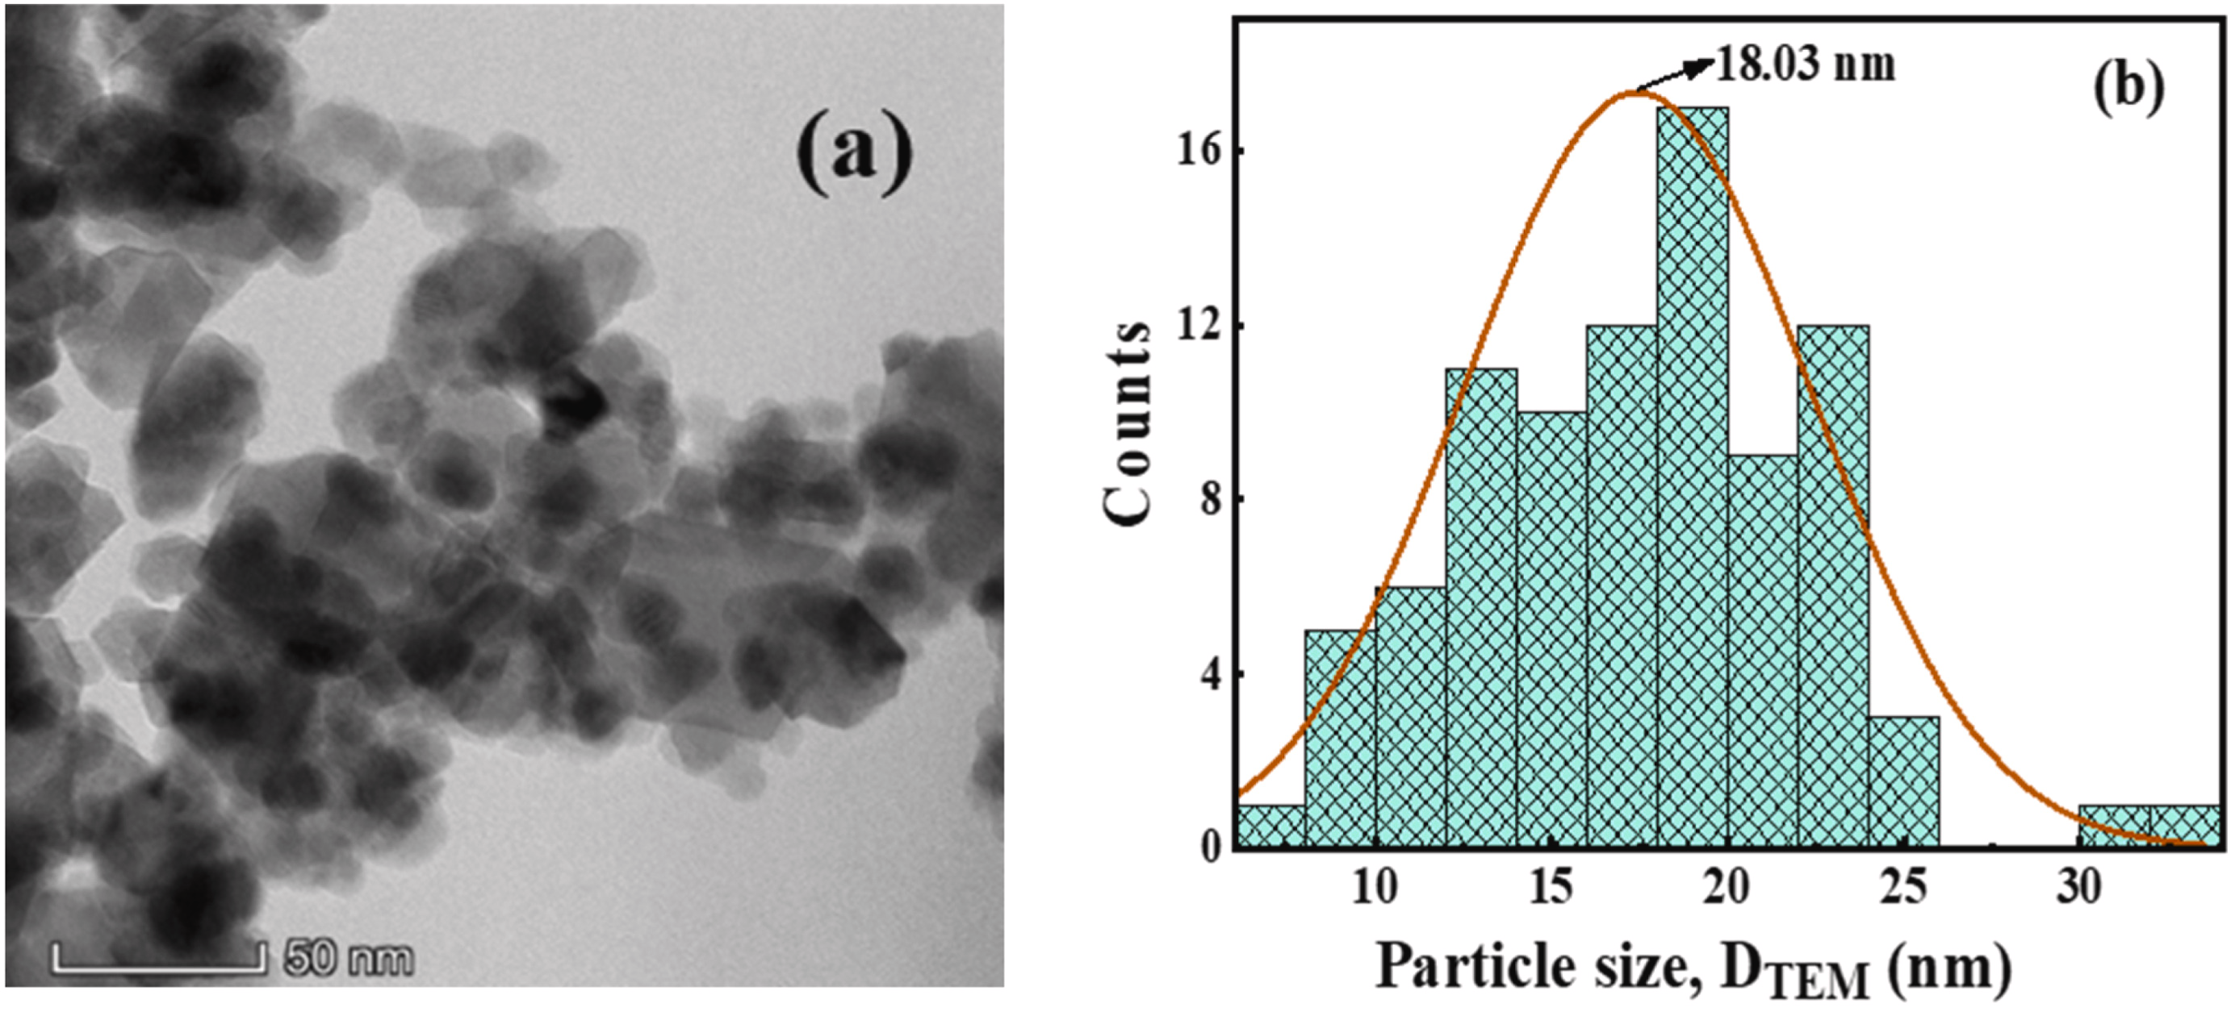
Direct coprecipitation
CoFe₂O₄
Phase purity
Broad size distribution
Key points are :
Comparable solubility of hydroxides
Intermediate aging (disoolution – reprecipitation)
https://doi.org/10.1016/j.heliyon.2024.e34413

Slide 6
Direct coprecipitation
Ce_{0.5}Zr_{0.5}O₂
Precipitation of Ce and Zr precursors by addition of NH₄OH.
Zr(OH)₄ pH ≈ 2
Ce(OH)₃ pH ≈ 7.5
Zr(OH)₄ pH ≈ 2
Ce(OH)₄ pH ≈ 1
Preliminar oxidation of Ce^{III} to Ce^{IV} woth (NH₄)₂S₂O₈
Without
(NH₄)₂S₂O₈
With
(NH₄)₂S₂O₈
XRD analysis of samples calcined at 1000 °C

Slide 7
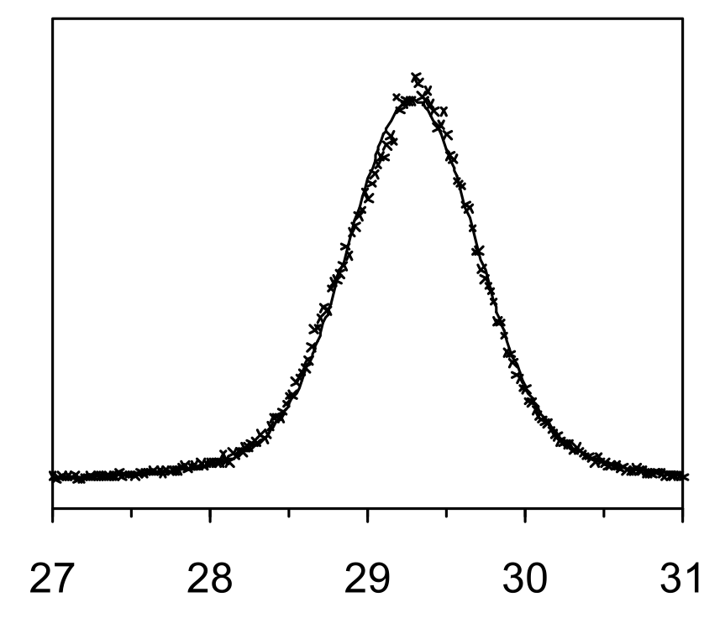
Inverse coprecipitation
Ce_{0.5}Zr_{0.5}O₂
Precipitation by addition of Ce and Zr precursors to NH₄OH.
Instantaneous quantitative precipitation of metal ions.
The statistical distribution of cations is «freezed» and maintained in the final oxide product.
XRD analysis of samples calcined at 1000 °C

Slide 8
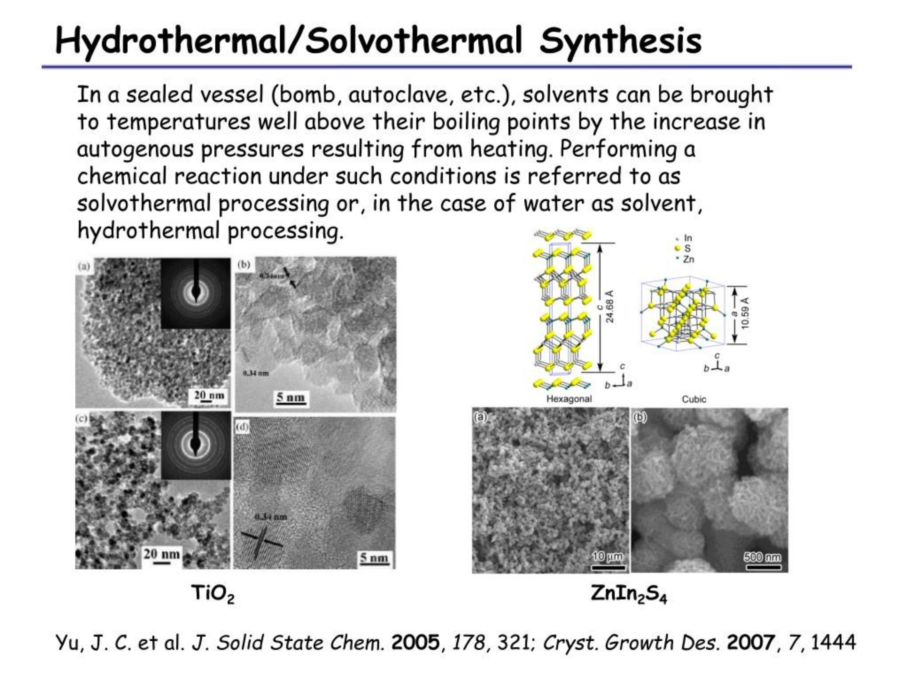

Slide 9
