Slide 1
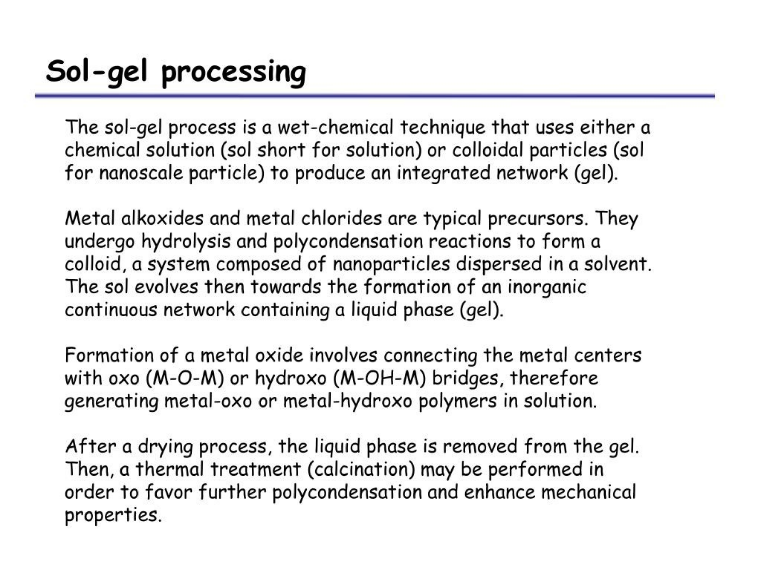

Slide 2
Sol-gel

Slide 3
Sol-gel

Slide 4
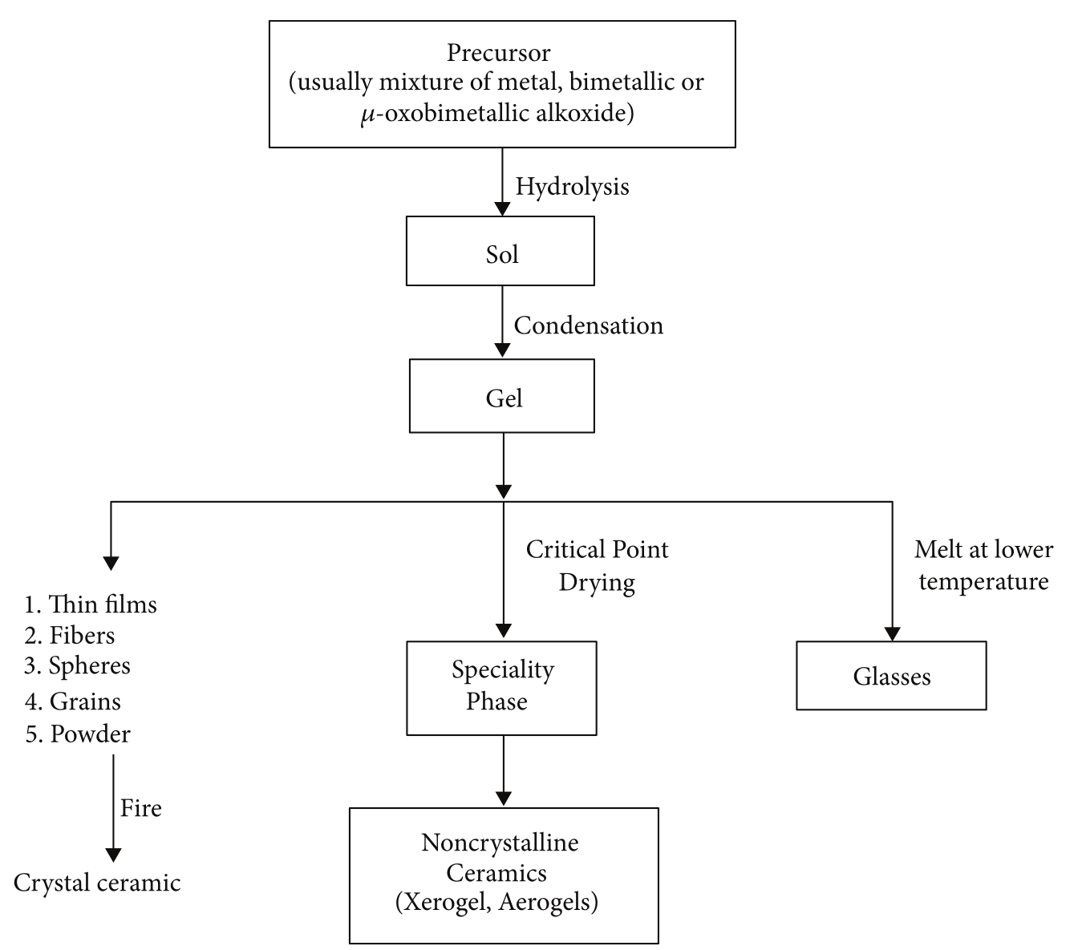
Sol-gel: synthesis steps

Slide 5
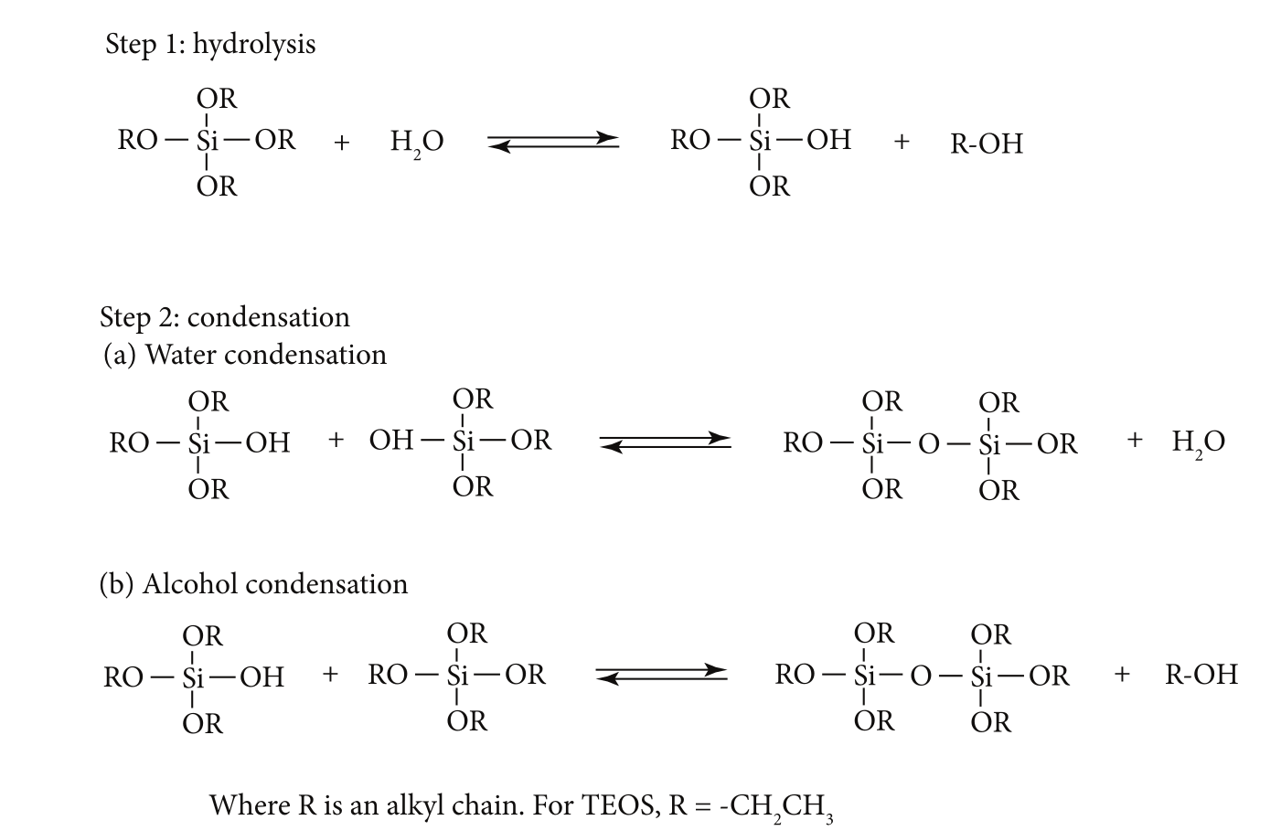
This process occurs in liquid solution of organometallic precursors (Tetramethyl orthosilicate (TMOS), Tetraethyl orthosilicate (TEOS), Zr(IV)-Propoxide, Ti(IV)-Butoxide, etc. ), which, by means of hydrolysis and condensation reactions, lead to the formation of a new phase (SOL).
Sol-gel: synthesis steps
Formation of SOL

Slide 6
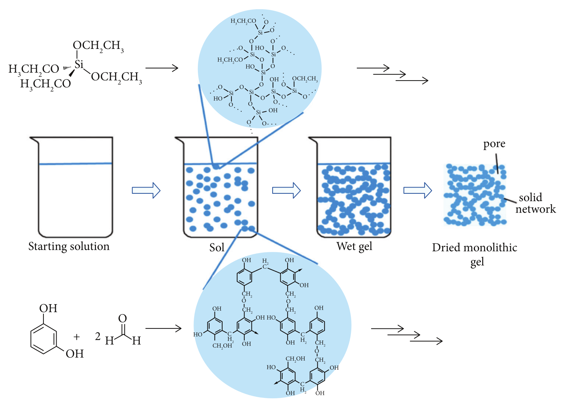
Sol-gel: synthesis steps
Further condensationcof SOL particles leads to a GEL

Slide 7
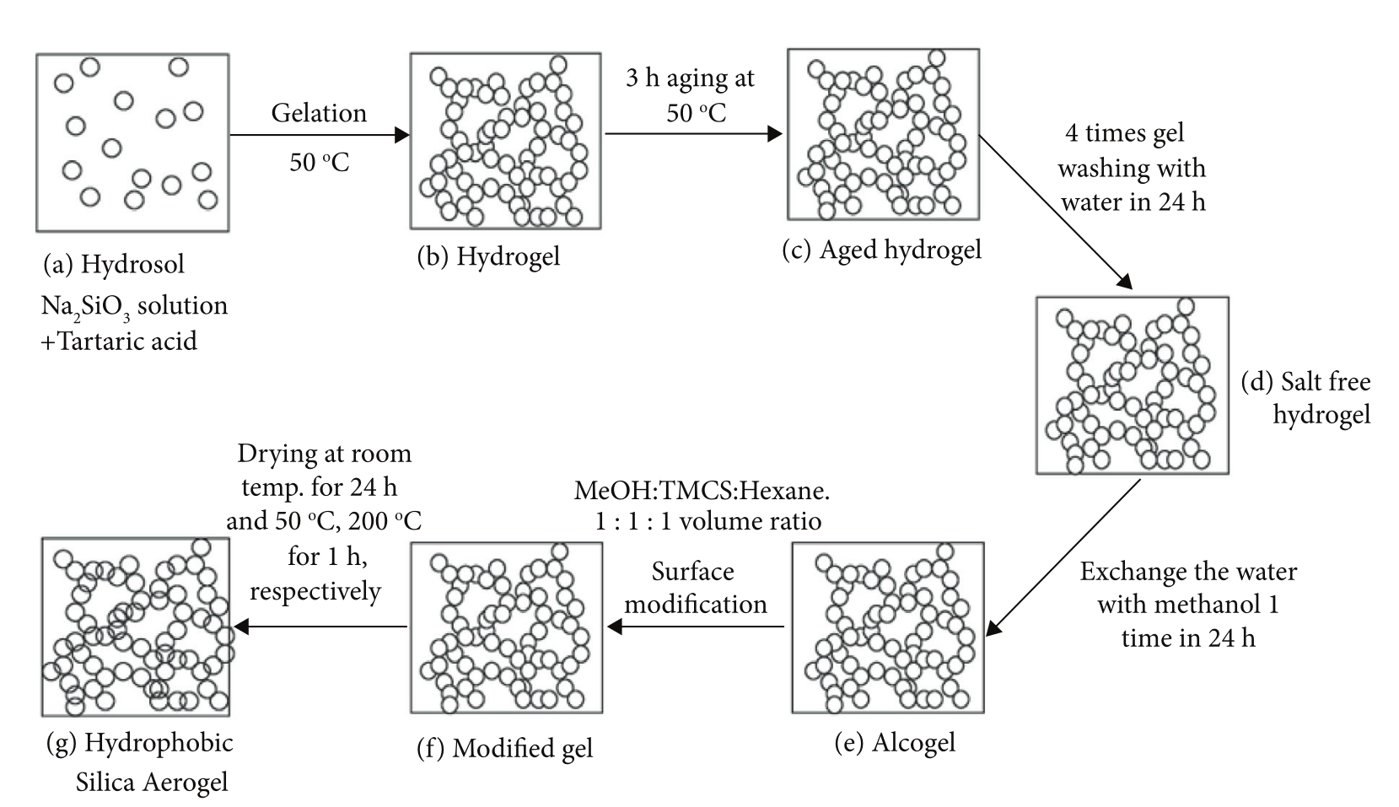
Sol-gel: synthesis steps

Slide 8
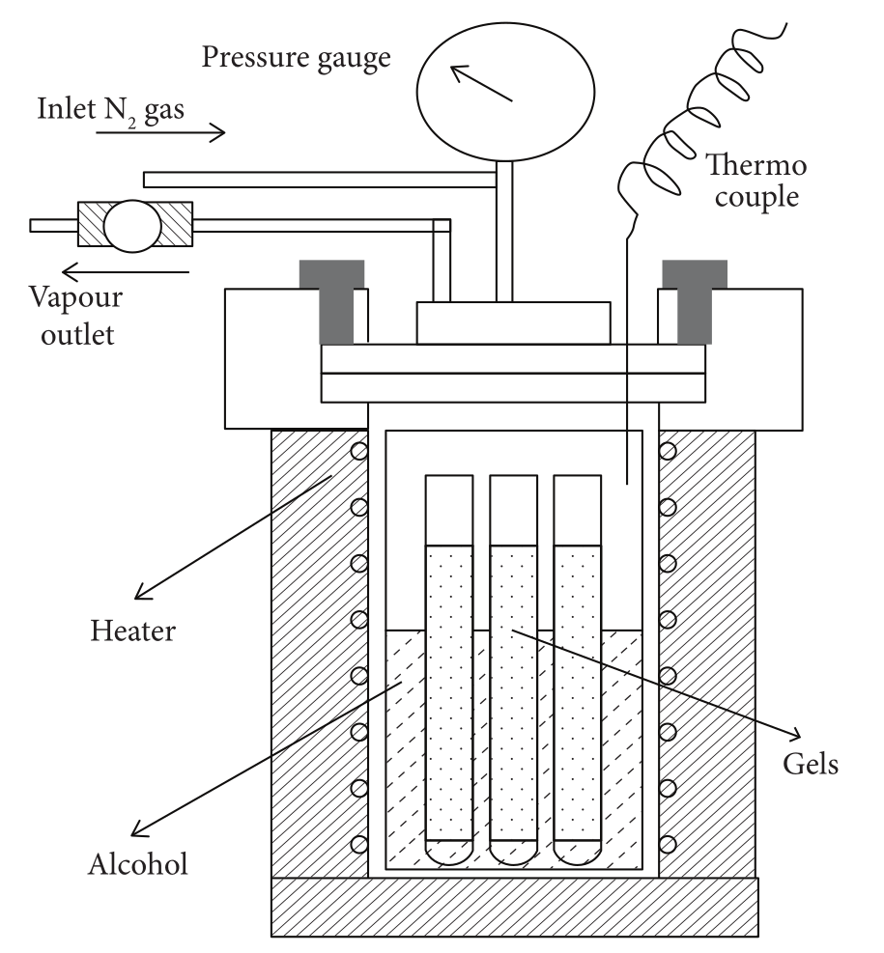
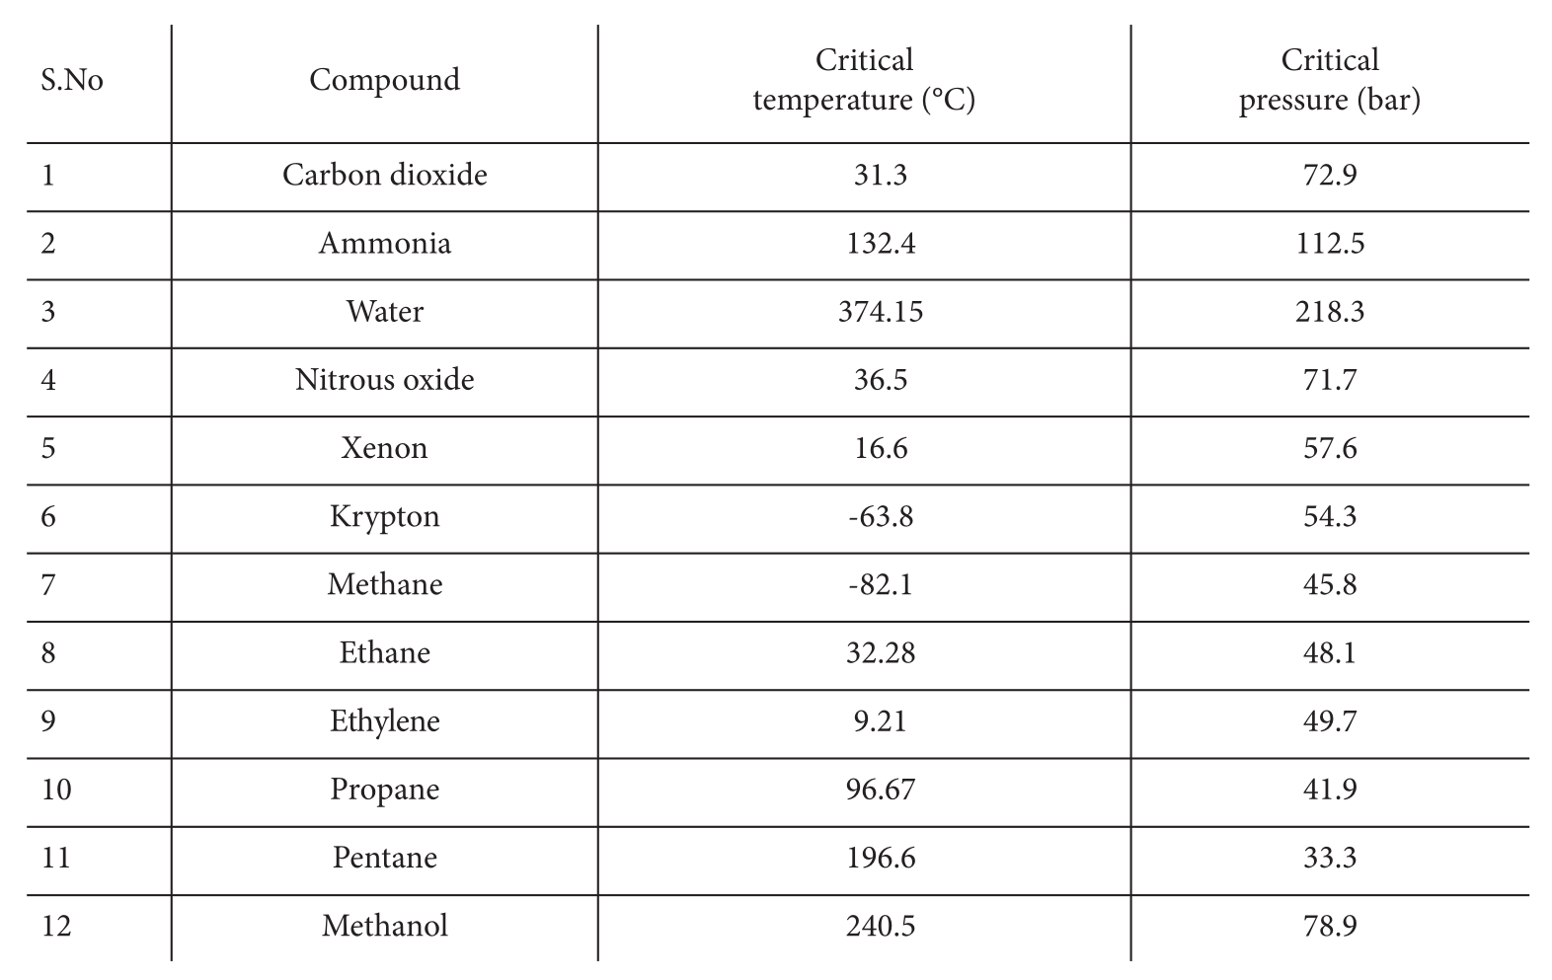
Sol-gel: synthesis steps

Slide 9
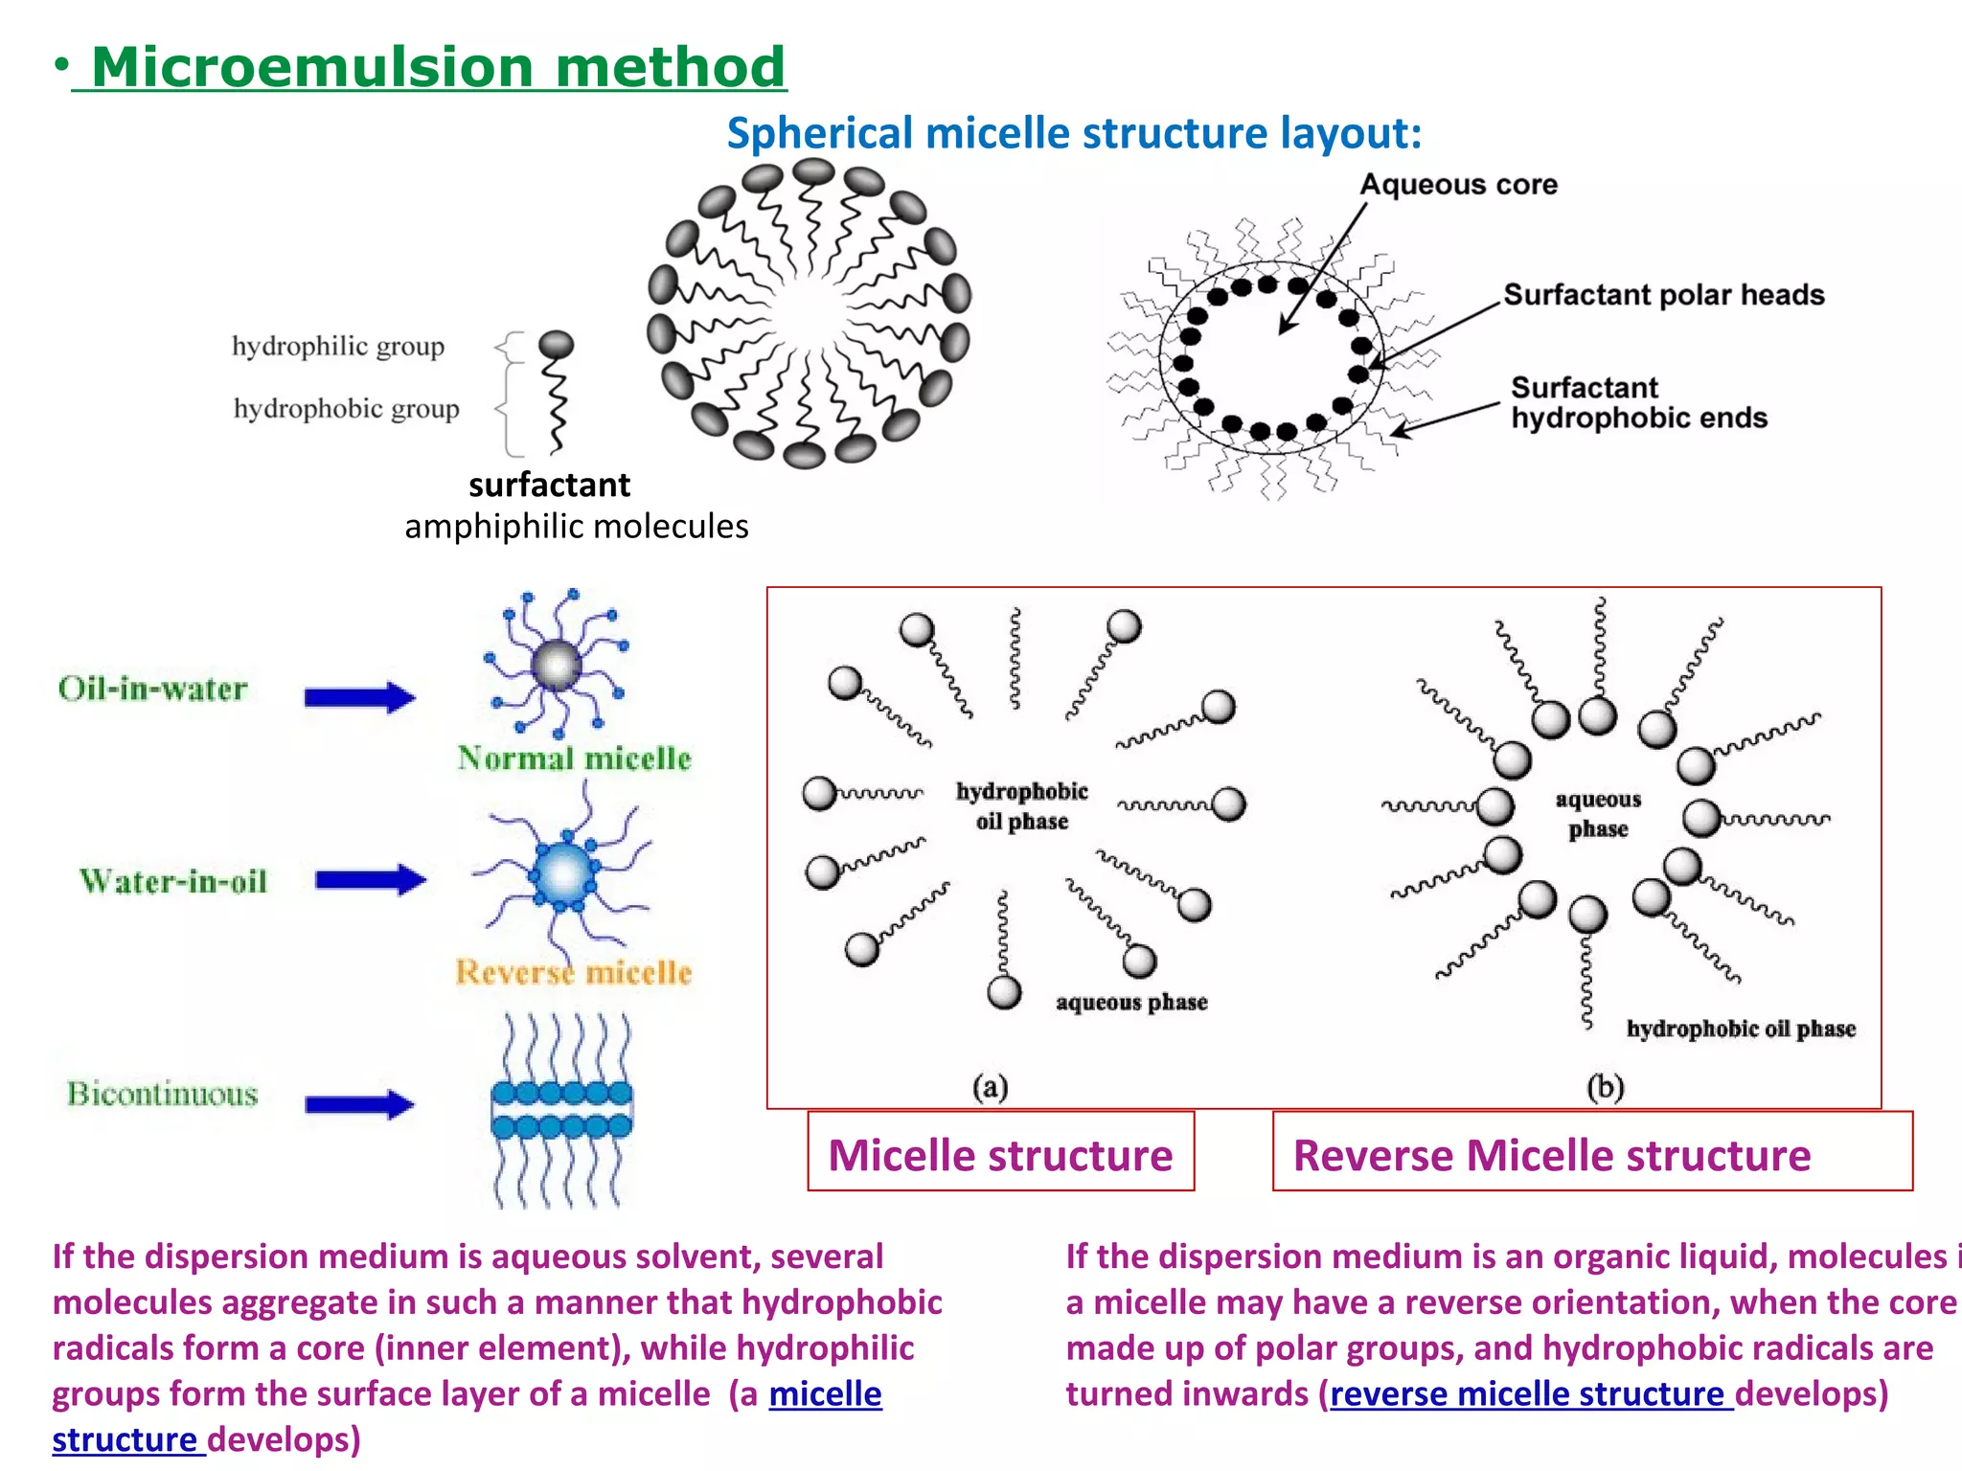

Slide 10
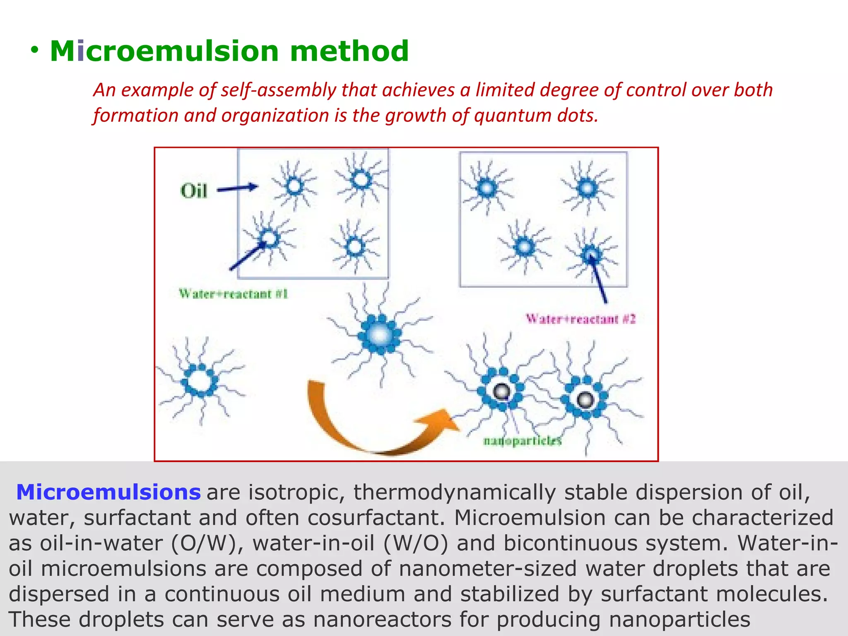

Slide 11
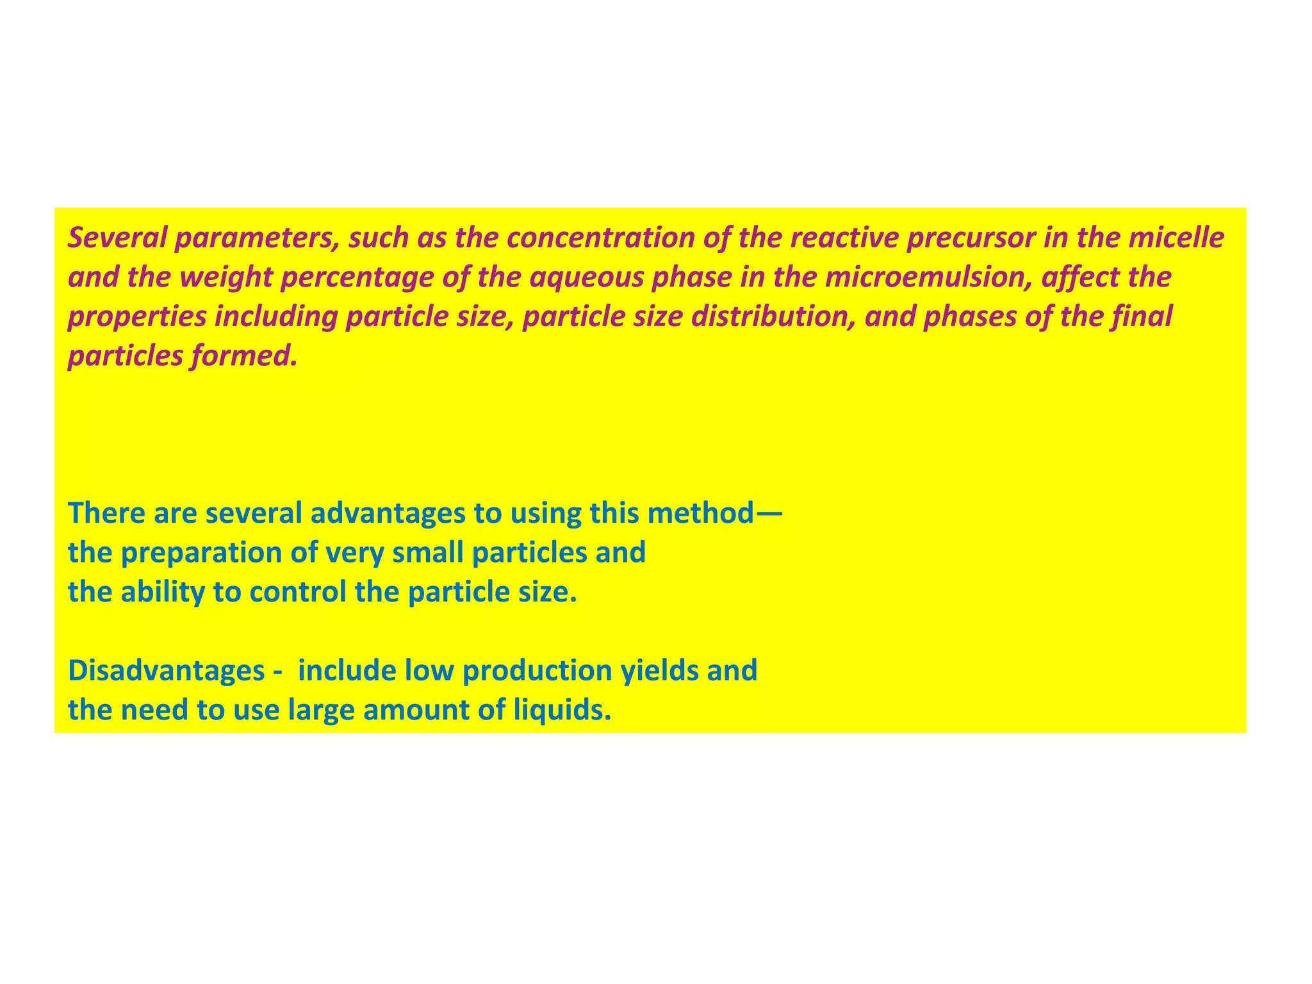

Slide 12
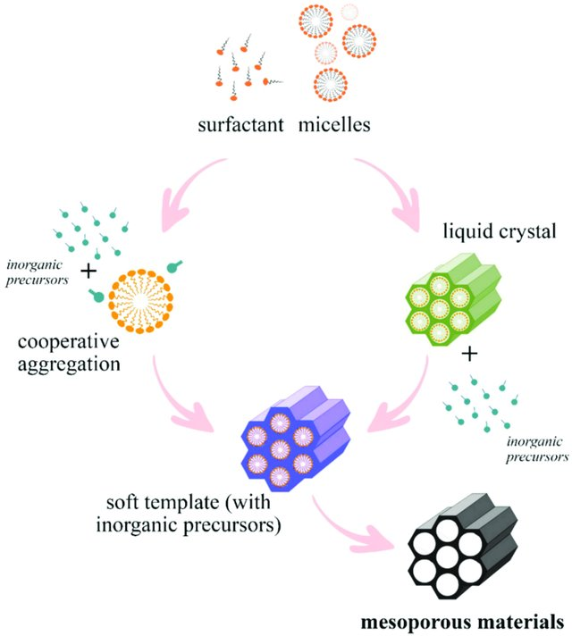
Soft-template synthesis

Slide 13
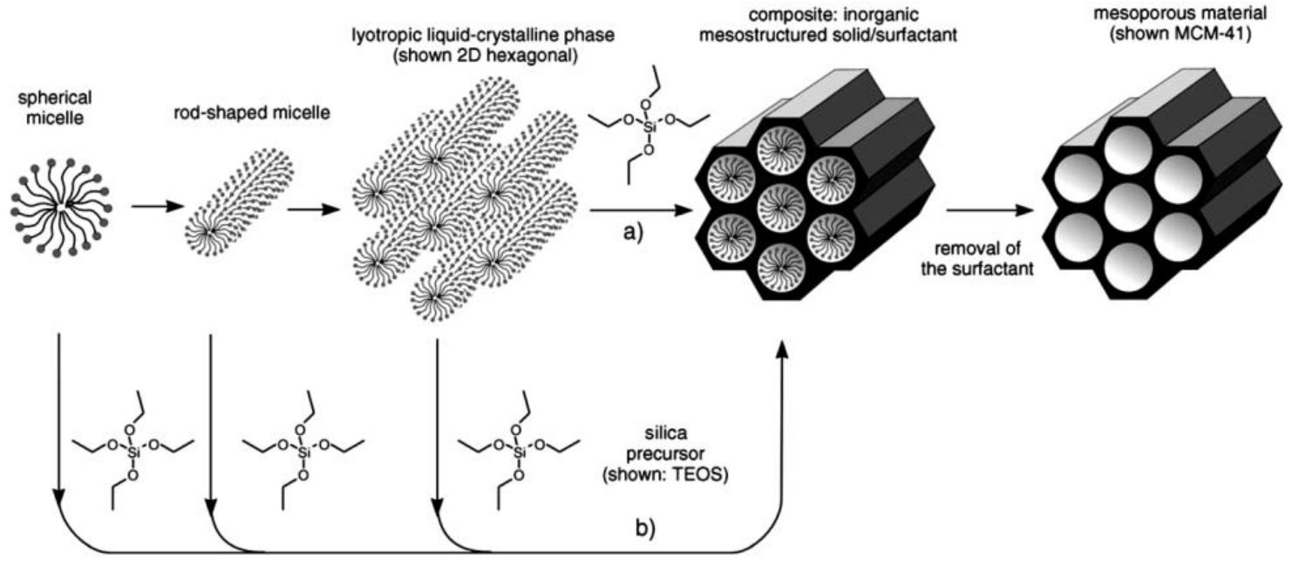
Soft-template synthesis

Slide 14
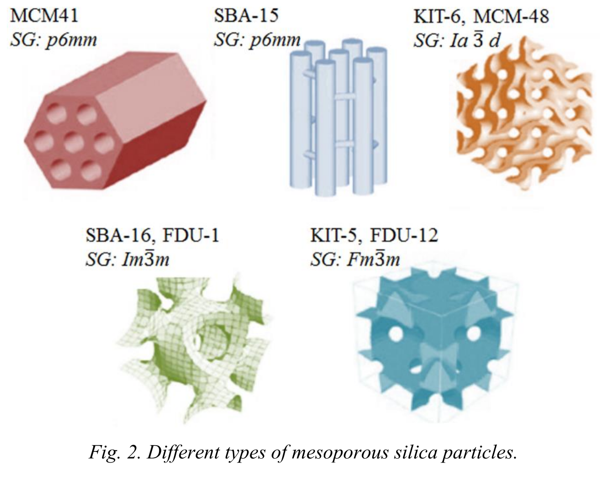
Soft-template synthesis

Slide 15
Hard-template synthesis
Materials prepared by filling the pore of a ordered silica used as template
SiO₂ is removed after crystallization of the product with HF or NaOH
Method to preserve the porous structure of template in the final material

Slide 16
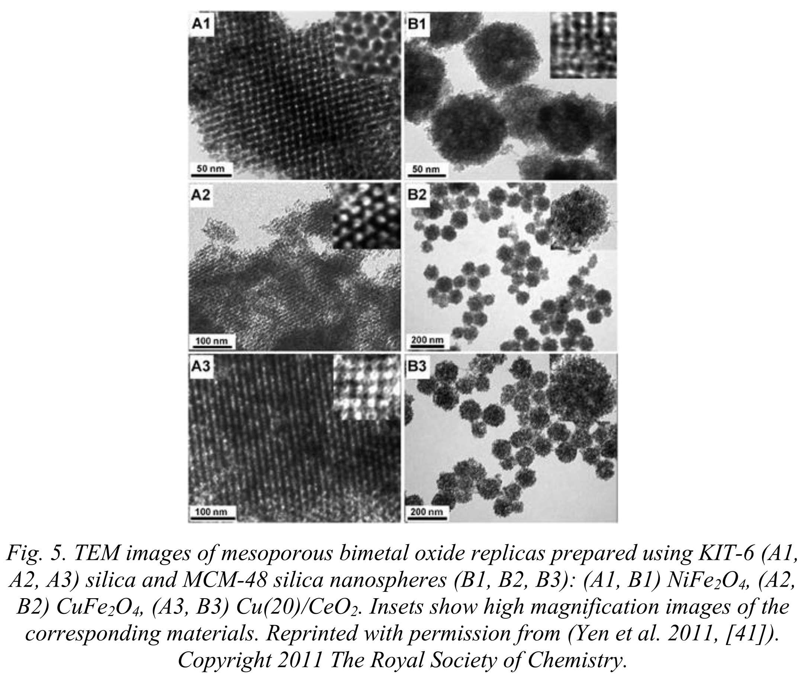
Hard-template synthesis
SiO₂ is removed with NaOH

Slide 17
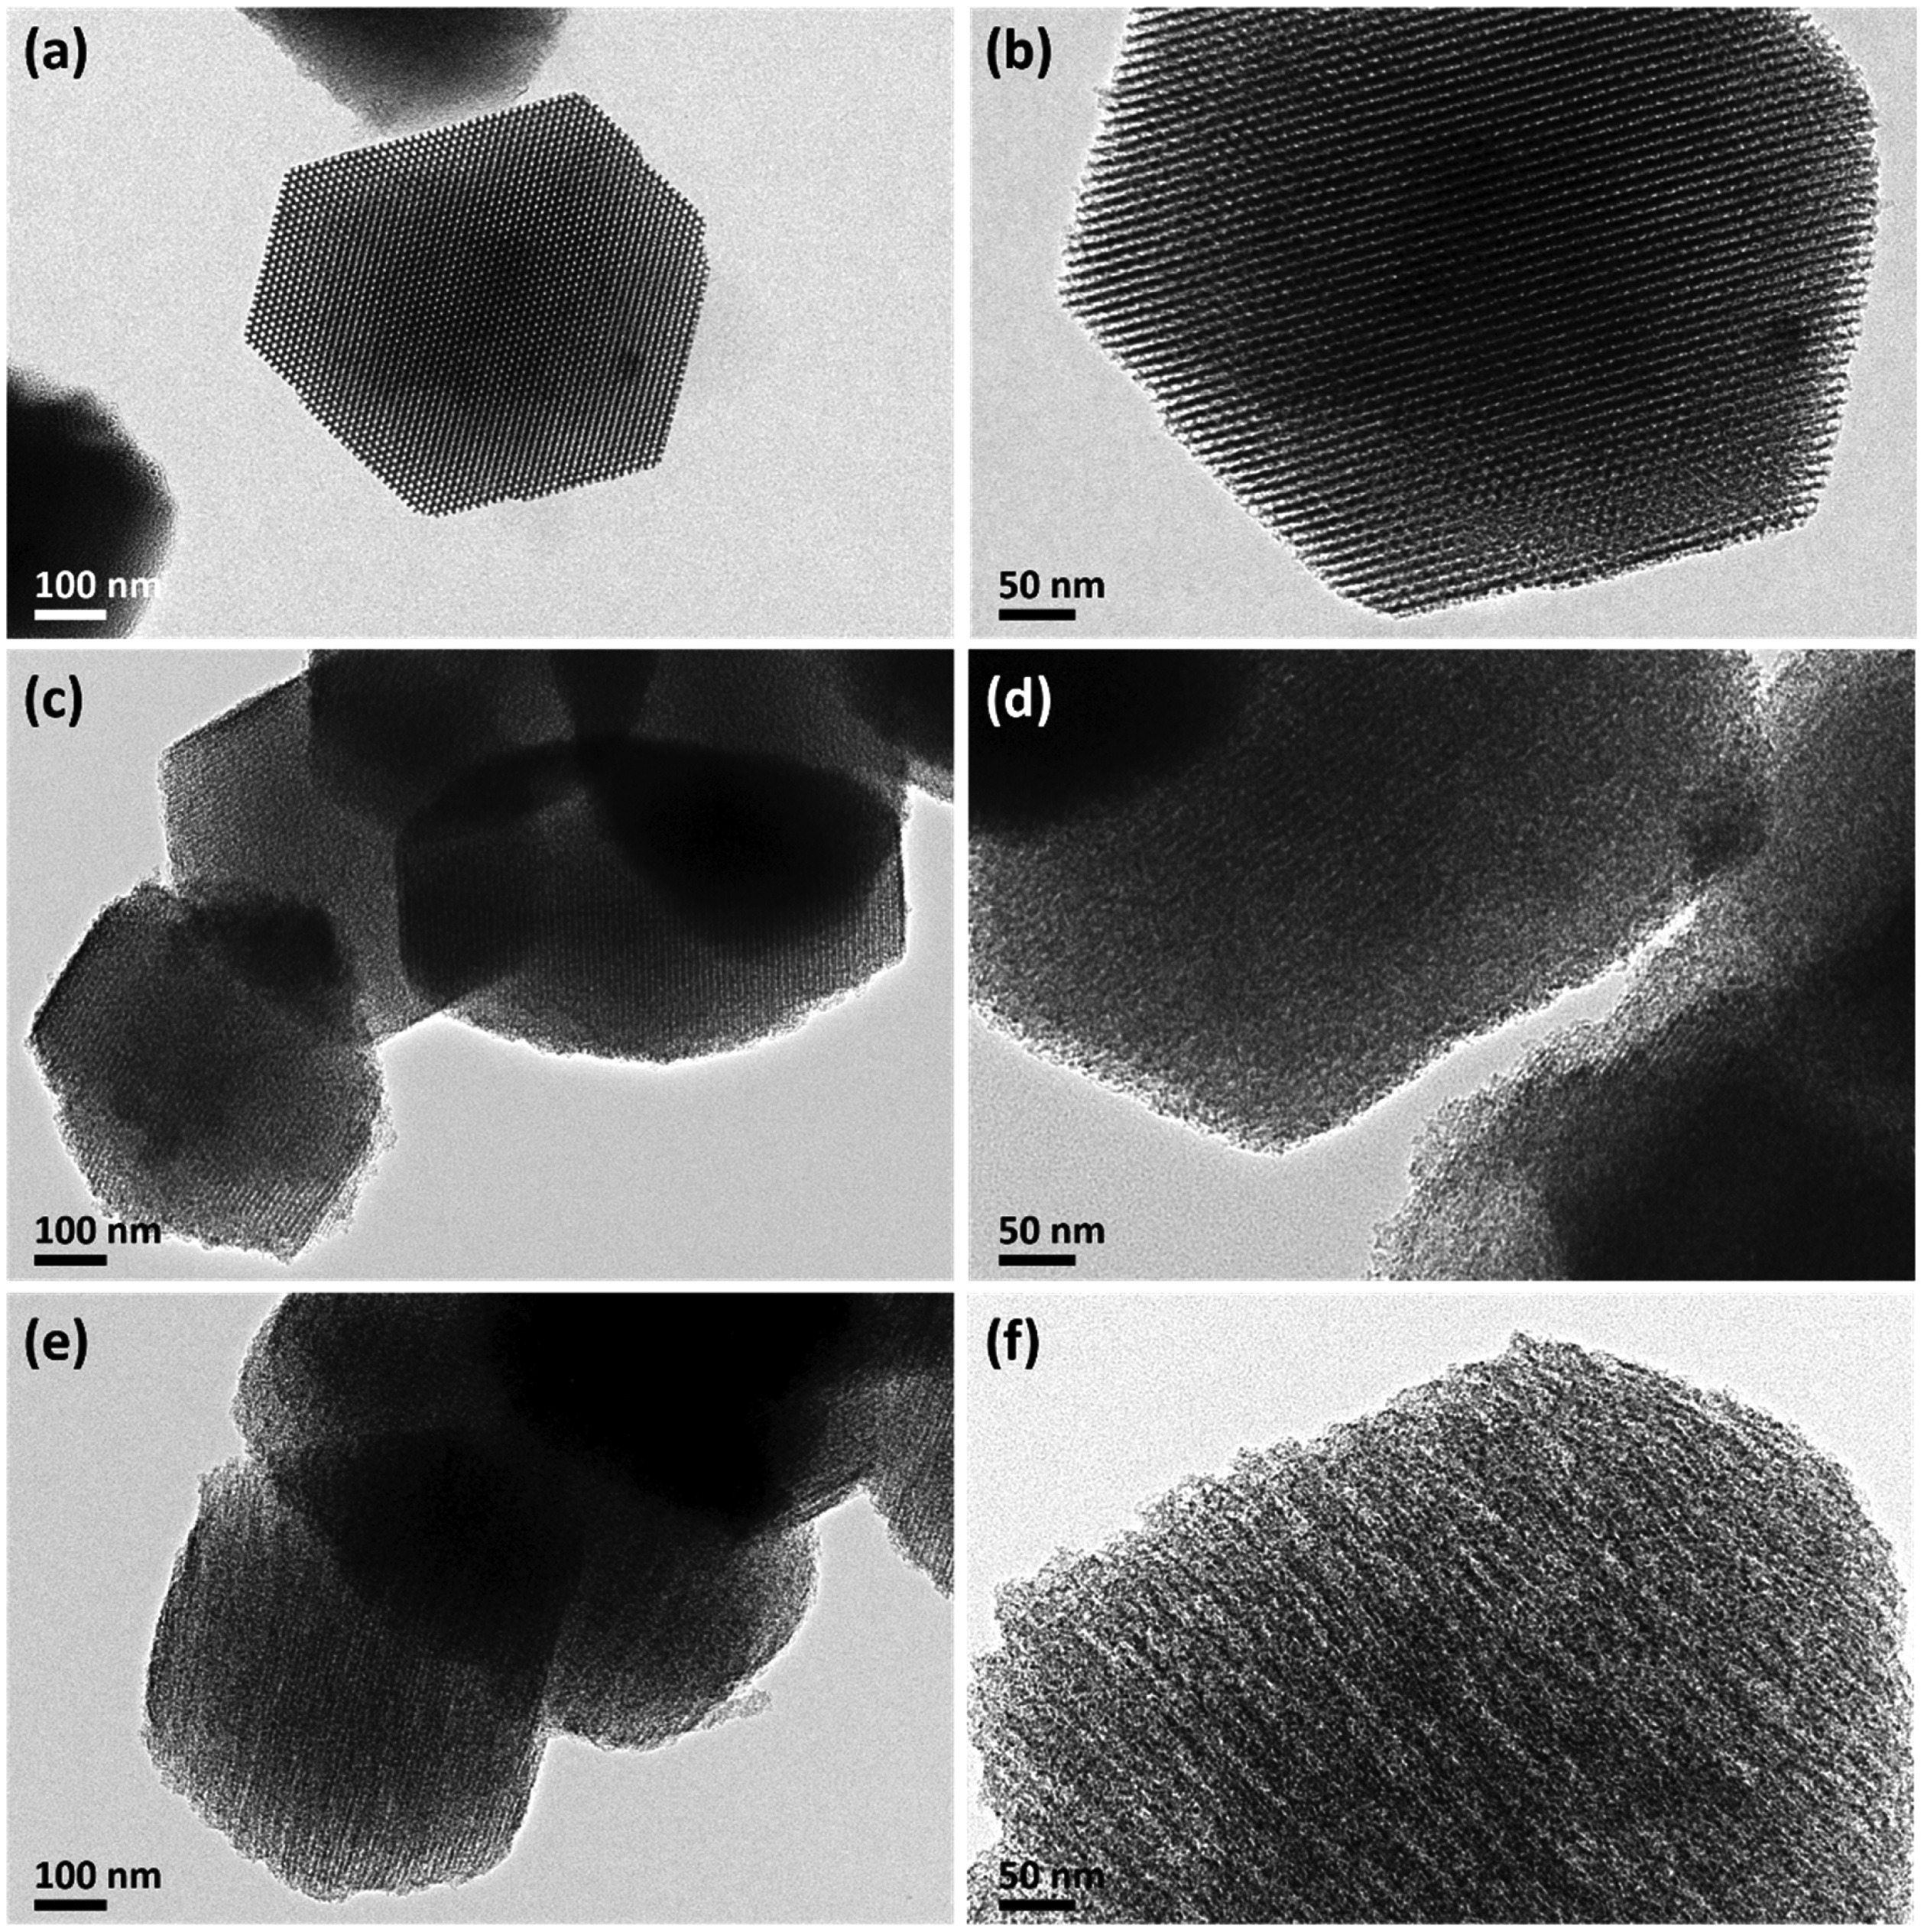
Hard-template synthesis
SiO₂ is removed with HF
SBA-15
Mesoporous carbon
N-doped mesoporous carbon

