Slide 1
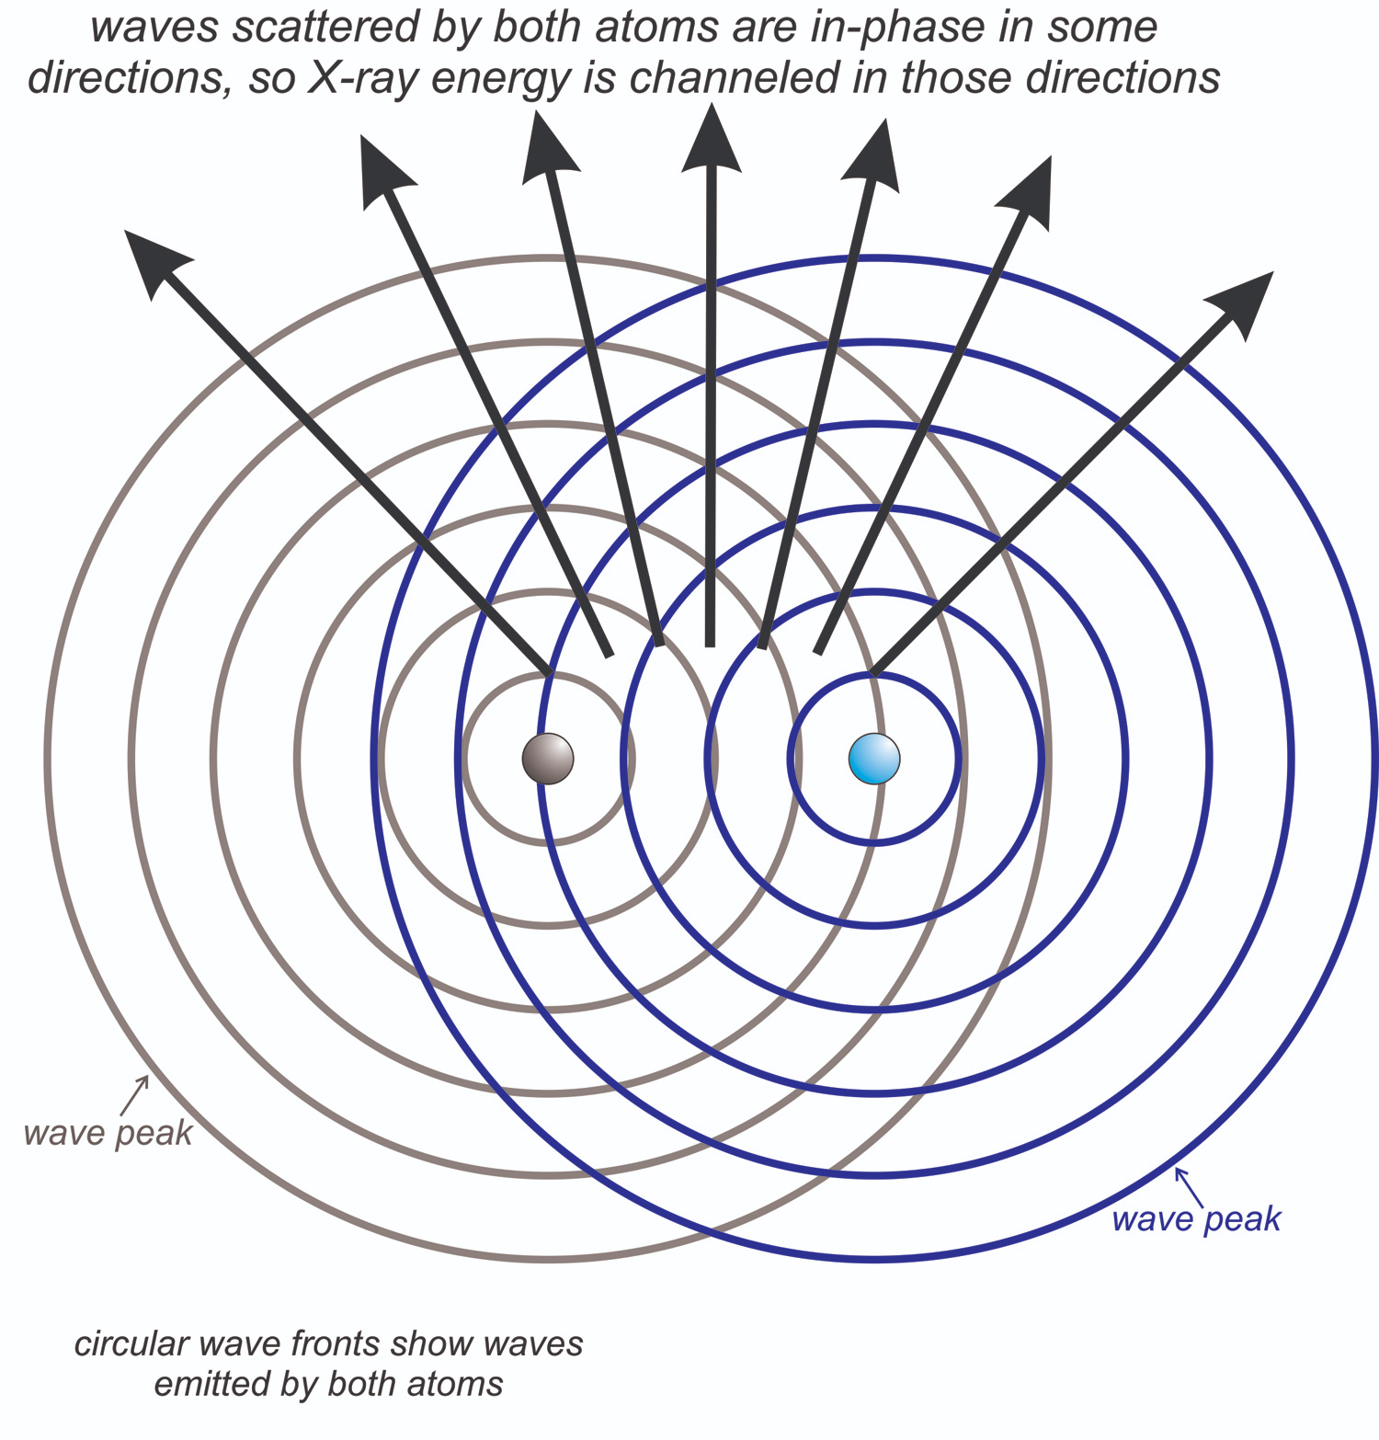
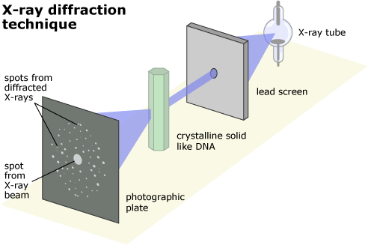
Diffraction
Waves scattered by 2 points:
Waves scattered by the lattice of a crystal (an infinite array of points)

Slide 2
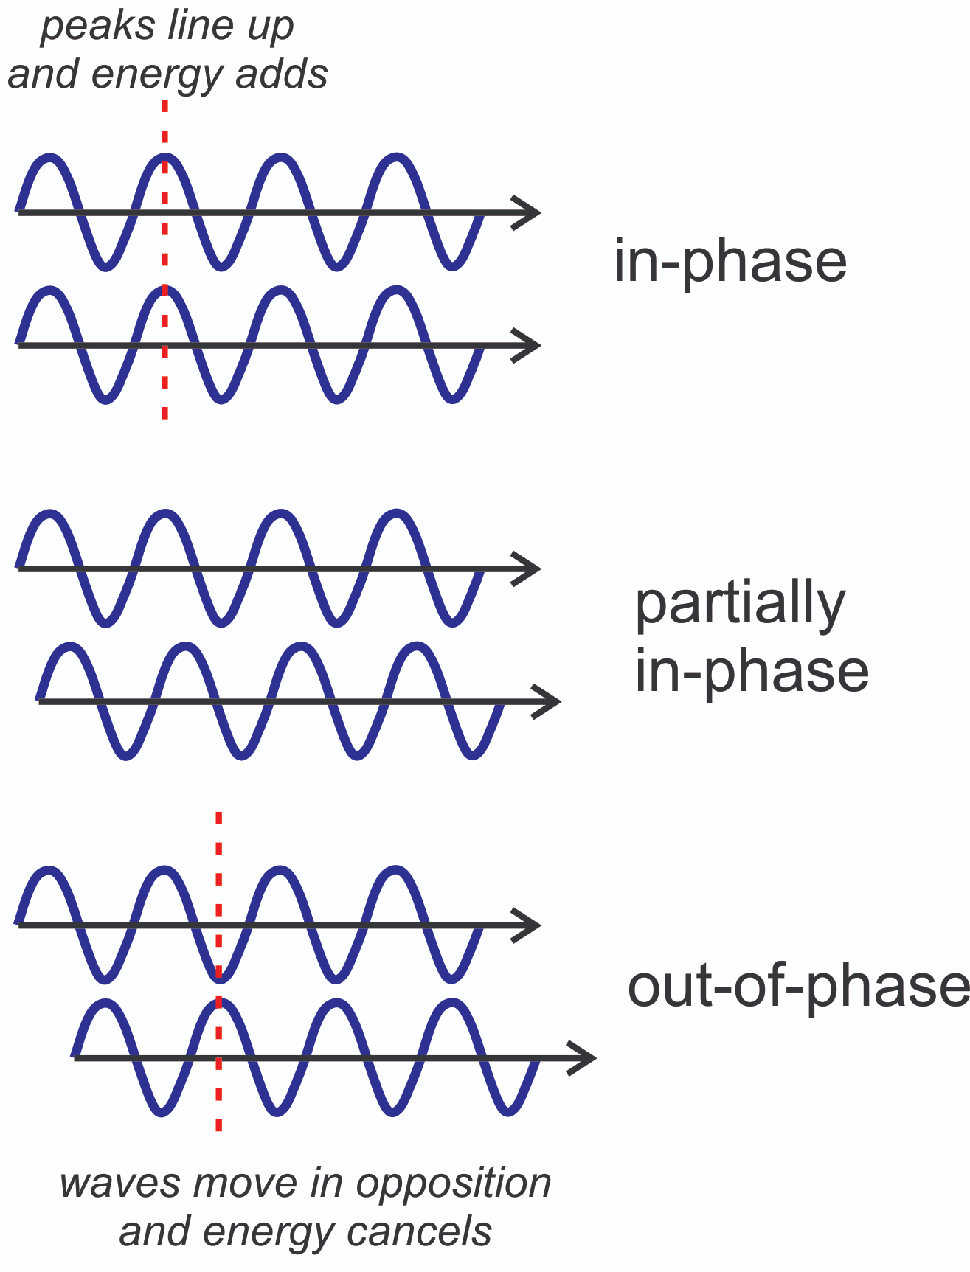
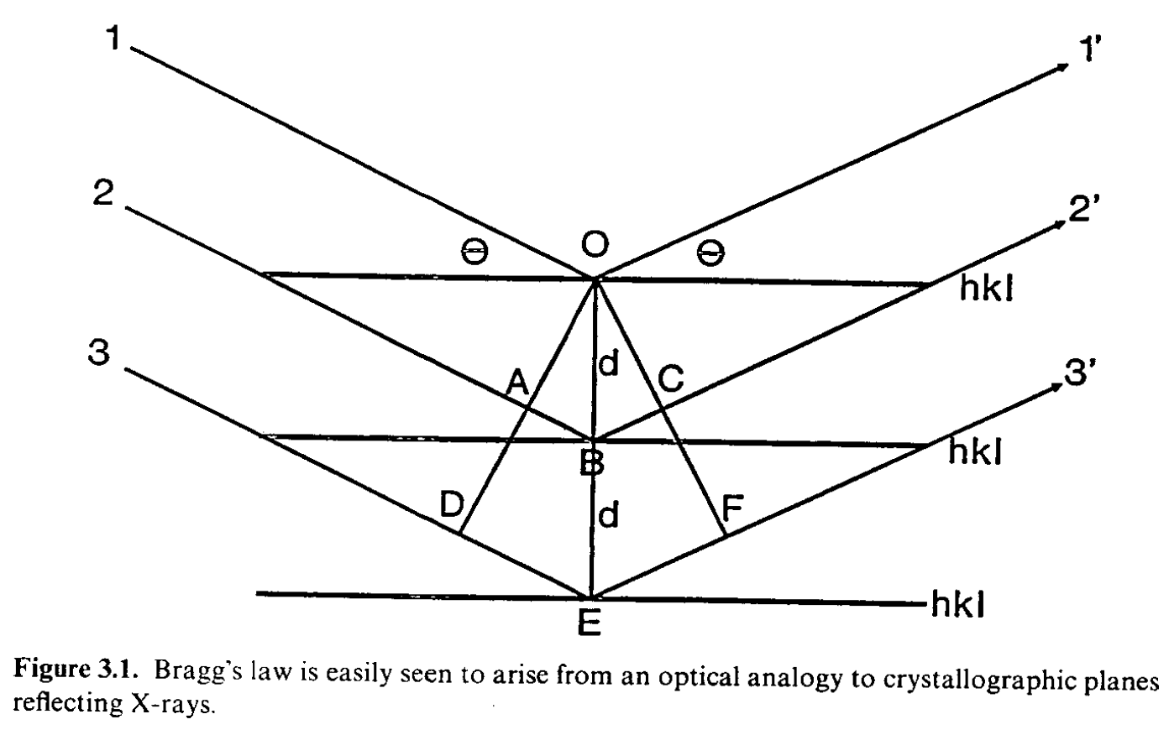
Bragg’s Law

Slide 3
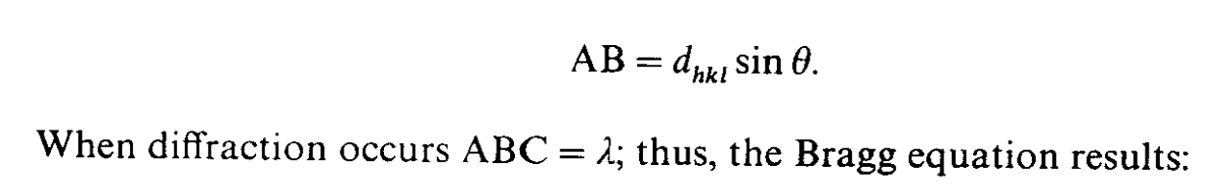

Bragg’s Law

Slide 4
Bragg’s Law
2θ
Note: the angle between incident and diffrated beam in 2θ

Slide 5
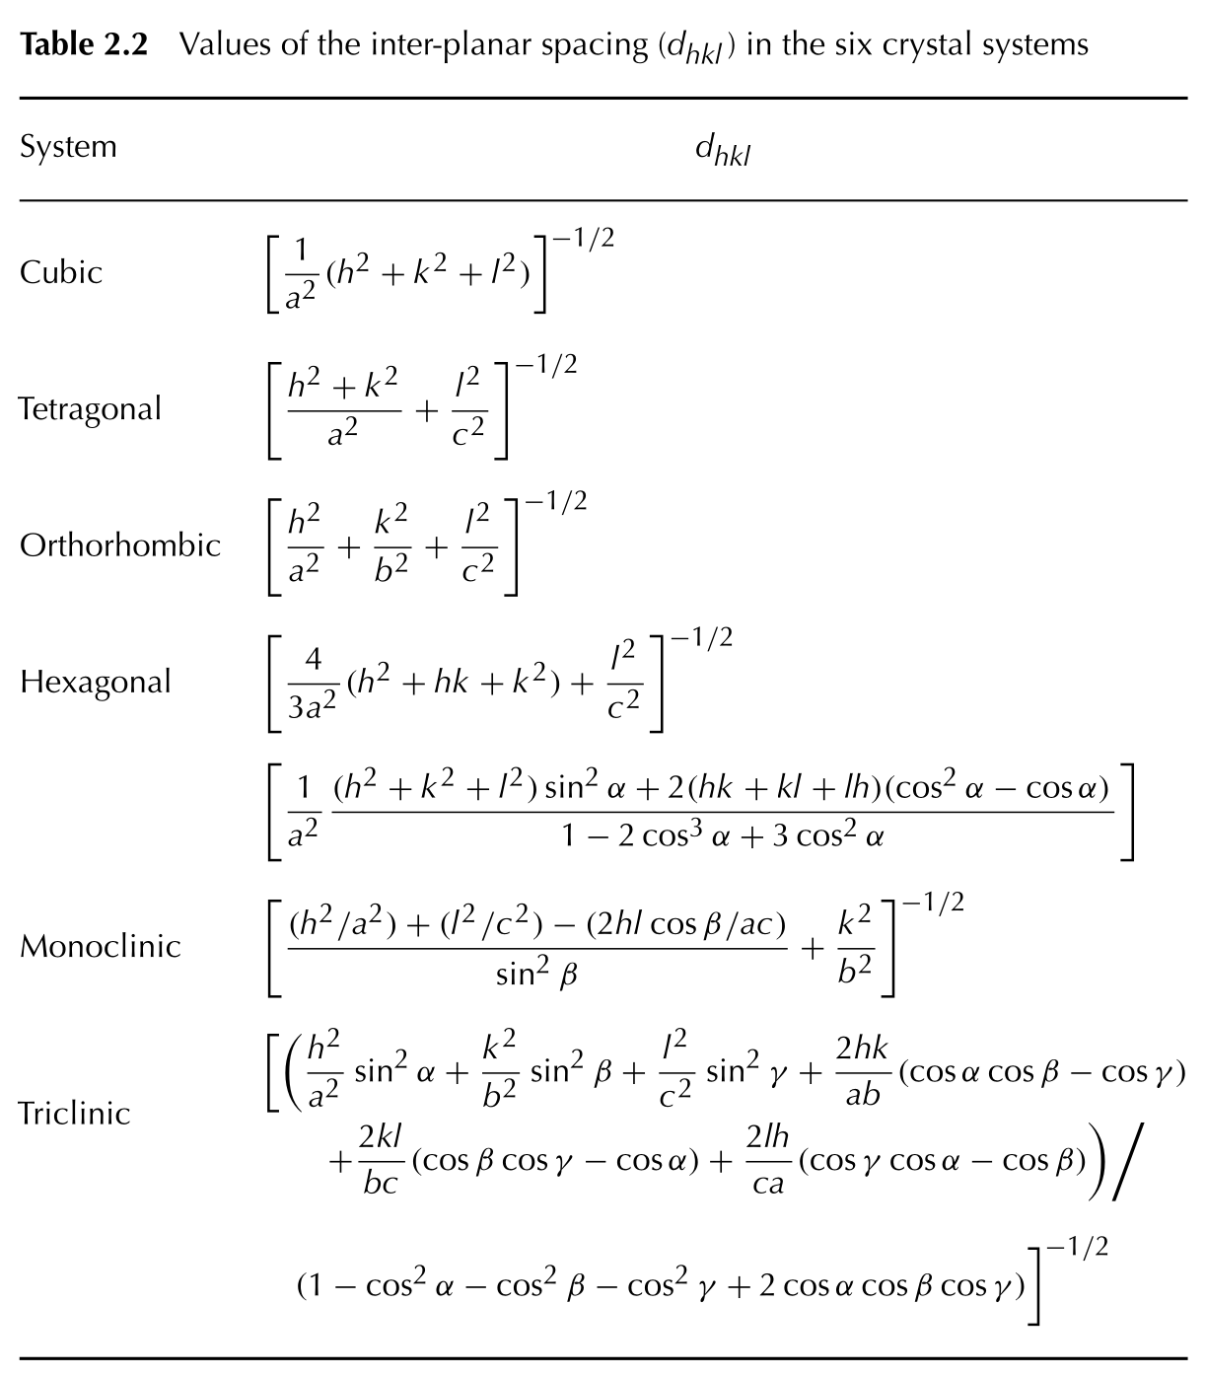
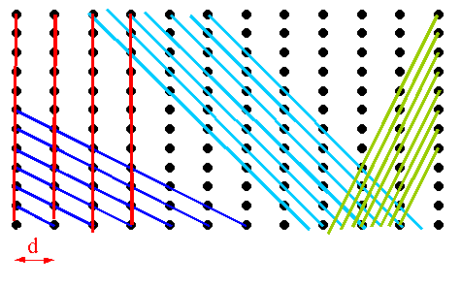
Ewald theory
d_{hkl}
Each family of planes is labeled with Miller indices (hkl)

Slide 6
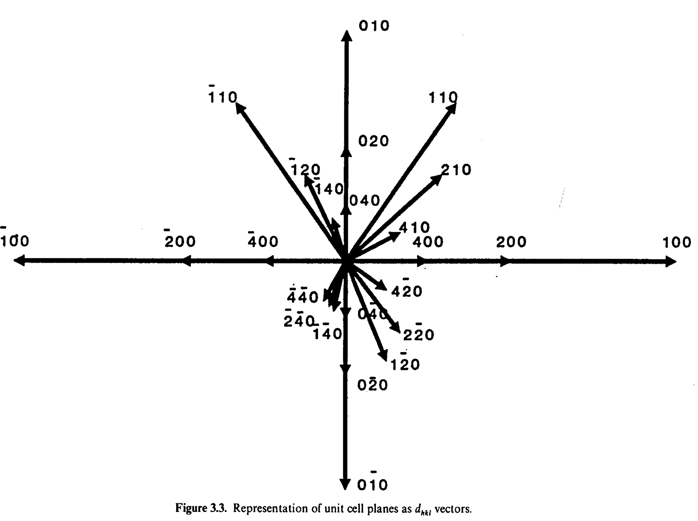
Ewald theory
d_{hkl} vectors
Module proportional to d
Orthogonal to the (hkl) family of planes

Slide 7
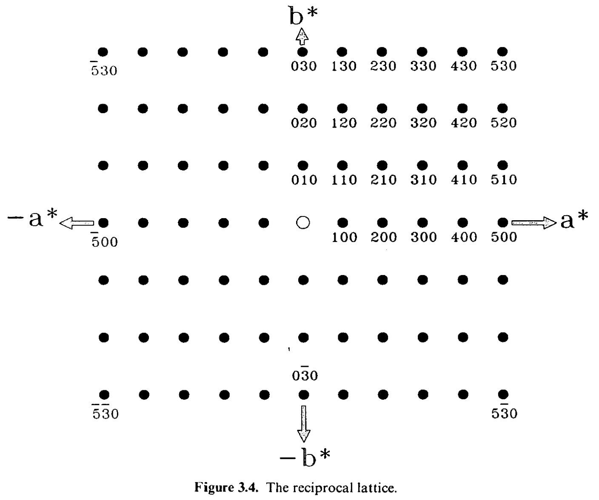
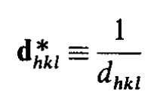
Ewald theory
Reciprocal lattice

Slide 8
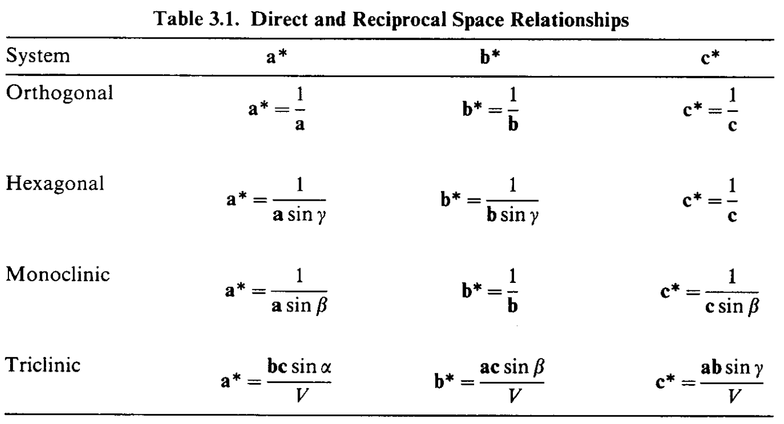

Ewald theory
Reciprocal lattice
Angles in reciprocal lattice are the additional angles of angles in direct lattice
!!! sum of vectors !!!

Slide 9
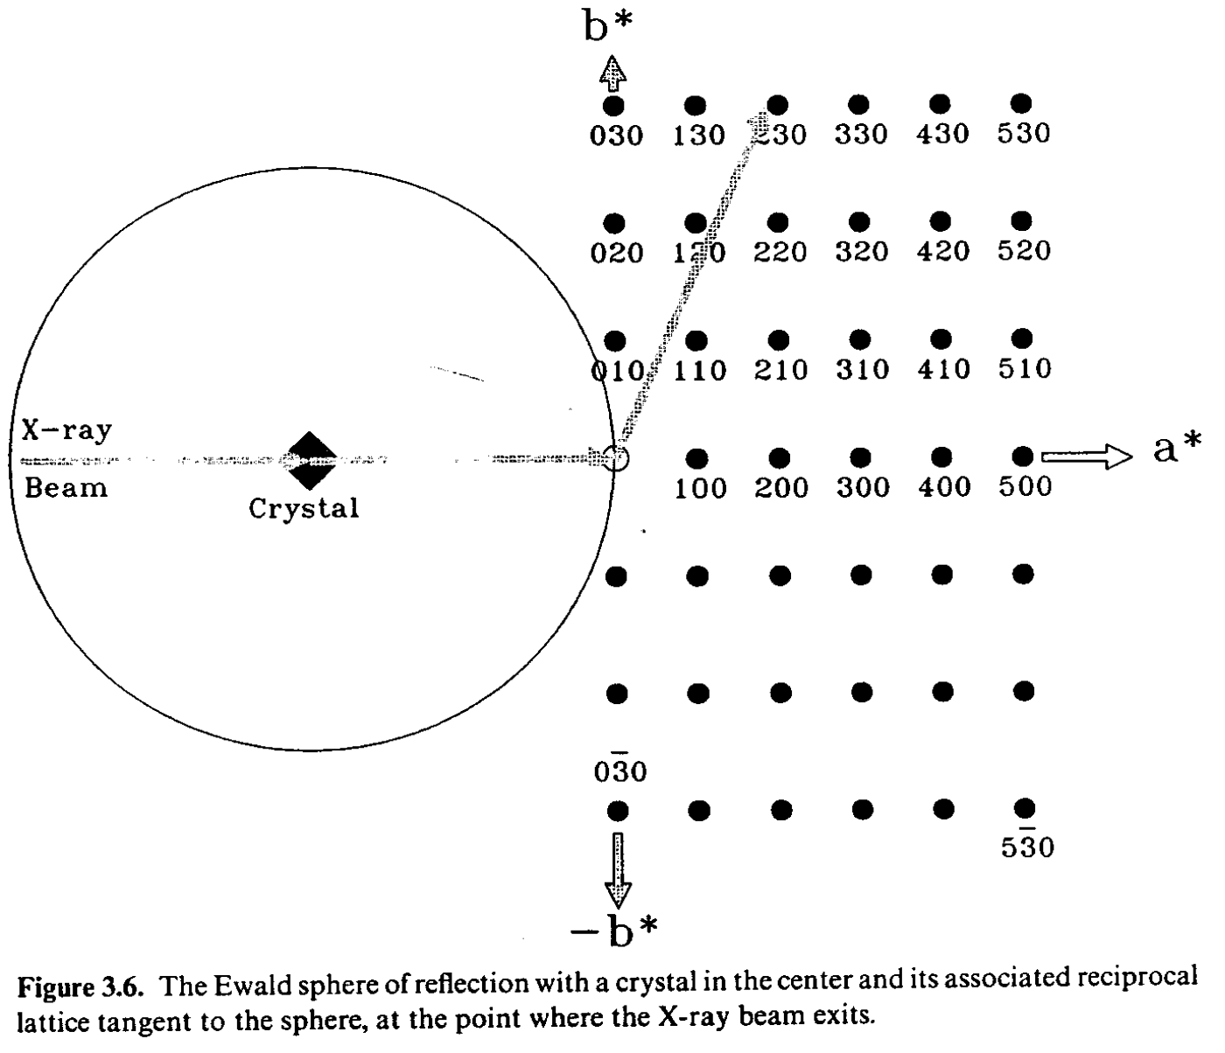
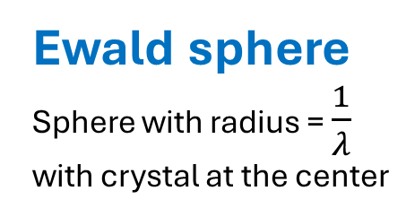
Ewald theory
Ewald sphere
Sphere with radius = $\frac{1}{λ}$ with crystal at the center

Slide 10
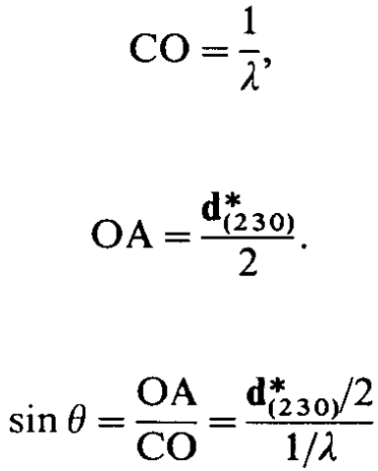
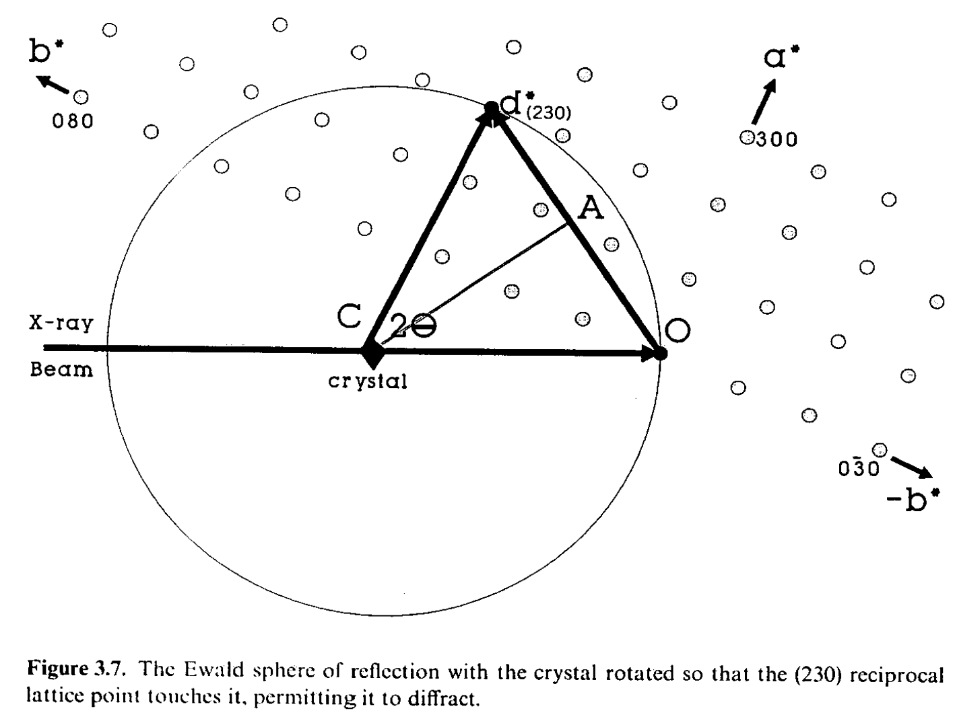
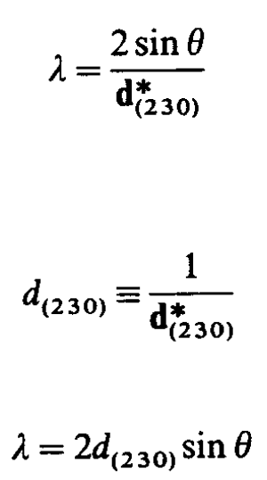
Ewald theory

Slide 11
Ewald theory
Single crystal diffraction
In the notation of the Ewald sphere, whenever a the crystal is rotated to permit a point in the reciprocal lattice to touch the sphere, the conditions for diffraction will be met and the diffracted beam will emerge in the direction connecting the center of the sphere to the reciprocal point in contact with the sphere.

Slide 12
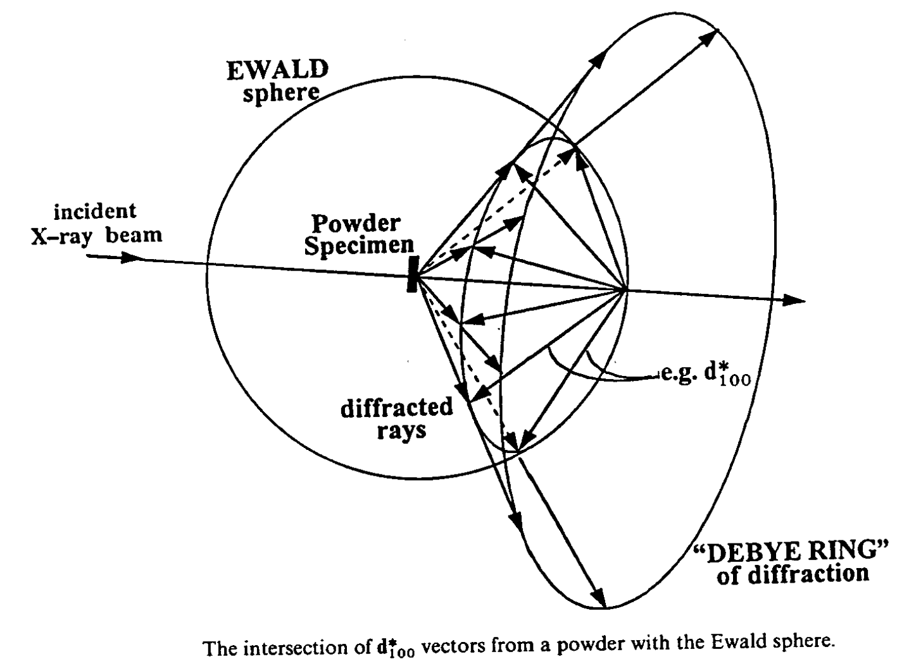
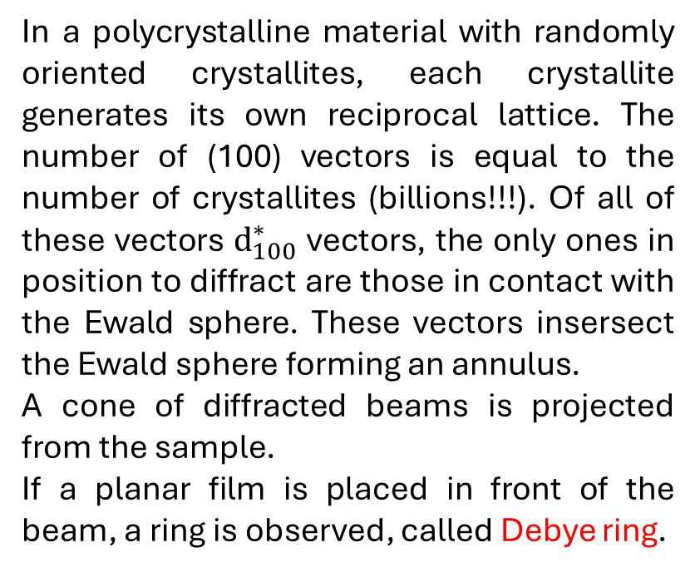
Ewald theory
Powder diffraction
In a polycrystalline material with randomly oriented crystallites, each crystallite generates its own reciprocal lattice. The number of (100) vectors is equal to the number of crystallites (billions!!!). Of all of these vectors $d_{100}^{∗}$ vectors, the only ones in position to diffract are those in contact with the Ewald sphere. These vectors insersect the Ewald sphere forming an annulus.
A cone of diffracted beams is projected from the sample.
If a planar film is placed in front of the beam, a ring is observed, called Debye ring.

Slide 13
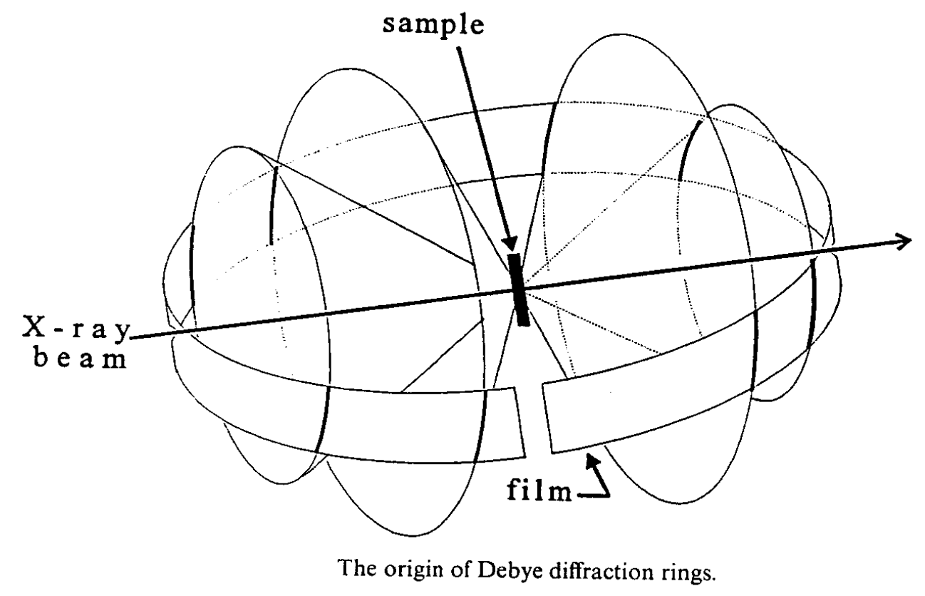
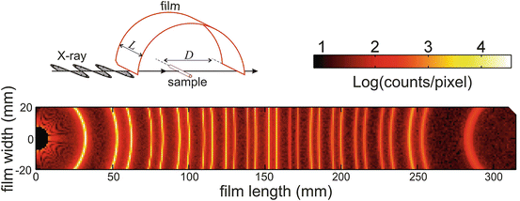
Ewald theory
Powder diffraction
Extending this procedure, each point in the reciprocal lattice will produce a cone of diffraction subtending its Bragg angle.
The Powder diffraction pattern of the sample can be acquired placing a film strip intersecting the various Debye rings.

Slide 14
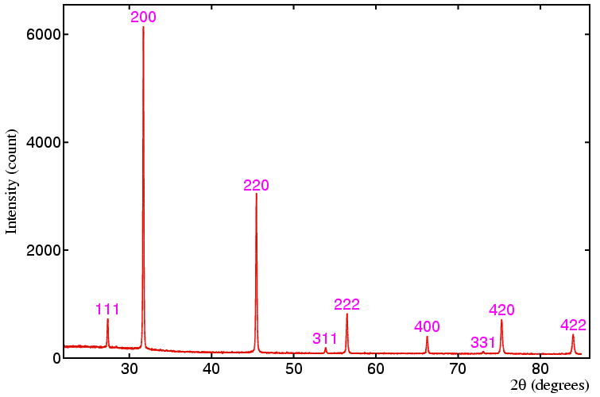
Powder X-Ray Diffraction
PXRD pattern of quartz

Slide 15
Powder X-Ray Diffraction
PXRD provides information from:
Position
Intensity
Broadnening
of reflections
PXRD pattern of quartz
PXRD provides information about:
Phase composition
Average crystallite size
Residual stress

Slide 16
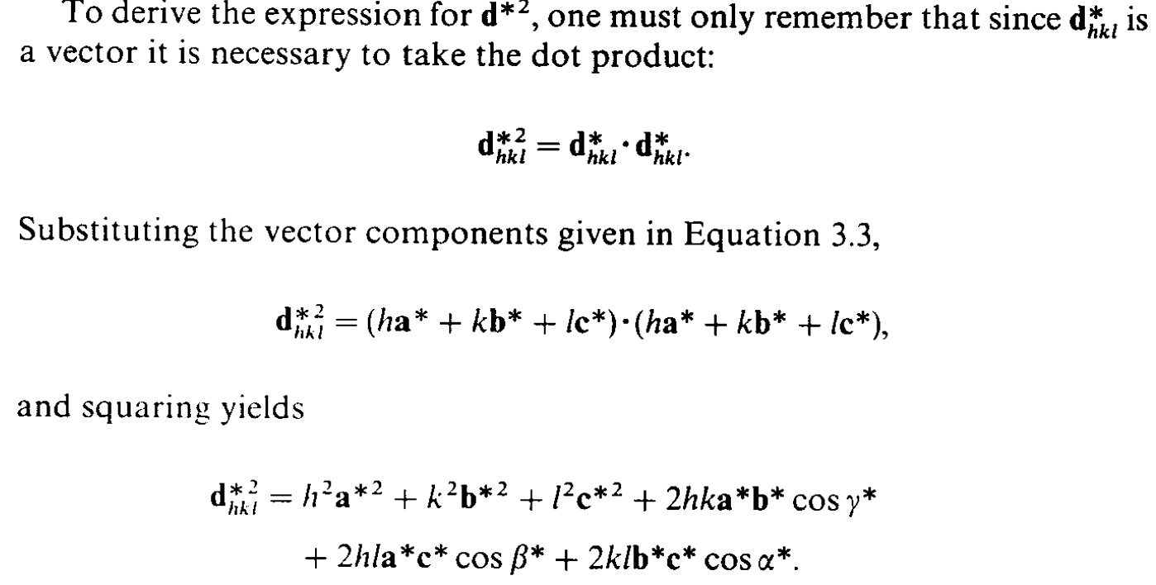
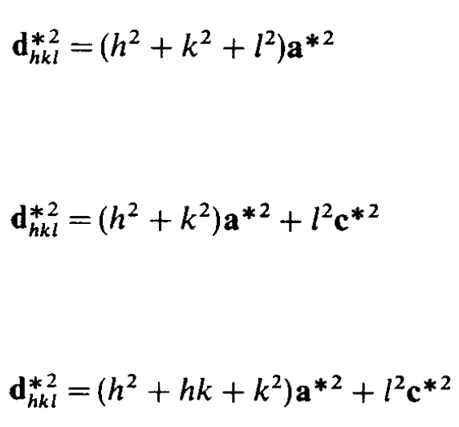

Position in 2θ
It’s possible to calculate position of reflections knowing the crystal structure
Cubic
Tetragonal
Hexagonal
Orthorombic

Slide 17
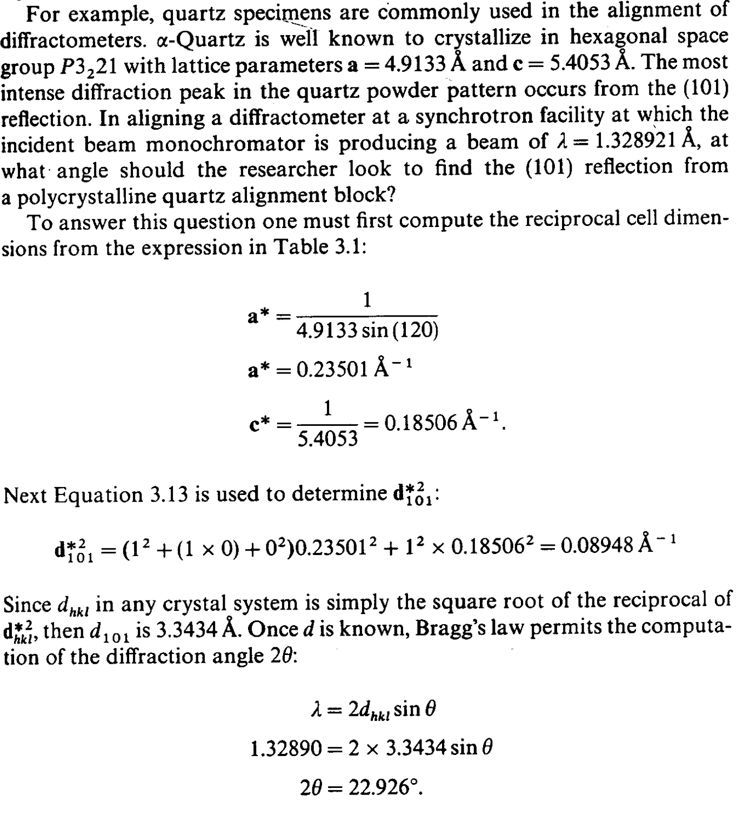
Position in 2θ
It’s possible to calculate position of reflections knowing the crystal structure

Slide 18

Position in 2θ
It’s possible to calculate position of reflections knowing the crystal structure
Calculated d_{hkl} for each reflection
Calculated cell parameters
(6 variables)
PXRD pattern of quartz

Slide 19
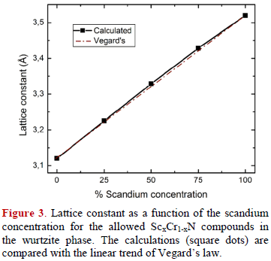
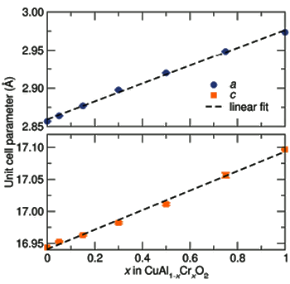

Position in 2θ
For substitutional solid solutions, change parameters depend on composition
$$a_{A_{x}B_{1−x}}=xa_{A}+(1−x)a_{B}$$
Deviation from Vegard’s Law
Change in oxidation state
Change in structure
Phase segregation

Slide 20
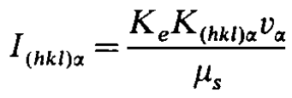
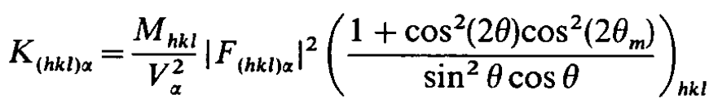
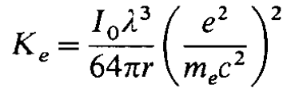
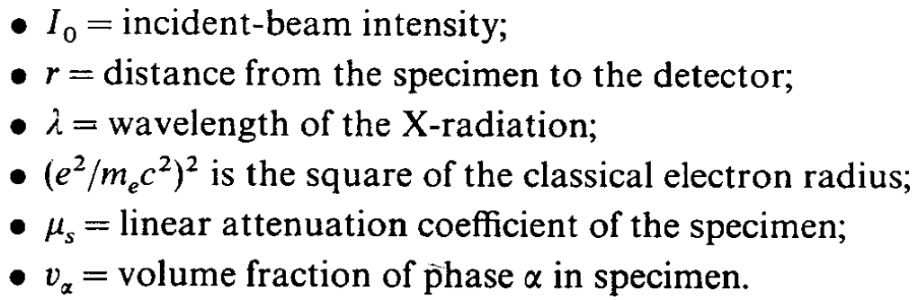
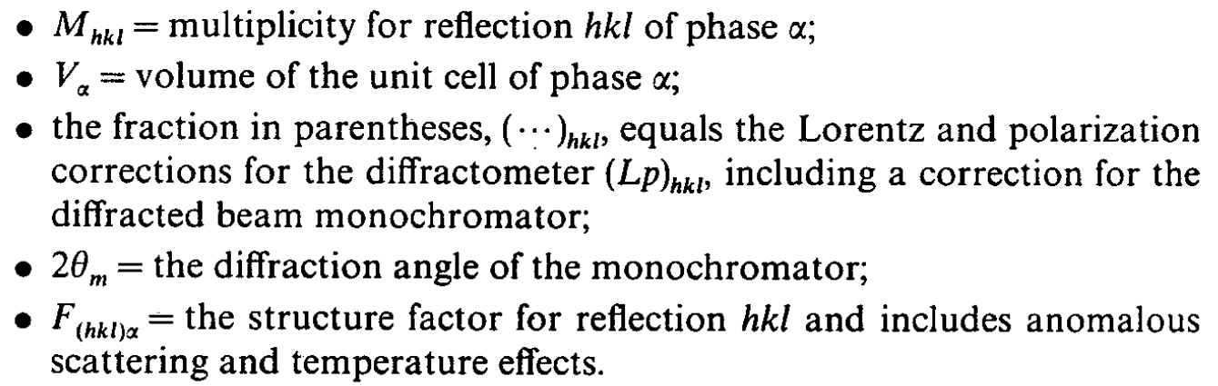
Intensity

Slide 21
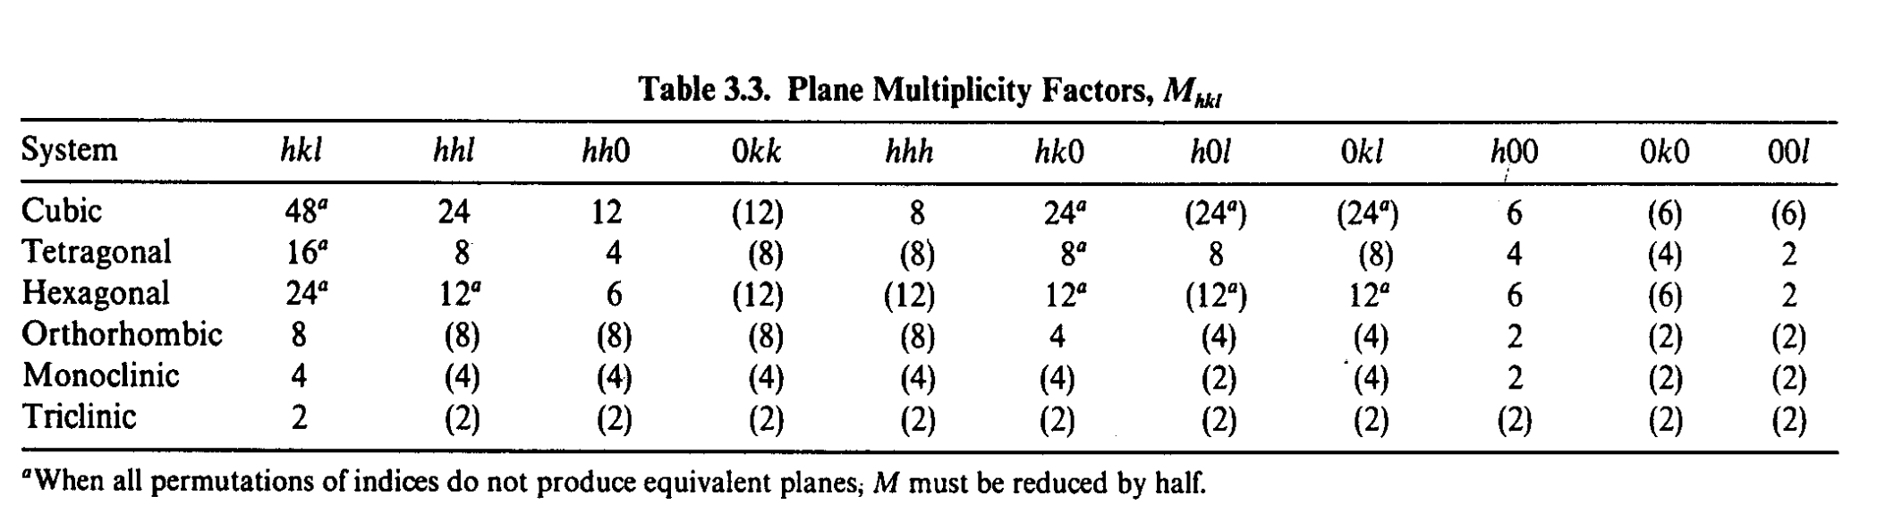
Intensity
Multiplicity
The number of equivalent planes cutting a unit cell in a particula hkl family
Polarization: Lorenz effect and monochromator (if present)
Lorenz effect: related with the time passed by a dot in reciprocal lattice lying on the Ewald sphere.
Plarization by monochromator: due to diffraction within the monochromator on diffracted beam.

Slide 22
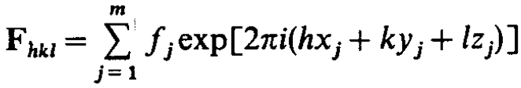
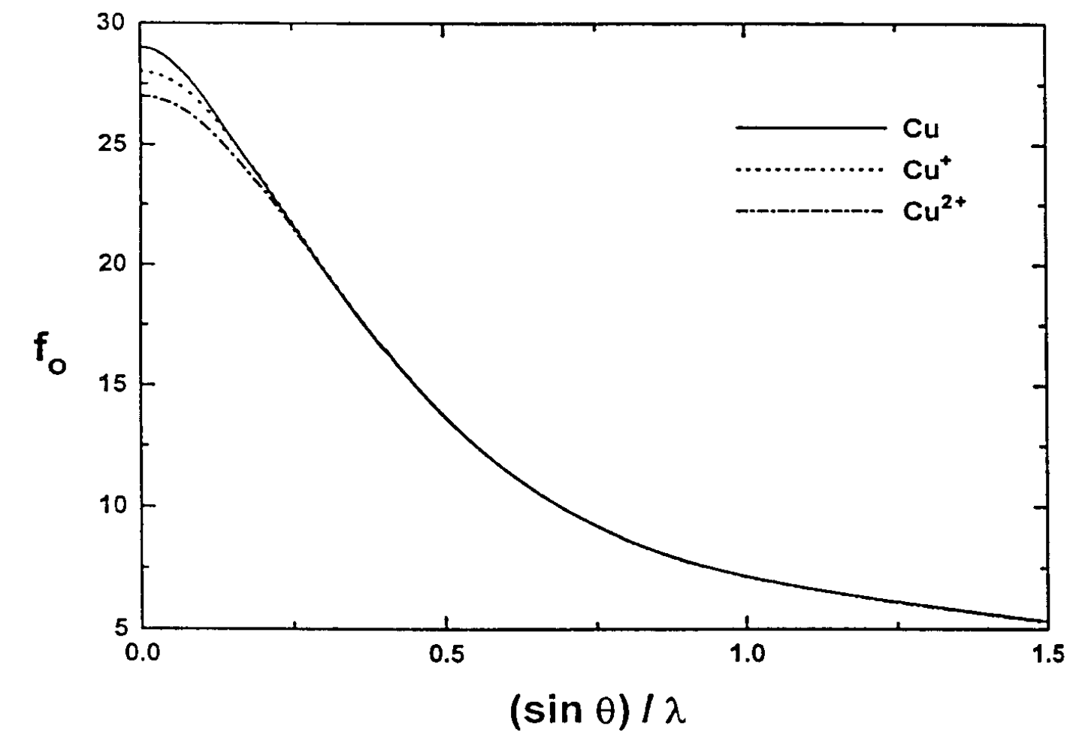
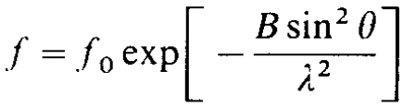
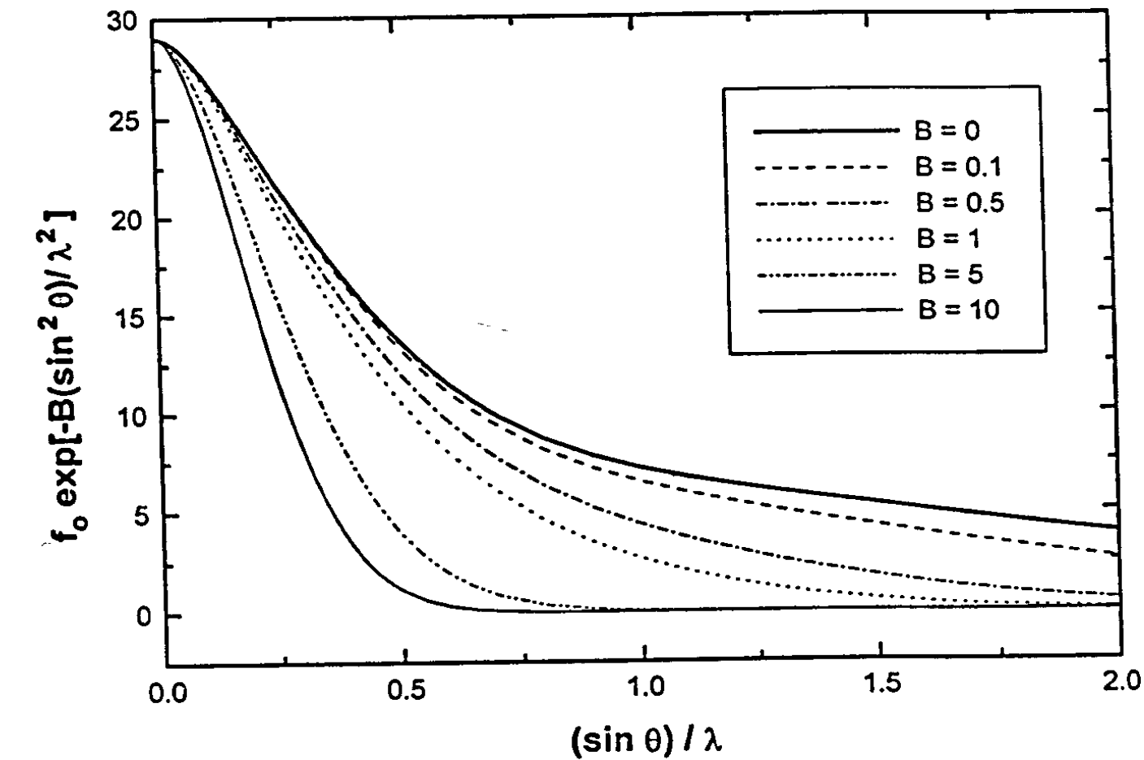
Intensity
Structure factor
Atomic scattering factor
(chemical nature of atoms)
Fractional coordinates
(position of each atoms)
x_{j}, y_{j}, z_{j}

Slide 23
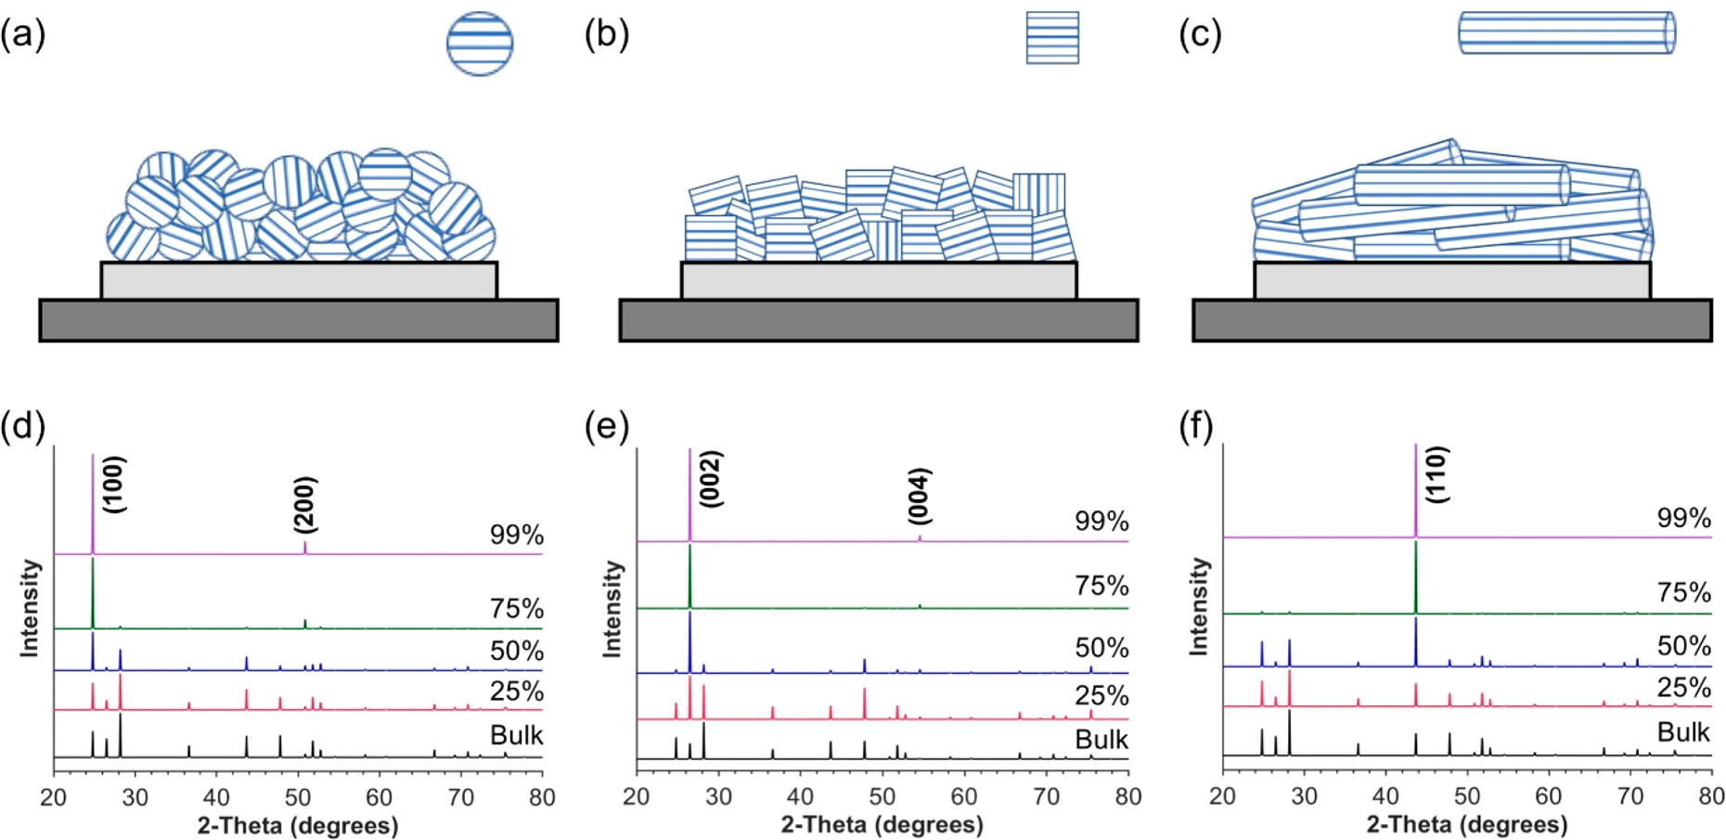
Intensity – Preferred orientation
Graphical representation of preferred orientation for nanoparticles having different shapes: (a) spheres, (b) cubes, and (c) rods. Simulated X-ray diffraction patterns for varying degrees of alignment (i.e., preferred orientation) of wurtzite CdS particles along specific crystallographic directions: (d) [100], (e) [001], and (f) [110].
Preferred orientation can be mimized by correct preparation of the sample and by spinning of the sample during analysis.

Slide 24
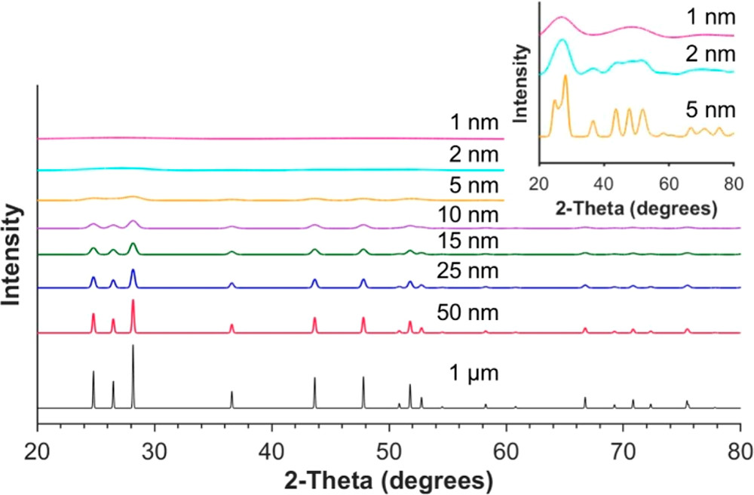
Broadening – Crystallite size
Simulated XRD patterns of CdS
with different average crystallite size

Slide 25
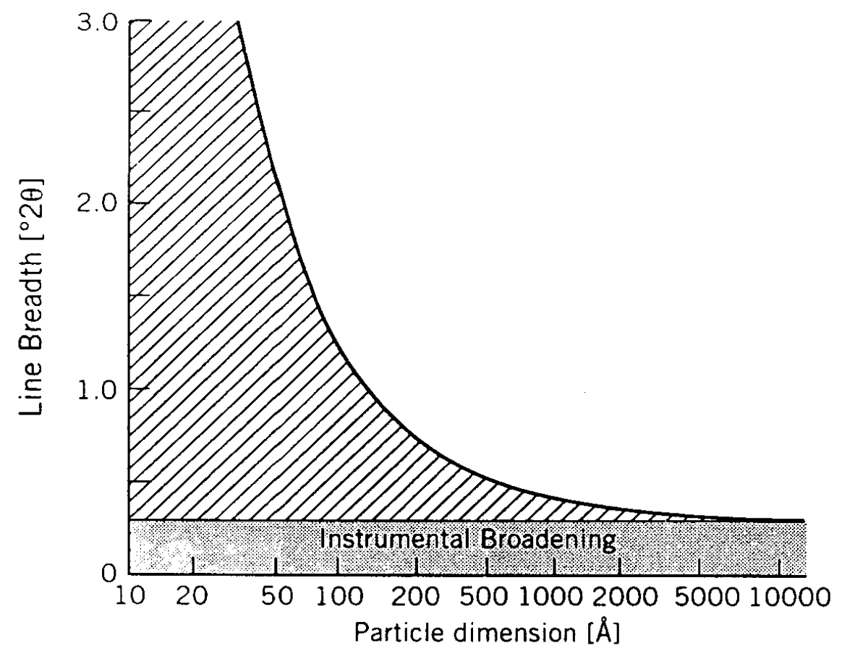
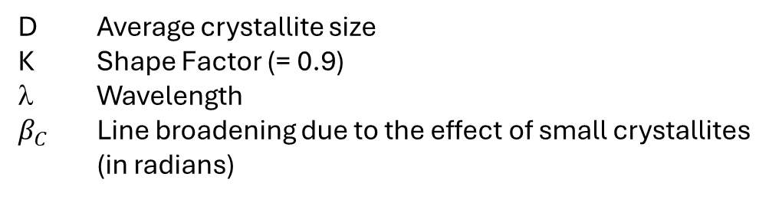
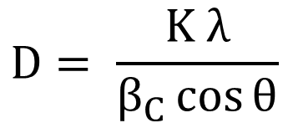
Broadening – Crystallite size
Scherrer’s equation
$$D= \frac{K λ}{β_{C}\cos{θ}}$$
D Average crystallite size
K Shape Factor (= 0.9)
λ Wavelength
$β_{C}$ Line broadening due to the effect of small crystallites (in radians)

Slide 26
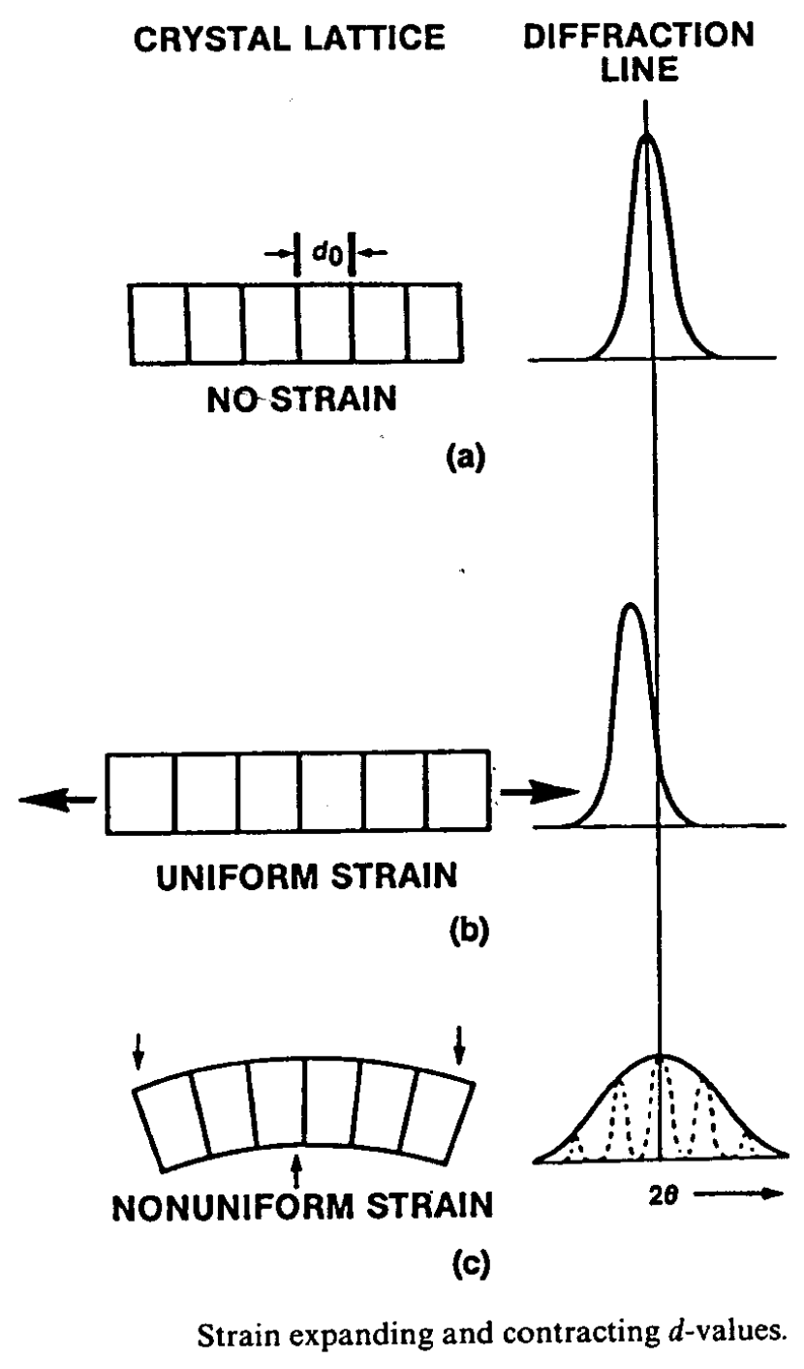
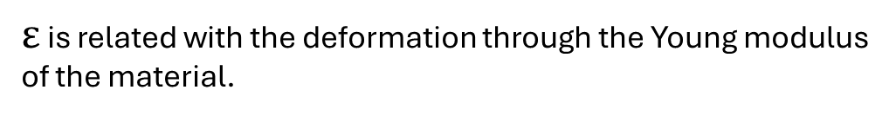
Broadening – Strain
Macrostress Uniform deformation of the material (compressive or tensile) results in shift of diffraction peaks.
Microstress A distribution of both compressive or tensile forces results in broadening of diffraction peaks at their original position.
$$β_{S}^{}=4ε\tan{θ}$$
$ε$ is related with the deformation through the Young modulus of the material.

Slide 27
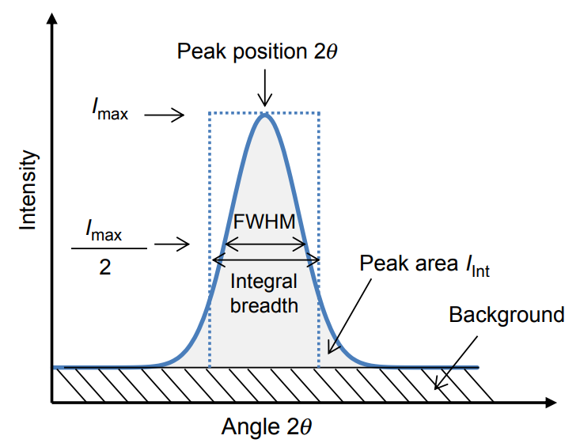
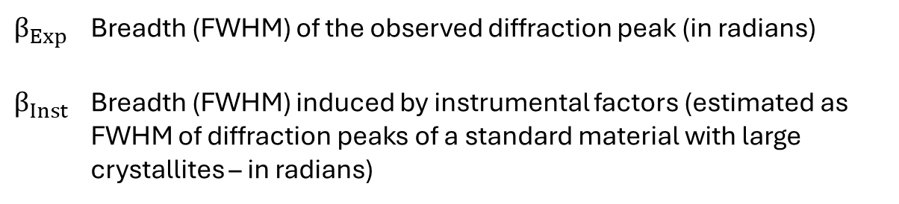


Broadening – Crystallite size & Strain
$β_{TOT}^{}=$ $β_{C}^{}+$ $β_{S}^{}$
$β_{TOT}^{2}=$ $β_{Exp}^{2} −$ $β_{Inst}^{2}$
$β_{Exp}^{}$ Breadth (FWHM) of the observed diffraction peak (in radians)
$β_{Inst}^{}$ Breadth (FWHM) induced by instrumental factors (estimated as FWHM of diffraction peaks of a standard material with large crystallites – in radians)
Full Width at Half Maximum
(FWHM)
FWHM depends on the mathematical function used to fit the peaks

Slide 28
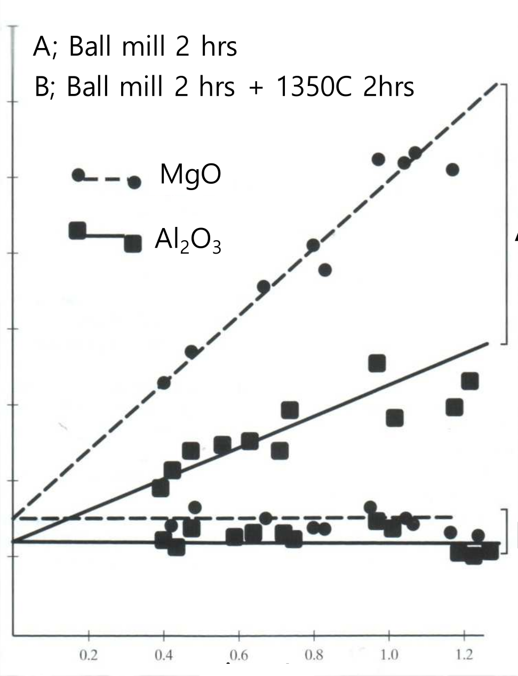
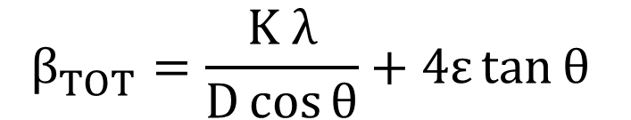


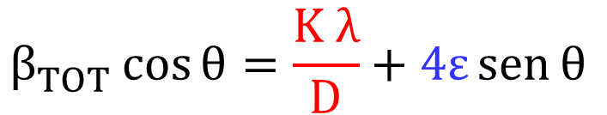
Broadening – Crystallite size & Strain
$β_{TOT}^{}=$ $β_{C}^{}+$ $β_{S}^{}$
A
$$β_{TOT}^{}=\frac{K λ}{D\cos{θ}}+4ε\tan{θ}$$
$$β_{TOT}^{}\cos{θ}$$
$$β_{TOT}^{}\cos{θ}=\frac{K λ}{D}+4ε\operatorname{sen}{θ}$$
B

Slide 29
Powder X-Ray Diffractometer

