Slide 1
Entrepreneurship: Successfully Launching New Ventures
Sixth Edition, Global Edition
Chapter 3
Feasibility Analysis
Notes:
If this PowerPoint presentation contains mathematical equations, you may need to check that your computer has the following installed:
1) MathType Plugin
2) Math Player (free versions available)
3) NVDA Reader (free versions available)

Slide 2
What Is Feasibility Analysis?
Feasibility Analysis
Feasibility analysis is the process of determining whether a business idea is viable.
It is the preliminary evaluation of a business idea, conducted for the purpose of determining whether the idea is worth pursuing.

Slide 3
Remember this?
We are here now
Figure 2.4 Five Steps to Generating Creative Ideas

Slide 4
When to Conduct a Feasibility Analysis
Timing of Feasibility Analysis
The proper time to conduct a feasibility analysis is early in thinking through the prospects for a new business.
The thought is to screen ideas before a lot of resources are spent on them.
Components of a Properly Conducted Feasibility Analysis
A properly conducted feasibility analysis includes four separate components (see next)

Slide 5
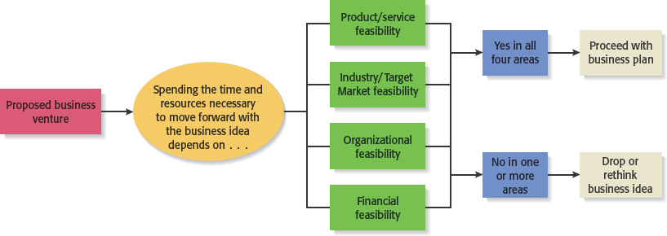
Feasibility Analysis
Figure 3.1 Role of Feasibility Analysis in Developing Successful Business Ideas

Slide 6
Outline for a Comprehensive Feasibility Analysis
Table 3.1 Feasibility Analysis
Part 1: Product/Service Feasibility
Product/service desirability
Product/service demand
Part 2: Industry/Target Market Feasibility
Industry attractiveness
Target market attractiveness
Part 3: Organizational Feasibility
Management prowess
Resource sufficiency
Part 4: Financial Feasibility
Total start-up cash needed
Financial performance of similar businesses
Overall financial attractiveness of the proposed venture
Overall Assessment

Slide 7
Product Feasibility Analysis (1 of 2)
Purpose
Is an assessment of the overall appeal of the good or service being proposed.
Before a prospective firm rushes a new product into development, it should be sure that the good or service is what prospective customers want.

Slide 8
Product Feasibility Analysis(2 of 2)
Components of product/service feasibility analysis
Product/Service Desirability
Product/Service Demand

Slide 9
Product Desirability (1 of 3)
First, find a (qualitative) sample of experts (can be also lead-users, suppliers, clients, other start-uppers) to whom make questions with the aim to determine the basic appeal of the product. For YOU, that means finding an answer to the following questions:
Does it make sense? Is it reasonable? Is it something users will get excited about?
Does it take advantage of an environmental trend, solve a problem, or take advantage of a gap in the marketplace?
Is this a good time to introduce the product or service to the market?
Are there any fatal flaws in the product or service’s basic design or concept? (ask to suppliers/manufacturers!)

Slide 10
Product Desirability (2 of 3)
Second, Administer a Concept Test
A concept statement should be developed.
A concept statement is a one-page description of a product idea that is distributed to people who are asked to provide feedback on the potential of the idea.
Do not forget to provide in your concept statement:
A description of the product
The intended target market
The benefits provided by the product
The P.o.D. relative to existing solutions
A short description of the team

Slide 11
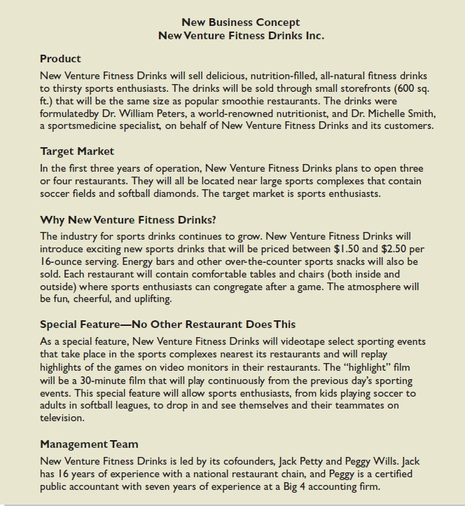
Product Desirability (3 of 3)
Figure 3.2 New Venture Fitness Drinks’ Concept Statement

Slide 12
Feedback from product desirability
Collected feedback will provide the entrepreneur with:
A sense of the viability of the product idea.
Suggestions for how the idea can be strengthened or “tweaked” before proceeding further.

Slide 13
Product Demand
There are three steps to assessing product/service demand.
Step 1: Talking Face-to-Face with Potential Customers
Step 2: Using Online Tools
Step 3: Library, Internet and Gumshoe Research

Slide 14
Product Demand
Step 1: Talking Face-to-Face with Potential Customers
The only way to know if your product or service is what people want is by talking to them.
The idea is to gauge customer reaction to the general concept of what you want to sell, and then tweak, revise, and improve on the idea based on the feedback.
In some cases, talking with potential customers will cause an entrepreneur to abandon an idea.
Entrepreneurs are often surprised to find that a product idea they think solves a problem gets lukewarm reception when they talk to actual customers.

Slide 15
Product Demand
Step 2: Using Online Tools
The second way to assess demand is to utilize online tools to gauge reaction from potential customers (especially in B2C markets).
Online tools include the following:
Administrating surveys (limesurvey, surveymonkey, googleforms, etc.) -> surveys are ok for finding support to hp coming from qualitative analysis
Utilizing Google Trends
Purchasing Google ADS (and do some S.E.O.) to direct users to landing pages to see how many people request additional information.

Slide 16
Let’s give a look to survey monkey
https://www.surveymonkey.com/mp/market-research-surveys/

Slide 17
Example
Google Ads Coupled With Landing Pages
Some entrepreneurs buy text ads on search engines that show up when a user is searching for a product that is close to their idea.
If the searcher clicks on the text ad, they are taken to a landing page that describes the idea.
There may be a link on the landing page that says “For future updates please enter your e-mail address.” Demand for the idea can be assessed by how many people click on the text ad and enter their e-mail address.

Slide 18
Product Demand
Step 3: Library, Internet and Gumshoe Research
Library Research
Library research provides access to archival data, which can provide useful information.
For example, if one were thinking about starting a company to sell educational toys, archival research may answer question such as:
What do industry experts say are the most important factors that parents consider when buying toys?
Is there a trade association for the makers of educational toys that can provide additional information?

Slide 19
Product Demand
Step 3: Library, Internet and Gumshoe Research
Internet Research
The Internet Resource Table in Appendix 3.3 provides specific recommendations of online resources to utilize.
For example, Statista.com, IBISWorld, etc. which are available for free through most university libraries, provides current industry reports and facts on hundreds of industries.
More general Internet research is also helpful

Slide 20
Product Demand
Step 3: Library, Internet and Gumshoe Research
Gumshoe Research
A gumshoe is a detective or an investigator that scrounges around for information or clues wherever they can be found.
Ask people what they think about your product or service idea. If your idea is to sell educational toys, spend time in watching how children interact with toys. Or ask the owner of a toy store to discuss your ideas.

Slide 21
Online tools available for determining Desirability and Demand (see Table 3.2)
3D PRINTING SERVICES
A/B SPLIT TEST
FORUMS FOR FEEDBACK ON BUSINESS IDEAS
LANDING PAGES (FOR ATTRACTIVITY TEST)
“MARKET” RESEARCH
ONLINE WHITEBOARD
FAST PROTOTYPING SERVICES
Q&A WEBSITES
SURVEY MANAGERS
WEBISTES USABILITY TESTING

Slide 22
Industry/Target Market Feasibility Analysis
Purpose
Is an assessment of the overall appeal of the industry and the target market for the proposed business.
An industry is a group of firms producing a similar product or service.
A firm’s target market is the limited portion of the market it plans to go after.

Slide 23
Industry/Target Market Feasibility Analysis
Components of industry/target market feasibility analysis
Industry Attractiveness
Target Market Attractiveness

Slide 24
Industry Attractiveness
Industries vary in terms of their overall attractiveness.
In general, the most attractive industries have some characteristics in common.
Particularly important—the degree to which environmental and business trends are moving in favor rather than against the industry.
In this phase, no need to go too much in deep with a….(following slide)

Slide 25
Industry Attractiveness: 5 forces framework
Porter, M.E. (1979). How Competitive Forces Shape Strategy. Harvard Business Review

Slide 26
Industry Attractiveness
Characteristics of Attractive Industries
Are early rather than late in their life cycle.
Are fragmented rather than concentrated.
Are growing rather than shrinking.
Are selling products and services that customers “must have” rather than “want to have.”
Have high rather than low operating margins.
Are not highly dependent on the low price of a key raw material, like gasoline or flour, to be profitable

Slide 27
Target Market Attractiveness
In general, start-ups target market niches that are large enough for the business but yet small enough to avoid attracting larger competitors (you can call them “blue oceans”).
Assessing the attractiveness of a target market is tough: market reports can cost a fortune (for a start-up). In the alternative, information concerning market trends can be collected from trade associations, intermediates, distributors, retailers, and competitors.

Slide 28
Organizational Feasibility Analysis
Purpose
Is conducted to determine whether a proposed business has sufficient management expertise, organizational competence, and resources to successfully launch a business.
Focuses on non-financial resources:
Management Prowess
Resource Sufficiency

Slide 29
Management Prowess
A proposed business should honestly evaluate the prowess, or ability, of its management team to satisfy itself that management has the requisites to launch the venture.
Two of the most important factors in this area are:
The passion that the sole entrepreneur or the founding team has for the business idea.
The extent to which the sole entrepreneur or the founding team understands the markets in which the firm will participate (previous experience is key).

Slide 30
Resource Sufficiency
This topic pertains to an assessment of whether an entrepreneur has sufficient resources to launch the proposed venture.
To test resource sufficiency, a firm should list the 6 to 12 most critical nonfinancial resources that will be needed to move the business idea forward successfully.
If critical resources are not available in certain areas, it may be impractical to proceed with the business idea.

Slide 31
Resource Sufficiency
Examples of nonfinancial resources that may be critical to the successful launch of a new business
Time
Access to distribution channels
Lab space, manufacturing space, or space to launch a service business
Internet Visibility (at acceptable costs)
Availability of contract manufacturers or service providers.
Key management employees (now and in the future).
Ability to obtain intellectual property protection.
Possibility to form favorable business partnerships with key partners belonging to the ecosystem

Slide 32
Financial Feasibility Analysis
Components of financial feasibility analysis (no need to go in detail)
Total Start-Up Cash Needed
Financial Performance of Similar Businesses
Overall Financial Attractiveness of the Proposed Venture

Slide 33
Total Start-Up Cash Needed
The first issue refers to the total cash needed to prepare the business to make its first sale.
An actual budget should be prepared that lists all the anticipated capital purchases and operating expenses needed to generate the first revenues
The point of this exercise is to determine if the proposed venture is realistic given the total start-up cash needed
The 3Fs (family, friends and fools) can be ok for the very beginning. Start-uppers must demonstrate to be able to navigate the financial markets (and talk about self-financing, equity, debt or crowd)

Slide 34
Financial Performance of Similar Businesses
Estimate the proposed start-up’s financial performance by comparing it to similar, already established businesses, if possible. How?
First, look for industry reports, some are for free and some require a fee;
Second, look for case studies, thesis, researches done on existing companies;
Third, look for / buy financial data;
Fourth, observe existing competitors and try to deduce how much they earn (how many clients/distributors do they have? How much do they ask for their services? How many people to they employ? etc.)

Slide 35
Overall Financial Attractiveness of the Proposed Venture
Financial Factors Associated With Promising Business Opportunities
Steady and rapid growth in sales during the first 5 to 7 years in a clearly defined market niche.
High percentage of recurring revenue—meaning that once a firm wins a client, the client will provide recurring sources of revenue (lock-in effect).
Ability to forecast income and expenses with a reasonable degree of certainty.
Internally generated funds to finance and sustain growth.
Availability of an exit opportunity for investors to convert equity to cash.

Slide 36
A Feasibility Analysis Template
Appendix 3.2 provides a template for completing a feasibility analysis.
It’s called “First Screen” because it’s a tool that can be used in the initial pass at determining the feasibility of a business idea.
If a business idea is ok at this stage, the next step is to complete a business plan.

Slide 37
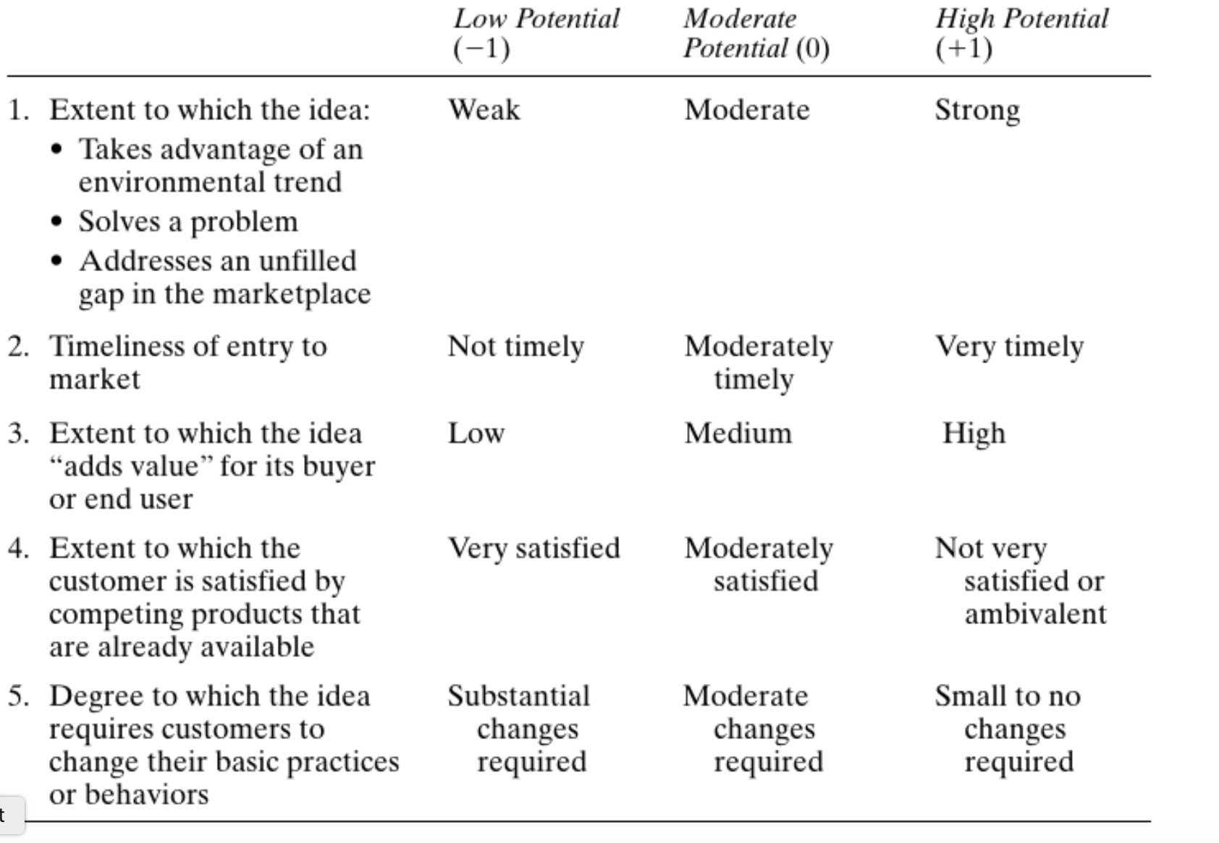
1. Strength of the business idea

Slide 38
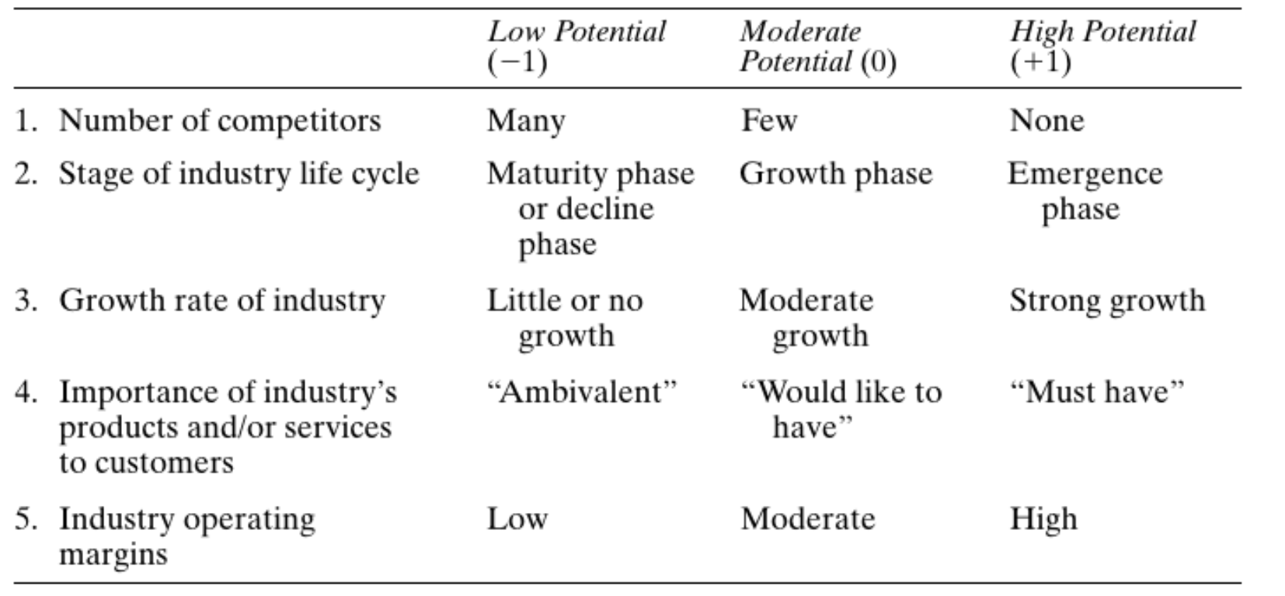
2. Industry-related issues

Slide 39
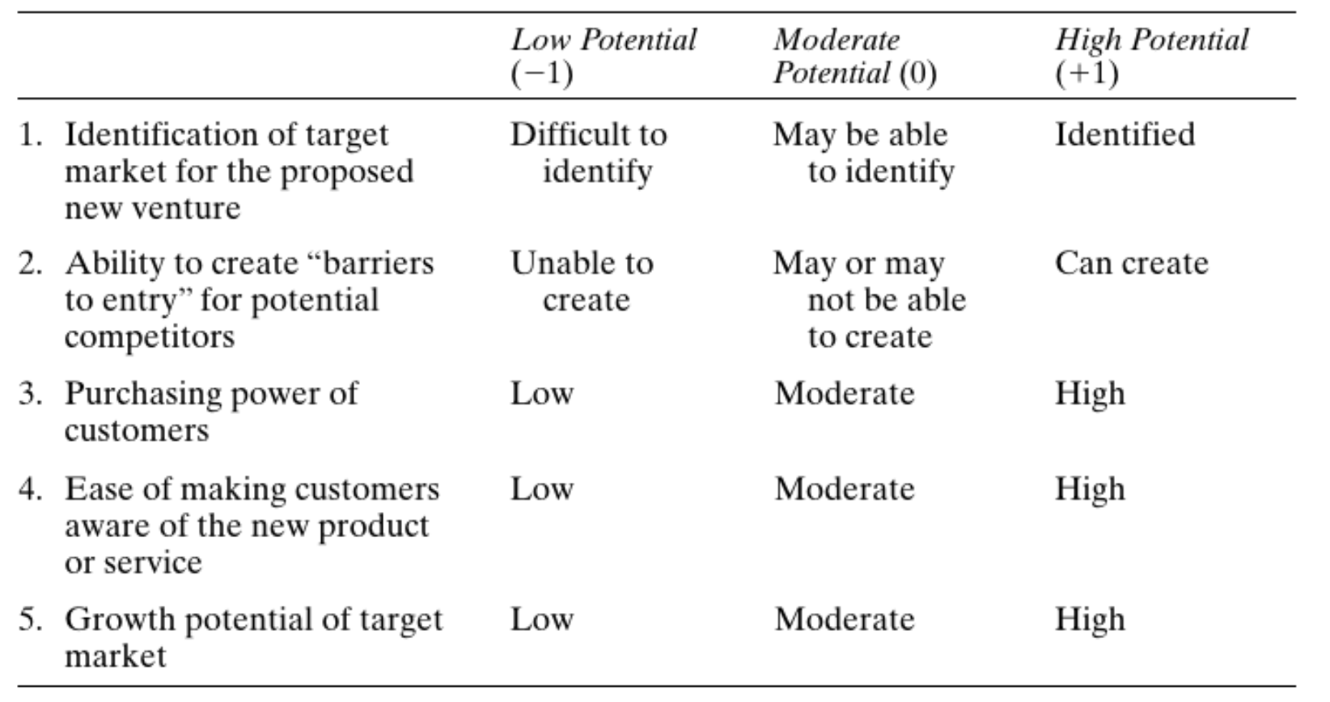
3. Target market and customer-related issues

Slide 40
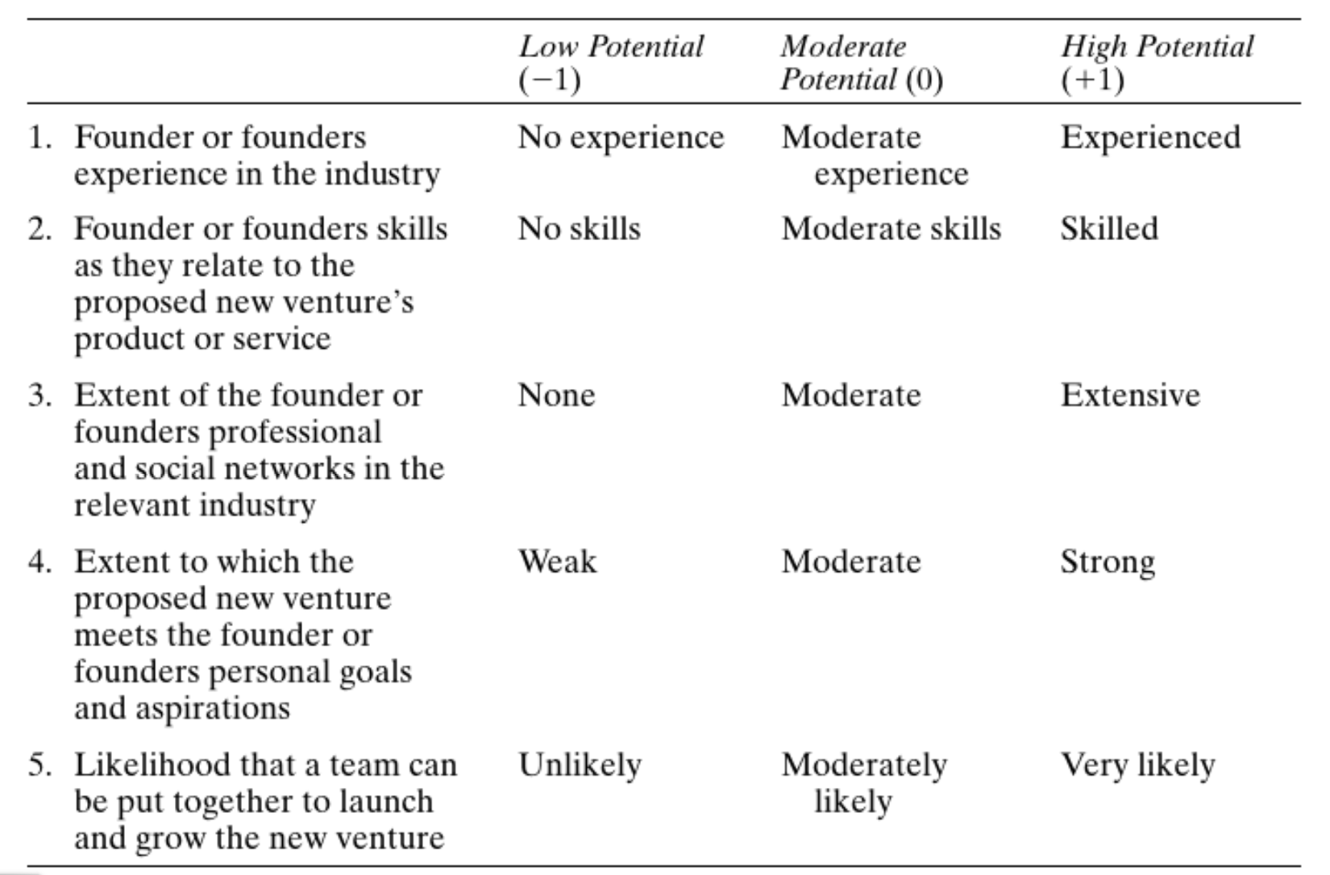
4. Founder(s)-related issues

Slide 41
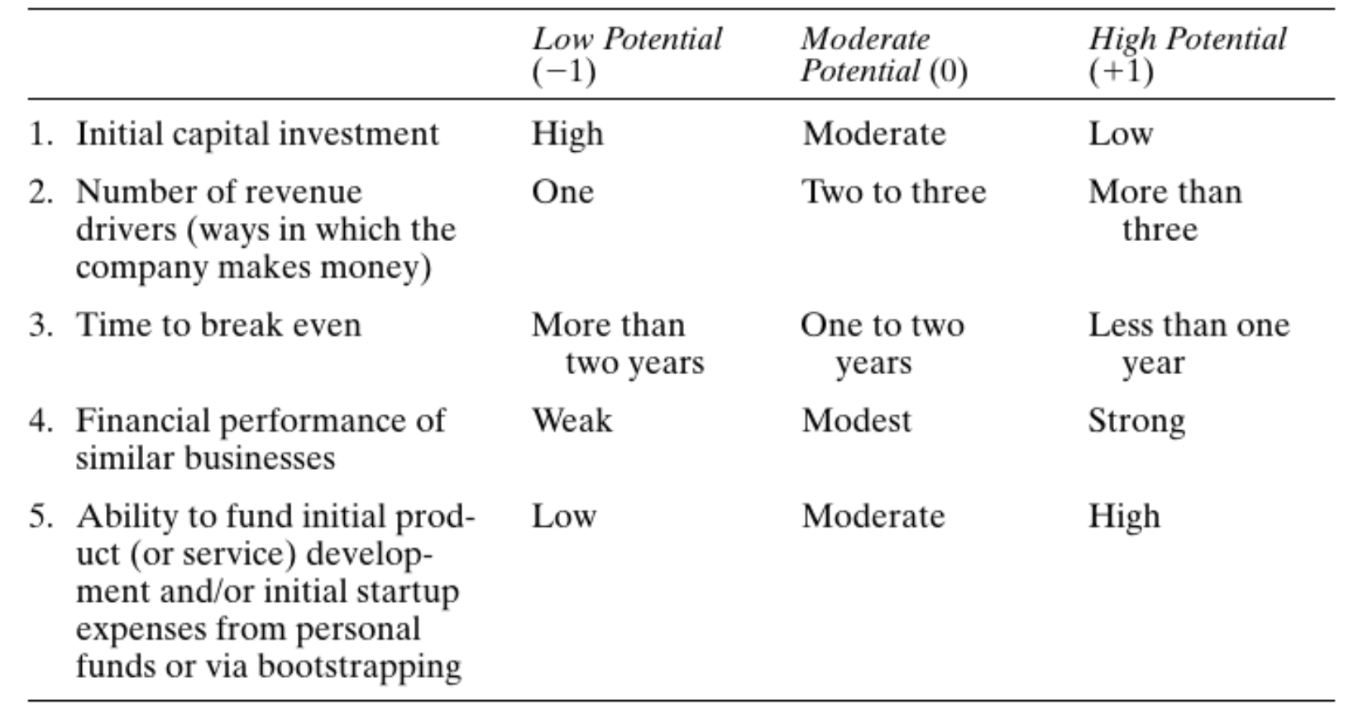
Financial issues

