Slide 1
Tipi di colture cellulari
Colture in monostrato/ in sospensione: le cellule tendono ad aderire alla superficie del recipiente di coltura; moltiplicandosi formano un monostrato, in quanto risentono dell’inibizione da contatto. Cellule trasformate possono formare pluristrati.
Colture a breve/lungo termine: nel primo caso il numero di cicli cui vanno incontro le cellule è ridotto; in colture a lungo termine le cellule si dividono molte volte, o addirittura illimitatamente (linee cellulari stabilizzate)
Colture clonali: le cellule vengono diluite prima della “semina” in modo da avere ogni cellula separata, che prolifera formando una singola colonia (clone).

Slide 2
Primary cultures
Primary cultures are defined as
cultures obtained from cells coming directly from tissue; embryos, adult cells in suspension or from tumors.
They generally contain a relatively heterogeneous mixture of cells in different physiological states.
There are cells that can grow in suspension or attached to an artificial matrix such as plastic but also to collagen.
Secondary cultures
are subcultures of primary cultures that become necessary when the cells reach confluence or completely cover the matrix to which they are attached.

Slide 3
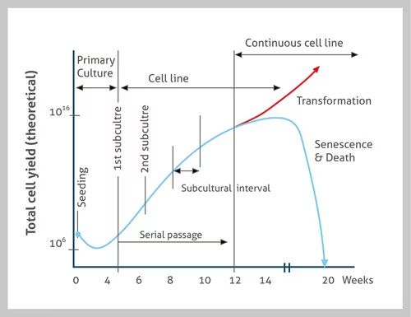
Evolution of a cell culture

Slide 4
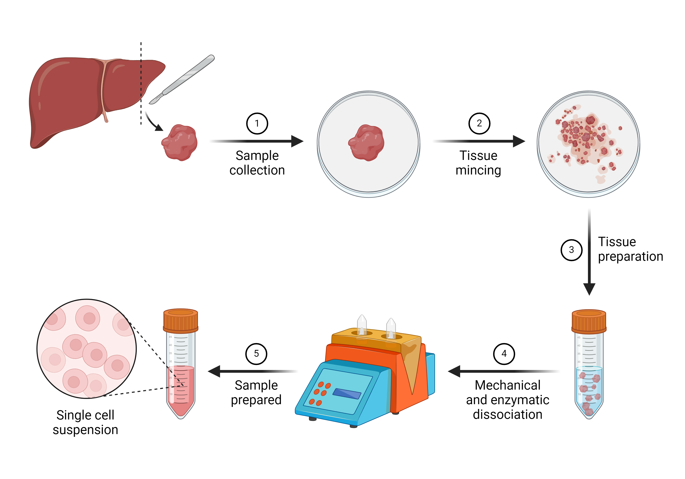
Primary cultures
Cells from a sample (organ, biopsy, embryos).
Mechanical dissociation
Enzymatic dissociation
Control of cell viability
and plating

Slide 5
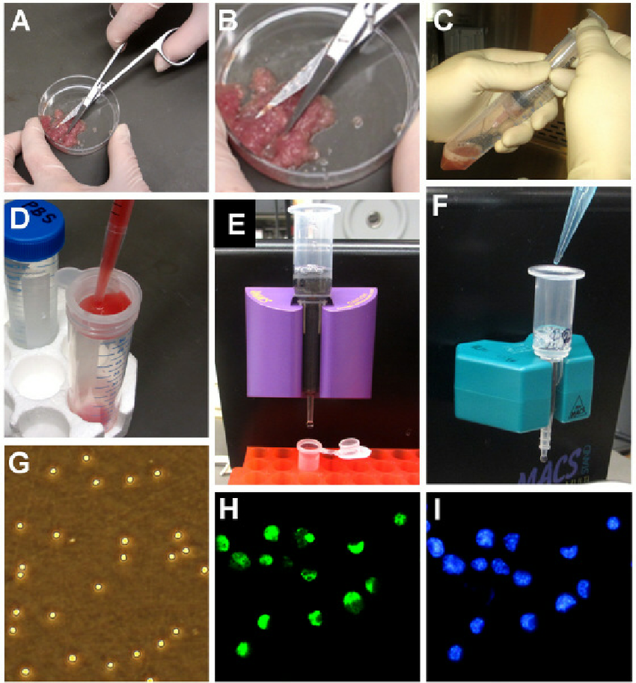
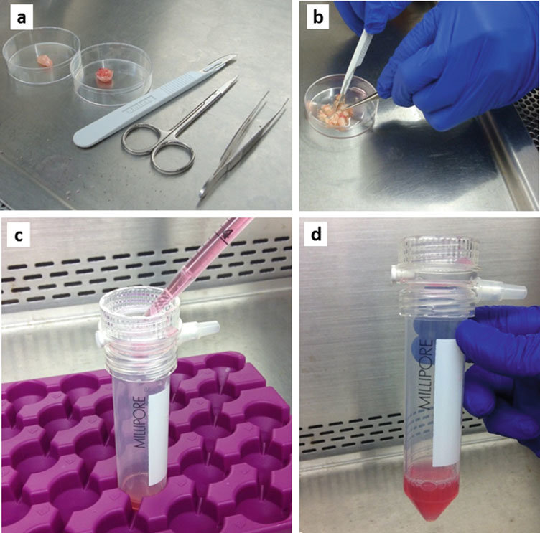
Mechanical dissociation
Mechanical dissociation of tissue involves
repeated mincing with scissors or sharp blades,
scraping the tissue surface,
homogenization,
vortexing, repeated aspiration through pipettes or sequentially smaller needles (e.g., 16-, 20-, and 23-gauge),
application of abnormal osmolarity stress,

Slide 6

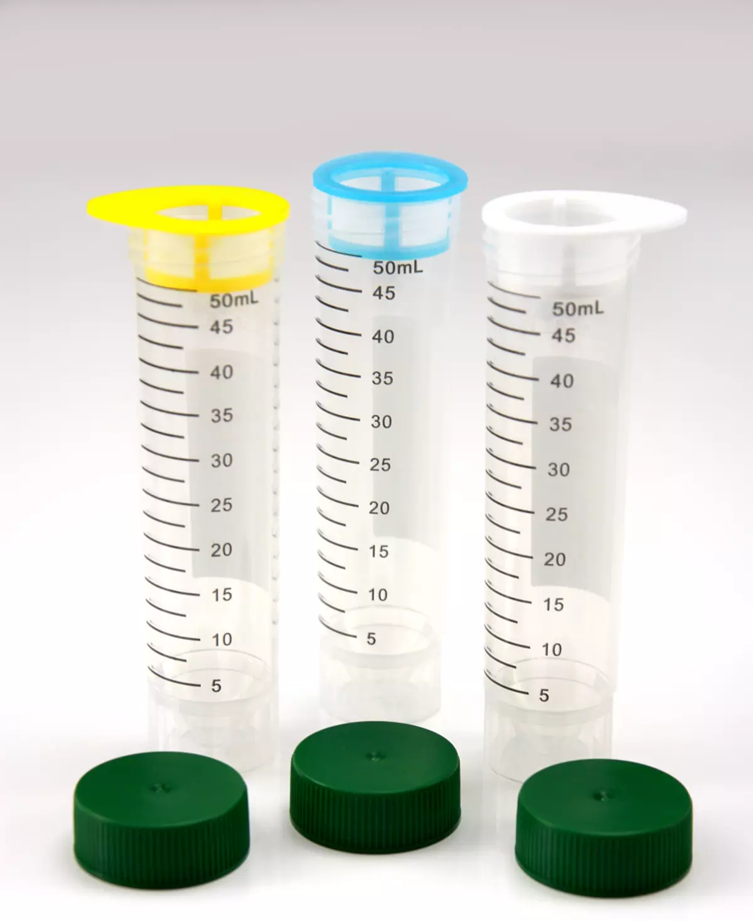
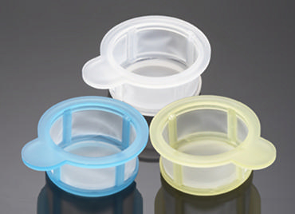
Cell strainers
are sterile, easy to use devices for rapidly isolating primary cells to consistently obtain a uniform single-cell suspension from tissues.
Fits 50 ml Falcon® conical tubes.
filtration through a nylon or steel mesh (50–100 μm opening),
This process generates single cell suspensions quickly with a minimal number of steps.
However, dissociation of tumor tissue using mechanical methods is not often a suitable technique, for obtaining tumor cells for culture because the technique results in a high percentage of dead cells that secrete degrading enzymes

Slide 7
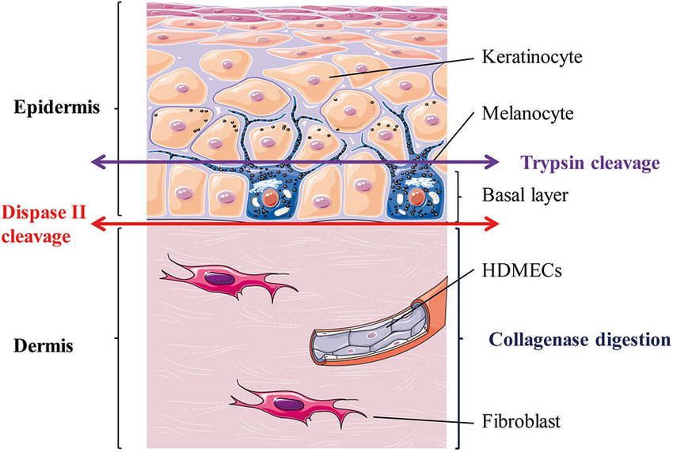
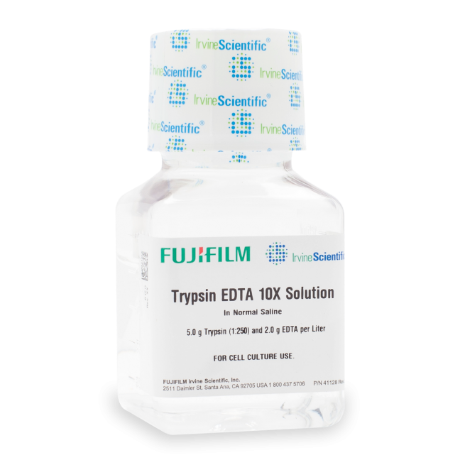
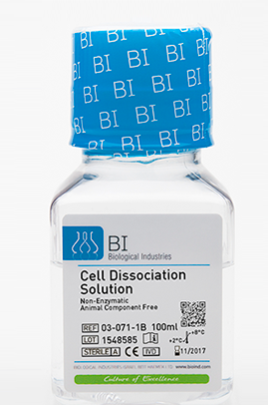
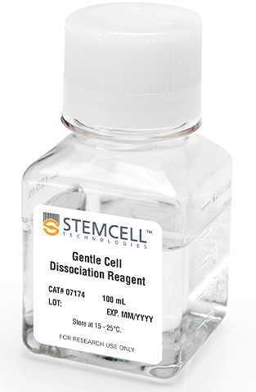
Enzymatic dissociation
Enzymatic dissociation is a commonly used practice to digest minced tissue into a single cell suspensions due to proper digestion of tissue and preservation of cell viability and integrity.
Numerous studies have shown that certain enzymes are more effective than others for dissociation of specific tissues.
papain,
elastase,
hyaluronidase,
collagenase,
pronase,
deoxyribonuclease.
Trypsin

Slide 8
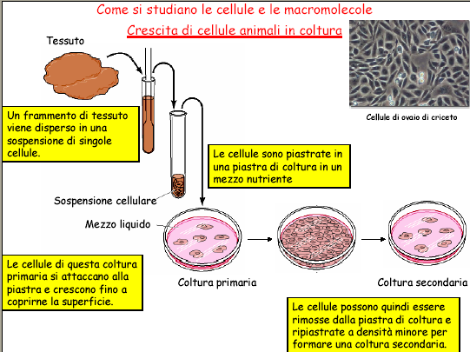

Slide 9
Primary culture
The cells are derived directly from the original tissue and retain many functional features that are also found in vivo.
During growth, selection occurs based on the degree of proliferation:
expansion of proliferating cells,
those that survive but cannot duplicate remain stationary,
while other cell types are not resistant.
This means that the proportions of the different cell types change over time until an equilibrium is reached that is significantly different from the initial situation.
When the proliferation has depleted the culture medium, a subculture must be established in a new container with fresh medium

Slide 10
Types of cell cultured in vitro
Primary cultures
Derived directly from animal tissue
embryo or adult?/ Normal or neoplastic?
Cultured either as tissue explants or single cells
Initially heterogeneous – become overpopulated with fibroblasts
Finite life span in vitro
Retain differentiated phenotype
Mainly anchorage dependant
Exhibit contact inhibition
Secondary cultures
Derived from a primary cell culture
Isolated by selection or cloning
Becoming a more homogeneous cell population
Finite life span in vitro
Retain differentiated phenotype
Mainly anchorage dependant
Exhibit contact inhibition

Slide 11
Cellule primarie animali: esempi
Linfociti/timociti
Macrofagi
Cellule di embrione di pollo/ratto
Cellule di fegato /cuore (di embrione)
Fibroblasti (cellule del tessuto connettivo)

Slide 12
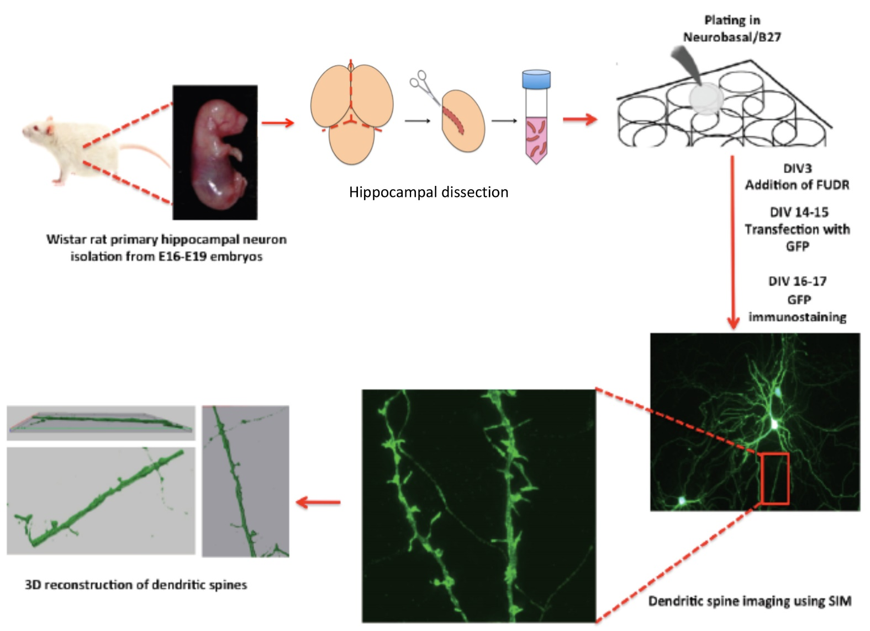

Slide 13
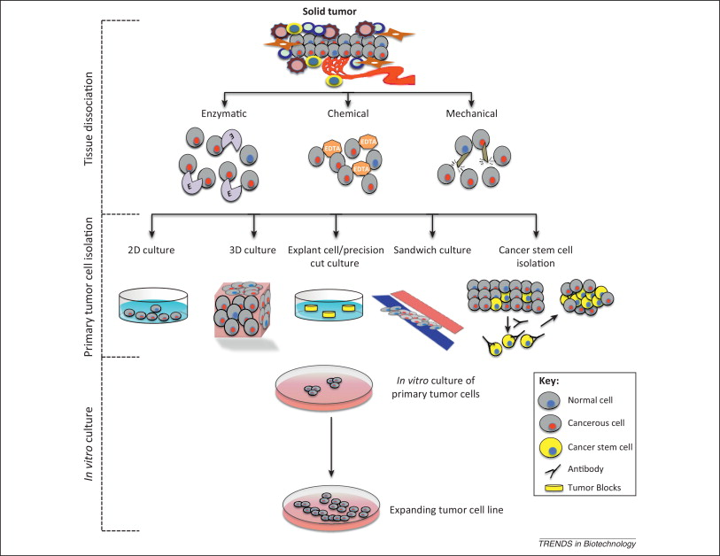

Slide 14
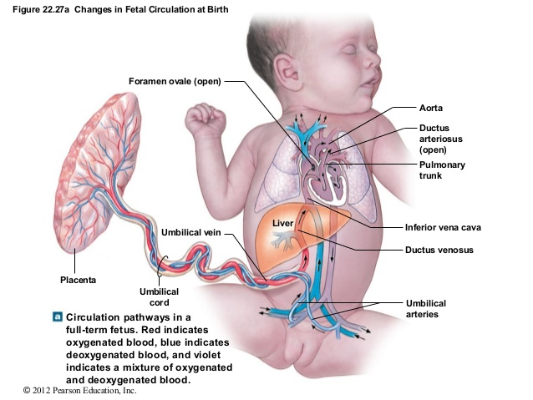
HUVEC - Human Umbilical Vein Endothelial Cells

Slide 15
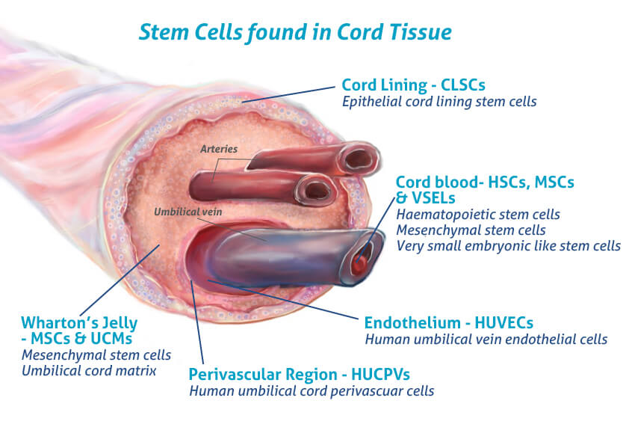
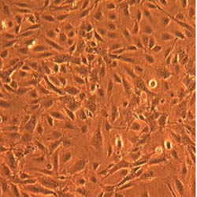
HUVEC
Human Umbilical Vein Endothelial Cell
Video isolamento cellule x2
isolation from umbilical cord was first described in 1973.
To date, this model is still widely used because of the high HUVEC isolation success rate, and because HUVEC are an excellent model to study a broad array of diseases, including cardiovascular and metabolic diseases.

Slide 16
Types of cell cultured in vitro
Primary cultures
Derived directly from animal tissue
embryo or adult?/ Normal or neoplastic?
Cultured either as tissue explants or single cells
Initially heterogeneous – become overpopulated with fibroblasts
Finite life span in vitro
Retain differentiated phenotype
Mainly anchorage dependant
Exhibit contact inhibition
Secondary cultures
Derived from a primary cell culture
Isolated by selection or cloning
Becoming a more homogeneous cell population
Finite life span in vitro
Retain differentiated phenotype
Mainly anchorage dependant
Exhibit contact inhibition

Slide 17
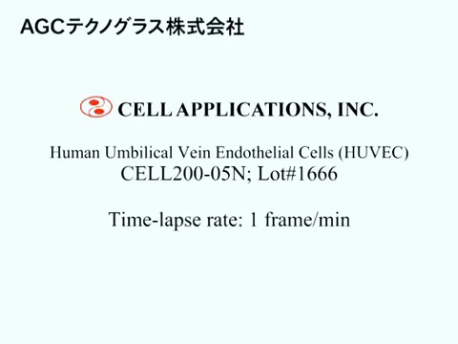

Slide 18
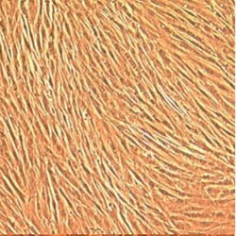
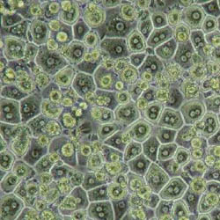
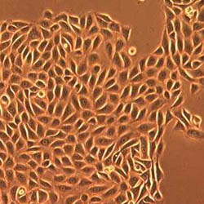
HUVEC
Human Umbilical Vein Endothelial Cells
NHLF
Normal Human Lung Fibroblasts
Human Hepatocytes
Normal Human Epidermal Keratinocytes

Slide 19
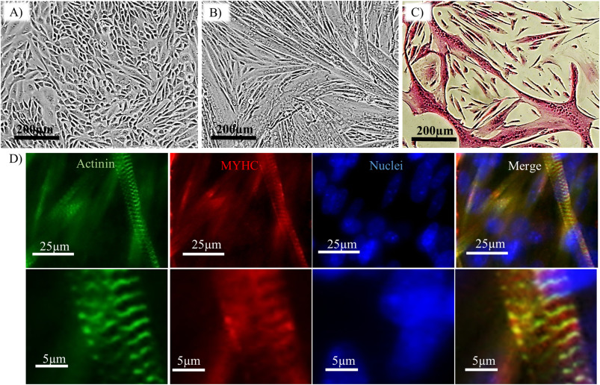
Differentiation of myoblasts into multinucleated myotubes.
Morphology of myoblasts after reaching 100% confluence; scale bar = 200 μm.
(B) Myotubes formed after 5 days of induction in differentiation medium (DM); scale bar = 200 μm.
(C) Staining of myotubes for Hematoxylin and Eosin (H&E).

Slide 20
Evoluzione di una linea cellulare in coltura
La coltura primaria è caratterizzata da un tempo di duplicazione lento, che aumenta notevolmente nei successivi passaggi in coltura, quando si parla di linea cellulare primaria.
Nella terza fase si nota la senescenza, con tempi di duplicazione progressivamente più lunghi (sino alla morte), a meno che non intervenga una trasformazione, che produce una linea cellulare immortalizzata in grado di replicarsi indefinitamente.
https://handling-solutions.eppendorf.com/cell-handling/about-cells-and-culture/detailview/news/what-is-primary-cell-culture/

Slide 21
Replicative senescence in animal cells growing in vitro was first discovered by Leonard Hayflick. He found that primary human diploid fibroblast cell lines ceased to proliferate after an extended number of serial passages (Hayflick, 1965).
- This phenomenon occurs independently of the presence of metabolites appropriate for growth.
- A major causal feature of replicative senescence is telomere erosion, a process in which the telomeres gradually shorten with increasing cellular divisions.
Continuous cell lines arise from single cells in which spontaneous or induced mutations have abrogated the genetic program of senescence.
They are therefore called immortal: they proliferate continuously in the presence of the appropriate metabolites. Many continuous cell lines have been obtained from tumor tissues (e.g. HeLa).

Slide 22
Cell Lines
Finite-life cell lines
– They can survive a limited number of cycles in culture; they grow in monolayers, being sensitive to contact inhibition; they are highly dependent on growth factors present in the serum.
Continuous (transformed) cell lines
– originate from mutations (spontaneous or induced with chemical, physical or biological agents) starting from primary cultures or from finite-life cell lines; they can be obtained from tumors. Less dependence on serum factors and less contact inhibition.
Clonal cell lines
– are lines derived from a single cell; they allow to obtain a population as homogeneous as possible

Slide 23
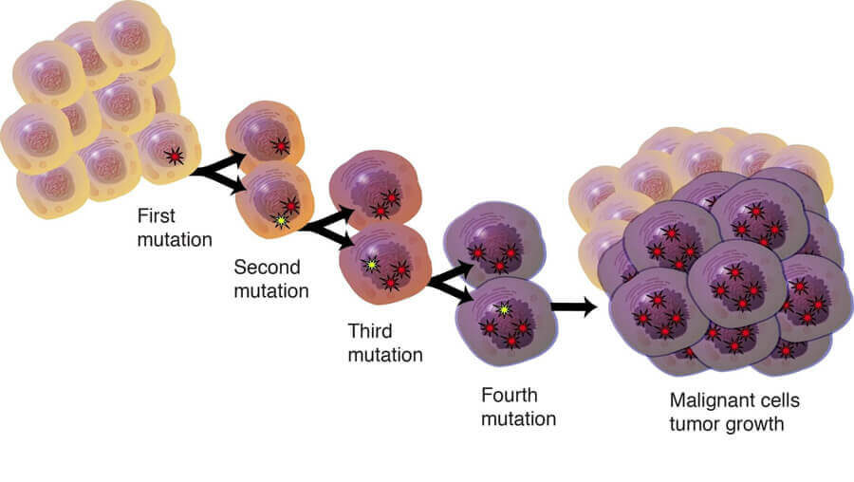
The transformation process makes a cell line immortal.
It begins with the acquisition by the cell line of the ability to proliferate indefinitely (immortalization);
it requires a certain number of mutations in different genes.
When it occurs in culture (even spontaneously), foci of transformation are observed under the microscope, that is, masses of cells similar to tumor cells, which are no longer affected by contact inhibition.

Slide 25
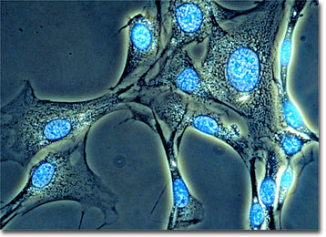
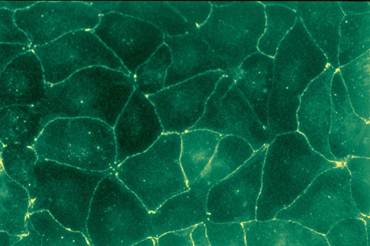
MOUSE 3T3 Fibroblast
3T3 cells come from a cell line established in 1962 by two scientists then at the Department of Pathology in the New York University School of Medicine,
Canine MDCK (epitelial)
(Madin-Darby Canine Kidney)
Derived from a kidney of an apparently normal adult female cocker spaniel in September 1958

Slide 26
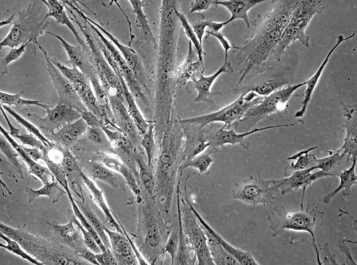
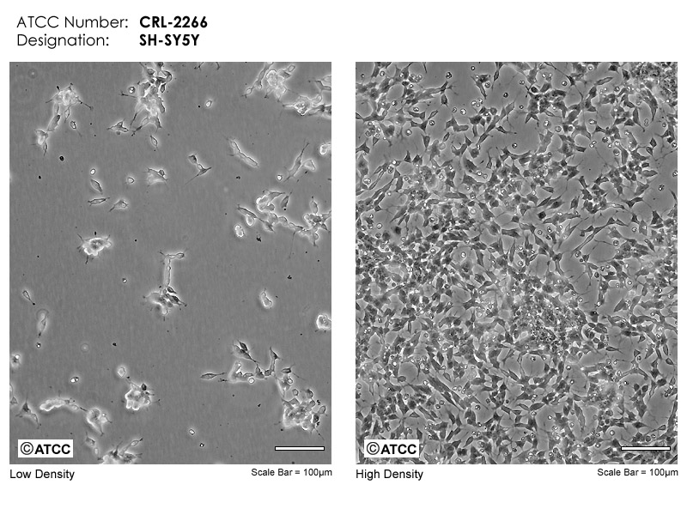
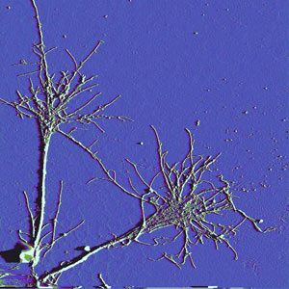
RAT L6
Mioblast
+ retinoic acid
SH SY5Y Neuronal
The cell line SH-SY5Y is a thrice-cloned neuroblastoma, originally from SK-N-SH and first reported in 1978.

Slide 27
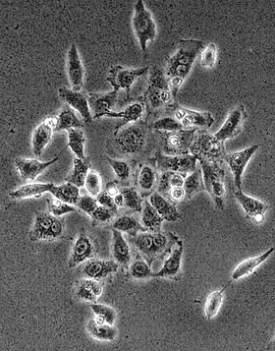
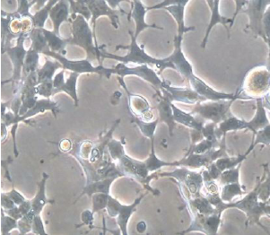
HEK 293
Origins of the HEK293 Cell Line
HEK293 is a cell line derived in 1973 from a spontaneously miscarried or aborted female fetus or Human Embryonic Kidney
https://www.hek293.com/

Slide 28
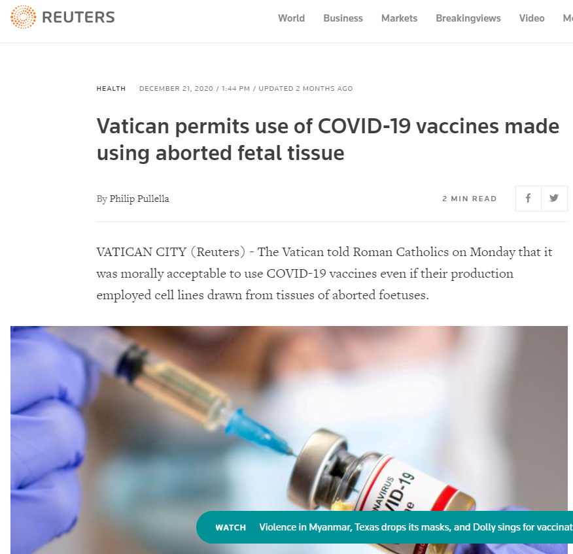

Slide 29
Linee cellulari particolarmente utilizzate.
3T3 fibroblast (mouse)
BHK21 fibroblast (Syrian hamster)
MDCK epithelial cell (dog)
HeLa epithelial cell (human)
PtK1 epithelial cell (rat kangaroo)
L6 myoblast (rat)
PC12 chromaffin cell (derived from a rat pheochromocytoma)
COS fibroblast (monkey)
CHO ovary (chinese hamster)
HEK-293 generated by transformation of embryonic kidney cells (human)

Slide 30
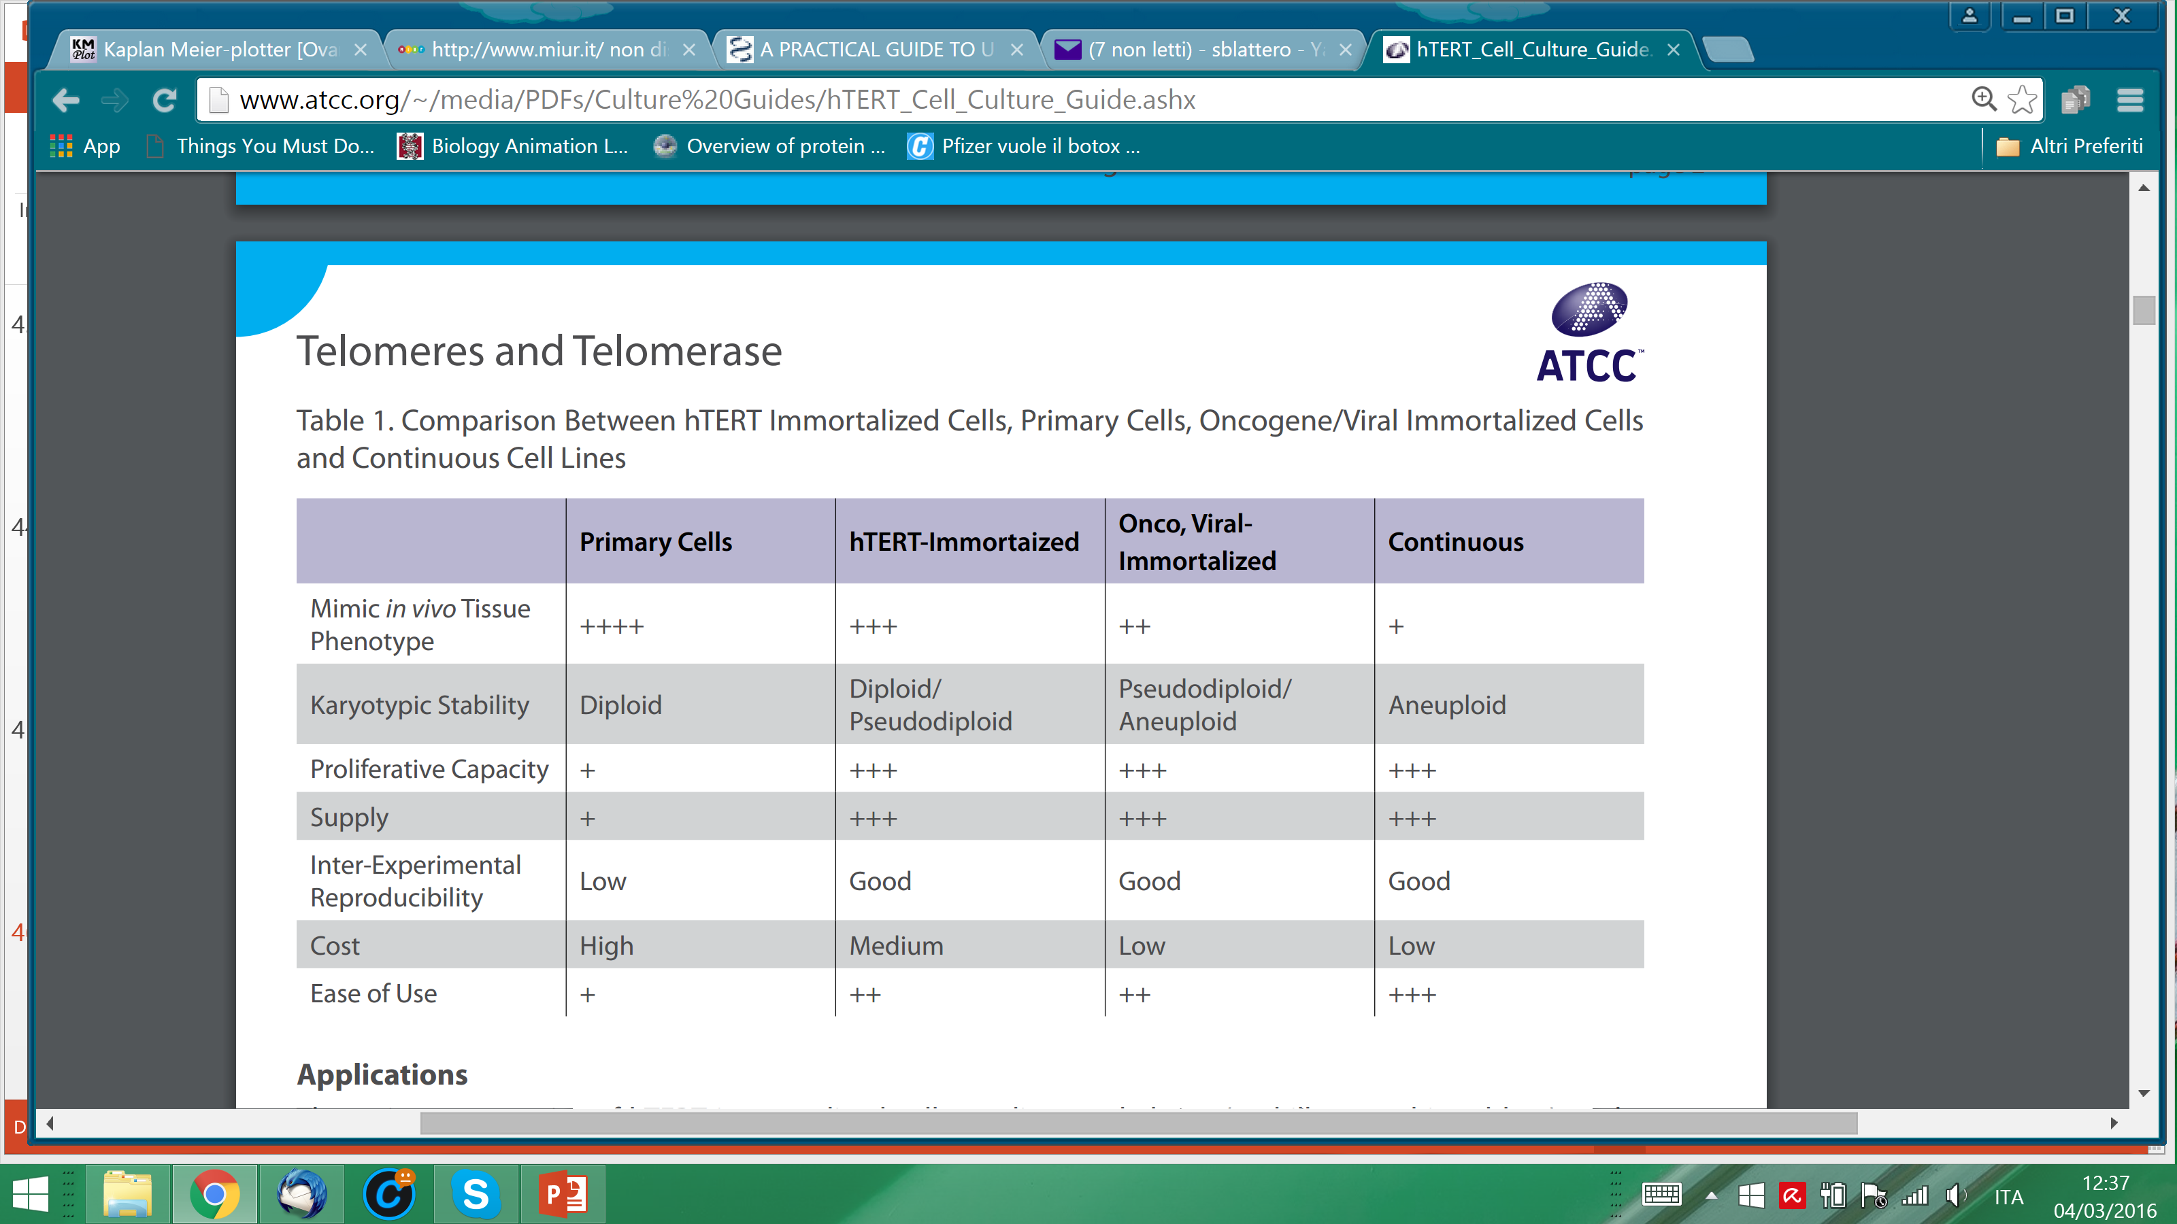
Primary cells
closely represent the physiological state of a particular cell type in vivo, but they are susceptible to replicative senescence, so their value in the laboratory setting is limited.
Continous cell lines,
on the other hand, are not encumbered by replicative senescence, but, they often contain numerous genetic mutations, exhibit an unstable karyotype and have protein expression patterns that are not comparable with the cell type they are intended to represent.

Slide 31
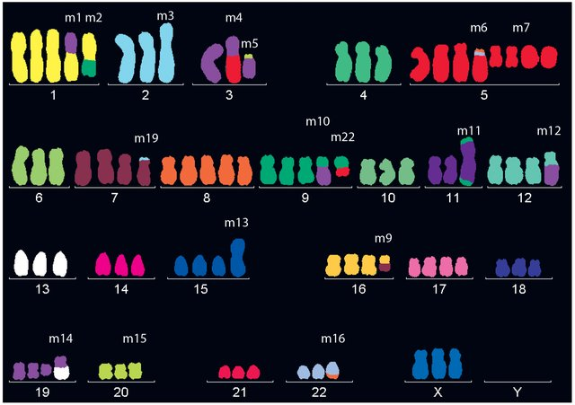

Slide 32
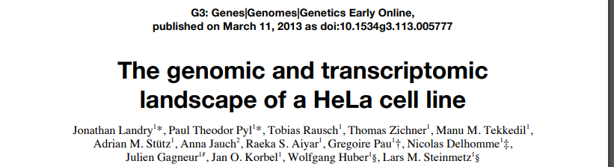
Indeed, substantial chromosomal aberrations in the HeLa cell line have been revealed by cytogenetic methods
A combination of these techniques (CGH), (FISH), (SKY)] has been used to determine the karyotype of a CCL2 HeLa cell line
This cell line contained two subclonal populations, which were both hypertriploid (3n+), with
- a variable total number of chromosomes (76−80)
- a variable number of abnormal chromosomes (22−25) per cell

Slide 33
Primary cells
closely represent the physiological state of a particular cell type in vivo, but they are susceptible to replicative senescence, so their value in the laboratory setting is limited.
Continous cell lines,
on the other hand, are not encumbered by replicative senescence, but they often contain numerous genetic mutations, exhibit an unstable karyotype and have protein expression patterns that are not comparable with the cell type they are intended to represent.

Slide 34
Strategies for Creating Immortal Cells
Several methods exist for immortalizing mammalian cells in culture conditions.
One method is to use viral genes, such as the simian virus 40 (SV40) T antigen, to induce immortalization.
SV40 T antigen has been shown to be the simplest and most reliable agent for the immortalization of many different cell types and the mechanism of SV40 T antigen in cell immortalization is relatively well understood. The transforming activity of TAg is due in large part to its perturbation of the retinoblastoma (pRb) and p53 tumor suppressor proteins.
The most recently discovered approach to cell immortalization is through the expression of Telomerase Reverse Transcriptase protein (TERT), particularly for cells that are most affected by telomere length, such as human cells

Slide 35
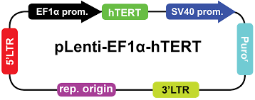
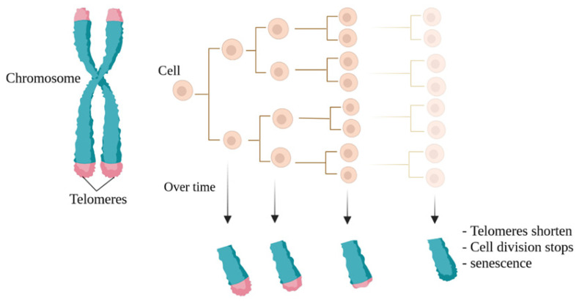
The enzyme telomerase can prevent the shortening of telomeres
the transfer of exogenous hTERT cDNA (encoding the catalytic subunit of human telomerase)
can be used to prevent telomere shortening, overcome telomere-controlled senescence, and immortalize primary human cells.

Slide 36
hTERT Immortalization of Primary Cells
Transfection of hTERT into human primary cells leads to elongation and maintenance of the telomere ends of the chromosomes.
In many instances, forced expression of hTERT alone enables the cells to repress replicative senescence and overcome the growth crisis, effectively leading to their immortalization.
In some cases, more than one immortalization agent may be required to successfully immortalize a particular cell type. For example primary cell lines may be immortalized using a combination of hTERT with one or more of the following genes encoding:
- viral (simian virus 40 (SV40) large T antigen
human papilloma virus-16 (HPV-16) E6/E7)
non-viral (Cdk-4 and Bmi-1) oncoproteins.
hTERT immortalized cells are mostly diploid, but may become pseudo-diploid especially at high passage number.
In many cases, when cells become pseudo-diploid they still retain most primary cell functions.

Slide 37
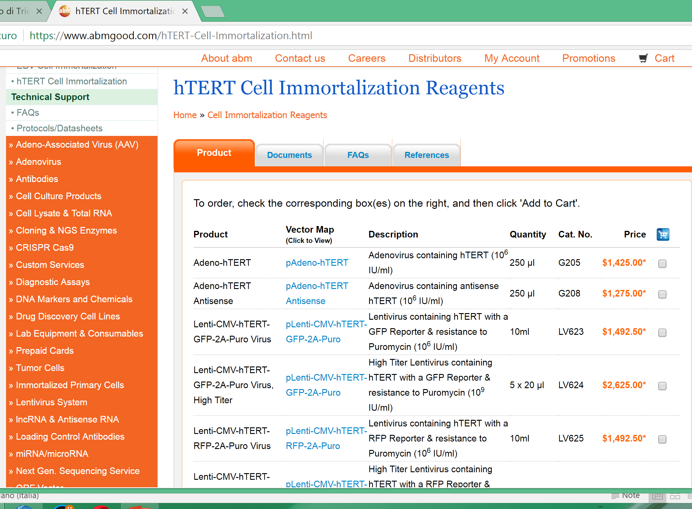

Slide 38
