Slide 1
In order to study which phase of the cell (tumour) process is influenced by the molecule under examination, experimental models are used.
They are distinguished as:
1. monovariable models
they are performed only in vitro since a single phase of the process is evaluated
2. Multivariable models
they include multiple process steps, they can be in vitro and in vivo (using mice or rats.)

Slide 2
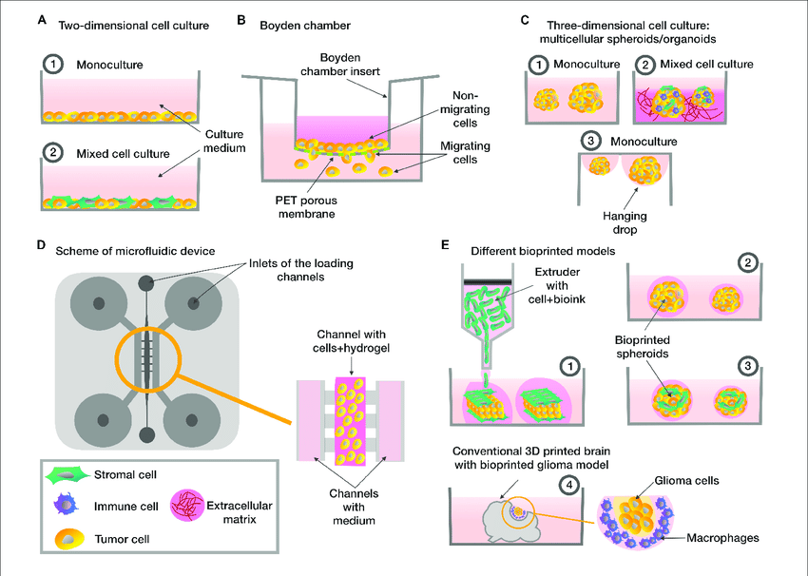
in vitro models
They allow to evaluate:
Adhesion
Spreading
migration
Invasion
Proliferation

Slide 3
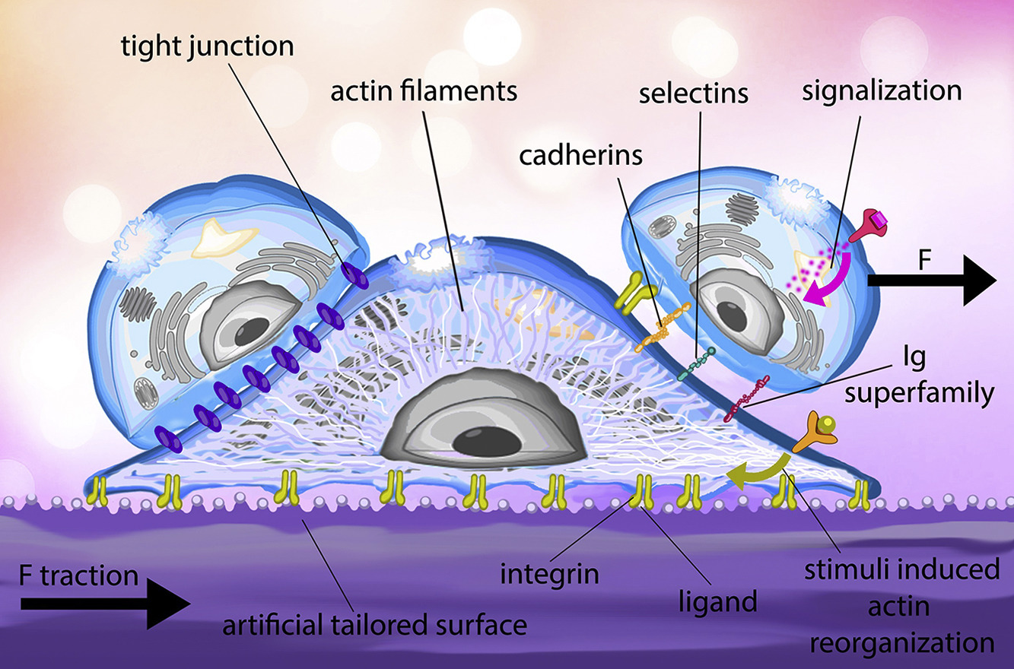
Cell adhesion
is a complex process involved in migration/invasion, embryogenesis, wound healing and tissue remodeling.
Cells adhere to the extracellular matrix, forming complexes with cytoskeleton components that can affect cell motility, differentiation, proliferation, and survival.

Slide 4
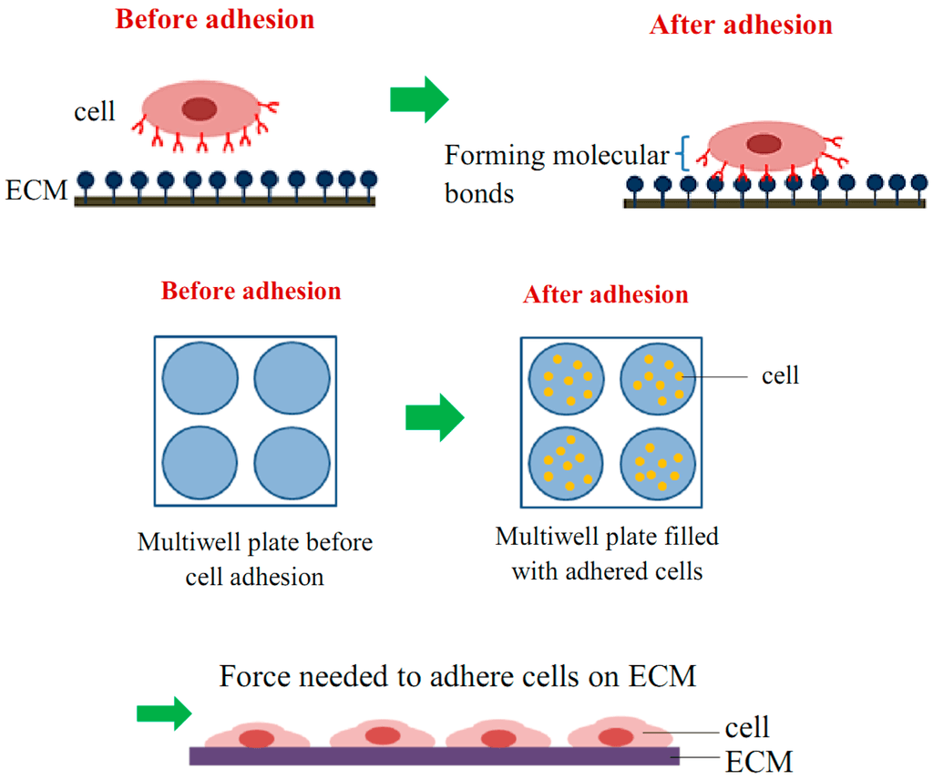
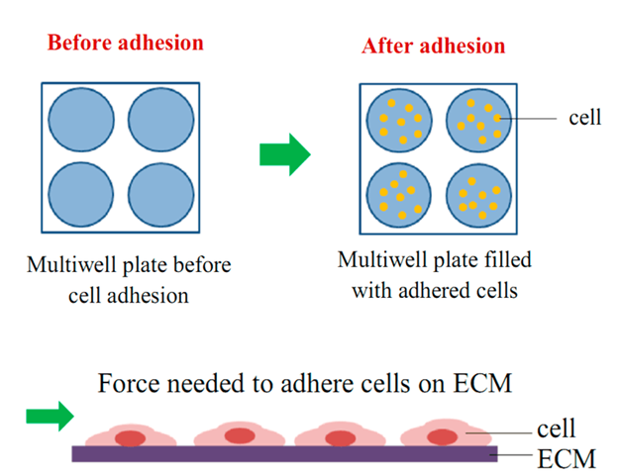
Cell adhesion
- Cells are seeded onto the substrate.
- Adherent cells attach, while non-adherent cells are washed away.
- Adherent cells are quantified.

Slide 5
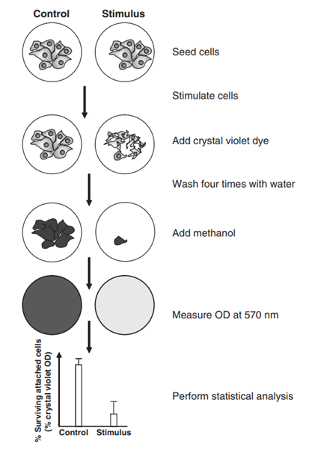
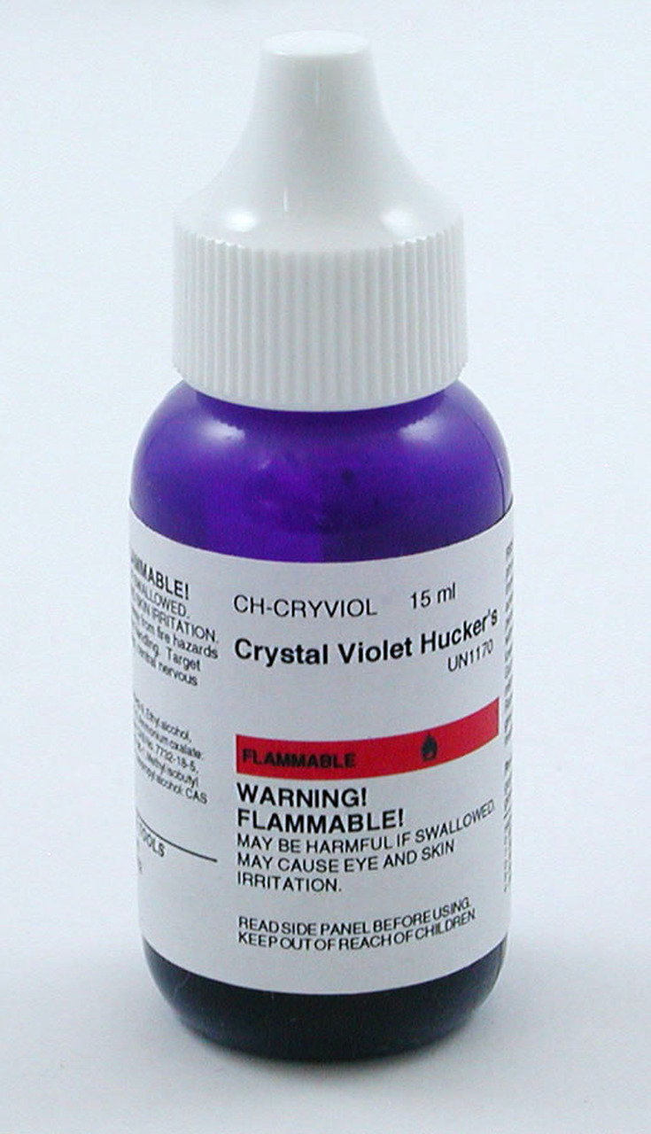
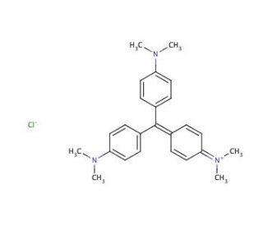
Crystal Violet staining
Crystal violet stains nucleic acids and proteins
It is used to reflect the cell number in 96-well plates.

Slide 6
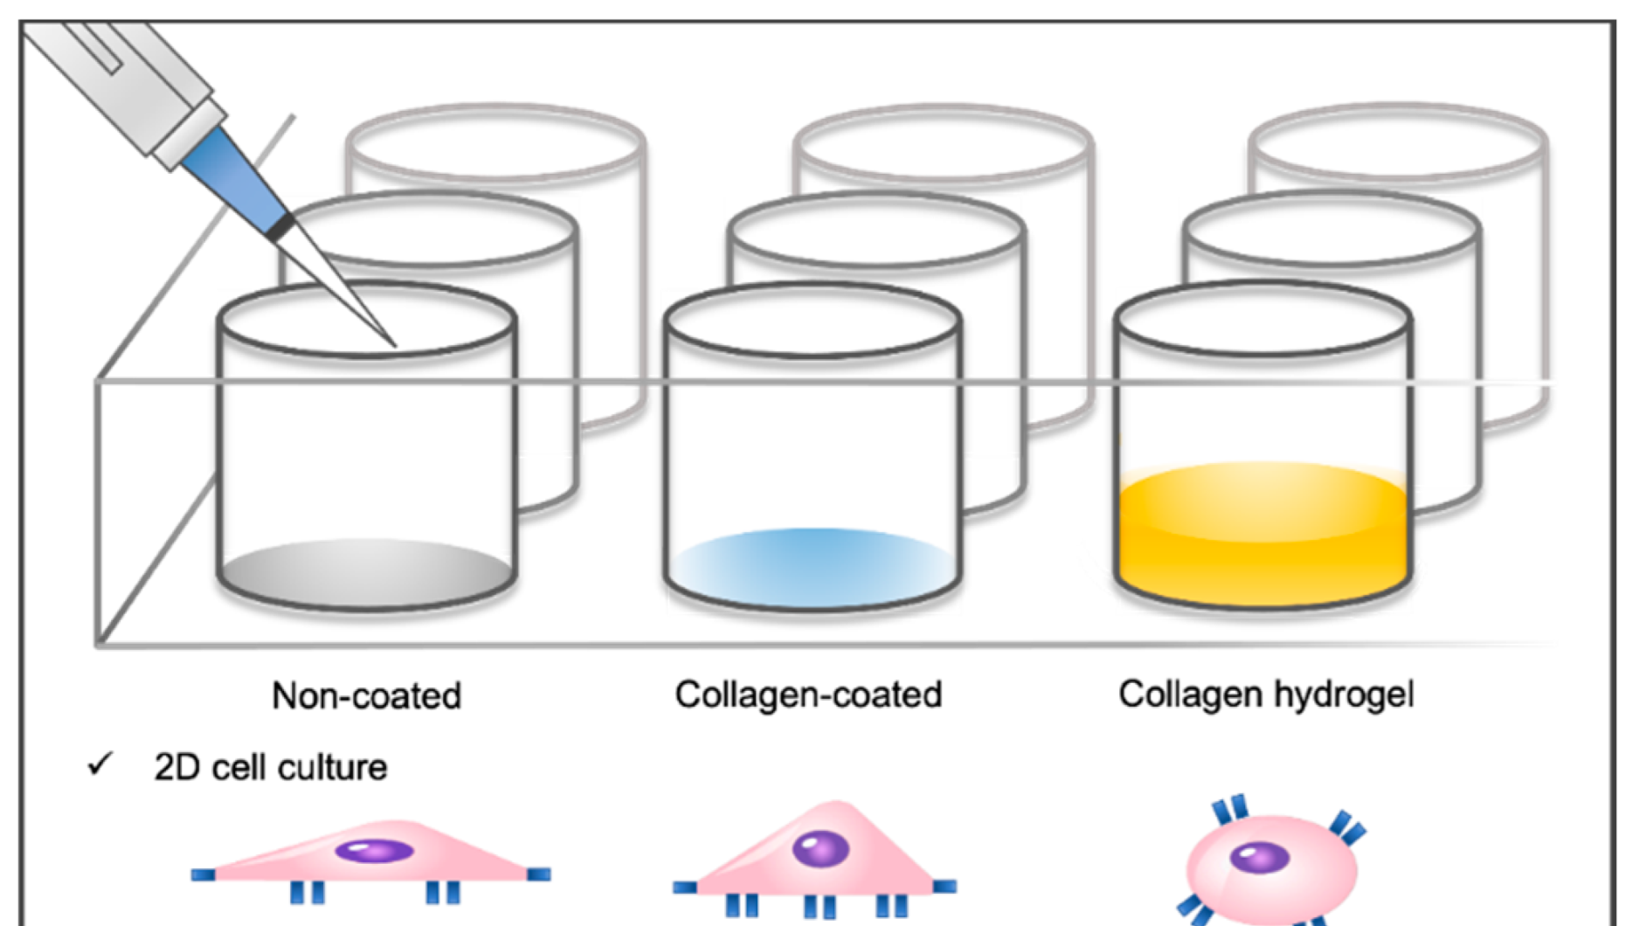
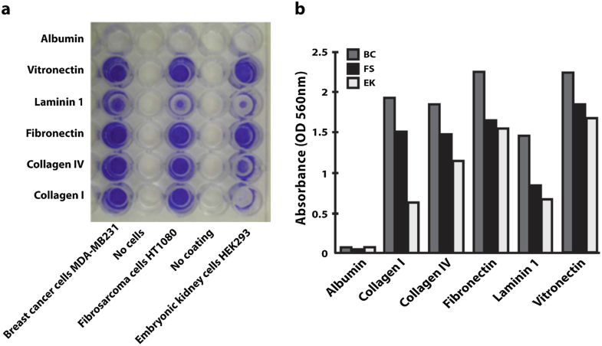
Fibronectin coated

Slide 7
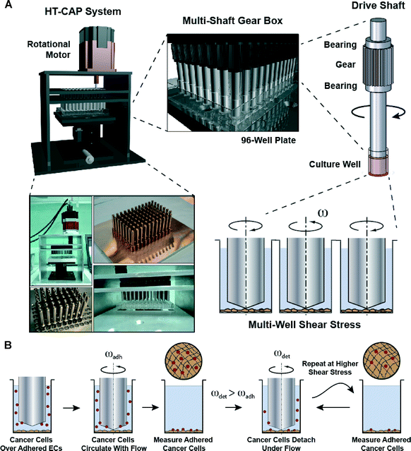

Slide 8
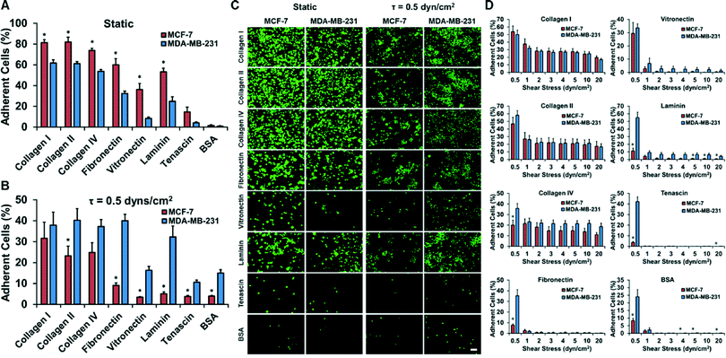

Slide 9
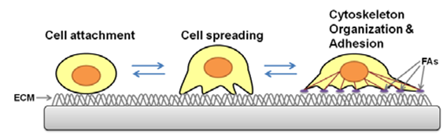
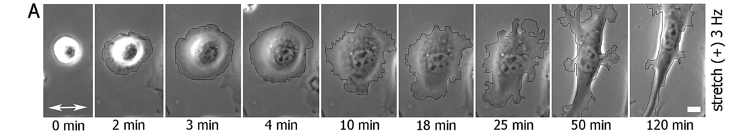
Cell spreading assay
Cell spreading is when cells in its rounded morphology in suspension flatten out on a substrate.

Slide 10
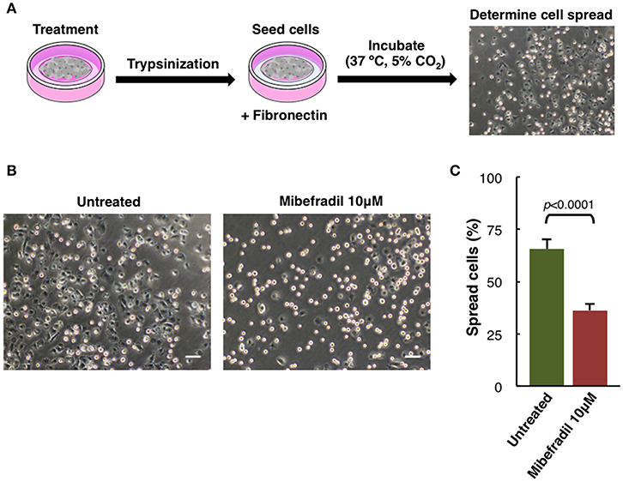
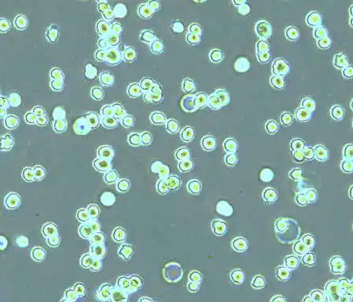
Cell spreading assay
- Cells were treated for 24 h,
- trypsinized
seeded onto fibronectin coated plate.
After 1 h cells were fixed with 2% PFA
- phase-contrast images were captured.
FIGURE 5. (B) phase-contrast images. Scale bars, 50 μm.
C) Plot showing the percentage of spreading cells. Round bright cells were considered unspread. Values are percentage of spread cells ± SD (n = 3 independent experiments; at least 600 cells for each experiment were counted). The corresponding p-value obtained by unpaired two-tailed Student's t-test is shown.

Slide 11
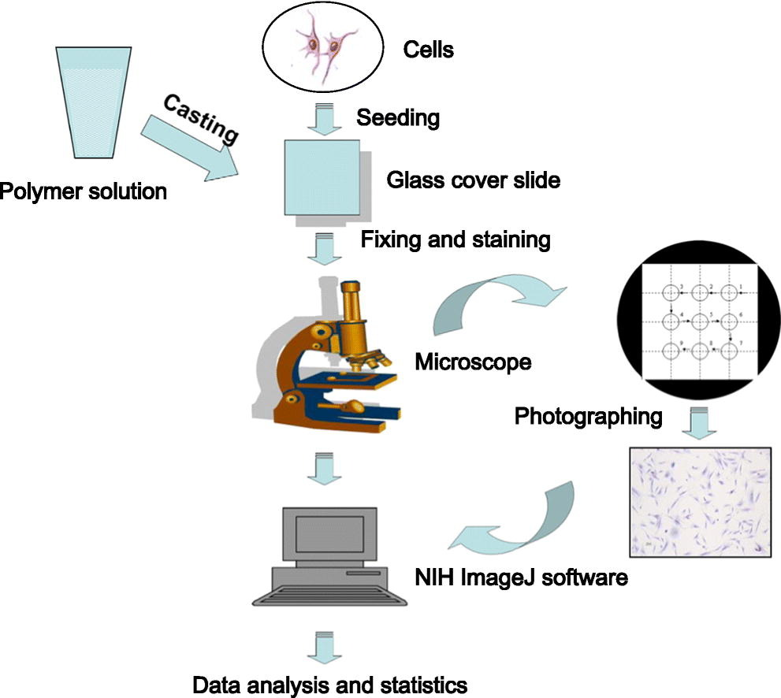
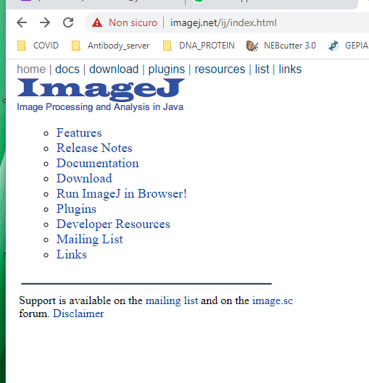
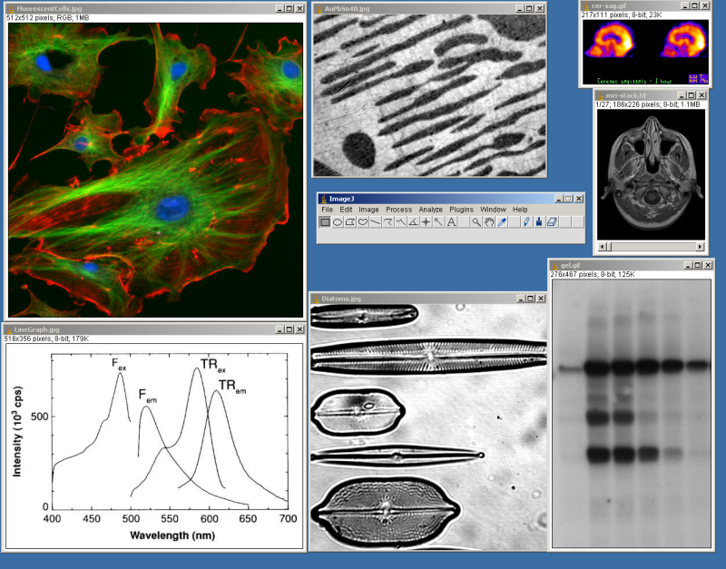

Slide 12
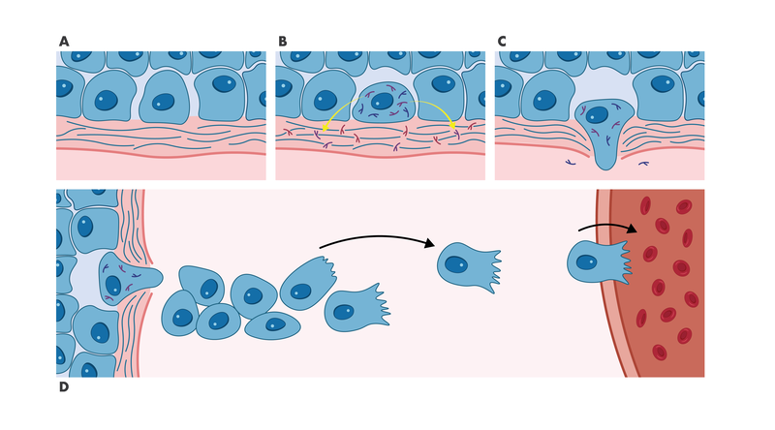
Early Metastasis Process
The early steps of the metastasis process involve
A) Loosening of the intercellular junctions between tumor cells,
B) Degradation of the intracellular matrix of the basement membrane,
C) Invasion into surrounding tissue,
D) Migration to endothelial vessels.
modeled with the Invasion Assay.
modeled with the Migration Assay.

Slide 13
Definition of migration and invasion
Migration is often used as umbrella term in biology to describe any directed cell movement within the body.
The ability to migrate allows cells to change their position within tissues or between different organs.
In pathology, invasion (of carcinomas) is defined as
the penetration of tissue barriers, and infiltration (intrusion) into the underlying interstitial tissues (by malignant tumor cells)

Slide 14
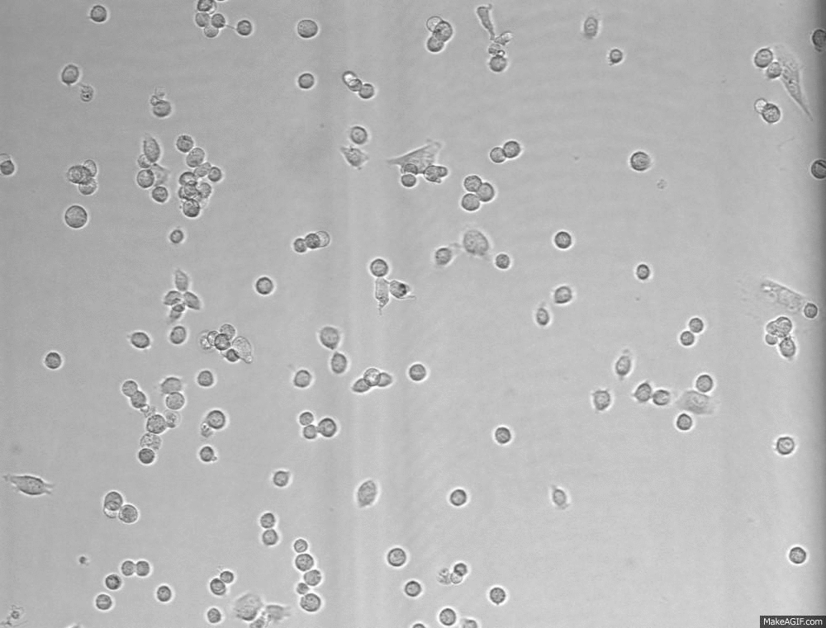
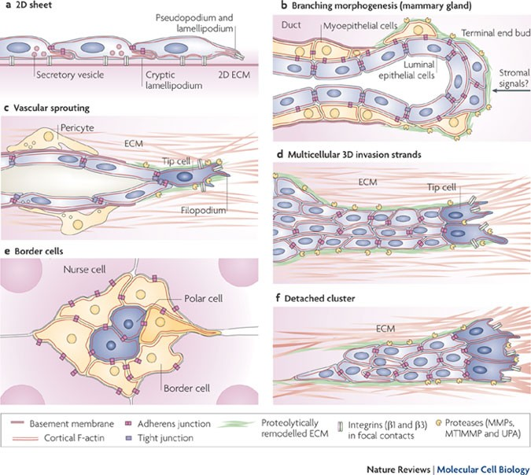
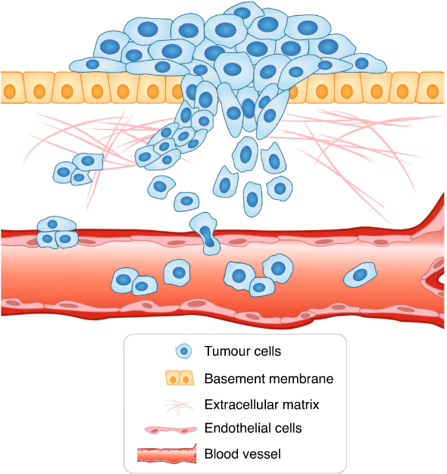
Migration and invasion are clearly separated terms in experimental cell biology.
Migration is defined as:
the directed movement of cells on a substrate such as basal membranes, ECM fibers or plastic plates.
Therefore, migration is occurring on 2D surfaces without any obstructive fiber network
Invasion is defined as:
cell movement through a 3D matrix, which is accompanied by a
restructuring of the 3D environment.
Invasion requires adhesion, proteolysis of extracellular matrix components and migration, therefore invading cells remodel the ECM.

Slide 15
Migration Assays
Wound healing assay
Cell Exclusion Zone assay
Boyden Chamber

Slide 16
In vitro wound-healing assay (scratch assay)
This popular, technically non-demanding and cheap assay can be used to study migration of cells on 2D surfaces.
A confluent plate of any type of attached cells is ‘‘wounded’’ by scraping off an area of cells, which is most easily done using a plastic pipette tip

Slide 17
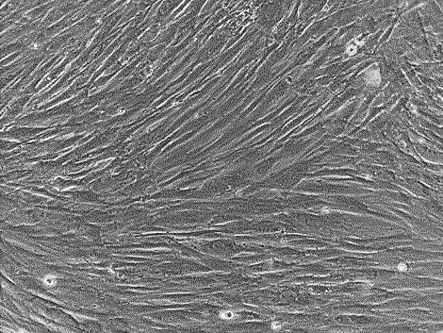
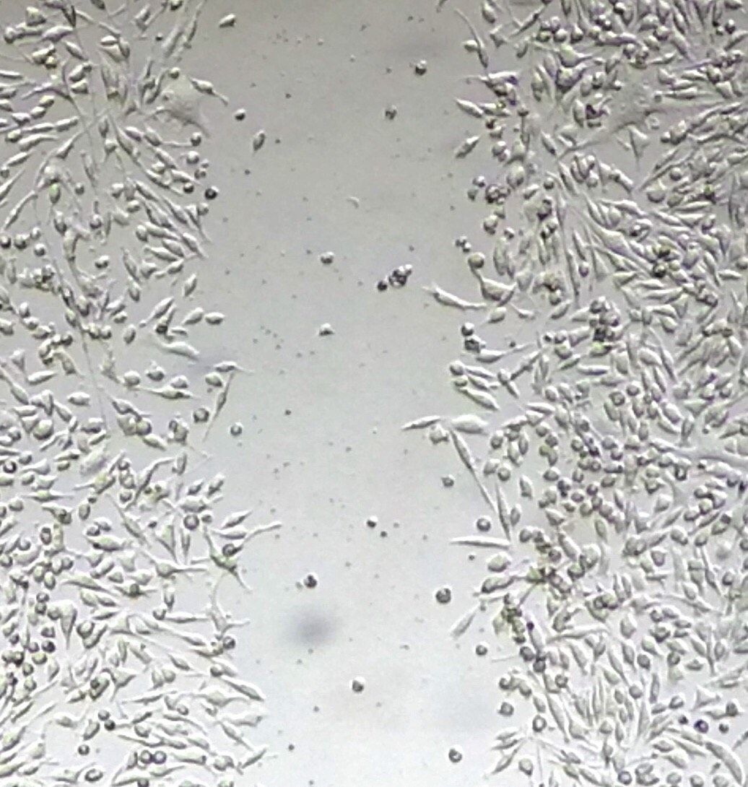
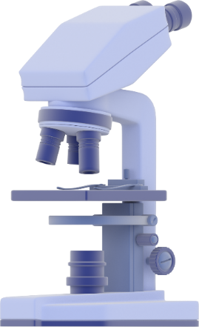
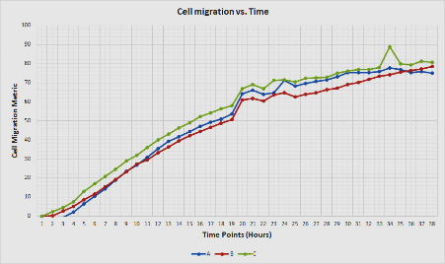
Workflow of the wound healing assay
1. Cell Culture
  Cell seeding
  Confluent monolayer
3. Data Acquisition
  Image capturing
  Gap measurement
  Data collection
2. Scratch Making
Data Analysis

Slide 18
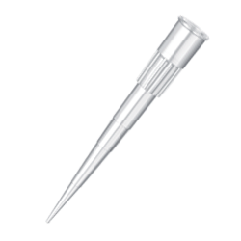
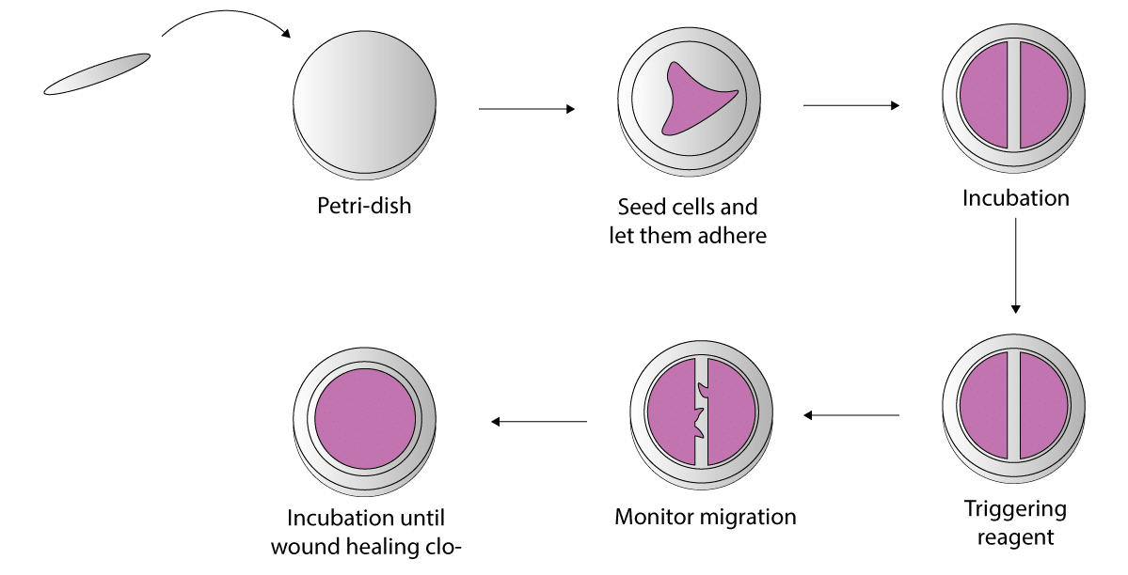
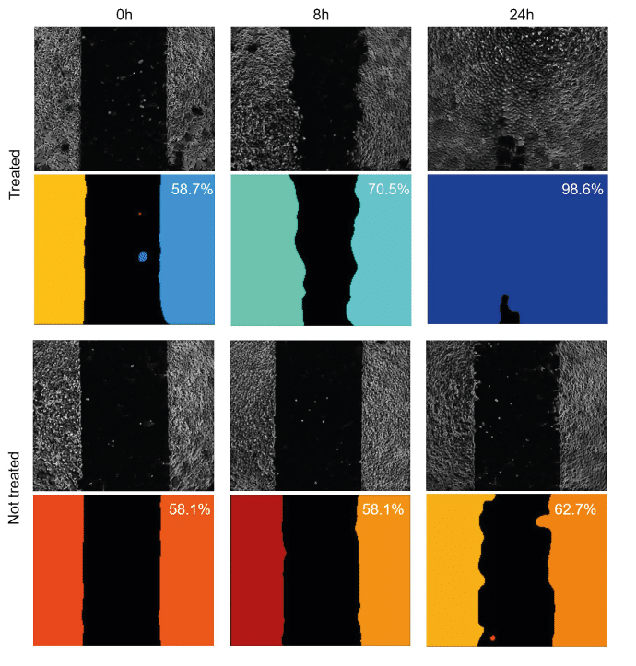
Workflow of the wound healing assay

Slide 19
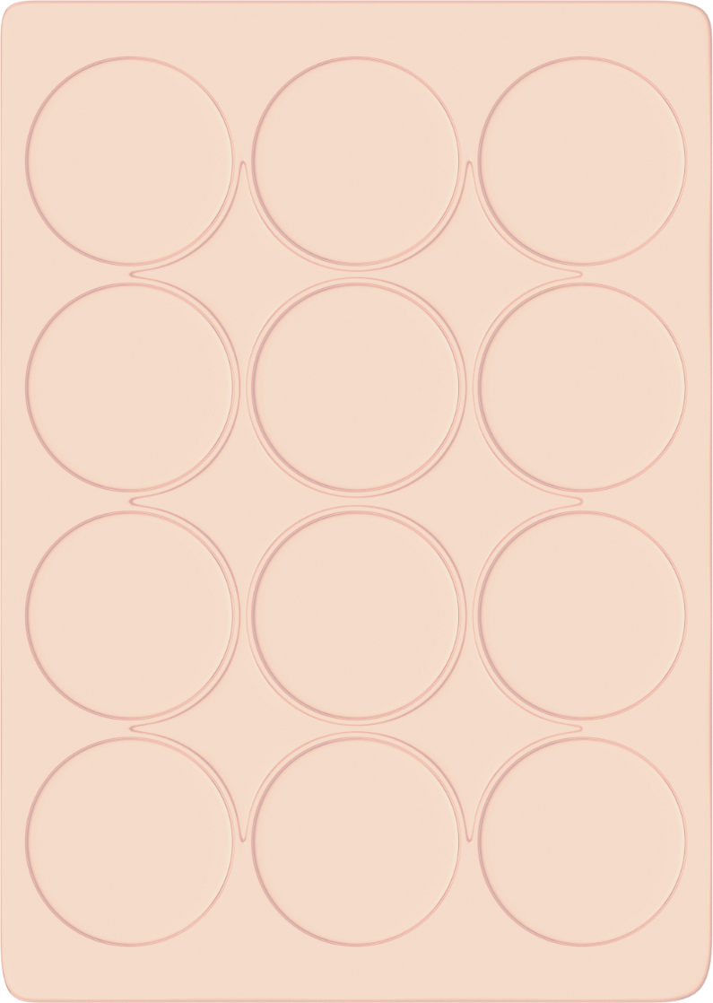
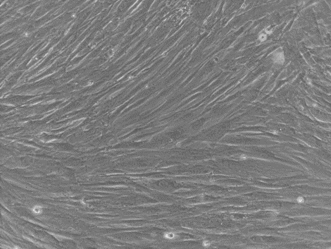
Cell Culture
Triplicates
The first step of the assay is to
culture a confluent cell monolayer.
This monolayer represents the in vivo conditions of the tissue before wounding such as, an intact epithelium.
Sample A
Sample B
Sample C
cell proliferation can be a confounding factor.
Cell proliferation can compete with cell migration to fill the gap made during the assay. If this occurs, the cell medium can be optimized to reduce cell proliferation.
Decreasing the concentration of serum (serum starvation) is the most common change.
Seed your cells in multi-well plates and incubate until they form near-confluent monolayers

Slide 20
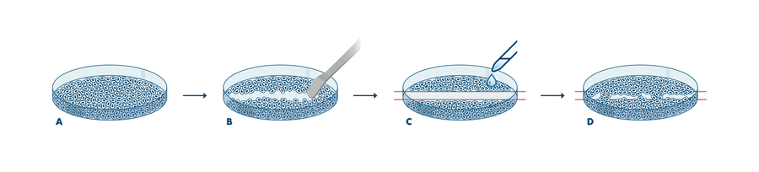
Scratch-making
After the cells have become confluent, the next step is to make a cell-free gap in the monolayer. The most frequently used method is to wound the monolayer by mechanical scratching (scratch wound) or stamping.
Drawbacks with the manual method of wounding include low throughput and well-to-well variation of the gap width.

Slide 21
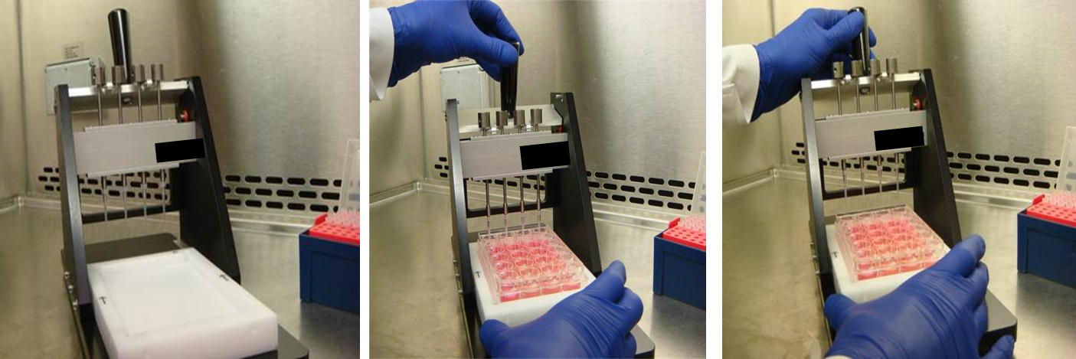
Scratch-making
This reproducibility can be improved with the use of commercial tools for making uniform gaps. Modifications to the wound healing assay that make use of automation can increase both throughput and improve reproducibility.
Ensuring reproducibility is important for the following data acquisition step.
To enhance reproducibility, a scratch-making device creates identical linear scratches in all wells.

Slide 22
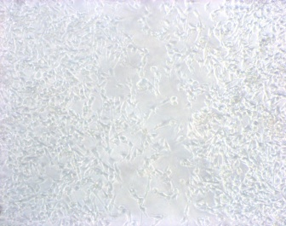
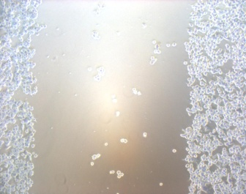
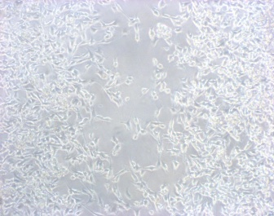
Migration
(Wound Healing Migration Assay)
CONTROL
TIME 0
Time 48 Hrs
*
Notes:
22

Slide 23
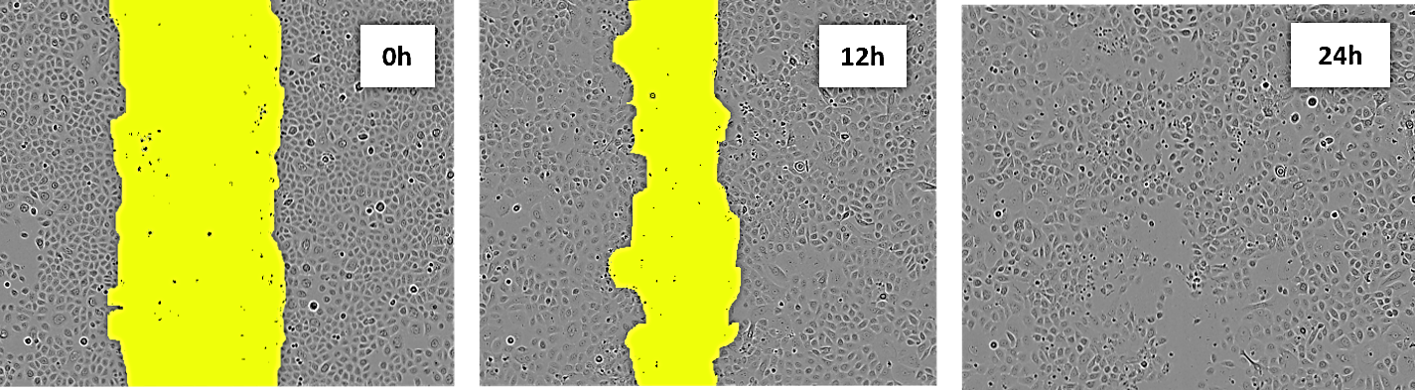
Data acquisition – scratch images for time-lapse
With a cell-free gap prepared, optical microscopy can be used to observe cells migrating into the wound area.
Cell migration is best viewed using phase-contrast imaging rather than fluorescence,
Collective migration of human skin cells in vitro. Example of images captured during a wound healing experiment. Keratinocyte monolayers were scraped with a pipette tip and images were taken at 0, 12, and 24 h using time-lapse photography as the cells repopulate the scratch area “wound” in the center.
The yellow color indicates the scratch area

Slide 24
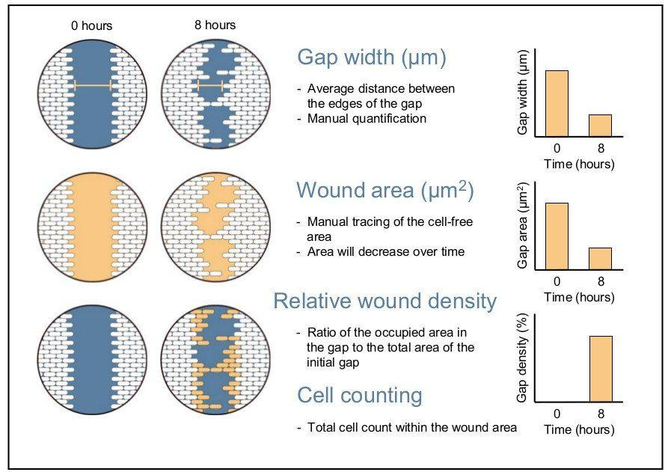
Data Analysis
Once images of the gap closing have been acquired, several methods of analysis can be used to quantify the rate of cell migration.
The first method measures the change in the wound width
The second method calculates the change in wound area over time as a percentage of wound closure.
The final method measures the relative wound density over time expressed as a percentage

Slide 25
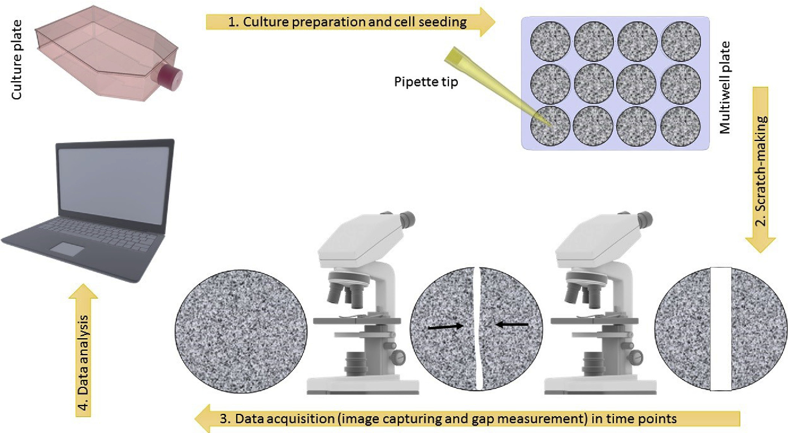
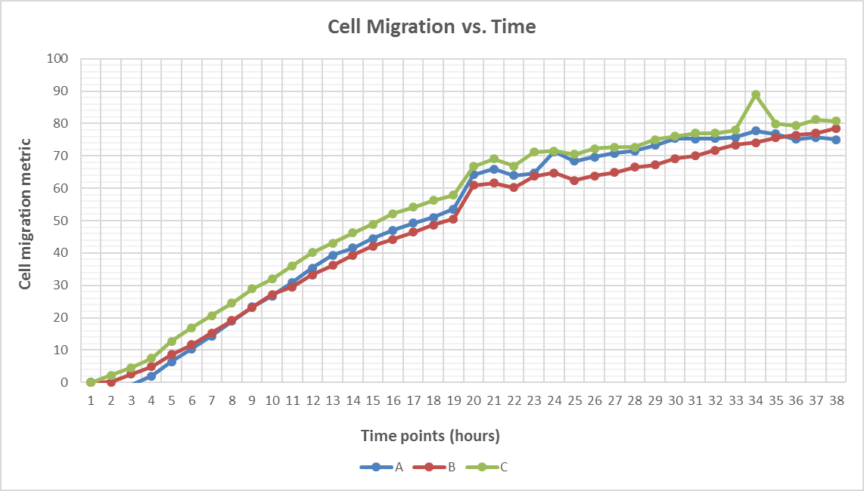
Data acquisition – scratch images for time-lapse
A series of time-lapse images (snapshot method) can be acquired as cells migrate into the cell-free gap.
These time points should be collected within 24 hours of the experiment being started to minimize the confounding effects of cell replication on gap closure.

Slide 26
Applications
Qualitative and Quantitative analysis of collective cell migration under different experimental conditions.
Studying the effects of cell-matrix and cell-cell interactions on cell migration.
High-throughput platforms for genes involved in cancer cell migration, small molecule screening and drug discovery.

Slide 27
Advantages
Relatively inexpensive and easy to perform
Can visually observe cell movement and morphology throughout the experiment
Testing conditions can be easily adjusted for different purposes
Creates a strong directional migratory response
Ability to coat assay surface with an appropriate extracellular matrix (ECM)
Suitable for endpoint and kinetic assays and amenable to high throughput screening platforms

Slide 28
Limitations
May not be suitable for studying specialized primary cells since a relatively large number of cells is required for the assay (performed in a tissue culture dish)
Not suitable for chemotaxis studies or for non-adherent cells
Lack of standardization in its application makes it difficult to reproduce experiments, especially when using manual scratching
Scratching introduces mechanical injury to the cells, leading to release of cellular contents into the surroundings and potentially influencing the migration process
Cell proliferation may confound the measurement of migration. Therefore, suppression of proliferation is a necessary intervention.

Slide 29
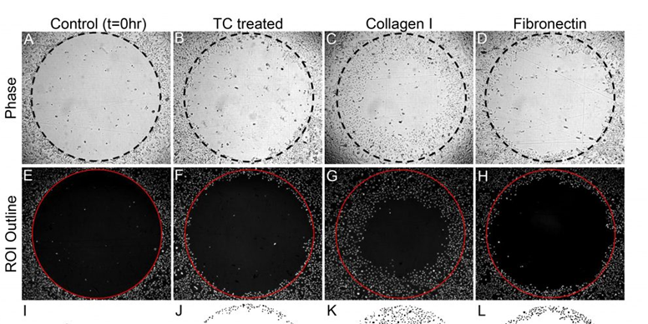
Cell exclusion zone assay
A possibility to circumvent the problem of cell remnants is to create cell exclusion zones at the time of cell seeding with e.g. microstencils
These stoppers are positioned prior to seeding of the cells and create an exclusion zone with the tip of the stopper

Slide 30
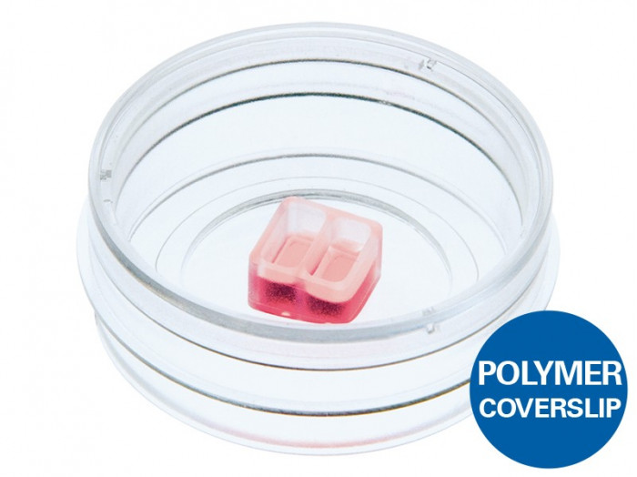
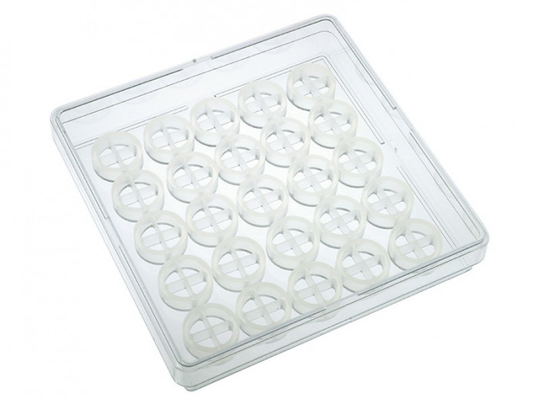
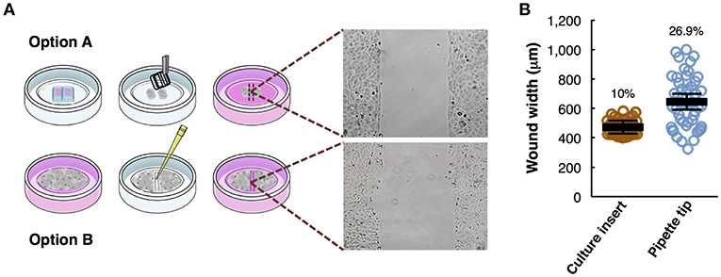
Video Wound healing
TEC_CELL_02_Cell Migration_IBI_Wound

Slide 31
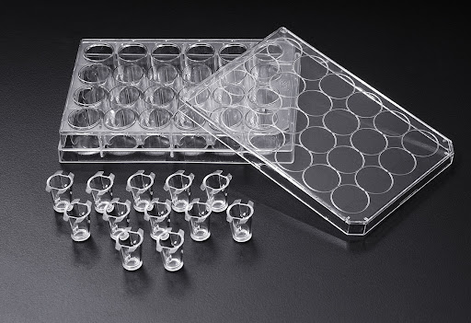
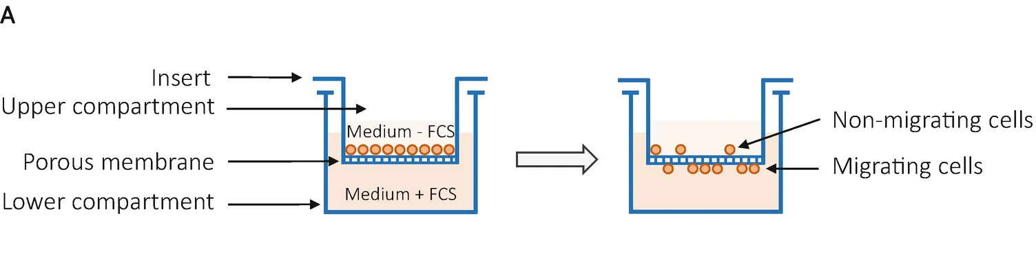
Transwell migration assay (Boyden chamber assay)
The transwell assay was originally introduced by Boyden (and is therefore often called Boyden chamber assay) to analyze the chemotactic responses of leukocytes.
Improved, simplified and disposable versions of the original chambers were developed.

Slide 32
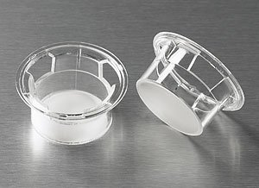
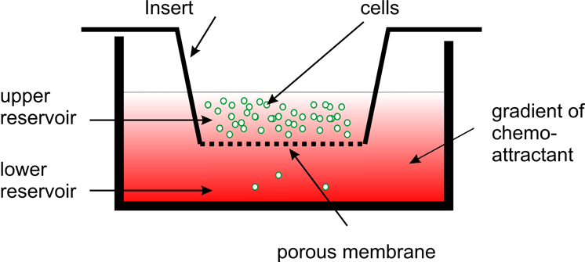
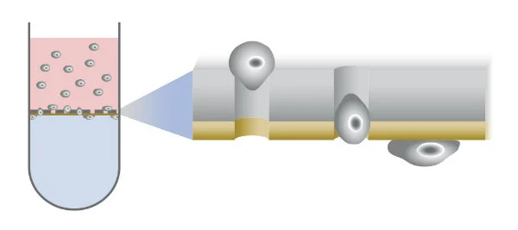
The principle of this assay is based on two medium containing chambers separated by a porous membrane through which cells transmigrate.
The size of the cells to be analyzed, determines the required pore size of the membranes.

Slide 33
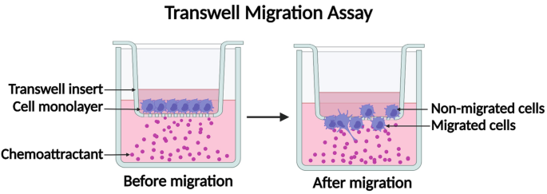


Cells are seeded in medium in the upper part
- migrate in vertical direction through the pores of the membrane into the lower compartment, in which medium containing an attractant or simply higher serum content is present.
Cell are stained and counted

Slide 34
The advantages of the method are:
the broad availability of different cell culture inserts and sizes;
the relative ease of the experimental setup and the – albeit only short – medium or cytokine/chemokine gradient between the upper (cell culture insert) and lower (culture vessel) growth medium.
there are some drawbacks
This method is an endpoint assay if simple cell staining procedures are used.
Non-invaded cells, which stayed on the upper side of the transwell insert, have to be eliminated prior to staining of the invasive cells at the bottom of the membrane.

Slide 35
Migration and invasion are clearly separated terms in experimental cell biology.
Migration is defined as:
the directed movement of cells on a substrate such as basal membranes, ECM fibers or plastic plates.
Therefore, migration is occurring on 2D surfaces without any obstructive fiber network
Invasion is defined as:
cell movement through a 3D matrix, which is accompanied by a
restructuring of the 3D environment.
Invasion requires adhesion, proteolysis of extracellular matrix components and migration, therefore invading cells remodel the ECM.

Slide 36

Transwell invasion assay
The principal technical setup of the transwell invasion assay equals the transwell migration assay.
In addition, the porous filter is overlaid by a thin layer of ECM, before seeding the cells into the top chamber .

Slide 37

Corning Matrigel matrix is a solubilized basement membrane preparation extracted from the Engelbreth-Holm-Swarm (EHS) mouse sarcoma, a tumor rich in extracellular matrix proteins
The primary components of Matrigel are four major basement-membrane ECM proteins:
laminin (~60%),
collagen IV (~30%),
entactin (~8%)
heparin sulfate proteoglycan perlecan (~2–3%)
Matrigel also contains tumour-derived proteins, including growth factors

Slide 38

During preparation, the reconstituted form of Matrigel undergoes gelation at temperatures in the range 22–37 °C, during which entactin acts as a crosslinker between the laminin and collagen IV to create a hydrogel — a water-swollen, crosslinked network.
Application
Cell Growth and Differentiation
Metabolism/Toxicology Studies
Invasion Assays
in vitro and in vivo Angiogenesis Assays
in vivo Angiogenesis Studies and Augmentation of Tumors in Immunosuppressed Mice

Slide 39
The ECM occludes the membrane pores, blocking non-invasive cells from migrating through.
By contrast, invasive cells can degrade the matrix and move through the ECM layer and adhere to the bottom of the filter

Slide 40
Matrigel basement membrane matrix
Collagen I
Collagen IV
Fibrinogen
Fibronectin
Laminin
Bovine Serum Albumin (BSA)

Slide 41

Viability and Proliferation Assays
Viability and proliferation are two distinct characteristics of cells.
Viability is a measure of the number of living cells in a population
proliferation is a measure of cell division.
It should be noted that not all viable cells divide. Although proliferation can readily be interpreted as viability, absence of proliferation should not automatically be taken as a sign of cell death.

Slide 42

MTT Cell Proliferation Assay
Measurement of cell viability and proliferation forms the basis for numerous in vitro assays of a cell population’s response to external factors
The yellow tetrazolium MTT
(3-(4, 5-dimethylthiazolyl-2)-2, 5-diphenyltetrazolium bromide)
is reduced by metabolically active cells into
intracellular purple formazan

Slide 43

The reduction of tetrazolium salts is now widely accepted as a reliable way to examine cell proliferation.

Slide 44



MTT Cell Proliferation Assay
Measurement of cell viability and proliferation forms the basis for numerous in vitro assays of a cell population’s response to external factors
The reduction of tetrazolium salts is now widely accepted as a reliable way to examine cell proliferation.
The yellow tetrazolium MTT (3-(4, 5-dimethylthiazolyl-2)-2, 5-diphenyltetrazolium bromide) is reduced by metabolically active cells
The resulting intracellular purple formazan can be solubilized and quantified by spectrophotometric means.

Slide 45



The MTT Cell Proliferation Assay measures:
- the cell proliferation rate
- conversely, when metabolic events lead to apoptosis or necrosis, the reduction in cell viability
PER MISURARE LA CRESCITA CELLULARE
PER MISURARE LA CITOTOSSICITÀ

Slide 46


https://www.thermofisher.com/it/en/home/life-science/cell-analysis/cell-viability-and-regulation/cell-proliferation.html

