Slide 1
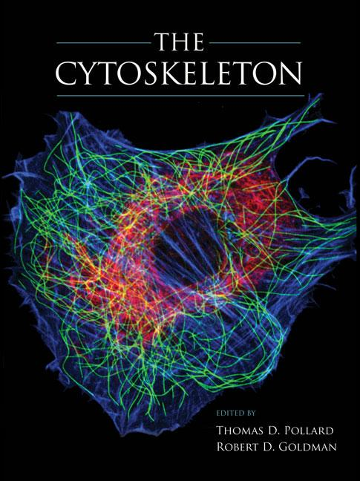
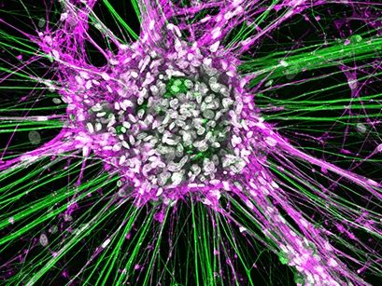
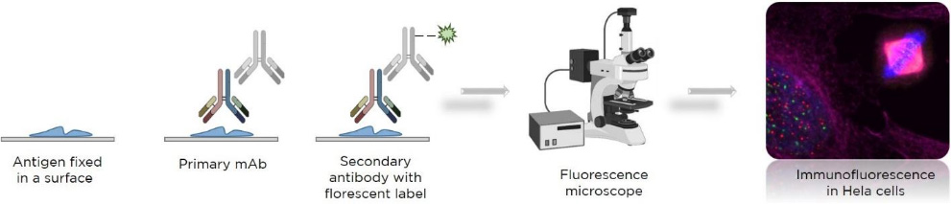

Slide 2
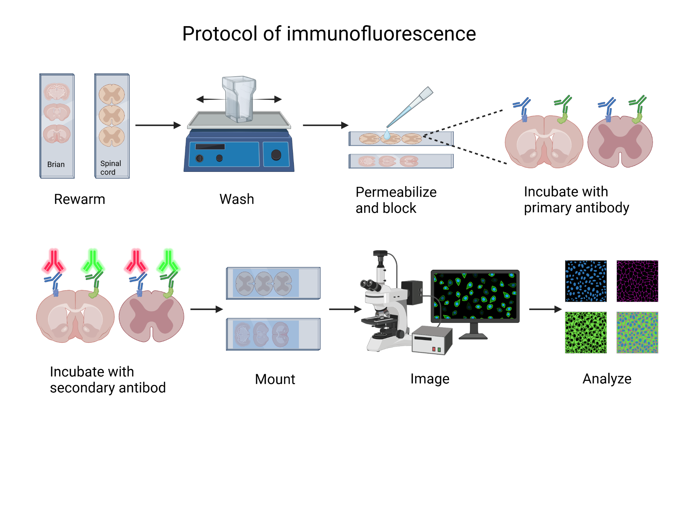

Slide 3
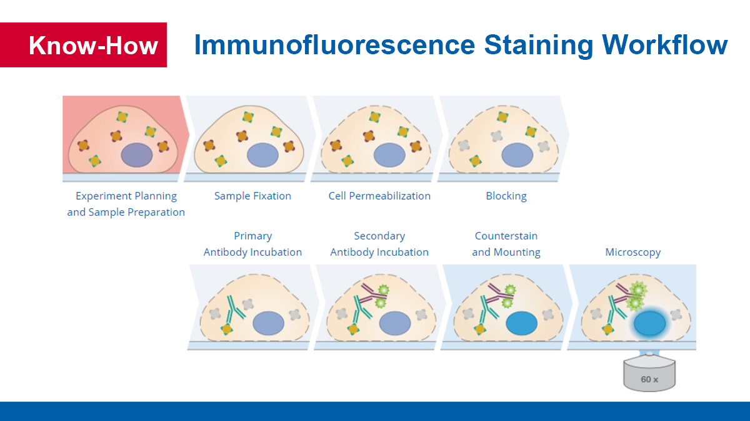

Slide 4
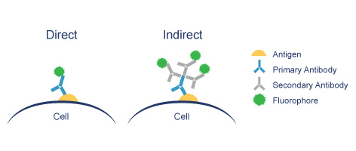
Fluorescence Microscopy
Major Function: Localization of specific cellular molecules – example proteins
Major Advantages:
Sensitivity:“glow” against dark background
Cells may be fixed or living
Fluorescent dyes or proteins (Flurochromes)
flurochromes may be indirectly or directly associated with the cellular molecule
Multiple flurochromes may be used simultaneously

Slide 5
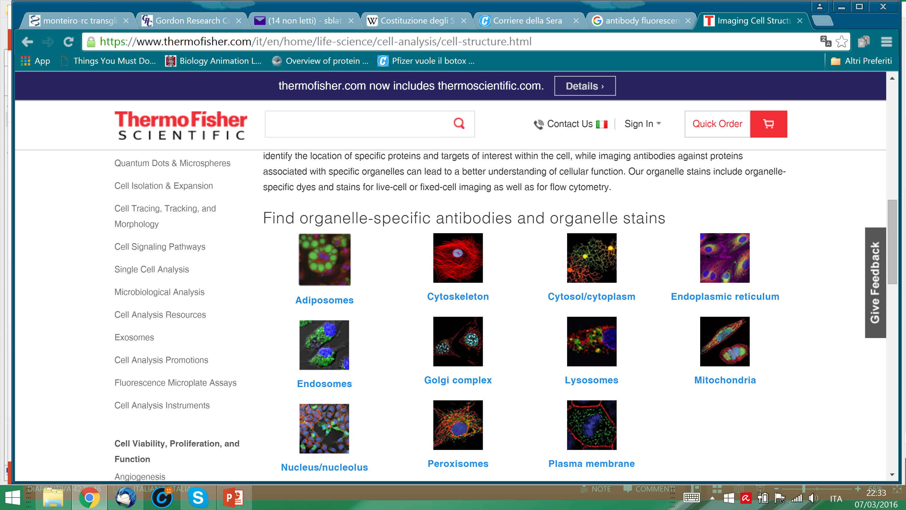

Slide 6
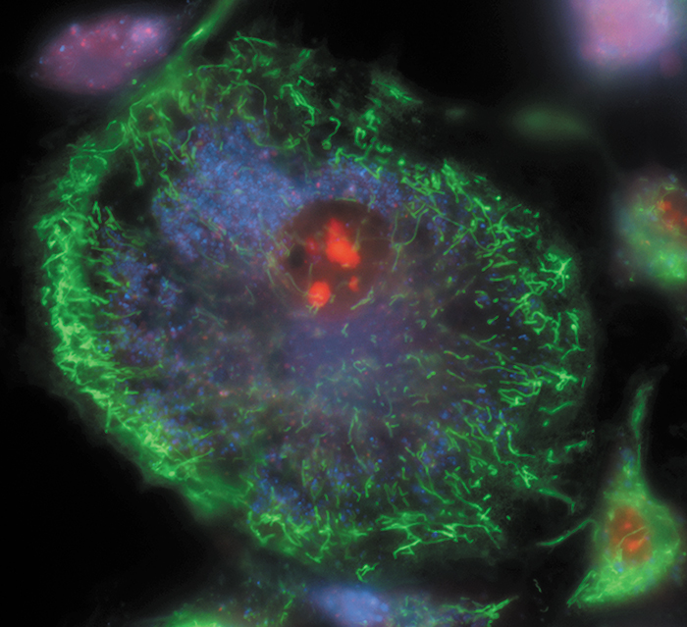
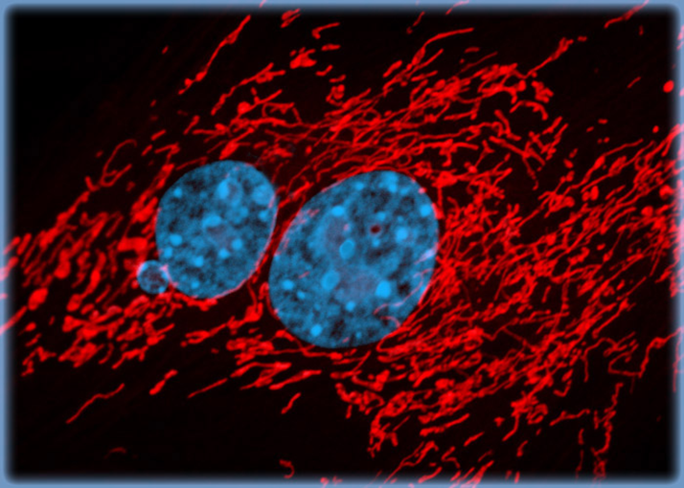
MitoTracker® probes for live cells
MitoTracker® probes are cationic dyes that are selectively sequestered by mitochondria in live cells because of their charge—like other mitochondrial dyes, they depend on the membrane potential for loading

Slide 7
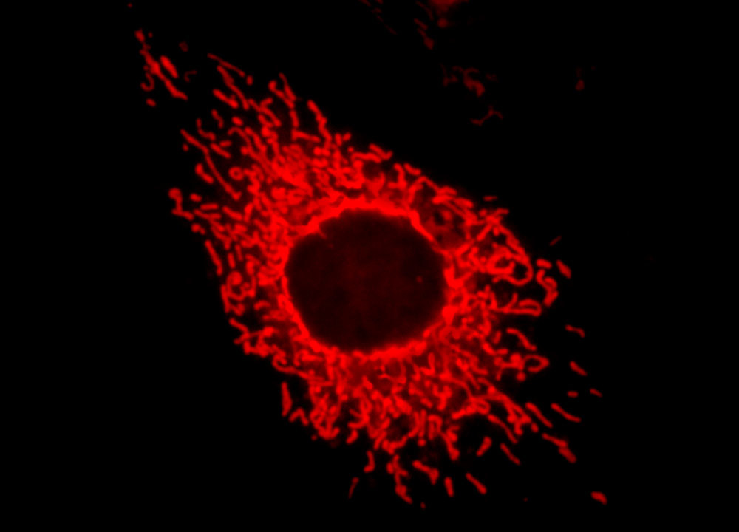
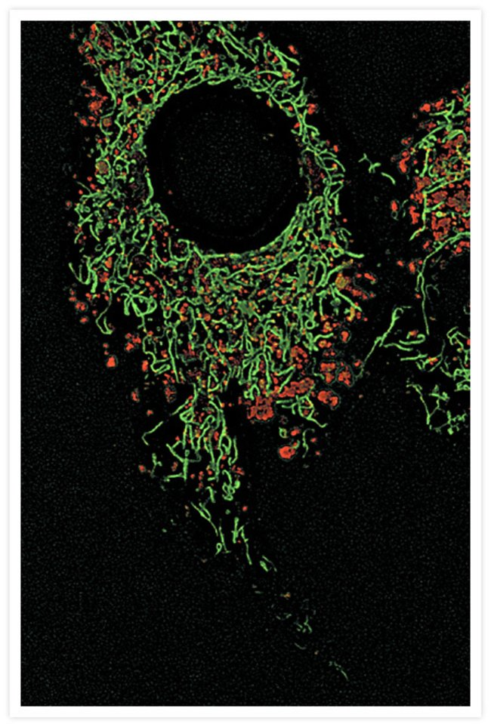
MitoTracker dyes are cationic fluorophores that accumulate electrophoretically into mitochondria in response to the highly negative mitochondrial membrane potential.
However, unlike rhodamine MitoTracker dyes possess a reactive chloromethyl group that forms a covalent bond with thiols on proteins and peptides, which traps MitoTracker dyes within mitochondria.
Two of the more popular probes are MitoTracker® Deep Red and MitoTracker® Green.

Slide 8
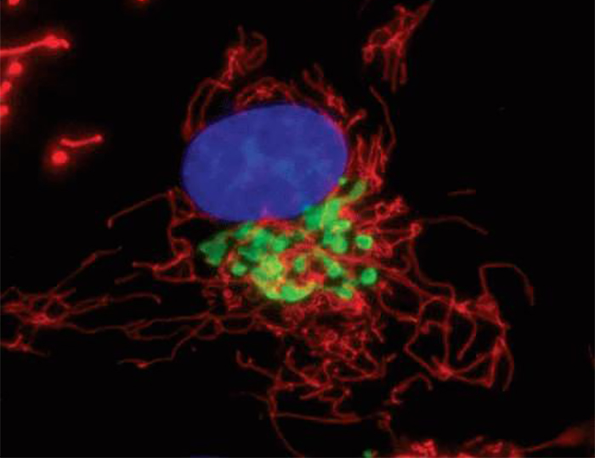
CellLight® reagents for Golgi complex
Use CellLight® reagents when you want to label the Golgi complex in live cells to follow the dynamics of intracellular behavior.

Slide 9
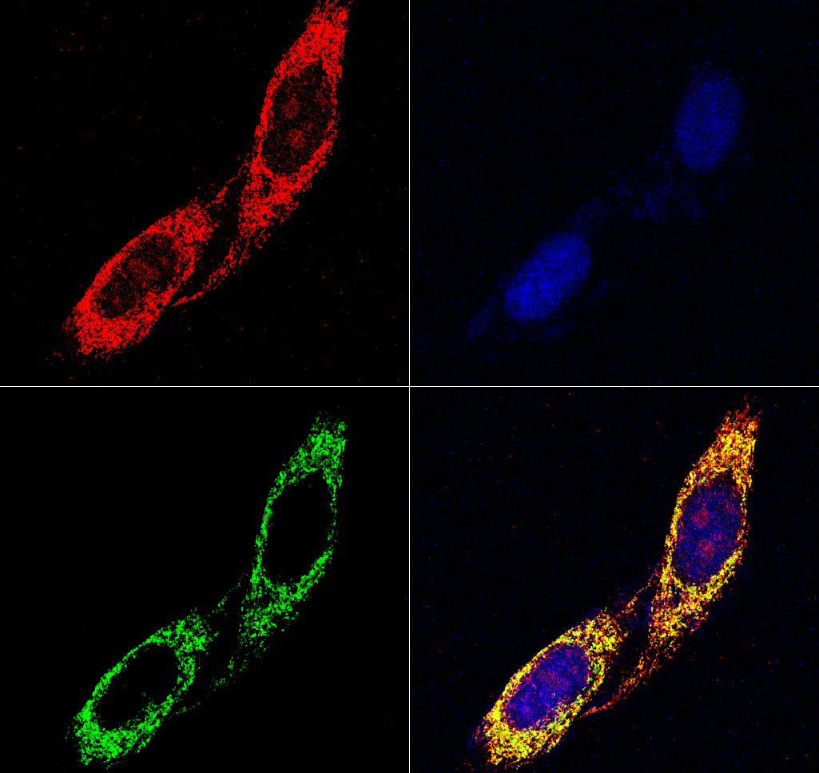
4
MitoTracker-Orange CMTMRos
4’,6-diamidino-2-phenylindole (DAPI)
TRAP1 Mouse Monoclonal
+ Goat anti-Mouse-FITC
Felts et al., JBC, 2000

Slide 10
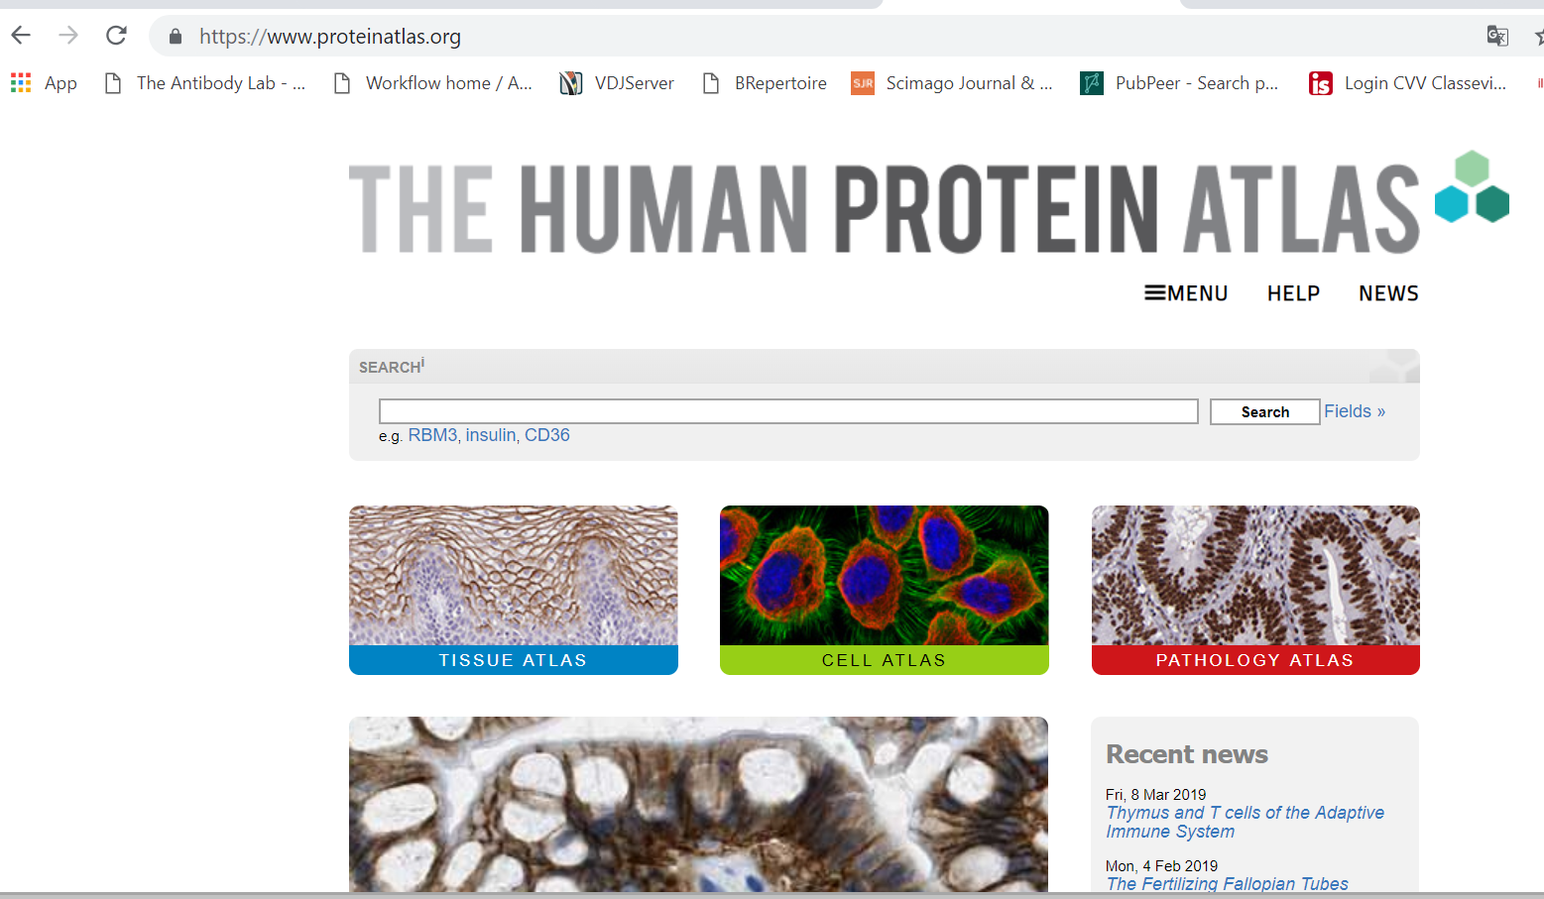

Slide 11
Causes of fluorescence and bioluminescence
Luciferase / luciferin
Fluorescent proteins
Also mediate color without fluorescence
Orange – phycoerythrin in red algae, cyanobacteria, some corals
Pigments

Slide 12
Fluorescent proteins

Slide 13
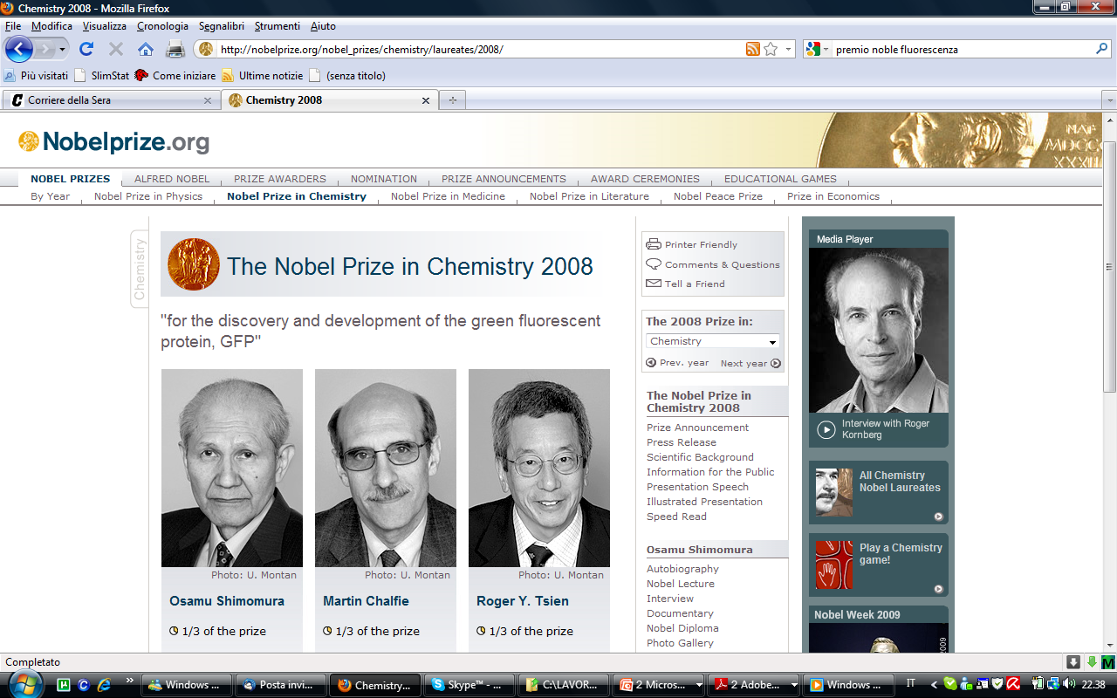

Slide 14
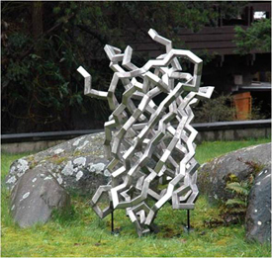

Slide 15
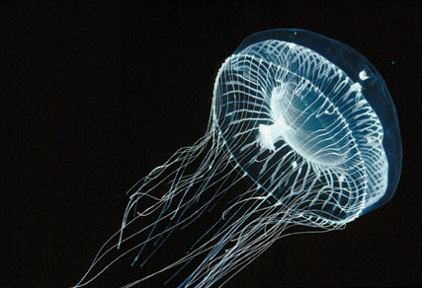
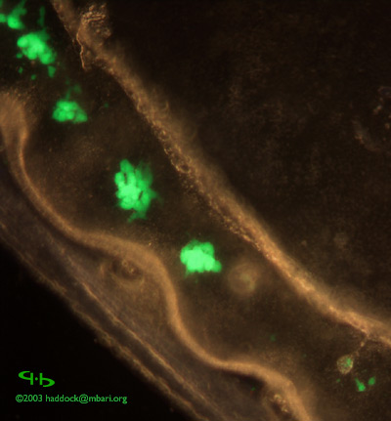
Where GREEN FLUORESCENT PROTEIN - GFP comes from

Slide 16
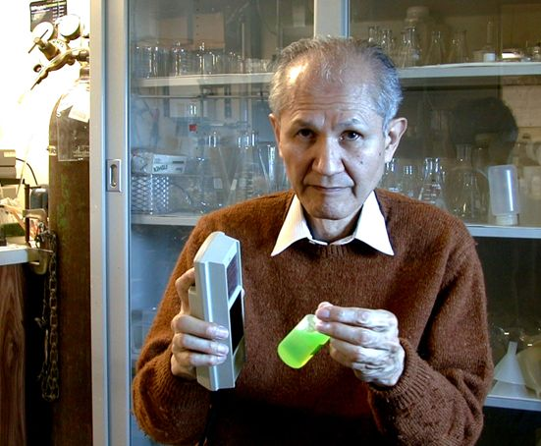
Osamu Shimomura (1928 - 2018)

Slide 17
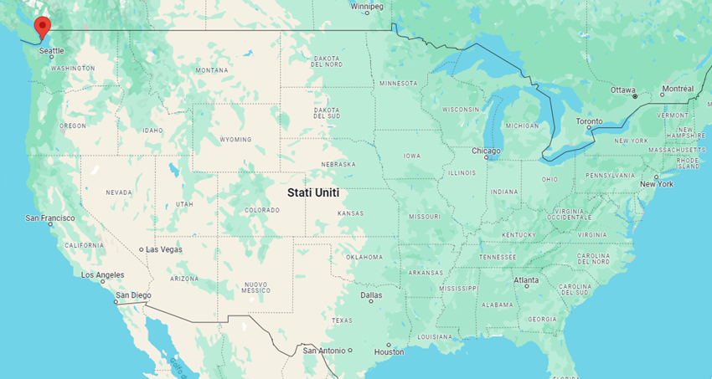
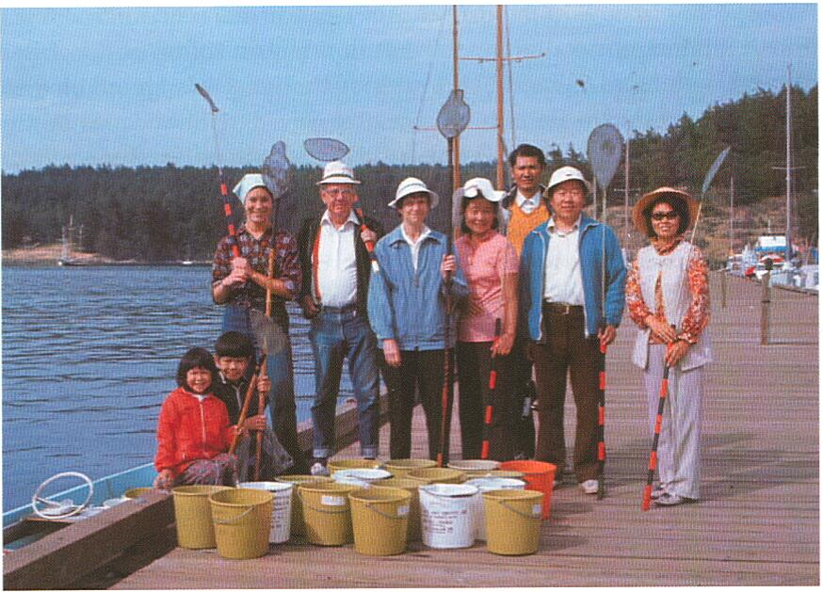
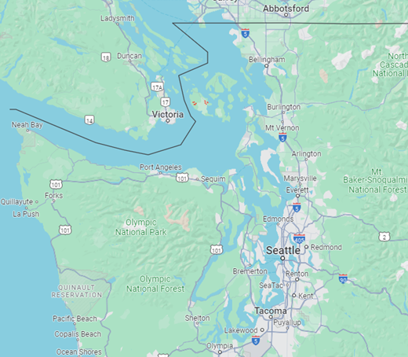
Over the summers of 19 years, Shimomura and co-workers collected 85.000 jellyfish off Friday Harbor in Washington on the West Coast of North America.
An undertaking it is difficult to contemplate in modern day science.

Slide 18
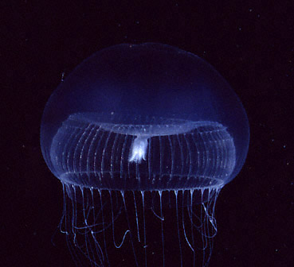
GFP natural function
Aequorin emits blue light in the presence of calcium
Aequorin binds to GFP
Blue light from Aequorin excites GFP and GFP emits green light
Ca2+
Aequorin
GFP

Slide 19
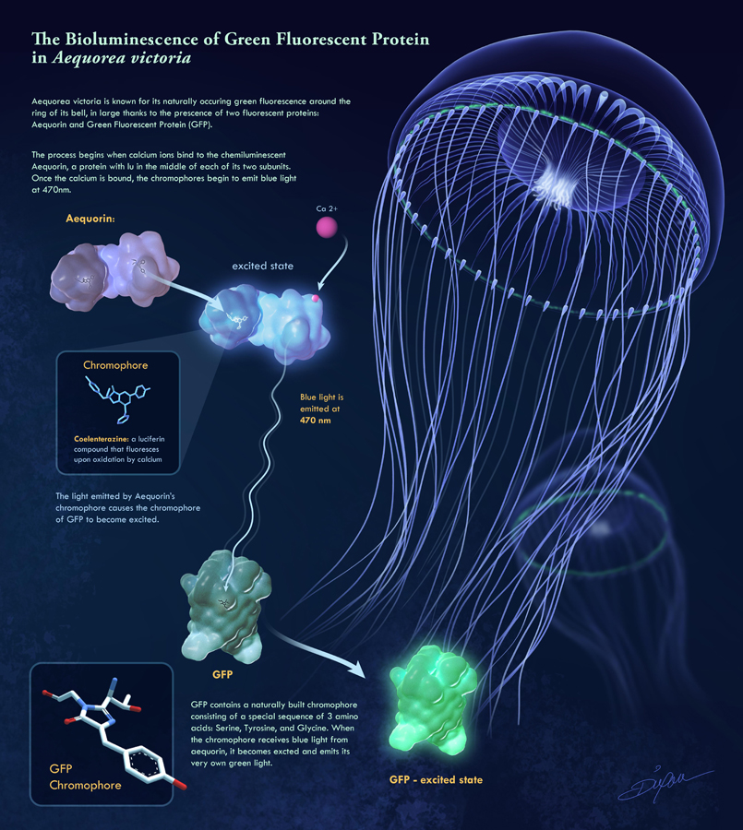

Slide 20
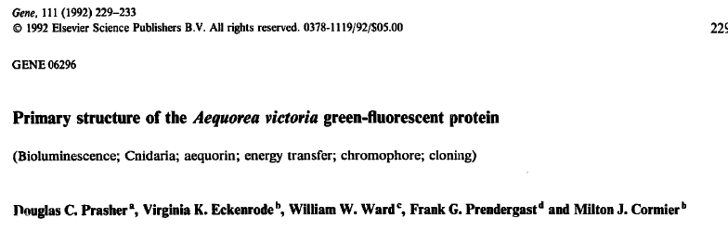
GFP
1962 - GFP purified from 10,000 jellyfish Aequorea victoria
1969 "Green protein" named green fluorescent protein.
1992 - sequence of GFP published in Gene

Slide 21
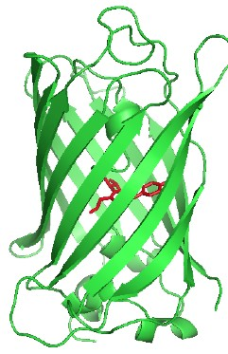
1994 - GFP gene sequence alone mediates fluorescence
No need for co-factors
Expressed in neurons
1995 - S65T mutation discovered
Improved emission
1996 - structure determined
1996 - Improved version evolved by DNA shuffling
1999 - fluorescent proteins from coral

Slide 22
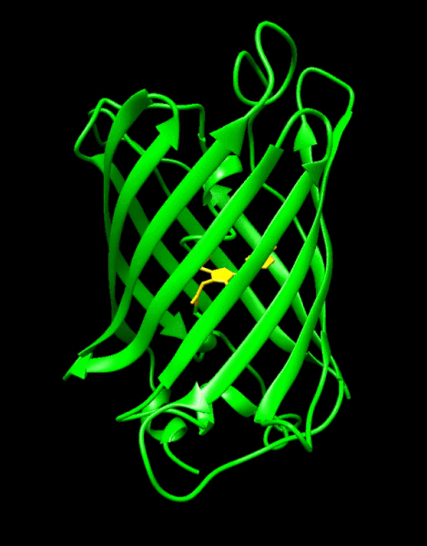
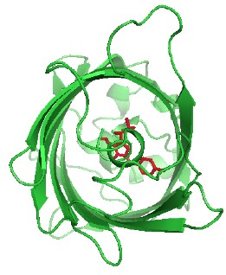
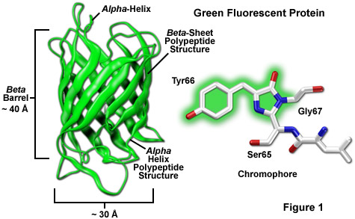
GFP properties
239 aa, 28 kDa
11 stranded beta can
6 loops at each end
Chromophore protected from Outside
Chromophore forms alone

Slide 23
GFP structure
Stable: 10M urea, 85°C, pH 4-11
very well Expressed 80 mg / liter -> 5g / liter
Monomeric when expressed in cytoplasm
Can be dimeric at high concentrations
Folds slowly - t/2 5-50 minutes from denatured and preoxidised
Does not tolerate insertions
Stable chromophore requires no other cofactors
Detection limits (no. GFP molecules):
CHO 10,000 cytoplasm; 2,000 on surface
Bacteria 1,000 cytoplasm; 400 on surface

Slide 24
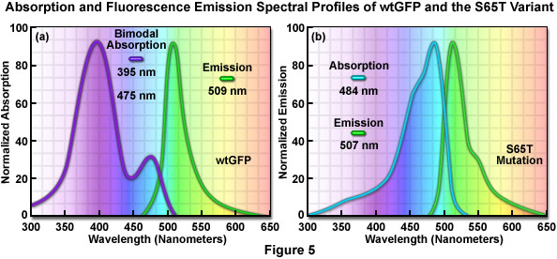
The original wt GFP had several major drawbacks that reduced its effectiveness as a tool for cell imaging.
- Its folding efficiency and thus fluorescent signal drops dramatically at physiologically relevant temperatures such as 37°C,
- its maturation rate is very slow and it had a strong tendency to aggregate.
- Two separate excitation peaks were also observed due to the coexistence of neutral (λex∼395 nm) and phenolate (λex∼475 nm) forms of the chromophore.
- Excitation at ∼475 nm was preferred as its lower energy is less damaging to the cell. However, the 475 nm excitation wavelength was only a minor contributor to fluorescence (∼15% compared to excitation at ∼395 nm).

Slide 25
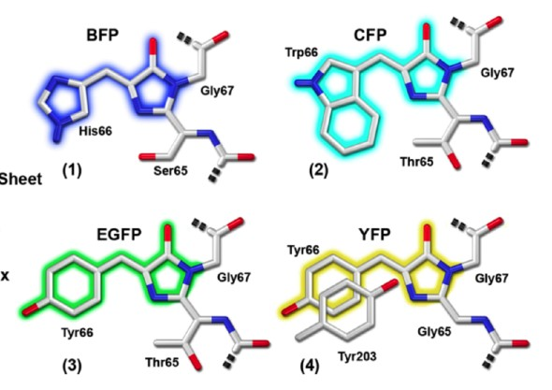
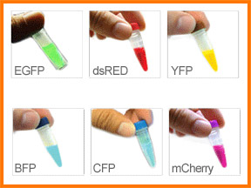
The excitation maximum of green fluorescent protein is readily shifted to 488 nanometers (in the cyan region) by introducing a single point mutation altering the serine at position 65 into a threonine residue (S65T).
This mutation is featured in the most popular variant of green fluorescent protein, termed enhanced GFP (EGFP),
This matched the spectral characteristics of commonly available FITC filter sets, increasing the practicality of use by the general researcher

Slide 26
GFP properties
239 aa, 28 kDa
11 stranded beta can
6 loops at each end
Chromophore protected from Outside
Chromophore forms alone

Slide 27
What about other colors
Mutate GFP to different colors
BFP - CFP - YFP
Look for other natural proteins, and mutate if necessary
dsRed, Fp611, mFruit series

Slide 28
Other colors based on GFP
Shaner et al.,. J Cell Sci 2007;120(Pt 24):4247-4260

Slide 29
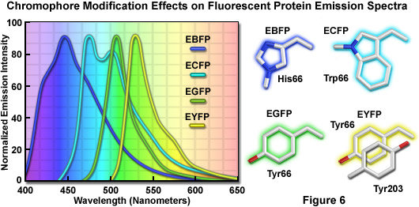

Slide 30
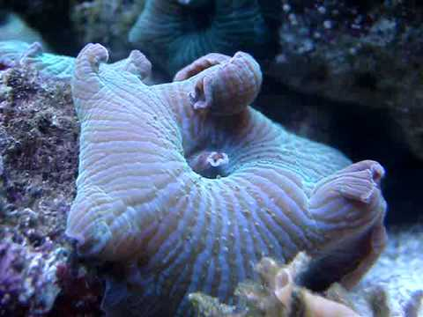
The construction of red-shifted mutants from the Aequorea victoria jellyfish green fluorescent protein beyond the yellow spectral region has proven largely unsuccessful,
investigators have turned their search to the tropical reef corals.
The first coral-derived fluorescent protein to be extensively utilized was derived from Discosoma striata and is commonly referred to as DsRed.

Slide 31
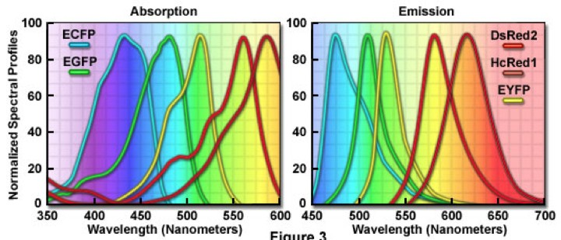
Excitation / emission curves

Slide 33
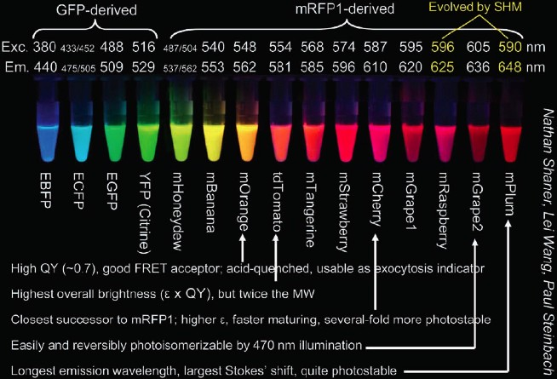
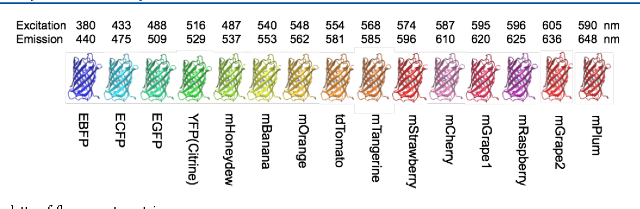
The fluorescent protein palette

Slide 34
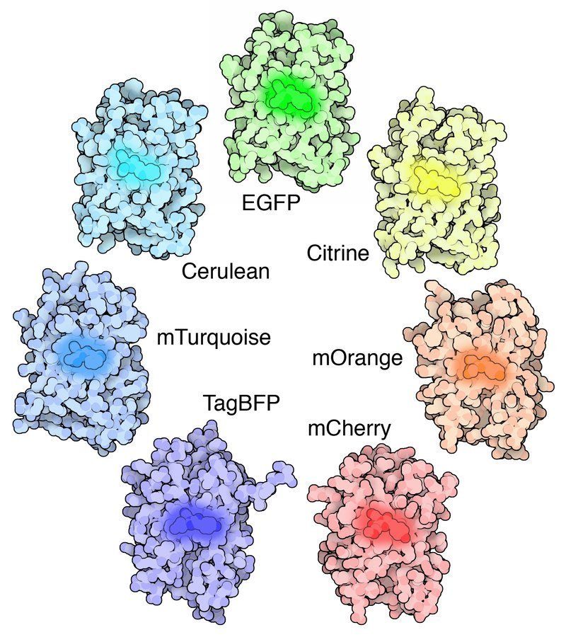
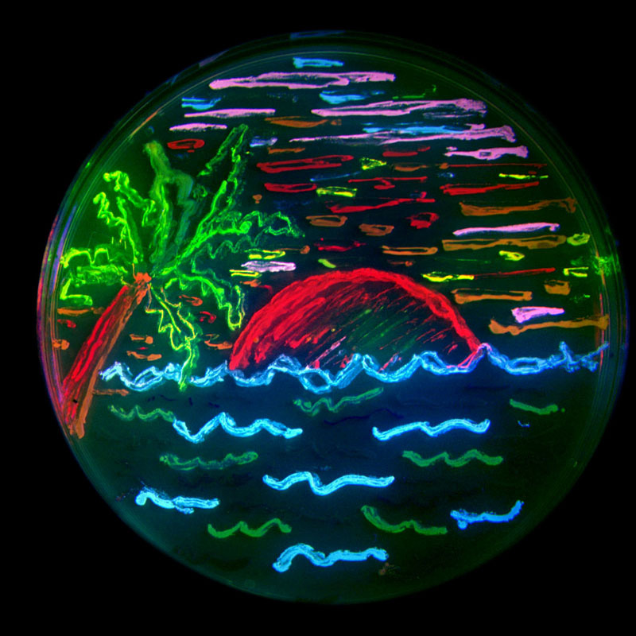
https://www.fpbase.org/

Slide 35
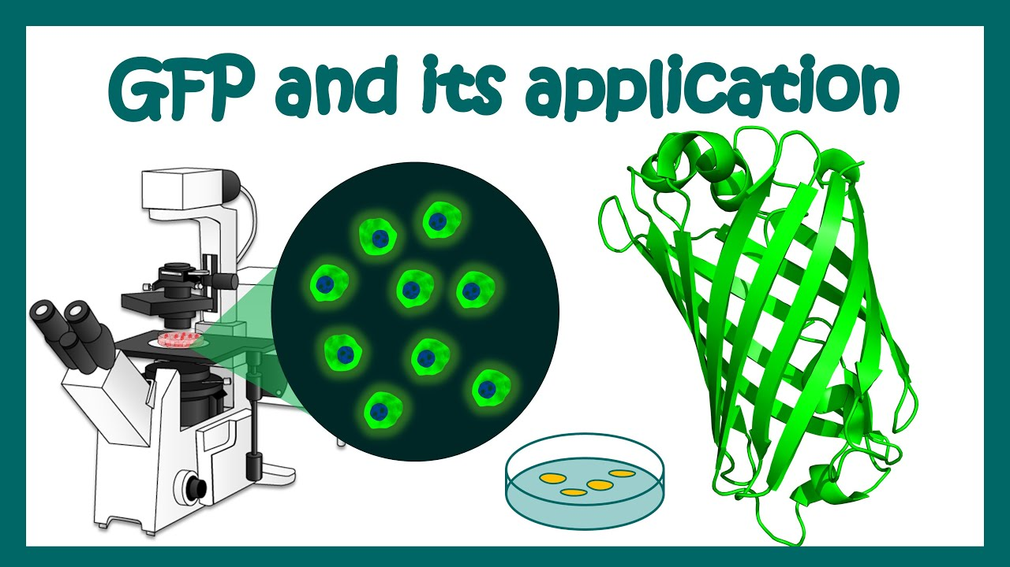
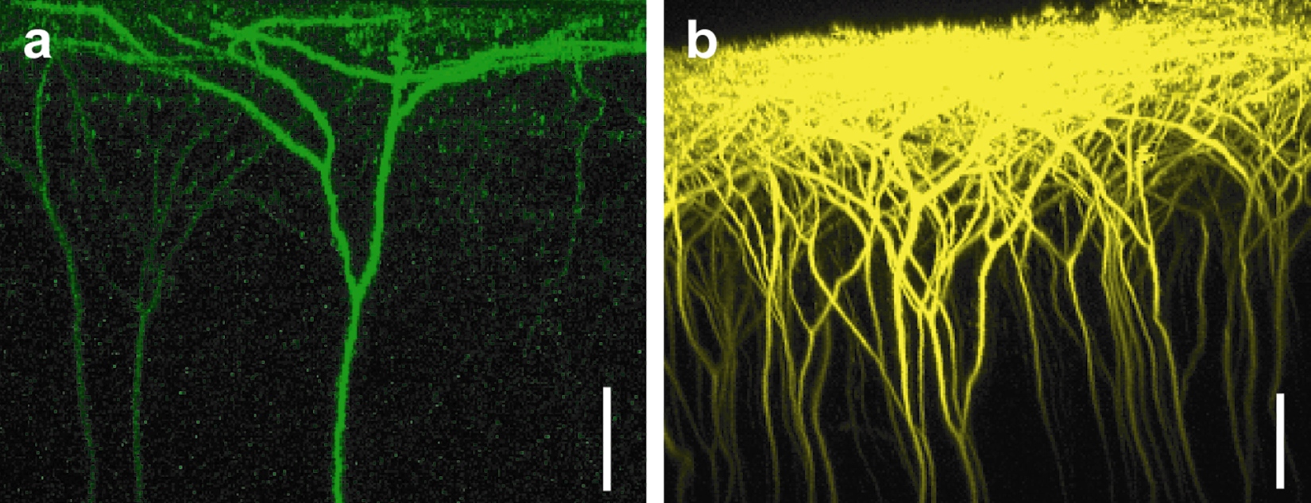
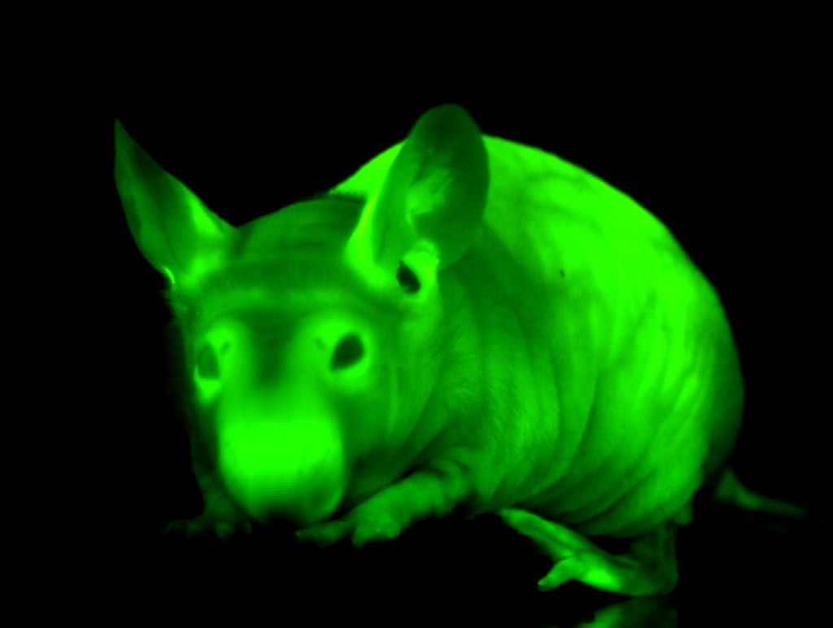
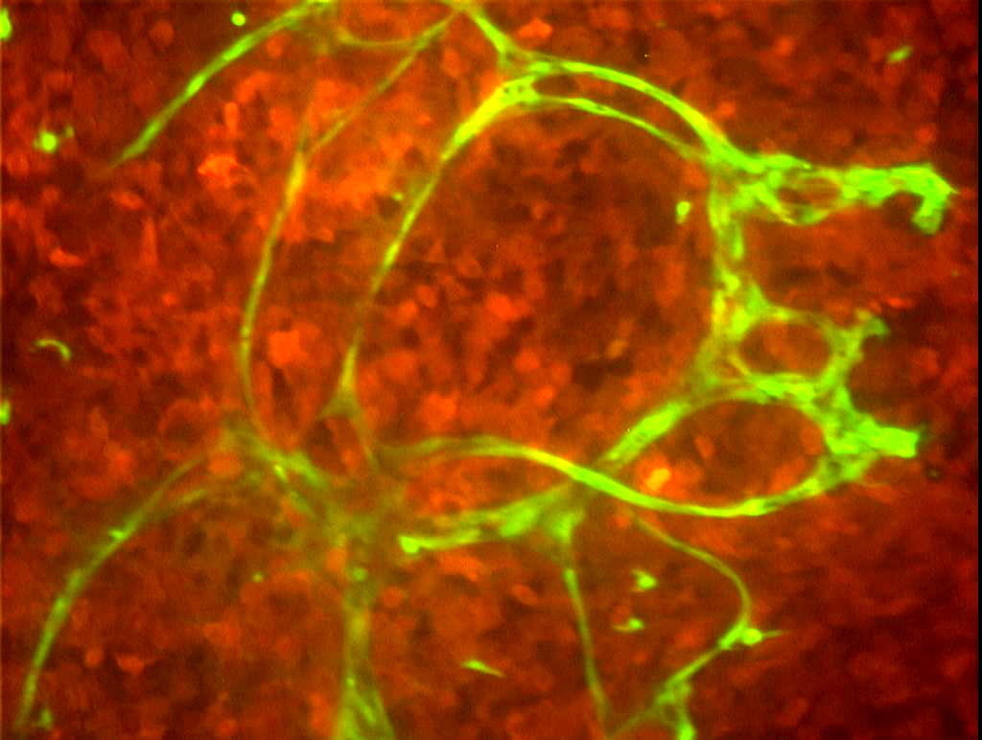
Fluorescent Protein in cell and Molecular biology
Fluorescent proteins are quite versatile and have been successfully employed in almost every biological discipline from microbiology to systems physiology.

Slide 36
Two ways to use fluorescent proteins
As gene reporter
As fusion-protein

Slide 37
Use of Green Fluorescent Protein (GFP)
As a reporter molecule to monitor gene expression
Transgenic organism made with the GFP-coding sequence
under the transcriptional control of the promoter belonging to the gene of interest

Slide 38
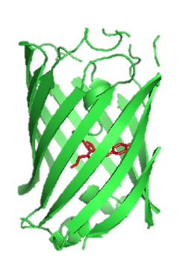
Gene A
Promoter
for gene A
Coding region
Can be used to
visualize the
expression of
Gene A
GFP-reporter gene construct
Promoter
for Gene A
Coding region for
GFP
Promoter for Gene A regulates the expression of GFP

Slide 39
Using fluorescent proteins as gene reporters
promoter
GFP gene
GFP expressed wherever original promoter is active

Slide 40
Using fluorescent proteins as gene reporters
promoter
GFP gene
GFP expressed wherever original promoter is active
Whole cell is fluorescent

Slide 41
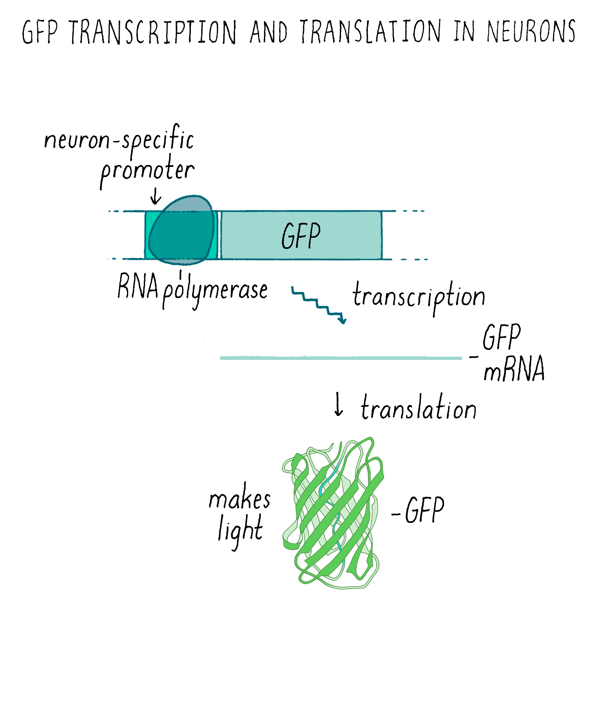
Using fluorescent proteins as gene reporters
GFP expressed wherever original promoter is active

Slide 42
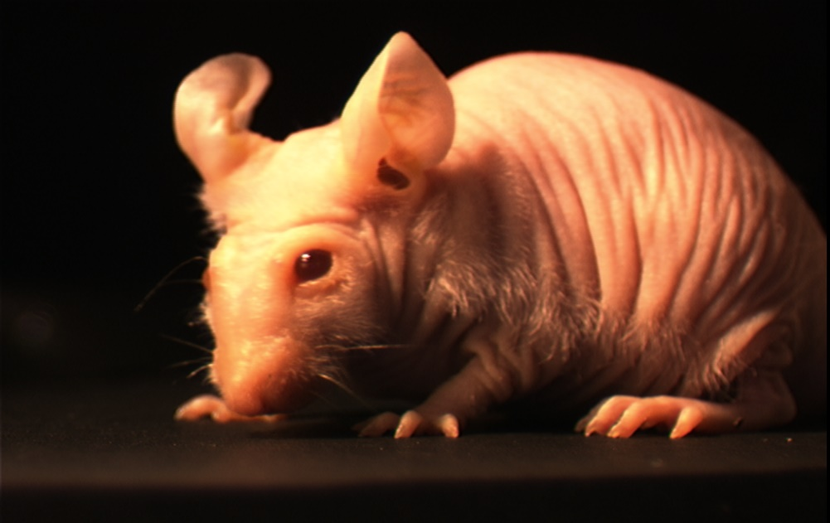
Transgenic GFP mice
Under normal light
Under blue light

Slide 43
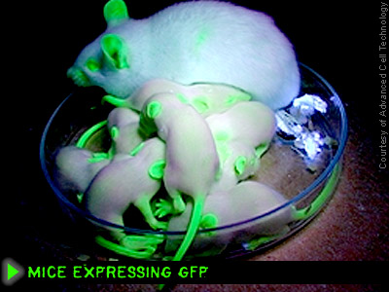
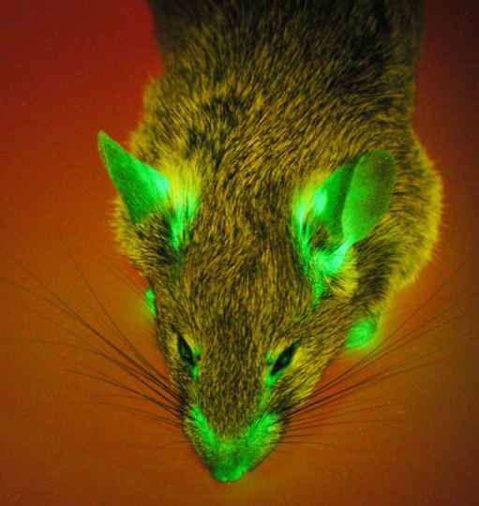

Slide 44
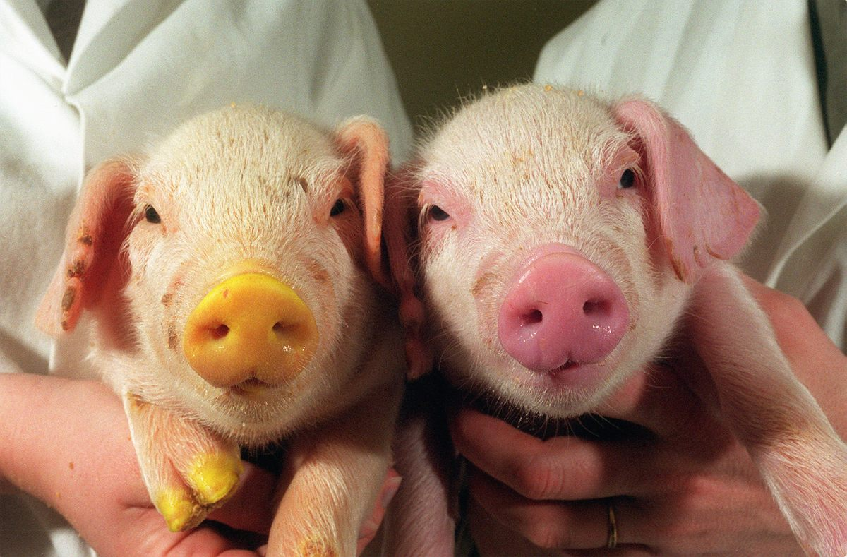
Transgenic pigs

Slide 45
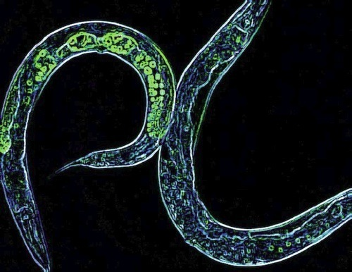

Slide 46

…and cats

Slide 47


Slide 48


Slide 49




…and fish
A
B
Red
Red
Orange
Orange
Yellow
Yellow
Green
Green
Wild Type
Wild Type
C
D

Slide 50


Slide 51



Mice with FP expressing tumors

Slide 52
Visualizing tumor angiogenesis
GFP expressing
blood vessels
RFP expressing tumor

Slide 53

In tissue culture cells

Slide 54


Slide 55

Individual neurons

Slide 56
The fluorescent protein palette

Slide 57


Slide 58

Use of Green Fluorescent Protein (GFP)
As a tag to localize proteins

Slide 59

Use of Green Fluorescent Protein (GFP)
As a tag to localize proteins
The GFP-encoding sequence is placed at the beginning or end of the gene for another protein
This yields a chimeric protein consisting of the protein of interest with a GFP domain attached
GFP-fusion protein often behaves like the original protein, directly revealing its subcellular location

Slide 60
Using fluorescent proteins as fusion proteins
promoter
Protein X
GFP gene
GFP- protein X Fusion
expressed wherever (original) promoter is active

Slide 61
Using fluorescent proteins as fusion proteins
promoter
Protein X
GFP gene
GFP- Fusion
expressed wherever (original) promoter is active

Slide 62
Three ways to make Green fluorescent protein “GFP” fusion constructs:
PROTEIN X
GFP
C-Ter Fusion
GFP
PROTEIN Y
N-Ter Fusion
PROTE-
GFP
-in Z

Slide 63

Clone protein HERE
PROTEIN X
GFP

Slide 64

Clone protein HERE
GFP
PROTEIN Y

Slide 65

How to Image Fluorescence
Exciter filter
Barrier filter
Excitation source
Imaging device

Slide 66
multiple fluorescent protein labeling in living cells using fusion products targeted at sub-cellular (organelle) locations.

Slide 67
Fig. 3. (A-L) Subcellular localization of selected monomeric FP fusions (listed in Table 1) with targeting proteins imaged in widefield fluorescence. Images are pseudocolored to match the FP emission profile.
(A) EBFP2-mito-N-7 (human cytochrome C oxidase subunit VIII; mitochondria);
(B)mCerulean-paxillin-N-22 (chicken;
focal adhesions);
(C) mTFP1-actin-C-7 (human _x0004_-actin; filamentous actin);
(D)mEmerald-keratin-N-17 (human cytokeratin
18; intermediate filaments);
(E) superfolder GFP-lamin B1-C-10
(human lamin B1; nuclear envelope);
(F) mVenus-Cx43-N-7 (rat _x0005_-1 connexin-43; gap junctions);
(G) YPet-EB3-N-7 YPet-EB3-N-7 (human microtubule-associated protein; RP/EB family
(H) mKO-Golgi-N-7 (Nterminal
81 amino acids of human _x0004_-1,4-
glactosyltransferase; Golgi complex);
(I) tdTomato-zyxin-N-7 (human zyxin;
focal adhesions);
(J) TagRFP-tubulin-C- 6 (human _x0005_-tubulin; microtubules);
(K)mCherry-vimentin-N-7 (human
vimentin; intermediate filaments);
(L)mPlum-_x0005_-actinin-N-19 (human nonmuscle; cytoskeleton).
M-Q) Fusion of mEGFP with human histone H2B (mEGFP-H2B-N-6). (M) interphase;
(N)prophase; (O) prometaphase;
(P)metaphase; (Q) anaphase.

Slide 68

Michael W. Davidson

