Slide 1
Luciferins and luciferases

Slide 2
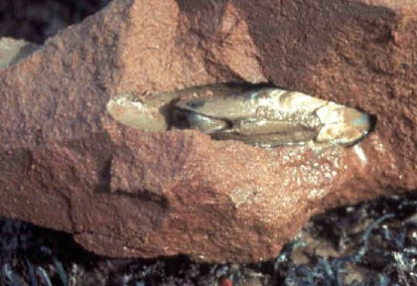
The common piddock
A fluorescent clam that drills its way into rock

Slide 3
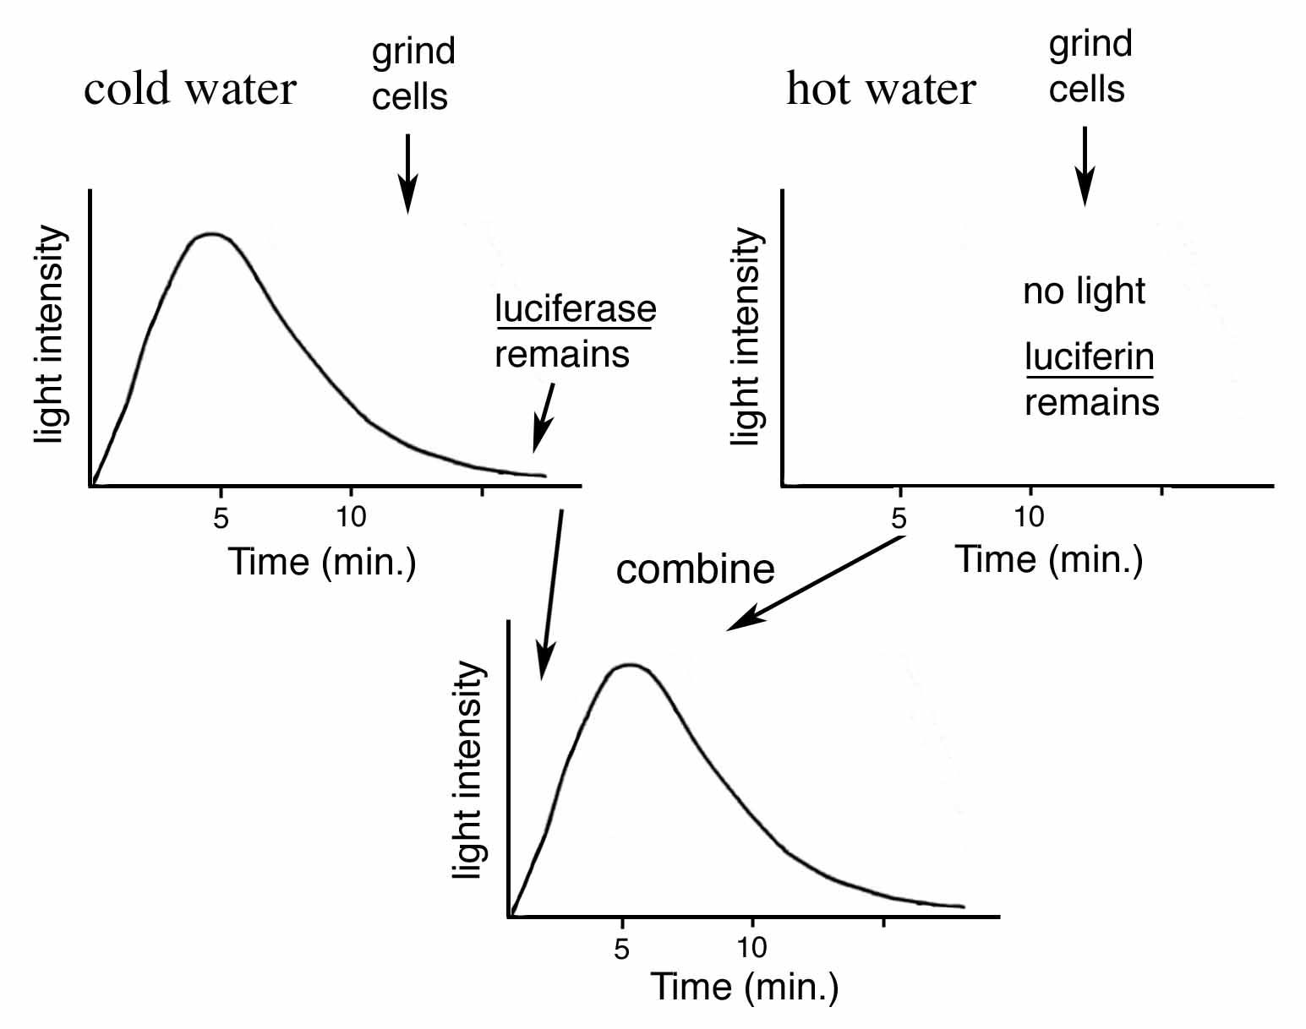
The luciferin (substrate) / luciferase (enzyme) reaction (Dubois 1885-7)
First carried out on the common piddock, then on firefly extracts

Slide 4
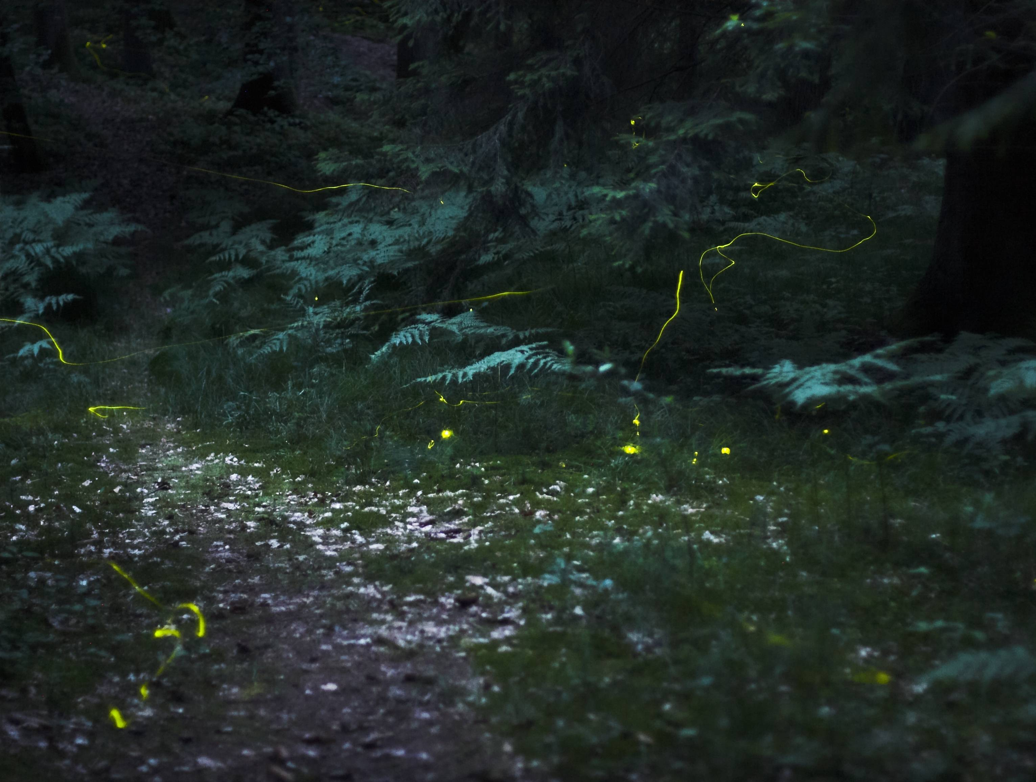
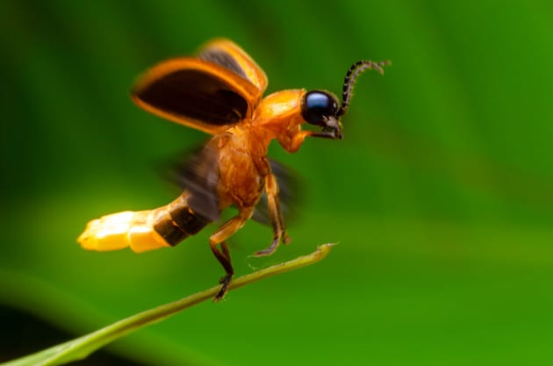

Slide 5
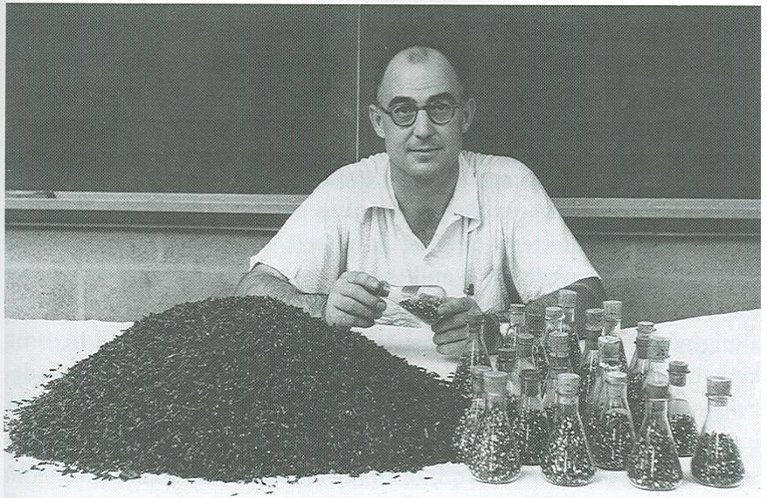
Understanding luciferase

Slide 6
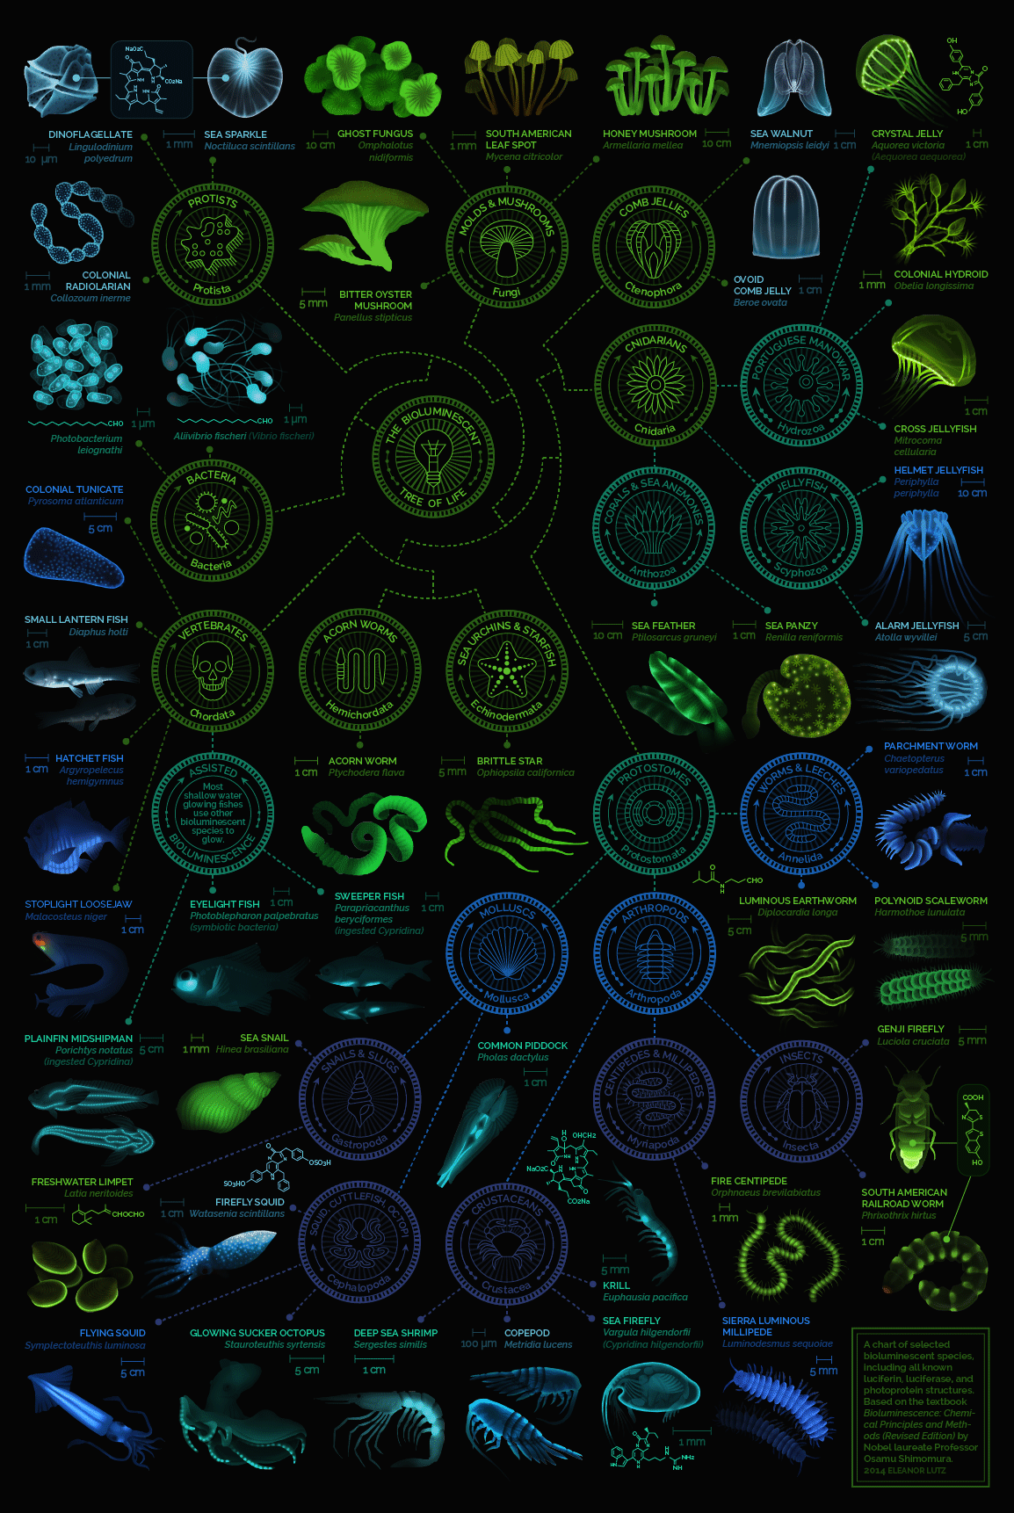

Slide 7
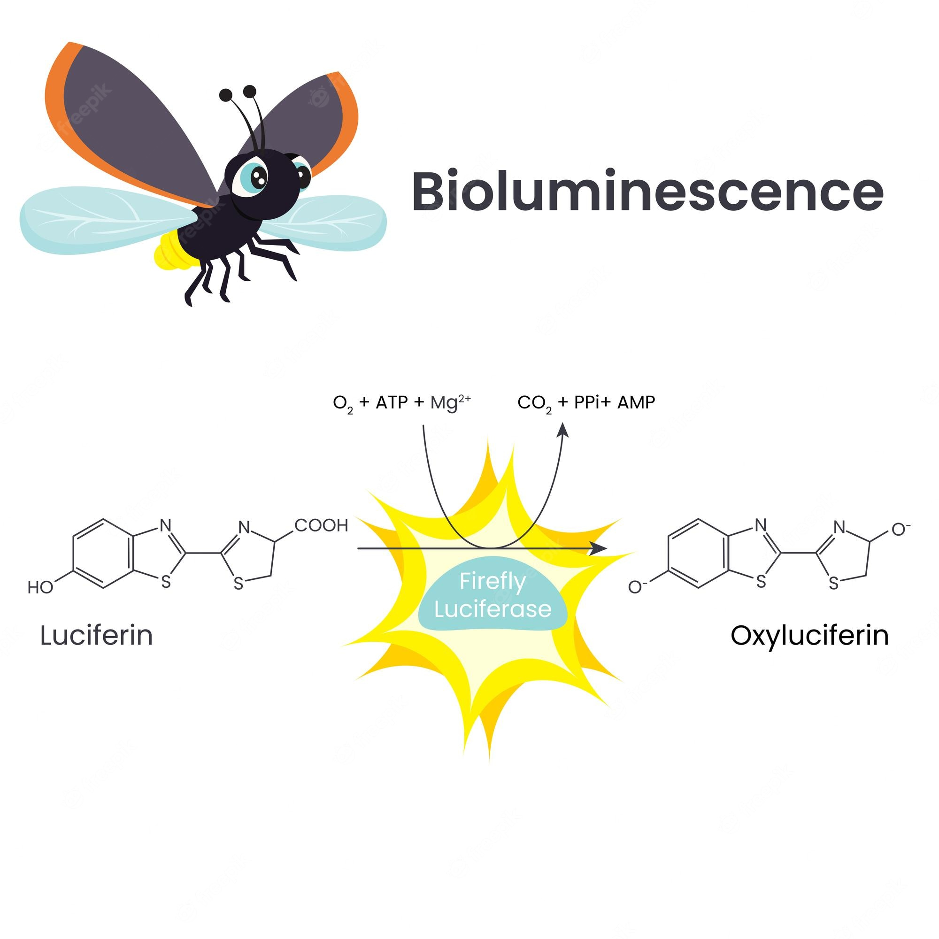

Slide 8
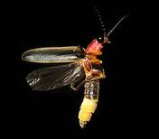
Photinus pyralis
Luciferase:
Firefly luciferase (Photinus pyralis)
Firefly luciferase produces light by ATP-dependent oxidation
Bioluminescence or light emission is determined by a luminometer

Slide 9
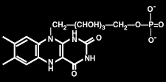
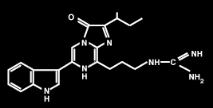
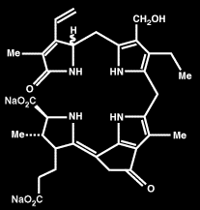
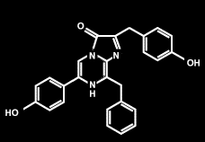
Luciferin chemistry
- There are many different luciferins,
- each specific luciferin has its own special luciferase.
Terrestrial organisms
Bacteria
Vargulin
Firefly
Marine organisms
Dinoflagellate
Coelenterazine
Emission maxima of most luminous marine organisms 450-490 nm
Best Wavelenghth for light trasmission in ocean water
Maximal sensitivity of visual pigments of most marine organisms

Slide 10
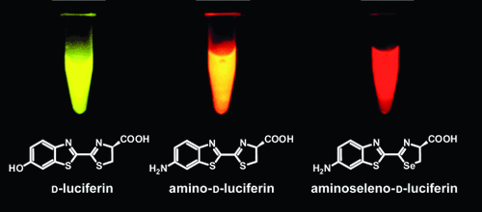

Slide 11
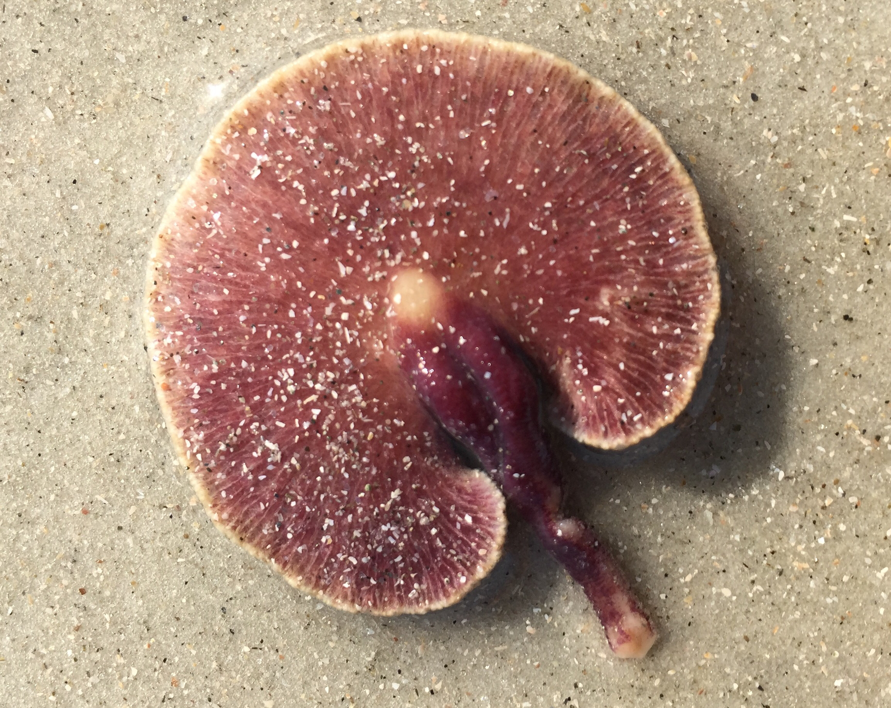
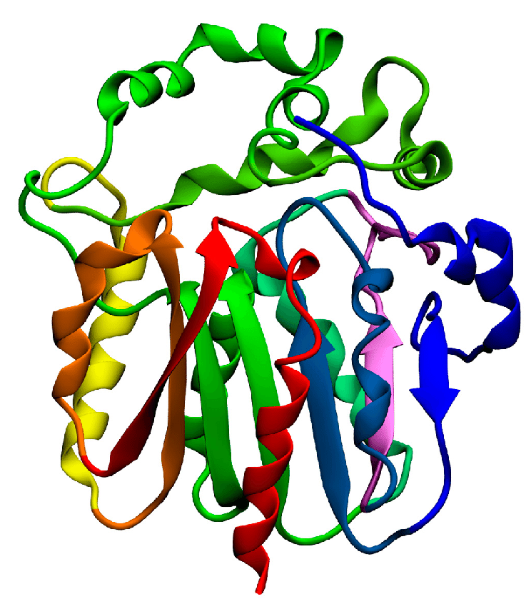
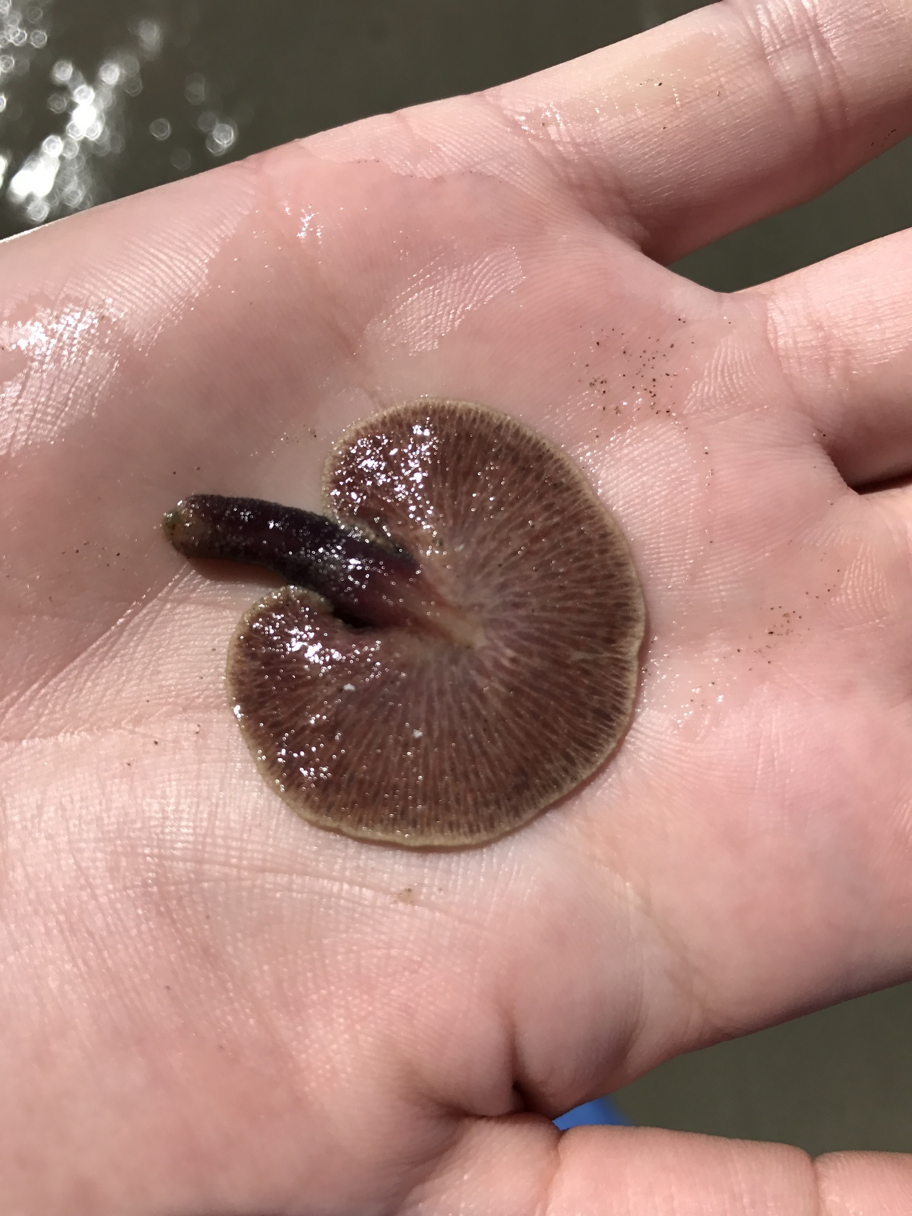
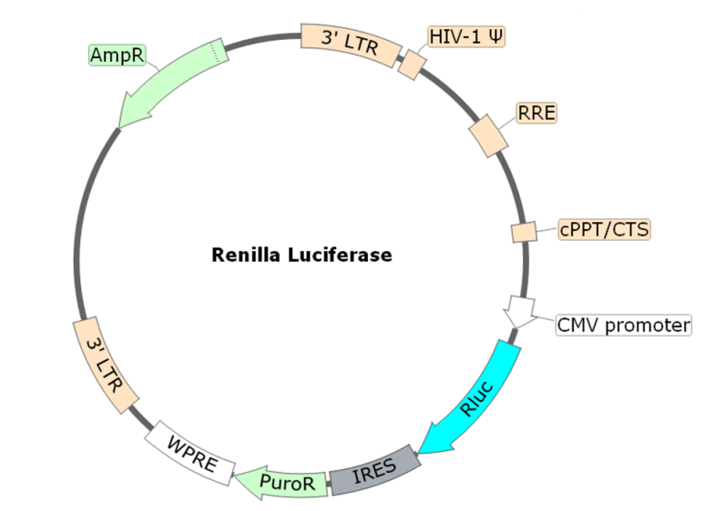
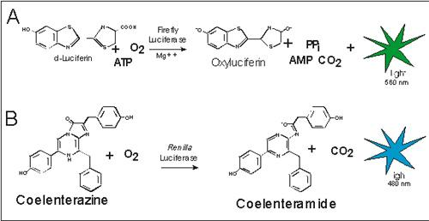
Renilla reniformis
è un celenterato coloniale

Slide 12
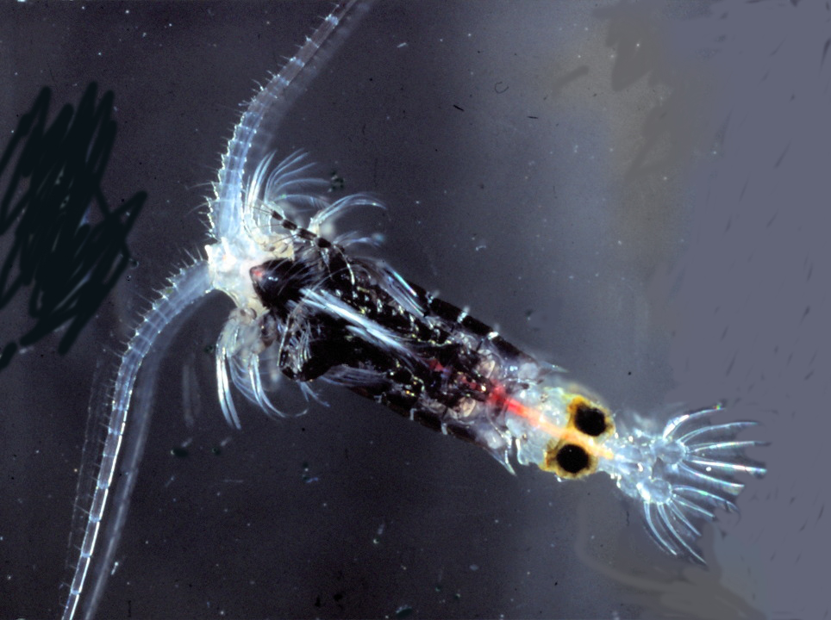
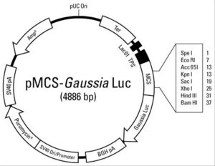
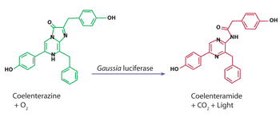
Gaussia Princeps
è un copepode mesopelagico
si trova nelle acque temperate e
tropicali di tutto il mondo

Slide 14
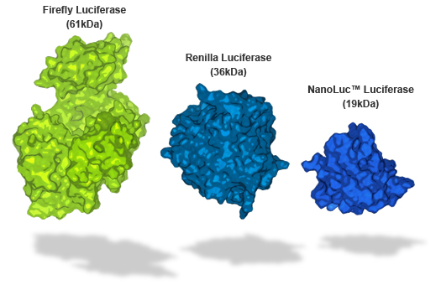
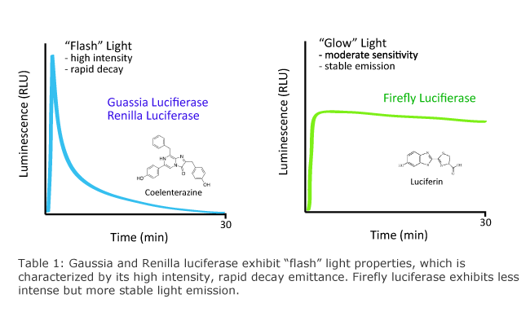
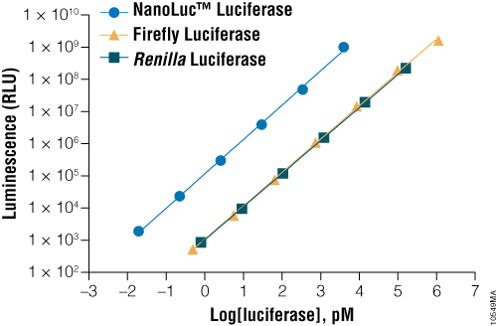

Slide 15
Biotechnological uses of luciferase
Pyrosequencing (454 sequencing)
In PCA to monitor protein protein interactions
To test for anti-oxidants
As a reporter gene
To assess promoter strength and activity
In vivo imaging
Cancer biology

Slide 16
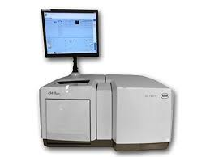

Slide 18
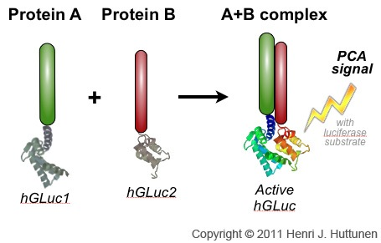

Slide 21
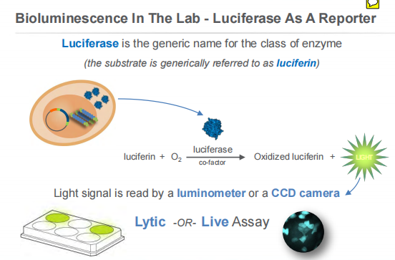

Slide 23
The luciferase reporter assay is commonly used as a tool to study
- gene expression
- at the transcriptional level.
It is widely used because it is
convenient,
relatively inexpensive,
gives quantitative measurements instantaneously.
It has broad applications across various fields of cell and molecular biology – wherever you want to measure or track expression of a cloned gene.

Slide 24
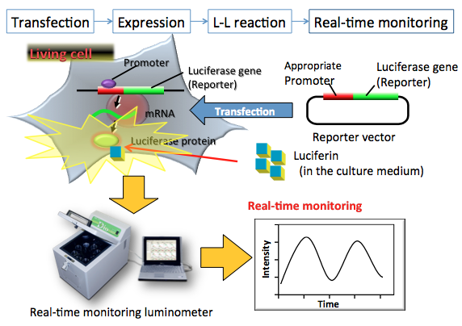

Slide 26
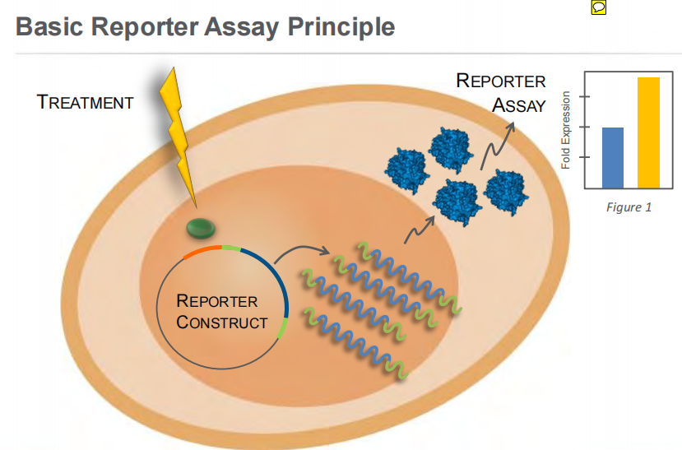
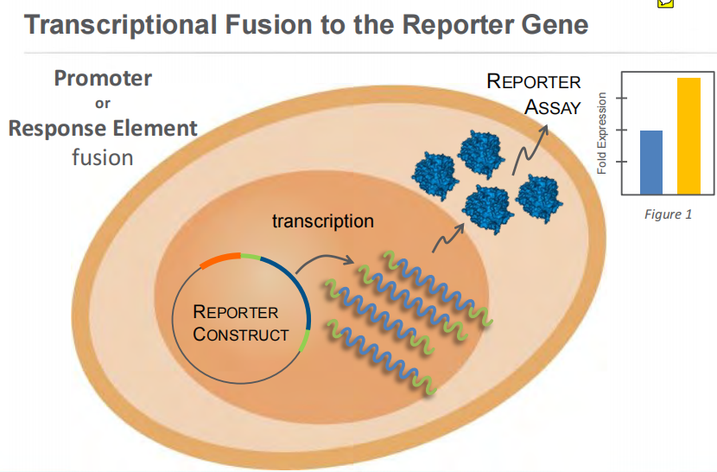
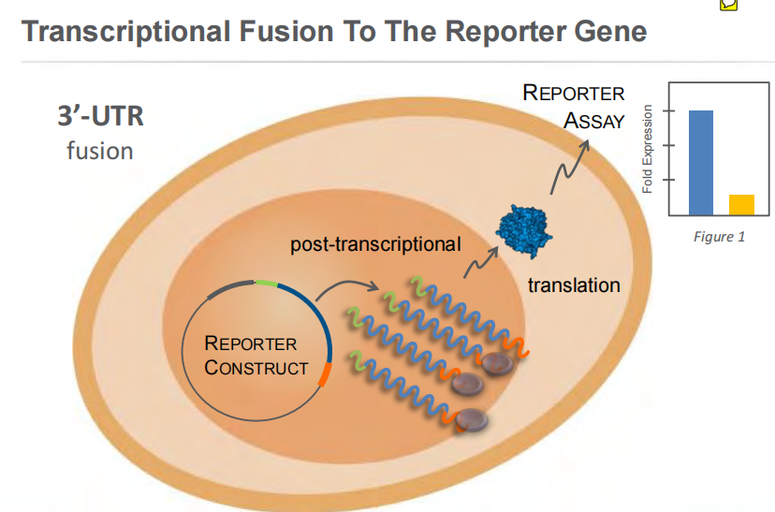

Slide 27
LUCIFERASE

Slide 28
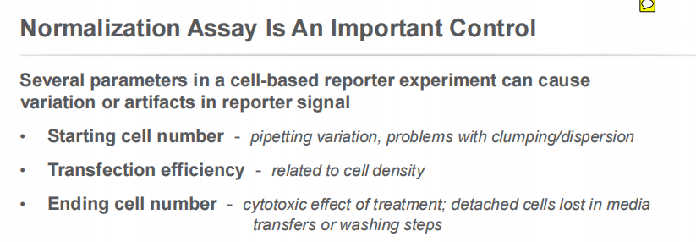

Slide 29
Dual-Luciferase Reporter Assay System

Slide 30
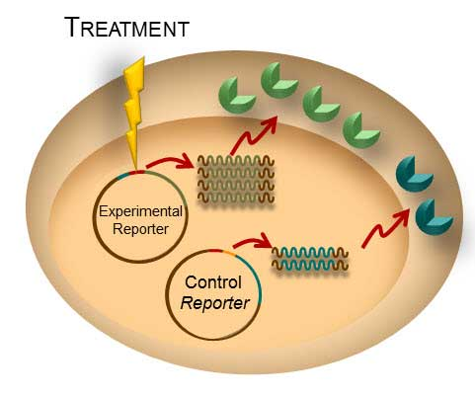
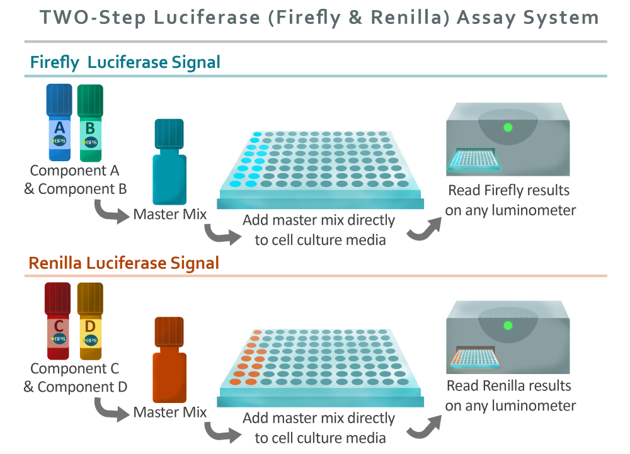
A
B

Slide 31
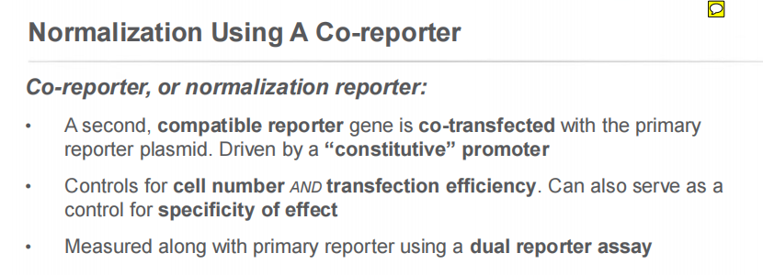
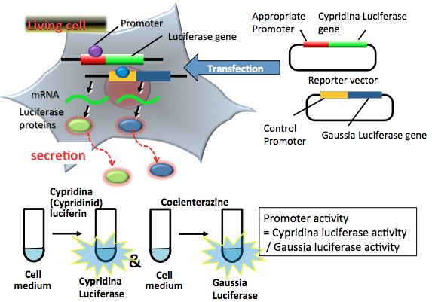

Slide 33
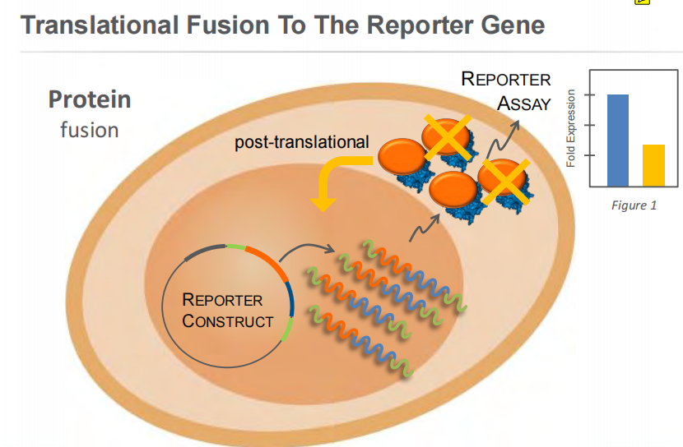

Slide 34
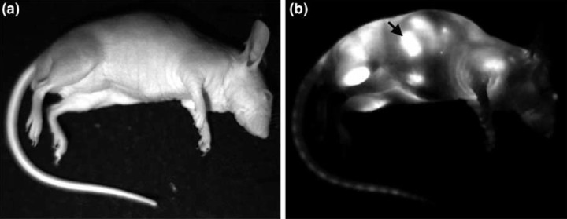
In vivo imaging of luciferase expression in mice
Since the luciferase gene can be stably transfected into cells under the control of most any promoter, signal will not be lost following dilution by cell division.
Luciferase assays in mammalian systems are particularly sensitive because they are not subject to high background as a result of tissue autofluorescence

Slide 35
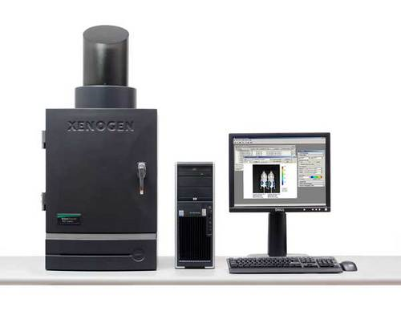
Bioluminescent imaging is dependent on highly sensitive detectors.
Typically a charged-coupled device (CCD) camera is used to image luciferase signal in whole animals.
CCD cameras can be cooled to reduce thermal noise, and therefore background.
.
Additionally, CCD systems detect the entire visible spectrum and near infrared wavelengths, allowing them to detect the light that is not absorbed by mammalian tissues

Slide 38
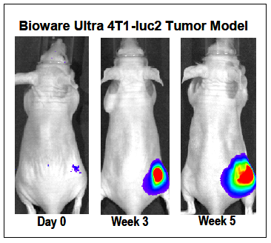

Slide 39
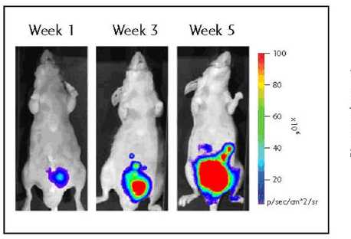
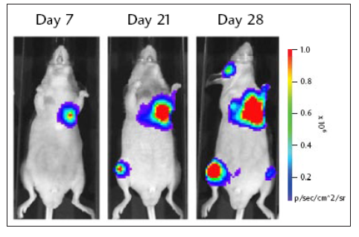
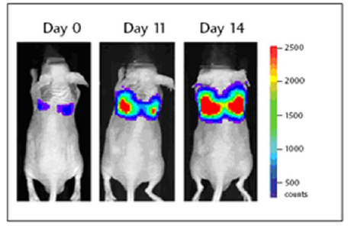
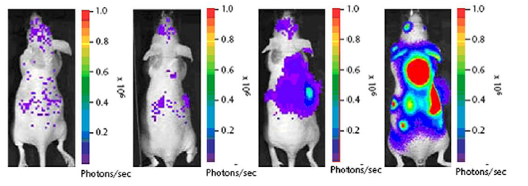
Bone metastasis
Prostate model
Melanoma
Breast cancer

Slide 40
