Slide 1
Nanomaterials Laboratory
‘Pre lab’: 8 hours; Lab: 12 hours
Paolo Pengo

Slide 2
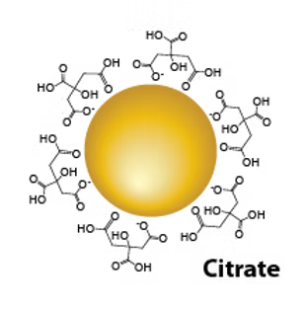
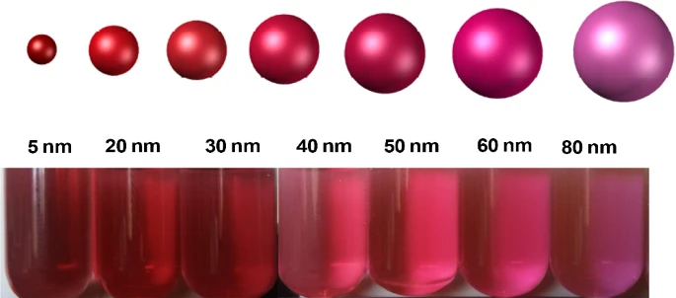
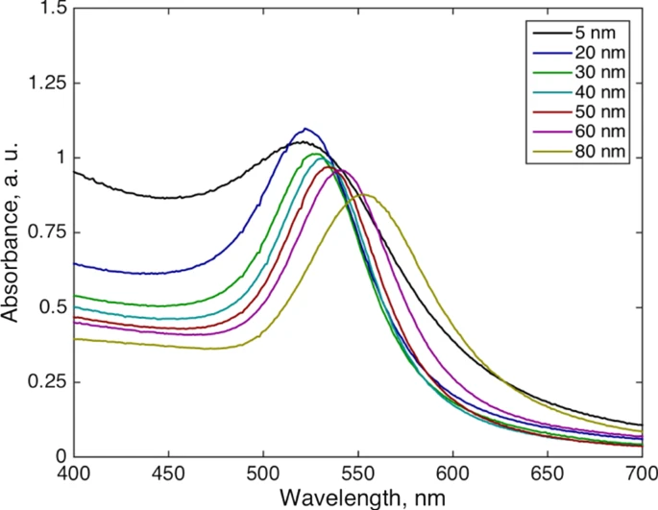
Colloidal gold
HAuCl₄
+
Boiling Water

Slide 3
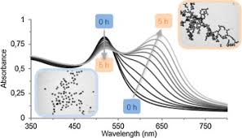
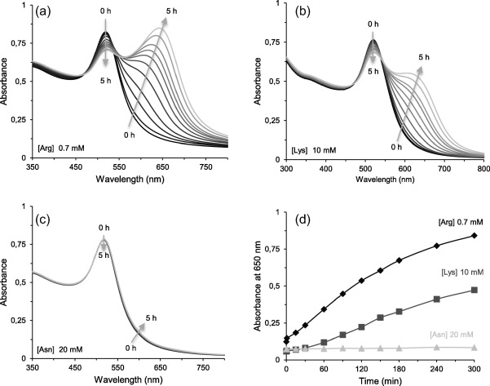
Colloidal gold
Aggregation induced by electrolytes
UV–Vis absorption spectra of a GNPs suspension recorded as a function of time at pH 7 and 1 mM citrate in the presence of (a) 0.7 mM arginine; (b) 10 mM lysine; (c) 20 mM asparagine at pH 7 and 1 mM in citrate and (d) evolution of the absorbance at 650 nm in the presence of different amino acids ([Arg] 0.7 mM; [Lys] 10 mM and [Asn] 20 mM).
Au NP solution without NaCl (left) and with NaCl (right). b UV–visible absorption spectra of aqueous solutions of Au NPs with 15 nm of diameter, without and with NaCl (optical path= 2 mm). Cryo-TEM images of c non-aggregated Au NPs (without NaCl) and of d aggregated Au NPs (with NaCl)
Journal of Colloid and Interface Science 464 (2016) 160–166
Gold Bull (2013) 46:319–327

Slide 4
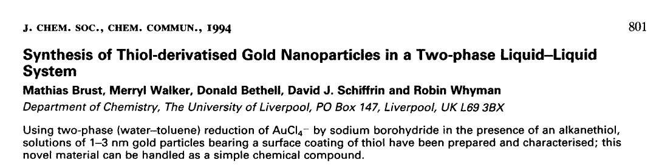
Alkanethiolate protected gold nanoparticles
This paper is now very relevant for historical reasons: it paved the way to a wealth of new applications of nanoparticles and new research fields.

Slide 5
Alkanethiolate protected gold nanoparticles
Going down to the basics: what is the most relevant and new contribution of this paper?
Essentially the authors describe that by using a self assembled monolayer of thiolate ligands covalently grafted to the surface of a nanometer sized gold crystal is possible to provide steric stabilization of small gold particles making them stable towards irreversible aggregation.
These systems can be treated as common organic compounds: they can be dried, dissolved in a series of organic solvents (or water depending on the nature of the thiolate), they can be processed according to standard ‘wet chemistry’ techniques.
Most importantly they can be functionalized to provide an enormous variety of supramolecular systems and new materials.

Slide 6
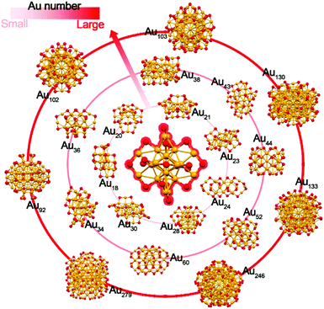
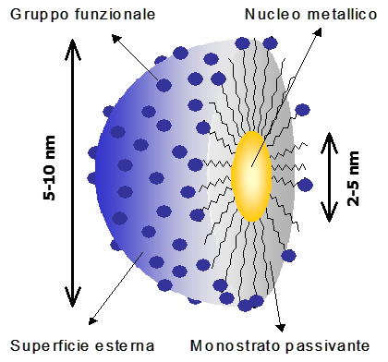
Alcanethiolate protected gold nanoparticles
An inherent feature of these systems is their polydispersity: we do not obtain a single species, rather a population of species very similar to each other.
On the other hand, along the years research allowed to devise methods for obtaining ‘atomically precise’ nanoparticles or clusters.
We can tune to a certain extent the structure of these systems by acting on some synthetic parameters.
Nanoscale, 2018, 10, 10758-10834

Slide 7
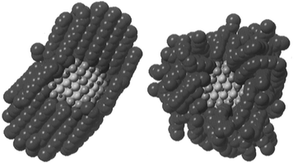
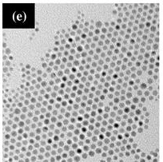
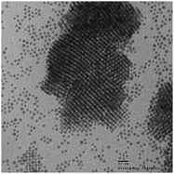
Alcanethiolate protected gold nanoparticles
Ligands anchored to the gold core but still dynamic
Long range ordering in the solid state, A 2D-lattice
Starting to go 3D
Equilibrium configurations of passivated Au140 isolated crystallites. The structures at the left and middle correspond to low- (200 K) and high-temperature (350 K) configurations for Au140(C12H25S)62 illustrating “bundling” at low temperature,
J. Phys. Chem. 1996, 100, 32, 13323–13329
Phys. Chem. Chem. Phys., 2012,14, 6509-6513

Slide 8
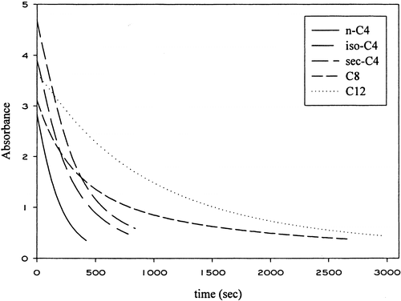
Alcanethiolate protected gold nanoparticles
Stability as a function of the coating shell structure
The thicker the monolayer the higher the stability
Plots representing a first-order fit of absorbance data for the reaction of NaCN with the gold clusters over a wide range of protecting ligand sizes and chain lengths.
J. Am. Chem. Soc. 1998, 120, 8, 1906–1911

Slide 9
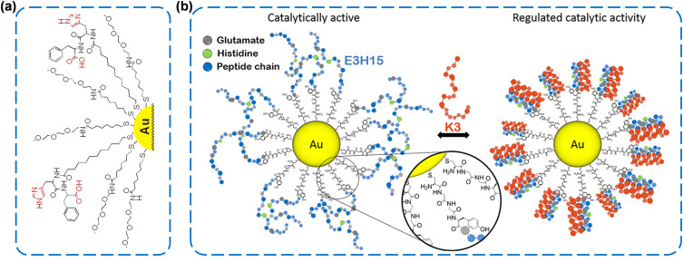
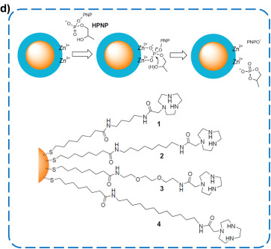
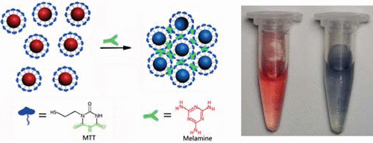
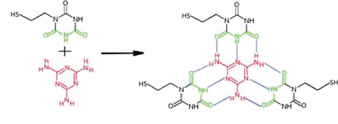
Alcanethiolate protected gold nanoparticles as scaffolds
Giant, 12, 2022, 100122
J. Am. Chem. Soc. 2009, 131, 27, 9496–9497

Slide 10
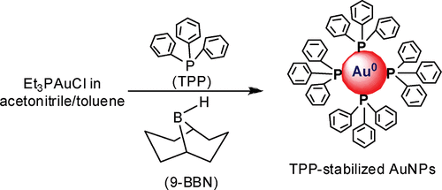
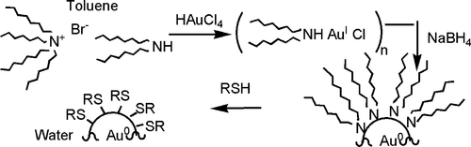
Alcanethiolate protected gold nanoparticles
Can we use ligands other than thiols?
Yes, we can
Phosphines
Amines
Langmuir 2009, 25, 23, 13279–13283
Langmuir 2008, 24, 8, 4120–4124
But… phosphines are easily oxidized and amines are only weak stabilizers that can be displaced by other species

Slide 11
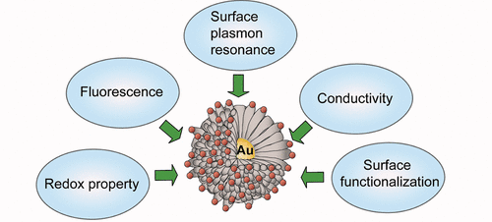
Alcanethiolate protected gold nanoparticles
Applications
Biological/Biomedical/Nanomedicine
Therapeutics and/or diagnosis
Sensor development
Small molecules or biomolecules
Nanoparticles size and substrate interactions
Catalysis
Biomimetic
CO oxidation, Alkene epoxidation, alcohol oxidation
Chem. Rev. 2020, 120, 2, 464–525
Chem. Rev. 2012, 112, 5, 2739–2779
Chem. Rev. 2015, 115, 19, 10575–10636

Slide 12
Alcanethiolate protected gold nanoparticles
What shall we be doing?
Using the procedure outlined by Brust (and following works) we shall prepare dodecanethiolate protected gold nanoparticles.
Purification and characterization of the obtained material will also be part of the Lab activity.
UV-Vis
IR
NMR
DLS
For those interested in the Laboratory of microscopy:
TEM

Slide 13

Alkanethiolate protected gold nanoparticles
Synthesis with some mechanistic insights
I shall refer to thiols as ‘ligands’ because after the preparation they will be bound on the nanoparticles surface.
Thiols are responsible for reduction of Au(III) to Au(I)
In the past it was believed that upon reduction to Au(I) and in the presence of excess thiols, ‘Au(I)SR’ intermediates
were formed. This now appears unlikely. Au-thiolate species forms only if water is presence in the reaction mixture and
they are detrimental to the outcome of the synthesis (very polydisperse preparations).
J. Am. Chem. Soc. 2010, 132, 9582–9584

Slide 14
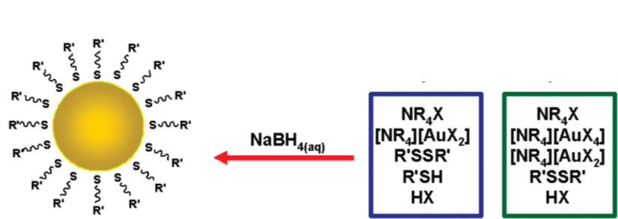
Alkanethiolate protected gold nanoparticles
Synthesis with some mechanistic insights
The reducing agent, NaBH₄ in our case, brings about the reduction of the gold species Au(I) or Au(III) eventually present.
Upon reduction small Au crystallites are formed and their growth is limited by the presence of sulfur containing species that act as capping agents.
Synthetic parameters for the control over size
• High thiol/ligand molar ratio favor small particles.
• Fast reduction favor small particles (more nucleation centers are formed (almost) simultaneously.
• Low temperatures help in narrowing size dispersion.

Slide 15
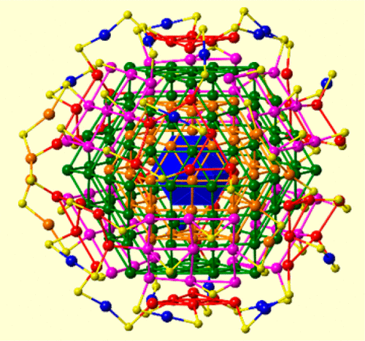
Alkanethiolate protected gold nanoparticles
The structure of the gold-sulfur interface
Au₂₅(SCH₂CH₂Ph)₁₈⁻
Faradaurate-279: Au₂₇₉(SPh-tBu)₈₄
Nature Chem. 2012, 4, 443–455
J. Am. Chem. Soc. 2008, 130, 3754-3755
J. Am. Chem. Soc. 2017, 139, 43, 15450–15459

Slide 16
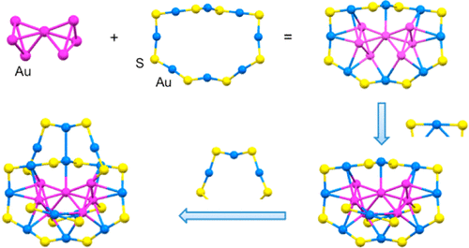
Alkanethiolate protected gold nanoparticles
The structure of the gold-sulfur interface
Au₃₈(SR)₂₄
Au₂₀(SR)₁₆
A
B
Schematic of the crystal structure of Au38(PET)24 and B) the arrangement of staples on the Au23 core. PET is 2-phenylethanethiolate
J. Am. Chem. Soc. 2014, 136, 34, 11922–11925
Small 2021, 17, 2101855

Slide 17
Alkanethiolate protected gold nanoparticles
The structure of the gold-sulfur interface is heterogeneous in terms of how the ligands are bound to the gold core
The properties of different ligands are therefore different.
Their chemical reactivity may be different.
The ‘chemical environment’ of different ligands is different: the weak interactions they have each other and with the solvent are different.
Different ‘chemical environment’ means different response to NMR: chemical shifts are not the same for the same group of protons in different ligands.
We will see this leads to complex NMR spectra.

Slide 18
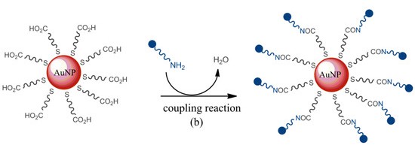
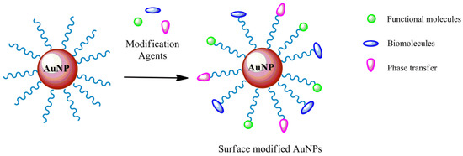
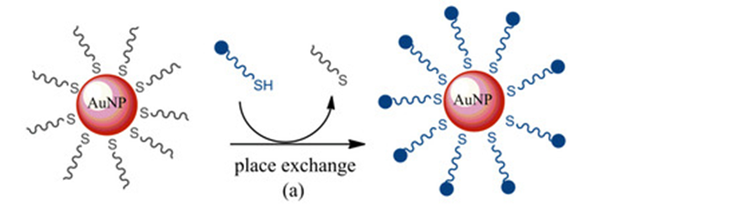
Alkanethiolate protected gold nanoparticles
Easy functionalization
Post synthetic on pre-existing functional groups
Place exchange

