Slide 1
NMR of hybrid organic-inorganic nanoparticles
Paolo Pengo

Slide 2
NMR of hybrid organic-inorganic nanoparticles
At variance with purely inorganic nanoparticles, hybrid systems such as noble metal nanoparticles passivated by an
organic monolayer can be analysed by techniques that are common for small organic molecules.
This is a powerful tool because it allows to assess different properties of the nanoparticles, such as their structure,
surface chemistry.
NMR can also be used for analyzing the single steps of nanoparticle syntheses but also to check for their purity.
NMR can be used to assess the interaction of small molecules for the nanoparticles monolayer through NoE spectroscopy.
NMR can be used to the size of nanoparticles through dedicated 2D-NMR experiments such ad the Diffusion ordered
NMR spectroscopy (DOSY)
NMR can give, by an indirect way, information on the size of nanoparticles through analysis of the line shape in a conventional spectrum.

Slide 3


NMR spectroscopy
In a homogeneous static magnetic field of given direction, suppose z, and intensity B0 the angular momentum of nuclear
spin can only assume certain angles with respect to B0 (quantization of directions). The projections of P along the
direction of B0 can only assume values
$$P_{B}=m\frac{h}{2π}$$
Where m is called the magnetic quantum number and can assume for a given I only the values ​​–I, -I+1, -i+2,….,+I i.e. 2I+1
values ​​in total. These states are called nuclear Zeeman levels. Each of these states corresponds to an energy
$$E_{m}=−μ_{B}B_{0}=−γm\frac{h}{2π}B_{o}$$
In the absence of an external magnetic field, the nuclear Zeeman levels are degenerate, that is, they have the same energy.
In the presence of an external magnetic field, the nuclear Zeeman levels have different energy as a function of the value of m.

Slide 4
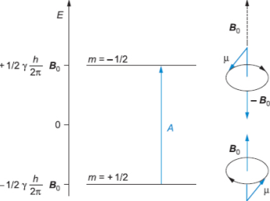
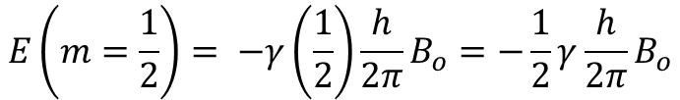
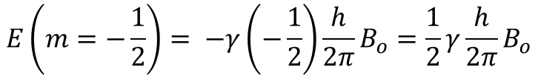
¹H NMR spectroscopy
Let's focus on the proton, i.e. ¹H. This nucleus has nuclear spin quantum number I = ½
The possible values ​​of the magnetic quantum number are therefore: -1/2 and +1/2 the possible nuclear Zeeman levels
have therefore energies
$$E\left(m=−\frac{1}{2}\right)= −γ\left(−\frac{1}{2}\right)\frac{h}{2π}B_{o}=\frac{1}{2}γ\frac{h}{2π}B_{o}$$
state β
β
$$E\left(m=\frac{1}{2}\right)= −γ\left(\frac{1}{2}\right)\frac{h}{2π}B_{o}=−\frac{1}{2}γ\frac{h}{2π}B_{o}$$
state α
α
In a static magnetic field of intensity B0, therefore, there are two states for a proton: a lower energy state with the projection of the nuclear magnetic moment parallel to B0 (the α state) and a higher energy state in which the projection of the nuclear magnetic moment is antiparallel to B0 (the β state). The ‘energy separation’ of the states is proportional to the intensity of the magnetic field B0.

Slide 5


¹H NMR spectroscopy
The energy separation between the α and β states (i.e. β-α) is:
$$∆E=γ\frac{h}{2π}B_{o}$$
It is a small amount compared to the average heat energy at room temperature.
The quantity
$$ν_{0}=\frac{\left|γ\right|}{2π}B_{o}$$
it is called Larmor frequency and is typical of a certain nucleus that is affected by a B0 field
Clearly the Larmor frequency depends linearly on the applied magnetic field.
The two states α and β are differently populated for a given value of B0 with a slight excess for the α state which
has a lower energy.
β
α

Slide 6
NMR spectroscopy
Relaxation
Following the absorption of radio waves we have the excitation of nuclear spins. The return to the initial situation
(thermally balanced) is called RELAXATION.
Relaxation involves the release of energy (heat) to the environment, this process is called spin-lattice relaxation and occurs with a rate constant of 1/T1 where T1 is called the Longitudinal Relaxation time because it concerns the magnetization of the sample along the z direction, i.e. B0.
The transverse component of the magnetization (on the xy plane) relaxes instead with a time constant 1/T2
where T2 is called the transverse relaxation time or spin-spin.

Slide 7
NMR spectroscopy
How do we acquire an NMR spectrum?
We need to apply an oscillating (radiofrequency) magnetic field B1 orthogonal to B₀
This induces a deflection of the magnetization along the z axis and focuses the spins, generating a component
Transverse, Mxy which 'follows' the rotating magnetic field B1
(a) Equilibrium situation in the presence of only the static magnetic field B0
(b) Rotating (oscillating) magnetic field in the xy plane
(c) Generation of a transverse component of the magnetization in the xy plane

Slide 8
Spettroscopia NMR
How is an NMR spectrum acquired?
When B1 is 'turned off' the spins are no longer focused and the xy component of each of them begins to rotate
with its own Larmor frequency.
y
y
y
The characteristic time
Necessary to observe the
loss of coherence on the xy plane is called transverse relaxation time
x
M_{xy}
x
x
Mxy component when B1 IS 'on'. The xy projections of all spins are coherent and move together with the frequency of B1
When B1 is 'turned off' the coherence of the xy projections of each spin is lost. Each projection rotates with its own Larmor frequency.
During this process the loss of coherence cancels the value of Mxy. It is said that the system 'relaxes'

Slide 9
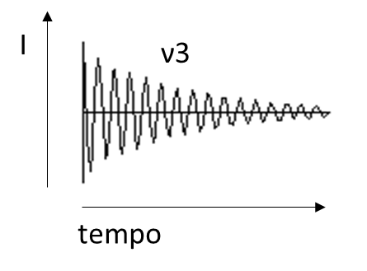
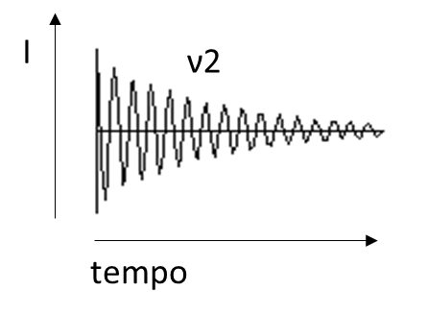

Spettroscopia NMR
How is an NMR spectrum acquired?
The NMR signal that gives rise to the spectrum is detected on the xy plane.
The rotation of the projection of a spin with Larmor frequency ν1 induces an oscillating current (voltage) in a
coil located on the y axis. The same goes for a spin with Larmor frequency ν2 etc.
y
x
ν1
ν2
Receiving coil
FID (free induction decay)
Sum of all signals due to
spin 1, 2, 3 etc

Slide 10
Spettroscopia NMR
How is an NMR spectrum acquired?
An NMR spectrum is the Fourier transform of the FID
FT

Slide 11
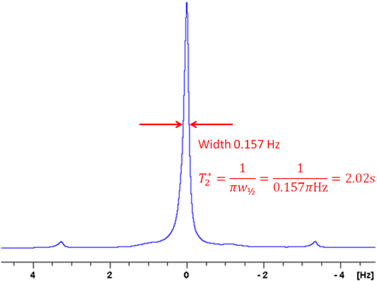

The NMR signal that gives rise to the spectrum is detected in the xy plane
The spin-spin (or transverse) relaxation time T2 is used to quantify the rate of the decay of the magnetization
It is an exponential decay and T2 is the
‘time constant’ of this decay.
The width at half-height of a NMR signal is inversely proportional to the T2 relaxation time of the nucleus.
$$W_{1/2}=\frac{1}{πT_{2}}$$
Where we consider W_{1/2} as the width at half maximum

Slide 12
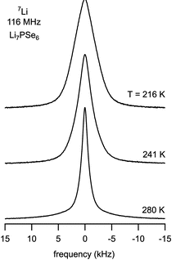
Line width and line broadening in NMR
W_{1/2} progressively
decreases
T2 progressively
increases
Please note: by definition the shorter the T2 the faster is the relaxation
What are the factors affecting the T2 relaxation time?
An important factor although not the only one is the presence of static local dipolar fields and their fluctuations. Qualitatively stimulate relaxation. Local fields are due to the applied field and the fields generated by neighboring nuclei and dipoles.

Slide 13
Line width and line broadening in NMR
The static dipolar fields created by neighboring dipoles is proportional to μ / r³ where r is the distance between the spins and the dipole.
A detailed analysis shows that the relaxation rate constants generated by the dipole–dipole mechanism are proportional to the square of the dipole–dipole coupling, and hence are proportional to the inverse sixth power of the distance between the nuclei.
Please note: this means that spins and dipoles need to be very close!
Therefore dipole-dipole interactions as a source of T2 relaxation (larger T2) is more and more relevant the more compact or denser are the systems we consider.
Since T2 relaxation is caused by transient magnetic fields that are usually due to molecular motion, T2 decreases as the molecular reorientation rates or molecular rotations slow down due to enhanced spin-spin interactions.

Slide 14
Line width and line broadening in NMR
How can we characterize the motion of a molecule in the context of T2 relaxation?
As far as NMR phenomena are concerned we need to look at molecular motions that take place with frequencies
close to the Larmor frequencies of the nuclei we are taking into account.
These motions are molecular rotations.
To characterize the rotational motion of a molecule we need to consider its rotational correlation time (τc), the time required for a rotation of 1 radian.
small molecules rotate fast and have smaller τc
Large molecules rotate slowly and have longer τc

Slide 15
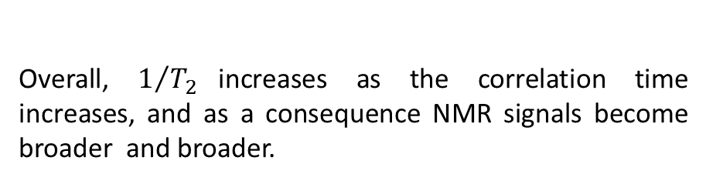
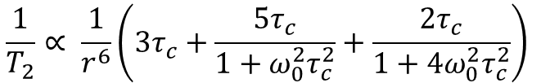
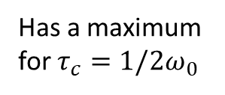
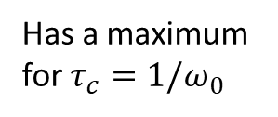
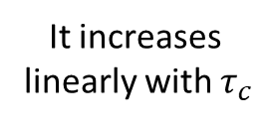
Line width and line broadening in NMR
Under this context, a simplified view is the following
$$\frac{1}{T_{2}}∝ \frac{1}{r^{6}}\left({3τ}_{c}+\frac{{5τ}_{c}}{1+ω_{0}^{2}τ_{c}^{2}}+\frac{{2τ}_{c}}{1+{4ω}_{0}^{2}τ_{c}^{2}}\right)$$
Where τc is the correlation time $ω_{0}$ is the Larmor frequency.
It increases
linearly with $τ_{c}$
Has a maximum
for $τ_{c}=1/2ω_{0}$
Overall, $1/{T_{2} }$increases as the correlation time increases, and as a consequence NMR signals become broader and broader.
Has a maximum
for $τ_{c}=1/ω_{0}$

Slide 16
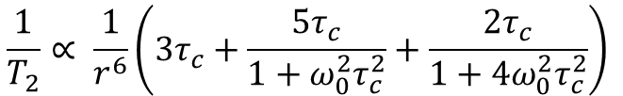

correlation times and molecular size
The correlation time depends on the size of the molecule, the larger the molecule, the shorter is the correlation time.
$$τ_{c}≈\frac{4πηR^{3}}{3kT}$$
Remember that
$$\frac{1}{T_{2}}∝ \frac{1}{r^{6}}\left({3τ}_{c}+\frac{{5τ}_{c}}{1+ω_{0}^{2}τ_{c}^{2}}+\frac{{2τ}_{c}}{1+{4ω}_{0}^{2}τ_{c}^{2}}\right)$$
Information we want
Observable
These two equations together give us the possibility of correlating the width od a NMR signal with the size of the molecule where the nuclei that originate the signals reside.
This works but since, in general, we do not know τc we need some sort of ‘calibration’

Slide 17
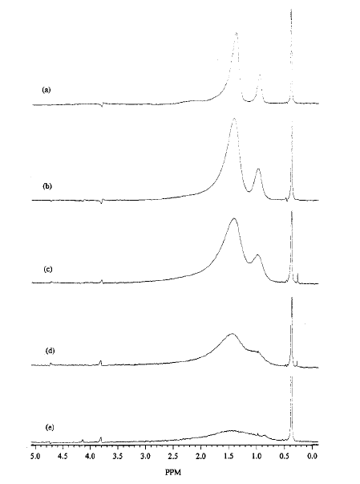
Typical NMR spectra of dodecanethiolate protected gold nanoparticles
Size increase
The signal of the methyl group can be analysed with a relative ease.
Knowing the size of the particles by other techniques, TEM for instance we can look for a correlation between the signal width and the nanoparticle size.
Bnzene d₆
Langmuir 1998, 14, 17-30

Slide 18
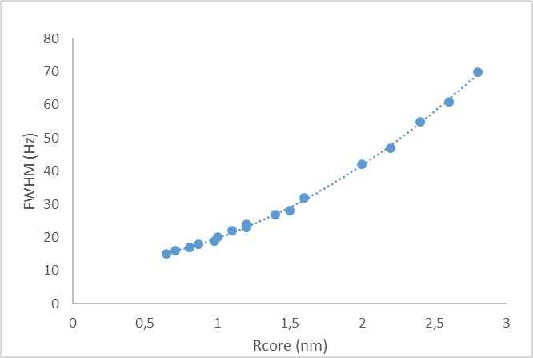
Correlation of FWHM for the methyl signal and nanoparticle size
By TEM
By NMR
If you determine the FWHM, by
using these data you can get an
estimation of the nanoparticles size.

Slide 19
NMR of hybrid organic-inorganic nanoparticles
If we are dealing with ligand protected nanoparticles, a basic use of NMR is: (i) to check whether or not the ligands are bound to the core surface and (ii) the purification processes have been successful and there are no unbound ligands left in the nanoparticle preparation.
Ligands bound to the nanoparticle surface give NMR signals that may be somewhat different from those of the free, unbound, ligand. This is primarily due to the fact that once bound to a surface, the ligands experience a severely reduced degrees of conformational freedom. A monolayer self-assembled on a metal surface is something very like to a condensed phase. As a result the ligands are also closely packed.
Close packing and reduced conformational freedom of the ligands are sources of line broadening in the NMR spectra.

