Slide 1
Introduction to Dynamic Light Scattering (DLS)
Paolo Pengo

Slide 2
Introduction to Dynamic Light Scattering (DLS)
DLS is primarily used to obtain information on the average size of particles or macromolecules dispersed in a solvent.
In addition to the size, DLS also allows to obtain information on the dispersion of the size about the average value.
If we are dealing with mixtures containing populations of particles of very different size, DLS can give us information
on each individual population.
The technique is based on light scattering from particles in a dispersion that are experiencing the so called Brownian motion.
That is the random motion of particles suspended in a medium due to the solvent molecules hitting the particles.
The trajectories of the particles cannot be described analytically or monitored individually, and only probabilistic
models can be used for data handling. This is the most difficult aspect in understanding DLS
In the interpretation of the data we assume that the particles, are spherical , then it is possible to apply the Stokes-Einstein relation and hence have a formula that easily gives the diffusion coefficient and hence their diameter.

Slide 3
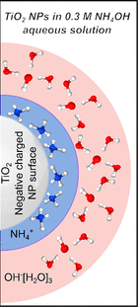
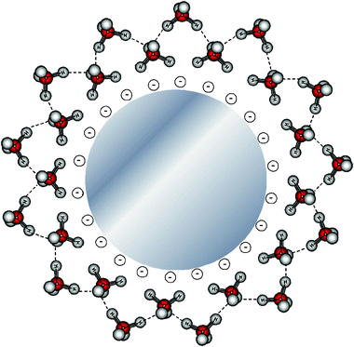
Introduction to Dynamic Light Scattering (DLS)
Attention here and henceforth! What is the particles diameter in solution/suspension?
Particles in solution are not ‘naked’, they are interacting with the solvent which may be more or less strongly bound.
These solvent layers move with the particles as these move, the ‘solvodynamic diametere’ is actually what DLS sees.
If the particles are charged, close to their surface, besides the solvent molecules there will be a layer of counter ions electrostatically interacting with the particles, also these ions move with the particles.
In general the solvodynamic size of a particle is different from that determined by other techniques such as SEM or TEM where the solvent molecules have been removed.
Ions and water molecules interacting with the surface of silver nanoparticles
Ions and water molecules interacting with the surface of titania nanoparticles
Phys. Chem. Chem. Phys., 2009, 11, 11258-11263
ACS Appl. Nano Mater. 2020, 3, 264–273

Slide 4

Diffusion of light by particles
When light impinges on particle or matter in general, the electric field of the light induces an oscillating polarization of electrons. Hence the particles become a secondary source of light and subsequently scatter light. The frequency shifts, the angular distribution, the polarization, and the intensity of the scatter light are determined by the size, shape and molecular interactions in the scattering material.
Different models can be used for describing the scattering of light, the suitability of a model respect to others is based on the evaluation of the dimensionless size parameter, α which is defined as:
Where D is the diameter of the particle and λ the wavelength of the impinging radiation
$α$= $πD/λ$
When α ≪ 1 that happens for small particles respect to the wavelength of light (typically the upper limit is taken to be about 1/15 the wavelength) we have the Rayleigh scattering
When α ≈ 1 that happens for particles with size comparable to the wavelength of light, we have the Mie scattering
These are the main forms of elastic light scattering (involving negligible energy transfer)
Notes:
he kinetic energy of the particles is conserved within the system in which the scattering occurs. Therefore, the scattered photons have the same energy as the incident photons.

Slide 5
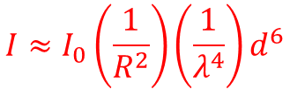
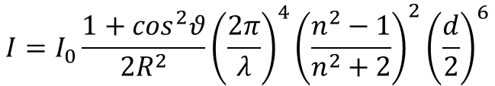
Scattering di Rayleigh
Particles much smaller than wavelength of light.
The intensity of the scattered light is given by the following equation
$$I=I_{0}\frac{1+\cos^{2}θ}{{2R}^{2}}{\left(\frac{2π}{λ}\right)}^{4}{\left(\frac{n^{2}−1}{n^{2}+2}\right)}^{2}{\left(\frac{d}{2}\right)}^{6}$$
Where R is the distance of the particle from the detector, θ is the scattering angle (the angle of observation), n is the refractive index of the particle and d is the particle diameter.
For our purposes it suffices to remember that
•The scattered intensity decreases with the square of the distance (this is true for any light source).
•The scattered intensity increases with the fourth power of 1/λ (shorter wavelength are scattered more than longer ones).
•The scattered intensity increases with the sixth power of the particle diameter (large particles are much better scatterers than smaller ones)
$$I≈I_{0}\left(\frac{1}{R^{2}}\right)\left(\frac{1}{λ^{4}}\right)d^{6}$$
Notes:
The strength of the scattering depends on the frequency, whereby electromagnetic waves with shorter wavelengths are scattered more strongly. The kinetic energy of the random particles of the system in which the scattering takes place remains the same in Rayleigh scattering, consequently the frequency of the incident light coincides with that of the scattered light. The scattering has its origin in the polarizability of the particles (refractive index term) of the medium through which the electromagnetic wave passes. Rayleigh scattering has no effect on the state of the medium itself.

Slide 6
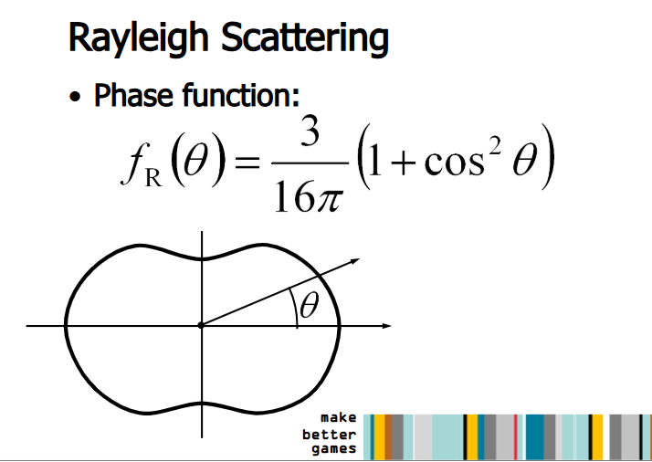
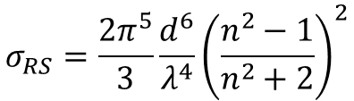
Scattering di Rayleigh
Particles much smaller than wavelength of light.
Integrating the scattered intensity on a sphere around the particles it is possible to calculate the so called
Rayleigh scattering cross-section $σ_{RS}$
$$σ_{RS}=\frac{2π^{5}}{3}{\frac{d^{6}}{λ^{4}}\left(\frac{n^{2}−1}{n^{2}+2}\right)}^{2}$$
The Reyleigh scattering is not isotropic, The scattering intensities depend on the observation angle θ
We need to choose at what angle observing the scattered light

Slide 7
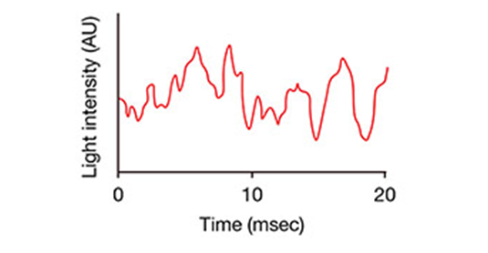
Fluctuation of light intensity induced by particle motion
The observed signal depends on the phase addition of the scattered light falling on the detector. In A, two beams are in opposite phase and 'cancel each other out' resulting in zero intensity detected. In B, the two beams are in phase and 'enhance each other' resulting in a sum of the intensity detected.
Overall, as light scatters from the moving particles, this motion imparts a randomness to the phase of the scattered light, such that when the scattered light from two or more particles is added together, there will be a changing constructive or destructive interference. This leads to time-dependent fluctuations in the intensity of the scattered light.
Notes:
As light scatters from the moving macromolecules, this motion imparts a randomness to the phase of the scattered light, such that when the scattered light from two or more particles is added together, there will be a changing constructive or destructive interference. This leads to time-dependent fluctuations in the intensity of the scattered light (Fig. 1).

Slide 8
Fluctuation of light intensity induced by particle motion
There seems to be little information in observing a collective property of a sample which is however due to the time-dependent behavior of a collection of particles, it looks like a random signal. However, this dynamics is not entirely random, since it is a consequence of time-dependent interactions of each particle with its surroundings. We can only provide a statistical description of the characteristic time scales and amplitudes of these changes by comparing the value of intensity at time t with the value of intensity at time t′ later.
How can we convert fluctuations in scattered intensity into information od particle size?
This can be done by using Autocorrelation functions

Slide 9
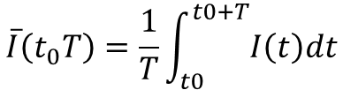
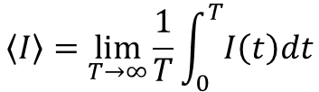
Autocorrelation functions
The time dependence of a property that is changing in a almost random manner will look like noise around an average value
What value should we give for this property? Of course the average over a time period large respect to the time taken by the fluctuations. If the noise is completely random it will average to zero
At equilibrium the average value of a property fluctuating over time (intensity of scattered light in this case) is
simply the time average:
$$\overline{I}\left(t_{0}T\right)=\frac{1}{T}\int_{t0}^{t0+T}{I\left(t\right)dt}$$
Where t0 is the time at which the measurement starts and T the time taken for the measurement, ideally an infinite time.
It is also important to realize that this time average has to be independent of t0, the time at which the measurement starts and considering that ideally we want to observe the system for an infinite time we have:
$$\left\langle I\right\rangle =\lim_{T→∞}{\frac{1}{T}\int_{0}^{T}{I\left(t\right)dt}}$$
Where the angle brackets simply mean time average

Slide 10
Autocorrelation functions
In general, correlation is a statistical method for measuring the degree of non-randomness in an apparently random data set.
Correlation functions provide a concise method for expressing the degree to which two dynamic properties are correlated over a period of time. We need to understand some basic properties of these functions.
Let’s start from scratch
small
large
t
t+τ
t+τ
the property I may have two different values at two different times, t and t+τ so, in general, A(t+τ) ≠ A(t),
however, if τ is small A(t+τ) should be very close to A(t), as τ increases, the difference would be more likely to be nonzero.
Hence, in some sense, we can say that A(t+τ) is correlated to A(t) when τ is small but this correlation is lost when τ is large respect to the time of the fluctuations.
Notes:
Autocorrelation, sometimes known as serial correlation in the discrete time case, measures the correlation of a signal with a delayed copy of itself. Essentially, it quantifies the similarity between observations of a random variable at different points in time

Slide 11
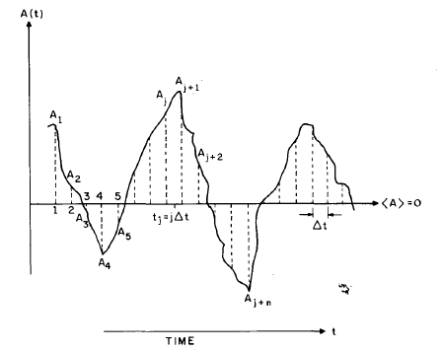
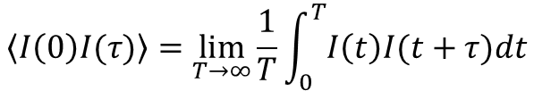
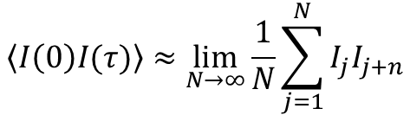
Autocorrelation functions
A measure of this correlation is given by the autocorrelation function of the scattered intensity that is defined as:
$$\left\langle I\left(0\right)I(τ)\right\rangle =\lim_{T→∞}{\frac{1}{T}\int_{0}^{T}{I\left(t\right)I(t+τ)dt}}$$
How can we estimate this?
Let suppose to divide the time axis into N discrete intervals Δt so that T=NΔt and that t=j Δt and τ = n Δt so that t+τ =(j+n) Δt. If we further assume that A varies very little in the interval Δt the integral can be approximated to
$$\left\langle I\left(0\right)I(τ)\right\rangle ≈\lim_{N→∞}{\frac{1}{N}\sum_{j=1}^{N}{I_{j}I_{j+n}}}$$
This approximation is very powerful because it gives us the possibility to understand several properties of the
correlation function, in particular its variation with time.

Slide 12
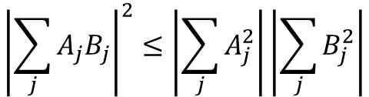


Time dependence of the Autocorrelation function
To understand the time dependence of the autocorrelation function we need to resort to little math, the Schwartz inequality
$${\left|\sum_{j}{A_{j}B_{j}}\right|}^{2}≤\left|\sum_{j}{A_{j}^{2}}\right|\left|\sum_{j}{B_{j}^{2}}\right|$$
If we take Bj =Aj+n we have:
${\left|\left\langle I\left(0\right)I(τ)\right\rangle \right|}^{2}≈{\left(\lim_{N→∞}{\frac{1}{N}\sum_{j=1}^{N}{I_{j}I_{j+n}}}\right)}^{2}≤\lim_{N→∞}{\frac{1}{N}\left|\sum_{j}{I_{j}^{2}}\right|\lim_{N→∞}\frac{1}{N}}\left|\sum_{j}{I_{j+n}^{2}}\right|$= $\left|\left\langle {I(0)}^{2}\right\rangle \right|\left|\left\langle {I(0)}^{2}\right\rangle \right|$
or
$${\left|\left\langle I\left(0\right)I(τ)\right\rangle \right|}^{2} ≤\left|\left\langle {I(0)}^{2}\right\rangle \right|\left|\left\langle {I(0)}^{2}\right\rangle \right|$$
$$\left\langle I\left(0\right)I(τ)\right\rangle ≤\left\langle {I\left(0\right)}^{2}\right\rangle$$
It thus appears that that either the autocorrelation function remains equal to its initial value or it decays from its initial
value which is a maximum.

Slide 13
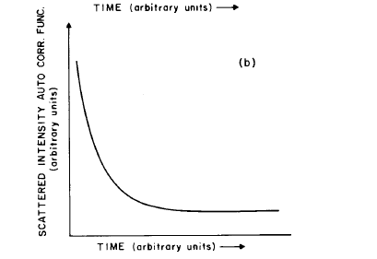






Autocorrelation functions
What we observed is that for τ large respect to the characteristic times of the fluctuations A(t+τ) and A(t) are expected to be uncorrelated however, it cannot vanish but it reaches a ‘baseline level’ L when correlation is completely lost.
Therefore the time correlation function starts at $\left\langle {I(0)}^{2}\right\rangle$ and ends at the Baseline level B the way in which it decays
is exponential, so that in general we can write what follows:
It is this part here that contains the information on the
particles size.
$$g_{2}(τ)≈L+\left[\left\langle {I\left(0\right)}^{2}\right\rangle −B\right]exp⁡(−2Γτ)$$
The decay is due to the randomization of phases which is
the result of the particle Brownian motion, Γ is the ‘rate of decay’ and is a function of the diffusion coefficient of the particles. It also depends on the wavelength, the refractive index of the solution and the scattering angle.
$$\left\langle {I\left(0\right)}^{2}\right\rangle$$
$$Γ=−Dq^{2}$$
$$L$$
$$D=\frac{k_{B}T}{6πηr}$$
$$q=\frac{4πn}{λ}\sin{\frac{θ}{2}}$$

Slide 14

Autocorrelation functions
Therefore, by fitting the decay of the autocorrelation function we can get information on the radius (diameter) of the particles assumed as spheres via the stokes Einstein equation for the diffusion coefficient.
$$D=\frac{k_{B}T}{6πηr}$$
Where η is the dynamic viscosity of the solvent (suspension) and r is the radius of the particles.
However, usually a DLS instrument gives the diameter value.
Autocorrelation function (correlogram)
Final analysis output

Slide 15

In Summary
In (DLS), the time-dependent fluctuations in the scattered light are measured by a single photon counting module. The rate of fluctuations is directly related to the rate of diffusion of the molecule through the solvent, which is related in turn to the particles' hydrodynamic radii. Smaller particles diffuse faster, causing more rapid fluctuations in the intensity than larger particles. Therefore, the fluctuation in light intensity contains information about the diffusion of the molecules and can be used to extract a diffusion coefficient and calculate a particle size.
By fitting the decay of the autocorrelation function we can get information on the radius (diameter) of the particles assumed as spheres.

Slide 16
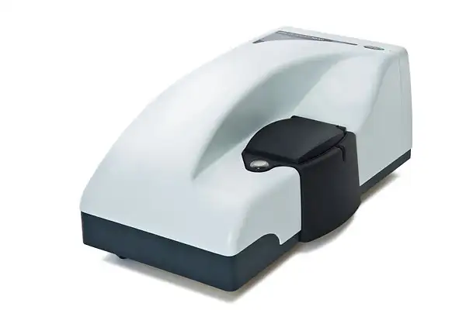
DLS setup
Typical DLS setup with a detector for the backscattering
And with the standard 90° configuration.
You will use an instrument configured for 173° analyses.
This has the advantage that the lased beam will travel less into the cuvette, allowing the analyses of very concentrated samples.
Journal of Controlled Release 2016, 235, 337–351
Malvern Zetasizer nano

Slide 17
Points of attention
Since the scattering intensity is much higher for large particles if you suspect to have unwanted aggregates in your sample, these need to be removed (centrifugation, filtration through 0,22 μm or 0,44 μm membrane filters) otherwise you may not see a signal coming from your analyte.
DLS sees dust as a ‘particle’ and will respond to its presence producing a signal that may obscure the signal due to your actual analyte. Solvents need to be filtered whenever possible or at least to be checked as blanks prior to the analysis.
DLS response may be concentration dependent because at high concentrations multiple scattering may occur giving an apparent size of your analyte that is smaller than real. Whenever possible run DLS analyses of your analyte at various concentration to check that there are no such artifacts.

