Slide 2

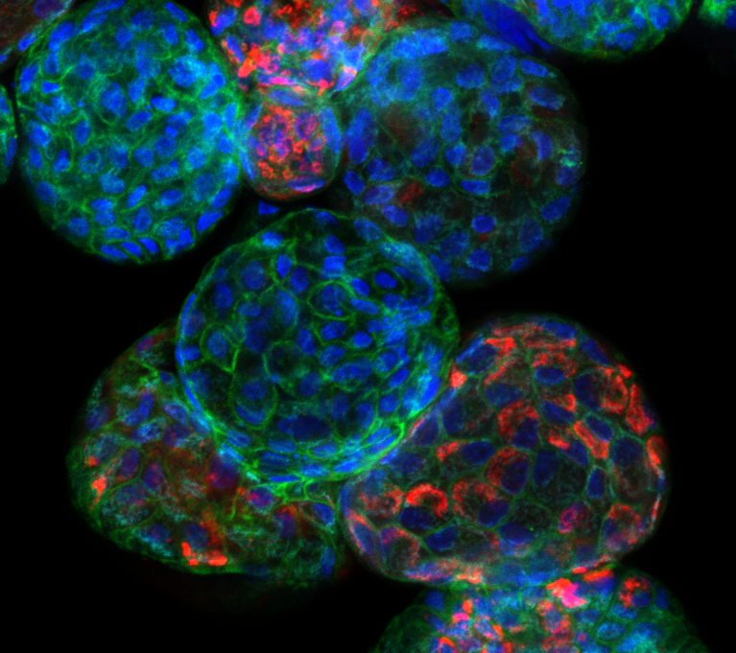
ORGANOIDS
research in 3 dimensions
Luigina De Leo
Ricercatrice Sanitaria - Laboratorio di Gastroenterologia Pediatrica

Slide 3
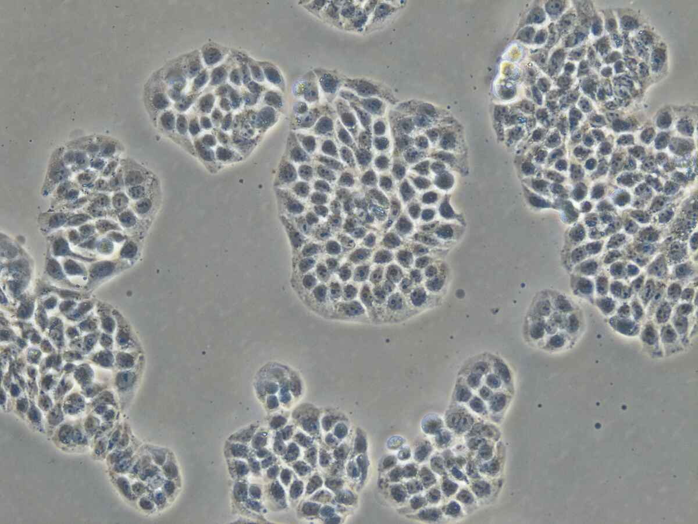
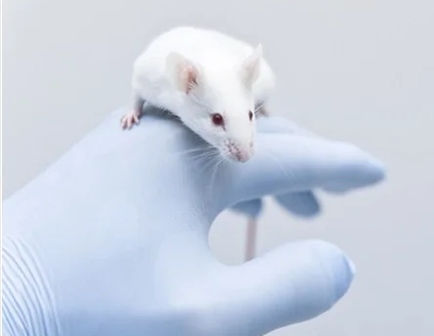
EXPERIMENTAL MODELS
In vitro - 2D cell cultures
In vivo – animal models
Reduced cell-to-cell interactions
Cells have a flat shape grown in monolayer
Cells exposed to liquid interface
Cells in contact with surface
Cell-ECM interaction only on one surface
Low differentiation
Established method
Cheap and simple
Physiological complexity
Conserved cellular interactions
Cellular heterogeneity
High costs
Species differences

Slide 4
SPECIES-SPECIFIC DIFFERENCES

Slide 5
THREE-DIMENSIONAL CELL CULTURE
Bridges the gap between 2D cell culures and in vivo models
SPHEROIDS
ORGANOIDS

Slide 6
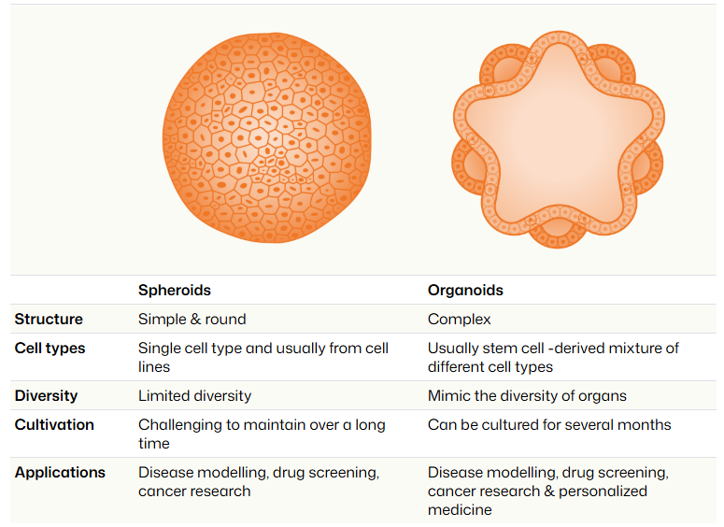
SPHEROIDS
ORGANOIDS

Slide 7
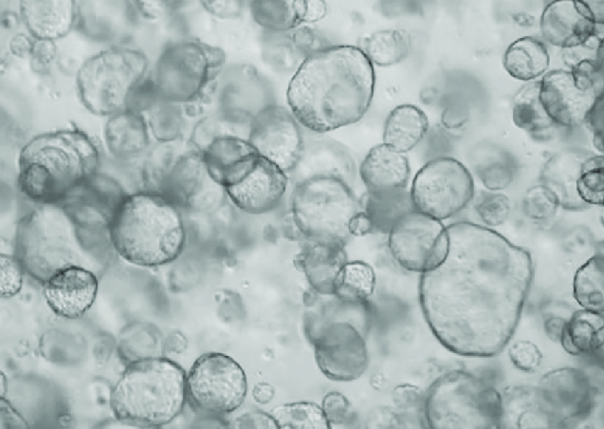
ORGANOIDS
3D cell cultures derived from stem cells that have the capability to self-organize and differentiate into structures resembling their corresponding organs
Cell-to-cell interaction
Cells grow in 3D aggregates
Adesion distributed in 3D
Cells are embedded
Cells interact with ECM
High cell differentiation rate
Species specific
Method standardization in work
Expensive

Slide 8
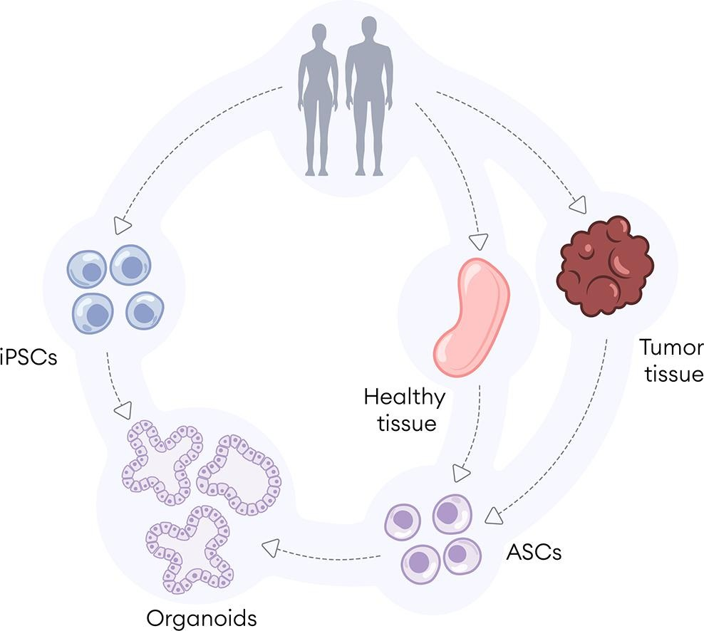
ORGANOIDS GENERATION
iPSCs – induced Pluripotent Stem Cells
ASCs – Adult stem Cells

Slide 9
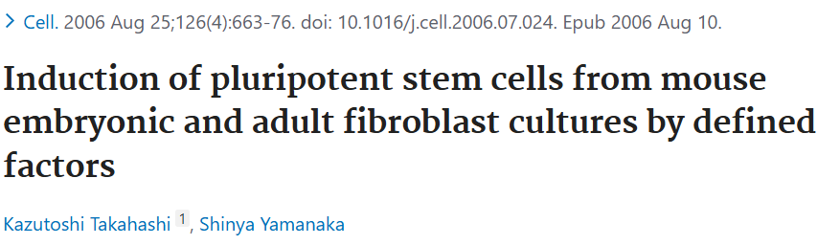
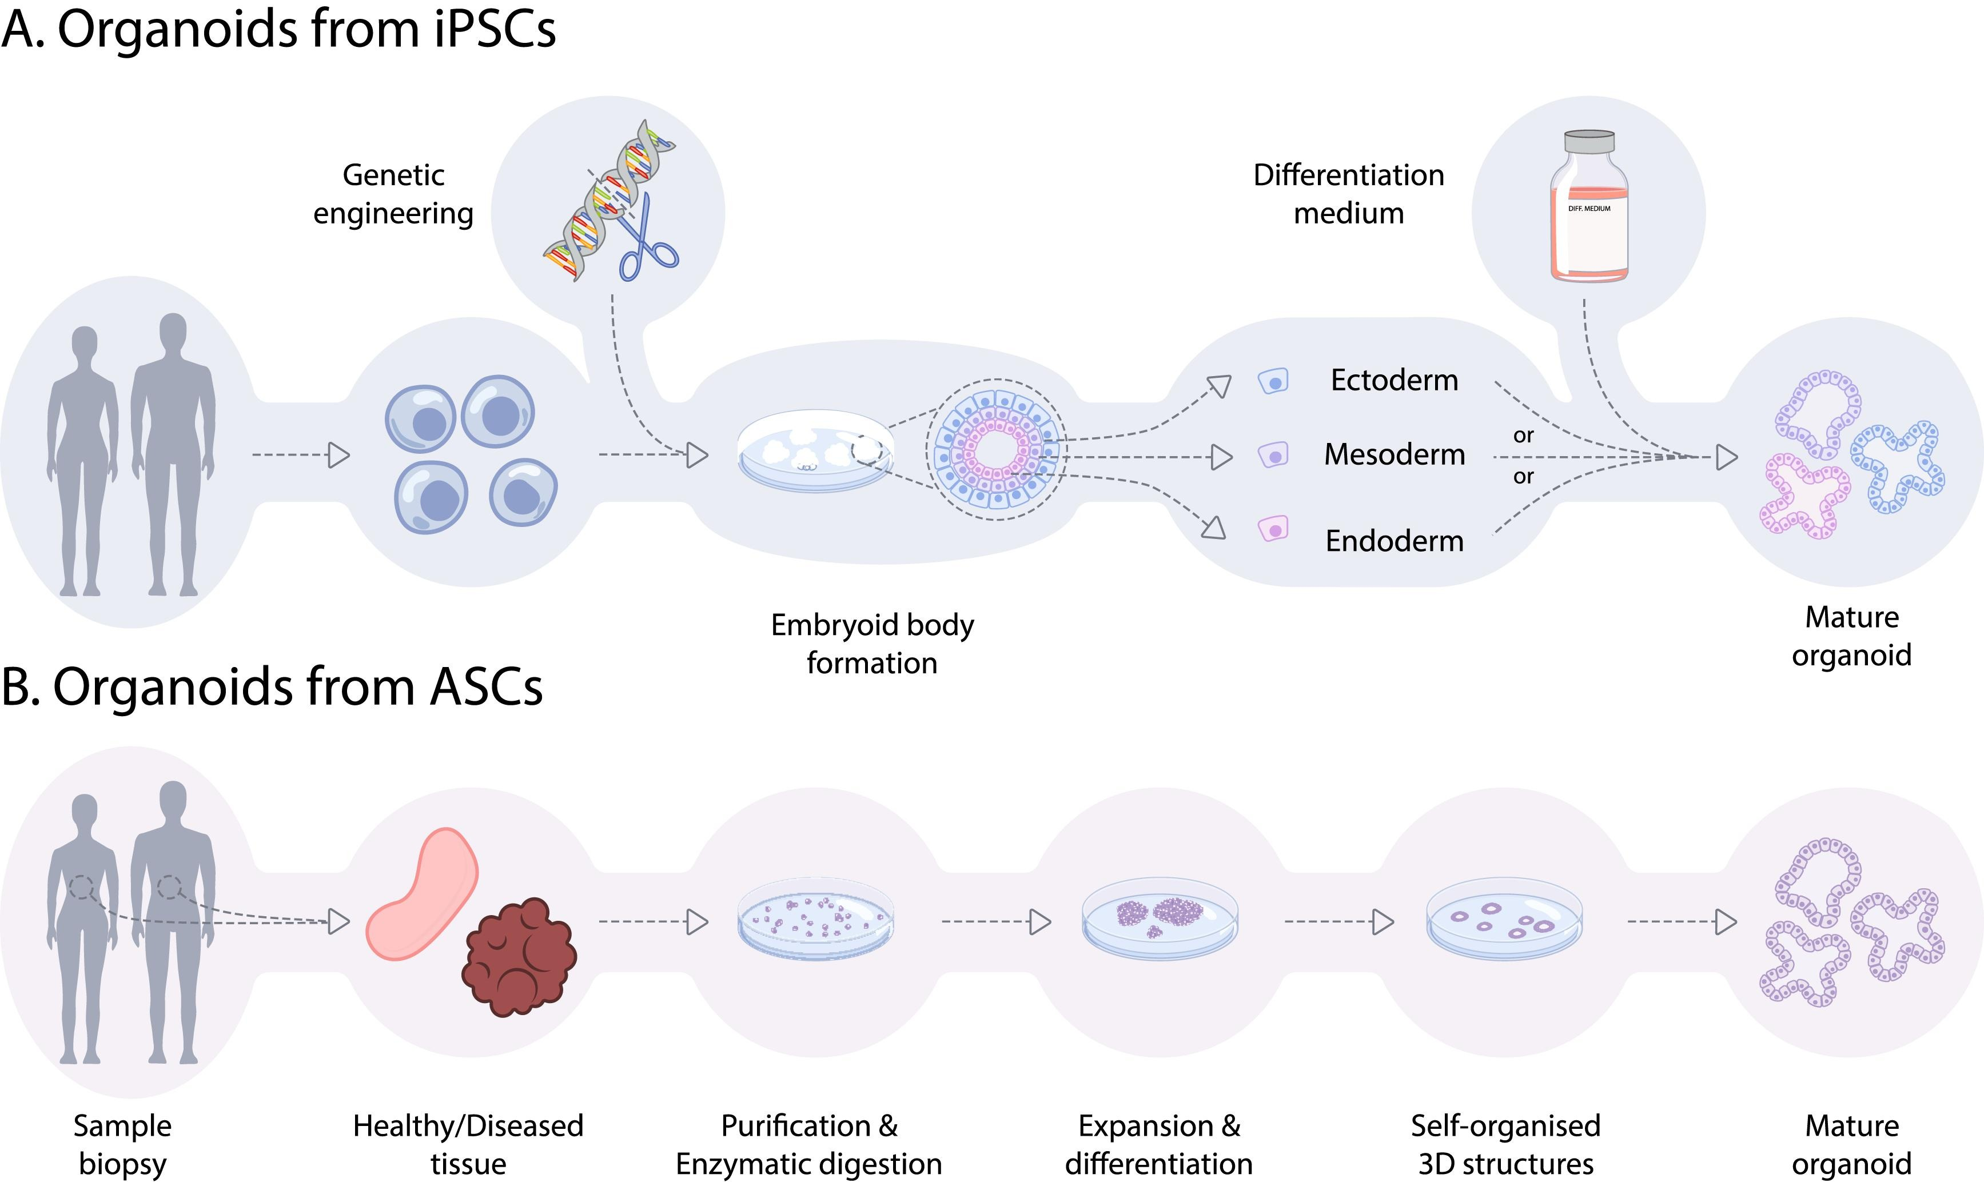
iPSCs-derived organoids
Differentiated cells can be reprogrammed into pluripotent stem cells

Slide 10
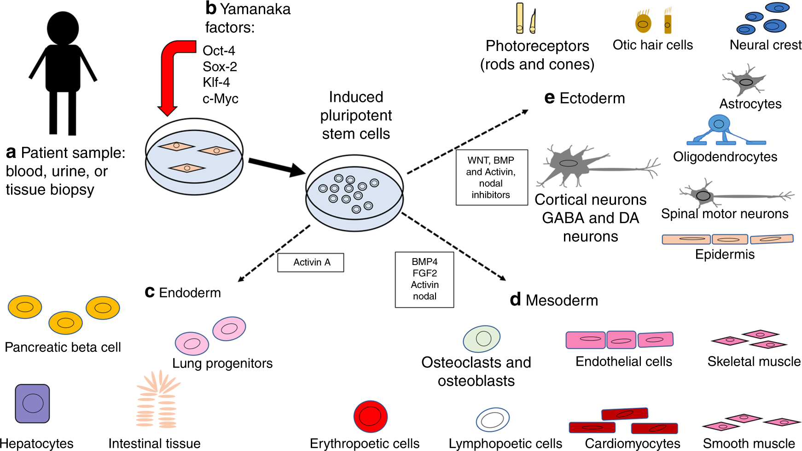
iPSCs-derived organoids

Slide 11

iPSCs-derived organoids
Protocols for the generation of iPSCs-derived organoids are complex and time consuming.
These organoids are used to model a wide range of tissues and developmental stages

Slide 12
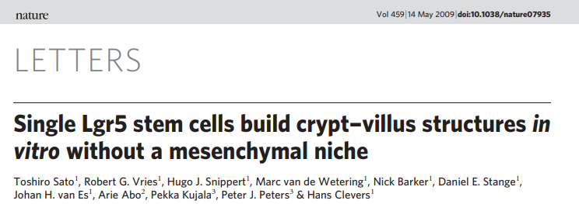
ASCs-derived organoids
LGR5+ intestinal stem cells form polarized epithelial structures with proliferative crypts and differentiated villus compartments

Slide 13
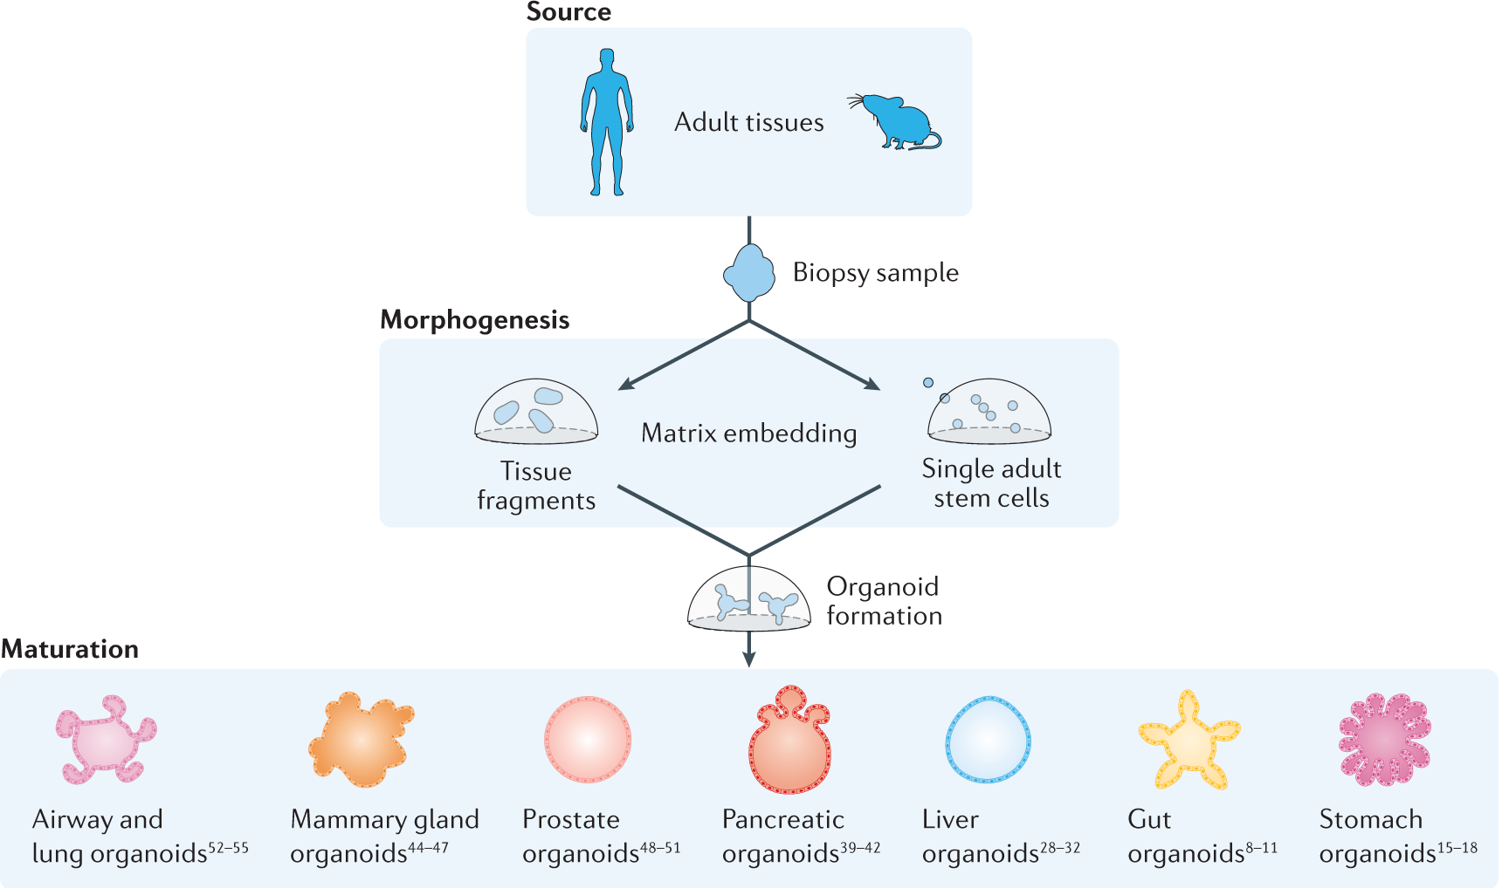
ASCs-derived organoids
Generated directly from patient tissues
Faithfully recapitulate tissue-specific characteristics and disease phenotypes
Available for a limited number of tissues

Slide 14
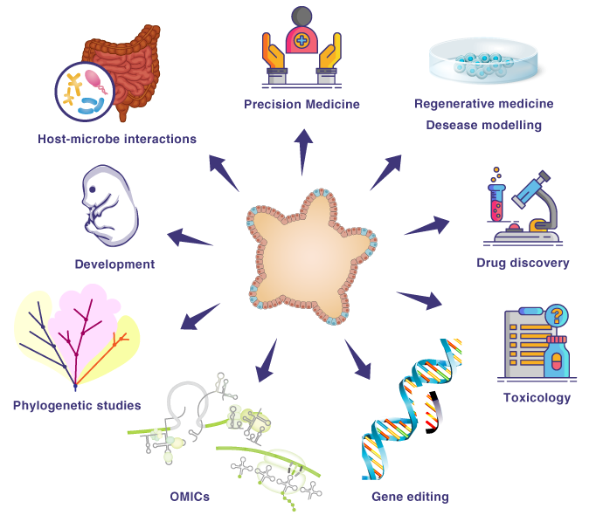
APPLICATIONS OF ORGANOIDS

Slide 15
APPLICATIONS OF ORGANOIDS

Slide 16
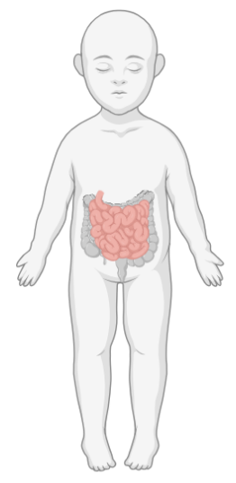
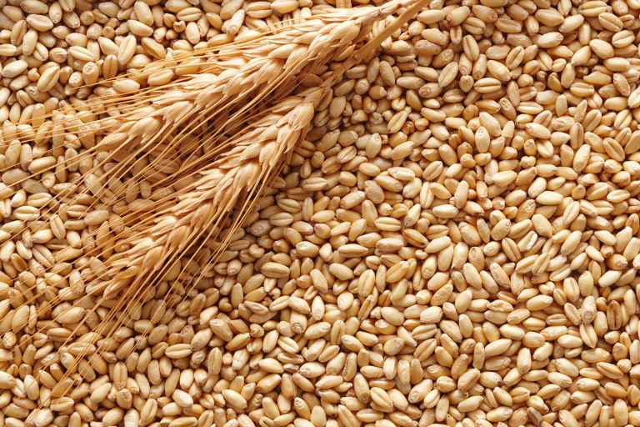
COELIAC DISEASE (CD)
Chronic autoimmune enteropathy caused by gluten ingestion
Wheat
Notes:
Origine e funzione della gliadina e dei peptidi
Il glutine è la più importante proteina di riserva del grano, della segale e dell’orzo e di molte altre specie di cereali.
Vedi https://www.my-personaltrainer.it/nutrizione/glutine.html
La gliadina e la glutenina sono le due componenti principali del glutine. La gliadina è solubile in alcool 60% mentre la glutenina è insolubile.

Slide 17
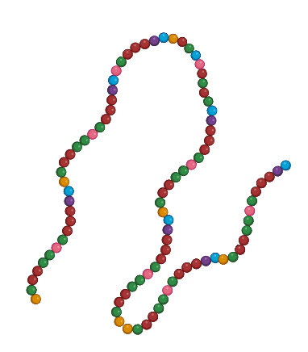

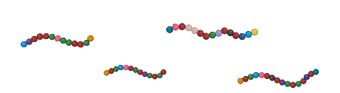
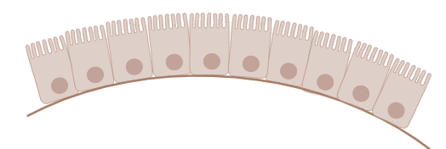
COELIAC DISEASE (CD)
Chronic autoimmune enteropathy caused by gluten ingestion
Gliadin
Gluten
Wheat
Gliadin peptides
Enterocyte
Gut lumen
Intestinal epithelium
Notes:
Origine e funzione della gliadina e dei peptidi
Il glutine è la più importante proteina di riserva del grano, della segale e dell’orzo e di molte altre specie di cereali.
Vedi https://www.my-personaltrainer.it/nutrizione/glutine.html
La gliadina e la glutenina sono le due componenti principali del glutine. La gliadina è solubile in alcool 60% mentre la glutenina è insolubile.
Gliadins, key components of gluten, are complex proteins unusually rich in prolines and glutamines and are not completely digestible by intestinal enzymes [24]. The final product of this partial digestion is a mix of peptides that can trigger host responses

Slide 18

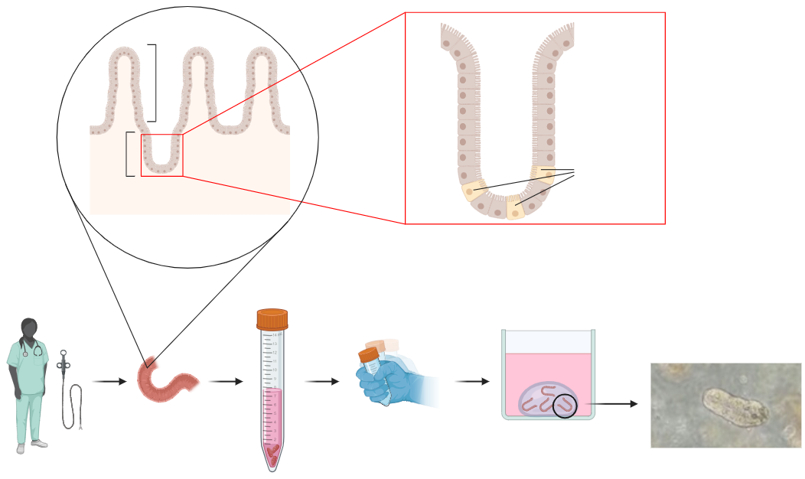
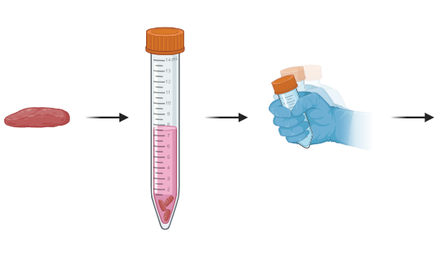
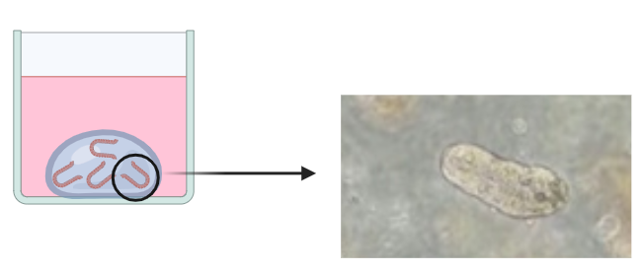
INTESTINAL ORGANOID GENERATION
Villus
Crypt
Lgr5+
Biopsy
Duodenum
Vigorous shaking
Matrigel drop
Medium containing
reducing and
chelating agents
Intestinal crypt
after seeding

Slide 19

SAMPLE COLLECTION
30 pediatric patients
10 control subjects
(patients with minor intestinal disorders not CD-related)
20 CD patients

Slide 20
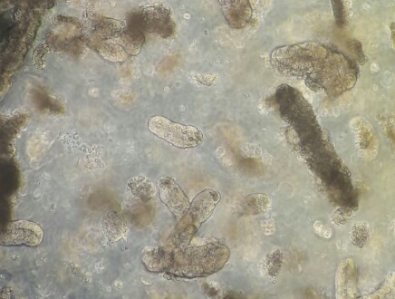
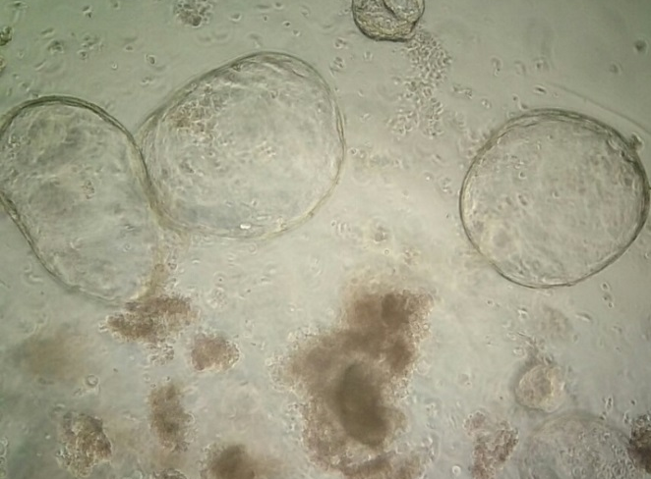
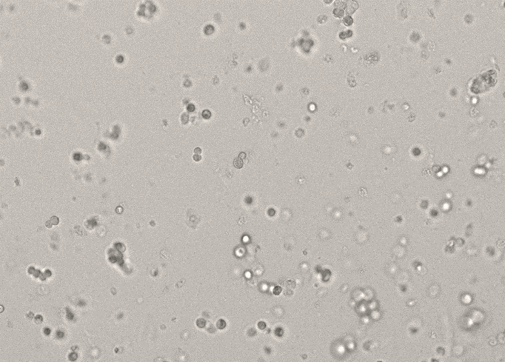
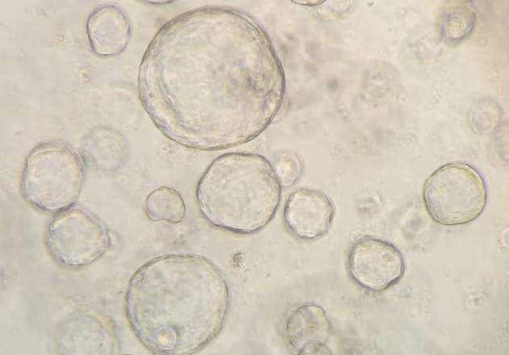
INTESTINAL ORGANOID GENERATION AND PASSAGE
Collection
Dissociation
Replating
Passage 0
Day 0
Passage 0
Day 2
Passage 1
Day 0
Passage 1
Day 5
Successful organoid culture for all the 30 patients
No relevant differences at microscope evaluation and in rate of growth and expansion between CD- and control-derived organoids
Notes:
Establishment of human small intestinal stem organoid culture was successful for all the 30 patients → intestinal inflammation typical of CD does not affect the generation of intestinal organoids
Abbiamo generato una delle più grandi banche di organoidi intestinali da celiaci e controlli. Da tutte le biopsie prelevate da tutti e 30 pazienti sono state generate con successo le colture di organoidi → Large-scale generation of a comprehensive biobank of intestinal organoids.
A prima vista non sembra esserci differenza tra organoidi generati da celiaco e da controllo. Macroscopicamente non sono diversi, crescono con la stessa velocità e tutti quanti riusciamo a portarli avanti per almeno 10-15 generazioni. Quindi, a prima vista sembra che non ci sia una diversità. Sono invece diversi dal punto di vista della reattività con la gliadina?

Slide 21

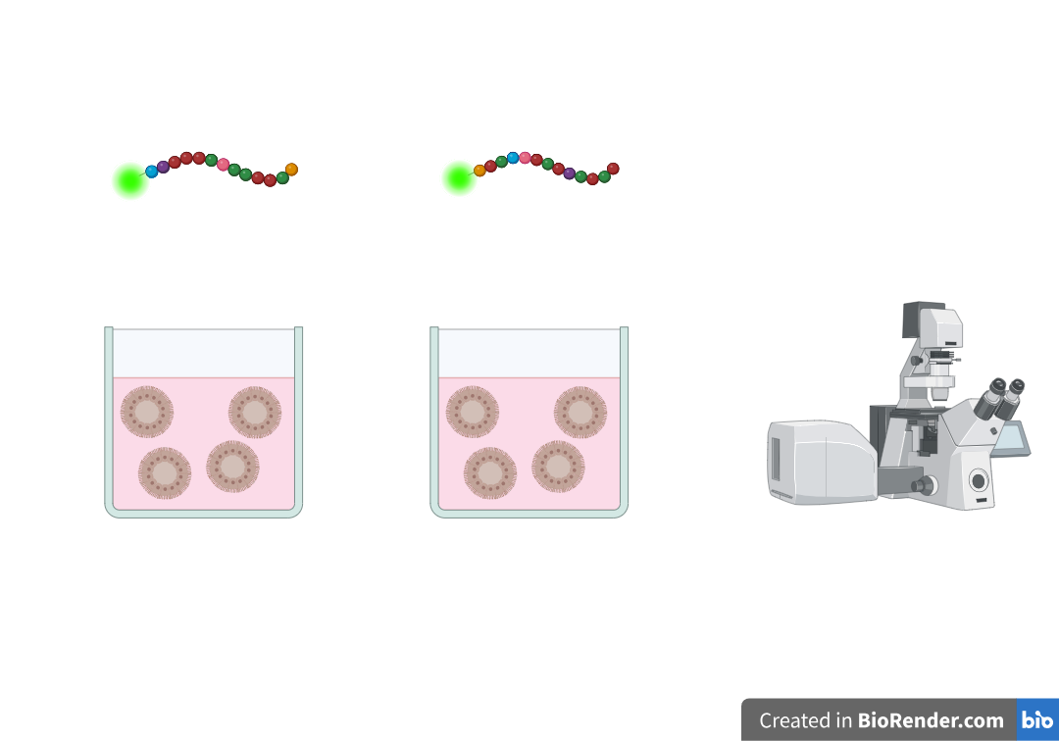
GLIADIN PEPTIDE - INTESTINAL ORGANOID INTERACTION
Gliadin
p31-43
LGQQQPFPPQQPY
scramble p31-43
YQPLFQPQGPQPQ
Gliadin peptides
Confocal microscopy
Notes:
FITC = fluoresceina isotiocianato
Abbiamo visto che la gliadina è una miscela complessa di proteine. Di questa, è stato recentemente caratterizzato uno di questo peptidi, che si chiama p31-43 e risulta essere tossico in un modello cellulare (Caco-2). Cosa succede se mettiamo gli organoidi in incubazione con questo peptide? Per controllare questa cosa abbiamo preso un altro peptide che è lo scramble.

Slide 22
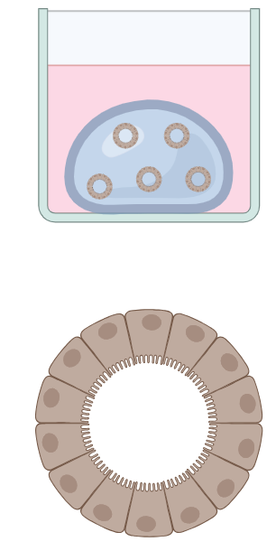
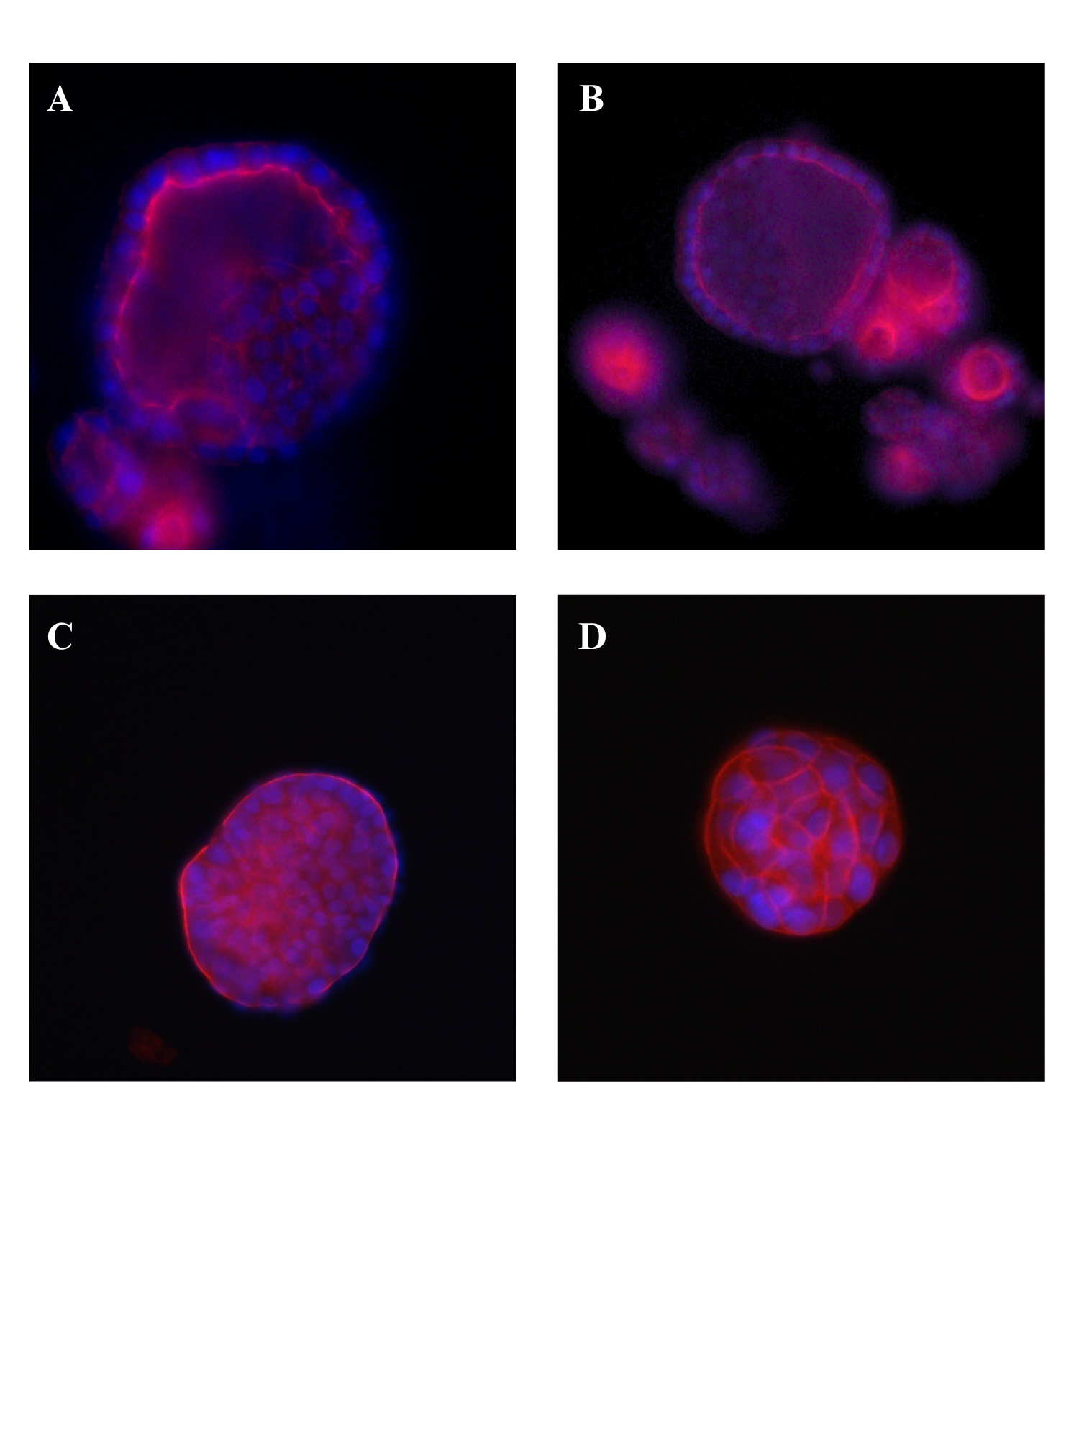
POLARITY OF INTESTINAL ORGANOIDS
Intestinal organoids in a Matrigel drop
Basolateral-out intestinal organoid
Hoechst 33342 (nuclei)
Alexa Fluor 594 phalloidin (F-actin)

Slide 23
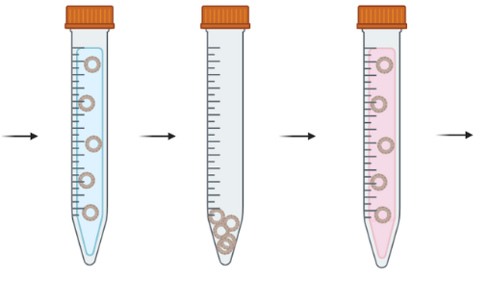
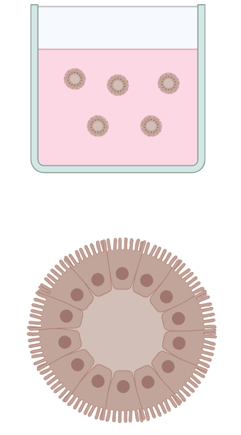
POLARITY OF INTESTINAL ORGANOIDS
Intestinal organoids in a Matrigel drop
Matrigel elimination by centrifugation
Intestinal organoids in growth medium
Basolateral-out intestinal organoid
Apical-out intestinal organoid
Notes:
Dire «ABBIAMO MESSO A PUNTO» → abbiamo lavorato per mettere a punto un protocollo che ci permetta di invertire la polarità dell’organoide.

Slide 24
POLARITY OF INTESTINAL ORGANOIDS
Intestinal organoids in a Matrigel drop
Matrigel elimination by centrifugation
Intestinal organoids in growth medium
Basolateral-out intestinal organoid
Apical-out intestinal organoid
The effectiveness of the procedure in reversing organoid’s polarity is confirmed
Hoechst 33342 (nuclei)
Alexa Fluor 594 phalloidin (F-actin)
Notes:
Dire «ABBIAMO MESSO A PUNTO»
IN UN MEZZO ADEGUATO SPONTANEAMENTE SI GIRANO → VEDI IMMAGINE.

Slide 25
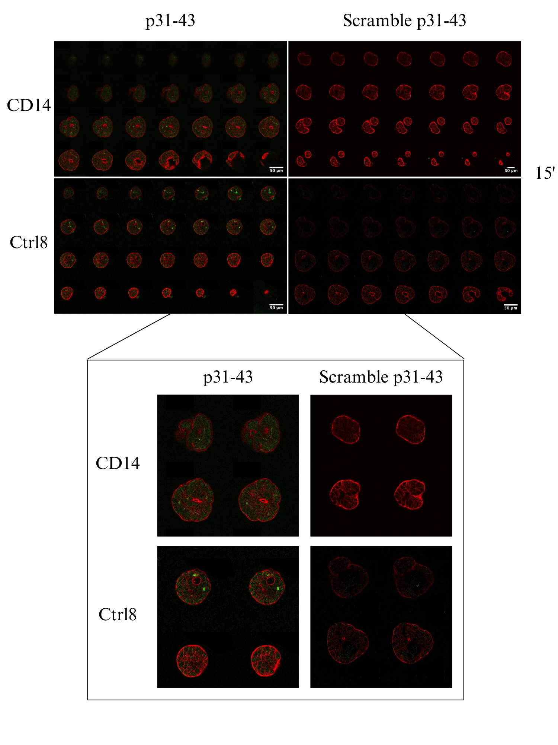
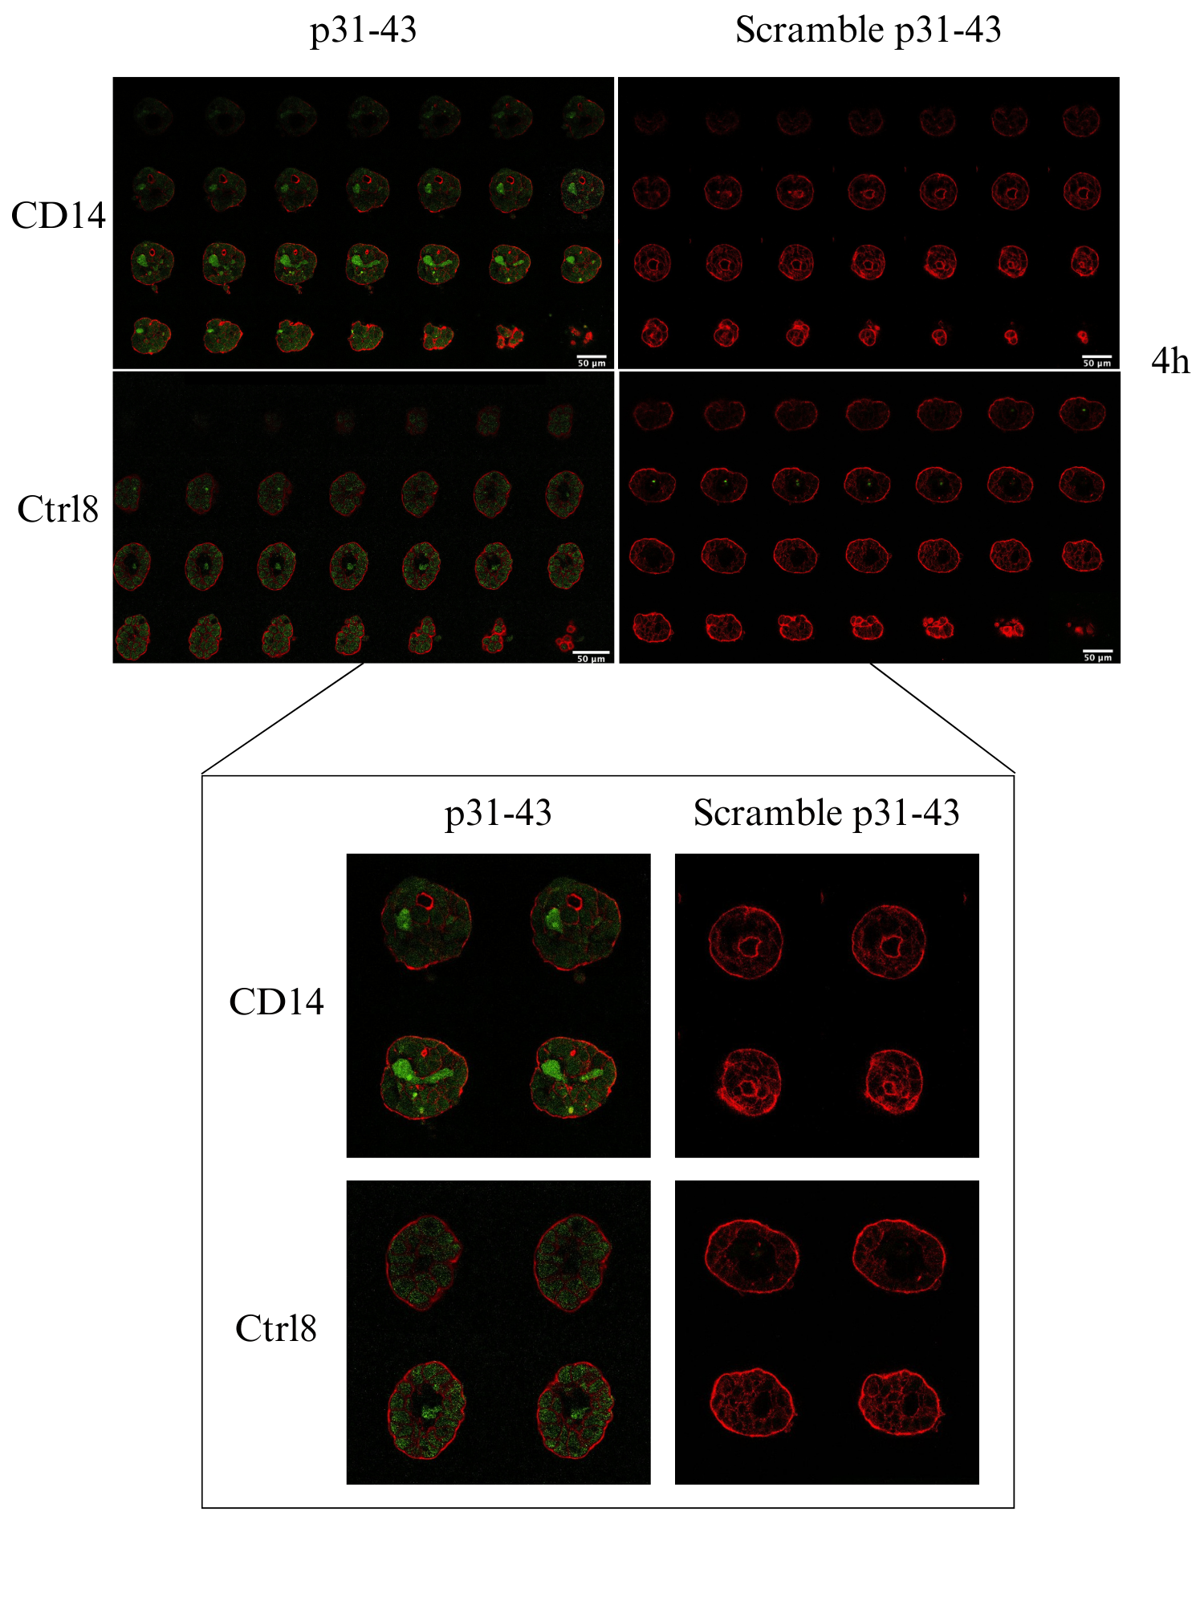
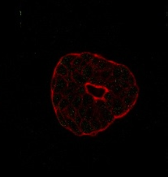
GLIADIN PEPTIDE - INTESTINAL ORGANOID INTERACTION
p31-43
Scramble
p31-43
Scramble
CD
Specificity of interaction
Progressive internalization
Ctrl
Alexa Fluor 594 phalloidin (F-actin)
FITC (peptide)
15-minute incubation
4-hour incubation
Notes:
CHIAMALO SEMPRE PEPTIDE TOSSICO, no p31-43
Specificare che nelle immagini si osserva una sezione di un organoide, sia per il celiaco che per il controllo, entrambi incubati con i due diversi peptidi. Quello che devo guardare è la fluorescenza in verde: si vede che per il celiaco e per il controllo è uguale.

Slide 26
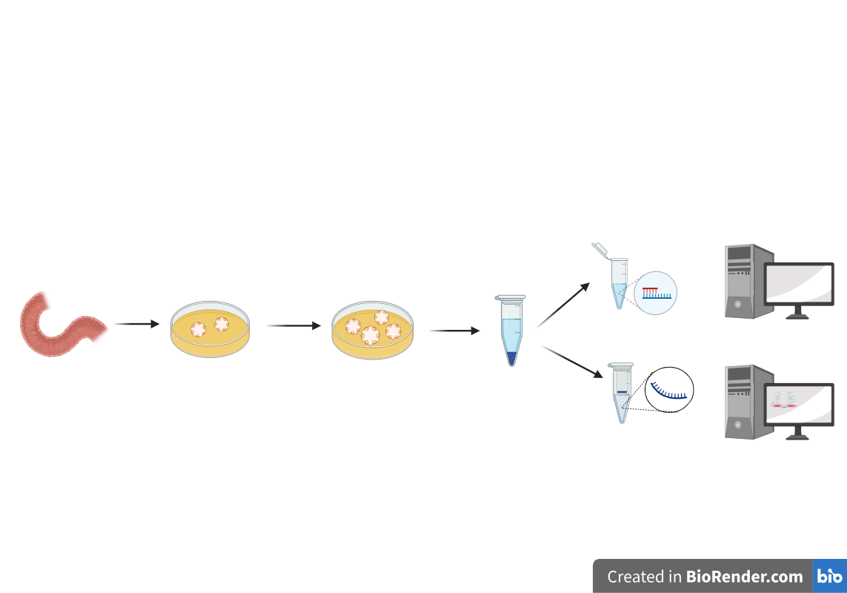
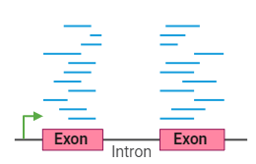
CONCLUSIONS
The toxic peptide p31-43 specifically interacts with IEOs → IEO is a good model to study the role of the intestinal epithelium in the pathogenesis of CD.
NEXT STEPS
Confocal microscopy:
  to increase the number of IEOs;
  to quantify the peptide internalization.
Gene expression profiling to identify genes and pathways dysregulated by gliadin peptide.
IEOs - p31-43 incubation

Slide 27
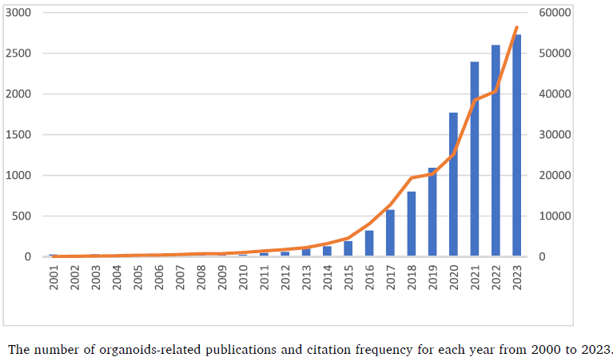
Number of organoids-related publications and citations
Is organoid a well-established model?

Slide 28
Characterization of intestinal organoids over passages

Slide 29
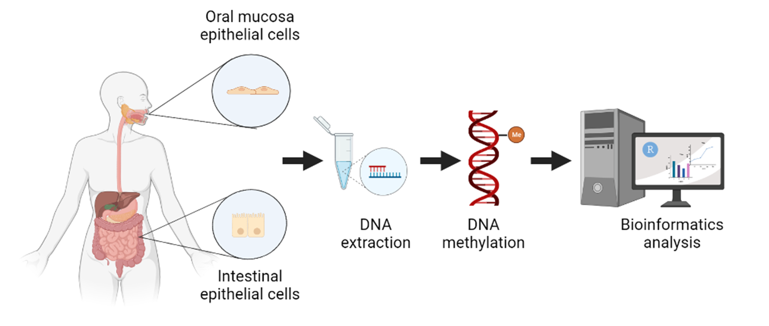
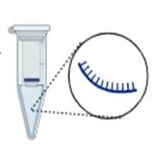
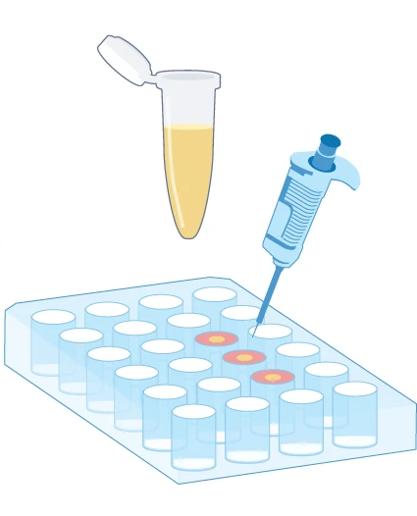
Characterization of intestinal organoids over passages
DNA extraction
DNA methylation (DNAm) analysis
passaging
Duonenum
IEOs generation
Collection of IEOs every 5 passages
(from passage 1 to 30)
RNA extraction
Gene expression analysis
Cytokine measurement after inflammatory stimuli
Functional analysis
Created with BioRender

Slide 30
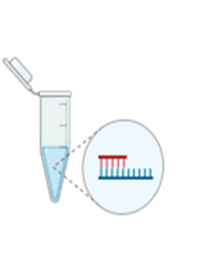

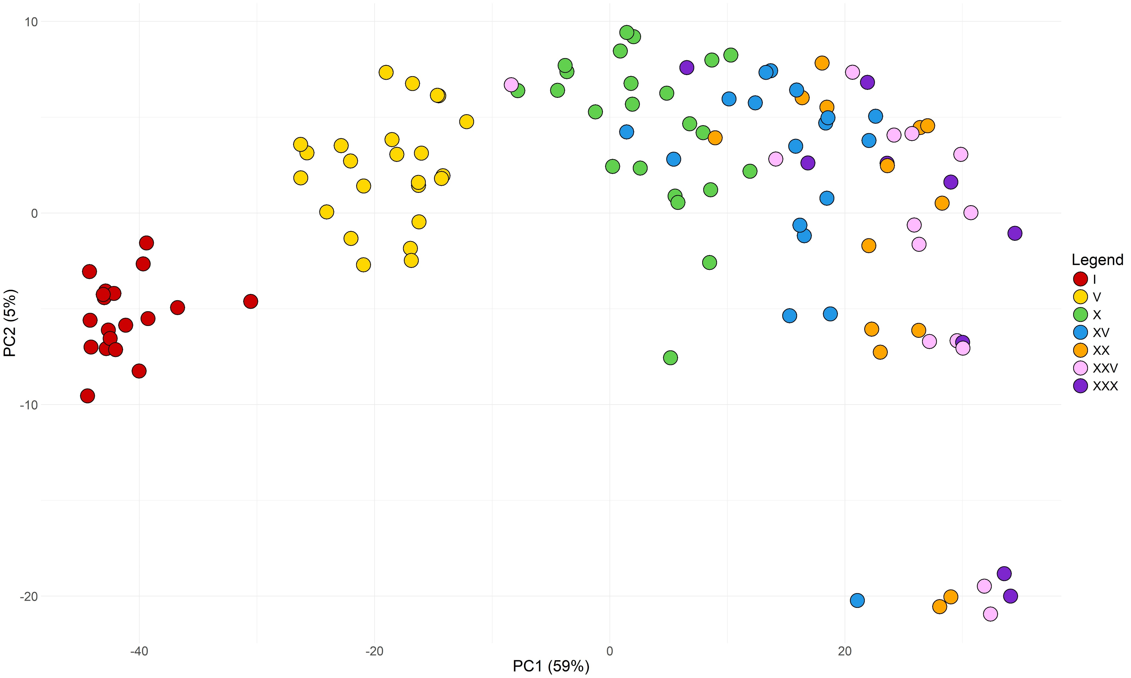
RESULTS - DNA METHYLATION
Principal Component Analysis (PCA) revealed:
  associations between DNAm profile and passage;
  reproducible effect of passage on DNAm profile of organoids generated from different patients.

Slide 31
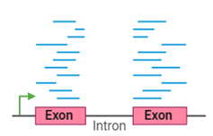
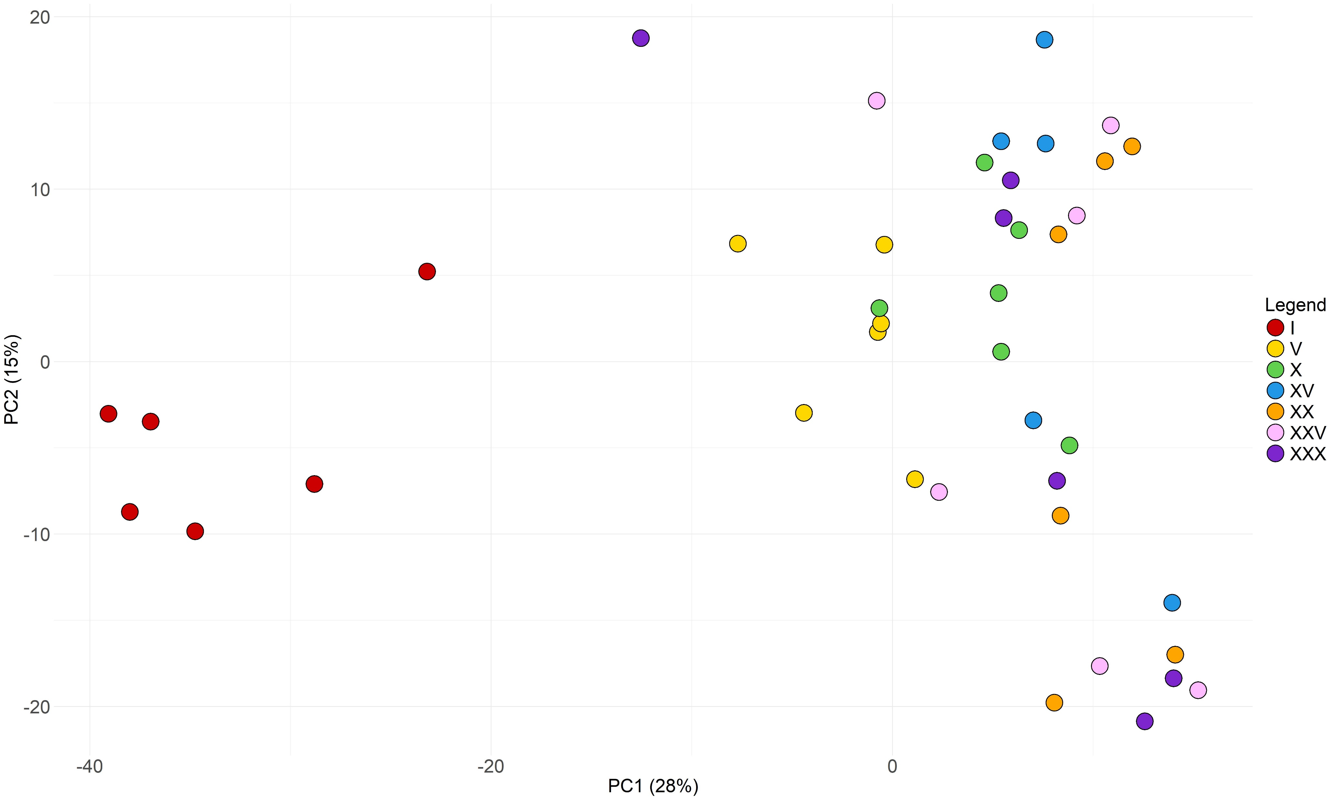
RESULTS – GENE EXPRESSION
Principal Component Analysis (PCA) plot shows differences in the global transcriptional profile between IEOs at passage 1 and IEOs at higher passages (5-30).

Slide 32
CONCLUSIONS
DNAm and transcriptomic data suggest that culture duration of IEOs could affect experimental results;
In the experimental design the passage of IEOs has to be considered.

Slide 33
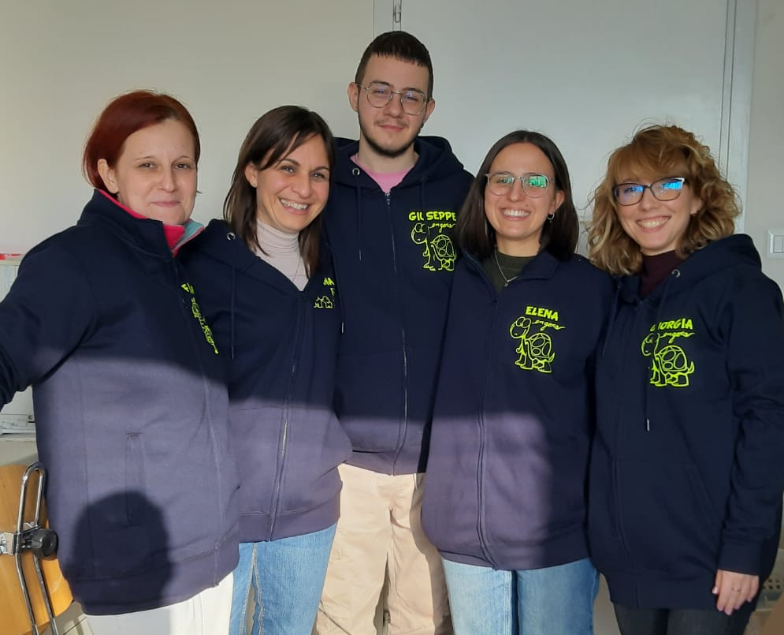
Giuseppe
Fabiana
Elena
Giorgia

