Slide 1

DATA PROTECTION AND CYBERSECURITY IN eHEALTH SYSTEMS

Slide 2
WHAT’S HACKING – OPEN DISCUSSION
Denial-of-service attack and DDoS
Spoofing
Mixed threat attack
Man-in-the-middle
Man-in-the-browser
ARP poisoning
Ping flood
Ping of death
Smurf attack
Format string attack
Supply chain attack
Social engineering
Exploit
Thermal attack
Smudge attack
Shoulder surfing (computer security)
Network
Wiretapping
Fiber tapping
Port scan
Idle scan
Keystroke logging
Data scraping
Backdoor
Buffer overflow
Heap overflow
Stack overflow
Little excerpt from https://en.wikipedia.org/wiki/Cyberattack

Slide 3
WHAT’S SECURITY – OPEN DISCUSSION

Slide 4
eHEALTH SYSTEM SECURITY
BANKING
Data
OWNER
=
Data
USER
Bank account holder
Bank account holder
MEDICINE
Data
OWNER
≠
Data
USER
Patient
Healthcare professional
In medicine the owner of data does not have the knowledge to use it → data have to be shared with others

Slide 5
SHARED CARE
Shared care =
«A continuous and coordinated activity of different persons in different institutions under employment of different methods at different times in order to be able to help patients optimally with respect to their medical, physiological, an social being»
Data sharing and system integration is required to allow all the healthcare team to ensure continuity of care.

Slide 6
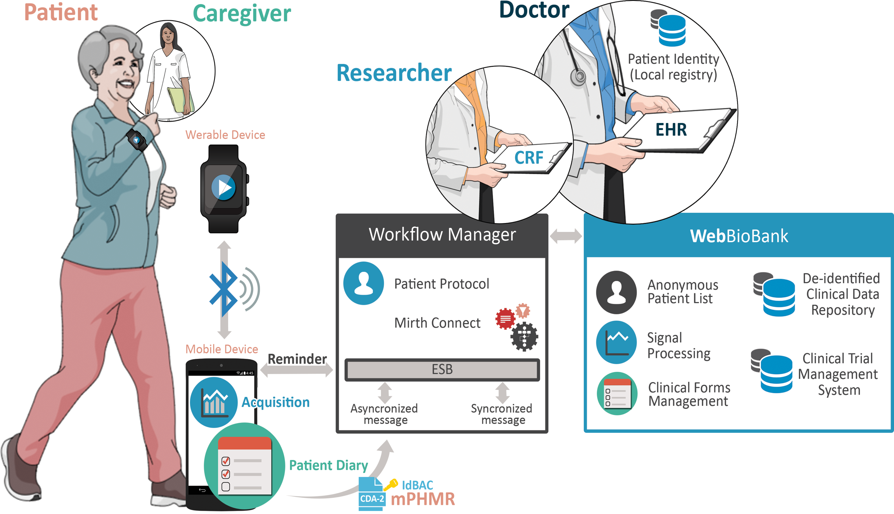
COMPLEX SCENARIOS
Data transmission over different networks
Data storage
Multiple access to the system

Slide 7
TYPES OF SOFTWARE
Software as accessory to medical device
‘accessory for a medical device’ means an article which, whilst not being itself a medical device, is intended by its manufacturer to be used together with one or several particular medical device(s) to specifically enable the medical device(s) to be used in accordance with its/their intended purpose(s) or to specifically and directly assist the medical functionality of the medical device(s) in terms of its/their intended purpose(s);
Software as medical device (SaMD)
The term “Software as a Medical Device” (SaMD) is defined as software intended to be used for one or more medical purposes that perform these purposes without being part of a hardware medical device

Slide 8
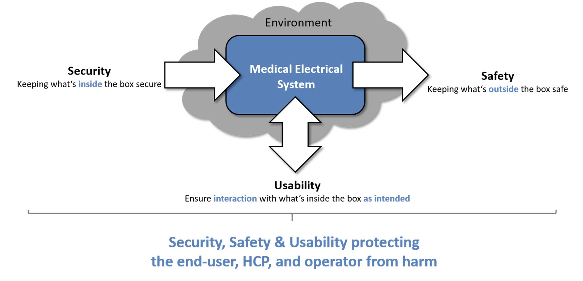
SECURITY, SAFETY, AND USABILITY IN COMPLEX SYSTEMS
From: ISO/IEEE 11073-40102:2022(E)

Slide 9
SOFTWARE QUALITY
The software should perform its intended functions to meet its intended use (requirements)
The software is safe (does not create injury or damage to the patient)
The software provides a reasonable level of availability, reliability, and correct operation;
The software is reasonably secure from cybersecurity intrusion and misuse.

Slide 10
GENERAL APPROACH TO SOFTWARE QUALITY
Performance verification
Risk assessment

Slide 11
RISK ANALYSIS
Risk
Patient harm
Risk Analysis
The combination of the probability of occurrence of harm and the severity of that harm.
Physical injury or damage to the health of patients, including death.
The systematic use of available information to identify hazards and to estimate the risk.
Threat
a process that magnifies the likelihood of a negative event, such as the exploit of a vulnerability.
Vulnerability
a weakness in the infrastructure, networks or applications that potentially exposes to threats.

Slide 12
CYBERSECURITY RISKS
Process of preventing unauthorized access, modification, misuse or denial of use, or the unauthorized use of information that is stored, accessed, or transferred from a medical device to an external recipient.
DATA AND INFORMATION PROTECTION
PROTECTION OF SOFTWARE FUNCTIONALITY
DATA PRIVACY/ CONFIDENTIALITY
PATIENT’S SAFETY

Slide 13
TYPES OF CYBERSECURITY RISKS
Loss of authenticity
the property of being genuine and being able to be verified and trusted; confidence that the contents of a message originates from the expected party and has not been modified during transmission or storage
Loss of availability
the property of data, information, and information systems to be accessible and usable on a timely basis in the expected manner (i.e. the assurance that information will be available when needed).
Loss of integrity
the property of data, information and software to be accurate and complete and have not been improperly modified
Loss of confidentiality
the property of data, information, or system structures to be accessible only to authorized persons and entities and are processed at authorized times and in the authorized manner, thereby helping ensure data and system security. Confidentiality provides the assurance that no unauthorized users (i.e., only trusted users) have access to the data, information, or system structures.

Slide 14
LEVEL OF CYBERSECURITY RISK
Higher cybersecurity risk
The device is capable of connecting (e.g., wired, wirelessly) to another medical or non-medical product, or to a network, or to the Internet; AND
A cybersecurity incident affecting the device could directly result in patient harm to multiple patients.
Examples: implantable cardioverter, defibrillators (ICDs), pacemakers, left ventricular assist devices (LVADs), brain stimulators and neurostimulators, dialysis devices, infusion and insulin pumps, and the supporting connected systems that interact with these devices such as home monitors and those with command and control functionality such as programmers.
Standard cybersecurity risk
Medical device not meeting the criteria for higher risk

Slide 15
PROTECTION OF SOFTWARE
Neuromodulation devices
Pacemakers
Implantable defibrillators

Slide 16
PHYSICAL SAFETY: DATA BACKUP
Service interrupted (earthquakes, fire, energy, malware)
Destruction (natural events)
Theft (or delete)
POSSIBLE CAUSES
Local backup (immediate, RAID, mirror disks)
Remote backup with short recovery time (depends on the system and the network)
Remote backup with long recovery time ( >30 km, non continuous)
BACKUP LEVELS

Slide 17
DATA PROTECTION: BASIC CONCEPTS
Authentication:
Process of verifying the identity of an object/actor
Identification
Autentication that defines univocally the identity of an object/actor
Authorization
Process of allowing to use a specific object or accessing a specific information
Access control
Process guaranteeing that the content of an object is known only to its creator or to whom is allowed to use it
Accountability
Signature of who is responsible for the content of an object (cannot be denied)
Audit
Process that guarantee that the security measures declared are properly set up and working

Slide 18
CYBERSECURITY CORE CONCEPTS: CIA
Confidentiality
defined by the International Organization for Standardization in ISO/IEC 27002 as “ensuring that information is accessible only to those authorized to have access.”
confidentiality breach primarily means eavesdropping on information somewhere between the source (e.g., sensor) and the receiver (e.g., personal computer, physician’s computer, hospital server) or unauthorized access to stored information
Integrity
Aka authenticity: data is not modified or deleted without authorization.
Integrity is violated when information is changed by a user that is not authorized to do so (directly on the devices e.g., because of a virus or on the way from information source to receiver)
Authentication technologies help ensure that the original data is not altered or deleted during the transfer. They also provide technological means to check if the data came from the right sender and not from a sender that only pretends to be the sender (electronic signatures and certificates).
Availability
The information is available when it is needed by authorized users.
Non repudiation
undeniable and immutable account about where the received information originates, where it is going, who is requesting it, and who is providing it, in such a way that no entity can deny what its contribution was to the overall activity.
Non-repudiation can be achieved through electronic signatures and audit trails.

Slide 19
CYBERSECURITY MEASURES
Prevent all unauthorized use
Ensure code, data, and execution integrity
Protect confidentiality of data
Content of Premarket Submissions for Management of Cybersecurity in Medical Devices
Draft Guidance for Industry and Food and Drug Administration Staff
October 2018

Slide 20
PREVENT UNAUTHORIZED USE: ACCESS TRUSTED
Limit access to devices through the authentication of users
Use automatic timed methods to terminate sessions within the system where appropriate for the use environment.
Employ a layered authorization model by differentiating privileges based on the user role (e.g., caregiver, patient, health care provider, system administrator) or device functions.
Use appropriate authentication (e.g., multi-factor authentication to permit privileged device access to system administrators, service technicians, maintenance personnel).
Strengthen password protection. Do not use credentials that are hardcoded, default, easily-guessed, easily compromised (i.e., passwords which are the same for each device; unchangeable; can persist as default; difficult to change; and vulnerable to public disclosure). Limit public access to passwords used for privileged device access.
Consider physical locks on devices and their communication ports to minimize tampering.

Slide 21
AUTHENTICATION AND IDENTIFICATION
USER
SERVICE PROVIDER
AND port
Access request
Access request acknowledge
Identification request
Credentials presentation
Identification received
Access verified
Access list verification
The type of access list depends on the method used to implement the checkpoint
Access granted
Access request
Decision
Decision acknowledge
Decision notification

Slide 22
METHODS OF AUTHENTICATION
AUTHENTICATION
METHODS
CIÒ CHE SI SA (informazione)
Informazioni che solo il soggetto può conoscere
Password, passphrase, PIN, codice di accesso
Facilità di individuazione/difficolta di memorizzazione
CIÒ CHE SI HA (oggetti)
Basati su qualcosa che l’individuo possiede: Smart card, badge,
Custodia del dispositivo/facilità di smarrimento
Necessità di punti lettori
CIÒ CHE SI È (caratteristiche personali)
Riconoscimento biometrico=valutazione delle caratteristiche fisiche o comportamentali del soggetto
Non possono essere segreti
Identificazione non certa

Slide 23
BIOMETRICS
SEGNALE O IMMAGINE
SENSORE
ESTRAZIONE CARATTERISTICHE
CARATTERISTICHE
CONFRONTO CON TEMPLATE
TEMPLATE
PUNTEGGIO DI MATCHING
DECISIONE
SOGLIA

Slide 24
THRESHOLD CRITICALITIES
L’identificazione basata su biometria non è certa perchè è basata su caratteristiche personali che non sono sempre stabili
Elementi di variabilità:
  Variabilità intrinseca della caratteristica biometrica (es: voce rauca, mano sudata, etc.)
  Variabilità introdotta dal sensore (es: sensore sporco)
  Variabilità del metodo di misurazione (es: posizione dell’occhio rispetto al sensore)
  Fattori esterni (es: luminosità dell’ambiente, rumore di fondo)
  Incertezza della stima della caratteristica (metodo matematico di stima o ricostruzione)
Esiste una probabilità di errore calcolabile utilizzando misure di accuratezza

Slide 25
ACCURACY MEASURES
Matrice di confusione (in epidemiologia)
REALE
 | POSITIVO | NEGATIVO
POSITIVO | VERI POSITIVI | FALSI POSITIVI
NEGATIVO | FALSI NEGATIVI | VERI NEGATIVI
PREDETTO/STIMATO
TOTALE = VP+FN+FP+VN
ACCURATEZZA = (VP+VN)/TOTALE
SENSIBILITÀ = VP/(VP+FN) – proporzione di valori riconosciuti come positivi tra tutti i positivi
SPECIFICITÀ = VN/(FP+VN) – proporzione dei valori riconosciuti come negativi tra tutti i negativi

Slide 26
FAILURE TO ENROLL
Nei sistemi biometrici si valuta anche quante volte il sistema non riesce ad acquisire il campione con qualità sufficiente per poter procedere all’identificazione.

Slide 27
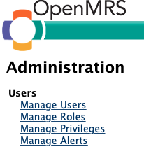
DEFINITION OF USER ROLES

Slide 28
DEFINITION OF USER ROLES

Slide 29
AUTENTICATE AND CHECK CRITICAL COMMANDS
Use authentication to prevent unauthorized access to device functions and to prevent unauthorized (arbitrary) software execution.
Require user authentication before permitting software or firmware updates, including those affecting the operating system, applications, and anti-malware.
Use cryptographically strong authentication resident on the device to authenticate personnel, messages, commands and as applicable, all other communication pathways
Authenticate all external connections. For example, if a device connects to an offsite server, then it and the server should mutually authenticate, even if the connection is initiated over one or more existing trusted channels.
Authenticate firmware and software. Verify authentication tags (e.g., signatures, message authentication codes (MACs)) of software/firmware content, version numbers, and other metadata. The version numbers intended to be installed should themselves be signed /haveMACs. Devices should be electronically identifiable (e.g.,model number, serial number) to authorized users.
Perform authorization checks based on authentication credentials or other irrefutable evidence. For example, a medical device programmer should have elevated privileges that are granted based on cryptographic authentication or a signal of intent that cannot physically be produced by another device, e.g., a home monitor, with a software-based attack.
Devices should be designed to “deny by default,” i.e., that which is not expressly permitted by a device is denied by default. For example, the device should generally reject all unauthorized connections (e.g., incoming TCP, USB, Bluetooth, serial connections).
The principle of least privilege should be applied to allow only the level of access necessary to perform a function.

Slide 30

CRYPTOGRAPHY
CRYPTOGRAPHY is the practice and study of techniques for secure communication in the presence of third parties (called adversaries). More generally, it is about constructing and analyzing protocols that prevent adversaries to understand the content of the message
The word cryptography comes from the Greek words kryptos meaning hidden and graphein meaning writing

Slide 31
CRYPTOGRAPHY ARCHITECTURE
Mathematical process or method that transforms a plain text into a non-readable text
ALGORITHM
Information (usually alphanumeric) that is able to modify te behaviour of the cryptographyc algorithm.
KEY (k_{i})
m=D(c,k₂)
k₁
c=E(m,k₁)
Encrypt E
Original text (plain)
Alphabetic text m
Alphabetic text c
Coded text
k₂
Decrypt D
Encode E’
Original text (plain)
Digital Alphabetic text m’
Digital Alphabetic text c’
Coded text
Dencode D’

Slide 32
KERCKHOFFS PRINCIPLE
The security of a cryptosystem should depend solely on the secrecy of the key and the private randomizer.
A method of secretly coding and transmitting information should be secure even if everyone knows how it works

Slide 33
SYMMETRIC AND ASIMMETRIC CRYPTOGRAPHY
SENDER
RECEIVER
Source
Message
(plain)
Decrypted
Message
(plain)
k1=k2 → symmetric key cryptography
k1<>k2 → asymmetric key cryptography:
k1 receiver public key
k2 receiver private key
k1
coding
decoding
k2
Coded
Message
Coded
Message

Slide 34
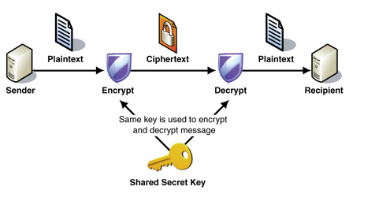
SYMMETRIC ENCRYPTION
The sender and the recipient have to share the key
The key is used both to encrypt and to decrypt

Slide 35
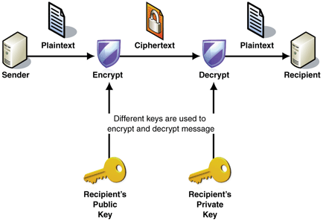
ASYMMETRIC ENCRYPTION
The public key of the recipient is used only to encrypt data (cannot decrypt). It can be openly distributed to those who want to encrypt a message to the recipient.
The private key of the recipient is used to decrypt messages, and only the recipient must be able to access it.

Slide 36
ASYMMETRIC: TWO LOCKERS ALGORITHM
SENDER A
RECEIVER B
The client (e.g., your browser) generates a secret (pre-master secret).
1
server’s public key
It encrypts it with the server’s public key (from its TLS certificate).
2
The server decrypts it with its private key.
Both sides now derive symmetric session keys for encrypting all future data.
3

Slide 37
ASYMMETRIC VERSUS SYMMETRIC ENCRYPTION
 | Advantages | Disvantages
Symmetric key | Easy to implement Low computational requirements → speed execution | Need to share the key
Asymmetric key | Different keys for the sender and the receiver Knowing the public key does not allow decrypting the message | More difficult to implement High computational requirements → slow execution

Slide 38
SECURE SOCKETS LAYER
The Secure Sockets Layer (SSL) is a computer networking protocol that manages server authentication, client authentication and encrypted communication between servers and clients.
SSL uses a combination of public-key and symmetric-key encryption to secure a connection between two machines, typically a Web or mail server and a client machine, communicating over the Internet or an internal network.

Slide 39
HOW SSL WORKS
The SSL protocol includes two sub-protocols: the record protocol and the "handshake" protocol.
These protocols allow a client to authenticate a server and establish an encrypted SSL connection: a server that supports SSL presents its digital certificate to the client to authenticate the server's identity.
The authentication process uses public-key encryption to validate the digital certificate and confirm that a server is in fact the server it claims to be.
Once the server has been authenticated, the client and server establish cipher settings and a shared key to encrypt the information they exchange during the remainder of the session.
The handshake also allows the client to authenticate itself to the server. In this case, after server authentication is successfully completed, the client must present its certificate to the server to authenticate the client's identity before the encrypted SSL session can be established.

Slide 40
HOW TRANSPORT SECURITY LAYER WORKS
TLS è l’evoluzione di SSL, oramai inutilizzato, il suo funzionamento è molto simile, ecco le differenze principali:
Handshake SSL/TLS – Meno Passaggi per TLS
Messaggi di avviso – TLS aggiunge un messaggio di avviso e li cripta
Autenticazione dei messaggi. SSL usa MD5 (obsoleto) mentre TLS utilizza invece il codice di autenticazione dei messaggi basato su hash (HMAC, dipende dalla versione).
Suite di cifratura – TLS usa algoritmi più moderni e più sicuri.

Slide 41
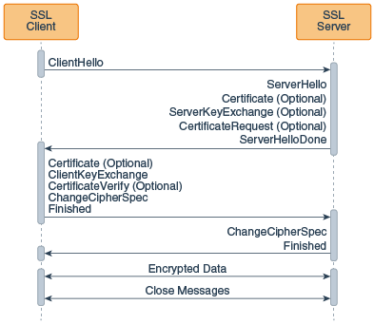
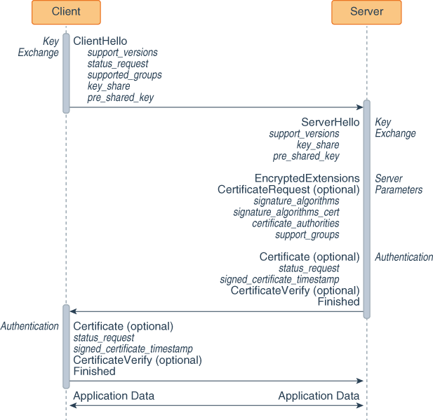
HOW TRANSPORT SECURITY LAYER WORKS
TLS 1.2
https://docs.oracle.com/javase/8/docs/technotes/guides/security/jsse/tls.html
TLS v. 1.3+

Slide 42
ENSURE TRUSTED CONTENT: CODE INTEGRITY
Only allow installation of cryptographically verified firmware/software updates. Use cryptographically signed updates to help prevent unauthorized reduction in the level of protection (downgrade or rollback attacks) by ensuring that the new update is more recent than the currently installed version.
Where feasible, ensure that the integrity of software is validated prior to execution, e.g., ‘whitelisting’ based on digital signatures.

Slide 43
ENSURE TRUSTED CONTENT: DATA INTEGRITY
Verify the integrity of all incoming data (ensuring it is not modified in transit or at rest, and it is well-formed/compliant with the expected protocol/specification).
Ensure capability of secure data transfer to and from the device, and when appropriate, use methods for encryption and authentication of the end points with which data is being transferred.
Protect the integrity of data necessary to ensure the safety and essential performance of the device.
Use current recommended standards for cryptography and for cryptographic protection for communications channels.
Use unique per device cryptographically secure communication keys to prevent leveraging the knowledge of one key to access a multitude of devices.

Slide 44
ENSURE DATA INTEGRITY: DIGEST
To ensure document integrity it is possible to use HASH FUNCTIONS (implementing message DIGEST):
DIGEST →
  Short string of predefined length
  Characterizes the document
  Verify the integrity of the document itself
  Calculated by the sender, sent to the receiver, calculated by the receiver and compared to the one that the receiver received → if the two match → the integrity of the document is preserved

Slide 45
HASH FUNCTIONS
Message/Document digests are created through hash functions
The ideal hash function has four main properties:
  it is easy to compute the hash value for any given message
  it is infeasible to generate a message from its hash
  it is infeasible to modify a message without changing the hash
  it is infeasible to find two different messages with the same hash.

Slide 46
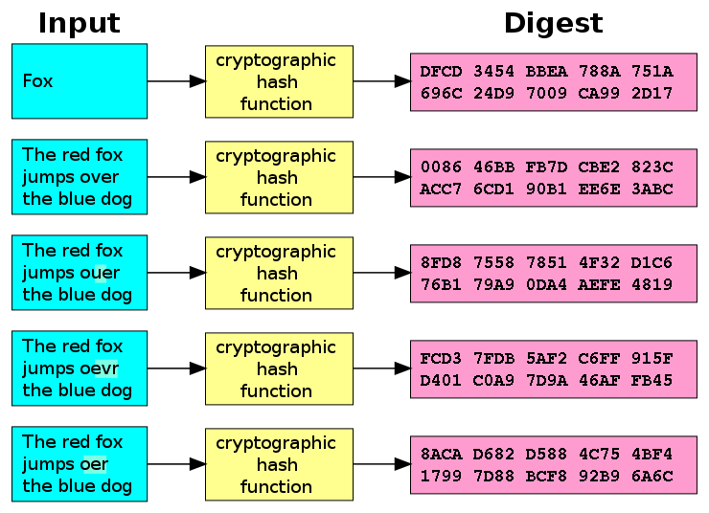
MESSAGE DIGEST EXAMPLE

Slide 47
ENSURE TRUSTED CONTENT: EXECUTION INTEGRITY
Where feasible, use industry-accepted best practices to maintain/verify integrity of code while it is being executed on the device.

