Slide 1

DATA PROTECTION AND CYBERSECURITY IN eHEALTH SYSTEMS 2

Slide 2
PRIVACY AND CONFIDENTIALITY
Privacy is an important part of confidentiality, especially when it comes to protected health information(PHI).
PHI is defined as individually identifiable health information transmitted or maintained by a covered entity or its business associates in any form or medium (45CFR160.103 [B1]).
The U.S. Health Insurance Portability and Accountability Act (HIPAA) limits the circumstances in which an individual’s PHI may be used or disclosed by covered entities (HHS [B7]).
Similarly, the EU General Data Protection Regulation states that personal data shall be processed lawfully, fairly, and in a transparent manner; collected for specified, explicit, and legitimate purpose; and kept in a form that permits identification of data subjects for no longer than is necessary for the purposes for which the personal data is processed (Official Journal of the EU [B19]).
loss of confidential protected health information (PHI), are not considered “patient harms” but are regulated by national privacy rules (GDPR, HIPAA)
Little excerpt from https://en.wikipedia.org/wiki/Cyberattack

Slide 3

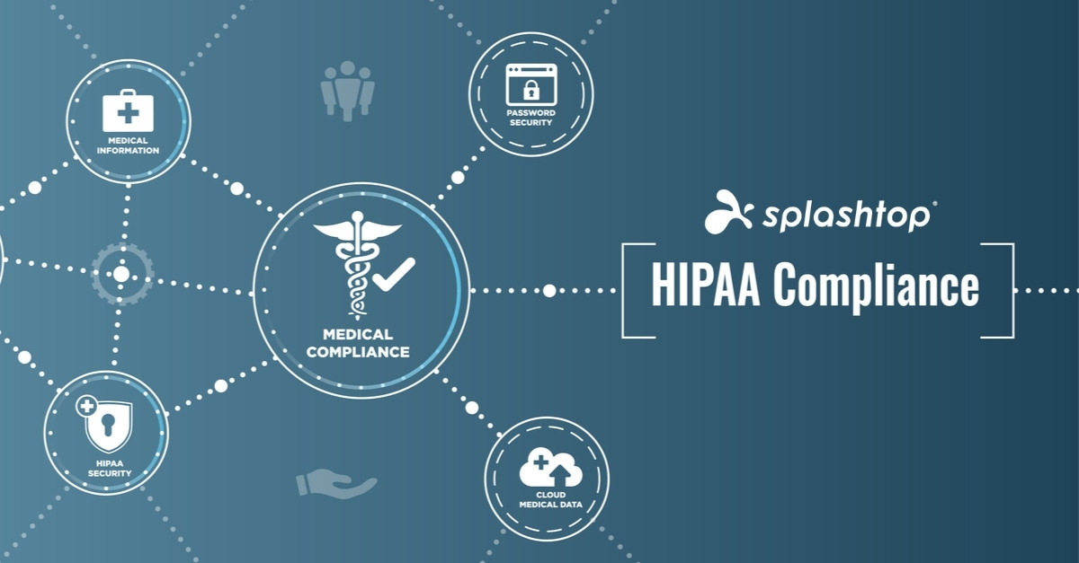

PROTECTION OF DATA

Slide 4
GDPR GOALS

Slide 5
GDPR PERSONAL DATA AND PROCESSING
Processing: operations performed on personal data, including by manual or automated means. It includes the collection, recording, organisation, structuring, storage, adaptation or alteration, retrieval, consultation, use, disclosure by transmission, dissemination or otherwise making available, alignment or combination, restriction, erasure or destruction of personal data.

Slide 6
GDPR: FINES

Slide 7
GDPR: INDIVIDUAL RIGHTS

Slide 8
GDPR: SUBJECTS

Slide 9
GDPR: SUBJECTS

Slide 10

HIPAA Security Rule
Health Insurance Portability and Accountability Act
The HIPAA Security Rule contains the standards that must be applied in order to safeguard and protect electronically created, accessed, processed, or stored PHI (ePHI) when at rest and in transit.
It has three parts:
  technical safeguards
  physical safeguards
  administrative safeguards

Slide 11
HIPAA techincal safeguard

Slide 12
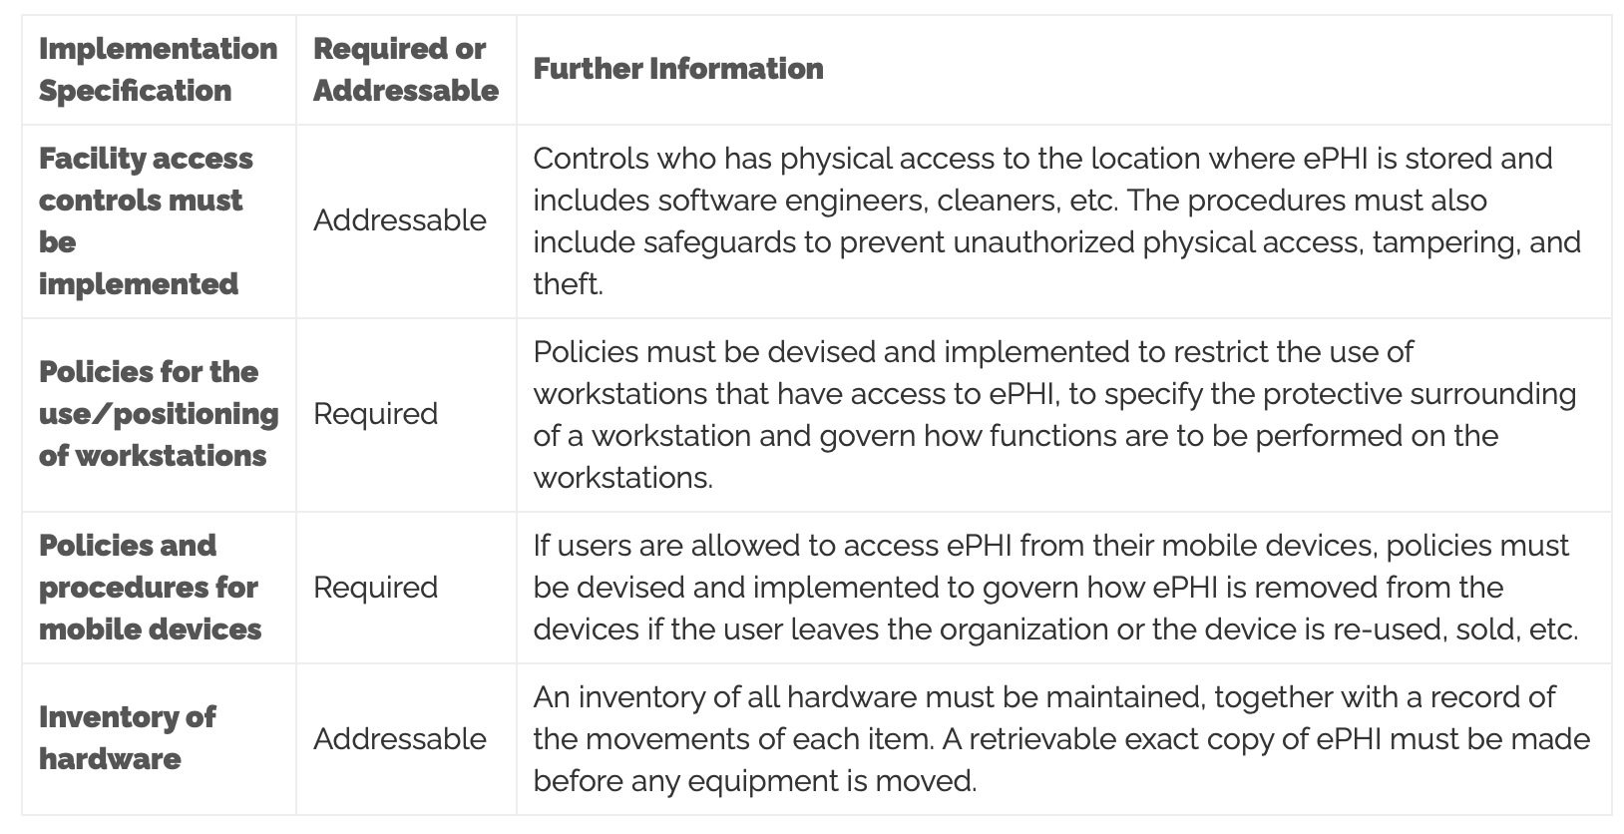
HIPAA physical safeguard

Slide 13
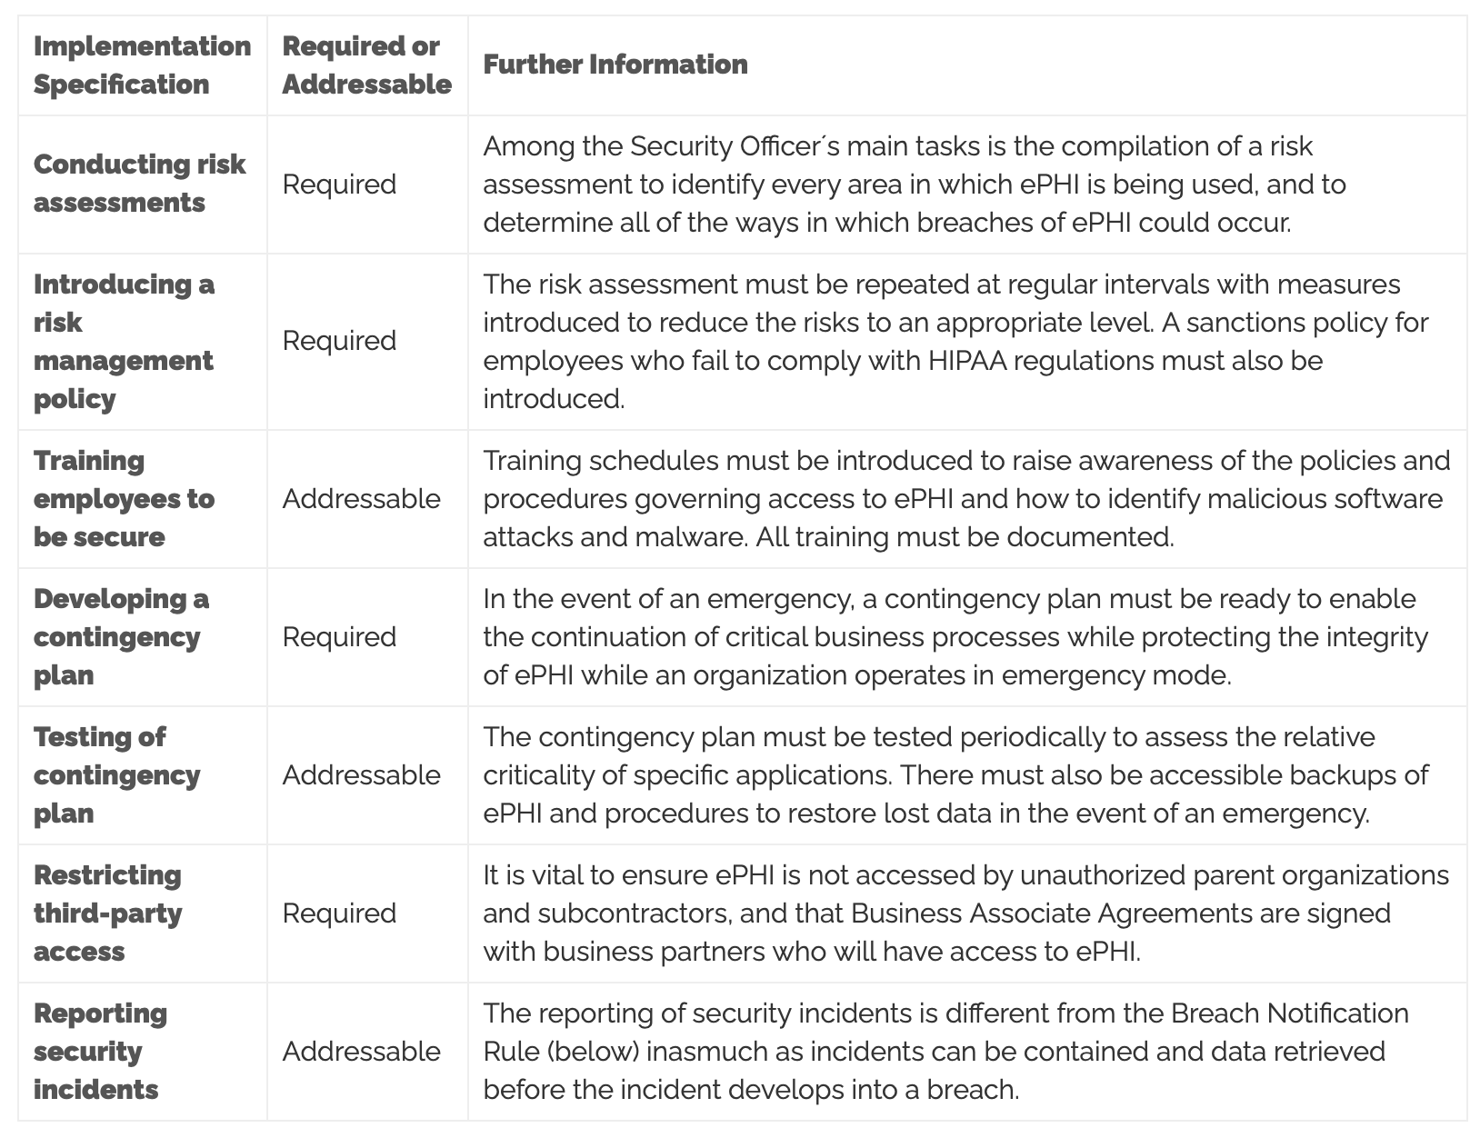
HIPAA administrative safeguard

Slide 14
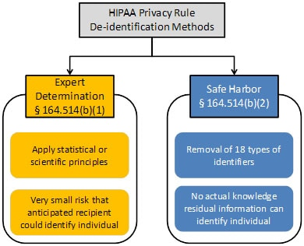
HIPAA de-identification
EXPERT DETERMINATION + SAFE HARBOR

Slide 15
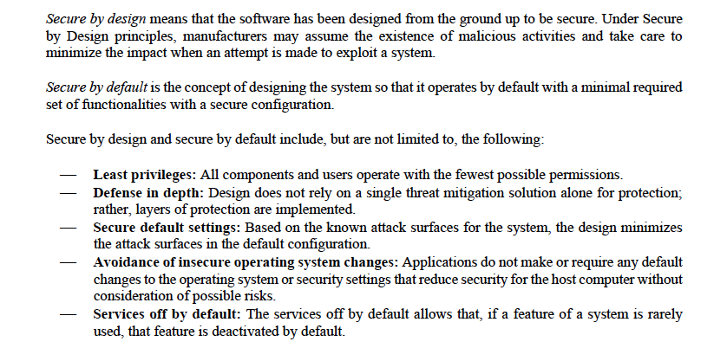
Secure by design and secure by default

Slide 16
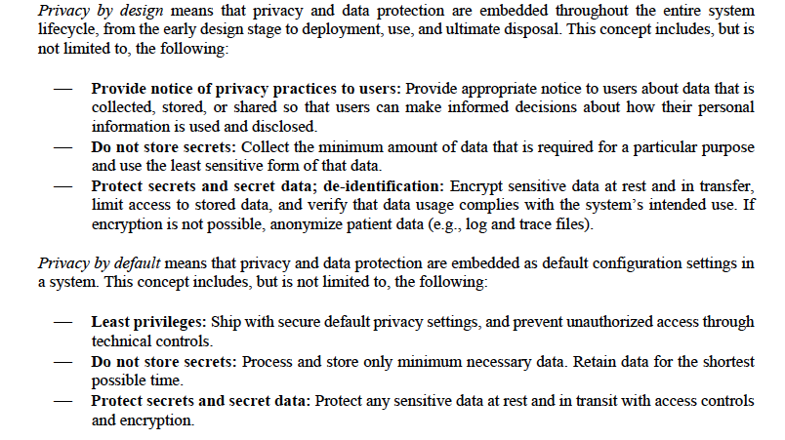
Privacy by design and privacy by default

Slide 17
Cybersecurity measures: detect, respond, and recover
Appropriate design should anticipate the need to detect and respond to dynamic cybersecurity risks, including the need for deployment of cybersecurity routine updates and patches as well as emergency workarounds
Detect:
  Routine security and antivirus scanning
  Tracking and control of software updates
Respond:
  User notification of cybersecurity risk detection
  Architecture to rapid deploy of patches and updates
Recover:
  Implement features to protect critical functionality
  Recovery of device configuration by authorized user

Slide 18
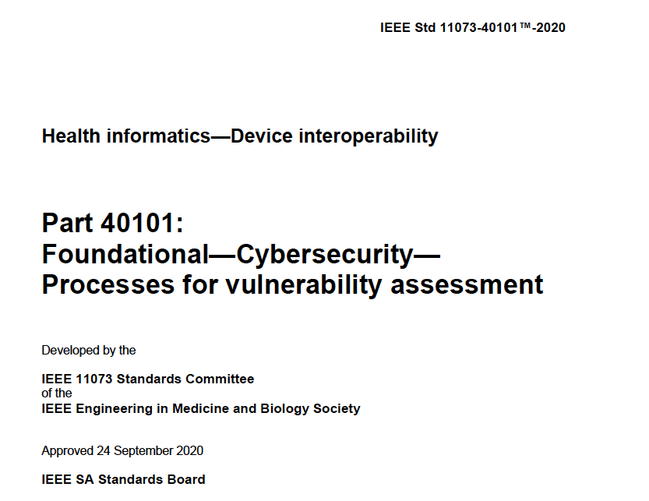
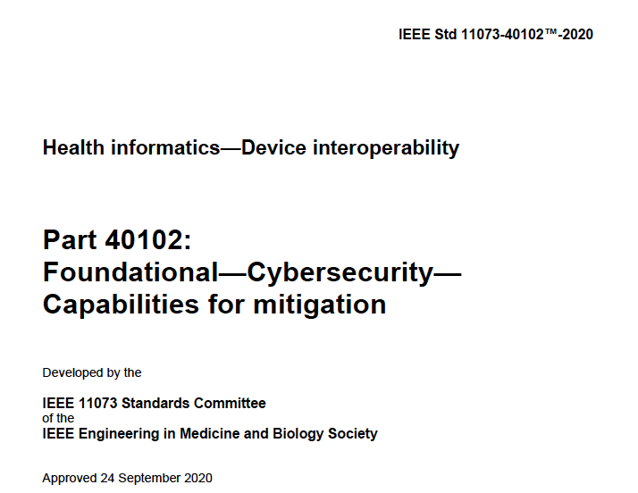
Approach to cybersecurity assessment
Family of standards devoted to point-of-care/personal complex eHealth devices/systems requiring interoperability

