Slide 1
METODI IMMUNO CHIMICI
- ELISA (Enzyme-Linked Immunoassorbent Assay) e LFD
Western blot
Radioimmunotest
Immunoistochimica
Immunoprecipitazione (IP/coIP CHIP RIP)
etc etc
METODI IMMUNOMETRICI
permettono la determinazione quantitativa di molecole (es proteine) in fluidi, tessuti e omogenati

Slide 2
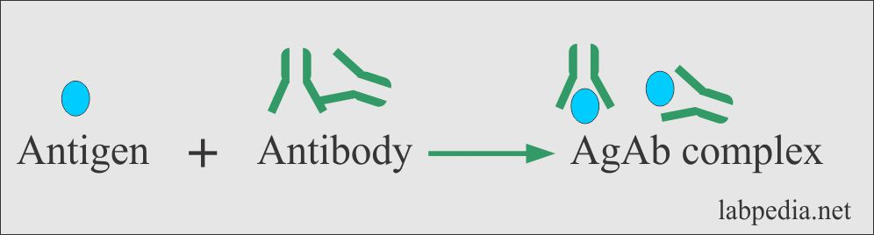
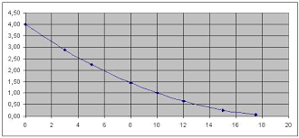
METODI IMMUNOMETRICI
I metodi immunometrici, sfruttando le caratteristiche uniche di
Affinità - Avidità selettività – specificità
del legame antigene-anticorpo,
Permettono lo sviluppo di metodi altamente specifici per la quantificazione dell’analita, anche in matrici complesse.
Complesso
antigene-anticorpo
quantificazione del
complesso antigene - anticorpo
Antigene
anticorpo
+

Slide 3
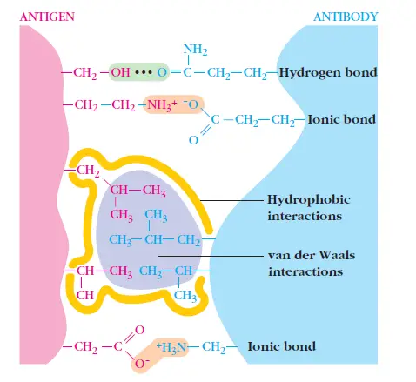
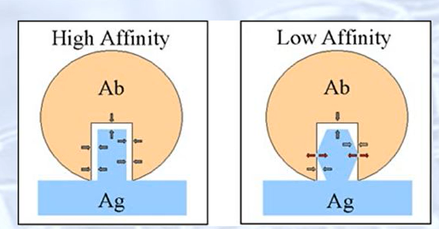
Affinity
Antibody affinity is the strength of the reaction between
a single antigenic determinant and
a single BINDING site on the antibody.
It is the sum of the attractive and repulsive forces operating between the antigenic determinant and the combining site of the antibody as illustrated

Slide 4
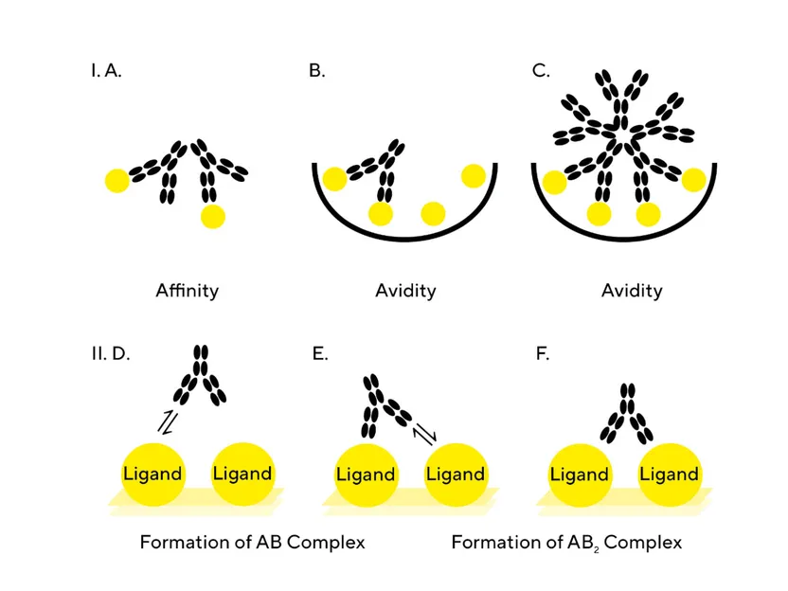
Affinity Vs Avidity

Slide 5
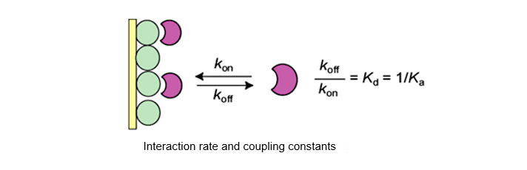
What is Binding Affinity?
Binding affinity is the strength of the binding interaction between
a single biomolecule (e.g. protein or DNA)
to its ligand/binding partner.
- the antibody association rate (k_{on}) of the antibody, how quickly it binds to its antigen.
Binding affinity is typically measured and reported by the
equilibrium dissociation constant (K_{D})
which is used to evaluate and rank order strengths of bimolecular interactions.
K_{​D} is the ratio of (k_{off})/(k_{on})
- the antibody dissociation rate (k_{off}), how quickly it dissociates from its antigen
1/K_{​D} = K_{​a} is the ratio of (k_{on})/(k_{off})

Slide 6
INTERACTION ANTIGEN-ANTIBODY
k_{on}
Ab
+
An
An-Ab
k_{off}
k_{on}
[An-Ab]_{eq}
K_{a} =
=
k_{off}
[Ab]_{eq}
[An]_{eq}
K_{a} is the equilibrium or affinity constant (generally expressed in L / mol)
it is independent of the concentration of Ag and Ab
it just depends
- the type of molecules
- from the medium
- the temperature

Slide 7
(k_{off})= sec⁻¹
(k_{on})= M⁻¹ Sec⁻¹
K_{​D} = (k_{off})/(k_{on})
K_{​D}= M
Ka=1/K_{​D}
Small K_{D} value = greater binding affinity of the ligand for its target.
larger K_{D} value, = target molecule and ligand are attracted weakly to bind to one another.
What is the typical K_{D} value for an antibody? What would one expect to be a good K_{D} value?
Most antibodies have K_{D} values in the low micromolar (10⁻⁶⁾ to nanomolar (10⁻⁷ to 10⁻⁹) range.
High affinity antibodies generally considered to be in the low nanomolar range (10⁻⁹)
with very high affinity antibodies being in the picomolar (10⁻¹²) range.

Slide 8
Range of Biological Dissociation Constants
K_{a} è la costante di Affinità
espressa generalmente in L/mol
1/ K_{a} = Kd costante di dissociazione all’equilibrio
adrenocorticoid receptor 10⁻¹⁰
neuropeptide 10⁻⁹
trypsin 8 x 10⁻⁵
Lambda rep (monomer/dimer) 2 x 10⁻⁸
lambda rep (dimer/DNA) 1 x 10⁻¹⁰
Un anticorpo adatto per lo sviluppo di metodi immunometrici deve avere una K_{a} = 10⁹-10¹² M⁻¹

Slide 9
SCATCHARD PLOT (I)
L’affinità dell’anticorpo per l’analita può essere determinata graficamente mediante diagramma di Scatchard (VALE X 1 MOLECOLA x 1 Ab).
Riprendendo l’equazione:
k_{a}
[An-Ab]_{eq}
K_{eq} =
=
k_{d}
[Ab]_{eq}
[An]_{eq}
si definisce Ab_{t} = [Ab]_{eq} + [An-Ab]_{eq} (concentrazione totale di anticorpo). Riarrangiando l’equazione ed introducendo Ab_{t} si ottiene:
[An-Ab]_{eq}
= K_{eq} Ab_{t} - K_{eq} [An-Ab]_{eq}
[An]_{eq}

Slide 10
SCATCHARD PLOT (II)
[An-Ab]_{eq}
= K_{eq} Ab_{t} - K_{eq} [An-Ab]_{eq}
[An]_{eq}
Rappresentando [An-Ab]/[An] (rapporto tra analita legato ed analita libero, cioè bound/free)
rispetto ad [An-Ab] (bound) si ottiene un diagramma di Scatchard, dove
la pendenza è – K_{eq},
l’intercetta sull’asse x è Ab_{t}.

Slide 11
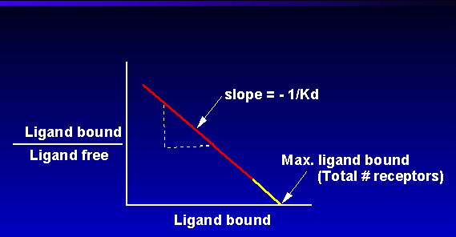
Rappresentando [An-Ab]/[An] (rapporto tra analita legato ed analita libero, cioè bound/free)
rispetto ad [An-Ab] (bound) si ottiene un diagramma di Scatchard, dove la pendenza è – K_{eq},
l’intercetta sull’asse x è Ab_{t}.

Slide 12
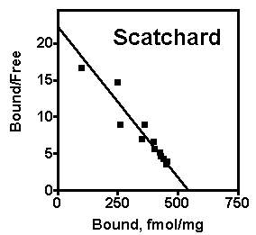
Un anticorpo adatto per lo sviluppo di metodi immunometrici deve avere una K_{eq} = 10⁹-10¹² M⁻¹

Slide 13
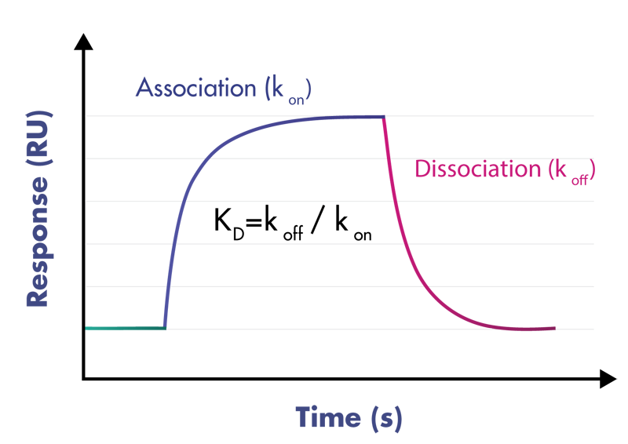
The K_{D} values are determined by measuring the k_{on} and k_{off} rates of a specific antibody/antigen interaction and then using a ratio of these values to calculate the K_{D} value

Slide 14
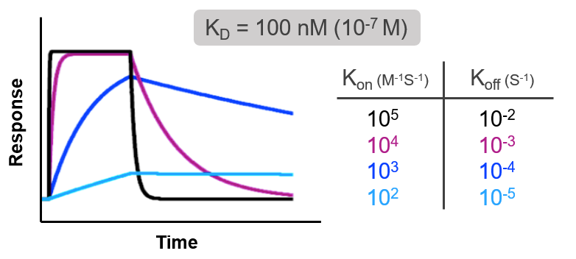












Ab1
Ab4
Ab3
K_{​D} = (k_{off})/(k_{on})
Ab2
Ab1
Ab2
Ab3
Ab4

Slide 15
K_{​D} = (k_{off})/(k_{on})
Ab1
Ab2
Ab3
Ab4

Slide 17
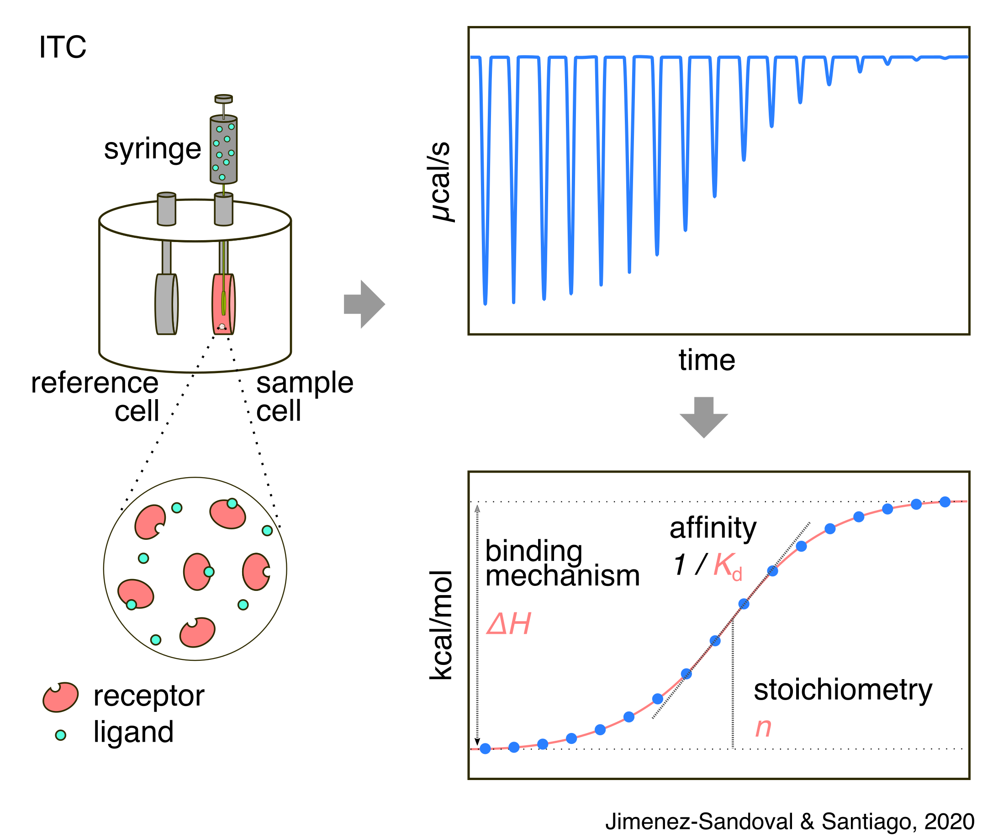
Isothermal Titration Calorimetry (ITC)
Isothermal Titration Calorimetry (ITC) is a technique used in quantitative studies of a wide variety of biomolecular interactions.
It works by directly measuring the heat
that is either released or absorbed
during a biomolecular binding event.
https://www.malvernpanalytical.com/en/products/technology/microcalorimetry/isothermal-titration-calorimetry/

Slide 18
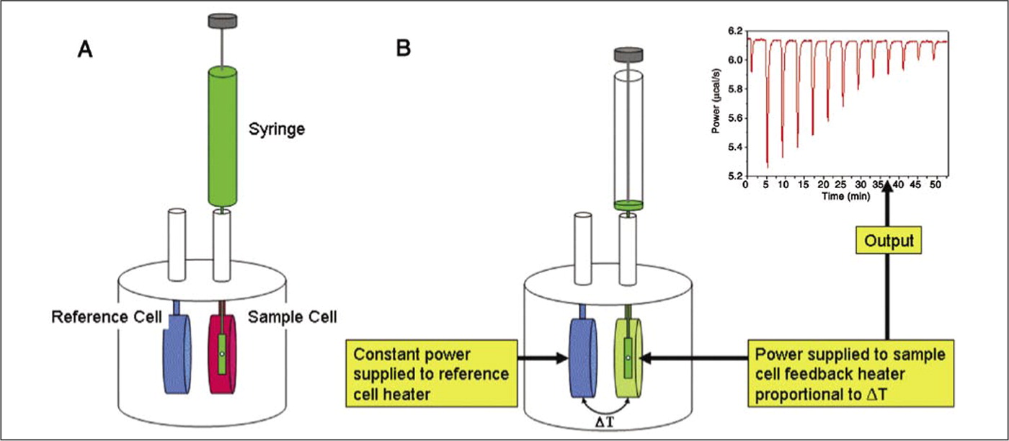
- When binding occurs, heat is either absorbed or released
- this is measured by the sensitive calorimeter
- gradual titration of the ligand into the sample cell containing the biomolecule of interest.
https://www.youtube.com/embed/o_IpWcWKNXI

Slide 19
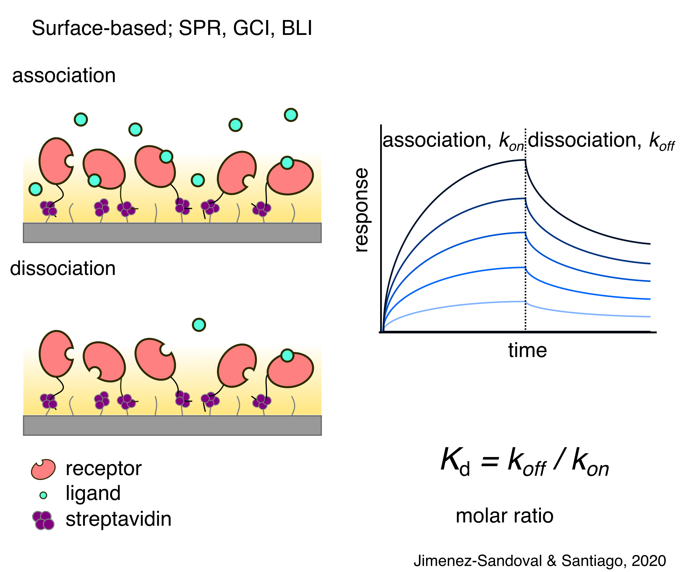

Surface-based methods: SPR, BLI

Slide 20
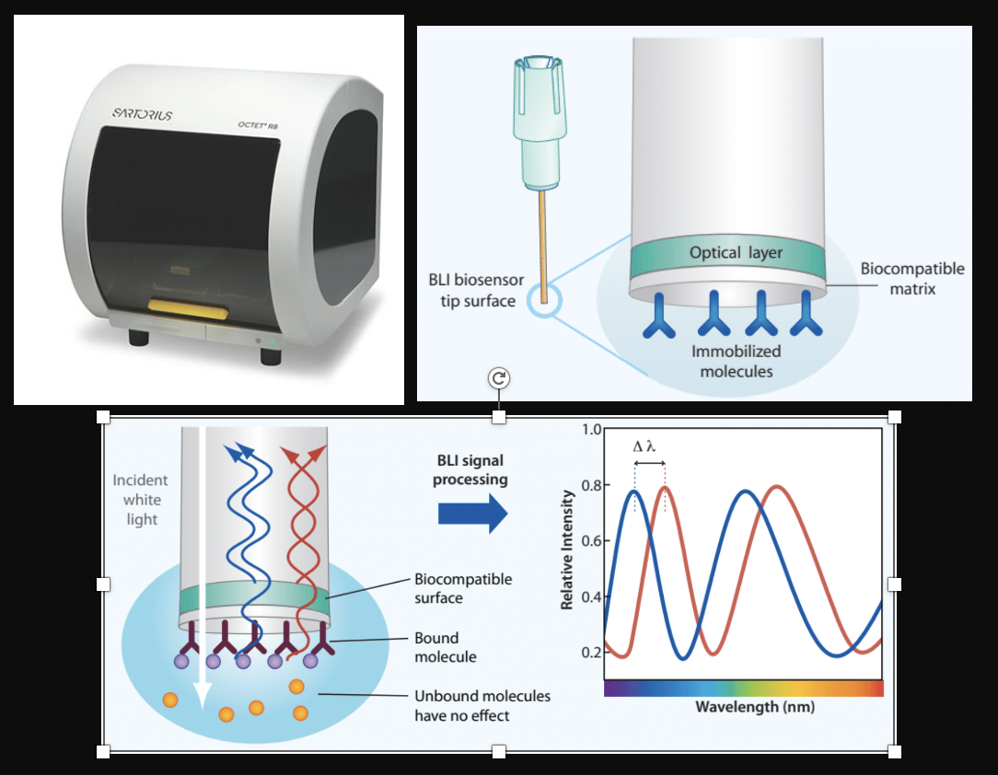
BioLayer Interferometry
for Label-Free Biomolecular Interaction
Notes:
Hello everyone
I’m going to give a brief overview of Product marketing activities for the Allegro product range
NEXT SLIDE

Slide 21
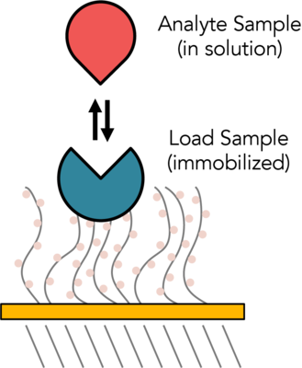
Biosensor Surface Chemistry
Optical layer
Two-dimensional
binding surface
Biocompatible Matrix
- minimizes non-specific binding
Uniform
Non-denaturing
|------ 600 μm ------|

Slide 22
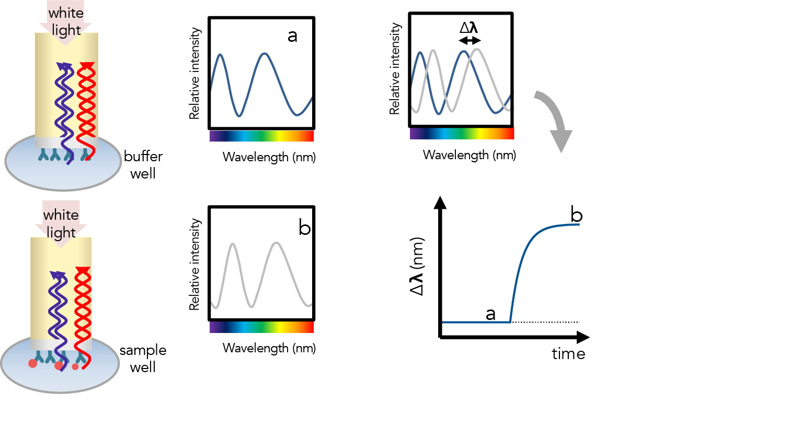
Optical layer reflects simple white light; second reflection from tip of biosensor, both reach detector
Analyte binding changes thickness of bio-layer, which is measured at detector

Slide 23
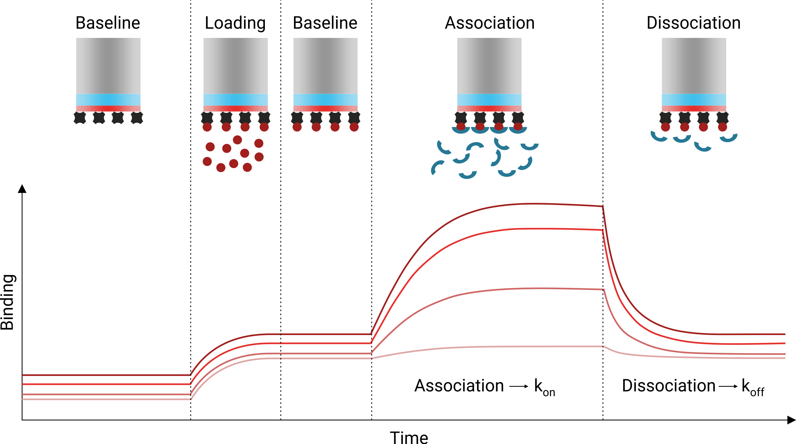

Slide 24
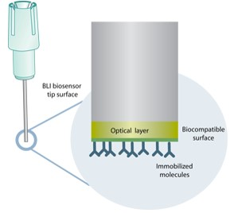
ForteBio BLI Systems: Label-Free Protein Analysis
Size
MW
Bacteria
Virus
Antibody - Antigen
Receptor - Ligand
DNA - DNA
DNA - Protein
Antibody Fragment - Antigen
Antigen – Fusion Protein
Antibody - Peptide
Multiple Antibody Pairings
Antibody - Small Molecule
Protein - Small Molecule
1000 nm
Cells
Bacteria
Virus
IgM
IgA
IgG, IgD, IgE
Antibody Fragments
Proteins
Peptides
Nucleotides (DNA)
Small Molecules
Atoms
200 nm
75 nm
1,000,000
7 nm
100,000
1,000
1 nm
150
0.1 nm
1

Slide 25
BLI Biosensor Types Available
Biosensor | Application
Antibody-Specific Capture
• Anti-Human IgG Fc Capture (AHC) | Human IgG Fc region, kinetic analysis
• Anti-Human IgG Fc Capture (AHQ) | Human IgG Fc region, quantitation
• Anti-Mouse Fc Capture (AMC) | Mouse IgG1, 2a & 2b Fc regions, kinetic analysis
• Anti-Mouse Fc Capture (AMQ) | Mouse IgG1, 2a & 2b Fc regions, quantitation
• Anti-Human Fab-CHI (FAB) | Fab-CH1 domains of human IgG
• Protein A (ProA) | Quantitation of various species IgG
• Protein G (ProG) | Quantitation of various species IgG
• Protein L (ProL) | Quantitation of IgG via kappa light chain
Affinity Tag Capture
• Streptavidin (SA) | Biotinylated ligands
• High Precision Streptavidin (SAX) | Biotinylated ligands (4% CV)
• Super Streptavidin (SSA) | Biotinylated ligands (high-density surface, small molecules)
• Anti-GST (GST) | GST-tagged recombinant proteins
• Anti-Penta HIS (HIS) | HIS-tagged recombinant proteins
• Anti-Penta HIS 2nd Gen (HIS2) | HIS-tagged recombinant proteins
• Ni-NTA (NTA) | HIS-tagged recombinant proteins
Immobilization
• Amine Reactive 2nd Gen (AR2G) | Covalent coupling to reactive amine groups
• Aminopropylsilane (APS) | Adsorption to hydrophobic moieties

Slide 26
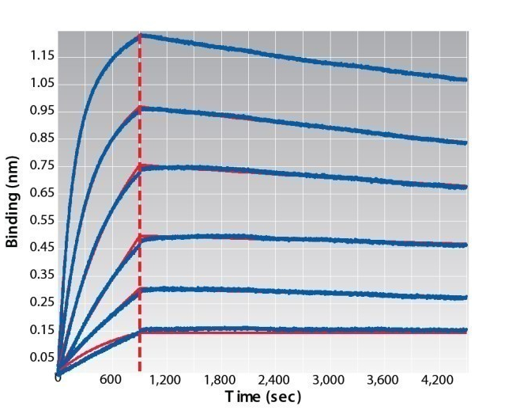
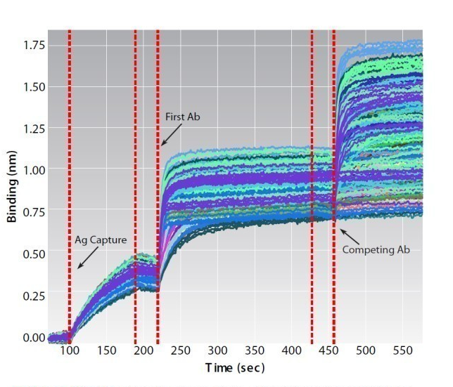
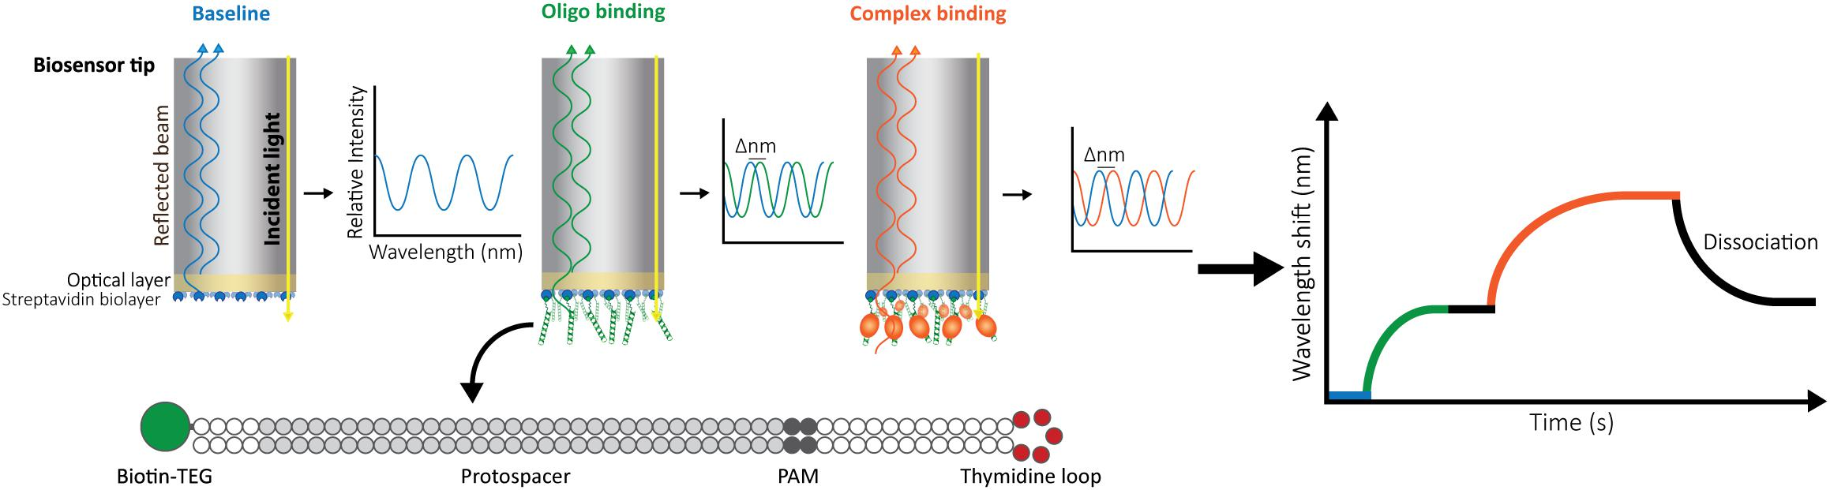
What ForteBio BLI Systems Provide
Kinetics
k_{a}, k_{d}, K_{D}
Proteins, Abs
Peptides, oligos
Small molecules
Specificity
Function testing
Epitope binning
Rank ordering
Isotyping
Notes:
What information does one gain from the Octet? The range is quite versatile – from kinetics data – information such as Ka, Kd and affinity constants for a wide range of molecules to Quantitation consisting of simple single step quantation assay up to more complex multi step assays such as Elisa. Another very valuable way the Octet can help you with your work is to gain specificity information about your molecules. By that I mean such things as functionality testing, epitope binning, ranking order, isotyping, competition assay and the list goes on.

Slide 27
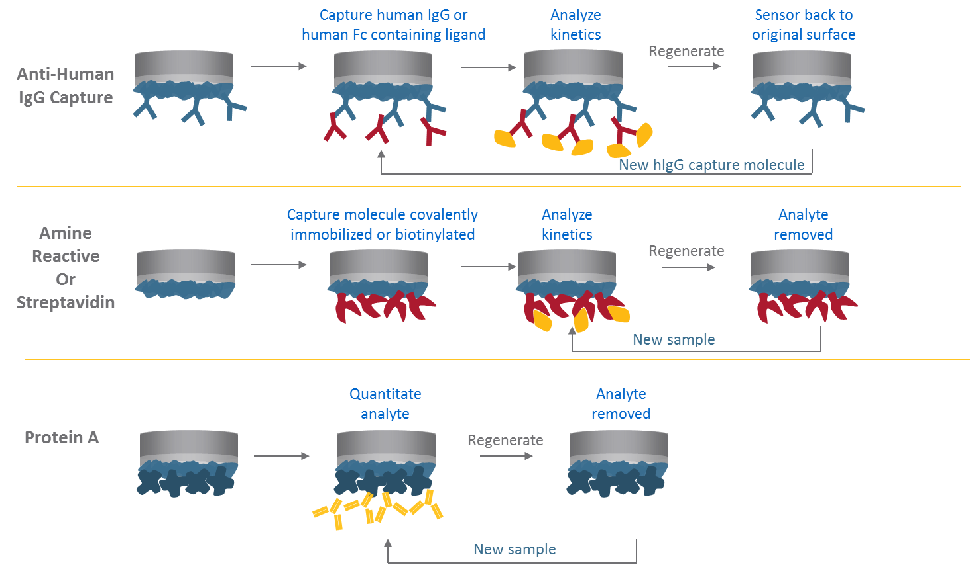
Biosensor regeneration

Slide 28
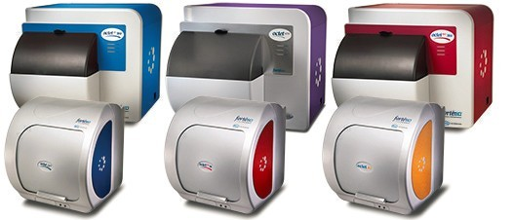
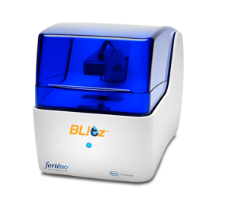
ForteBio BLI Systems: Label-Free Protein Analysis
Definitive Kinetic Analysis
Fast Protein Quantitation
Analyze Unpurified Samples
Straightforward Operation

Slide 29
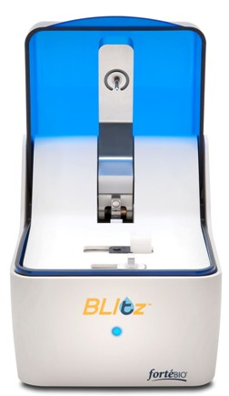
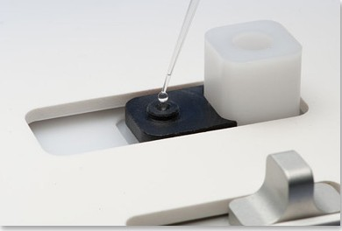
ForteBio BLI Systems: Blitz
Needs only 4 µL of sample in drop holder.
Can use 250 µL in tube holder.

Slide 30
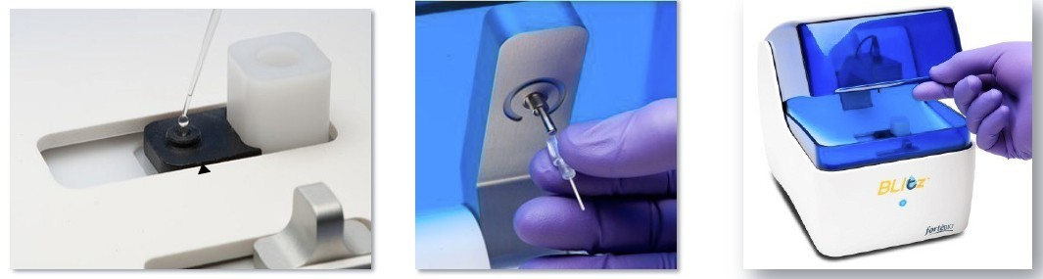
Data Collection on the Blitz
All steps are prompted by the software

Slide 31
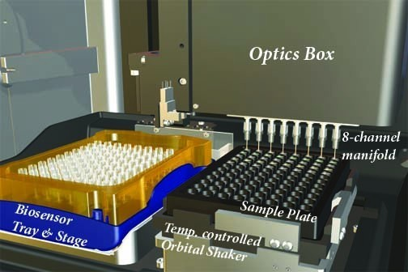
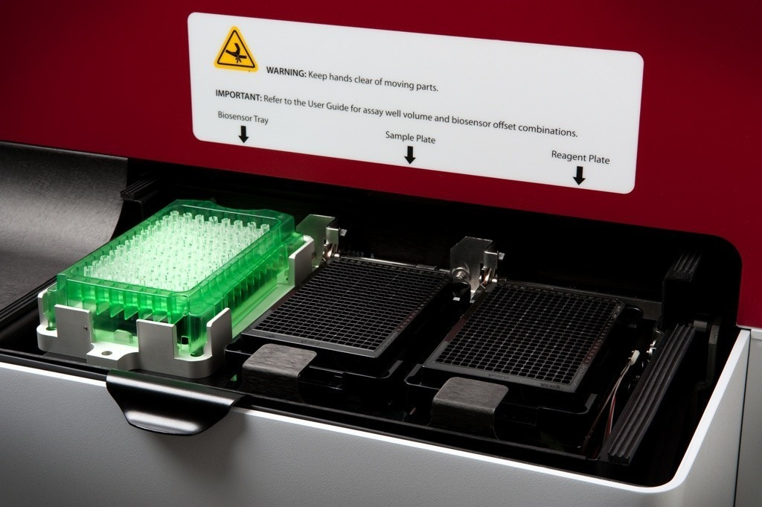

ForteBio BLI Systems: Octet
Octet 96
Octet 384/HTX
One biosensor tray
One 96-well sample/reagent plate
8 simultaneous readings
One biosensor tray
Two 96-well or 384-well sample/reagent plates
16 simultaneous readings (Octet 384)
8, 16, 32, 48, or 96 simultaneous readings (Octet HTX)

Slide 32
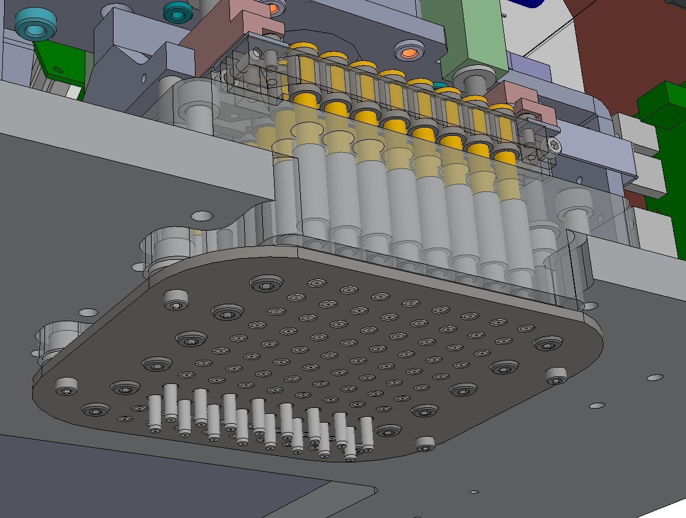
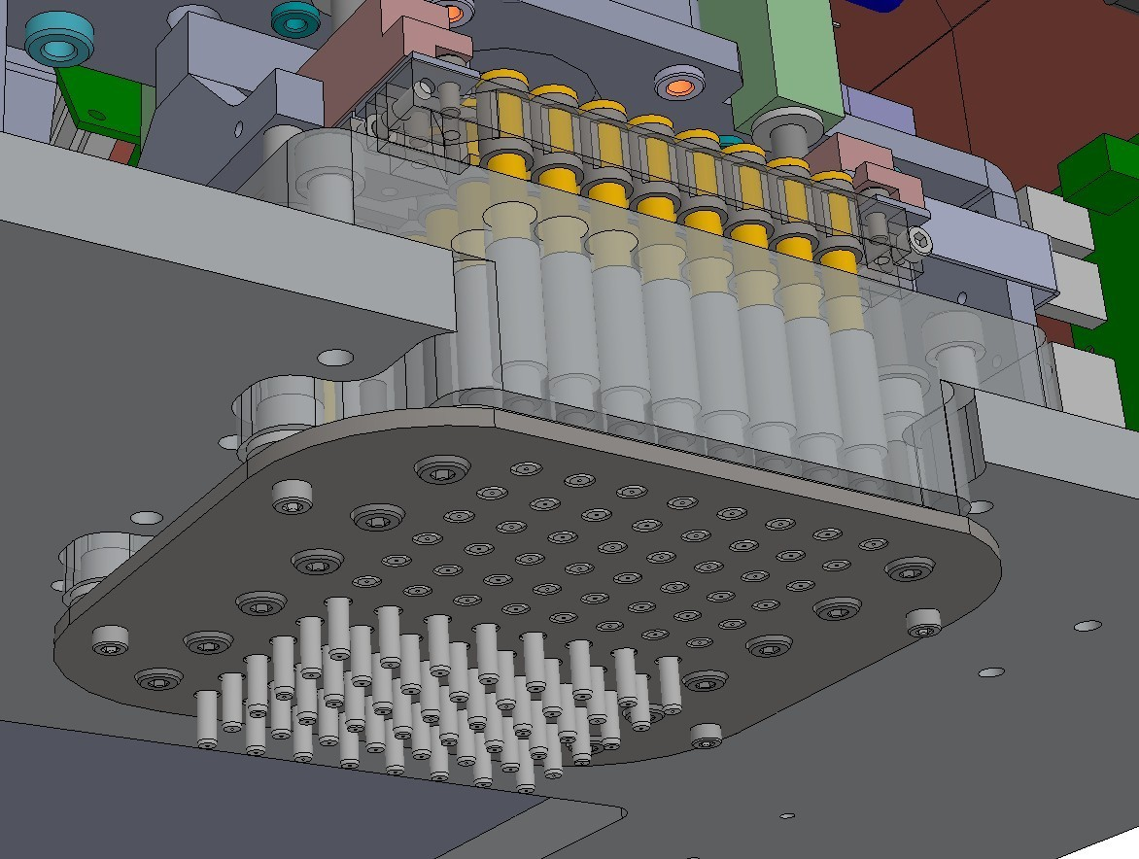
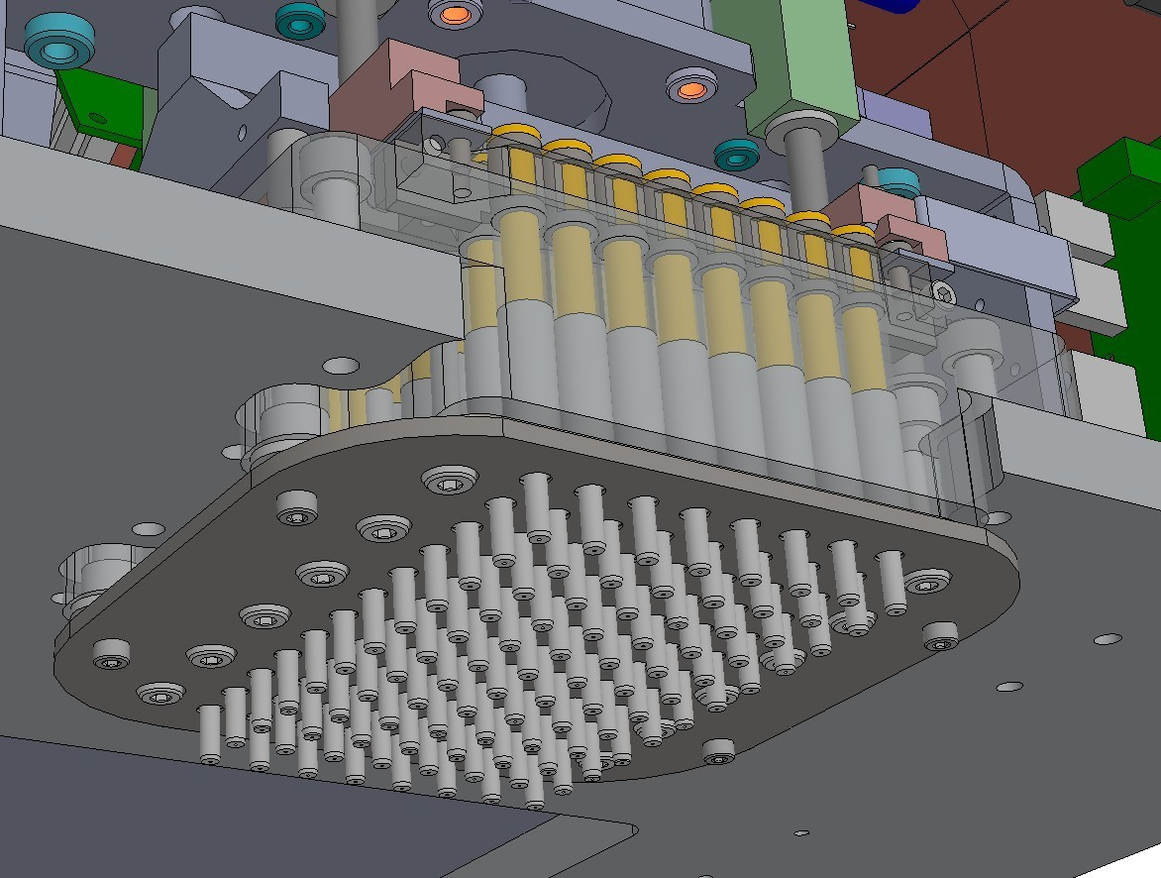
HTX Breakthrough Technology:
User-Selectable Read Head
8 or 16 sensors – RED96/384 sensitivity
32 or 48 sensors – QK384 sensitivity
96 sensor – QK384 sensitivity
Notes:
What sets the HTX apart?
“You don’t have to choose anymore” We can do it all, high resolution and accelerated workflow
Note. Competitors: Biacore, Proteon, Wasatch, etc. focus on either high resolution kinetics/affinity or throughput. Hydra provides both.

Slide 33
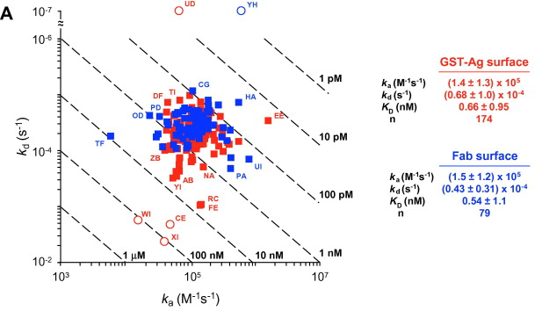
Analytical Biochemistry Volume 386, Issue 2, 15 March 2009, Pages 194-216 Analytical Biochemistry
A global benchmark study using affinity-based biosensors
To explore the variability in biosensor studies, 150 participants from 20 countries were given the same protein samples and asked to determine kinetic rate constants for the interaction.

Slide 34
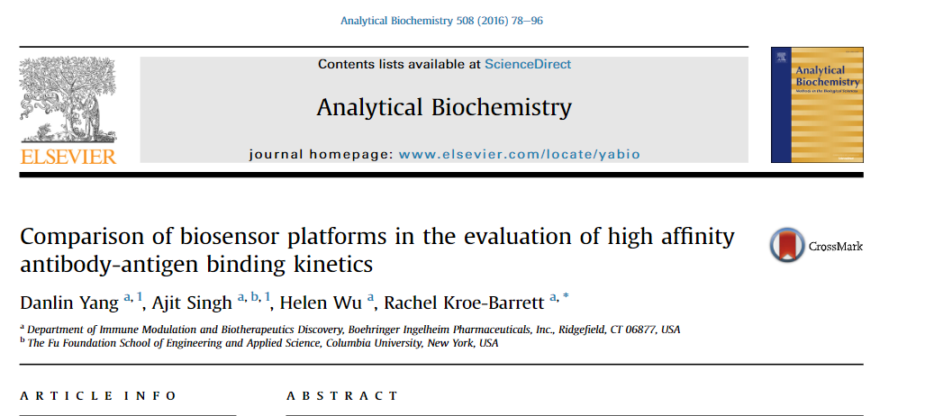
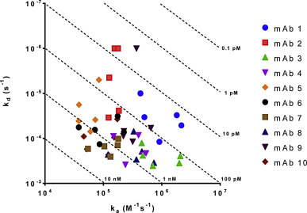
To address these questions, a panel of ten high-affinity monoclonal antibodies was simultaneously evaluated for their binding kinetics against the same antigen on four biosensor platforms:

