Slide 1

INTRODUCTION TO FLUTTER

Slide 2

DART PROGRAMMING LANGUAGE
Why:
Web Development: With dart2js, Dart code can be compiled to efficient JavaScript.
Command-line and Server Apps: Dart can also be used for backend development, though this is less common than Node.js or Python.
Flutter: The main reason Dart gained popularity. Flutter uses Dart to build cross-platform mobile apps (iOS, Android), as well as desktop and web apps from a single codebase.
What it is:
Compiled language: Dart can be compiled both ahead-of-time (AOT) to native machine code (used in mobile apps for performance) and just-in-time (JIT) for fast development cycles with hot reload.
Strongly typed: It uses a sound type system but allows type inference and some flexibility with dynamic.
C-style syntax: Similar to Java, JavaScript, and C#, making it familiar for many developers.

Slide 3

DART PROGRAMMING LANGUAGE
Type System | Sound/static with optional type inference | Strictly statically typed
Null Safety | Enforced by default (non-nullable by default) | Optional (from Java 8+ with annotations)
Constructors | Named constructors, optional/default parameters | Overloaded constructors only
Functions | First-class citizens, can be assigned to vars | Not first-class; use interfaces/lambdas
Getters/Setters | Built-in via get/set | Manually defined via methods
Collection literals | Built-in ([], {}) with spread/if elements | No native collection literals (use APIs)
Extension methods | Yes | ❌ No (Java 21+ might include preview features)
Mixins | Yes | ❌ No (Java uses abstract classes/interfaces)

Slide 4
DART PROGRAMMING LANGUAGE
The Dart language
is type safe:
var staticType = "String";
it uses static type checking to ensure that a variable's value always matches the variable's static type
Type Inference
dynamic dynamicType = "String";
dynamicType = 10;
Usage of dynamic type combined with runtime checks
Dart has built-in sound null safety.
The following code sample showcases several Dart language features, including libraries, async calls, nullable and non-nullable types, arrow syntax, generators, streams, and getters. To learn more about the language, check out the Dart language tour or https://dart.dev/language
https://github.com/marcoprenassi/Flutter_Tutorial/

Slide 5
DART PROGRAMMING LANGUAGE
The Dart language
has type Inference
is type safe
it uses static type checking to ensure that a variable's value always matches the variable's static type
Usage of dynamic type combined with runtime checks
Dart has built-in sound null safety.

Slide 6
DART PROGRAMMING LANGUAGE – HELLO WORLD
void main() {
print('Hello, World!');
}

Slide 7
DART PROGRAMMING LANGUAGE - VAR
Dart has built-in sound null safety.
var flybyObjects = ['Jupiter', 'Saturn', 'Uranus', 'Neptune'];
var image = {
'tags': ['saturn'],
'url': '//path/to/saturn.jpg’};
void main() {
/// Types declaration
var name = 'Voyager I';
var year = 1977;
var antennaDiameter = 3.7;
}

Slide 8
DART PROGRAMMING LANGUAGE – EXPLICIT/NULLABLE
is type safe
/// Explicit not nullable declaration and assignment
int declaredType;
declaredType = 5;
/// Explicit nullable declaration and check
int? nullableVariable;
if(nullableVariable == null)
print("Nullable");

Slide 9
DART PROGRAMMING LANGUAGE - STATIC/DYNAMIC
it uses static type checking to ensure that a variable's value always matches the variable's static type
/// Static type assignment
var staticType = "String";
staticType = 10.toString(); /// everything’s an object!
/// Dynamic type assignment
dynamic dynamicType = "String";
dynamicType = 10;

Slide 10
DART PROGRAMMING LANGUAGE – FINAL and CONST
Final is calculated only one time at RUNTIME and then cannot be changed.
Const is calculated at COMPILE TIME and cannot be assigned or changed at runtime.
/// final and const variables
final finalVar = DateTime.now();
const constVar = 3.14;

Slide 11
DART PROGRAMMING LANGUAGE – STRING FORMAT
/// String formatting
print('String formatting:');
print(name + " " + year.toString() + " " + image['url'].toString());
print("$name $year ${image['url']}"); // Best practice for DART

Slide 12
DART PROGRAMMING LANGUAGE – IF STATEMENT
/// If Statement
print("If statement:");
if (year >= 2001) {
print('21st century');
} else if (year >= 1901) {
print('20th century');
}

Slide 13
DART PROGRAMMING LANGUAGE – SWITCH CASE
/// Switch statement
print("Switch statement:");
switch(year) {
case(1977):
print("Correct Year");
case(1978):
print("Incorrect Year");
}

Slide 14
DART PROGRAMMING LANGUAGE – FOREACH
/// Foreach object
for (final object in flybyObjects) {
print(object);
}

Slide 15
DART PROGRAMMING LANGUAGE – FOR CYCLE
/// For Cycle and increment operators
for (int month = 1; month <= 3; month++) {
print(month);
}
print("---");
for (int month = 1; month <= 3; ) {
print(++month); // Count and print
}

Slide 16
DART PROGRAMMING LANGUAGE – WHILE LOOP
/// While loop
while (year < 1985) {
year += 1;
}

Slide 17
DART PROGRAMMING LANGUAGE – INLINE CONDITIONS
int a;
if (year != null) {
a = year;
} else {
a = 0;
}
/// Inline conditions
var a = year ?? 0; // Not Null
print(a);
var b = year > 1982 ? 1 : -1; // Condition
print(b);
int b;
if (year > 1982) {
b = 1;
} else {
b = -1;
}

Slide 18
DART PROGRAMMING LANGUAGE – IMPORT and =>
flybyObjects.where(...)
This filters the list using a condition.
It returns an iterable* of elements that match the condition.
(name) => name.contains('tu')
This is a **lambda expression (also called an arrow function).
It checks if the name (a String) contains the substring 'tu'.
Examples: 'Jupiter' → false, 'Saturn' → true…
.forEach(print)
Iterates over the filtered results and prints each one.
print is passed directly as a function to forEach.
Syntactic sugar makes arrows fat
the ’=>’ operator
for 1 and ONLY 1 single instruction, no blocks {}!
import tutorial_1.dart’;
void main () {
flybyObjects.where((name) => name.contains('tu')).forEach(print);
}
* Iterator, Intent: “Provide a way to access the elements of an aggregate object sequentially without exposing its underlying representation.” — Design Patterns, Gamma et al., 1994, p. 257.
** “Lambda expressions let you express instances of single-method interfaces (functional interfaces) more compactly.” — Effective Java, Joshua Bloch, 3rd Edition, Chapter 7, Item 42: Prefer Lambdas to Anonymous Classes

Slide 19
DART PROGRAMMING LANGUAGE – CLASSES
int? : The getter returns a value of type int?, meaning it can return either an int (a year) or null.
get launchYear : This defines a getter called launchYear. You can access it like a property (e.g., Spacecraft.launchYear), but it’s actually a method.
=> [… Single line expression];
This uses Dart’s fat arrow syntax (=>) to return the result of the expression on the right. 1 single line function.
launchDate?.year: This is a null-aware access.
If launchDate is not null, return launchDate.year.
If launchDate is null, return null.
/// class
class Spacecraft {
String name;
DateTime? launchDate;
/// Read-only non-final property
int? get launchYear => launchDate?.year;
/// Constructor, with syntactic sugar for assignment to members.
Spacecraft(this.name, this.launchDate) {
/// Initialization code goes here.
}
}
Spacecraft(String name, DateTime? launchDate) {
this.name = name;
this.launchDate = launchDate;
}
Equivalent to

Slide 20
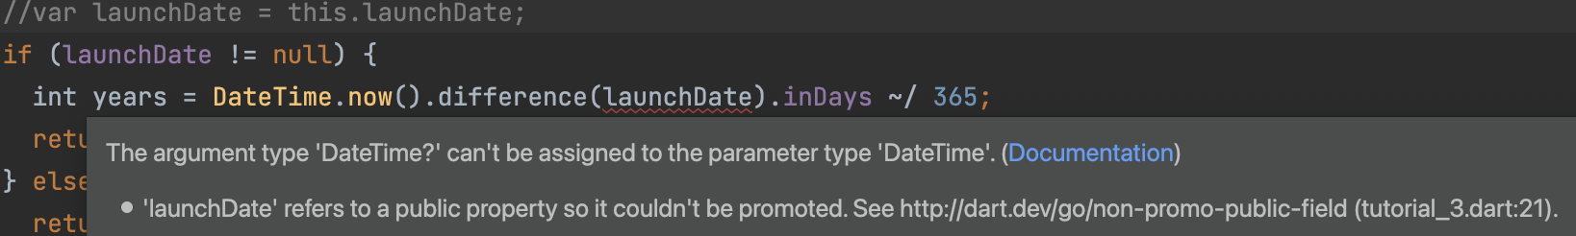
DART PROGRAMMING LANGUAGE – METHODS
@override
String toString() {
return describe();
}
/// Named constructor that forwards to the default one.
Spacecraft.unlaunched(String name) : this(name, null);
/// Method.
String describe() {
String tempString = ('Spacecraft: $name');
/// Type promotion doesn't work on getters.
var launchDate = this.launchDate;
if (launchDate != null) {
int years = DateTime.now().difference(launchDate).inDays ~/ 365;
return '$tempString Launched: $launchYear ($years years ago)';
} else {
return '$tempString Unlaunched';
}
}
}

Slide 21
DART PROGRAMMING LANGUAGE – OBJECTS and LISTs
/// objects
var Apollo = Spacecraft("Apollo 1", null);
print(Apollo.toString());
var Apollo2 = Spacecraft("Apollo 2", DateTime.now());
print(Apollo2.toString());
/// Lists
/// ---
var SpacecraftList = {Apollo, Apollo2, Spacecraft("Moon Lander", DateTime(1978))};
SpacecraftList.forEach((spacecraft){print(spacecraft.toString());});

Slide 22
DART PROGRAMMING LANGUAGE – ENUM
/// Simple Enum
enum PlanetType { terrestrial, ice, gas }
/// Enum that enumerates the different planets in our solar system
/// and some of their properties.
enum Planet {
mercury(planetType: PlanetType.terrestrial, moons: 0, hasRings: false),
venus(planetType: PlanetType.terrestrial, moons: 0, hasRings: false),
// ···
uranus(planetType: PlanetType.ice, moons: 27, hasRings: true),
neptune(planetType: PlanetType.ice, moons: 14, hasRings: true);
/// A constant generating constructor
const Planet(
{required this.planetType, required this.moons, required this.hasRings});
/// All instance variables are final
final PlanetType planetType;
final int moons;
final bool hasRings;
/// Enhanced enums support getters and other methods
bool get isGiant =>
planetType == PlanetType.gas || planetType == PlanetType.ice;
}

Slide 23
DART – THROW and CATCH EXCEPTIONs
throw FormatException('Expected at least 1 section’);
try {
isThisThingWorking();
}
on Exception {
print(“This thing is not working!”);
}

Slide 24
DART – ASYNCHRONOUS PROGRAMMING (basic)
Asynchronous programming
A
B
A
C
B
Synchronous programming
?
C
U1
U2
S
U1
U2
S

Slide 25
DART – ASYNCHRONOUS PROGRAMMING (basic)
the DART Future is a promise of a value, or a function return;
It encapsulates values to hold on their memory for future use.
Future<TYPE/OBJECT>
Future<void> fetchUserOrder() {
// Imagine that this function is fetching user info from another service or database.
return Future.delayed(const Duration(seconds: 2), () => print('Large Latte'));
}
void main() {
fetchUserOrder();
print('Fetching user order...');
}

Slide 26
DART – ASYNC AND AWAIT
- async marks a function that runs asynchronously and returns a Future.
- await pauses execution until the awaited Future completes.
async
B
A
C
Future<String> createOrderMessage() async {
var order = await fetchUserOrder();
return 'Your order is: $order’;
}
Future<String> fetchUserOrder() =>
Future.delayed( const Duration(seconds: 2), () => 'Large Latte', );
Future<void> main() async {
print('Fetching user order...’);
print(await createOrderMessage());
}
await
?

Slide 27
DART – ASYNCHRONOUS PROGRAMMING (basic)
// THIS IS WRONG!
String createOrderMessage() {
var order = fetchUserOrder();
return 'Your order is: $order';
}
Future<String> fetchUserOrder() =>
// Imagine that this function is more complex and slow.
Future.delayed(
const Duration(seconds: 2),
() => 'Large Latte',
);
void main() {
print(createOrderMessage());
}

Slide 28
DART – ASYNCHRONOUS PROGRAMMING (basic)
import 'dart:math';
import 'dart:async';
Future<String> fetchUserOrder() {
// Simulate a delay and return a mock order
return Future.delayed(
Duration(seconds: Random().nextInt(5)),
() => 'Large Latte with sugar',
);
}
Future<String> createOrderMessage() async {
var order = await fetchUserOrder();
return 'Your order is: $order';
}
Future<void> getLatte() async {
final seconds_delay = Random().nextInt(5);
// Simulate a delay and then print
return Future.delayed(
Duration(seconds: seconds_delay),
() => print('Latte ready in $seconds_delay seconds'));
}
Future<void> getSugar() async {
final seconds_delay = Random().nextInt(5);
// Simulate a delay and then print
return Future.delayed(
Duration(seconds: seconds_delay),
() => print('Sugar taken in $seconds_delay seconds'),
);
}
Future<void> main() async {
print('Fetching user order...');
// Run both getLatte and getSugar in parallel
await Future.wait([
getLatte(),
getSugar(),
]);
print(await createOrderMessage());
}

Slide 29
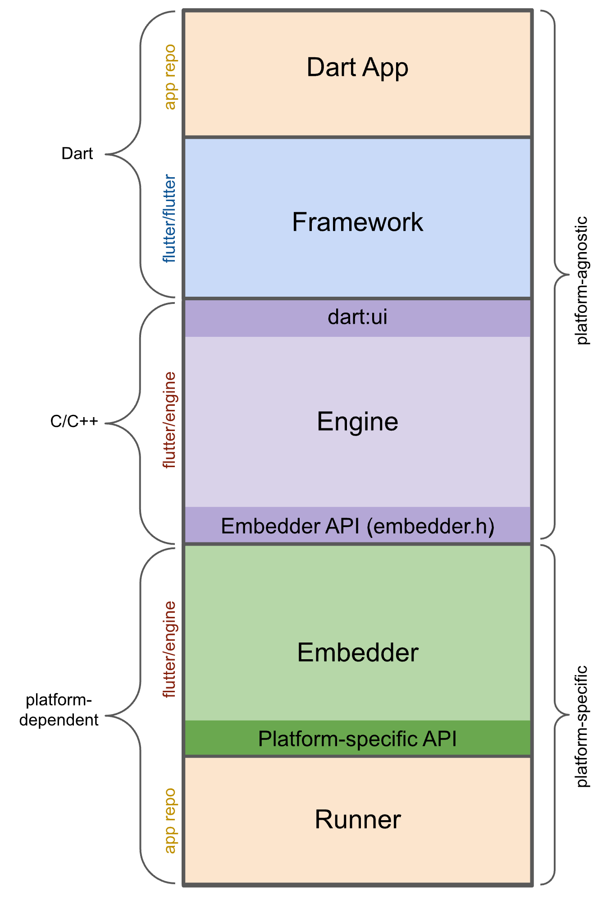
FLUTTER ARCHITECTURE
Dart App
Composes widgets into the desired UI.
Implements business logic.
Owned by app developer.
Framework (source code)
Provides higher-level API to build high-quality apps (for example, widgets, hit-testing, gesture detection, accessibility, text input).
Composites the app's widget tree into a scene.
Engine (source code)
Responsible for rasterizing composited scenes.
Provides low-level implementation of Flutter's core APIs (for example, graphics, text layout, Dart runtime).
Exposes its functionality to the framework using the dart:ui API.
Integrates with a specific platform using the Engine's Embedder API.
Embedder (source code)
Coordinates with the underlying operating system for access to services like rendering surfaces, accessibility, and input.
Manages the event loop.
Exposes platform-specific API to integrate the Embedder into apps.
Runner
Composes the pieces exposed by the platform-specific API of the Embedder into an app package runnable on the target platform.
Part of app template generated by flutter create, owned by app developer.

Slide 30
FLUTTER HELLO WORLD!
import 'package:flutter/material.dart';
void main() {
runApp(
const Center(
child: Text(
'Hello, world!',
textDirection: TextDirection.ltr,
),
),
);
}

Slide 31
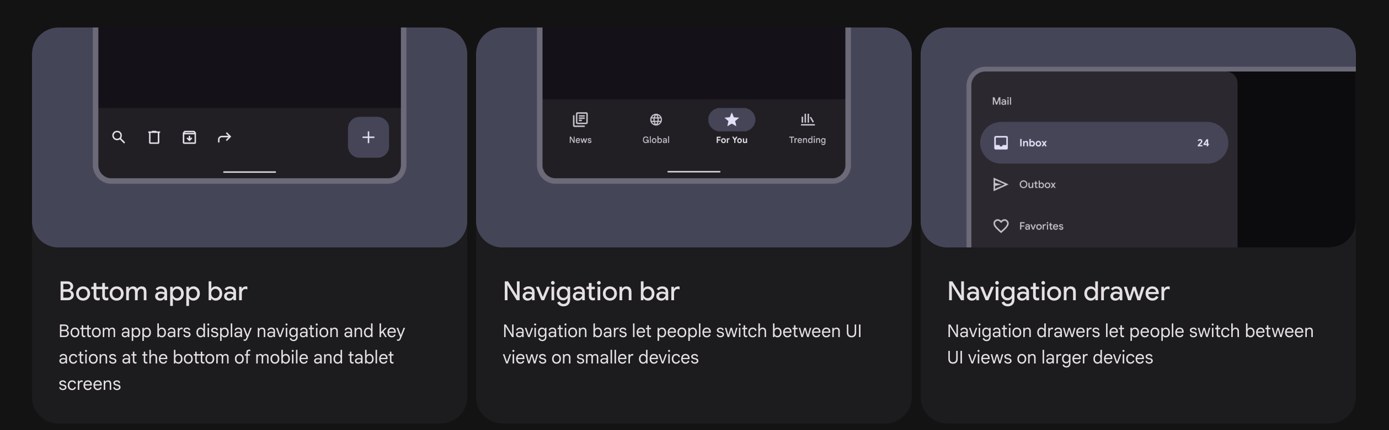
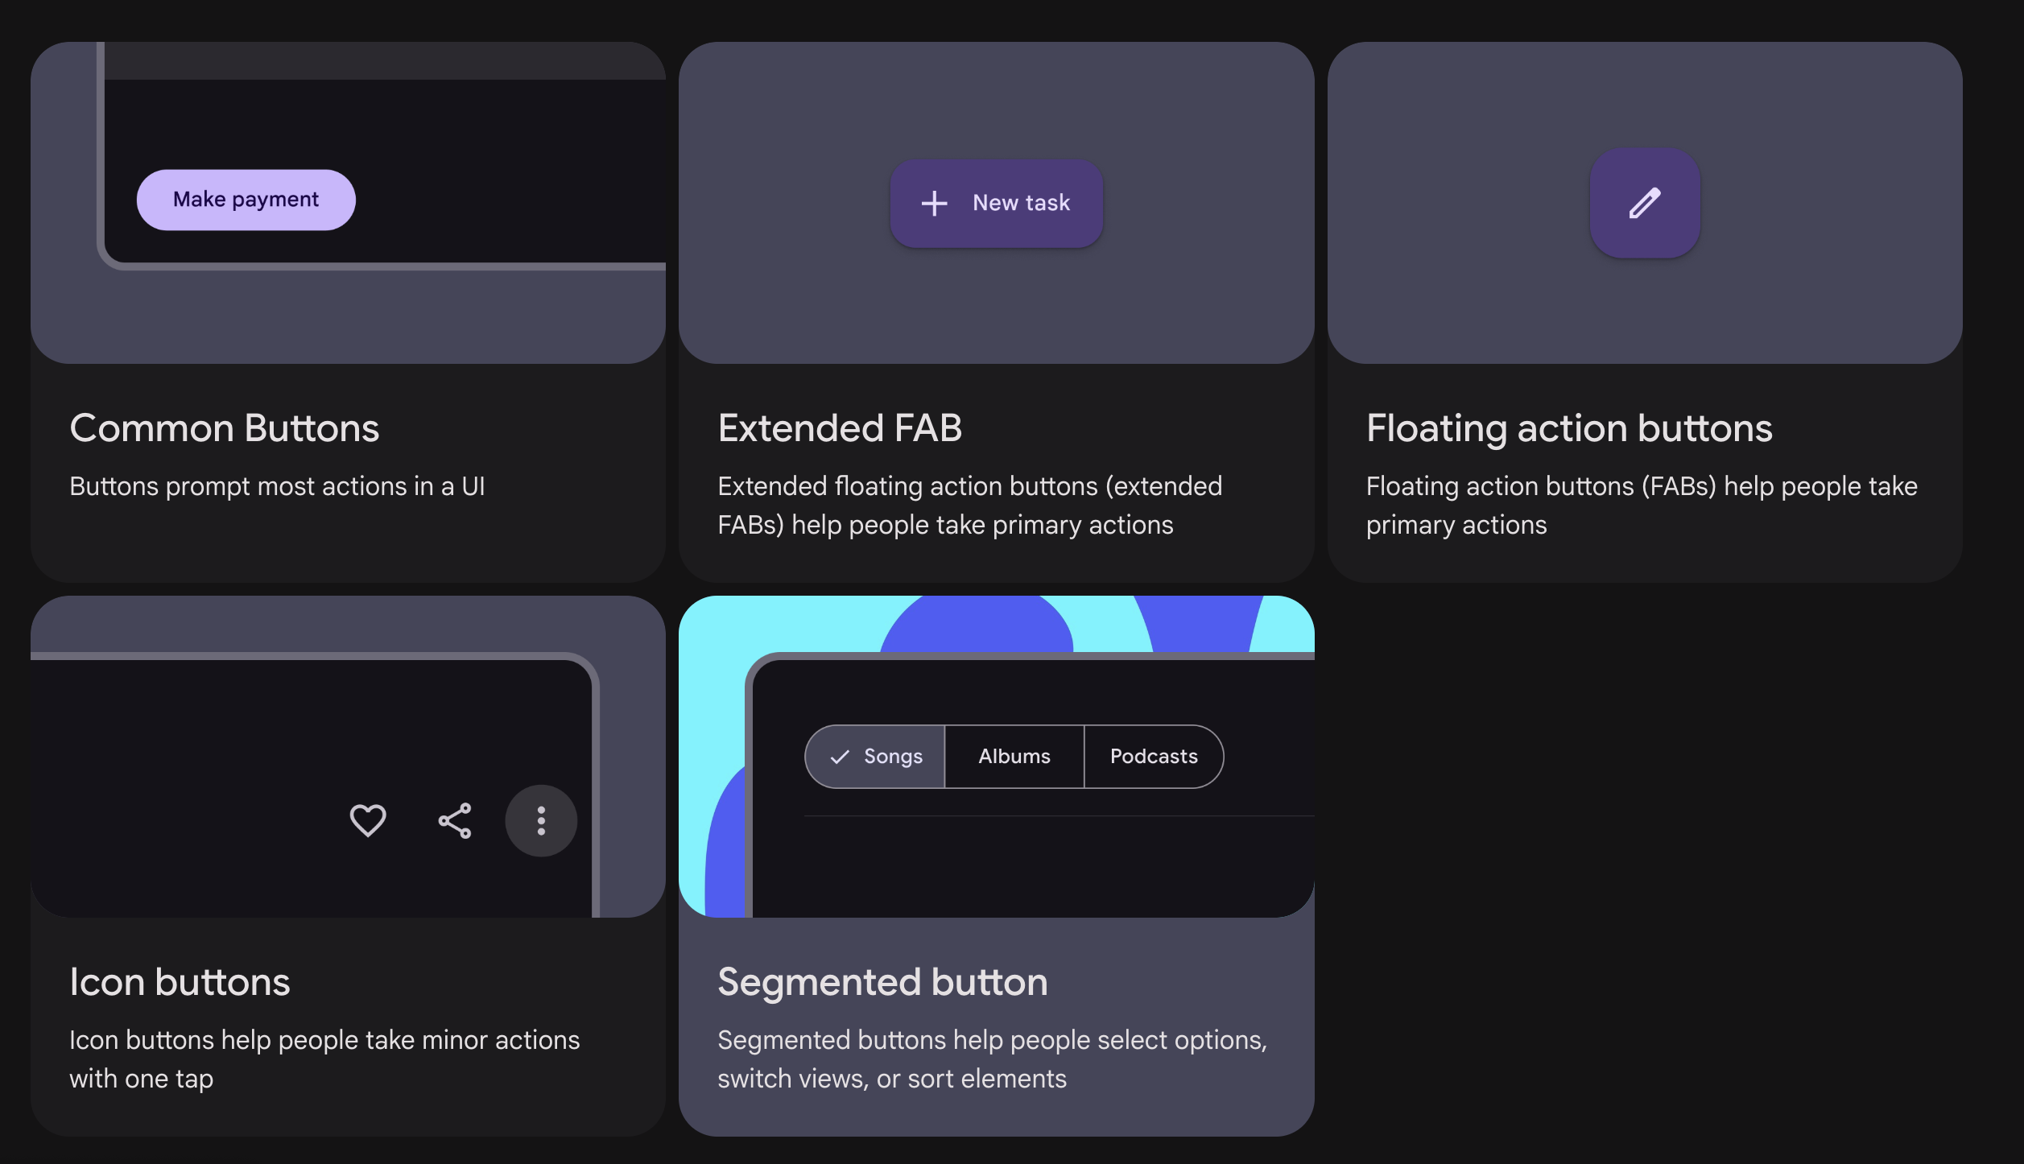
GOOGLE MATERIAL DESIGN GUIDELINES
What's Material?
Material Design is a design system built and supported by Google designers and developers. Material.io includes in-depth UX guidance and UI component implementations for Android, Flutter, and the Web.
The latest version, Material 3, enables personal, adaptive, and expressive experiences – from dynamic color and enhanced accessibility, to foundations for large screen layouts and design tokens.
All Material 3 content, guidelines, imagery, and resources are available under the Apache 2.0 or CC BY 4.0 license.
https://m3.material.io/
https://www.figma.com/community/file/1035203688168086460

Slide 32
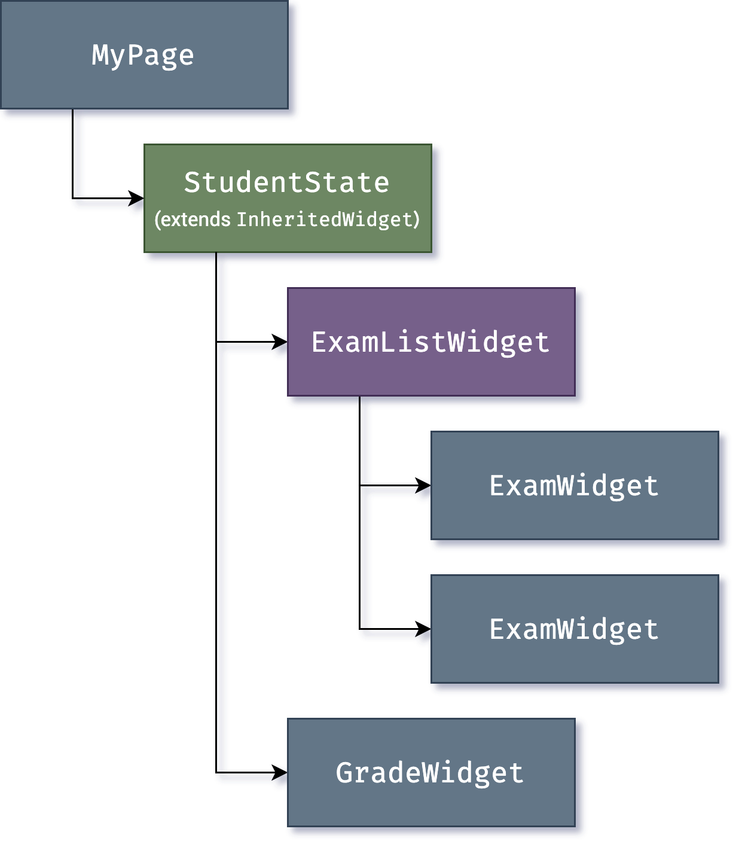
WIDGETs

Slide 33
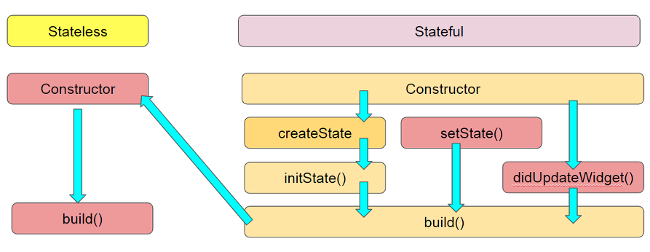
WIDGET LIFECYCLE

Slide 34
WIDGET LIFECYCLE
createState
When Flutter is instructed to build a StatefulWidget, it immediately calls createState()
Init State
Called when this object is inserted into the tree.
When inserting the render tree when invoked, this function is called only once in the life cycle. Here you can do some initialization, such as initialization State variables.
setState
The setState() method is called often from the Flutter framework itself and the developer.
didChangeDependencies
Called when a dependency of this [State] object changes.
didUpdateWidget
Called whenever the widget configuration changes.
deactivate
Called when this object is removed from the tree. Before dispose, we will call this function.
dispose
Called when this object is removed from the tree permanently.
didChangeAppLifecycleState
Called when the system puts the app in the background or returns the app to the foreground.
https://stackoverflow.com/questions/41479255/life-cycle-in-flutter

Slide 35
WIDGETS
https://docs.flutter.dev/ui/widgets
Text:
The Text widget lets you create a run of styled text within your application.
Row, Column:
These flex widgets let you create flexible layouts in both the horizontal (Row) and vertical (Column) directions. The design of these objects is based on the web's flexbox layout model.
Stack:
Instead of being linearly oriented (either horizontally or vertically), a Stack widget lets you place widgets on top of each other in paint order. You can then use the Positioned widget on children of a Stack to position them relative to the top, right, bottom, or left edge of the stack. Stacks are based on the web's absolute positioning layout model.
Container:
The Container widget lets you create a rectangular visual element. A container can be decorated with a BoxDecoration, such as a background, a border, or a shadow. A Container can also have margins, padding, and constraints applied to its size. In addition, a Container can be transformed in three-dimensional space using a matrix.

Slide 36
MATERIAL SHOWCASE
import 'package:flutter/material.dart';
void main() => runApp(MaterialApp(
title: 'Material UI Showcase',
theme: ThemeData(primarySwatch: Colors.teal), // Define Material theme
home: MaterialShowcaseApp(),
));
class MaterialShowcaseApp extends StatefulWidget {
@override
_MaterialShowcaseAppState createState() => _MaterialShowcaseAppState();
}
class _MaterialShowcaseAppState extends State<MaterialShowcaseApp> {
int _selectedIndex = 0; // Keeps track of which page is selected (Home or Form)
final List<Widget> _pages = <Widget>[
HomePage(), // Page 0: Home with cards and list
FormPage(), // Page 1: Form with input field
];
[...]
@override
Widget build(BuildContext context) {
return Scaffold( […]
// HomePage displays a scrollable list of cards
class HomePage extends StatelessWidget { […] }
// FormPage displays a simple form with input and submit button
class FormPage extends StatelessWidget {[…]}

Slide 37
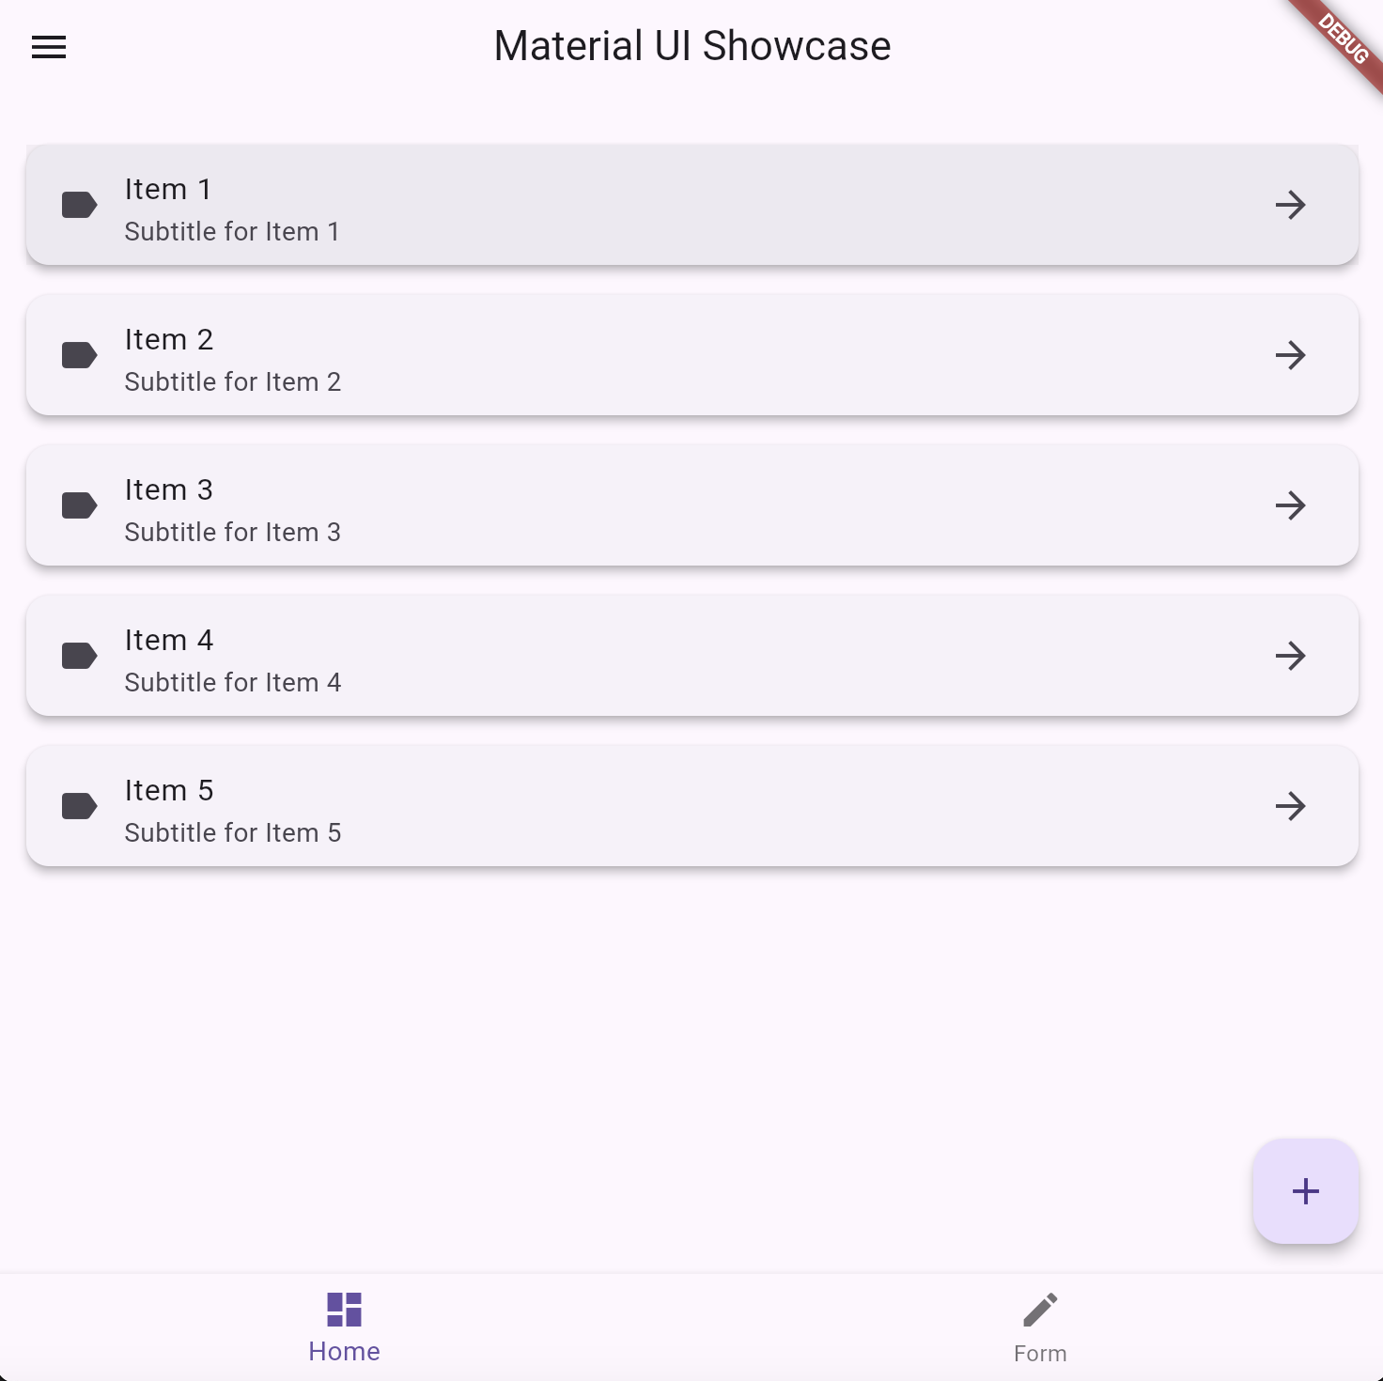
MATERIAL SHOWCASE
// HomePage displays a scrollable list of cards
class HomePage extends StatelessWidget {
final List<String> entries = List<String>.generate(5, (i) => "Item ${i + 1}"); // Sample items
@override
Widget build(BuildContext context) {
return ListView(
padding: EdgeInsets.all(16),
children: entries.map((entry) {
return Card(
elevation: 4, // Shadow depth
margin: EdgeInsets.symmetric(vertical: 8),
child: ListTile(
leading: Icon(Icons.label), // Icon on the left
title: Text(entry), // Main text
subtitle: Text('Subtitle for $entry’),
// Smaller text below
trailing: Icon(Icons.arrow_forward),
// Icon on the right
onTap: () {}, ),); // Tap action (can be expanded)
}).toList(),
);
}
}

Slide 38
MATERIAL SHOWCASE
MaterialApp
└── MaterialShowcaseApp (StatefulWidget)
└── Scaffold
├── AppBar
│ └── Text (title)
├── Drawer
│ └── ListView
│ ├── DrawerHeader
│ │ └── Text
│ └── ListTile (x2)
│ ├── Icon (leading)
│ └── Text (title)
├── Body (from _pages)
│ ├── HomePage (StatelessWidget)
│ │ └── ListView
│ │ └── Card (x5)
│ │ └── ListTile
│ │ ├── Icon (leading)
│ │ ├── Text (title)
│ │ ├── Text (subtitle)
│ │ └── Icon (trailing)
[…]
[…]
│ └── FormPage (StatelessWidget)
│ └── Padding
│ └── Form
│ └── Column
│ ├── Text (headline)
│ ├── SizedBox
│ ├── TextFormField
│ │ └── InputDecoration
│ │ ├── labelText
│ │ └── OutlineInputBorder
│ ├── SizedBox
│ └── ElevatedButton
│ └── Text
├── FloatingActionButton
│ └── Icon
└── BottomNavigationBar
├── BottomNavigationBarItem (Home)
│ ├── Icon (Icons.dashboard)
│ └── Text (label: 'Home')
└── BottomNavigationBarItem (Form)
├── Icon (Icons.edit)
└── Text (label: 'Form')
Optional:
└── SnackBar (triggered from FloatingActionButton and Submit button)

Slide 39
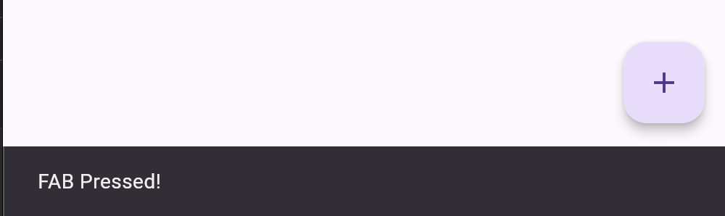
Callback Gestures
// Floating Action Button at the bottom right
floatingActionButton: FloatingActionButton(
child: Icon(Icons.add),
onPressed: () => ScaffoldMessenger.of(context).showSnackBar(
SnackBar(content: Text('FAB Pressed!')), // Show message when clicked
),
),

Slide 40
Callback Gestures
Callback Name | Triggered When… | Type
onTap | The user taps the widget | void Function()
onTapDown | The pointer touches the screen | void Function(TapDownDetails)
onTapUp | The pointer lifts after a tap | void Function(TapUpDetails)
onTapCancel | Tap is interrupted (e.g., dragged off widget) | void Function()
onDoubleTap | The user double-taps | void Function()
onLongPress | The user presses and holds | void Function()
onLongPressStart | Long press starts | void Function(LongPressStartDetails)
onLongPressMoveUpdate | Finger moves during long press | void Function(LongPressMoveUpdateDetails)
onLongPressEnd | Long press ends | void Function(LongPressEndDetails)
onSecondaryTap | Right-click or long-press on Android | void Function()

