Slide 1
Discovering Macromolecular Interactions

Slide 2
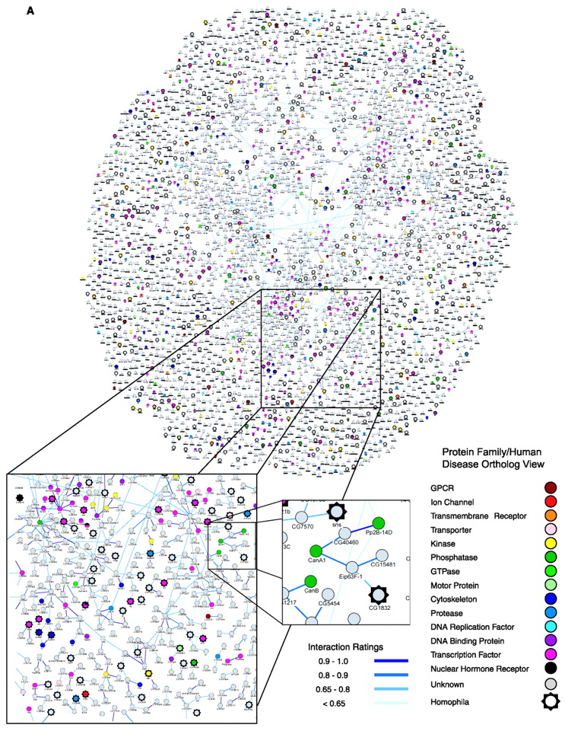

Slide 3
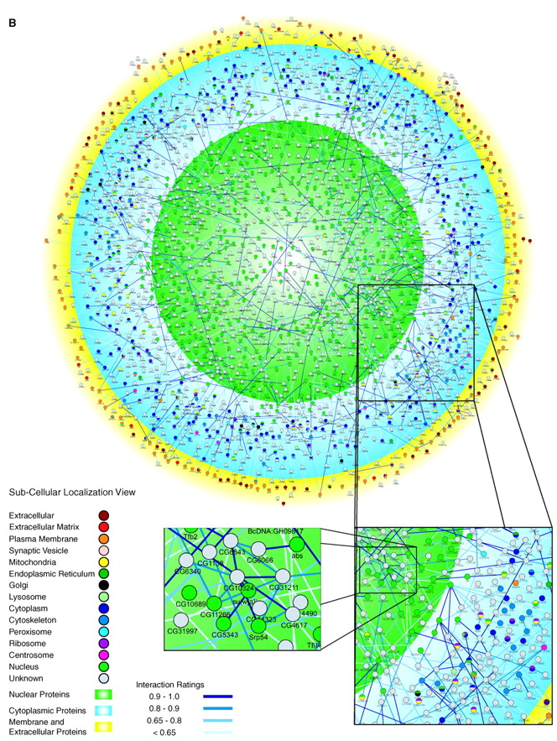
An experimental strategy for identifying new molecular actors in a process

Slide 4
An experimental strategy for identifying new molecular actors in a process
DATABASE search

Slide 5
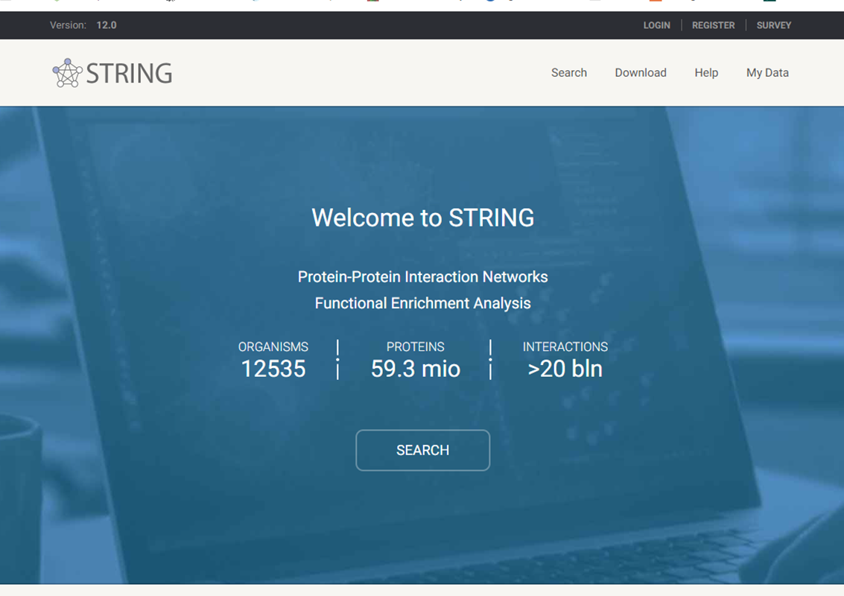

Slide 6
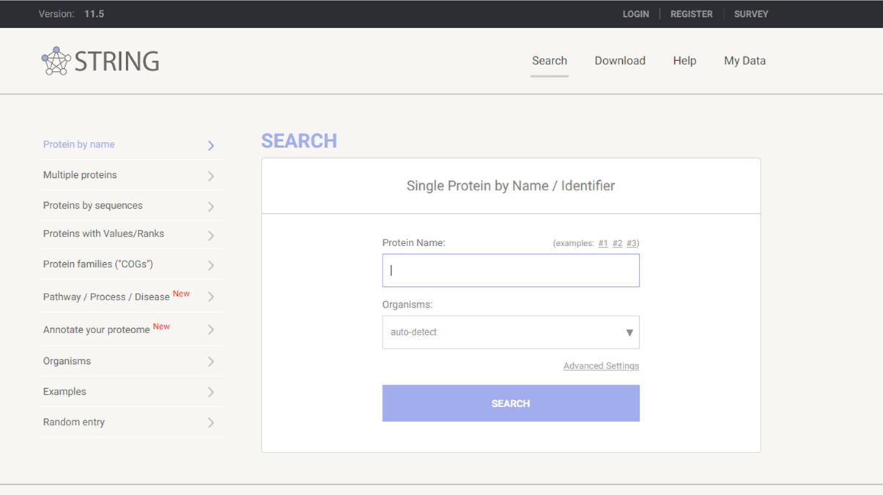

Slide 7
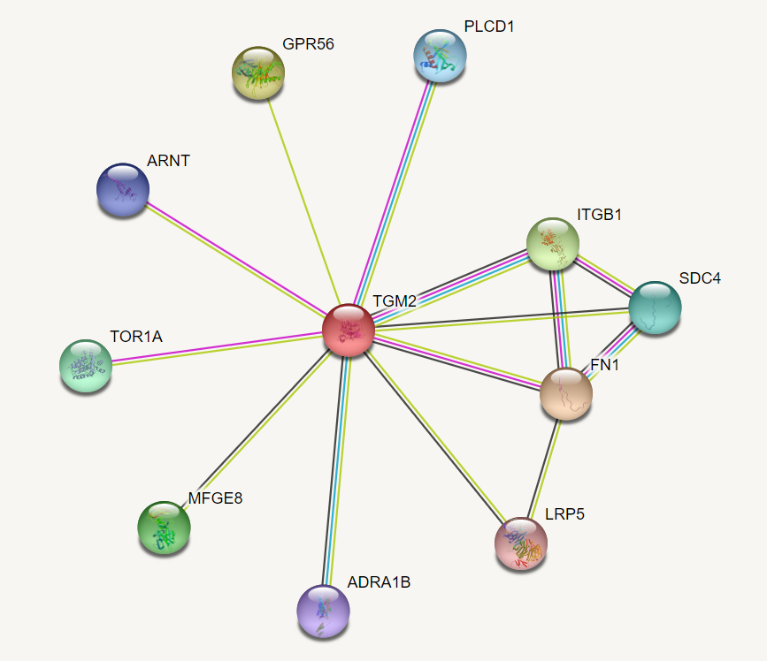

Slide 8
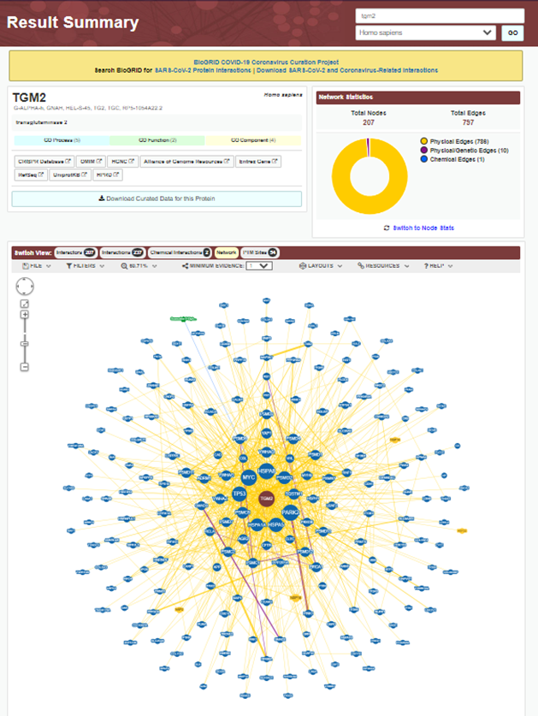
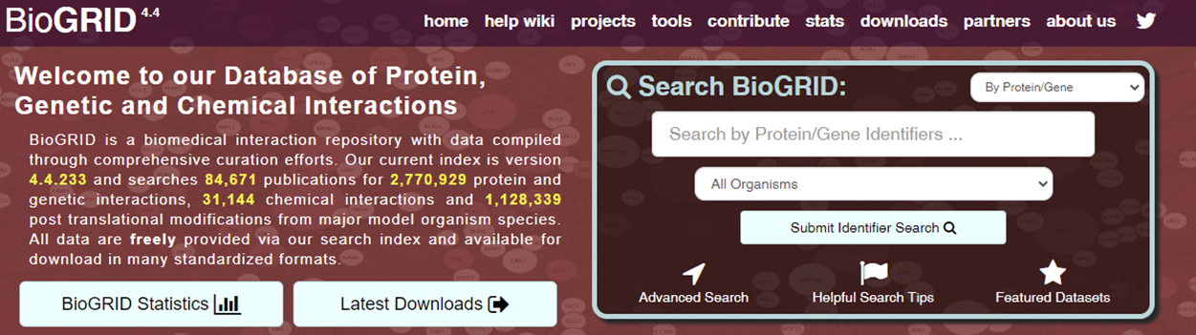

Slide 9
An experimental strategy for identifying new molecular actors in a process
DATABASE search
Candidate approach
General screening

Slide 10
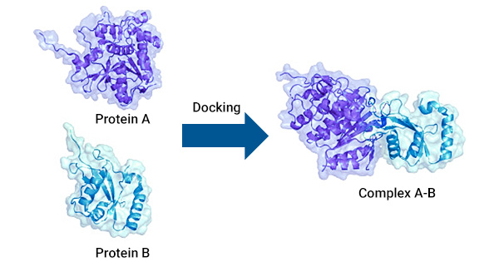
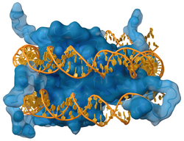
Types of Interactions
Protein / Protein
Protein / nucleic acid
  extracellular
  intracellular
  DNA
  RNA

Slide 11
Interaction detection Methods
(co)-immunoprecipitation
glutathione-S-transferase (GST) pull down
co-purification
  chromatography, tandem affinity purification (TAP)
yeast two hybrid
phage display/expression libraries
FRET
solution binding- Scatchard analysis

Slide 12
(Co)-
ImmunoPrecipitation (IP)
Immunoprecipitation (IP)
is a cellular and molecular biology method used in laboratories
- to isolate (or purify)
- a protein of interest
- via a solid phase (agarose or Sepharose™ resin or magnetic particles).
Using an antibody to isolate and purify a protein from a whole cell lysate.
Normally you will “only” purify the protein the antibody recognizes.
Any additional proteins that co-purify are candidates for interacting proteins.

Slide 13
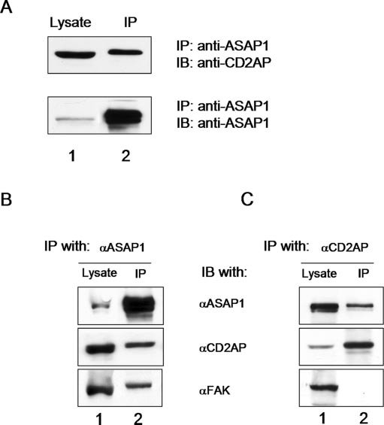

Slide 14





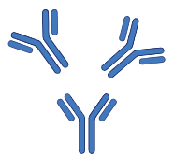

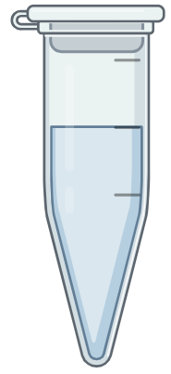



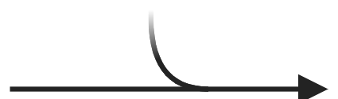
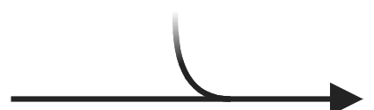

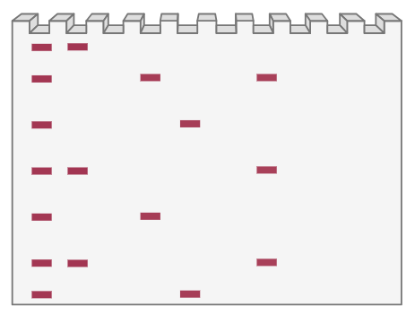

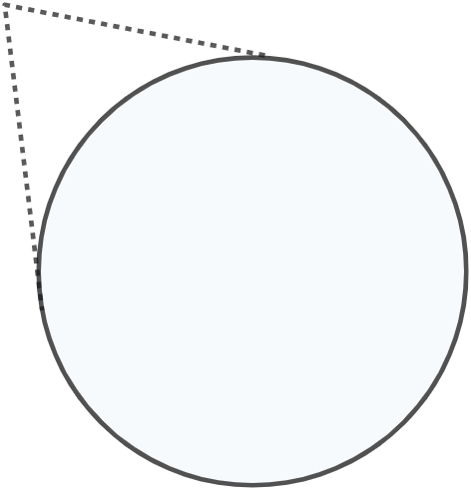



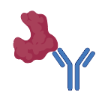
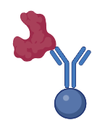









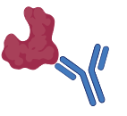
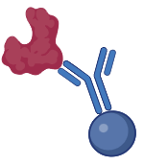



Immunoprecipitation Protocol
Cell lysates
(total protein)
Antigen-antibody
complex
Antigen-antibody-bead complex
(with other proteins)
Antigen-antibody-bead complex
(no other proteins)
Downstream
applications
(Western blot)
Add antibodies and incubate
Add Protein A/G
beads and incubate
Wash and elute
Purify
Protein of
interest

Slide 15
Immunoprecipitation Protocol
2- Add an antibody
(monoclonal or polyclonal) against a specific target protein
forms an immune complex with that target.
Cell lysates
(total protein)
Antigen-antibody
complex
1- lysate cell
Add antibodies and incubate
Protein of
interest

Slide 16
Immunoprecipitation Protocol
3- The immune complex is then captured, or precipitated, on a beaded support
to which an antibody-binding protein is immobilized (such as Protein A or G),
any proteins not precipitated on the beads are washed away.
Antigen-antibody
complex
Antigen-antibody-bead complex
(with other proteins)
Antigen-antibody-bead complex
(no other proteins)
Add Protein A/G
beads and incubate
Wash

Slide 17
Immunoprecipitation Protocol
4- the antigen is eluted from the support
(and antibody, if it is not covalently attached to the beads and/or when using denaturing buffers)
5- The antigen is analyzed
- by sodium dodecyl sulfate-polyacrylamide gel electrophoresis (SDS-PAGE),
- followed by Western blot detection to verify the identity of the antigen.
Antigen-antibody-bead complex
(no other proteins)
Downstream
applications
(Western blot)
Purify

Slide 18
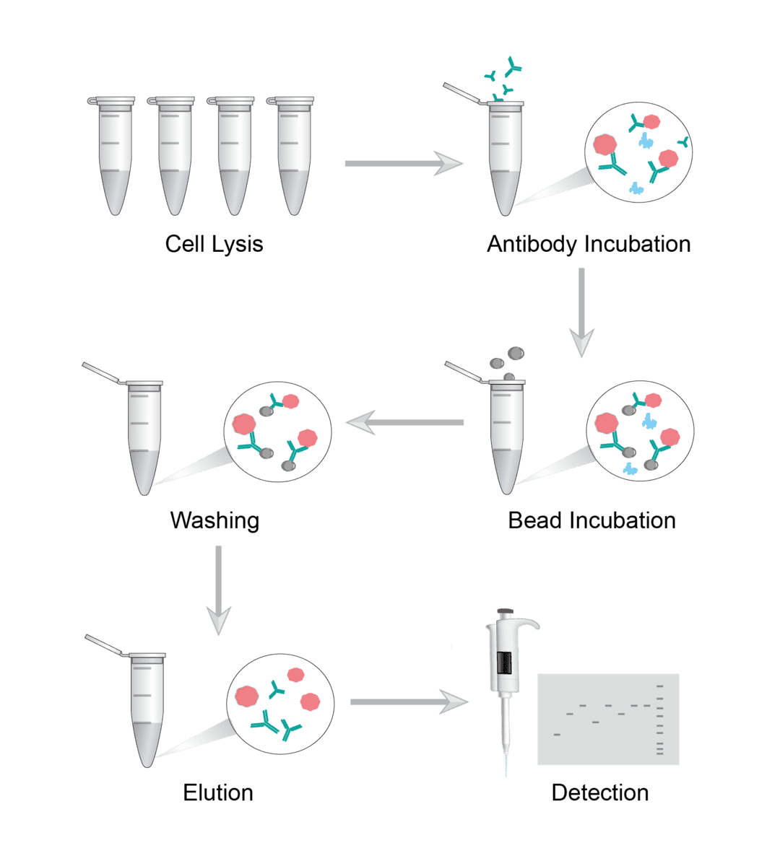

Slide 19
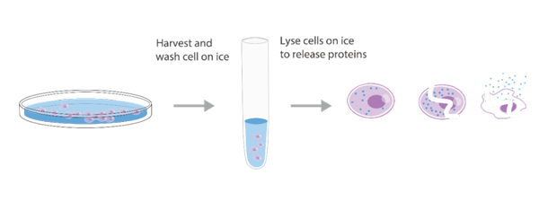
IP optimization
Empirical testing is nearly always required to optimize IP conditions to obtain the desired yield and purity of target proteins.
Lysis Buffers
The quality of the sample that is used for IP applications critically depends on the right lysis buffer, which
stabilizes native protein conformation,
inhibits enzymatic activity,
minimizes antibody binding site denaturation
maximizes the release of proteins from the cells or tissue.
The lysis buffer used for a particular application depends on the target proteins that will be immunoprecipitated, because the location of the protein in the cell (e.g., membrane, cytosol, nucleus) affects the ease of release during lysis.

Slide 20
NON DENATURING buffers
are used when
the IP antigen is detergent-soluble
the antibody can recognize the native form of the protein.
These buffers contain non-ionic detergents, such as NP-40 or Triton X-100.
DENATURING buffers
such as radio-immunoprecipitation assay (RIPA) buffer
are more stringent than non-denaturing buffers because of the addition of ionic detergents like SDS or sodium deoxycholate.
While these buffers do not maintain native protein conformation, proteins that are difficult to release with non-denaturing buffers, such as nuclear proteins, can be released with denaturing buffers.
Both buffers contain NaCl and Tris-HCl and have a slightly basic pH (7.4 to 8).

Slide 21
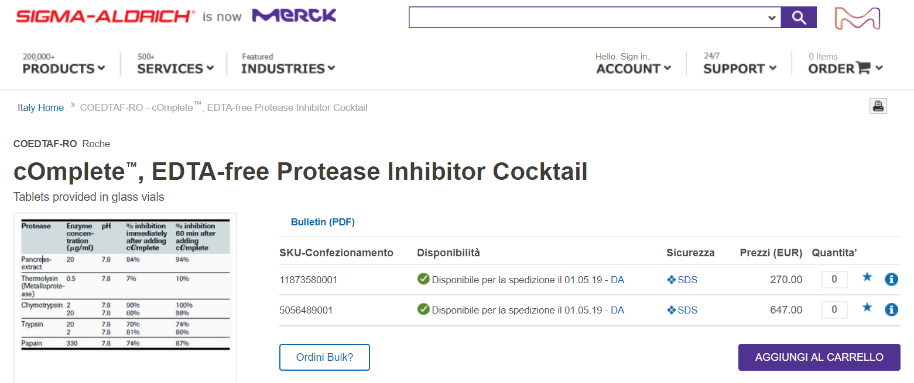
** Because cell lysates also contain proteases and phosphatases that can modify or degrade the target protein, most IP protocols are performed at 4°C.
** Protease (asomal) inhibitors, such as PMSF, aprotinin and leupeptin are commonly added to the lysis buffer just prior to use, along with sodium orthovanadate or sodium fluoride as a phosphatase inhibitor.
While these components can be added individually, commercial inhibitor cocktails are available that are higher quality and easier to use.

Slide 22
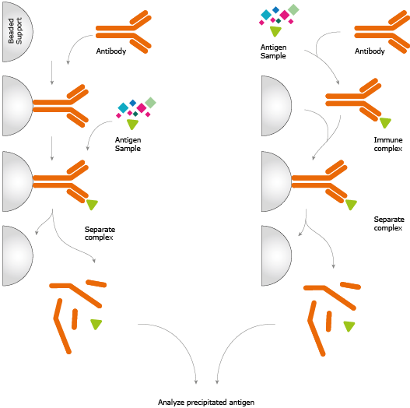
Diagram of immunoprecipitation (IP)
pre-immobilized antibodies.
or free antibodies.

Slide 23
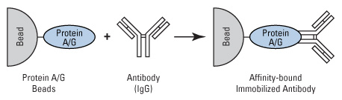
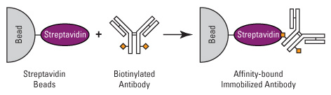
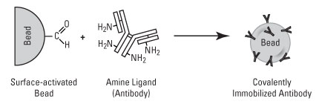

Slide 24
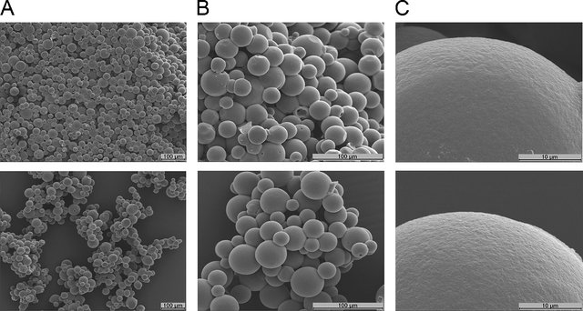
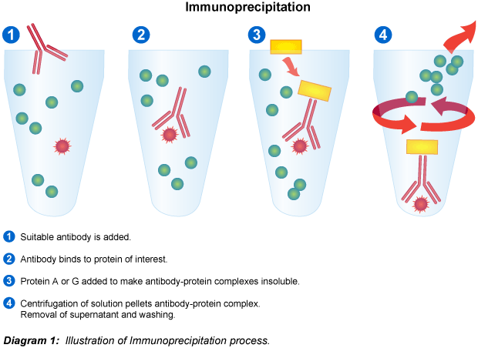
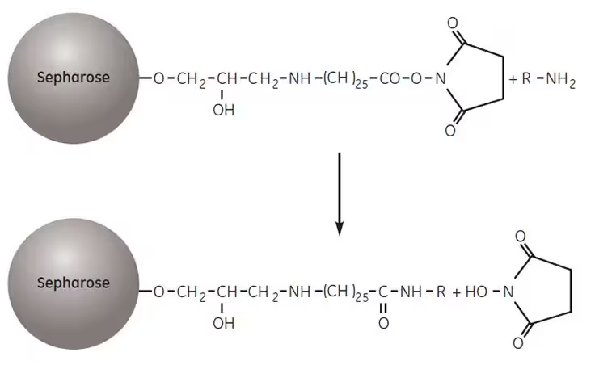
Because IP developed as an adaptation of column affinity chromatography, the IP technique was first done using small aliquots (10–25 µL) of agarose resin in microcentrifuge tubes.

Slide 25
Magnetic particles, such as Dynabeads™ and Pierce™ magnetic beads, have largely replaced agarose beads as the preferred support for immunoprecipitation and other micro-scale affinity purification procedures.
Magnetic particles are solid and spherical, and antibody binding is limited to the surface of each bead.

Slide 26
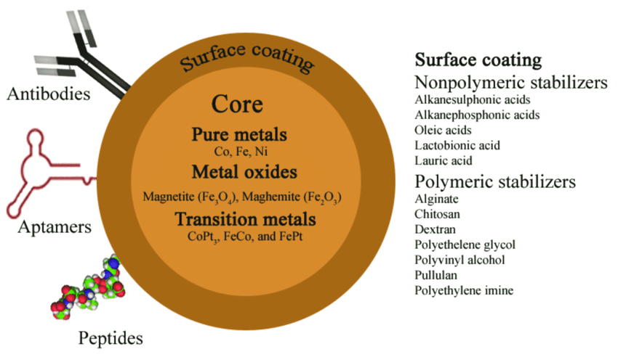
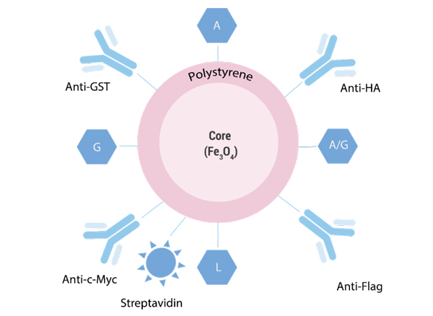
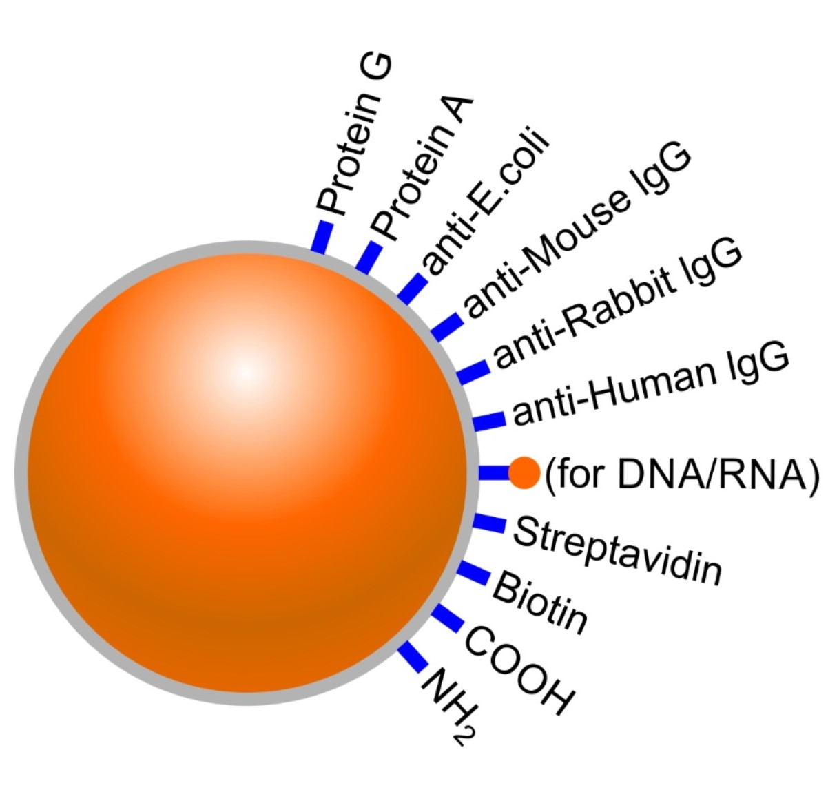

Slide 27
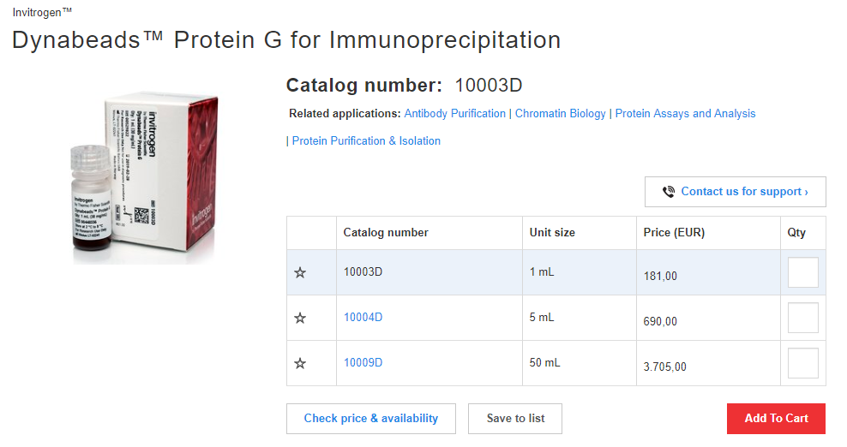
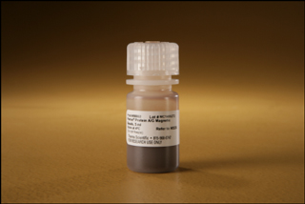
The advantages of magnetic beads for IP
Capacity and yield–, even if the antibody-binding capacity is lower compared to agarose, the final antigen yield is often the same or greater with magnetic beads.
Reproducibility and purity–magnetic beads generally provide higher reproducibility and purity compared to agarose. Pre-clearing is usually not necessary with magnetic beads.
Ease of use, speed, and automation an individual magnetic bead IP experiment can be completed in about 30 minutes.

Slide 28


Slide 29
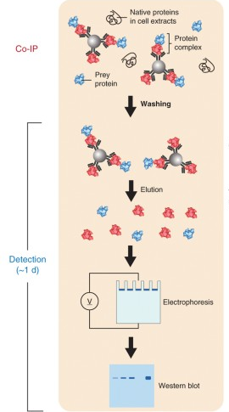
Co-Immnunoprecipitation (Co-IP)
Co-immunoprecipitation is an extension of IP that is based on the potential of IP reactions to capture and purify the primary target (i.e., the antigen) as well as other macromolecules that are bound to the target by native interactions in the sample solution.
Therefore, whether or not an experiment is called an IP or co-IP depends on whether the focus of the experiment is:
the primary target (antigen) -------> IP
the secondary targets (interacting proteins) -------> co-IP

Slide 30
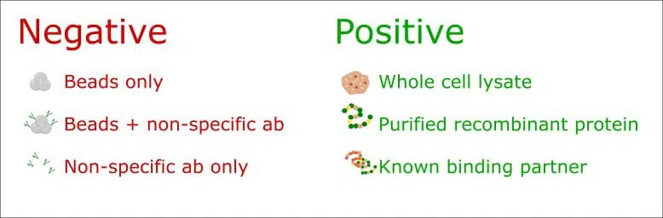
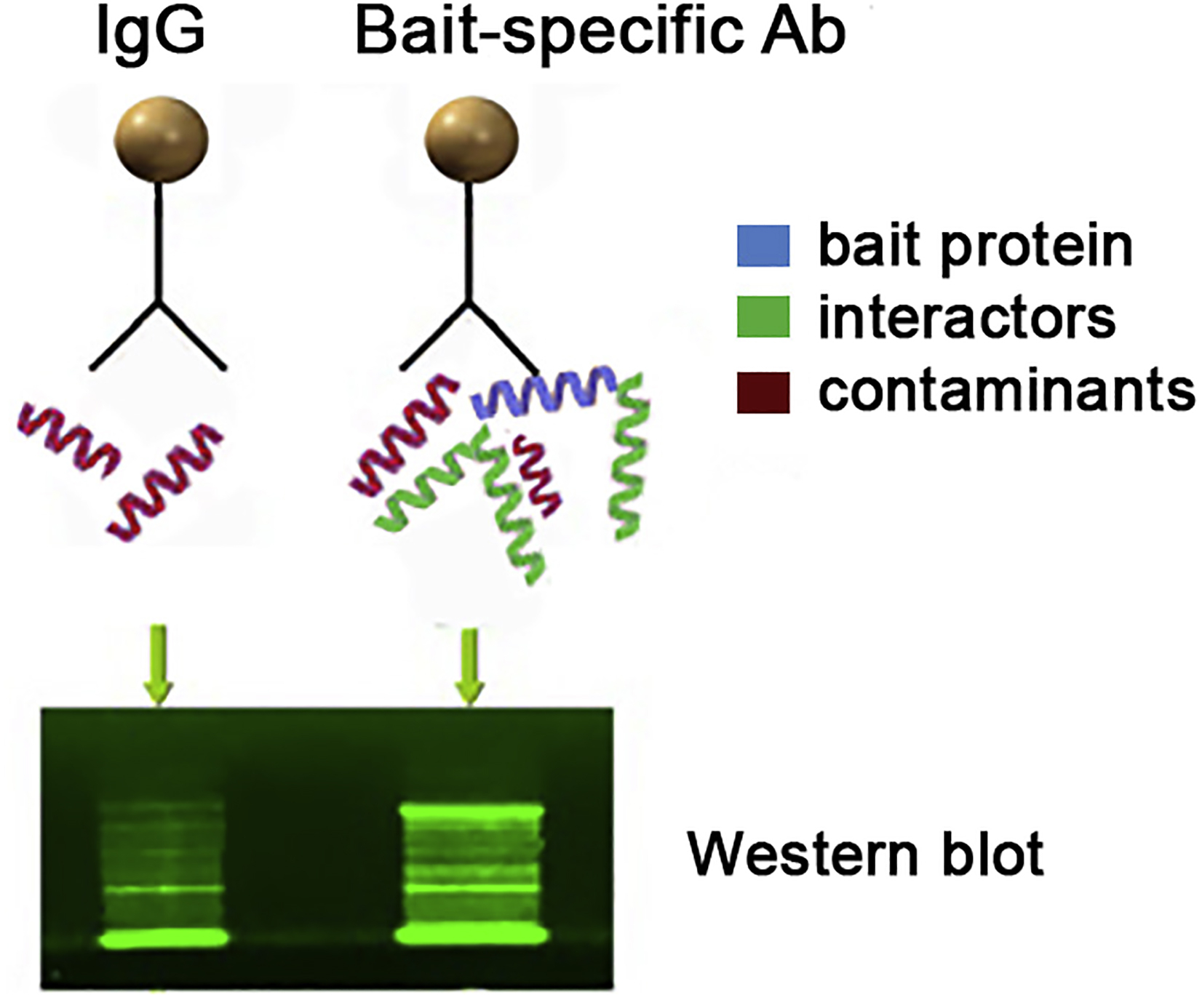
Controls are crucial for a successful Co-IP experiment

Slide 31
