Slide 1

FLUTTER and API REST

Slide 2
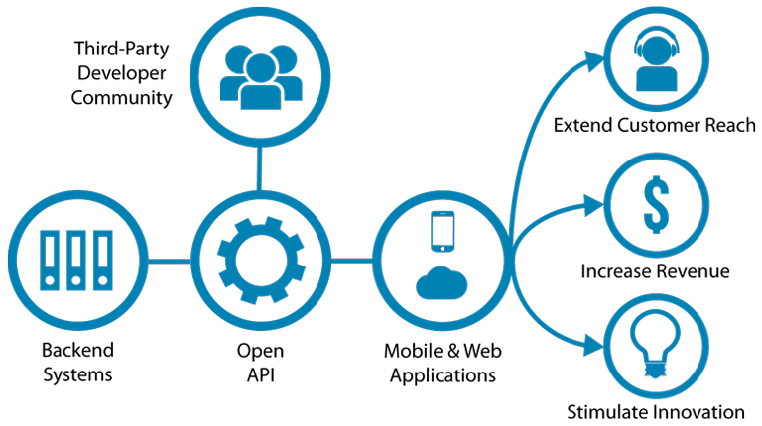
COS’E’ UN APPLICATION PROGRAMMING INTERFACE
openAPI

Slide 3
REST vs SOAP in breve
Simple Object Access Protocol (SOAP)! → POST ← GET, xml is an envelope
HTTP POST /ReturnValue HTTP/1.0 Host: www.abc.net Content-Type: text/xml; charset = utf-8 Content-Length: nnn
<?xml version = "1.0"?> <SOAP-ENV:Envelope xmlns:SOAP-ENV = "http://www.w3.org/2001/12/soap-envelope"
SOAP-ENV:encodingStyle = "http://www.w3.org/2001/12/soap-encoding">
<SOAP-ENV:Body xmlns:m = "http://www.abc.net/values"> <m:Value> <m:ValueName>Temperature</m:ValueName> </m:GetValue> </SOAP-ENV:Body>
</SOAP-ENV:Envelope>
HTTP/1.0 200 OK Content-Type: text/xml; charset = utf-8 Content-Length: nnn
<?xml version = "1.0"?> <SOAP-ENV:Envelope xmlns:SOAP-ENV = "http://www.w3.org/2001/12/soap-envelope"
SOAP-ENV:encodingStyle = "http://www.w3.org/2001/12/soap-encoding">
<SOAP-ENV:Body xmlns:m = "http://www.abc.net/values"> <m: ValueResponse > <m: Value >25.0</m: Value>
</m: ValueResponse > </SOAP-ENV:Body>
</SOAP-ENV:Envelope>
How to “move fast”: HTTP GET http://www.abc.net?value=temperature -> Response…
With RESTful: HTTP GET http://www.abc.net/values/temperature -> 25.0 (in JSON: {“temperature”: 25.0})
also: let’s use all the commands available in HTTP

Slide 4
HTTP Commands
Request method | RFC | Request has payload body | Response has payload body
GET | RFC 9110 | Optional | Yes
HEAD | RFC 9110 | Optional | No
POST | RFC 9110 | Yes | Yes
PUT | RFC 9110 | Yes | Yes
DELETE | RFC 9110 | Optional | Yes
CONNECT | RFC 9110 | Optional | Yes
OPTIONS | RFC 9110 | Optional | Yes
TRACE | RFC 9110 | No | Yes
PATCH | RFC 5789 | Yes | Yes
https://en.wikipedia.org/wiki/HTTP

Slide 5
RESTful
Uniform interface: One piece of data belong to a single URI
Client-server decoupling: You only need to know the URI of the server to interact
Statelessness: all the information to process is included in the message, no previous operations required
Cacheability: everything that is cacheable must be cached, to improve performance (client AND server side)
Layered system architecture: the architecture is transparent to the layers inside
Code on demand*: could give runnable code as a response (this is risky and must be done only on-demand).

Slide 6
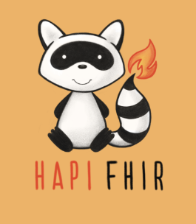
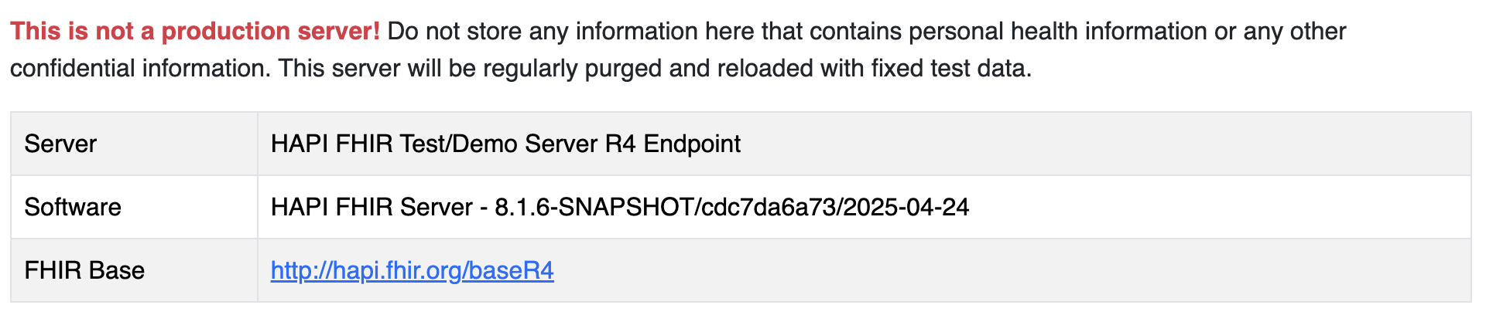
HAPI FHIR Test Server
HAPI FHIR is a complete implementation of the HL7 FHIR standard for healthcare interoperability in Java. We are an open community developing software licensed under the business-friendly Apache Software License 2.0. HAPI FHIR is a product of Smile Digital Health.
from https://hapifhir.io/
public test server URL: https://hapi.fhir.org/

Slide 7
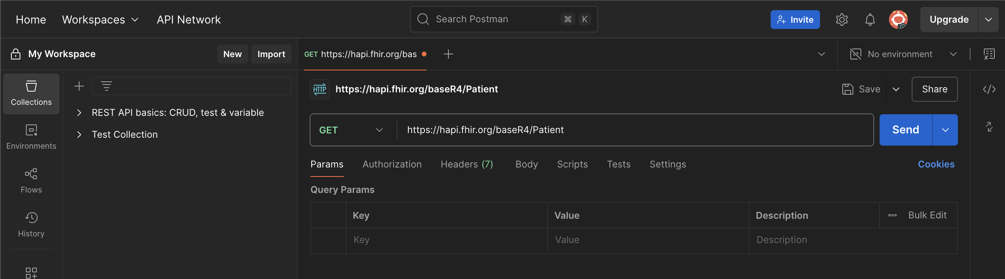
POSTMAN / CURL / INVOKE-RESTMETHOD
POSTMAN WEB: https://web.postman.co/
Unix (macOs + Linux):
curl -H "Accept: application/fhir+json" https://hapi.fhir.org/baseR4/Patient/example
Windows powershell:
$response = Invoke-RestMethod ` ← BEWARE: THIS IS NOT A ‘, it is a `, AltGr + \ in an Italian keyboard!!!
-Uri "https://hapi.fhir.org/baseR4/Patient" `
-Method GET `
-Headers @{ "Accept" = "application/fhir+json" }

Slide 8
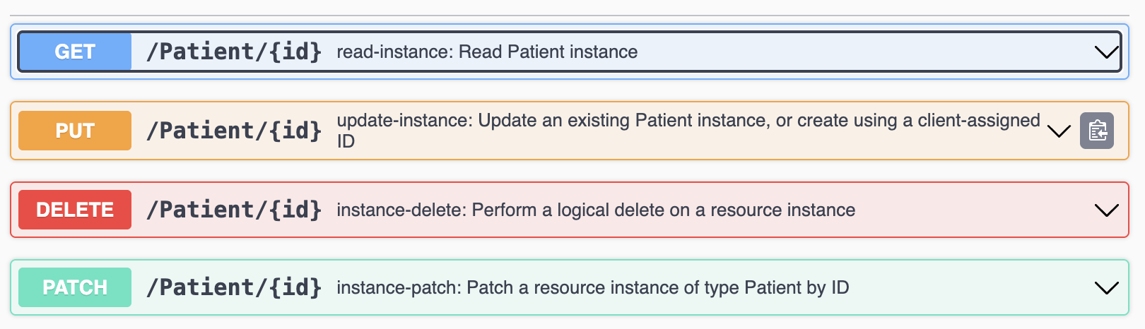
SWAGGER
Swagger:
https://hapi.fhir.org/baseR4/swagger-ui/
Swagger allows you to describe the structure of your APIs so that machines can read them. The ability of APIs to describe their own structure is the root of all awesomeness in Swagger.
from https://swagger.io/docs/specification/v2_0/what-is-swagger/

Slide 9
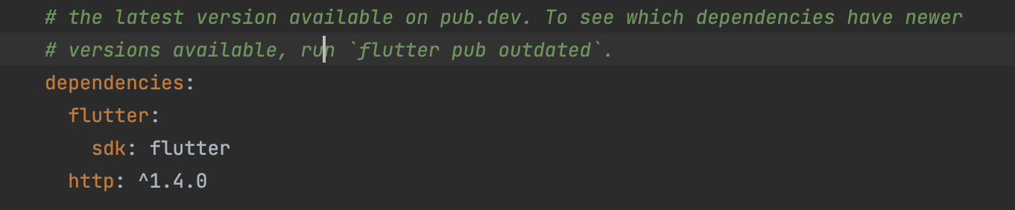
API IN FLUTTER
Let’s add http requests module to our app
[…]
try {
final response = await http.get(Uri.parse(url));
if (response.statusCode == 200) {
final decoded = json.decode(response.body);
return JsonEncoder.withIndent(' ').convert(decoded);
} else {
return 'Error: ${response.statusCode}';
}
} catch (e) {
return 'Request failed: $e';
}
}
}
import 'package:http/http.dart' as http;
import 'dart:convert';
class FhirService {
static Future<String> fetchObservations(String patientId) async {
final url = 'https://hapi.fhir.org/baseR4/Observation?subject=Patient/$patientId';
// I am exploiting a PARAMETER to search the patient's observations
[…]

Slide 10
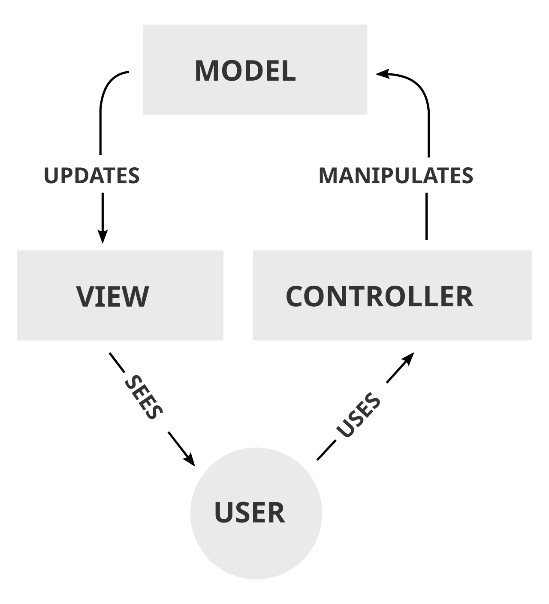
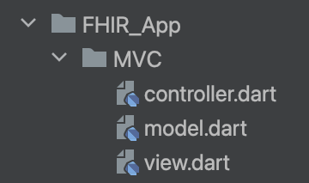
MODEL VIEW CONTROLLER PATTERN
An “evolution” of the original Observer Pattern, in which a subject (Model) notifies various Observers (Views)
Adding a Controller who handles the Users Interaction.

