Slide 3
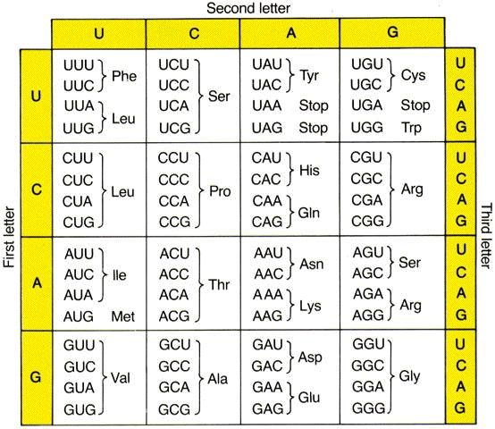
Because of the degeneracy of all genetic codes, 18/20 amino acids are encoded by more than one codon (2, 3, 4, or 6).
If synonymous codons are strictly neutral,
they should be used randomly

Slide 4

The genome hypothesis
- All genes in a genome tend to have the same coding strategy.
- That is, they employ the codon catalog similarly and show similar choices between synonymous codons.
- Different taxa have different coding strategies.
An example:
21 of the 23 leucine residues in the E. coli outer membrane protein II (ompA) are encoded by the codon CUG, although 5 other codons for leucine are available.
Richard Grantham

Slide 6
Codon usage bias
intended as:
the non-random usage of synonymous codons in the protein translation process,
can be observed in virtually all organisms.
This phenomenon widely varies across different species and it is expected to significantly influence molecular genome evolution
One can locate “optimal” codons which are expected to be translated more efficiently than others.
We can define the “codon bias” of a specific gene, relative to the optimal codons…

Slide 7
Universal and species-specific patterns of codon usage
Universal patterns:
Codons that contain the CG dinucleotide are universally avoided (low-usage codons). This phenomenon is particularly notable as far as the arginine codons CGA and CGG are concerned.
Two selective factors have been convincingly invoked to explain codon usage bias.
translation optimization
(2) folding stability of the mRNA

Slide 8
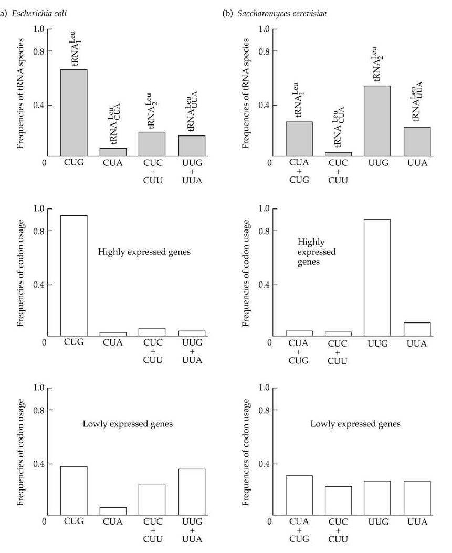
Gouy and Gautier (1982) and Bennetzen and Hall (1982) found positive correlation between degree of codon bias and level of gene expression.
The translation efficiency of a codon
is related to
the relative quantity of tRNA molecules
That recognize the particular codon.

Slide 9
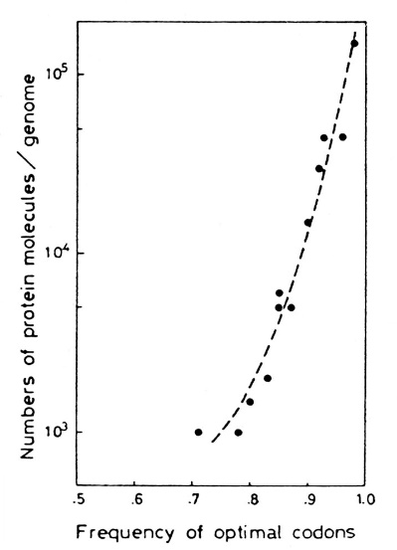
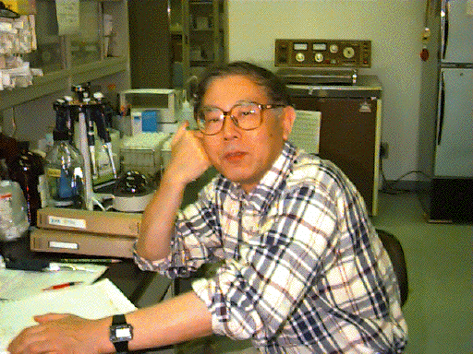
tRNA Abundance:
Translational efficiency depends on availability of tRNAs.
tRNA content is the major determinant of the bias between groups of codons recognized by different synonymous tRNAs.
Codons recognized by abundant tRNAs are used more often than those recognised by rare tRNAs, particularly in highly expressed genes, probably owing to selection at the level of translation against codons recognized by rare tRNAs.
Toshimishi Ikemura

Slide 10

Codon Usage
is related to
Translation
Efficiency
Toshimishi Ikemura

Slide 11
Measures of codon-usage bias
The relative synonymous codon usage (RSCU) was first suggested by Sharp et al. (1986).
RSCU is
the number of times a codon appears in a gene
divided by
the number of expected occurrences under equal codon usage.
n = number of synonymous codons (1 ≤ n ≤ 6) for the amino acid under study,
X_{i} = number of occurrences of codon i.
If the synonymous codons of an amino acid are used with equal frequencies,
their RSCU values will equal 1.

Slide 12
n = number of synonymous codons (1 ≤ n ≤ 6) for the amino acid under study,
X_{i} = number of occurrences of codon i.
In una Proteina di 200 aa trovo il seguente uso di Isoleucine
AUU = 7
AUC = 18
AUA = 2
Qual è il valore di RSCU per il codone AUC ?
the number of times a codon appears in a gene
divided by
the number of expected occurrences under equal codon usage.

Slide 13
The codon adaptation index (CAI) measures the degree with which genes use preferred codons.
compile a table of RSCU values for highly expressed genes.
From this table, it is possible to identify the codons that are most frequently used for each amino acid.
The relative adaptiveness of a codon (w_{i}) is computed as
where RSCU_{max} = the RSCU value for the most frequently used codon for an amino acid.

Slide 14
Codon Adaptation Index (CAI)
Codon adaptation index is a measurement of the relative adaptiveness of the codon usage of a gene towards the codon usage of highly expressed genes
The CAI index is defined as the geometric mean of these relative adaptiveness values.
The CAI index ranges from 0 to 1
being 1 if a gene always uses, for each encoded amino acid, the most frequently used synonymous codon in the reference set.

Slide 15
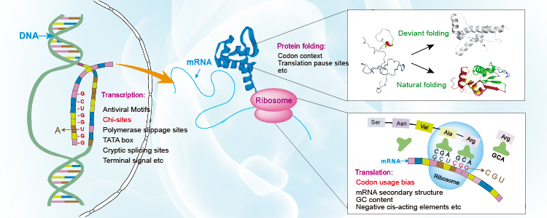
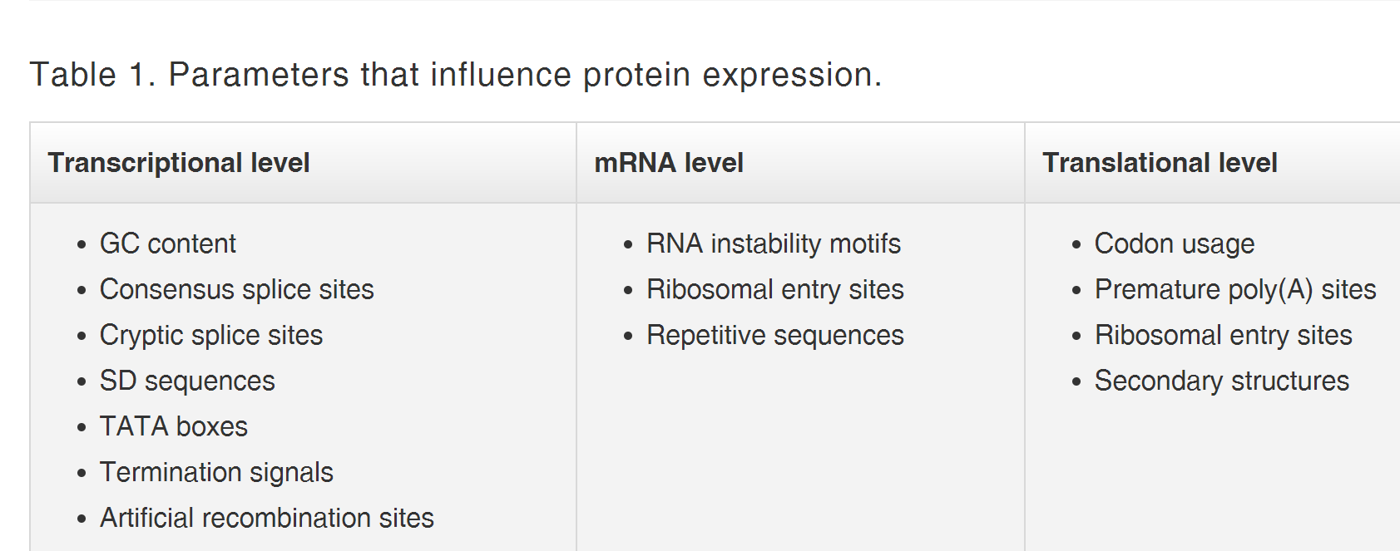

Slide 22
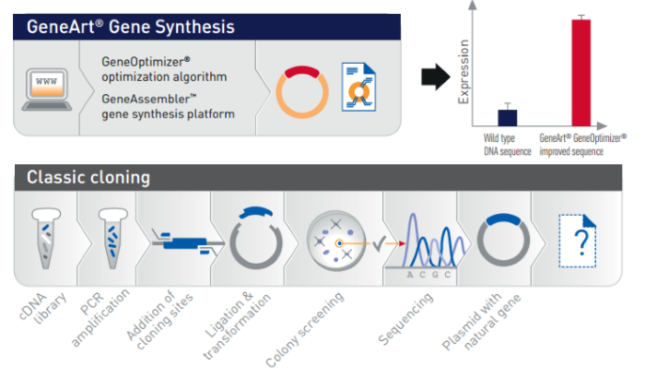

Slide 24
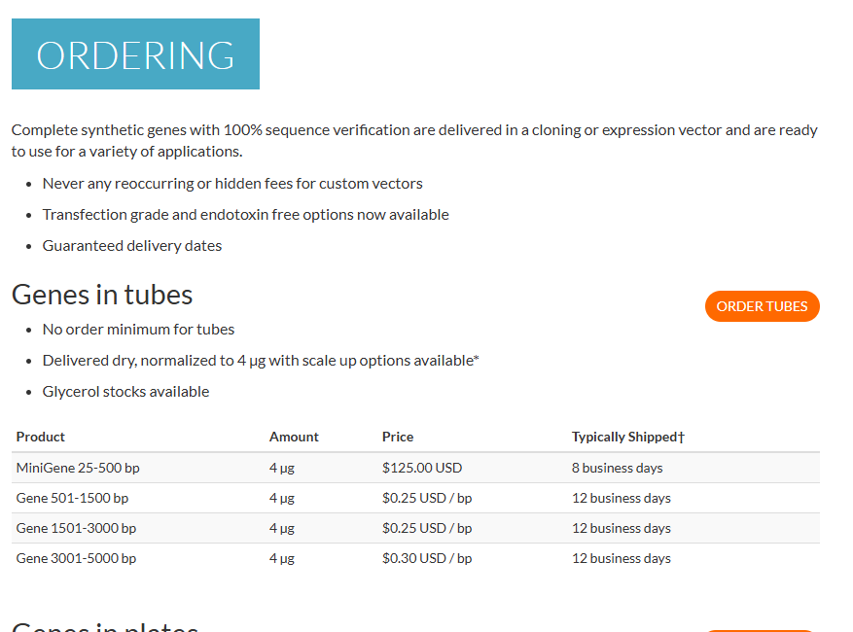

Slide 27
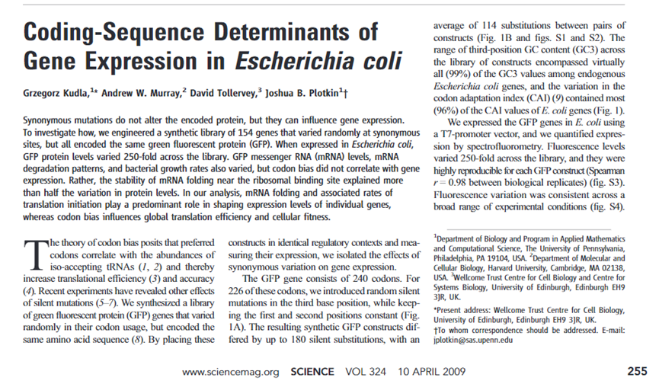

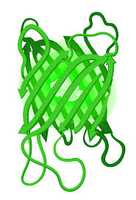
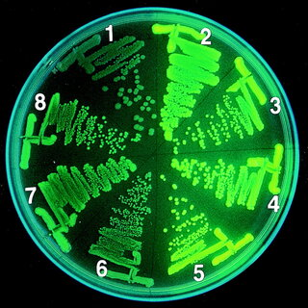
Synonymous mutations do not alter the encoded protein, but they can influence gene expression.
To investigate how, we engineered a specific gene:
- all encoded the same green fluorescent protein (GFP).
- a synthetic library of 154 genes that varied randomly at synonymous sites,
When expressed in Escherichia coli, GFP protein levels varied 250-fold across the library.

Slide 28
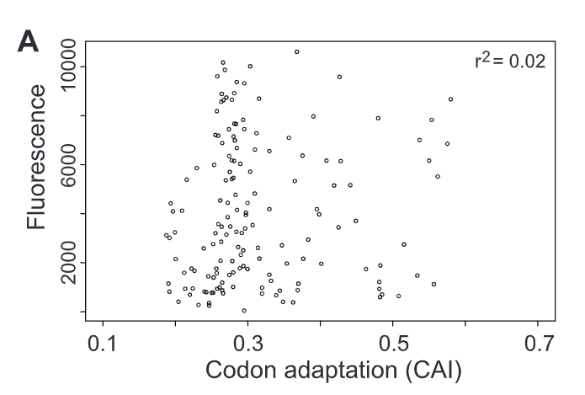
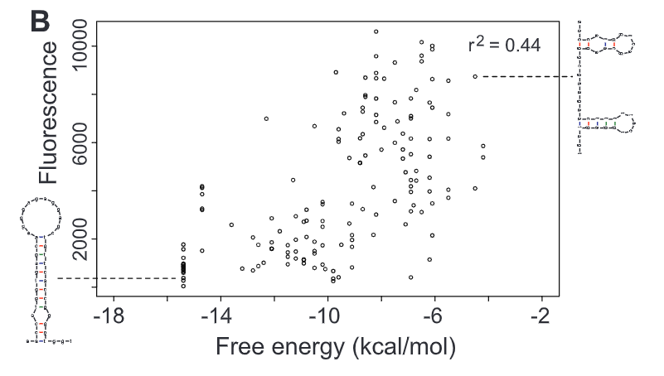
Codon bias did not correlate with gene expression.
Stability of mRNA folding near the ribosomal binding site explained more than half the variation in protein levels.
In our analysis, mRNA folding and associated rates of translation initiation play a predominant role in shaping expression levels of individual genes, whereas codon bias influences global translation efficiency and cellular fitness.

