Slide 1

SeisRaM Group, University of Trieste
Estimation of regression laws for ground motion parameters using as case of study the Amatrice earthquake.
L. Tiberi¹, G. Costa¹
1 University of Trieste, DMG, Trieste, SeisRaM group
Vienna, 25th April 2017 Lara Tiberi

Slide 2
Estimation of regression laws for ground motion parameters using as case of study the Amatrice earthquake.
Introduction
The possibility to directly associate the damages to the ground motion parameters is always a great challenge, in particular for civil protections.
Even if there are few regression law estimations in literature for the Italian territory (e.g. Faccioli and Cauzzi (2007) and Faenza and Michelini (2010)), the availability of new accelerometric data allows us to estimate a new set of high quality regression laws.
Vienna, 25th April 2017 Lara Tiberi
The 1895 Ljubljana earthquake: can the intensity data points discriminate which one of the nearby faults was the causative one?

Slide 3
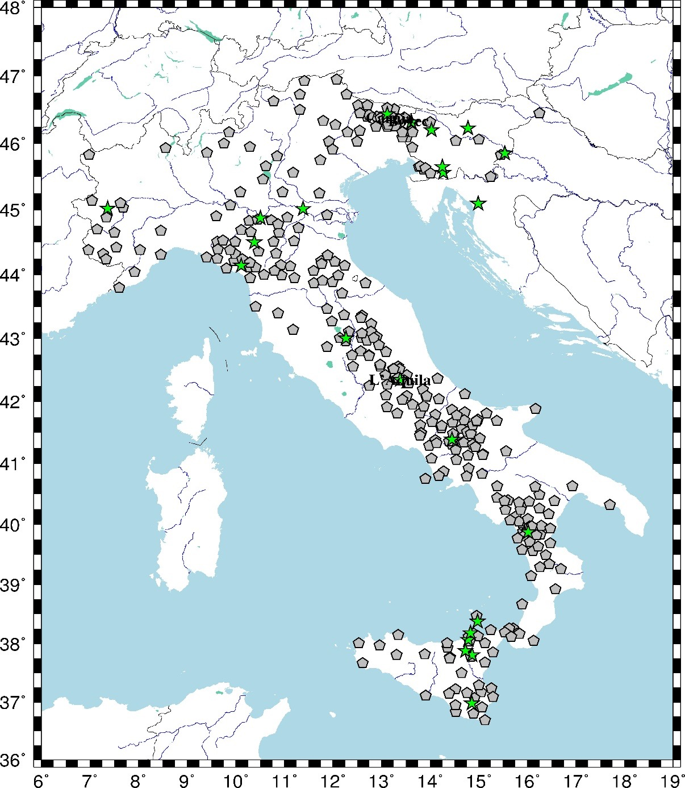
Estimation of regression laws for ground motion parameters using as case of study the Amatrice earthquake.
Input Data
Data collected using the CE3RN (Central Eastern European Earthquake and Research Network) and the RAN (National Accelerometric Network managed by the Civil Defence of Rome) stations
ML >= 3.8
GMPs (ground motion parameters) estimated using an automatic procedure that works daily in a real time mode. (Gallo et al. (2014))
The green stars are the epicentral location of the studied events and the grey pentagons are the station sites, where we have calculated the GMPs values.
Vienna, 25th April 2017 Lara Tiberi

Slide 4
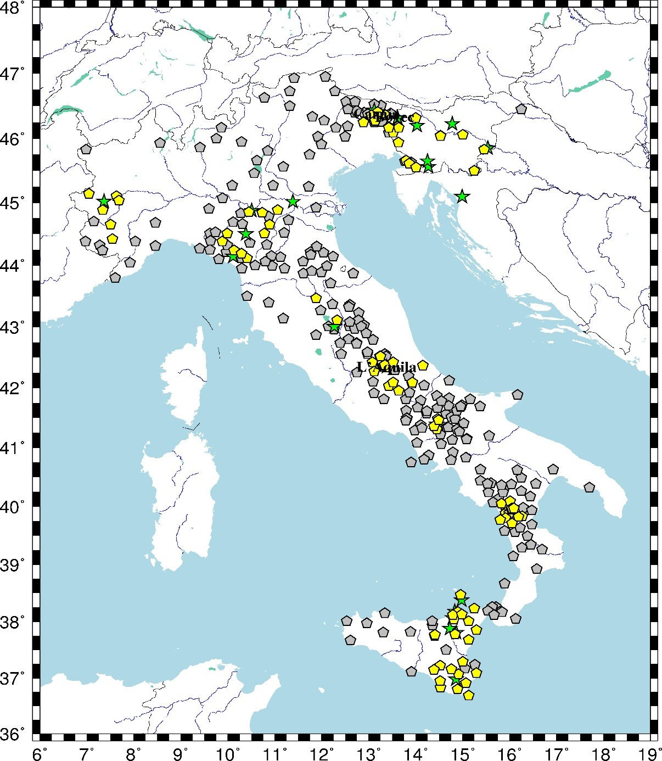
Estimation of regression laws for ground motion parameters using as case of study the Amatrice earthquake.
Input Data
Data collected using the CE3RN (Central Eastern European Earthquake and Research Network) and the RAN (National Accelerometric Network managed by the Civil Defence of Rome) stations
Macroseismic data collected from the ARSO macroseismic archive (for the slovenian events) and from the DBMI15 (for the italian events).
Maximum distance of 4 km, with an average value of :
(1.8 ± 1.8) km
115 pairs of intensity - GMPs values
Data set used for the regression law estimation. The green stars are the epicentral location of the studied events and the grey pentagons are the station sites, where we have calculated the GMPs values and the yellow one are those with an observed intensity associated.
Vienna, 25th April 2017 Lara Tiberi

Slide 5
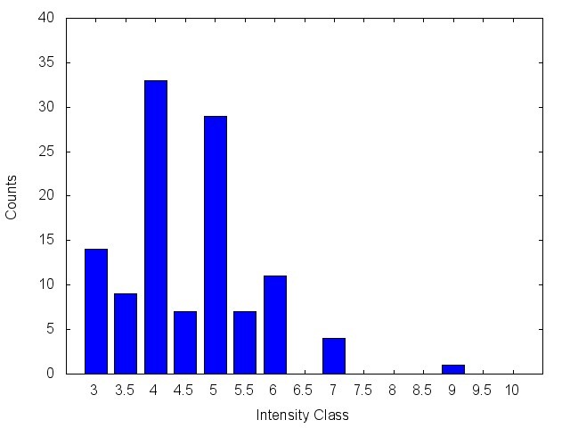
Estimation of regression laws for ground motion parameters using as case of study the Amatrice earthquake.
Input Data
GMPs data divided into 0.5 intensity classes
Vienna, 25th April 2017 Lara Tiberi

Slide 6
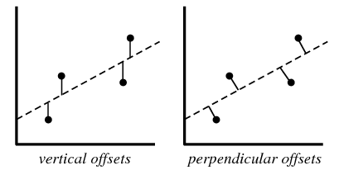
Estimation of regression laws for ground motion parameters using as case of study the Amatrice earthquake.
Regression laws and used algorithms
I = a * log₁₀(GMP) + b
Not linear least-squares (NLLS) (Levenberg, 1944) needs initial values for a and b (set 1.0 in this study) and the independent variable must be known with greater accuracy than the dependent one.
Orthogonal distance regression (ODR) (Boggs et al., 1987) estimates errors perpendicularly to the line not vertically. So it takes into account the errors of both variables. So it is possible to invert the relation.
Vienna, 25th April 2017 Lara Tiberi

Slide 7
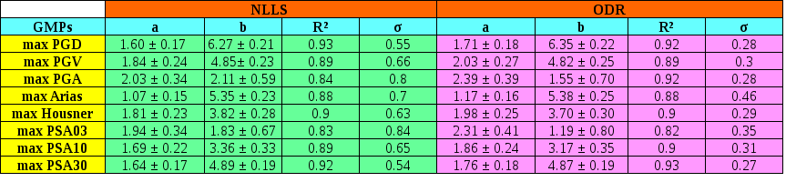
Estimation of regression laws for ground motion parameters using as case of study the Amatrice earthquake.
Results
a, b and R² values are consistent between the two different algorithms.
The main differences are the standard deviations lower using ODR than the NLLS.
Vienna, 25th April 2017 Lara Tiberi

Slide 8
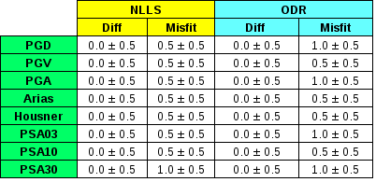


Estimation of regression laws for ground motion parameters using as case of study the Amatrice earthquake.
Test on input data
How much are the data close to the regression line, so how much does the line represent well the data used?
Test using the data set of estimation of the laws.
Vienna, 25th April 2017 Lara Tiberi

Slide 9
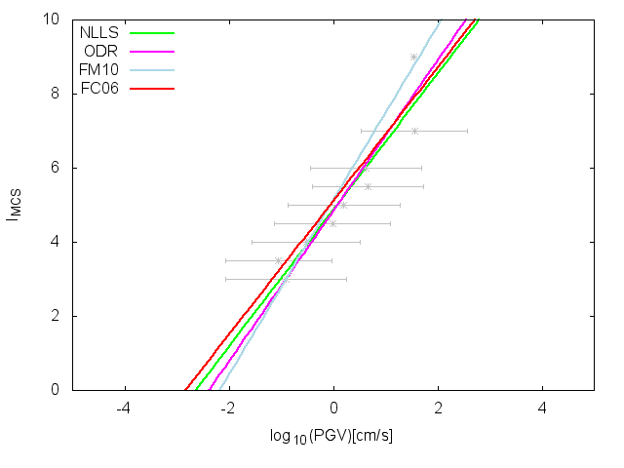
Estimation of regression laws for ground motion parameters using as case of study the Amatrice earthquake.
Comparisons: PGV relations
I_{MCS} = (1.84 ± 0.24)* log PGV + (4.85 ± 0.23) , σ = 0.66, R² = 0.89
NLLS
I_{MCS} = (2.03 ± 0.27)* log PGV + (4.82 ± 0.25) , σ = 0.30, R² = 0.89
ODR
I_{MCS} = (2.35 ± 0.09)* log PGV + (5.11 ± 0.07) , σ = 0.26
Faenza and Michelini (2010)
I_{MCS} = (1.80 ± 0.17)* log PGV + (5.09 ± 0.22) , σ = 0.71, R² = 0.61
Faccioli and Cauzzi (2006)
Vienna, 25th April 2017 Lara Tiberi

Slide 10
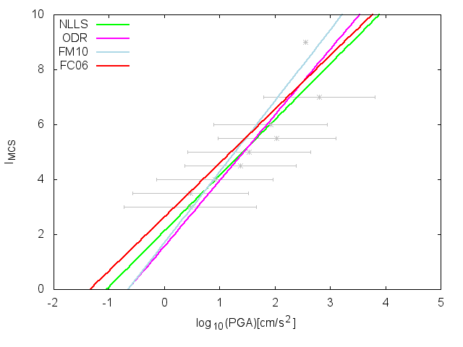
Estimation of regression laws for ground motion parameters using as case of study the Amatrice earthquake.
Comparisons: PGA relations
I_{MCS} = (2.03 ± 0.34)* log PGA + (2.11 ± 0.59) , σ = 0.80, R² = 0.84
NLLS
I_{MCS} = (2.39 ± 0.39)* log PGA + (1.55 ± 0.70) , σ = 0.28, R² = 0.92
ODR
I_{MCS} = (2.58 ± 0.14)* log PGA + (1.68 ± 0.22) , σ = 0.35
Faenza and Michelini (2010)
I_{MCS} = (1.96 ± 0.29)* log PGA + (2.62 ± 0.10) , σ = 0.89, R² = 0.38
Faccioli and Cauzzi (2006)
Vienna, 25th April 2017 Lara Tiberi

Slide 11
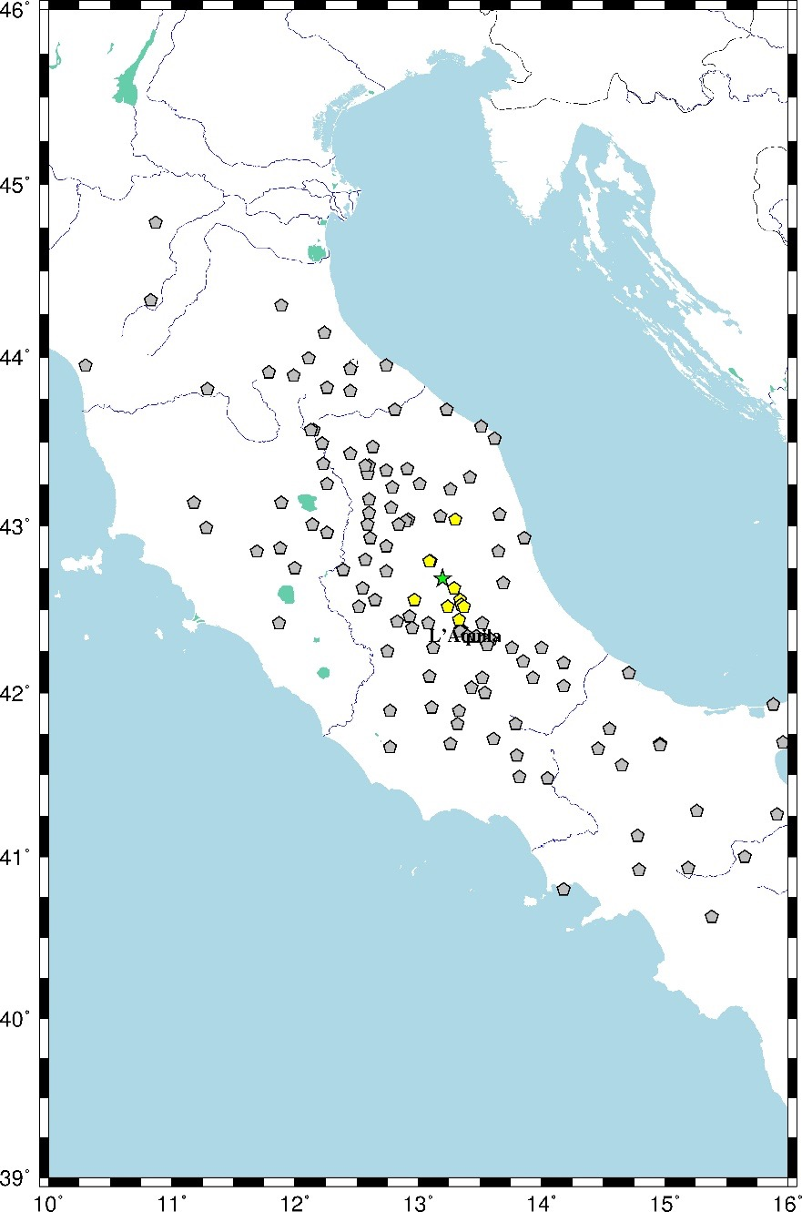
Estimation of regression laws for ground motion parameters using as case of study the Amatrice earthquake.
Amatrice earthquake
Amatrice earthquake occurred the 24th August of 2016, 01:36 UTC with a Mw of 6.1.
Data collected using the RAN (National Accelerometric Network managed by the Civil Defence of Rome) stations.
Macroseismic data collected from Albini et al. (2016).
The green star is the epicentral location of Amatrice event and the grey pentagons are the station sites, where we have calculated the GMPs values, and the yellow one are those with an observed intensity associated.
Vienna, 25th April 2017 Lara Tiberi

Slide 12
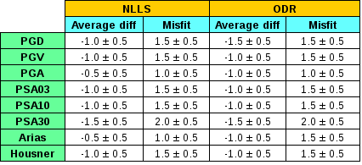
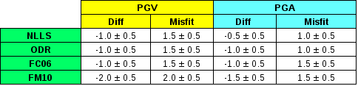
Estimation of regression laws for ground motion parameters using as case of study the Amatrice earthquake.
Test using Amatrice earthquake data
Vienna, 25th April 2017 Lara Tiberi

Slide 13
Estimation of regression laws for ground motion parameters using as case of study the Amatrice earthquake.
Adding Amatrice earthquake to the initial dataset
Amatrice earthquake occurred the 24th August of 2016, 01:36 UTC with a Mw of 6.1.
Data collected using the RAN (National Accelerometric Network managed by the Civil Defence of Rome) stations.
Maximum distance of 4 km, with an average value of :
(1.8 ± 1.8) km
125 pairs of intensity - GMPs values
The green stars are the epicentral location of the studied events and the grey pentagons are the station sites, where we have calculated the GMPs values, and the yellow one are those with an observed intensity associated.
Vienna, 25th April 2017 Lara Tiberi

Slide 14
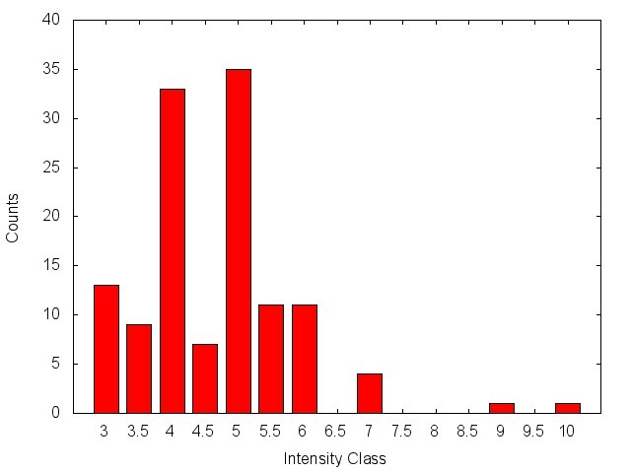
Estimation of regression laws for ground motion parameters using as case of study the Amatrice earthquake.
Adding Amatrice earthquake to the initial dataset
Original dataset
Average distance of :
(1.8 ± 1.8) km
115 pairs of intensity - GMPs values
Original dataset + Amatrice data
Average distance of :
(1.8 ± 1.8) km
125 pairs of intensity - GMPs values
Vienna, 25th April 2017 Lara Tiberi

Slide 15
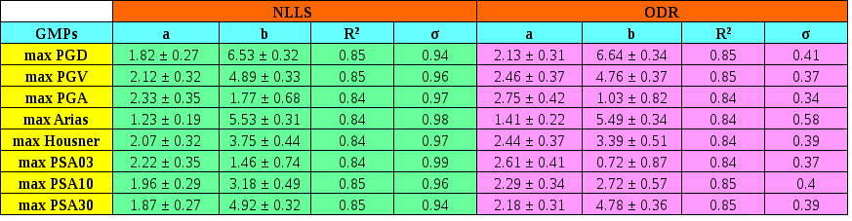
Estimation of regression laws for ground motion parameters using as case of study the Amatrice earthquake.
Regression laws including Amatrice:
without Amatrice
with Amatrice
The quality of the regression laws decreases including Amatrice data, probably due to the near fault effects in some points.
Vienna, 25th April 2017 Lara Tiberi

Slide 16

Estimation of regression laws for ground motion parameters using as case of study the Amatrice earthquake.
Regression laws including Amatrice:
without Amatrice
with Amatrice no AMT
Without considering the AMT data, above the fault, the regression laws quality increased. These parameters are not significant for the near-fault intensity estimation.
Vienna, 25th April 2017 Lara Tiberi

Slide 17
Estimation of regression laws for ground motion parameters using as case of study the Amatrice earthquake.
To conclude
We estimated a set of regression laws between Intensity and 8 different ground motion parameters. Using two different algorithms the results are basically coincident.
We used the Amatrice earthquake as test and we found a great correspondence between the observed and the calculated intensities,even if the number of the data is not statistically significant but better than the regression laws found in literature.
Using the Amatrice data in the estimation of the regression laws, the quality of the laws slightly decreases. This is probably due to the near fault effects. The used ground motion parameters seem not be significant in near fault. We will try to express the damages with a multi-component and multi-parametric relation.
Vienna, 25th April 2017 Lara Tiberi
The 1895 Ljubljana earthquake: can the intensity data points discriminate which one of the nearby faults was the causative one?

Slide 18
Estimation of regression laws for ground motion parameters using as case of study the Amatrice earthquake.
Thank for your attention
Vienna, 25th April 2017 Lara Tiberi
The 1895 Ljubljana earthquake: can the intensity data points discriminate which one of the nearby faults was the causative one?

