Slide 1
Electronic Systems Design
Teacher: Stefano Marsi

Slide 2
Course duration
First section (Teacher : Prof. Stefano Marsi)
The course (5 CFU) lasts a total of about 8 weeks (until end of November)
Second Part (Teacher : Prof. Sergio Carrato)
The course (4CFU) will take place during the second semester

Slide 3
How the course is structured
The course is essentially practical
Relatively few theoretical lessons
  Various exercises on Friday at 10:00 am
  Use of state-of-the-art teaching materials
    Programmable circuits
    Development Boards
    Software
  Free availability of the software to students.

Slide 4
How the course is structured
Attendance of the course and exercises guarantees that the exam will be passed with a positive outcome
If the frequency have been global
There will be NO written essays or oral exams
The final grade will be function:
  of the results achieved during the course
  of the commitment shown during the exercises
  of the interest shown in the topics covered
In the case of "occasional" attendance, the exam must be integrated with appropriate written/practical/oral tests
  The positive exam is NOT repeatable!
  But possibly it can be supplemented with an oral test

Slide 5
How the course is structured
In practice, how the course will take place:
  About 20 hours of classroom lessons to illustrate:
    The structure of modern programmable circuits
    The structure of a versatile development board
    The functioning of an appropriate development tool
    All accompanied by practical demonstrations and tutorials
  Two/four hours a week will be dedicated to independently carrying out a guided exercise or tutorial (with supervision).
  The laboratory will remain available to students during normal office hours (unsupervised)
  If necessary, a system will be set up to manage the "loan" of the boards.
  In the middle and at the end of the course developed a project from scratch (which will be evaluated for the purposes of the final grade)

Slide 6
How the course is structured
It will contribute to the definition of the grade in the intermediate tests
  An appropriate functional demonstration of the correct operation of the device in real time
  The drafting (after the fact) of a good report
    NOT long-winded
    Well documented
    Written with appropriate language and in a scientifically correct way.
  The report must be submitted no later than 7 days from the date of the exercise.
At the end of the course, each student will define in agreement with the teacher a final project in which to converge the knowledge acquired.
  This project can be carried out independently or in a group
  There are no deadlines

Slide 7
Course Schedule
For the first two weeks:
  Lectures only
    Monday (15:15 – 16:45)
    Thusday (16:15 – 17:45)
    Friday (10:15 – 11:45)
For a further few weeks:
  Lectures on Monday (2 hours)
  Lectures or Workshop on Thusday (2 hours)
  Workshop on Friday(2 hours)
Last weeks:
  TBD

Slide 8
LEARNING OBJECTIVES
Knowledge of the structure of modern programmable circuits
In-depth study of the structure of a modern development tool and the tools available to the designer
Practical applications on a versatile and modern development environment
Specific knowledge of a development board for the testing of real-time architectures (Board: DE1-SoC)
Basic knowledge of the Verilog HDL language

Slide 9
RECOMMENDED PREREQUISITES
Boolean algebra
Basics of digital electronics (logic gates, flip flops, etc…)
Finite state machines
Asynchronous and synchronous logic circuits
Familiarity with using a PC

Slide 10

Teaching materials
The course was partially supported by
  “Donation” of
    12 DE1Boards
    6 DE2 Boards
    6 DE1-SoC Boards
  Free Software
  Materiale didattico (Corsi, Tutorials, lab test, …)
®

Slide 11
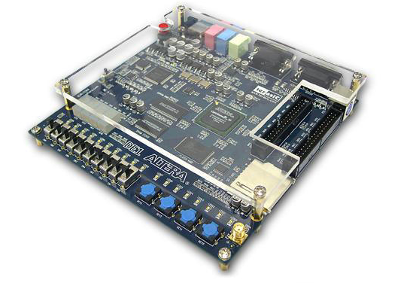
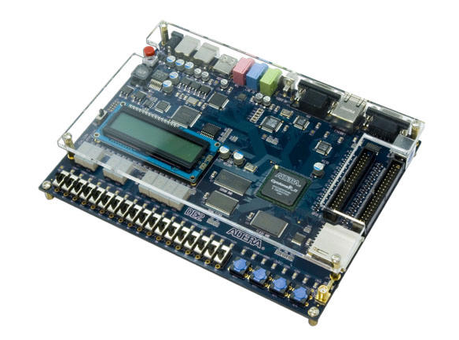
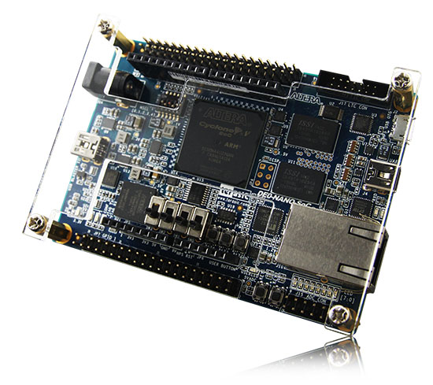
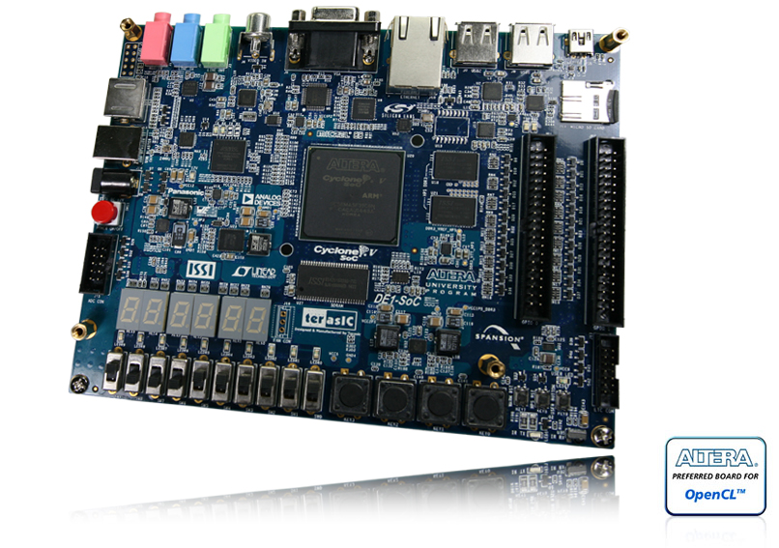
Schede di Sviluppo
DE1
DE2
DE0-Nano-SoC
DE1-SoC

Slide 12
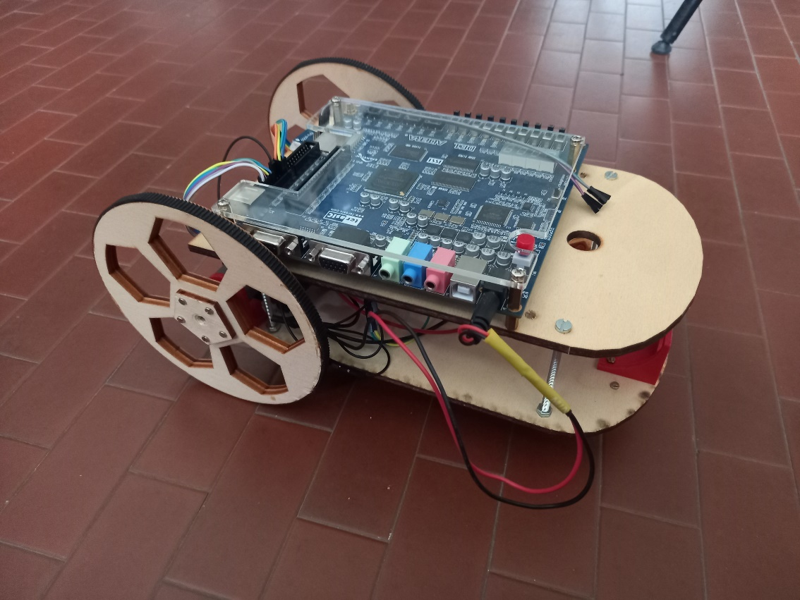
Rover
For any end-of-course project
  2 PWM controllable motors
  2 Rotary Encoders
  Echo Sonar
  Gyroscope+Accelerometer
  4-channel PWM receiver
  Line Tracker
  Other...

Slide 13

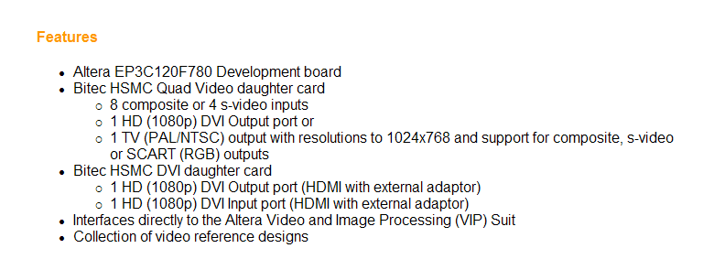
Other development boards
Per eventuali tesi future

Slide 14
Development Software
Quartus® II Software
  Description
  Simulation
  Synthesis
  Analysis of the results
  Platform Builder
Altera/Intel Monitor Program
  Compilation and debugging
Platform Designer
  Block design of advanced systems
ModelSim/Questa Simulation Software
  Advanced simulation
DSP Builder Toolkit
    From Matlab to HDL

Slide 15
Teaching materials
Materials closely related to the course:
  Moodle – Electronic Systems Design
  https://moodle2.units.it/course/view.php?id=15515
Materials related to programmable circuits, the development tool, the board adopted, including tutorials and University Program.
  https://fpgacademy.org/
  http://cd-de1-soc.terasic.com/
  https://www.intel.com/content/www/us/en/products/details/fpga/cyclone/v/docs.html
Communications:
  Moodle forums
NOTE: All material is in constant updating status

Slide 16
Teaching materials
Moodle-UNITS website of the course
  Slides, tutorials, manuals, software, visual analyzer, links, student relations, mailing lists,…
Altera/Intel Site
  Training (Great for self-taught)
    Training Courses
    University Program
    Video
    Demonstration

Slide 17
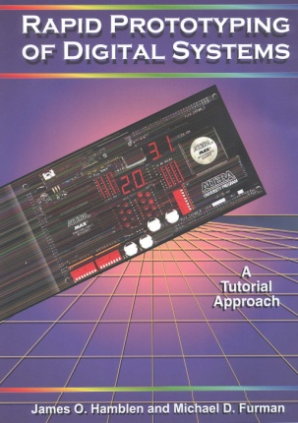
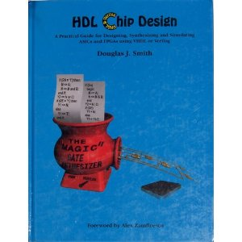

Textbooks
Rapid Prototyping of Digital Systems
James O. Hamblen and Michael D. Furman
Includes:
Two tutorials on the Altera design tool environment
Overview of programmable logic
Design library
Also includes a CD-ROM containing logic simulation and design examples
Hdl Chip Design:
A Practical Guide for Designing, Synthesizing & Simulating Asics & Fpgas Using Vhdl or Verilog
Douglas J. Smith
Verilog HDL Synthesis
A Practical Primer
J. Bhasker
Moltissimo altro materiale reperibile in rete

Slide 18

Once upon a time:
Altera Innovate Italy
Annual Competition
  Donation DE1
  Can be used as a "final essay"”
  Enrich the curriculum:
  …. You might even win!!
Info su:
  http://www.innovateeurope.org/eu/

