Slide 1
Dedicated logic circuits
Technological solutions

Slide 2
Electronic Components
Source: Dataquest
Logic
Standard
Logic
ASIC
Programmable
Logic Devices
(PLDs)
Gate
Arrays
Cell-Based
ICs
Full Custom
ICs
SPLDs
(PALs)
CPLDs
FPGAs
Acronyms
ASIC = Application Specific IC
SPLD = Simple Prog. Logic Device
PAL = Prog. Array of Logic
CPLD = Complex PLD
FPGA = Field Prog. Gate Array
Common Resources
Configurable Logic Blocks (CLB)
  Memory Look-Up Table
  AND-OR planes
  Simple gates
Input / Output Blocks (IOB)
  Bidirectional, latches, inverters, pullup/pulldowns
Interconnect or Routing
  Local, internal feedback, and global

Slide 3
Key parameters
Number of pieces to be produced
  Cost of the prototype
  Cost of the chip in production
Performance:
  Occupied area
  Working frequency
  Power dissipation
Time to Market

Slide 4
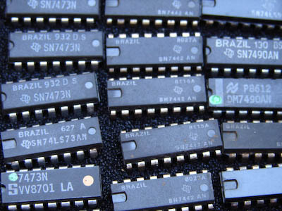
Glue logic
By now unfeasible for any circuit that is not purely didactic or extremely simple:
  High cost
  Poor performance
  Very high area
  Very high power
  dissipation

Slide 5
Full Custom
Great performance
Very high prototype cost
Low cost for mass production
Very complex and laborious project (requires a group of specialists occupied for some time)
Long times before having the finished product:
  Project
  Passage through the foundry
  Testing

Slide 6
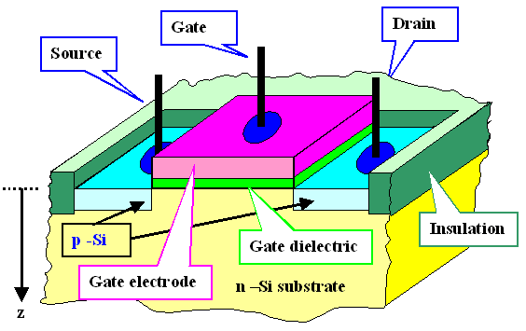
MOS transistor

Slide 7
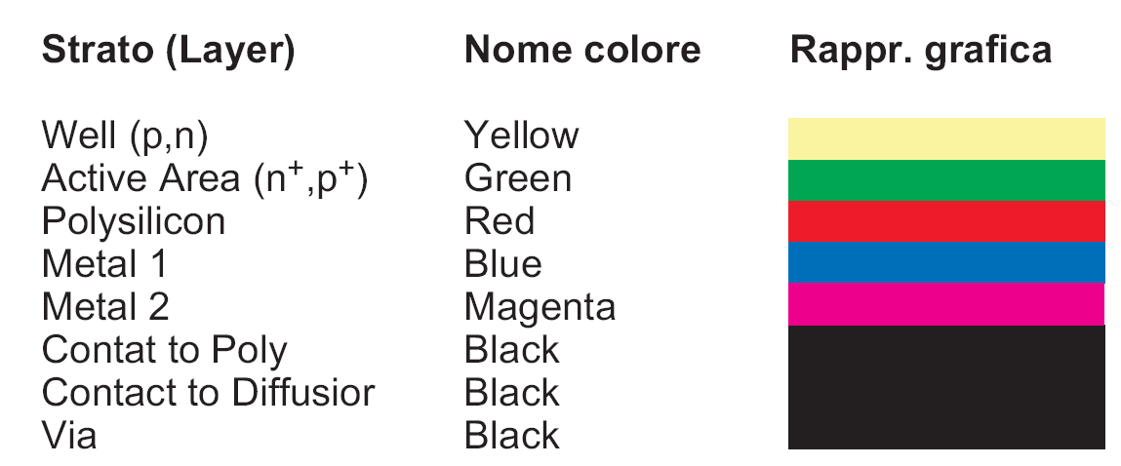
Layout layers representation

Slide 8
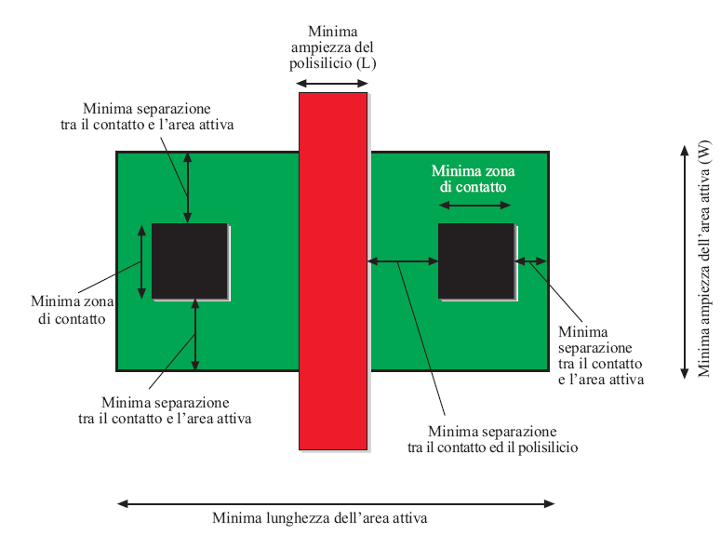
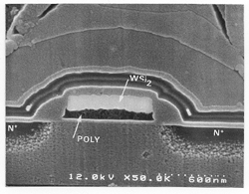
MOS transistor representation

Slide 9
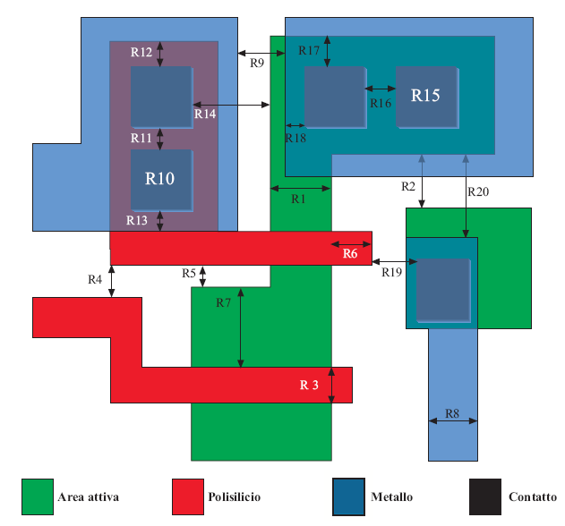
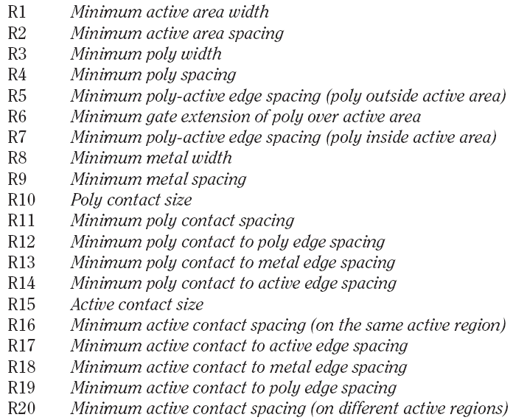
Design rules (layout rules)

Slide 10
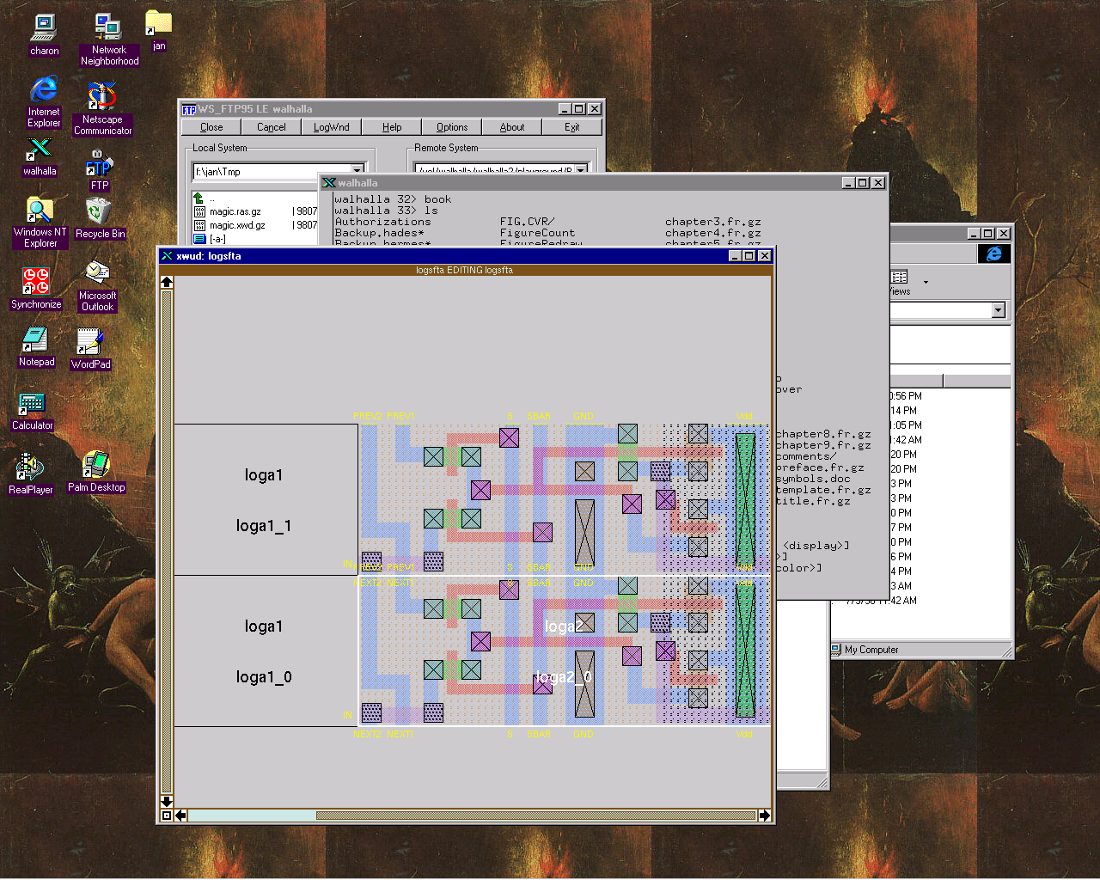
Full custom

Slide 11
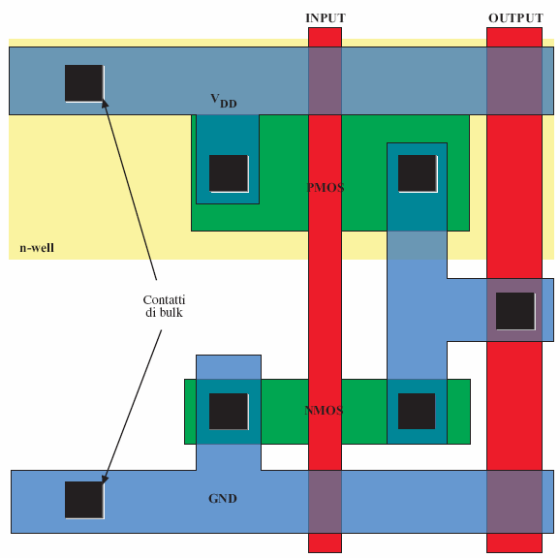
CMOS inverter layout
Typical layout
of a standard cell

Slide 12
Semi Custom - CELLS based
High Performance
High prototype cost
Low cost for mass production
Fairly complex project (requires a few specialists employed for a certain amount of time)
Long times before having the finished product:
  Project
  Passage through the foundry
  Testing

Slide 13
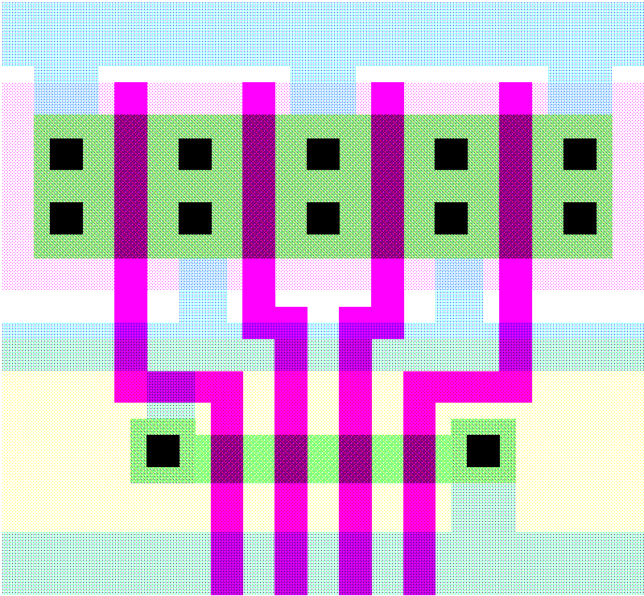
4-input NAND Gate Layout
Vdd
Out
GND
In1
In2
In3
In4

Slide 14
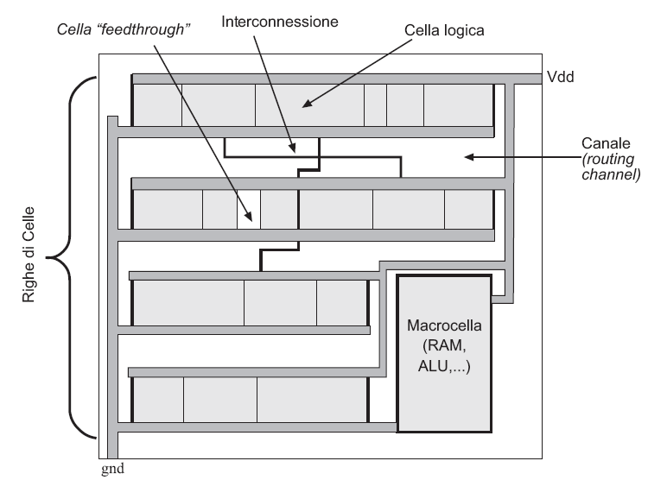
Standard Cell Layout
M Olivieri, Elementi di progettazione dei sistemi VLSI – vol 2

Slide 15
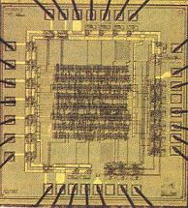
Standard Cell — Example

Slide 16
Gate Array
Decent performance
Medium prototype cost
Medium cost for mass production
Moderately complex project
Moderate times before having the finished product:
  Project
  Passage through the foundry
  Testing

Slide 17
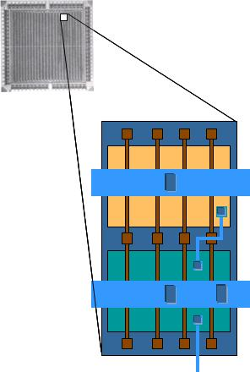
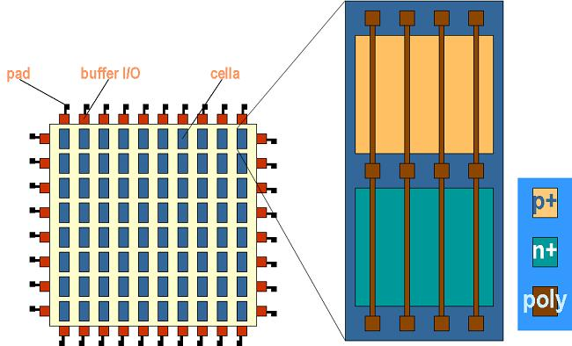
Gate Array

Slide 18
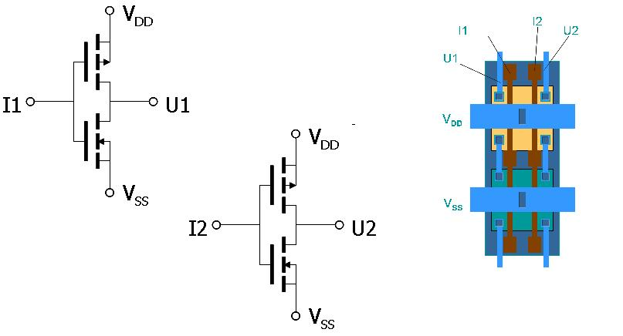
Gate Array

Slide 19
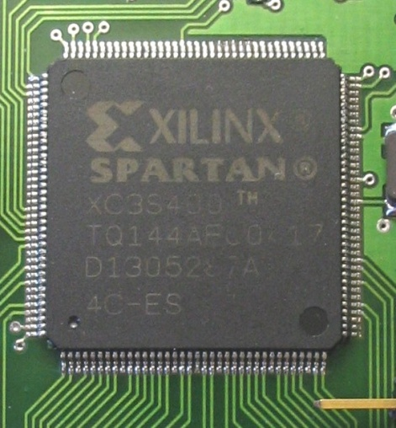
Programmable circuits
Good-fair-very good performance
Low prototype cost
Medium to high cost for mass production
Not very complex project
Short times before having the finished product:
  Project
  Programming phase
  Testing

Slide 20
Conclusions
The gap between programmable devices and ASICs is closing thanks to
  Introduction of very low cost FPGAs.
  Introduction of high-performance FPGAs.
  Possible possibility of making an FPGA configurable through masks in the foundry
The market and production of FPGAs is constantly growing.

