Slide 1
Programmable Devices

Slide 2
Programmable devices
  They are hardware devices (chips) that provide more or less complex logical elements that can be appropriately interconnected according to different configurations according to the project specifications.
  They have:
    Logic Components (Logic Gates, Flip-Flops, Buffers),
    Connection lines,
    Interconnection systems (Multiplexers, connections),
    I/O Ports,
  Types of Programmable Circuits:
      PLA, PAL, ROM.
      CPLD
      FPGA

Slide 3
Programmable Devices
Different devices can be classified according to different aspects:
  Programming Mode:
    Mask programmable(MPGA),
    programmable once(Fuse o Antifuse),
    reprogrammable (EEPROM, SRAM),
    Reconfigurable (SRAM),
  Connections:
    Global,
    Local and distributed

Slide 4
Programming Mode
  FUSE
    Le connessioni tra linee sono inizialmente tutte attive,
    Unnecessary connections are permanently disabled during programming.
  ANTIFUSE
    The connections between lines are initially all inactive,
    During the programming phase, useful connections are permanently activated.
  EEPROM
    The connections are all inactive initially,
    During programming, they can be switched on or off electrically in non-destructive way,
    The state is maintained even when there is no power.

Slide 5
Programming Mode
  SRAM
  The connections are all inactive initially:
    During programming, they can be switched on or off electrically non-destructively,
    The state is NOT maintained when there is no power,
    Higher programming speed than EEPROM technology.
    Depending on the technology, programming can take place:
      During the non-operational phase of the device (reprogrammable)
      During the operational phase of the device (reconfigurable)
        Various parts of the device can be configured separately

Slide 6
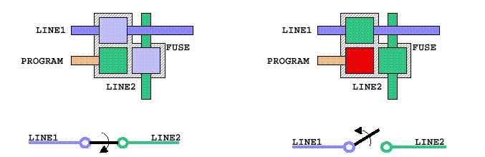
Fuse
The lines of the device are originally all connected:
  The programming consists of "BURNING" (melting) some connections in such a way as to keep only the necessary ones,
  Programming is done by means of a voltage higher than that of normal operation.

Slide 7
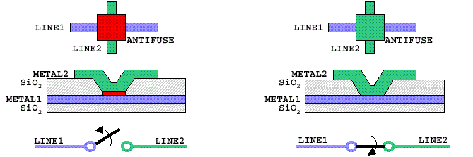
Antifuse
The lines of the device are originally all disconnected:
  The programming consists of "CREATING" (anti-fused) the necessary connections,
  Programming is done by means of a voltage higher than that of normal operation.

Slide 8
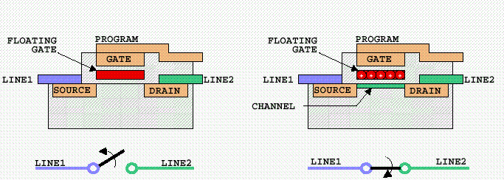
EEPROM
The lines of the device are originally all disconnected:
  The programming consists of "DEPOSITING" a charge on the floating gate of the transistor in order to send it into conduction,
  Erasing can be done electrically or by exposure to UV rays.

Slide 9
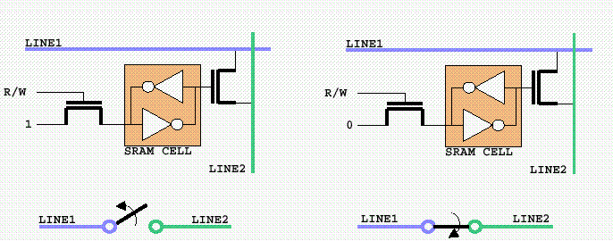
SRAM (RAM statica)
The lines of the device are originally all disconnected:
  Programming consists of "STORING" a logical value ('0' or '1') in a Static RAM cell

Slide 10
Connections
Global Connection:
  Line that crosses a large part of the device and is shared by many logical elements:
    High delays,
    It can be driven by a single logic element (low flexibility)
Local connection:
  Line that crosses a small part of the device and is shared by a few elements:
    Shorter delays,
    High flexibility.

Slide 11
Connections
Global connections are characteristic of:
  Two-level logic devices:
    PAL, PLA, ROM,
  CPLD (Complex Programmable Logic Device)
Local connections are characteristic of:
  FPGA (Field Programmable Gate Array)

Slide 12

2-level programmable logic
They are used to realize two-level logic functions:
NOTE1: Any combinatorial function can be expressed as the sum of minimum terms.
NOTE2: multi-level functions can be implemented by exploiting feedback.
They have:
    A fixed number of inputs (Input Buffer)
    An AND plan (to achieve the minimum terms)
    An OR plan (to realize the sums)
    A fixed number of outputs (Output Buffer)
Notes:
input buffer: diodi di tosatura, trigger di schmitt
output buffer: resistenze di protezione, pull up, buffers, alta impedenza, in-out, ....

Slide 13
2-level programmable logic
Vi sono tre tipi principali:
  PLA (Programmable Logic Array)
    Programmable AND plan,
      Implement only the minimum terms necessary.
    Programmable OR plan,
  PAL (Programmable Array Logic)
    Programmable AND plan,
    OR plane fixed,
      Imposes a constraint on the minimum number of terms that the function contains.
  ROM (Read Only Memory)
    AND plane fixed,
      Implement all possible minimum terms (DECODER)
    Programmable OR plan,

Slide 14
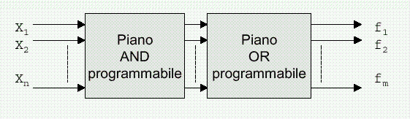
Programmable Logic Array (PLA)
Allows you to realize any logical function
This is expressed in sums of implicants

Slide 15
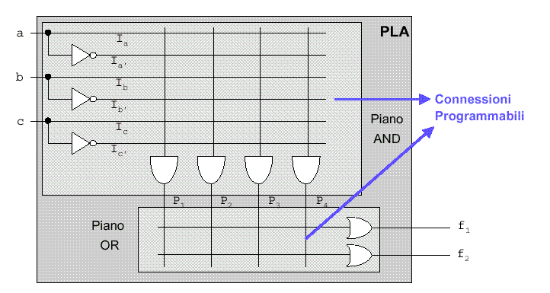
Programmable Logic Array (PLA)
Logical diagram of a PLA:
  Example with 3 inputs and two outputs (unprogrammed)
Notes:
eventualmente wired-ande/o wired or

Slide 16
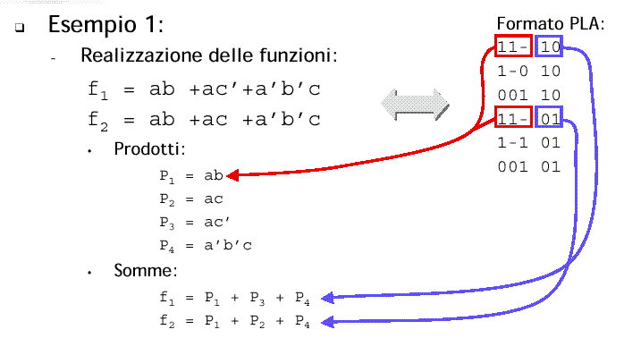
Programmable Logic Array (PLA)

Slide 17
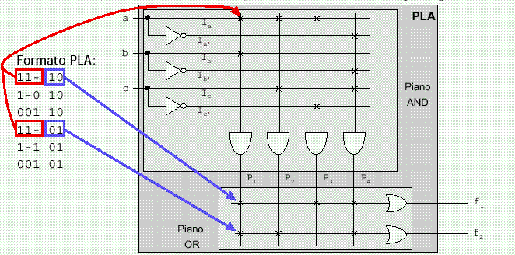
Programmable Logic Array (PLA)

Slide 18
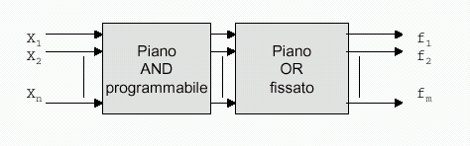
Programmable Array Logic (PAL)
Programmable AND plane and set OR plane,
Allows you to implement sums of products,
  There may be a limit on the maximum number of products that can contribute to the realization of a function

Slide 19
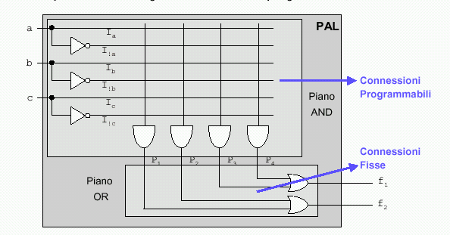
Programmable Array Logic (PAL)
Logical diagram of a PAL:
  Example of PAL with 3 inputs and 2 outputs (unprogrammed)

Slide 20
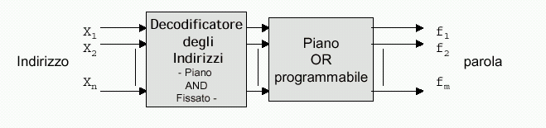
Read Only Memory (ROM)
  It can be realized with a fixed and complete AND plan and with a programmable OR plan,
  In practice, it implements m functions with n inputs,
  an input configuration (ADDRESS) is associated with an output configuration (WORD),
  The AND plane acts as an address DECODER.

Slide 21
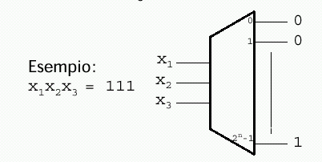
Read Only Memory (ROM)
AND Plane (Address Decoder)
  realizes all possible minterms.
  for each active input configuration one and only one output line

Slide 22
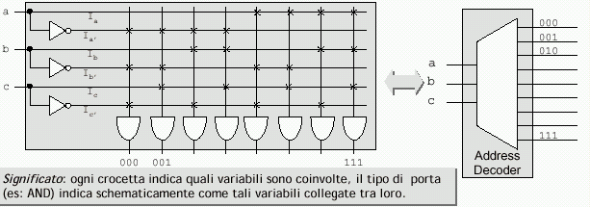
Read Only Memory (ROM)
Schema logico del piano AND

Slide 23
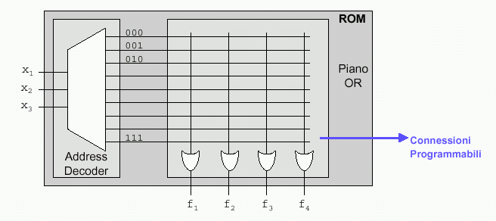
Read Only Memory (ROM)
Schema logico di una ROM:
  Example of a 3-input and 4-output ROM (unprogrammed)

Slide 24
Read Only Memory (ROM)
Esempio:
  dalla tabella di verità della funzione a più uscite

Slide 25
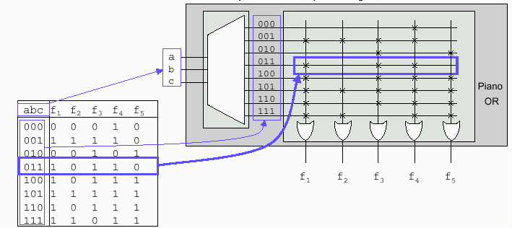
Read Only Memory (ROM)
Realizzazione della funzione

Slide 26
Advanced PLA and PAL
PLA and PAL allow only two-level combinatorial networks to be implemented,
This limit can be exceeded,
  Introducing a reaction network,
    allows you to implement combinatorial networks with more than two levels,
  Introducing memory elements (Flip-Flop),
    allows you to implement sequential machines (synchronous)

Slide 27
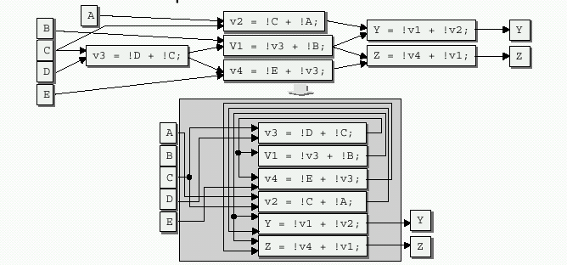
Advanced PLA and PAL
Example of implementing a multi-level combinatorial network thanks to feedback

Slide 28
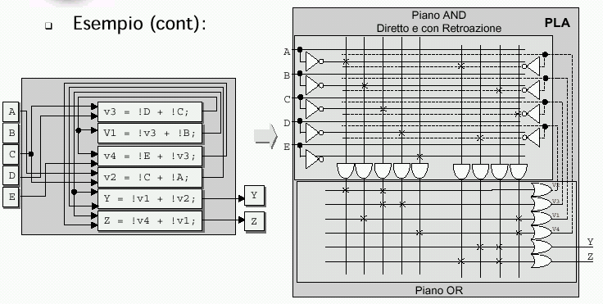
Advanced PLA and PAL
Example: Implementation

Slide 29
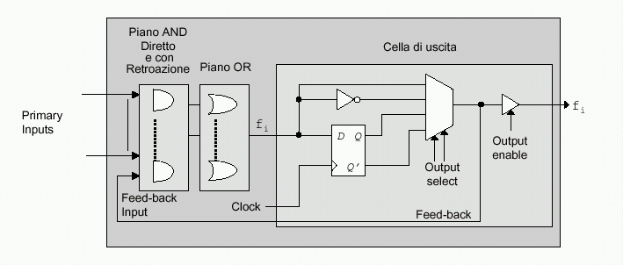
Advanced PLA and PAL
Adding memory output elements can further expand the performance of the device

Slide 30
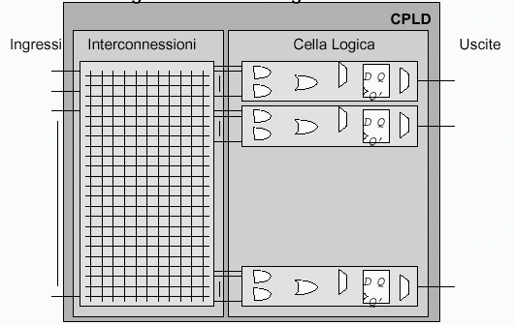
CPLD
Complex Programmable Logic Device
They are the logical evolution of PAL and PLA
They are characterized by:
  Global connections
  Concentrated Logic.
Compared to PAL and PLA:
  They are more
  complex and larger
  in size
  Achieve higher
  performance.

Slide 31
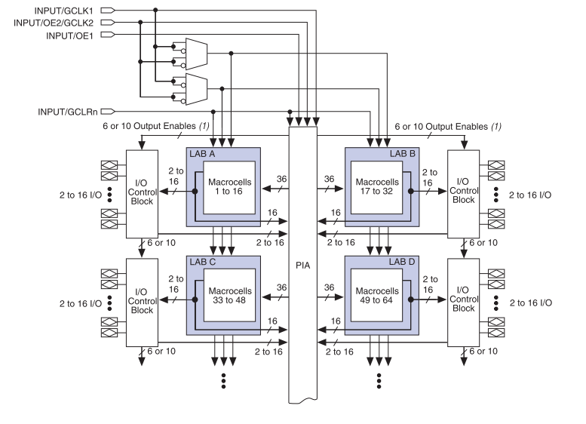
CPLD – MAX 3000 A
Logic array blocks (LABs)
Macrocells
Expander product terms (shareable and parallel)
Programmable interconnect array (PIA)
I/O control blocks
4 dedicated Inputs
  2 global clock
  1 output enable
  1 global clear

Slide 32
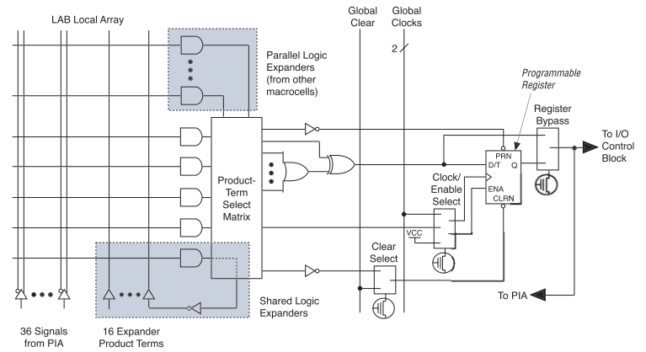
Max 3000 – Logic Array Blocks
16 macrocells
  logic array (5 minterms each)
  product–term select matrix
  programmable register
36 signals from the PIA and 16 from other macrocells as logic inputs
Global controls for secondary register functions

Slide 33
MAX 3000 – PTSM & expansions
Product Term Select Matrix
  Select how to use the various signals:
    To realize logical functions (sums of products),
    As control signals for FF,
Sherable logic expansion:
    Allows feedback,
    The result can be used by other macrocells,
    Introduces some delay.
Parallel Logic Expansion
    Allows you to develop more complex logic functions by exploiting from adjacent macrocells,
    Introduces some delay.

Slide 34
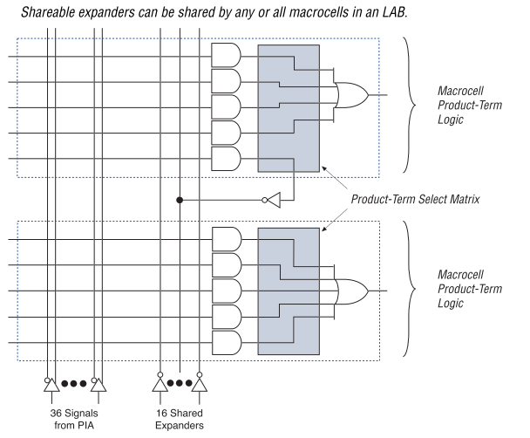
MAX 3000 – Sherable expansions

Slide 35
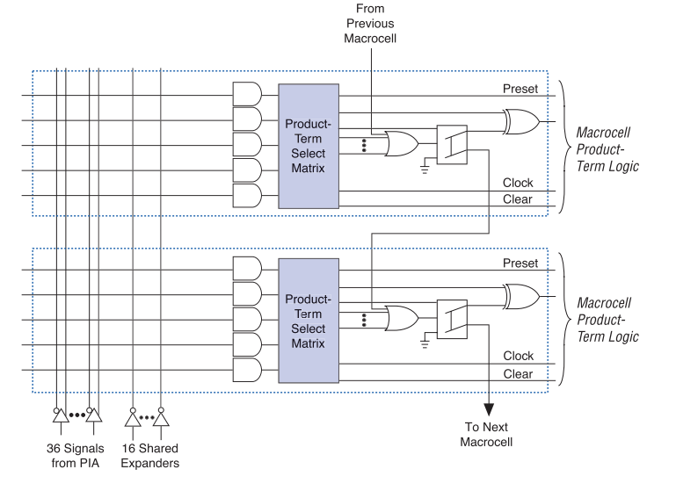
MAX 3000 – Parallel expansions

Slide 36
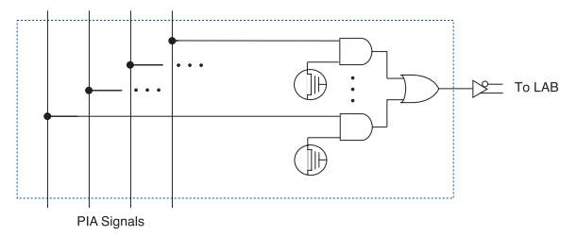
MAX 3000 - PIA
Programmable Interconnected Array
  The PIA is a programmable global bus that provides for the availability of all the signals that feed it inside the device, which can be divided into:
    dedicated MAX3000 inputs,
    I/O pins
    Macrocell outputs.
  The delay of these signals is well defined

Slide 37
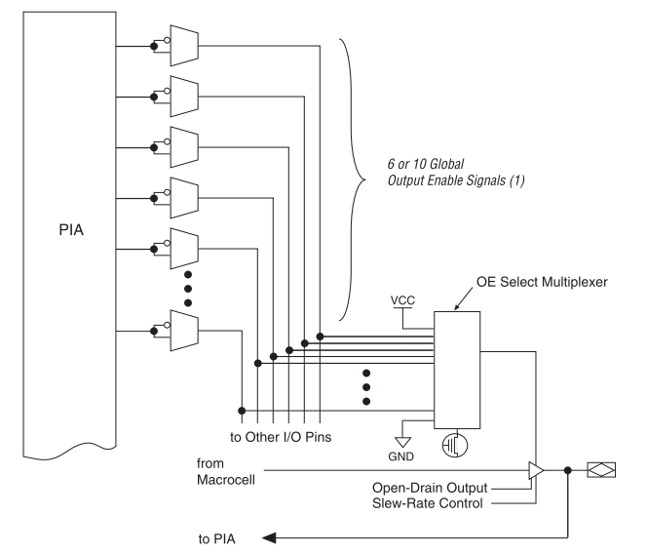
MAX 3000 – I/O Control Blocks

Slide 38
MAX 3000 – I/O Control Blocks
I/O PINs can be configured:
  Such as, inputs, outputs, or bidirectional,
  Can be placed in high impedance,
    Through dedicated lines (direct or denied) of OEs (which derive from the PIA),
      Using other I/O PINs,
      Through the outputs of macrocells,
    They can be placed perpetually in high impedance,
    They can be placed permanently as buffers,
  A slew-rate check is provided,

Slide 39
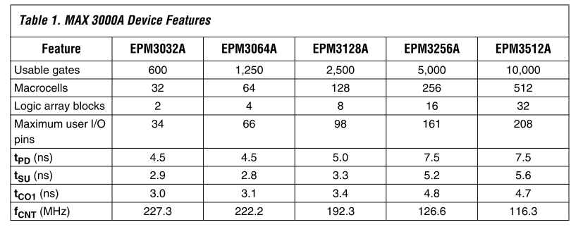
MAX 3000 – Product Family

Slide 40
MAX3000 - Q e A
Q: It is possible to carry out through CPLD MAX3000 the following
architecture?

Slide 41
MAX3000 - Q e A
Q: It is possible to carry out through CPLD MAX3000 the following
architecture?
A: NO with a CPLD you can only achieve
DIGITAL circuits

Slide 42
MAX3000 - Q e A
Q: It is possible to carry out through CPLD MAX3000 the following
function, i.e. a predetermined asynchronous DELAY ?
In
Out
RIT = 20ns

Slide 43
MAX3000 - Q e A
Q: It is possible to carry out through CPLD MAX3000 the following
function, i.e. a predetermined asynchronous DELAY ?
In
Out
RIT = 20ns
A: NO: there is no way or no element that can
perform this function.
Note1: in digital circuits the delay is an (unwanted) consequence of the circuit structure itself and not a parameter to be satisfied
Note2: A delay element is however achievable in SYNCHRONOUS mode

Slide 44
MAX3000- Q e A
Q: Is it possible to perform the following logic function via CPLD MAX3000 (the inputs and outputs are connected directly to the I/O pins of the device)?

Slide 45
MAX3000- Q e A
Q: Is it possible to perform the following logic function via CPLD MAX3000 (the inputs and outputs are connected directly to the I/O pins of the device)?
A: NO: There is no direct connection between the pins and the internal logic, but you have to go through the I/O buffers
(The development tool typically automatically fixes this type of error)

Slide 46
MAX3000 - Q e A
Q: It is possible to implement the following function through CPLD MAX3000 (a pilot logic other logics using a tri-state bus)
Logic 2
Logic 3
Logic 1

Slide 47
MAX3000 - Q e A
Q: It is possible to implement the following function through CPLD MAX3000 (a pilot logic other logics by structuring a tri-state bus)
Logic 2
Logic 3
Logic 1
A: NO! The only tri-state buffers of the device are available in the I/O blocks and therefore cannot be used to drive internal logic of the device itself! (Any loop from the output pin would have to pass through an input buffer that would cancel out the effect

Slide 48
FPGA: Introduction
  FPGAs (Field Programmable Gate Arrays) are programmable devices consisting of an array of logic components that can be connected to each other.
Complex Programmable Logic Device (CPLD)
Field-Programmable Gate Array (FPGA)
Architecture PAL/22V10-like Gate array-like
More Combinational More Registers + RAM
Density Low-to-medium Medium-to-high
0.5-10K logic gates 1K to 3.2M system gates
Performance Predictable timing Application dependent
Up to 250 MHz today Up to 200 MHz today
Interconnect “Crossbar Switch” Incremental

Slide 49
FPGA
FPGAs make available to the user:
  Logical components (CLB - Slice) consisting of:
    logic, small memory, flip-flop, buffer, multiplexer.
  Connection lines:
    both local (short) and distributed (long)
  Interconnection matrices:
    to connect various lines to each other and from these to the logic blocks.
  I/O Blocks:
    special logic blocks dedicated to I/O provide buffers, protections, Fan-outs, pull-up and pull-down resistors, impedance adapters, …
  Blocchi particolari:
    Memories, Multipliers, PLLs, Decoders, …

Slide 50
FPGA
Pros and cons:
  Extremely versatile,
  High computational complexity,
  Slower than CPLDs and ASICs,
  High cost per individual member
  (but there are particularly cheap families),
  Reduced prototype cost,
  Very short "Time to market",
  Possibility of "upgrade" of the circuit (even remotely),
  Excellent for the creation of prototypes, (but they are also increasingly used in high production volumes),
  Ability to support embedded systems.

Slide 51
XC4000 Architecture and Features
Xilinx Architecture (1995)

Slide 52
XC4000 Architecture
Programmable
Interconnect
I/O Blocks (IOBs)
Configurable
Logic Blocks (CLBs)

Slide 53
XC4000E/X Configurable Logic Blocks
C1
C2
C3
C4
2 Four-input function generators (Look Up Tables)
- 16x1 RAM or
Logic function
2 Registers
- Each can be
configured as Flip
Flop or Latch
- Independent
clock polarity
- Synchronous and
asynchronous
Set/Reset
H1 DIN S/R EC
S/R
Control
G4
DIN
G3
G
F'
SD
YQ
G2
Func.
G'
D
Q
G1
Gen.
H'
EC
1
RD
H
G'
Y
Func.
H'
S/R
Gen.
Control
F4
F3
F
DIN
SD
F2
Func.
F'
D
Q
XQ
Gen.
G'
F1
H'
EC
1
RD
H'
X
K
F'

Slide 54
Look Up Tables
Combinatorial Logic is stored in 16x1 SRAM Look Up Tables (LUTs) in a CLB
Example:
Look Up Table
4-bit address
Combinatorial Logic
A B C D Z
0 0 0 0 0
0 0 0 1 0
0 0 1 0 0
0 0 1 1 1
0 1 0 0 1
0 1 0 1 1
. . .
1 1 0 0 0
1 1 0 1 0
1 1 1 0 0
1 1 1 1 1
A
4
2
(2 )
B
Z
= 64K !
C
D
Capacity is limited by number of inputs, not complexity
Choose to use each function generator as 4 input logic (LUT) or as high speed sync.dual port RAM
WE
G4
G3
G
G2
Func.
G1
Gen.

Slide 55
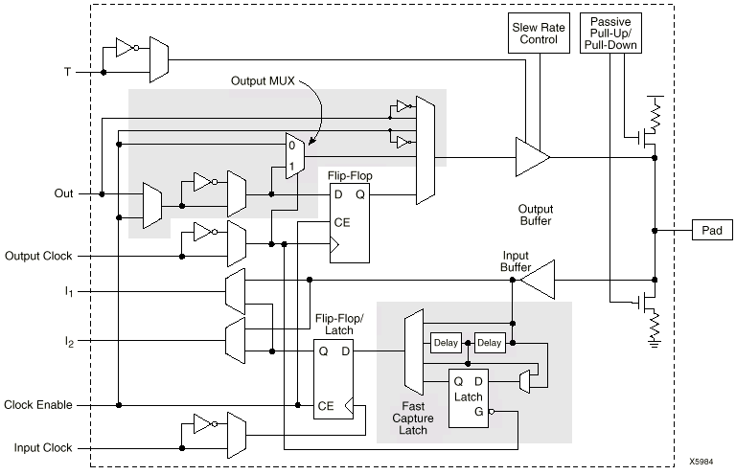
XC4000X I/O Block Diagram
Shaded areas are not included in XC4000E family.

Slide 56
Xilinx FPGA Routing
1) Fast Direct Interconnect - CLB to CLB
2) General Purpose Interconnect - Uses switch matrix
3) Double Lines
4) Long Lines
  Segmented across chip
  Global clocks, lowest skew
  2 Tri-states per CLB for busses
CLB
CLB
Switch
Matrix
Switch
Matrix
CLB
CLB

Slide 57
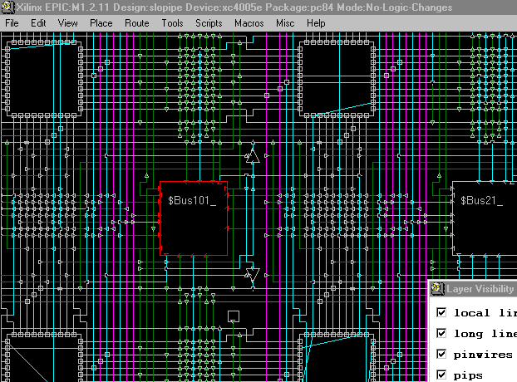
What’s Really In that Chip?
Programmable Interconnect Points, PIPs (White)
Switch
Matrix
Routed Wires (Blue)
Direct
Interconnect
(Green)
CLB
(Red)
Long Lines
(Purple)

Slide 58
Altera Cyclone V

Slide 59
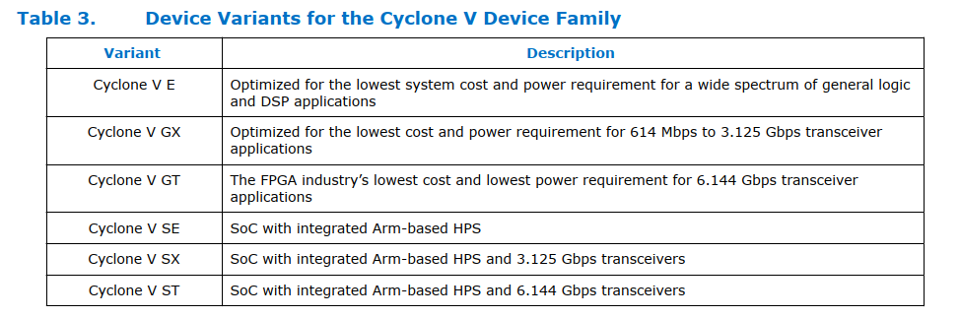
Variants

Slide 60
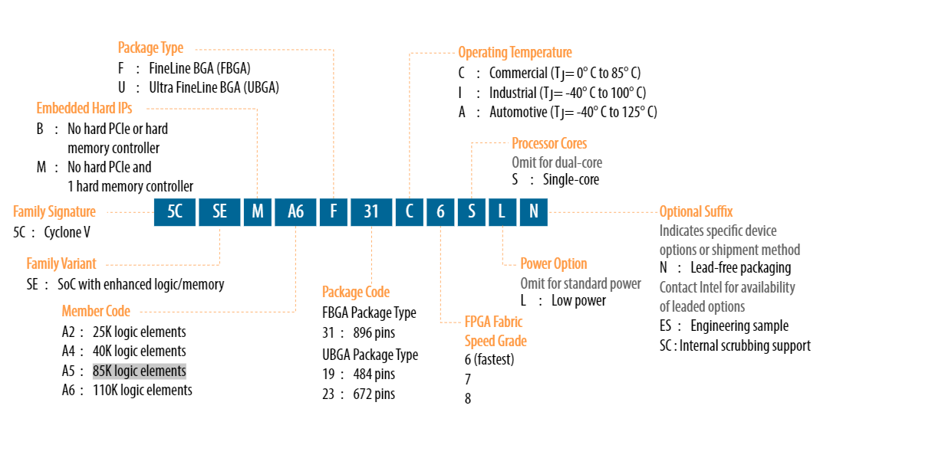
Altera Cyclone® V SE 5CSEMA5F31C6N

Slide 61
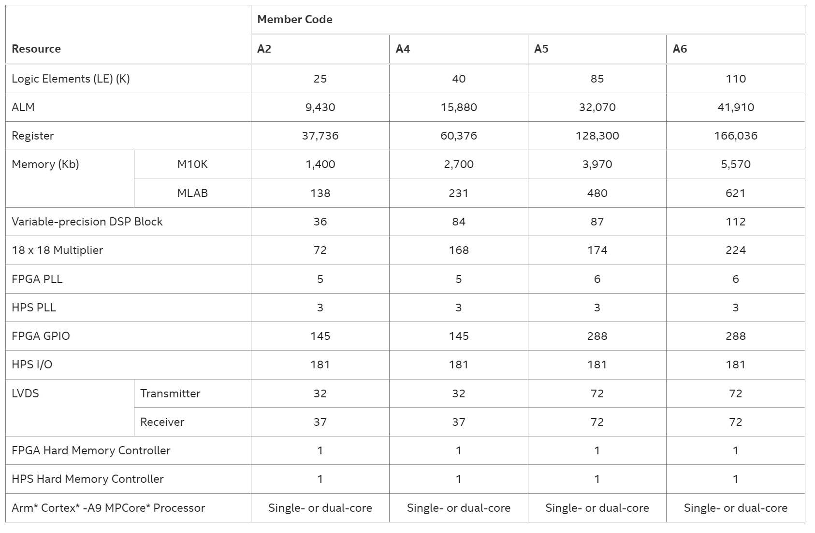
Resources
Notes:
ALM = Adaptive Logic Module
LVDS (Low-Voltage Differential Signaling)

Slide 62
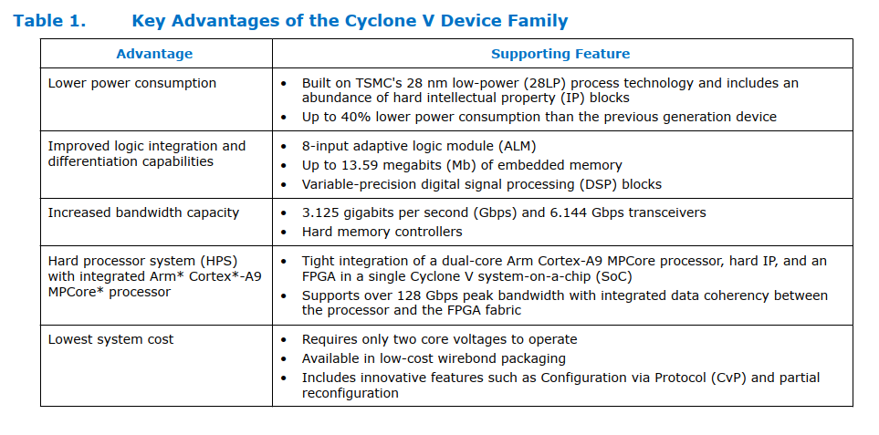
Features

Slide 63
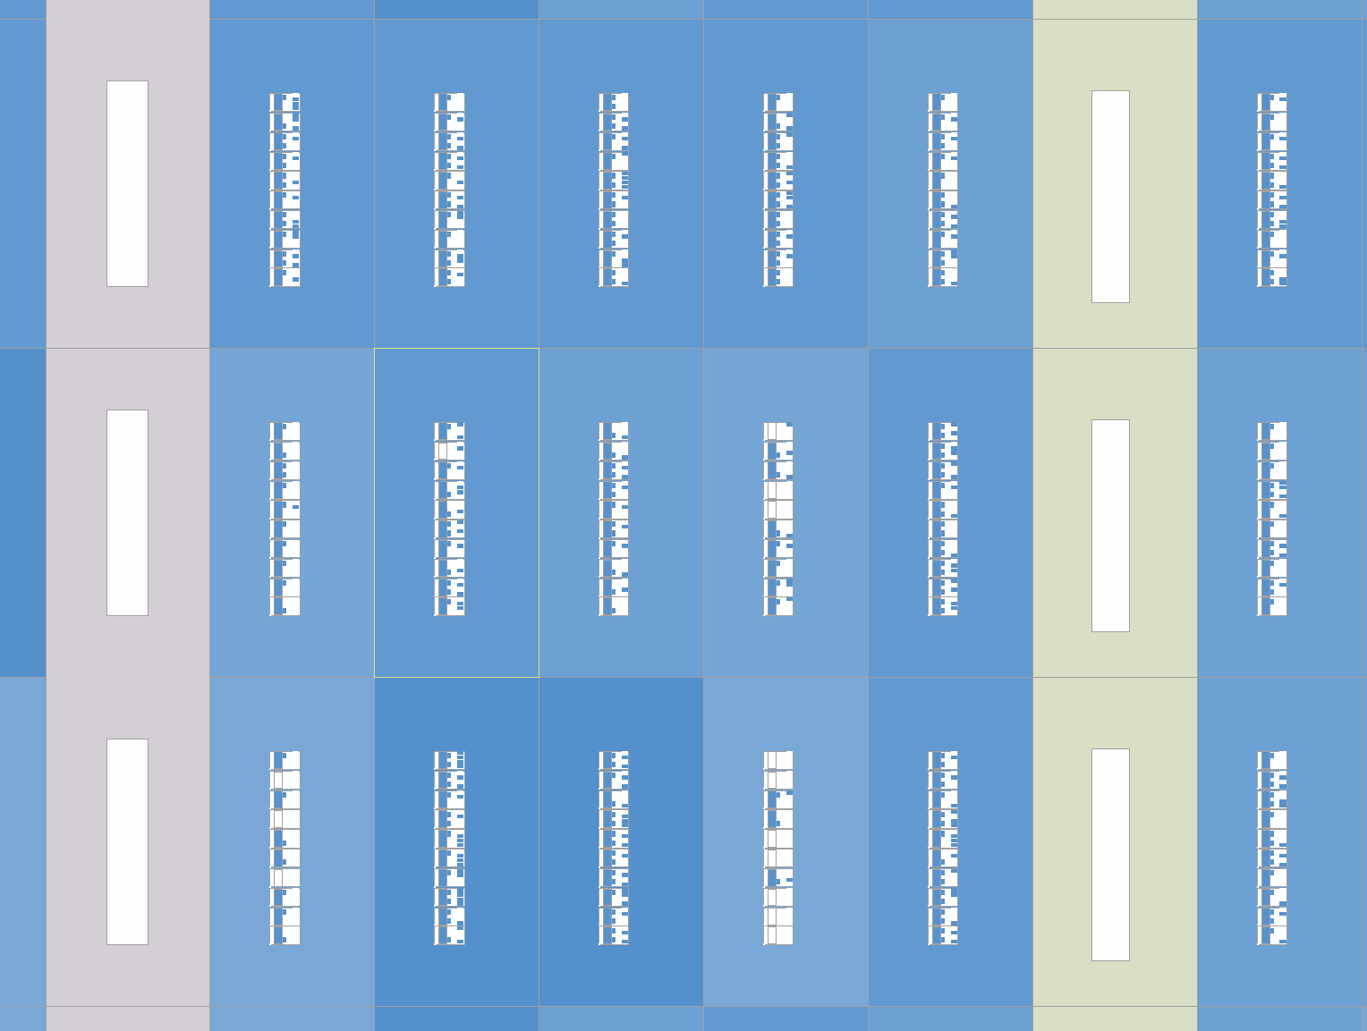
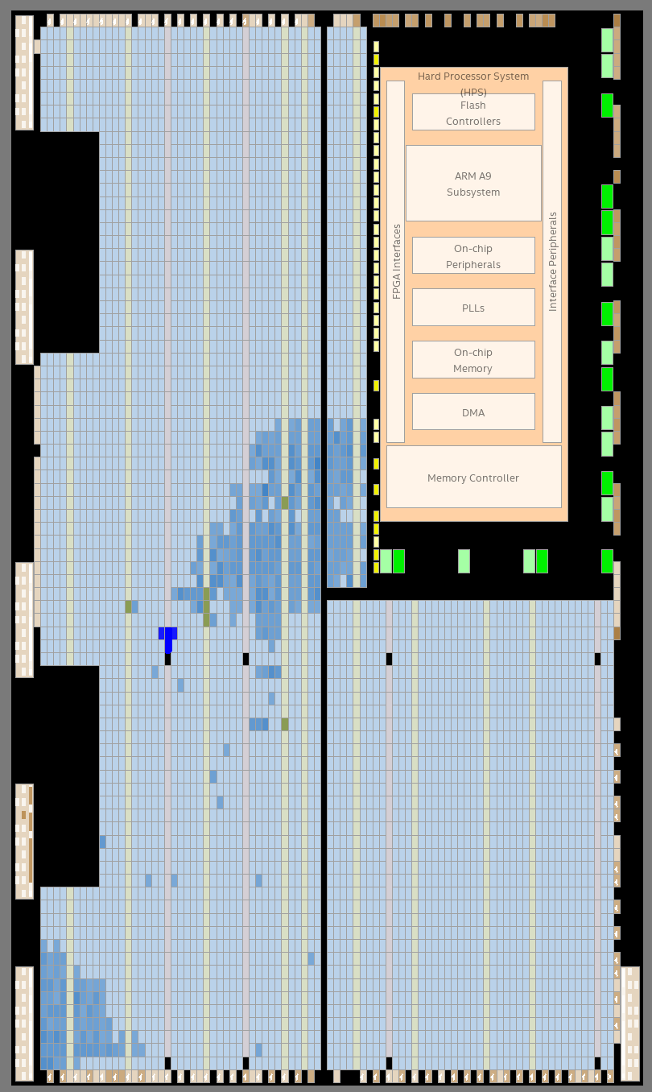
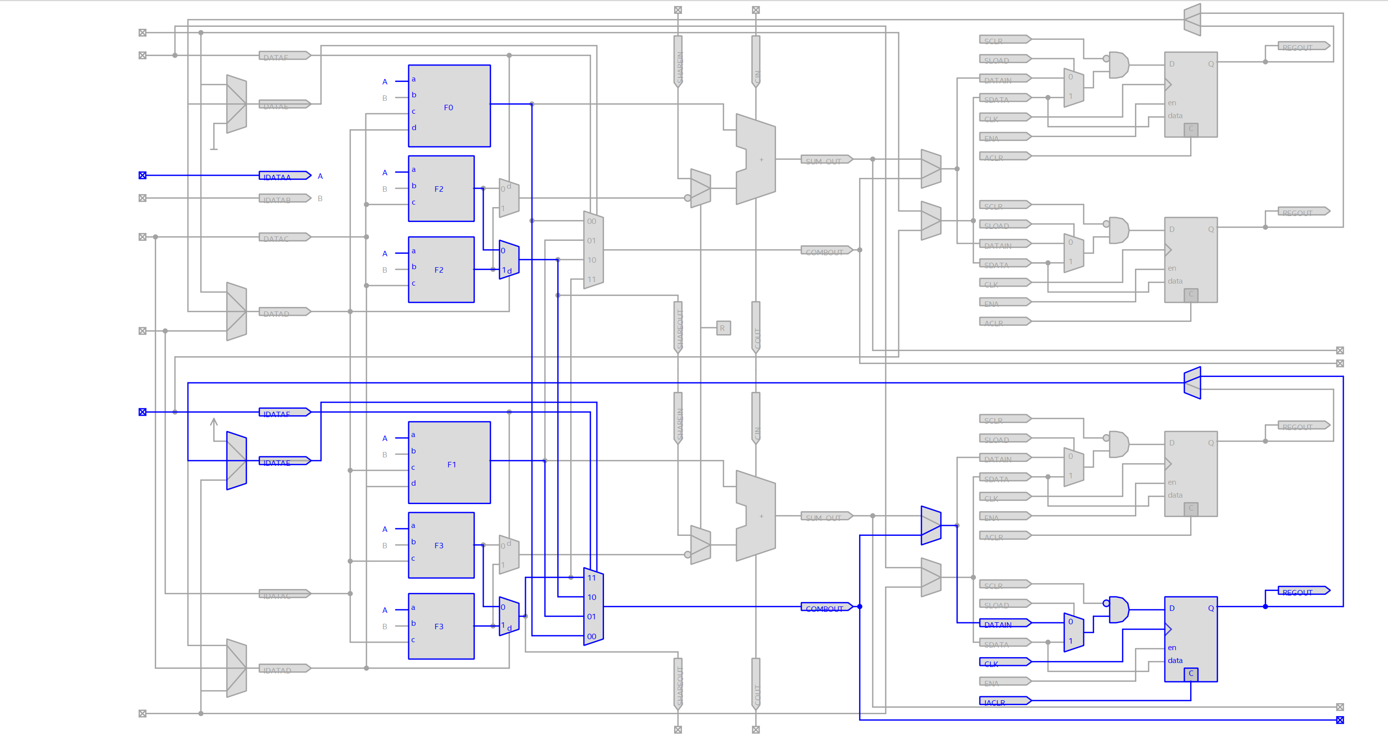
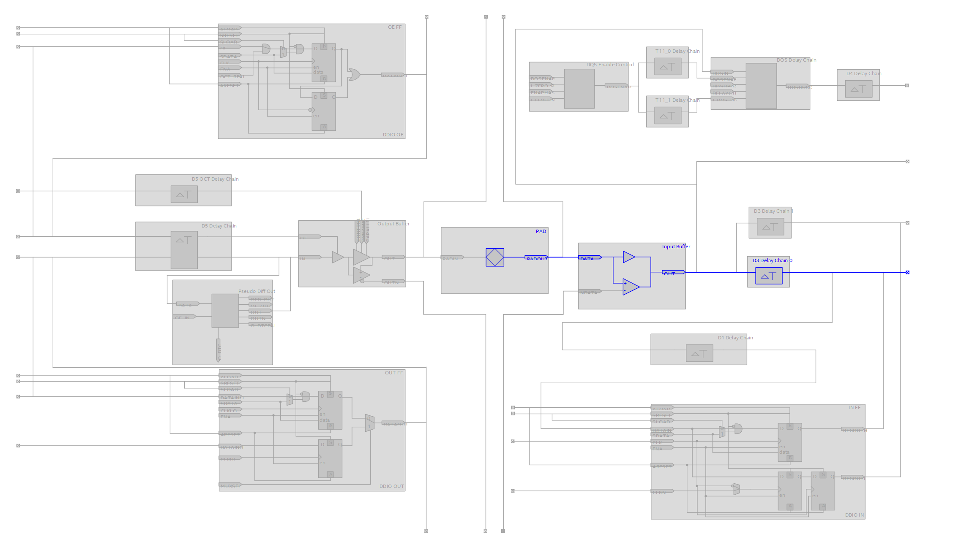
Resources

Slide 64
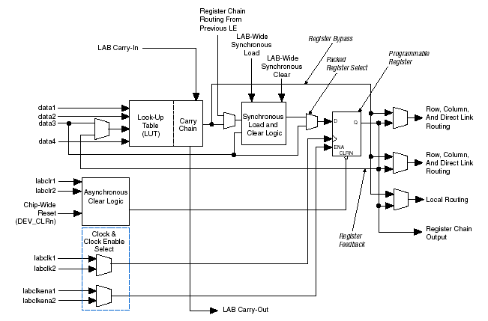
Cyclone II Logic Element (LE)

Slide 65
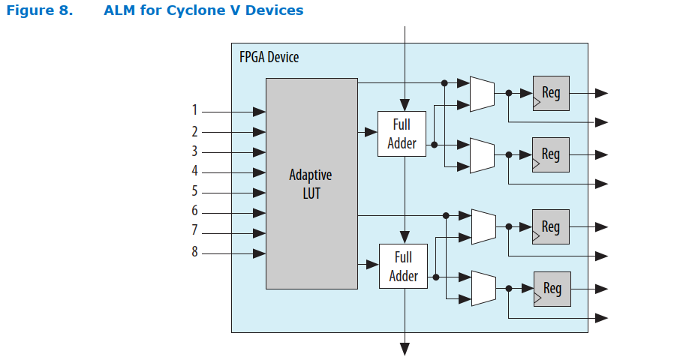
Cyclone V ALM
ALM = Adaptive Logic Module

Slide 66
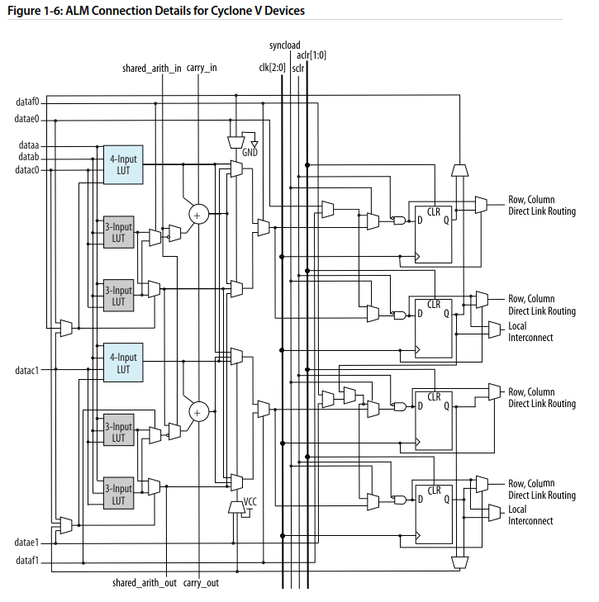
Cyclone V ALM - detail

Slide 67
ALM Operating Mode
Normal
  Multiple separate logic functions,
  Two generic 5-input functions,
  One generic 6-input function,
  Some 8-Input Functions,
  4 registers.

Slide 68
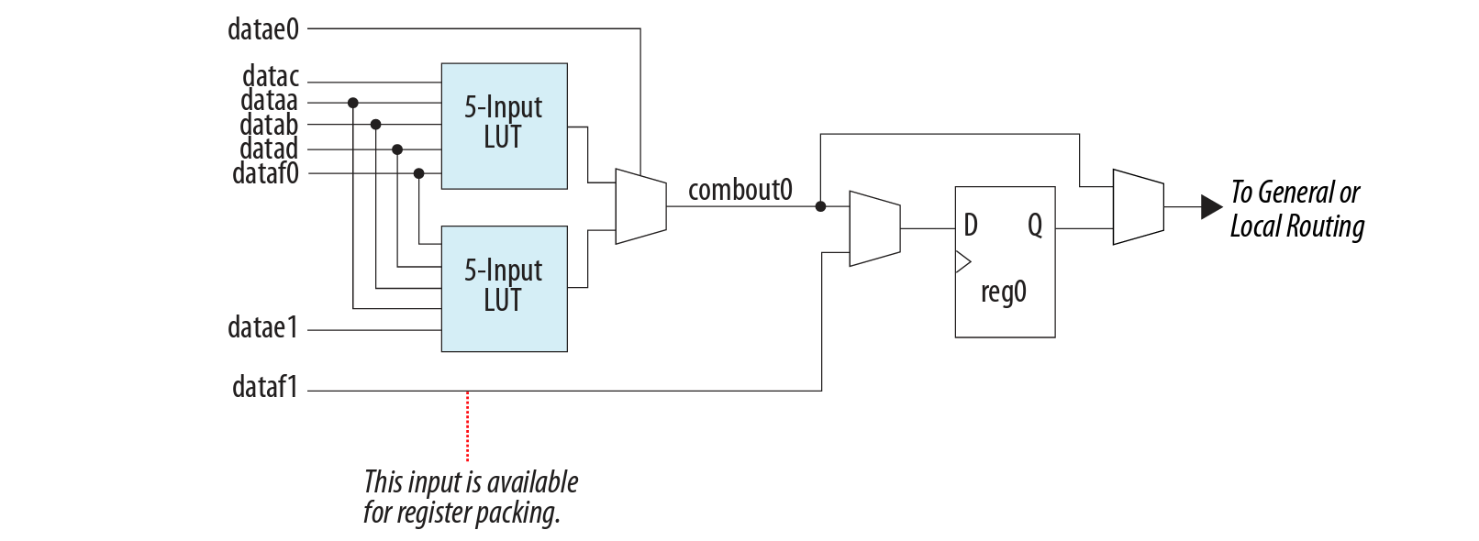
ALM Operating Mode
Extended LUT
  2 functions and a selector switch:
  (Useful for the "if – else»).
  Accessible register chain with dedicated input.

Slide 69
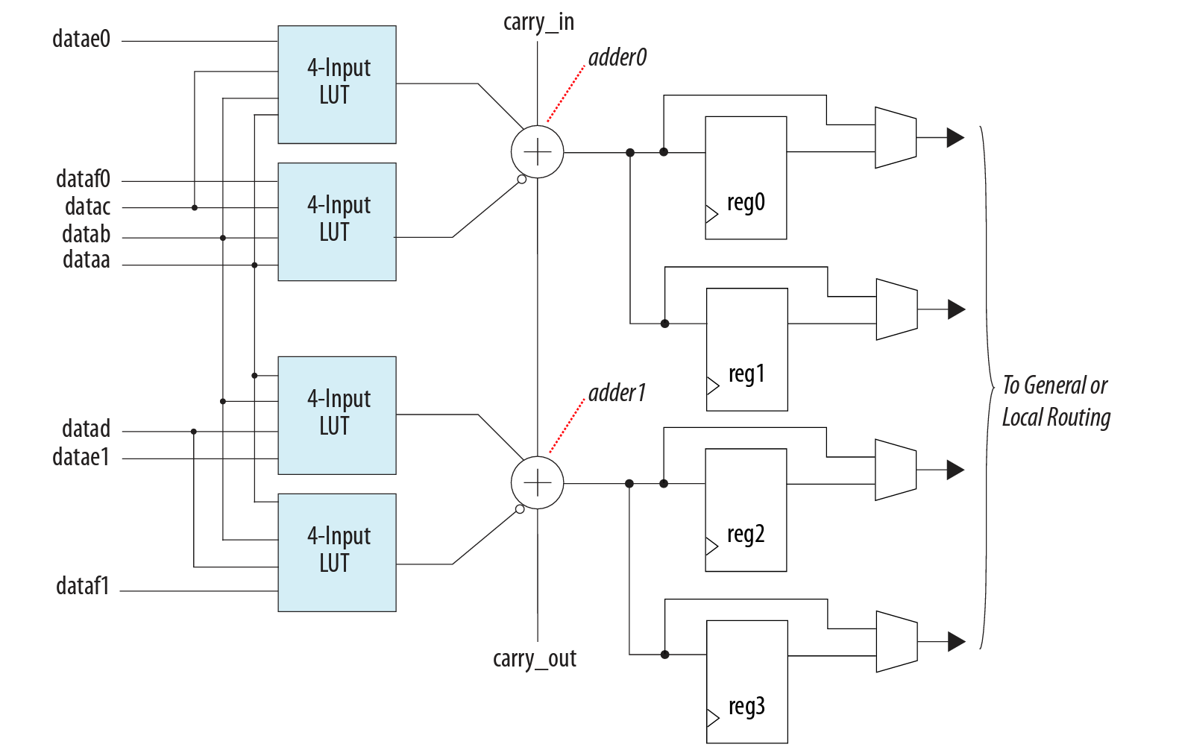
ALM Operating Mode
Arithmetic Mode
  The Carry Chain passes 5 ALMs, then eventually connects to the next LAB in the same column

Slide 70
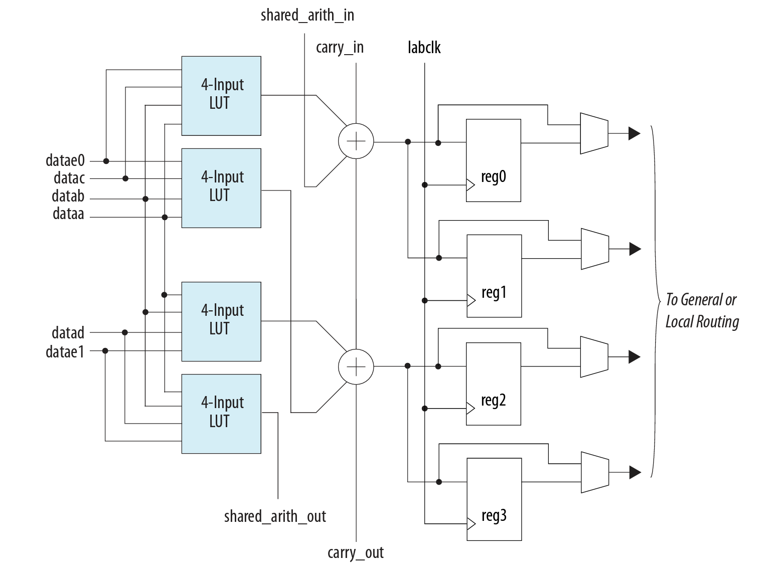
ALM Operating Mode
Shared Arithmetic Mode
  Each LUT calculates the sum and carryover of 3 bits,
  The Shared Arith Chain has the same logic as the Carry Chain,
  3-input adder with N bit,

Slide 71
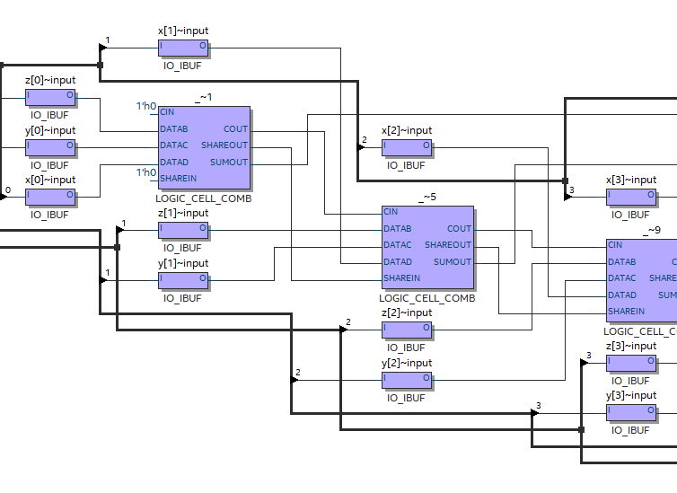
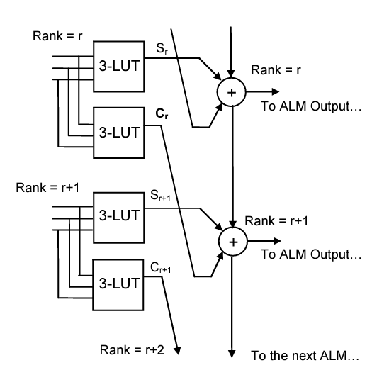
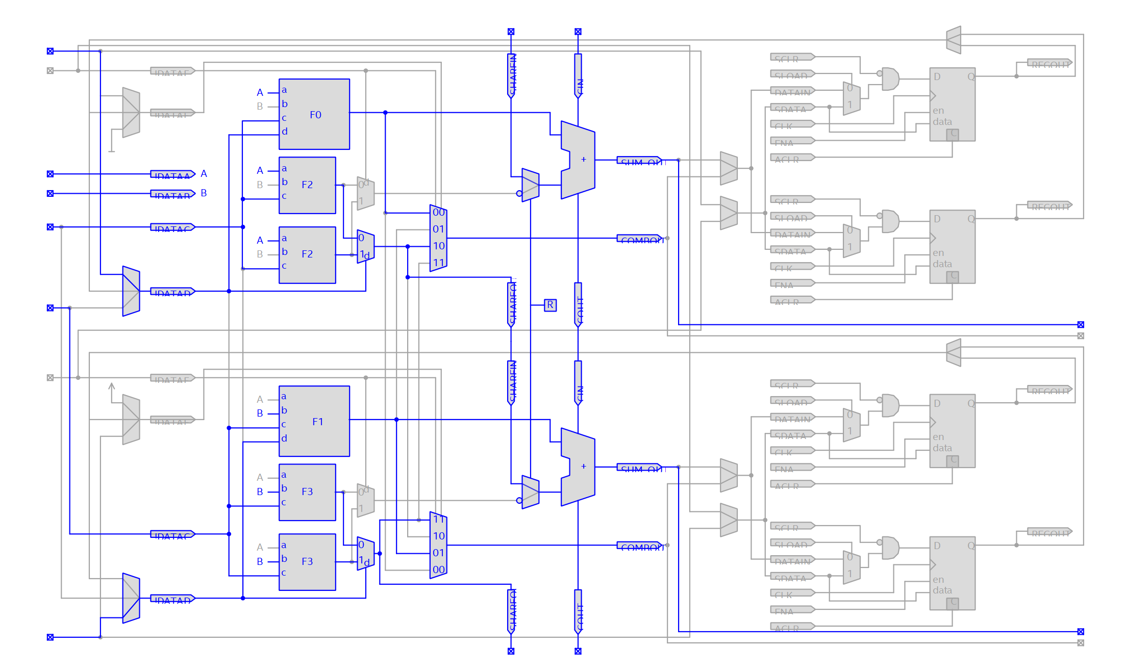
3-input N bit adder
X+Y+Z

Slide 72
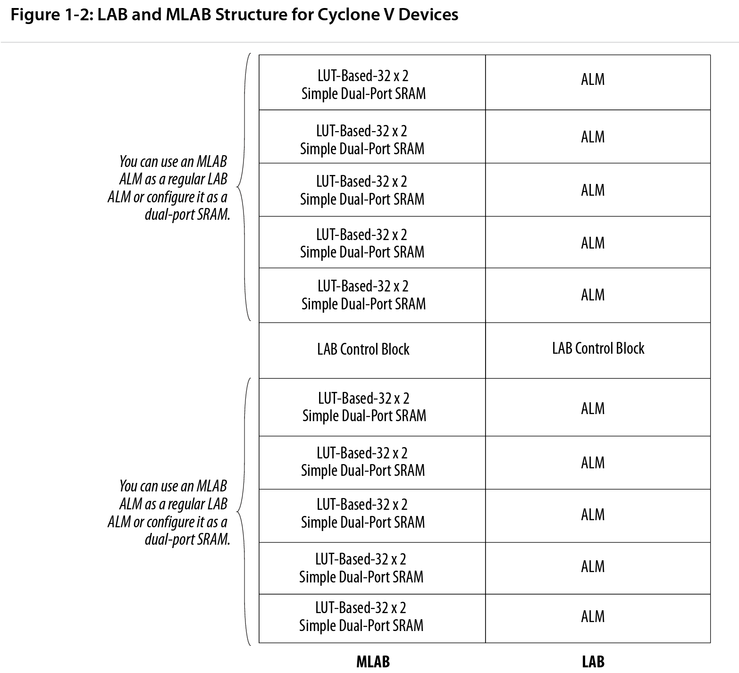
LAB - MLAB
10 ALMs are "enclosed" in a LAB,
Each ALM can be configured as a 2*32 bit memory,
A quarter of the LABs can be used as MLABs,
MLAB provides 10*2*32=640 bits SRAM dual port,
LAB Control Signals.
Notes:
Alm: Adaptive Logic Module
LAB: Logic Array Block
Mlab: lab destinati ad essere impiegati come piccolo memorie

Slide 73
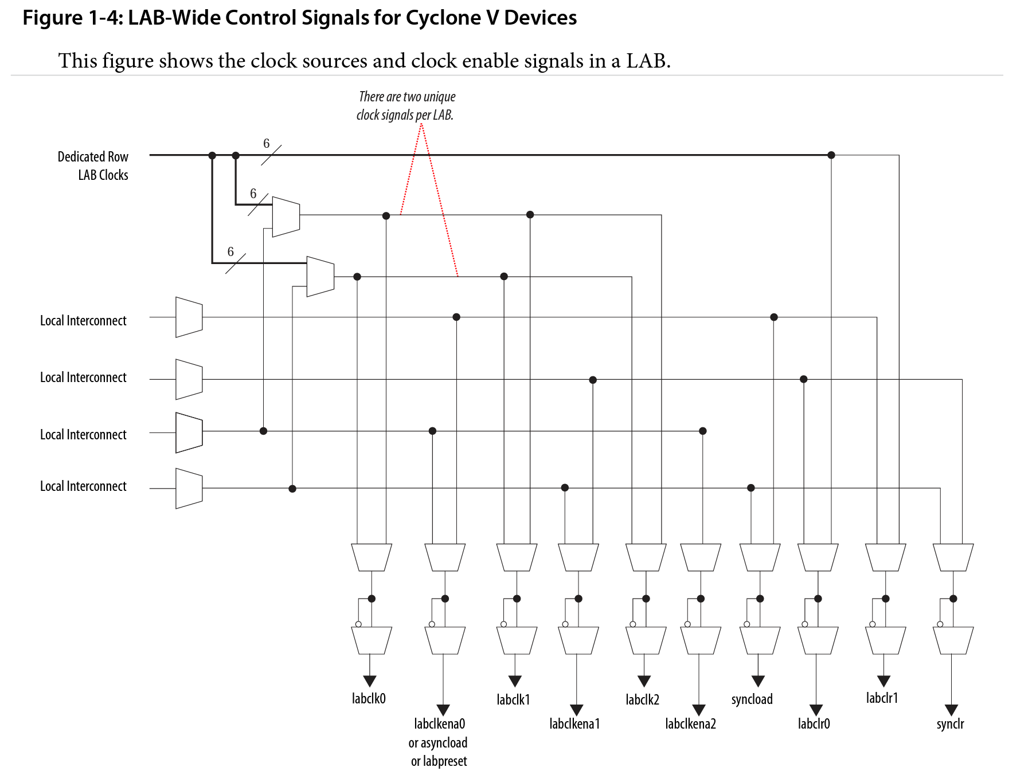
LAB Control Signals

Slide 74
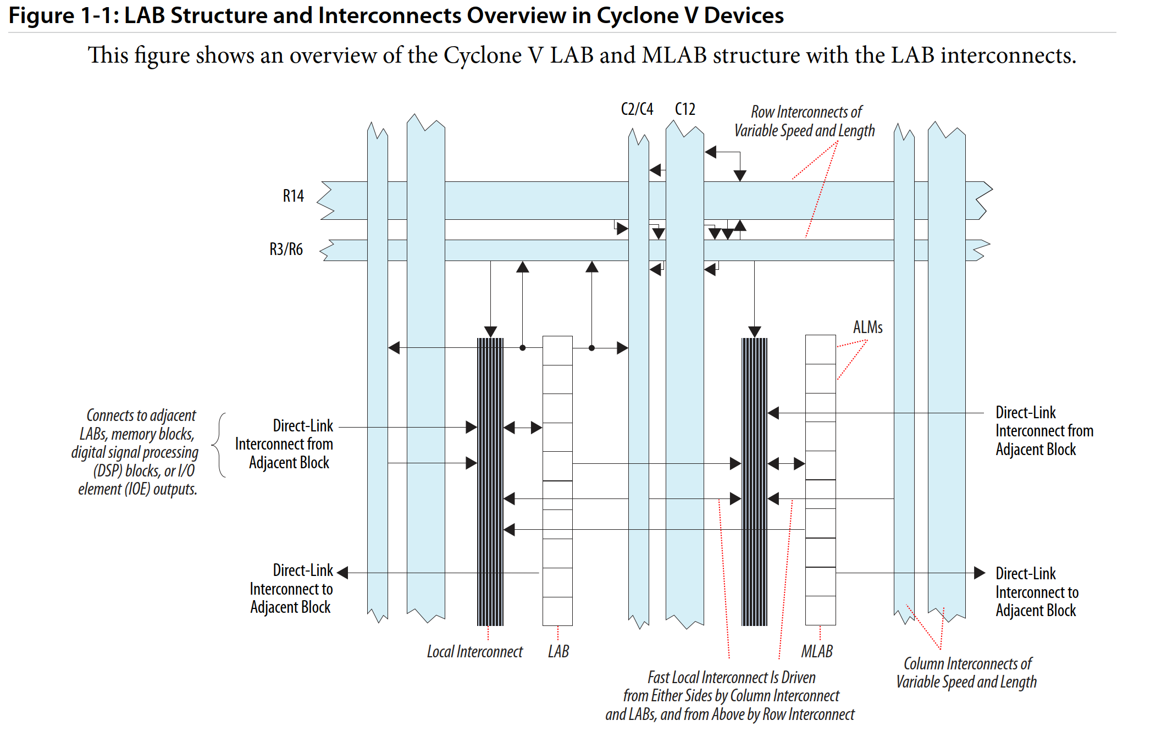
LAB/MLAB interconnections
LAB (logic array blocks)
Interconnections

Slide 75
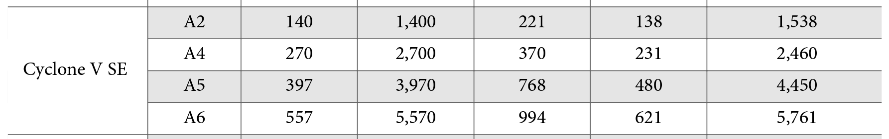
Embedded Memory Blocks
10 Kb M10Kblocks— ideal for larger memory arrays while still providing a large number of independent ports.
640 bit MLABs—enhanced memory blocks ideal for wide and shallow memory arrays.
  shift registers for DSP applications,
  wide shallow FIFO buffers
  filter delay lines
Notes:
Ulteriori informazioni su tempi e modalità di accesso, gestione dei conflitti per Dual Port, configurazioni consentite, vedasi Manuale

Slide 76
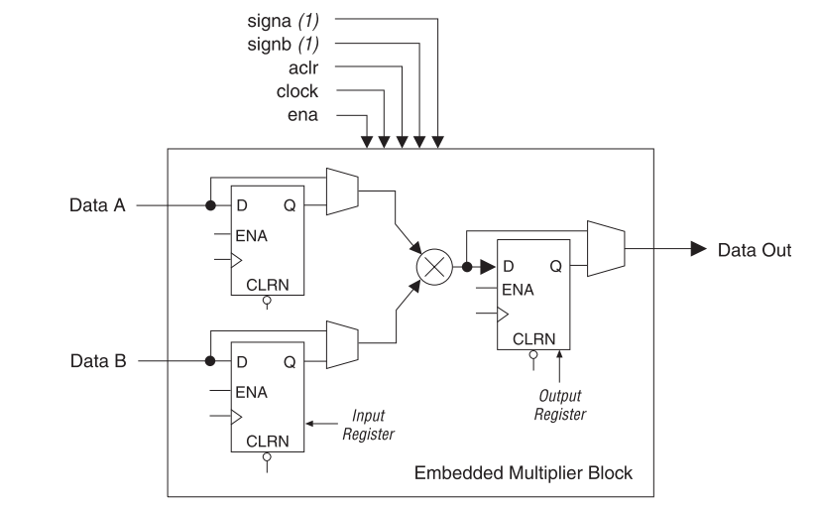

Embedded Multipliers in Cyclone II
Configurable as:
  1 Multiplier 18x18
  2 Multipliers 9x9
Up to 250MHz
Input/output registers avaliable
Signed/Unsigned operation

Slide 77



Variable-Precision DSP Block

Slide 78


Variable-Precision DSP Block

Slide 79


Variable-Precision DSP Block
Configuration as independent multipliers

Slide 80

Variable-Precision DSP Block
Complex Multiplier

Slide 81


Variable-Precision DSP Block
Multipy & Add Mode

Slide 82




Variable-Precision DSP Block
Systolic FIR Mode (27 Bits)
Notes:
Struttura sistolica (o per meglio dire in pipeline)
Shift registers messi in parallelo a 27 bits (1 solo ciclo di clock)

Slide 83

Variable-Precision DSP Block
Systolic FIR Mode a 27 bits
Notes:
Nota: nel caso della doppia moltiplicazione parallela il registro di ingresso ci mette 2 cicli di clock per ogni shift del campione. Ma poiché ingressi ed uscite sono pilotati dal medesimo clock questo implica che l’uscita debba essere «sottocampionata» ovvero deve metterci, come l’ingresso 2 cicli di clock per ogni campione. Inoltre dei due campioni in ingresso il secondo è già disponibile all’uscita dello shift register in ingresso già dopo un ciclo, per questo esso (ed il suo coefficiente) vengono ritardati di un ciclo per sincronizzarsi con i dati presenti sul secondo moltiplicatore.

Slide 84

Variable-Precision DSP Block
Systolic FIR Mode (18 bit)
Notes:
Struttura sistolica (o per meglio dire in pipeline)
Shift registers messi in cascata a 18 bits (possibili 4 cicli di clock)

Slide 85

Variable-Precision DSP Block
Systolic FIR Mode a 18 bits
Notes:
Nota: nel caso della doppia moltiplicazione parallela il registro di ingresso ci mette 2 cicli di clock per ogni shift del campione. Ma poiché ingressi ed uscite sono pilotati dal medesimo clock questo implica che l’uscita debba essere «sottocampionata» ovvero deve metterci, come l’ingresso 2 cicli di clock per ogni campione. Inoltre dei due campioni in ingresso il secondo è già disponibile all’uscita dello shift register in ingresso già dopo un ciclo, per questo esso (ed il suo coefficiente) vengono ritardati di un ciclo per sincronizzarsi con i dati presenti sul secondo moltiplicatore.

Slide 86

Clock distribution Nets on Xilinx
High speed
Low skew
4 distribution nets
4 dedicated input PADS
4 dedicated Global buffers with inputs or
  from clock pad
  from internal signal

Slide 87



Clock Networks
Cyclone SE A5
  16 Single-ended or 8 Double-ended input Pins
  Global clock Networks GCLK =16
  Regional clock Networks RCLK = 66 (Dual region options)
  Peripheral clock Networks PCLK = 18
GCLK
RCLK
PCLK

Slide 88




Clock Networks
Notes:
Non basta un semplice AND per disabilitare il clock, ci vuole un sistema di sincronizzazione che garantisca l’abilitazione/ disabilitazione sincronizzata.

Slide 89

Clock Networks
Spine Clocks (30 Section clock per quadrant)
Clock Sources:
  Input Pins (Dedicated Pins with High fan-out)
  PLL Outputs
  High Speed Serial Interfaces (HSSI)
  Internal Logic

Slide 90
PLL (teoria)
Phase
Detection
Low Pass
Filter
VCO
Frequency
Divider
Phase Detection: provides a signal proportional to the phase shift between the input signals,
Low Pass Filter: Integrates previous signal variations,
VCO: Voltage-controlled local oscillator,
Freq. Divider (possible): useful for changing the freq. of the output signal.

Slide 91


Digital Phase Frequency detector

Slide 92
PLL (applicazioni)
Analog:
  Reconstruction of the "carrier" from a modulated signal,
  FM Demodulator (the input signal to the VCO is the demodulated signal),
  Frequency synthesizer (a stable signal is placed on the input and using the divider can be synthesized signals with higher frequency).
Digital:
  Clock recovery (from a synchronous digital signal),
  Deskewing or Clock Realignment,
  Generating Clocks at Different Frequencies and Distributions.

Slide 93

Cyclone II - PLL
Clock Multiplication and Division: Using freq. dividers (m/n)
Phase Shift (delay compensation)
Programmable Duty Cycle: Using C0,C1,C2
Clock Outputs: 3 for global clock nets and 1 to a dedicated Out Pin
Manual clock switchover: to switch between different sources
Lock signal available
Clock feedback modes: zero delay, normal mode, no compensation mode
Control signals: pllenable, areset, pfdena
Notes:
Il VCO esce con 8 segnali in quanto realizzato come ring oscillator differenziale a 4 stadi.

Slide 94

Cyclone V - PLL

Slide 95
PLL
Cyclone V PLLs provide general-purpose clocking as well as support for the following features:
  Clock multiplication and division
  Programmable phase shifting
  Programmable duty cycle
  Up to nine internal clock outputs
  Clock outputs for differential I/O support
  Manual clock switchover
  Gated lock signal
  Control signals

Slide 96
I/O Features in Cyclone V
Single-ended, non-voltage-referenced, and voltage-referenced I/O standards
Low-voltage differential signaling (LVDS), RSDS, mini-LVDS, HSTL, HSUL, and SSTL I/O standards
Serializer/deserializer (SERDES)
Programmable output current strength
Programmable slew rate
Programmable bus-hold
Programmable pull-up resistor
Programmable pre-emphasis
Programmable I/O delay
Programmable voltage output differential (VOD)
Open-drain output
On-chip series termination (RS OCT) with and without calibration
On-chip parallel termination (RT OCT)
On-chip differential termination (RD OCT)
High-speed differential I/O support

Slide 97


I/O Banks Locations

Slide 98

I/O Buffer and Registers
The I/O elements (IOEs) in Cyclone® V devices contain a bidirectional I/O buffer and I/O registers to support a complete embedded bidirectional single data rate (SDR) or double data rate (DDR) transfer.

Slide 99

Half Data Rate – Output Register
Notes:
Manca l’inversione del clock sul DDR Output register !

Slide 100

Half Data Rate – Input Register

Slide 101

Programmable Pre-Emphasis
At a high frequency, the slew rate may not be fast enough to reach the full V_{OD} level before the next edge, producing pattern-dependent jitter. With pre-emphasis, the output current is boosted momentarily during switching to increase the output slew rate.

Slide 102
Hard Memory Controller
The Cyclone® V devices feature dedicated hard memory controllers. You can use the hard memory controllers for LPDDR2, DDR2, and DDR3 SDRAM interfaces. Compared to the memory controllers implemented using core logic, the hard memory controllers allow support for higher memory interface frequencies with shorter latency cycles.
The hard memory controllers use dedicated I/O pins as data, address, command, control, clock, and ground pins for the SDRAM interface. If you do not use the hard memory controllers, you can use these dedicated pins as regular I/O pins.

Slide 103

Multitrack Interconnections
Connections between LEs, M4K, multipliers, device I/O pins
Fast Local Interconnect
Row interconnections
  Direct link interconnects between LABs and adjacent blocks
  R4 Interconnects traversing four blocks to the right or left
  R24 interconnects for high-speed access across the length of the device

Slide 104

Multitrack Interconnections
Columns interconnections
  Register chain interconnects within an LAB
  C4 interconnects traversing a distance of four blocks in an up and down direction
  C16 interconnects for high-speed vertical routing through the device

Slide 105


Connections

Slide 106
FPGA Configuration

Slide 107
Generalità
The data storage is of the SRAM (Volatile)
An FPGA MUST be configured every time it is powered up:
  There are several programming methods:
    Active Serial (AS) a 100 MHz Serial memory chip required,
    Passive Serial (PS) A "master" device is required”,
    Fast Passive Parallel (FPP) a 8 or 16 bits ( 32 bits ???),
    CvP (Conf. Via Protocols) via PCIe,
    JTAG (protocollo dedicato)
  The programming method depends on the status of 5 special pins: MSEL[4..0]

Slide 108

Modalità di Programmazione

Slide 109

Dispositivi di Memoria
There are suitable memory devices on the market to easily interface with the FPGA:
  EPCS : Single Output (1x)
  EPCQ : Quad Output (4x)

Slide 110

Active Serial (AS)
The FPGA plays an active role in programming:
Interfaces via 4 Pins to serial memory:
  DCLK (Generate the clock)
  nCS (drive the Select chip)
  ASDI (Control data)
  DATA (receives data)
Interfaces with the external
environment through:
  nSTATUS
  CONF_DONE
  nCONFIG
  Which have both input (to receive commands) and output (to report status or any errors) function
  nCE (chip enable)

Slide 111

Configuration Sequence

Slide 112
Fasi di Programmazione
Power UP
  Waits for voltage values to exceed a certain threshold and keeps nCONFIG low.
Reset Stage
  FPGA resets its state,
  FPGA lowers nSTATUS and CONF_DONE,
  Tri-state all I/O PINs with weak pull-up resistances,
  After a programmed time through MSEL releases nSTATUS if it assumes the high value (with pull-up resistance) it goes to the next phase.
Configuration Stage (mode AS)
  generates DCLK via internal oscillator,
  Lower nCS0 (to enable memory),
  Generate control signals via ASDi,
  After receiving all the data, release CONF_DONE. If this takes on a high value (with pull-up resistance) it goes to the next phase.

Slide 113
Fasi di Programmazione
Inizialization Stage
  The initialization clock can be generated via an internal generator or taken from the outside via the CLKUSR pin. This pin can be used to control initialization (initialization is completed after 299 cycles)
  You can use (optionally – via software) the INIT-DONE pin to get the signal that the initialization phase is completed.
User Mode
  All I/O pins take their final function,
  You can re-program the FPGA again by lowering nCONFIG for at least 2us.
Errori
  If an error is detected during configuration, nSTATUS lowers and CONF_DONE remains low.
  If the "Auto-restart configuration after error" option has been activated via Software, the FPGA resets the memory with a pulse on nCS0 and starts again

Slide 114

Multiple Device Configuration (AS + PS)
One memory,
The first Device acts as the master, controls the data flow and activation of the second Device and works in AS,
All other devices work in PS,
Thanks to shared CONF_DONE, all devices initialize at the same time.

Slide 115

Passive Serial (PS)
The FPGA has a passive role,
The data stream is controlled by an external device (e.g. a CPLD or a microprocessor) ,
The FPGA interacts with it via nSTATUS and CONF_DONE.

Slide 116

Multi Devices (PS)

Slide 117

JTAG
The JTAG protocol, created for the testability of circuits, has access to all pins, so it can be used to program and control the device,
  E.g. it can control the CONF_DONE or nSTATUS pins during setup,
Uses 4/5 dedicated pins.

Slide 118

Programming EPC
It is possible to reprogram the serial memory:
  Through JTAG protocol,
  Through Active Serial.

Slide 119

Programming EPC
DE1-SOC mounts a JTAG configurable EPCQ256,
Serial Flash Loader is used,
  a soft IP that interfaces the JTAG protocol with the Flash Serial interface.

