Slide 1
The Verilog HDL language
Introduction to the Verilog HDL language for describing digital systems

Slide 2
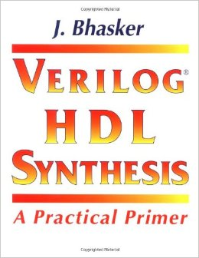
Suggested Books
J. Bhasker
Verilog HDL Synthesis – A pratical Primer
Star Galaxy Publisher

Slide 3
Disclaimer
  It is NOT a complete course on Verilog,
  You will NOT learn the Verilog syntax in detail,
  The semantic aspects will NOT be explored,
  You will NOT learn how to develop extensions or integrations.
  You will understand what are the reasons that push you to use Verilog,
  You will understand the basic concepts and be able to interpret a system described through Verilog,
  You will be able to describe "practical utility" systems in Verilog.

Slide 4
Introduction
  Who is it for??
  Designers of circuits and logic systems using Computer Automated tools for Electronic design (CAE) systems
  A bit of history:
    Initially developed in 1984-85 by Philip Moorby,
    In 1990 Cadence adopted it under the name Verilog-XL,
    IEEE standardization arrives in 1995 followed by an integration in 2001,
    It is later extended to the System-Verilog version (more oriented to the description of systems),
    Leads to the birth of Verilog-A (for analog systems),
  Now: Due to the current complexity of the circuits, it has outclassed other methodologies (schematic capture)

Slide 5
What Verilog HDL is (and what it is NOT)
HDL = Hardware Description Language
It is NOT a SW programming language.
  A software programming language describes a series of operations that are performed in a certain sequence on a dedicated processor.
It is a hardware description language.
  Describes the operation and/or structure of a logic circuit that has already been, or will be realized, with a dedicated HW,
  Describes the succession of logical signals with which to stimulate the circuit.

Slide 6
Objectives
DOCUMENT:
  For example, the system has already been built and you want to evaluate the compatibility of the signals with other systems.
SIMULATION:
  Stimulus signals can be generated to simulate the operation of a system.
SYNTHESIS.
  Describe the system at different levels of abstraction that are progressively more precise, until the lowest one (e.g. logic gates) is able to be physically realized.

Slide 7
Advantages (compared to other types of description)
Project “technology - independent”
  Used by different suppliers/vendors (both HW and SW)
  Facilitates "upgrades" of the designed system,
  The project documentation is "STANDARD”
Improvement in project quality:
  Allows you to analyze various alternatives,
  Allows multiple levels of abstraction,
    Verification at a high level of abstraction,
    Performance Comparison Across Abstraction Levels,
    Integration between blocks developed at various levels,
  Reuse and share of already developed blocks,

Slide 8
Considerations
  It is less "immediate" than a digital scheme,
  It is syntactically not so user friendly,
  Not everything written in Verilog is physically "synthesizable".
  There are development tools that allow you to derive descriptions in Verilog starting from Schemas, Finite State Machines, Truth Tables, graphs, time diagrams, etc….

Slide 9
Fundamentals
Description of LOGIC circuits,
Description according to different levels of abstraction,
  Including the ability to describe a structure,
Ability to describe the simultaneity in the execution of processes,
Ability to describe particular "states" of a physical connection (0, 1, z, x).

Slide 10
Abstraction Layers
A system does not always have to be defined with a high degree of detail:
  It may not have been realized yet,
  It could be a way to test its specifications and/or compatibility between interacting systems,
  It could be a way to "simulate" the operation of an already existing element.
A low level of abstraction:
  It is useful when you want to physically make the device,
  Typically comes out of a synthesis process (automatic or manual).

Slide 11
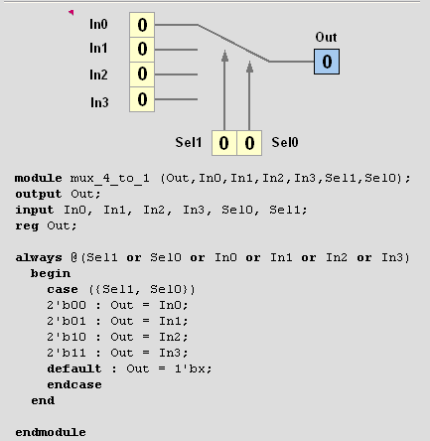
Behavioral Level
It describes the functioning of the system without explaining the mechanisms that make it happen

Slide 12
Behavioral Description
It describes how the system works NOT its physical structure,
There is no specific intent to describe the HW, in fact it could be used to,
  Describe the specifications of a system to be implemented,
  Describe a signal flow (e.g. for the simulator),
  Describe an existing system without going into detail (e.g. to check compatibility)
It is an absolutely generic description and not focused on a specific "target"”,
Not everything that is described in this way can (or must) be synthesized.

Slide 13
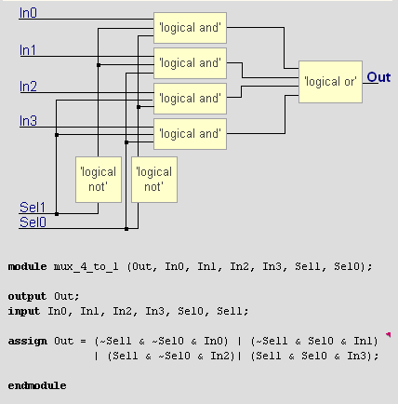
Dataflow level
It represents how it works based on the "data flow" that is being processed

Slide 14
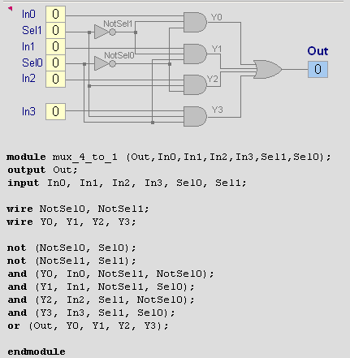
Structural Level
Represents a structure composed of multiple functional blocks.

Slide 15
Structural Description
Describes the structure of a circuit as an interconnection of elements,
If you want to be able to simulate it, every single element that composes it must be "known”
Often it arrives from a synthesis process,
It is often dedicated to a specific HW and therefore it can be less "target independent"”.

Slide 16
Simultaneous processes
In the real world (and in logic circuits) processes are "concurrent" with each other”
SW description languages describe a series of operations to be carried out in sequence,
In Verilog HDL, you can describe both competing and sequential operations,
Simulations based on "simulated time"”.
Proc 1
Proc 3
Proc 2
Proc 4

