Slide 1
Basics of
Verilog HDL
Introduction to the syntax of
Verilog HDL

Slide 2
Basic concepts
Describes a multi-level system of abstraction,
Allows you to describe the contemporaneity of the processes,
Not everything described in Verilog is intended to be summarized (part of it is intended for simulation),
The way you write is reflected in the final architecture of the system.

Slide 3
VERILOG HDL Basics
Verilog HDL is CASE sensitive,
The "keywords" are all in "lowercase"”,
The character ';' is a line terminator,
// is used to comment on a single line,
/* */ is used to comment on multiple lines,
Time specifications are only useful for simulation purposes – they are NOT synthesized.

Slide 4
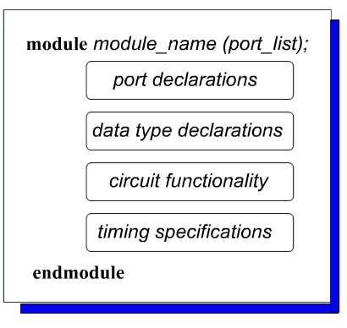
Module
It represents a process, so any element or instruction must be inside a "Module”
It is concurrent with the other processes ("modules”)
The various "modules"
can reside in the same
file or on several
separate files

Slide 5
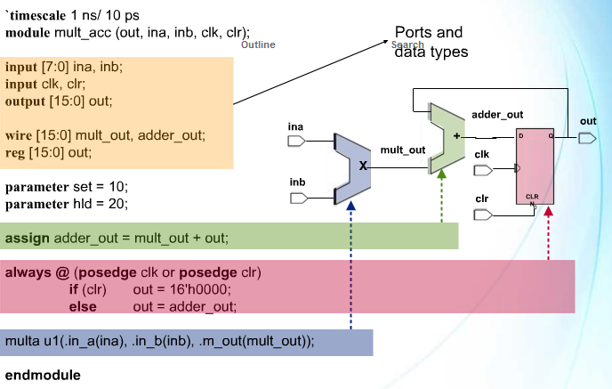
A first example
Continuous assignment
Sequential block
Module instanstation

Slide 6
Ports
Port List
  List with the names of the various ports,
  Example:
  module mult_acc(out,ina,inb,clk,clr);
Port Types
  input
  output
  inout
Port Declaration
  <port type> <port name>;
  Example:
    input [7:0] ina,inb;
    input clk,clr;
    output [15:0] out;

Slide 7
User Identifiers
Composed by {[A-Z], [a-z], [0-9], _, $}, ma ..
.. They cannot start with$ or [0-9]
  myidentifier OK
  m_y_identifier OK
  3my_identifier NO
  $my_identifier NO
  _myidentifier$ OK
Case sensitivity
  myid ≠ Myid

Slide 8
Signal classes
Nets
Registers
The main difference is that while the "Nets" must be connected to a driver to provide an output value, the "registers" retain the value even when they are disconnected from it

Slide 9
Nets (Links)
They represent the physical connections between the various logical blocks.
They take on the value Z when disconnected,
Nets can be of different types:
  wire
  tri (tri-state)
  wand/triand (wired-AND)
  wor/trior (wired-OR)
  Supply0/tri0 (stato alto)
  Supply1/tri1 (stato basso)
In the following examples, Y is evaluated whenever A or B changes
Notes:
Supply0: stato basso
Tri0 : pulldown.
wire è un net generico che può assumere lo stato z se non ci sono driver attivi, ma non è pensato per applicazioni tri-state.
tri è esplicitamente progettato per sistemi tri-state, dove il segnale può andare in alta impedenza e tornare a 0 o 1 quando guidato attivamente da driver multipli.

Slide 10


Esempi
A
wire Y; // declaration
assign Y = A & B;
Y
B
wand Y; // declaration
assign Y = A;
assign Y = B;
A
Y
B
wor Y; // declaration
assign Y = A;
assign Y = B;
dr
A
Y
tri Y; // declaration
assign Y = (dr) ? A : z;

Slide 11
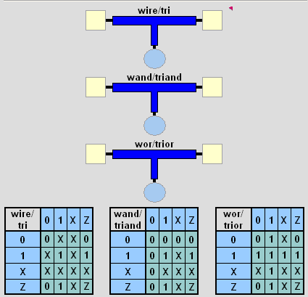
Nets

Slide 12
Registers
They represent variables designed to store a value
There is only one type: reg
  reg A, C; // declaration
  // assignments are always done inside a procedure
  A = 1;
  C = A; // C gets the logical value 1
  A = 0; // C is still 1
  C = 0; // C is now 0
Reg values are explicitly updated within procedures

Slide 13
I/O Port Rules
The I/O ports of a module are subject to certain constraints
NETS signals can be used as input, output, inout gates.
REGISTERS signals can only be used as output gates.

Slide 14
Value Sets
0: represents the low logic level,
1: represents the high logic level,
x: represents the unknown level,
Z: represents the high impedance line or the open line.
Note that not everything written in Verilog, even if syntactically correct, can then be realized:
Es: if (sel == x) …
Although syntactically it might make some sense, there is absolutely no way to accomplish such a function

Slide 15
Verilog Numbers
<size>’<radix> <value>
  4’b010x = 010x
  8’d15 = 00001110
  8’h b1 = 10110001
  12’o 5zx0 = 101zzzxxx000
No of
bits
Binary → b or B
Octal → o or O
Decimal → d or D
Hexadecimal → h or H
Consecutive chars
0-f, x, z

Slide 16
Verilog Numbers
You can enter "_" to improve readability:
  12’b 000_111_010_100
  12’b 000111010100
  12’o 07_24
Bit extension:
  MS bit = 0, x or z ⇒ extend this
    4’b x1 = 4’b xx_x1
  MS bit = 1 ⇒ zero extension
    4’b 1x = 4’b 00_1x
Represent
the same number

Slide 17
Verilog Numbers
If size is omitted (not recommended)
  Or is derived from the value,
  Or it takes the number of bits specified by the simulator,
  Or it takes a number of bits by default.
(in Quartus-Altera default is 32-bits)
If radix is also omitted, it is assumed to be in decimal:
  15 = <size>’d 15

Slide 18
Negative numbers
They are marked with a "-" sign that precedes the <size>
Es:
-8’d3; OK
4’d-5; NO
They are represented in two's complement

Slide 19
Multi net / multi reg
They represent buses:
  wire[3:0] busA;
  reg [1:4] busB;
  reg [1:0] busC;
The digit on the left represents the most MSB,
Section assignment:
  busC[1] = busA[2];
  busC[0] = busA[1];
Assignment via location:
busB[1] = busA[3];
  busB[2] = busA[2];
  busB[3] = busA[1];
  busB[4] = busA[0];
busC = busA[2:1]; ⇔
busB = busA; ⇔

Slide 20
Arithmetic operators
  +: sum,
  -: subtraction, negative,
  *: multiplication,
  /: division,
  %: module.
If one of operands is "x" or "z" the result will be "x”
If operands and result are the same size, the carry bit is lost
Negative values are saved (in reg) as a complement of two, but in subsequent operations they are considered as "unsigned”

Slide 21
Arithmetic Operators (Examples)
ain =5; bin =10; cin =2’b10; din=2’b0x;
ain+cin = 7;
bin-cin =8;
-bin = -10;
ain*bin=50:
bin/ain =2;
bin%ain =0;
reg [15:0] regA;
..
regA = -4’d12; // stored as 2¹⁶-12 = 65524
regA/3 // evaluates to 21861

Slide 22
Bitwise Operators
& → bitwise AND
| → bitwise OR
~ → bitwise NOT
^ → bitwise XOR
~^ or ^~ → bitwise XNOR
If the dimensions are different:
  The result takes on the size of the largest operand,
  The smaller operand is "extended" to the left with additional zeros.

Slide 23
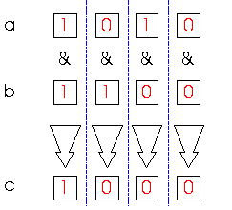
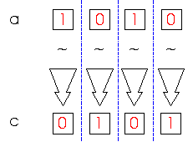
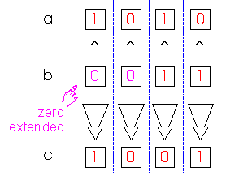
Bitwise Operators (examples)
c = ~a;
c = a & b;
a = 4’b1010;
b = 4’b1100;
c = a ^ b;
a = 4’b1010;
b = 2’b11;

Slide 24
Reduction Operators
& → AND
| → OR
^ → XOR
~& → NAND
~| → NOR
~^ or ^~ → XNOR
One multi-bit operand → One single-bit result
  a = 4’b1001;
  ..
  c = |a; // c = 1|0|0|1 = 1

Slide 25
Relational Operators
> → greater than
< → less than
>= → greater or equal than
<= → less or equal than
Result is one bit value: 0, 1 or x
  1 > 0 → 1
  ’b1x1 <= 0 → x
  10 < z → x

Slide 26
Equality Operators
== → logical equality
!= → logical inequality
=== → case equality
!== → case inequality
  “case” also includes the evaluation on X and Z... obviously this operation is NOT summarized
  4’b 1z0x == 4’b 1z0x → x
  4’b 1z0x != 4’b 1z0x → x
  4’b 1z0x === 4’b 1z0x → 1
  4’b 1z0x !== 4’b 1z0x → 0
Return 0, 1 or x
Return 0 or 1

Slide 27
Logical Operators
&& → logical AND
|| → logical OR
! → logical NOT
They work with 1-bit values: 0, 1 or x
The result is only 1 bit: 0, 1 or x
  A = 6; A && B → 1 && 0 → 0
  B = 0; A || !B → 1 || 1 → 1
  C = x; C || B → x || 0 → x
but C&&B=0

Slide 28
Shift Operators
>> → shift right
<< → shift left
The result is the same size as the original data, the empty positions are filled with“0”
a = 4’b1010;
...
d = a >> 2; // d = 0010
c = a << 1; // c = 0100

Slide 29
Concatenation Operator
{op1, op2, ..} → concatenates op1, op2, .. to single number
Operands must be sized !!
  reg a;
  reg [2:0] b, c;
  ..
  a = 1’b 1;
  b = 3’b 010;
  c = 3’b 101;
  catx = {a, b, c}; // catx = 1_010_101
  caty = {b, 2’b11, a}; // caty = 010_11_1
  catz = {b, 1}; // WRONG !!
Replication ..
  catr = {4{a}, b, 2{c}}; // catr = 1111_010_101101

Slide 30
Conditional Operator
cond_expr ? true_expr : false_expr
Describes a Multiplexer 2-in-1..
A
1
Y
B
Y = (sel)? A : B;
0
sel

Slide 31
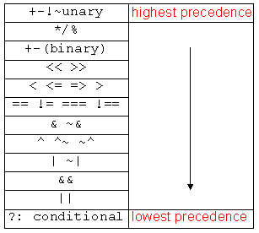
Operator Precedence
Utilizzo delle parentesi
per modificare la priorità

Slide 32
Integer & Real Data Types
Declaration
  integer i,k;
  real r;
Employed as registers (within procedures)
  i = 1; // assignments occur inside procedure
  r = 2.9;
  k = r; // k is rounded to 3
Integers are not initialized!!
Reals are initialized to 0.0
It is NOT certain that they can be synthesized

Slide 33
Time Data Type
Used only in the simulation phase,
They are NOT synthesized,
Declaration,
  time my_time;
Used internally in procedures,
  my_time = $time; // get current sim time
Simulation works based on simulated time, not real time.
Notes:
assign #6 n = ~b;
assign #3 m = a & b;
assign #3 p = n & c;
assign #2 w2 = m | p;

Slide 34
Arrays
Syntax
  integer count[1:5]; // 5 integers
  reg var[-15:16]; // 32 1-bit regs
  reg [7:0] mem[0:1023]; // 1024 8-bit regs
Accessing to Items:
  Single element: mem[10] = 8’b 10101010;
  Range inside an element (Use of temp variabile):
    reg [7:0] temp;
    ..
    temp = mem[10];
    var[6] = temp[2];

Slide 35
Arrays
Limitation: The entire array or a subset of elements cannot be accessed.
  var[2:9] = ???; // WRONG!!
  var = ???; // WRONG!!
Multi-dimensional arrays are not allowed.
  reg var[1:10] [1:100]; // WRONG!!
Not allowed for Real.
  real r[1:10]; // WRONG !!

Slide 36
Strings
Implemented with regs:
  reg [8*13:1] string_val; // can hold up to 13 chars
  ..
  string_val = “Hello Verilog”;
  string_val = “hello”; // MS Bytes are filled with 0
  string_val = “I am overflowed”; // “I ” is truncated
Escaped chars:
  \n newline
  \t tab
  %% %
  \\ \
  \“ “

