Slide 1
Basics of
Verilog HDL
Descriptions of a digital system

Slide 2
Module
module my_module(out1, .., inN);
output out1, .., outM;
input in1, .., inN;
.. // declarations
.. // description of f (maybe
.. // sequential)
endmodule
in1
my_module
out1
in2
out2
f
inN
outM
Everything written in Verilog must reside inside a "module"
The only exceptions are any directives to the compiler
Within a Verilog file there can be multiple "modules"

Slide 3
Port Assignments
module
Inputs
Outputs
Inouts
reg or net
net
module
reg or net
net
module
net
net

Slide 4
Assignments
In Verilog, there are two basic ways to make an assignment:
  Countinuous assignment,
    Instant Assignment
    describes a purely combinatorial functioning.
  Procedural assignement,
    Conditional Assignment
    describes mostly sequential operation.

Slide 5
Continuous Assignment
opzionale
NET type
Syntax:
  assign #del <id> = <expr>;
Where and how it should be written:
  inside a“module”
  outside of a“procedure”
  to the left of the "=" there must be a NET,
  to the right of the "=" there can be NET, REGISTER, or a function call.
Proprietà:
  are all run in parallel (they are concurrent)
  execution is independent of the order in which they were written,
  are always active if one of the operands on the right changes, the result is immediately updated,
  Delays are NOT synthesized but can be used in simulation to model for instance a gate delays.

Slide 6
Continuous Assignment (Es.)
wire adder_out = mut_out + out;
is equivalent to:
wire adder_out;
assign adder_out = mut_out + out;
or
assign #5 adder_out = mut_out + out;

Slide 7
Example: Half Adder
A
module half_adder(S, C, A, B);
output S, C;
input A, B;
wire S, C, A, B;
assign S = A ^ B;
assign C = A & B;
endmodule
S
B
C
A
S
Half
Adder
B
C

Slide 8
Procedural Assignments
A module can contain multiple processes,
Each process is executed in parallel to the others, but the instructions contained in it are executed sequentially,
There are 2 fundamental processes:
  initial → Executed only once,
  (useful for simulation but ignored by the synthesis)
  always → Performed in a continuous cycle,
They cannot be nested inside each other,
The variables that are assigned within a process must be of type reg (integer, real, time, realtime)

Slide 9
Procedural Assignments (Es.)
module clk_gen(clk);
output clk;
reg clk;
initial
clk = 1’b0; // parte da 0
always
#5 clk = !clk; // ogni 5 units si inverte
initial
#100 $finish // istruzione per il simulatore
Of course, neither delays nor initialization can be synthesized... but this description can be useful, for example, to provide a signal to a circuit under test

Slide 10
Always Block
Most commonly, the always block is triggered in correspondence with an event(@)
  always @(signal1 or signal2 or ..) begin
  ..
  end
  always @(posedge clk) begin
  ..
  end
  always @(negedge clk) begin
  ..
  end
Synchronized execution on signals (circuits
Combinators) sensitivity list with all the signals involved
Synchronized execution on the rising edge of the clk
(sequential circuits) sensitivity list with synchronism signals only
Synchronized execution on the clk falling edge
(sequential circuits) sensytivity list with only
synchronism

Slide 11
Block vs. NON-Block assignments
There are two types of assignment:
Block assignment (=)
  The execution of the instruction follows the exact order in which it was written,
NON-Block assignment (<=)
  Executes a statement without having to wait for the previous statement to finish,
Note a variable assigned in one of the two ways can NOT be assigned in the other way
initial
begin
#5 a=b;
#10 c=d;
end
initial
begin
#5 a<=b;
#10 c<=d;
end
a=b
c=d
a=b
c=d
0
5
10
15
0
5
10
15

Slide 12
Timing
d
initial begin
#5 c = 1;
#5 b = 0;
#5 d = c;
end
c
b
0
5
10
15
Time
Each assignment is
blocked by its previous one

Slide 13
Timing
d
initial begin
fork
#5 c = 1;
#5 b = 0;
#5 d = c;
join
end
c
b
0
5
10
15
Time
Assignments are
not blocked here

Slide 14
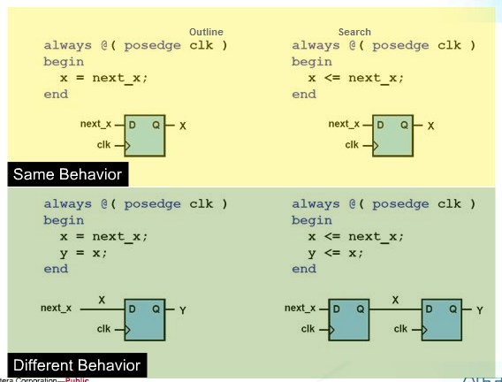
Block vs. NON Block assignments

Slide 15
Behavioral description
The processes or procedures are particularly suitable for behavioral descriptions of the circuit,
Types of declarations
  IF – ELSE
    conditions evaluated from top to bottom,
    Order of priority.
  CASE
    Conditions assessed in one step,
    without any priority.
  LOOP
    Repetitive Operations.

Slide 16
IF - ELSE
Es. 4-to-1 mux:
module mux4_1(out, in, sel);
output out;
input [3:0] in;
input [1:0] sel;
reg out;
wire [3:0] in;
wire [1:0] sel;
always @(in or sel)
if (sel == 0)
out = in[0];
else if (sel == 1)
out = in[1];
else if (sel == 2)
out = in[2];
else
out = in[3];
endmodule
if (expr1)
true_stmt1;
else if (expr2)
true_stmt2;
..
else
def_stmt;

Slide 17
CASE
E.g. 4-to-1 mux:
module mux4_1(out, in, sel);
output out;
input [3:0] in;
input [1:0] sel;
reg out;
wire [3:0] in;
wire [1:0] sel;
always @(in or sel)
case (sel)
0: out = in[0];
1: out = in[1];
2: out = in[2];
3: out = in[3];
endcase
endmodule
case (expr)
item_1, .., item_n: stmt1;
item_n+1, .., item_m: stmt2;
..
default: def_stmt;
endcase

Slide 18
CASEZ e CASEX
CASEZ
  "Z" values are interpreted as "Don't Care”
  the "z" values can be replaced by“?”
CASEX
  The "z" and "x" values are interpreted as "don't care”
Casez (encoder)
4’b1???: out =3;
4’b01??: out =2;
4’b001?: out =1;
4’b0001: out =0;
default: out =0;
endcase
Casex (encoder)
4’b1xxx: out =3;
4’b01xx: out =2;
4’b001x: out =1;
4’b0001: out =0;
default: out =0;
endcase
Se encoder = 4’b1zzz out=3
Se encoder = 4’b1xzx out=3
Notes:
Casez per circuiti sintetizzabili
Casex solo per testbench

Slide 19
LOOP - for
for (init_assignment;cond;step_assignment)
stmt;
Es.
module count(Y, start);
output [3:0] Y;
input start;
reg [3:0] Y;
wire start;
integer i;
initial
Y = 0;
always @(posedge start)
for (i = 0; i < 3; i = i + 1)
#10 Y = Y + 1;
endmodule

Slide 20
LOOP - while
Es.
module count(Y, start);
output [3:0] Y;
input start;
reg [3:0] Y;
wire start;
integer i;
initial
Y = 0;
always @(posedge start) begin
i = 0;
while (i < 3) begin
#10 Y = Y + 1;
i = i + 1;
end
end
endmodule
while (expr) stmt;

Slide 21
LOOP - repeat
E.g.
module count(Y, start);
output [3:0] Y;
input start;
reg [3:0] Y;
wire start;
initial
Y = 0;
always @(posedge start)
repeat (4) #10 Y = Y + 1;
endmodule
repeat (times) stmt;
can be a whole
or a variable

Slide 22
LOOP - forever
Esempio tipico :
Generazione del clock
module test;
reg clk;
initial begin
clk = 0;
forever #10 clk = ~clk;
end
other_module1 o1(clk, ..);
other_module2 o2(.., clk, ..);
endmodule
T_{clk} = 20 time units
forever stmt;
Runs continuously until
at the end of the simulation

Slide 23
Structural description (Gate Level)
Use library primitives or pre-compiled forms:
  and, nand, nor, or, xor, xnor, buf, not, bufif0, bufif1, notif0, notif1
Usage:
  nand (out, in1, in2); 2-input NAND without delay
  and #2 (out, in1, in2, in3); 3-input AND with 2 t.u. delay
  not #1 N1(out, in); NOT with 1 t.u. delay and instance name
  xor X1(out, in1, in2); 2-input XOR with instance name
They must be written internally to the module but outside the procedures,
It makes extensive use of continuous assignments.

Slide 24
Example: Full Adder
in1
A
S
I1
A
S
sum
Half
Adder
ha1
Half
Adder
ha2
in2
B
C
I2
B
C
I3
cout
cin
module full_adder(sum, cout, in1, in2, cin);
output sum, cout;
input in1, in2, cin;
wire sum, cout, in1, in2, cin;
wire I1, I2, I3;
half_adder ha1(I1, I2, in1, in2);
half_adder ha2(sum, I3, I1, cin);
assign cout = I2 || I3;
endmodule
Module
name
Instance
name

Slide 25
Hierarchical Names
ha2.A
in1
A
S
I1
A
S
sum
Half
Adder
ha1
Half
Adder
ha2
in2
B
C
I2
B
C
I3
cout
cin
Remember to use instance names,
not module names

Slide 26
Mixed Model
The code can contain simultaneously
structural and behavioral descriptions
module simple(Y, c, clk, res);
output Y;
input c, clk, res;
reg Y;
wire c, clk, res;
wire n;
not(n, c); // gate-level
always @(res or posedge clk)
if (res)
Y = 0;
else
Y = n;
endmodule
res
c
n
Y
clk

Slide 27
Syntactic structures
The way you write the code affects the realization of the circuit,
Synthesis recognizes particular constructs and acts accordingly,
The code must already be written by predicting the final structure of the circuit and not hoping for a superior intelligence (synthesizer) capable of achieving what we ourselves have not been able to design,
80% of the success of a circuit lies in how the source code was written, 15% in the synthesis tool and the remaining 5% in any optimizations.

Slide 28
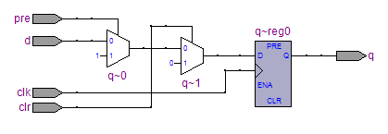
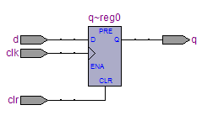
Synchronous and asynchronous controls
module sync (d,clk,clr,pre,q);
input d,clk,clr,pre;
output q;
reg q;
always @(posedge clk)
begin
if (clr)
q <= 1’b0;
else if (pre)
q <= 1’b1;
else
q <= d;
end
endmodule
module async (d,clk,clr,q);
input d,clk,clr;
output q;
reg q;
always @(posedge clk or posedge clr)
begin
if (clr)
q <= 1’b0;
else
q <= d;
end
endmodule

Slide 29
Clock Enable
module clk_ena(d,ena,clk,q);
input d,ena,clk;
output q;
reg q;
always @(posedge clk)
if (ena)
q <= d;
endmodule

Slide 30
Functional Counter
module cntr(q,aclr,clk,func,d);
input aclr,clk;
input [7:0] d;
input [1:0] func;
output [7:0] q;
reg [7:0] q;
always @(posedge clk or posedge aclr)
begin
if (aclr)
q <= 8’h00;
else
case(funct)
2’b00: q <= d;
2’b01: q <= q+1;
2’b10: q <= q-1;
2’b11: q <= q;
endcase
end
endmodule

Slide 31
Tasks & Functions
Similar to other languages, they implement code blocks (subprograms)
Useful in case of repetitive code,
Promote code readability,
Functions:
  Returns only one value based on its inputs,
  Mostly used for combinatorial logic,
  Used in expressions (Es: assign c=mult(a,b) ).
Task:
  They are like "procedures" in other languages,
  Used for both sequential and combinatorial logic,
  Used as a "statement” (Es: mult_out(a,b))

Slide 32
Functions def. (Es.)
function [15:0] mult
input [7:0] a,b;
reg [15:0] r;
integer i;
begin
if (a[0] ==1)
r=b;
else
r=0;
for (i=1;i<=7; i=i+1)
begin
if (a[i] ==1)
r=r +(b <<i);
end
mult=r;
end
endfunction
mult: Function Name
and exit of the same
a, b : Inputs,
r, i : local variables,
realization of a
combinatorial algorithm.
Statement:
assign c=mult(a,b);

Slide 33
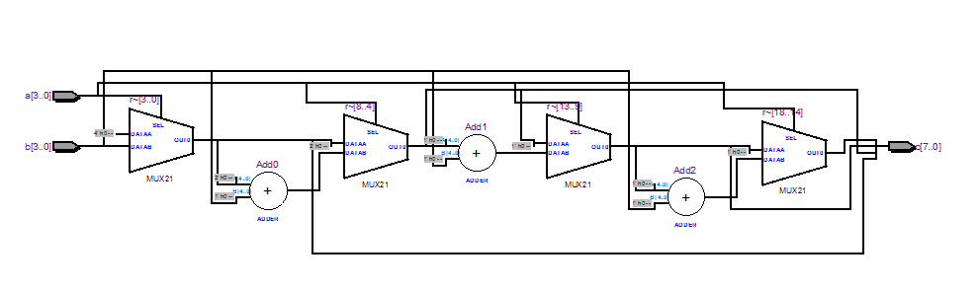
Realizzazione

Slide 34
Task
They are not passed
data to the task
module test;
task add;
input a,b;
output c;
begin
c=a+b;
endtask
initial
begin: init1
reg p;
add(1,0,p);
$display (“p=%b”,p);
end
Task Definition
Using the Task
I valori vengono passati
nell’ordine stesso in cui compaiono
The call to a task is "replaced" with the text described in the task itself

Slide 35
Differenze fra Tasks e Functions
Functions
Tasks
A function can invoke another function but not another task,
Cannot contain delays, events (@), or time checks
(it only realizes combinatorial circuits, i.e. a function is executed in zero time,
Must have at least one entrance,
Returns a value.
A task can invoke other tasks or functions,
Can contain delays, events, or time controls (combinatorial or sequential circuits),
Equivalent to a text replacement,
Can have zero or more inputs,
Can have multiple outputs,
can use in-out signals.

Slide 36
System Tasks
Always written inside procedures
$display(“..”, arg2, arg3, ..); → much like printf(), displays formatted string in std output when encountered
$monitor(“..”, arg2, arg3, ..); → like $display(), but .. displays string each time any of arg2, arg3, .. Changes
$stop; → suspends sim when encountered
$finish; → finishes sim when encountered
$fopen(“filename”); → returns file descriptor (integer); then, you can use $fdisplay(fd, “..”, arg2, arg3, ..); or $fmonitor(fd, “..”, arg2, arg3, ..); to write to file
$fclose(fd); → closes file
$random(seed); → returns random integer; give her an integer as a seed

Slide 37
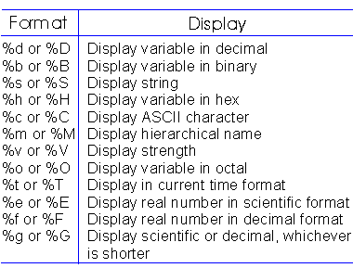
$display & $monitor string format

Slide 38
Compiler Directives
` include “filename” → inserts contents of file into current file; write it anywhere in code ..
`define <text1> <text2> → text1 substitutes text2;
  e.g. `define BUS reg[31:0] in declaration part: `BUS data;
`timescale <time unit>/<precision>
  e.g. `timescale 10ns/1ns later: #5 a = b;
50ns

Slide 39
Parameters
in[3:0]
p_in[3:0]
A. Implelementation
without parameters
out[2:0]
wu
wd
clk
module dff4bit(Q, D, clk);
output [3:0] Q;
input [3:0] D;
input clk;
reg [3:0] Q;
wire [3:0] D;
wire clk;
always @(posedge clk)
Q = D;
endmodule
module dff2bit(Q, D, clk);
output [1:0] Q;
input [1:0] D;
input clk;
reg [1:0] Q;
wire [1:0] D;
wire clk;
always @(posedge clk)
Q = D;
endmodule

Slide 40
Parameters
module top(out, in, clk);
output [1:0] out;
input [3:0] in;
input clk;
wire [1:0] out;
wire [3:0] in;
wire clk;
wire [3:0] p_in; // internal nets
wire wu, wd;
assign wu = p_in[3] & p_in[2];
assign wd = p_in[1] & p_in[0];
dff4bit instA(p_in, in, clk);
dff2bit instB(out, {wu, wd}, clk);
// notice the concatenation!!
endmodule
in[3:0]
p_in[3:0]
out[2:0]
wu
wd
clk
A. Implelementation
without parameters (cont.)

Slide 41
Parameters
module top(out, in, clk);
output [1:0] out;
input [3:0] in;
input clk;
wire [1:0] out;
wire [3:0] in;
wire clk;
wire [3:0] p_in;
wire wu, wd;
assign wu = p_in[3] & p_in[2];
assign wd = p_in[1] & p_in[0];
dff instA(p_in, in, clk);
// WIDTH = 4, from declaration
dff instB(out, {wu, wd}, clk);
defparam instB.WIDTH = 2;
// We changed WIDTH for instB only
endmodule
B. Implelementation
with parameters
module dff(Q, D, clk);
parameter WIDTH = 4;
output [WIDTH-1:0] Q;
input [WIDTH-1:0] D;
input clk;
reg [WIDTH-1:0] Q;
wire [WIDTH-1:0] D;
wire clk;
always @(posedge clk)
Q = D;
endmodule

Slide 42
Testing Modules
module top_test;
wire [1:0] t_out; // Top’s signals
reg [3:0] t_in;
reg clk;
top inst(t_out, t_in, clk); // Top’s instance
initial begin // Generate clock
clk = 0;
forever #10 clk = ~clk;
end
initial begin // Generate remaining inputs
$monitor($time, " %b -> %b", t_in, t_out);
#5 t_in = 4'b0101;
#20 t_in = 4'b1110;
#20 t_in[0] = 1;
#300 $finish;
end
endmodule

