Slide 1
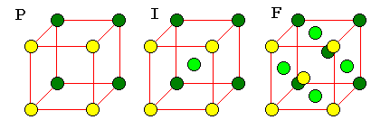
Solid state chemistry

Slide 2
Difference Between Amorphous and Crystalline Solids
Amorphous
Amorphous solids (means without form) are the solids which lacks the regular arrangement of atoms or molecules and hence they have a short range order or no order in their structure : ABCBBACBCACCB...
Do not have sharp melting point (because all bonds are not equally strong)
Isotropic (Physical properties are same in different directions)
Examples: glass, wax, plastics, etc.
Crystalline
A crystalline solid is the one in which there is a regular repeating pattern in the structure, or in other words, there is long-range order : ABCABCABCABC…
Have sharp melting point (because all bond are equally strong)
Anisotropic (Physical properties are different in different directions)
Examples: diamond, table salt, ice, methanol, sodium chloride, etc.

Slide 3
CRYSTAL SYSTEMS AND BRAVAIS LATTICES
Crystals of different substances have similar shapes and hence the crystals are classified into the so called crystal systems depending upon their axial ratio and the interfacial angles α, β and γ. In three-dimension, there are 7 crystal systems. Bravais showed that throughout the seven crystal systems there are fourteen unique lattice types possible. These are known as Bravais or space lattices. These seven crystal systems with examples are :
Cubic(CsCl, NaCl, Cu)
Tetragonal(SnO2)
Orthorhombic(PbSO4, MgSO4)
Monoclinic(FeSO4, LiSO4 ⋅ H2O)
Triclinic(FeSO4 ⋅ 5H2O, K2Cr2O7)
Trigonal (Rhombohedral)(Sb, As, CaCO3)
Hexagonal(Zn, Cd, Ni, As, SiO2)
The characteristics features of these crystal systems and the corresponding Bravais lattices are as follows:

Slide 4
No. | Crystal class | Intercepts on Axes | Angles between Axes | Bravais space lattice
1 | Cubic | a = b = c | α = β = γ = 90⁰ | Simple, body-centred, face-centred
2 | Tetragonal | a = b ≠ c | α = β = γ = 90⁰ | Simple, body-centred
3 | Orthorhombic | a ≠ b ≠ c | α = β = γ = 90⁰ | Simple, body-centred, face-centred, Base(side)-centred
4 | Trigonal | a = b = c | α = β = γ ≠ 90⁰ | Simple
5 | Hexagonal | a = b ≠ c | = β = 90⁰, γ = 120⁰ | Simple
6 | Monoclinic | a ≠ b ≠ c | α = γ = 90⁰ ≠ β | Simple, base-centred
7 | Triclinic | a ≠ b ≠ c | α ≠ β ≠ γ | Simple

Slide 5
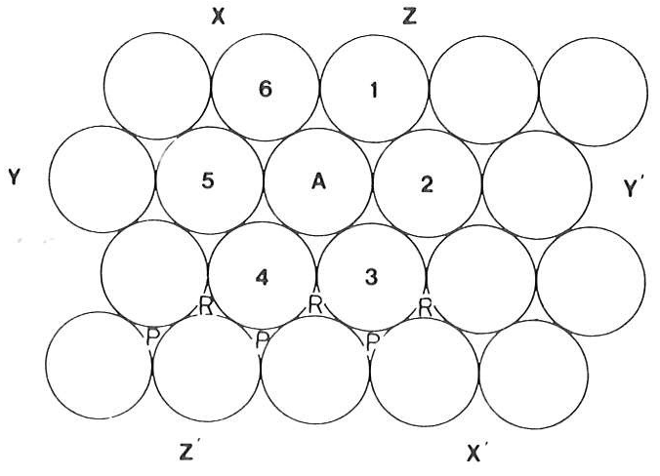
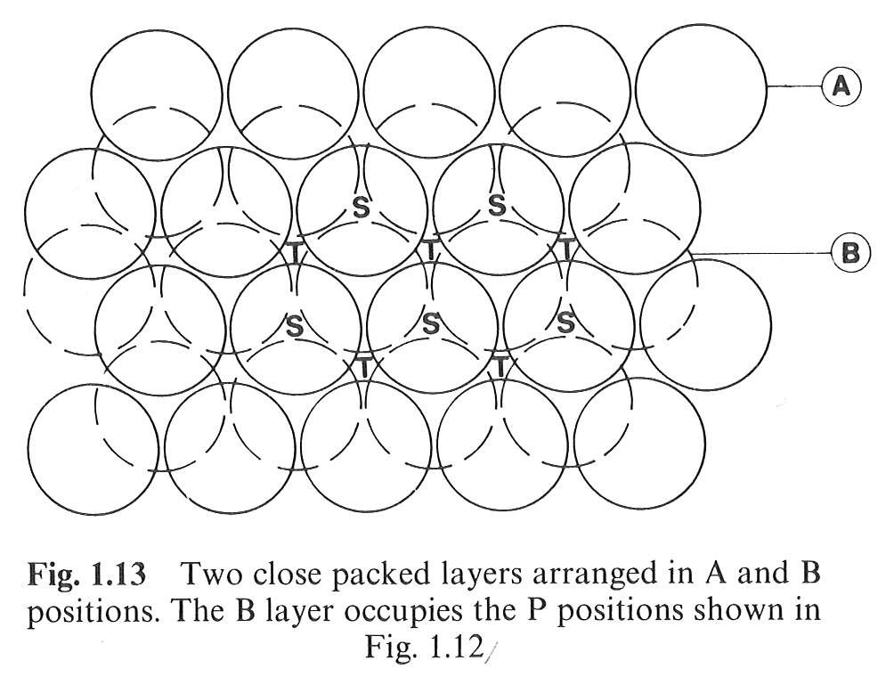
Closed Packed Structures
In a closed packed structure the constituent atoms are so arranged as to occupy minimum possible volume, reaching the maximum density.
2-layers closed packed structure
Planar closed packed spheres

Slide 6
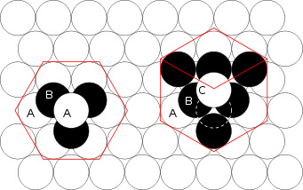
Closed Packed Structures
hcp
ccp
Hexagonal Closed Packed
Cubic Closed Packed

Slide 7
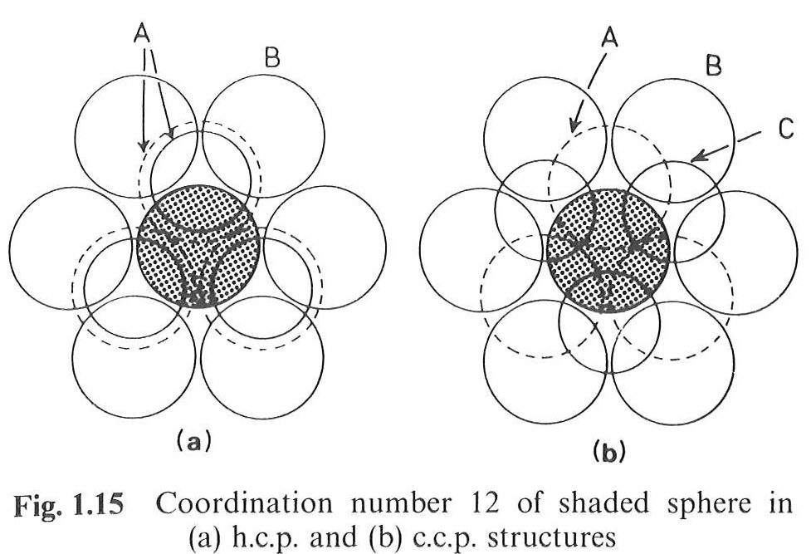
Closed Packed Structures
hcp
ccp
Hexagonal Closed Packed
Cubic Closed Packed

Slide 8
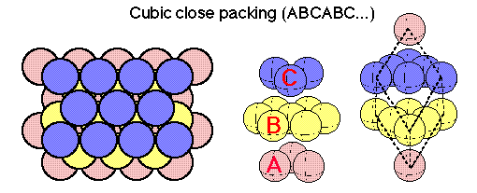
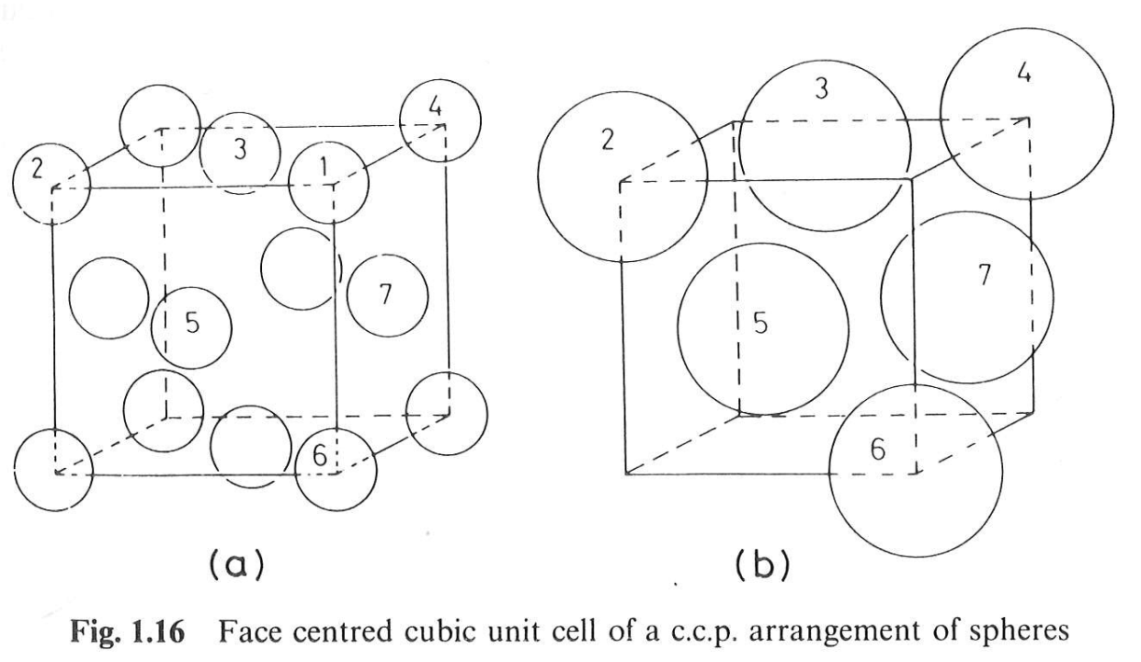
c.c.p. structure
(111) Of a FCC structure

Slide 9
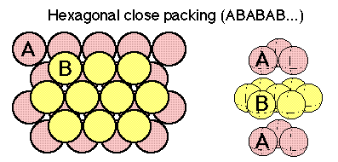
h.c.p. structure

Slide 10
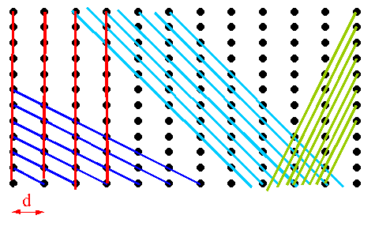
MILLER INDICES
The crystal structure may be regarded as made up of an aggregate of a set of parallel equidistant planes passing through at least one lattice point or a number of lattice points. These planes are known as Lattice Planes. For a given crystal, lattice planes can be chosen in different ways as shown in Fig.
Miller Indices are the three smallest possible integers, which have the same ratio as the reciprocals of intercepts of the plane concerned on the three axis.

Slide 11
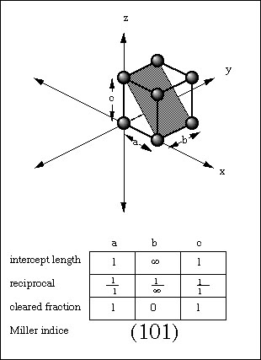

Slide 12
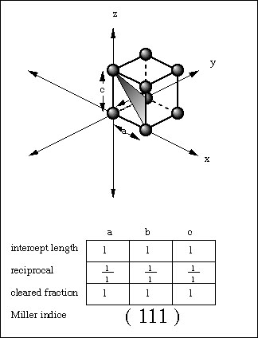

Slide 13
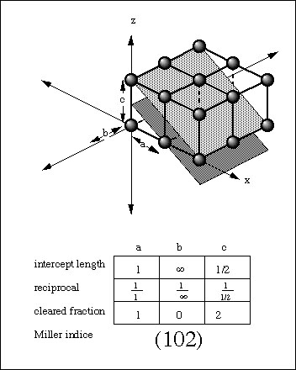

Slide 14
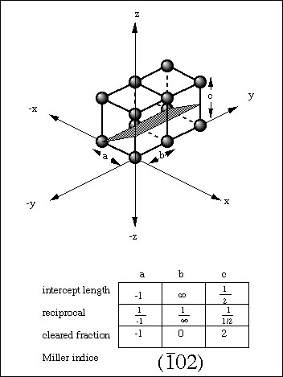

Slide 15
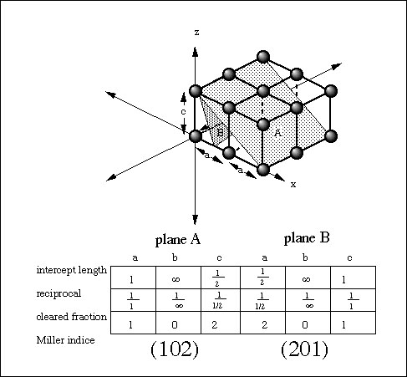

Slide 16
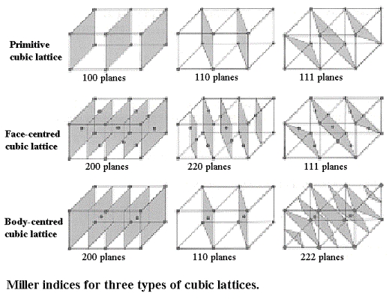

Slide 17
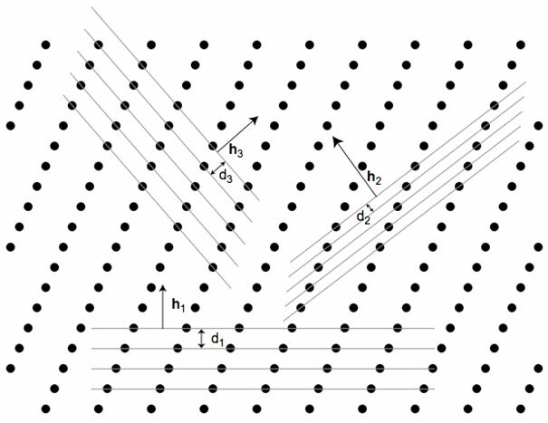
INTERPLANER DISTANCE OR SPACING
Interplaner spacing is defined as the perpendicular distance d_{hkl} between corresponding planes. It is also perpendicular distance from the origin to the set of parallel planes (see Fig.)

Slide 18
For a cubic lattice, a = b = c, therefore, we get
Also, For a cubic lattice,
d₁₀₀ = a d₁₁₀ = a/√2 d₁₁₁ = a/√3.

Slide 19
Physical Parameters for Crystal Structure
(i) Number of Atoms per Unit Cell
Number of atoms per unit cell determines how closely the solid is packed and is given by
N = N_{c}/8 + N_{f}/2 + N_{i}
here N_{c} is the number of corner atoms, N_{f} the number of face centred atoms and N_{i} the number of body centred atoms(see Fig.).
For SC crystal : In a SC crystal, there are 8 atoms only, each at one corner. Each atom is shared by 8 unit cells. Therefore, we have
N = N_{c}/8 = 8/8 = 1
For BCC crystal :N = N_{c}/8 + N_{f}/2 + N_{i} = 8/8 + 0 + 1 = 2
For FCC crystal :N = N_{c}/8 + N_{f}/2 + N_{i} = 8/8 + 6/2 + 0 = 4

Slide 20
(ii) Coordination Number (CN)
In a crystal, the number of nearest neighbours of the same type and at equal distances from the given atom is called coordination number.
For SC : The corner atoms are the nearest neighbours of each other. Here CN = 6 (see Fig.) which is a group of 8 unit cell and atom at the centre has six corner atoms as its nearest neighbours).

Slide 21
For BCC : In this case all the corner atoms are at equal distances from the body centered atom.
Hence CN = 8.
For FCC : Here the nearest neighbours of any corner atom are the face centered atoms of the surrounding unit cells. Now for any corner atom there are 4 face centered atoms in each plane and there are three such planes. Therefore, CN = 12.

Slide 22
(iii) Atomic Radius and Nearest Neighbour Distance (NND)
In a crystal the atoms are assumed to be spheres in contact. Now atomic radius is defined as half the distance between the nearest neighbours in a crystal of pure element, i.e., the distance between the centres of neighbouring atoms.
For SC : In a SC structure, corner atoms are the nearest neighbours and are in touch with each other. If the side of the unit cell is ‘a’ and ‘r’ be the radius , then
2r = a or r = a/2
Now Nearest Neighbour Distance(NND) is given by 2r
Therefore, NND = 2r = a

Slide 23
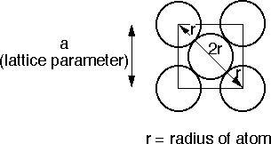
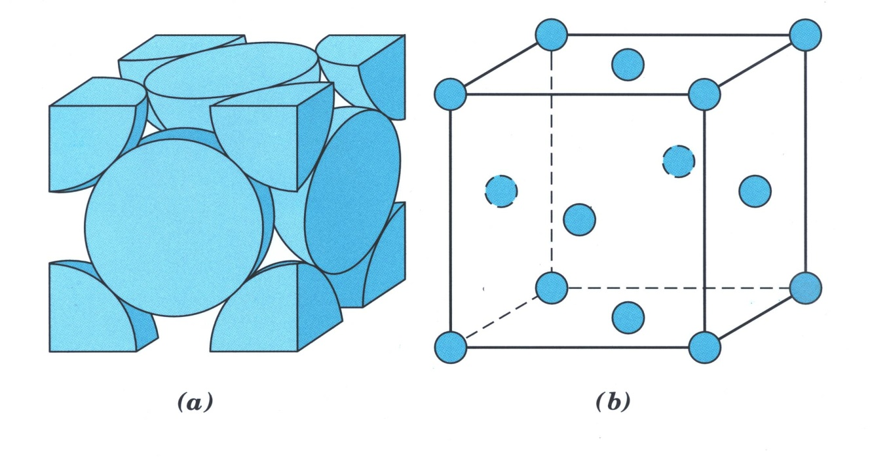
For FCC : r = √2 a/4
NND = a/√2

Slide 24
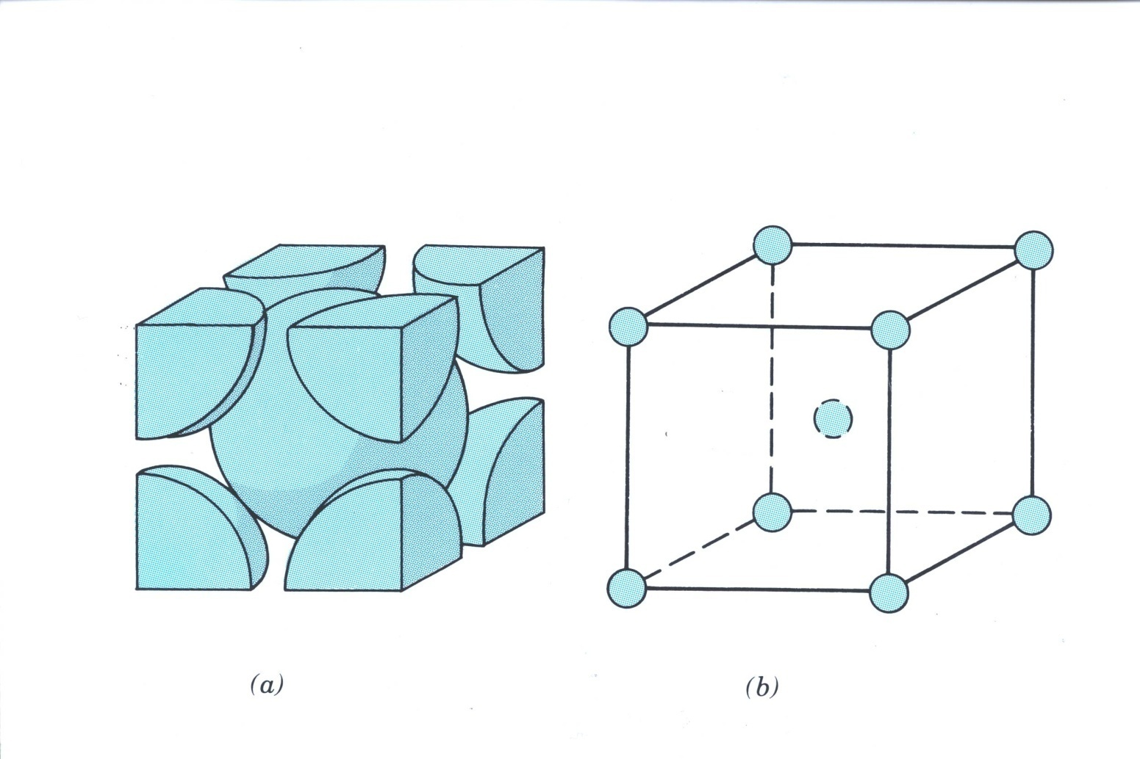
For BCC : r = √3 a/4
NND = √3 a/2.

Slide 25
(iv) Atomic Packing Fraction (or Factor) (APF)
It is defined as the ratio of the volume of the atoms occupying the unit cell to the volume of the unit cell. It is also called relative packing density.
APF = Volume occupied by the atoms in a unit cell / Volume of the unit cell.
SC Crystal : No. of atoms/unit cell = 1
Volume of one atom = 4/3 πr³
Side of the unit cell = a = 2r
Volume of the unit cell = a³
APF = = = π/6 = 0.52 = 52%.
BCC Crystal : No. of atoms/unit cell = 2
Volume of two atoms = 2x4/3 πr³
Side of the unit cell = a = 4r/√3
Volume of the unit cell = a³
APF = = = √3π/8 = 0.68 = 68%.
FCC Crystal : No. of atoms/unit cell = 4
Volume of four atoms = 4x4/3 πr³
Side of the unit cell = a = 4r/√2
Volume of the unit cell = a³
APF = = = √2π/6 = 0.74 = 74%.

Slide 26
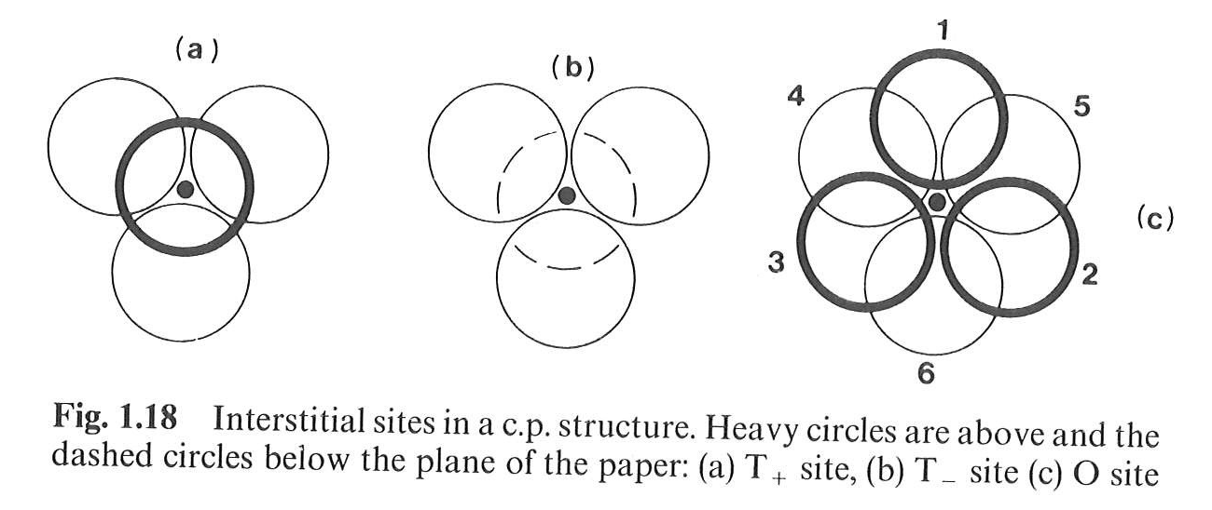
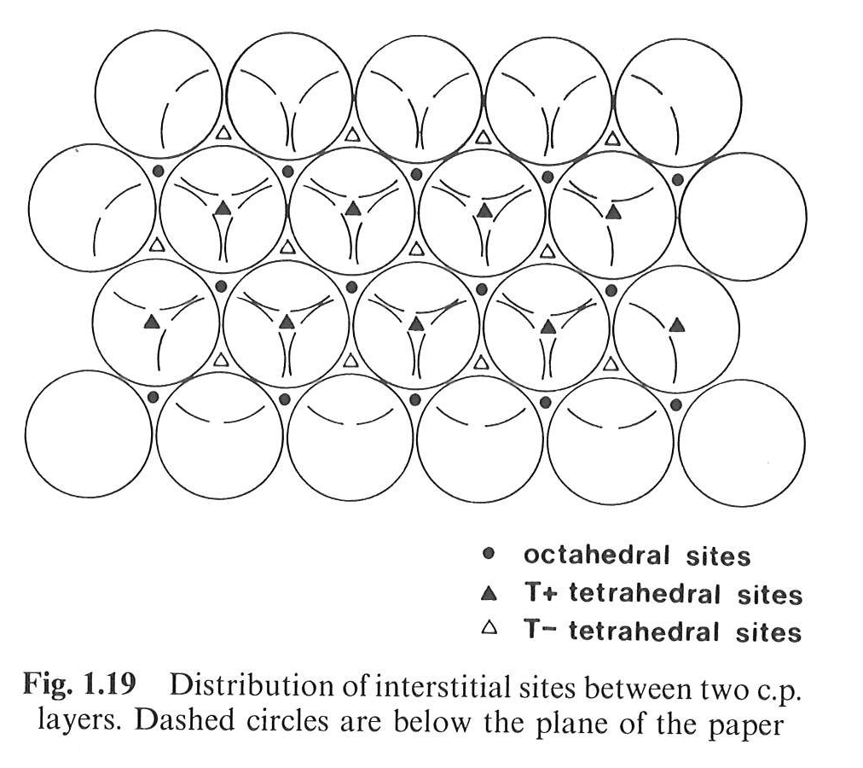
Interstitial sites in Closed Packed Structures

Slide 27
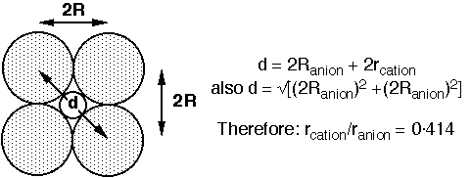
Interstitial sites in Closed Packed Structures
Having determined what types of interstitial sites are available, we must now decide:
(a) Which sites are occupied by a given cation: this determined by the radius ratio (= r_{cation}/r_{anion})
(b) How many sites are occupied: this is determined by the stoichiometry.
For an octahedral site:
For a tetrahedral site, r_{cation}/r_{anion} = 0.225.
For these two values, the close packed structure of anions is maintained.

Slide 28
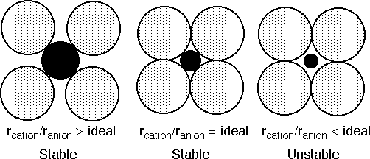

Interstitial sites in Closed Packed Structures
Stable Bonding Configurations in Ionic solids.
In reality an ideal fit of a cation into the close packed anion arrangement almost never occurs. Now consider what would be the consequence of placing a cation that is (a) larger than the ideal, (b) smaller than the ideal, into the cation sites.
For a stable coordination the bonded cation and anion must be in contact with each other.
If r_{cation}/r_{anion} becomes too big, the close packed structure of anions is converted into a simple cubic structure

Slide 29
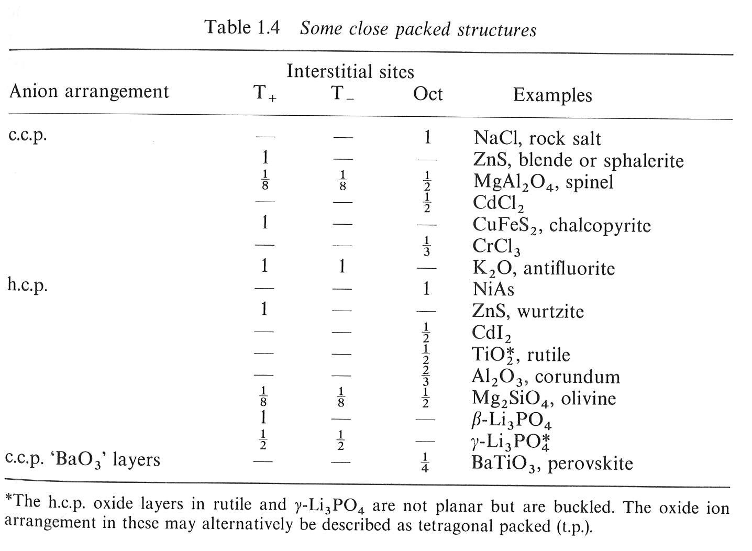
Interstitial sites in Closed Packed Structures

Slide 30
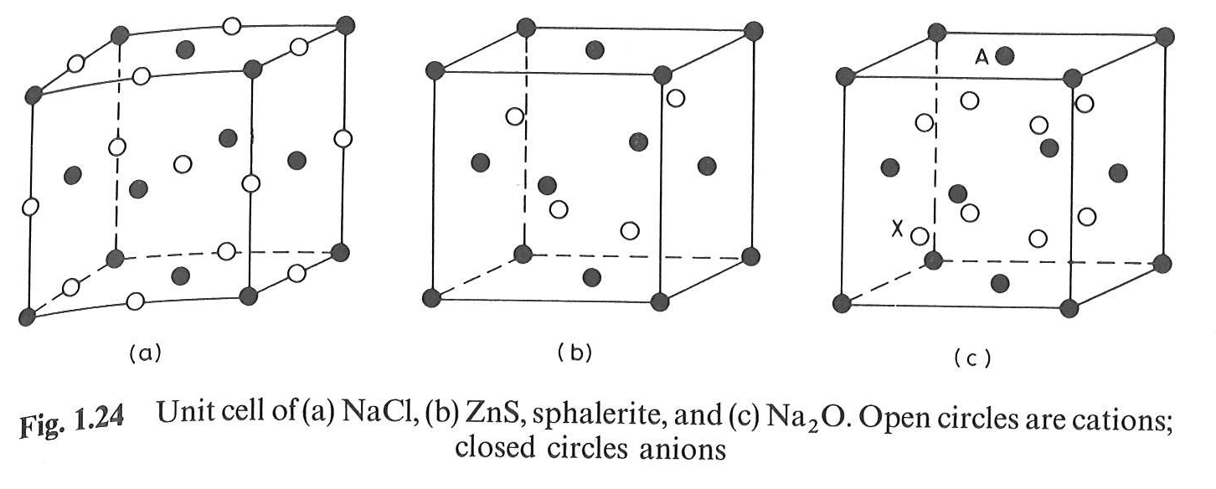
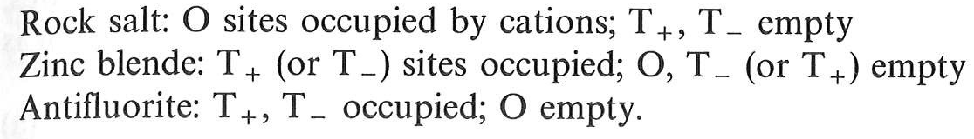
Cubic structures

Slide 31
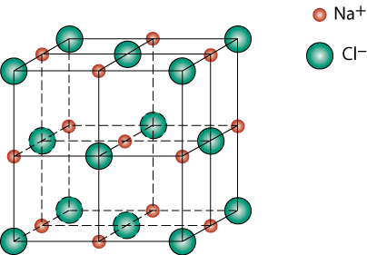
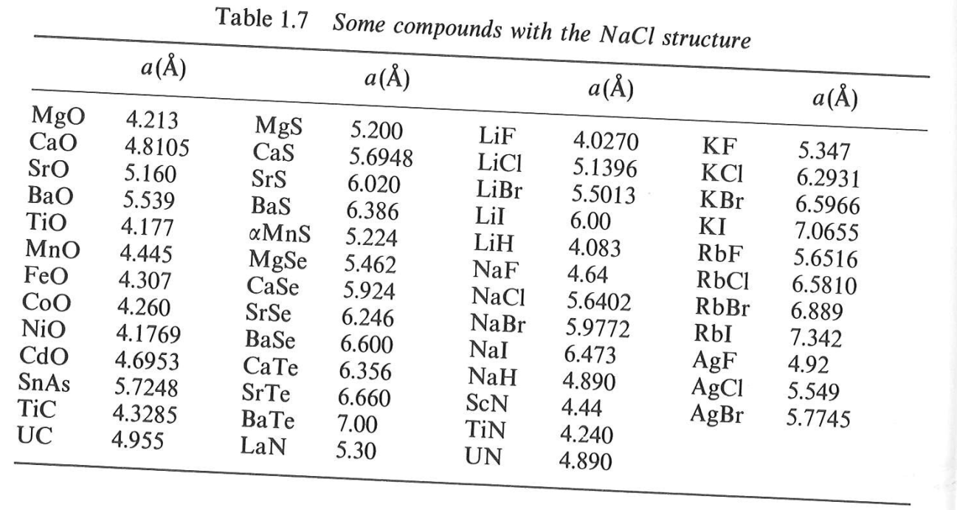
Rock salt structure
r_{Na} = 0.102 nm
r_{Cl} = 0.181 nm
r_{Na}/r_{Cl} = 0.564
Octahedral sites preferred

Slide 32
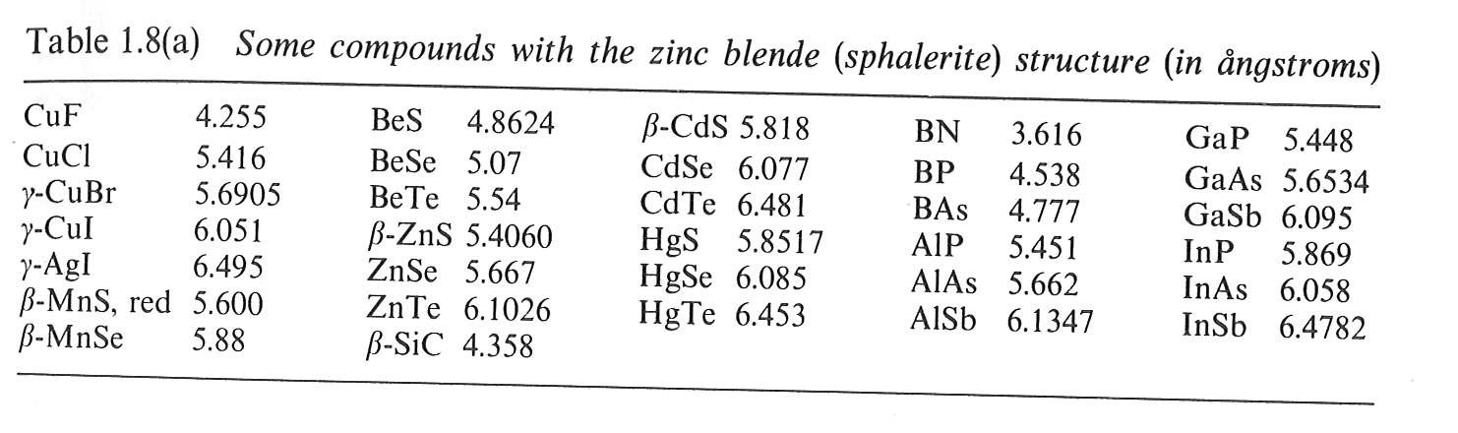
Zinc blende structure
Zn ²⁺
S ²⁻
r_{Zn}/r_{S} = 0.40
tetrahedral sites preferred

Slide 33
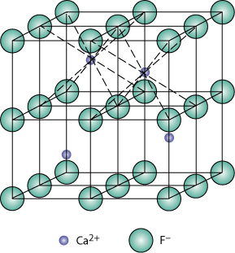
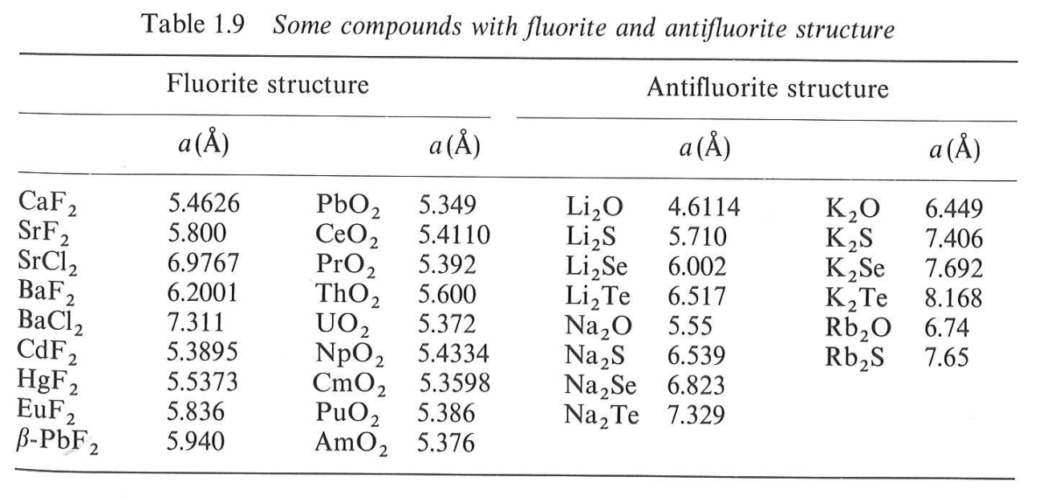
Fluorite and antifluorite
Calcium Fluorite (CaF₂)
Cations in cubic sites
UO_{2,} ThO₂, ZrO₂, CeO₂
Antifluorite structure –
positions of cations and anions reversed
Fluorite structure
r_{Ca}/r_{F} = 0.958
cubic sites preferred

Slide 34
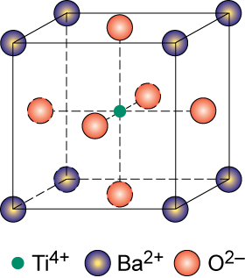
Perovskite ABO₃
Perovskite structure
Ex: complex oxide
BaTiO₃

Slide 35
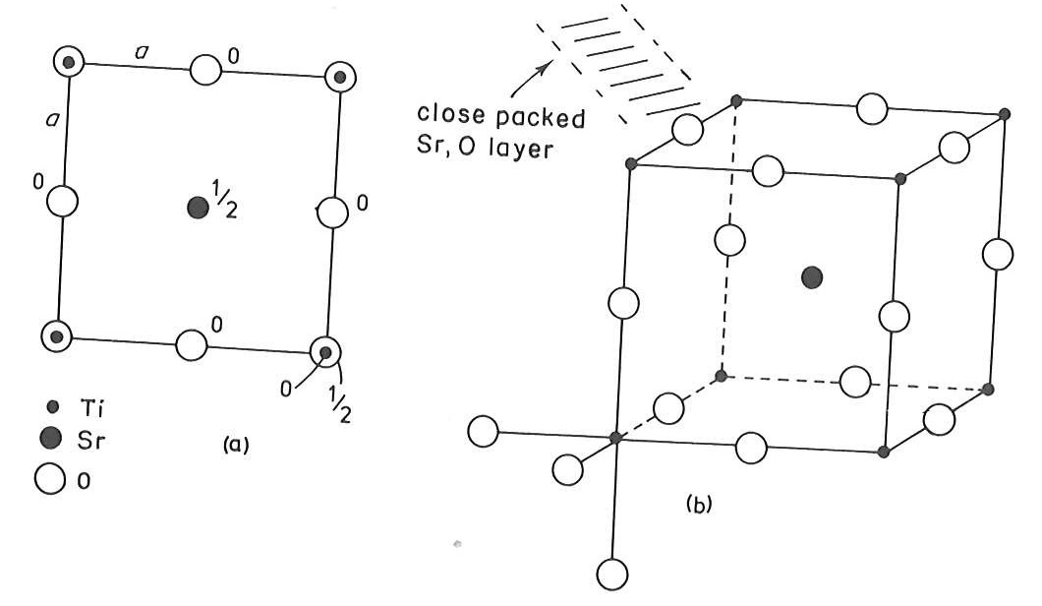
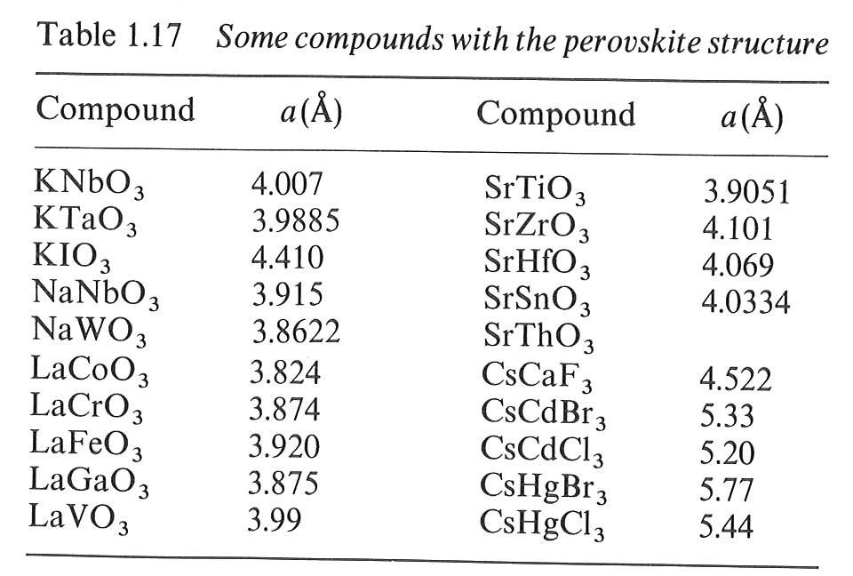
Perovskite ABO₃

Slide 36
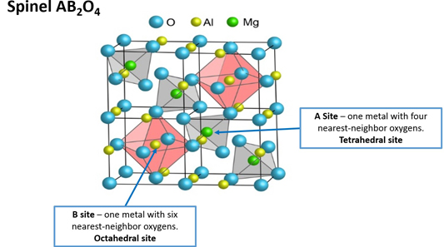


Spinels
Normal
Inverse

Slide 37
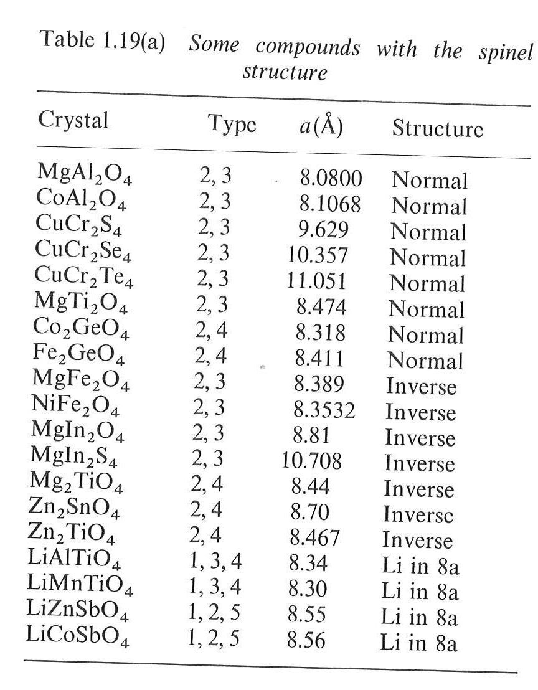
Spinels
Normal
Inverse
In order to explain the adoption of a particular cation distribution in a spinel structure, one must take into account the crystal field stabilization energies (CFSE) of the transition metals present. Some ions may have a distinct preference for the octahedral site depending on the d-electron count. If the A²⁺ ions have a strong preference for the octahedral site, they will displace half of the B³⁺ ions from the octahedral sites to tetrahedral sites. Similarly, if the B³⁺ ions have a low or zero octahedral site stabilization energy (OSSE), then they will occupy tetrahedral sites, leaving octahedral sites for the A²⁺ ions.

Slide 38
DEFECTS IN SOLIDS
No real crystal is perfect. Real crystals feature defects or irregularities in their ideal arrangements and it is these defects that critically determine many of the electrical and mechanical properties of real materials.
Ideally a perfect crystal is the one in which atoms are arranged in perfectly regular manner in all directions. The deviations of crystals from their perfect periodicity are called defects or imperfections.
These imperfections can be of different types such as:
point defects (zero–dimensional defects),
line defects (one–dimensional)
defects over a surface or a plane (two–dimensional) and volume defects (three–dimensional).

Slide 39
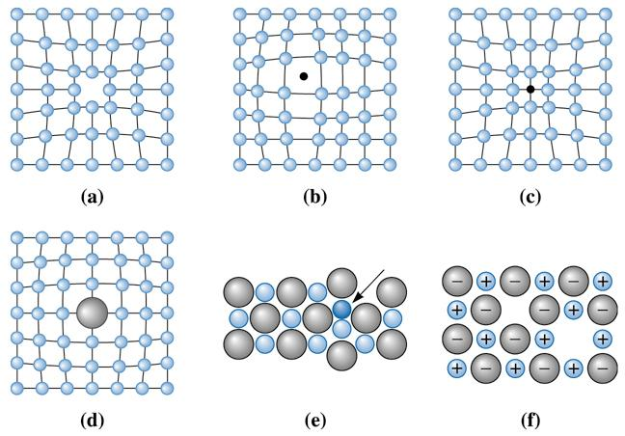
(c) 2003 Brooks/Cole Publishing / Thomson Learning

Slide 40
Point Defects
A point defect is a very localized imperfection in the regularity of a lattice and it does not spread over more than one or two lattice spacings. These defects are observed in metallic crystals (vacancies, substitutional impurity and interstitials) as well as in ionic crystals (Schottky and Frenkel) and are discussed here in brief.
Vacancies
The absence of an atom or ion from a normally occupied site in a crystal is called a vacancy (see Fig.)
Substitutional Impurity
In this kind of defect, a foreign atom occupy a regular site in the crystal structure (see Fig.), i.e., .substitutional atom replaces the host atom from its position. For example, when a pure semiconductor crystal of Silicon or Germanium is doped with a trivalent or pentavalent impurity, we call it a substitutional impurity.

Slide 41
Interstitial Impurity
An interstitial is an atom or ion which can be inserted into the voids between the regularly occupied sites. In a closed packed arrangement of atoms the packing fraction is generally less than one. Therefore an extra atom, of smaller size than the parent atom, can enter the interstitial space without disturbing the regularly positioned atoms. Such an extra impure atom is called interstitial impurity while an extra atom in an interstitial position is called self – interstitial atom, as shown in Fig. If the size of the extra atom is not small then it will produce atomic distortion.

Slide 42
Schottky Defect
In a metal, a vacancy is created if an atom is missing from its lattice position. In ionic crystals, a cation – anion pair will be missing from the respective lattice sites, as shown in Fig. Creation of such a pair, of one cation vacancy together with one anion vacancy, is called Schottky defect. Thus the interior of the ionic crystals remain electrically neutral.
Frenkel Defect
When an atom or ion leaves its normal position or site and is found to occupy another position in the interstice we get a Frenkel defect. Thus, in this case, two imperfections are created – an interstitial and a vacancy as shown in Fig. Normally anion leaves its parent site and occupy the interstitial space. These defects are dominant in open structures such as silver halides. Also a Frenkel defect does not affect the electrical neutrality of a crystal.

Slide 43
Shottky defect
n = number of vacancy pairs
N = total number of sites
E = energy required to produce a pair
of vacancies in the interior of a crystal

Slide 44
Frenkel defect
n = number of vacancies = number of atoms in interstitial sites
N = total number of sites
N_{i} = number of interstitial positions in the crystal
E_{i} = energy required to produce a pair of vacancies in the interior of a crystal

Slide 45
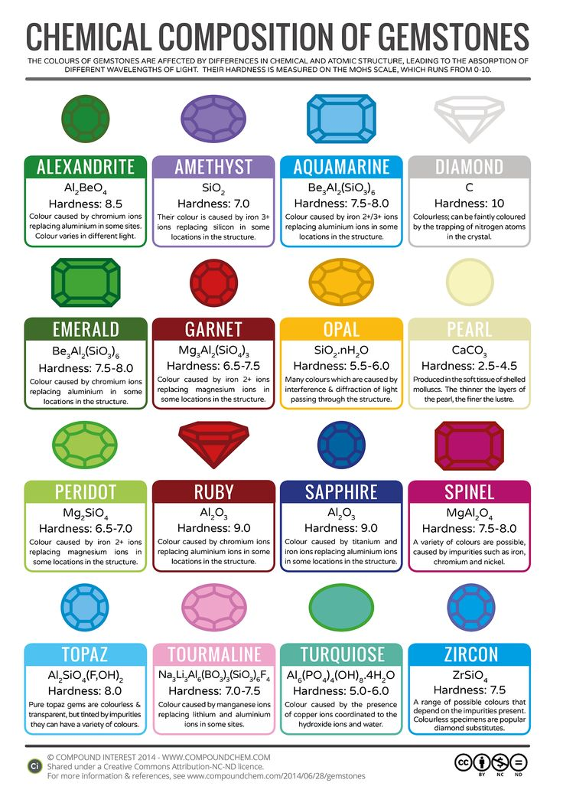
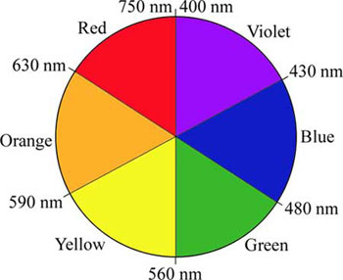
Emerald and Ruby:
Cr³⁺ impurities
Cr₂O₃: green

Slide 46
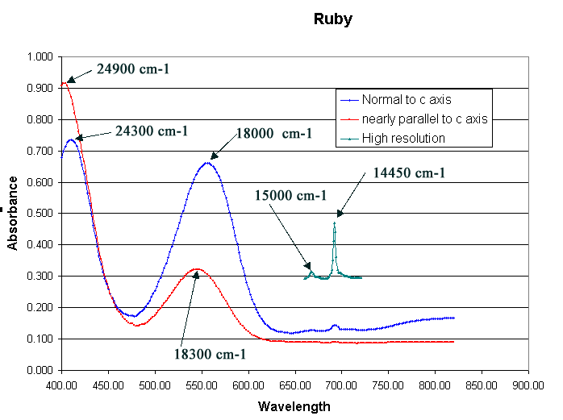
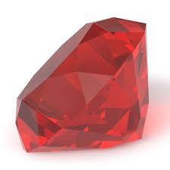
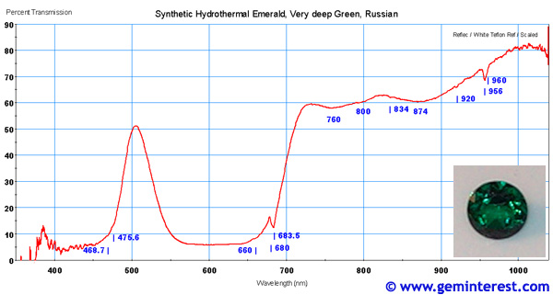

Slide 47
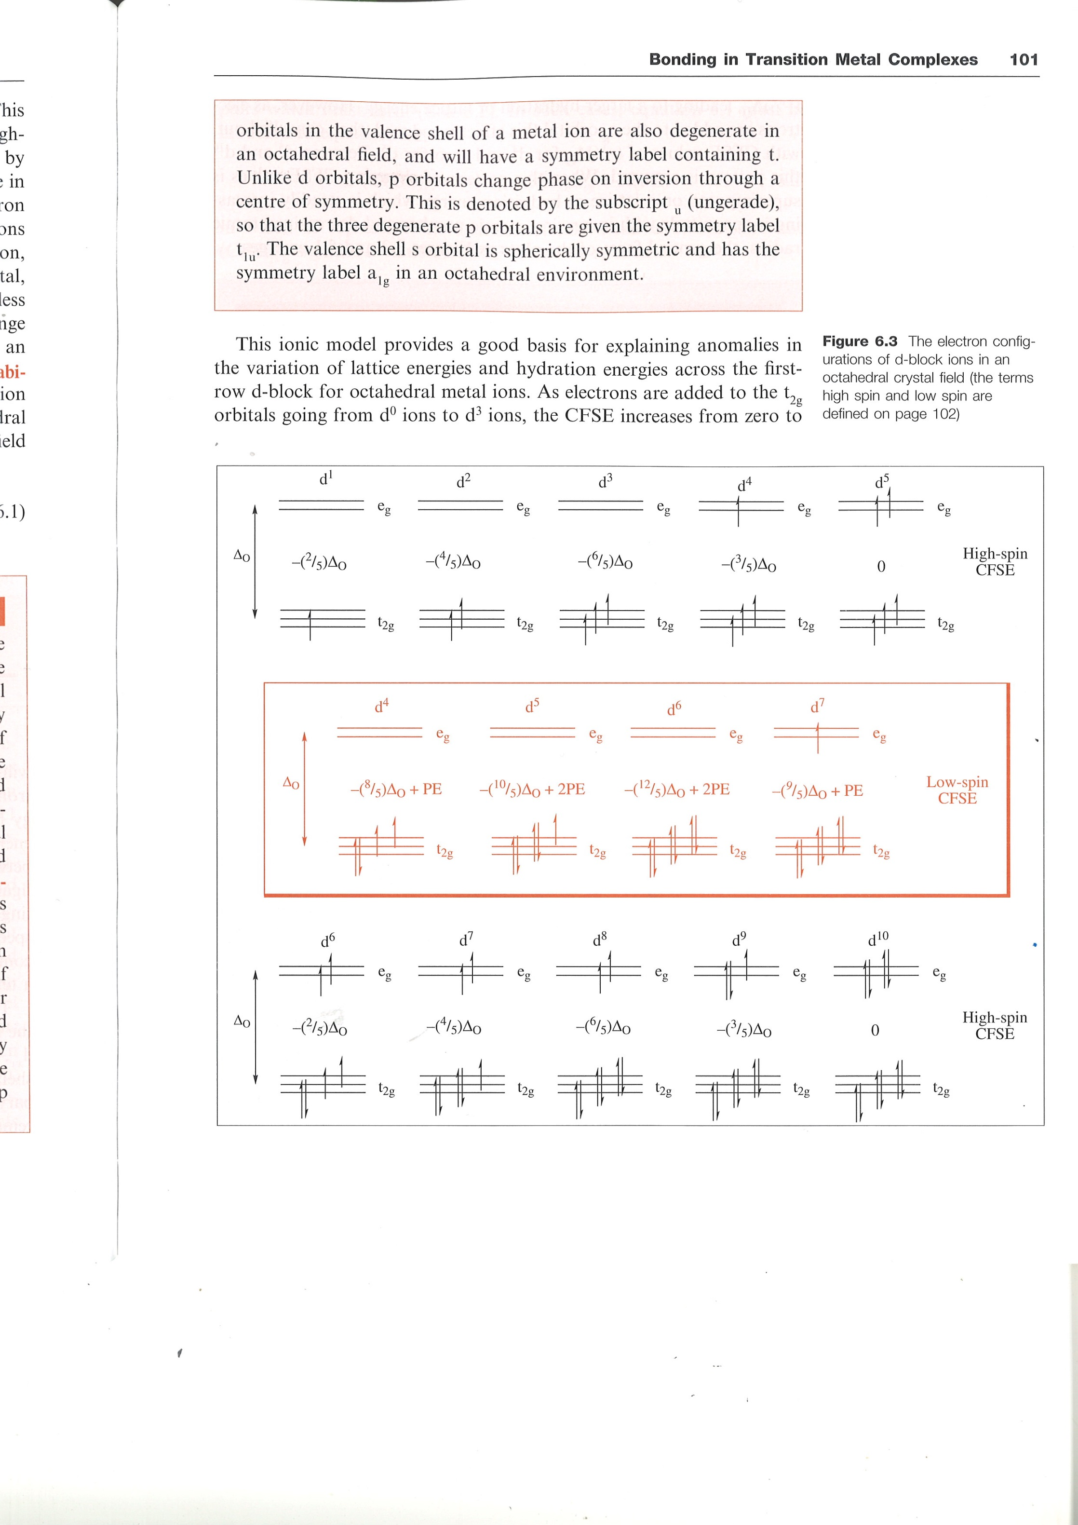
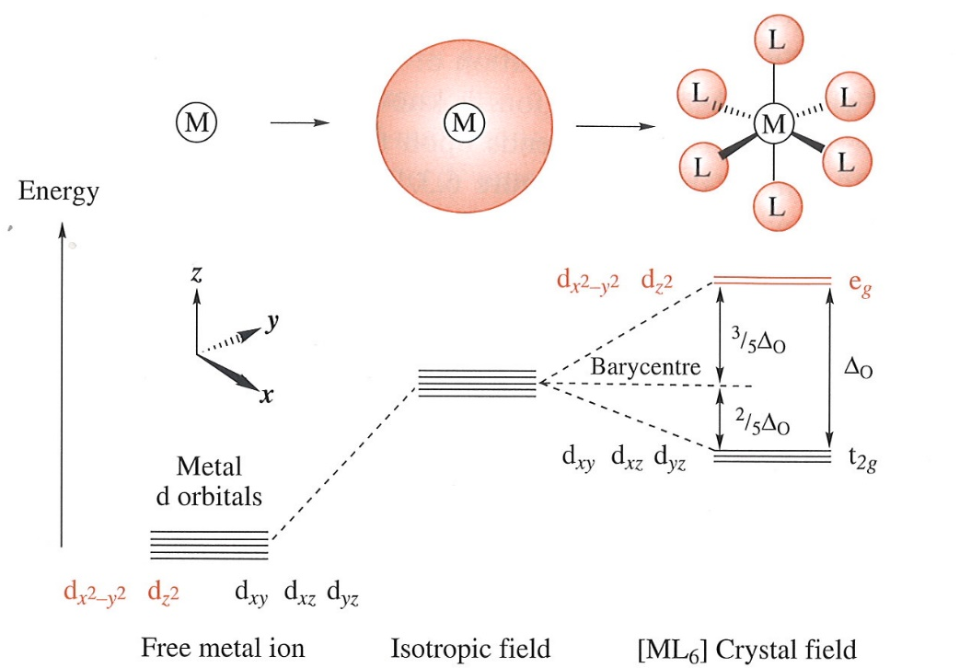
Δ_{O1}
Cr-O distance in Be₃Al₂(SiO₃)₆ is larger than in Al₂O₃
Δ_{O1} < Δ_{O2}
Δ_{O2}

Slide 48
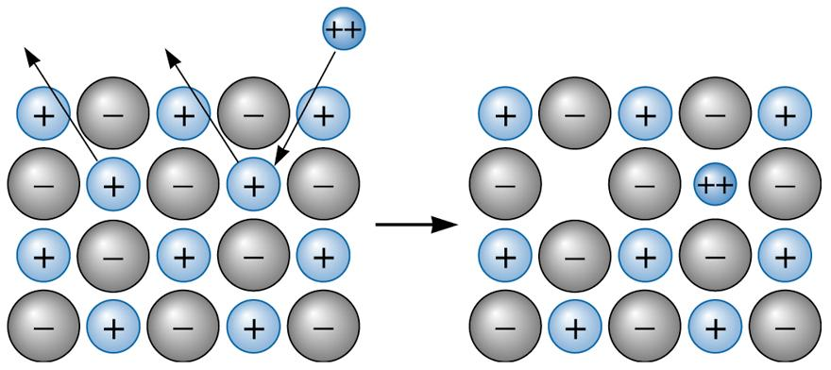
Charge compensation: vacancy formation
When a divalent cation replaces a monovalent cation, a second monovalent cation must also be removed, creating a vacancy.

Slide 49
Charge compensation: change in oxidation state
When a divalent cation replaces a monovalent cation, an anion must change its oxidation state.

Slide 50
Electronic properties of materials
Justify:
Electron transport properties
Optical properties

Slide 51
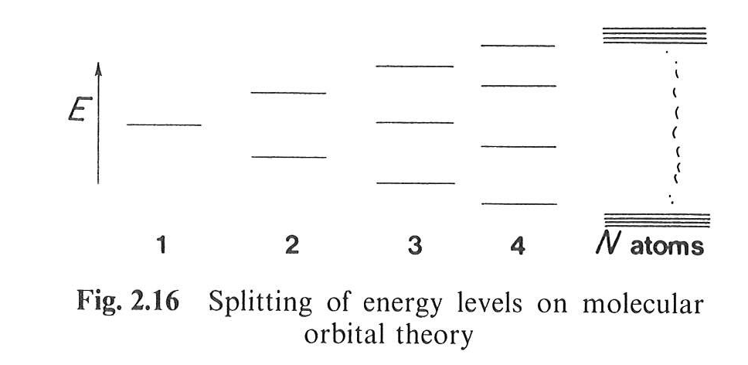
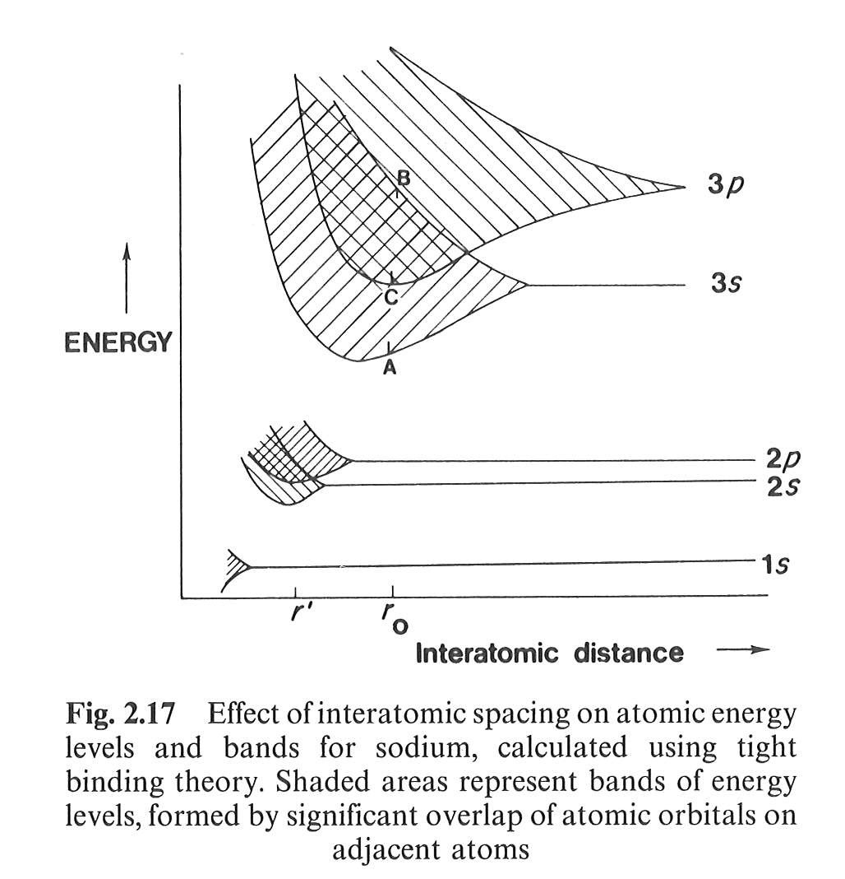
Metallic bond: LCAO model
Molecular orbital for N atoms:
In the case of Na
(and other metals)
Metallic bond
Overlapping of the energy states deriving for higher occupied and lowest unoccupied atomic orbitals: electrons are allowed to spread around over all the atoms in the “molecule” (= crystal).

Slide 52
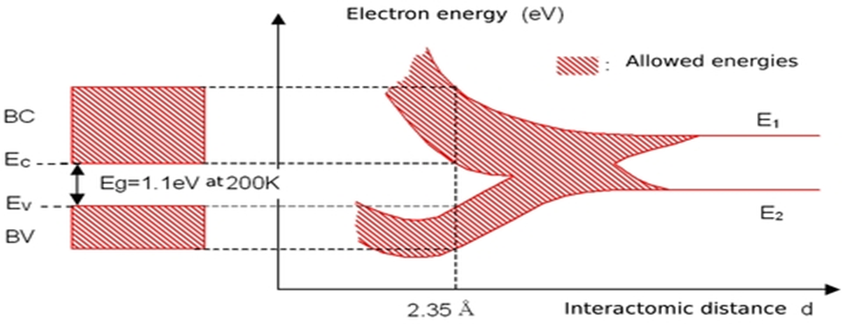
Metallic bond: LCAO model
In the case of Si:
3p
3s

Slide 53
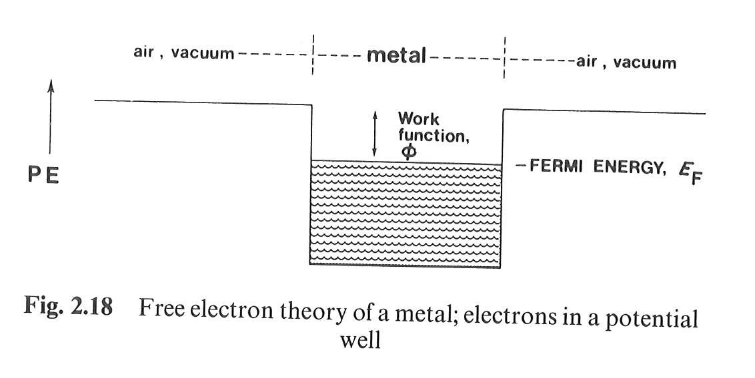
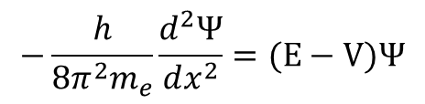



Free Electron Model
In one dimension:
In 3D (crystal):
$$−\frac{h}{8π^{2}m_{e}}\frac{d^{2}Ψ}{dx^{2}}=(E−V)Ψ$$
$$E= \frac{h^{2}}{8m_{e}}\left(\frac{n_{a}^{2} }{a^{2}}+\frac{n_{b}^{2} }{b^{2}}+\frac{n_{c}^{2} }{c^{2}}\right)$$
Many states with the same energy!!!!
$$V=0; Ψ_{x=0}=0;Ψ_{x=a}$$
$$E= \frac{n^{2}h^{2}}{8m_{e}a^{2}}$$

Slide 54


Free Electron Model
Density of states
$$N_{\left(E\right)}dE=\frac{2{\left(2m_{e}\right)}^{3/2}VE^{1/2}}{π^{2}ℏ^{3}}dE$$
Fermi-Dirac “filling” function
E_{F} = Fermi Level
Energy of the highest
occupied state at 0 K

Slide 55


Band structure model
Electrical properties of a material depend on the filling of bands

Slide 56

Band structure model: metal

Slide 57


Band structure model: insulator
$$\text{λ} \left(\text{nm}\right)\text{= }\frac{\text{hc}}{\text{E}\text{ (}\text{eV}\text{)}}\text{=}\frac{\text{1240}}{\text{E}\text{ (}\text{eV}\text{)}}$$

Slide 58

Intrinsic semiconductor
Eg
Band Gap
max 3.2 – 3.3 eV

Slide 59



Extrinsic semiconductor
n-type
p-type

Slide 60

Electron-hole formation

Slide 61


Direct band gap
Indirect band gap

Slide 62


Tauc plot
$$αhυ=A{\left(hυ−E_{g}\right)}^{n}$$
n = 1/2 for direct allowed transitions
n = 2 for indirect allowed transitions
Direct
Indirect
 | Material | Colour | Direct E_{g} (eV) | Indirect E_{g} (eV)
a | CoWO₄ | Blue | 2.68 | 1.80
b | NiWO₄ | Ochre | 2.95 | 1.82
c | CuWO₄ | Brown-Green | 2.41 | 1.78
d | ZnWO₄ | White | 5.85 | 3.14

