Slide 1
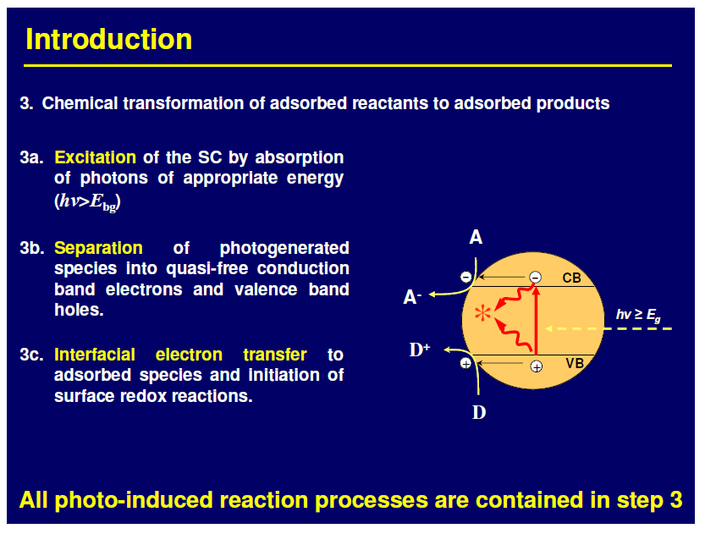

Slide 2
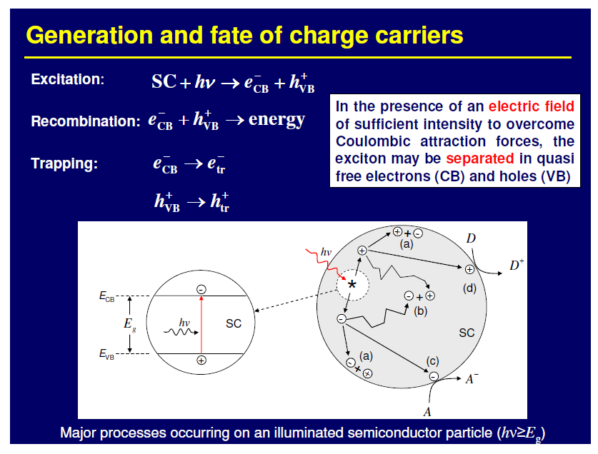

Slide 3
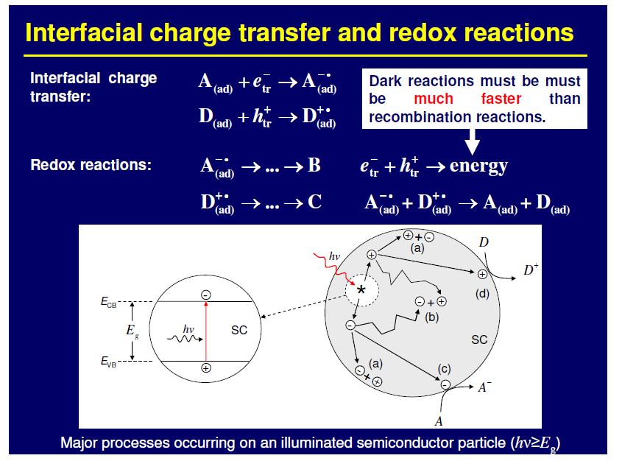

Slide 4
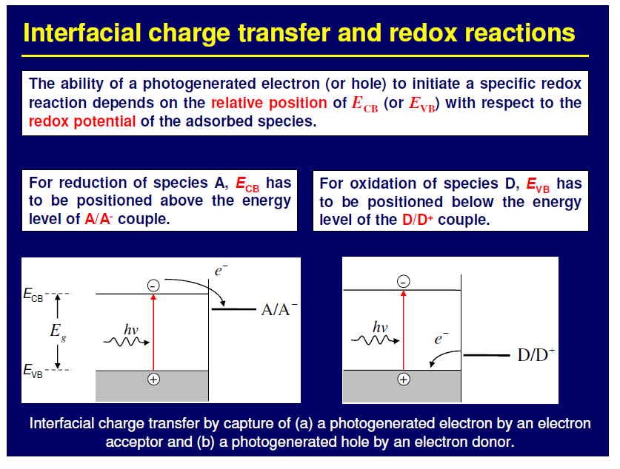

Slide 5
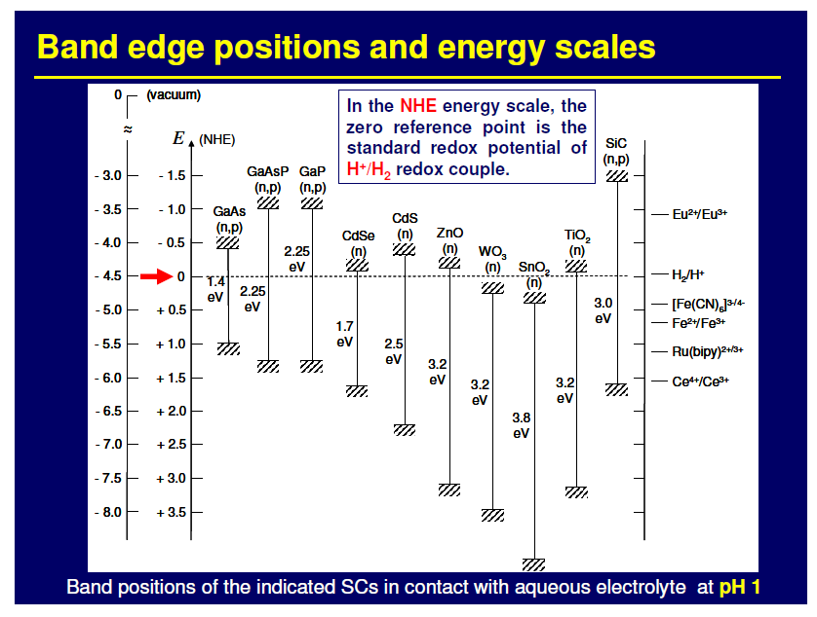

Slide 6
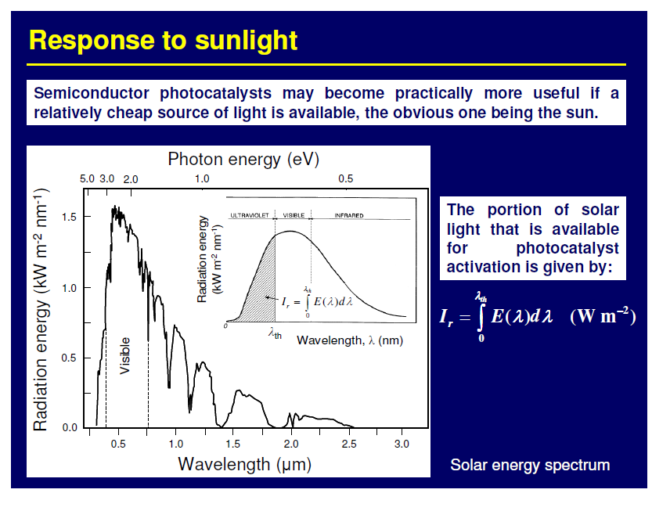

Slide 7
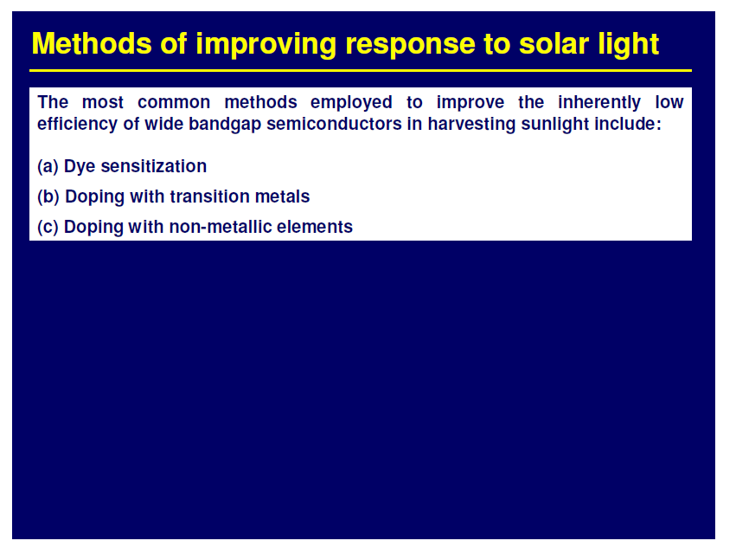

Slide 8
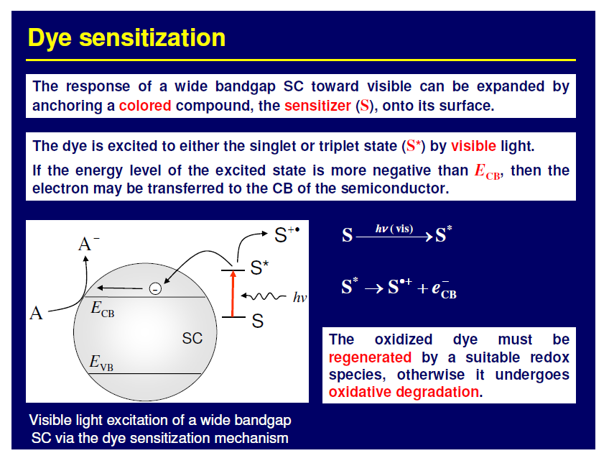

Slide 9
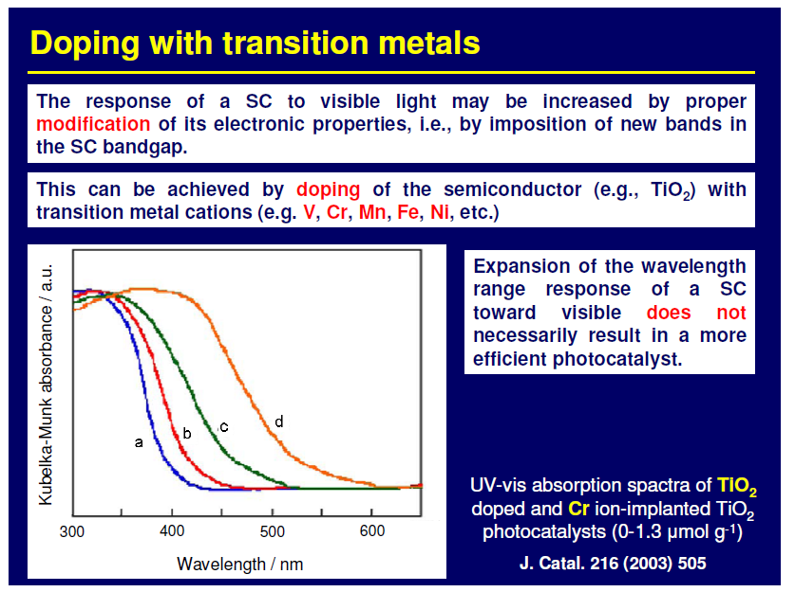

Slide 10
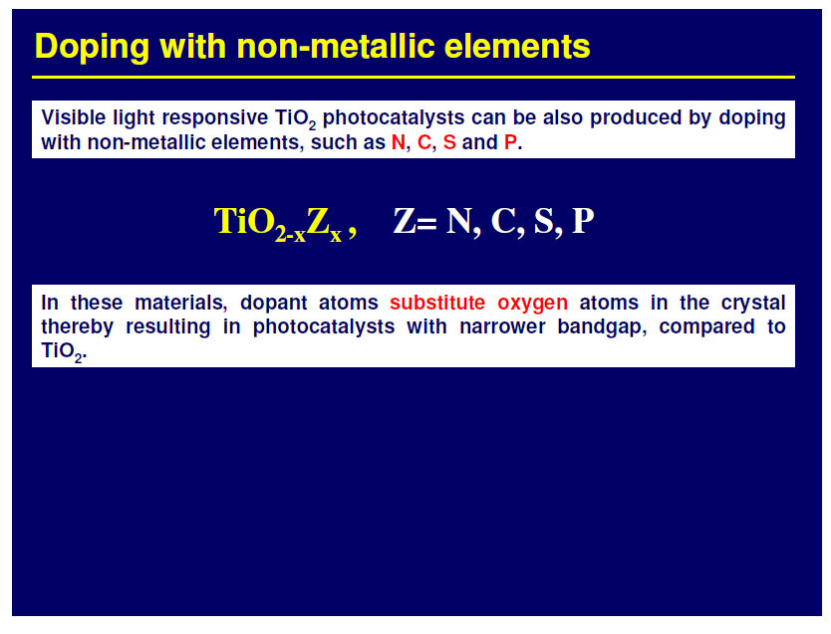

Slide 11
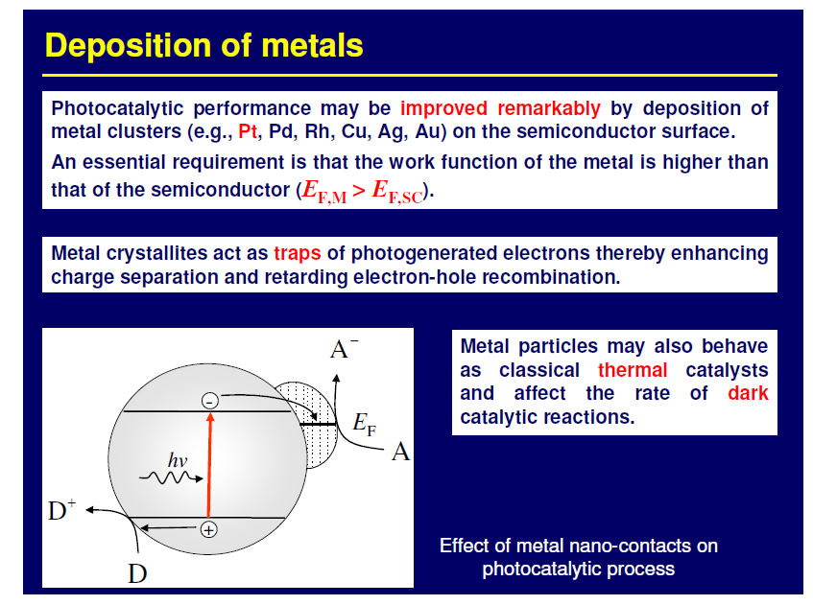

Slide 12
Position of the redox potentials of various metallic couples related to the energy levels of the conduction and valence bands of TiO₂ Degussa P25 at pH=0

Slide 13
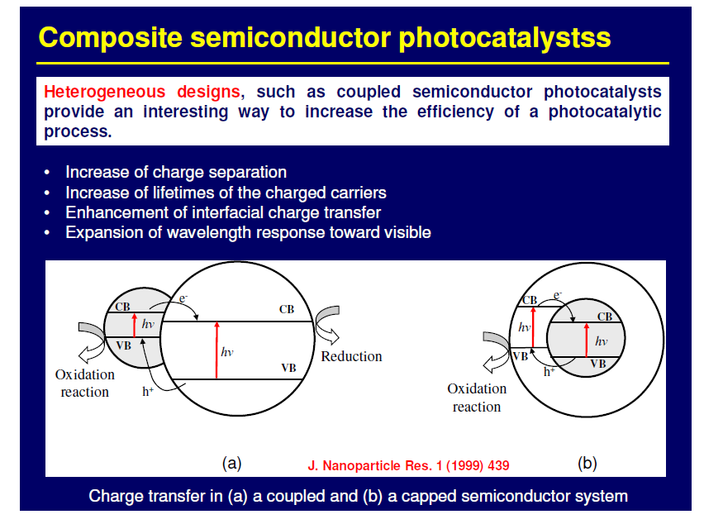

Slide 14
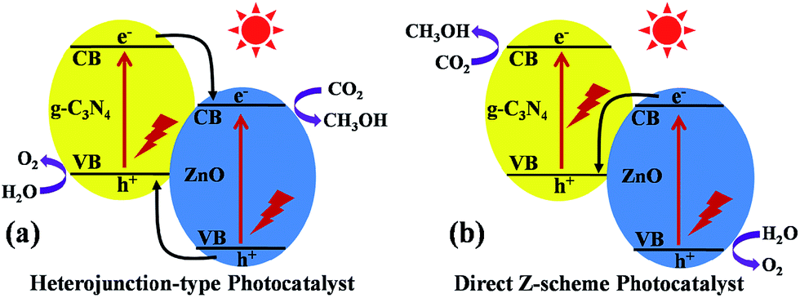
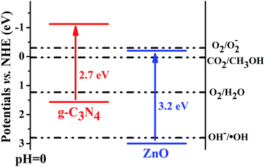
Z-Scheme
Harvesting of visible light
Allowing the occurence of more energy demanding semireactions

Slide 15
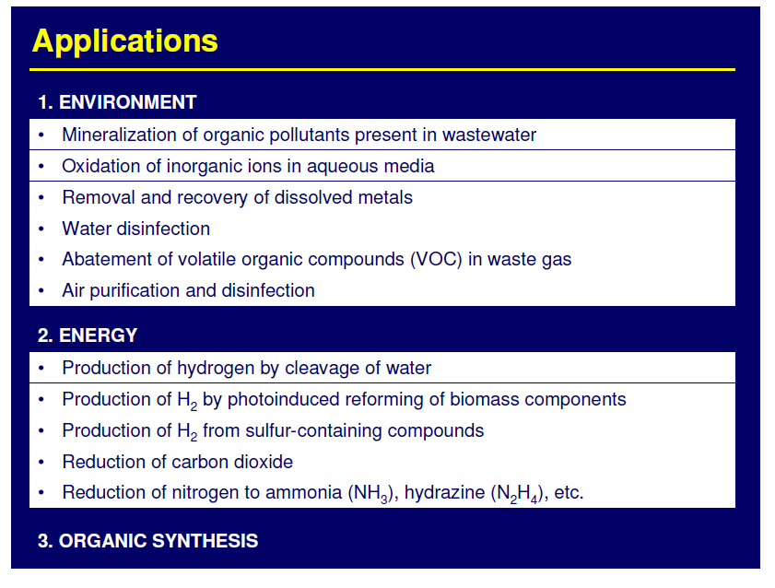

Slide 16
Types of photocatalytic reactions

Slide 17
Mineralization of organic pollutants
semiconductor
Organic pollutant + O₂
CO₂ + H₂O + minerals
hν> E_{bg}
The reaction is non-selective and pratically all organic pollutants can be degraded under selected conditions

Slide 18
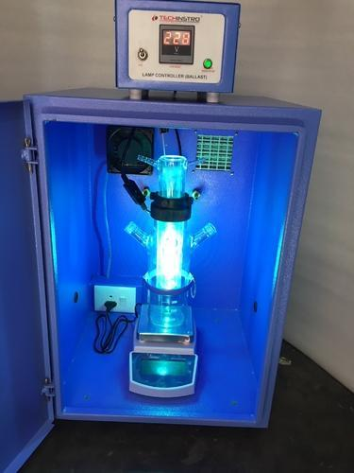
Mineralization of organic pollutants
Photoreactor
Sampling and analysis at various irradiation times

Slide 19
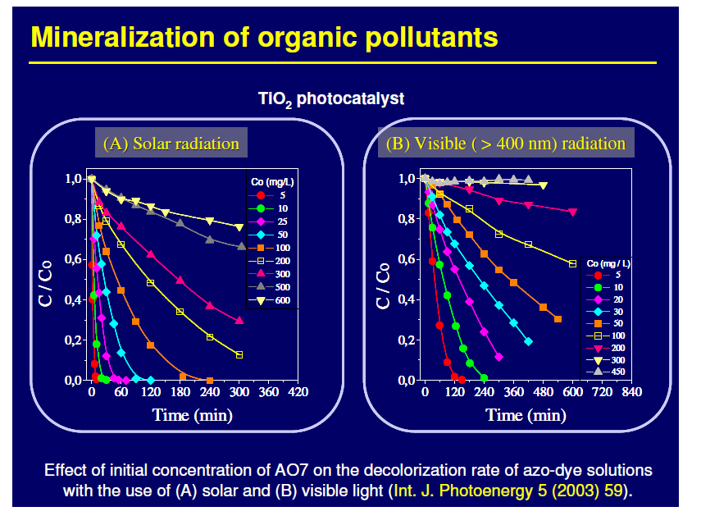

Slide 20
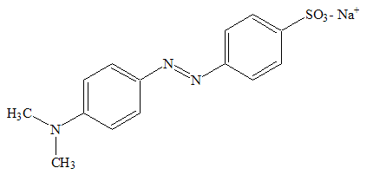
Photocatalysis
Dyes degradation: TiO₂-based materials
Apparent first order constant
for Methyl Orange degradation
TiO₂-B9N5
Doping with B and/or N affects structure and activity.
B and /or N induces defects formation, increasing absorption of light.
TiO₂-N5
P25
TiO₂-B9
TiO₂
MO
k
Degradation products
J. Hazard. Mat. 146 (2007), 529-534.
Chem. Phys. 339 (2007), 111-123.
Inorg. Chim. Acta 361 (2008), 3980-3987.
Notes:
20

Slide 21
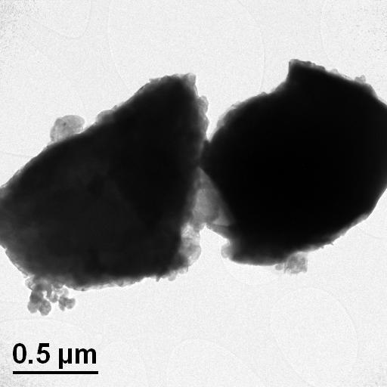
Photocatalysis
Dyes degradation: other materials
Bi₂O₃/Bi₂O_{4-x} nanocomposite
Improved activity by formation of nanocomposites (Bi₂O₃, ZnO, NiO).
Un-conventional photocatalysts (MWO₄, M = Co, Ni, Cu, Zn)
Methylene Blue
Decolourization (%)
Bi₂O₃
J. Am. Chem. Soc. 130 (2008), 9658-9659.
Photophys. Photochem. Sc. 8 (2009), 677-682.
Bi₂O_{4-x}
Chem. Phys. Lett. 472 (2009), 212-216.
Chem. Phys. Lett. 483 (2009), 254-261.
Chem. Phys. Lett. 498 (2010), 113-119.
Notes:
21

Slide 22
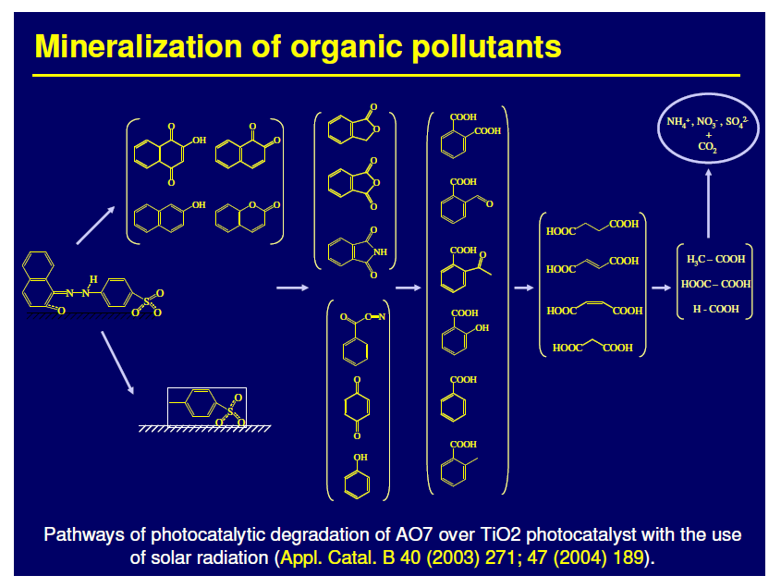

Slide 23
Photocatalytic deNOx

Slide 24
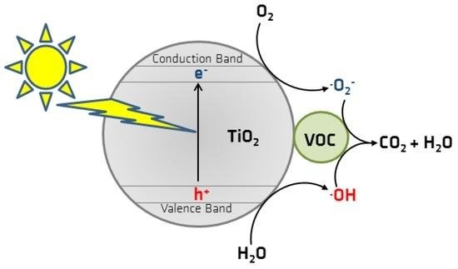
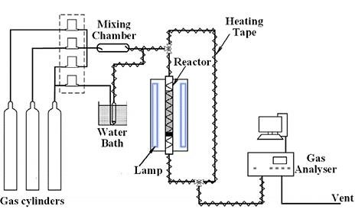
Photocatalytic deVOCs

Slide 25
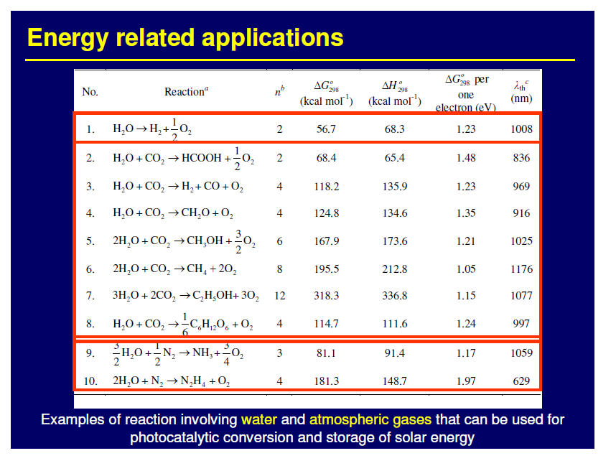

Slide 26
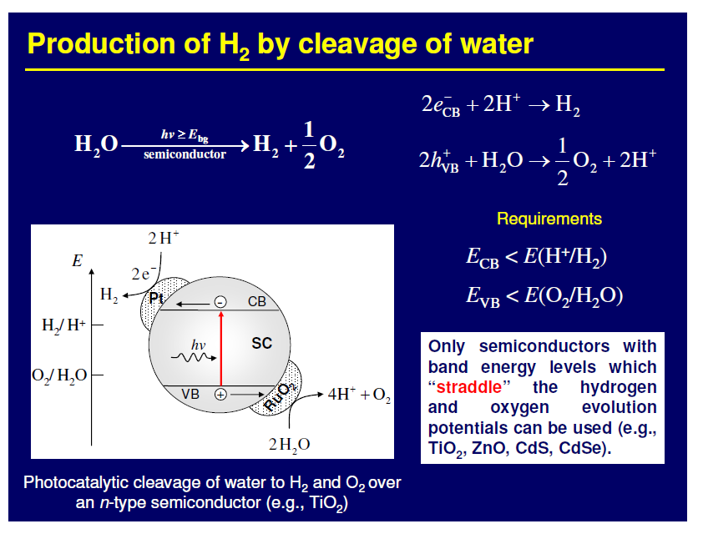

Slide 27
Band-gap energies and relative band position of different semiconductors relative to the water oxidation/reduction potential (vs. NHE)
-2.0
ZrO₂
ZnS
SiC
KTaO₃
SrTiO₃
CdS
GaP
-1.0
TiO₂
CdSe
Si
0
MoS₂
WO₃
Fe₂O₃
H⁺/H₂
1.0
V vs NHE (pH=0)
O₂/H₂O
2.0
3.0
4.0
5.0
3.4
3.2
3.0
3.6
2.4
1.7
2.25
3.0
1.1
1.75
2.8
2.3 eV

Slide 28
Metal / TiO₂
TiO₂
Metal
+ ½ O₂
e⁻
H₂
H₂O
Conduction Band
cat
2H⁺
hν
h⁺
Valence band
H₂O
2H⁺+½O₂
Thechnological solution: separation of red and Ox reactions
Chemical solution: use of sacrifical agents
Inorganic compounds: S²⁻/SO₃²⁻, Ce⁴⁺/Ce³⁺, IO₃⁻/I⁻
Organic compounds: EDTA, methanol, ethanol, glycerol, etc.

Slide 29
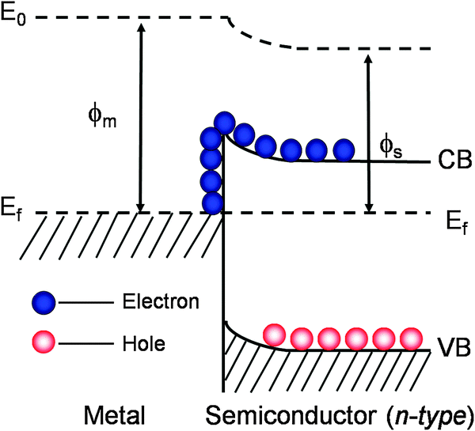
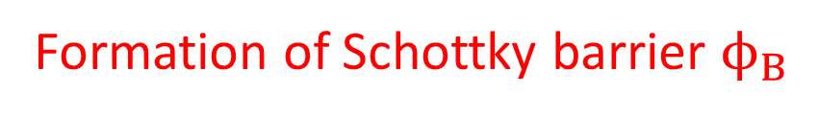


Metal / TiO₂
Formation of Schottky barrier $ϕ_{B}$
$ϕ_{B}$ depends on metal work function
$$ϕ_{B}$$
ChemistrySelect 2020, 5, 1013 –1019

Slide 30
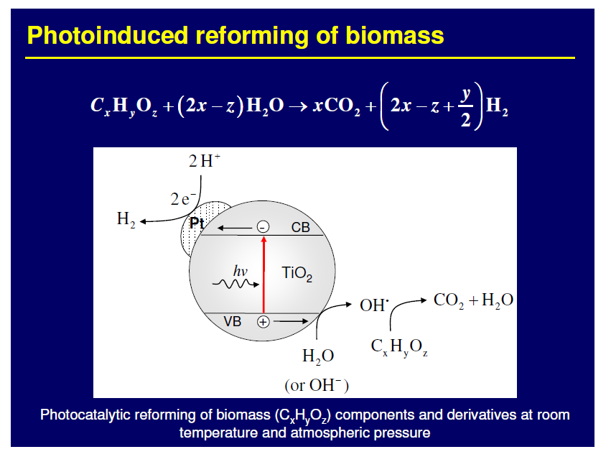

Slide 31
Pt/TiO₂ photocatalysts were prepared through photodeposition procedure

Slide 32
675 μmol h⁻¹ g⁻¹
Cu/TiO₂ photocatalysts were prepared through wet impregnation procedure

Slide 33
Pt/TiO₂ photocatalyst was prepared through impregnation procedure
Unknown amount of Pt deposited on TiO₂ films
Max H₂ production in EtOH/water:
Approx. 11000 μmol h⁻¹ g⁻¹

Slide 34
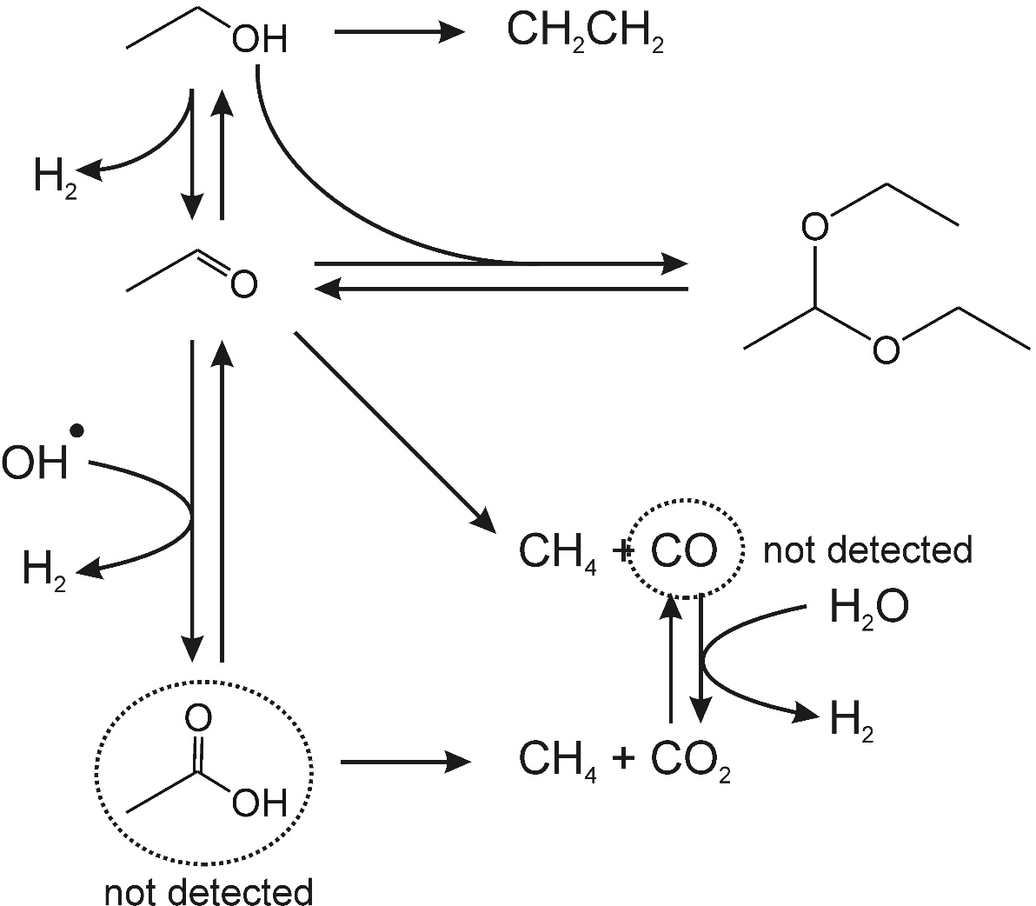
H₂ production from ethanol
Possible pathway
Accumulated
in solution
ChemCatChem 3 (2011), 574-577

Slide 35
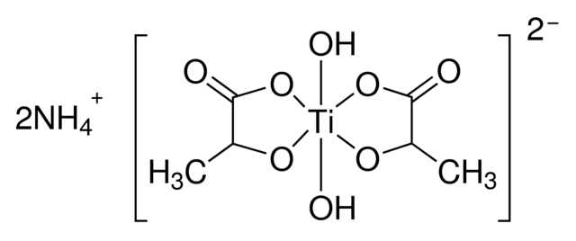
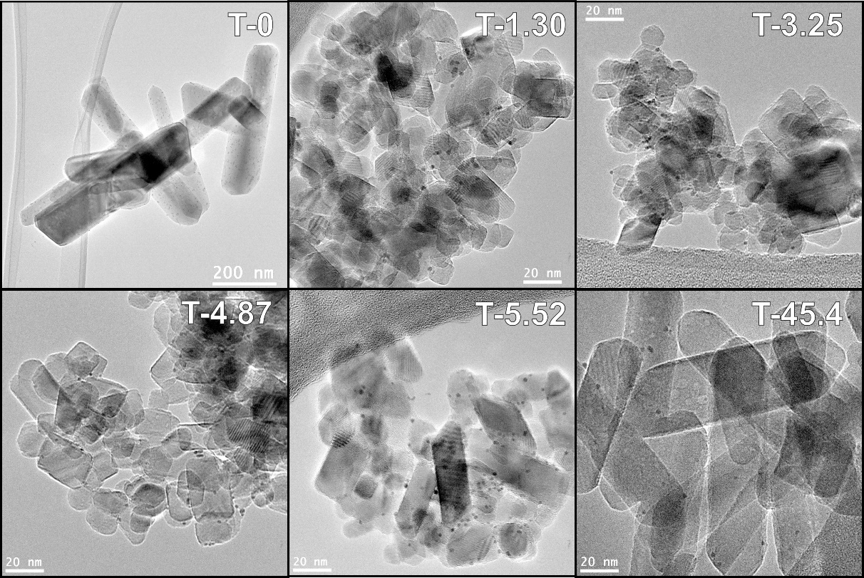
TUNING TiO₂ COMPOSITION
+ Urea
TiO₂
160°C x 24h
R + A
Rutile
Anatase
A + B
A + B
Brookite
Appl. Catal. A-Gen. 518 (2016), 167-175

Slide 36
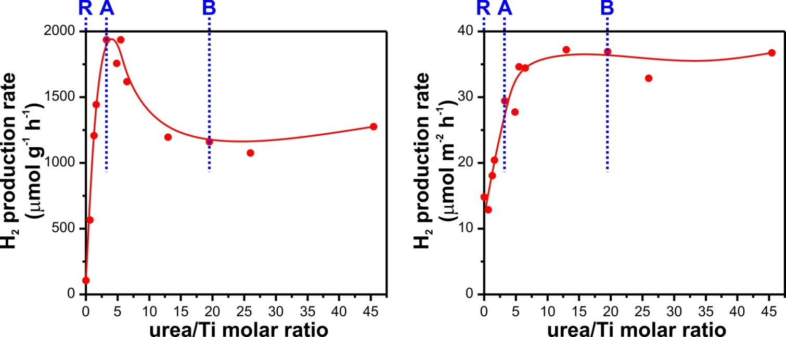
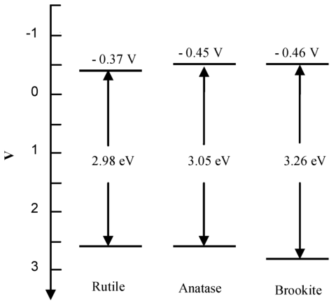
TUNING TiO₂ COMPOSITION
Ethanol/water solution
Simulated sunlight
Per mass
Per surface area
Pt 0.2 wt% added as co-catalysts
Brookite:
Favorable electronic properties
Well defined morphology and exposed facets
Appl. Catal. A-Gen. 518 (2016), 167-175

Slide 37
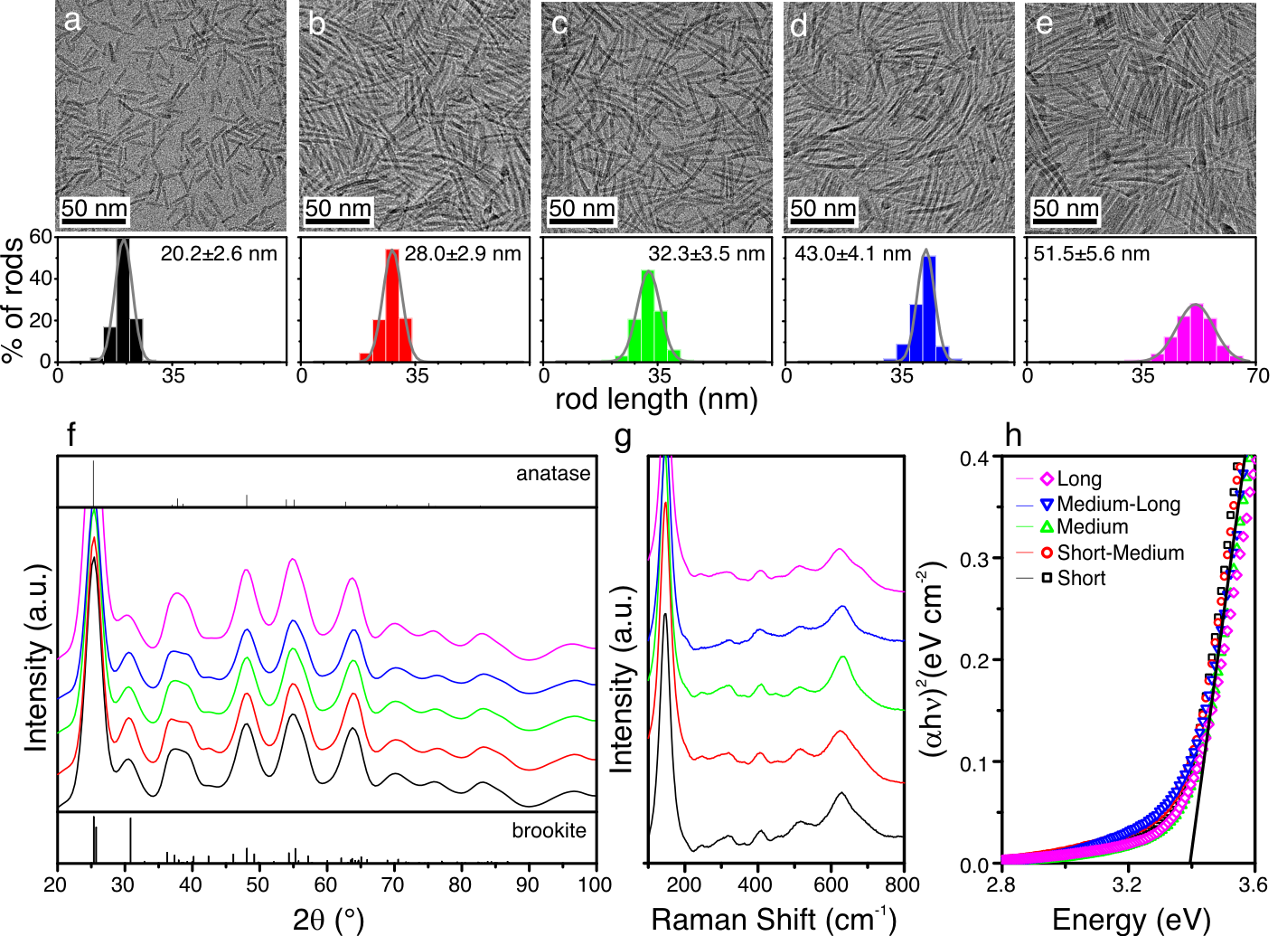
TiO₂ BROOKITE NANORODS
Montini et al. Proc. Nat. Acad. Sci., 113 (2016), 3966-3971

Slide 38
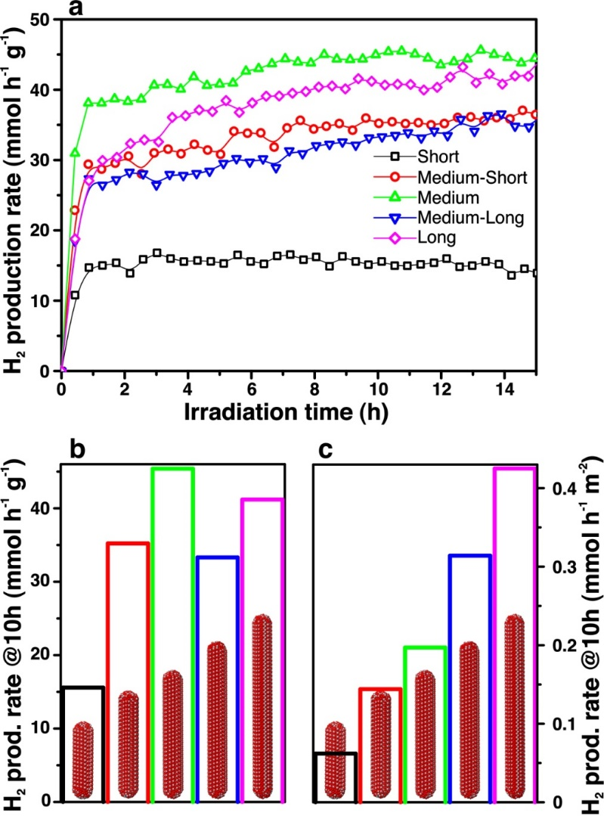
TiO₂ BROOKITE NANORODS
Per mass
Per surface area
Montini et al. Proc. Nat. Acad. Sci., 113 (2016), 3966-3971

Slide 39
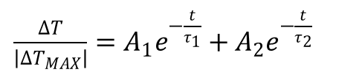
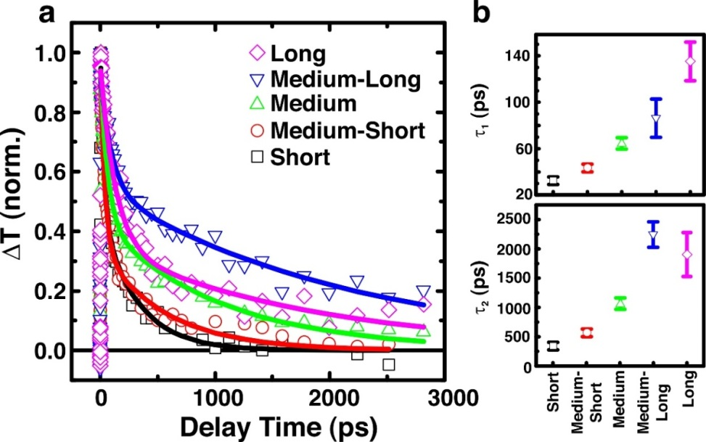
TiO₂ BROOKITE NANORODS
50 fs ultraviolet (4.0 eV) pump pulse
Per surface area
Increase life-time of electron/hole pairs with length
Montini et al. Proc. Nat. Acad. Sci., 113 (2016), 3966-3971

Slide 40
Pt/TiO₂ photocatalysts were prepared through wet impregnation procedure

Slide 41
H₂ production from glycerol
Possible pathway
Accumulated
in solution
ChemCatChem 3 (2011), 574-577

Slide 42
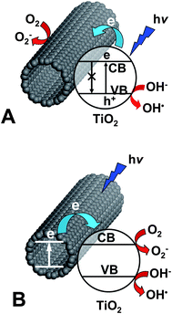
TiO₂/CARBON NANOMATERIALS
Formation of hybrid materials
CNTs as electron sink
CNTs as sensitizer
W.-D. Zhang, B. Xu, L.-C. Jiang, J. Mater. Chem. 20 (2010), 6383.

Slide 43
Pd@TiO₂/CARBON NANOTUBES
After calcination
20 nm
Porous Pd@TiO₂ shell around CNT
Anatase phase
EF-TEM
500 nm
Green Chem. doi: 10.1039/C6GC01979J

Slide 44
Pd@TiO₂/CARBON NANOTUBES
Ethanol/water solution
H₂ production under
UV-vis irradiation
Glycerol/water solution
Green Chem. doi: 10.1039/C6GC01979J

Slide 45
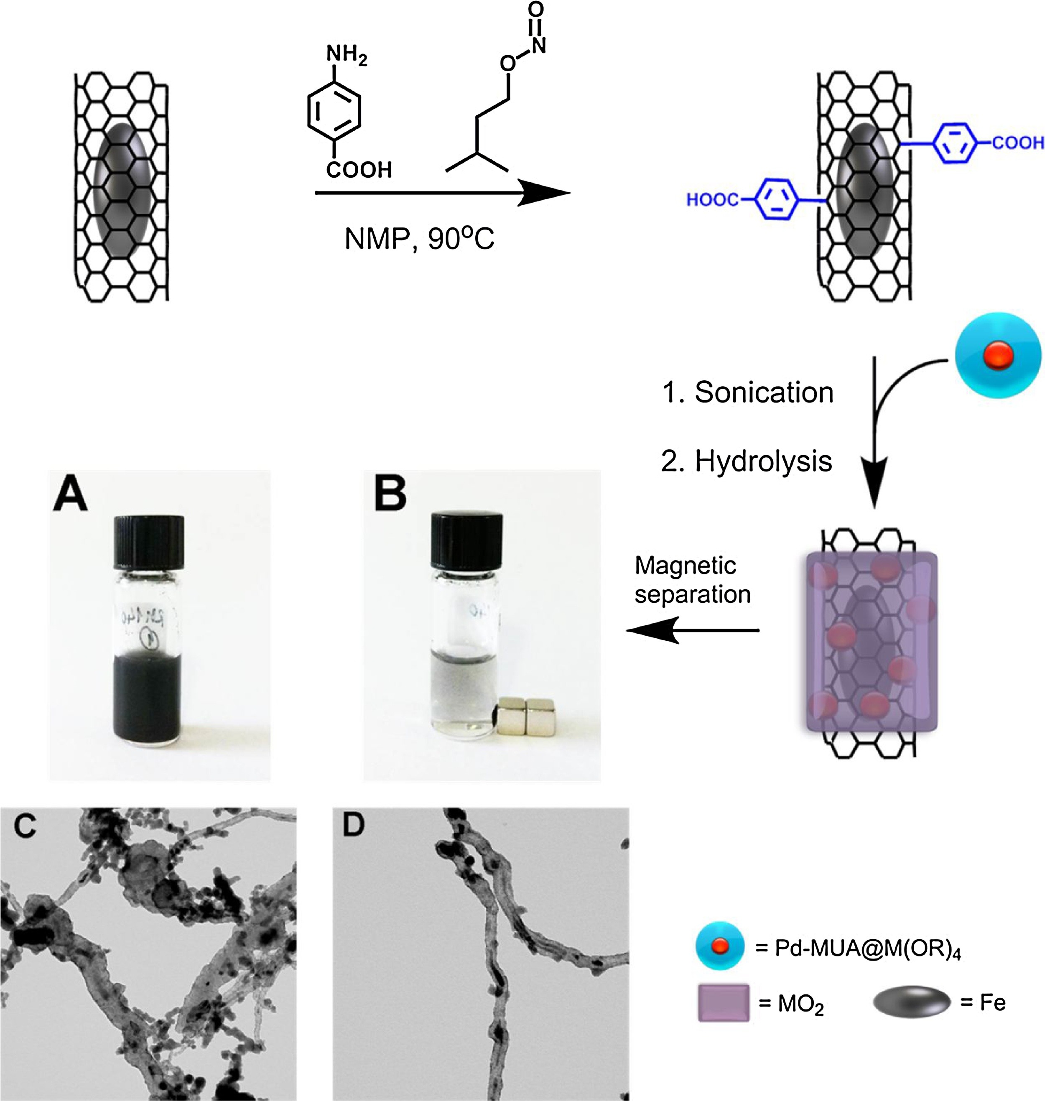
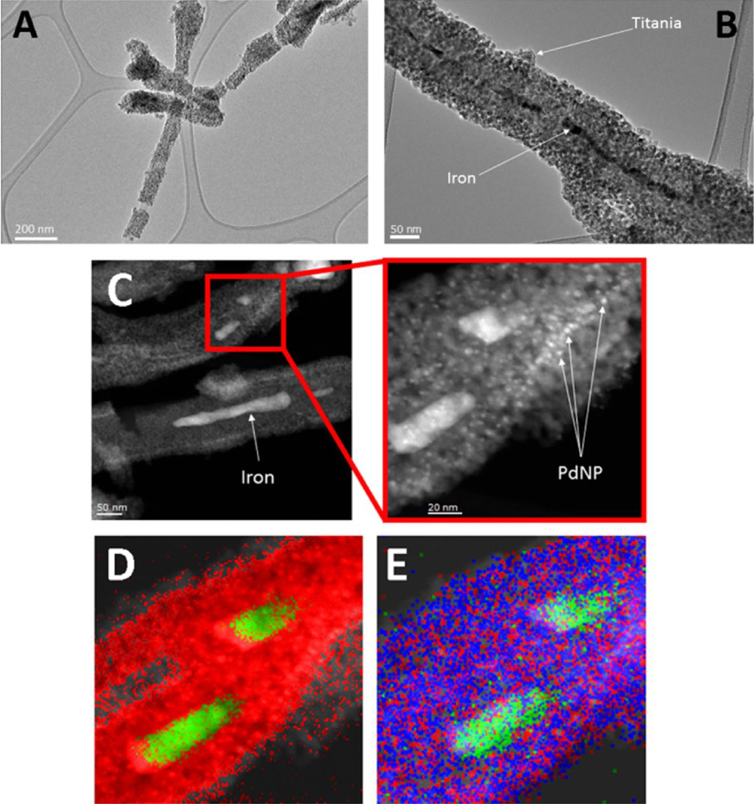
Pd@TiO₂/CARBON NANOTUBES@Fe
Purification by magnetic separation
Before
After
Appl. Catal. B-Environ. 227 (2018), 356-365

Slide 46
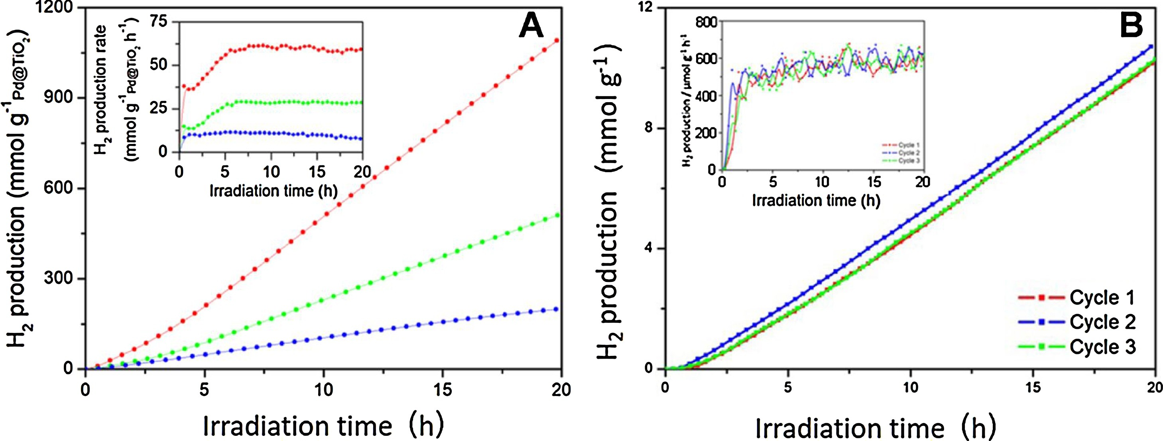
Pd@TiO₂/CARBON NANOTUBES@Fe
EtOH : H₂O = 1:1
UV-vis irradiation
Pd@TiO₂/Fe@CNT-magnetic
Pd@TiO₂/Fe@CNT-filtered
Pd@TiO₂
Appl. Catal. B-Environ. 227 (2018), 356-365

Slide 47
Pd@TiO₂/CARBON NANOTUBES@Fe
EtOH : H₂O = 1:1
Simulated Sunlight irradiation
Pd@TiO₂/Fe@CNT-magnetic
Easily reusable by magnetic recovery from the reaction mixture!!!
Appl. Catal. B-Environ. 227 (2018), 356-365

