Slide 1
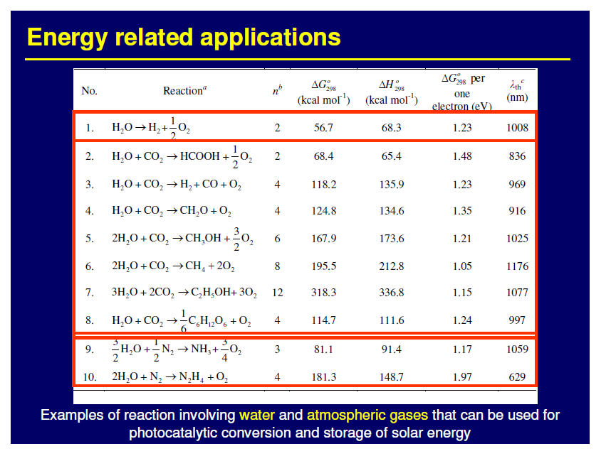

Slide 2
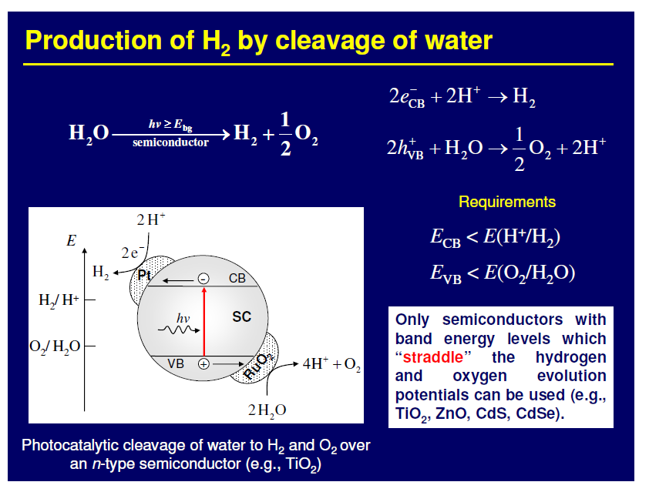

Slide 3
Band-gap energies and relative band position of different semiconductors relative to the water oxidation/reduction potential (vs. NHE)
-2.0
ZrO₂
ZnS
SiC
KTaO₃
SrTiO₃
CdS
GaP
-1.0
TiO₂
CdSe
Si
0
MoS₂
WO₃
Fe₂O₃
H⁺/H₂
1.0
V vs NHE (pH=0)
O₂/H₂O
2.0
3.0
4.0
5.0
3.4
3.2
3.0
3.6
2.4
1.7
2.25
3.0
1.1
1.75
2.8
2.3 eV

Slide 4
Metal / TiO₂
TiO₂
Metal
+ ½ O₂
e⁻
H₂
H₂O
Conduction Band
cat
2H⁺
hν
h⁺
Valence band
H₂O
2H⁺+½O₂
Thechnological solution: separation of red and Ox reactions
Chemical solution: use of sacrifical agents
Inorganic compounds: S²⁻/SO₃²⁻, Ce⁴⁺/Ce³⁺, IO₃⁻/I⁻
Organic compounds: EDTA, methanol, ethanol, glycerol, etc.

Slide 5
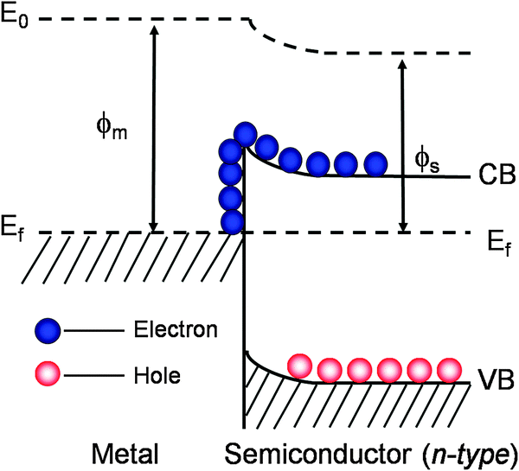
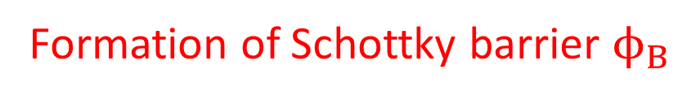


Metal / TiO₂
Formation of Schottky barrier $ϕ_{B}$
$ϕ_{B}$ depends on metal work function
$$ϕ_{B}$$
ChemistrySelect 2020, 5, 1013 –1019

Slide 6
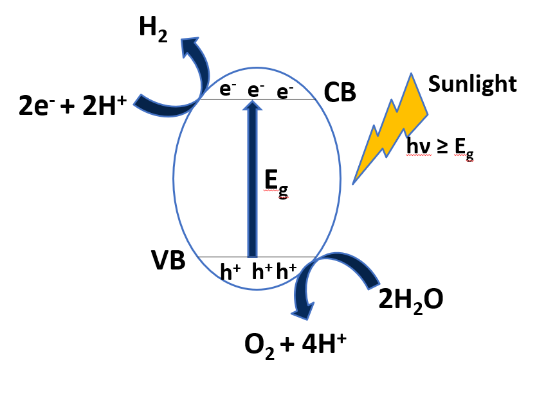
Green Hydrogen production by photocatalysis
Overall water splitting
Drawbacks:
Easy recombination of H₂ and O₂
Possible photoleaching of materials

Slide 7
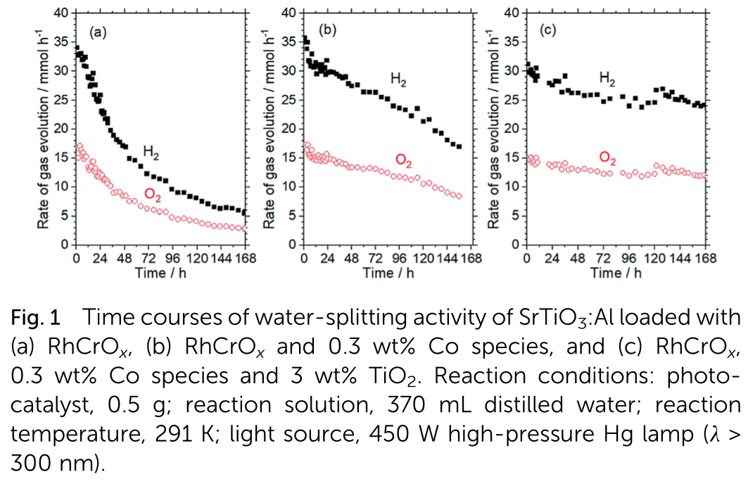
Water splitting
CoOOH/RhCrO_{x}/SrTiO₃:Al photocatalyst
Domen et al. Chem. Sci., 2019, 10, 3196

Slide 8
Water splitting
Al is dopant of SrTiO₃ reducing band gap
In the absence of CoOOH, holes migrate to RhCrO_{x}, indicing leaching of Cr(VI)
Cr-deficient RhCrO_{x} is able to activate O₂ and recombine it with H₂
CoOOH collect photoexcited holes and catalyse H₂O oxidation, avoiding oxidative corrosion of the RhCrO_{x} cocatalyst and corrosion
Amorphous TiO₂ is used as protecting layer
Domen et al. Chem. Sci., 2019, 10, 3196

Slide 9
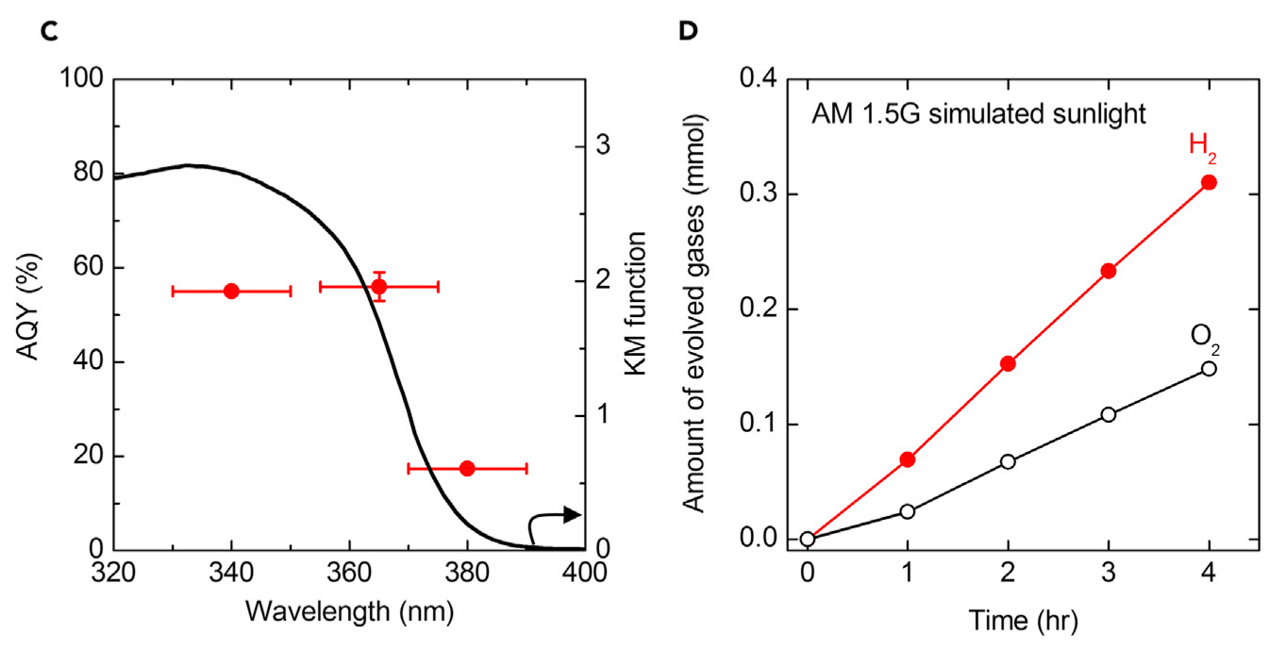
Water splitting
AQY
STH = 0.4%
Domen et al. Joule 2, 2018, 509–520

Slide 10
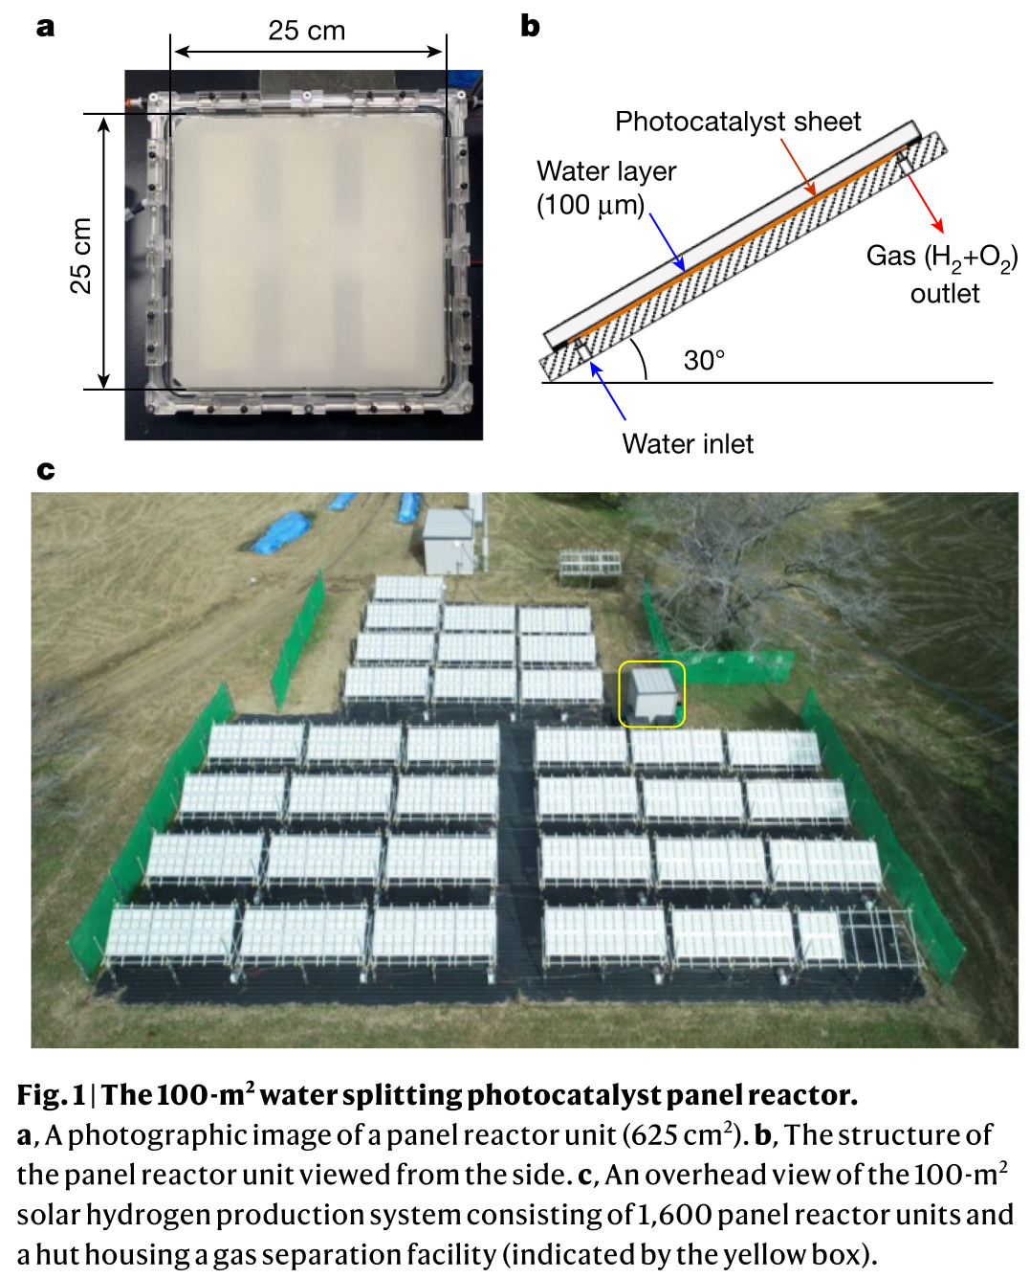
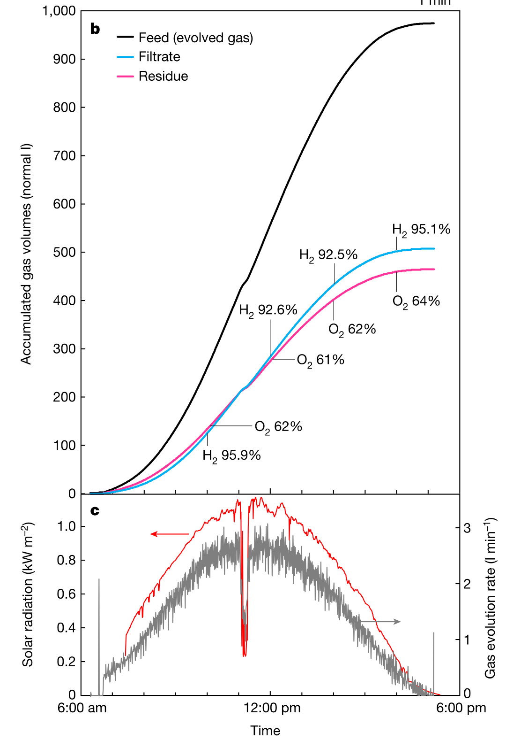
Water splitting
Photocatalytic solar hydrogen production from water on a 100 m² scale
Installed at the Kakioka Research Facility within the University of Tokyo
More efficient separation membranes are required to produce high-purity H₂
Domen et al. Nature 598, 2021, 304-307

Slide 11
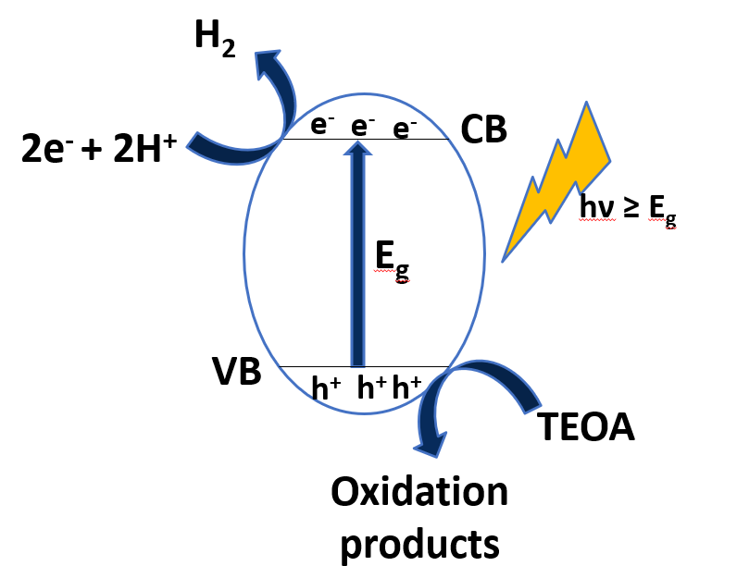
Green Hydrogen production by photocatalysis
Overall water splitting
H₂ evolution reaction
LHC

Slide 12
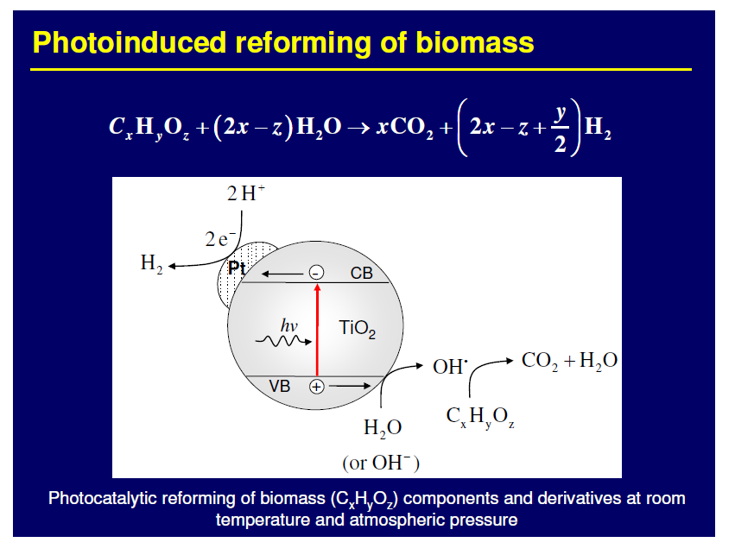

Slide 13
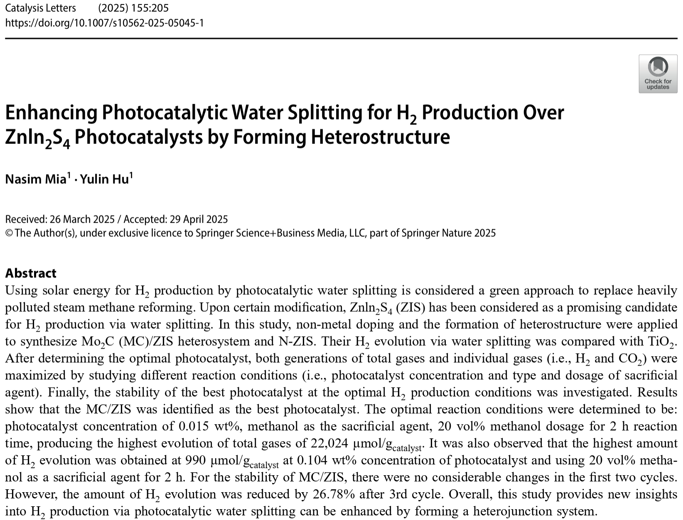
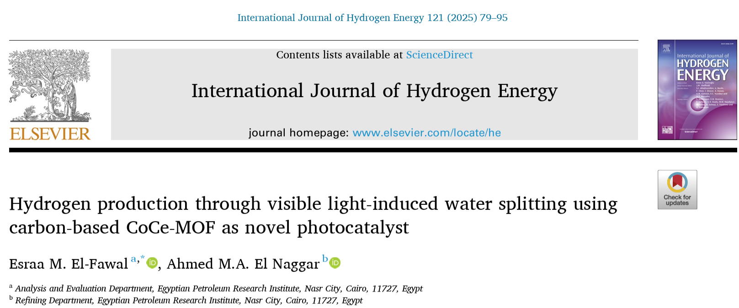
Water splitting
BE AWARE !!!

Slide 14
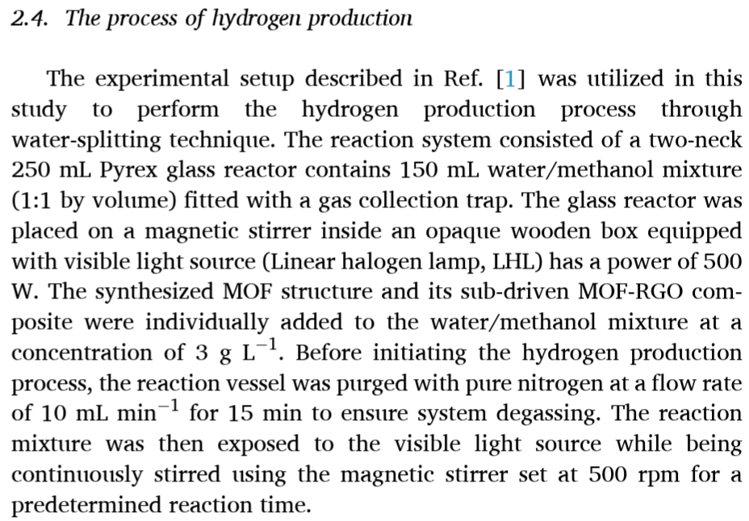
Water splitting
BE AWARE !!!

Slide 15
Pt/TiO₂ photocatalysts were prepared through photodeposition procedure

Slide 16
675 μmol h⁻¹ g⁻¹
Cu/TiO₂ photocatalysts were prepared through wet impregnation procedure

Slide 17
Pt/TiO₂ photocatalyst was prepared through impregnation procedure
Unknown amount of Pt deposited on TiO₂ films
Max H₂ production in EtOH/water:
Approx. 11000 μmol h⁻¹ g⁻¹

Slide 18
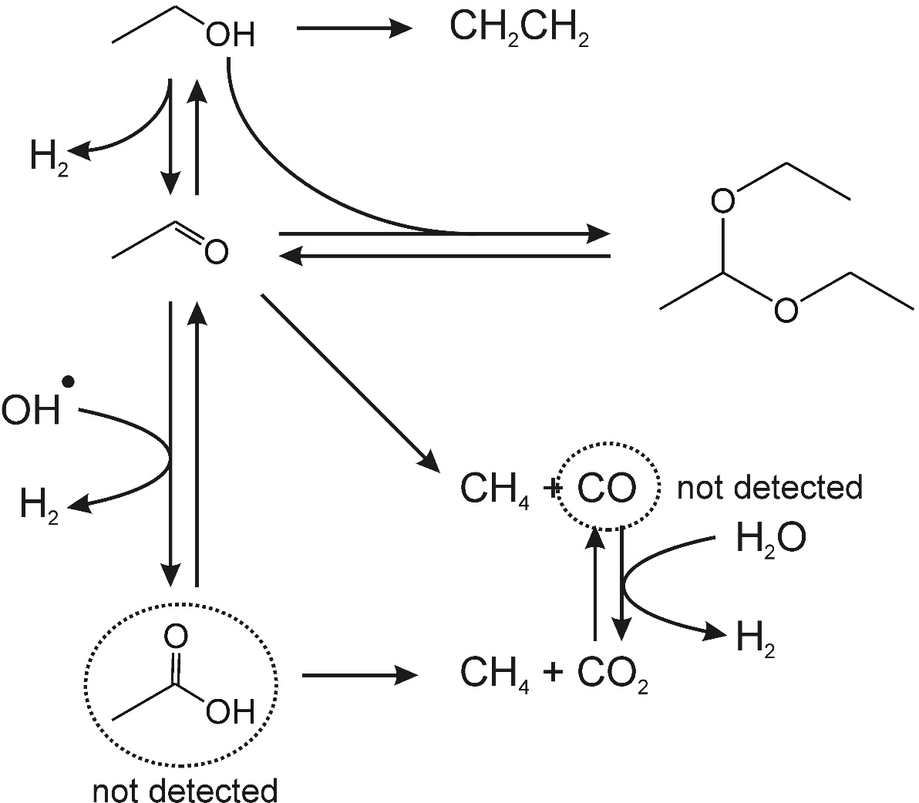
H₂ production from ethanol
Possible pathway
Accumulated
in solution
ChemCatChem 3 (2011), 574-577

Slide 19
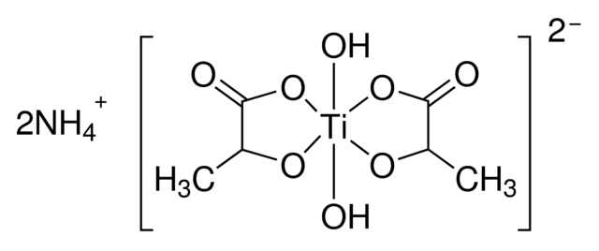
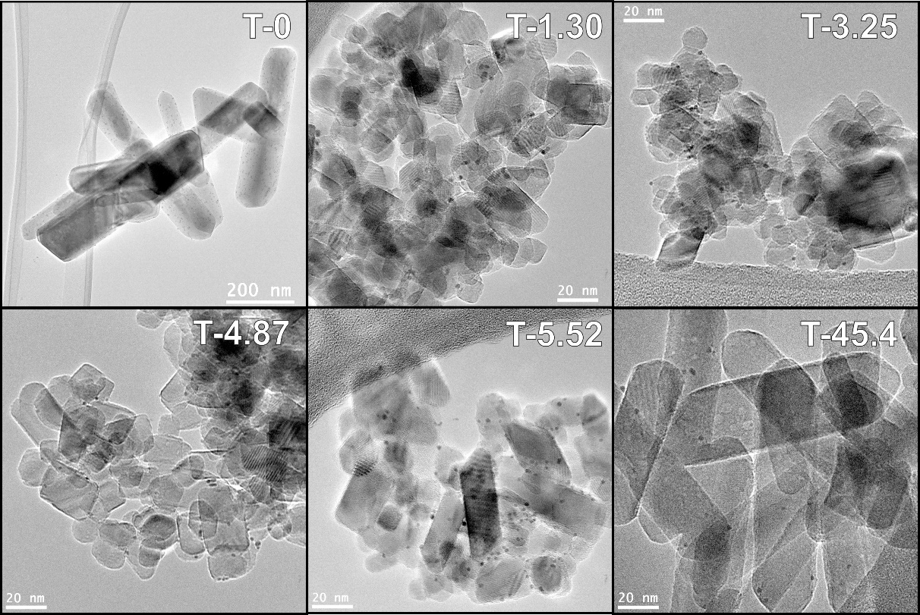
TUNING TiO₂ COMPOSITION
+ Urea
TiO₂
160°C x 24h
R + A
Rutile
Anatase
A + B
A + B
Brookite
Appl. Catal. A-Gen. 518 (2016), 167-175

Slide 20
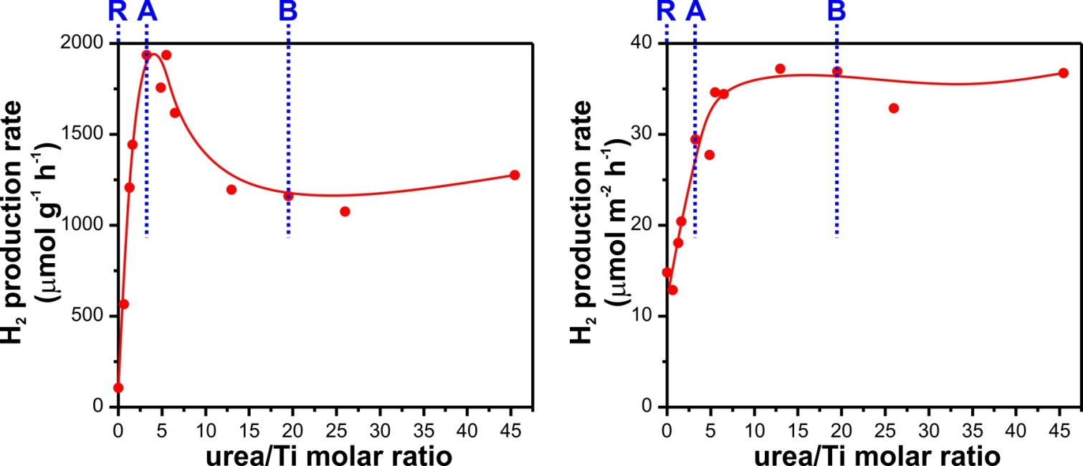
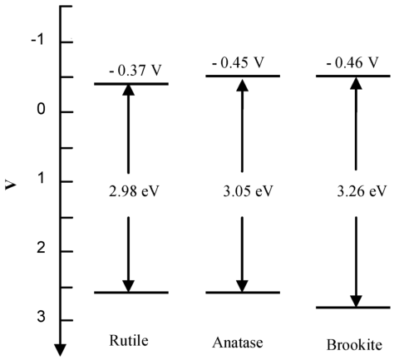
TUNING TiO₂ COMPOSITION
Ethanol/water solution
Simulated sunlight
Per mass
Per surface area
Pt 0.2 wt% added as co-catalysts
Brookite:
Favorable electronic properties
Well defined morphology and exposed facets
Appl. Catal. A-Gen. 518 (2016), 167-175

Slide 21
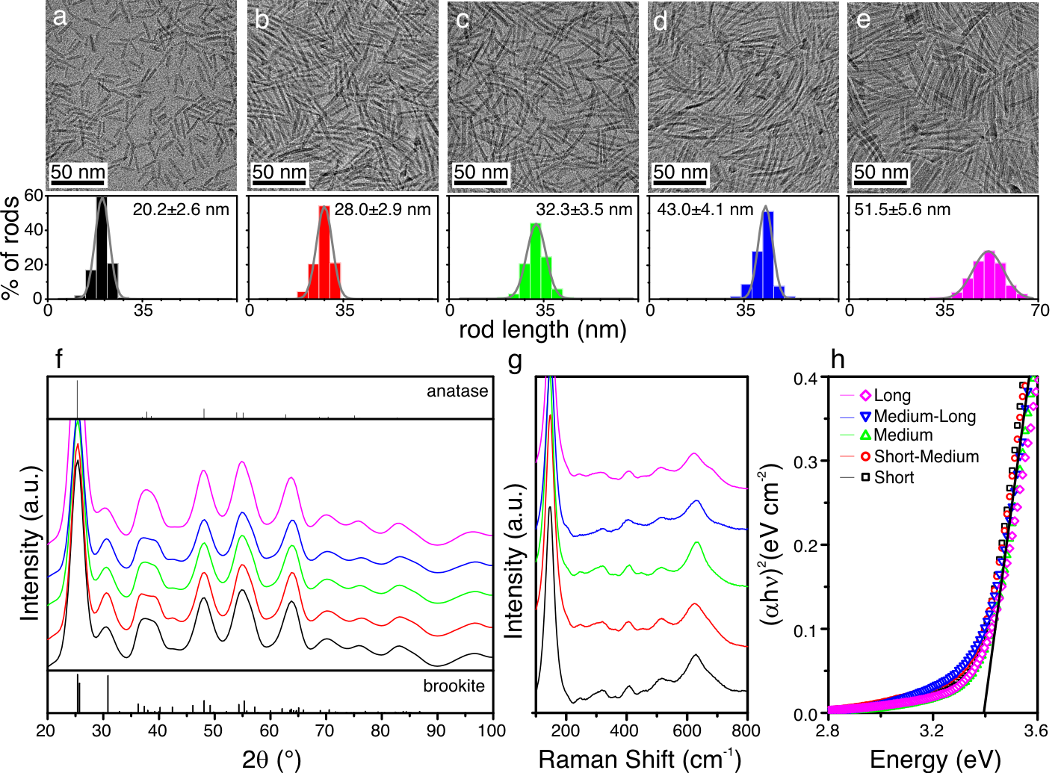
TiO₂ BROOKITE NANORODS
Montini et al. Proc. Nat. Acad. Sci., 113 (2016), 3966-3971

Slide 22
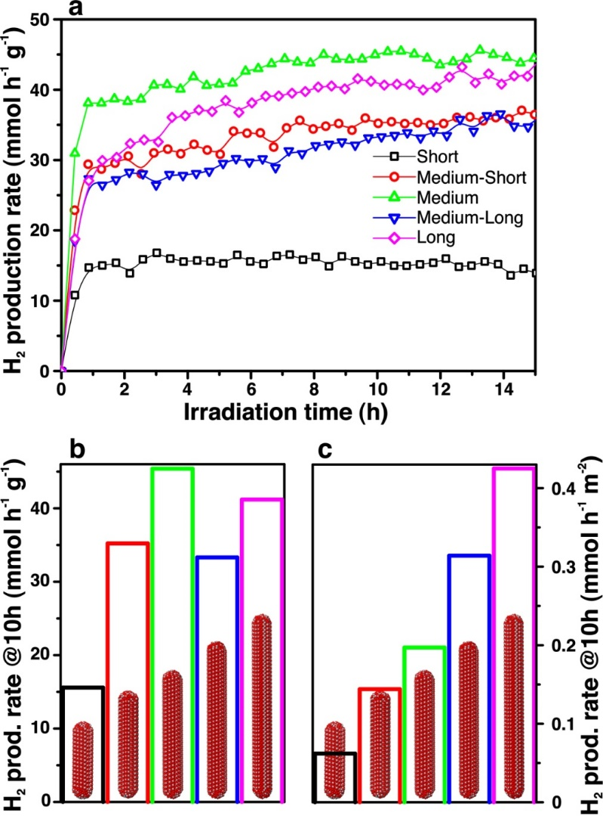
TiO₂ BROOKITE NANORODS
Per mass
Per surface area
Montini et al. Proc. Nat. Acad. Sci., 113 (2016), 3966-3971

Slide 23
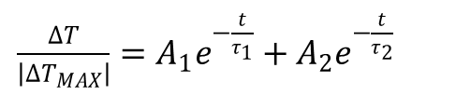
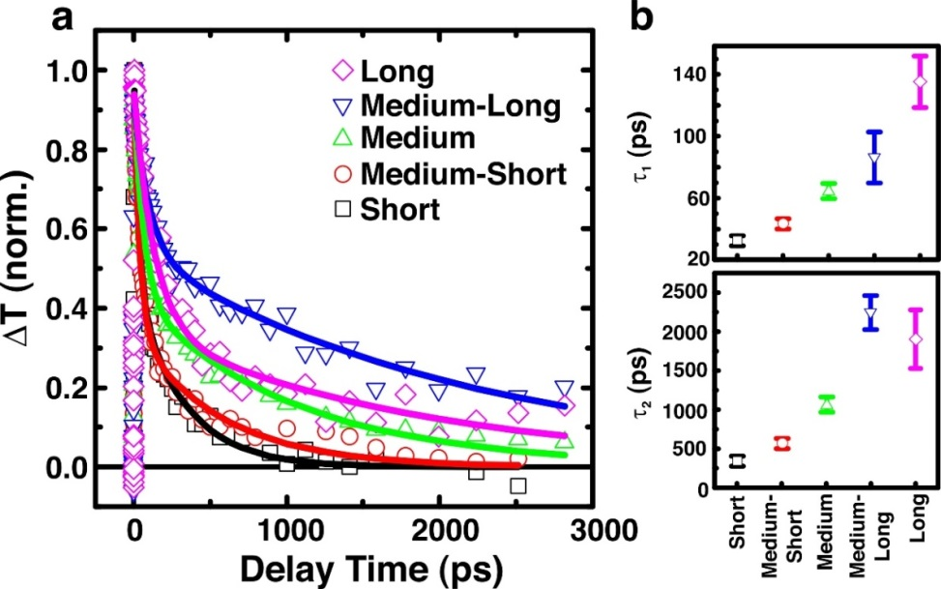
TiO₂ BROOKITE NANORODS
50 fs ultraviolet (4.0 eV) pump pulse
Per surface area
Increase life-time of electron/hole pairs with length
Montini et al. Proc. Nat. Acad. Sci., 113 (2016), 3966-3971

Slide 24
Pt/TiO₂ photocatalysts were prepared through wet impregnation procedure

Slide 25
H₂ production from glycerol
Possible pathway
Accumulated
in solution
ChemCatChem 3 (2011), 574-577

Slide 26
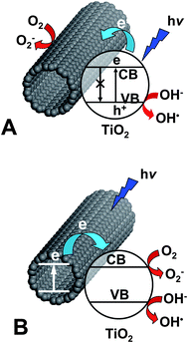
TiO₂/CARBON NANOMATERIALS
Formation of hybrid materials
CNTs as electron sink
CNTs as sensitizer
W.-D. Zhang, B. Xu, L.-C. Jiang, J. Mater. Chem. 20 (2010), 6383.

Slide 27
Pd@TiO₂/CARBON NANOTUBES
After calcination
20 nm
Porous Pd@TiO₂ shell around CNT
Anatase phase
EF-TEM
500 nm
Green Chem. doi: 10.1039/C6GC01979J

Slide 28
Pd@TiO₂/CARBON NANOTUBES
Ethanol/water solution
H₂ production under
UV-vis irradiation
Glycerol/water solution
Green Chem. doi: 10.1039/C6GC01979J

Slide 29
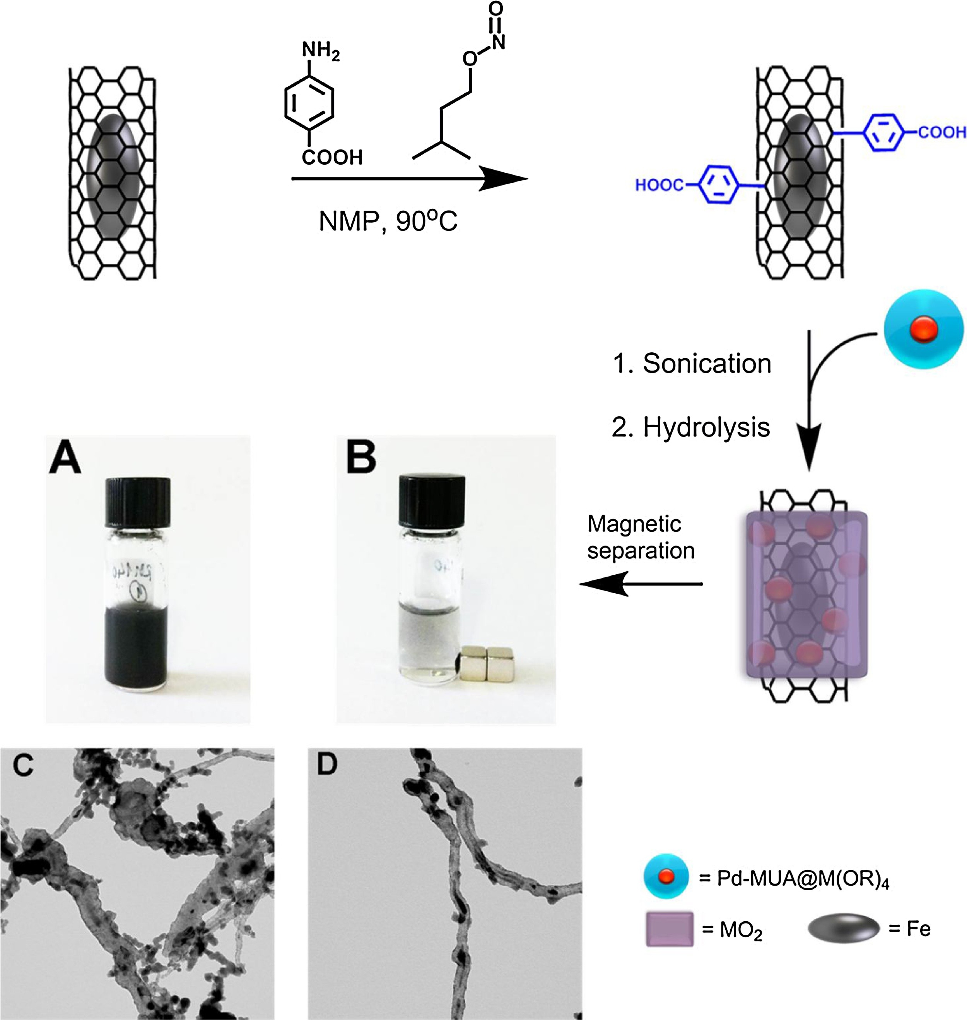
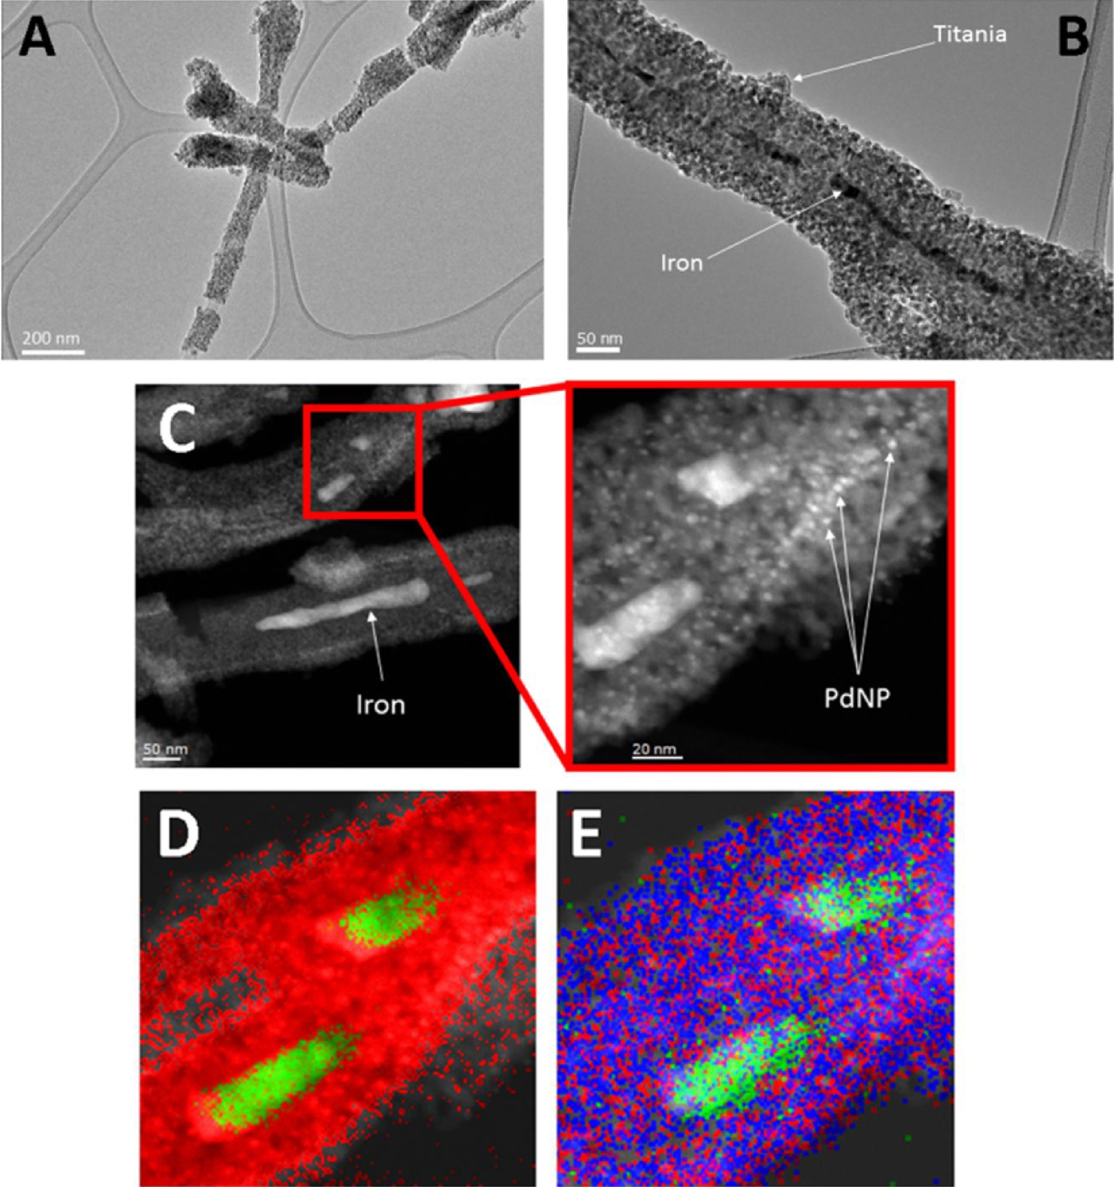
Pd@TiO₂/CARBON NANOTUBES@Fe
Purification by magnetic separation
Before
After
Appl. Catal. B-Environ. 227 (2018), 356-365

Slide 30
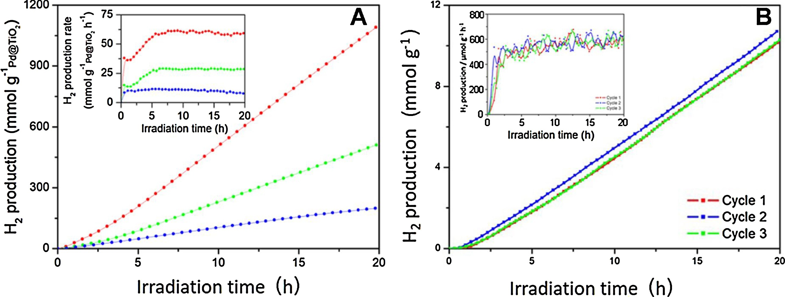
Pd@TiO₂/CARBON NANOTUBES@Fe
EtOH : H₂O = 1:1
UV-vis irradiation
Pd@TiO₂/Fe@CNT-magnetic
Pd@TiO₂/Fe@CNT-filtered
Pd@TiO₂
Appl. Catal. B-Environ. 227 (2018), 356-365

Slide 31
Pd@TiO₂/CARBON NANOTUBES@Fe
EtOH : H₂O = 1:1
Simulated Sunlight irradiation
Pd@TiO₂/Fe@CNT-magnetic
Easily reusable by magnetic recovery from the reaction mixture!!!
Appl. Catal. B-Environ. 227 (2018), 356-365

Slide 32
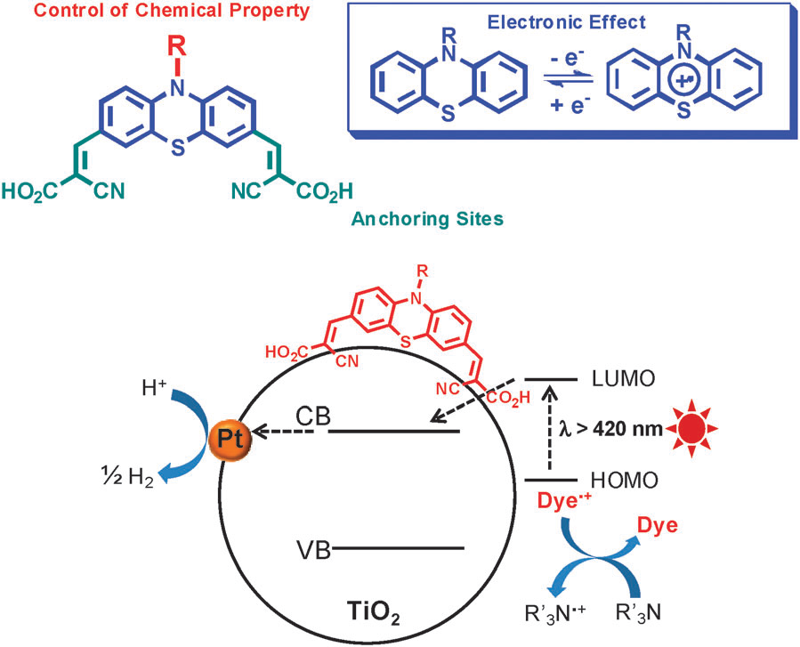
DYE SENSITIZED PHOTOCATALYSTS
Materials active under visible light (λ > 420nm)
Not sustainable Sacrificial Electron Donor

Slide 33
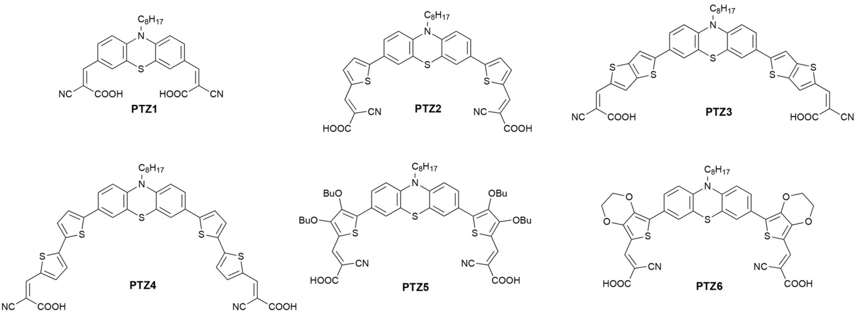
PHENOTIAZINE-BASED DYES
Effect of molecular structure
ChemSusChem 8 (2015), 4216-4228

Slide 34
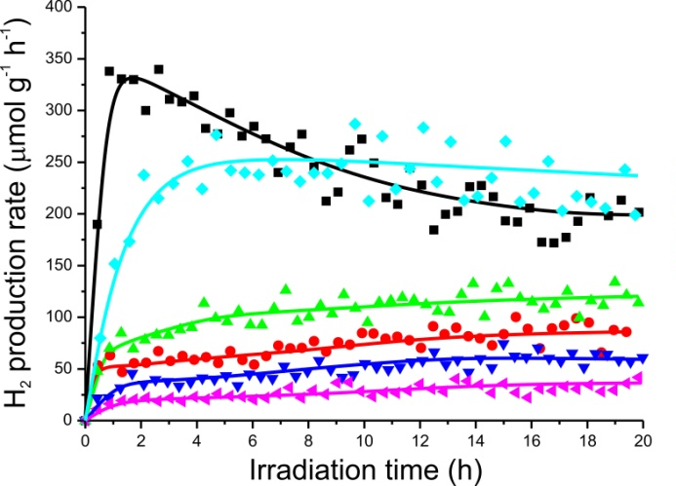
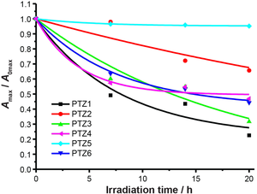
PHENOTIAZINE-BASED DYES
Effect of molecular structure
Active
&
Stable
ChemSusChem 8 (2015), 4216-4228

Slide 35
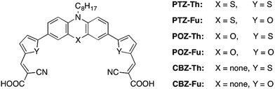
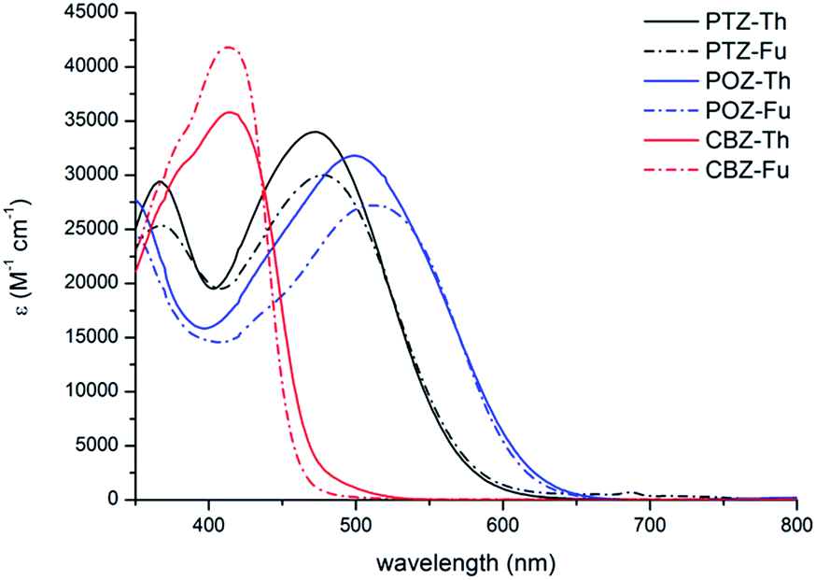
PHENOTIAZINE-BASED DYES
Effect of aromatic structure
Phenotiazine
Phenoxazine
Carbazole
Sustain. Energ. Fuels, 1 (2017), 694-698

Slide 36
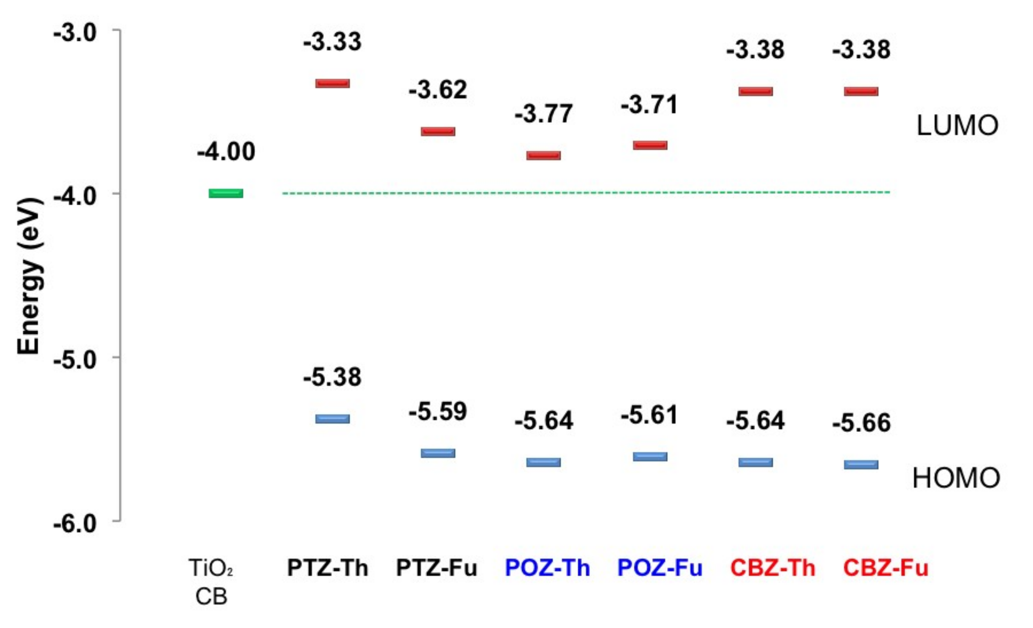
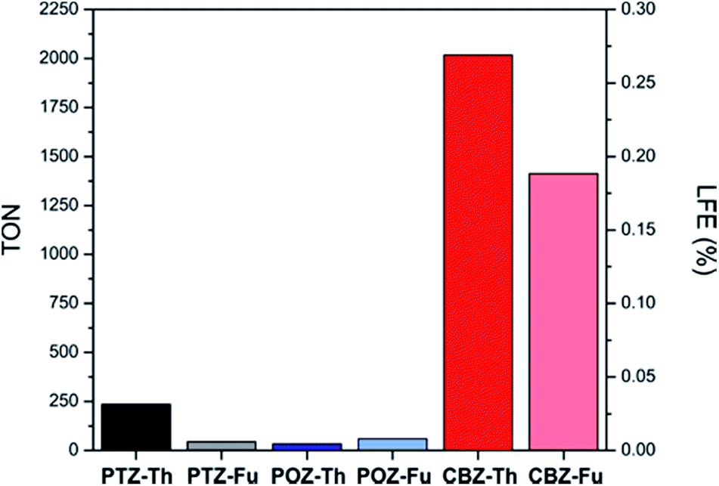
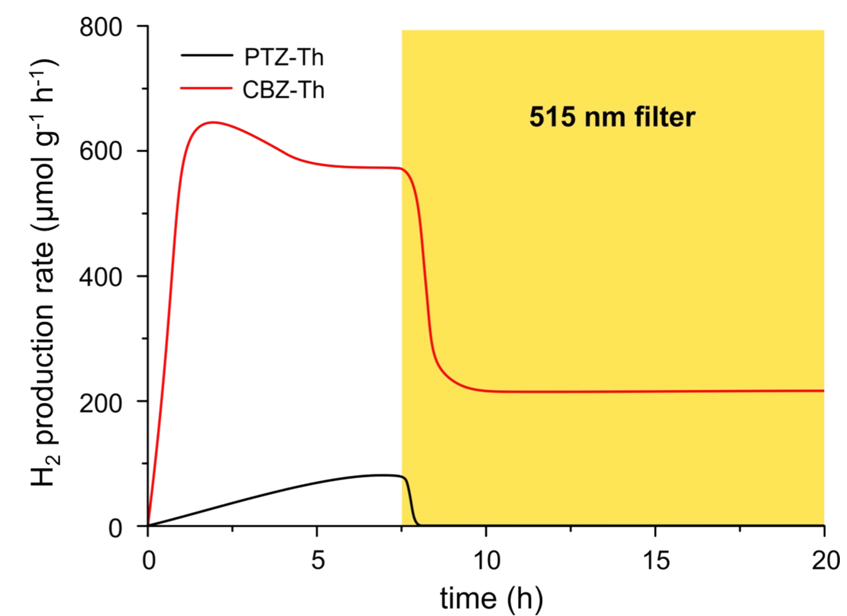
PHENOTIAZINE-BASED DYES
Effect of aromatic structure
High energy of LUMO
Ligand-to-Metal Charge Trasfer
Sustain. Energ. Fuels, 1 (2017), 694-698

