Slide 1
LESSON 2
Past, present and future of functional genomics

Slide 2
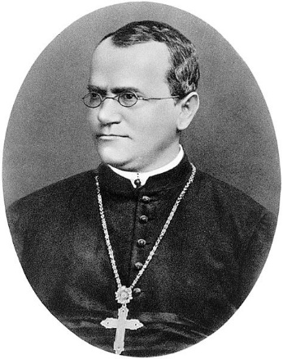
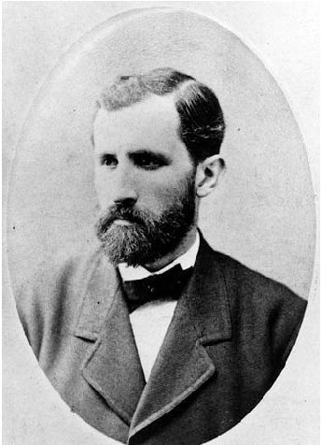
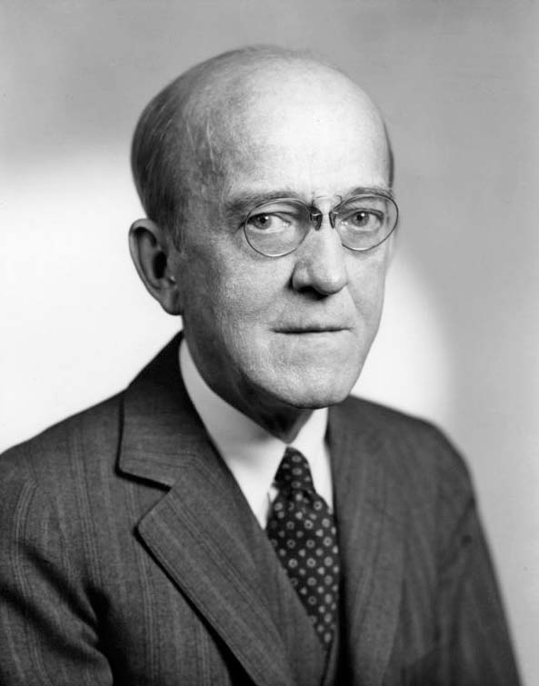
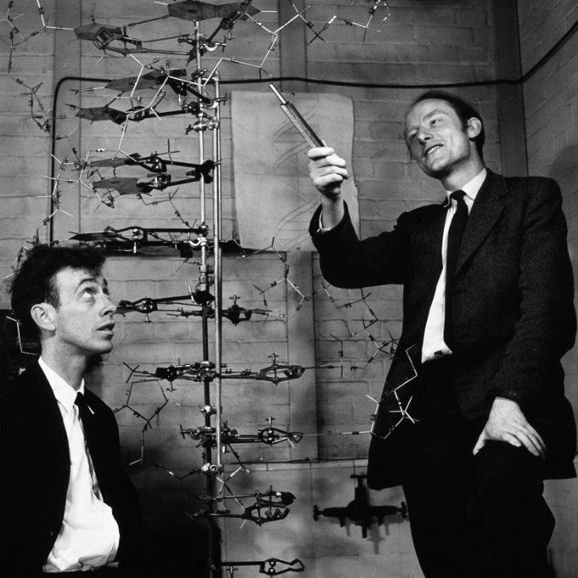
Milestones in genetics and genomics
1865 1871 1944 1953
Mendel Miescher Avery Watson & Crick

Slide 3
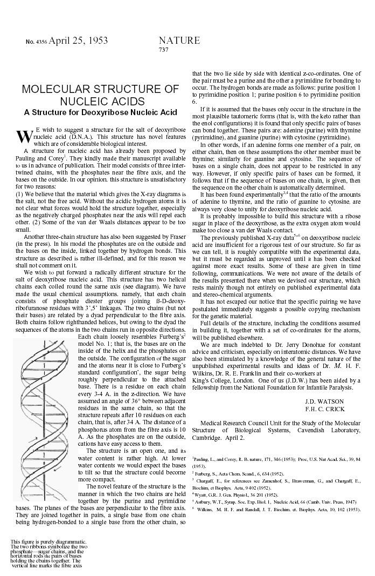

April 1953
The double helix DNA structure is discovered

Slide 4
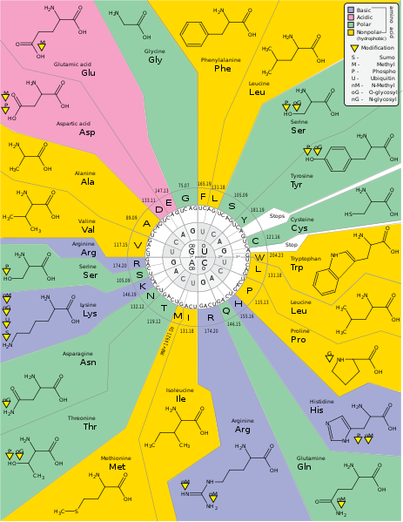
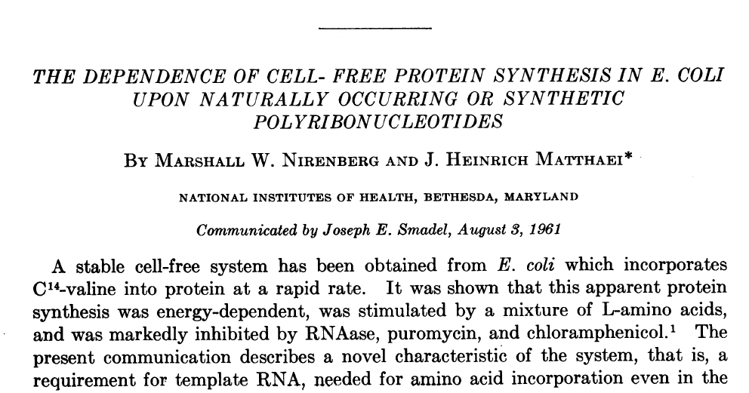
The ’60s
The genetic code
Nirenberg & Matthaei, 1961
The nature of codons

Slide 5
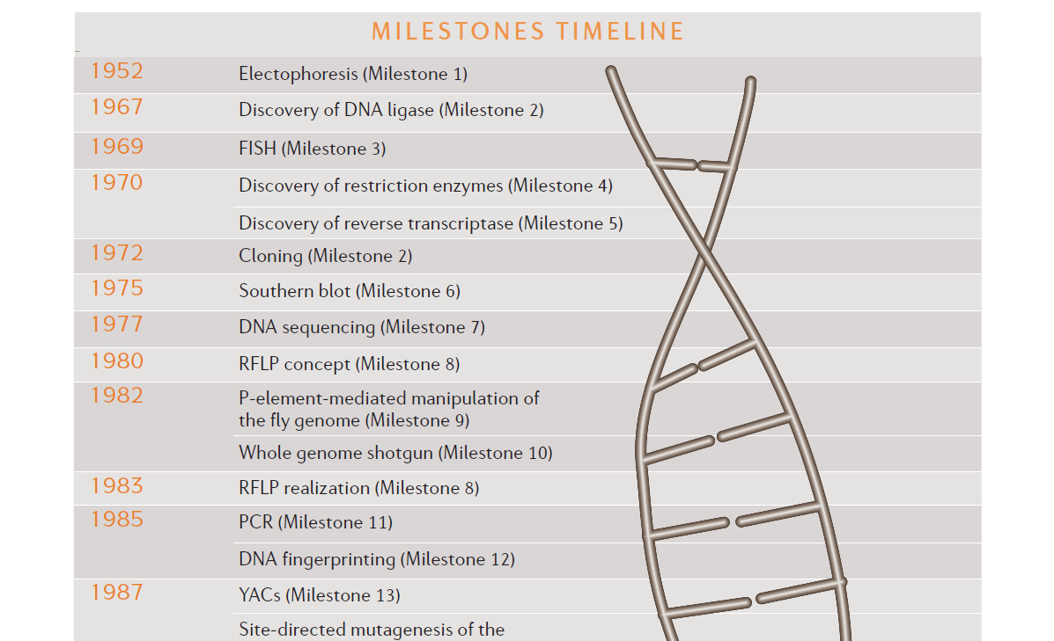

Slide 6
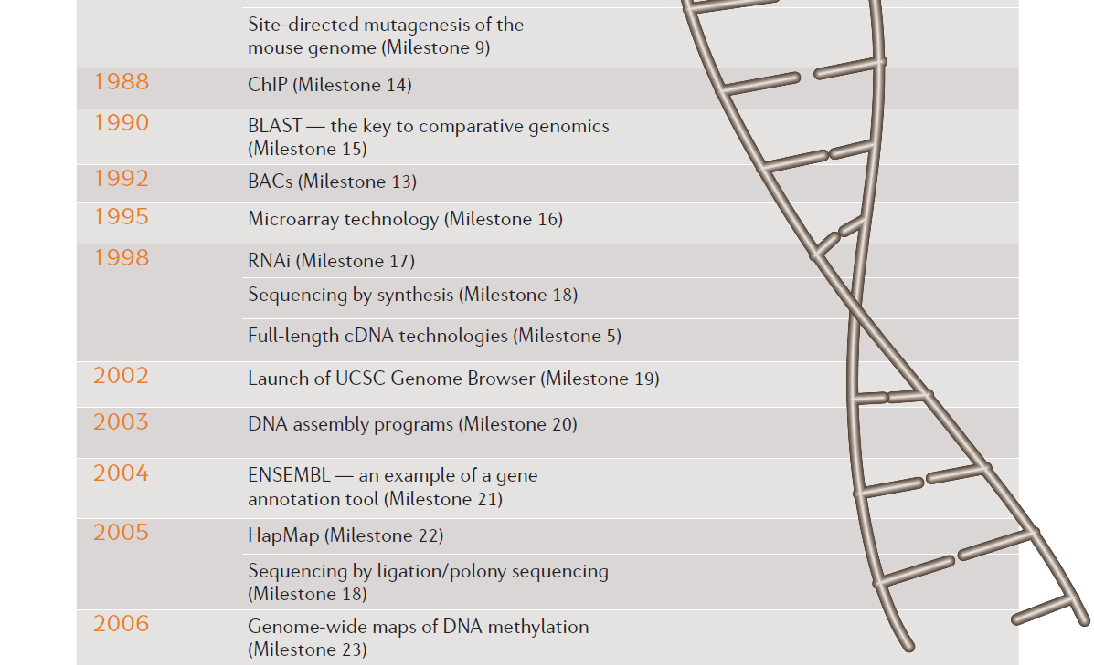

Slide 7

What about the most recent developments?
Let’s have a quick look (we will dig much deeper into many of these points later:
https://www.nature.com/immersive/d42859-020-00099-0/index.html

Slide 8

THE ORIGINS OF THE TERM «GENOMICS»
1987 -> the journal «Genomics» is founded
«For the newly developing discipline of [genome] mapping/sequencing (including analysis of the information) we have adopted the term GENOMICS.”

Slide 9
MAIN SUBJECT AREAS IDENTIFIED BY THE EDITORIAL
1) Chromosomal assignments of genes and DNA fragments by Mendelian and physical mapping approaches, including the description of new techniques
2) Reports of nucleic acid sequences of cloned genes or other interesting portions of a genome
3) Description of chromosomal and spatial distribution of gene families and genes that share nucleic acid or amino acid sequence domains
4) Comparative analyses of genomes to yield structural, functional, or evolutionary insights
5) Patterns of organization within the genome that provide insights into gene regulation and development

Slide 10
MAIN SUBJECT AREAS IDENTIFIED BY THE EDITORIAL
6) Methods for large-scale genomic cloning, restriction mapping, and DNA sequencing
7) Computational methods and descriptions of algorithms for the manipulation of DNA and protein sequence data
8) Novel means for representing and correlating DNA sequence, restriction endonuclease cleavage, and chromosomal gene mapping data-toward understanding the hierarchy of chromosome structure
9) Analysis of genetic linkage data in pursuit of information on inherited disorders
10) Development of experimental, computational, and database management techniques of broad applicability for obtaining or using data on human genome organization, as well as the illustration of innovative parallel studies on genomes from lower organisms.

Slide 11
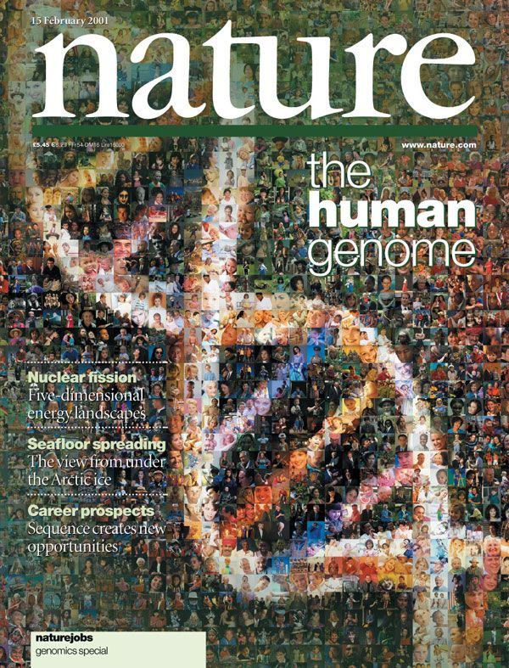
1990 – 2003 – THE HUMAN GENOME PROJECT
https://www.genome.gov
Estimated cost: about 2,7 billion dollars
Time required: 2 years less than originally planned
EXPECTED GOALS | OBTAINED GOALS
Sequencing 95% of the genome with 99,99% accuracy | Sequencing 99% of the genome (excluding repeats) with 99,99% accuracy
Mapping100,000 SNPs | Mapping 3,7 million SNPs
Sequencing a few model species: E. coli, S .cerevisiae, C. elegans, D. melanogaster | Goal met + mouse, rat and many others

Slide 12
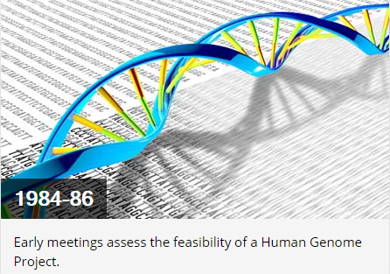
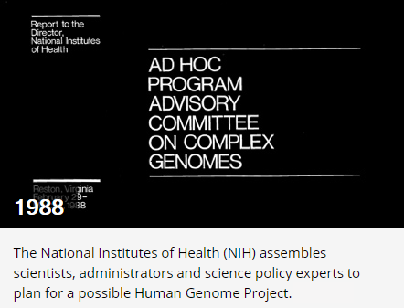
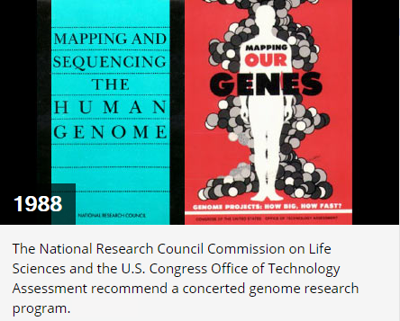
A ROADMAP TO THE HUMAN GENOME PROJECT

Slide 13
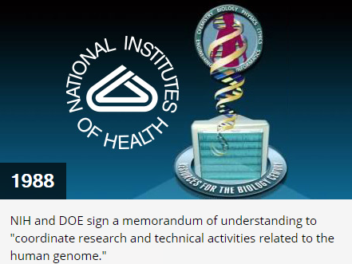
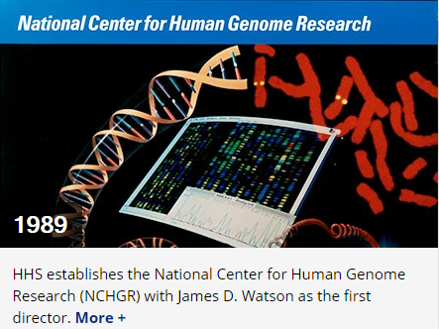
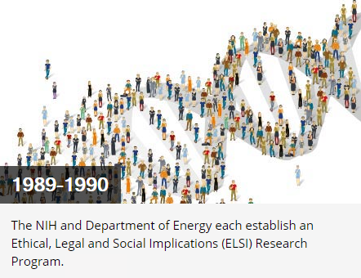
A ROADMAP TO THE HUMAN GENOME PROJECT

Slide 14
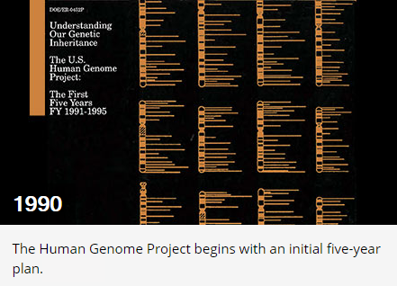
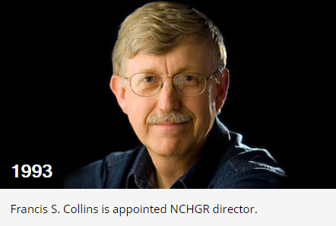
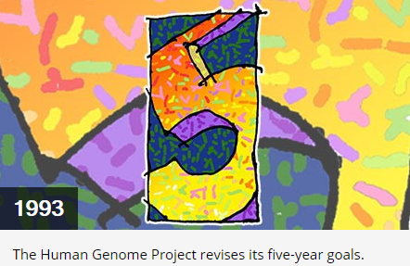
A ROADMAP TO THE HUMAN GENOME PROJECT
NHGR: National Human Genome Research Institute

Slide 15
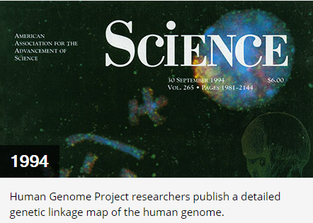
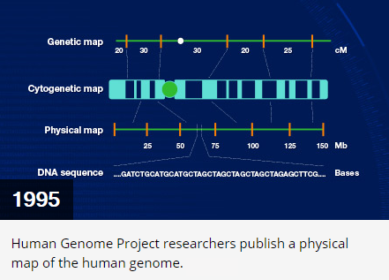
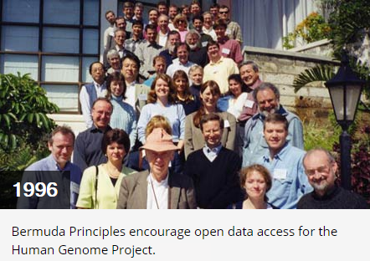
A ROADMAP TO THE HUMAN GENOME PROJECT
Physical map - definition
https://www.genome.gov/genetics-glossary/Physical-Map

Slide 16
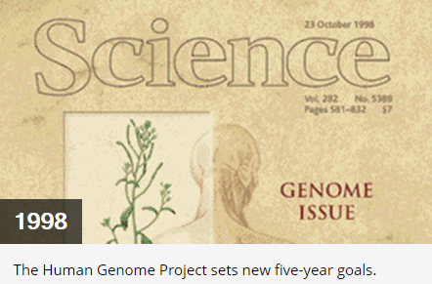
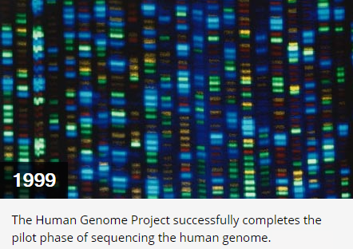
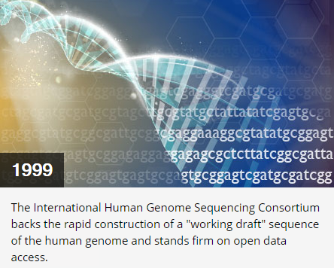
A ROADMAP TO THE HUMAN GENOME PROJECT

Slide 17
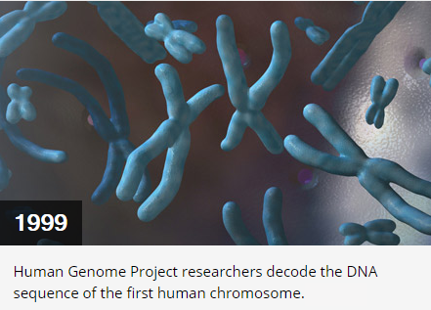
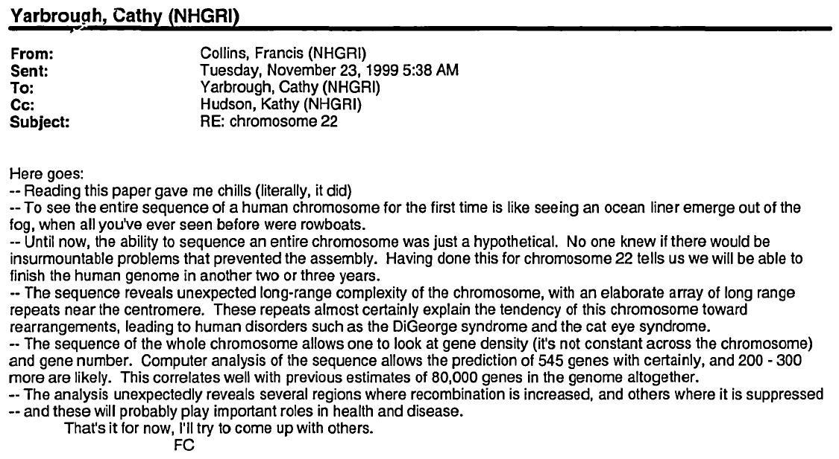
A ROADMAP TO THE HUMAN GENOME PROJECT
Mail sent by Francis Collins to Cathy Yarbrough after chromosome 22 was sequenced
N.B. PDF file available on Moodle

Slide 18
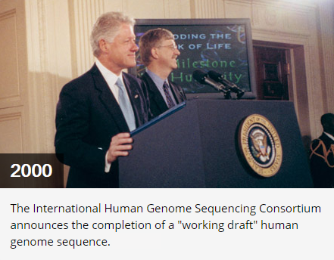
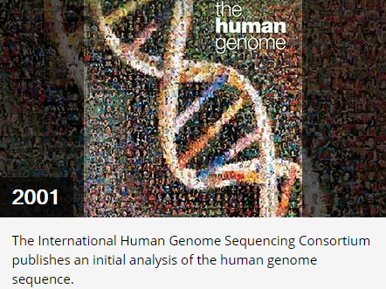
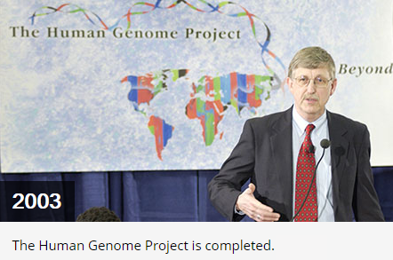
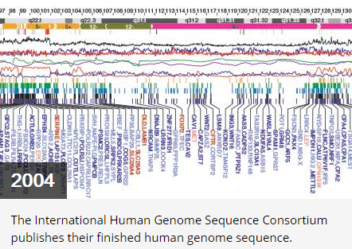
A ROADMAP TO THE HUMAN GENOME PROJECT
N.B. PDF file about the 2004 genome paper available on Moodle
N.B. PDF file about the 2001 genome paper available on Moodle

Slide 19
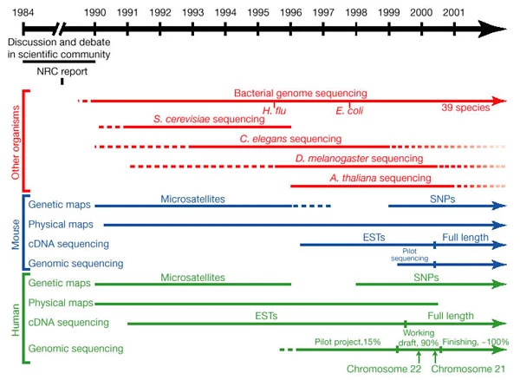
A COMPLETE TIMELINE OF THE HUMAN GENOME SEQUENCING PROJECT
Note the parallel development of side projects focused on other organisms
A brief glossary:
-SNPs: single nucleotide polymorphisms
-EST: expressed sequence tags –> the precursor of RNA-seq; it involved the generation and sequencing of cDNAs

Slide 20

UNA CURIOSITA’: IL PROGETTO PARALLELO DI CRAIG VENTER
Rather than the Human Genome Project we should speak of “Human Genome Projects,” since in 1998 Craig Venter, leader of the Institute for Genomic Research in Maryland, announced the founding of a private company called Celera Genomics, whose stated goal was to complete the sequencing of the human genome using its own team by 2001
There was a difference in philosophy: Venter believed the project was taking too long and believed (contrary to the Bermuda Agreement) that it was appropriate to secrete part of the human genome, covering the genes in patents and making them available to customers for a fee
All this led to a “rush” to assemble, which encouraged an acceleration of the HGP. Eventually both projects achieved their goal in 2001, leading to a joint announcement in which all were winners (albeit with two separate publications)
N.B. a brief article about this story is available on Moodle

Slide 21
A LONG LIST OF COMPANION PAPERS…
A physical map of the human genome. The International Human Genome Mapping Consortium. Nature 409, 934-941
The sequence of the human genome. The Celera Genomics Sequencing Team. Science Feb 16 2001: 1304-1351.
The physical maps for sequencing human chromosomes 1, 6, 9, 10, 13, 20 and X. D. R. Bentley, et al. Nature 409, 942-943
A physical map of the human Y chromosome. Charles A. Tilford, et al. Nature 409, 943-945
A high-resolution map of human chromosome 12. Kate T. Montgomery, et al. Nature 409, 945-946
A physical map of human chromosome 14. Thomas Brüls, et al. Nature 409, 947-948
Integration of telomere sequences with the draft human genome sequence. H. C. Riethman, et al. Nature 409, 948-951
Comparison of human genetic and sequence-based physical maps. Adong Yu, et al. Nature 409, 951-953
Integration of cytogenetic landmarks into the draft sequence of the human genome. V. G. Cheung, et al. Nature 409, 953-958
Mining the draft human genome. Ewan Birney, et al. Nature 409, 827-828
Keeping time with the human genome. Jonathan D. Clayton, et al. Nature 409, 829-831
Expressing the human genome. Rossella Tupler, et al. Nature 409, 832-833
Functional annotation of mouse genome sequences. Joseph H. Nadeau, et al. Science Feb 16 2001: 1251-1255.
A genomic perspective on membrane compartment organization. Jason B. Bock, et al. Nature 409, 839-841
Genomics, the cytoskeleton and motility. Thomas D. Pollard. Nature 409, 842-843
Can sequencing shed light on cell cycling?. Andrew W. Murray, et al. Nature 409, 844-846
Evolutionary analyses of the human genome. Wen-hsiung Li, et al. Nature 409, 847-849
Experimental annotation of the human genome using microarray technology. D. D. Shoemaker, et al. Nature 409, 922-927
Guide to the draft human genome. Tyra G. Wolfsberg, et al. Nature 409, 824-826

Slide 22
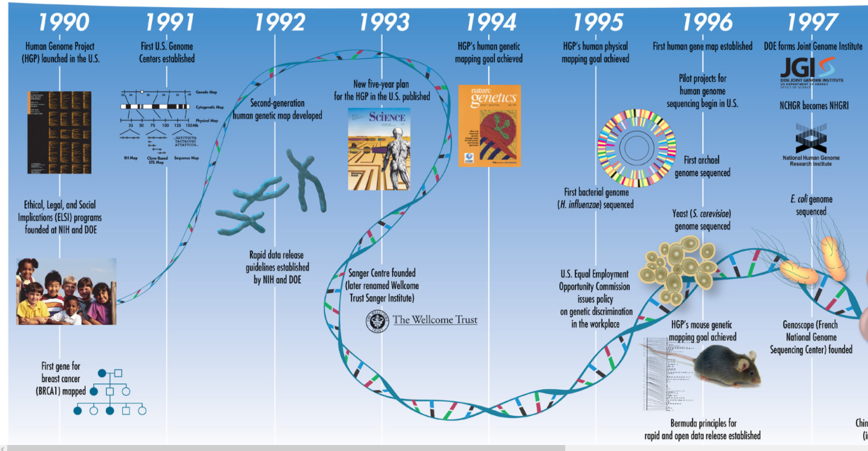
THE HUMAN GENOME AS A DRIVER FOR THE GLOBAL DEVELOPMENT OF GENOMICS

Slide 23
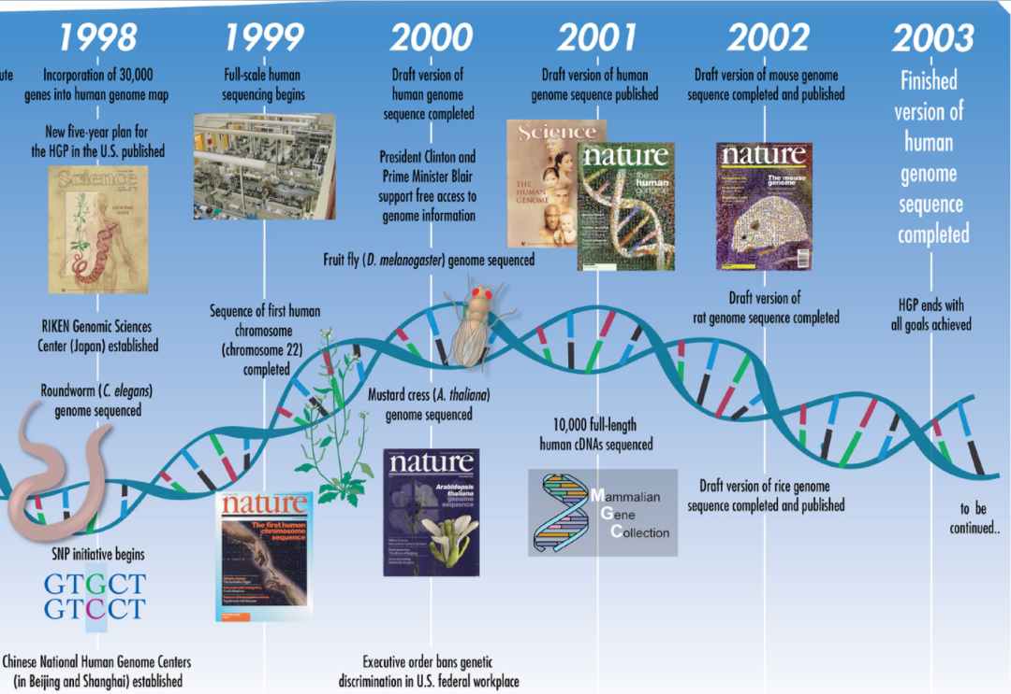
THE HUMAN GENOME AS A DRIVER FOR THE GLOBAL DEVELOPMENT OF GENOMICS

Slide 24
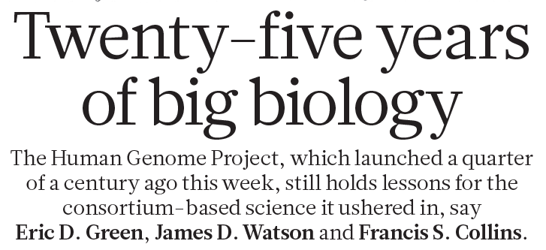
THE FIST 25 YEARS OF GENOMICS (NOW, 35!)
What are the new goals that can be achieved?
How have sequencing technologies (and costs) changed over the years?
What additional potential do advances in computer science offer for the analysis of genomic data?

Slide 25
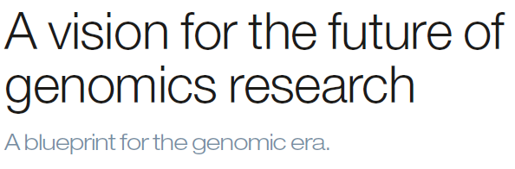
THE NEW FRONTIERS IN HUMAN GENOMICS…
Collins et al. 2003, Nature
«the successful completion this month of all of the original goals of the HGP emboldens the launch of a new phase for genomics research, to explore the remarkable landscape of opportunity that now opens up before us. […] If we, like bold architects, can design and build this unprecedented and noble structure, resting on the firm bedrock foundation of the HGP, then the true promise of genomics research for benefiting humankind can be realized.”

Slide 26
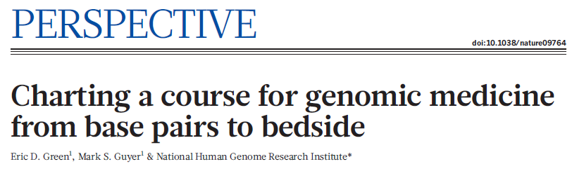
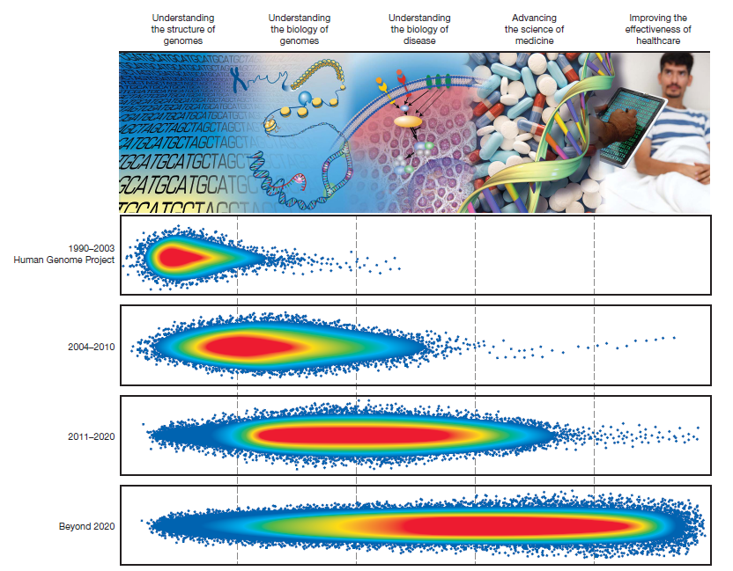
…REVISITED IN 2011…
Green et al. 2011, Nature
«Progress in genomics has been monumental. Although staggering challenges remain, the fundamental goals have not changed—genomics and related large-scale biological studies will, in ways not previously available, lead to a profound understanding about the biology of genomes and disease, to unimagined advances in medical science, and to powerful new ways for improving human health.”

Slide 27
…AND PROJECTED IN THE FUTURE
BOLD PREDICTIONS FOR HUMAN GENOMICS BY 2030
Generating and analyzing a complete human genome sequence will be routine for any research laboratory, becoming as straightforward as carrying out a DNA purification.
The biological function(s) of every human gene will be known; for non-coding elements in the human genome, such knowledge will be the rule rather than the exception.
The general features of the epigenetic landscape and transcriptional output will be routinely incorporated into predictive models of the effect of genotype on phenotype.
Research in human genomics will have moved beyond population descriptors based on historic social constructs such as race.

Slide 28
BOLD PREDICTIONS FOR HUMAN GENOMICS BY 2030
Studies that involve analyses of genome sequences and associated phenotypic information for millions of human participants will be regularly featured at school science fairs.
The regular use of genomic information will have transitioned from boutique to mainstream in all clinical settings, making genomic testing as routine as complete blood counts.
The clinical relevance of all encountered genomic variants will be readily predictable, rendering the diagnostic designation ‘variant of uncertain significance (VUS)’ obsolete.
An individual’s complete genome sequence along with informative annotations will, if desired, be securely and readily accessible on their smartphone.
Individuals from ancestrally diverse backgrounds will benefit equitably from advances in human genomics.
Breakthrough discoveries will lead to curative therapies involving genomic modifications for dozens of genetic diseases.

Slide 29

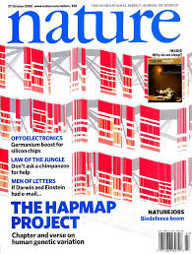
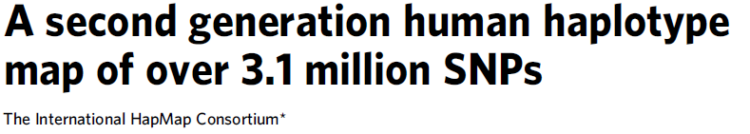
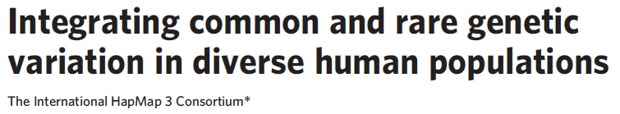
STUDY OF GENETIC VARIATION (NOT JUST IN HUMAN)
The HapMap project: toward building an atlas of human genetic variation

Slide 30
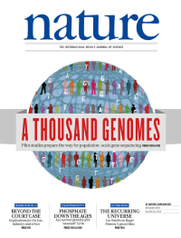
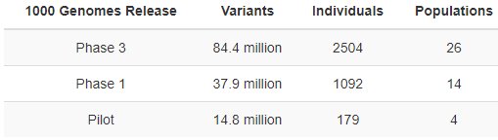
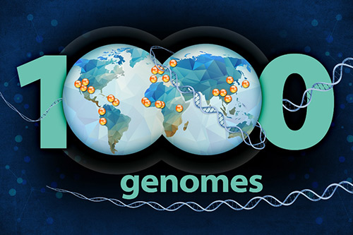
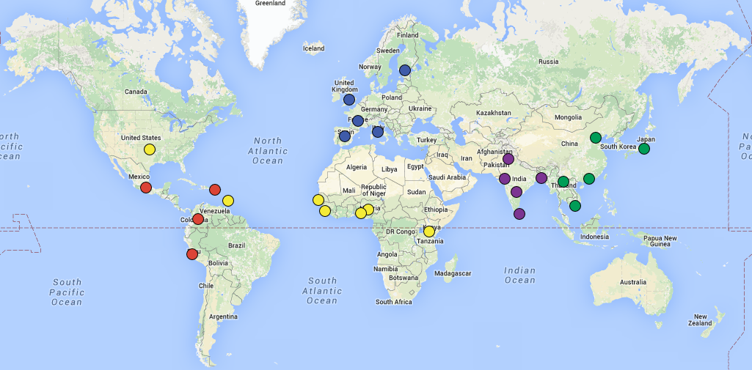
1000K GENOMES PROJECT
Nature, 2010
Data about 2535 individuals belonging to 26 populations

Slide 31
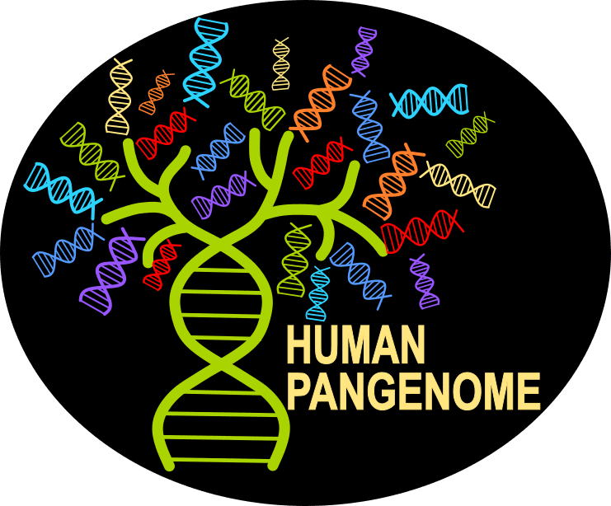
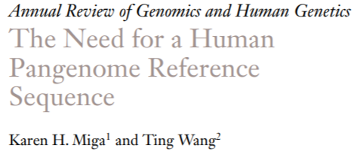
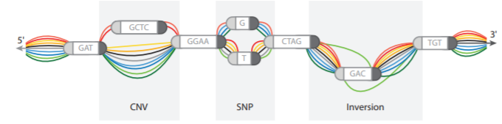
IS A «REFERENCE GENOME» ENOUGH?
The Human Pangenome Reference Consortium
A single reference genome cannot summarize human (or any other species) genetic diversity
Structural variation exists = genomic regions not shared by all individuals
Pan-genome = collection of core regions shared by all individuals + dispensable regions, which may be absent in some individuals

Slide 32
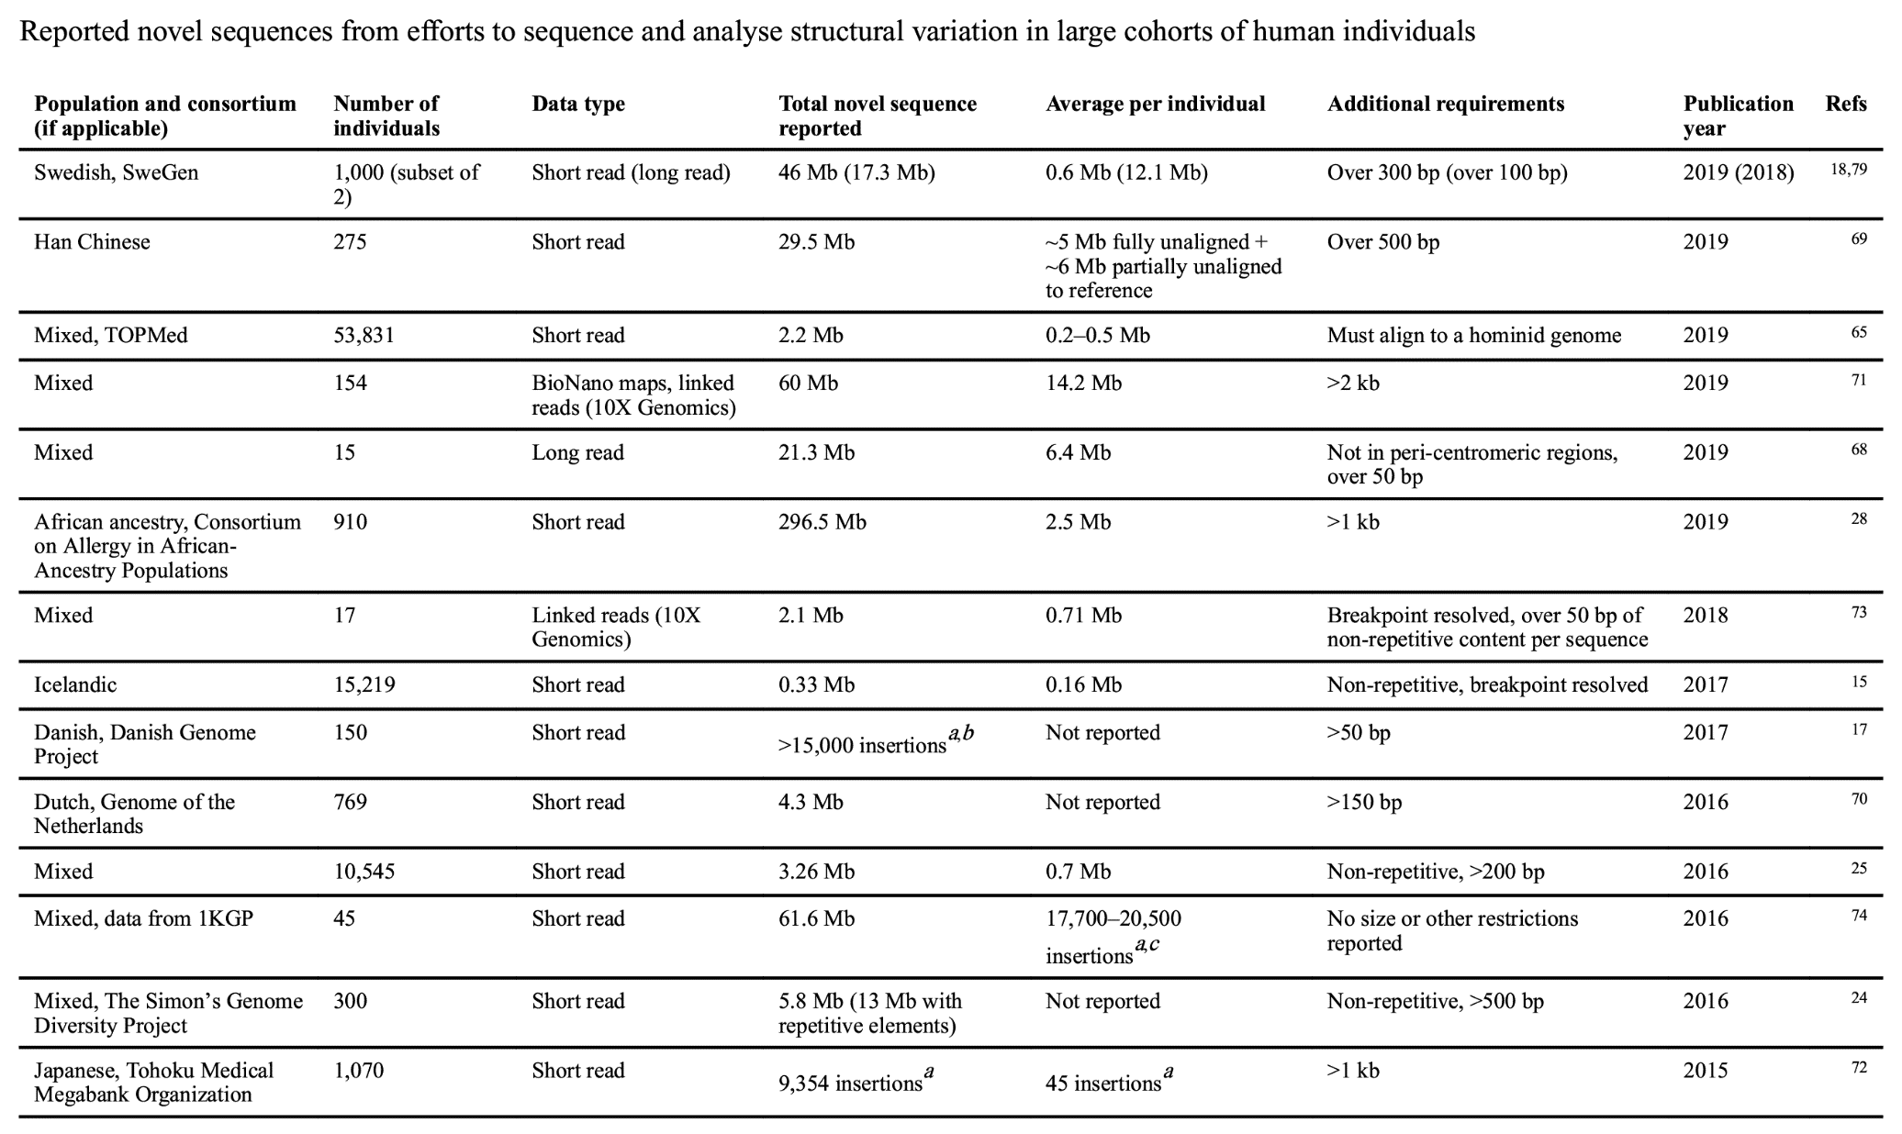
IS A «REFERENCE GENOME» ENOUGH?
This table reports the amount of accessory genomic sequence NOT included in the reference human genome identified by genomic resequencing of multiple individuals

Slide 33
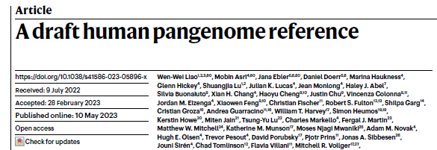

HUMAN PANGENOME CONSORTIUM – THE FIRST RESULTS
Complete re-sequencing of 47 human genomes (94 different haplotypes)
Recovery of sequence data not included in the reference genome (=structural variations)
119 million accessory base pairs added to the reference assembly
1115 gene duplication events detected not included in the reference genome
34% improvement in accuracy of small variation detection (SNPs and indels)
This article (Liao et al. 2023) is available on Moodle

Slide 34



THE T2T CONSORTIUM – THE NATURAL BROTHER OF HGP
Although the sequencing of the human genome had long been declared complete, in reality a considerable portion of our chromosomes remained, in fact, unknown, as they were characterized by extreme repetitiveness, which prevented the completion of assembly
Centromeric regions
Telomeric and subtelomeric regions
High-copy number repeat gene clusters (rRNAs)
Large part of the Y chromosome

Slide 35


THE T2T CONSORTIUM – THE NATURAL BROTHER OF HGP
Next you can see (in red) the new regions completed by the T2T consortium
Not just repetitive regions! 1956 new genes, 99 of them protein-coding
The reference article is available on Moodle
Method: DNA sequencing of a hydatidiform mole (an abnormal form of pregnancy in which a sperm fertilizes an egg that has lost its DNA, then leading by duplication of the paternally derived genome to a diploid 46, XX or 46, XY karyotype). The genome is in complete homozygosity, thus limiting assembly problems related to sequence variations normally found between die haplotypes (of maternal and paternal origin)

Slide 36

THE T2T CONSORTIUM – THE NATURAL BROTHER OF HGP
N.B: The T2T genome was obtained from a 46 karyotype, XX, thus lacking the Y chromosome. This was obtained through a second study (available on Moodle)
In the genome generated by the HGP, about 50% of the genomic sequence of the Y chromosome was missing!
This was due to the presence of numerous inverted tandem repeats in the long arm
The T2T-Y assembly resolved the pseudoautosomal region (responsible for the pairing of X and Y chromosome in metaphase plate) and clarified the sequence of several other highly complex regions.

Slide 37

OUR GENOME IN NUMBERS
About 3.055 Gb (3 billion base pairs) in humans (except chrY, which includes about 60Mb of additional sequence, thus bringing the total sequence to about 3.1Gb). “Standard” size for mammals
Size NOT PROPORTIONAL to morphological complexity of organisms (c-value paradox)
Wide variability within the same phyla
Large impact of repetitive elements on the size (and structure) of a genome
Lungfish genome >100 Gb!
Pufferfish (Fugu) 380 Mb (millions of base pairs)

Slide 38

OUR GENOME IN NUMBERS
About 3-5 million SNPs in each human genome
Each individual carries about 60 de novo mutations relative to its parents
Humans are a species characterized by a LOW level of inter-specific genetic variability
In other species, genetic variation is enormous, even in direct comparison between homologous chromosomes
We will discuss the number of genes in each genome later, when we address the topic of annotation

Slide 39
THE ISSUE OF MONEY…
Recall that the cost of sequencing the human genome was $2.7 billion
In 2003, Collins wrote, referring to the goals that would be achievable in the case of “technological leaps,” proposing it as a way to stimulate a form of “creative dreaming.”
«the ability to sequence DNA at costs that are lower by four to five orders of magnitude than the current cost, allowing a human genome to be sequenced for $1,000 or less”

Slide 40


…PRETTY MUCH SOLVED!
Today the cost of sequencing DNA using NGS (Next Generation Sequencing) approaches is less than a hundredth of $ per Mb -> $1000 for a complete genome

Slide 41

The availability of new technologies also leads to a change in approach
Strategy used by the HGP on the left (Sanger sequencing)
“Modern” approach based on next generation sequencing techniques on the right

Slide 42


THE $1000 GENOME GOAL HAS ALREADY BEEN MET (THE 100$ GENOME GOAL IS NEXT)
Illumina HiSeq X
Released to the market in 2015
N.B. the cost is for sequencing only! This leaves laboratory costs for extraction, purification, and library preparation (quite low) + costs for bioinformatic data analysis

Slide 43
TO GET A BASIC IDEA…
Re-sequencing a human genome (or any genome in the same order of magnitude) with Illumina technologies today costs about 1,000 euros
De novo sequencing of an organism for which a genome is not available requires a combination of other sequencing techniques. A “chromosome-scale” assembly of a vertebrate can be achieved for less than 10000 euros
The transcriptome of a human sample can be sequenced for less than 100 euros for a “basic” approach (quantification of expression levels); more advanced approaches (alternative splicing study, etc.) require a few hundred euros
Sequencing of viral and microbial genomes has negligible costs (the major cost is related to the preparation of libraries)

Slide 44


THE ISSUE OF TIMING… SOLVED
The human genome has been sequenced with Sanger technologies over a period of several years, reaching a rate of about 1,400Mb of sequence obtained per year (N.B. to sequence a genome you need to get significantly higher coverage than 1X!)
Compare this to the outputs that an Illumina sequencer today can produce in 24 hours or so

Slide 45


MAIN IMPLICATIONS FOR HUMAN HEALTH
Ability to explore the relationships between genotype and phenotype on a much finer scale than in the past
Let us remember that we do not know the effect of most mutations and that we still do not know the function of a great many human genes (all the more reason we know nothing or almost nothing about non-model organisms!).

Slide 46


MAIN IMPLICATIONS FOR HUMAN HEALTH
GWAS – Genome Wide Association Studies
Association between SNPs and phenotypic traits (usually presence of a disease related to genetic traits)
Not just GWAS…
Ability to use panels of target genes or genome fractions for targeted sequence analysis
Commercial panels applied for example in cancer genomics or for screening genetic variations associated with diabetes, hypertension, neurodegenerative diseases, etc.

Slide 47




MAIN IMPLICATIONS FOR HUMAN HEALTH
Cancer genomics (+transcriptomics & epigenomics): a new discipline
Single cell approaches: transcriptomics and more
Major international initiatives such as the Cancer Genome Atlas
Toward the development of personalized medicine/precision medicine

Slide 48


MAIN IMPLICATIONS FOR HUMAN HEALTH
“All of us” program (originally called ‘Precision Medicine Initiative Cohort Program’)
https://allofus.nih.gov/
Established in 2015 with an NIH appropriation of $130 million, with budget then increased year by year“
“The mission of AoU is to accelerate health and medical breakthroughs, enabling individualized prevention, treatment and care from all of us.”
This is not a genomics-only project, but of course it involves the massive collection of genetic data
By 2025, All of US has already enrolled nearly 300000 partecipants

Slide 49

BESIDES HUMAN GENOMICS, WHICH ARE THE MAIN OTHER FIELDS OF APPLICATION?
Comparative genomics and conservation genomics
Vertebrates Genome Project – goal: sequencing the genome of all extant vertebrate species
https://vertebrategenomesproject.org

Slide 50


BESIDES HUMAN GENOMICS, WHICH ARE THE MAIN OTHER FIELDS OF APPLICATION?
Earth BioGenome Project – goal: obtain the genome sequence of all living organisms!
https://www.earthbiogenome.org

Slide 51

THE EBG ROADMAP
Lewin et al. 2018, PNAS
«with the current cost of US $1,000 (and plummeting rapidly) for sequencing an average vertebrate-sized genome to draft level, genomes of all ∼1.5 million known eukaryotes, up to 100,000 new eukaryotic species, and a defined number of eDNA samples from biodiversity hotspot collection sites can be sequenced to a high level of completeness and accuracy for approximately US $4.7 billion”

Slide 52


NOT JUST CONSERVATION GENOMICS: DE-EXTINCTION PROJECTS
There are those who go beyond simply conserving endangered species, and even plan the revival of species that have been extinct for thousands of years
Beyond these futuristic projects, this approach is most interesting for the study of evolution
https://www.nature.com/articles/s41587-021-01096-y

Slide 53





EVOLUTIONARY GENOMICS: THE MAMMOTH EXAMPLE
De-extinction projects? Let’s have a look at Colossal Biosciences: https://colossal.com

Slide 54

GENOMICS AND EVOLUTION IN HOMINIDS
Svante Pääbo, Nobel Laureate 2022
Application of genomics to the study of ancient DNA
The Neanderthal Genome Project
Obtaining the complete genome of Neanderthal man - published in Nature January 2014
Article available on Moodle!

Slide 55





BESIDES HUMAN GENOMICS, WHICH ARE THE MAIN OTHER FIELDS OF APPLICATION?
COUNTLESS POSSIBILITIES… JUST A FEW EXAMPLES LISTED HERE
LIVESTOCK GENOMICS
AGRICULTURAL GENOMICS
PATHOGEN GENOMICS
BIODIVERSITY GENOMICS
ENVIRONMENTAL METAGENOMICS

Slide 56

THE DIFFERENT LAYERS OF COMPARATIVE GENOMICS

Slide 57

THE DIFFERENT LAYERS OF COMPARATIVE GENOMICS
Practical example: Genomic comparison between Sarbecoviruses
Detection of recombination events
Identification of regions under positive selection and hypervariable sites
Estimation of evolutionary divergence times using phylogenomic approaches

Slide 58


GENOMICS AND EVOLUTION
Studying species evolution
Studying adaptation to different environments
Evo-devo studies
Classical example:
Hox gene cluster study

Slide 59



GENOMICS AND EVOLUTION
Identification of massive gene gain or gene loss events, often related to adaptation
Study of polyploidization events (e.g., salmon)
Study of pangenomes (e.g., bacteria, some plants, fungi, but probably also some metazoans)

Slide 60


MOVING TO EPIGENOMICS
Nature, 2012
Genomics + epigenomics -> transcriptomics (and, thereby, proteomics)
Towards an integrated multi-disciplinary approach -> multi-omics

Slide 61

THE ENCODE PROJECT – AN INTEGRATED VIEW ON THE REGULATION OF GENE EXPRESSION
«The goal of ENCODE is to build a comprehensive parts list of functional elements in the human genome, including elements that act at the protein and RNA levels, and regulatory elements that control cells and circumstances in which a gene is active.”

Slide 62

NOT JUST DNA - TRANSCRIPTOMICS
Several of the genomic techniques we will study in the next few lectures are also applicable to the study of RNA molecules, with appropriate modifications
Transcriptomics studies (large-scale simultaneous analysis of all mRNAs expressed in a biological sample, had already begun with microarrays
These have gradually been replaced by RNA-sequencing approaches, which are cheaper, more accurate and applicable even to non-model organisms without the need for a reference genome
An emerging and rapidly growing field is represented by «spatial transcriptomics», based on single-cell approaches

