Slide 1
LEZIONE 3 DNA sequencing technologies

Slide 2
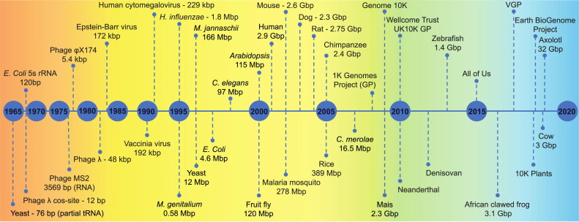
The long walk to genome sequencing
Moving towards more and more ambitious targets
Larger and more complex genomes become increasingly feasible

Slide 3
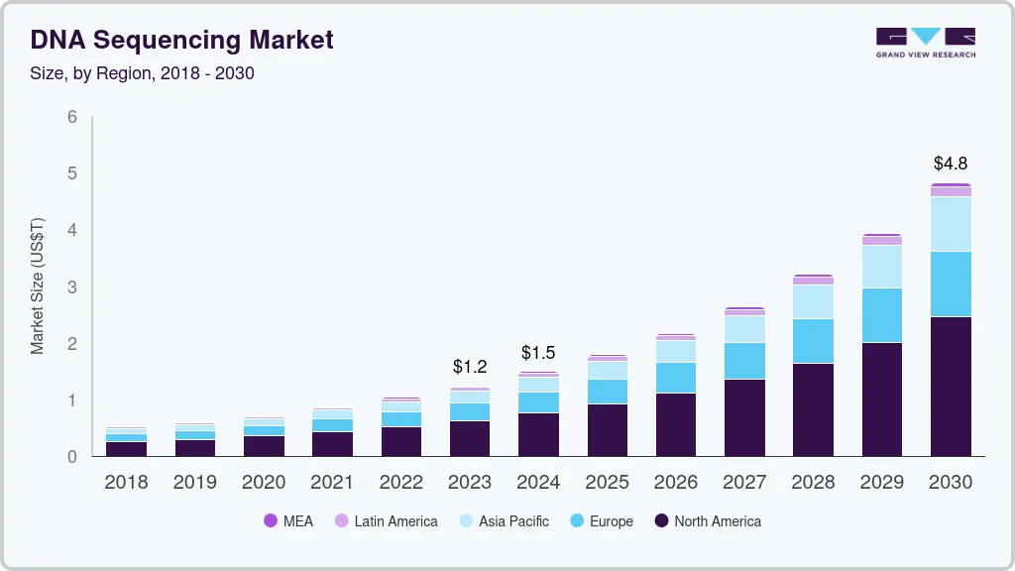
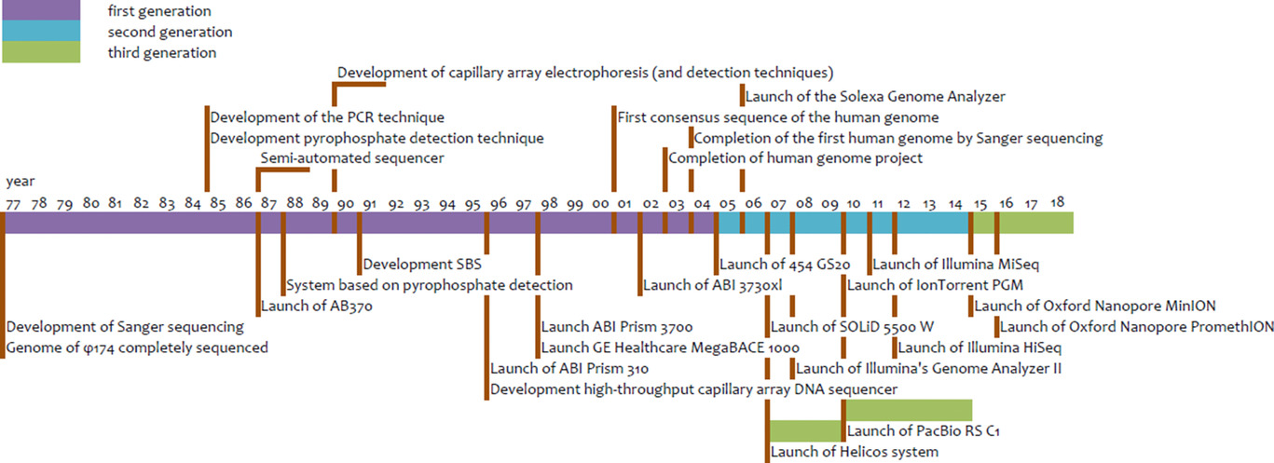
Sequencing market demand grows exponentially
The market demand for DNA sequencing resources grows very rapidly
The DNA Sequencing Market Size was valued at USD 12.39 billion in 2023 and is projected to grow to USD 48.22 Billion in 2030

Slide 4

Service vs technology costs
As mentioned previously, the cost of sequencing has been lowered in a way that no one could have predicted within a few years, to the point that the $1000 genome goal has already been reached and the $100 genome goal no longer seems like a mirage
But how much technology is behind a next-generation sequencer?
Illumina is currently the leading company in the field
A NovaSeq 6000 sequencer that can generate a human genome in less than 48 hours at a cost of less than $1,000 has a market cost of about $350,000!

Slide 5
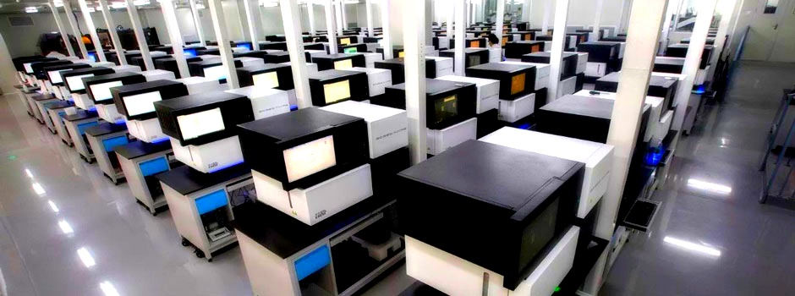
A large sequencing center looks something like this....
Add to this the costs related to reagents needed for sequencing, those needed for hardware and data storage resources (hundreds of Tb of sequence data), and those of technical personnel...

Slide 6
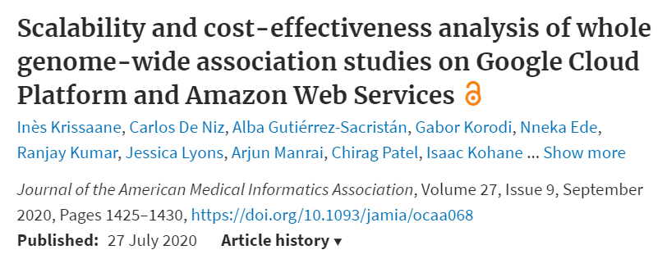

Are we «drowning» in data?
The problem, rather than being one of generating the data affordably and in a reasonable timeframe, now seems to be one of finding ways to manage it
A REAL EXAMPLE
In 2014, the Cancer Genome Atlas offered $18M to anyone who could move 2.6 petabytes of data to a cloud
Giants of the caliber of Google and Amazon are very sensitive to this issue, partly for reasons of economic perspective, offering to maintain a copy of any sequenced genome at a cost of 25 euros per year (which equates to about 0.02 euros per Gb of data - on average a genome file takes up 100 to 400 Gb).

Slide 7
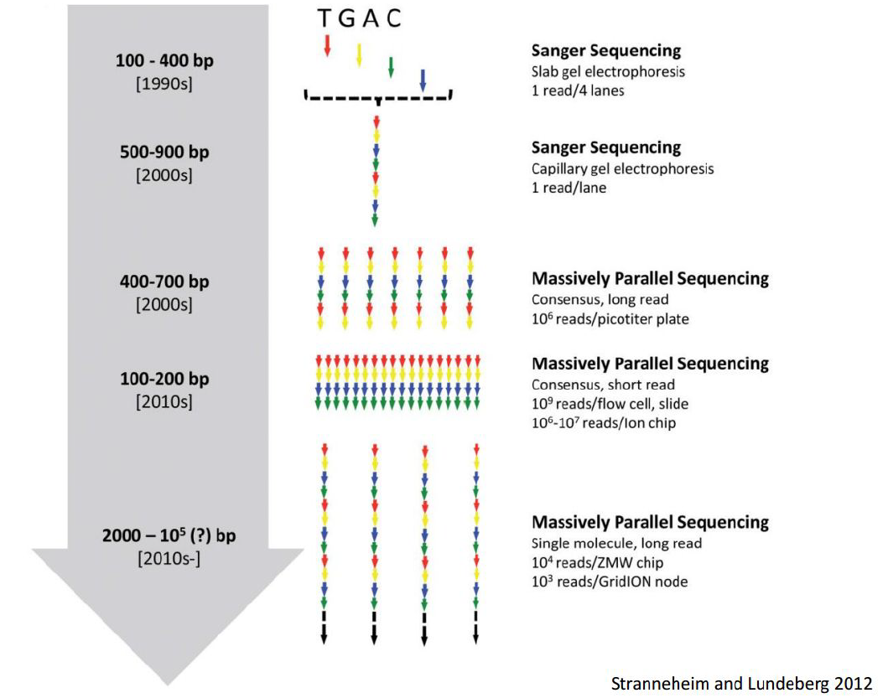
Sequencing – the evolution of «throughput»
Throughput refers to “processivity,” or the amount of data produced by a sequencer per unit time
There has been a shift from low-throughput (Sanger) to high-throughput techniques within a decade
At the same time, we are seeing a clear differentiation of applications for ultra-high-throughput sequencing (short reads produced in the hundreds of millions/billions) and single-molecule sequencing (extremely long reads, but in smaller quantities)

Slide 8
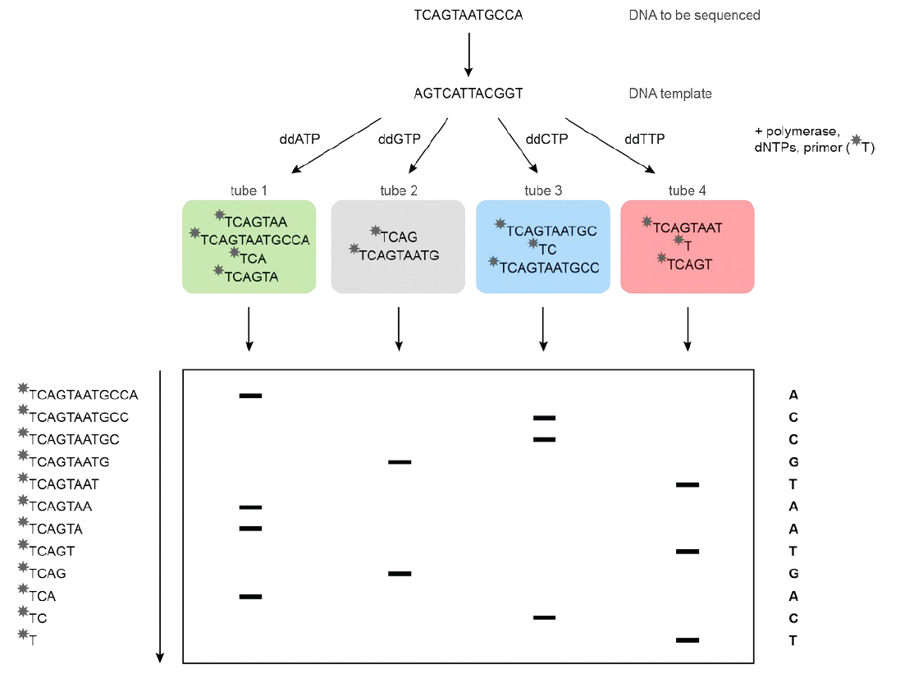
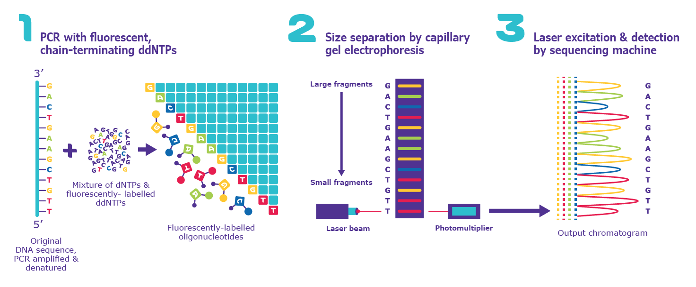
It all started with Sanger…
CONS
Rather laborious and, above all, very expensive methodology!
Definitely a low-throughput approach
PROS
Fairly long (up to 900bp) and accurate (few errors) reads
OK for small projects

Slide 9
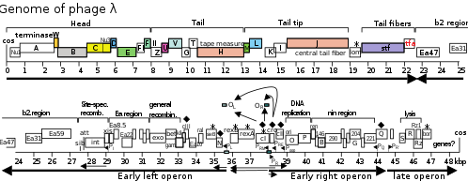
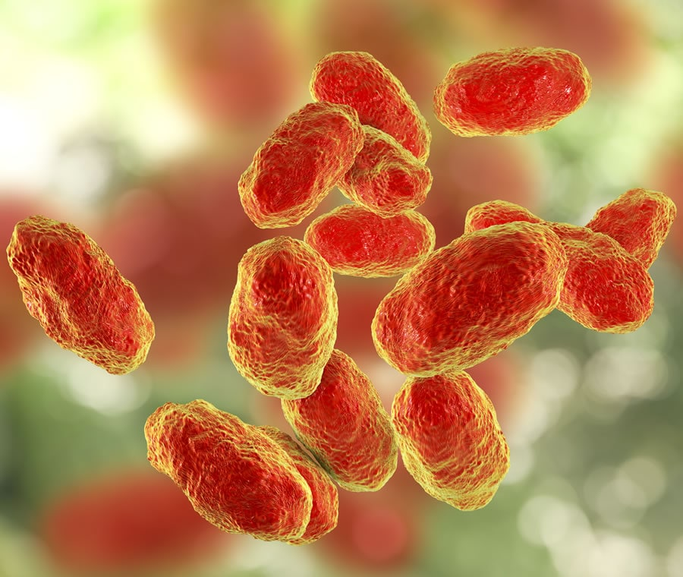
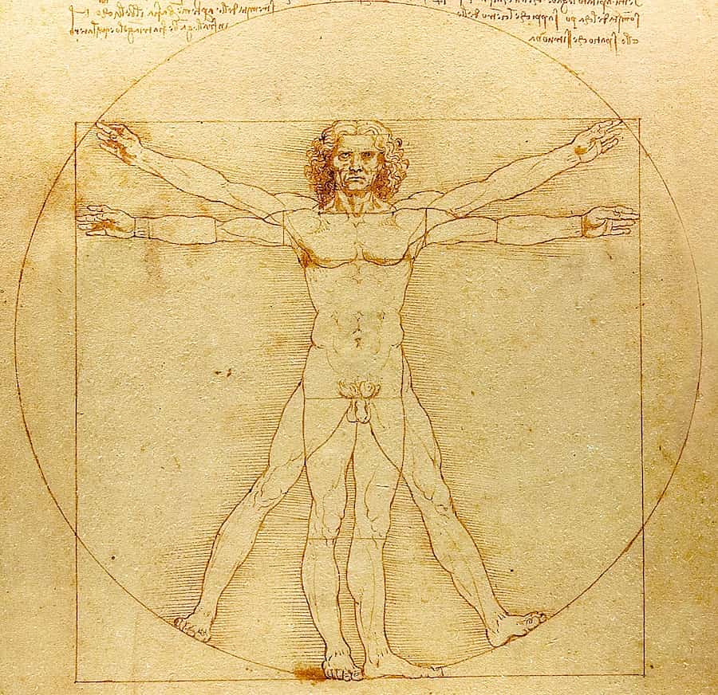

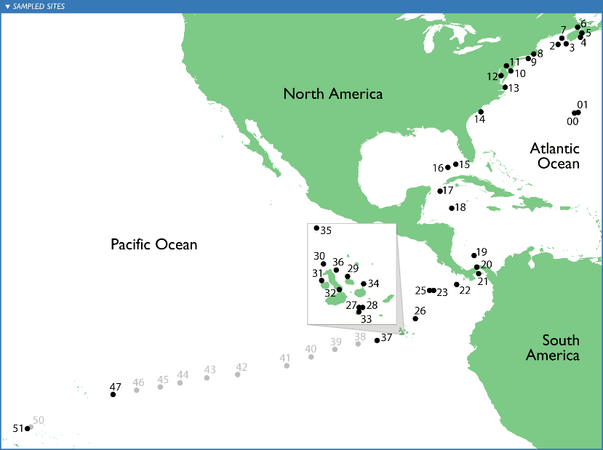
Let's not forget the great results obtained through this technique!
1980 – Lambda virus (30-40 Kb)
1994 – H. influenzae (1.8 Mb)
2001 – H. sapiens e D. melanogaster (up to 3Gb)
2007 – Global Ocean Sampling Expedition (first large metagenomics data collection)
NB: the HGP project was entirely run with Sanger sequencing!

Slide 10
What have been the causes of the rapid development of “next-generation” sequencing?
Rationale: as mentioned previously, the Human Genome Project was a driving force.
Applications: genome assembly required raw data with certain characteristics (e.g., length) that for other applications were not strictly necessary -> differential gene expression studies, resequencing, etc. (these would only require short reads, i.e. the number of reads is more important than their length). The need for accuracy (i.e. low error rate) is also a key factor for some applications
Technological advances: development of commercial analysis platforms, distribution of user-friendly software, hardware and network quality improvements for data transfer
Birth of sequencing centers: experience and skills originally of a few become available to many; governments begin to invest in genomics, seeing its potential in various areas

Slide 11
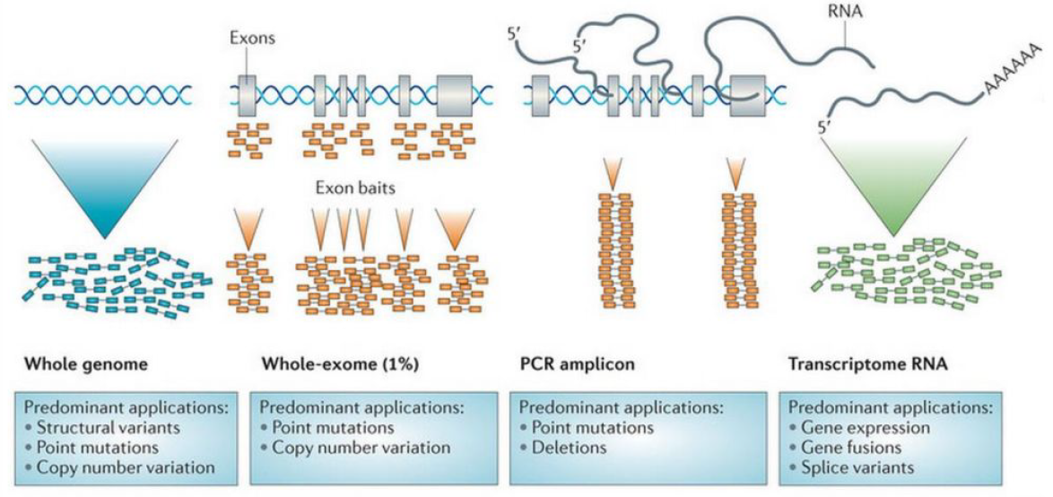
Broad range of applications: not just whole genome sequencing!
N.B. we also speak generically of “DNA sequencing” when referring to sequencing of RNA molecules because, due to their perishability, these must be converted to cDNA before being analyzed (we will see the exception of Oxford Nanopore sequencing)

Slide 12
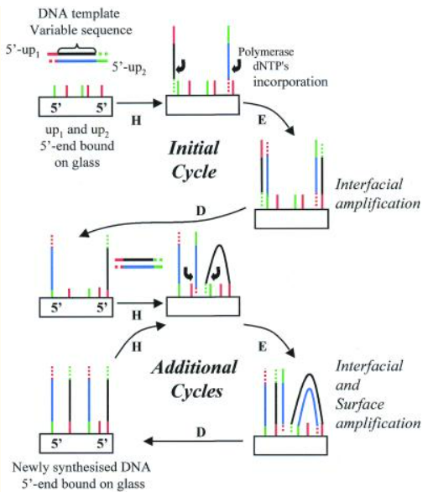
Polony sequencing: the breakthrough
The concept of “polony sequencing” has been chased, with mixed success, since the 1990s, but it was not until the mid-2000s that it found success with the development of techniques (and platforms) capable of generating reads of a useful length for analytical purposes
Polony = Polymerase colony
«Polymerase colony, or polony, technologies perform multiplex amplification while maintaining spatial clustering of identical amplicons”
It is possible to use an emulsion amplification of DNA fragments. Today this term is used as a synonym for “cluster” but, in reality, we must remember that this is inappropriate, as the term cluster refers to solid-phase amplification typical of Illumina technology
Adessi et al. 2000
Paper available on Moodle

Slide 13
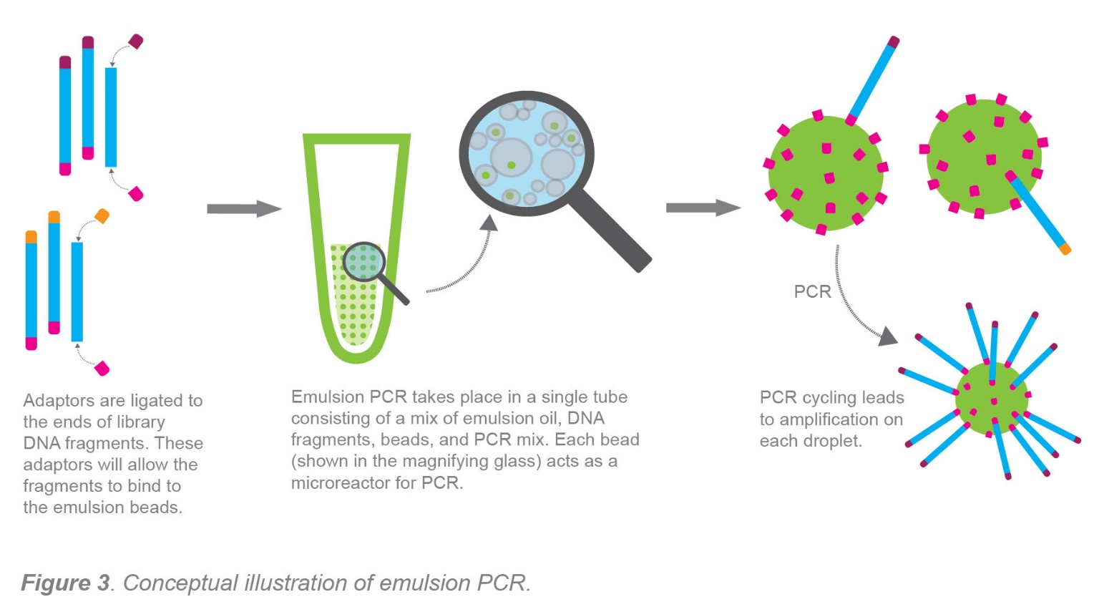
Emulsion PCR: a definition
“Emulsion PCR (EmPCR) is a commonly employed method for template amplification in multiple NGS-based sequencing platforms. The basic principle of emPCR is dilution and compartmentalization of template molecules in water droplets in a water-in-oil emulsion. Ideally, the dilution is to a degree where each droplet contains a single template molecule and functions as a micro-PCR reactor”
Kanagal-Shamanna 2016
Dressman et al. 2013, PNAS
Reference paper for emulsion PCR
https://dx.doi.org/10.1073%2Fpnas.1133470100

Slide 14
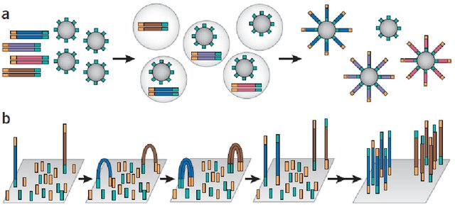
Emulsion PCR vs bridge PCR
The figure below displays a comparison between:
Emulsion PCR (454 pyrosequencing, IonTorrent) -> generation of proper polonies, clonal amplification in water droplets present in emulsion using microbeads
Bridge PCR (Illumina) -> Cluster generation, clonal amplification by exploiting a solid support
In both cases, clonal amplification is ensured by the addition of adapters to the ends of the fragments to be sequenced with the generation of a sequencing library. Adapters are sequences complementary to those immobilized on the beads or on a solid support

Slide 15
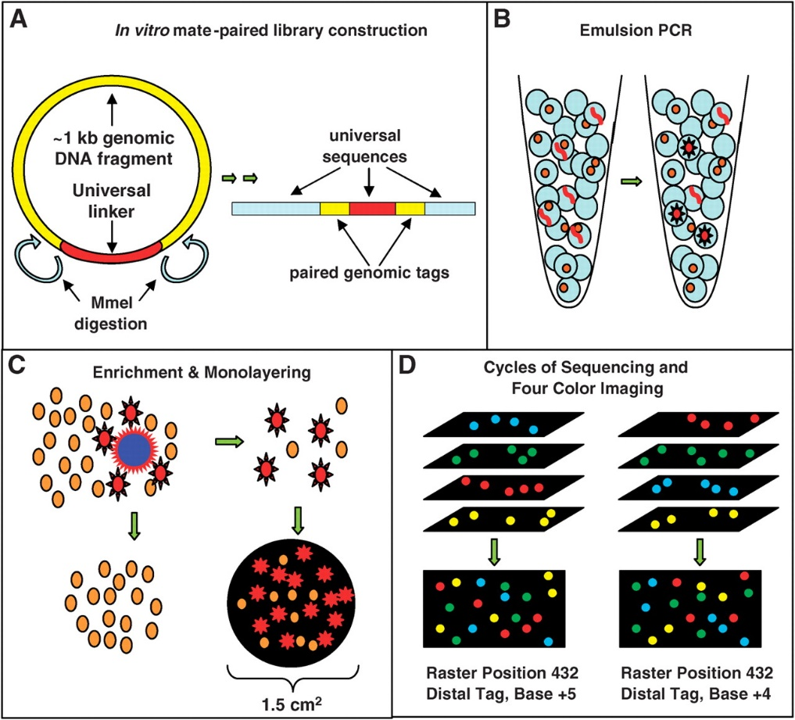
Why do we talk about «next-generation sequencing»/NGS?
The real revolution stands in ultra-high throughput
Each sequencing run can generate hundreds of millions of reads (now billions) of limited length
Reads are obtained by the presence of a high-resolution optical reader, which records the light signal obtained for each polony, which is physically associated with very precise coordinates of the solid support (N.B. as we will see, in some modern sequencers the sequence is not determined anymore by optical readers)
Timelines are much shorter, and the total cost is enormously lower (cost per sequenced base)
Several different technologies have been developed over the years… Illumina, IonTorrent (LifeTechnologies), 454 (Roche), SOLiD (Applied Biosystems), etc. –> MANY OF THESE ARE ALREADY “DEAD” (they have been replaced by their improved successors)
Shendure et al. 2005

Slide 16
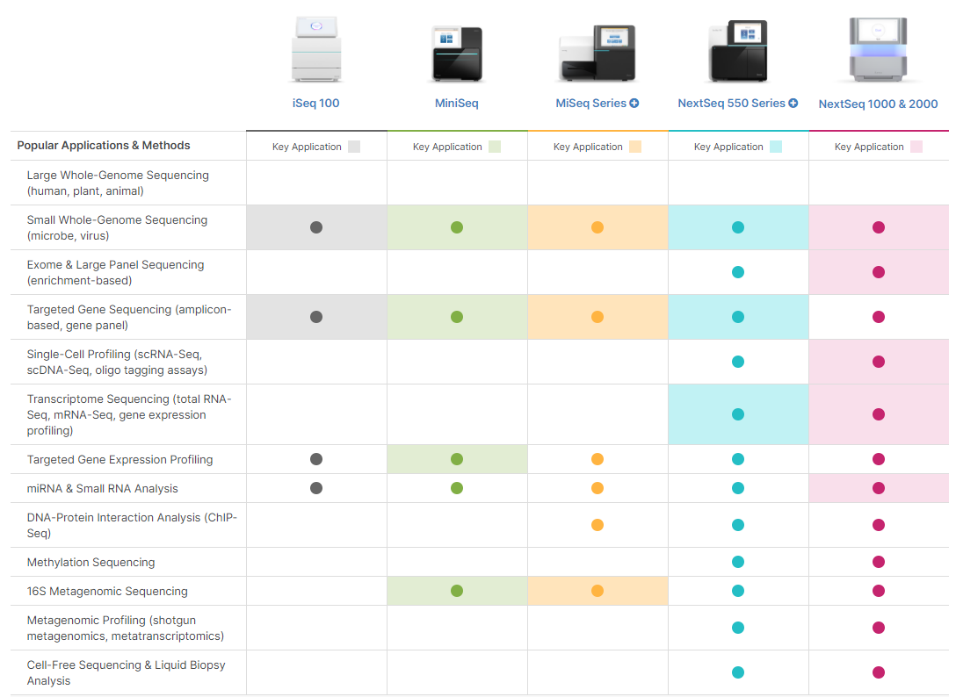
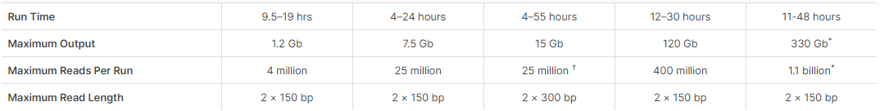
A first example of NGS platforms: Illumina - different solutions for different goals
These are so-called benchtop sequencers designed to meet the needs of small laboratories
Not suitable for all applications
Note, however, the time required to complete a run and the output. You can try to compare this capability with the time and cost that was required to sequence the human genome 20 years ago...

Slide 17
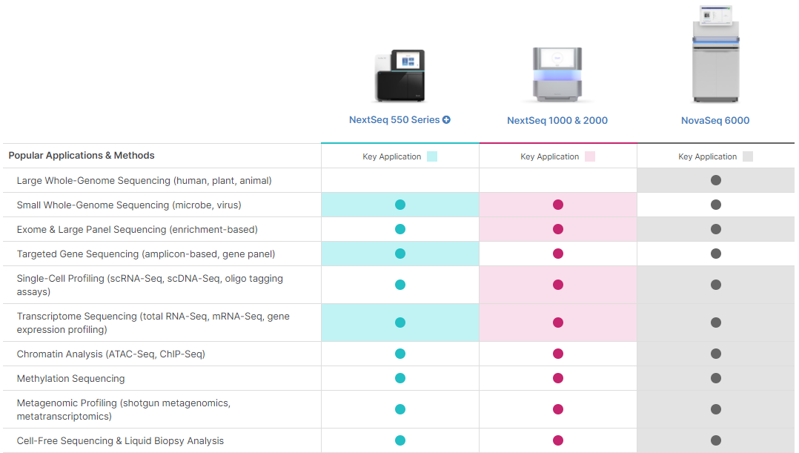
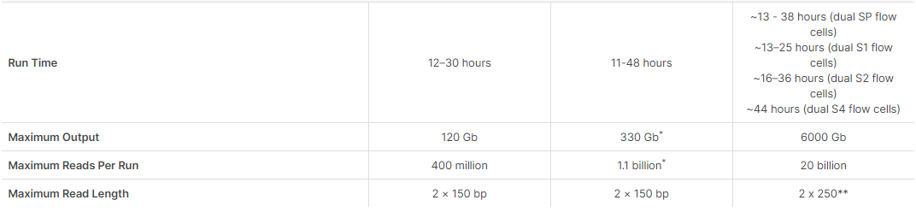
A first example of NGS platforms: Illumina - different solutions for different goals
These are the so-called “production-scale” sequencers, designed for sequencing centers
The type of possible applications is markedly different from those seen previously
Sequencing approaches even on large and complex genomes
Very high processivity

Slide 18
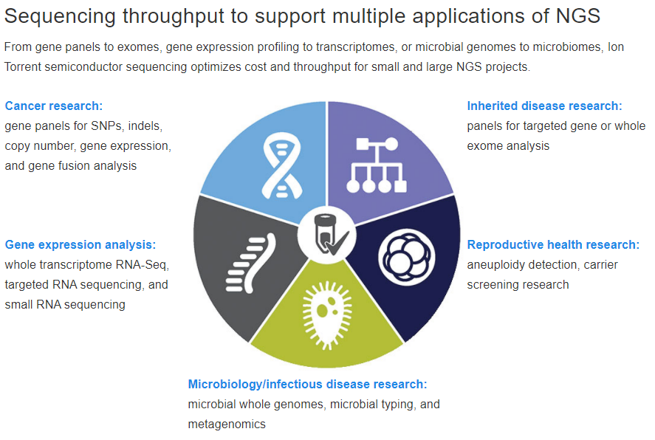
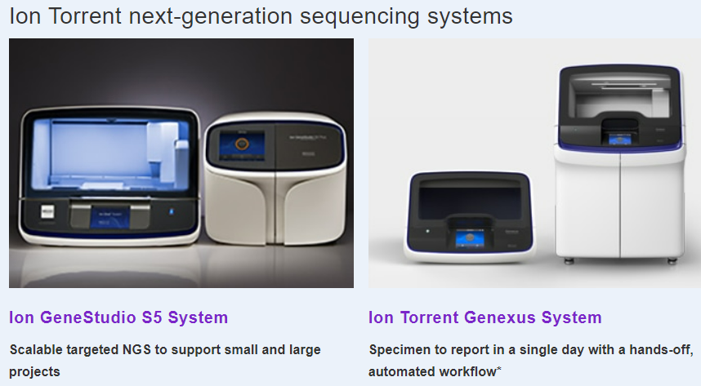
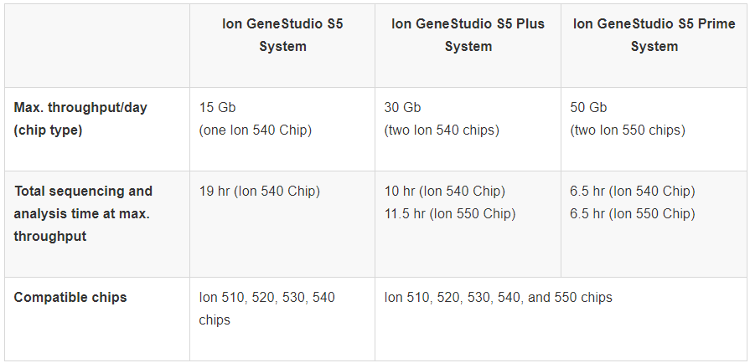
Another example: Ion Torrent platforms
As we will see in a moment, these platforms are based on a different sequencing approach, with lower throughput, which are very suitable for some applications (see image above on the right)

Slide 19
SOME TERMINOLOGY
Read: the sequence string read by the platform. We usually refer to “short reads” when we are talking about sequences of 100-250 bp produced by Illumina sequencers, for example, and “long reads” when we are talking about sequences of several Kb (but potentially even Mb) produced by third-generation sequencers
Coverage (or depth): the average number of times a given position in a genome or target sequence is read during the sequencing process
Paired-end (PE) sequencing: methodology for determining both ends of a DNA fragment (insert). Term typically associated with Illumina sequencing (N.B. applicable to only a few other platforms!), which can also be done via single-end (SE) mode
Multiplex sequencing: where multiple samples are to be sequenced simultaneously, a barcode can be inserted to discriminate reads belonging to different libraries

Slide 20
SOME TERMINOLOGY
Trimming: the procedure of “cleaning” the reads (from adapters or bases of poor read quality) that precedes all subsequent operations
Mapping: the procedure of aligning reads to a reference genome (or transcriptome) in order to identify their origin, detect polymorphism or calculate gene expression levels
Assembly: the procedure of reconstructing, using complex algorithms, the complete DNA (or cDNA) sequence that originated the reads
Duplicate reads: reads that are identical to each other, which in most cases may correspond to technical artifacts crated during the library preparation stage. However, they may also correspond to sequences that are highly represented in the extracted nucleic acids. These could be, for example, repetitive sequences of genomic DNA (in that case, they should be identified as multi-mapped reads, i.e. reads that map to multiple positions of the target genome with the same score), or mRNAs extracted at very high levels in RNA-seq experiments

Slide 21
NEXT GENERATION SEQUENCING – THE EARLY PHASES (development in the early ‘2000s)
Although different second-generation platforms use different chemistries, all of them based on sequencing clonal clusters
The process begins with a single target molecule, which is the subject of an amplification process (similar to a conventional PCR). This process serves, as we shall see, to establish a signal-to-noise ratio sufficient to allow the proper detection of the nucleotide present at a given position in each clonal cluster
Sequencing by synthesis (SBS)
Sequencing by ligation (SBL)
ABI SOLiD
Pyrosequencing chemistry
454 Life Sciences
Reversible terminators chemistry
Solexa (will later become Illumina)
These examples are the first three released in the market between 2005 and 2010. As we shall see, other alternative strategies have been developed later with mixed sucess

Slide 22
NEXT GENERATION SEQUENCING – THE BASICS
WHICH ADVANTAGES DOES IT BRING COMPARED WITH A CLASSICAL APPROACH?
No subcloning in vectors, no use of E. coli -> no cloning bias, definitely less laboriousness in laboratory practices
Possibility to obtain, due to high throughput, “digital counts” of gene expression (the number of reads produced for each mRNA molecule is directly proportional to its expression level)
In gene expression experiments, the large amount of data makes it possible to increase the dynamic range (i.e., to study even rare variants and under-expressed genes)
Great versatility for a wide range of applications
Great reduction in cost and time to generate a sequence (multi-parallel processing)
Less robotics required in the steps prior to loading the library onto the sequencer

Slide 23
NEXT GENERATION SEQUENCING – THE BASICS
BUT LET US REMEMBER THAT THESE TECHNIQUES ALSO INITIALLY CARRIED DISADVANTAGES, AT LEAST APPARENT ONES, COMPARED WITH SANGER SEQUENCING (most of these issues have been solved or mitigated over the years)
Generating shorter reads; in early Solexa platforms 25/50 bp, (today we exceed 150/200). This clearly does not apply to techniques that generate long reads (PacBio and ONT).
Higher error rate due to base calling” methodology; problem later resolved/reduced over the years for most technologies
Great difficulty in analyzing data, which are different format to previous data: bottlenecks due to need to program new algorithms
Stress on IT infrastructure of sequencing and genomics centers -> need for huge data storage units
Assemblies, mapping and processing of raw data require a lot of CPUs

Slide 24
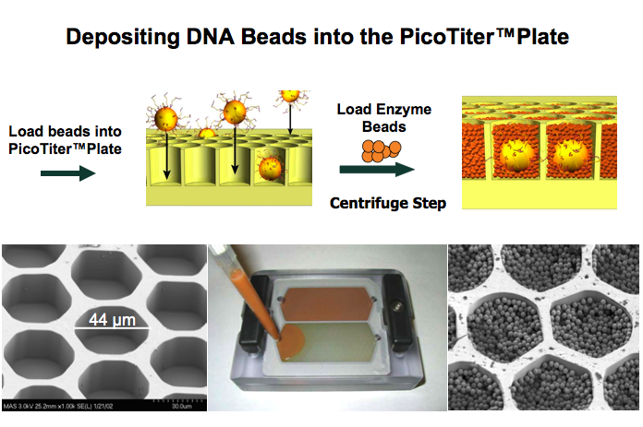
IN DETAIL: ROCHE 454-SOME MENTION OF AN ABANDONED PLATFORM
Pyrosequencing
A mixture of beads, sequencing enzymes and the sstDNA library are deposited in the 44μm wells
The bead deposition process maximizes the number of wells that contain an individual fragment of the single strand DNA library
The PicoTiter plate is loaded onto the sequencer
N.B. The library sequences contain a biotin-conjugated adapter that allows their binding to streptavidin-coated beads

Slide 25
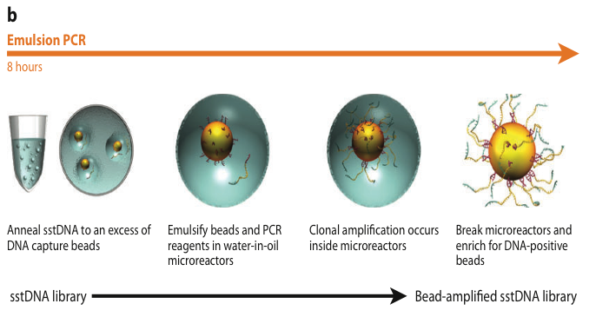
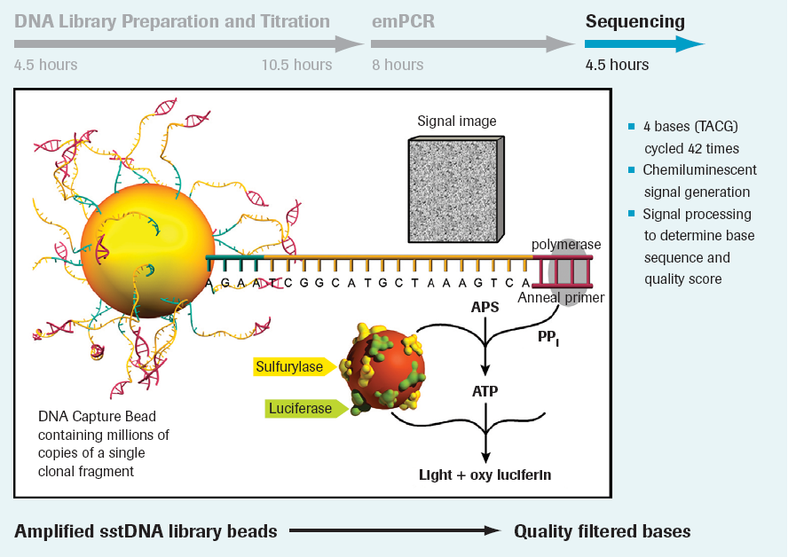
SEQUENCING CHEMISTRY
Emulsion PCR for polony generation
Sequential introduction of nucleotides
Nucleotide incorporation generates a light signal that is detected by a camera
This is related to the combined enzymatic activity of sulfurylase and luciferase upon release of a pyrophosphate group -> pyrosequencing
Rather long reads (several hundred bp) but with high error rate
For the most curious: https://www.youtube.com/watch?v=bFNjxKHP8Jc

Slide 26
COMPETITION WITH ILLUMINA LED TO A QUICK DECLINE
Selling stopped in 2013
N.B. centers that acquired these platforms in the past kept using it for a while

Slide 27
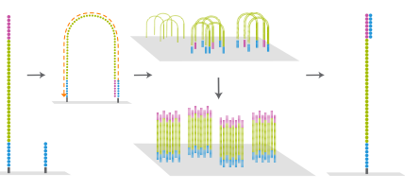
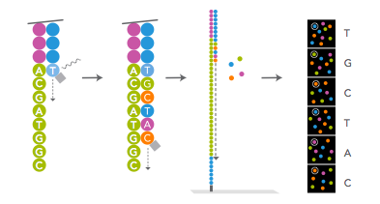
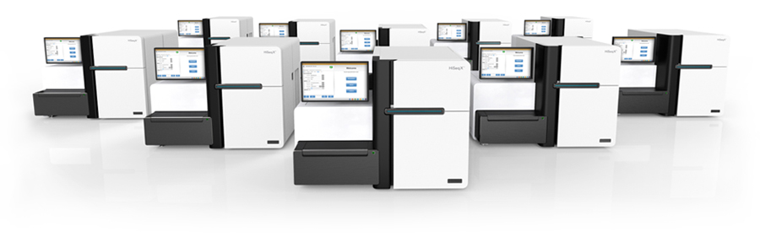
ILLUMINA SEQUENCING
Company initially called Solexa, later acquired by Illumina
Initially very short reads (15, 25, 50 bp), but very rapid increase in both length and accuracy (error rate gradually lower and lower)
Different platforms (MiSeq, HiSeq, NextSeq, NovaSeq, etc.) with different applications (and throughput)

Slide 28
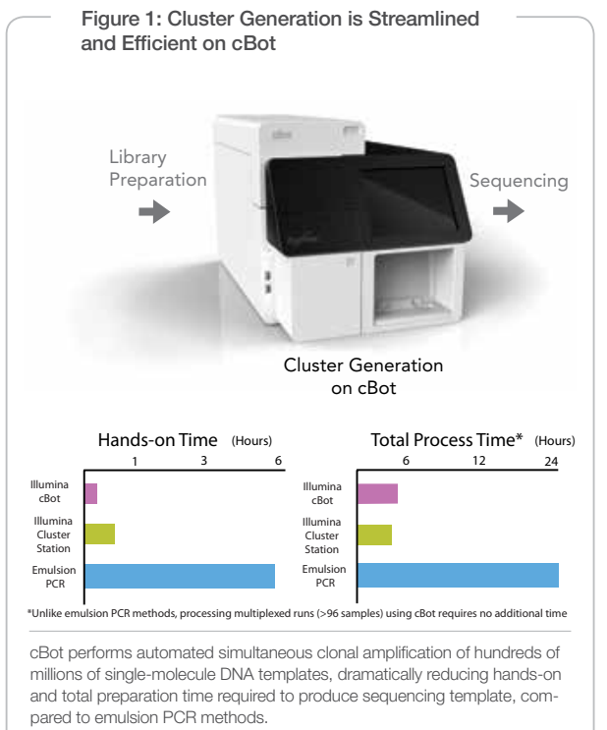
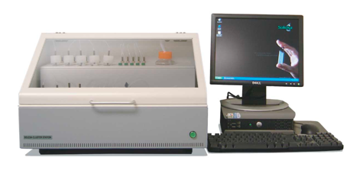
CLUSTER STATION
Tool to prepare the flow-cell (i.e., the glass substrate on which the library fragments will be sequenced in parallel)
Each flow-cell contains several lanes
Each lane can be used to sequence one or more libraries in parallel (and in this case the preparation of barcoded libraries is required)
The cBot is the most up-to-date type of Illumina cluster generation system. This process occurs BEFORE the sequencing

Slide 29
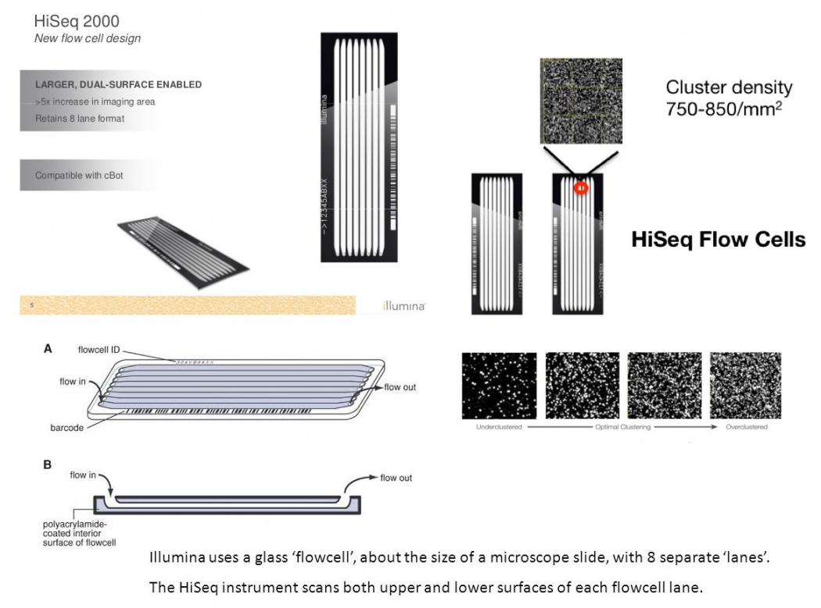
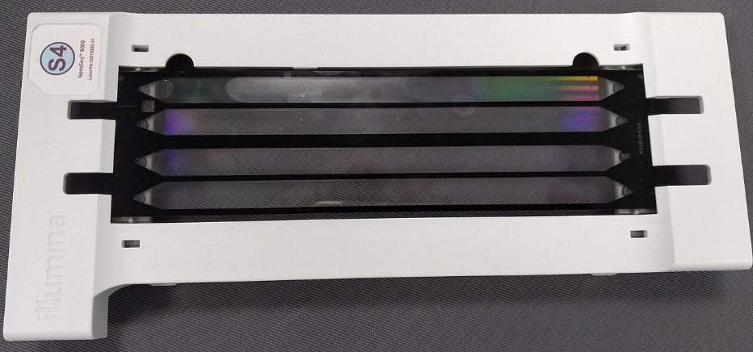
THE ORGANIZATION OF A FLOWCELL
N.B. the design of flowcells changes very rapidly. Illumina flowcells of the latest generation have 2 or 4 lanes

Slide 30
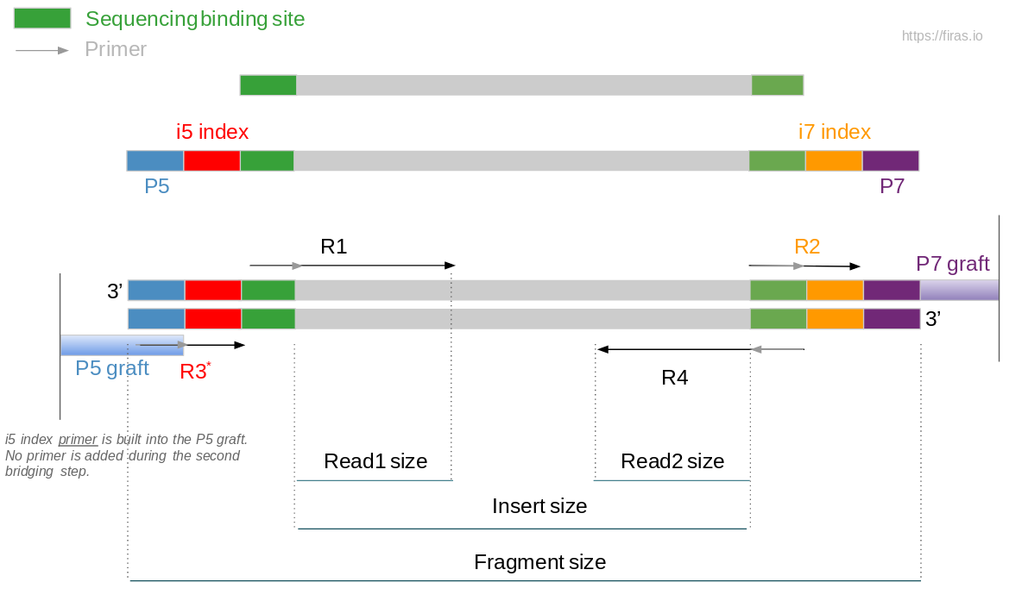
ILLUMINA LIBRARY PREPARATION
Libraries can be prepared following different methods depending on the objectives of a study (which we will discuss more about later: SE, PE, mate-pair, Hi-C, etc.)
They always start from dsDNA molecules, or from cDNA (thus derived from mRNA), which must still be fragmented before they can be analyzed (unless they derive from the PCR amplification of specific targets, as in the case of metabarcoding or exome sequencing -> no fragmentation is required)
All library preparation protocols involve the addition of adapters at the 5’ and 3’ ends
In particular, these additional sequences include those for primer binding, indexes (barcodes), and sequences complementary to the immobilized oligos on the flow-cell
Barcodes allow to analyze several samples on the same flow-cell (following multiplexing)

Slide 31
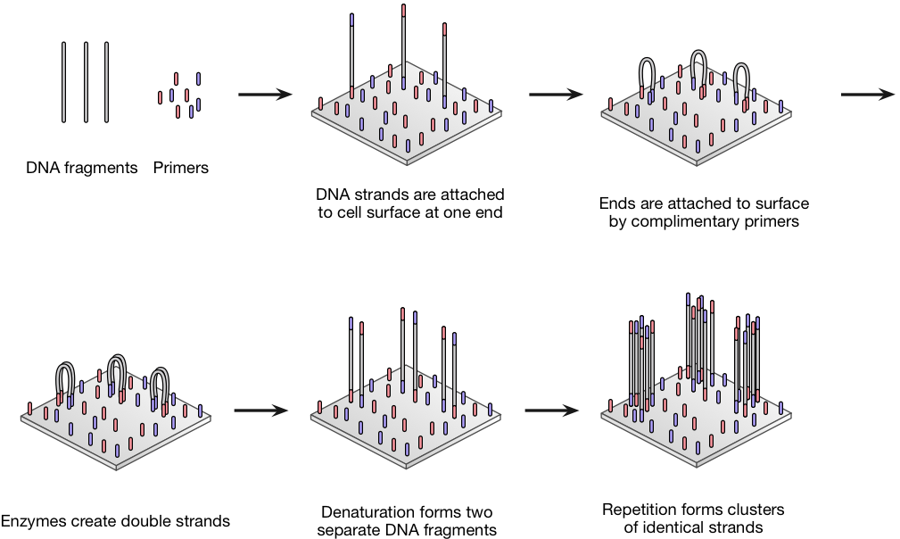
BRIDGE AMPLIFICATION – CLUSTER GENERATION
There are two different types of oligos immobilized on the flowcell, complementary to the outermost sequences of the adapters added to the library
After hybridization of the library fragment with these oligos (at both ends), DNA polymerase creates a second strand complementary to the immobilized one
Denaturation follows
The product of bridge amplification are two strands identical to the initial one, spatially close together
The process is repeated cyclically
At the end, the immobilized “reverse” strands are removed

Slide 32
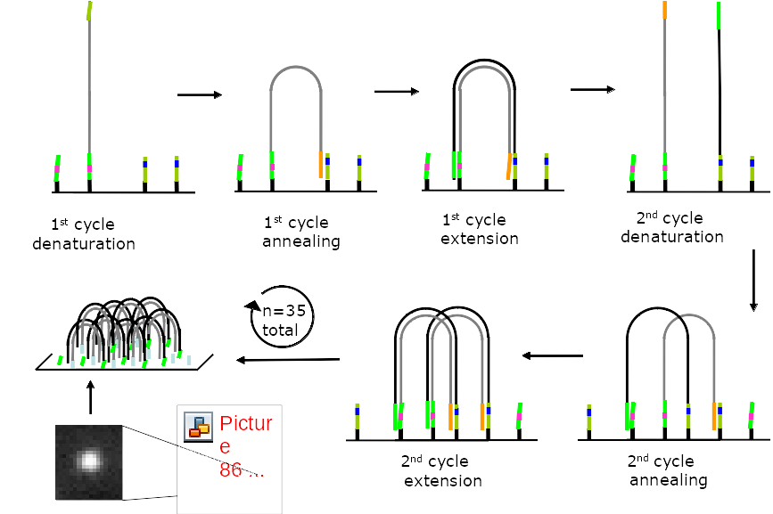
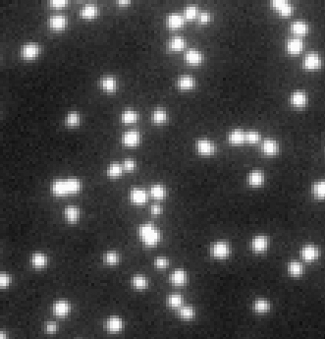
BRIDGE AMPLIFICATION – CLUSTER GENERATION
This is an example of the early configuration of Solexa/Illumina sequencing, with just 35 cycles of sequencing performed

Slide 33
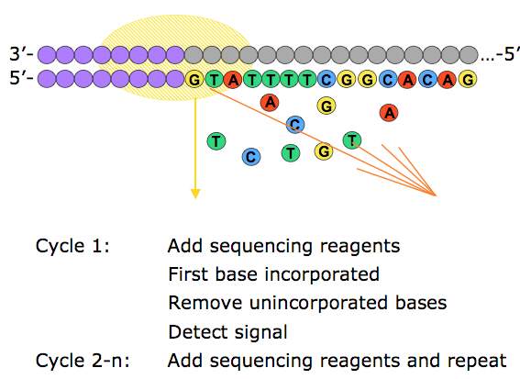
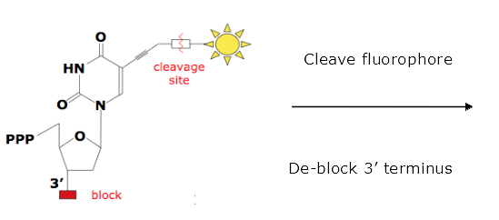
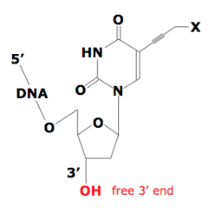
SEQUENCING CHEMISTRY
What we have just described is only the cluster construction phase!
The actual sequencing takes place later
A single modified base (with a reversible terminator) is added to each cycle by DNA polymerase
In the original (later modified) chemistry, each base was linked to a different fluorophore (4-color chemistry). Today, 2-color chemistry is used.
A high-resolution image of the flowcell is captured with each cycle

Slide 34
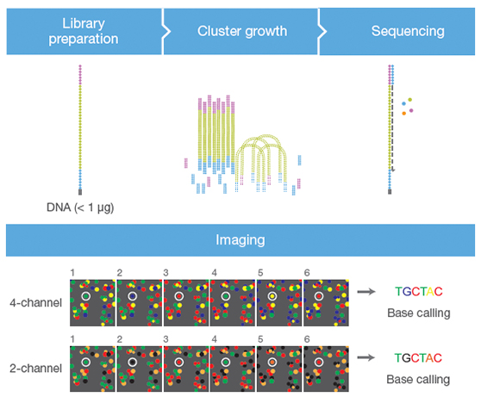
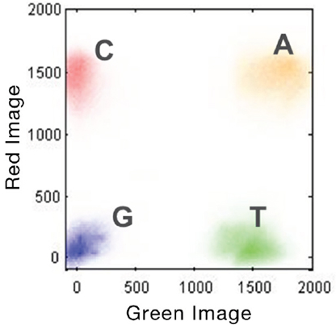
SEQUENCING CHEMISTRY
Difference between 2- and 4-color chemistry
G = no signal
A = red signal + green signal = orange
The image needs to be acquired only in two channels (instead of 4) -> higher speed of analysis, lower size of the output

Slide 35
PAIRED-END SEQUENCING
After sequencing read 1, the so-called “index sequencing primer” is added, which introduces a short recognizable sequence of 7 nucleotides that is read and will be used for demultiplexing
Then the original strand is used to regenerate (by bridge amplification) the complementary strand
The original strand is deleted
Primer 2 is added and sequencing is carried out as done for read 1
N.B.: A video of the process is available on Moodle or at this link: https://www.youtube.com/watch?v=fCd6B5HRaZ8

Slide 36
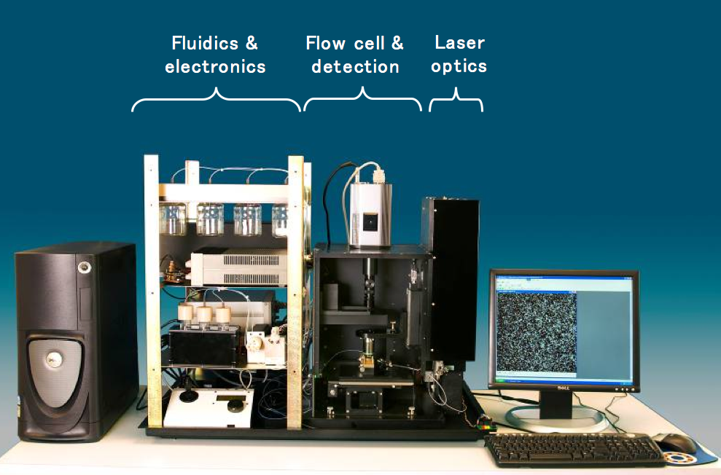

Slide 37
A GREAT COMMERCIAL SUCCESS
Due to its great versatility, steadily declining costs, and the wide availability of new platforms and third-party companies investing in compatible technologies, Illumina continues to be the leader of NGS sequencing

Slide 38
ILLUMINA SEQUENCING – A FEW THINGS TO KEEP IN MIND
Short reads (currently for most applications 100-150 bp, but increasing to 250/300bp (with significant quality drop in the last positions)
Clonal bridge amplification
This is a sequencing by synthesis (SBS) methodology
High accuracy (>99.9%, or <0.1% error); however, this also depends on length of reads and type of platform
Ability to perform single-end or paired-end sequencing depending on the type of application. N.B. the distance between the two paired reads does NOT depend on the platform type, but rather depends on the type of paired-end library prepared (classical shotgun library, mate-pair, Hi-C, Omni-C, etc.)

Slide 39
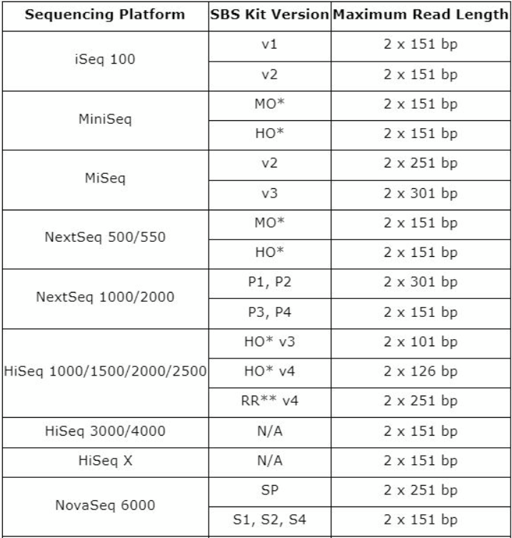
WHY CAN’T ILLUMINA READS BE LONGER?
Keep in mind that the sequencing proceeds by the addition of one nucleotide per cycle
The efficiency of the addition is very high, but it can’t be 100% (i.e. occasionally, one nucleotide might be skipped)
At each sequencing cycle there is a small chance that a single newly synthesized DNA strand in a cluster will be «out of phase», generating the wrong light signal
This leads to a progressive, but exponential, decrease in the signal to noise ratio and, consequently, to a lower quality of base calls

Slide 40
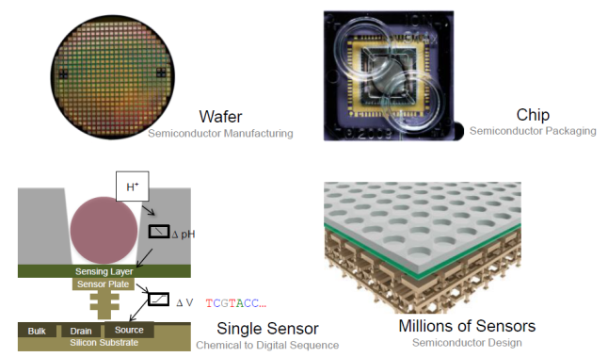
ION TORRENT SEQUENCING
semiconductor sequencing
Described by many as the “world's smallest pH meter”
Based on the release of H+ ions whenever a nucleotide is incorporated
Again, we are talking about a sequencing by synthesis methodology
Video (also available on Moodle): https://www.youtube.com/watch?v=zBPKj0mMcDg

Slide 41
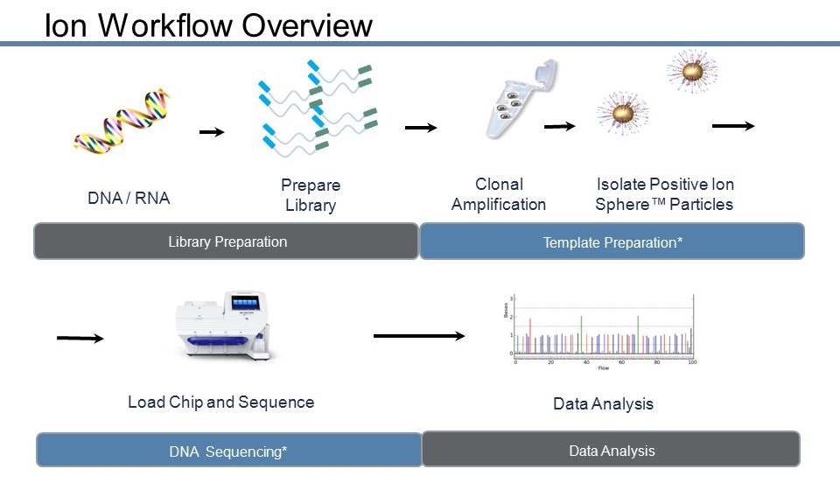
ION TORRENT SEQUENCING - WORKFLOW
Clonal amplification by emulsion PCR takes place (no amplification on solid support)
It is necessary to prepare a library that contains adapters to enable bead binding and sequencing
Possibility of using barcodes, as in Illumina sequencing
Sequencing is done through chips that contain numerous wells in which to house the beads
Shares many similarities with 454 pyrosequencing

Slide 42
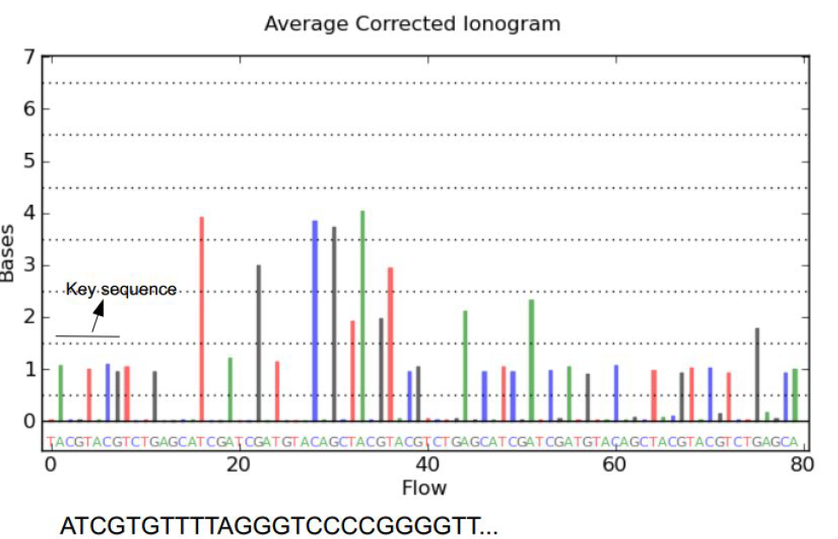
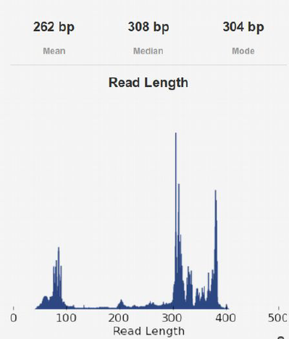
ION TORRENT SEQUENCING - OUTPUT
Ionogram
This needs to be converted into sequence
Note how homopolymeric stretches and thresholds are given to determine the number of identical nucleotides to be included
Cyclic addition of nucleotides in the reaction (one at a time), with incorporation of zero, one or more new nucleotides and signal proportionality (pH variance)
Average length of reads of a few hundred bases

Slide 43
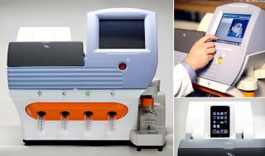
ION TORRENT SEQUENCING – MAIN FEATURES AND APPLICATIONS
The throughput of a run is determined by the type of chip used
The length of reads depends on the GC composition of the targets, but is typically 200-250 bp. Reads are single-end
Recommended use is for small and medium-sized projects that require rapid “turnaround”
Relatively high error rate compared to Illumina
Difficulty in accurately sequencing homopolymeric regions
KEY APPLICATIONS
Amplicon sequencing (PCR)
Small or medium-size genomes (virus, bacteria, fungi)
Targeted sequencing (custom panels, exon capture, etc.)

Slide 44


Slide 45



The Ion GeneStudio S5 is the flagship platform as far as IonTorrent sequencers are concerned. Unlike other platforms, sequencing depth is determined by the chip used and not by the machine
Cost of platforms affordable even for small and medium-sized laboratories (about 50K euros)
Output is “scalable” depending on the objective of a project
Costs of consequence are also flexible depending on the throughput required
Very fast turnaround times

Slide 46
ION TORRENT SEQUENCING – COMMERCIAL SUCCESS AND EARLY SIGNS OF DECLINE?
IonTorrent platforms have carved out an important space in the field of metagenomic analysis, for the analysis of targeted gene enrichment panels, and had an important role in the COVID-19 pandemics (sequencing of small viral genomes). Nowadays, other platforms produce far superior data, but the fact that IonTorrent platforms are cheap and widespread will keep them alive for a few more years…

Slide 47
BGI-SEQ: THE NEW GUY IN TOWN
Based on combinatorial probe anchor synthesis (cPAS): initially developed by Complete Genomics, later acquired by the Chinese company BGI -> BGIseq systems
They make use of DNA “nanoballs” that are then attached to a solid support. Formation of circular ssDNAs, multiplied by circular amplification (rolling circle amplification) to create 3D masses of 300-500 copies of each sequence.
Immobilization on the (positively charged) support occurs by electrostatic interaction. The initial sequencing strategy involved the addition of chain-terminating dNTPs (as in IIllumina technology), bound directly to a fluorophore. The most recent developments (partly because of legal issues related to an Illumina patent diatribe!), however, involve unlabeled incorporated nucleotides (“cold nucleotides”) being recognized by specific fluorescently labeled antibodies. It is a sequencing by synthesis strategy. Output comparable in reads length and quality to Illumina. Growing technology! https://www.youtube.com/watch?v=0bqIBtMS3xw (video also available on Moodle)

Slide 48


BGISEQ
The DNBSEQ-G400 is BGIseq's flagship instrument, included in a rather large panel of sequencers dedicated to different applications
It is a medium-output benchtop sequencer
It can generate single-end or paired-end reads of comparable length (in some cases slightly longer) than Illumina platforms, also in PE mode

Slide 49
COMMERCIAL SUCCESS (AND INSUCCESS)
A technology that never really took off… and another one that finally made it
SOLiD (Applied Biosystems): sequencing by ligation (following emulsion PCR), one of the first systems launched on the market along with Illumina and 454, but with less luck. Output and length of reads comparable to Illumina (paired-end sequencing also possible), but lower accuracy. For the most curious: https://www.youtube.com/watch?v=nlvyF8bFDwM

Slide 50


GENAPSYS SEQUENCING – THE NEWCOMERS
X
BANKRUPTCY
Applications (1.2-2Gb of sequence generated per run):
-small bacterial or viral sequencing projects
-metagenomics
-targeted resequencing
-miRNA sequencing
Very inexpensive sequencers!
New sequencing chemistry. It uses a chip reminiscent of that of IonTorrent technology, with wells equipped with electrical sensors inside which are immobilized marbles to which are anchored the clonally amplified fragments to be sequenced. CMOS (Complementary Metal Oxide Semiconductor) Technology
Nucleotides are read through impedance changes, which occur at the incorporation of each nucleotide (sequencing by synthesis) and are measured by the sensor and interpreted

Slide 51



ELEMENT BIOSCIENCES AVITI – THE NEWCOMERS
A new entry to the market, it uses a new sequencing chemistry based on avidites, and is therefore referred to as avidity sequencing (reference article: https://www.nature.com/articles/s41587-023-01750-7 ). It is still a method based on sequencing by synthesis-although a bit peculiar. It exploits (like Illumina and BGIseq) solid-state amplification, being able to operate in both single-end and paired-end modes, yet managing to achieve very good performance even for lengths of reads (e.g., 2x300) where Illumina struggles greatly in terms of quality

Slide 52

ELEMENT BIOSCIENCES AVITI – THE NEWCOMERS
A comparison between AVITI and Illumina – base quality vs reads length
AVITI = Cloudbreak chemistry
Higher quality compared with both the Illumina 4- and 2-channel sequencing chemistry
This is combined with a 20% increase in the speed of the process

Slide 53

AVIDITY SEQUENCING – The technology
Before sequencing:
Creation of polonies on solid support, by circularization of target DNA molecules (similar approach to rolling circle amplification of BGIseq), except that creation of polonies occurs after hybridization of molecules with immobilized oligos on solid support
Sequencing
Addition cycles of polymerases and the avidites (4 types, one for each nucleotide), i.e., polymer complexes attached to fluorophores and conjugated to a high number of nucleotides capable of interacting with the template chains of the polonies. The avidites ARE NOT INCORPORATED into the new complementary DNA chain, but serve only to detect the nucleotide. They are then removed by washing, and chain elongation occurs with untagged, but reversibly terminated nucleotides (so that a single nucleotide can be added per cycle, as in the case of Illumina and BGI-seq)

Slide 54


SINGULAR GENOMICS – THE NEWCOMERS
G4 sequencing platform (benchtop sequencer)
New market release based on independently developed sequencing chemistry, microfluidics and optics systems
Not much is yet known about sequencing chemistry, which at any rate is based on sequencing by synthesis on solid support (like Illumina) and fluorescence detection, allowing paired-end sequencing and reads length similar to Illumina
Singular Genomics relies heavily on speed of analysis and greater flexibility than existing lllumina platforms

Slide 55

SINGULAR GENOMICS – THE NEWCOMERS
Scalable output: up to 4 lanes per analysis
Possible applications:
-RNA-seq (key application)
-single-cell RNA-seq
-whole exome sequencing
-metagenome sequencing
-whole genome resequencing
G4 platform specifics
Singular Genomics has recently released the G4X platform, which is focused on spatial multi-omics, i.e. the visualization of the location of target mRNAs and proteins in Formalin-fixed, paraffin-embedded (FFPE) samples or single cells

Slide 56




ULTIMA GENOMICS – THE NEWCOMERS
Strengths:
Reduced reagent-related costs (solid media are circular silicon “wafers”)
Less microfluidics: all reagents are deposited in the center of the wafer and are distributed over its surface by centrifugal force (like a spinning CD)
Use of a “mostly natural sequencing-by-synthesis” (mnSBS) strategy: it combines the addition of a mix of natural nucleotides and fluorophore-modified nucleotides (in the minority), all of the same type for each cycle (A, T, G or C) and without terminators, allowing fluorescence detection with lower signal-to-noise ratio and longer reads (up to 300 bp at the time)
Above: a UG100 sequencer
N.B. In this case, somewhat like IonTorrent and pyrosequencing, the signal strength is proportional to the number of nucleotides added

Slide 57


ULTIMA GENOMICS – THE NEWCOMERS
N.B. this is a sequencing by synthesis method, where reads are obtained in a SE mode, thanks to the detection of fluorescence signals with an optical reader
A video about the UG100 sequencer is available on Moodle
UG100 sequencer specifications

Slide 58


ULTIMA GENOMICS – THE NEWCOMERS
Will the UG100 sequencer deliver what it promises?
According to Illumina: NO
You may read this interesting report published by Illumina on October 7th, 2025 (note, Illumina clearly has a conflict of interest…): https://www.illumina.com/science/genomics-research/articles/ultima-ug-100-vs-illumina-novaseq-x-wgs-data.html
Key highlights: Ultima Genomics does not seem to be particularly good at handling homopolymeric sequence stretches and repetitive sequence, leading to much higher error rates.
GC-rich genomic regions are under-represented(the graph on the left-hand side shows the relative coverage observed for DNA sequences with “biased” nucleotide content in both technologies

Slide 59



PACBIO ONSO – SEQUENCING BY BINDING
As we will see in a moment, Pacific Biosciences is a company specialized in the production of third-generation sequencers (long reads)
To enter the market for short reads sequencers (which have several applications) it acquired Omniome, a company that was developing an alternative sequencing technology
Sequencing by binding
Detection of the fluorophore-labeled nucleotides occurs during an interrogation step, WITHOUT incorporation into the chain (because the previous nucleotide is blocked). After removal of the blocking group (activation), it is possible to incorporate the next (untagged, but blocked) nucleotide
September 2021: Omniome acquisition from PacBio for $800 million
The Onso sequencer aims to eliminate read errors through extremely high accuracy, offering itself as the solution for particularly “problematic” sequences

Slide 60


PACBIO ONSO – SEQUENCING BY BINDING
Sequencing occurs on dual-lane flowcells
It can be performed in a paired-end mode, with reads length up to 150 bp
A nice 3D tour of how an Onso platform works is available at this link: https://embed.envoke-demos.com/pac-bio/Onso
Key possible areas of application
Linked with the very low error rate of this approach, since they enable a clear discrimination between real biological variation and noise (i.e. sequencing errors)
Cancer genomic (low frequency variants)
Pathogen genomics (characterization of genetic heterogeneity in viral/microbial populations)

Slide 61
WILL THESE COMPETITORS OF ILLUMINA AND BGI-SEQ HAVE SUCCESS?
It’s way too early to tell…
Currently their cumulative generated sequencing data is < 1% of the total and only Element Biosciences presently represents a significant actor on the market
However, each of these alternative strategies have their own merits and may reach a major breakthrough in the coming years

Slide 62

THIRD-GENERATION SEQUENCING: NEW PERSPECTIVES FOR SEQUENCING COMPLEX GENOMES (BUT NOT ONLY...)

Slide 63

FROM THE SECOND TO THE THIRD-GENERATION SEQUENCING

Slide 64

THIRD-GENERATION SEQUENCING: NEW PERSPECTIVES FOR SEQUENCING COMPLEX GENOMES (BUT NOT ONLY...)
«Even though versatile applications have just started, already it has been envisioned that they will bring no less impact than the current next-generation sequencers. This new type of sequencer is still under development, having an obvious disadvantage in its sequencing fidelity. However, at the same time, it has substantial advantages over the previous sequencers. For example, this sequencer can read DNA more than 100 kb in length. Several applications have begun making use of these advantages. Indeed, the new sequencer has already revealed its potential in its applications for diseased genome sequencing in humans either by the de novo assembly approach or by the mapping-based approach.”

Slide 65

THIRD-GENERATION SEQUENCING: NEW PERSPECTIVES FOR SEQUENCING COMPLEX GENOMES (BUT NOT ONLY...)
Third-generation sequencing is often used as a synonym for long-read sequencing
Two companies in play, with very different technologies: Pacific Biosciences (PacBio) and Oxford Nanopore (ONT)
NO clonal amplification
Simplified library preparation, with less likelihood of introducing bias
Several applications, some of which are impossible with second-generation sequencing

Slide 66
SMRT SEQUENCING (PAC BIO)
Single Molecule Real-Time Sequencing (SMRT)
Relatively simple workflow that does not require particularly long timelines (basecalls <1 day, polymerase reads > 1 base per second)
No pre-sequencing amplification required -> less bias and theoretically more uniform coverage
Very long reads! > 10 Kb
DISADVANTAGES
Cost per bp quite high
Error rate very high (in particular in the early development phases!)

Slide 67

SMRT SEQUENCING - OVERVIEW OF THE TECHNOLOGY
Based on nanophotonic display chambers (about 70 nm, with volume of 20 zeptoliters –>10⁻²¹L) called ZMW (Zero Mode Waveguide)
A single DNA molecule is inserted into each ZMW together with a single DNA polymerase molecule -> sequencing by synthesis
Fluorophore-labeled dNTPs are used
Incorporation of dNTPs by DNA polymerase releases a fluorescent signal
Video (available also on Moodle): https://www.youtube.com/watch?v=WMZmG00uhwU

Slide 68

SMRT SEQUENCING - OVERVIEW OF THE TECHNOLOGY
Original read mode reads Pac Bio -> Continuous Long Reads (CLR). Length > 20 Kb, but with rather high error rate (close to 10%)
New more accurate mode -> Circular Consensus Sequencing (CCS)
Made possible by preparation of SMRTbell libraries

Slide 69

SMRT SEQUENCING - OVERVIEW OF THE TECHNOLOGY
CCS (SMRTbell libraries) -> HiFi (High Fidelity) reads - average length 15-16 Kb
If a read occurs only once (1 pass) the error rate is very high (about 10%), but additional reads originating subreads separate from adapter reads may allow for correction. 10 passes = 99.9% accuracy
Ability to combine the length of PacBio long reads with the accuracy of Illumina short reads.

Slide 70

The use of CLR reads in the past required subsequent error correction by a polishing procedure through Illumina reads, which were more accurate
Today, HiFi reads make it possible to overcome this limitation and are, for example, included in the sequencing pipelines of many large genomic projects, including the VGP
Of course, this does not mean that HiFi reads can completely replace Illumina reads because, as we shall see, there remain issues related to de novo assembly of highly repetitive regions, which are solved with particular Illumina libraries

Slide 71



Revio sequencers
Latest PacBio platform launched on the market
Large reduction in sequencing costs per bp
Implementation of the HiFi approach (already present in the previous Sequel II)

Slide 72


OXFORD NANOPORE: AN ALTERNATIVE APPROACH
Initially based on hemolysin alpha pore (diameter about 1 nm, about 100 thousand times smaller than a human hair)
No amplification needed -> NO sequencing by synthesis
No labeling of nucleotides with fluorescent markers
It is necessary in any case to prepare a library with adapters in order to allow the sequences to pass through the pores

Slide 73

OXFORD NANOPORE: AN ALTERNATIVE APPROACH

Slide 74


Reads of alterations in the current flowing through the pore
Potential for reading extremely long reads (> 2 Mb of genomic DNA!)
Very long development (since 1995!)
Major issues related to high error rate, but continuous improvements through the development of new modified nanopores
Latest generation nanopores, R10 series, provide > 97% accuracy

Slide 75

ONT is the only commercially available technology capable of directly sequencing RNA molecules -> great potential for studying full-length mRNAs (and related alternative splicing events
Potential for development in direct protein sequencing as well, with techniques still under development
See video on Moodle for an instructional video on how the technique works

Slide 76

MINION – A PORTABLE SEQUENCER
Price: 2000$

Slide 77

GRIDION – THE BENCHTOP SEQUENCER
Price: about 67,000$

Slide 78

PROMETHION – THE SEQUENCER FOR LARGE PROJECTS
Price: 436,000$

Slide 79

TOWARDS THE DEVELOPMENT OF PORTABLE SEQUENCERS
Great focus on developing smartphone-compatible, portable and “field” instrumentation for all stages of analysis (including sample preparation)

Slide 80




NOT JUST PACBIO AND NANONPORES. OTHER APPROACHES (WITH MIXED FORTUNES)
Helicos Bioscience: single molecule fluorescent sequencing, similar to the PacBio approach, bankruptcy in 2015
Stratos Genomics (acquired by Roche, which had previously acquired another company called Genia): use of xpandomers -> SBX (Sequencing By Expansion), with nanopore-based approach.
Quantapore: another nanopore-based approach, similar to that of Oxford Nanopore, with the initial goal of 100$ genome
N.B: goals re-defined: direct protein sequencing!

Slide 81


ROCHE SEQUENCING BY EXPANSION – A NEW COMPETITOR
After a very long development, Roche has recently officially announced the future release on the market of SBX, becoming a direct competitor of PacBio and ONT
Accuracy > 99,8%
Very high throughput: 7 human genomes at 30X coverage in 1 hour
High flexibility of output, both in terms of reads length and throughput
See a video on Moodle

Slide 82
THIRD GENERATION SEQUENCING TECHNOLOGIES ARE STILL EXPANDING THEIR MARKET
This is mostly due to the fact that a good compromise between read length, throughput and accuracy has been just very recently met
N.B.: although the fraction of deposited experiments in SRA may not seem to have grown in the past 3 years, keep in mind that the number of experiments does not take into account their individual size. Since the throughput is increasing over time, the actual amount of generated data with these methodologies is much higher than you believe

