Slide 1
LECTURE 5 Whole genome sequencing/resequencing and targeted resequencing approaches

Slide 2
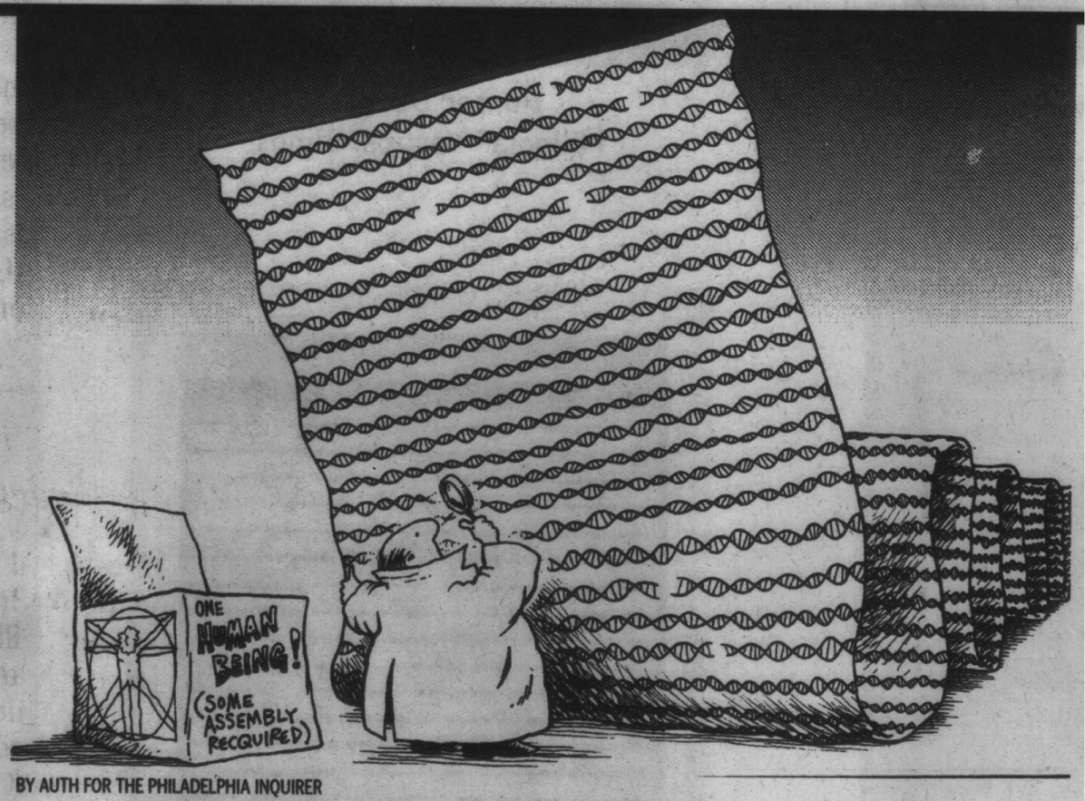
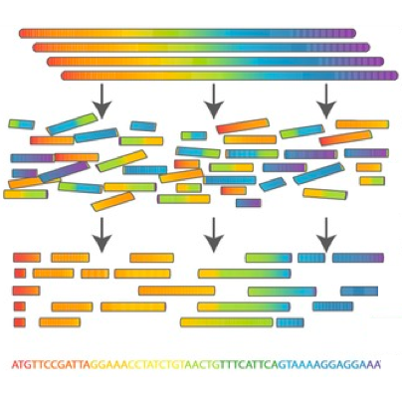
A few notes about sequence assembly
We will use many tools that use “reference sequences,” usually consisting of genomes or transcriptomes that have already been previously assembled
But how do you get a reference sequence from the raw data you get from a sequencer?
Reconstructing very long sequences (eukaryotic chromosomes can exceed 100 Mb) is not an easy task

Slide 3
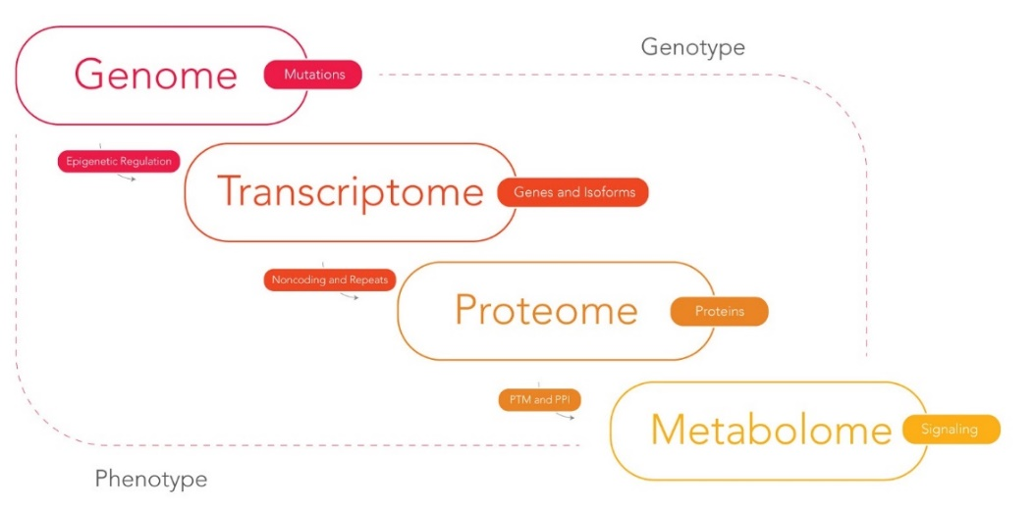
De novo transcriptome assembly? When and why?
The genome is much larger -> requires more sequencing effort -> more cost, more time, more effort (e.g., in humans only 1% of the genome is transcribed)
The transcriptome is a reduction of the genome, but it represents only the transcribed portion, so it is by its nature limited to regions translated into proteins + UTRs
Cannot allow the study regulatory elements (i.e. because they are not expressed)
Very narrow applications (generation of reference sequences for gene expression studies by RNA-seq, study of alternative splicing)
Higher complexity than one might think: transcripts are expressed at very different levels, whereas a genome will have uniform sequencing coverage

Slide 4
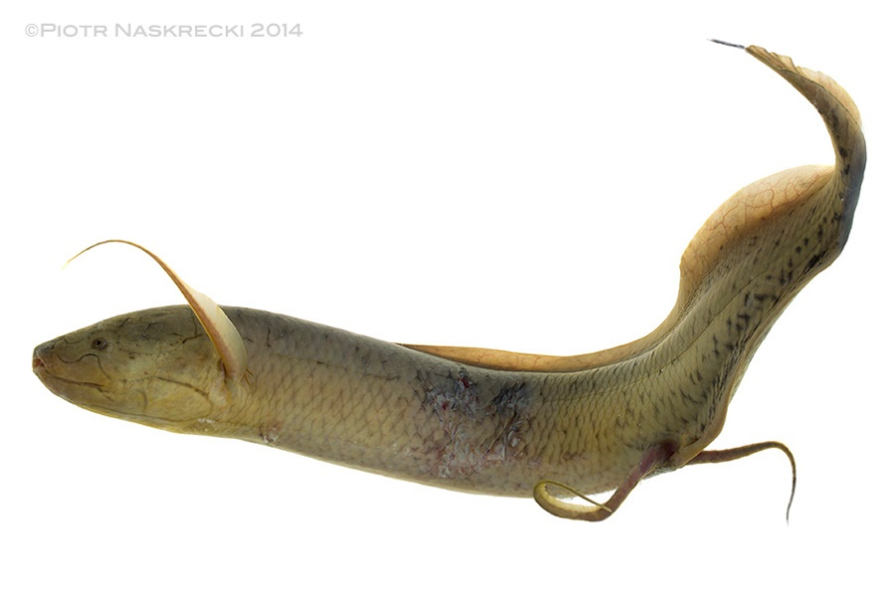
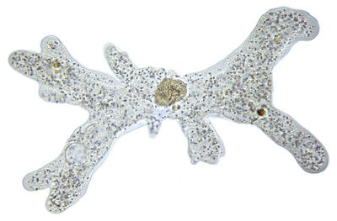
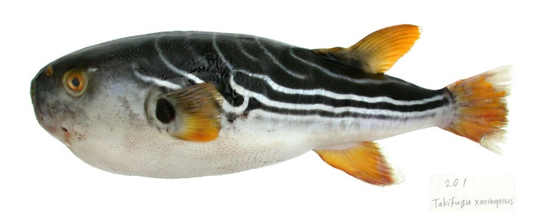
Why do we prefer to work on de novo genome assemblies?
If you have a choice, it is always advisable to work on a reference genome, even for gene expression studies (you can better handle paralogs, allelic variants, etc.
In some cases, we are (or were) forced to work on a transcriptome (lack of funds, size, etc.)
As costs come down, it gradually becomes easier to work even on non-model organisms and more complicated targets. In 2025, reference genomes are becoming more and more common, so the generation of reference transcriptomes will become less and less relevant
However, transcriptome assemblies are still very important for gene annotation purposes
130 Gb genome!!!!
670 Gb genome!!!!
0,3 Gb genome!!!!

Slide 5
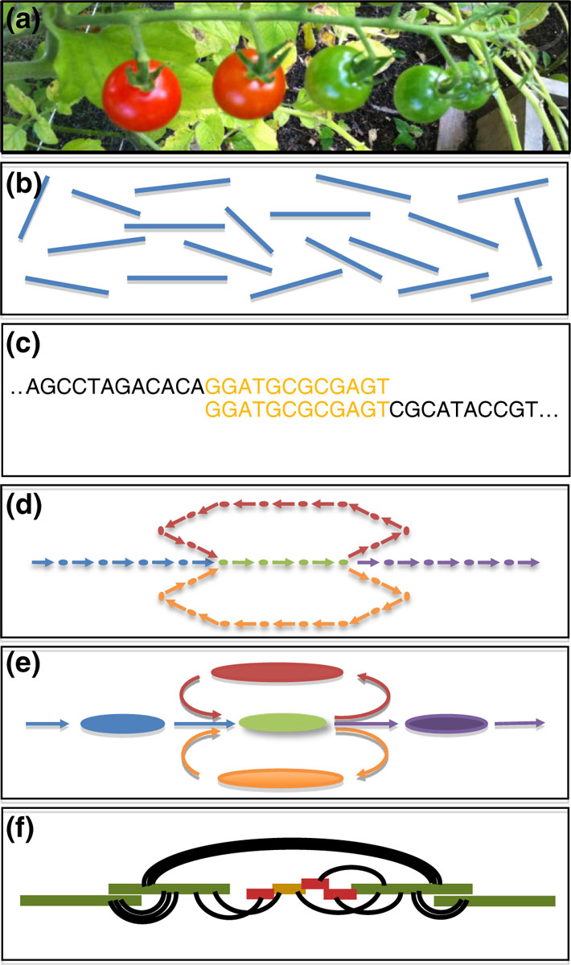
A simple scheme for a de novo assembly (with second-generation reads)
(a)Sequencing of DNA (or RNA) from the biological sample of interest.
(b)The output of sequencing are millions (sometimes billions!) of short, disordered reads generated from random locations in the genome (or transcriptome)
(c)The reads are compared with each other to discover regions of overlap
(d)These overlaps are assembled into a large “graph” in which nodes represent k-mers connected to each other according to mutual overlaps
(e)The graph is refined to correct errors and simplify the relationships between k-mers in long regions of contiguity (the contigs)
(f)The k-mer information and other accessory information (e.g., paired end reads) are used to orient and reunite contigs into longer scaffolds, resolving any conflicts
Schatz et al. Genome Biology 2012 13:243

Slide 6
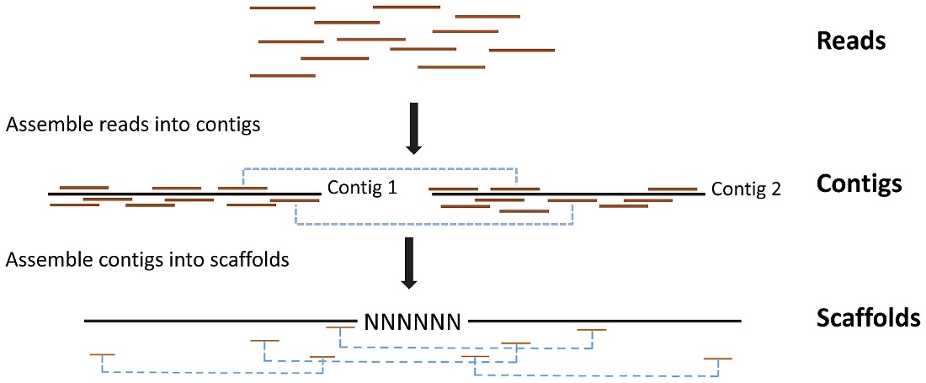
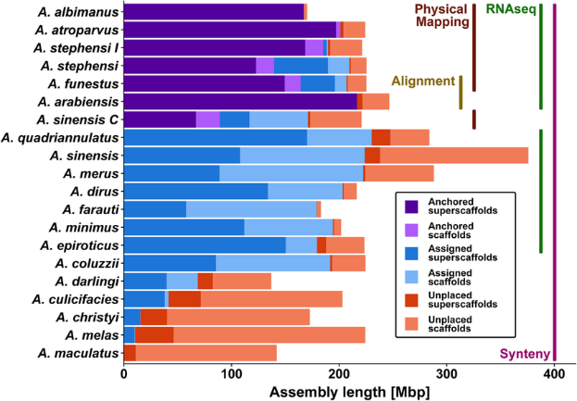
A few key definitions
Contigs: are genome chunks whose nucleotide sequence, reconstructed from reads, is known and supported with a good level of confidence
Scaffolds: are longer portions of genome sequence, which include contigs whose position and orientation to each other are known, but which can be separated from gaps of estimable size
Placed scaffolds: are the scaffolds assigned to a specific position in a chromosome
Unlocalized scaffolds: are the scaffolds attributable to a chromosome, but whose location or orientation are unknown
Unplaced scaffolds: these are the scaffolds not attributed to any chromosome
The set of placed scaffolds constitutes a chromosome (N.B. often the attribution of the chromosome, with sequence-karyotype correspondence, is difficult, and is therefore referred to as linkage groups)

Slide 7
A few key elements we are not going to study in detail in this course (I)
These topics will be studied in greater detail in the computational genomics course, so the following slides are not going to provide detailed information. However, keep in mind that these steps are extremely important and they should be always carefully planned and performed before any whole genome sequencing approach takes place
Raw sequencing data needs to be TRIMMED: the trimming procedure concerns the removal of low-quality/failed reads, and the identification/removal of portion of reads characterized by poor quality (i.e. base calls are not very confident, due to unclear signals) and the presence of adapters/barcodes (keep in mind that these can be sequenced as well!). Usually, residual short reads are also discarded (based on setting an arbitrary length threshold). This is fundamental for ALL sequencing-based approaches, not just for de novo genome/transcriptome assembly. The more stringent the trimming, the higher the amount of data loss, but also the lower the probability of including errors

Slide 8
A few key elements we are not going to study in detail in this course (II)
For de novo genome (or transcriptome) assembly approaches, clean reads data need to be assembled using appropriate assembly algorithms. These can be very complex and change quite significantly depending on reads length, sequencing throughput and the type of application (i.e. the algorithms used for genome assembly are much different from those used for transcriptome assembly). They may need to be able to handle paired-end reads, long reads, or both read types in combination
All the approaches that use reference genomes (for example, whole genome resequencing, RNA-seq, ChIP-seq, bisulfite-seq, etc.) require that clean reads are mapped against the reference genome itself (this is usually annotated, allowing a clear interpretation of the element (e.g. gene, exon, promoter, etc.) each read can be assigned to. The MAPPING procedure also depends on the use of dedicated algorithms, which can determine which criteria (e.g. stringency, tolerance of the presence of SNPs, etc.) are used to allow the alignment vs the reference

Slide 9

Let’s plan how to sequence a genome
How large is the genome of interest?
How many repeated elements does it have and how are they distributed?
Is a genome of a species close to the one of interest already available to get an idea of its characteristics?
What kind of sequencing should I use and what kind of libraries?
What quality of assembly do I want to achieve?
While we are not going to study how to assemble a genome from an algorithmic point of view, we are going to identify which are the main issues linked with this approach and what strategies we might use to face (and hopefully solve) them

Slide 10
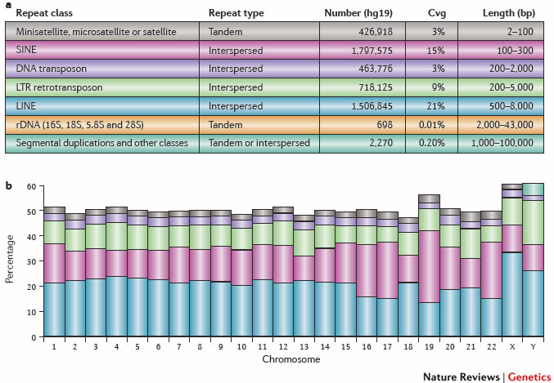
Repeats: a huge problem for genome assembly
Many genomes are rich in repeated elements.
50% of the human genome!
Most common source of assembly errors.
If I use reads with size n > the size of the repetitive region I overcome the problem
Old-style” solution (now abandoned): Illumina mate-pair libraries with longer library fragments (resulting in greater distance between the two reads of a pair, more details in later slides)
Current approach (due to reduced cost and error rate): long reads (PacBio, Nanopore), combined with the use of Hi-C libraries (sequenced in paired-end mode, as we will see later)
Sanger was definitely better than Illumina in this respect! Longer reads, but more expensive and with lower throughput

Slide 11
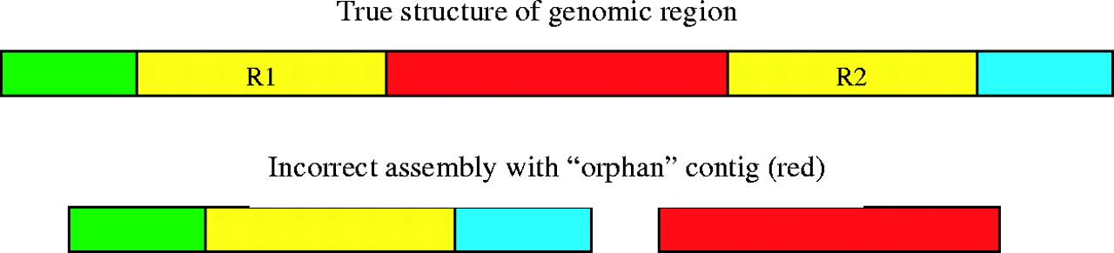
What might happen when the assembly algorithm enounters a repeat?
Salzberg S L , and Yorke J A Bioinformatics 2005;21:4320-4321
Assemblies might «collapse» in regions nearby a repeated element

Slide 12
Why are paired-end reads so important?
Without pairing the assembly generates many contigs with unknown mutual orientation
Contig
Consensus (15- 30Kbp)
This is made possible by the fact that the distance between paired reads is known (we select it in the library preparation step by fragmenting the DNA and choosing the desired size fragments!)
The greater the distance between paired-end reads the more efficient the process will be
However, we need a congruent number of reads that confirm the pairing information (one observation is not enough)
Reads
?
Paired reads allow for “bridging,” bringing contigs together into longer units of contiguity (scaffolds)
2-pair
Mean & Std.Dev.
is known
Scaffold

Slide 13
Several gaps are usually present in genome and transcriptome assemblies
Physical gaps
Sequencing gaps
sequencing gap - we know the order and orientation of contigs by paired reads that act as a “bridge.” The gap is “filled” by strings of N (NNNNNNNN...). We can find them internal to the scaffolds (between one contig and another)
physical gap - We have no information regarding the relationship to adjacent contigs. They could potentially correspond to the ends of chromosome sequences (if we assemble a genome) or messenger RNAs (if we assemble a transcriptome)

Slide 14
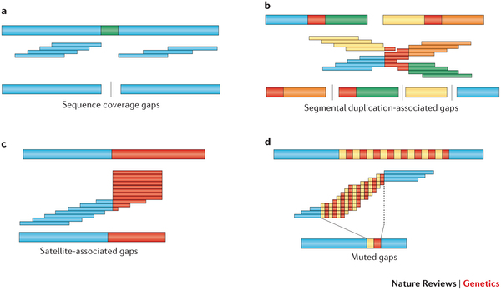
Other sources of issues
It is related to low coverage, either because the total coverage obtained from the library is not sufficient or because we have compositional biases that have affected fragmentation -> determines the presence of a gap
Segmental duplications (regions in red) -> major problems...This breaks contigs and risk creating chimeras
With satellite DNA sequences the assembly algorithm gets into a “loop” from which it cannot get out and consequently truncates the sequence
Repeats that are identical or which may be mistakenly “collapsed” -> the sequences before and after the repeats are correct, but the overall length in the assembled sequence is incorrect (shorter)
Sometimes it can be difficult to notice the complications to which these problems lead, especially if they result not in fragmentation but in the generation of apparently good contigs...

Slide 15
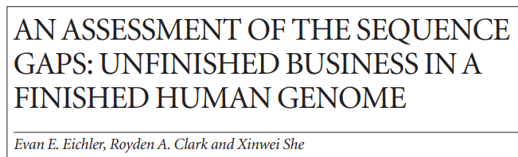
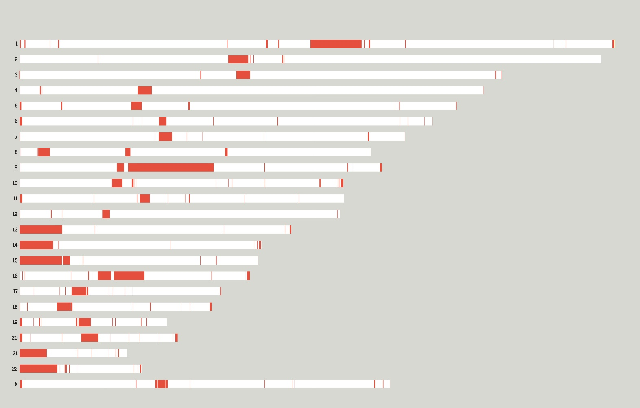
Gaps in the human genome
We have previously talked about the T2 project,” which led to filling the many remaining gaps in the reference genome assembly
Specifically, prior to the efforts of the T2T consortium, the human reference genome still contained:
-368 “unresolved issues”
-regions of difficult-to-resolve ambiguities
-102 gaps
These concerned: rRNA gene clusters, segmental duplications, satellite DNA arrays, centromeric sequences, etc.
Remember that each white bar is a chromosome, each red region is an unresolved part of the reference assembly!

Slide 16
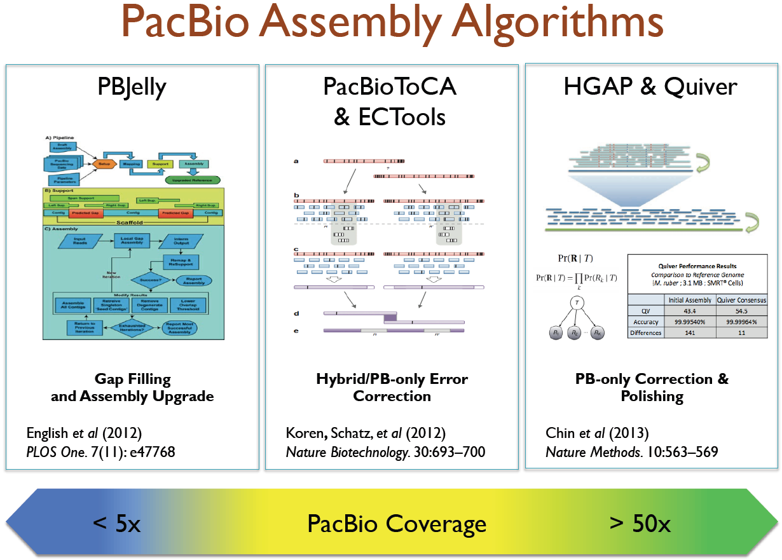
De novo assembly strategies: the early NGS strategies
Depending on the size and complexity of the target genome, the aim was to generate both long a short reads, in variable abundance ratio
Both reads types could be used simultaneously to obtain the so-called hybrid assemblies
The underlying idea was to exploit the advantages of both methods (read length for PacBio/ONT and low error rate/pair-ending for Illumina) to improve the quality of the assembly
N.B. Due to the reduced cost of PacBio and ONT reads, many assembly strategies started to use Illumina reads only for polishing and scaffolding purposes, obtaining the first draft assembly by only using long reads

Slide 17
De novo assembly strategies: the pre-2020 typical strategy
Assemblies made exclusively with high coverage long reads, short reads for polishing/scaffolding only
This approach has become increasingly attractive because of reduced sequencing costs. Need to plan sequencing with at least 30-40X PacBio coverage, and greater than 60X (but preferably >100X for highly heterozygous genomes) with ONT. Combination with high coverage of short reads (usually Illumina, >100X if possible). Popular type of approach until about 2020, with PacBio CLR reads (no HiFi) and ONT before major improvements implemented on error rate
Advantage: use of reads generated with the same platform for assembly, guaranteed to get very long average contigs. Polishing of the assembled sequence can be done with the long reads themselves (tools such as Arrow, Racon, etc.), or with parallel use of second-generation short reads (Illumina), with higher coverage and lower cost. Alternatively, polishing can also be done BEFORE assembly, on the long reads themselves. N.B. in this case the short reads are not used for assembly, but only for error reduction. Scaffolding can improve the continuity of the assembly using PE information
Problem: high cost, poor ability to handle genomic regions with high heterozygosity (see next slides), difficulty in achieving chromosome-scale assemblies. Possible residual presence of misassemblies. N.B. these problems, very important in the pre-reads PacBio Hi-Fi era, have been largely overcome, making polishing less crucial

Slide 18
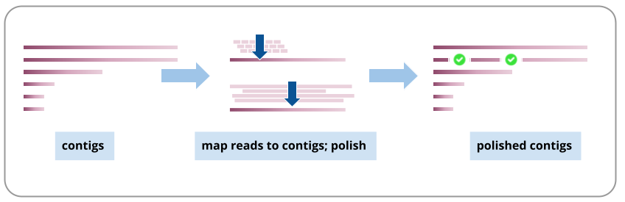
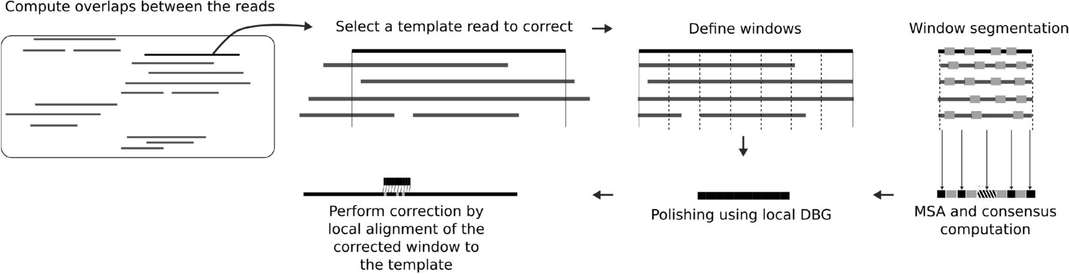
POLISHING
Polishing: sequencing error correction procedure, which usually takes advantage of “coverage,” that is, the fact that each position of the genome to be assembled has been read multiple times, assumed in most cases to be correctly
Example 1: post-assembly polishing
The reads are mapped against contigs and their consensus is used to correct any errors that may be present
Example 2: Pre-assembly polishing
The reads are mapped to the long reads to correct errors prior to assembly

Slide 19
De novo assembly strategies: the current strategy
Assemblies made exclusively with high coverage long reads, Illumina reads (from Hi-C/Omni-C libraries) for scaffolding only
Very popular approach today, used by all large genomic sequencing consortia (WGP, DToL, EBP, etc.). Needs use of high-quality third-generation reads (mainly PacBio Hi-fi reads with about 50X coverage, or ONT with higher coverage (due to higher error rate), >100X
Advantage: use of very long, high quality reads. All funds (or nearly all) can be focused on increasing coverage with Hi-fi or ONT reads. Polishing is not required, as long as the coverage is sufficiently high, although it can always be done if Illumina reads are available. Illumina Hi-C or Omni-C libraries (we will study these later) sequenced in PE mode allow excellent scaffolding even with relatively low coverage (30X). There is the possibility of chromosome phasing (reconstructing both alternative haplotypes) in a diploid genome
Problem: obtaining DNA of sufficient quality and quantity to use this approach, both for HiFi and Hi-C libraries!

Slide 20
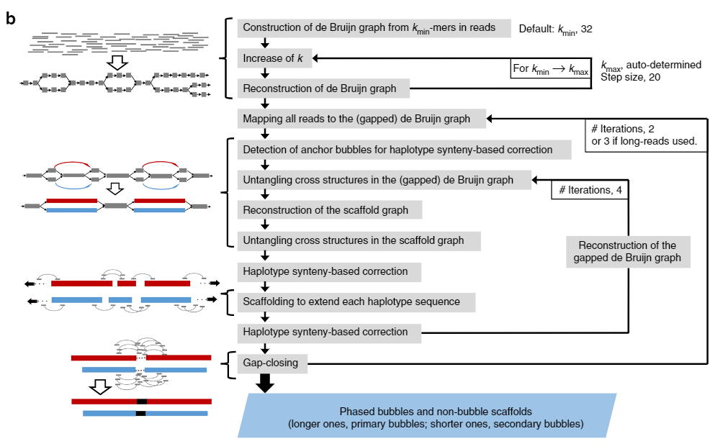
Two examples of assembly pipelines
Platanus (below) vs Canu (right hand side)
N.B. many assemblers include within them polishing and/or scaffolding modules and often work with iterative loops

Slide 21
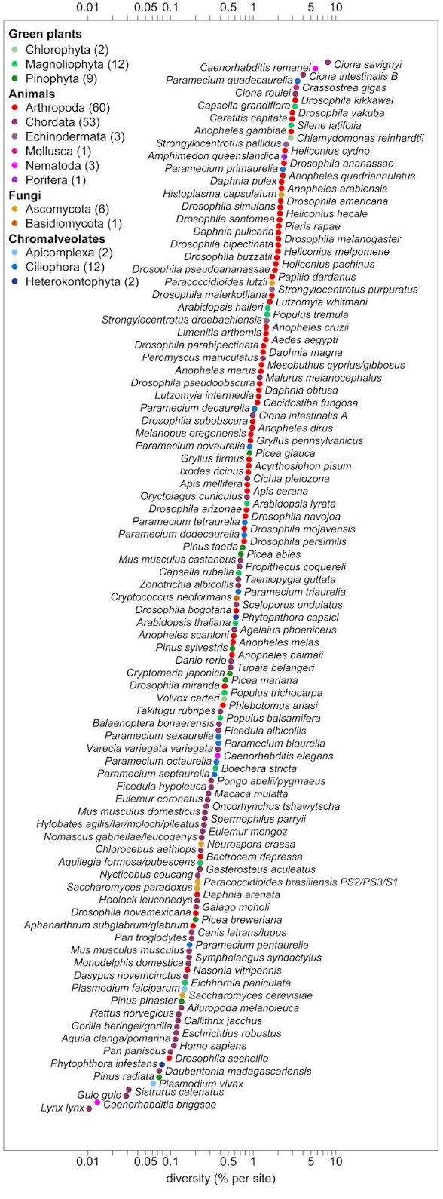
Another issue for de novo genome assembly: heterozygosity
Heterozygosity is defined as the extent to which the sequences of the two homologous chromosomes diverge
It basically depends on the genetic variability of the population and therefore changes considerably from species to species
Typically, species with a small reproductive population will have low heterozygosity and vice versa
Mode of reproduction also affects--marine species that reproduce by dispersing gametes tend to have high heterozygosity
Human-> very low heterozygosity (0.1%)

Slide 22
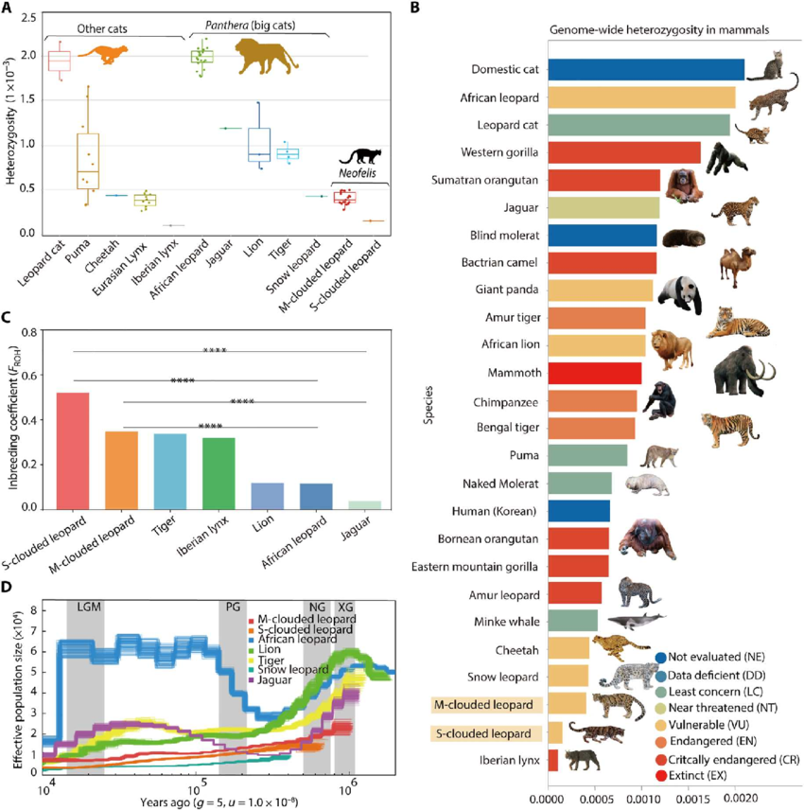
How can heterozygosity be evaluated and what are its impacts on the assembly?
In the case of highly heterozygous genomes, differences between the two homologous chromosomes may lead to the separate assembly of the two haplomes
In essence, the old-school assembly algorithms followed two alternative paths and separately assembled highly polymorphic genomic regions (e.g. those with a high density of SNPs, or characterized by structural variations
As a result, the size of the assembled genome was larger than to the actual expected size
Heterozygosity can be evaluated by graphs of the distribution of k-mers with software such as Jellyfish

Slide 23
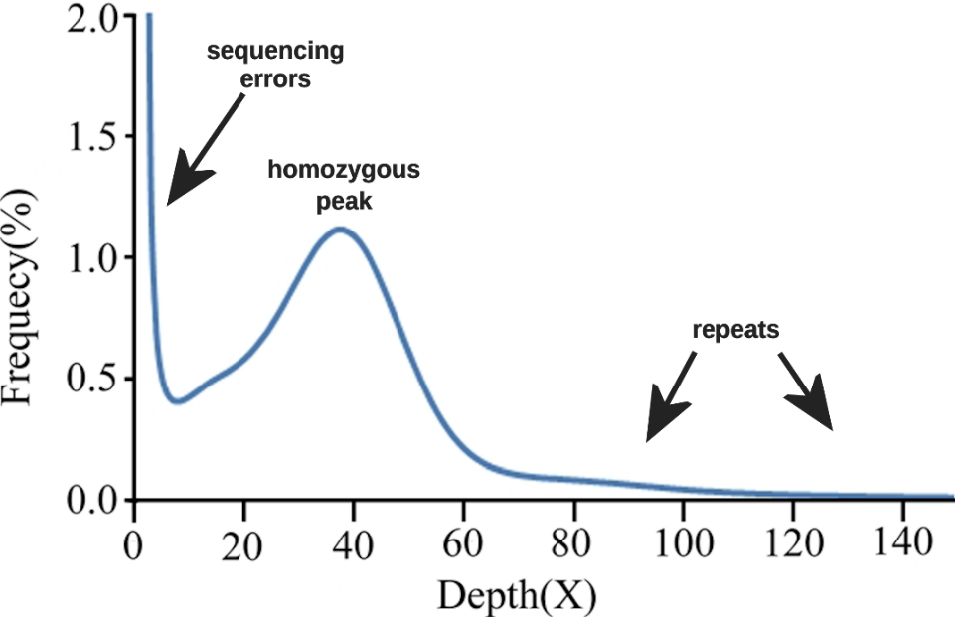
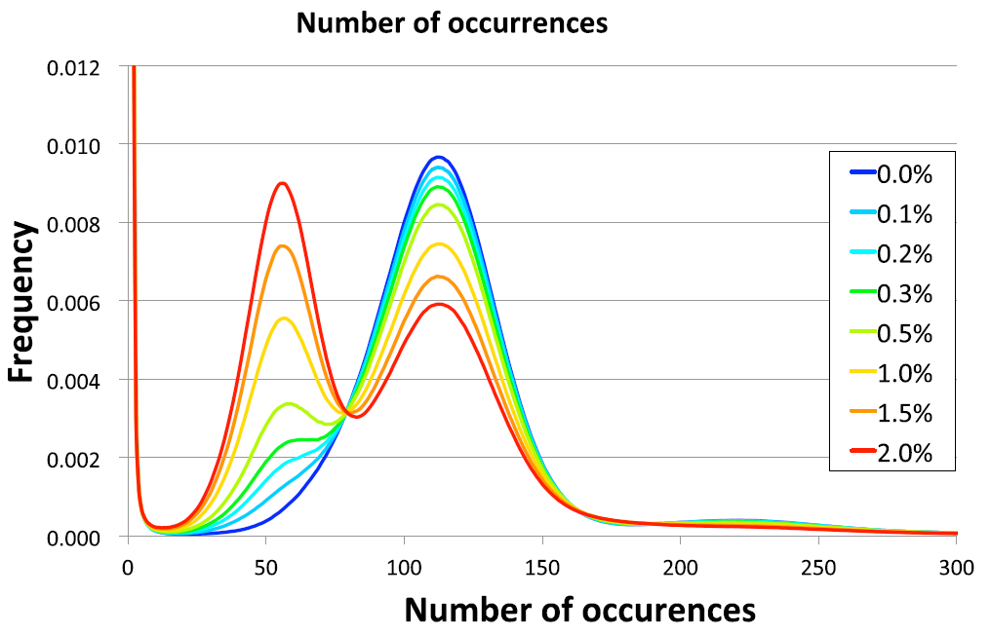
How can heterozygosity be evaluated and what are its impacts on the assembly?
The greater the relative height of the peak on the left increases, the more heterozygous the genome is
In a genome in complete homozygosity you will notice a single peak with coverage equal to the sequencing depth of the genome
In a heterozygous genome you will always notice a second peak, more or less high, located exactly in the middle of the first one
You will always notice a high peak at zero due to k-mers that contain sequencing errors
In the right part of the graph you can see the k-mers found many times in the genome, that is, those derived from repeated regions

Slide 24
How can we handle heterozygosity?
Option 1: ignore it. Attempt to generate a single haploid genome assembly, “collapsing” any polymorphisms and allelic variants (as originally done for the human genome) -> monoploid assembly. Approach possible only with species with low heterozygosity
Option 2: Generate a reference haploid assembly, plus a collection of “accessory” scaffolds representing the alternative haplotype, relating only to genomic regions characterized by sequence hypervariability
Option 3: Generate a diploid assembly, with the two alternative haplotypes. This approach requires the use of “ploidy-aware” assemblers, such as Platanus-allee, FALCON-unzip, HiCanu and Hifiasm, or involves the use of post-assembly tools such as Haplomerger. N.B. This is the current approach used in projects that exploit a combination of long reads and Hi-C libraries
N.B.#1: to generate a de novo genome assembly, one ALWAYS starts from a SINGLE INDIVIDUAL, to limit technical problems related to heterozygosity
N.B.#2: usually in species with high heterozygosity, the size of the genome assembly exceeds the expected size of the haploid genome

Slide 25
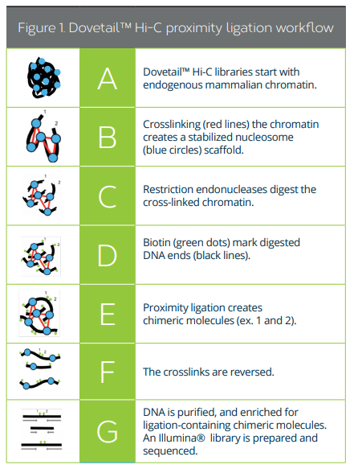
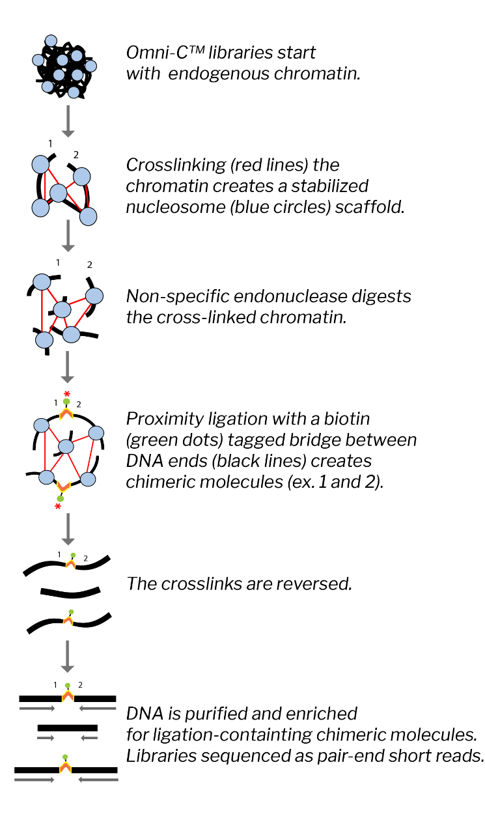
CHROMOSOME PHASING: A SMALL REVOLUTION
Chromatin conformation capture libraries: Hi-C and Omni-C libraries
1)chromatin crosslinking by glutarate
2)Enzymatic cutting of the DNA chain
3)Proximity ligation with biotin-labeled bridges
4)Reversion of crosslinks
5)Purification of fragments

Slide 26
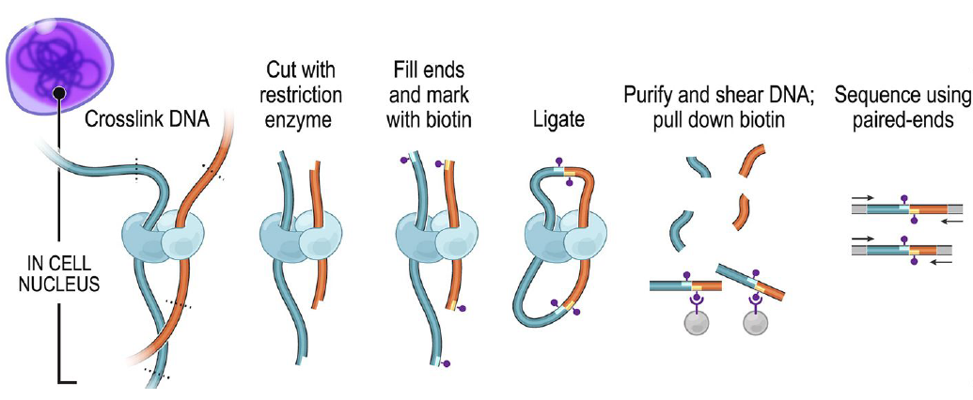
CHROMOSOME PHASING: A SMALL REVOLUTION
Notice how the 2 ends of the fragments included in the library carry sequences originally far apart in the chromosome, but spatially close. Illumina paired-end sequencing creates very long “bridges”

Slide 27
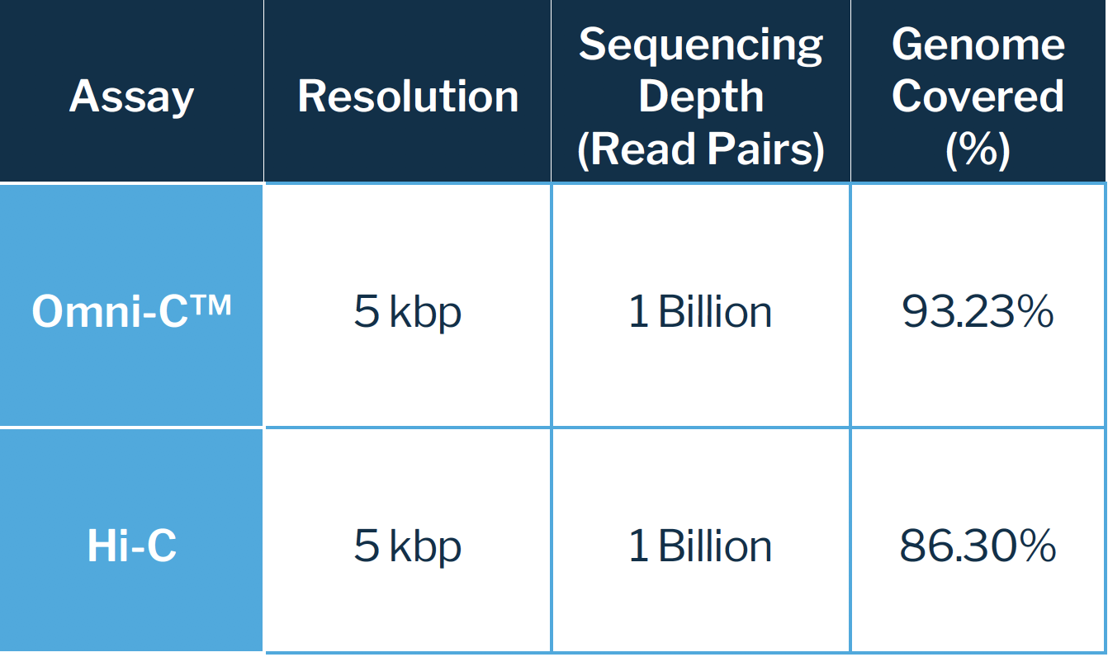
CHROMOSOME PHASING: A SMALL REVOLUTION
We get chimeric DNA fragments that correspond to regions very distant from each other in the linear sequence of genomic DNA, but very close spatially to each other in the 3D chromatin structure
Difference between Hi-C and Omni-C libraries : the former cut with a restriction enzyme (specific cut, not random), the latter with a nonspecific endonuclease -> greater genome coverage, more uniformity
Sequencing should be done in paired-end mode with Illumina (or BGIseq, prospectively also with AVITI or Onso)
For Hi-C or Omni-C libraries we need to use a genome coverage close to 30X

Slide 28
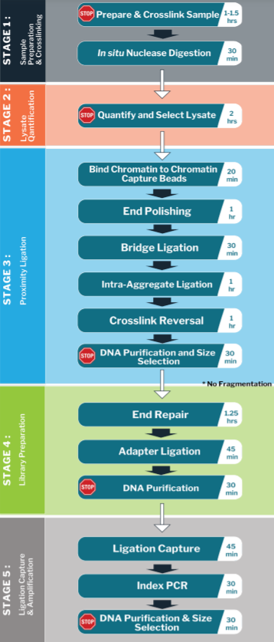
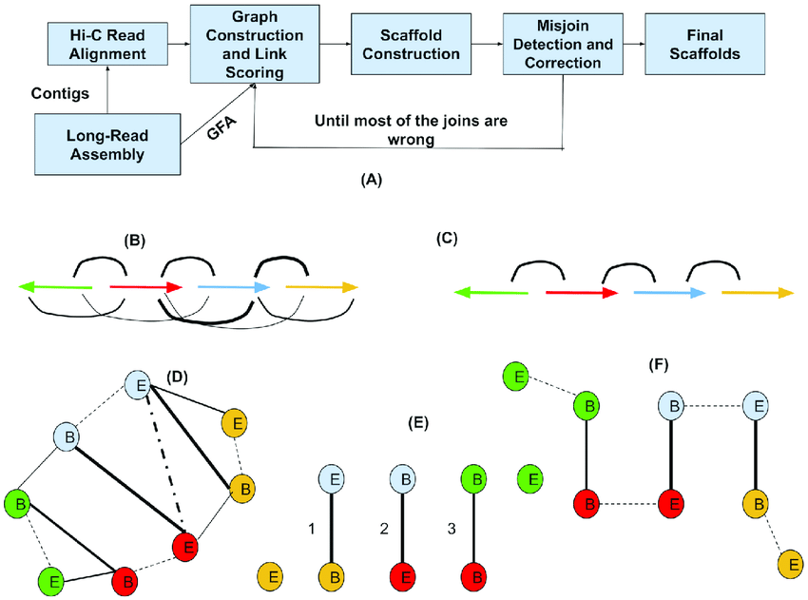
Hi-C: a few additional notes
Must start from very fresh biological samples: blood or tissue. Required about 1 million cells (nucleated!) or about 50 milligrams of tissue
Procedure for preparing the libraries laborious: 2 days of work
These libraries are used exclusively for scaffolding, but not for assembly or polishing (they are not evenly distributed along the genome)
New technical challenges for assemblies: development of new software specifically for scaffolding with libraries of this type (long-range information): SALSA2, 3D-DNA, etc.

Slide 29
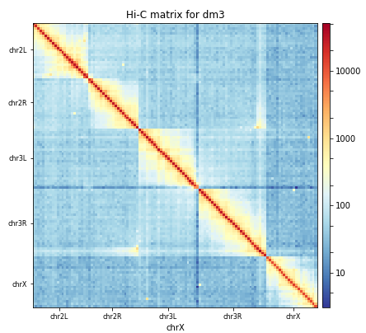
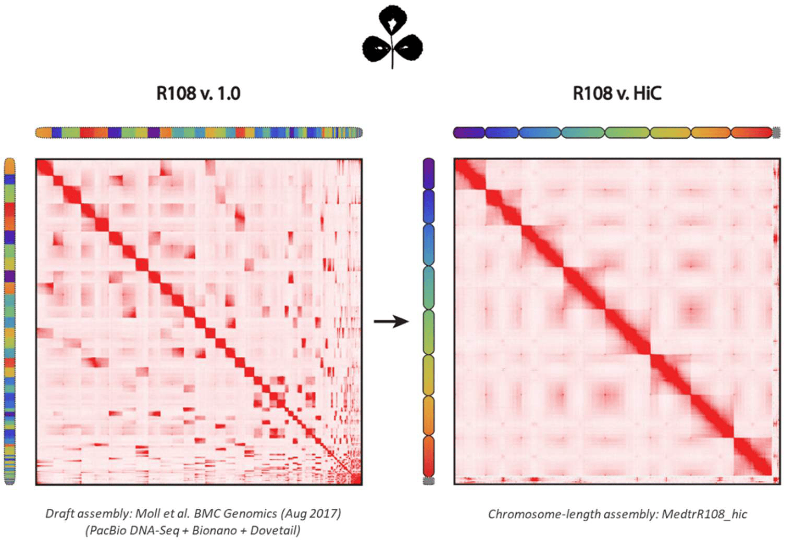
What does a contact map related to a library obtained by chromatin proximity ligation look like? The graphs below represent the density of contacts observed between pairs of paired-end library reads
Left ideal case: intrachromosomal contacts very well evident, interchromosomal contacts rare, simple delineation of individual chromosomes, density peak follows bisector of graph (indicates no erroneous inversions or creation of chimeric chromosomes related to erroneous fusion of multiple scaffolds
Right -> Comparison of a contact map obtained in the same genome for a highly fragmented “draft” assembly and for a chromosome-scale assembly. The contact map can be used to reorder scaffolds and figure out which ones are derived from the same chromosome

Slide 30
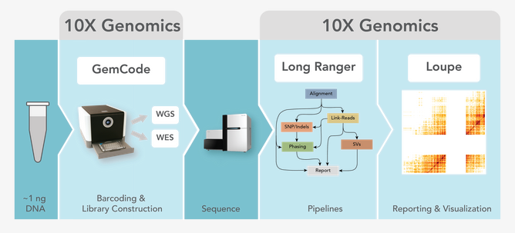
TECHNOLOGICAL INNOVATION RUNS FAST…
Innovative techniques, designed to help better resolving chromosome scale assemblies, have been abandoned within a very few years
Example: 10X Genomics Chromium. Basic idea: create barcoded libraries for each individual DNA molecule (chromosomes), so that the assembly of each chromosome can proceed separately -> computational complexity reduction
Approach taken off the market recently, but the same technology has been used by 10X Genomics to develop techniques for single-cell genomics

Slide 31
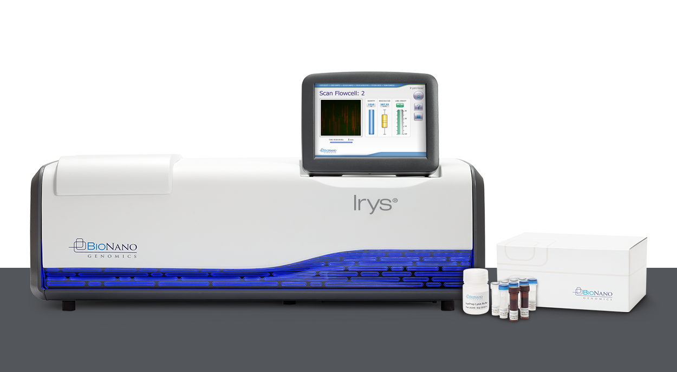
OPTICAL MAPS
Bionano optical maps - Saphyr and Irys platforms
Whole genome imaging
Study of structural variations with high resolution: translocations, large indels, inversions, etc.
Not true sequencing (in the sense that individual nucleotides are not determined), but it is a useful complementary strategy to further improve the quality of complex genome assemblies

Slide 32
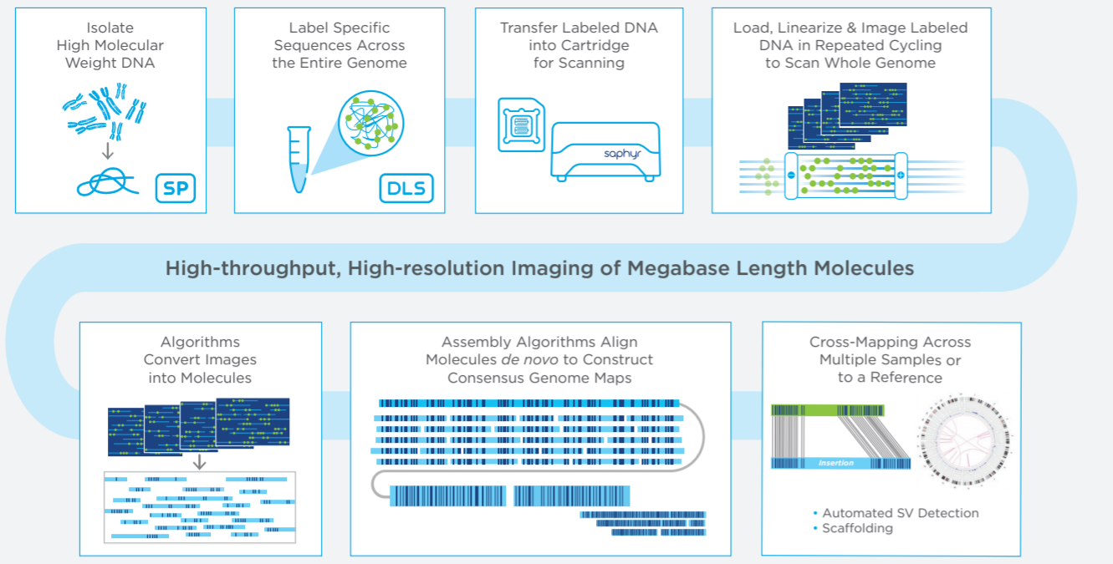
OPTICAL MAPS
Starting with ultra-high molecular weight DNA
Added fluorescent molecules that bind specific DNA sequences, creating unique fluorescence patterns for each genomic region
Linearized and labeled DNA passes through nanochannels
Construction of optical maps based on fluorescence patterns that help detect structural changes. Currently used mainly in humans and model organisms, but has already found application in other targets

Slide 33
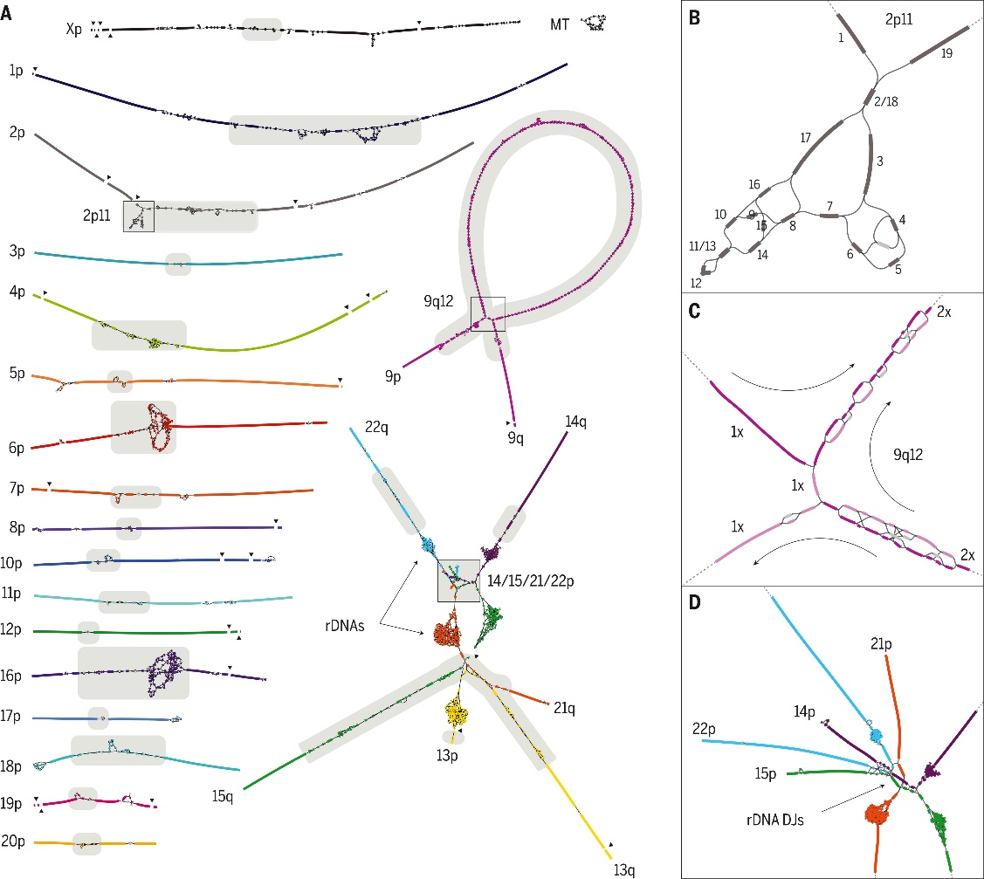
How the “gaps” in the human genome were filled by the T2T consortium - technical aspects
Combination of many of the techniques we have discussed!
30X coverage with PacBio HiFi reads
120X coverage with ultralong ONT reads
100X coverage Illumina reads (generated from PCR-free libraries)
70X coverage reads Illumina Hi-C
In addition, development and application of ad hoc bioinformatics approaches for managing and assembling these data

Slide 34

Once we have an assembly, how do we evaluate its quality?
If I have an estimate of the size of the genome, I can estimate how close the size of the assembled genome comes to it
How many scaffolds have I obtained? How is their length distributed?
Are the contigs and scaffolds assembled correctly?
Do I find all the genes I expect in my assembly? If a housekeeping gene is missing maybe something is wrong!
What about the repeats? How did I handle them?

Slide 35
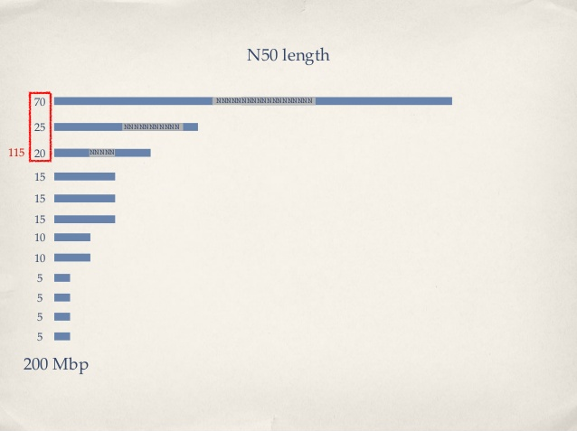
Quality measure based on the length of contigs (or scaffolds): the N50
N50 = length of the shortest contig in a set of contigs that globally reach 50% of the length of the assembly
That is: if I sorted all contigs from longest to shortest, calculated the sum of their lengths, and stopped as soon as I reached half of the total length, how long would the contig I stopped on be?

Slide 36
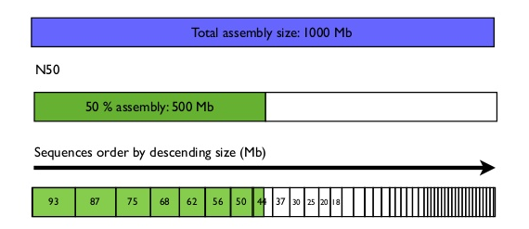
Other useful metrics
Sometimes N25 or N75 is reported.
The meaning is the same, but 25% or 75% of the total length of the assembly is taken as the reference
L50 (or L25/L75), on the other hand, refers to the number of contigs required to achieve 50 (or 25/75) % of the total length of the assembly
N.B. these metrics are applicable to both contigs and scaffolds and therefore the best values should tend to be obtained by working on the scaffolds
L50 = 7 sequences
N50 = 44 Mb

Slide 37

Evaluating the number of assembled genes
Benchmarking Universal Single-Copy Orthologs
«Collections of orthologous groups with near-universally-distributed single-copy genes in each species, selected from OrthoDB root-level orthology delineations across arthropods, vertebrates, metazoans, fungi, and eukaryotes»
The tool evaluates how many complete, fragmented, duplicated or missing genes are present in the assembly
Also excellent for assessing transcriptome completeness, not only in terms of presence/absence, but also in terms of % of assembled length compared with that expected if the transcript was complete
Based on the use of HMMs

Slide 38
OrthoDB is the reference dataset for BUSCO
It is a database of genes that need to be:
1)Orthologous
2)Single-copy
3)Evolutionarily conserved
Depending on the target species, we can choose a more or less extensive reference database (e.g., Mammalia or Metazoa rather than Eukaryota)

Slide 39
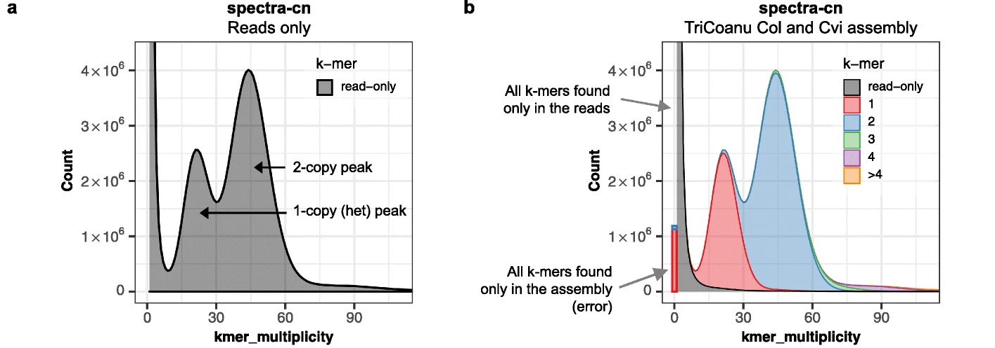
Evaluation of k-mer completeness and multiplicity
This is usually done with a software named Merqury
K-mer completeness (and multiplicity) is another important metric complementary with those previously discussed for evaluating whether a genome assembly correctly and completely represents all genomic regions and both haplotypes (i.e. including allelic variability and structural variations)
Ideally, 100% of the k-mers should be associated with at least one of the two assembled haplotypes in a fully phased chromosome-scale diploid genome assembly
In old-style genome assemblies, without chromosome phasing, many k-mers (those associated with the alternate haplotype) are expected to be missing

Slide 40
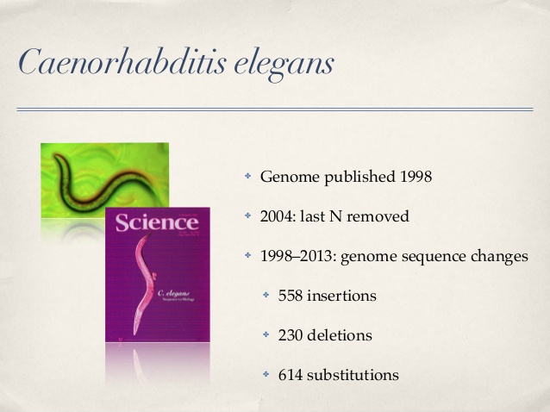
Let's keep in mind that no genome is perfect.... Technological improvements help!
We have already talked about this for the human genome, selling the progress made by the T2T consortium, but let's keep in mind that as far as “standard” genomes are concerned, this level of attention so far has not been there!
Genome finishing is a practice for now used only in model organisms or very small genomes

Slide 41
Pre-processing or raw sequencing data
Independently of the type of application (e.g., this also applies to sequencing approaches dedicated to de novo assembly of genomes seen in the last block of slides) the raw reads CANNOT be directly used, as is, for any type of analysis
When I obtain sequencing data, I must ask myself:
1) Have I obtained a number of reads consistent with my expectations?
2) Do the reads I have obtained meet, in quality and length, what was agreed upon with the sequencing center?
3) In case I sequenced multiple libraries in parallel (thanks to the addition of barcodes), is the number of reads obtained for the different samples uniform or unbalanced?
4) Do the reads obtained actually match exclusively the target organism of our analysis (this is not always 100% certain because of exogenous contamination!)?

Slide 42
Pre-processing or raw sequencing data
In addition to these considerations, I have to ask how much the presence of any sequencing errors may affect data analysis or interpretation of results
If sequencing errors are not adequately removed, they could result in the misidentification of genetic polymorphisms
For this reason, minimizing the presence of errors is especially critical for resequencing approaches, whose primary goal is precisely to detect the presence of mutations in heterozygosity or homozygosity (in case the organism is diploid)
How can a truly existing mutation be discriminated from a sequencing error when these are present at a very high rate?
The problem becomes even more important when the interest is to detect mutations associated with only a fraction of the cells analyzed (e.g., cancer genomics)

Slide 43
Resequencing: what are its goals?
Identification of genetic variation in the population (population genomics studies) or in individuals (study of diseases or investigation of traces of natural selection)
What am I interested in? GWAS (Genome-Wide Association Study)? Interest in non-coding, regulatory, or protein-coding regions alone? Structural genomics studies (indel detection, inversions, translocations, etc.)? Targeted interest in a narrow panel of genes (e.g., in those involved in the development of certain diseases)?
Whole genome resequencing approaches -> sequencing coverage such as to ensure complete mapping of variation along the entire genome
Targeted resequencing -> targeted approaches in constructing libraries so as to reduce the complexity of the data produced by limiting the production of reads to certain target genomic regions
Cost and sequencing strategies depend on the type of application we have in mind and the goal of our study

Slide 44
Targeted sequencing
Reduced cost and complexity of analysis
I can analyze more samples at the same cost (because I can reduce the number of reads needed to analyze the single sample)
Exome sequencing approaches -> sequencing of all exons within a genome; I therefore exclude introns and intergenic regions, plus regulatory regions
Custom panels -> I select only a few specific targets, which may represent a subset of a few dozen or hundreds of genes, or fragments thereof (e.g., exons where mutations are known to be associated with certain diseases)
Targeted amplicon sequencing: a single target region is analyzed from which information is expected to be derived, for example, about the biodiversity of a sample -> metagenomics approaches (mitochondrial DNA), polymorphic targets (MHC locus), etc.

Slide 45
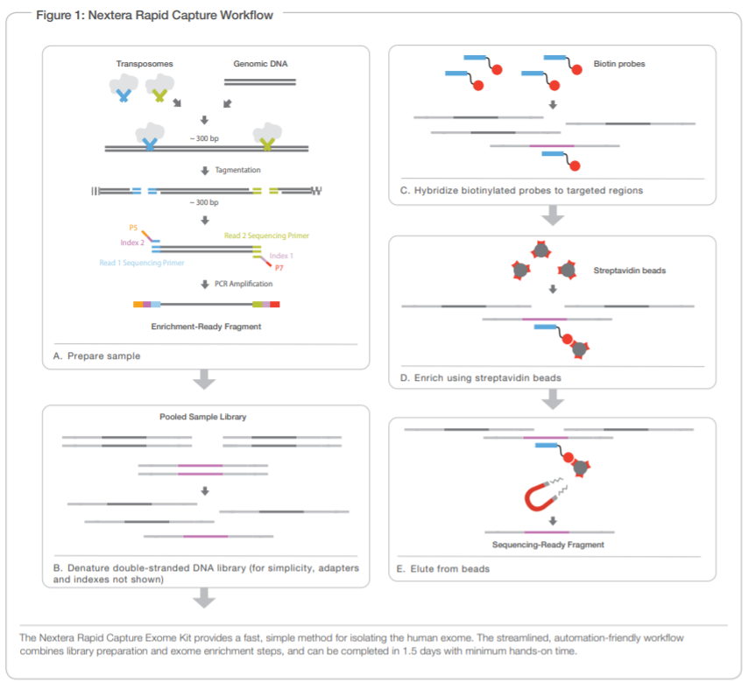
How do I selectively include only genomic regions of interest in a library?
Can use biotinylated + magnetic pulldown probes .
This approach may allow, depending on experimental design, isolation of regions from a few tens of Kb to over 50 Mb
Example in the figure: Illumina Nextera exome capture
Probes are complementary to target sequences (in this case exons)

Slide 46
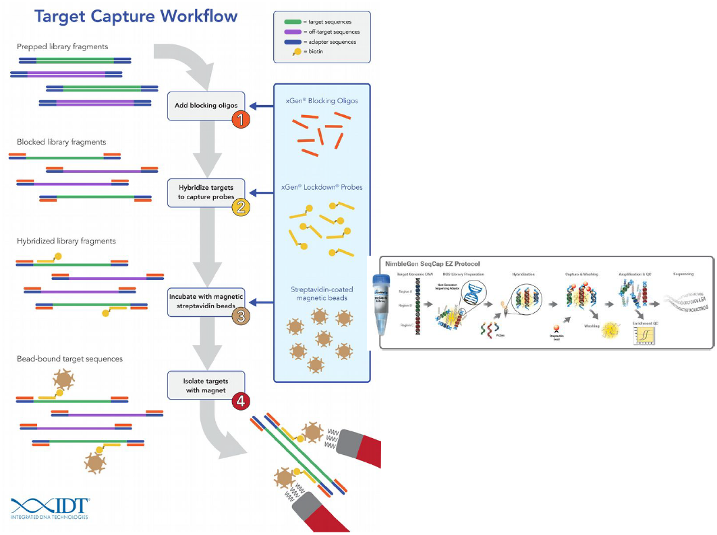
Example of the workflow of a commercial kit
A key goal is always to minimize the capture of “off-target” fragments
This kit (from IDT) uses “blocker” oligonucleotides that prevent hybridization between sequencing adapters present at the ends of library fragments

Slide 47
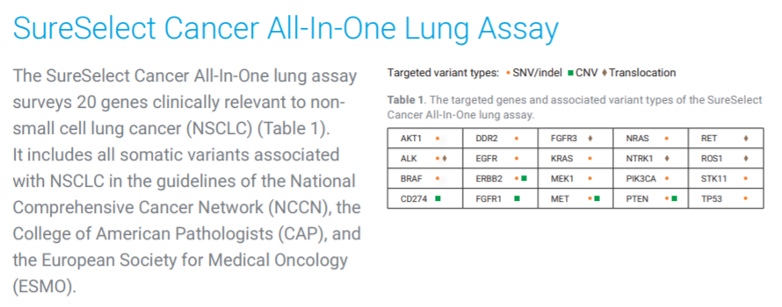
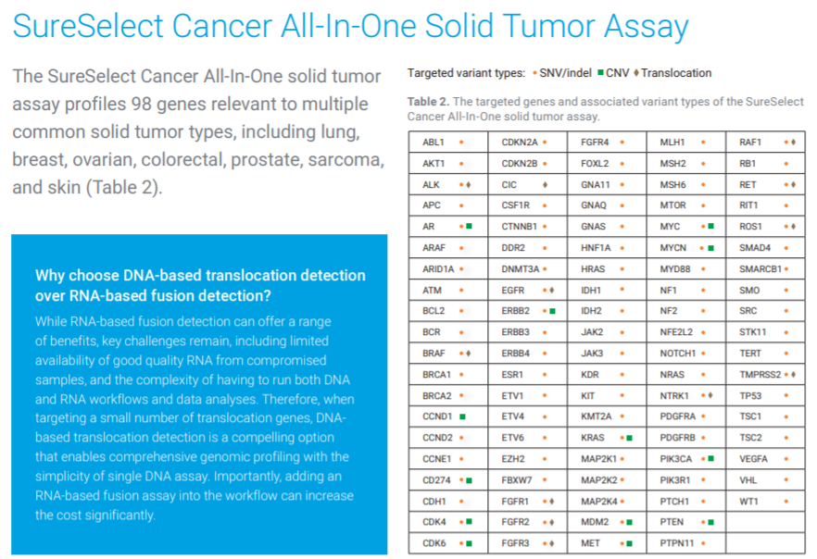
Target enrichment panels
Example: SureSelect lung cancer
20 target genes
Example: SureSelect Solid Tumor
98 target genes
The smaller the target panel, the fewer reads required -> lower overall cost, ability to sequence multiple barcoded libraries simultaneously, on “benchtop” sequencers

Slide 48
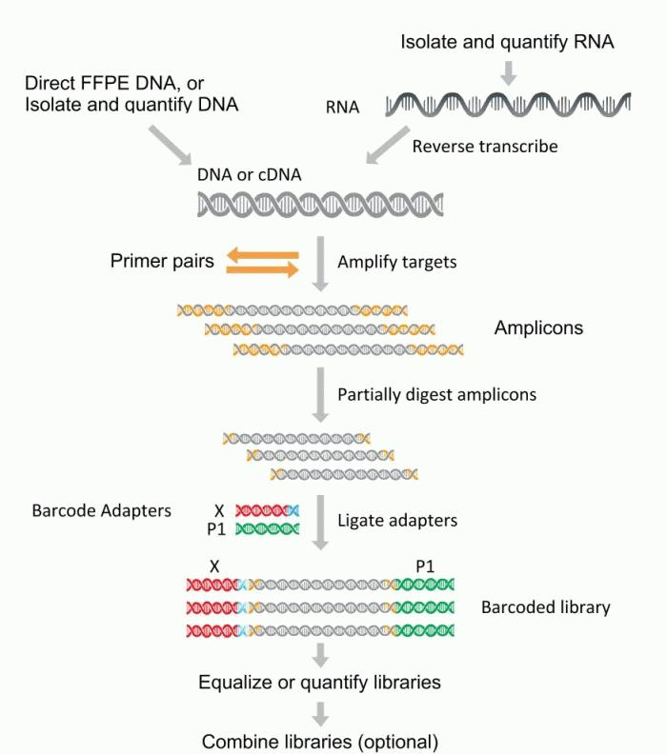
Ampliseq panels
Ability to simultaneously amplify (and then sequence) by multiplex PCR hundreds of genomic regions in a single project
N.B. also compatible with targeted sequencing from RNA, after retrotranscription into cDNA
Compatible with Illumina or IonTorrent sequencing (potentially also AVITI, BGIseq, Singular Genomics, Ultima Genomics and Onso)
Amplification sizes in the range of a few hundred bp (typically the entire amplicon should be sequenced in IonTorrent, or the two paired-end reads should be partially overlapping to cover the entire amplicon)

Slide 49
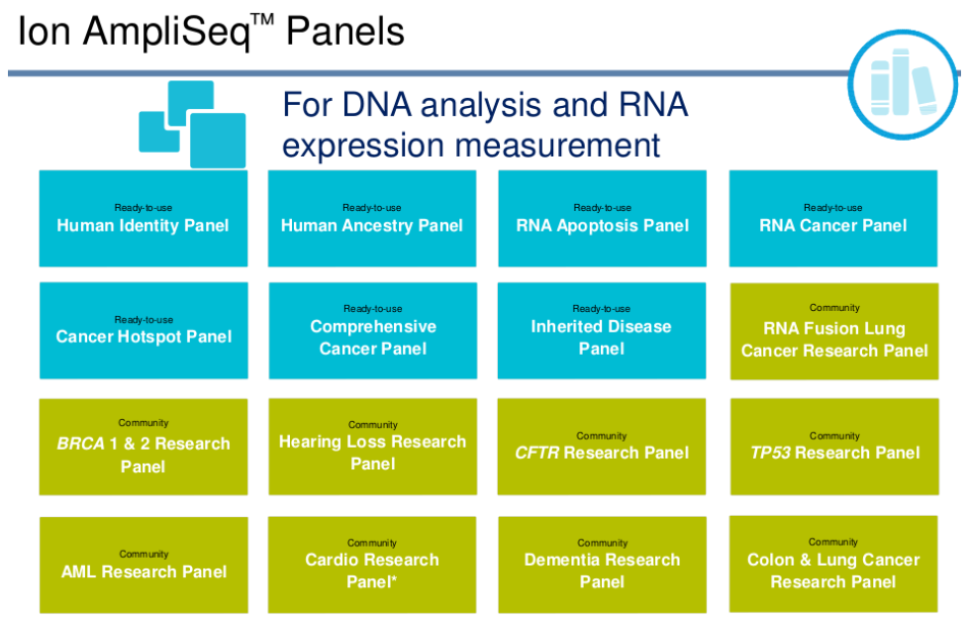
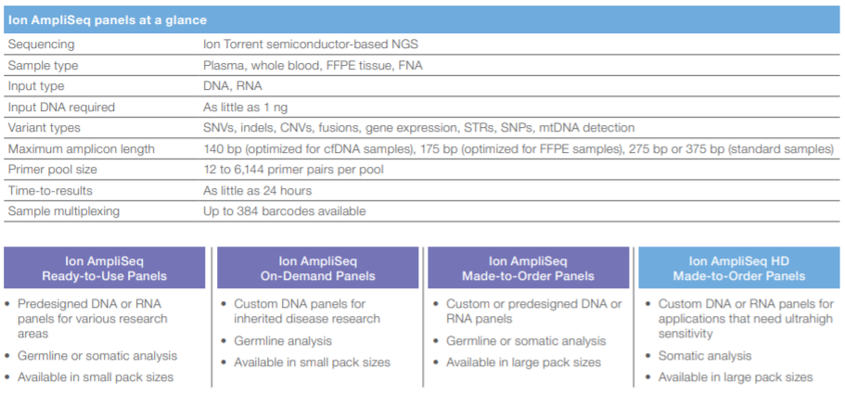
Ampliseq panels
Reduced DNA input: typically 50-100 ng, but for certain applications even less
Possibility of barcoding
12 to 6144 pairs of primers -> possible molecular targets
Amplicon size from 140 to 375 bp (IonTorrent)
Target: 20X coverage

Slide 50
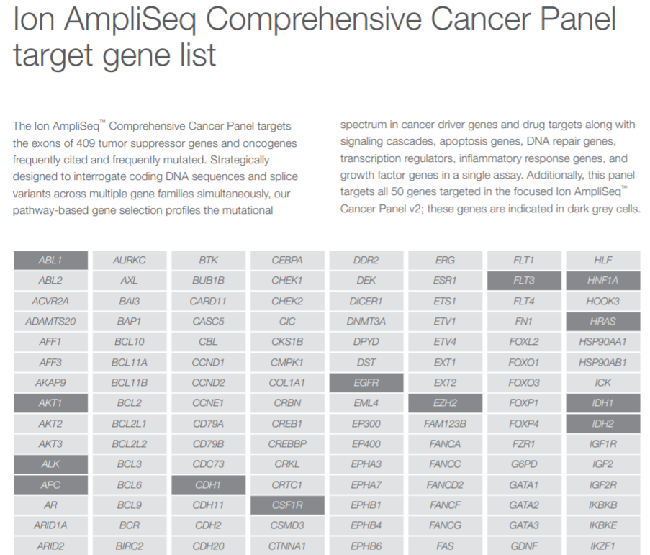
Example: Ampliseq comprehensive cancer panel
409 target genes, all exons covered
Targets are all oncogenes or oncosuppressors that have been frequently reported in the literature to be mutated in cancer diseases (COSMIC database)
Input: 40 ng of genomic DNA
Cost: about €1,000 for 8 reactions
The Hotspot Cancer Panel is significantly smaller (only 50 target genes - 207 amplicons) and naturally has slightly lower costs (96-reaction kit at 10 thousand euros)

Slide 51
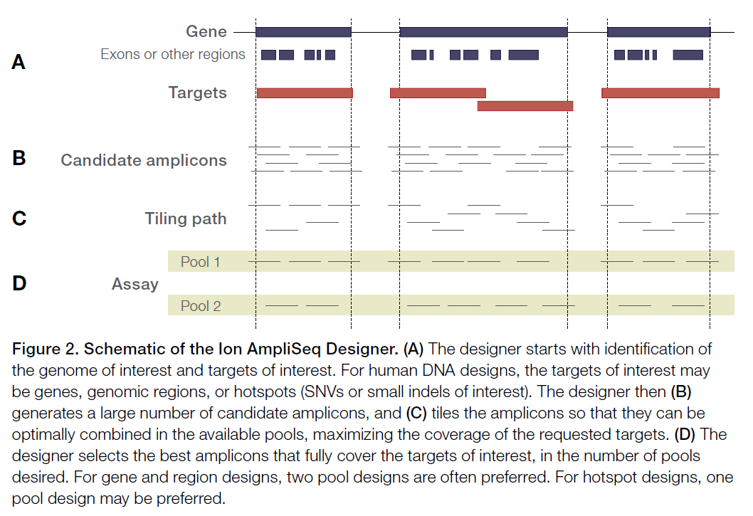
Example: Ampliseq exome panel
293,903 pairs of primers
Covers about 97% of the protein-coding exons annotated in the human genome
No UTR, no lincRNA, no miRNA
Input: 50 ng of genomic DNA
Rationale: about 85% of known mutations associated with inherited genetic diseases fall in coding exons or exon-exon junctions
Cost: about 1,000 euros for 8 reactions
Amplicon size (including adapters!): 225-275 bp
Average insert size: 202 bp -> similar to average length of human exons

Slide 52
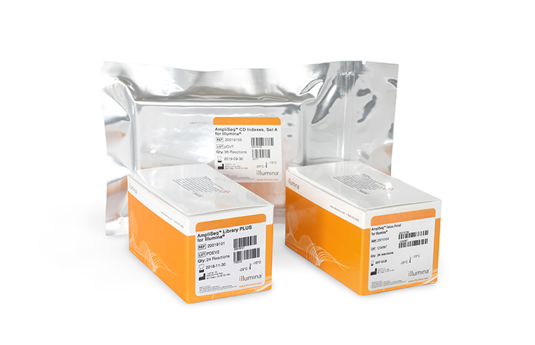
Example: Ampliseq custom panels
It is possible to have an algorithm design, entirely in silico, the best experimental design for a resequencing strategy on a custom dataset
Just select the name of the target genes (in case of model organisms) or provide the sequence in fasta format of the targets (also lends itself well to non-model species
The algorithm draws the primers so that the sample is analyzed in two distinct pools, to avoid overlapping (and hybridization) of amplicons
N.B. a similar approach is also possible for target enrichment
We must always keep in mind the maximum amplicon sizes so that these are compatible with the average length of the reads we expect to obtain

Slide 53
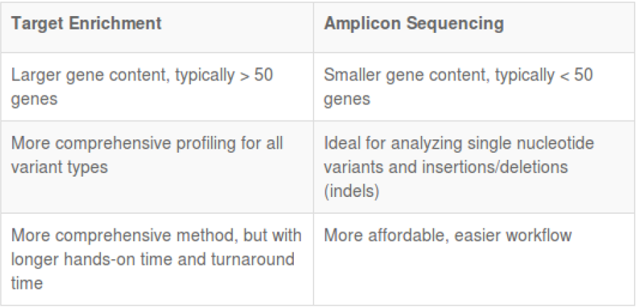
Amplicon sequencing vs target enrichment
N.B. THIS WAS ONLY AN ISSUE IN THE INITIAL STAGES! WE NOW HAVE DEFINITELY OVERCOME THIS PROBLEM

Slide 54
Whole Genome Resequencing (WGR)
This is certainly a more expensive approach than targeted approaches: coverage required usually >= 30X (if using Illumina)
Illumina strategy to detect SNPs and small indels, with costs that allow application even on a rather large number of samples
Example: genomic resequencing of different populations to derive information on genetic variation in the human genome (HapMap projects, 1000K genomes, etc.). Resequencing of a congeneric species, of selected “breeds” in breeding species, of a variety (especially in plants), of a bacterial strain, of a viral lineage (SARS-CoV-2), using an already available genome as a reference. Very important for medical genetics and population genetics
For the study of structural variants (wide indels, alternative haplotypes, copy number variation) -> long reads (not forgetting optical mapping approach, for highly detected structural variations). More expensive approach, limited to single individual, or at least to a limited number of subjects

Slide 55
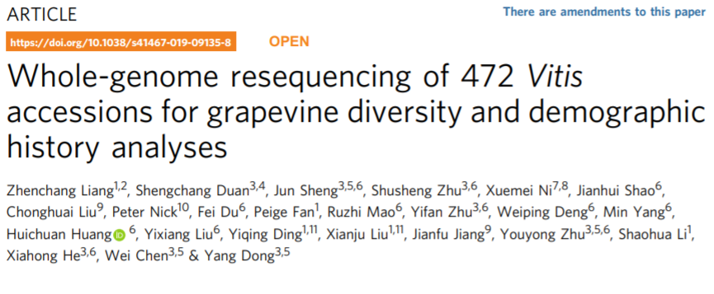

Whole Genome Resequencing (WGR)
The goal may be to perform variant detection.
As we have already mentioned this must depend on an accurate management of reads in the trimming phase
However, it also depends on a proper mapping strategy to avoid nonspecific alignments, especially in case of paralogous genes and repetitive sequences

Slide 56

Whole Genome Resequencing (WGR)
It has many applications in biomedicine because it potentially allows identification of disease-associated variants
Used in population genomics for the identification of phenotypic variants
Sequencing coverage must be appropriate to allow me to discriminate real variants from possible bioinformatics artifacts, related to mapping reads that contain errors
How many variants do we expect to find for each individual genome position? In a diploid individual naturally at most 2 (so either 100% concordant reads, or with close to 50%-50% split between the two alleles)

Slide 57

GWAS – Whole Genome Association Study
These are genetic association studies, analyzing whether a particular group of subjects of interest (e.g., suffering from a disease) shows a statistically higher frequency of mutations at certain loci than observed in a control group (e.g., healthy patients)
The two groups must be carefully controlled to be absolutely comparable for all other relevant factors (e.g., sex, age, other diseases, smoking/non-smoking status, etc.), so as to avoid the identification of spurious correlations
Results are usually shown graphically in the form of Manhattan plots and allow the identification, without any prior knowledge, of candidate genomic sites, facilitating in many cases the planning of targeted therapies
In a Manhattan plot, chromosomes are indicated on the X axis and the logarithm of the probability (of nonrandom association) is plotted on the Y axis. Peaks exceeding the (arbitrary) threshold indicate the location of candidate sites

Slide 58
Variant detection – How to?
Why may it be necessary/useful to vary the thresholds of the mapping parameters, so that some degree of divergence between reads and reference can be tolerated?
First, to allow mapping of reads that have some sequencing errors that could not be detected/removed during trimming (depends, of course, on the sequencing mode used). Using too stringent parameters could lead to discarding almost all reads, resulting in insufficient data (e.g., errors, despite being or rare, are still possible in Illumina reads), while too lax mapping could lead to confusing true polymorphisms with sequencing errors
Secondly, to analyze what really interests us: SNPs and other genetic variations. The reference genome is usually derived from a single individual -> regions where there are differences between this individual and the one from which I obtained the sequencing data would lead to areas without read mapping if the parameters used are too stringent. All individuals in a population are marked by some degree of inter-individual genetic variability, which depends on the species being considered (this concept is related to that of heterozygosity)

Slide 59
Variant detection – how to set parameters?
We always keep in mind the possibility of ambiguous mappings, related for example to the presence of paralogous genes (some reads might find a match with identical similarity in two distinct regions of the reference genome). The problem is obviously very relevant for short reads and diminishes for long reads
We must always ask ourselves what is the expected level of variation between the reads we have obtained and the reference sequence, based on these factors:
The sequencing platform and the expected error rate
The sequencing depth (coverage) we have used
The genomic characteristics of our target organisms (ploidy, heterozygosity rate, etc.)
The aim of the analysis (SNP detection, whole genome resequencing, identification of somatic mutations, etc).

Slide 60

A practical example
In this case, the reference genome reports an A at the position of interest
However, from the literature, it is known that some individuals may show polymorphisms at this position: G or T. This information is usually retrievable from appropriate databases, such as ClinvAR IN NCBI
A SNP may or may not be linked to the development of a disease. It depends on its position (exon, intron, promoter, intergenic, etc.) and its effect on the encoded protein (synonymous or nonsynonymous substitution?), including on the 3D structure

Slide 61
A practical example
Let us imagine that we conducted Illumina sequencing with 100X coverage for a whole genome resequencing study (remember that the error rate is very low)
What situations do we expect to observe (assuming no errors)?
1)Homozygosity: 100% of the reads contain A, G or T
2)Heterozygosity: 50% of the reads contain one nucleotide and 50% of the reads contain another (e.g. 50% A and 50% G, 50% A and 50% T, or 50%G and 50% T)
Since sequencing errors are always possible, there would be nothing unusual in observing a situation with 99% A and 1% G -> it is useful to set a minimum threshold of observation frequency for calling a variant, to discriminate between errors and real variants. The expected situation should approach a 50%-50% frequency if a locus is in heterozygosity
N.B.: All this is not valid for tetraploid organisms (4n)! In this case we might observe 3 or even 4 variants simultaneously (with frequencies 50%-25%-25% or 25%-25%-25%-25%)
In the case of somatic mutations, these might be present with much lower frequency (this is because they affect only a subset of cells among those considered, a very important aspect in molecular oncology!)

Slide 62



The fate of unmapped reads
Unmapped reads are generally discarded and not subjected to any additional analysis
However, they are far from being useless, as they can occasionally include a wealth of “hidden” information
This is, for example, the case of structural variants in pan-genomic approaches. Keep in mind that unmapped reads do not find any match against your reference, so they may include both inter-individual sequence variants (e.g. hypervariable alleles) and contamination that might be worth investigation. See a few examples below

Slide 63
Resequencing approach: Covid-19
Target genome: 30Kb
Importance in tracking the emergence of variants that could have important phenotypic effects, altering transmissibility and/or ability to cause reinfection through immune escape phenomena
The SARS-CoV-2 genome accumulates, on average, about 1 mutation every 2 weeks
Viral RNA can be extracted from each swab (but beware! Also the RNA of the host is extracted in large excess, since mucosal cells are taken)
Therefore, direct sequencing cannot be done, and the approach to be used is “targeted” resequencing
Ability to enrich libraries by specifically sequencing only SARS-CoV-2
RNA extraction must be followed by a cDNA retrotranscription step
Limited to buffers from which a good amount of RNA can be obtained (those with Ct < 35)

Slide 64

Resequencing approach: Covid-19
The ARTIC network aims to provide standardized protocols for sequencing and bioinformatic analysis of SARS-CoV-2 genomes.
Focused on sequencing approaches via MinION (for convenience of use in the field), but adaptable to Illumina sequencing as well. Remember that ONT can generate very long reads, but nothing prohibits analyzing short amplicons!
The goal is to adhere to WHO recommendations regarding sharing of genomic sequencing data of pathogens related to outbreaks (see ancillary file on Moodle)
«In relation to disease outbreaks, there should be a commitment by all stakeholders and institutions involved to make publicly available full data on pathogen genomes in order to quickly generate open, interpretable, and actionable information”

Slide 65

Resequencing approach: Covid-19
Development of rapid workflows, based on amplicon sequencing
Priming systems capable of amplifying the entire genome, via amplicons between 400 and 600 bp in length
It was possible to use protocols very similar to those previously developed for Zika, Ebola and other viruses

Slide 66

Resequencing approach: Covid-19
Why was it preferred to use an amplicon sequencing approach and not target capture enrichment? Here are some excerpts from a paper that explains it well
«The main benefits of the PCR-based approach […] are cost and sensitivity. In theory, both PCR and cell culture require only one viral copy, making them both exquisitely sensitive. In practice, however, the reaction conditions do not allow single-genome amplification, and, typically, multiple starting molecules are required. PCR also has limited sensitivity in cases in which the template sequence is divergent from the expected because of primer-binding kinetics. However, in an outbreak situation in which isolates are highly related, and low cost per sample and rapid turnaround time are required, PCR is particularly suitable.”

Slide 67
Resequencing approach: Covid-19
About the possibility to use target capture enrichment:
«Such methods, however, are limited by the efficiency of the capture step because of the kinetics of nucleic acid hybridization in complex samples such as those containing the human genome. The complete hybridization of all probes to targets can take hours (typical protocols suggest a 24-h incubation, although shorter times may be possible) and may never be achieved because of competitive binding by the host DNA. These methods suffer from a coverage bias, which worsens at lower viral abundances, resulting in increasingly incomplete genomes, as demonstrated by recent work on the Zika virus. They work best on samples with higher viral abundances and may not have the sensitivity to generate near-complete genomes for the majority of isolates in an outbreak. Probes for hybridization capture are also more expensive than PCR primers because they are usually designed in a fully overlapping 75-nt scheme, which can run to hundreds of probes per virus and thousands for panels of viruses.”

Slide 68

Resequencing approach: Covid-19
The pattern of primers design is critical!
We need to use at least two pools with alternatively designed primers so that the entire viral genome can be sequenced, without unwanted pairing between partially overlapping amplicons

Slide 69

Resequencing approach: Covid-19
Why has ONT sequencing been used so much for SARS-CoV-2 sequencing?
«Viral WGS can be used to study the transmission and evolution of SARS-CoV-2, and is increasingly recognised as a critical tool for public health responses to COVID-19. Nanopore sequencing offers an alternative to established short-read platforms for viral WGS with several advantages. ONT devices: (i) are relatively inexpensive, highly portable and require minimal associated laboratory infrastructure; (ii) enable rapid generation of sequencing data and even real-time data analysis; (iii) require comparatively simple procedures for library preparation and; (iv) offer flexibility in sample throughput, accommodating single (e.g., Flongle), multiple (e.g., MinION/GridION) or tens/hundreds (e.g., PromethION) of specimens per flow-cell. Therefore, ONT sequencing could further empower SARS-CoV-2 surveillance initiatives by enabling point-of-care WGS analysis and improved turnaround time for critical cases, particularly in isolated or poorly resourced setting”

Slide 70

Resequencing approach: Covid-19

Slide 71

Resequencing approach: Covid-19
GISAID-NextStrain, previously developed for monitorning other viruses (influenza, Zika, West Nile, Ebola, ecc.)
https://www.gisaid.org
Publicly accessible portal to deposit, access and explore SARS-CoV-2 sequencing data
Over 20 million SARS-CoV-2 genomes sequenced

Slide 72

Targeted resequencing: new perspectives
Any targeted resequencing procedure, whether based on the design of primers or on the use of probes for targeted enrichment, requires steps in the laboratory that can be quite delicate, time-consuming, and are in any case subject to bias (amplification efficiency may be variable from target to target, hybridization between probes and genomic regions of interest may not be successful, etc.)
ONT adaptive sampling -> selection of genomic regions of interest is done directly at the sequencer level
How does it work? See the video on Moodle
A database of sequences of interest is provided for resequencing. DNA molecules are read in real-time for each pore, so it is possible to check whether what is being sequenced is of interest (it proceeds) or not (the molecule is discarded, freeing the pore for the next molecule)

