Slide 1
LECTURE 9 Single-cell and spatial –omic approaches

Slide 2
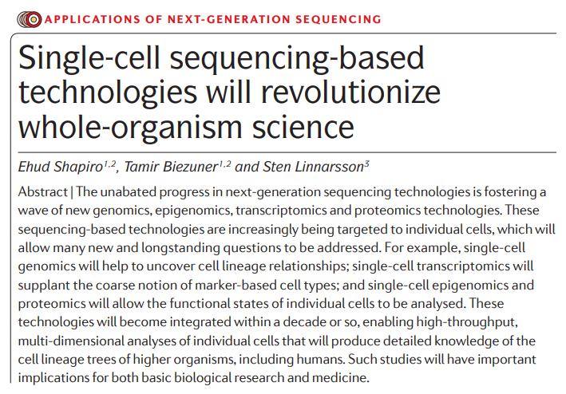
The young story of single-cell sequencing
So far, we have always discussed about bulk RNA-sequencing approaches, which target a large number of cells analyzed simultaneously, providing average levels of expression
Single-cell approaches can, however, greatly improve the resolution of the analyses, clarifying the biological role of single cells
N.B. Although single-cell approaches are most frequently used for RNA-seq, other –omic applications are also possible, although there are some limitations

Slide 3
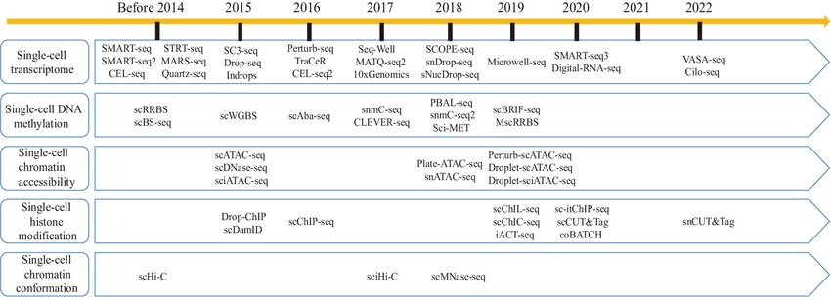
The young story of single-cell sequencing
Single-cell sequencing approaches include a large number of different techniques that have been developed over the years, most of which deal specifically with sc-RNA-seq
However, the development of different cell isolation protocols, library preparation strategies and microfluidics devices strongly contributed to the recent extension of single-cell sequencing approaches to genomic DNA, paving the way to new applications
Here, we are going to briefly discuss a few key points shared by most scRNA-seq strategies, and some quick notes about other possible single-cell omic approaches will be provided in the new few lessons

Slide 4
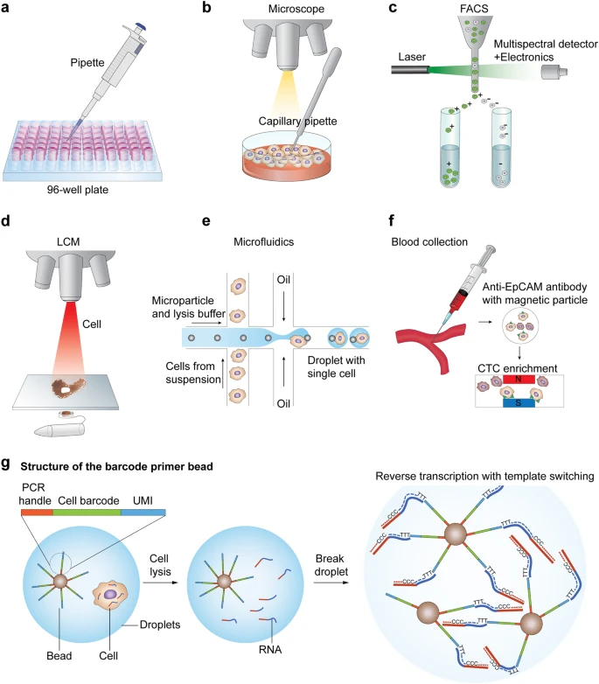
Single-cell RNA-seq approaches
The ability to perform these studies depends on our ability to isolate individual cells from a biological sample
Multiple approaches are possible, but each one has its advantages and its disadvantages. The main factors to be considered are:
Throughput (i.e. number of cells that can be analyzed)
Specificity of isolation of cells of interest
Need to dissociate cells, losing spatial information
High cost of the equipment needed and technical expertise required

Slide 5
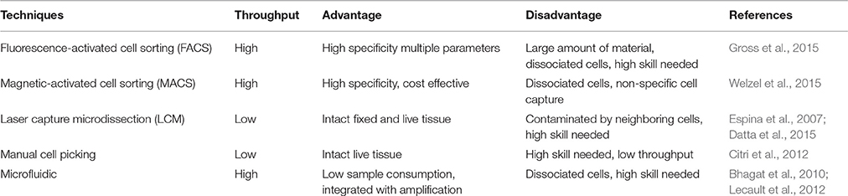
Single-cell isolation approaches
FACS (Fluorescence Activated Cell Sorting): allows the identification of different cell types in a heterogeneous cell population based on size, granularity, and fluorescence. Fluorescence is due to the use of monoclonal antibodies directed towards surface markers of target known cell types
Cells need to be separated from each other before the analysis and a large number of cells is required in suspension (>10,000 per sample); requires the use of fluorescent markers, one for each type of known target cell type (resolution up to 10-15 types)

Slide 6
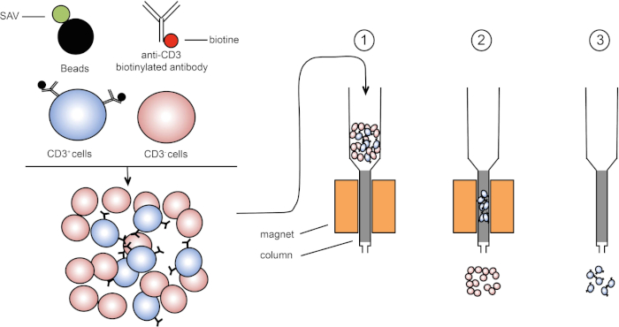
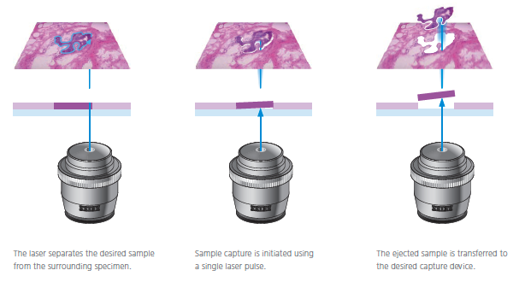
Single-cell isolation approaches
Magnetic-Activated Cell Sorting (MACS): magnetic beads coated with an antibody specific towards a surface antigen can be used to separate target cells in a sample from all the other cell types. Cost-effective and simple, but (i) can only target surface antigens and (ii) unlike FACS does not allow to discriminate populations by expression level
Laser Capture Microdissection (LCM): allows high precision, can work with solid tissue samples, usually previously fixed on a slide, but requires highly trained staff for cell identification; the throughput is low
Manual Cell Picking/Micromanipulation: similar to LCM, but involves the use of pipettes for cell picking. Can be also used on live cell cultures or on embryos. Very low throughput, requires highly skilled staff

Slide 7
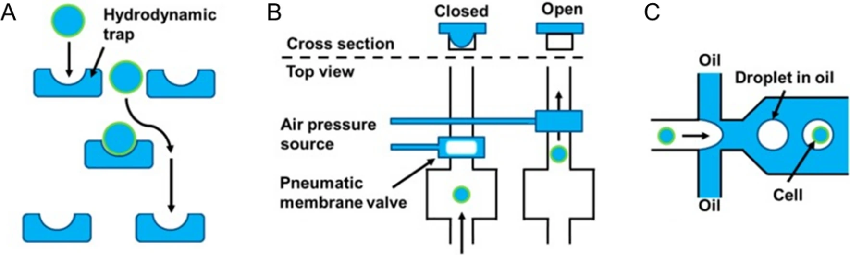
Single-cell isolation approaches
Microfluidic devices: their use has been steadily increasing over the past few years due to the possible application to very low reaction volumes, the ease of use and the possibility to combine them with FACS/MACS approaches
These approaches can isolate single cells based on 3 main types of approaches: (1) traps-based methods; (2)valves-based methods; (3) droplet-based methods
Traps are very simple, as they are basically microwells that can only accommodate a single cell; valve-based methods are the most complex ones, and they usually involve the combination of FACS/MACS; in droplet-based methods, each cell is associated with a droplet and beads in oil (resembles emulsion PCR, but beads are not magnetic)

Slide 8
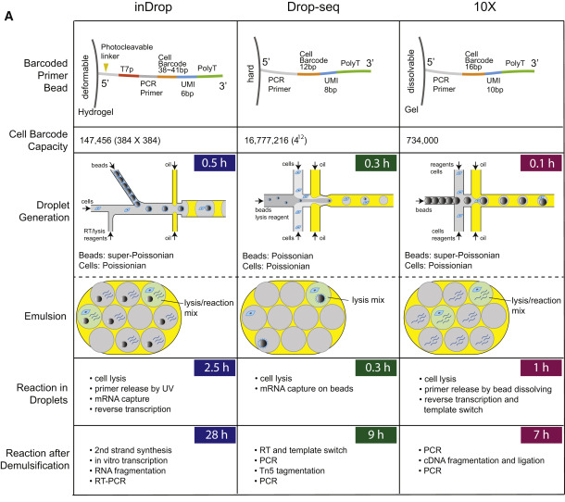
Droplet-based approaches
This slide shows three examples of different commercial kits used for a microfluidics droplet-based scRNA-seq approach
The beads serve the purpose of isolating mRNAs, since their surface is coated with oligos ending with polyT and including PCR primers (for polony generation), UMI and cell barcodes
The libraries are prepared with dual indexes (one barcode at each end), allowing a very high level of multiplexing
Different strategies are used for library preparation, which in any case also requires a cell lysis step before mRNA isolation

Slide 9
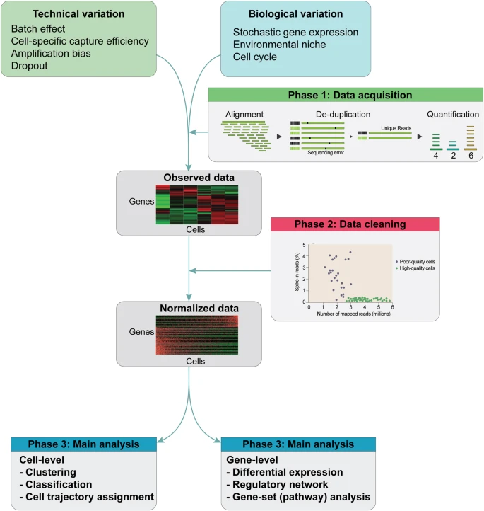
Single-cell RNA-seq approaches
Because mRNA input is low and selection strategies are based on poly-A selection, it is known that only the top 10-20% of the most highly expressed transcripts will be represented in the library
We exclusively use a 3'-tag library preparation approach because of the need to keep the costs down and analyzing large numbers of cells in parallel
Fundamental use of barcodes and UMIs (reads derived from each cell must be clearly identifiable!).
Approach subject to much more potential bias than classical RNA-seq approaches

Slide 10
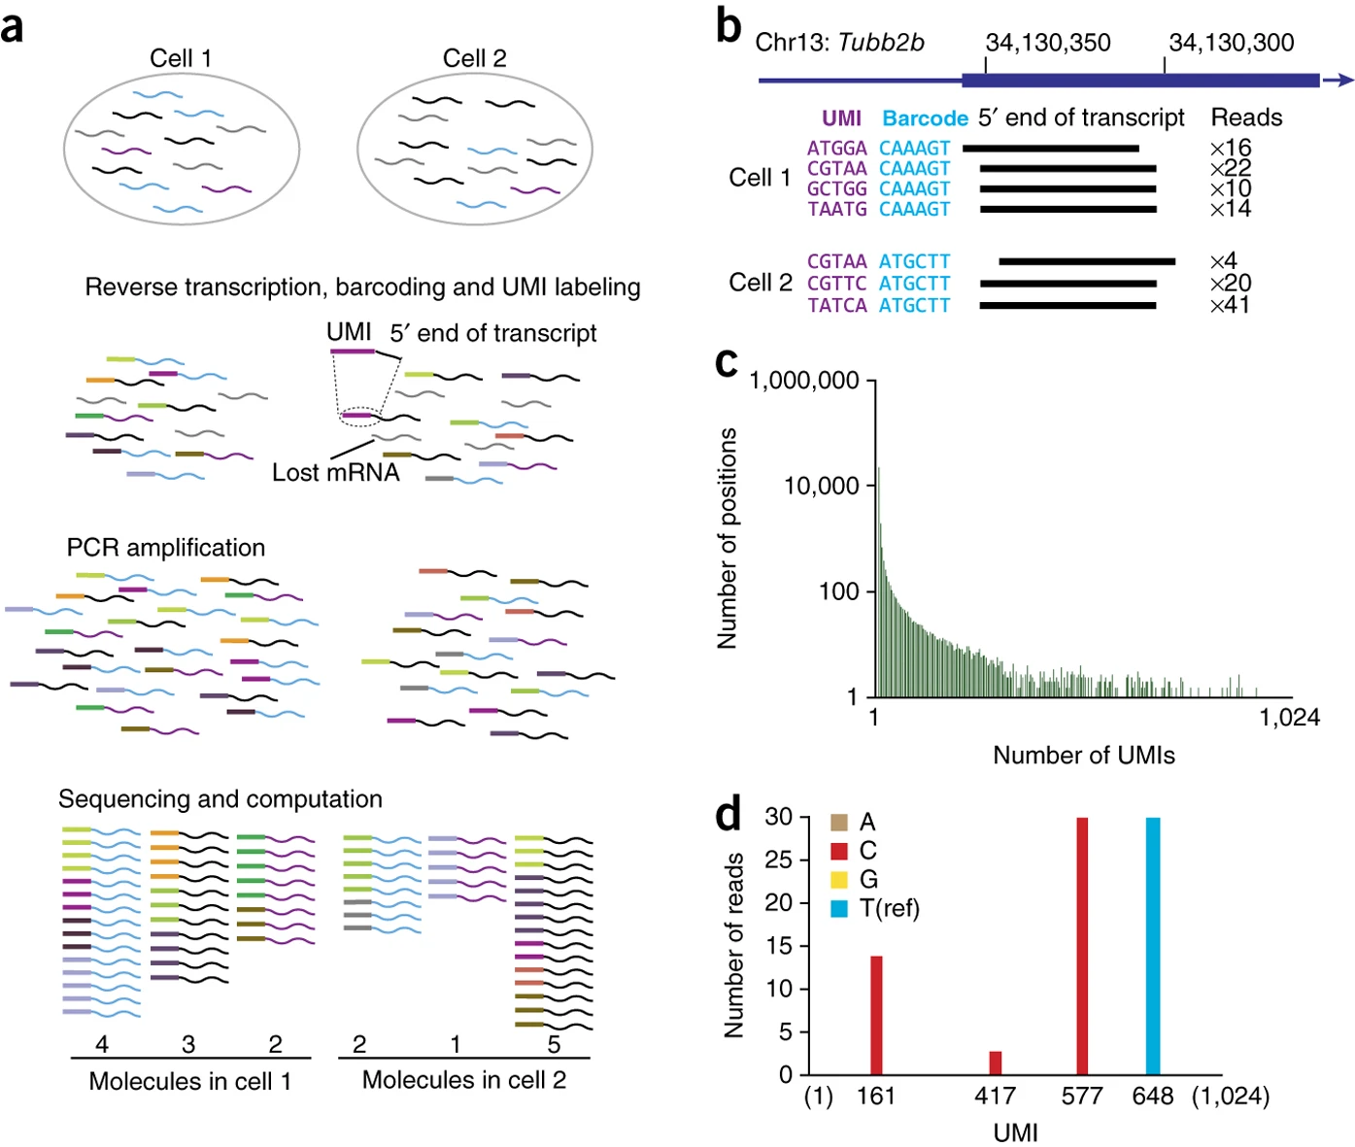
Single-cell RNA-seq: barcodes and UMI
Each barcode identifies a cell
Each UMI identifies a molecule
Useful in scRNA-seq because you start with little input RNA and consequently the “amplification noise” can be considerable
Dramatically reduces the number of duplicate reads, ensuring more accurate quantification
Usually the target of scRNA-seq analysis ranges from about 500 to 10 thousand cells (each one is characterized by a unique barcode), but some methods now allow even higher numbers of cells

Slide 11
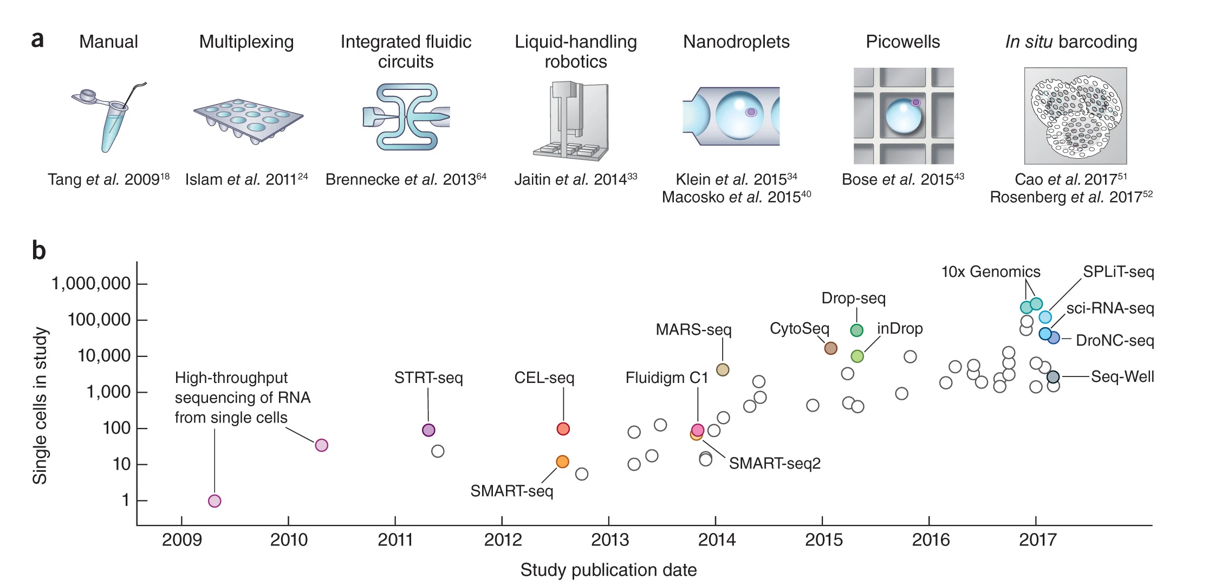
Single-cell RNA-seq: throughput
In scRNA-seq approaches the throughput (i.e. the number of cells) is basically determined by the mod of cell isolation and by the features of the biological sample analyzed. Over time, the development of new technologies has allowed a progressive increase in throughput

Slide 12
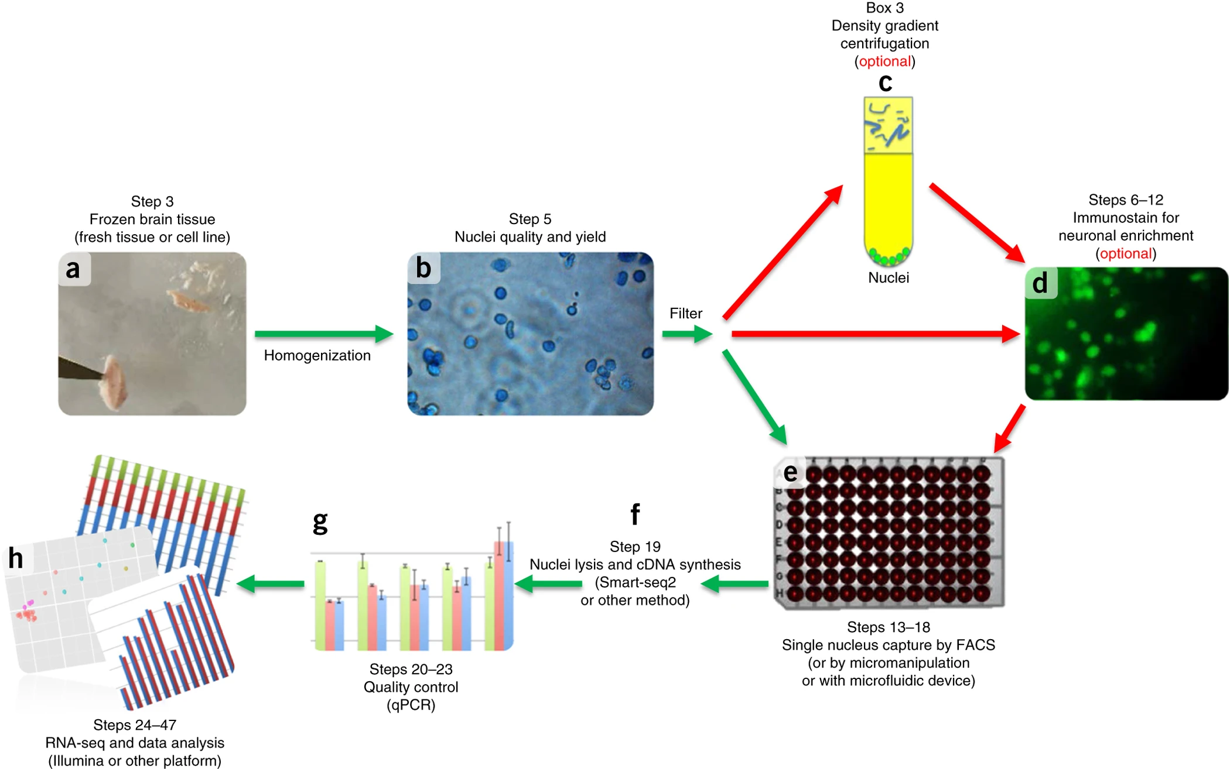
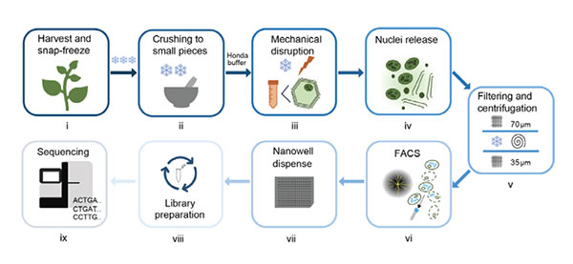
Single-cell vs single-nuclei RNA-seq
Some cell types (e.g., adipocytes, neurons, extracellular matrix cells) can be extremely difficult to separate
Nucleus isolation allows analysis of these cells as well, using a rapid (and not too aggressive) isolation protocol
Pros: ability to analyze expression profiles of any cell type, easy operation even from non-fresh, frozen or preserved samples by various methods
Cons: highlights nuclear transcription (pre-splicing), no possibility to study alternative splicing (because isolated mRNA molecules are pre-mRNA), excludes mitochondrial and plastidial transcripts

Slide 13
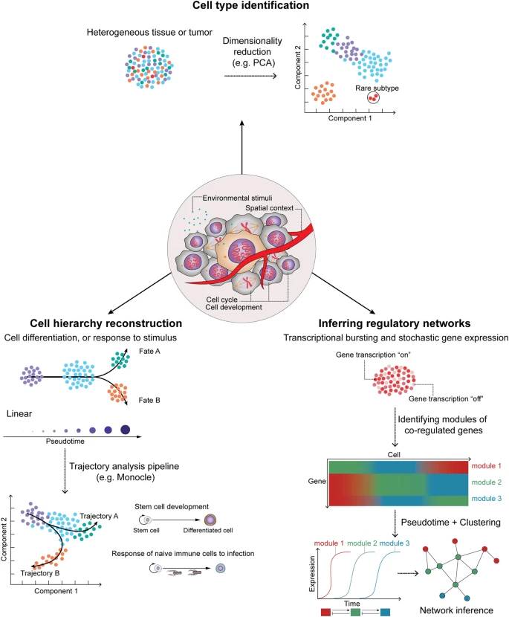
Single-cell RNA-seq: what is their goal?
What is the ultimate goal?
Identifying groups of cells that show similar expression profiles -> cell types that share the same function (specialized blood cells for example), or groups of cells with aberrant expression profiles (cancer cells)
At the same time, we can better define which genes are specifically expressed by highly specialized cells in a tissue
This information would be “lost” (because it is averaged with expression data from all other cell types) in RNA-seq data from a whole tissue

Slide 14
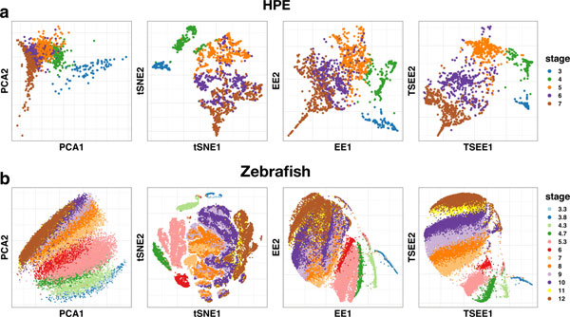
Graphical representation of scRNA-seq data
PCA-like graphs are the standard way for representing scRNA-seq data
N.B. in these representations, each dot corresponds to a cell type, colors are used to discriminate different tissues from each other
Some alternative algorithms have been developed in recent years, which seem in some cases to be able to present in a more “informative” graphical guise the main differences between different samples. These include the methods of tSNE (t-distributed stochastic neighbor embedding) and elastic embedding (EE), which are encountering strong expansion in recent years in the field of single-cell RNA-seq

Slide 15
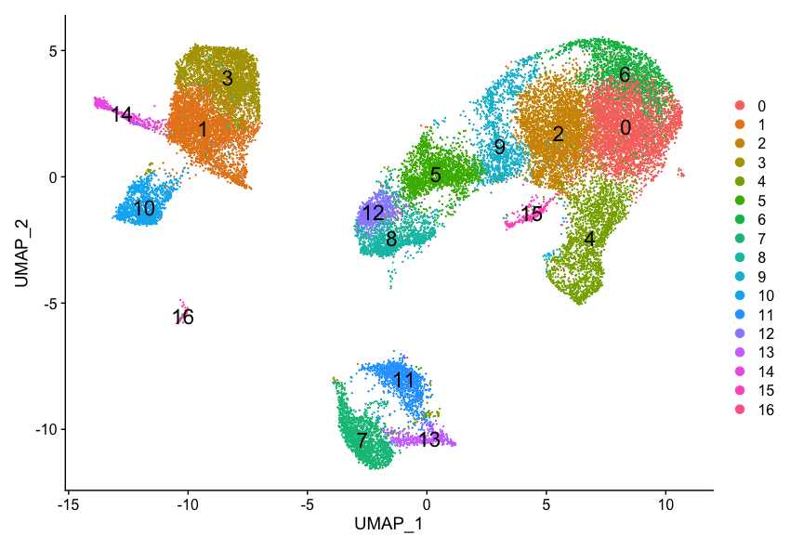
Graphical representation of scRNA-seq data
Final goals:
Identifying different cell populations that share a similar gene expression profile (these are usually labeled with different colors) -> this process is known as clustering
Functionally characterizing each cluster -> this exploits the high specificity of expression of one or more molecular markers, which are exclusively associated with a given cell type

Slide 16
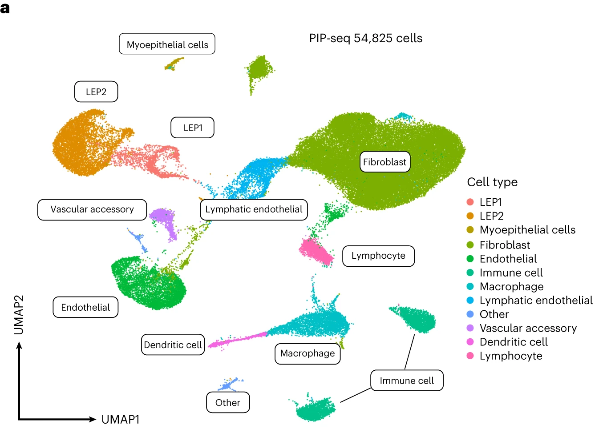
Graphical representation of scRNA-seq data
A few additional notes:
Some clusters may remain uncharacterized, if no molecular marker is known (especially in non-model organisms)
The distinction between different cell types is not always clear: cells may display a gradual shift from one type to another one, depending for example on their maturation
The number of generated clusters can be arbitrarily defined based on the required level of resolution

Slide 17
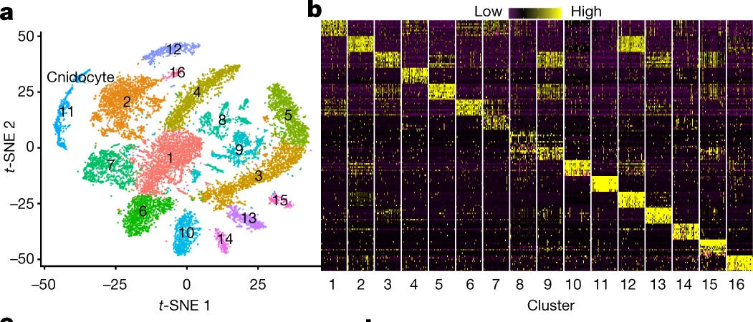
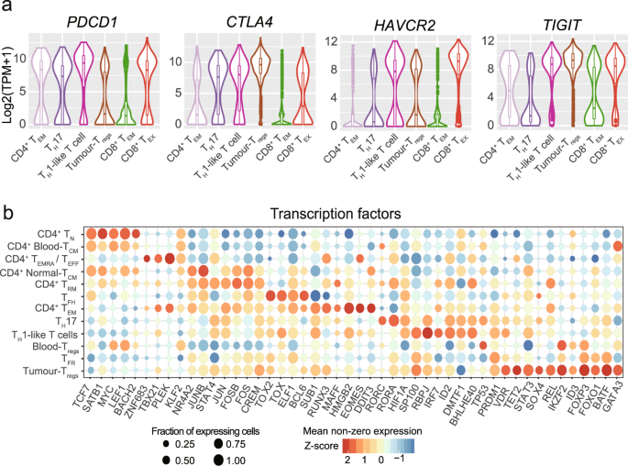
Graphical representation of scRNA-seq data
Heat maps can provide some help for the interpretation of scRNA-seq expression data, in particular in relation with clusters
Due to the usual presence of extreme inter-cellular variability, violin plots can be also very useful to display the distribution of gene expression levels of selected molecular markers across different cell types.
Bubble plots also help a lot, as they show: (i) the % of cells that express a given gene (bubble size) and the average expression level of the same gene (bubble color)

Slide 18
scRNA-seq: how much does it cost?
Cost is highly dependent on the type of sample, cell isolation approach and on the number of target cells. However, the library preparation step is always the most expensive phase. Sequencing itself is pretty cheap, due to the low number of reads required per cell (due to the low amount of RNA that can be recovered per cell). We can provide a few examples…
Chromium 10X: library prep is about 2000$ per sample, and each microfluidics chip is about 270$. Each cheap can be used for up to 40K cells (i.e. 8 samples, up to 5K cells theoretically possible, but the typical output is around 1K cells)
Subsequent sequencing would require about 50-100K reads per cell
Take home message: library prep costs about 10-20X more than bulk RNA-seq. Although the number of reads per cell is much lower than bulk RNA-seq, the total number of reads required is also higher due to the high number of cells analyzed

Slide 19
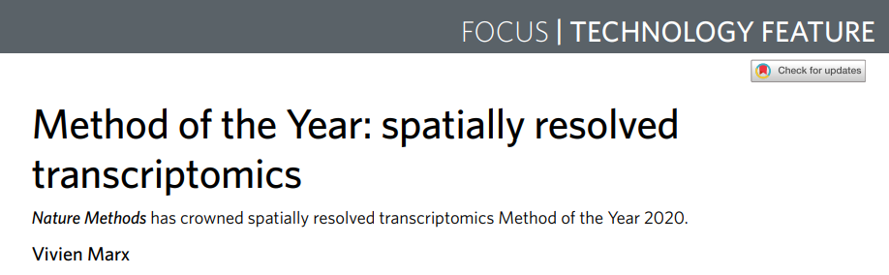
Spatial transcriptomics – what is it?
Despite their usefulness, most scRNA-seq methods require the disruption of the target sample for the isolation of single cells (or single nuclei), thereby precluding the possibility to study the spatial distribution of cells within tissues
Some cells types (e.g. neurons) are not as amenable for scRNA-seq approaches as others, and scRNA-seq data do not provide information about the subcellular localization of mRNAs, which can be sometimes quite a useful information
A growing number of platforms now allow the possibility to obtain a spatially resolved, high-dimensional assessment of gene transcription, known as ‘spatial transcriptomics’
This has been nominated the “method of the year” in 2020 by Nature Methods

Slide 20
Spatial transcriptomics: the platforms
Available commercial platforms are still at their early stage of development
Some of them hold promises not just for transcriptomics, but also for other omics approaches: spatial proteomics, for example, with the simultaneous use of multiple antibodies (we will see some examples about this)
They require, preferentially, fresh-frozen samples, in order to avoid RNA degradation; however, they can also work on FFPE (Formalin-fixed, paraffin-embedded) samples
RNA quality is obviously as important as in regular RNA-seq approaches
Usually, the samples need to be prepared as thin slices by microdissection, but some platforms also accept tissue blocks
Most applications still just concern human or mouse (due to the use of oligonucleotide probes/antibodies targeting specific mRNAs or proteins), but the technology itself could be potentially applied to any organism

Slide 21
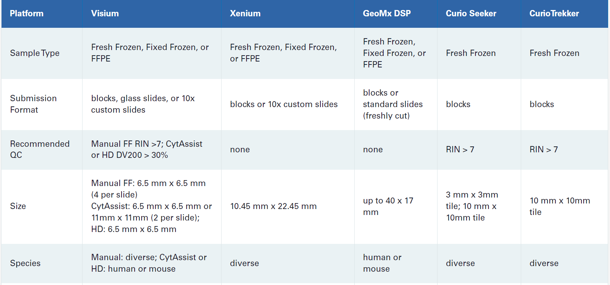
Spatial transcriptomics: the platforms

Slide 22
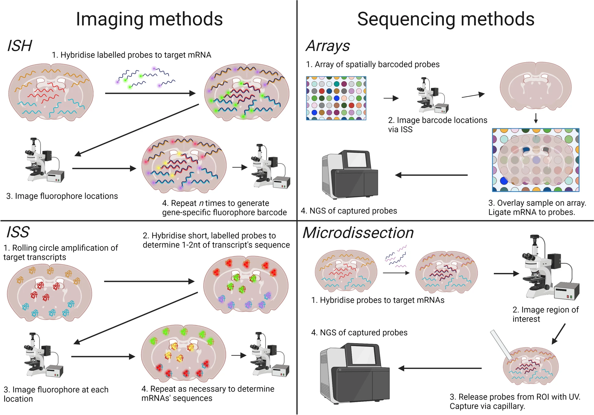
Different platforms, different approaches
imaging-based spatial transcriptomics
in situ hybridization (ISH) (use of a high number of probes directed against target mRNAs)
in situ sequencing (ISS) of target mRNAs amplified in situ with a sequencing by ligation approach
sequencing-based (NGS) spatial transcriptomics
array-based methods: record position and target capture
microdissection-based methods: use of spatially barcoded probes, with target area defined physically -> conceptually similar to ROI-based methods (ROI = Regions of Interest)

Slide 23
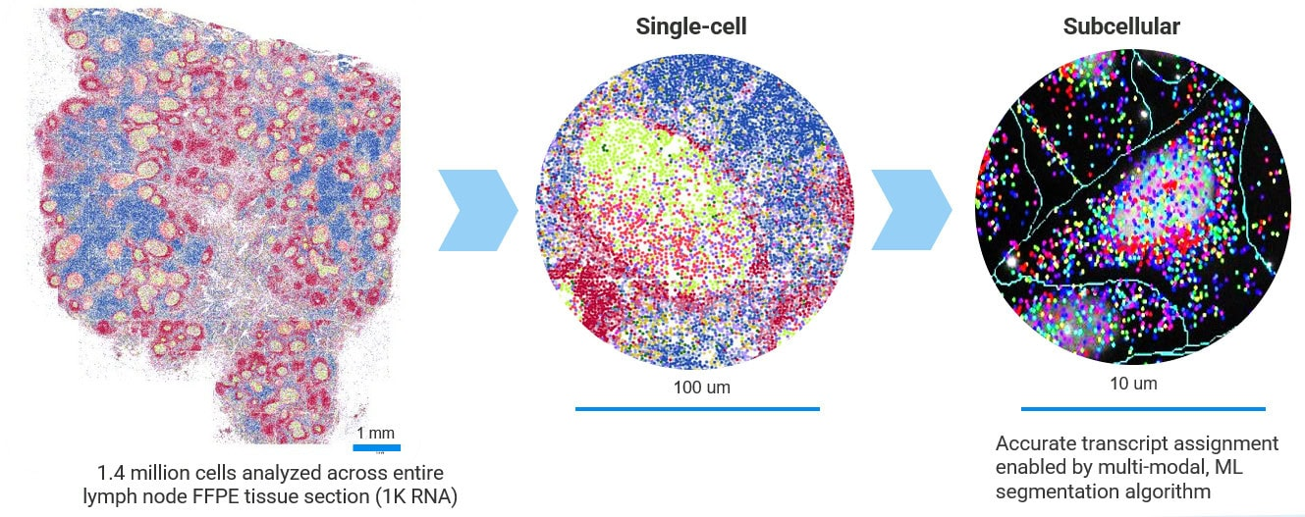
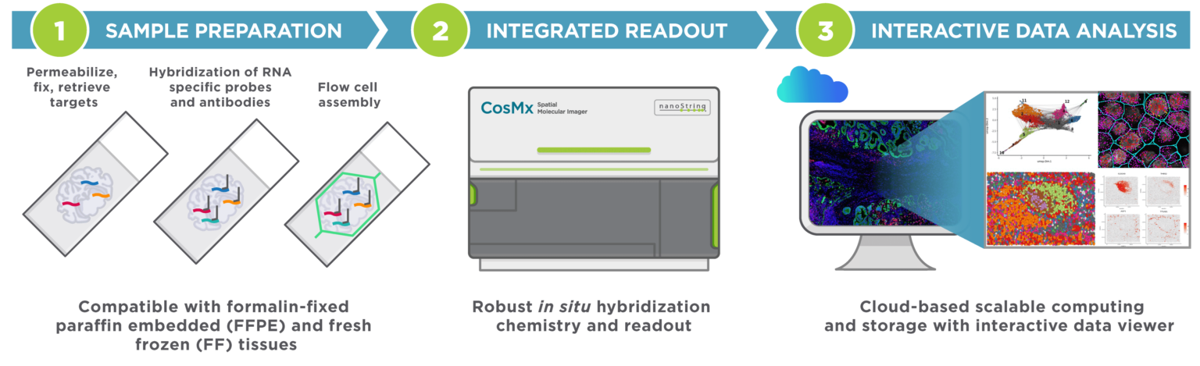
Imaging-based ISH platforms
One of the most important ISH-based platforms is the Nanostring CosMX
The newer releases of this platform allow multi-omics spatial analyses, which may exploit the use of antibodies for detecting up to 64 validated proteins with subcellular resolution
Another possible option is represented by the Vizgen MERFISH 2.0 technology, which requires the use of the Merscope platform (see video on Moodle)
Both of them use fluorophore-based oligonucleotide probes complementary to target mRNAs to be imaged

Slide 24
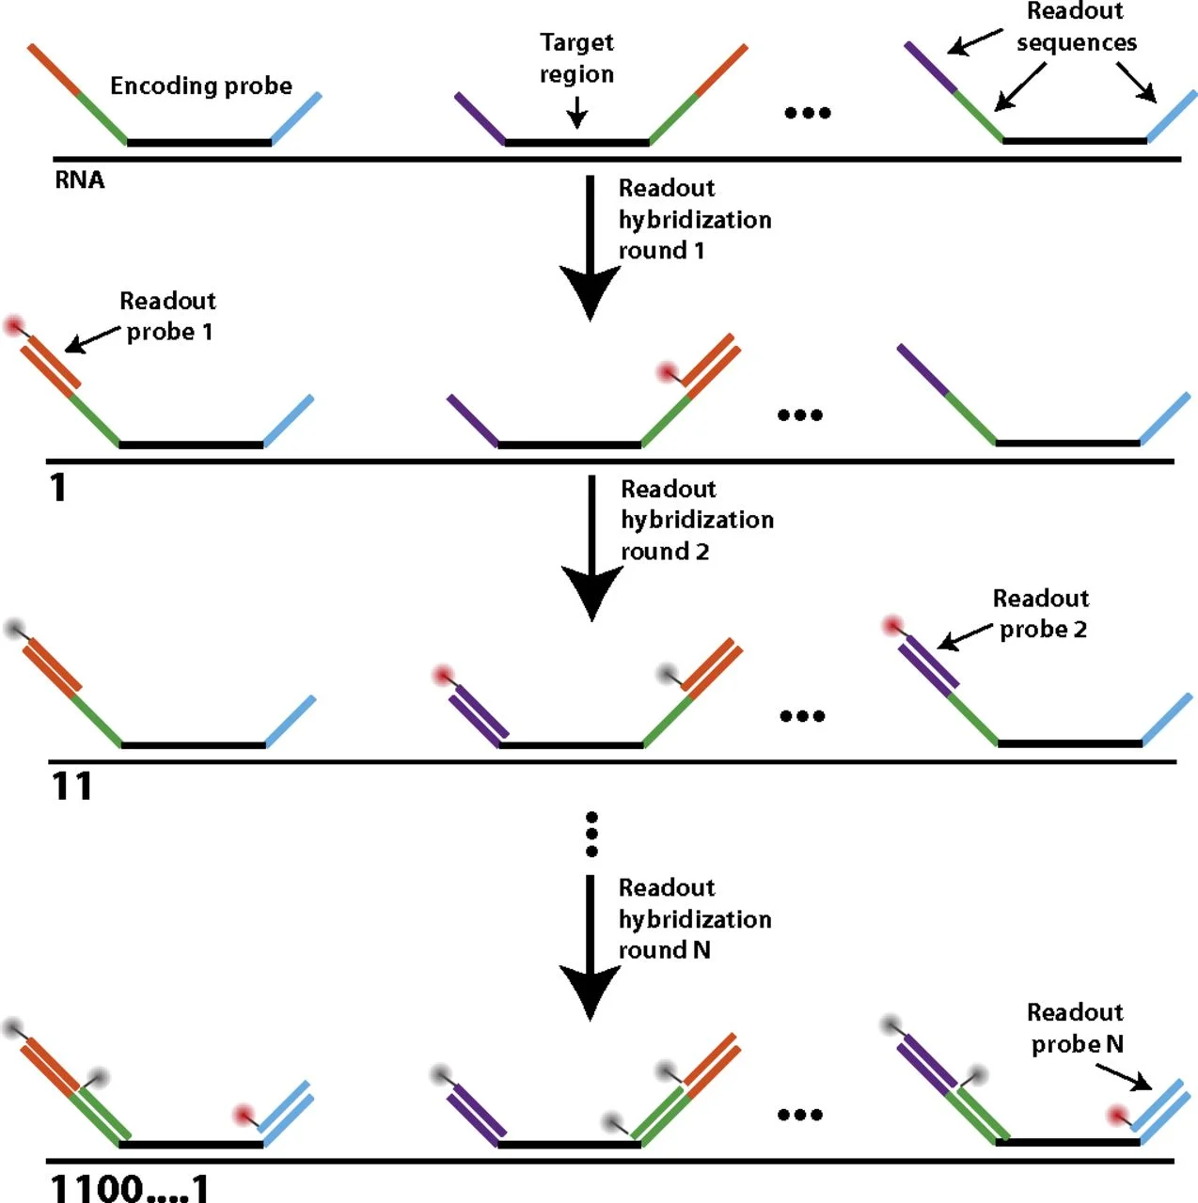
Imaging-based ISH platforms
Several different oligonucleotides, all marked with the same fluorophore, are used to target the same mRNA molecule (multiple probe oligonucleotides are needed to generate a sufficiently strong fluorescence signal to be detected by imaging)
Each mRNA molecule appears as a bright spot, observed by microscope
PROS: No reverse transcription of mRNA or PCR amplification needed! Accurate quantification (more bright spots = higher mRNA abundance). High spatial resolution (subcellular)
CONS: low multiplex capability – just a very few target mRNAs can be imaged since each fluorophore requires to be read in a specific channel
How can the number of targets be increased? Combinatorial barcoding (MERFISH) -> use of different oligos conjugated with different fluorophores in multiple sequential rounds of hybridization and imaging. This can increase the number of targets to a few hundred mRNAs (CosMX uses a more sophisticated approach to include thousands of targets). This avoids optical crowding

Slide 25
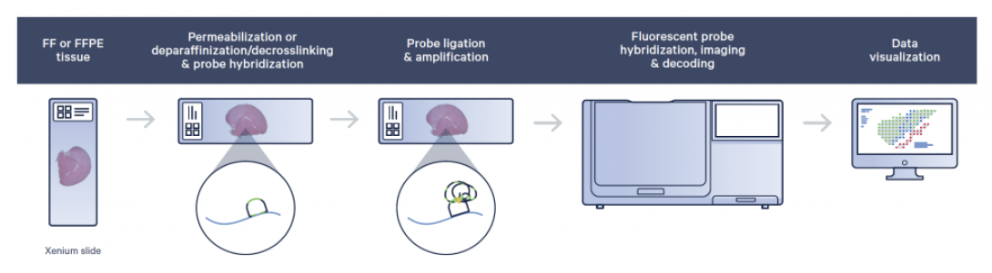
Imaging-based ISS platforms
ISS uses a particular type of padlock probes which allow, following hybridization and ligation, to amplify the signal thanks to rolling circle amplification and the creation of DNA nanoballs, thereby allowing a better signal-to-noise ratio. The sequence of the mRNAs is determined through sequencing by ligation (this is somewhat inspired by old SOLiD NGS).
The 10X Xenium platform used an ISS approach: following the use of padlock probes targeting specific mRNA targets, which lead to rolling circle amplification, the signal is given by several successive cycles of hybridization with fluorescently labeled probes. Temporal barcoding allows the identification of each target. See the video available on Moodle about the 10X Xenium platform for an example
Pros: high spatial resolution, leading to the identification of subcellular localization of mRNAs
Cons: high chance for errors, not all mRNAs can be profiled, the procedure is long and generates extremely large output files

Slide 26
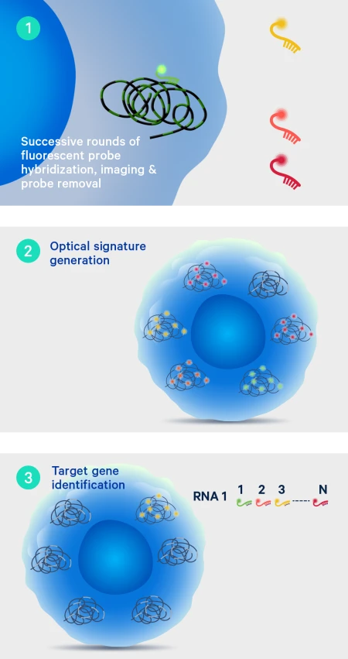
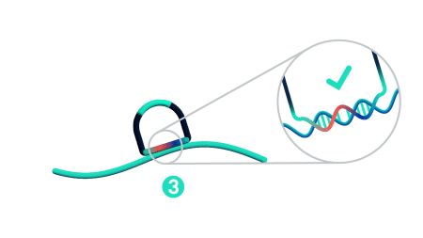
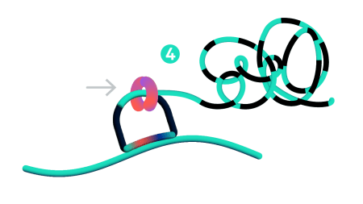
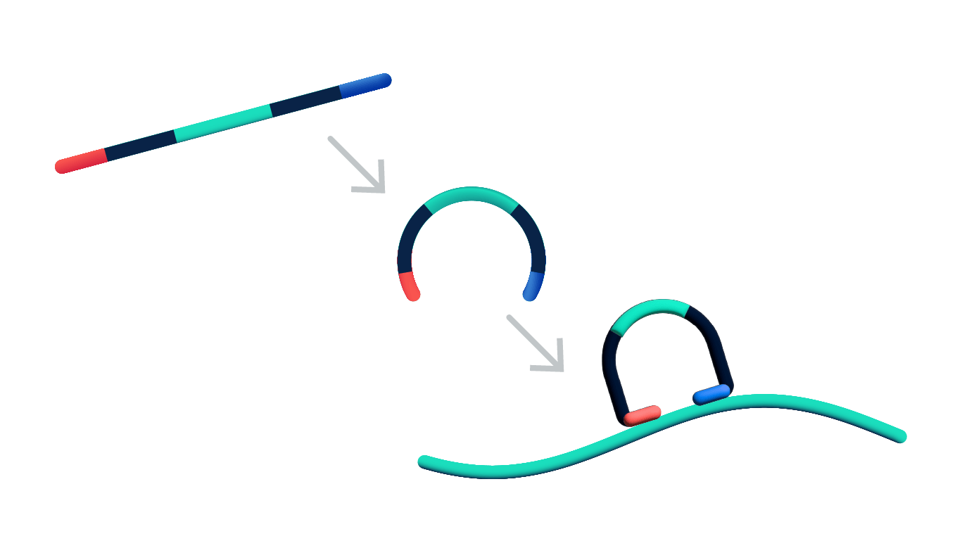
Padlock probes
In a padlock probe, hybridization with the target mRNA can only occur if both ends perfectly match the target. The central part of the probe is a barcode, which will be later used recognized by a fluorescent probe
Following oligo/target hybridization, the padlock probe is circularized by ligation
Rolling circle amplification occurs -> generation of DNA nanoballs, with each barcode repeated hundred of times
Fluorescent-labeled oligonucleotides complementary to the probe (i.e. the central part of the padlock probe) are added
Fluorescence is images by sequential cycles

Slide 27
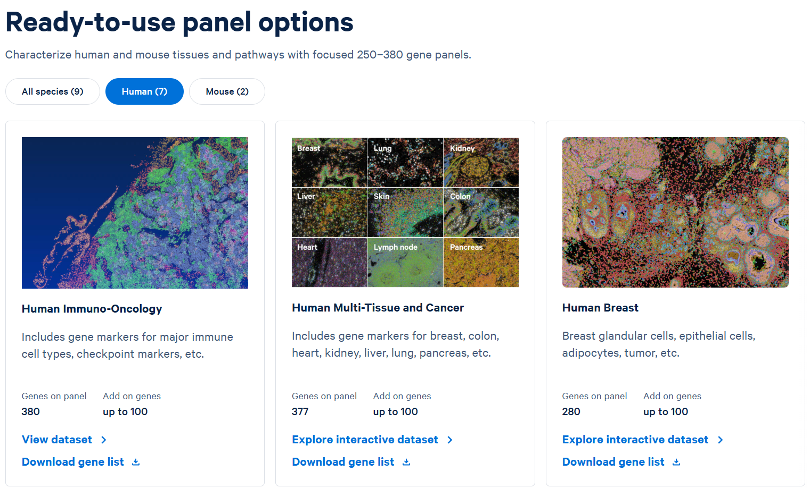
Imaging-based spatial transcriptomics
An example of a few commercially available Xenium target panels
They include a fixed number of genes present by default, plus up to 100 genes that can be added to generate custom panels

Slide 28
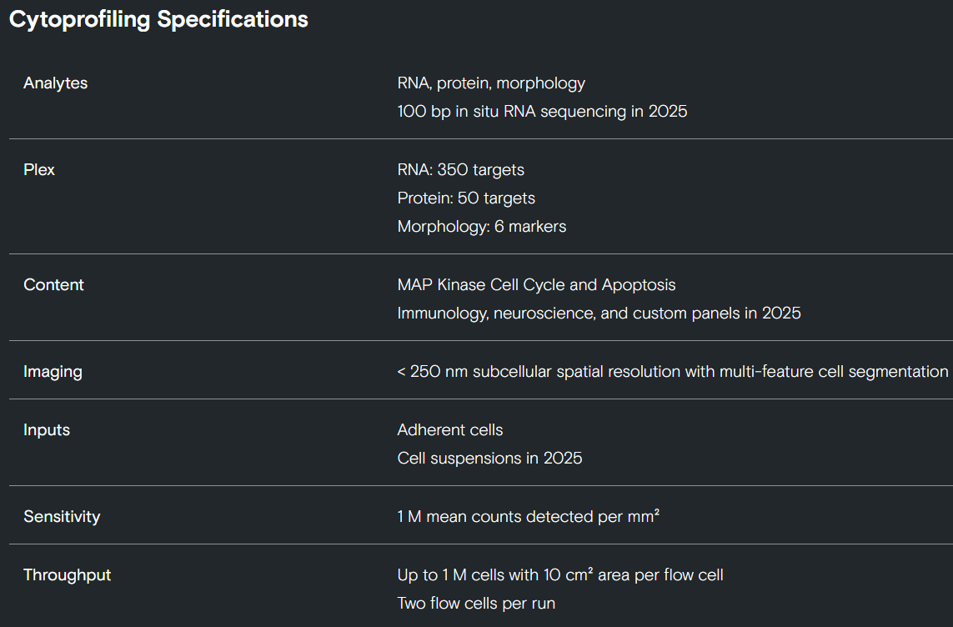
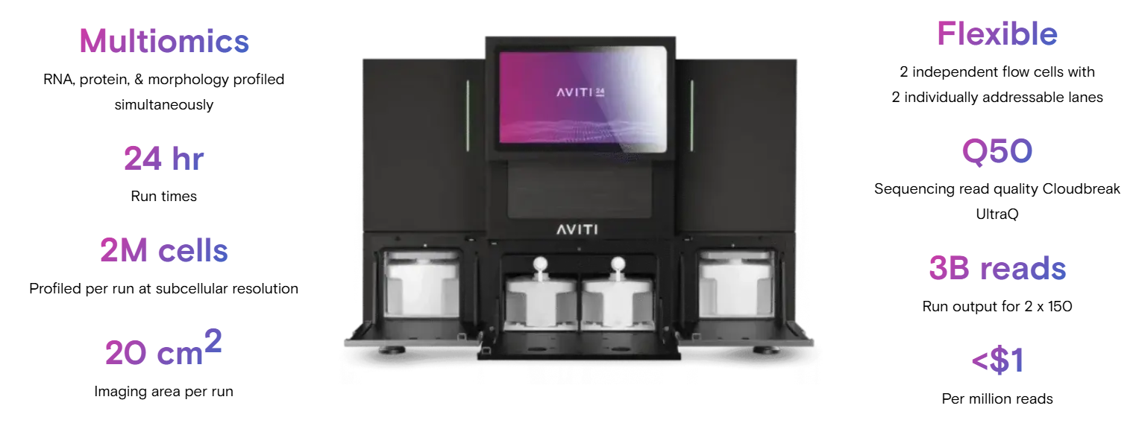
AVITI platforms for spatial omics applications
AVITI Teton cytoprofiling
Is this an enhanced in situ sequencing, imaging-based method, with multi-omics capabilities.
It exploits the use of avidites to capture simultaneously multiple layers of information: mRNA, protein and cell morphology

Slide 29
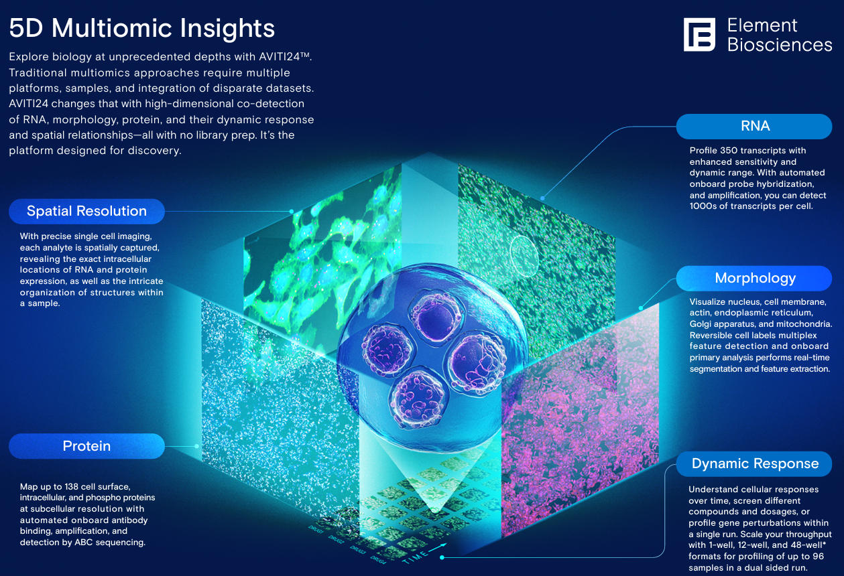
AVITI platforms for spatial omics applications
Teton cytoprofiling by AVITI
Morphological features: cell paint (i.e. antibodies conjugated with known barcodes, i.e. short oligonucleotides that can be sequenced with AVITI) is used to highlight six morphological features: nuclei, cell membrane, actin, endoplasmic reticulum, Golgi apparatus, and mitochondria
mRNA: up to 350 target mRNAs can be profiled, using complementary oligonucleotide probes, sequenced in situ using AVITI technology
Protein: up to 138 target proteins can be profiles, using antibodies conjugated with oligonucleotide probes, sequenced in situ using AVITI technology
See video on Moodle

Slide 30
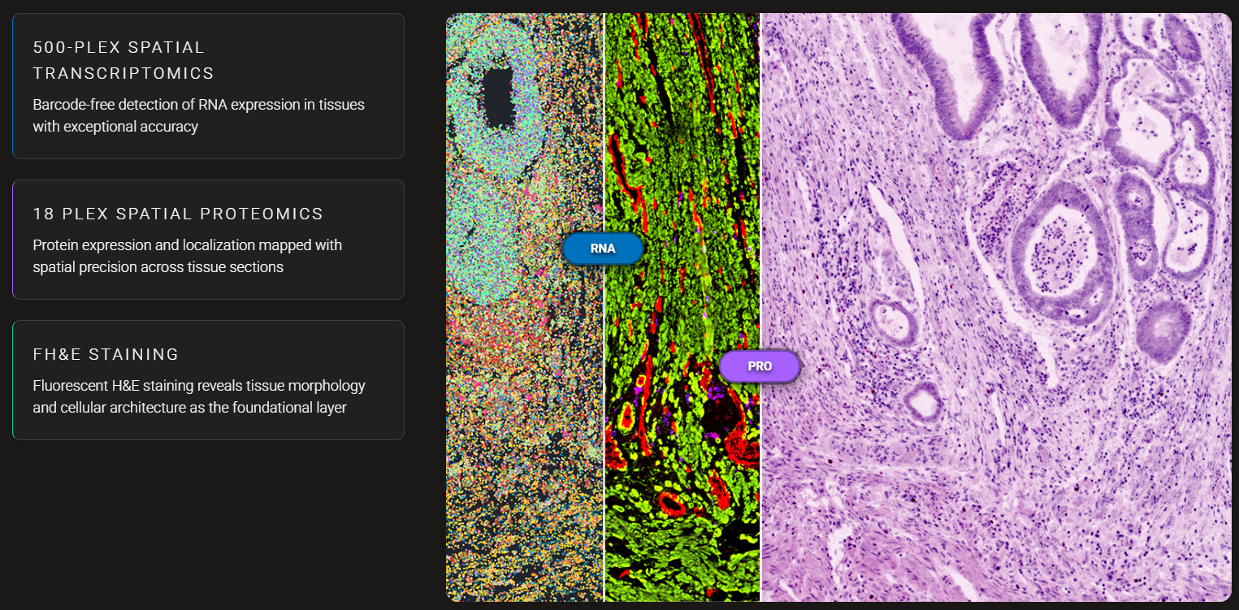
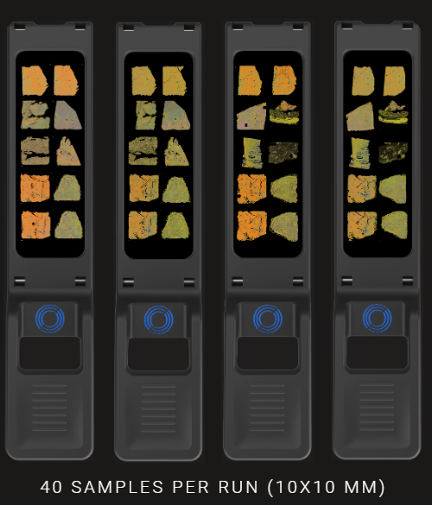
Singular genomics GA4x
This is another recently developed platform based on an enhanced ISS imaging-based approach. It exploits the use of oligonucleotides or antibodies (depending on whether the targets are mRNAs or proteins) to obtain a high-resolution spatial map of target molecules

Slide 31
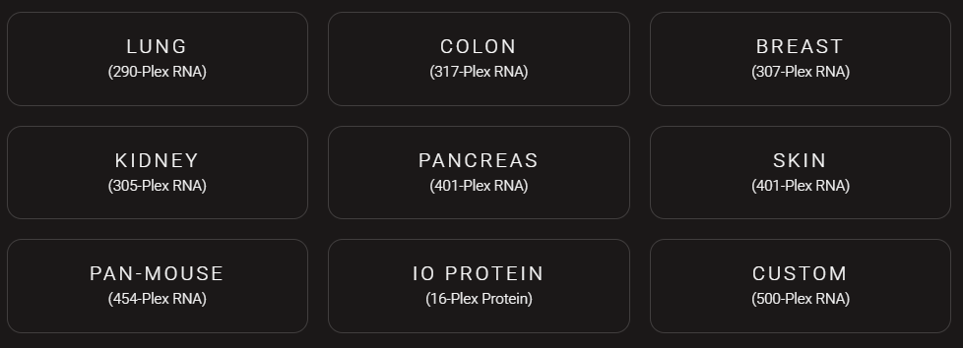
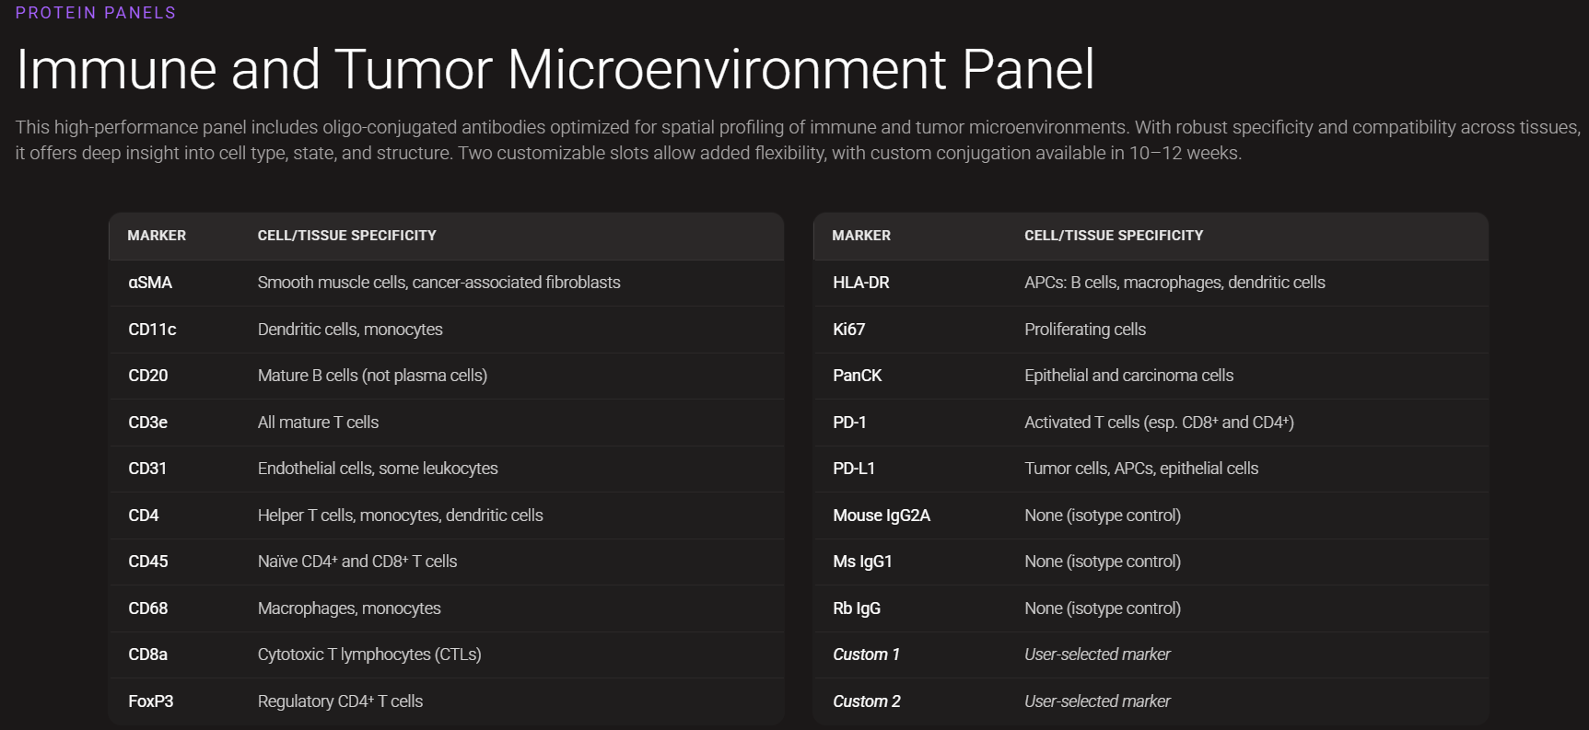
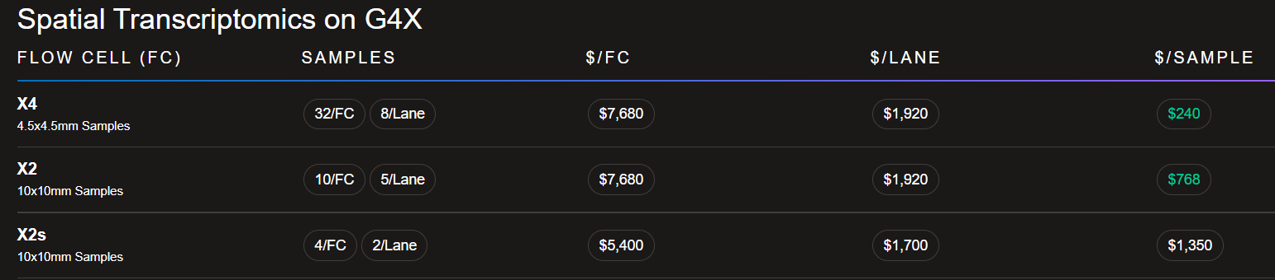
Singular genomics GA4x
All the aforementioned platforms can use pre-defined commercial panels of target mRNAs/proteins, but also allow the design of custom panels
Cost per sample: from 240$
https://www.singulargenomics.com/pricing

Slide 32
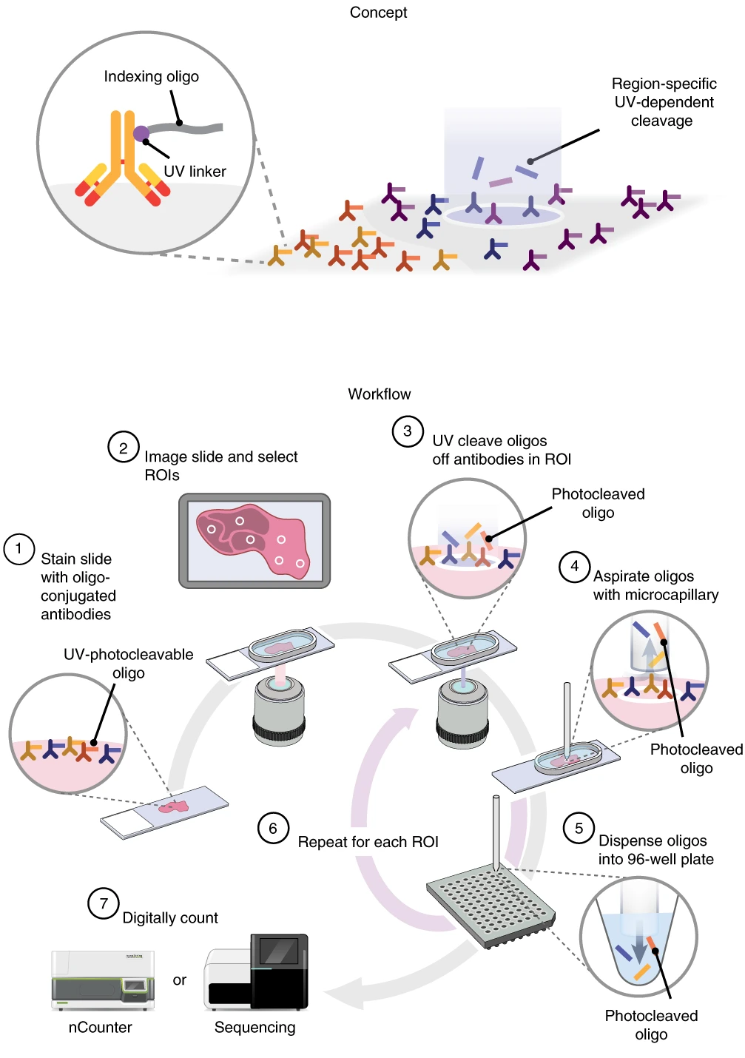
Sequencing-based spatial transcriptomics: microdissection and ROI-based methods
Microdissection-based methods are inspired by a few early precursors, such as Tomo-seq (where the tissue was cryosectioned, with each section undergoing RNA-seq). They currently used modern microdissection techniques
The Nanostring GeoMx DSP is one of the most modern devices: in this case genes are barcoded with gene-specific photocleavable probes (the probes can be either antibodies directed against the target protein, or oligos complementary to target mRNAs). When UV light is shone on the tissue, one region of interest at a time, probes are released and sequenced
N.B. although it is conceptually similar to a microdissection-based method, it IS NOT BASED on microdissection, but rather on the virtual (i.e. not physical) selection of regions of interest (ROIs)
Cons: low spatial resolution, mRNA degradation due to laser use, analyses restricted to target genes
See the video on Moodle for additional details

Slide 33
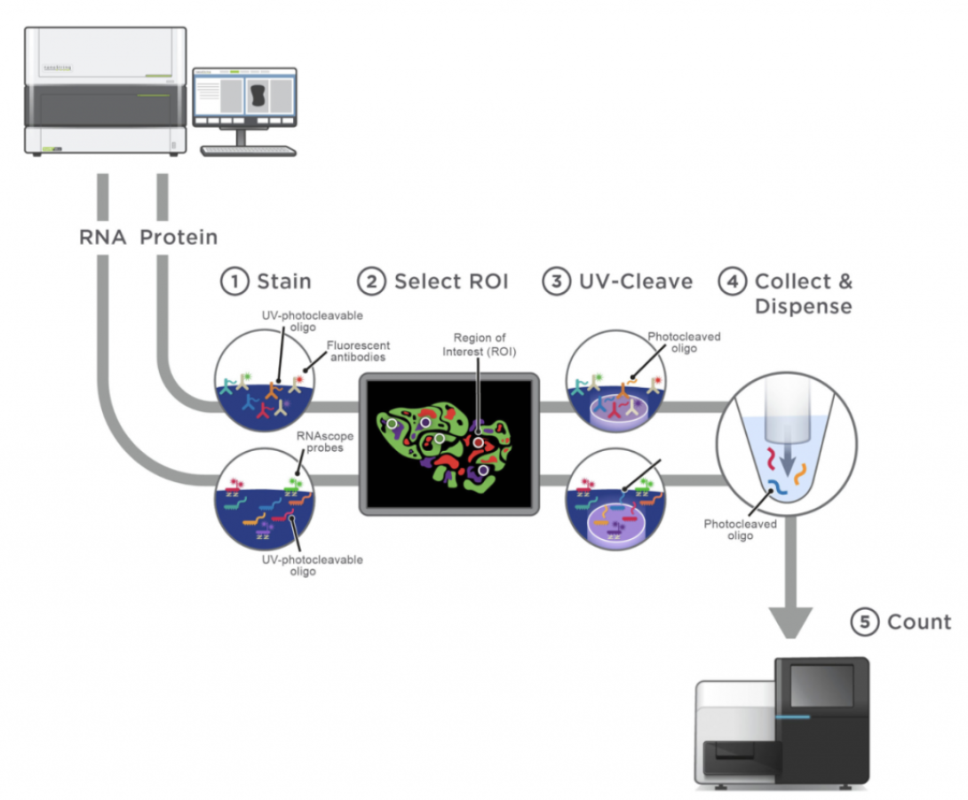
Sequencing-based spatial transcriptomics: ROI-based methods
Overview of the Nanostring GeoMX protocol
Note the possibility to use either:
-RNAscope probes (complementary to target mRNAs)
-Fluorescent antibodies (against target proteins)
These need to be fluorescently-labeled to allow the selection of the region of interest (ROI) for photocleavage and targeted sequencing

Slide 34
Sequencing-based spatial transcriptomics: a clarification
What does determine whether a spatial transcriptomic based is imaging or sequencing based? It’s the readout, i.e. what the final output of the process is. In imaging-based methods, the location of the target molecules is directed though the acquisition of high resolution images, obtained thanks to the use of fluorescent barcodes. The confusion in the nomenclature can arise from in situ sequencing methods, which are NOT sequencing-based, but rather imaging-based. In this case, the fluorescent probes are decoded by sequencing-like chemistry (e.g. sequencing by ligation, rolling circle amplification, use of avidites, etc.). The key point is that imaging-based methods DO NOT generate reads
On the other hand, sequencing-based methods need to be paired with a sequencing platform (usually Illumina, or other 2nd generation platforms)
For example, in the Nanostring GeoMX platform, photo-cleaved oligos are collected and placed in different wells, and subsequently used as an input for the generation of a barcoded library (one for each ROI) for sequencing

Slide 35
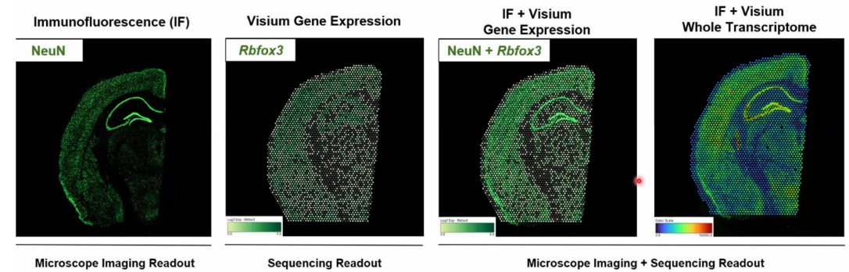
Sequencing-based spatial transcriptomics: array-based methods
Array-based methods do NOT use gene specific probes, but rather use a spatial array of generic mRNA probes (based on oligo-dT selection) that are used to barcode all the mRNAs associated with a given area in the grid of the array
Captured mRNAs are converted to cDNAs and used for library preparation and sequencing
An example is provided by 10X Visium. The spatial resolution of array methods is defined by the size of a capture area harbouring any given unique positional barcode
Pros: avoids image-processing pipelines; being untargeted, offers the opportunity to profile the full transcriptome. Cons: Spatial resolution is lower than imaging-based methods
Check this link for more details on Visium data analysis capabilities: https://www.10xgenomics.com/products/visium-analysis

Slide 36
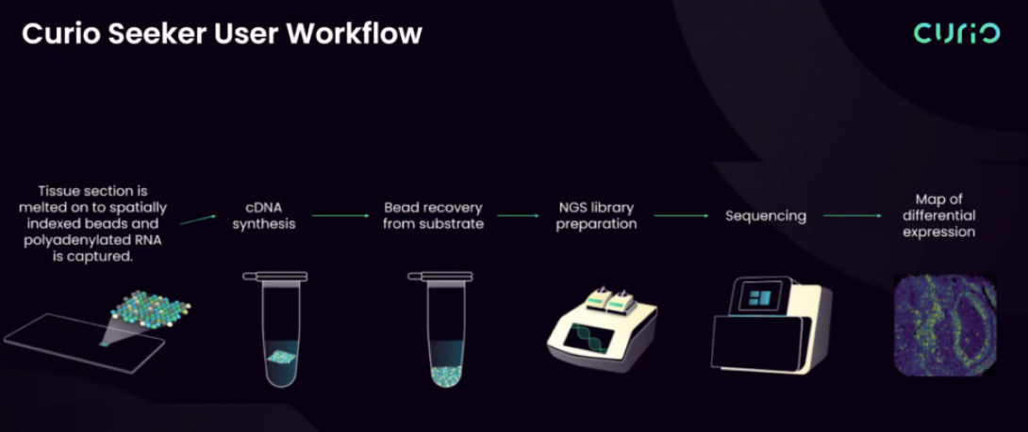
Sequencing-based spatial transcriptomics: Curio platforms
The Curio Seeker in another sequencing-based array platform, which uses spatially indexed beads to extract spatial information (check the video on Moodle)
The Curio Trekker allows single-nuclei tagging, offering the possibility to investigate spatial transciptomics at the single-cell level. This is conceptually more similar to a sequencing-based microdissection method, but it actually does not perform microdissection, but rather a nuclei dissociation step

Slide 37
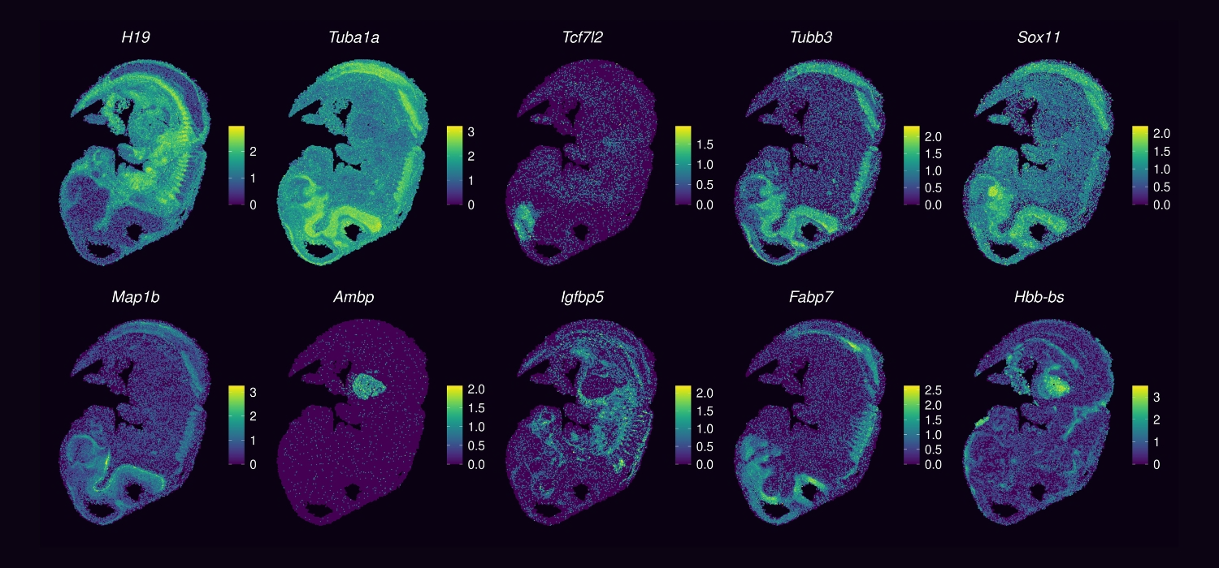
Sequencing-based spatial transcriptomics: Curio platforms
Example of the output of an analysis carried out with the Curio Seeker on a mouse ebryo (10 target genes)

Slide 38
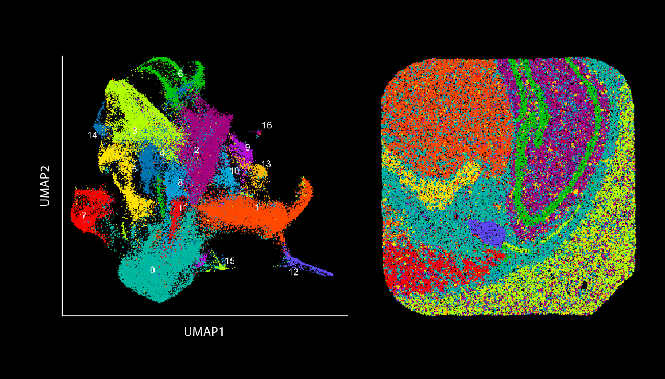
Relationships between scRNA-seq and spatial transcriptomic data
The first one allows the identification of cell clusters, without spatial information: the second one places these cell populations in a tissue context. N.B. the output of a spatial transcriptomic analysis can be also used to generate cell clusters (as in scRNA-seq)!

Slide 39
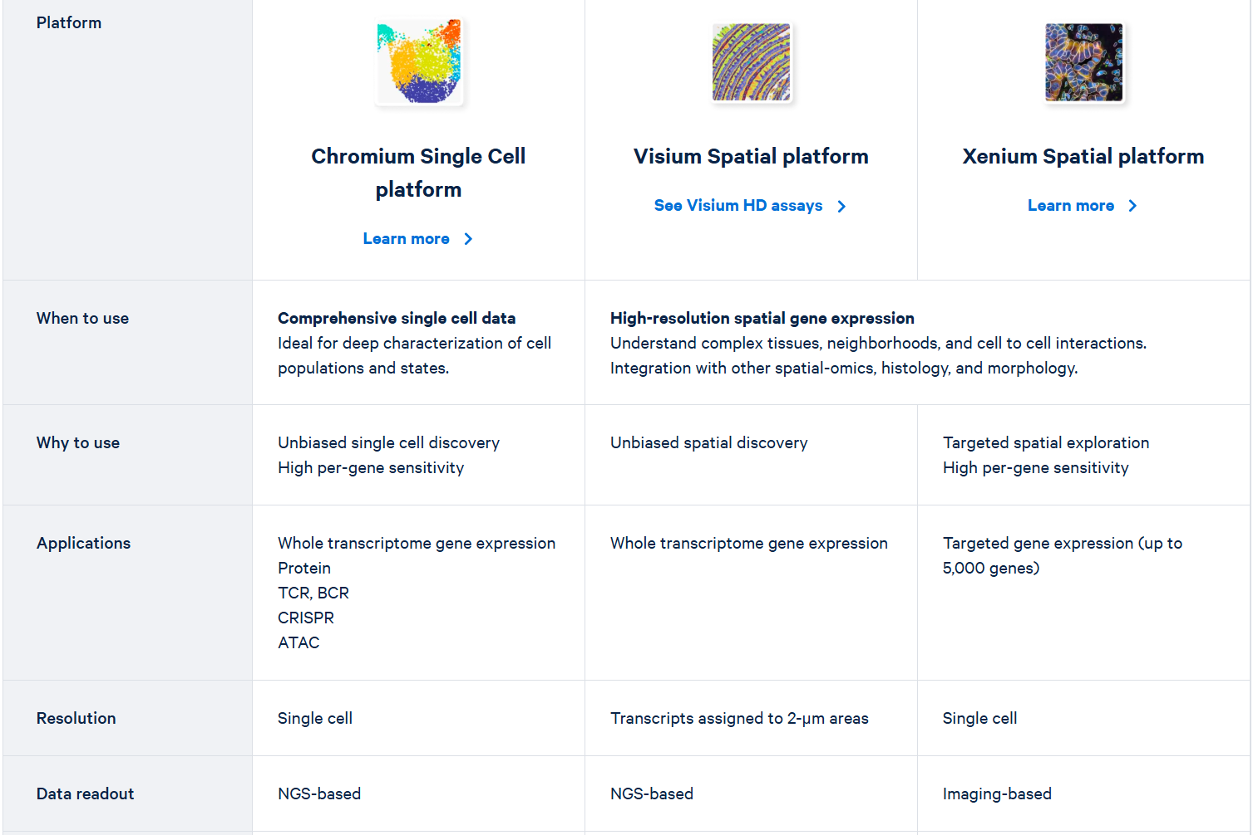
A general overview: which platoform should I use?
«classical»
single-cell methods
Require single-cell isolation
Spatial methods
Do not require single-cell isolation
This example derives from the 10X Genomics webpage: it helps the user to identify the most suitable platform to answer a given biological question

Slide 40
Spatial transcriptomics: how much does it cost?
The total cost is highly dependent on the size of the area to be investigated, on the number of targets of interest and on the technology selected
For example, the commercial price of a 10X Visium analysis (whole transcriptome spatial transcriptomics) can range between 8000 and 14000$ depending on the size of the slide (6,5 – 20 mm)
A 10X Xenium analysis has a variable cost related with probe design (standard panel vs custom panel), plus a cost for hybridization and imaging. The total price can range from 7500$ (1-50 gene targets) to about 12000$ (5000 targets)
The cost of a Nanostring analysis depends on the number of targets: from a few thousand euros or small target sets, to 15000 euros for up to 6K targets
N.B. in all the methods that require the use of oligonucleotides or antibodies to analyze target mRNAs/proteins, custom panels are much more expensive than commercial panels, since a high cost is associated with the design and production of these probes

